Slide 1

Some bulk Cu and aC coating preliminary results obtained with the Vacuum Pilot Sector during 2023 run
Quentin DUONG
TE – VSC – VSM
quentin.duong@cern.ch
06/12/2023

Slide 2
Outline
Description
72b and hybrid fills at 450 GeV
Hybrid physics fill at 6.8 TeV
Electron energy distribution for bulk Copper
TE – VSC – VSM

Slide 3
Disclaimer
I present the observations performed on some of the 2023 fills
Results are therefore preliminary
TE – VSC – VSM

Slide 4
Description
TE – VSC – VSM

Slide 5
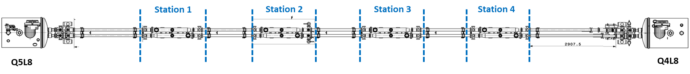
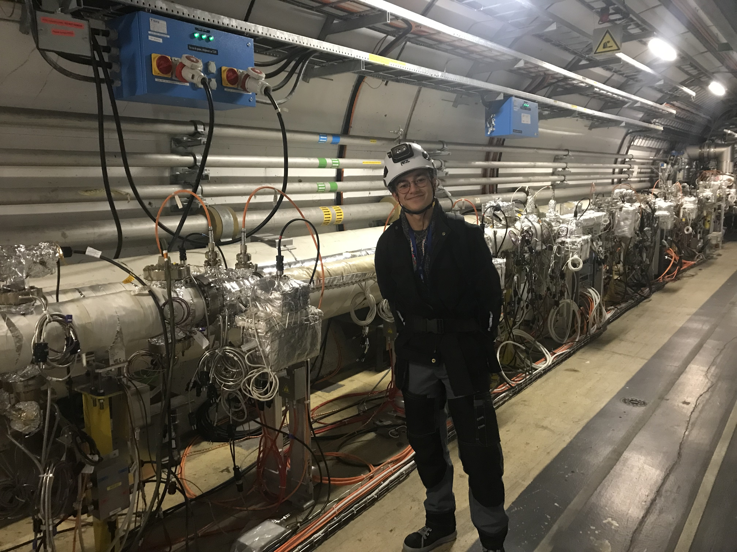
Layout
  a-C
  Cu
  Vacuum Pilot Sector (VPS)
  Location: between Q4L8 and Q5L8
  2 beamlines :
    External: B1 (Blue beamline)
    Internal: B2 (Red beamline)
  Installed in 2015:
    1.4m-long thick a-C coating ~500nm
    1.4m-long bulk Cu
TE – VSC – VSM

Slide 6


Electron cloud build-up
  Electron cloud = Primary + Secondary electrons
  Primary electrons:
    Photoelectrons induced by photoelectric effect
    Free electrons induced by bunch ionising the residual gas
  Secondary electrons: induced by primary electrons, accelerated by successive bunches, hitting the surface
PEY
SEY
accelerated e⁻
$$γ_{SR}$$
secondary e⁻
photoelectron
e⁻
free electron e⁻
Electron
cloud
p+
p+
  Two main material properties for ecloud:
  Photoelectron Yield (PEY)
  Secondary Electron Yield (SEY)
  $PEY=\frac{N_{{photo e}^{−}}}{N_{γ}}$ $SEY=\frac{N_{{sec e}^{−}}}{N_{e^{−}incident}}$
ionised gas i⁺
primary e-
Image current
Beam pipe
TE – VSC – VSM

Slide 7
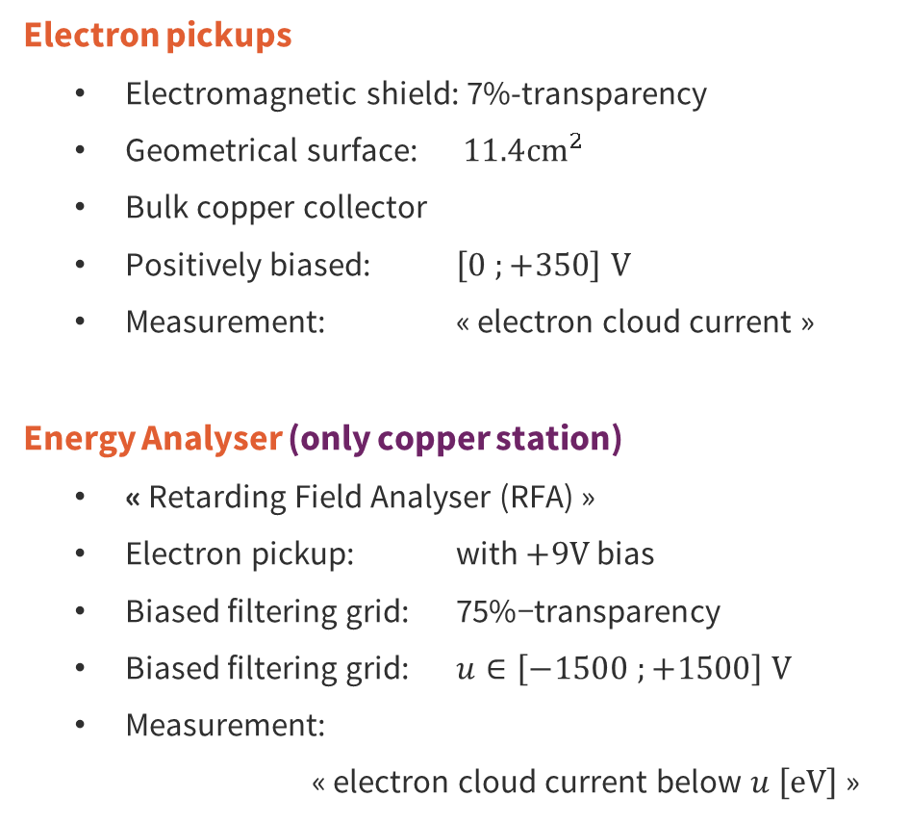
Electron current and energy detection
  Electron pickups
    Electromagnetic shield: 7%-transparency
    Geometrical surface: $11.4{cm}^{2}$
    Bulk copper collector
    Positively biased: $\left[0 ;+350\right] V$
    Measurement: « electron cloud current »
  Energy Analyser (only copper station)
    « Retarding Field Analyser (RFA) »
    Electron pickup: with $+9V$ bias
    Biased filtering grid: $\text{7}\text{5}\text{\%−}\text{transparen}\text{cy}$
    Biased filtering grid: $u∈\left[−1500 ;+1500\right] V$
    Measurement:
    « electron cloud current below $u \left[eV\right]$ »
  Electron pickups
  Energy Analyser
A
+9V
[0 ; 350] V
A
Cu
[-1.5 ; 1.5] kV
Cu
Cu
Cu
Cu
Electron
cloud
p+
p+
Image current
Beam pipe
TE – VSC – VSM

Slide 8


Total pressure detection
  Pressure elevation during LHC functionning
  Photodesorbed gas: induced by photons hitting the surface
  Electrodesorbed gas: induced by electrons hitting the surface
  Total pressure gauges
    Bayard-Alpert gauges « VGI »
    Measurement: « desorbed gas pressure »
PSD
$$γ_{SR}$$
photodesorbed gas
free electron e⁻
  Two main material properties for gas increase:
  Photodesorption
  Electrodesorption
  ${PSD}_{gas}∝\frac{{ΔP}_{gas}}{N_{γ}}$ ${ESD}_{gas}∝\frac{{ΔP}_{gas}}{N_{e^{−}}}$
Electron
cloud
p+
p+
ionised gas i⁺
electrodesorbed gas
Image current
Beam pipe
ESD
  Total pressure gauges
TE – VSC – VSM

Slide 9
72b and hybrid fills at 450 GeV
72b: fills 8673
Hybrid (7*8b4e+3*36b): fill 8736
TE – VSC – VSM

Slide 10
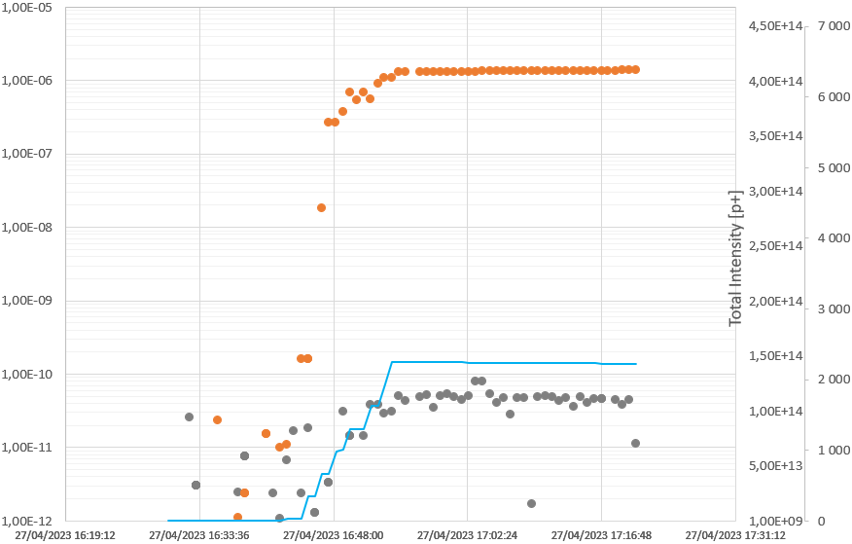
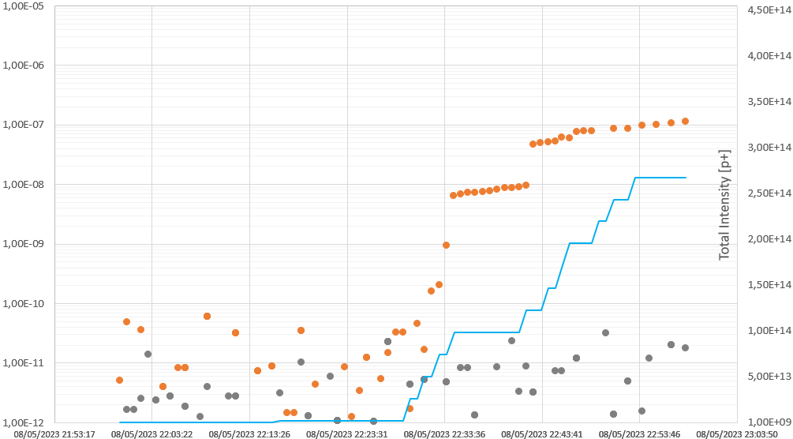





















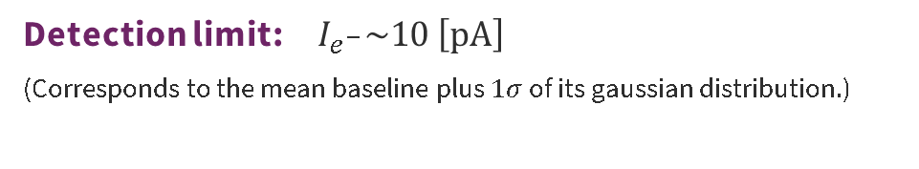














Electron cloud comparisons for 72b and hybrid fills
  72b
Electron flux [A.cm⁻²]
  Hybrid
$${10}^{−5}$$
$${4.5×10}^{14}$$
Cu B1
$${10}^{−6}$$
$${4.0×10}^{14}$$
$$×20$$
Cu B1
$${3.5×10}^{14}$$
$${10}^{−7}$$
$${3.0×10}^{14}$$
$${10}^{−8}$$
$${2.5×10}^{14}$$
Total beam intensity [p⁺]
$${10}^{−9}$$
B1 intensity
$${2.0×10}^{14}$$
B1 intensity
$${1.5×10}^{14}$$
$${10}^{−10}$$
a-C B1
a-C B1
$${1.0×10}^{14}$$
$${10}^{−11}$$
$${5×10}^{13}$$
$${10}^{−12}$$
$${1×10}^{13}$$
$$0$$
$$14$$
$$28$$
$$42$$
$$56$$
$$0$$
$$10$$
$$20$$
$$30$$
$$40$$
$$50$$
$$60$$
$$70$$
$$Time [min]$$
$$Time [min]$$
  Detection limit: $I_{e^{−}}\sim 10 \left[pA\right]$
  (Corresponds to the mean baseline plus $1σ$ of its gaussian distribution.)
  Copper is 4 orders of magnitude above carbon.
  Carbon below detection limit for 8b4e.
  For copper: $I_{72b}≈20×I_{hybrid}$
TE – VSC – VSM

Slide 11
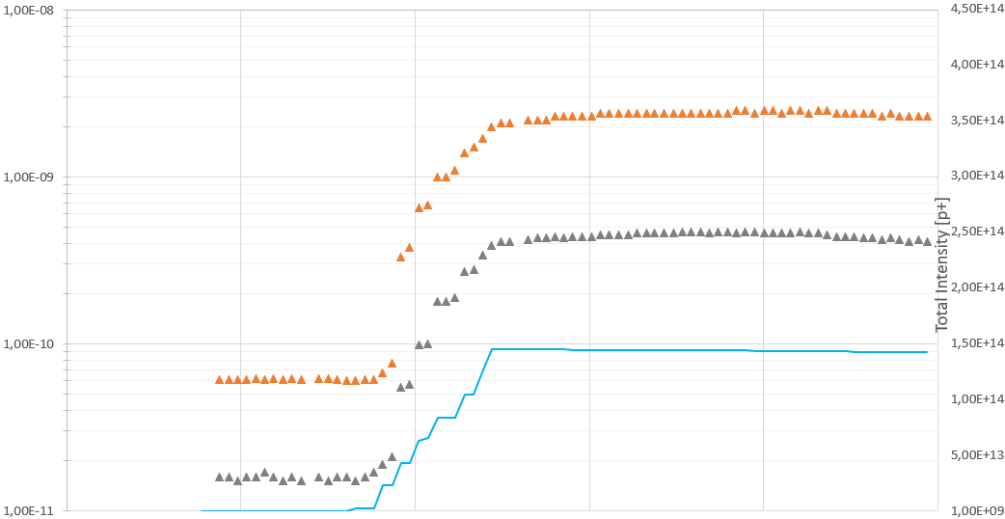
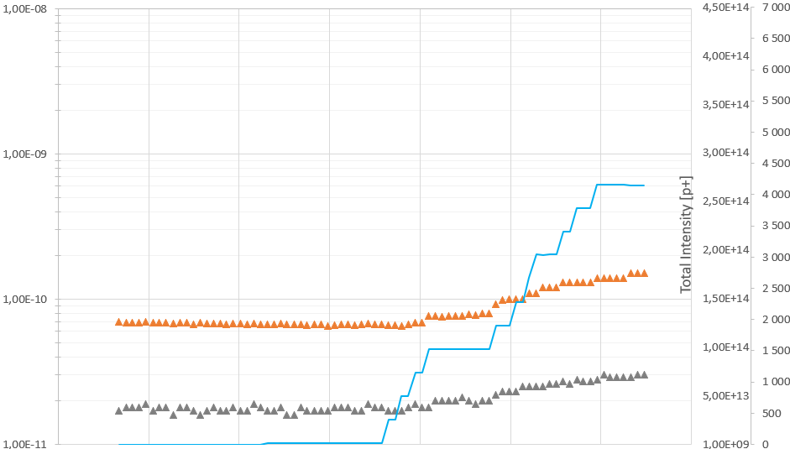




























Pressure comparisons for 72b and hybrid fills
  72b
Pressure [mbar]
  Hybrid
$${10}^{−8}$$
$${4.5×10}^{14}$$
Cu B1
$${4.0×10}^{14}$$
$${3.5×10}^{14}$$
a-C B1
$${10}^{−9}$$
B1 intensity
$${3.0×10}^{14}$$
$$×20$$
$${2.5×10}^{14}$$
$$×20$$
Total beam intensity [p⁺]
$${2.0×10}^{14}$$
B1 intensity
$${10}^{−10}$$
$${1.5×10}^{14}$$
Cu B1
a-C B1
$${1.0×10}^{14}$$
$${0.5×10}^{14}$$
$${10}^{−11}$$
$$0$$
$$0$$
$$14$$
$$28$$
$$42$$
$$56$$
$$70$$
$$0$$
$$10$$
$$20$$
$$30$$
$$40$$
$$50$$
$$60$$
$$70$$
$$Time [min]$$
$$Time [min]$$
  At equal beam intensity for copper: ${ΔP}_{72b}≈20×{ΔP}_{hybrid}$
  Pressure in carbon station possibly induced by RF bridge.
  Thus, pressure rise cannot always be considered as equivalent to electron presence.
TE – VSC – VSM

Slide 12
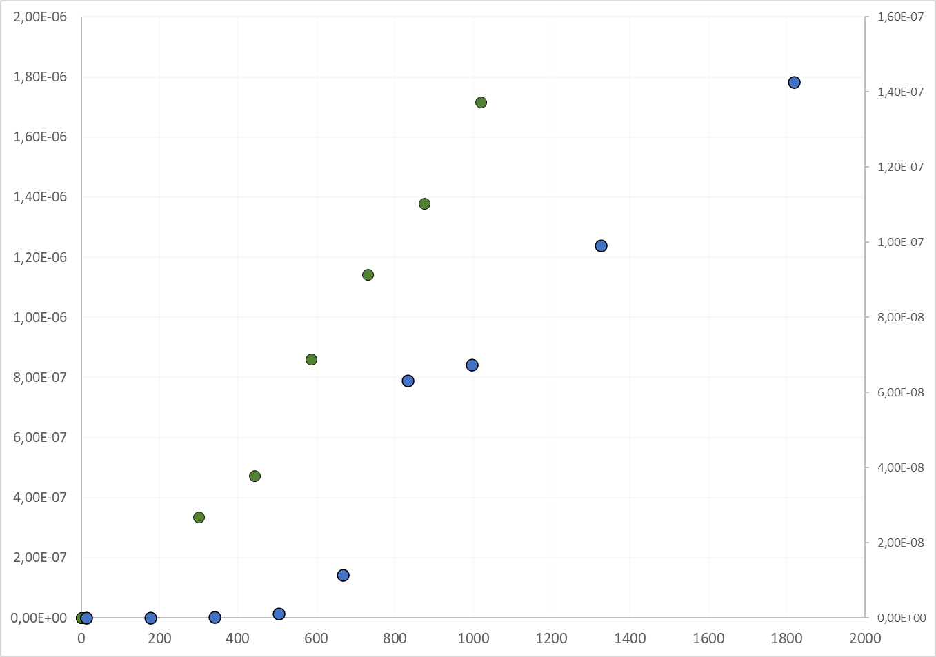













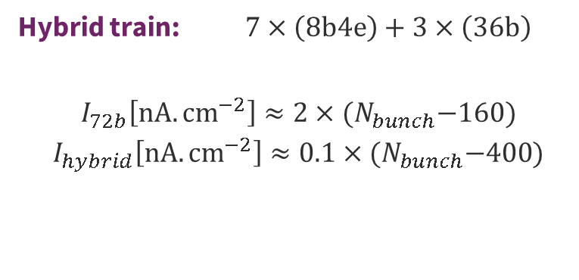








Electron cloud response of copper during injection
Electron flux 72b
[A.cm⁻²]
Electron flux hybrid
[A.cm⁻²]
4
6
8
10
12
14
:72b trains
$${20×10}^{−7}$$
$${16×10}^{−8}$$
  Hybrid train: $7×\left(8b4e\right)+3×\left(36b\right)$
  $$I_{72b}\left[nA.{cm}^{−2}\right]≈2×{(N}_{bunch}−160)$$
  $$I_{hybrid}\left[nA.{cm}^{−2}\right]≈0.1×{(N}_{bunch}−400)$$
72b
Hybrid
$${18×10}^{−7}$$
$${14×10}^{−8}$$
$${16×10}^{−7}$$
$${12×10}^{−8}$$
$${14×10}^{−7}$$
$${12×10}^{−7}$$
$${10×10}^{−8}$$
$${10×10}^{−7}$$
$${8×10}^{−8}$$
$${8×10}^{−7}$$
$${6×10}^{−8}$$
  More bunches needed for hybrid fill to reach linear behaviour
  For high number of bunches:
  $I_{e^{−}}∝N_{bunch}$
  $$I_{72b}≈20×I_{hybrid}$$
$${6×10}^{−7}$$
$${4×10}^{−8}$$
$${4×10}^{−7}$$
$${2×10}^{−7}$$
$${2×10}^{−8}$$
$$0$$
$$0$$
0
400
800
1200
1600
2000
Number of bunches
Hybrid trains:
5
8
10
13
15
21
28
TE – VSC – VSM

Slide 13
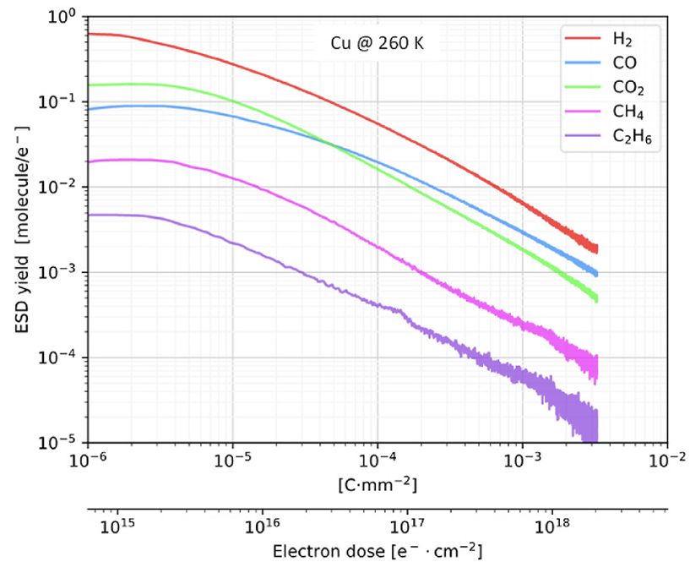
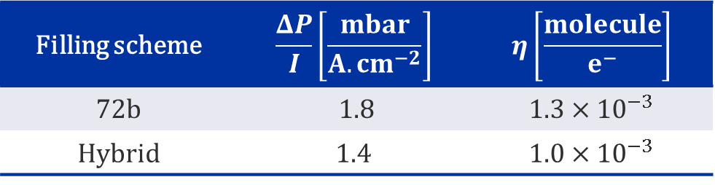

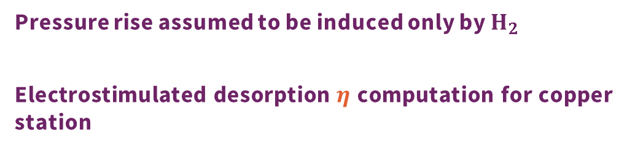
Cu ESD for 72b and hybrid fills
  Pressure rise assumed to be induced only by $H_{2}$
  Electrostimulated desorption $η$ computation for copper station
Filling scheme | $$\frac{ΔP}{I}\left[\frac{mbar}{A.{cm}^{−2}}\right]$$ | $$η\left[\frac{molecule}{e^{−}}\right]$$
72b | $1.$8 | $$1.3×{10}^{−3}$$
Hybrid | $$1.4$$ | $$1.0×{10}^{−3}$$
  Measured ESD correspond to a copper surface at a dose of a few ${10}^{18 }\left[e^{−}.{cm}^{−2}\right]$
M. Haubner et al. Vacuum 207 (2023) 111656
TE – VSC – VSM

Slide 14
Hybrid physics fill at 6.8 TeV
Hybrid (7*8b4e+5*36b): 8741
TE – VSC – VSM

Slide 15
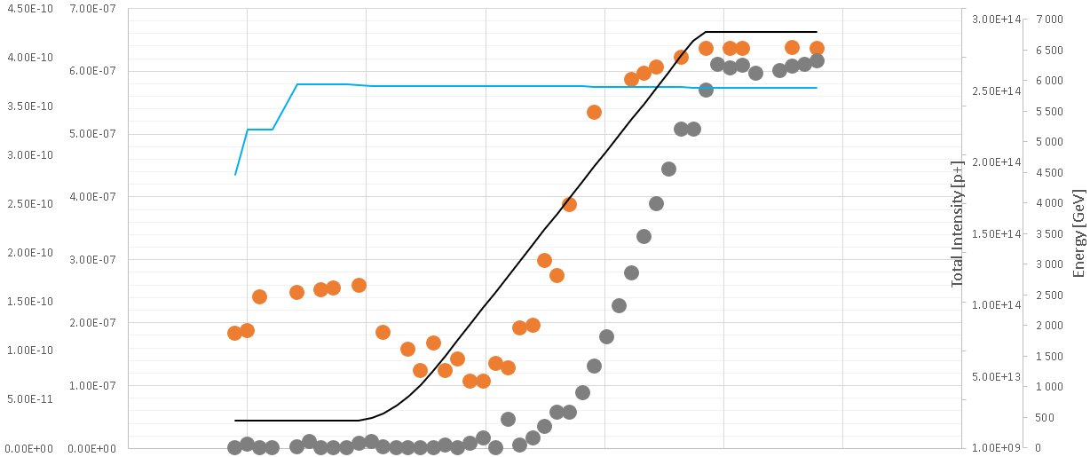










































Photoelectrons during energy ramp-up
a-C Cu
$${4.5×10}^{−10}$$
$${7×10}^{−7}$$
$${3.0×10}^{14}$$
$$7000$$
$${4.0×10}^{−10}$$
$${6×10}^{−7}$$
B1 intensity
$${2.5×10}^{14}$$
$$6000$$
$${3.5×10}^{−10}$$
Cu B1
$${5×10}^{−7}$$
$$5000$$
$${3.0×10}^{−10}$$
$${2.0×10}^{14}$$
$${2.5×10}^{−10}$$
$${4×10}^{−7}$$
$$4000$$
a-C B1
Beam energy [GeV]
Electron flux [A.cm⁻²]
Total beam intensity [p⁺]
$${1.5×10}^{14}$$
$${2.0×10}^{−10}$$
$${3×10}^{−7}$$
$$3000$$
$${1.5×10}^{−10}$$
$${1.0×10}^{14}$$
$${2×10}^{−7}$$
$$2000$$
$${1.0×10}^{−10}$$
$${1×10}^{−7}$$
$${0.5×10}^{14}$$
$$1000$$
$${0.5×10}^{−10}$$
Energy
$$0$$
$$0$$
$$0$$
$$0$$
$$0$$
$$7$$
$$14$$
$$28$$
$$35$$
$$42$$
$$49$$
$$56$$
$$Time [min]$$
  Photoelectrons detected by electron pickup at $\sim 2500GeV$ which corresponds to a synchrotron radiation critical energy of 2 eV, matching the work function of copper or carbon (~ 4-5 eV)
TE – VSC – VSM

Slide 16
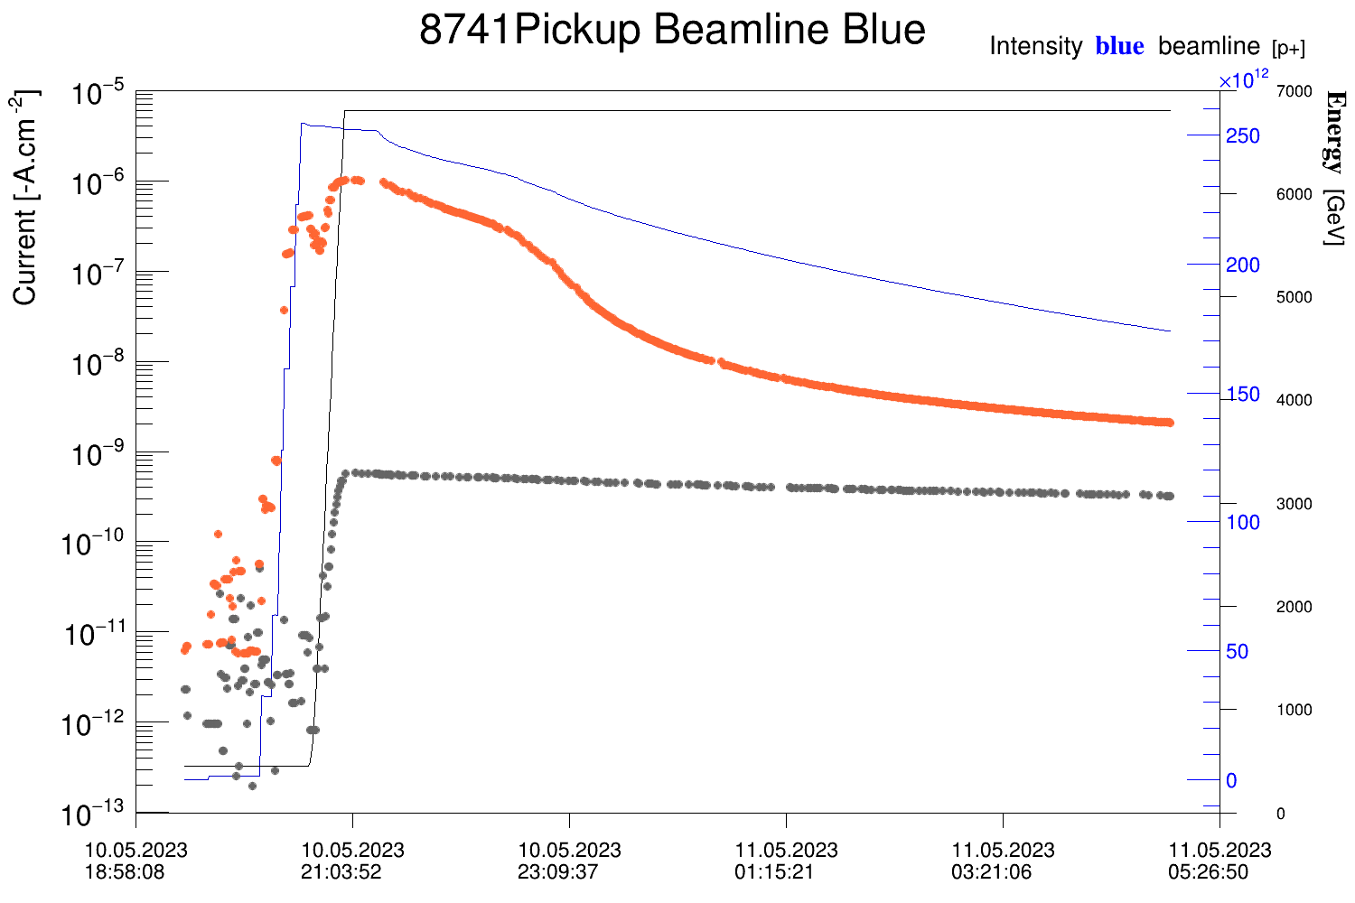



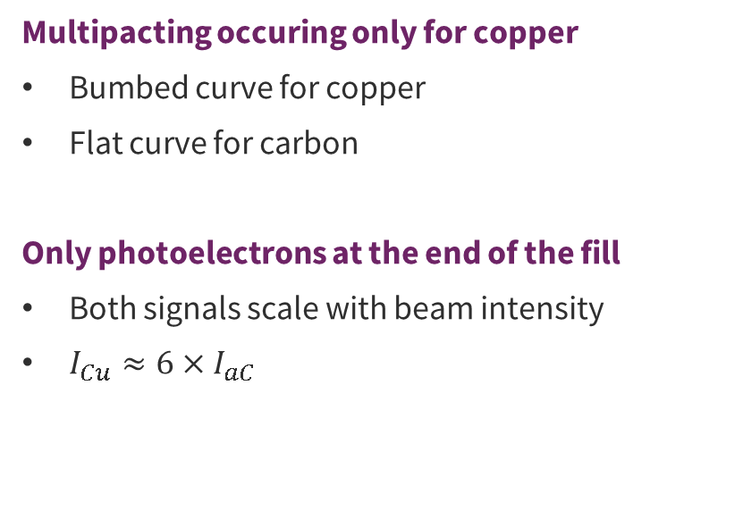




Electron cloud current evolution during a fill
  Multipacting occuring only for copper
  Bumbed curve for copper
  Flat curve for carbon
  Only photoelectrons at the end of the fill
  Both signals scale with beam intensity
  $I_{Cu}≈6×I_{aC}$
Energy
B1 intensity
Cu B1
Electron flux [A.cm⁻²]
a-C B1
  Provided the knowledge of the number of photons absorbed in the stations, one can compute their Photo Electron Yield
$$0$$
$$2$$
$$4$$
$$6$$
$$8$$
$$10$$
$$Time [h]$$
TE – VSC – VSM

Slide 17
Electron energy distribution for bulk Copper
Hybrid (7*8b4e+5*36b): 9072
TE – VSC – VSM

Slide 18
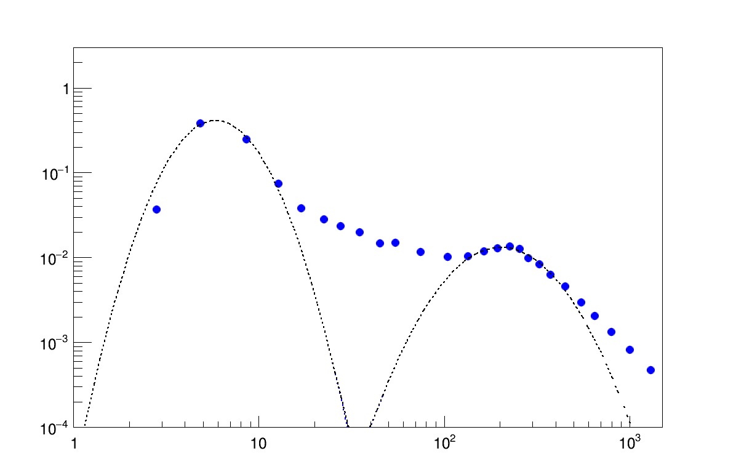



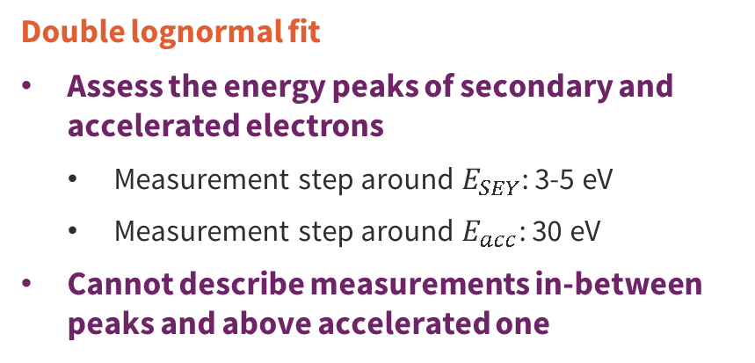

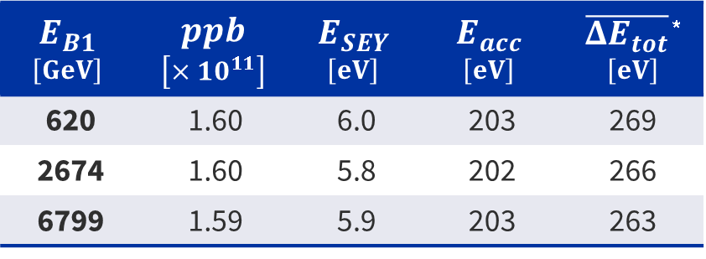

During energy ramp-up
Electron energy spectrum: Fill 9072
Secondary
electrons
  Double lognormal fit
  Assess the energy peaks of secondary and accelerated electrons
    Measurement step around $E_{SEY}$: 3-5 eV
    Measurement step around $E_{acc}$: 30 eV
  Cannot describe measurements in-between peaks and above accelerated one
Beam kicked
electrons
Normalised signal $\left[a.u\right]$
$$E_{B1}$$ $$\left[GeV\right]$$ | $$ppb$$ $$\left[×{10}^{11}\right]$$ | $$E_{SEY}$$ $$\left[eV\right]$$ | $$E_{acc}$$ $$\left[eV\right]$$ | $\overline{{ΔE}_{tot}}$ * $$\left[eV\right]$$
620 | 1.60 | 6.0 | 203 | 269
2674 | 1.60 | 5.8 | 202 | 266
6799 | 1.59 | 5.9 | 203 | 263
$$E_{SEY}$$
$$E_{acc}$$
  $$\overline{{ΔE}_{tot}}∝{ppb}^{2}×\ln\left|\sqrt{ppb}\right|$$
$$E_{e^{−}} \left[eV\right]$$
  No significant impact of the beam energy ramp-up on the electron energy distribution.
*J. Scott Berg. CERN LHC Project Note 97, July 1997.
TE – VSC – VSM

Slide 19
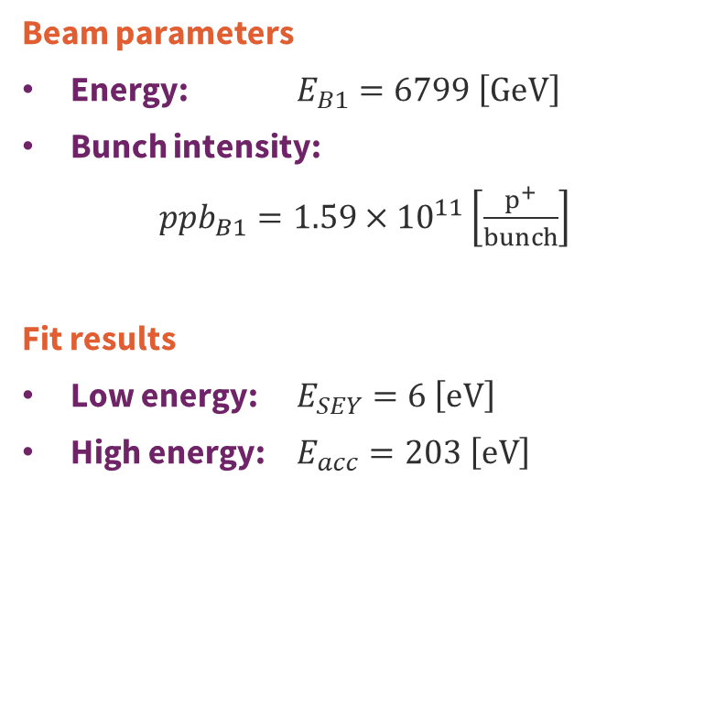




At Stable Beam: t = 0h
Electron energy spectrum: Fill 9072
  Beam parameters
  Energy: $E_{B1}=6799 \left[GeV\right]$
  Bunch intensity:
  ${ppb}_{B1}=1.59×{10}^{11}\left[\frac{p^{+}}{bunch}\right]$
  Fit results
  Low energy: $E_{SEY}=6 \left[eV\right]$
  High energy: $E_{acc}=203 \left[eV\right]$
Normalised signal $\left[a.u\right]$
$$E_{SEY}$$
$$E_{acc}$$
$$E_{e^{−}} \left[eV\right]$$
TE – VSC – VSM
06/12/2023
TE – VSC – VSM

Slide 20
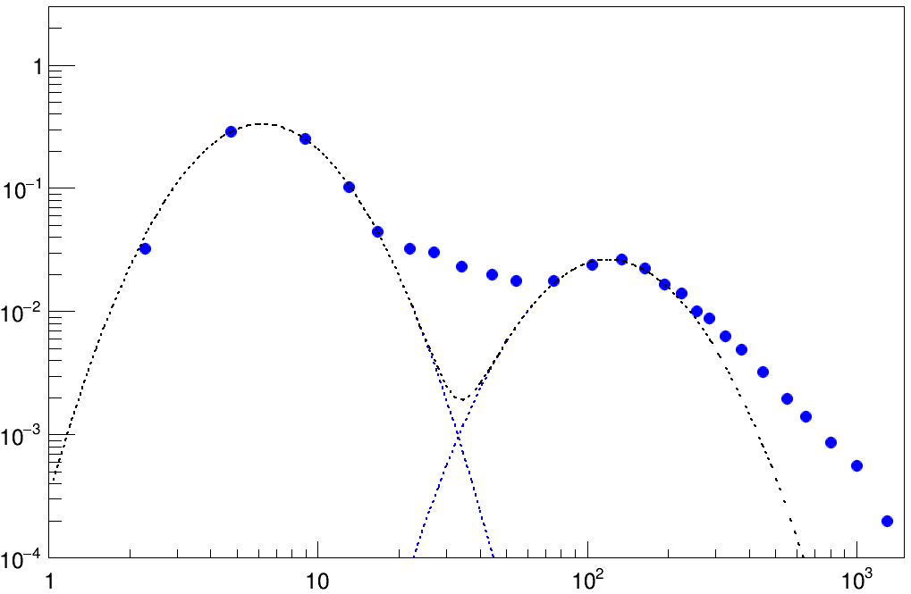



At Stable Beam: t = 6h
Electron energy spectrum: Fill 9072
  Beam parameters
  Energy: $E_{B1}=6799 \left[GeV\right]$
  Bunch intensity:
  ${ppb}_{B1}=1.23×{10}^{11}\left[\frac{p^{+}}{bunch}\right]$
  Fit results
  Low energy: $E_{SEY}=6 \left[eV\right]$
  High energy: $E_{acc}=120 \left[eV\right]$
Normalised signal $\left[a.u\right]$
$$E_{SEY}$$
$$E_{acc}$$
$$E_{e^{−}} \left[eV\right]$$
TE – VSC – VSM
06/12/2023
TE – VSC – VSM

Slide 21
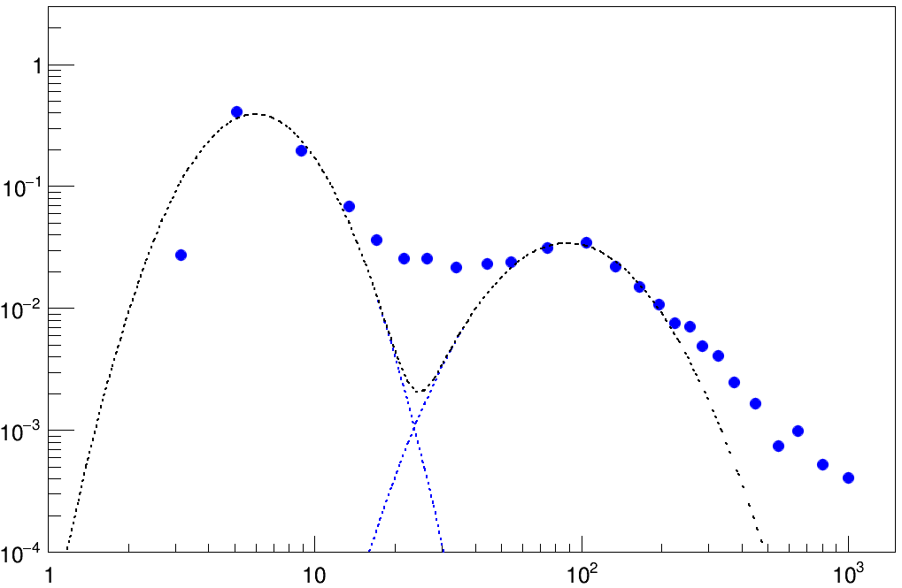
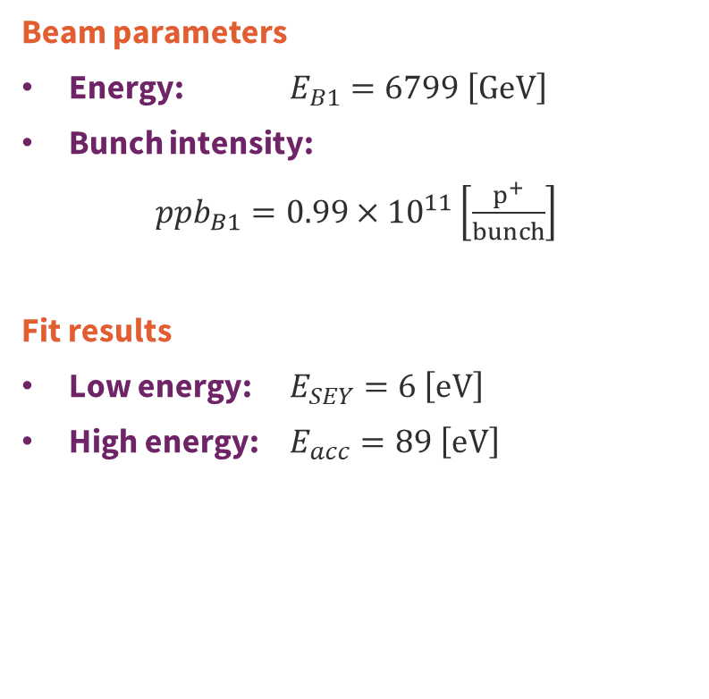

At Stable Beam: t = 11h
Electron energy spectrum: Fill 9072
  Beam parameters
  Energy: $E_{B1}=6799 \left[GeV\right]$
  Bunch intensity:
  ${ppb}_{B1}=0.99×{10}^{11}\left[\frac{p^{+}}{bunch}\right]$
  Fit results
  Low energy: $E_{SEY}=6 \left[eV\right]$
  High energy: $E_{acc}=89 \left[eV\right]$
Normalised signal $\left[a.u\right]$
$$E_{SEY}$$
$$E_{acc}$$
$$E_{e^{−}} \left[eV\right]$$
TE – VSC – VSM
06/12/2023
TE – VSC – VSM

Slide 22
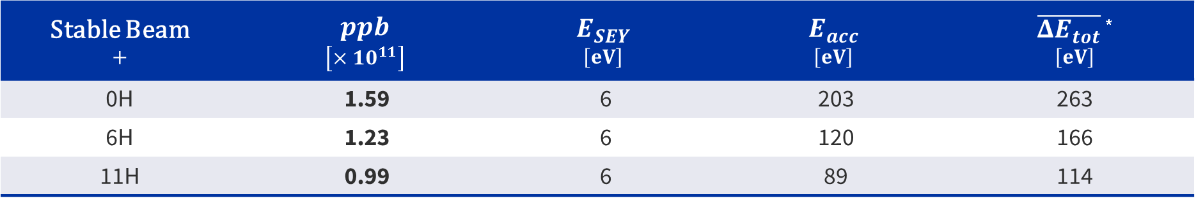

Impact of the beam intensity at 6800GeV
  $$\overline{{ΔE}_{tot}}∝{ppb}^{2}×\ln\left|\sqrt{ppb}\right|$$
Stable Beam $$+$$ | $$ppb$$ $$\left[×{10}^{11}\right]$$ | $$E_{SEY}$$ $$\left[eV\right]$$ | $$E_{acc}$$ $$\left[eV\right]$$ | $\overline{{ΔE}_{tot}}$ * $$\left[eV\right]$$
0H | 1.59 | 6 | 203 | 263
6H | 1.23 | 6 | 120 | 166
11H | 0.99 | 6 | 89 | 114
*J. Scott Berg. CERN LHC Project Note 97, July 1997.
  No impact of the bunch intensity on the energy of the secondary electrons.
  Decrease of the energy gained by accelerated electrons with bunch intensity.
  Kick energy formulae gives a reasonable energy assessment at 30%
TE – VSC – VSM
06/12/2023
TE – VSC – VSM

Slide 23
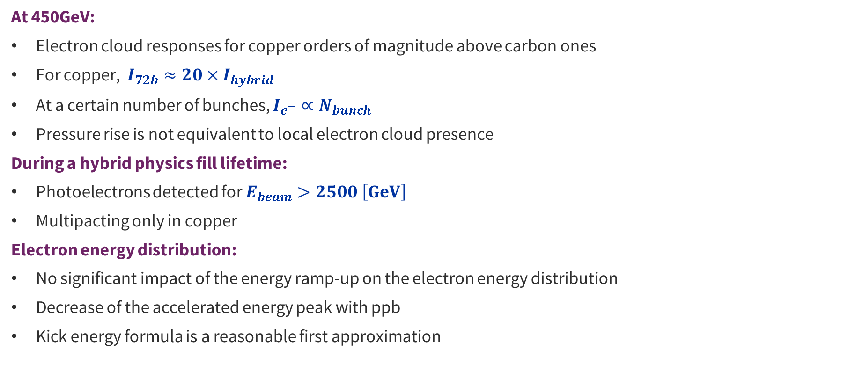
Summary
  At 450GeV:
  Electron cloud responses for copper orders of magnitude above carbon ones
  For copper, $I_{72b}≈20×I_{hybrid}$
  At a certain number of bunches, $I_{e^{−}}∝N_{bunch}$
  Pressure rise is not equivalent to local electron cloud presence
  During a hybrid physics fill lifetime:
  Photoelectrons detected for $E_{beam}>2500 \left[GeV\right]$
  Multipacting only in copper
  Electron energy distribution:
  No significant impact of the energy ramp-up on the electron energy distribution
  Decrease of the accelerated energy peak with ppb
  Kick energy formula is a reasonable first approximation
TE – VSC – VSM

Slide 24
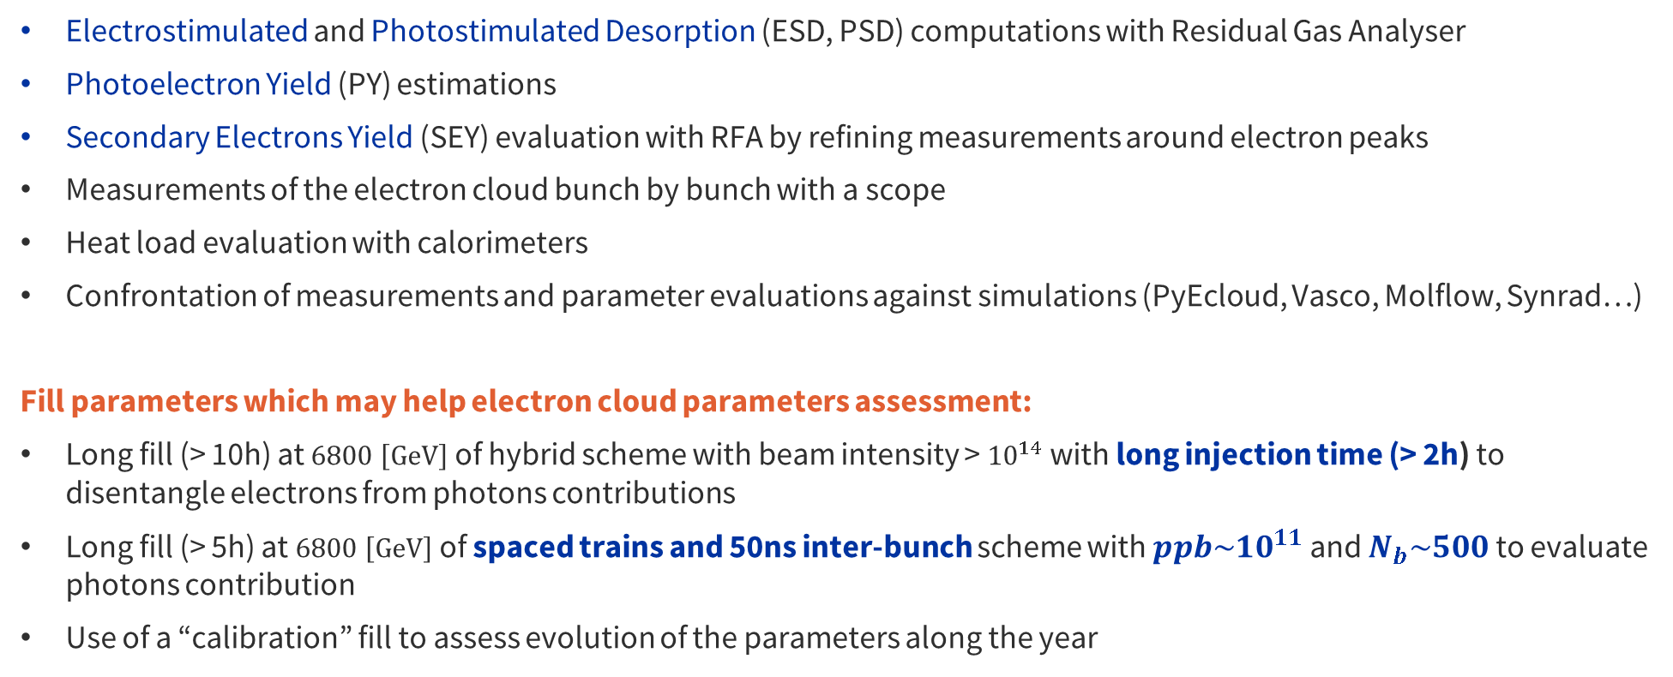
Perspectives
  Electrostimulated and Photostimulated Desorption (ESD, PSD) computations with Residual Gas Analyser
  Photoelectron Yield (PY) estimations
  Secondary Electrons Yield (SEY) evaluation with RFA by refining measurements around electron peaks
  Measurements of the electron cloud bunch by bunch with a scope
  Heat load evaluation with calorimeters
  Confrontation of measurements and parameter evaluations against simulations (PyEcloud, Vasco, Molflow, Synrad…)
  Fill parameters which may help electron cloud parameters assessment:
  Long fill (> 10h) at $6800 \left[GeV\right]$of hybrid scheme with beam intensity > ${10}^{14}$ with long injection time (> 2h) to disentangle electrons from photons contributions
  Long fill (> 5h) at $6800 \left[GeV\right]$of spaced trains and 50ns inter-bunch scheme with $ppb\sim {10}^{11}$ and $N_{b}\sim 500$ to evaluate photons contribution
  Use of a “calibration” fill to assess evolution of the parameters along the year
TE – VSC – VSM

Slide 25
Backups
TE – VSC – VSM

Slide 26
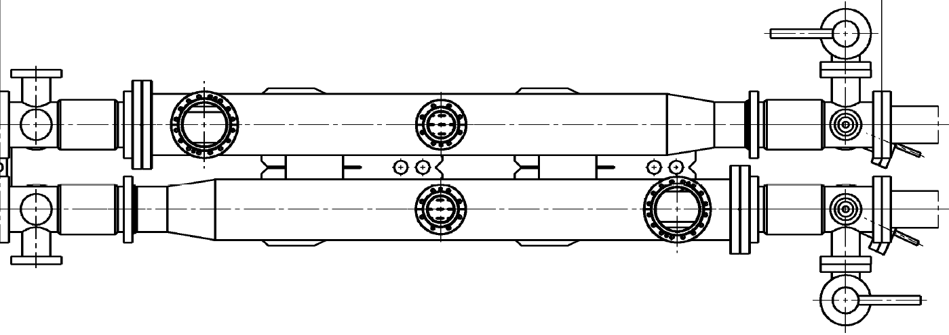
Station 2 – Amorphous carbon
Dash line : Downer side
Red line : Scope
Blue line : Keithley with variable bias
Liner B23
Position :
129
124
122
121
120
119
118
116
110
.5L8.
B
R
Ext
X
X
K4
7%
Canon 1-12
K6
7%
St 1
K5
Sc3a
St 3
z
7%
7%
K16
K18
Canon 1-12
Int
X
Sc3b
K17
X
Liner R25
NU : Unused
cal : calorimeter
Unused
xx % : pickup with a xx%-transparent grid
VGPB : Penning Gauge
ph : photodetector
VGI : Bayard-Alpert Gauge (BAG)
Trig : trigger
VQM : Vacuum Quality Monitor
RGA : Residual Gas Analyser
kick : kicker (Electron Kicker Detector)
VF : Vacuum Flange
VGRB : Pirani gauge​
RFA : Retarding Field Analyser
VPIA : Vacuum Pump
X
N : NEG cartridge
TE – VSC – VSM

Slide 27
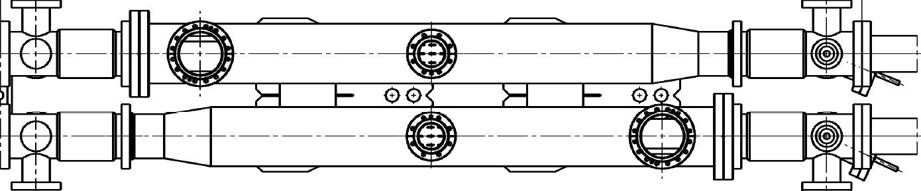
Station 3 – New unbaked copper
Dash line : Downer side
Red line : Scope
Blue line : Keithley with variable bias
Liner B26
Position :
92
87
85
84
83
82
81
79
73
.5L8.
B
R
Ext
X
X
Sc1a
7%
15%
50%
Canon 1-12
K8
7%
K9
St 2
K7
Sc2a
St 4
z
15%
7%
Sc1b
K21
7%
K26
Canon 1-12
50%
Int
X
Sc2b
K27
X
Int
Liner R27
NU : Unused
cal : calorimeter
Unused
xx % : pickup with a xx%-transparent grid
VGPB : Penning Gauge
ph : photodetector
VGI : Bayard-Alpert Gauge (BAG)
Trig : trigger
VQM : Vacuum Quality Monitor
RGA : Residual Gas Analyser
kick : kicker (Electron Kicker Detector)
VF : Vacuum Flange
VGRB : Pirani gauge​
RFA : Retarding Field Analyser
VPIA : Vacuum Pump
X
N : NEG cartridge
TE – VSC – VSM

Slide 28
Station 4 – Old unbaked copper
Dash line : Downer side
Red line : Scope
Blue line : Keithley with variable bias
Liner 7
Position :
55
50
48
46
44
42
36
4
.5L8.
B
R
Ext
X
X
Pt100 air B
SHV1
7%
0,2%
K12 + SHV2
St 3
HV BIAS 28
K11
Canon 1-12
LHCb
z
SHV3
7%
0,2%
K22 + SHV4
K23
K24
Canon 1-12
X
Pt100 air R
X
Int
Liner 8
NU : Unused
cal : calorimeter
Unused
xx % : pickup with a xx%-transparent grid
VGPB : Penning Gauge
ph : photodetector
VGI : Bayard-Alpert Gauge (BAG)
Trig : trigger
VQM : Vacuum Quality Monitor
RGA : Residual Gas Analyser
kick : kicker (Electron Kicker Detector)
VF : Vacuum Flange
VGRB : Pirani gauge​
RFA : Retarding Field Analyser
VPIA : Vacuum Pump
X
N : NEG cartridge
TE – VSC – VSM

Slide 29
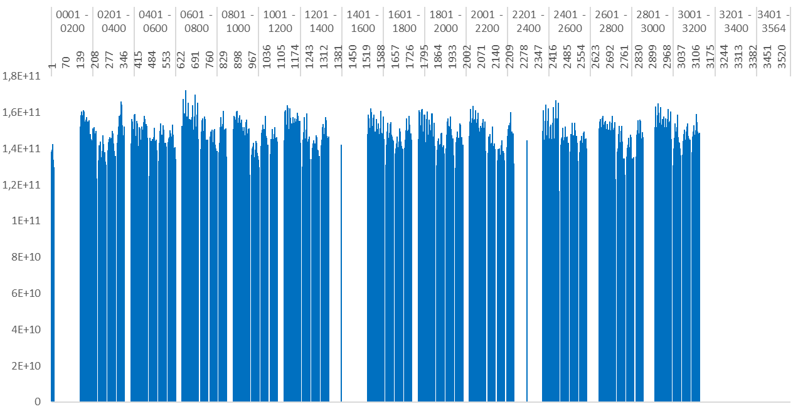

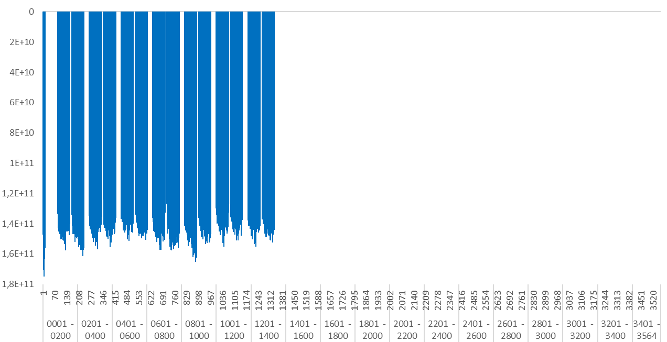

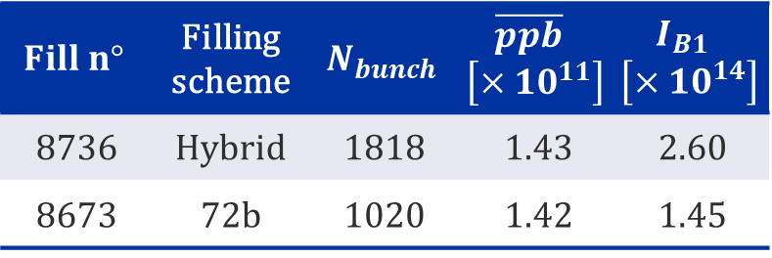
Hybrid and 72b filling schemes
1 turn of the LHC
« hybrid»
7*(8b4e) + 3*(36b)
  Fill 8736
$$Fill n°$$ | Filling scheme | $$N_{bunch}$$ | $$\overline{ppb}$$ $$\left[×{10}^{11}\right]$$ | $$I_{B1}$$ $$\left[×{10}^{14}\right]$$
8736 | Hybrid | 1818 | 1.43 | 2.60
8673 | 72b | 1020 | 1.42 | 1.45
  Fill 8673
2*(72b)
Ppb vs Bunch site number for hybrid (top) and 72b (bottom) filling scheme
TE – VSC – VSM

Slide 30
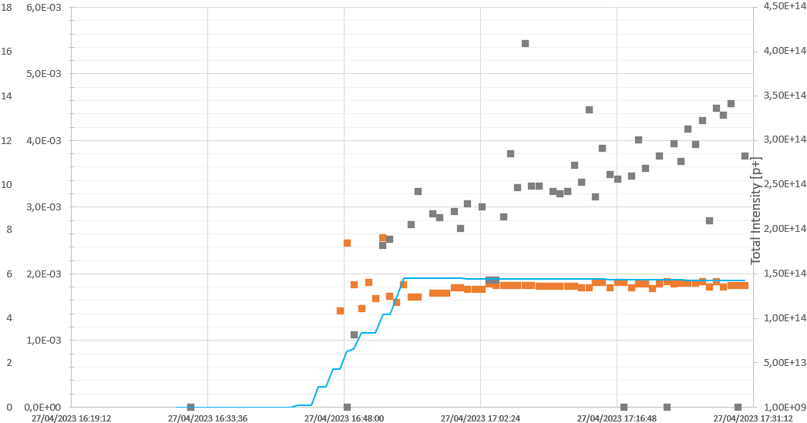
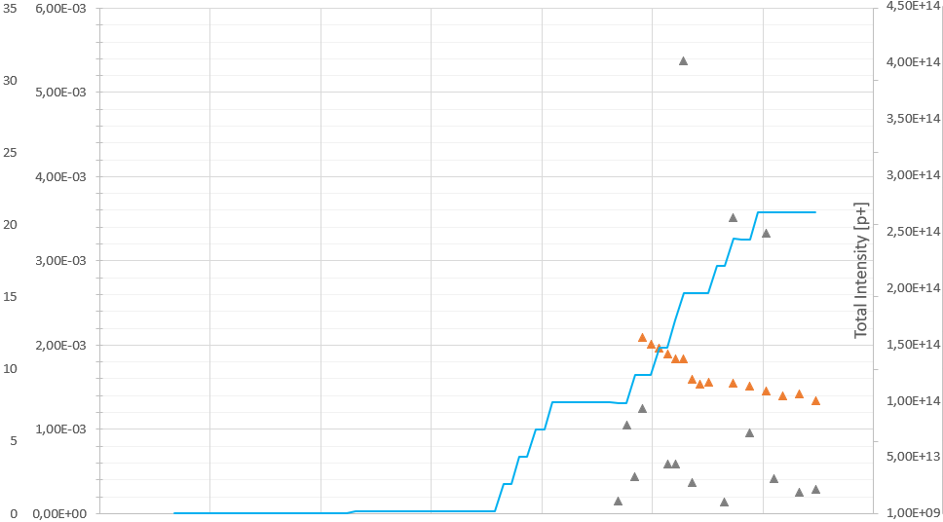


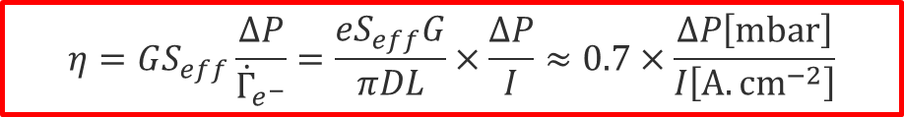











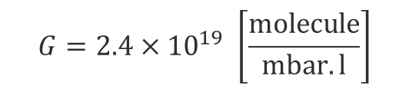




ESD formula and plots
$$G=2.4×{10}^{19 }\left[\frac{molecule}{mbar.l}\right]$$
$$L=137 \left[cm\right]$$
$$η=GS_{eff}\frac{ΔP}{{\dot{Γ}}_{e^{−}}}=\frac{eS_{eff}G}{πDL}×\frac{ΔP}{I}≈0.7×\frac{ΔP\left[mbar\right]}{I\left[A.{cm}^{−2}\right]}$$
$$D=8.2 \left[cm\right]$$
$$S_{eff}≈{2×S}_{NEG buffer}≈600 \left[l.s^{−1}\right]$$
  Fill 8673 – 72b
  Fill 8736 – hybrid
a-C Cu
a-C Cu
a-C B1
a-C B1
Pressure / Electron flux [mbar/(A.cm⁻²)]
Pressure / Electron flux [mbar/(A.cm⁻²)]
Cu B1
Cu B1
B1 intensity
B1 intensity
$$0$$
$$14$$
$$28$$
$$42$$
$$56$$
$$70$$
$$0$$
$$10$$
$$20$$
$$30$$
$$40$$
$$50$$
$$60$$
$$70$$
$$Time [min]$$
$$Time [min]$$
TE – VSC – VSM
$$L=137 \left[cm\right]$$

Slide 31
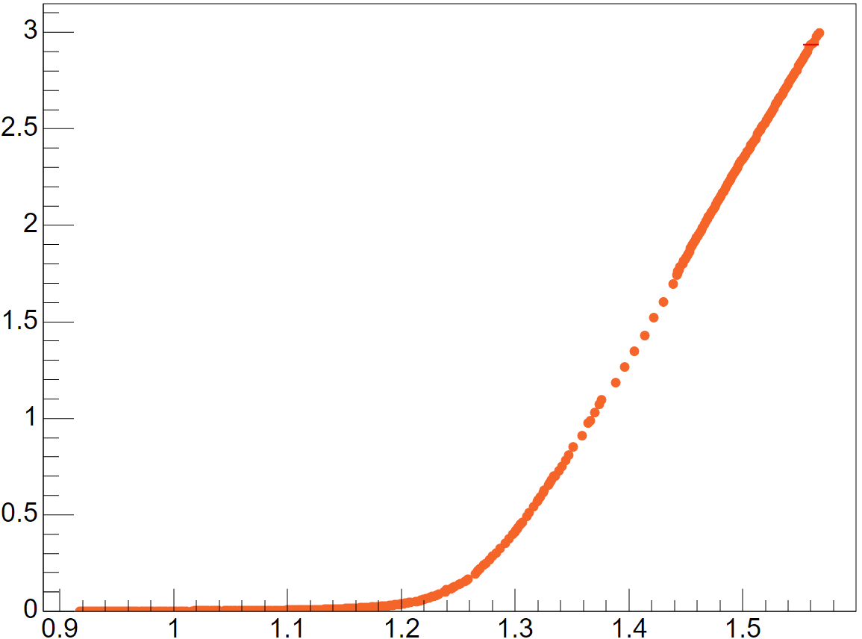
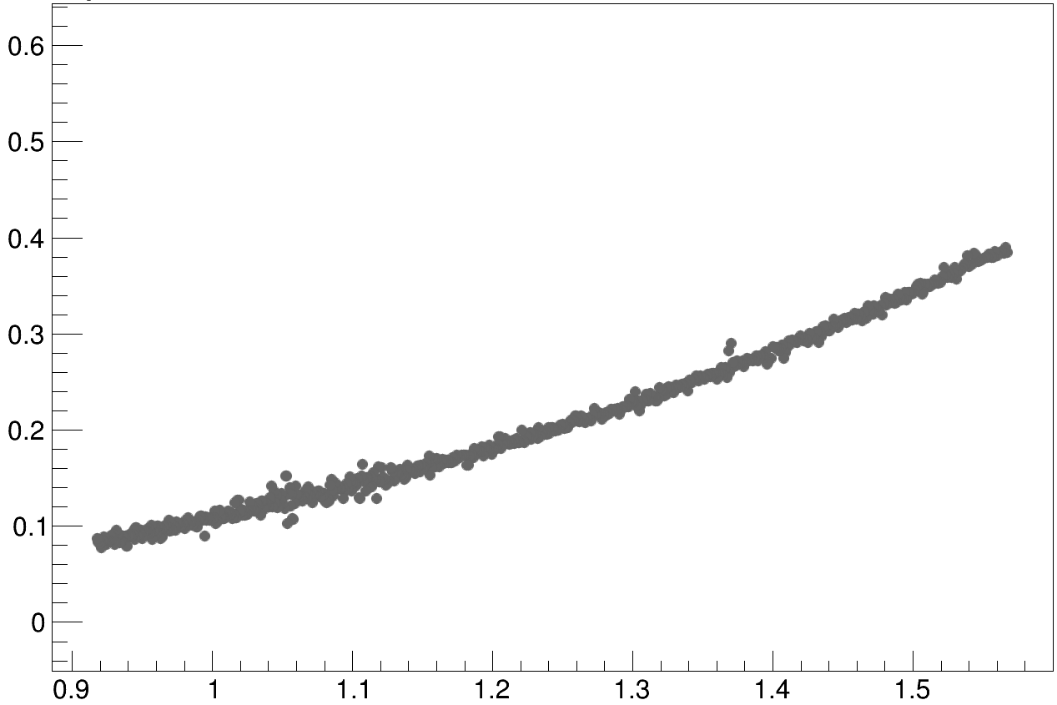


Ecloud as a function of beam mean ppb
$$×{10}^{−6}$$
Electron flux vs Mean ppb: Fill 9072
$$×{10}^{−9}$$
  Multipacting presence
  Barely present for carbon: ecloud mainly dominated by photoelectrons
  Huge contribution for copper
  Assymptotic root method
  Root of linear asymptotic behaviour for high ppb
  Method to assess the variations of multipacting with time
new-Cu B1
a-C B1
linear
multipacting
regime
Electron flux [A.cm⁻²]
Mean ppb $\left[{10}^{−11}×\frac{p^{+}}{bunch}\right]$
primary electrons
regime
  Assymptotic root method is NOT aimed at giving a multipacting threshold as ecloud effect has been identified for lower ppb.
Mean ppb $\left[{10}^{−11}×\frac{p^{+}}{bunch}\right]$
TE – VSC – VSM

Slide 32
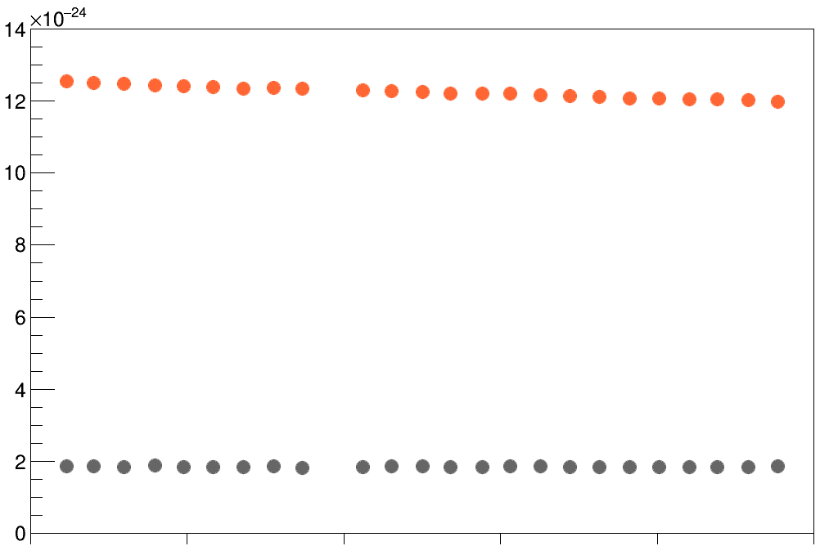





Electron flux scaling with beam intensity at end of fill
Electron flux normalised by beam intensity vs Time: Fill 8741
Cu B1
Normalised electron flux [A.cm⁻²]
$$0$$
a-C B1
$$Time [min]$$
$$6$$
$$12$$
$$18$$
$$24$$
$$30$$
TE – VSC – VSM

Slide 33
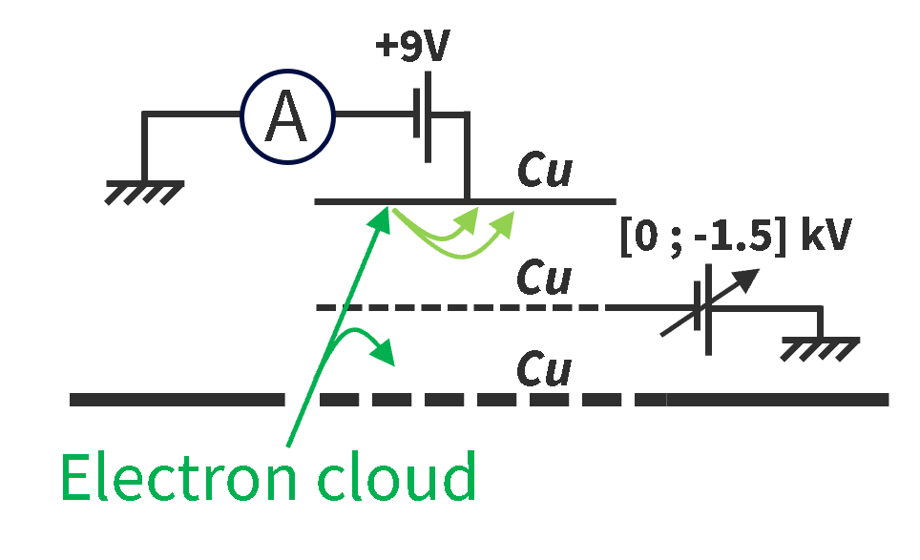
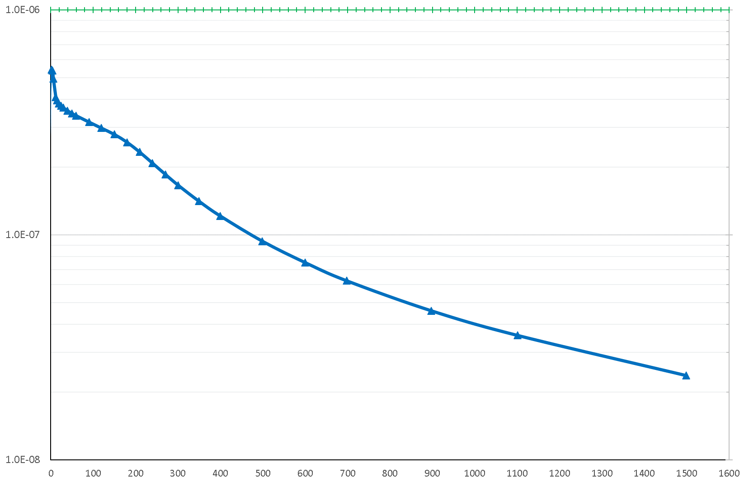
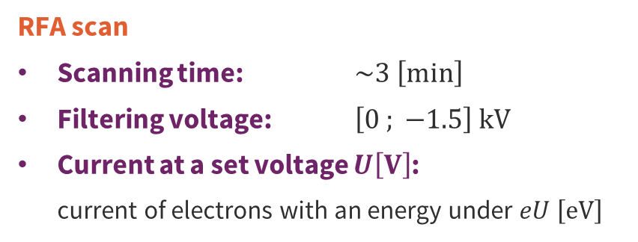


RFA raw data
Electron current vs Filtering voltage: Fill 9072
RFA scan: Fill 9072
  RFA scan
  Scanning time: $\sim 3 \left[min\right]$
  Filtering voltage: $\left[0 ; −1.5\right] kV$
  Current at a set voltage $U\left[V\right]$:
    current of electrons with an energy under $eU \left[eV\right]$
Electron current $\left[A\right]$
  The energy spectrum of the electrons can be obtained by derivating this curve.
$${−V}_{filter} \left[V\right]$$
TE – VSC – VSM

Slide 34
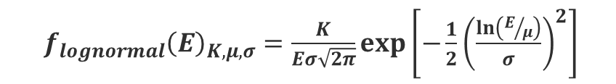

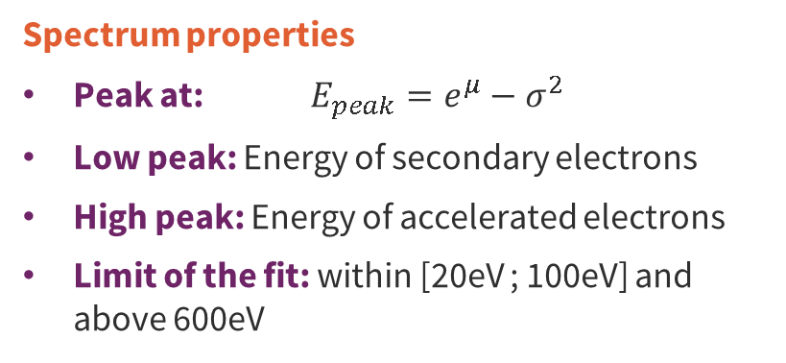

Energy spectrum double lognormal fit
Electron energy spectrum: Fill 9072
  $f_{lognormal}{\left(E\right)}_{K, μ,σ}=\frac{K}{Eσ\sqrt{2π}}exp\left[−\frac{1}{2}{\left(\frac{ln⁡\left(E/μ\right)}{σ}\right)}^{2}\right]$
  Spectrum properties
  Peak at: $E_{peak}=e^{μ}−σ^{2}$
  Low peak: Energy of secondary electrons
  High peak: Energy of accelerated electrons
  Limit of the fit: within [20eV ; 100eV] and above 600eV
Normalised signal $\left[a.u\right]$
$$E_{SEY}$$
$$E_{acc}$$
$$E_{e^{−}} \left[eV\right]$$
TE – VSC – VSM

Slide 35











Kick approximation principle
$${ΔE}_{wall}$$
$$e^{−}$$
$$\overline{{ΔE}_{kick}}$$
$$r_{c}$$
  Two different types of motions during the passage of a bunch:
  Autonomous approximation: The electrons are strongly pulled by the bunch and begin to oscillate around it.
  Kick approximation: The electrons haven’t started to move very much before.
  Deciding which approximation to use:
    consists of comparing the oscillation period with respect to the time for the bunch to pass
    is equivalent to introducing a transition radius to delimit the domains of validity of both approximations
$b=4 \left[cm\right]$
$$\overline{{ΔE}_{auto}}$$
  Introduction of the critical radius $r_{c}$ above which the kick approximation is used, and below which the autonomous approximation is used.
  Mean energy kick within these regions:
  Energy kick for an electron on the wall:
  Total mean energy gain:
$$\overline{{ΔE}_{auto}}$$
$$\overline{{ΔE}_{kick}}$$
$${ΔE}_{wall}$$
$$\overline{{ΔE}_{tot}}=\frac{r_{c}}{b} \overline{{ΔE}_{auto}}+\frac{b−r_{c}}{b} \overline{{ΔE}_{kick}}$$
Ref: “ Energy Gain in an Electron Cloud During the Passage of a Bunch ” – J. Scott Berg
TE – VSC – VSM

Slide 36


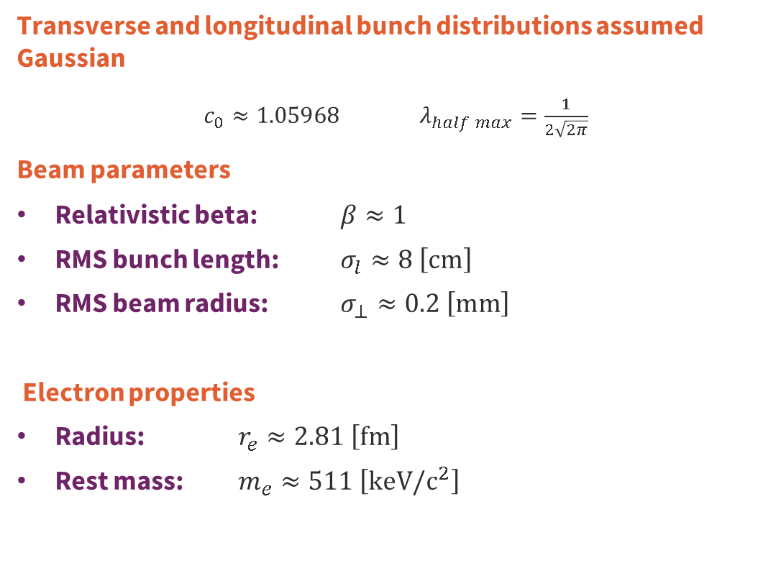

Kick approximation formulae
$${ΔE}_{wall}$$
$$e^{−}$$
$$\overline{{ΔE}_{kick}}$$
  Transverse and longitudinal bunch distributions assumed Gaussian
$c_{0}≈1.05968$ $λ_{half max}=\frac{1}{2\sqrt{2π}}$
Beam parameters
  Relativistic beta: $β≈1$
  RMS bunch length: $σ_{l}≈8 \left[cm\right]$
  RMS beam radius: $σ_{⊥}≈0.2 \left[mm\right]$
  Electron properties
  Radius: $r_{e}≈2.81 \left[fm\right]$
  Rest mass: $m_{e}≈511 \left[keV/c^{2}\right]$
$$r_{c}$$
$b=4 \left[cm\right]$
$$\overline{{ΔE}_{auto}}$$
  $$r_{c} =2\sqrt{\frac{ppb×r_{e}×σ_{l}}{πβ^{2}λ_{half max}}}$$
  $${ΔE}_{wall}=2m_{e}c^{2}{\left(\frac{ppb×r_{e}}{βb}\right)}^{2}$$
  $$\overline{{ΔE}_{auto}} =\frac{2}{π}{×ΔE}_{wall}\left[\ln\left(\frac{r_{c}}{c_{0}σ_{⊥}}\right)−\frac{1}{2}\right]$$
  $$\overline{{ΔE}_{kick}} =2×{ΔE}_{wall}\ln\left(\frac{b}{r_{c}}\right)$$
Ref: “ Energy Gain in an Electron Cloud During the Passage of a Bunch ” – J. Scott Berg
TE – VSC – VSM

Slide 37
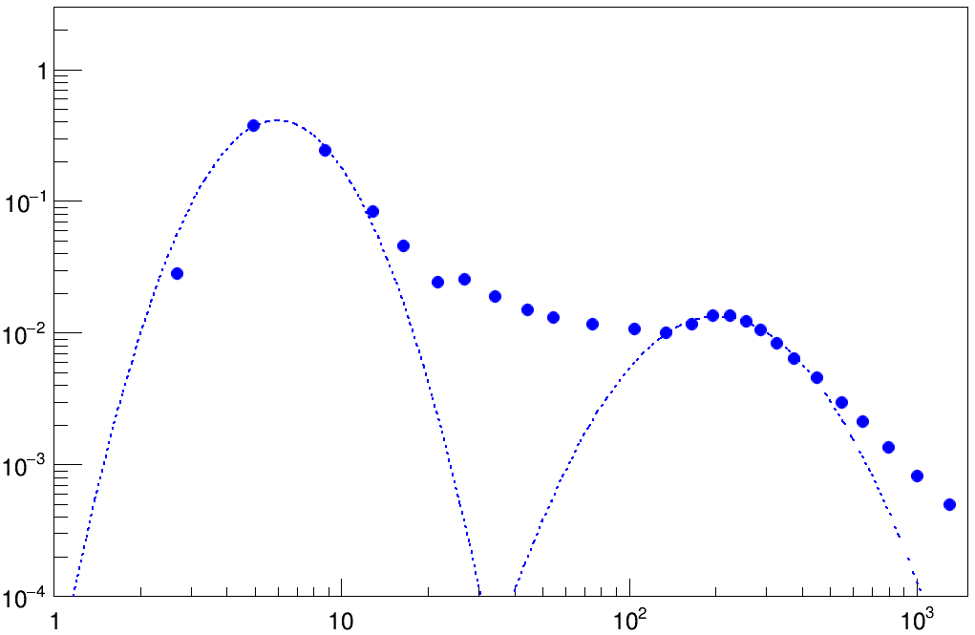

Energy ramp-up at 620GeV
Electron energy spectrum: Fill 9072
  Beam parameters
  Energy: $E_{B1}=620 \left[GeV\right]$
  Intensity: ${ppb}_{B1}=1.60×{10}^{11}\left[\frac{p^{+}}{bunch}\right]$
  Fit results
  Low energy: $E_{SEY}=6.0 \left[eV\right]$
  High energy: $E_{acc}=203 \left[eV\right]$
Normalised signal $\left[a.u\right]$
$$E_{SEY}$$
$$E_{acc}$$
$$E_{e^{−}} \left[eV\right]$$
TE – VSC – VSM
06/12/2023
TE – VSC – VSM

Slide 38


Energy ramp-up at 2074GeV
Electron energy spectrum: Fill 9072
  Beam parameters
  Energy: $E_{B1}=2074 \left[GeV\right]$
  Intensity: ${ppb}_{B1}=1.60×{10}^{11}\left[\frac{p^{+}}{bunch}\right]$
  Fit results
  Low energy: $E_{SEY}=5.8 \left[eV\right]$
  High energy: $E_{acc}=202 \left[eV\right]$
Normalised signal $\left[a.u\right]$
$$E_{SEY}$$
$$E_{acc}$$
$$E_{e^{−}} \left[eV\right]$$
TE – VSC – VSM
06/12/2023
TE – VSC – VSM

Slide 39


Energy ramp-up at 6799GeV
Electron energy spectrum: Fill 9072
  Beam parameters
  Energy: $E_{B1}=6799 \left[GeV\right]$
  Intensity: ${ppb}_{B1}=1.59×{10}^{11}\left[\frac{p^{+}}{bunch}\right]$
  Fit results
  Low energy: $E_{SEY}=5.9 \left[eV\right]$
  High energy: $E_{acc}=203 \left[eV\right]$
Normalised signal $\left[a.u\right]$
$$E_{SEY}$$
$$E_{acc}$$
$$E_{e^{−}} \left[eV\right]$$
TE – VSC – VSM
06/12/2023
TE – VSC – VSM

