Slide 1
Electron clouds in the LHC
Konstantinos Paraschou, Lotta Mether,
Giovanni Rumolo, Giovanni Iadarola
With input from:
Hannes Bartosik, Benjamin Bradu, Xavier Buffat, Pascal Hermes,
Sofia Johannesson,Yannis Papaphilippou, Valentine Petit, Milica Rakic, Luca Sabato
Joint Accelerator Performance Workshop 2023
Royal Plaza Montreux & Spa, Montreux, Switzerland
6th December 2023

Slide 2
Outline
SEY - Heat load Modelling
  Overview
  Remainder of Run 3
  Comparison between models
  Beam Degradation – Beam instabilities
  During stable beams
  During ramp
  At injection
  Beam degradation – Incoherent effects
      Emittance growth at injection,
      Slow losses during stable beams,
      Halo population

Slide 3
Outline
SEY - Heat load Modelling
  Overview
  Remainder of Run 3
  Comparison between models
  Beam Degradation – Beam instabilities
  During stable beams
  During ramp
  At injection
  Beam degradation – Incoherent effects
      Emittance growth at injection,
      Slow losses during stable beams,
      Halo population

Slide 4

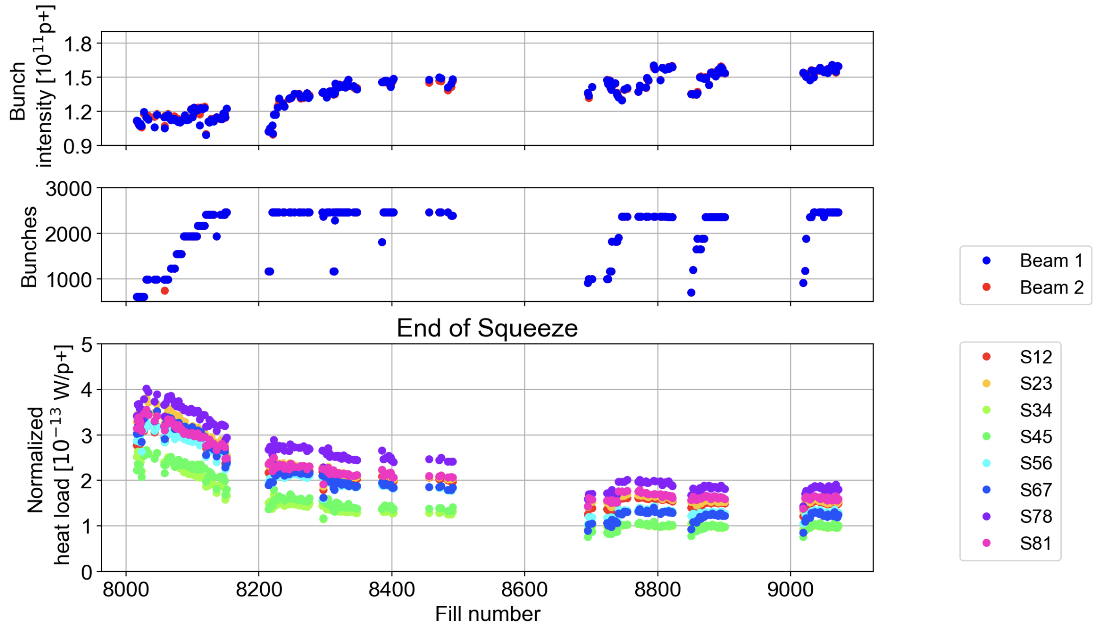

Heat load evolution - 2022
During 2022 intensity ramp-up:
Reached heat load limit (beam screen) in Sector 78.
Changed filling scheme from 5x48b to 5x36b.
Reduces heat load per proton but also maximum number of bunches.
      Could fit a few more bunches.
      Could continue raising bunch intensity.
5x48b
5x36b
2022
2023

Slide 5
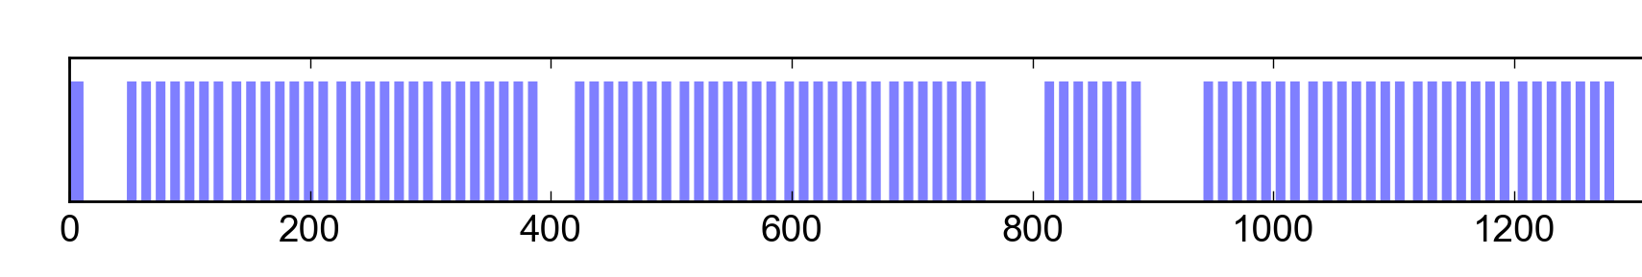
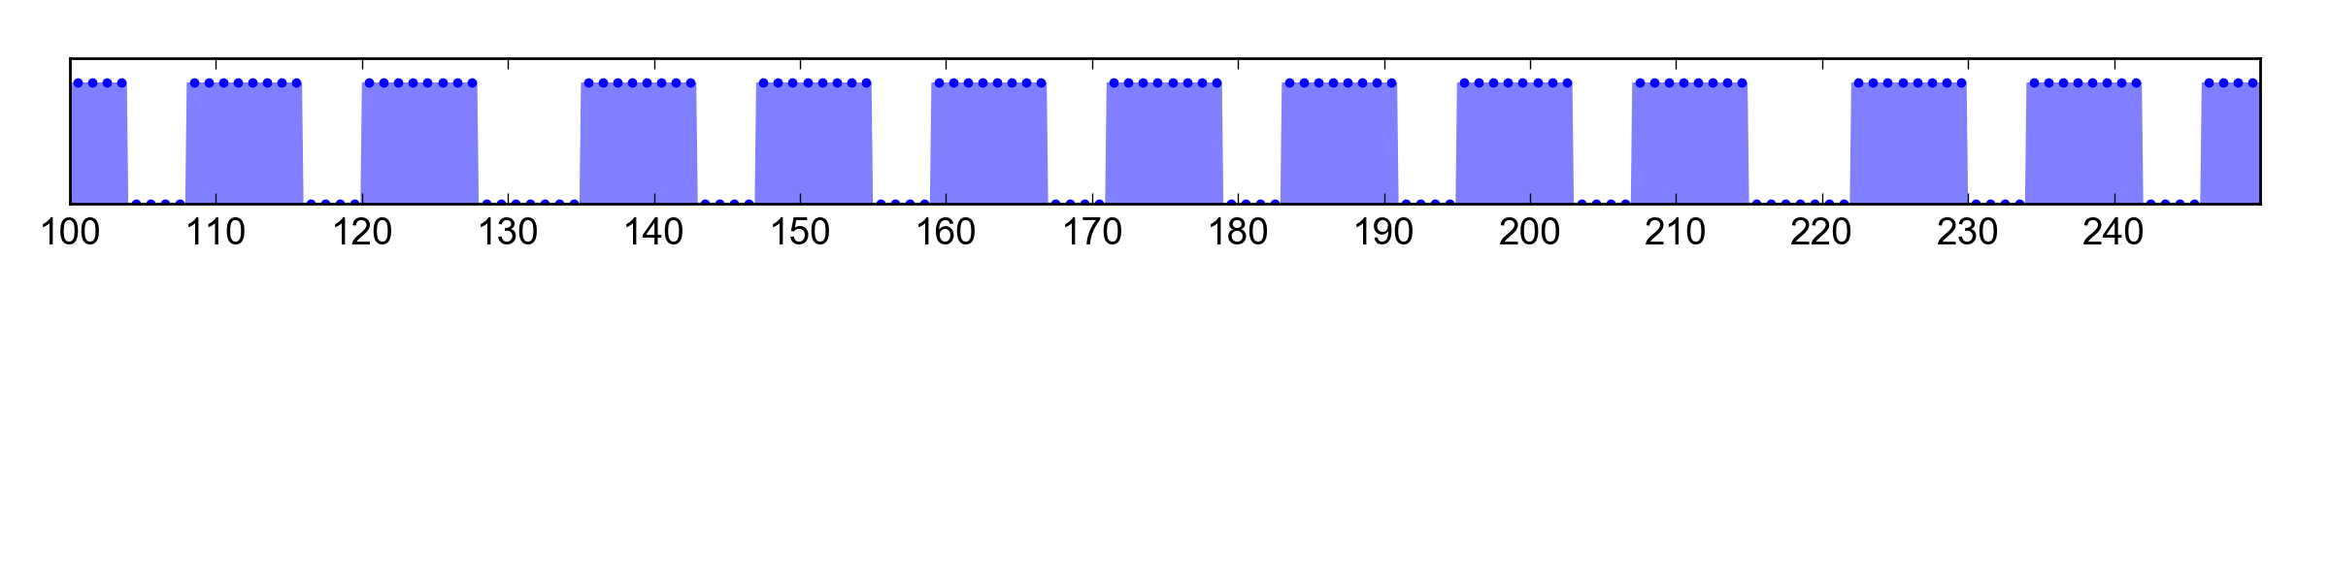
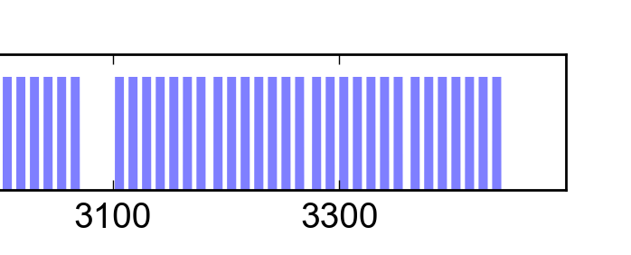
8b4e - Hybrid scheme
The 8b+4e scheme introduces gaps already on the rising slope of the e-cloud build-up
The cloud never reaches full saturation level: significant reduction of e-cloud effects
Trade-off between number of bunches and average heat load per bunch.
8b+4e filling scheme
8b
4e
8b
4e
8b
4e
8b
Hybrid filling scheme
1x56b
8b4e
5x36b
25 ns
1x56b
8b4e
5x36b
25 ns
8b
4e
8b
4e
8b
4e
8b

Slide 6
Heat load evolution - 2023
5x48b
5x36b
hybrid: 8b4e + 5x36b
2022
2023
Optimized for luminosity by reducing heat load per proton:
During 2022: Switch from 5x48b to 5x36b.
For 2023: Switch to hybrid scheme: 8b4e + 5x36b

Slide 7
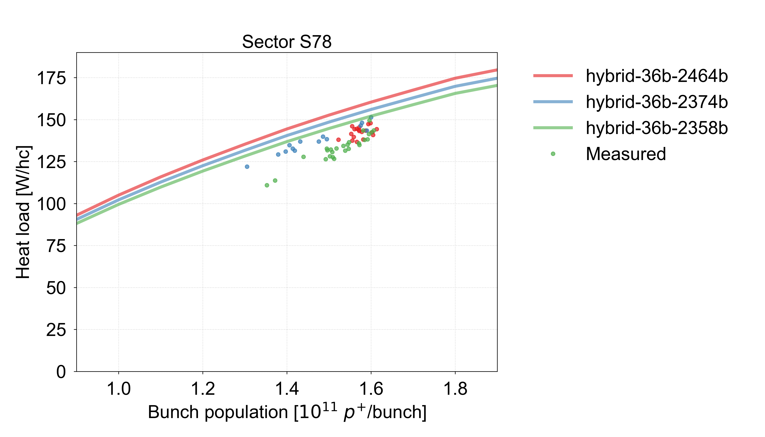
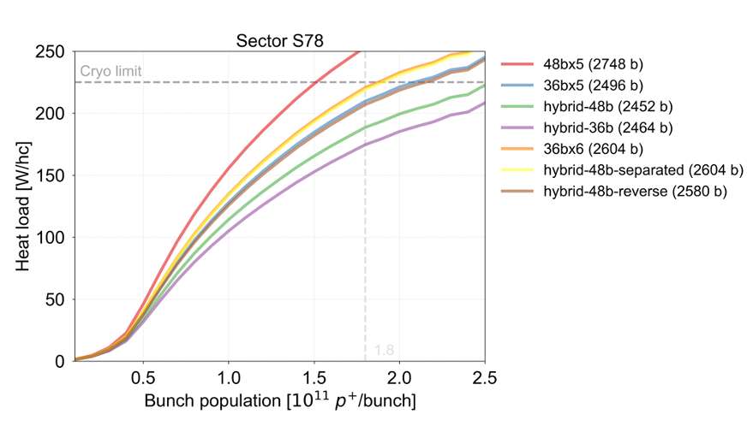
Heat load in 2023
Measured heat load was slightly smaller than predicted by few %.
Cryo limits reconfigured for more capacity in S78 (and less in S81). See Laurent’s talk.
Can we optimise filling scheme for more luminosity?
2023 measurements
(Physics fills)
Outlook for 2024
Plots for S81 in spare slides.

Slide 8
Options for remainder of Run 3
1.8 10¹¹ p/b | Number of collisions |  |  | S78 Heat load [W/hc] | S81 Heat load [W/hc]
Type | IP1/5 | IP2 | IP8 | S78 Margin [W/hc] | S81 Margin [W/hc]
hybrid-36b | 2452 | 1889 | 2067 | 175 (-50) | 146 (-44)
hybrid-48b | 2440 | 1952 | 2240 | 189 (-36) | 157 (-33)
5x36b | 2484 | 2121 | 2260 | 210 (-15) | 173 (-17)
6x36b | 2592 | 2097 | 2059 | 221 (-4) | 183 (-7)
reverse hybrid-48b (1) | 2600 | 1903 | 1924 | 217 (-8) | 179 (-11)
reverse hybrid-48b (2) | 2568 | 1913 | 1956 | 207 (-18) | 172 (-18)
separated hybrid-48b | 2592 | 2212 | 2206 | 219 (-6) | 181 (-9)
(Cryo less tight if we stay at lower bunch intensity)
2023, large cryo margin
Potential for more LHCb cols.
Pure 25ns, optimised IP2/8
Pure 25ns, cryo very tight
Tight cryo margin,
too long injections for MKI.
Heat load reduction and SPS
production should be tested.
Tight cryo margin, requires multiple SPS cycles.
“Reverse” hybrid schemes: 8b4e part comes after the 25ns part in SPS.
“Separated” hybrid scheme: Separate injections of 8b4e and 25ns from SPS.
Note: Schemes do not include INDIVs or smaller trains for injection steering.
Further optimisation is hard. Cornered from everywhere.

Slide 9
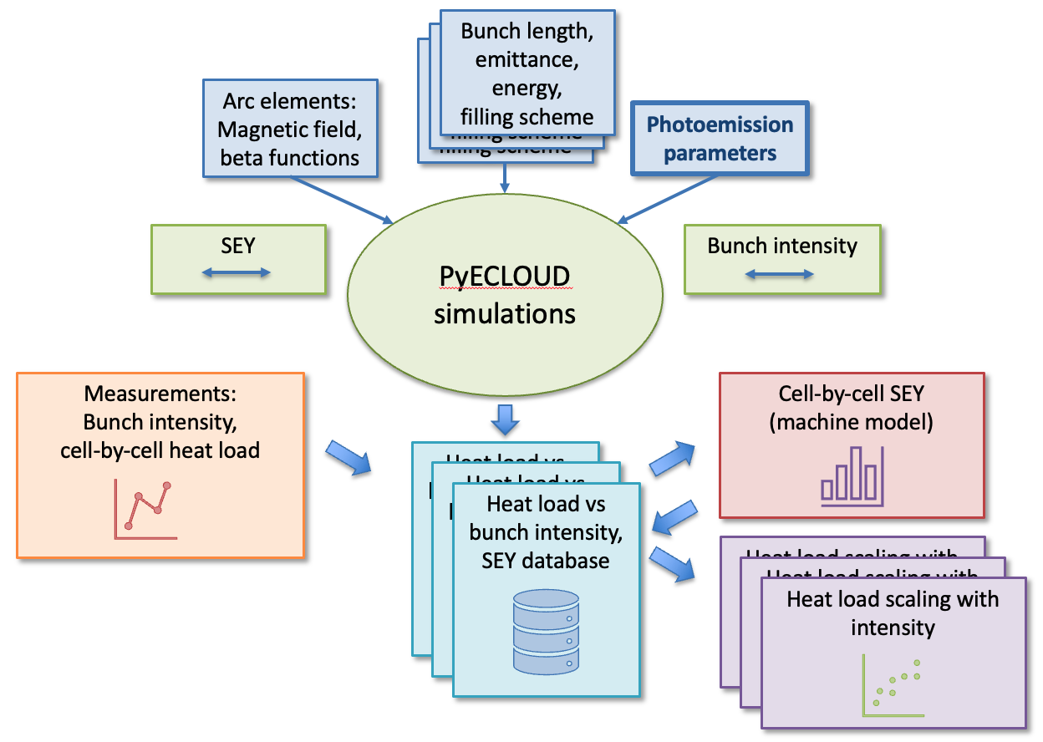
The e-cloud simulation model
The e-cloud heat load can be estimated based on the SEY, which is inferred by comparing heat load measurements to simulations with matching beam and machine parameters.

Slide 10
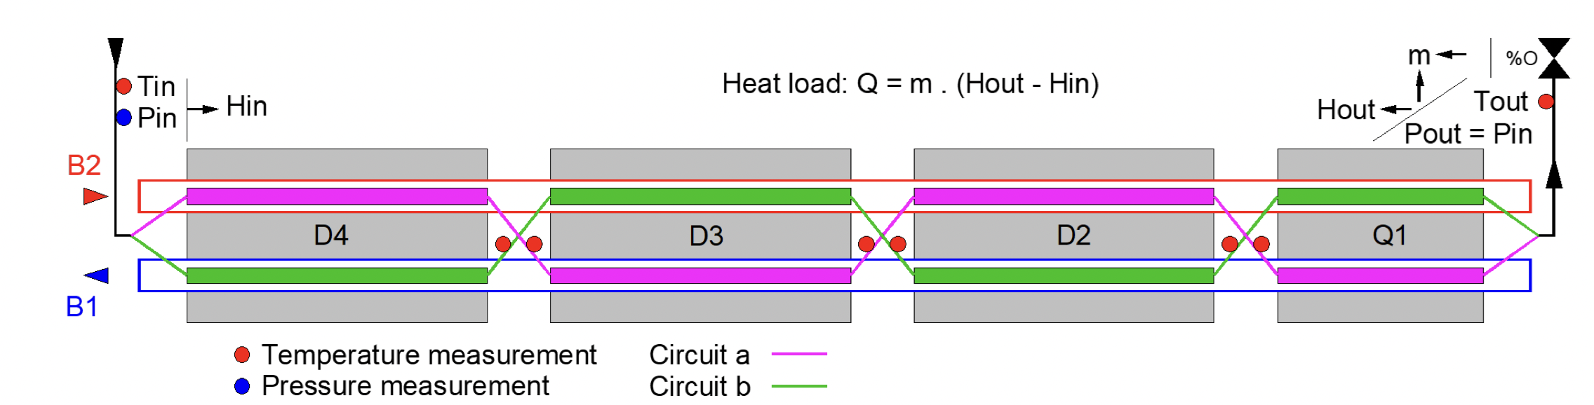
Typical half-cells – Instrumented half-cells
Typical half-cells:
  1 Heat load number for 3 dipole, 1 quadrupole + drift spaces (per beam)
Instrumented cells:
  1 Heat load number per dipole and quadrupole aperture → 8 heat load numbers
  Assumptions still need to be made for drift spaces.
  Only 8 half-cells are instrumented.
  Only 4 of them with reliable measurements in all of the apertures.

Slide 11
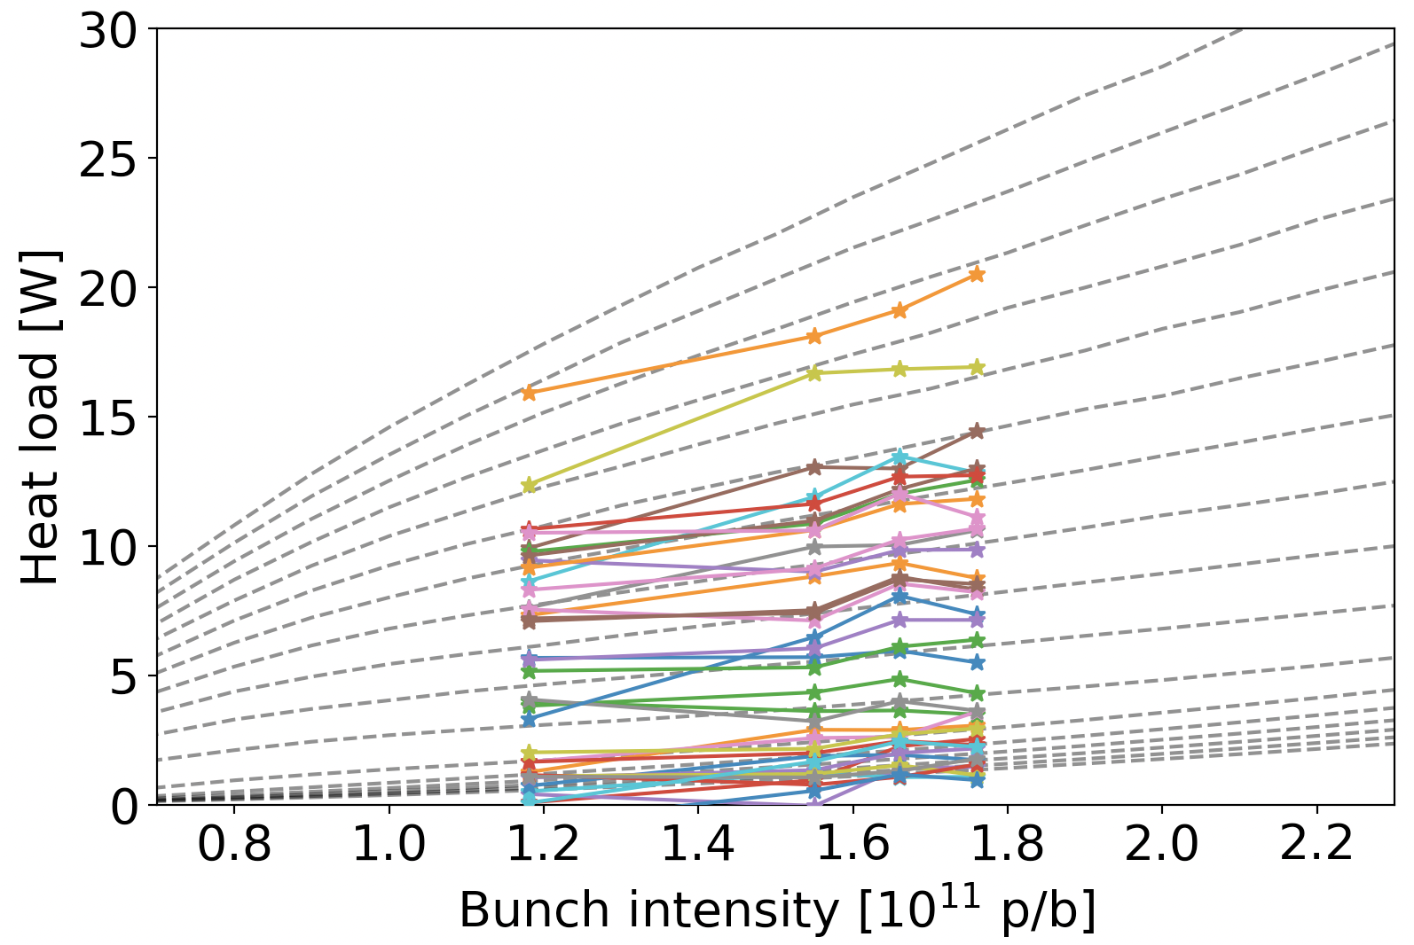
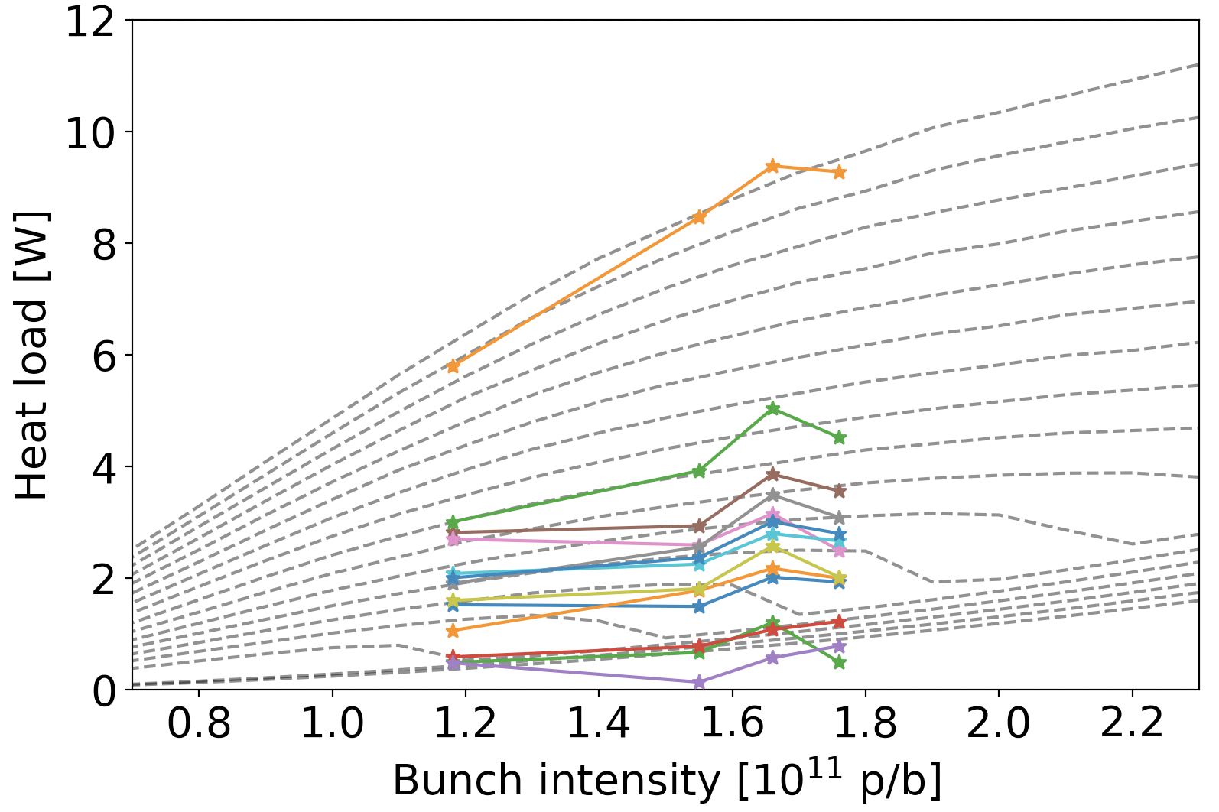
Instrumented half-cells modelling
SEY
Data from 2022 MD8403.
Aperture-by-aperture SEY fit
Worst dipole SEY = 1.7
Worst quadrupole SEY = 1.8
Much higher than expected by lab measurements (Valentine’s talk).
“Instrumented model”
Fit the SEY of each aperture.
Predict heat load for each aperture.
Sum over all apertures to obtain total heat load.
* Drift space is split equally among apertures (with same SEY as aperture).
“Uniform model”
Fit one SEY for entire halfcell.
Sum over dipoles, quadrupoles, drifts.
Instrumented dipoles
1.7
MD data
1.6
model
1.5
1.4
1.3
SEY
Instrumented quadrupoles
1.8
1.7
1.6
1.5
1.4
1.3

Slide 12
Instrumented cells vs cells with uniform SEY
 |  |  | Prediction at 1.8 10¹¹p/b, 2748b |  | Prediction at 2.3 10¹¹ p/b, 2748b
Cell | SEY list [Q1B1, Q1B2, D2B1, D2B2, D3B1, D3B2, D4B1, D4B2] | SEY σ/μ | Instrumented Model [W] | Uniform Model [W] | Instrumented Model [W] | Uniform Model [W]
33R2_7 | [1.79, 1.43, 1.49, 1.36, 1.52, 1.38, 1.42, 1.50] | 6% | 319 | 334 (+5%) | 394 | 378 (-4%)
15R2_3 | [1.35, 1.28, 1.42, 1.41, 1.30, 1.05, 1.52, 1.37] | 11% | 233 | 235 (+1%) | 293 | 248 (-15%)
31L2_3 | [1.27, 1.27, 1.51, 1.46, 1.08, 1.24, 1.17, 1.00] | 15% | 185 | 140 (-24%) | 242 | 184 (-24%)
33L5_7 | [1.09, 1.00, 1.00, 1.15, 1.43, 1.32, 1.23, 1.16] | 12% | 141 | 108 (-23%) | 199 | 108 (-18%)
Instrumented model: each aperture modelled with a different SEY
Uniform model: SEY is modelled as uniform along the half-cell
Some cells even exceed the cryo limit for a single half-cell (350 W).
“Uniform model” underperforms in extrapolating when the SEY is far from uniform.
Measurements at higher bunch intensity are extremely important for
the SEY - Heat load model.
MD #1: Measurement of heat load with high bunch intensity

Slide 13
Outline
SEY - Heat load Modelling
  Overview
  Remainder of Run 3
  Comparison between models
  Beam Degradation – Beam instabilities
  During stable beams
  During ramp
  At injection
  Beam degradation – Incoherent effects
      Emittance growth at injection,
      Slow losses during stable beams,
      Halo population

Slide 14
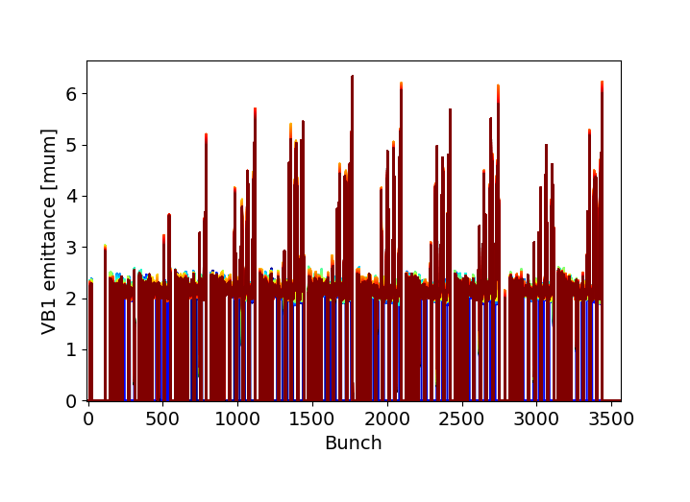
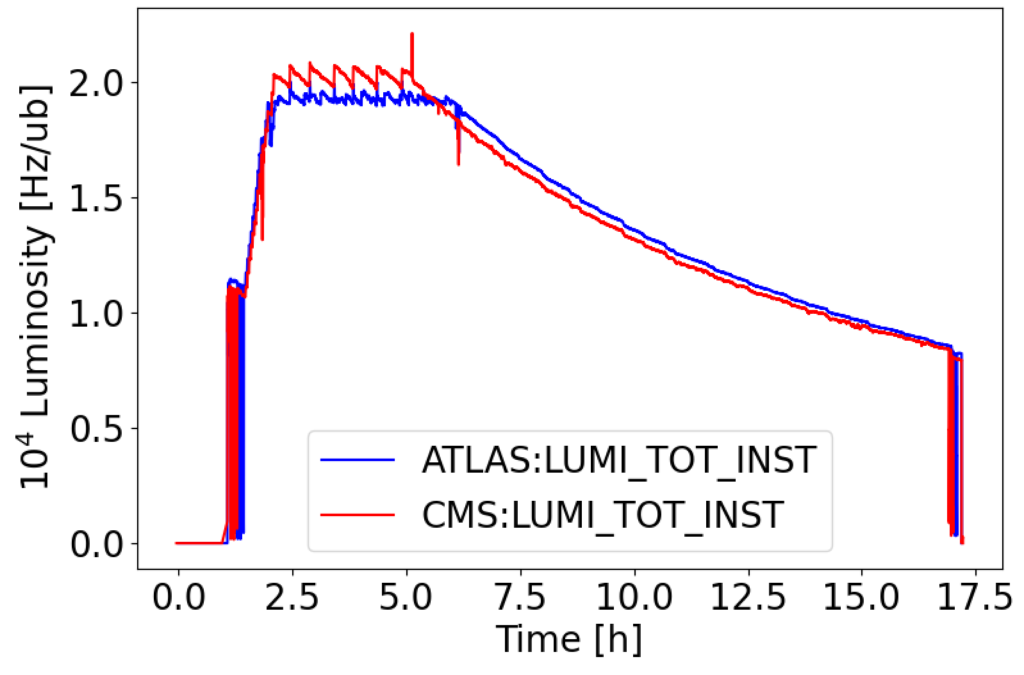
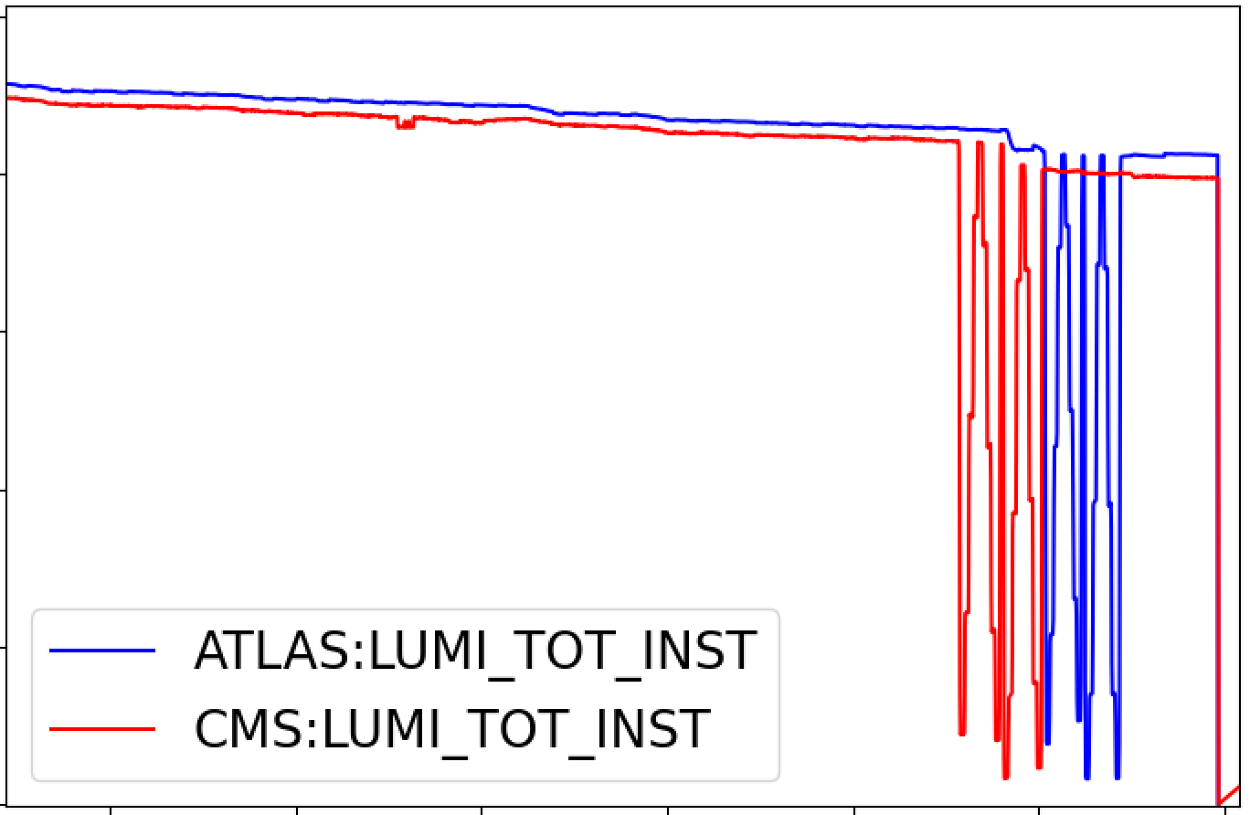

Beam stability at Flat top/stable beams
Emittance scan
Run 2:
Observed first in 2016 with 72b.
Intensity range: 0.7 – 1.0 10¹¹ p/b.
Cured by increasing Q’ to 22.
Later in year was not observed again, even with Q’ = 5.
Instability was “scrubbed away”
Run 3:
Observed since beginning of Run, in all filling schemes (even with hybrid)
Intensity range: 0.7 – 1.2 10¹¹ p/b.
Chromaticity is kept at Q’ = 20.
Instability still there during “emittance scans”.
Instability cannot be “scrubbed away”
Instabilities not limiting performance yet.
However, they don’t allow reducing chromaticity and affect lifetime indirectly.

Slide 15

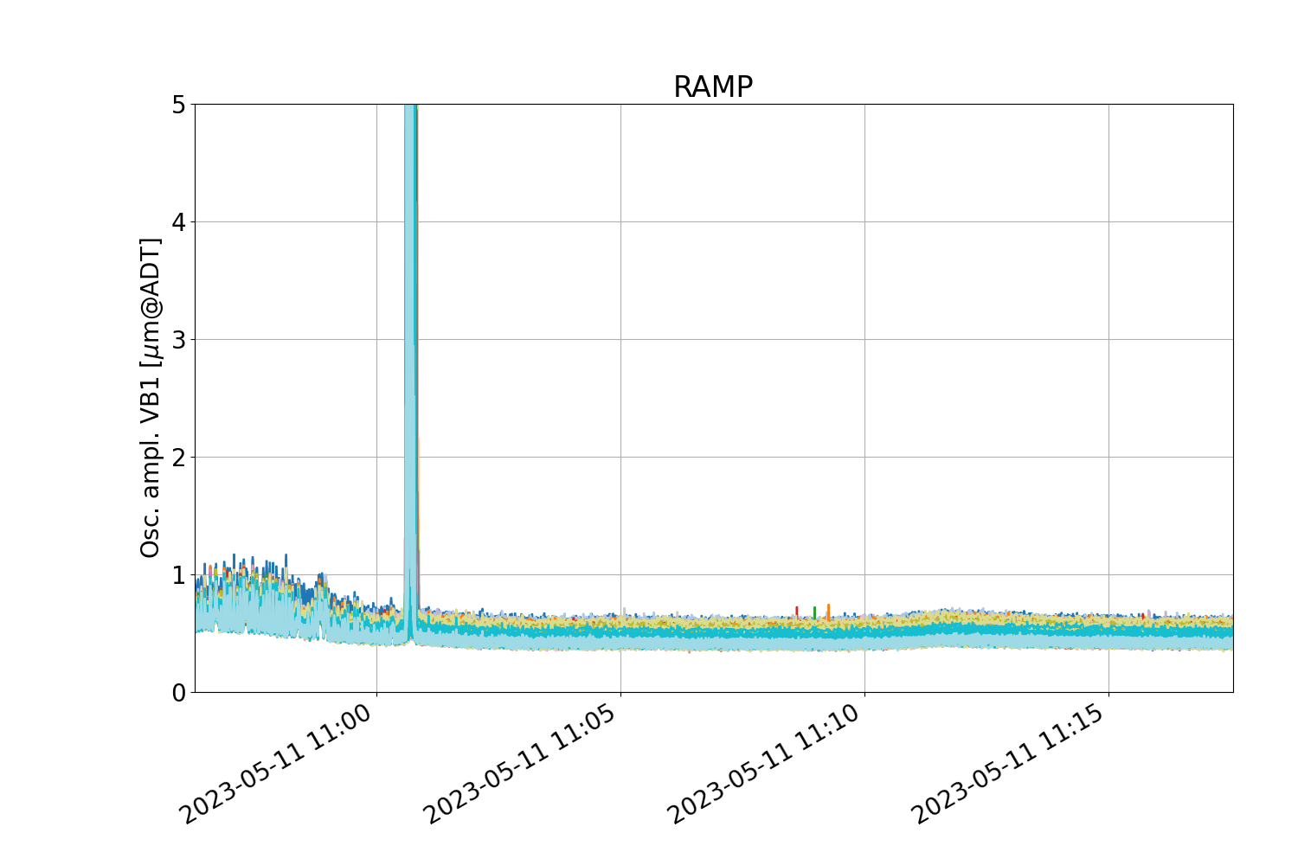
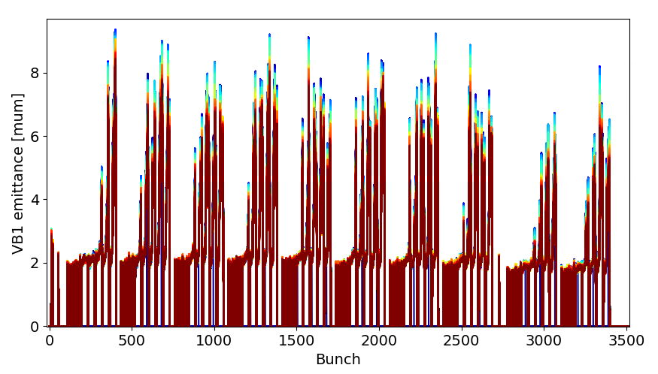
Beam stability during the ramp
Fill 8476
“Violent” instabilities observed during the ramp for several fills. Always at the same point in the ramp.
Instability always observed at point where the new 2023 injection optics knob is being removed (during ramp).
Problem traced back to bug in linear coupling correction during ramp, which is now fixed.
Instability not there after proper linear coupling correction.

Slide 16
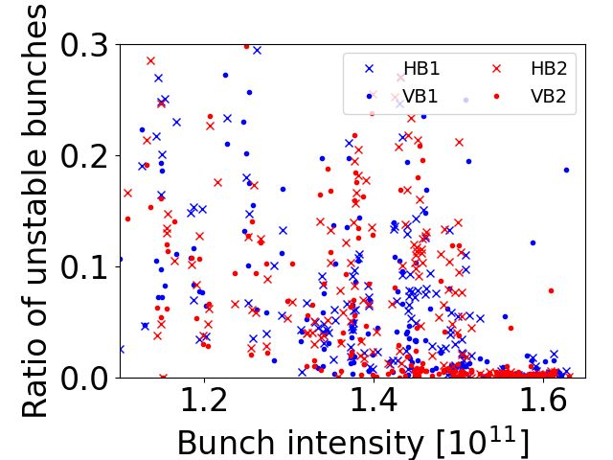
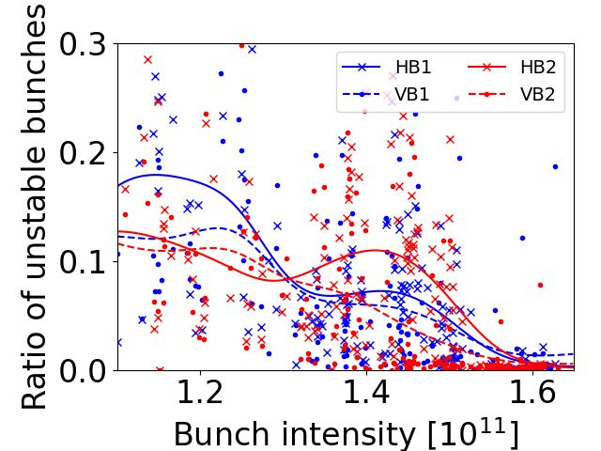
Beam instabilities at injection
Run 3 statistics:
Run 1: No instabilities with 50ns.
Run 2: Q’ = 15, Ioct = 50 A
  Few instabilities even after scrubbing
  → Weak blowup (~ 0.2 μm)
Run 3: Q’ = 20, Ioct = 39 A
Similar instabilities at “low” bunch
intensities. Well mitigated in 2023
(1.5 10¹¹ p/b, hybrid scheme)
Run 4: Q’ = ?, Ioct = ? A
[X. Buffat]
Were the instabilities scrubbed away in 2022/2023?
Did the increase in intensity help?
❌
✅

Slide 17
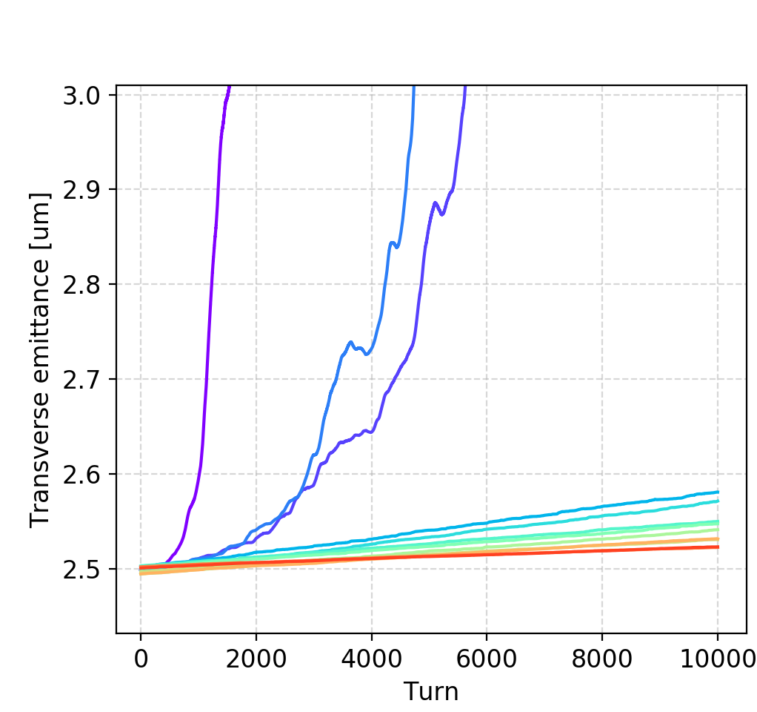
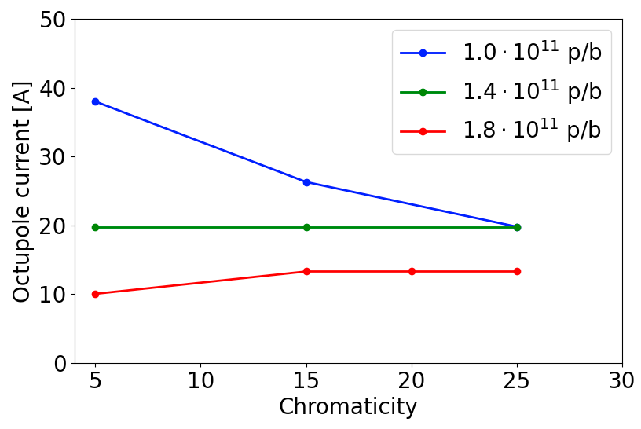
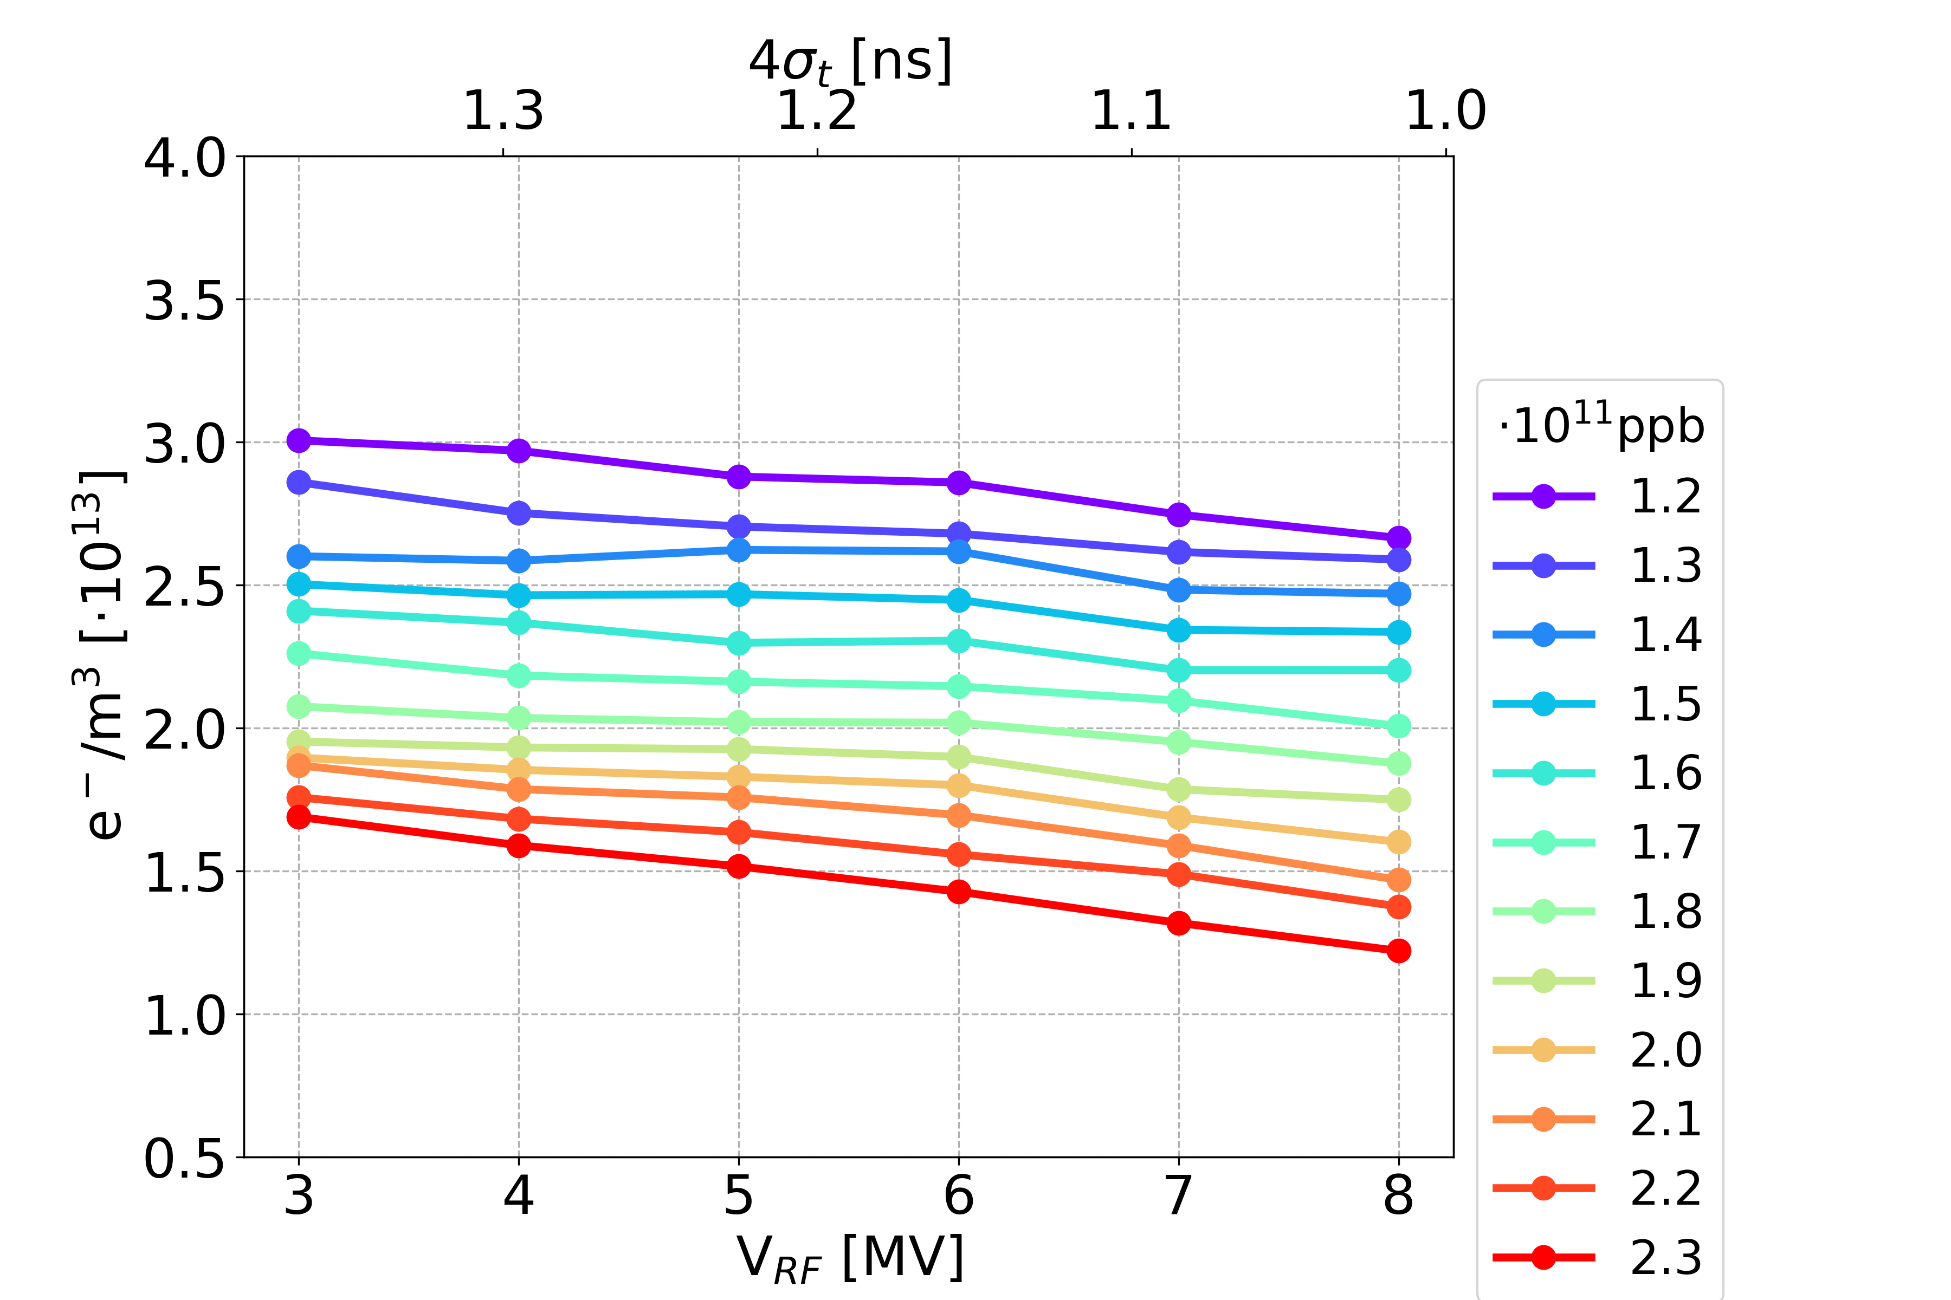
Beam instabilities at injection
Simulations,
instabilities driven by e-cloud in MQ
MD6845: Instability measurements with varying bunch intensity
Measurements
(Fills 8937 – 8946)
Stable
Unstable
[S. Johannesson]
Measurements confirm simulation predictions:
Higher bunch intensity reduces e-cloud coherent beam instabilities

Slide 18
Outline
SEY - Heat load Modelling
  Overview
  Remainder of Run 3
  Comparison between models
  Beam Degradation – Beam instabilities
  During stable beams
  During ramp
  At injection
  Beam degradation – Incoherent effects
      Emittance growth at injection,
      Slow losses during stable beams,
      Halo population

Slide 19
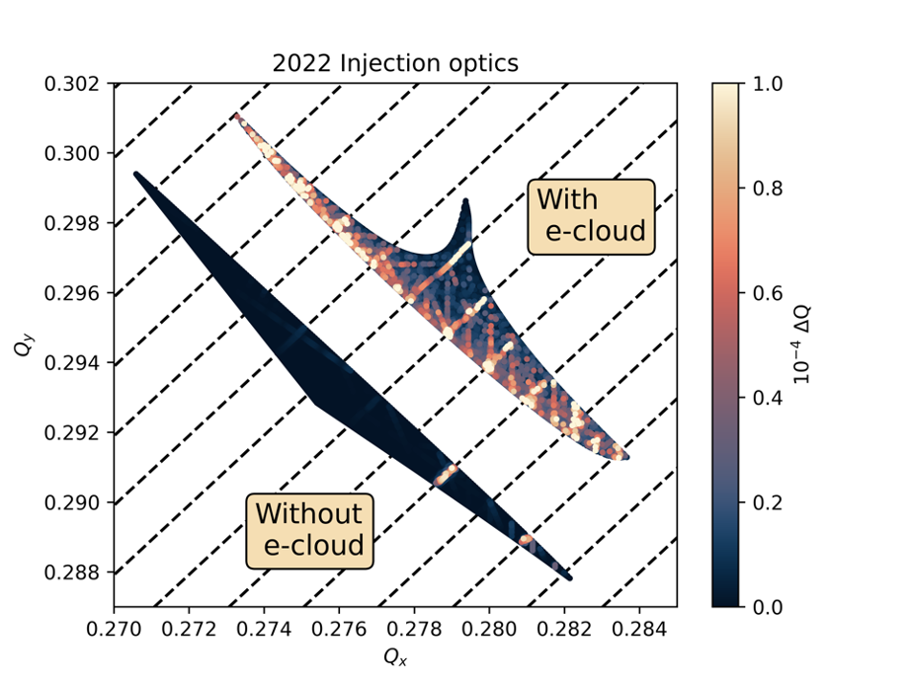
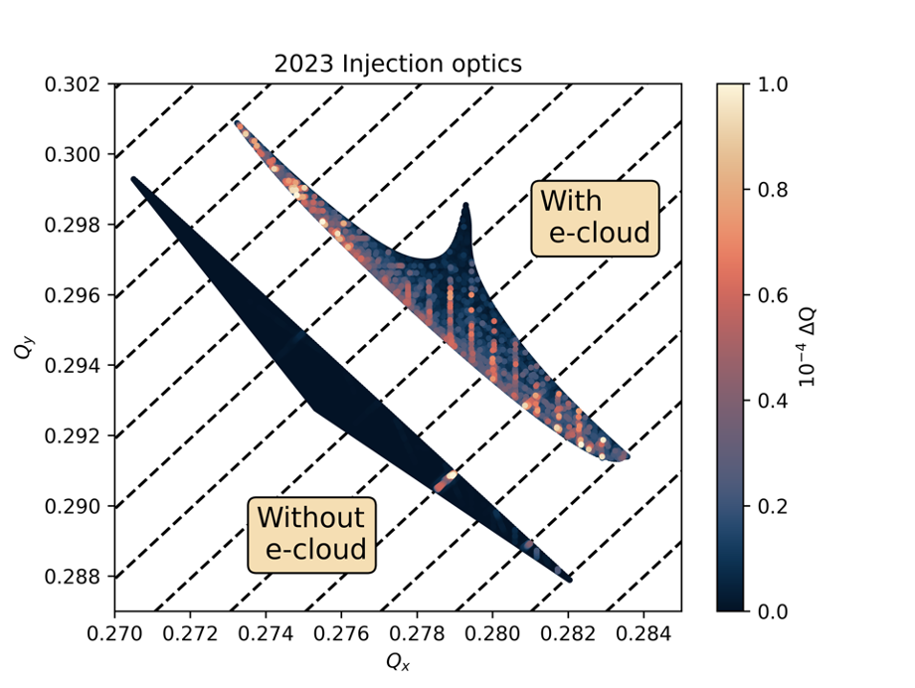
Optics and incoherent e-cloud effects at injection
2Q_{x} – 2Q_{y} + mQ_{ζ}
Electron cloud in main quadrupoles drives emittance growth at injection (in simulations)
Synchro-betatron resonances have been identified as cause
(2Q_{x} – 2Q_{y} + mQ_{ζ} = 4)
LHC Injection optics modified in 2023 with “phase knob” (see Tobias’ talk) to correct octupolar resonances from:
  Lattice octupoles (in arcs)
  Electron clouds in quadrupoles
  Simulations:
  Synchro-betatron resonances are greatly reduced.
  Significant decrease of emittance growth and transverse halo population growth.

Slide 20
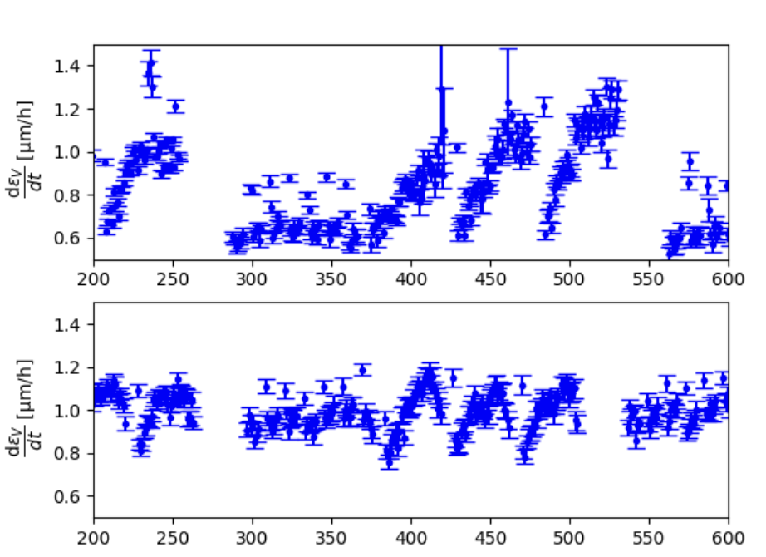
Emittance growth at injection
8b4e
BCMS (48b)
B1V
“8b4e” emittance growth seems larger.
“e-cloud” emittance growth seems less in 2023.
Different beams,
Different beam screen state.
2022, Fill 8297
8b4e
Bunch slot
Standard (48b)
2023, Fill 9070
Bunch slot
Is this the effect of 2023 injection optics?
Why is 8b4e different? Is it also the effect of the optics?
MD #2: Effect of injection optics on emittance growth and halo population at injection.
More details about emittance in Ilias’ talk.

Slide 21
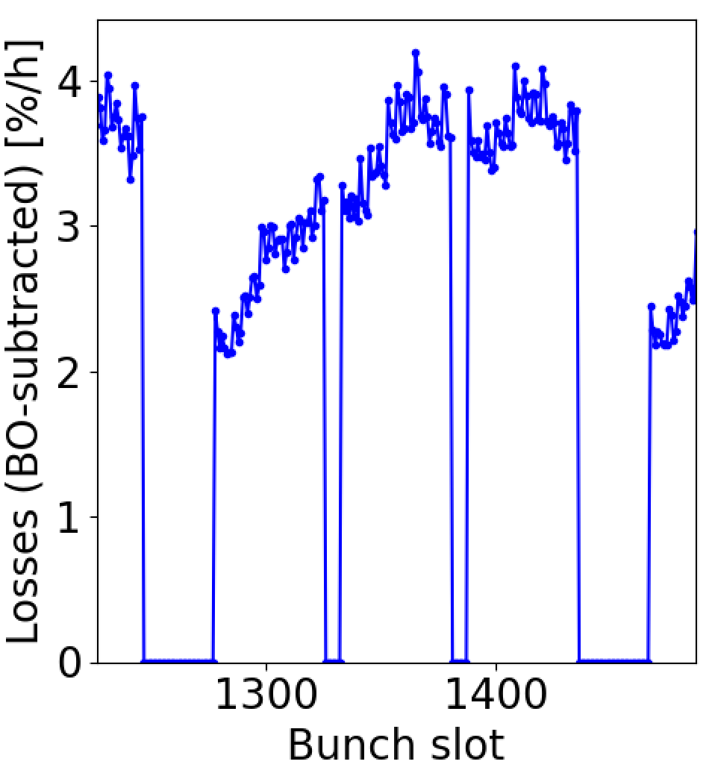
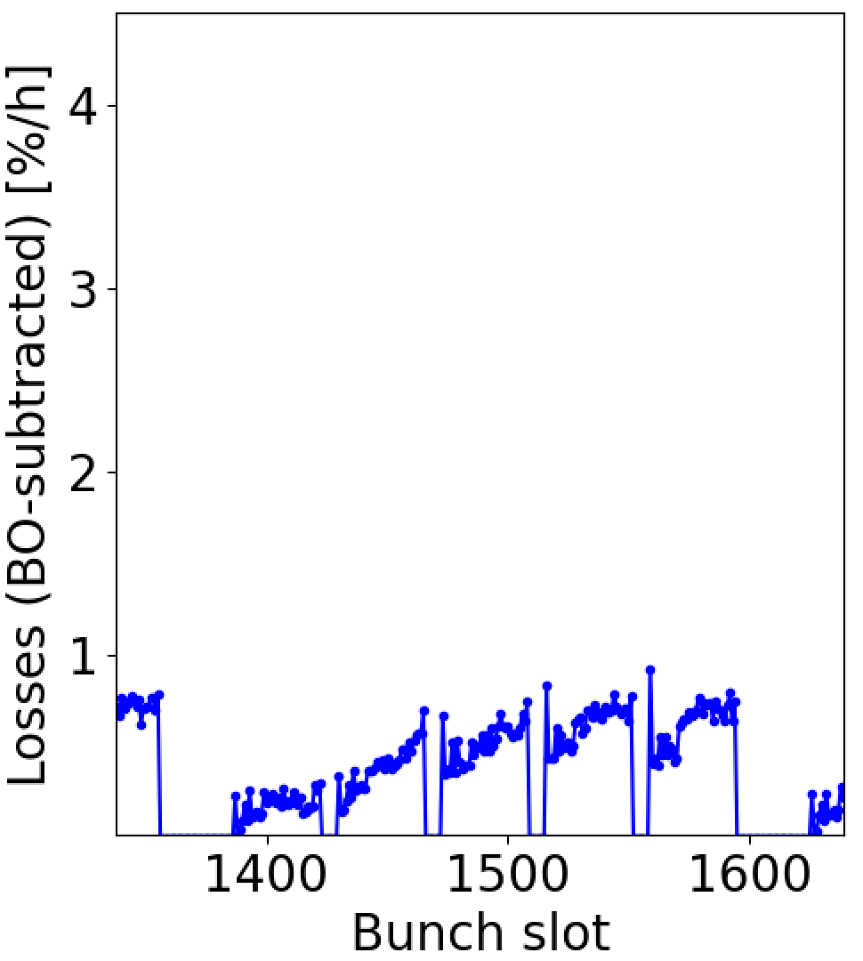
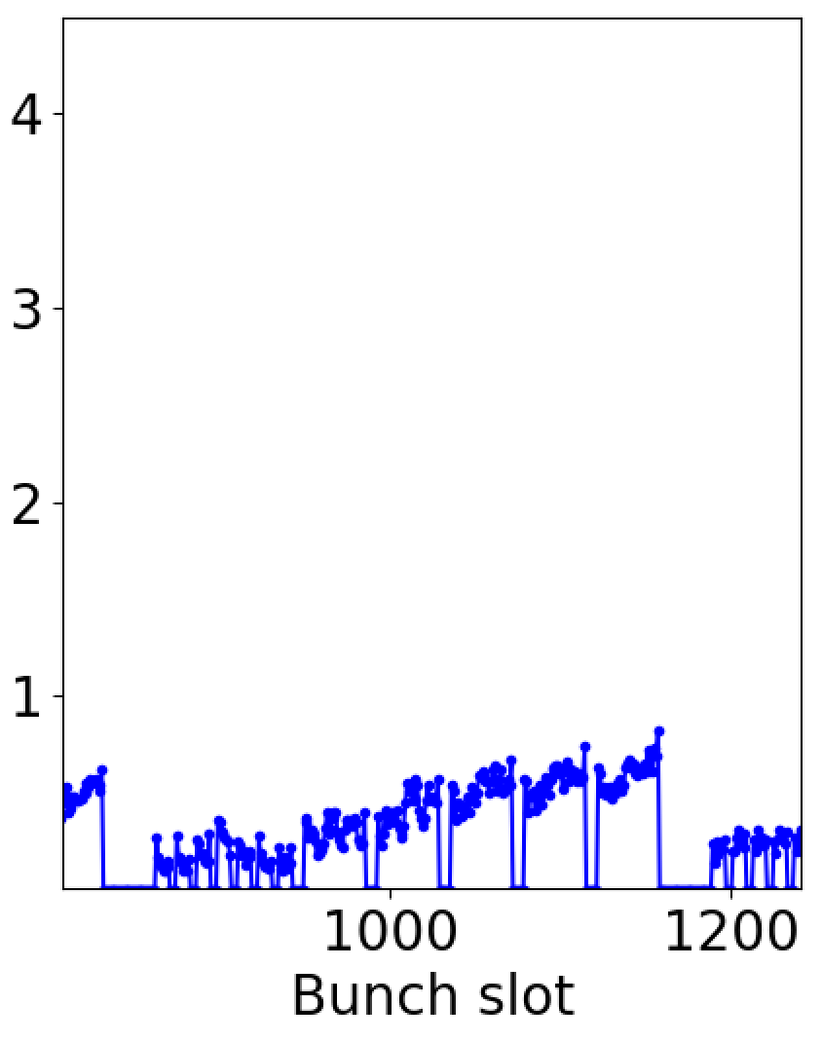
Slow losses during stable beams
During full duration of stable beams:
Extra steady slow losses all with e-cloud pattern (tails of bunch trains)
On top of luminosity burn-off.
Typical in Run 2.
Source was already found to be the e-cloud in Inner Triplets (two-beam chambers).
In Run 3 situation seems much better, possibly due to smaller emittances.
  Aiming for simulations of these losses within 2024.
3x48b
2022
Fill 8489,
β* = 30 cm
φ/2 = 160 μrad
2023
Fill 9063,
β* = 30 cm
φ/2 = 155 μrad
2018
Fill 7321,
β* = 30 cm
φ/2 = 160 μrad
5x36b
8b4e + 5x36b

Slide 22
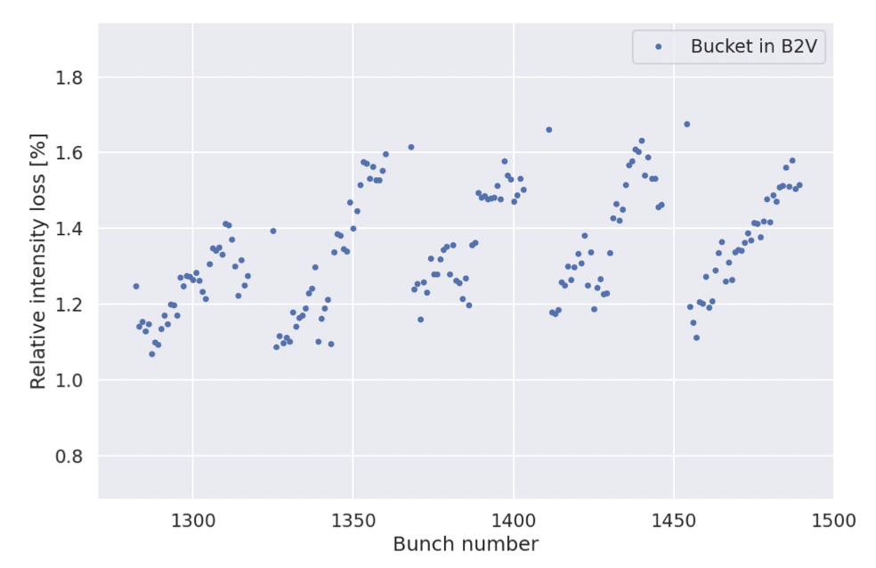

Halo population
MD8183
Work by Collimation team:
Milica Rakic, Pascal Hermes et al.
Measurement and analysis by collimation team:
End-of-fill MD after 15 hours of stable beams.
Beam scraping with TCP to 3.4 times the “reference” beam size (σ).
FBCT to resolve bunch-by-bunch effects.
Bunches towards tails of batches have more protons in transverse halo.
Clear signature of (incoherent)
electron cloud effects.
5x36b
Halo content [%]
> 3.4 σ
Bunch slot
*3.4 “reference” σ corresponds to around 5 times the “measured” σ.

Slide 23
Conclusion
Small optimisations of filling schemes are possible to gain some few bunches. Not trivial.
Instrumented cells give insight in SEY modelling. Model is ok for Run 3 target, but possible issues when extrapolating to Run 4.
Discrepancy: Fitted SEY (1.7-1.8) ≫ lab measurements (1.3), see Valentine’s talk.
E-cloud degrades beam quality in several ways. No major limitation from beam dynamics effects yet, but each effect has small impact in delivered luminosity and bunch-by-bunch fluctuations.
MD requests:
Measurement of heat load with high bunch intensity.
Effect of injection optics on emittance growth and halo population at injection.
Heat load with a 25ns fill similar to end of 2022.
Heat load with a 50ns fill.
Study of bunch-by-bunch tune shifts.
Stability studies at injection for optimal operational conditions.
Thank you for your attention!
Konstantinos Paraschou

Slide 24
Spare slides

Slide 25
Options for remainder of Run 3
1.8 10¹¹ p/b | Number of collisions |  |  | S78 Heat load [W/hc] | S81 Heat load [W/hc]
Type | IP1/5 | IP2 | IP8 | S78 Margin [W/hc] | S81 Margin [W/hc]
hybrid-36b | 2452 | 1889 | 2067 | 175 (-50) | 146 (-44)
hybrid-48b | 2440 | 1952 | 2240 | 189 (-36) | 157 (-33)
5x36b | 2484 | 2121 | 2260 | 210 (-15) | 173 (-17)
6x36b | 2592 | 2097 | 2059 | 221 (-4) | 183 (-7)
reverse hybrid-48b (1) | 2600 | 1903 | 1924 | 217 (-8) | 179 (-11)
reverse hybrid-48b (2) | 2568 | 1913 | 1956 | 207 (-18) | 172 (-18)
separated hybrid-48b | 2592 | 2212 | 2206 | 219 (-6) | 181 (-9)
(Cryo less tight if we stay at lower bunch intensity)
2023, large cryo margin
Potential for more LHCb cols.
Pure 25ns, optimised IP2/8
Pure 25ns, cryo very tight
Tight cryo margin,
too long injections for MKI.
Heat load reduction and SPS
production should be tested.
Tight cryo margin, requires multiple SPS cycles.
“Reverse” hybrid schemes: 8b4e part comes after the 25ns part in SPS.
“Separated” hybrid scheme: Separate injections of 8b4e and 25ns from SPS.
Note: Schemes do not include INDIVs or smaller trains for injection steering.
Further optimisation is hard. Cornered from everywhere.

Slide 26
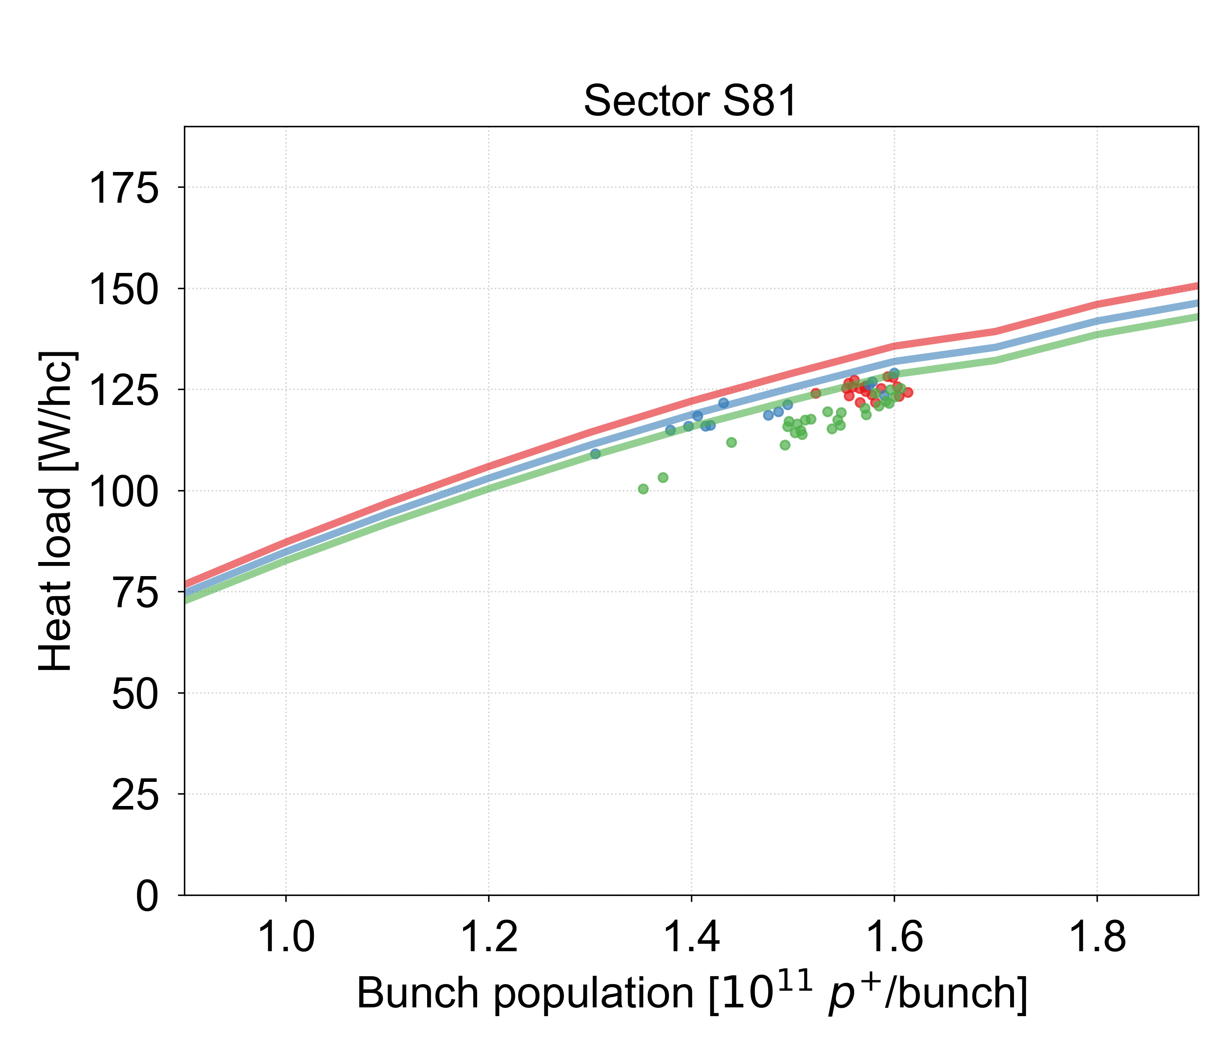
Measurements in 2023

Slide 27
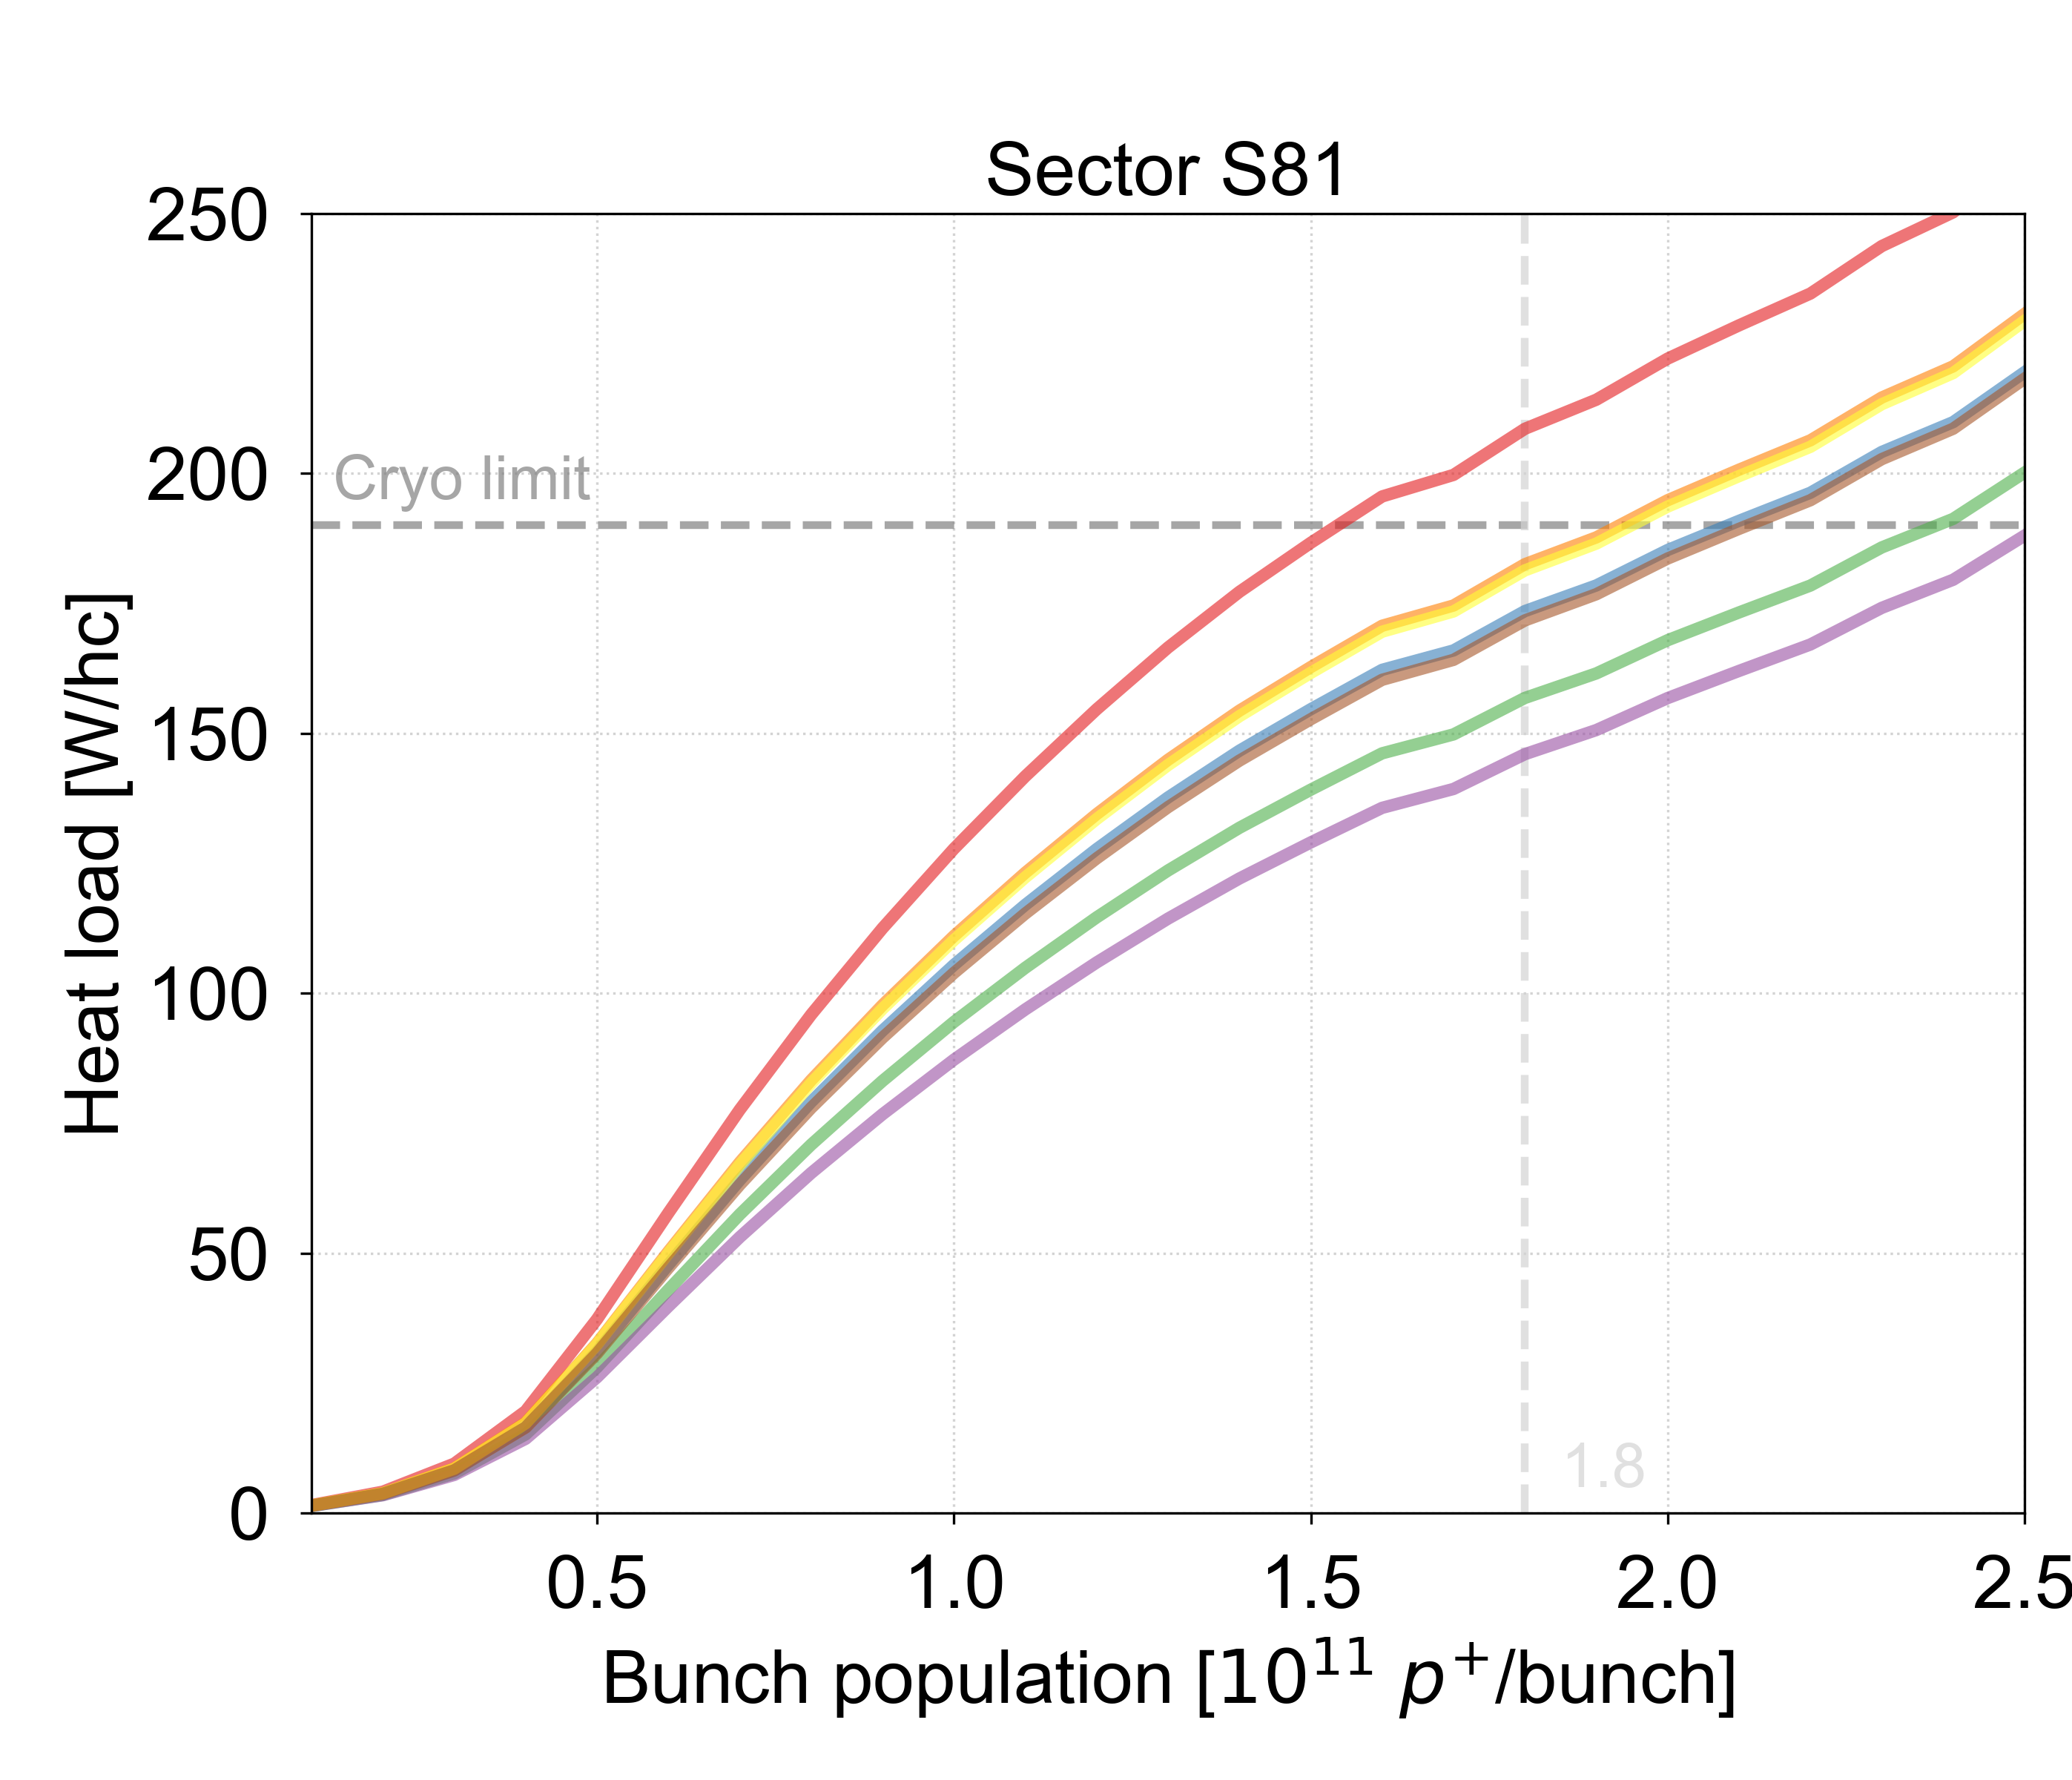
Model predictions S81

Slide 28
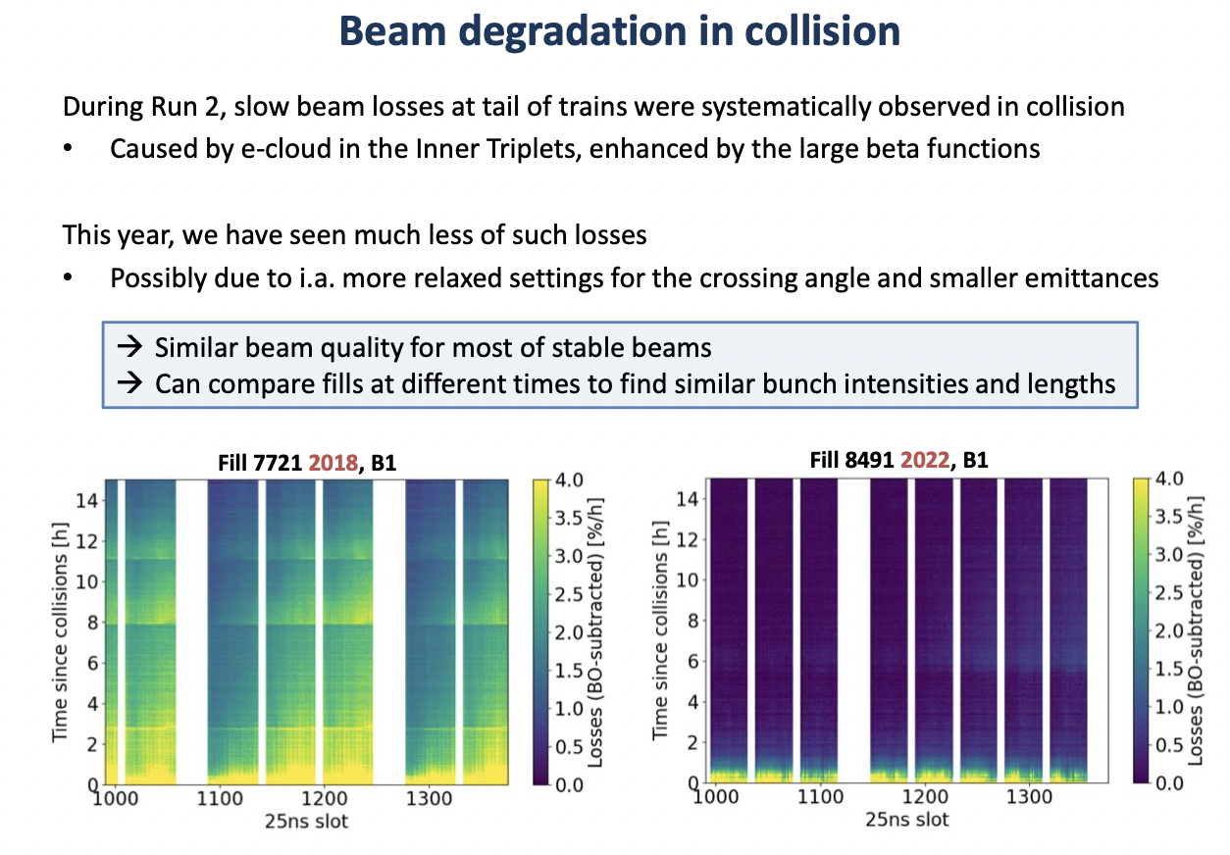
Slow losses during stable beams
7321
8489

Slide 29
Filling scheme LPC links
Hybrid-36b:
https://lpc.web.cern.ch/schemeEditor.html?user=lpc&scheme=Studies/25ns_2464b_2452_1889_2067_236bpi_mixed5x36b.json
Hybrid-48b:
https://lpc.web.cern.ch/schemeEditor.html?user=lpc&scheme=Studies/25ns_2452b_2440_1952_2240_248bpi_12inj_mixed.json
5x36b:
https://lpc.web.cern.ch/schemeEditor.html?user=gianni&scheme=20220809_36b_scheme/25ns_2496b_2488_2121_2260_144bpi_20inj_800ns_bs200ns.json
6x36b:
https://lpc.web.cern.ch/schemeEditor.html?user=lotta&scheme=LHC-2024/25ns_2604b_2592_2097_2059_6x36bpi_13inj_800ns_bs200ns.json
Reverse hybrid-48b 1:
https://lpc.web.cern.ch/schemeEditor.html?user=lotta&scheme=LHC-2023/25ns_2612b_2600_1903_1924_hybrid_25ns_5x48b_8b4e_1x56b_11inj.json
Reverse hybrid-48b 2:
https://lpc.web.cern.ch/schemeEditor.html?user=lotta&scheme=LHC-2023/25ns_2580b_2568_1913_1956_hybrid_8b4e_1x56b_25ns_5x48b_10inj.json
Separated hybrid-48b:
https://lpc.web.cern.ch/schemeEditor.html?user=lotta&scheme=LHC-2024/25ns_2604b_2592_2211_2204_separated_hybrid_25ns_5x48b_8b4e_3x56b_13inj.json

Slide 30
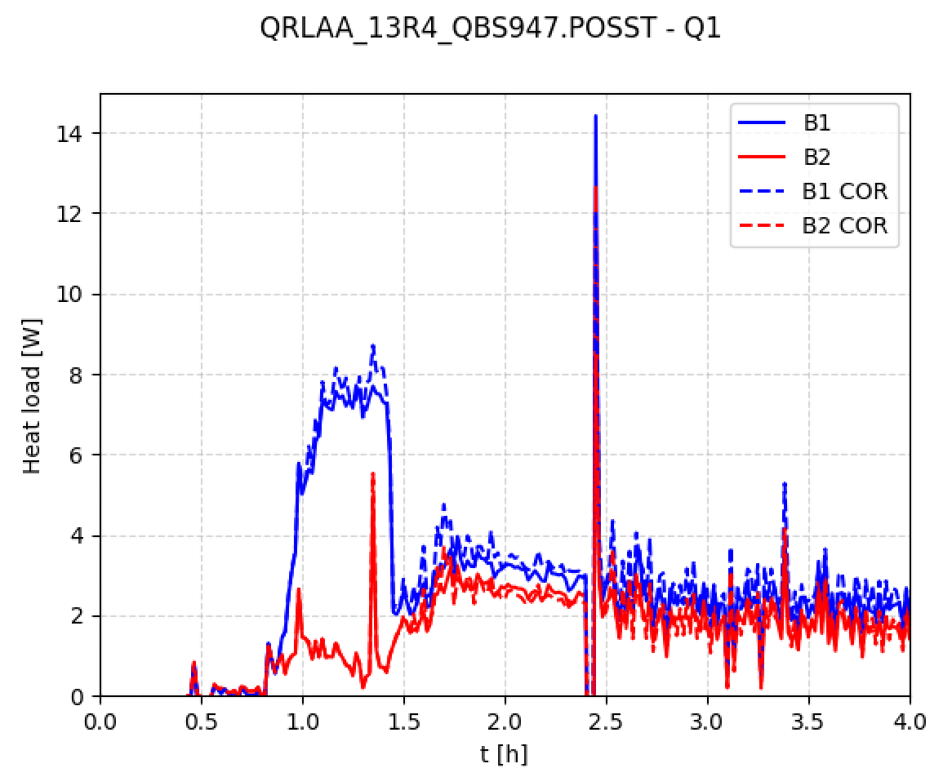
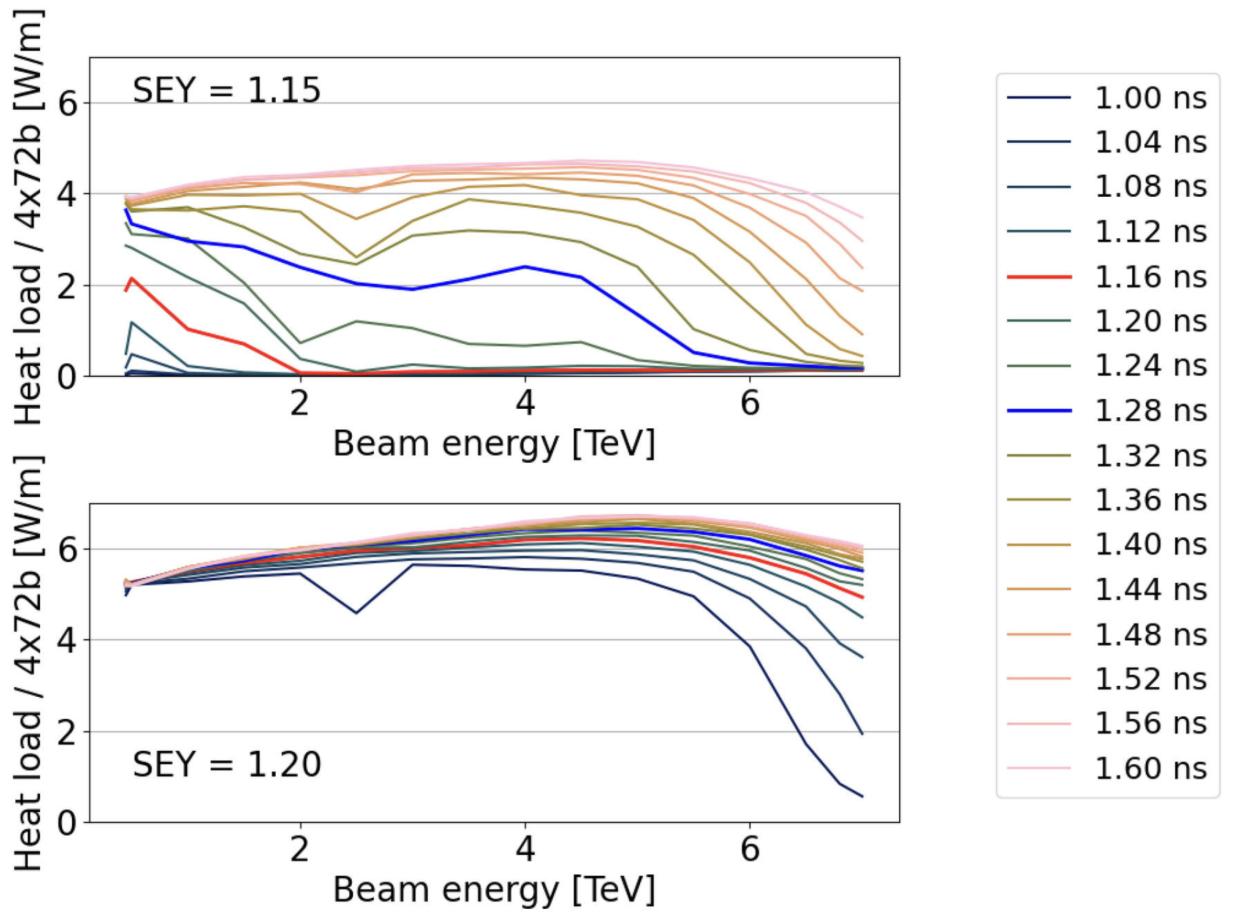
Instrumented quadrupoles modelling
Bunch
length
Fill 8151
Ramp
Simulations
Injection
Flat top
Curious effect observed in instrumented quadrupoles:
Heat load goes down with intensity.
Simulations show same behaviour but only when close to the multipacting threshold.
Multipacting threshold at slightly larger SEY for higher beam energies.

Slide 31
