Slide 2
LHC operational experience and view towards 2024
T. Persson
On behalf of the LHC OP team and LHC-coordination team
Input from:
I. Efthymiopoulos, S. Fartoukh,
S. Kostoglou, E. Maclean, K. Paraschou, R. Tomas
06.12.2023

Slide 3
Outline
Machine configuration in 2023
  What was different from 2022?
Operational improvements in 2023 and 2024
  Virtual luminosity
  Faster reaching luminosity target
  Conditional sequencer
High beta-run
Ions
  Configuration
  10Hz dump
What can we expect in 2024?
  Potential improvements to the cycle
    Combine LHCb rotation and pre-squeeze
    Continue to squeeze beyond 30 cm

Slide 4
2022
2023
Injection
Injection
Ramp
Ramp to 4 TeV
Pre-squeeze to
60cm
Ramp from 4TeV to 6.8TeV (tele-index from 1 to 0.5)
Tune change
Pre-squeeze to 1.2 m (constant tele-index)
Adjust
LHCb rotation
Tune change
Colour code explanation:
Green means it is a new part of the cycle
Yellow that it is partially changed
Blue that it is the same as in 2022
β* levelling from 60cm to 30cm (tele-index 2)
Adjust
β* levelling from 1.2m to 60 cm
β* levelling from 60cm-30cm

Slide 5
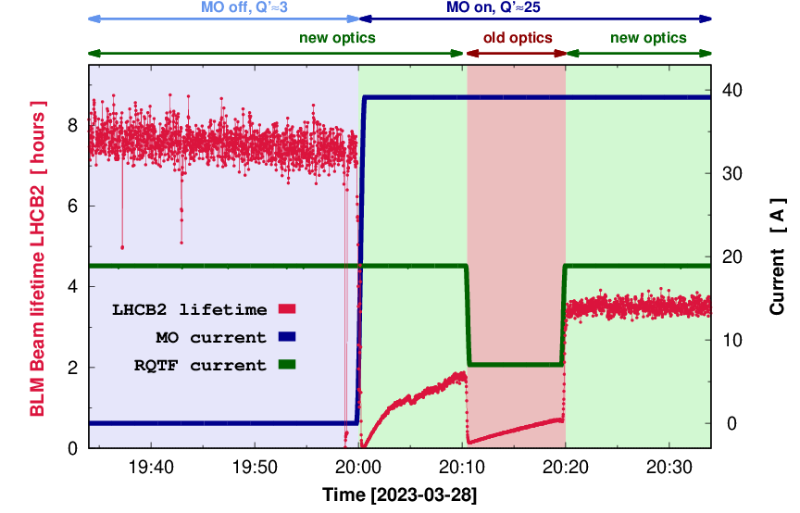
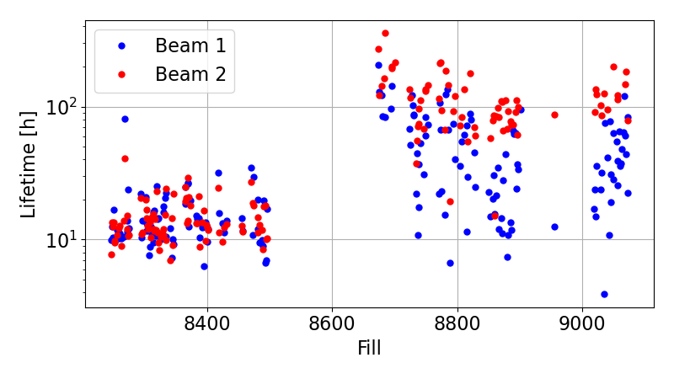
New phase knobs at injection
A new phase knob was introduced to change the phase advance between the arcs to reduce the negative impact of the main octupoles
-> Increased lifetime at injection
Lifetime start of ramp
2023
2022
Note that emittance was larger than in 2022! (see Ilia’s talk)!

Slide 6
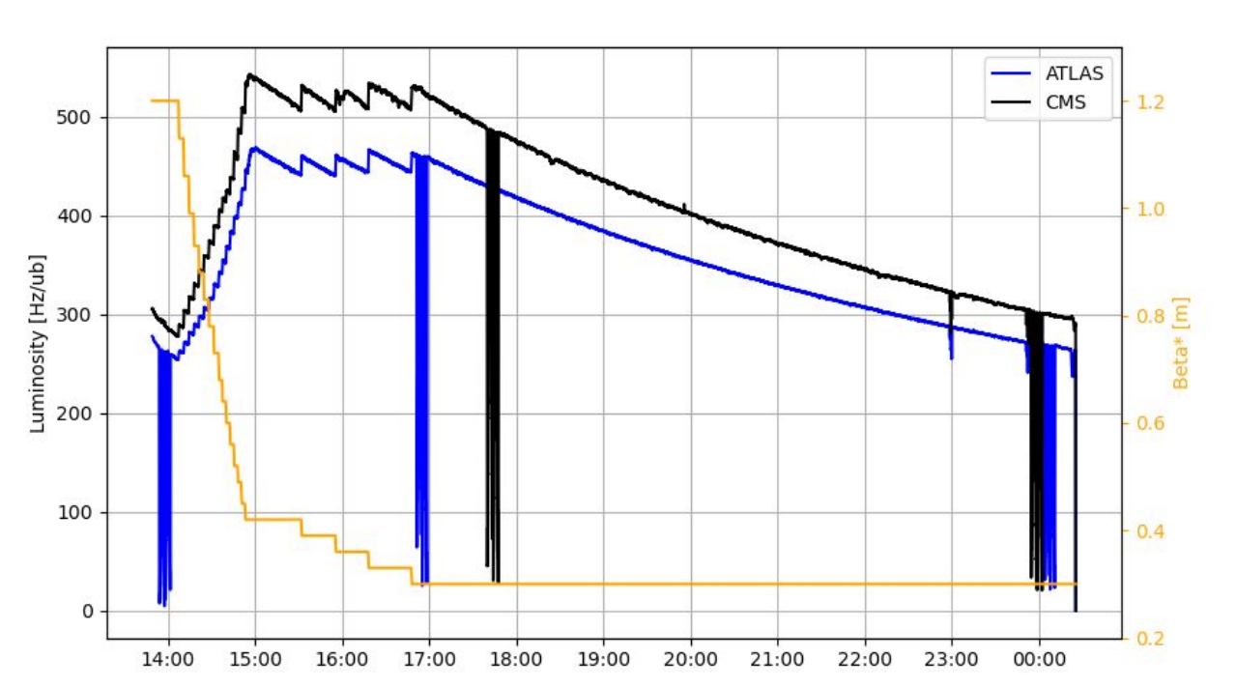
Luminosity in the early fills
Significant difference between ATLAS and CMS
When staying at 30 cm the relative difference decreased as the bunch length shortened
  Sign that part of difference was due to crossing angle
  The DOROS BPMs as well as the standard BPM system also showed crossing angle was larger in ATLAS
  The reported luminosity z-width region was also different between ATLAS and CMS

Slide 7
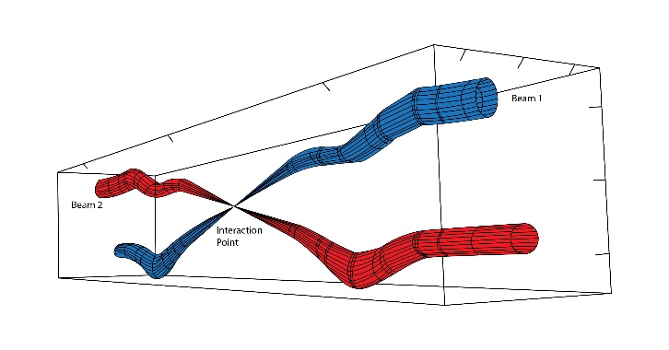
Crossing angle adjustment
The earlier we can get the z width of lumi-region from the experiments the better
  An independent observables to
  Big changes need revalidation so causes lost time
New agreement with MPP allows for modifications of 5 urad in 2023
  Want to keep this also in 2024
We need the crossing angle to reduce the parasitic encounters
Has an impact on the luminosity
  Larger crossing angle -> Less luminosity
We adjusted down the crossing angle for ATLAS by 10u rad which fixed the imbalance between ATLAS and CMS
  Done at the same time as retracting the collimator (see David’s talk)
    Saved time in terms of validation needed
  The correction was based on the DOROS BPMs at the Q1
    Plan to do use the DOROS to check the crossing next startup

Slide 8
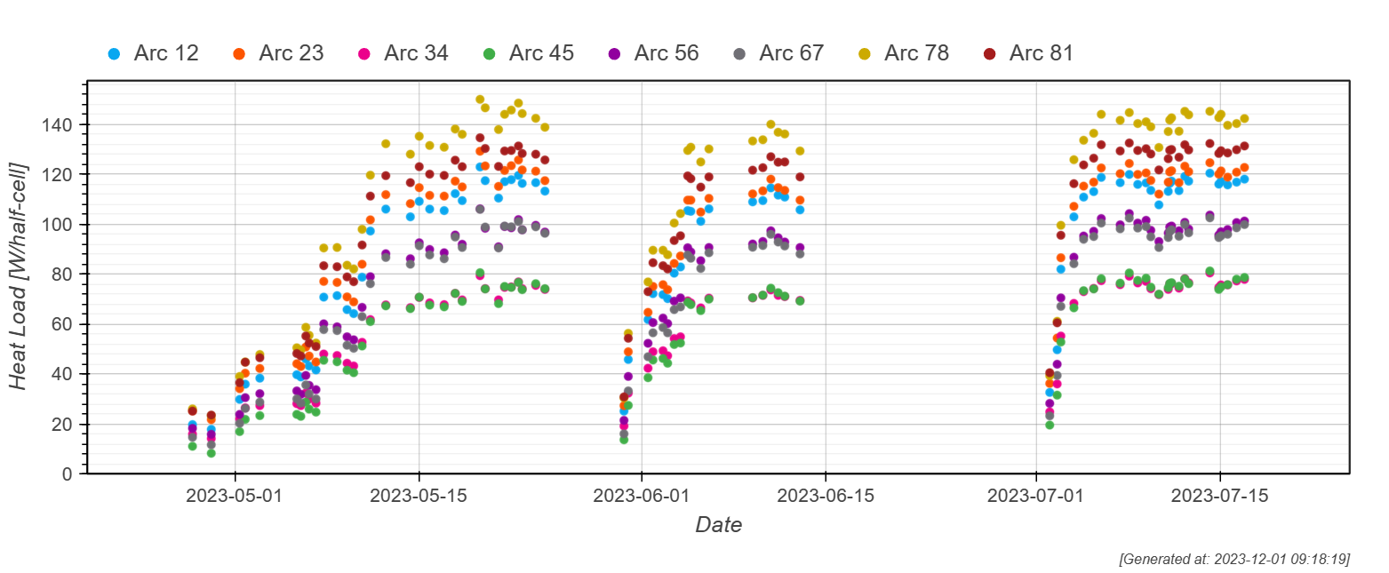
Heat Load and Filling scheme
The heat load is under control even for the highest intensity fill we are below 150W/half cell (2454 bunches)
  Up to 183W/half-cell in 2022 even though the total intensity was very similar
Thanks to hybrid filling scheme (mixture of 8b4e and 36 bunch train)
  First time we use it in normal operation
  Significant effort from the injectors to make this happen!

Slide 9
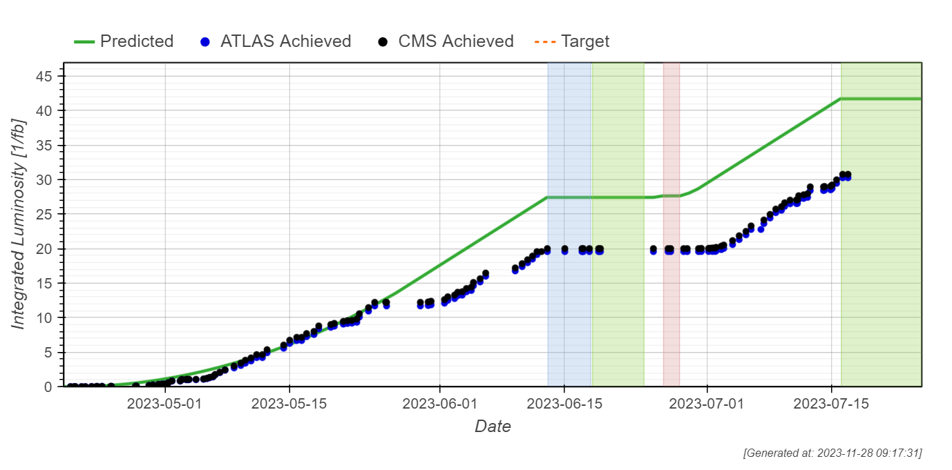
Luminosity production
At the time of the incident, we had just passed 32 fb-1.
Slope was around ~0.8 fb-1/day, we could not do much better with the bunch intensity (1.6E11 limited to avoid another RF-finger incident, see Mateo’s talk), given emittance and the stable beams fraction

Slide 10
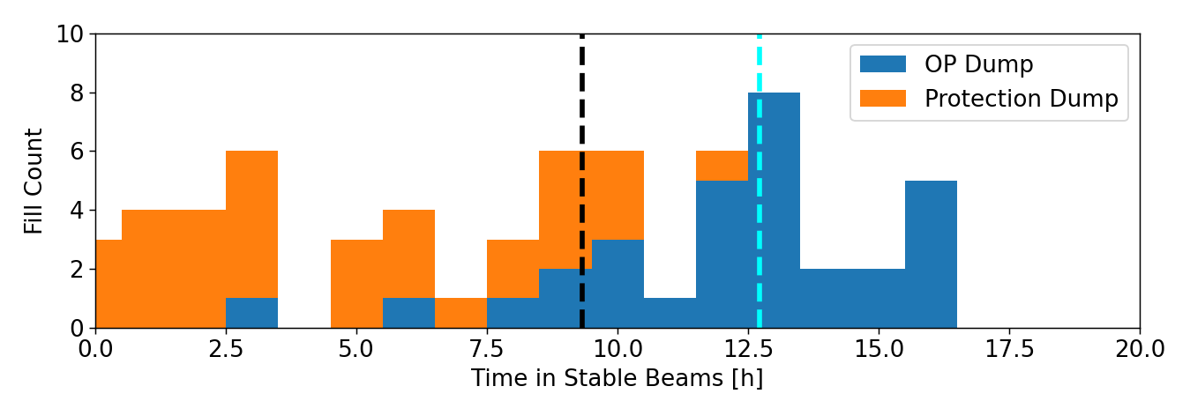
Why and when do we dump?
In the proton physics run, we had 63 dumps with more than 1200 bunches
  33 were protection dumps
  30 were OP dumps
In 2022 we had
  60 Protection dumps
  42 OP dumps

Slide 11
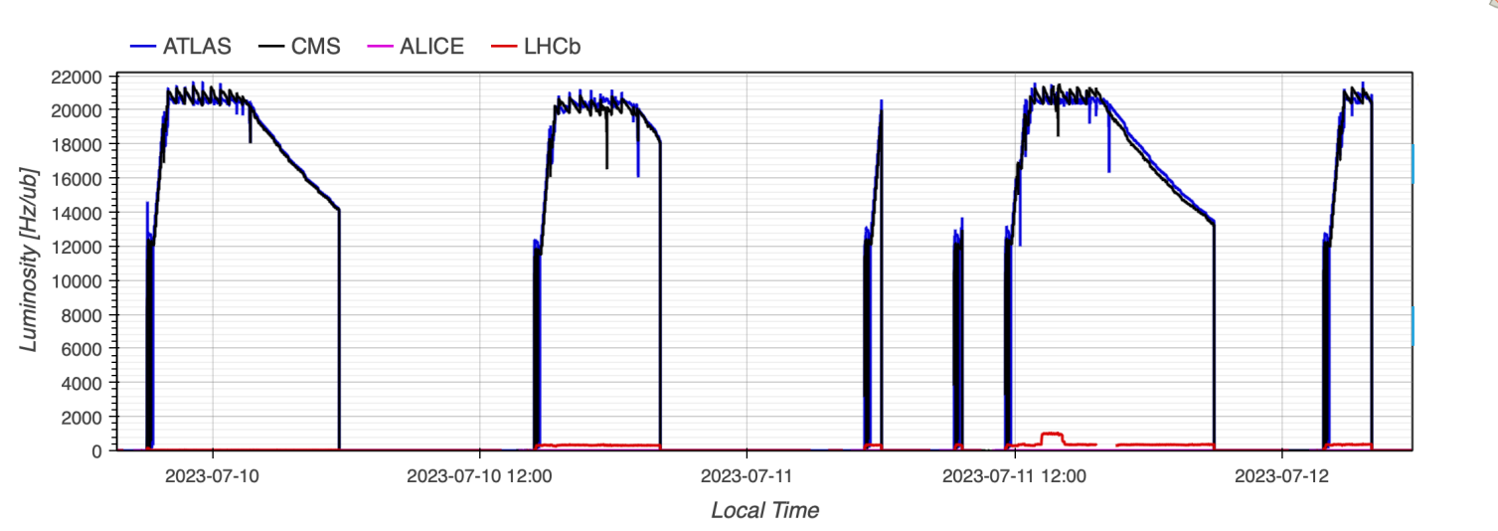
Impact of 1.6e11 and larger than expected emittance
At start of fill it takes ~45 minutes to level to target configuration which is designed for 1.8E11 vs 1.6E11 ppb and for ~10% smaller emittances (nominal vs BCMS)
Lumi lost, in particular, for the shorter fills
The green triangles show the potential gain of squeezing directly to the requested luminosity
The expected gain in integrated luminosity is around ~2-3% more for shorter fills

Slide 12
Squeeze in one step to target luminosity
The previous limitation was that we had to take every β* step
  Every step takes a few minutes due to the arming procedure of feedbacks, power converters and collimators
New method allows for one big first step to reach the desired β* giving the desired luminosity
  Much faster since orbit feedback, collimator etc can be played in one step
  Was tested successfully in 2023 with 3 bunches just before the incident
  Plan to use in 2024
Should we change the start of the collision, e.g. to 90cm?
  After the implementation of the “squeeze and collide” we would lose on decreasing the β* where we start to collide
  Squeeze takes always some time and now we will be already producing at this squeeze
    In particular for LHCb and ALICE where integrated lumi is directly determined by time in Stable beams
    One could envisage at some point colliding at the end of the ramp (rotation could be done above 5.5 TeV)

Slide 13
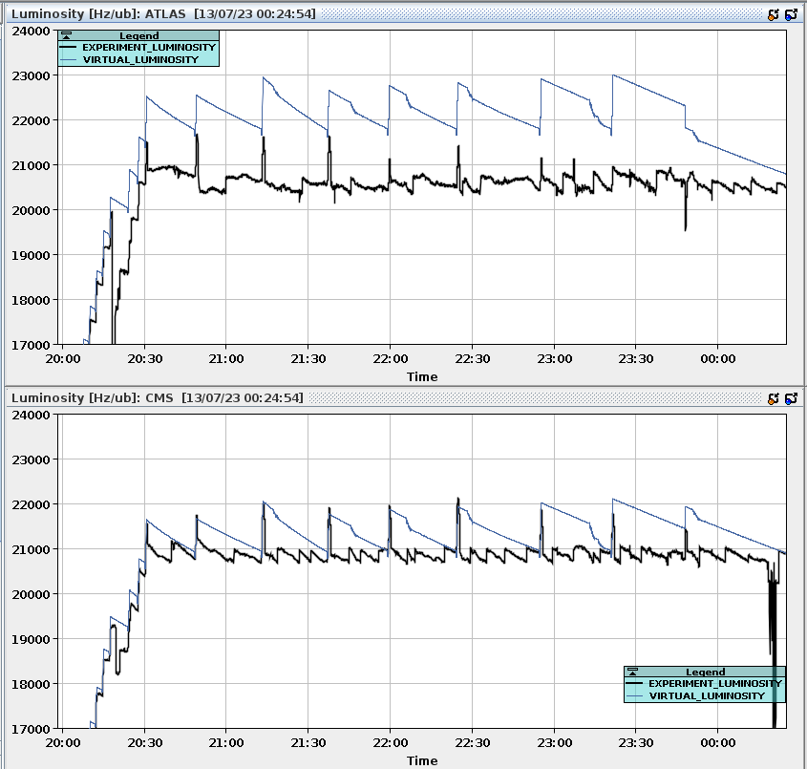
Pile-up à la carte
Most of the year we were β-levelling on CMS and then separating ATLAS
Last week of proton operation “virtual lumi” was introduced
  It is based on machine and beam parameters and gives the expected luminosity if they were heads-on
  Lumi-imbalance will be determined by the experimental calibration (as long as we are in levelling)
Use the virtual luminosity for β* levelling and separate to the requested pile-up
  Potential improvements for 2024
    ATLAS and CMS could request the pileup over dip (LHCb and ALICE already doing this)
    Try to anticipate the increase of luminosity by separating the beam at the same time

Slide 14
OP cycle in the very High-β run
Injection
(no phase knob)
Ramp&DeSqueeze
β* ~ 75/17/75/17 m
(IP1/2/5/8)
DeSqueeze to
β* = 120 m in IP1&5
DeSqueeze to
β* = 3/6 km! in H/V in IP1&5
Q change
Establish and optimize collisions
Deploy physics conf. of collimation and XRPs
Data tacking
Optics measured and corrected at 120m and 3/6km
All fills were below 3e11 in total bunch intensity so we could have the safe flag
The requested 300ub⁻¹ to TOTEM and 329ub⁻¹ to ALFA was delivered at 3km/6km during a total of 70h in 9 fills

Slide 15
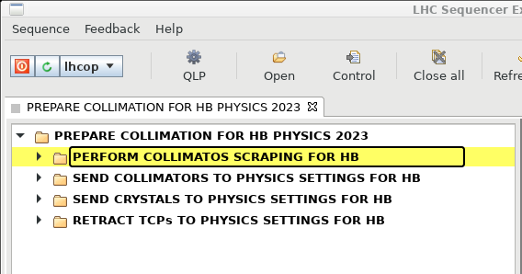
Automated collimation handling for the High-β run
Previously all tasks had to be manually. For the
first time they were included in a sequence ->
Less expert intervention was needed during the run
Sequence of tasks:
  Scraping using TCP.7
  Move standard collimators to physics settings
  Move crystals to physics settings
  Retract TCP.7 to physics settings
  Move XRPs to physics settings (dedicated seq.)
Very good reproducibility of the orbit fill-to-fill

Slide 16

Ion Run
A full ramp and squeeze down to β* of 50 cm in IP1, IP2 and IP8
  Squeeze to the lowest β* in the ramp so far
  The crystal collimation was used for the first time with ions (see collimation talk)
A very challenging operation
  Many technical issues
    Background (Matteo)
    Losses in the ramp (Sara)
    QPS (Jens)
    10Hz (Maria’s)
  Long time to fill, short time in stable beams
  Very dynamic run in terms of crystal optimization, filling schemes, levelling
Injection
Ramp and squeeze to β* 50cm
Tune change
Adjust
Stable beams
*Additional step of inverting crossing angle after end of ramp for neg-polarity (IP2)

Slide 17
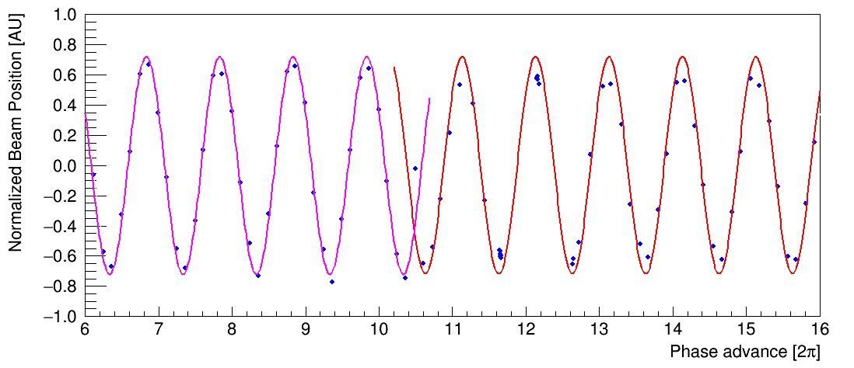
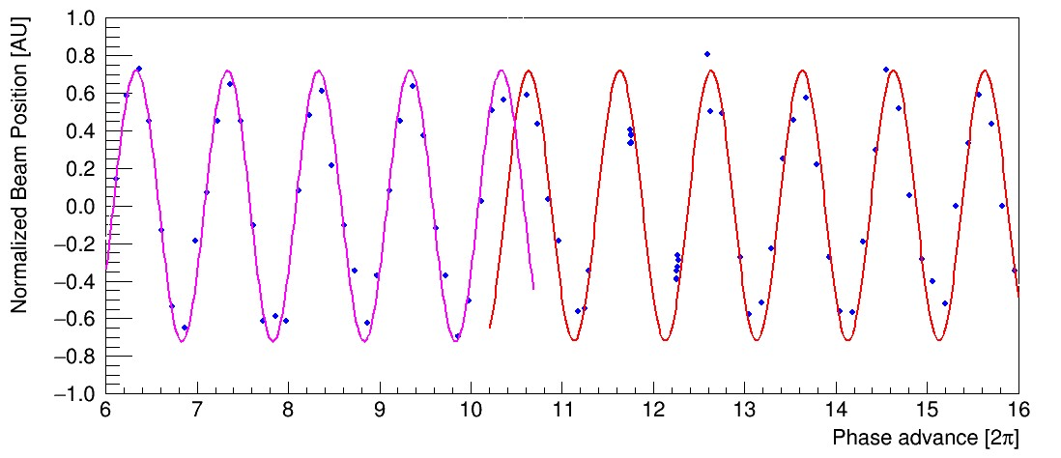
10Hz losses
#9299
MQ13.L2
B1
Two locations stand out:
  13L.2 and 13.L8
  The reason we don’t see Q6 this run is difference of location of the crystals vs normal collimation
Several Investigations are ongoing
  Having high-rate data when the beams are not dumped
    On demand like Post-mortem is investigated
  Proposal to equip MQ13.L8 and the two surrounding dipoles with an array of vibration sensors
    Survey for 4 weeks during commissioning
B2

Slide 18
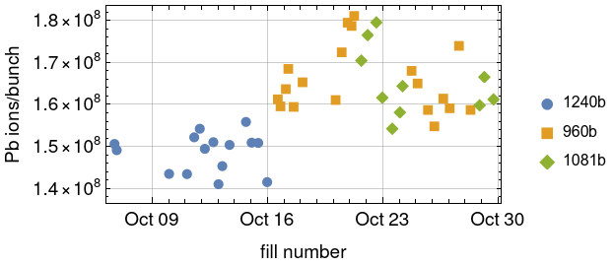
Beam quality
56-b trains
40-b trains
Bunch intensity at start of stable beams:
  56-bunch trains: 1.49x10⁸ Pb/bunch
  40-bunch trains: 1.66x10⁸ Pb/bunch
  Target: 1.8x10⁸ Pb/bunch – reached only in a few fills with 40b-trains
Observed degradation in injected intensity over time
  Could partially be recovered by injector optimization, then degrading again
  Crucial that enough time to setup is given to the team
Emittance
  BSRT not calibrated, so not reliable (not available at injection)
  From emittance scans, εx=2.5 µm εy=1.9 µm
  Target before the run: 1.65 µm average
Less impact on the integrated luminosity compared to the technical issues but potential room for improvement in the next ion run

Slide 19
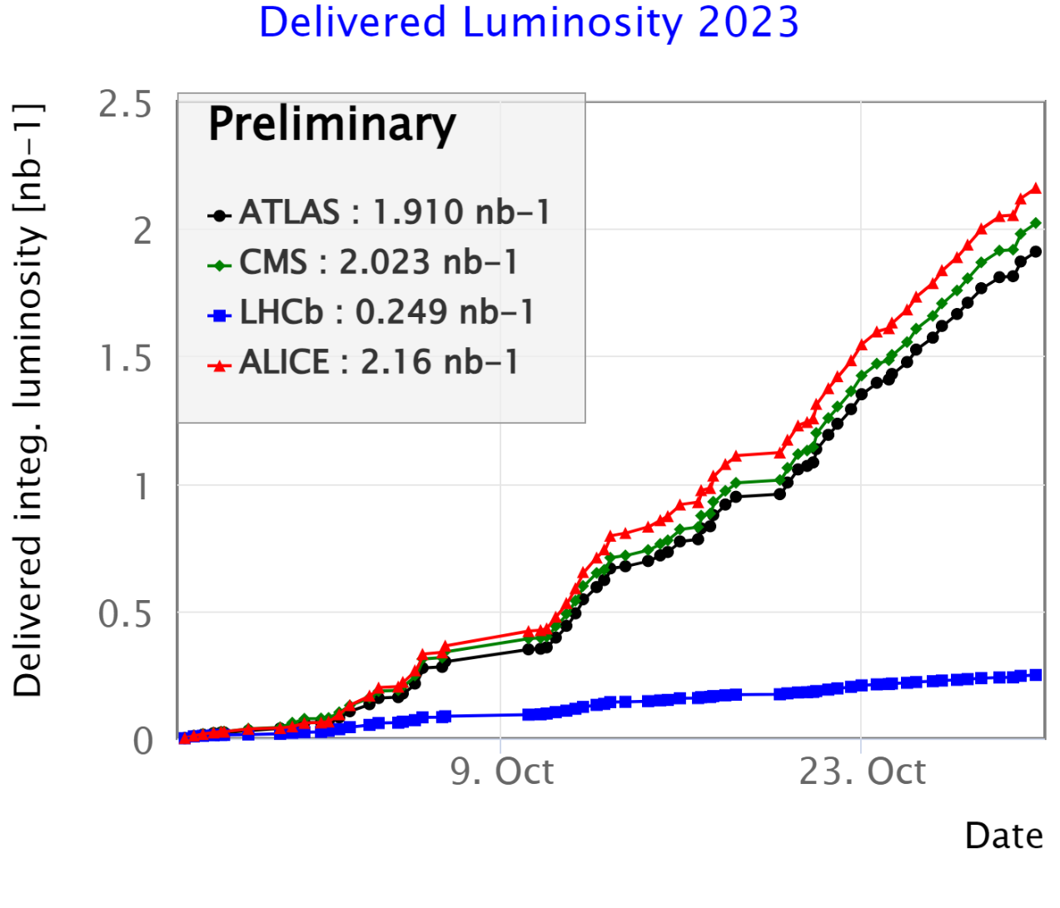
Integrated luminosity
Despite all the issues we manage to deliver a substantial amount of luminosity!
Comparison 2018:
  ATLAS: 1.797 nb⁻¹
  CMS: 1.802 nb⁻¹
  LHCb: 0.235 nb⁻¹
  ALICE: 0.905 nb⁻¹
ALICE luminosity without background issues:1.96 nb⁻¹

Slide 20
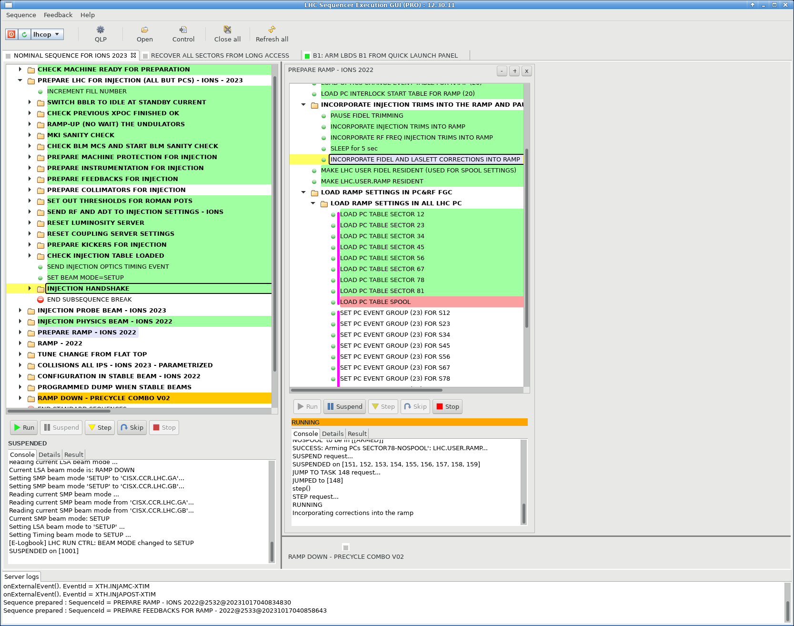
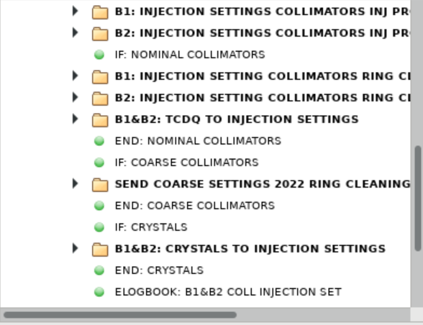
Conditional sequencer
The Sequencer is the most used application in the LHC
  New feature with conditions tried this year during the ion Run
  The most common use case for the LHC is when we want to run with coarse collimator settings (i.e. more open for optics measurements or other tests)
    Previously we had to skip and unskip part of the sequence every time -> easy to make mistakes
    Now there is a condition and condition, collimator in coarse and only that part played
The current implementation is a workaround
  An upgrade is needed to have it fully operational
  Feedback:
    Generally, very positive but some still some room for improvements
    In the overview it is not possible to see that the subsequence has been played

Slide 21
2024 proton cycle and estimates

Slide 22
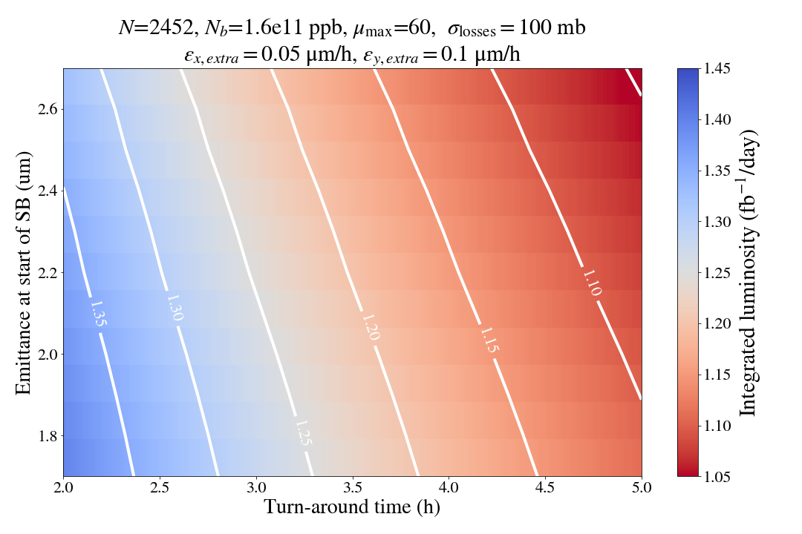
Luminosity production in 2024
Assumes the same configuration as 2023 but that we can reach the target straight away
  Of course if the cry reconfiguration would be successful the 36bunch trains would be very attractive!
  Assumes ideal levelling time (no technical faults)
  One could reach around 1.3 inverse femtobarn on a very good day
    Note that numbers are all at the beginning of stable beams
    In 2023 only a few fills we were at 1.6e11 at the beginning of stable beams

Slide 23
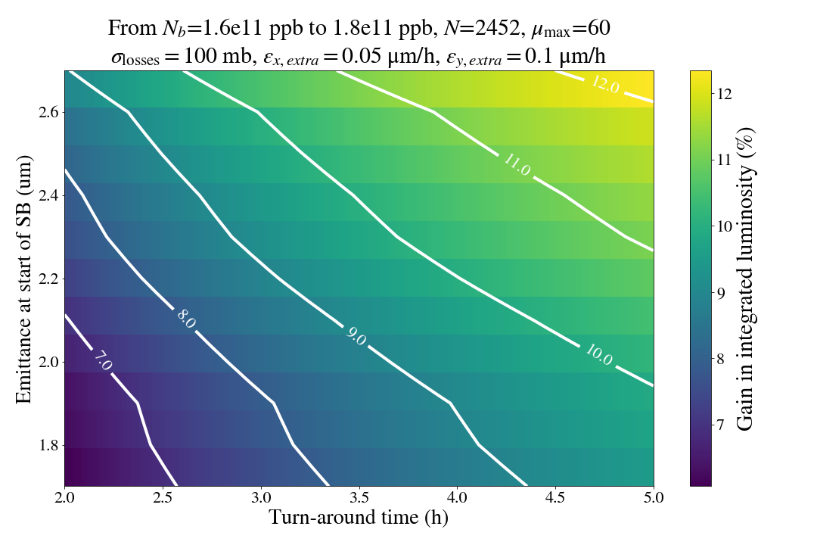
What is the impact of going to 1.8e11?
If we can reach 1.8e11
  Gives an increase of integrated luminosity of around 9% for realistic scenarios

Slide 24
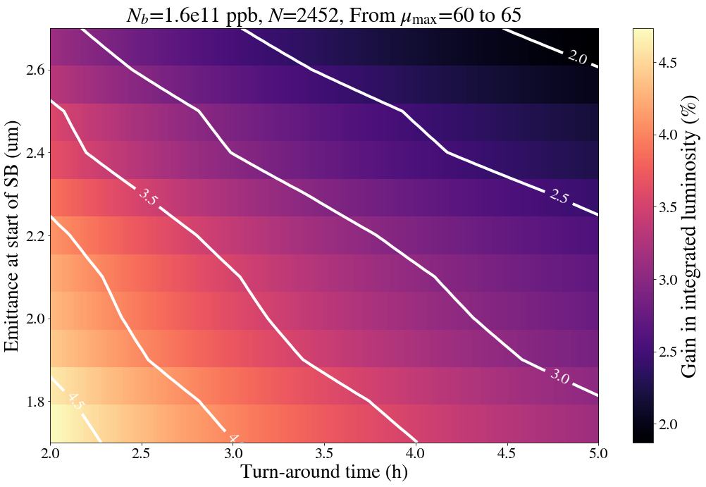
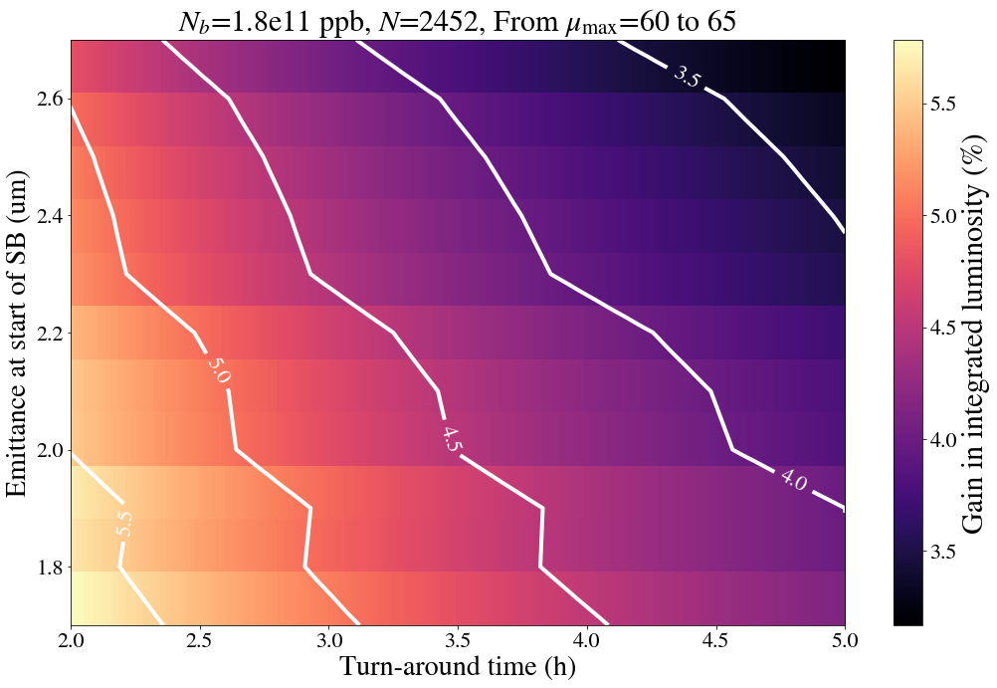
What about the pile-up (60 -> 65)?
1.6e11ppp
1.8e11ppb
Results in an increase of integrated luminosity in the range of 3-4%

Slide 25
Can we shorten the with cycle?
2023
2024?
Combing the pre-squeeze and LHCb rotation
  Saves around 5 min per fill
    Gives around 0.5%-0.6% more integrated luminosity for ideal fills
    More for shorter fills!
  Remember this is for all fills:
      Optics measurements
      Loss maps
      Intensity ramp-up
  Seen differently the LHCb rotation was played ~150 this year including commissioning, intensity ramp-up
    150*5 min = 750 min
    Factor 2 more fills in 2024 -> Rotating LHCb crossing angle for a full day (24h) in 2024!
Injection
Injection
Ramp to 6.8 TeV
Ramp to 6.8 TeV
Pre-squeeze to 1.2m
Pre-squeeze to 1.2m + LHC rotation in parallel
LHCb rotation
Tune change
Tune change
Adjust
Adjust
β* levelling from 1.2m – 30 cm
β* levelling from 1.2m – 30 cm

Slide 26
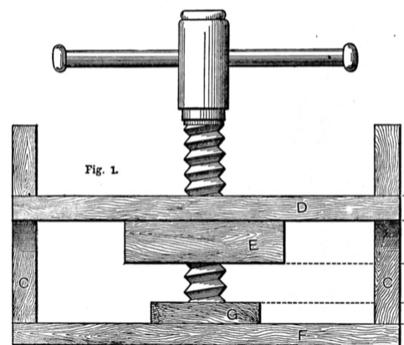

LHCb Rotation!

Slide 27
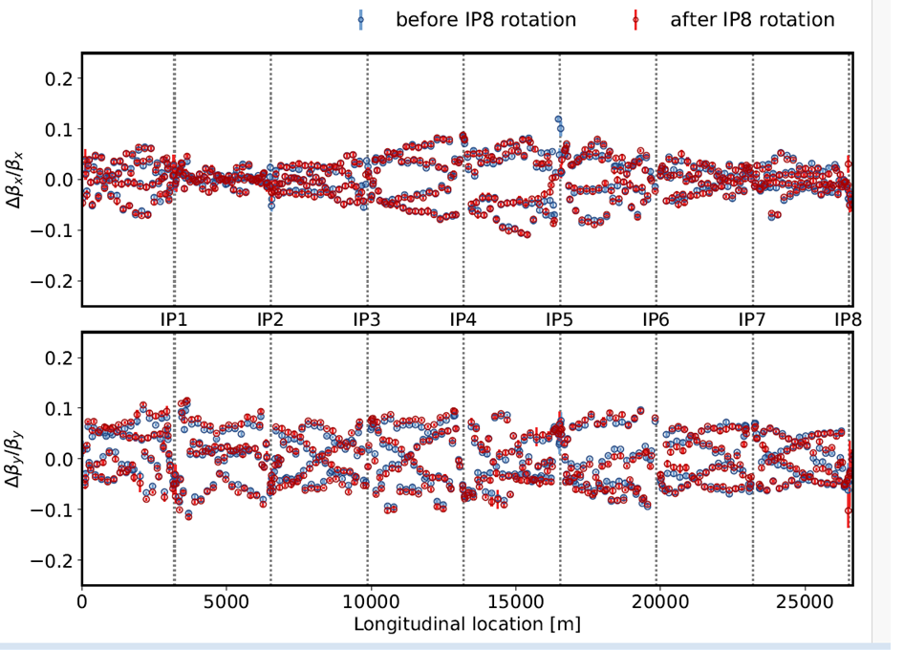
Any issues combining the pre-squeeze and LHCb rotation?
Only small changes to tune, coupling and chroma (1e-3) from the LHCb crossing angle rotation
No significant change in the optics from the rotation
No aperture limitation identified
Two different parts of the machine changed
-> No issue was identified in combining the two beam processes

Slide 28
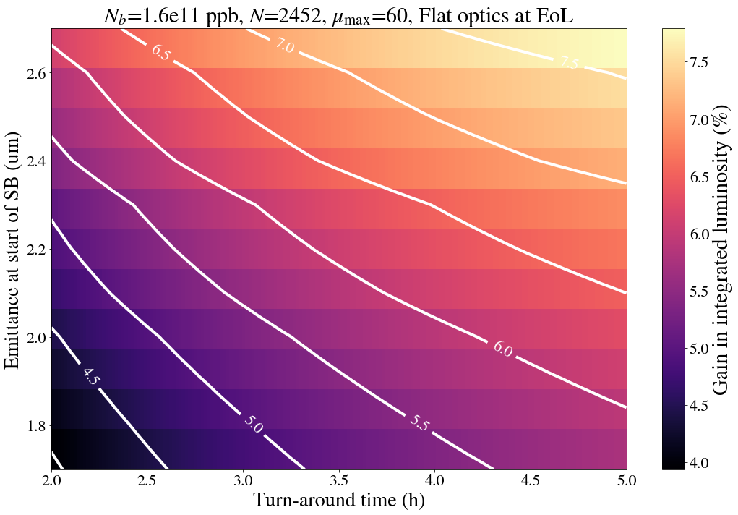
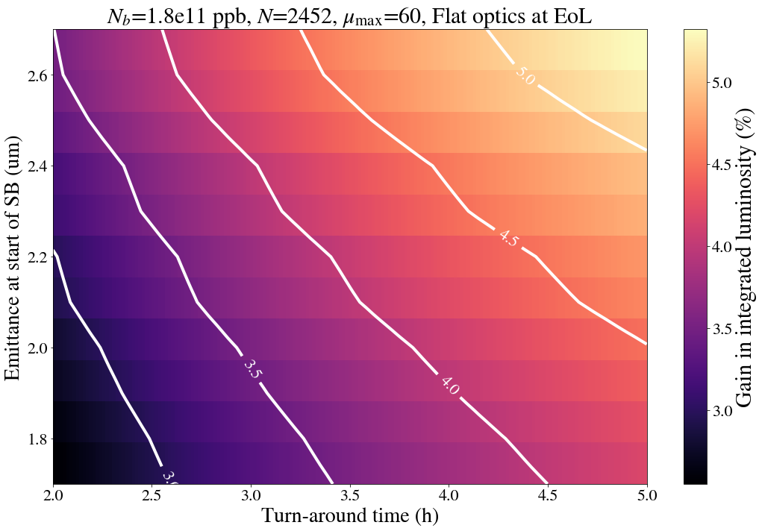
Squeeze further?
2024?
The most beneficial is to squeeze in the separation plane
  More available aperture and larger luminosity gain per squeeze centimetre
4 additional β* steps would be available to reach a full 30cm/20cm (xing/sep)
  Stay in the levelling longer in levelling
Injection
Ramp to 6.8 TeV
Pre-squeeze to 1.2m + LHC rotation in parallel
1.6e11ppp
1.8e11ppb
Tune change
Adjust
β* levelling from 1.2m – 30 cm
β* levelling from 30cm/30cm –
30 cm/20cm
This would increase integrated luminosity by ~4-5% in, assuming the ideal fill length. Not all fills reach the end-> smaller impact in reality

Slide 29
What is needed and is there a risk?
The collimation team is investigating the possibility to tighten collimators at 30cm/30cm
  TCT and TCLA IR7, TCDQ/TCSP IR6, TCS IR7 (see collimation talk)
    Some technical work is needed since the beta* levelling can only move the TCT and TCL
      Change strategy would need the agreement with MPP
      Could create two beam separate levelling beam processes (1.2m - 30cm and 30cm/30cm – 20cm/30cm)
  Would demonstrate the operation of flat optics and a tele-index of 3 for the first time in the LHC -> Pave the way for other flat optics, e.g. “full RP optics” (see Stephane’s talk)
  First-time estimate would be an additional ~24 hours of commissioning (split between OMC and collimation)
    Would be a net gain in terms of integrated luminosity
If there are issues not originally seen, we can stop the levelling at 30/30

Slide 30
Conclusion (2023)
The total integrated luminosity was mainly limited due to the faults
  The intensity limitation to 1.6e11 together with the larger-than-expected emittance also had an impact
  The 6x36b or 5x36b pure 25ns looks very attractive!
    Should we consider returning to BCMS in 2024 to get smaller emittance?
  The new “collide and squeeze” will enable us to go in one step to the requested luminosity
    No reason to change the start of colliding even if we would stay at 1.6e11
Ion run was extremely challenging with many different technical issues but still managed to produce good amount of luminosity

Slide 31
Outlook
Changes to the 2024 proton cycle could be:
  Inclusion of the LHCb rotation in the pre-squeeze (~1 day of beam time saved)
  Continue squeezing the beta* from 30cm down to 20cm in the separation plane
    Predicted gain in luminosity
    More time in levelling
    Low risk, only potentially ~1 day lost in commissioning
    Gain valuable experience with higher tele-index and flat optics!

Slide 32
Backup

Slide 33
Heat Load and Filling scheme
The heat load is under control even for the highest intensity fill we are below 150W/half cell (2454 bunches)
  Up to 183W/half-cell in 2022 even though the total intensity was very similar
Thanks to hybrid filling scheme (mixture of 8b4e and 36 bunch train)
  First time we use it in normal operation
  Significant effort from the injectors to make this happen!

Slide 34
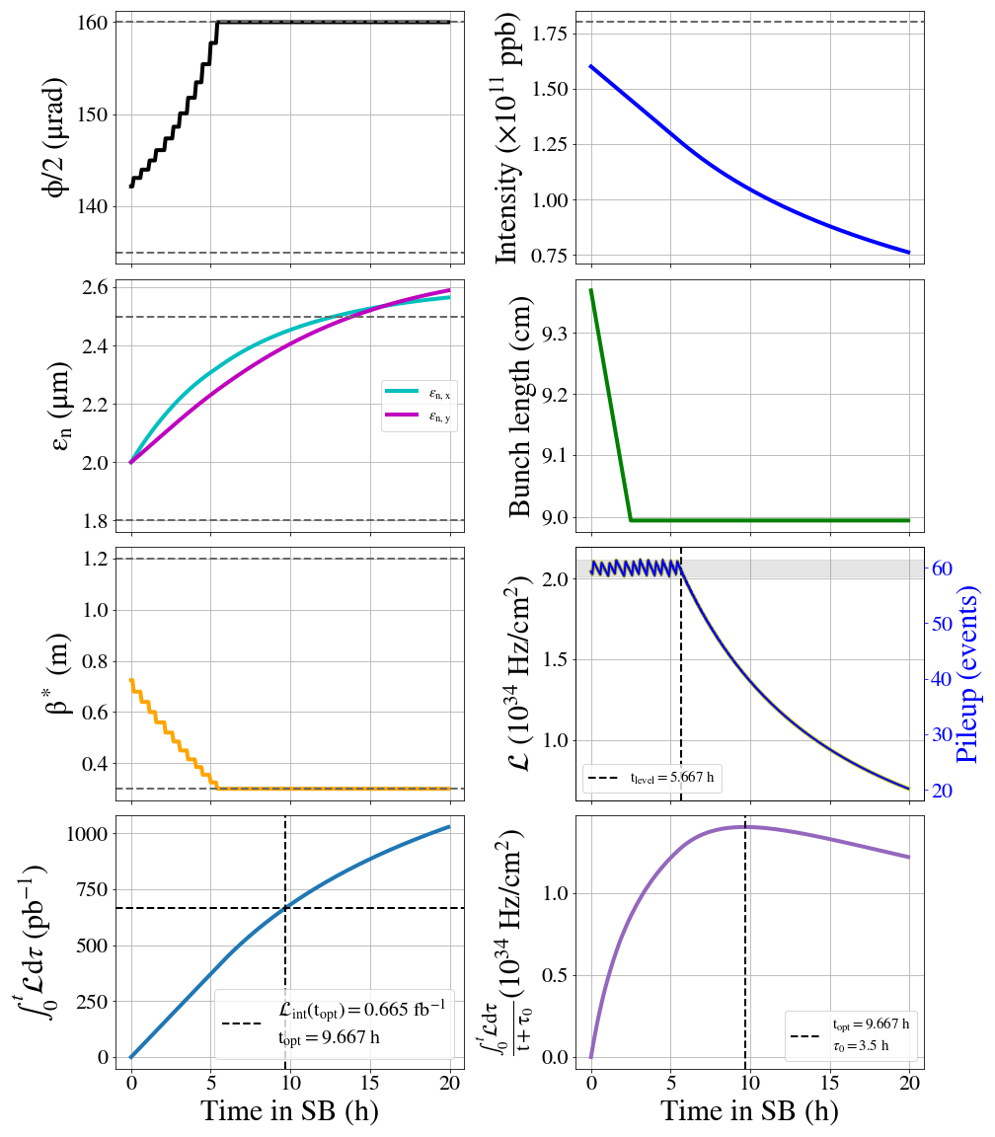
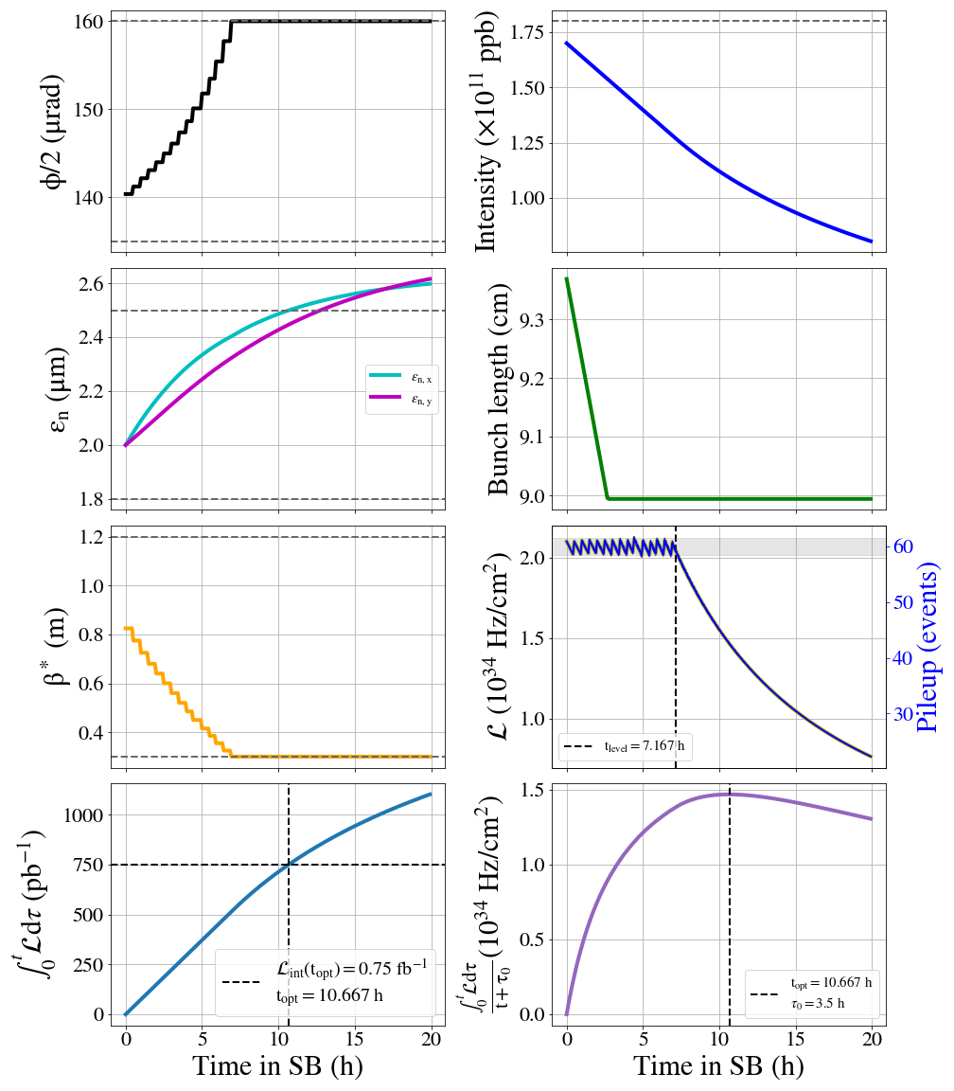
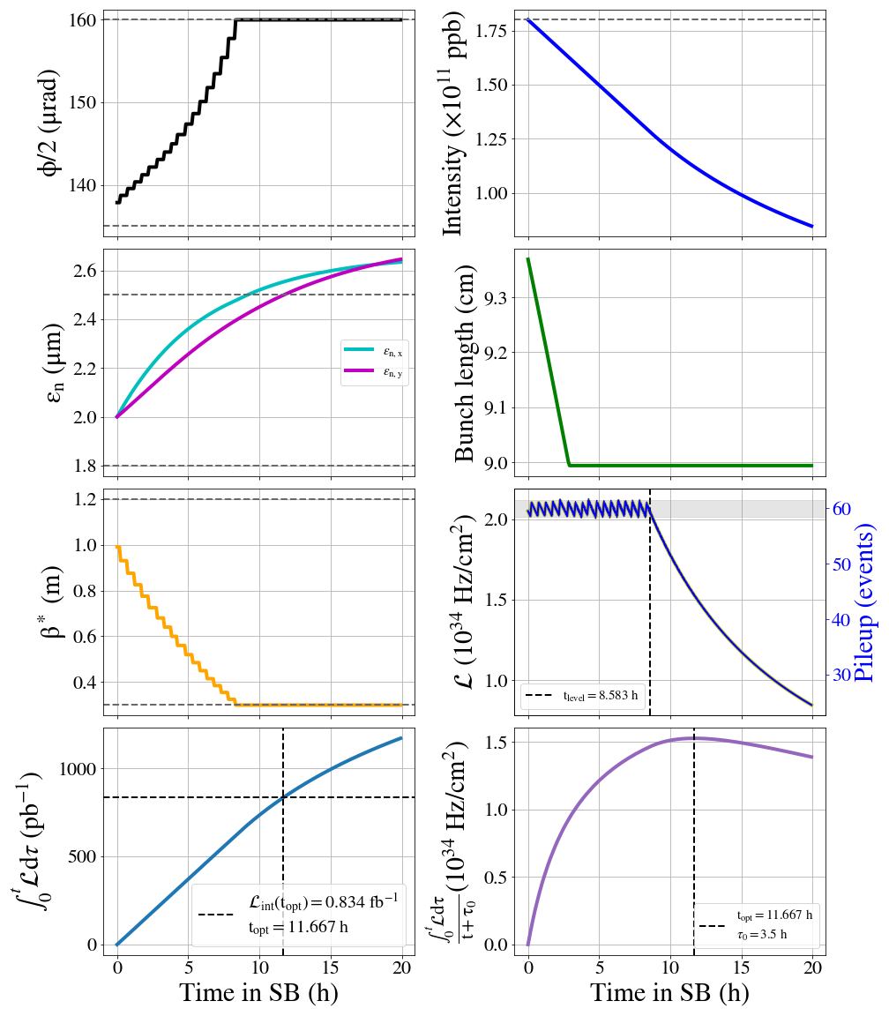
1.6e11ppb, 1.212 fb-1/day
1.7e11ppb, 1.27 fb-1/day
1.8e11ppb, 1.319 fb-1/day
1.6e11 to 1.7e11, +5%
1.6e11 to 1.8e11, +9%

Slide 35
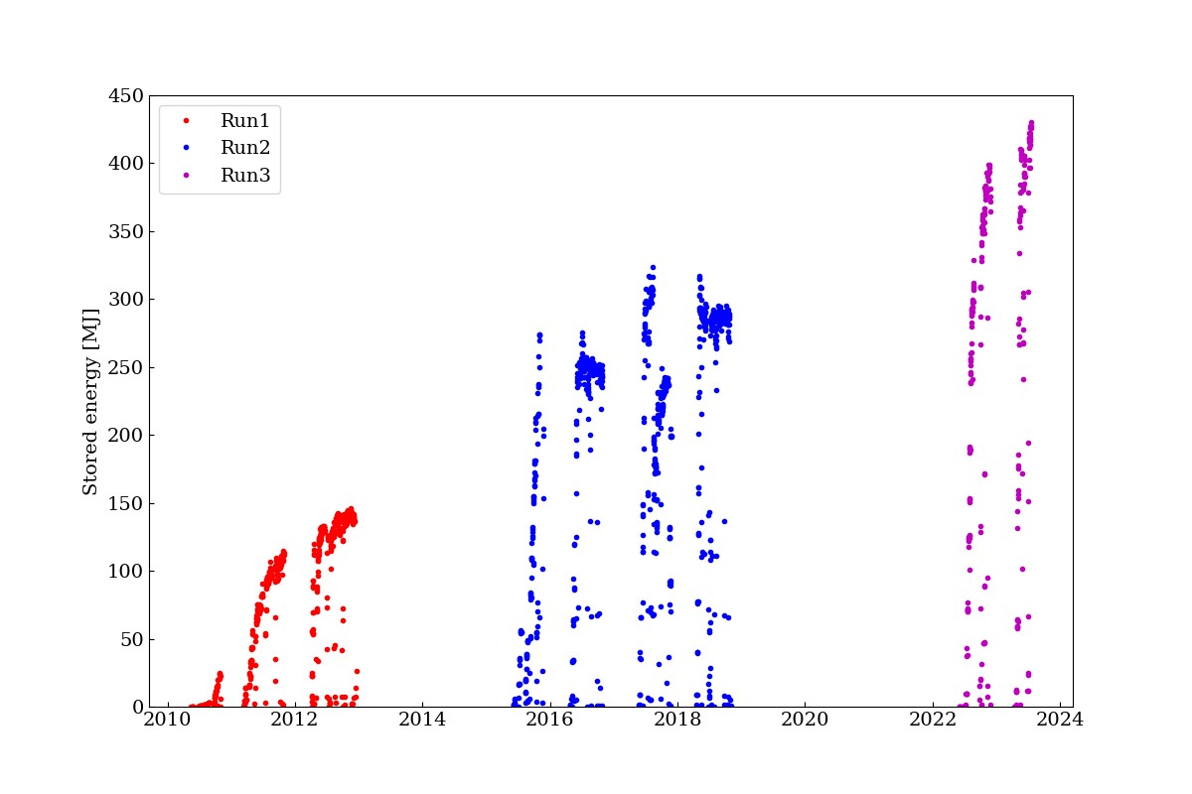
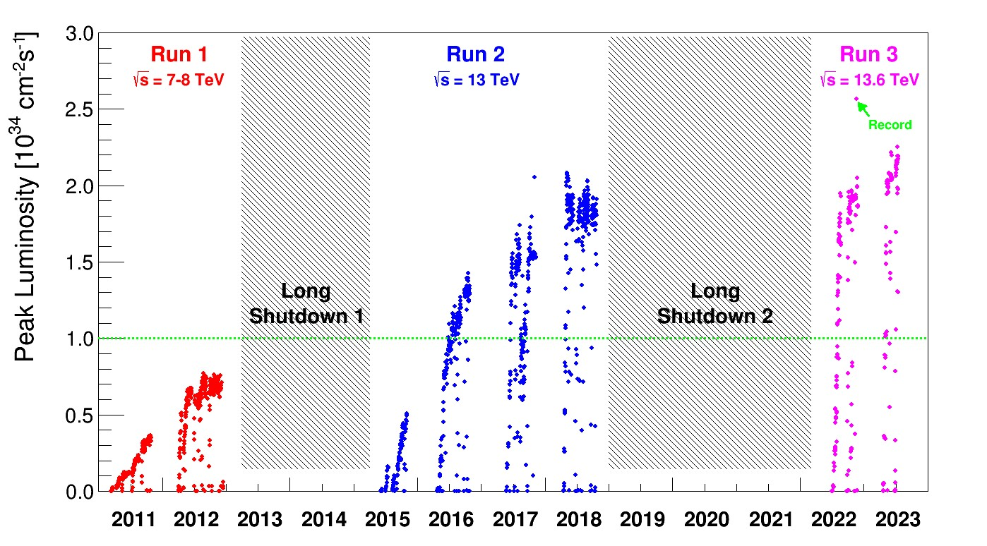
The bigger picture
Stored energy record of 425 MJ with 2464 bunches @ 1.6E11 ppb (@ start of SB) .

Slide 36
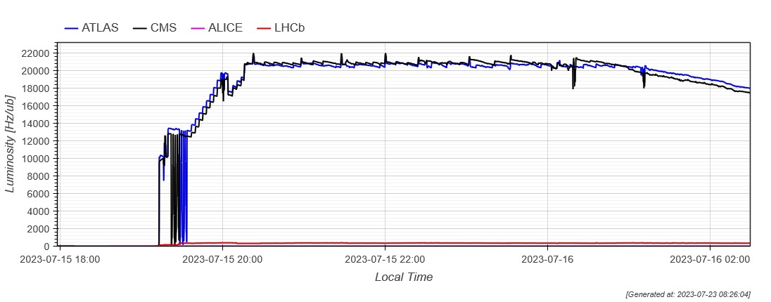
Levelling
Xing angle adjustment of ± 5 microrad to tune ATLAS vs CMS luminosities for levelling.
Just before the incident we agreed on and tested faster levelling to target on low intensity cycle (just over intermediate matched points). We did not have time to apply it.
Xing tuning
@120cm
@30cm
~ @60cm

Slide 37
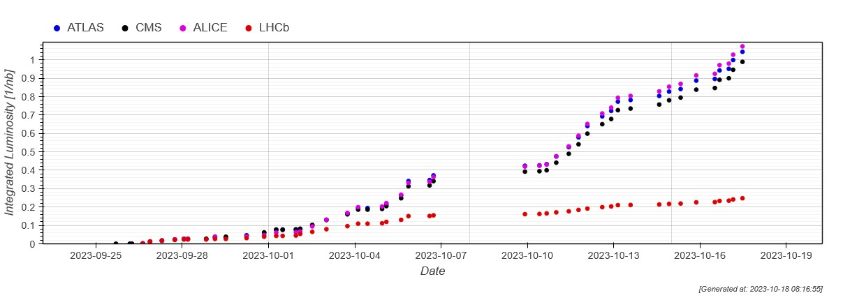
Production
Last week’s good slope with 4-5h fills producing ~50 ub/fill was disrupted by the WE quenches due to SEEs. Trying to recover the slope this week.
10 days left in this run, with ALICE in -/- polarity →expect to accumulate ~ 2.2 – 2.6 nb-1.

Slide 38
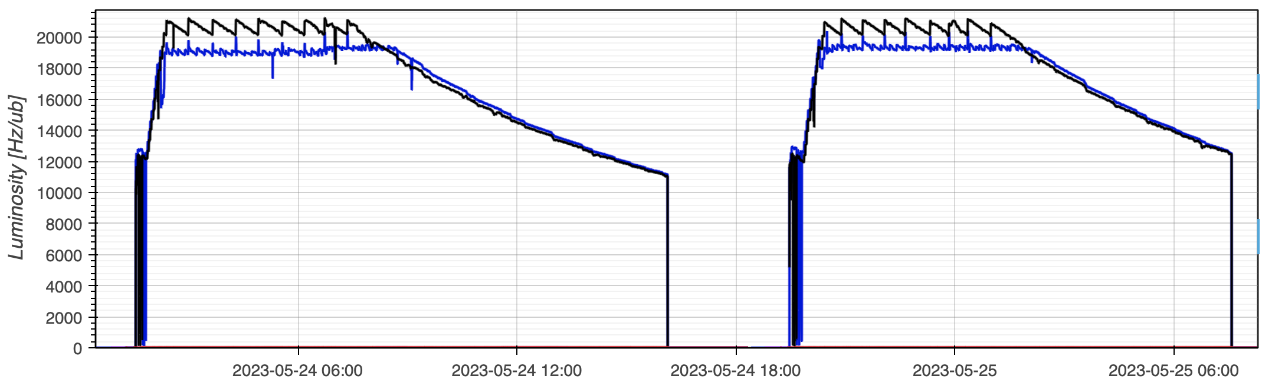
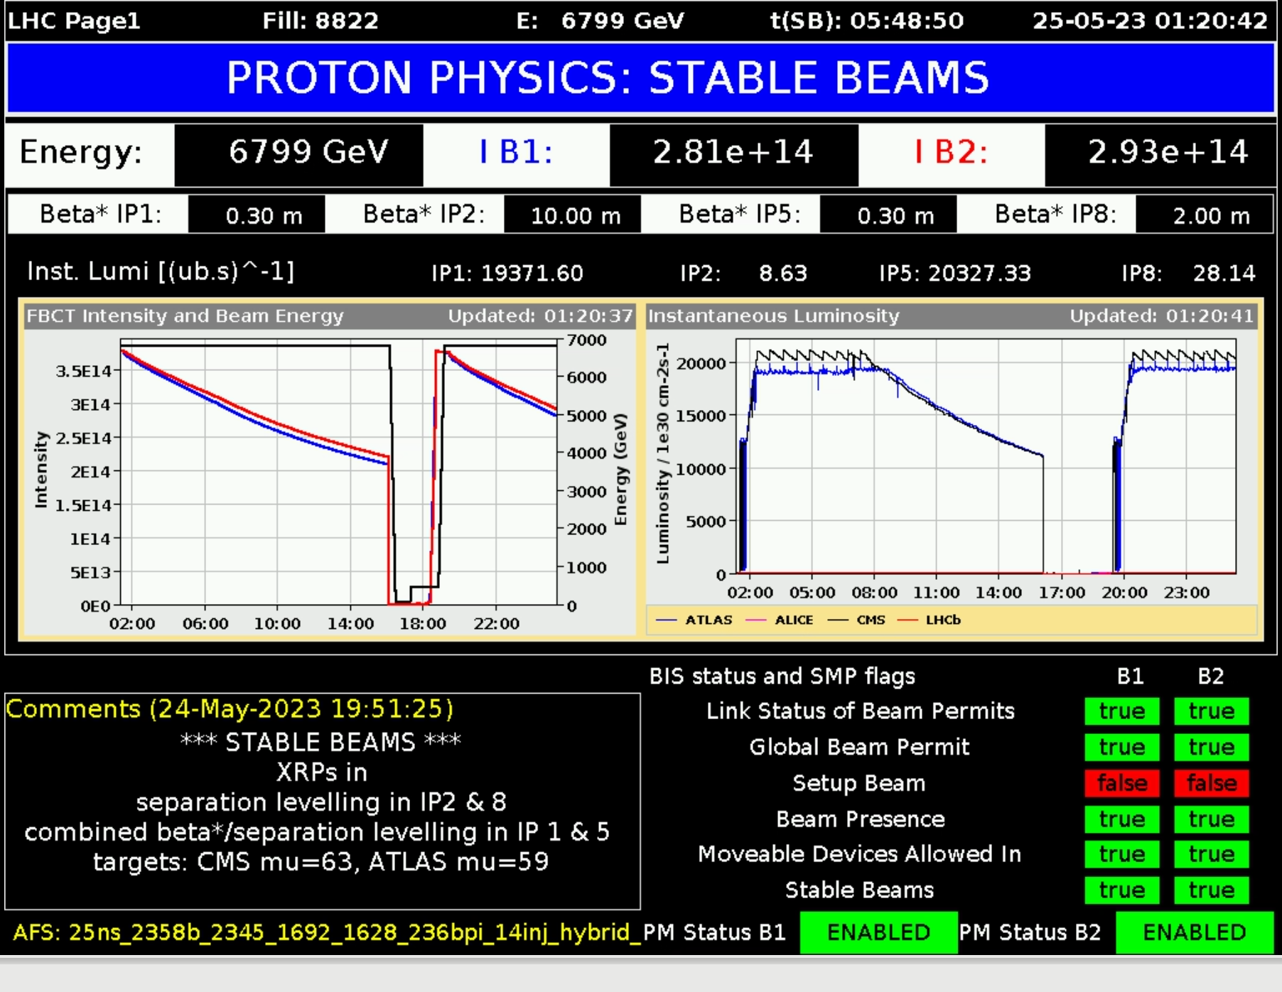
Physics fills performance end of May
New record: Integrated luminosity: ~1.2 fb⁻¹ in 24h !
Peak levelling just above 2.0 x 10³⁴cm⁻²s⁻¹
Pileup targets ATLAS/CMS = 63 / 59
  Thanks to combined separation β* levelling and separation levelling we can deliver different pile up to ATLAS and CMS!
Luminosity difference also reduce due to updated calibration factors
Max at start of stable beams: 409 MJ
1.59 x 10¹¹ p/b (Injected: 1.61)
24th to 25th of May 2023

Slide 39
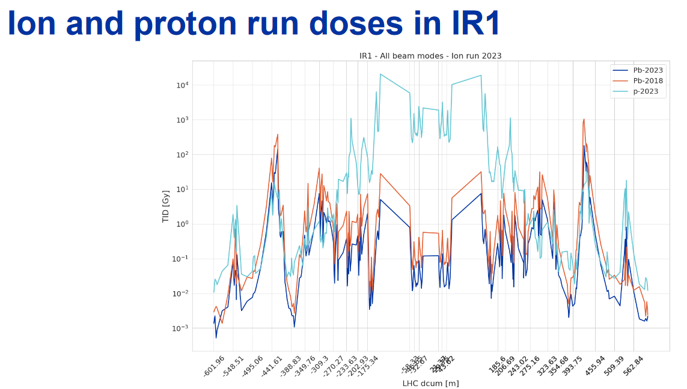
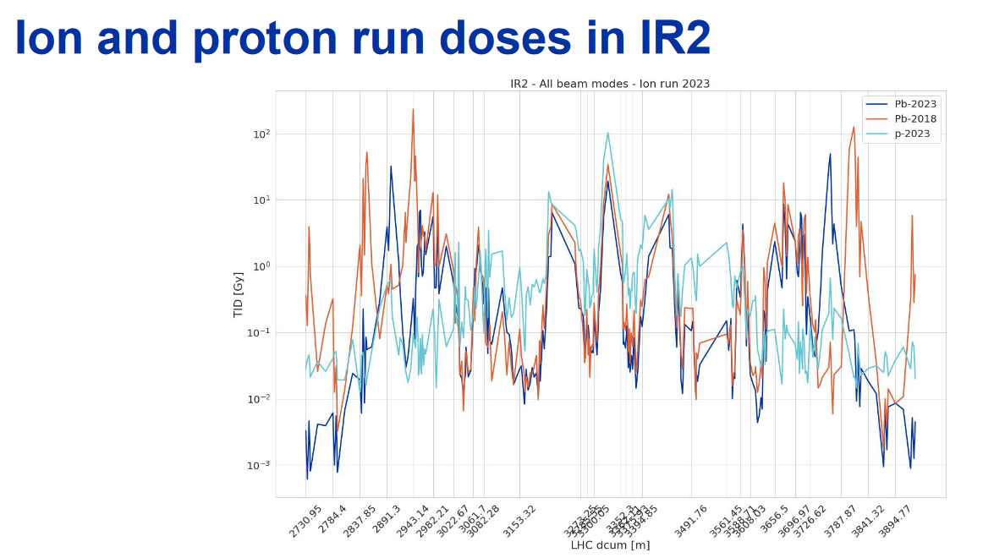
Radiation levels
IR1: ~ no change.
IR2: shift of the BFPP loss peak due to TCLD
R2E team

Slide 40
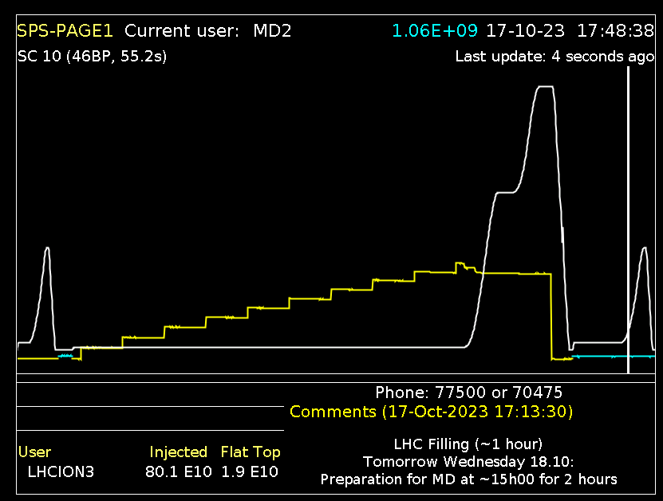
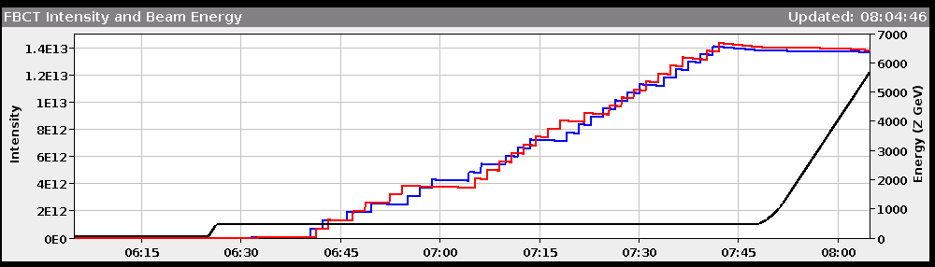
Injection
Long SPS 14 injection cycle (56 bunches) with slip-stacking is working well.
  Shorter 10 injection (40 bunches) version in service since Monday.
Sometimes injection is tedious when beams are rejected due to quality (bunch length, parameter spread), but overall, it is not our main issue.
Typical injection time for 1240b: ~1h15m.
10 inj cycle
960b injection (40b) – 1 hour

Slide 41
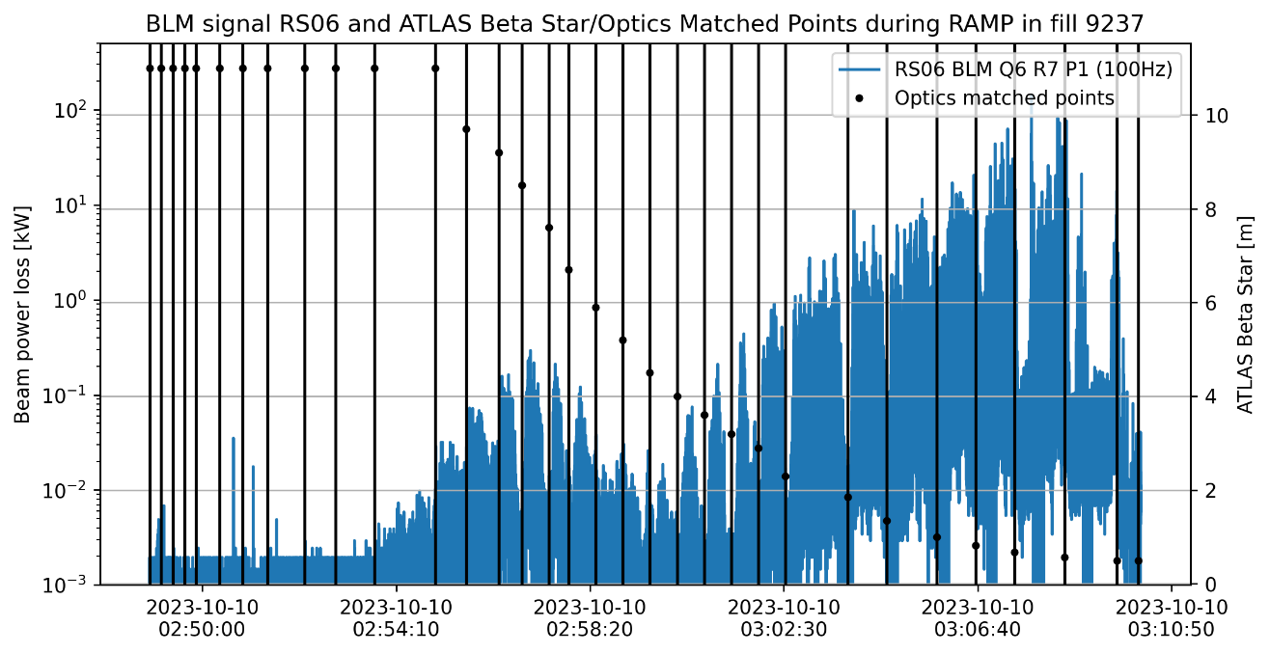
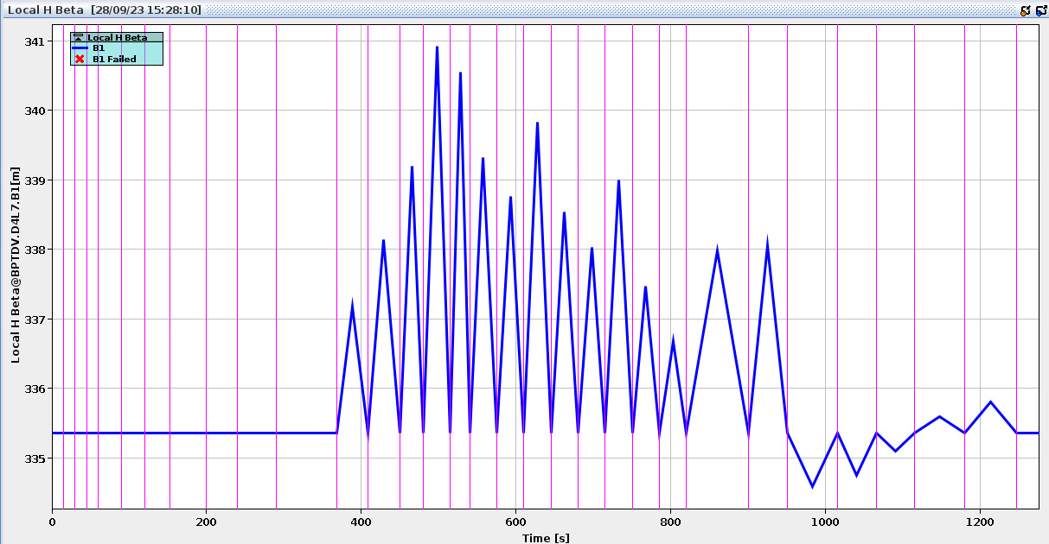
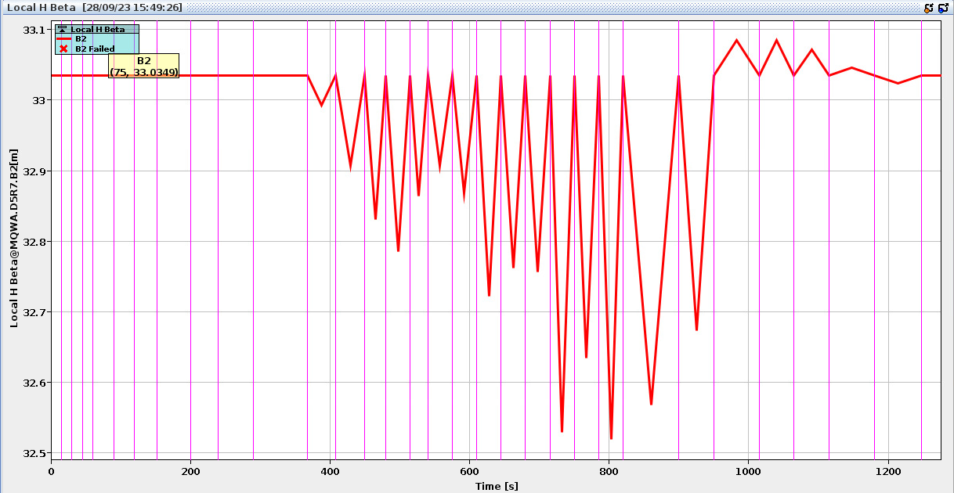
Ramp losses (1)
CRS to 50 cm (no FT squeeze): works well technically, lifetime drops (spikes) above 5.5 TeV coupled to the lower ion cleaning efficiencies are in issue in terms of losses.
  Lifetime drops not visible during setting up with coarse collimator settings.
B1 ramp power loss
Lifetime drops between matched points, losses peak in region of 5.5 to 6.3 TeV, typically 30-70% of dump threshold.
  Ramp to ramp fluctuations, loss moving spikes. 10 Hz modulation on top of ramp structures? Beam quality fluctuations ?
Simulated beat-beating between matched points (ideal model)
S. Morales

Slide 42
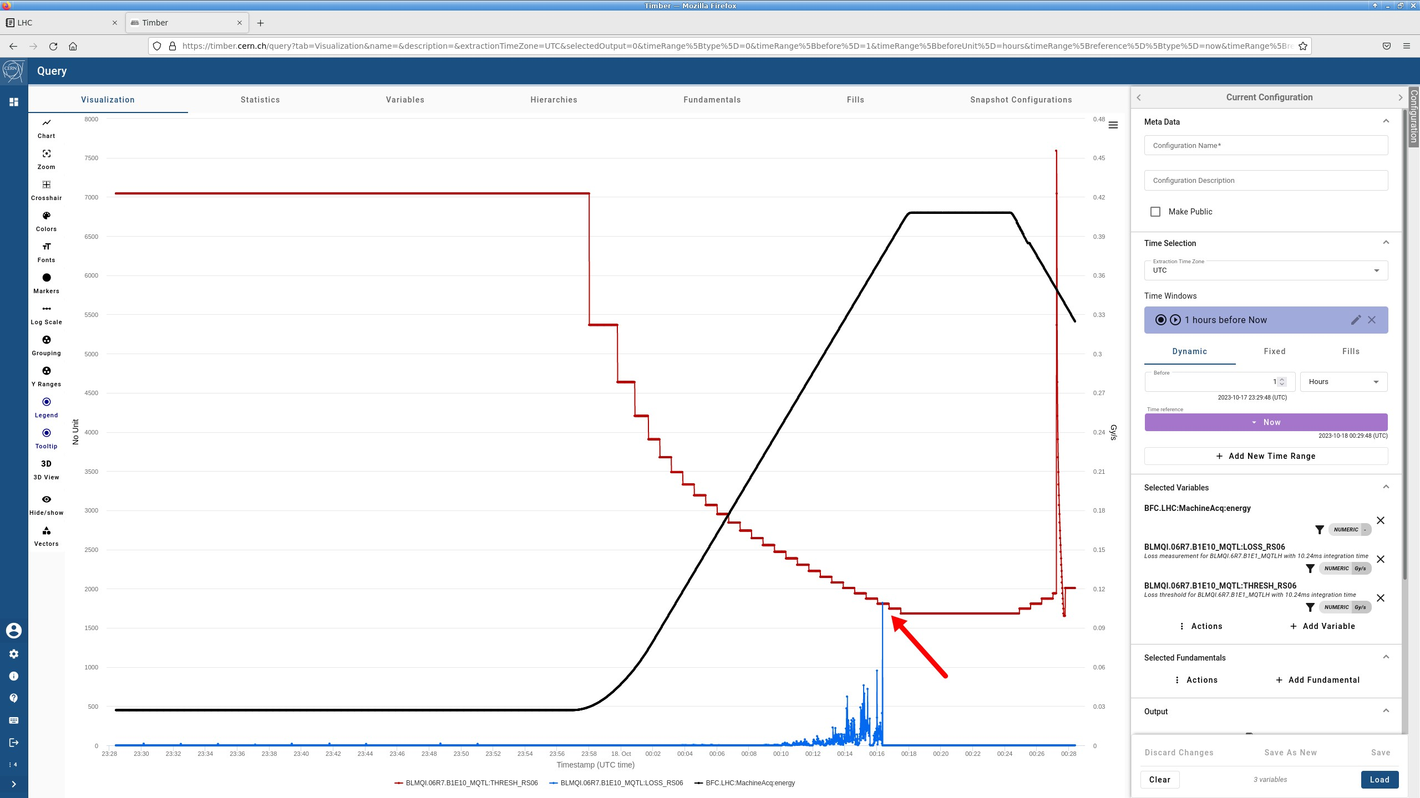
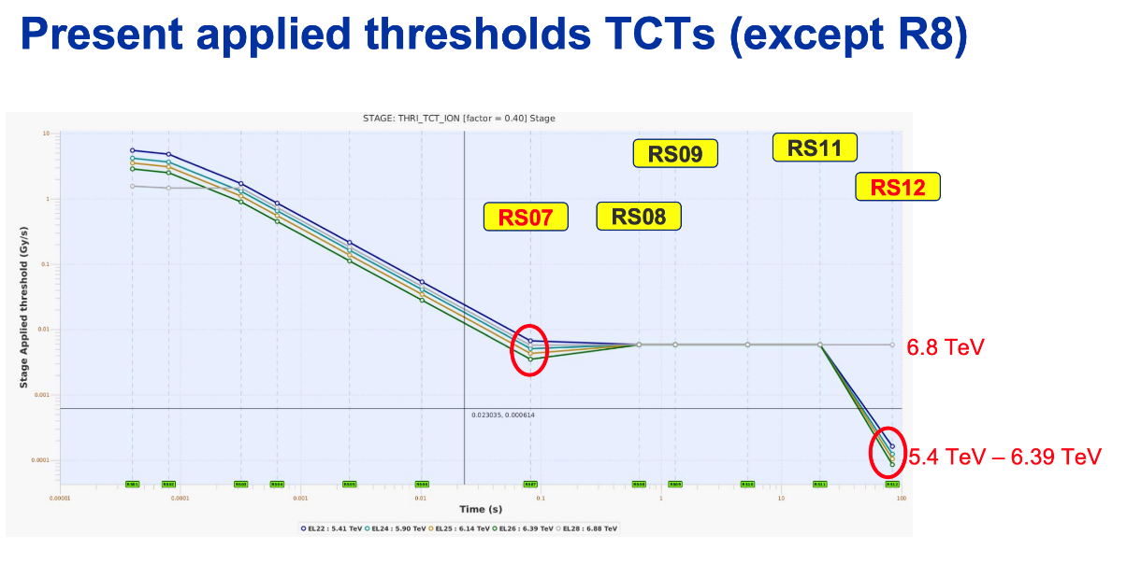
Ramp losses (2)
Dumps on losses – fast losses < 1 s – in the ramp mitigated by:
  Adapting BLM thresholds with “flat top” corrections applied at lower energies (avoids pushing thresholds too low in the ramp) and adjustment of monitor factors. Last iteration done yesterday…
  Smoothing out orbit feed-forward corrections. First step done; further improvements require changes in the settings generation that we do not want to push out now. Does not seem to be the main loss mechanism.
Operated successfully more than a week with 1240b with losses 30-70% of dump thresholds. Last Monday sudden increase leading to dumps → reduced # bunches to ~960.

Slide 43
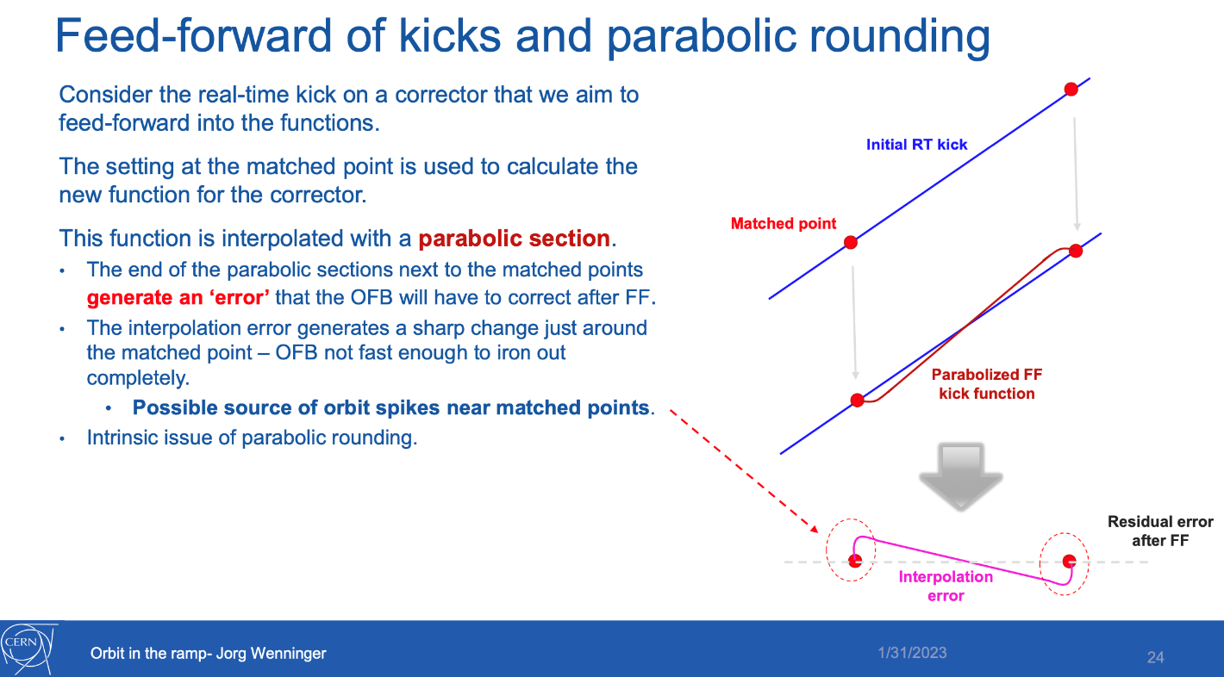
Orbit - smoothed ramp
LBOC @31.01.2023
Originally planned as pp MD, it was introduced as attempt to mitigate the losses in the ramp.
First iteration reduced by a factor ~2 the orbit spikes and seemed to help.
Very reproducible from ramp to ramp, largest losses are not at places of orbit excursions.

Slide 44
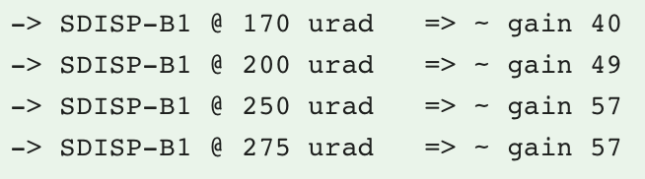
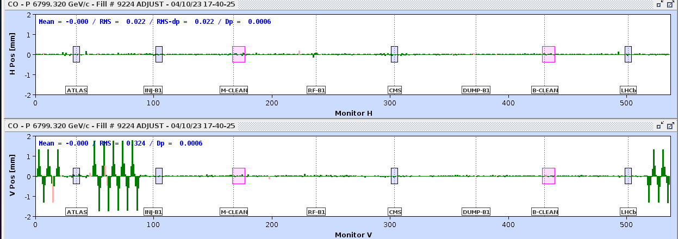
ALICE background
After many tests, the spurious dispersion knob for B1 (ATLAS xing compensation) was identified as an efficient cure.
  Optimum setting at 250 urad equivalent (~2.5 mm orbit bump in the arc).
Spurious dispersion in IR1 knob applied for both beams gave no further improvement.
Losses shifted from TCTPV.L2 to TCLD.R2.

Slide 45
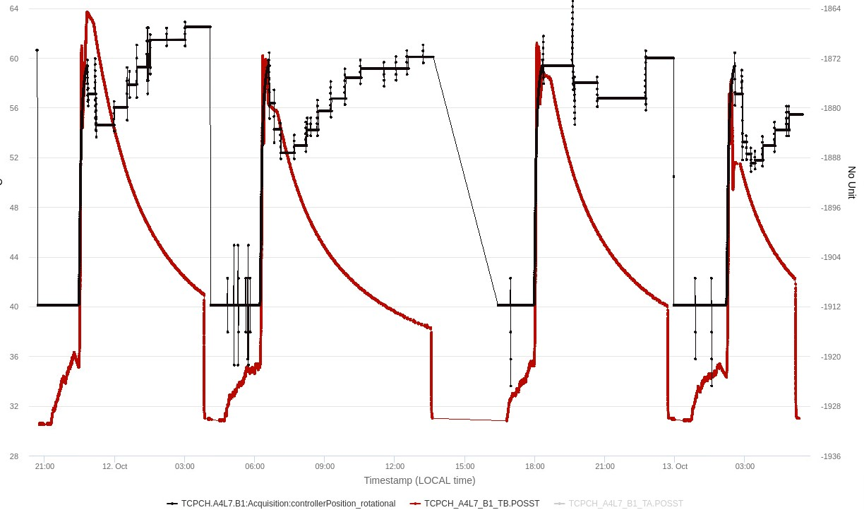
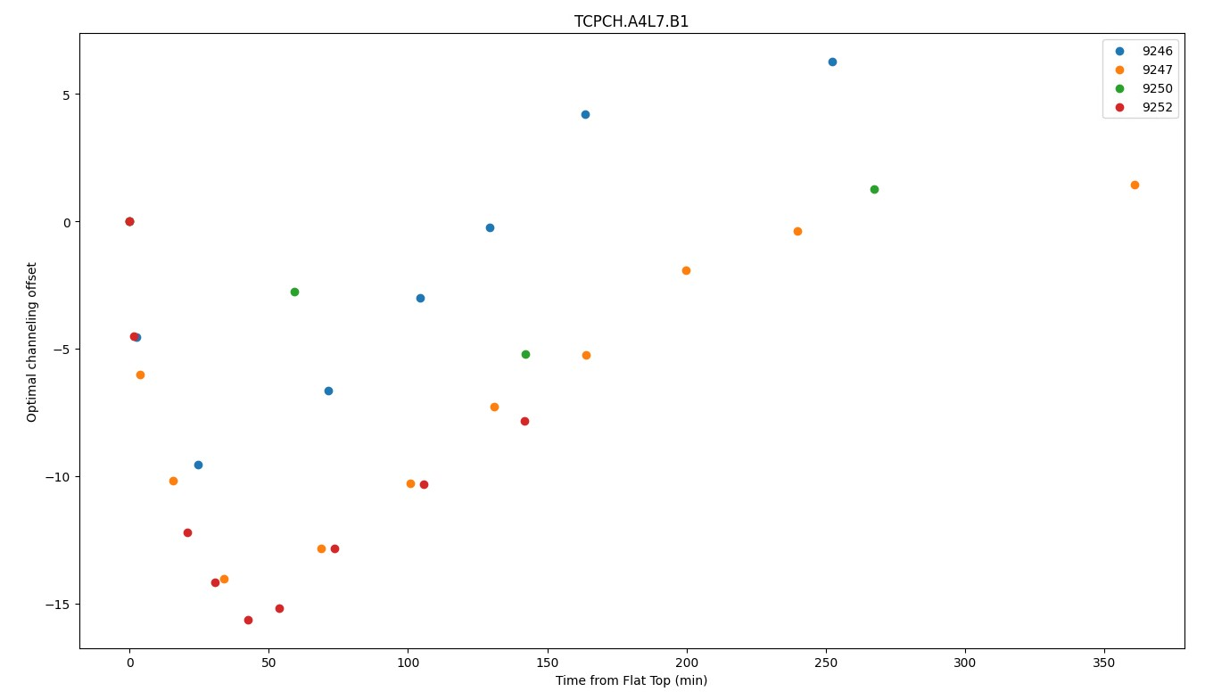
Xtal channeling (stability)
Xtal optimum
Drifts of the Xtal angles by ~10-15 urad for a channeling acceptance of 2 urad, in particular B1H.
  Systematic evolution in physics fills.
  Xtals can be in amorphous state, i.e. no channeling.
Regular Xtal channeling optimizations at injection, at FT and in SB.
  Since yesterday automated optimizations in SB.
Suspicion of temperature effects. Effort in progress between impedance, mechanics, controls and collimation.
D. Mirarchi

Slide 46
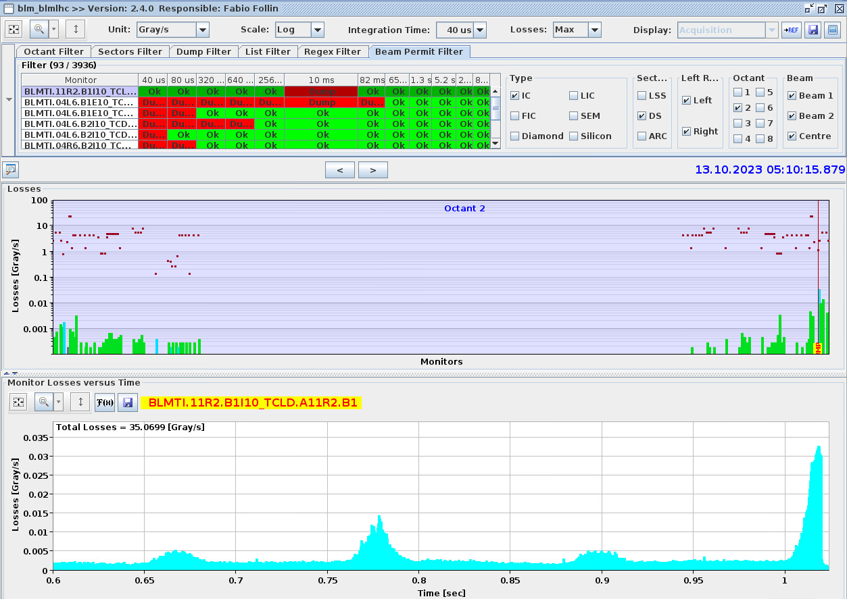
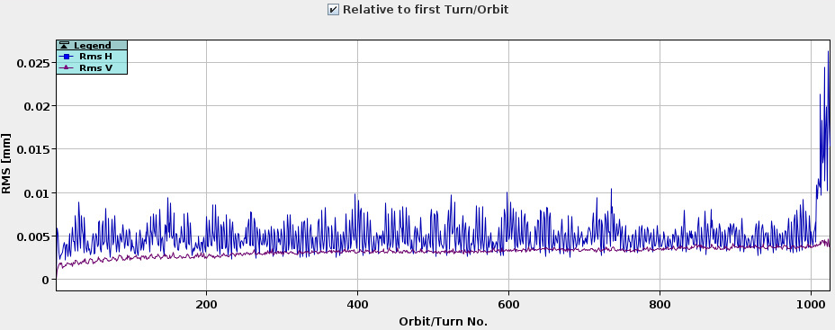
Dumps on TCLDs in SB
3 dumps on TCLD R2 BLMs in stable beams in conjunction with increased “10 Hz” activity.
  Beam loss in IR7 → leaking to TCLDs in IR2.
In the horizontal plane there is permanent activity around 10 Hz – in proton and ion runs. Occasional bursts of activity leads to dumps with ions.
  NB: triplet, Q6R2… horizontal modes : in the range 8 - 12 Hz.
“Noise” in H plane is activity around 10 Hz.
Increased activity → dump
Fill 9251
1 point every 20 ms (50 Hz sampling)
20 microm

Slide 47
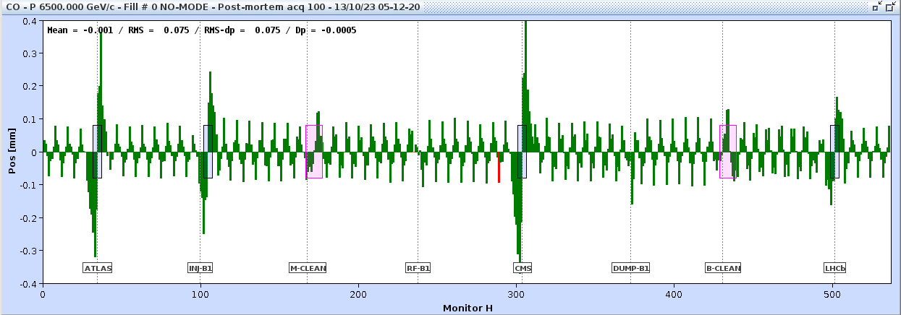

Dumps on TCLDs in SB
Peak-2-peak oscillation amplitude ~80 um (arc), frequency ~8.5 Hz.
For two cases, oscillation compatible with single (i.e. dominant) source in cell 13L8, kick amplitude ~0.4 microrad.
With – ALICE polarity, re-optimization of the TCLD jaw settings will be attempted to move losses to IR3.
Fill 9251

Slide 48


Extending β*-levelling in flat mode down to 24 cm in the || plane
[aperture estimate for 6.8 TeV & fixed θ_{x}/2=160 μrad; lumi estimate for γε=2.5 μm, σ _{z}=8cm]
IT aperture [σ]
Peak lumi gain [%]
9.2 σ
+11.8%
24 cm
28 cm
+4.9%
×2.4 more efficient than round optics at constant IT aperture
(and less BBLR impact w.r.t. round optics at fixed crossing angle)

Slide 49

Overview of “10 Hz-like” dumps
Run 2 and run 3, all dumps due to B1 horizontal plane.
All but 2 cases in 2018 in Pb operation – reduced cleaning efficiency !
Cell 13L8 was candidate for 2 dumps in pPb in 2016, alive again in 2023.

Slide 50

Luminosity
0.152 fb⁻¹
0.993 fb⁻¹

Slide 51

Orchestration of collisions
(1) fast β* ramp-up
(3) combined β* and separation levelling
(5) Separation levelling OFF
(4) "reverse" crossing angle tuning
(2) crossing angle tuning
fast β* levelling ramp up to mu=58 in ATLAS (~40mins @ 1.6E11 ppb)
crossing angle tuning to reduce ATLAS wrt CMS (-10urad once ATLAS @ max PU)
combined β*/separation levelling
crossing angle tuning back to nominal (once β* = 30cm)
ATLAS levelling not effective anymore - back head-on

Slide 52


Slide 53

β* and luminosity
The β* was measured from 1.2m down to 30 cm
  Offline analysis to align timing between the current reading and tune has been applied
Analysis indicates a ~1.5% higher luminosity from β* for ATLAS
  Large error-bar, or none where we only have a single measurement
  To reduce uncertainty we would need to perform more measurements
LNO section meeting, F. Carlier

Slide 54

2023 cycle
Part of the cycle is the same as in 2022
    In particular the most challenging part: β* between 60-30cm
  The new cycle was already measured during MDs in 2022

Slide 55


Losses going to collision (Adjust)
During the intensity ramp-up we got dumped due to losses when we went into collision
  Collimator with an angle was retracted (TCSPM.E5R7.B1 to 8.2 sigma) which fixed the issues with the dumps coming from high losses going in collisions
  Total losses were reduced by
    Optimizing the tunes, different values depending on which BBQ that was used
    Systematic effect of the trains on lead to non-perfect centring in the TCP
      Effect compensated in orbit feedback -> Less losses in particular for beam 1.
2022
2023

Slide 56



In case of a crossing angle one can calculate an approximative effective beam size following this formula

