Slide 1
Commissioning at the start of the run and after long failures
How can we improve?
David Nisbet
Many thanks to R. Bruce, Y. Dutheil, M. Hostettler, D. Mirarchi, F. Moortgat, T. Persson, S. Redaelli,
M. Solfaroli, G. Trad, J. Uythoven, J. Wenninger, C. Wiesner, D. Wollman,

Slide 2
Outline
A look back
- Commissioning in 2023
- Recovery from IT.L8
How can we improve?
Outlook to 2024 commissioning

Slide 3
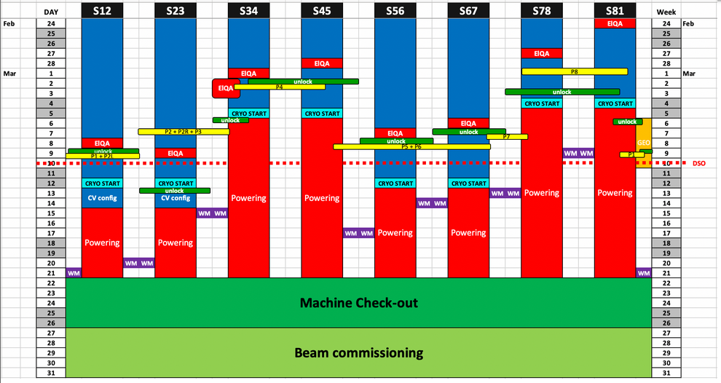
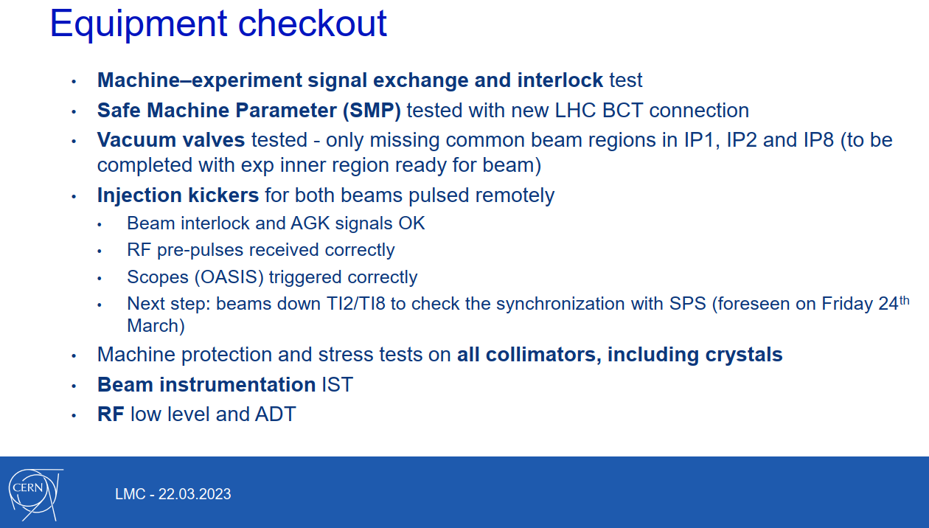
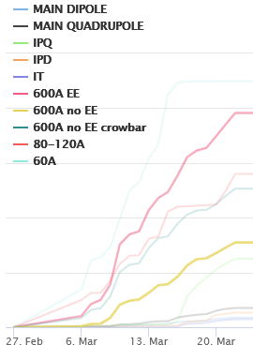
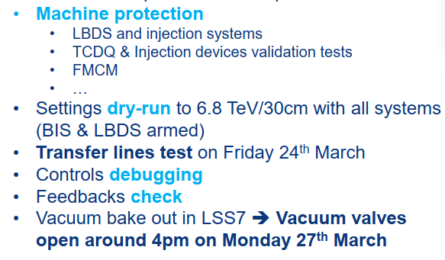
CONTEXT
Powering tests
Machine Checkout
Beam Commissioning
Beam Commissioning
Intensity Ramp-Up
Intensity Ramp-Up
PHYSICS
Problem found with TCPCH.A4L7.B1

Slide 4
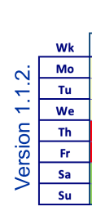
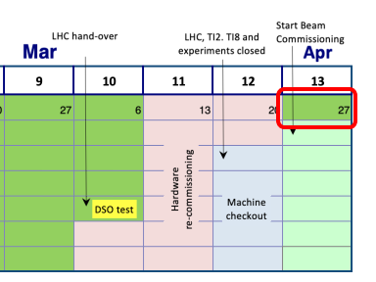
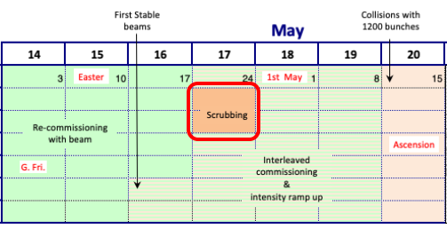
CONTEXT
Powering tests
Machine Checkout
Beam Commissioning
Beam Commissioning
Intensity Ramp-Up
Intensity Ramp-Up
PHYSICS
From 1st Turn
UP to 1200b STABLE beams
1st Stable Beams

Slide 5
Simplified commissioning flow
Probe
Probe Setup
450 GeV
6.8 TeV
Optics correction
Probe Setup
Ramp & squeeze setup
Optics correction
INDIV
Nominal Setup
Injection & dump protection
Collimation & aperture
Collimation & aperture
Collisions & β* levelling
MP validation
INJ. COLLISIONS
Trains
Train injection
Scrubbing
MP validation
(intensity ramp)
6.8 TeV PHYSICS

Slide 6
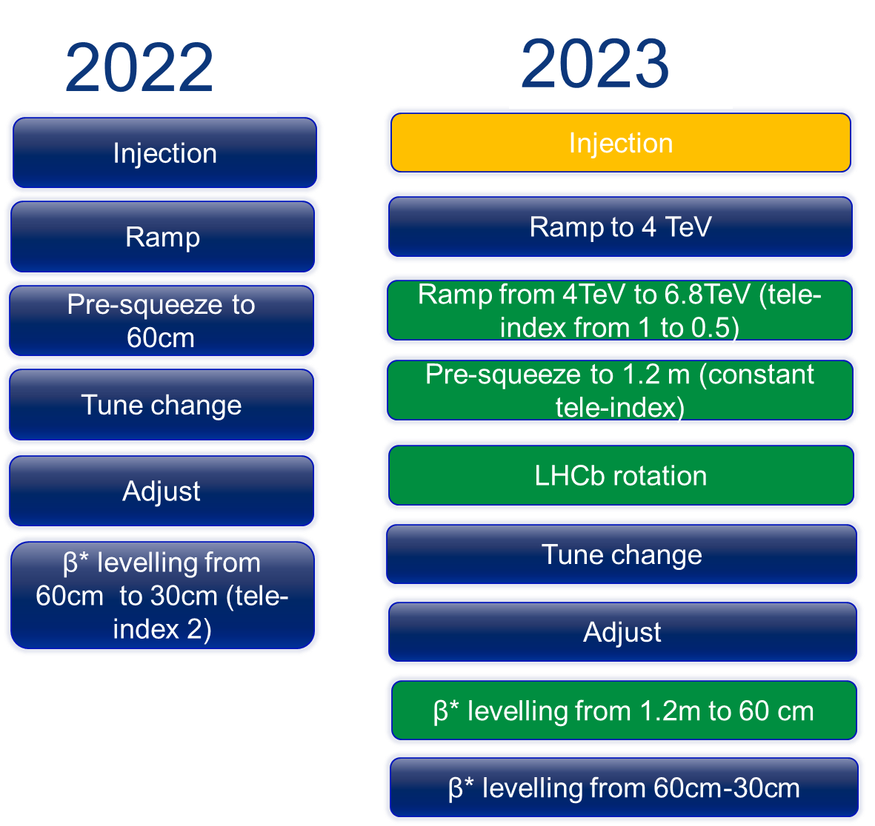
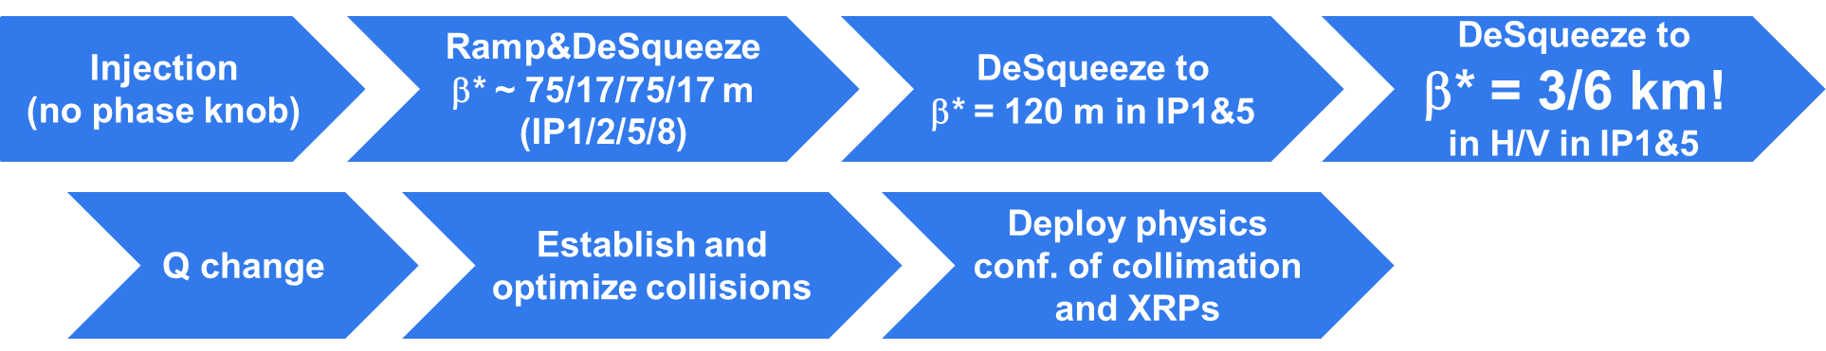
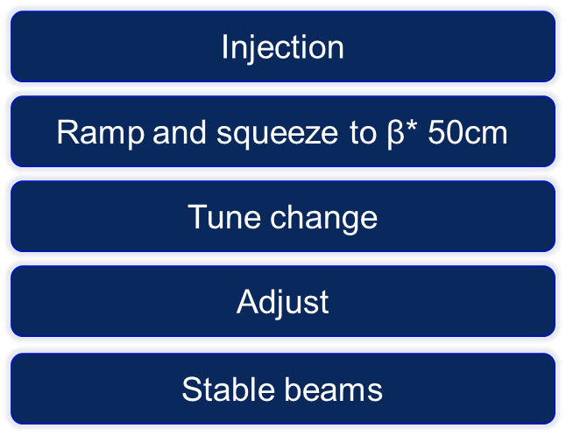
What did we commission in 2023?
Close attention needed with 4 out of the 5 cycles as they were new, or had modifications, compared to 2022
Proton physics cycle
  Some changes due to change of squeeze and addition of LHCb rotation
  However all changes previously validated in 2022 MDs
Pb-Pb ION cycle
  New cycle with crystal collimation in production (cycle checked, commissioned in September)
High Beta cycle (120m and 3km)
  New cycle (120m commissioned in June, 3km commissioned in September)
P-Pref cycle
  New cycle (commissioned in September)
VdM cycle
  No changes compared to 2022 (cycle checked, commissioned in June)
pp cycle
High Beta cycle
ION cycle

Slide 7
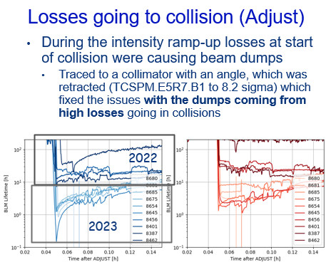
2023 Commissioning: as it happened
Schedule v1.1
25 days
40 days
Threading 28/03
Update
TCDIH.29206 02/05
SB 1200b 06/05
Injection SB 06/04
Update TCPSM, TCT and TCL settings 03/05
RF rupture disk 01/04
Begin loss maps 14/04
SCRUBBING 26/04
RAMP nominal 04/04
Injection nominal 29/03
12b Train setup 07/04
STABLE BEAMS 21/04

Slide 8
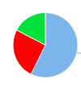

2023 Commissioning: in numbers
Availability for the commissioning and intensity ramp up was 74.7% (AFT)
  Including 2.5d stop to recover from an RF cryo module venting (ruptured disk)
First 3b stable beams at 6.8TeV after 25 days
  As scheduled
SB
FLT
OP
First stable beams with 1200b after 40 days (8 days early)
  Compared to 48days of scheduled commissioning time
  Including 3d to update and re-validate TCDIH, TCPSM, TCT and TCL positions
  This took 98 days in 2022
Observation 1:
  Simply avoiding the two “long” interruptions (ie >48hrs) would have allowed commissioning in ~34 days
  Commissioning in 2023 was an overall success
34

Slide 9
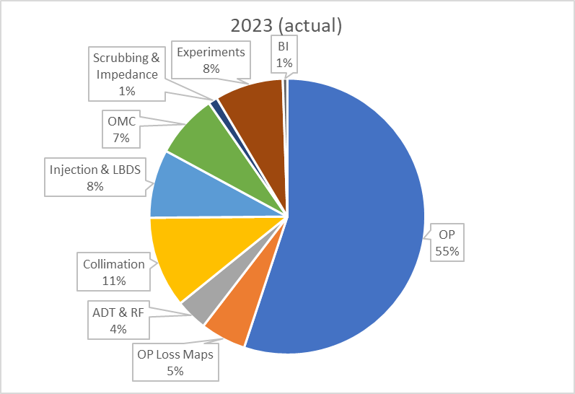
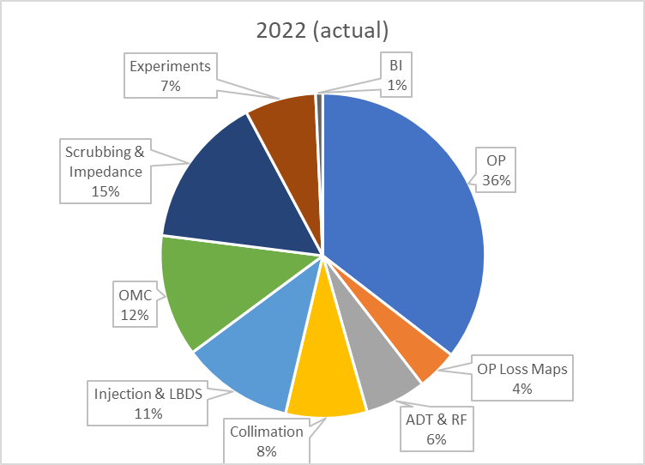
2023 Commissioning: activities
Total commissioning time in 2023 was 748 hrs
  Compared to 1556 hrs in 2022
  Calculated as actual commissioning time (excluding faults), to nearest 4hrs
In 2023 the commissioning phase needed less time for scrubbing
  Continuity of machine conditioning from 2022, and quick intensity ramp to 1200b
Activities to reach 1200b Stable Beams
748 hrs
1556 hrs

Slide 10
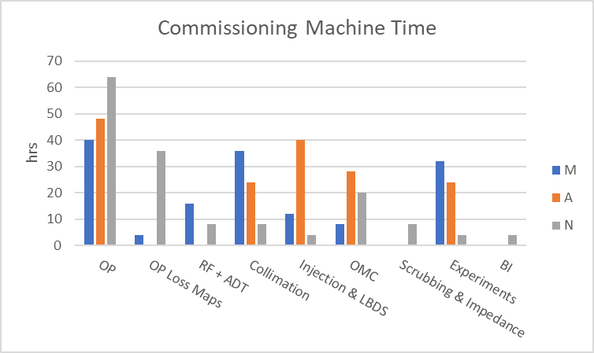
2023 Commissioning: teams and shifts
Total commissioning time in 2023 was 748 hrs
  Compared to 1556 hrs in 2022
  Calculated as actual commissioning time (excluding faults), to nearest 4hrs
In 2023 the commissioning phase needed less time for scrubbing
  Continuity of machine conditioning from 2022, and quick intensity ramp to 1200b
OMC with the highest number of night shifts
Loss maps by OP at night
Observation 2:
Team availability more difficult for nights
Similar problem with holidays (Easter is often in the middle of the commissioning phase)

Slide 11
2023 Commissioning: teams and shifts
Total commissioning time in 2023 was 748 hrs
  Compared to 1556 hrs in 2022
  Calculated as actual commissioning time (excluding faults), to nearest 4hrs
In 2023 the commissioning phase needed less time for scrubbing
  Continuity of machine conditioning from 2022, and quick intensity ramp to 1200b
Observation 3:
The experiments are now settling into production mode after 2yrs of run and will need less time at injection in stable beams
  <1 daytime shift early in the commissioning for splashes
  1 – 2 daytime shifts in Stable Beams at injection
  The rest is opportunistic if the commissioning schedule allows

Slide 12
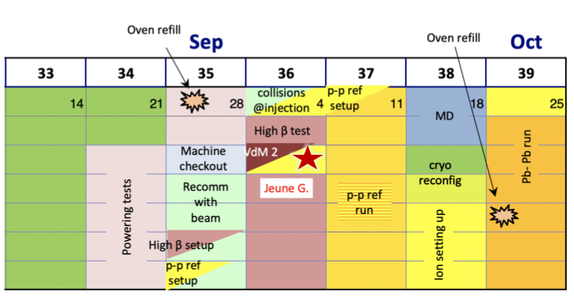
How did we do in 2023? Restart after IT.L8
Complex but very successful restart; LHC demonstrated excellent stability and reproducibility;
  pp, pp-ref, High Beta and VdM all commissioned consecutively
  VdM reached stable beams after only 9 days
As planned
As executed

Slide 13
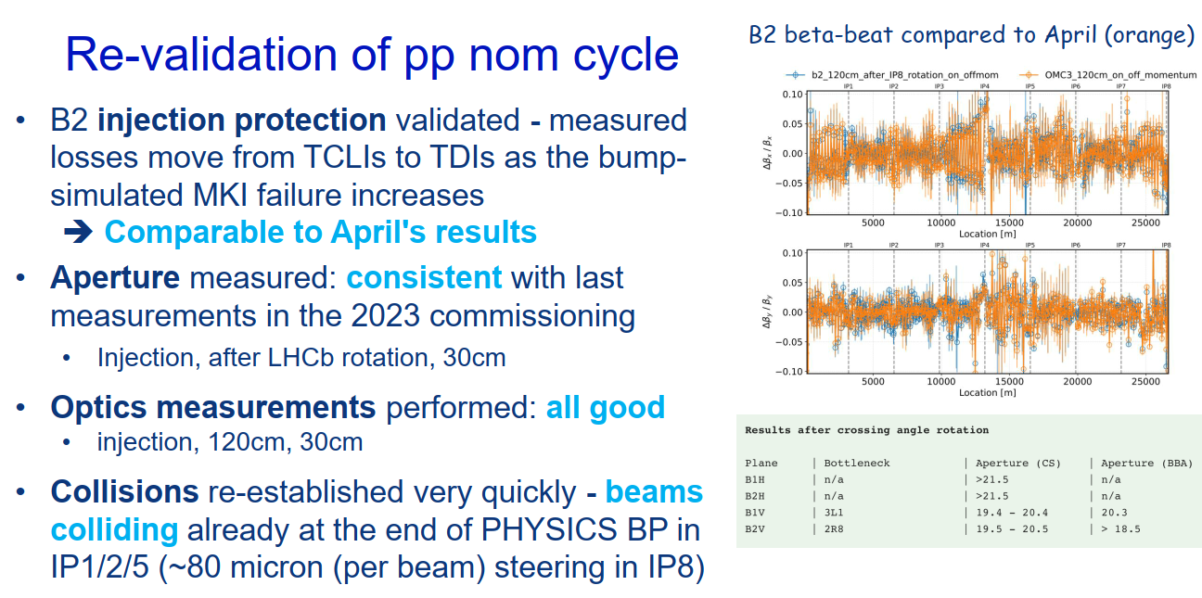
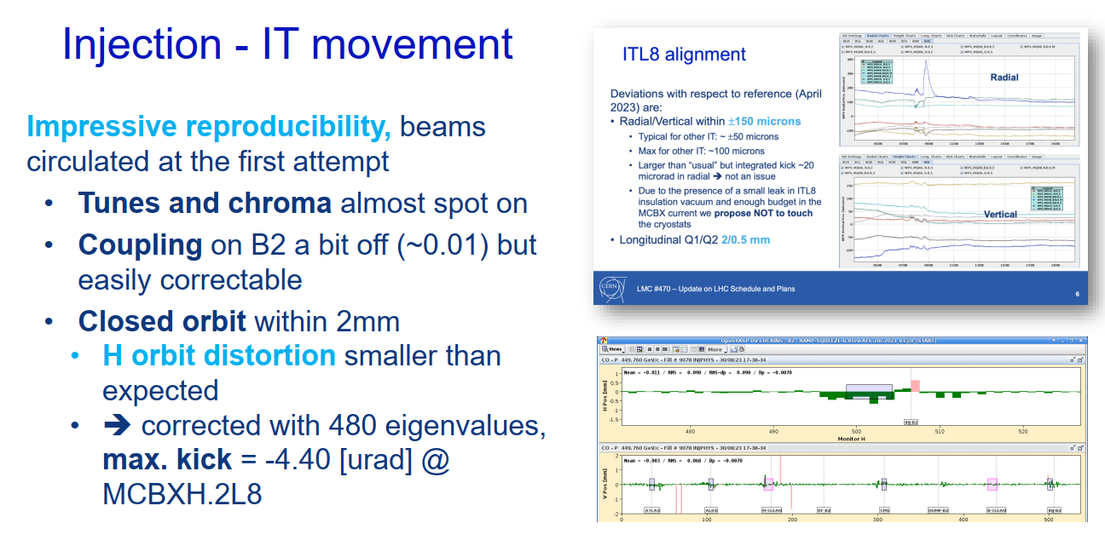
How did we do in 2023? Restart after IT.L8
Complex but very successful restart; LHC demonstrated excellent stability and reproducibility;
  pp, pp-ref, High Beta and VdM all commissioned consecutively
  VdM reached stable beams after only 9 days
Observation 4:
  The recipe to recover from the IT.L8 failure is a useful baseline for future recovery efforts.
  We are capable of commissioning multiple cycles sequentially, however can this be avoided as very demanding?
LMC 06/09/2023 M. Solfaroli

Slide 14
Commissioning at the start of the run and after long failures
As demonstrated by the commissioning time and performance
  Competent teams working effectively together
  The machine is very reproducible, allowing to quickly find previous performance
Important to ensure commissioning progresses safely
  The commissioning recipe is well understood and a thorough approach remains necessary following Technical Stops (Long or Short) to ensure no unexpected changes are left undetected;
Only marginal gains left for commissioning time
Through several discussions a common theme emerges
  Commissioning relies on experts at key moments (generally best effort)
  When an expertise is not available (at night, during holidays) then an alternative activity needs to be found
  An alternative may not be the optimal activity to progress commissioning, and may lead to added complexity in the CCC (eg switching cycles)

Slide 15
How can we improve?
Marginal gains, however can we instill a utopic virtuous circle?
System commissioning tools and procedures for the operations team
System experts (on call?) when really needed
Simpler planning, optimum advancement
Less switching between cycles, less complexity

Slide 16
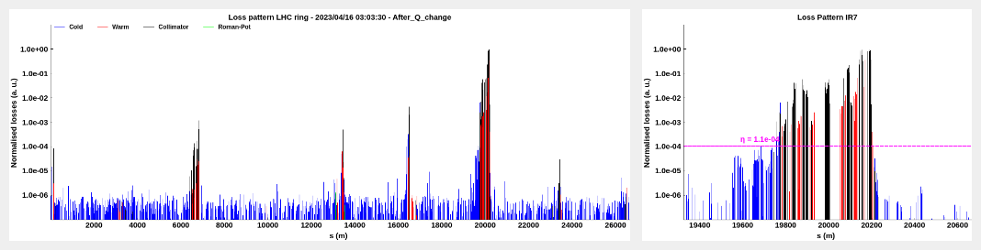
How can we improve: tools for OP
Observation 5: …delegating the test execution to the OP team, releasing some of the planning constraints, keeping the validation in the hands of the expert and equipment owners…
Example of tools assisting commissioning
  In 2023 the loss maps were almost entirely driven by OP thanks to continued improvement in automated tools
Tools under development
  Transfer Lines
    Add hoc tools developed to improve efficiency (injection sequencer to continuously request injections, re-arm the LBDS automatically after a dump, …)
    On-going effort from ABT to automate the setup of transfer line collimators
  Optics
    A tool in early stages of preparation to increase automation of the optics measurements so that OP can both acquire optics measurements data and assess the data quality
    Analysis made by OMC

Slide 17
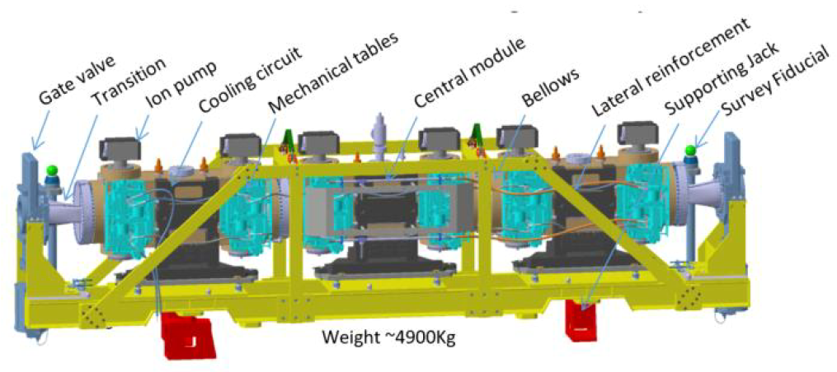
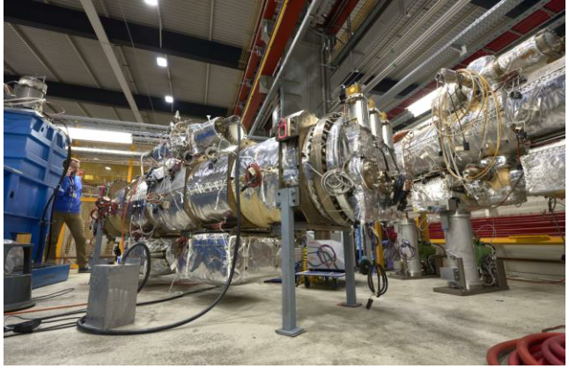
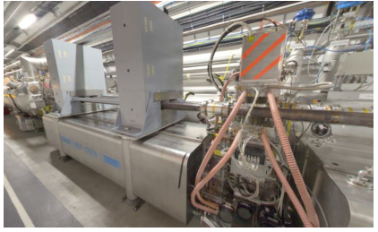
How can we improve: reminder of EYETS activities
Interventions on the beam aperture
LHC-TDIS-ARR-0002 - TDIS @P2 and @P8
LHC-MKI-EC-0009 - MKI Cool @P8
LHC-XAFP-EC-0007 - ALFA stations removal
Wirescanner removal and re-installation
Non-conformity found by X-ray (1st Nov) in one of the Warm Modules D5R4.B (BSRTM)
LHC-VC-EC-0003 - LESS in S67
LHC-MKB-EC-0005 - Replacement of plasma stoppers on MKBB2 tanks
Interventions to be verified with beam
LHC-BBLR-EC-0002 - BBLR wire repair on B1 - TCTV.4L1.B1 and TCTV.4L5.B1
LHC-X1ZDC-EC-0002 - Temporary shift of the BRAN on side 1-2 of LSS1
LHC-R-EC-0002 - Upgrade of measurement chain on LHC dipole power converters
Changes that are subject to decision on RP optics
LHC-LJ-EC-0051 - Triplet polarity inversion
Will require some conditioning
TDIS
MKIcool
ALFA

Slide 18
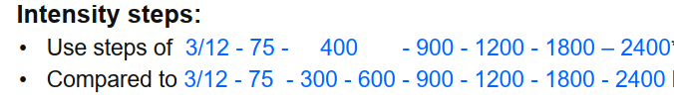
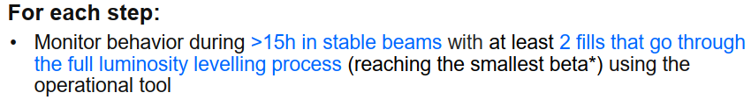
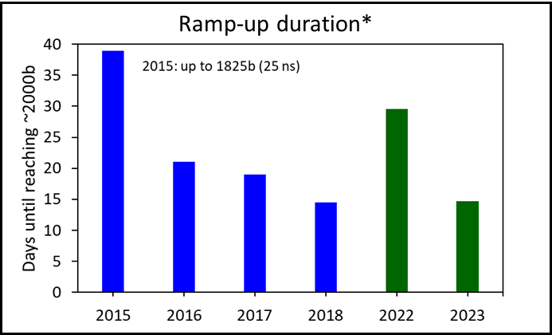
How can we improve: intensity ramp up
In 2023 the intensity ramp up was 15days
Included 3days to recommission the TCSPM and update the xing angle (with TCT and TCL updates)
Machine availability of 75%
Theoretical limit with the 2023 ramp up scheme is ~6d
With many interventions during the EYETS the 2023 approach is maintained in 2024
Above 75b the critical system experts are requested to verify the correct performance before proceeding to the next intensity step
This creates opportunities for other commissioning activities such as preparing other physics cycles
2023
2022
Observation 6: maintain enough “useful stocking filler” activities for the intensity ramp up. Essential that there is adequate expert support from system experts during the commissioning period. Would a standby service help?

Slide 19
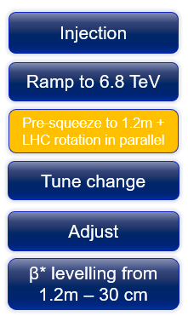
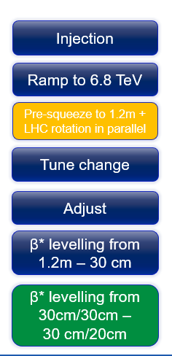
Outlook for 2024 commissioning
Three possible scenarios are being considered for the 2024 restart
  Minimal changes (maybe only move the LHCb rotation)
  Modest changes (consider a Beta* of 27.5cm)
  Significant changes (implement the “RP optics” for triplet lifetime)
See talk from Stephane later in this session
Minimal changes:
  Given the LHC stability and reproducibility, and extrapolating from 2023, the pp cycle could be re-commissioned in 30-35days (subject to machine availability).
Modest changes:
  Changing the Beta* will add some overhead to the pp commissioning time (however other cycles remain unchanged). A first estimate is 33-38 days for commissioning.
In 2024 Easter is 19 days after the start of commissioning.
  Minimal changes: the first Stable Beams possibly at the end of Easter weekend
  Modest changes: commissioning ongoing throughout Easter
Proton physics cycle
  3 options
O-O and p-O cycle
  Copy of ION cycle
Pb-Pb ION cycle
  Likely only modest changes, perhaps moving squeeze to Flat Top. Mainly re-check 2023 settings.
P-Pref cycle
  Re-check 2023 settings
VdM cycle
  Re-check 2023 settings

Slide 20
Conclusions
Commissioning in 2023 was a success, delivering 1200b pp physics in 40days
Thanks to the LHC demonstrating it is a stable and reproducible machine
And thanks to the effort, dedication and expertise from many many teams
The experience of commissioning & fault recovery shows we are very efficient when changes are modest and well prepared
Delivering 1200b stable beams 30days after the first turn is a realistic goal during run3
Such a result would be the sum of several marginal gains from tools, expert availability, optics stability, machine availability, experience from previous year, etc
Suitable tools, procedures and expert support are more important as the commissioning time gets shorter
A complementary benefit is that the operations team can handle more of the commissioning steps
This also leads to commissioning schedules being less complex and more adapted to efficient progress
Consider investing more time to finish the preparation of other cycles during the pp commissioning at the start of the year (for example interleaved with the intensity ramp-up)

