Slide 1

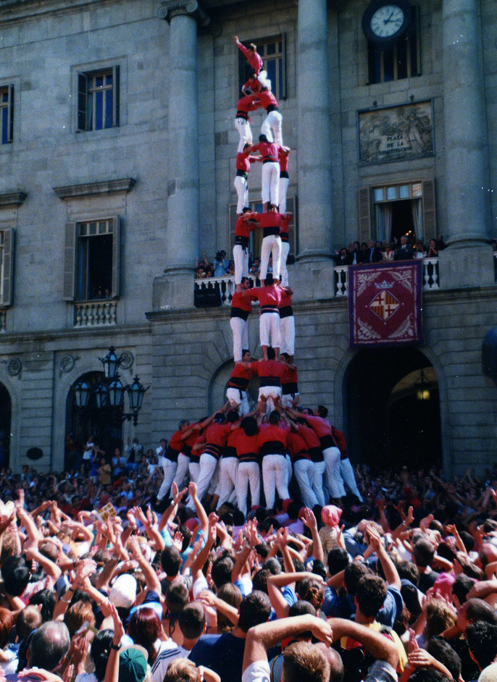
Emittance Evolution and
Stability in Run 3
H. Bartosik, X. Buffat, I. Efthymiopoulos, S. Fartoukh, L. Giacomel, M. Hostettler, S. Kostoglou, N. Mounet, G. Sterbini, G.Trad
06.12.2023

Slide 2
Outline
Data sets used for the analysis
  Data from 2022 : BCMS-type beams and from 2023 : hybrid STANDARD-type beams
Our basis of understanding: “The Model”, i.e. emittance evolution and luminosity model - reminder
Emittance
  Studies at injection energy
  Evolution during acceleration
  Evolution during collisions
  Bunch-by-bunch analysis on emittance, intensity, luminosity
  Bunch-to-bunch fluctuations
Beam lifetime and Luminosity
Beam stability
Summary & Outlook

Slide 3
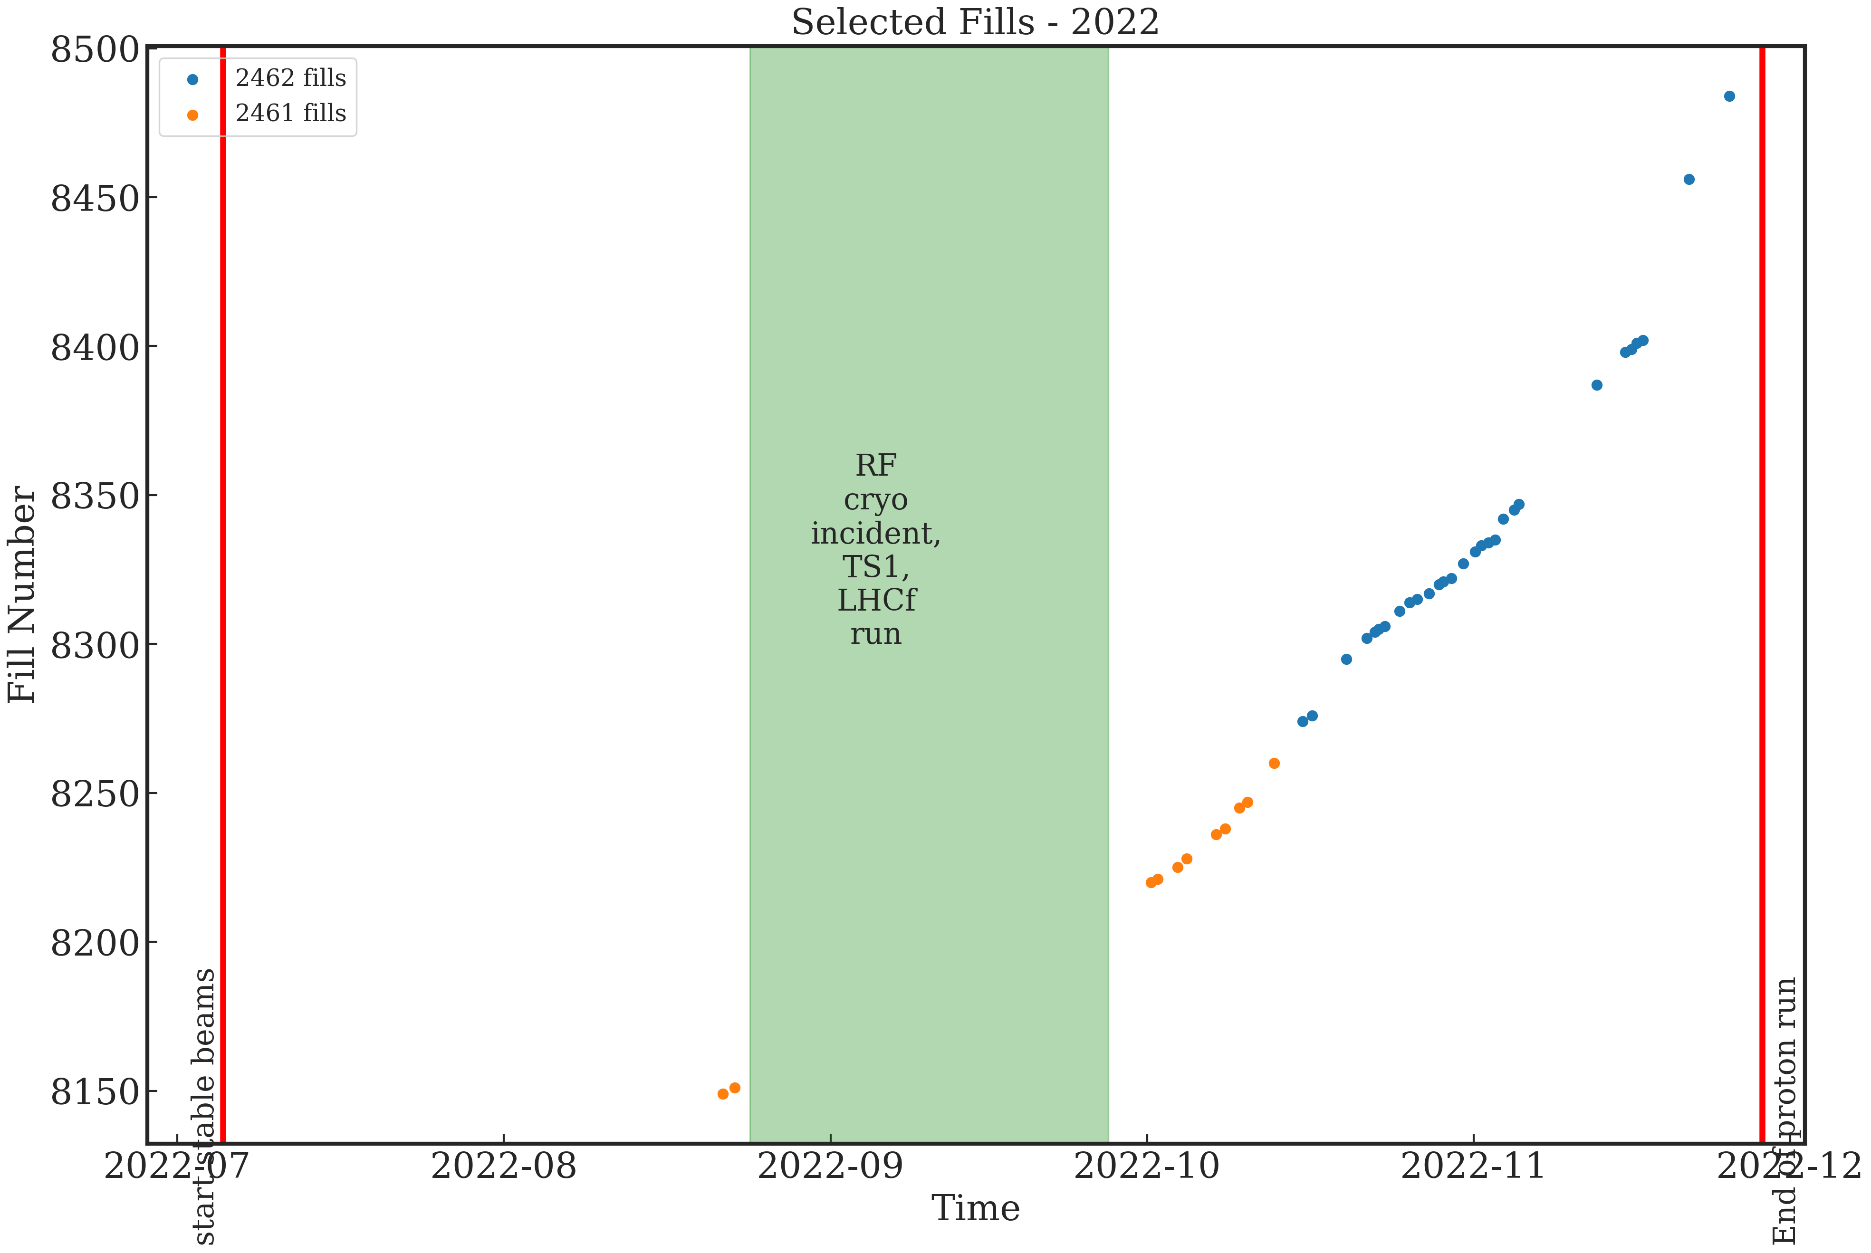
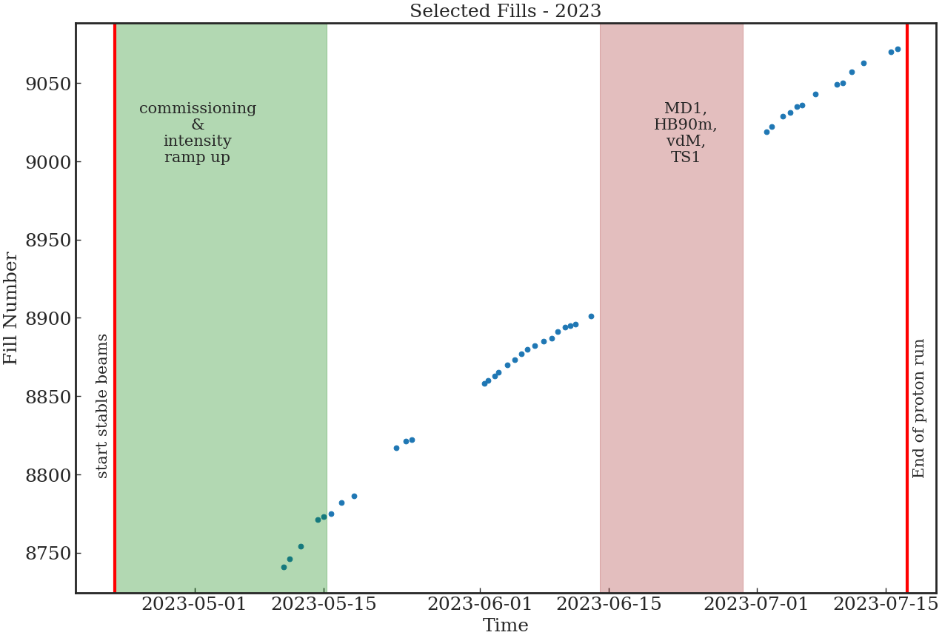
Data sets
Data and Fills selection – p-p data
2022
Analysis based on NXCALS data
Selection of fills with:
  > 5 h in collisions (STABLE), > 600 bunches / beam
40 fills in 2023, 68 fills in 2022
5× 36b trains
BCMS-type beams
Main filling schemes - 2022 | Fills
25ns_2462b_2450_1737_1735_180bpi_17inj_2INDIV | 29
25ns_2461b_2448_1737_1733_180bpi_16inj_1INDIV | 11
25ns_1935b_1922_1602_1672_192bpi_14inj_3INDIVs | 5
25ns_2413b_2400_1836_1845_240bpi_12inj_1INDIV | 4
2023
7×8b4e + 5× 36b trains
STANDARD-type beams
Main filling schemes - 2023 | Fills
25ns_2358b_2345_1692_1628_236bpi_14inj_hybrid_2INDIV | 17
25ns_2464b_2452_1842_1821_236bpi_12inj_hybrid | 8
25ns_2374b_2361_1730_1773_236bpi_13inj_hybrid_2INDIV | 7

Slide 4
The Emittance and Luminosity Model
…in a nutshell
Simulation tool aimed to understand the LHC beam emittance evolution and support optimization studies and operational scenarios towards the maximization of the delivered luminosity to the experiments
Initial development in 2017, with constant evolution throughout Run 2
The ingredients:
  uses MAD-X and LHC optics, can combine input from data for combined studies, can simulate single bunch or full beam effects
  effects included: IBS, synchrotron radiation, elastic cross-section, coupling, noise, luminosity burn-off (intensity losses + emittance blow-up), factors for extra emittance emittance growth or burn-off
Detailed presentation and performance in previous Evian workshops
  Latest update for 2018: 50% of the observed emittance blow-up at injection unexplained (0.24 (H-plane, 0., extra emittance blow-up (0.02 μm/h H and 0.08 μm/h V) during collisions added to match the data
Updated for Run 3 to include the optics and levelling scenarios,
  correct follow up of the conditions: optics changing, crossing angle, β* steps – separation to be done

Slide 5
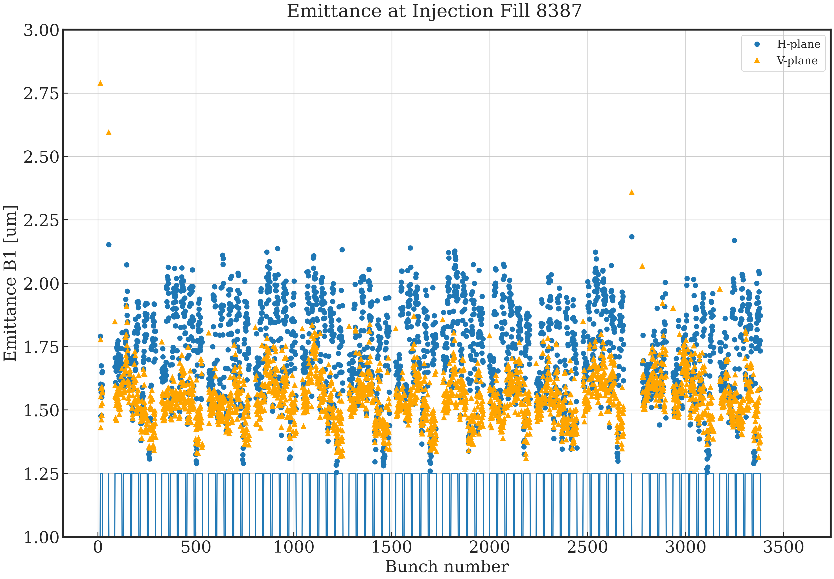
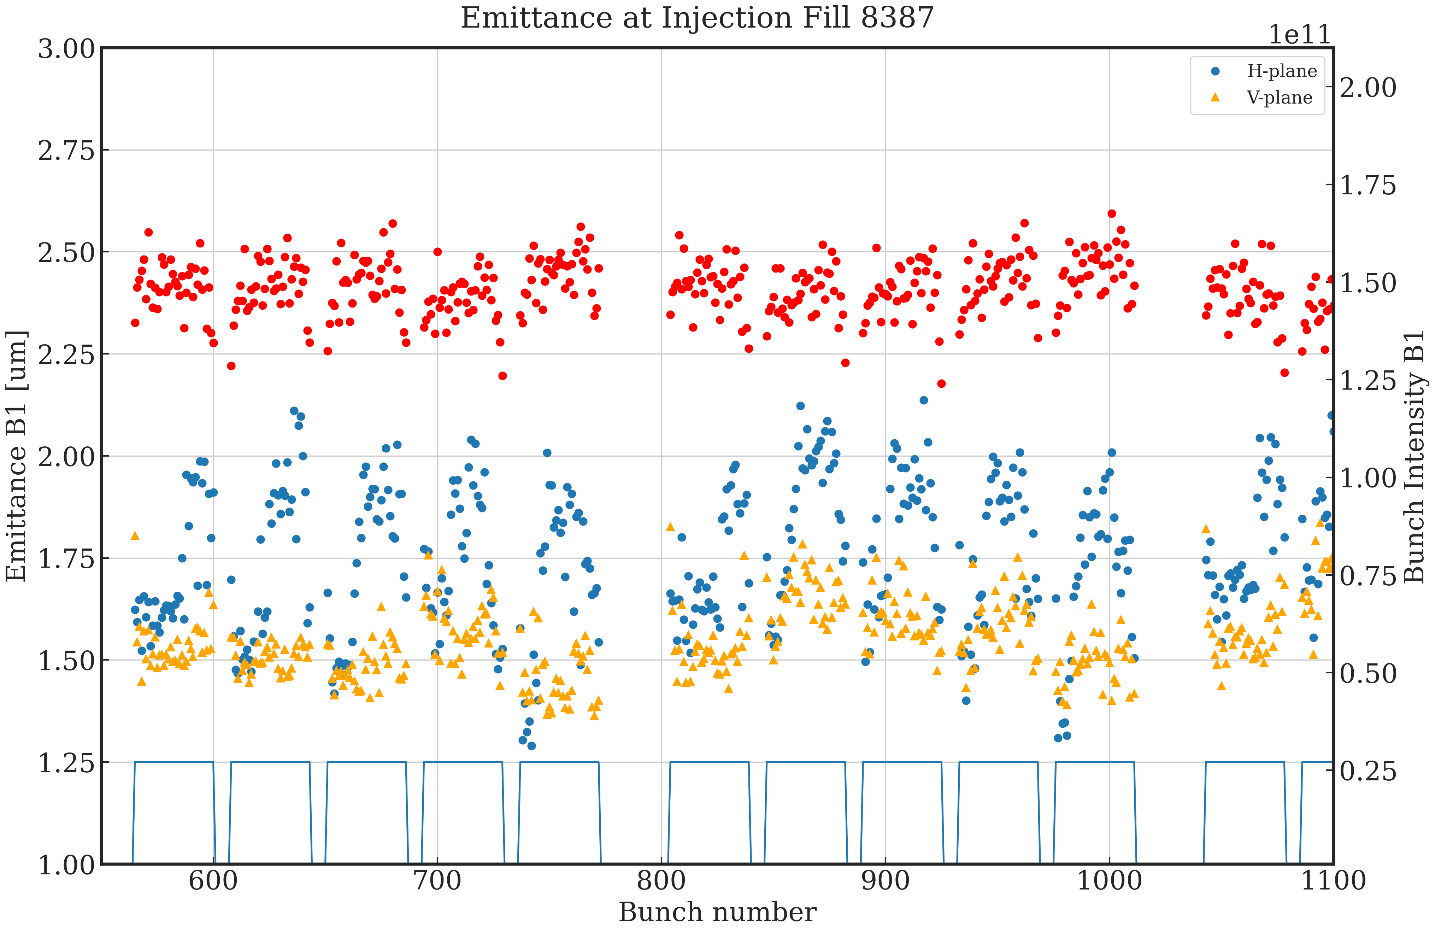
Emittance @ Injection
Example 2022 fill
Observations:
structure correlated with time in SPS – an Λ-shape, most likely due to e-cloud within the train
LHC B1
structure correlated with time in SPS
Notes:
I would add a legend that slide 11 is for B1 and slide 12 is for B2 otherwise it is not visible from the label

Slide 6
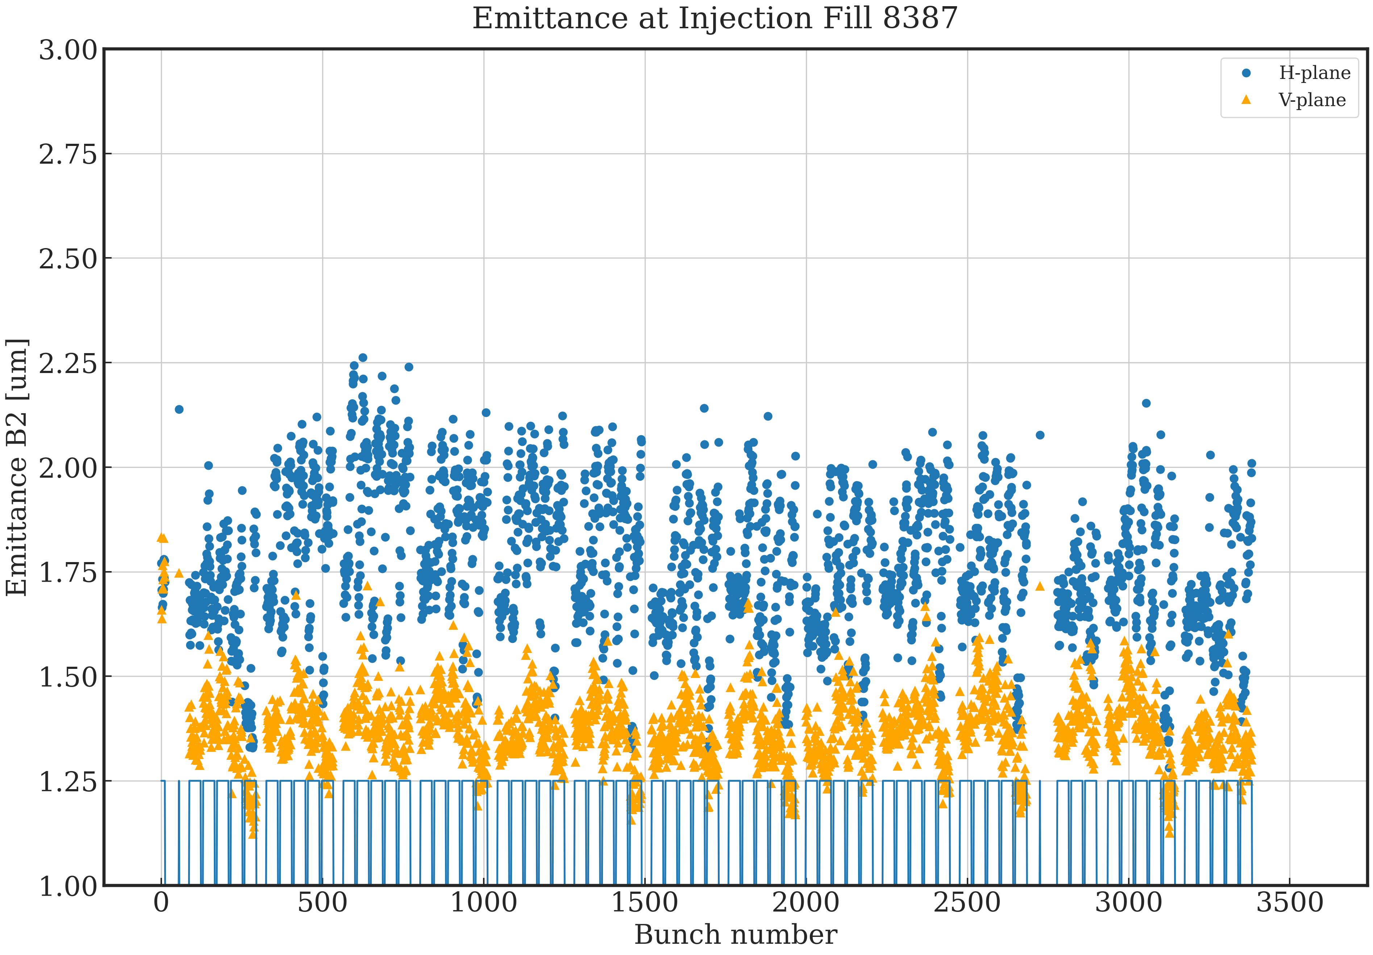
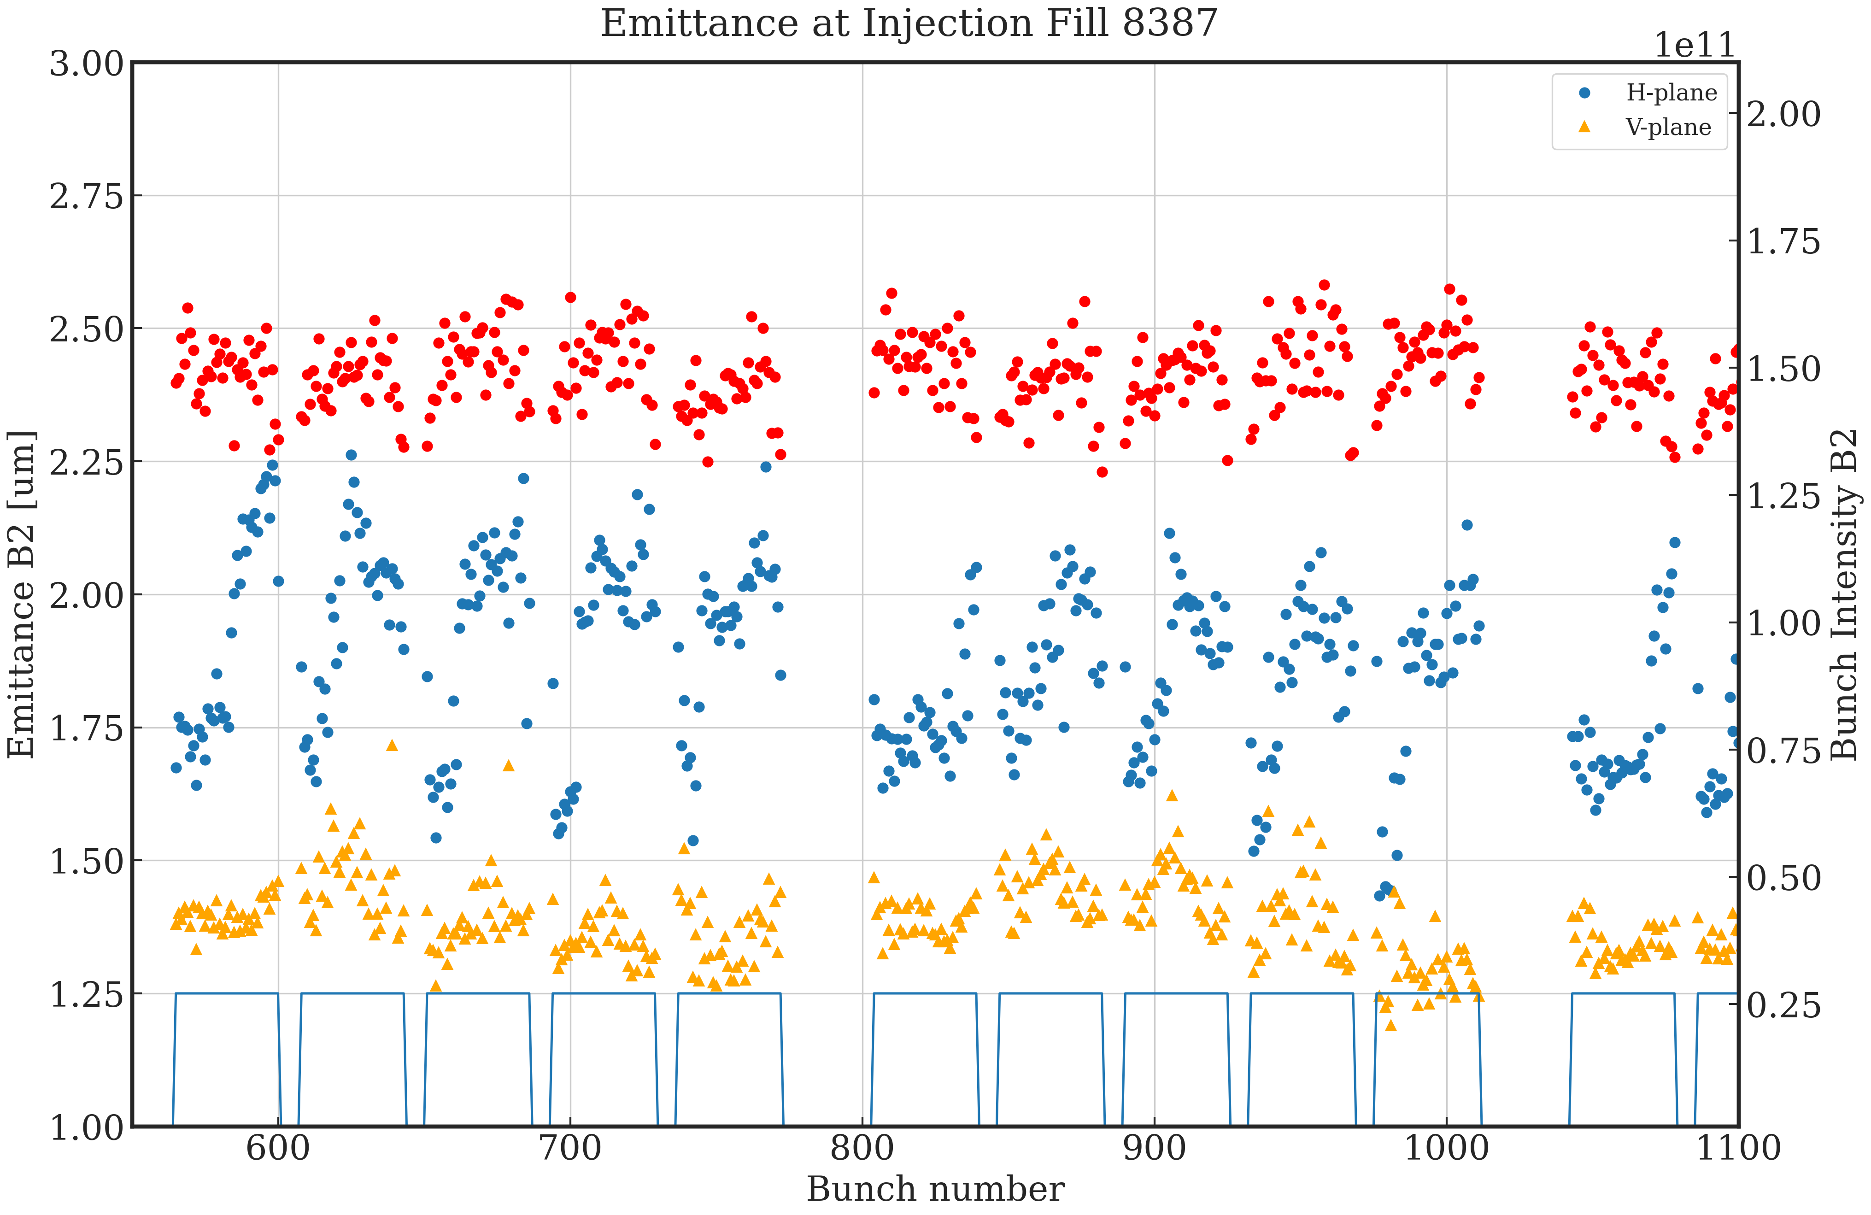
Emittance @ injection
Example 2022 fill
Observations: H-plane worse than vertical, small trend with number of injections
LHC B2
Notes:
I would add a legend that slide 11 is for B1 and slide 12 is for B2 otherwise it is not visible from the label

Slide 7
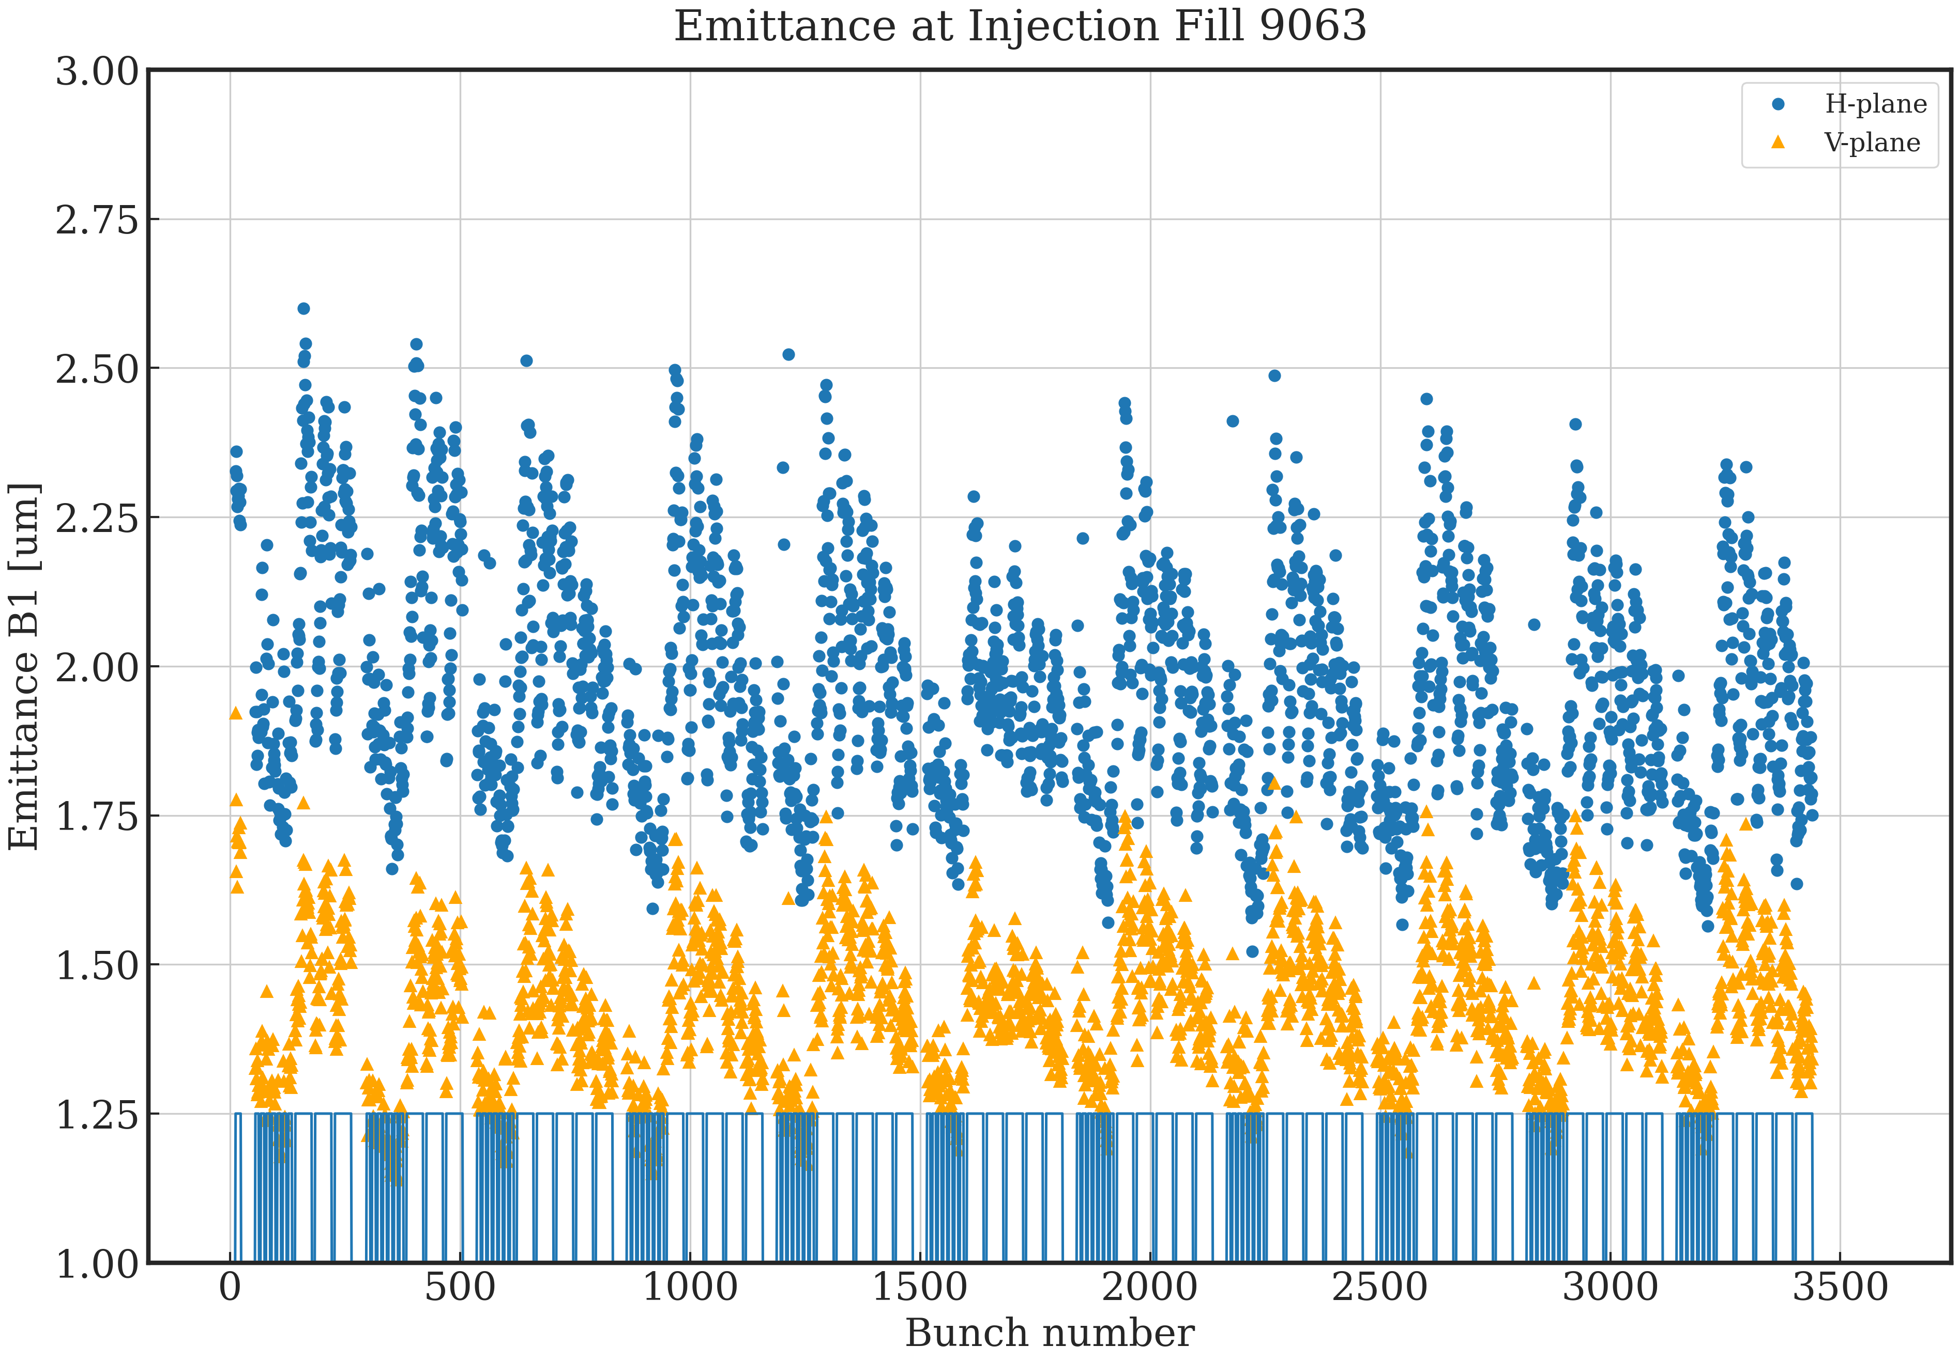
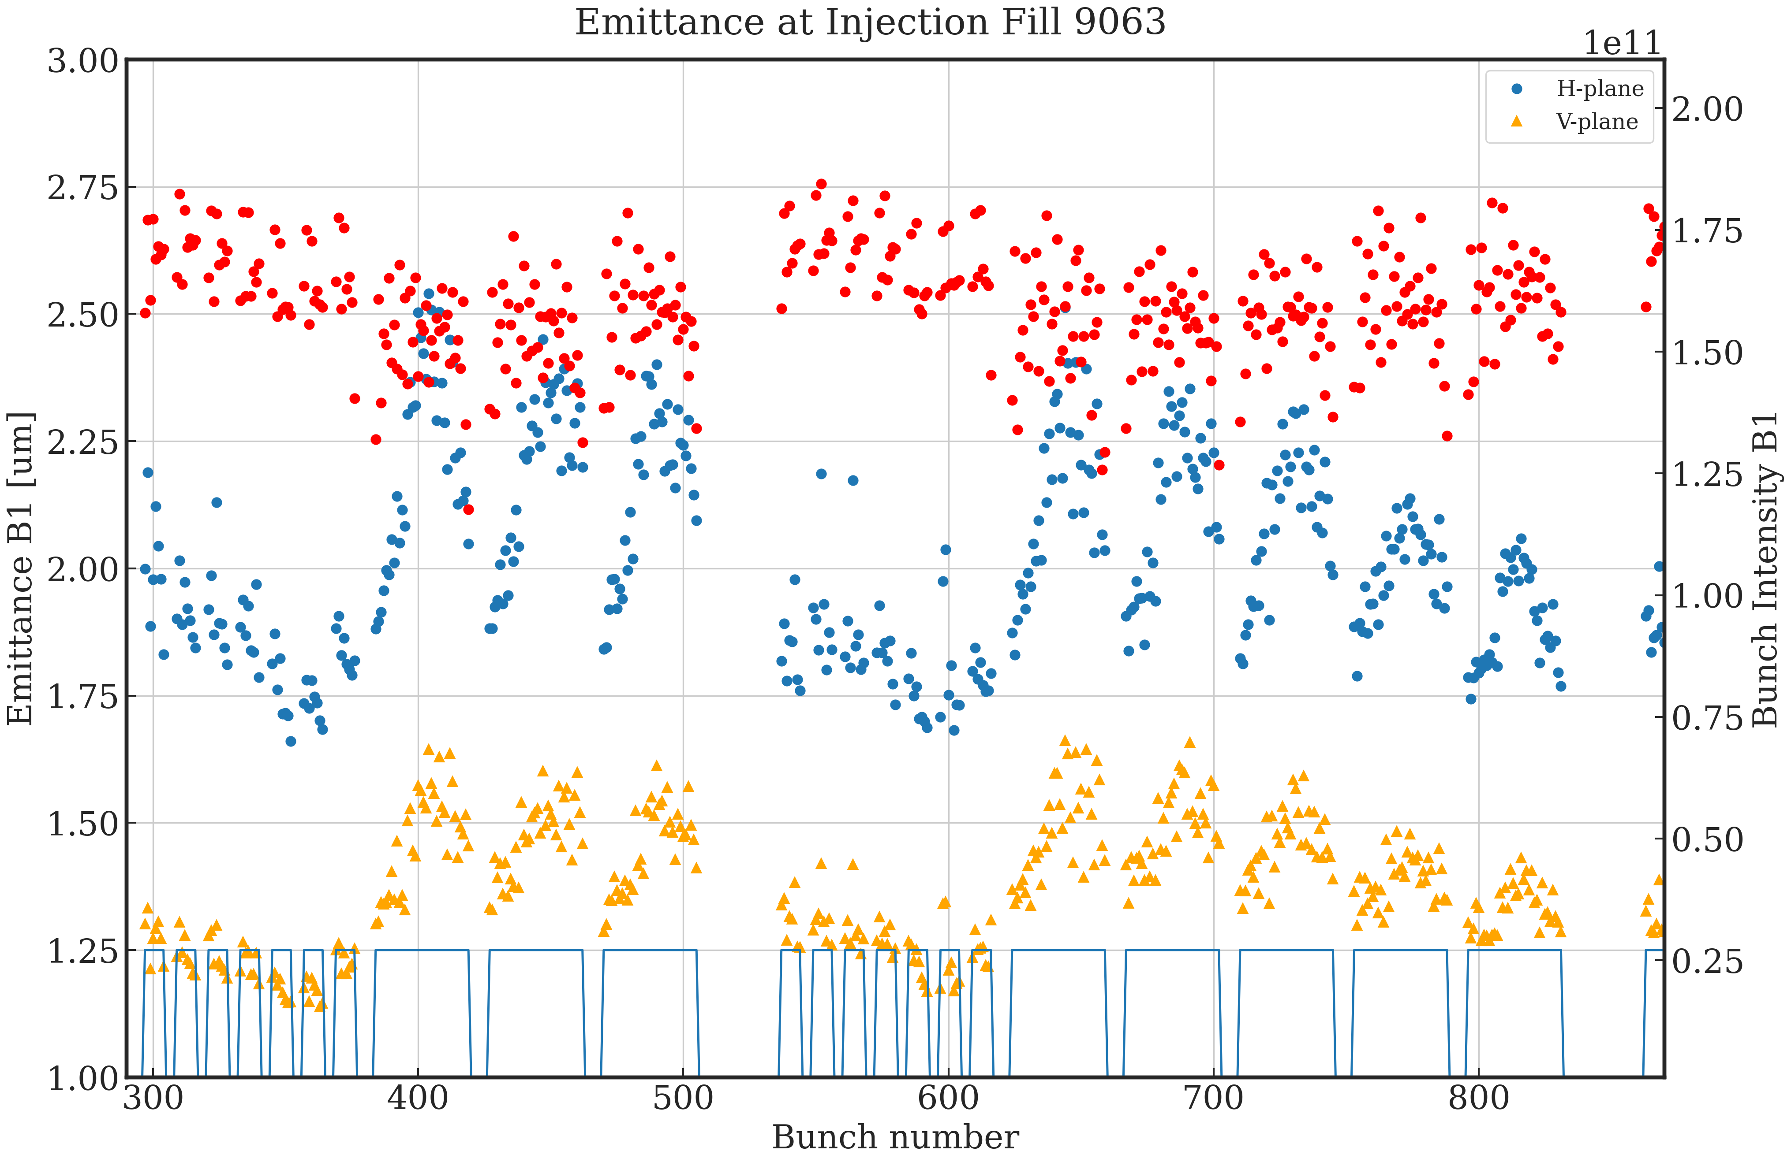
Emittance @ injection
Example 2023 fill
Observations: similar to 2022 but effects substantially enhanced, 8b4e lower emittances, small variation in intensity per train due to scraping?
LHC B1

Slide 8
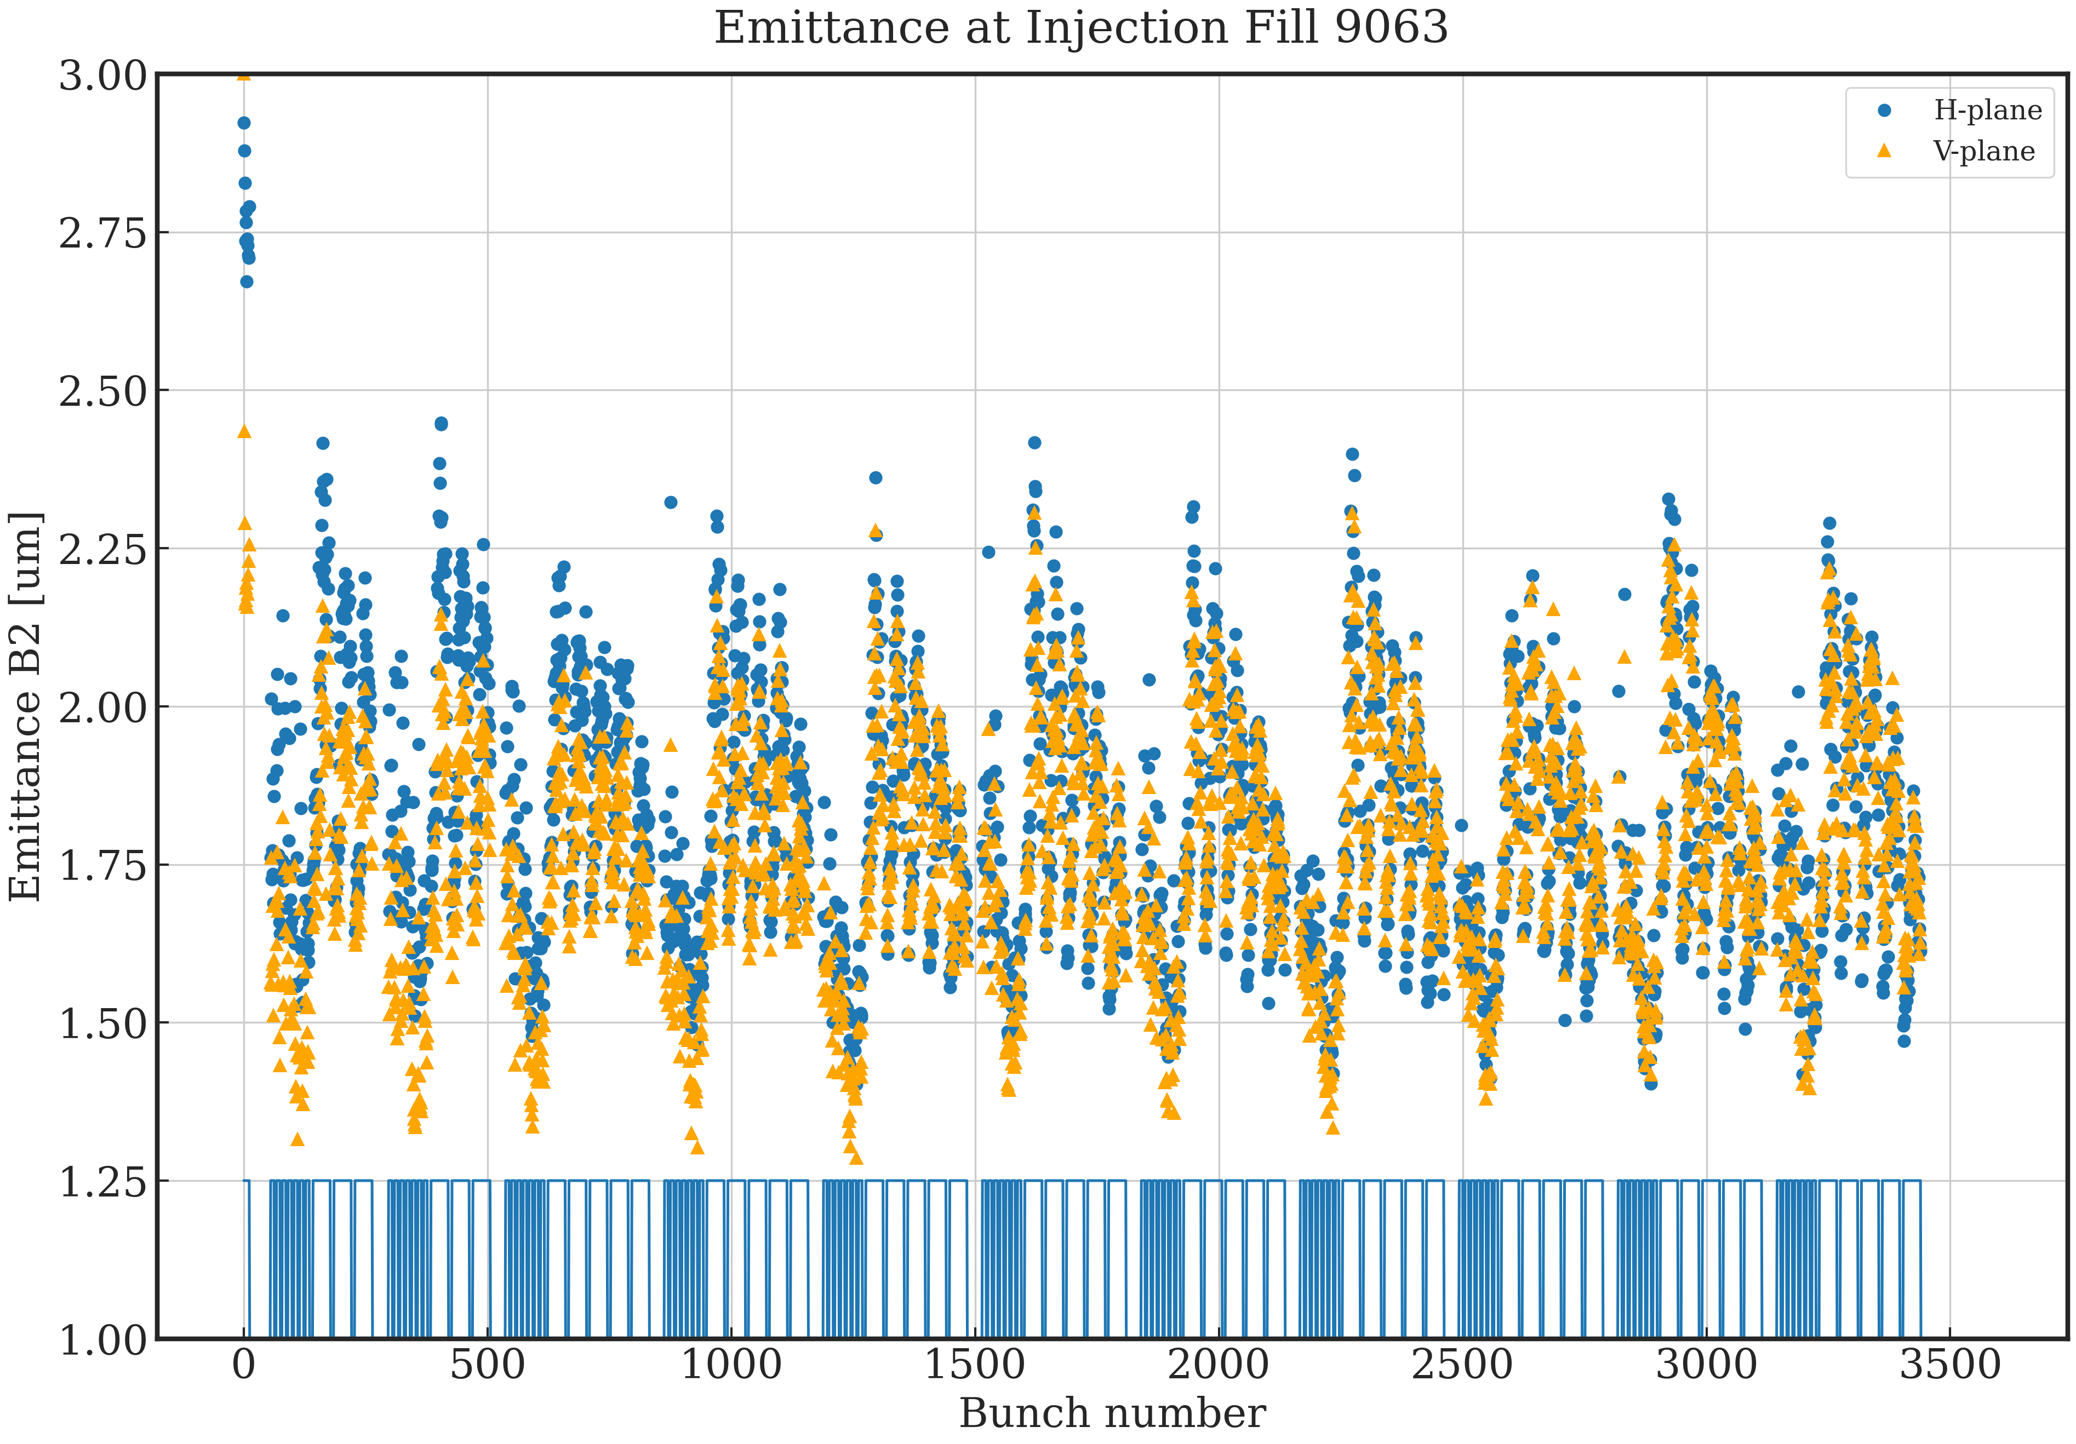
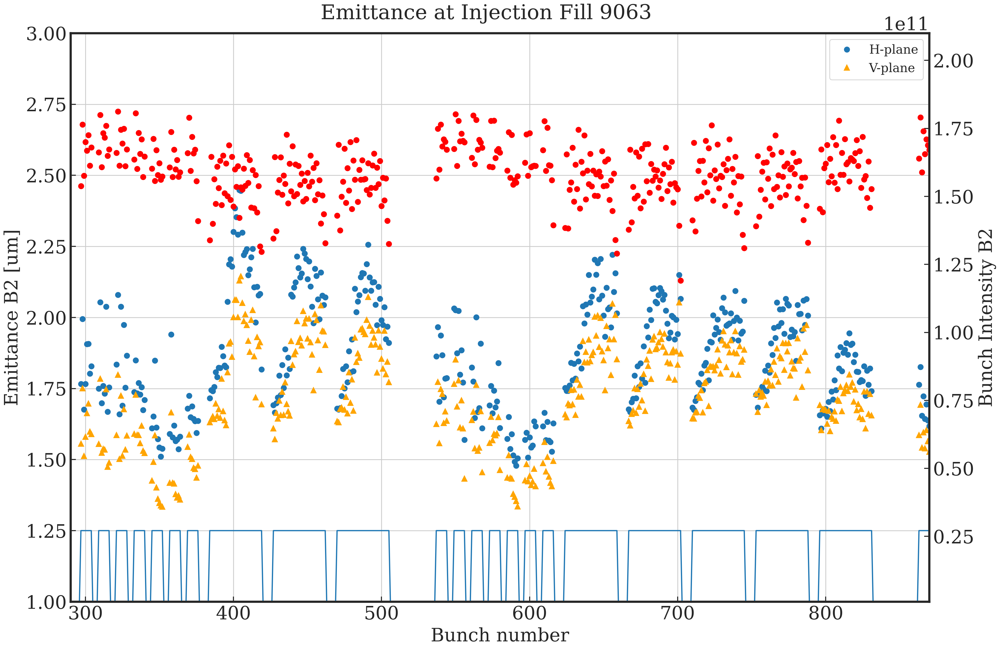
Emittance @ injection
Example 2023 fill
LHC B2

Slide 9
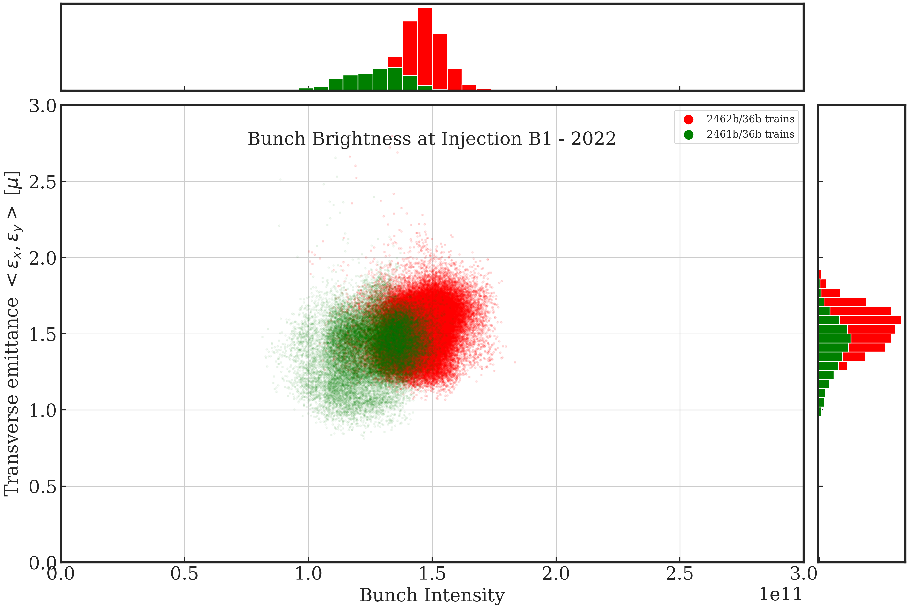
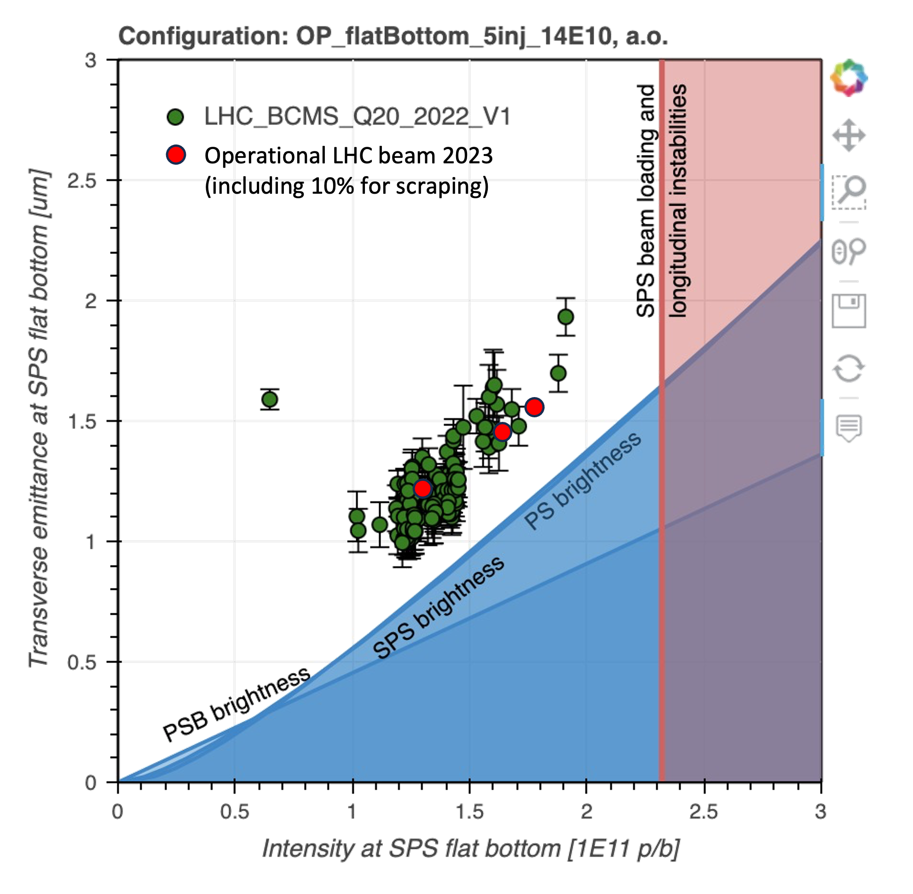
Emittance @ injection
Summary 2022 fills
LHC B1
B1-inj 2022 | Bunch Intensity | Emittance [μm]
36b trains | 1.45e11 | 1.77
B1-inj 2022 | Bunch Intensity | Emittance [μm]
2462b/36b trains | 1.45re11 | 1.53
2361b/36b trains | 1.26e11 | 1.41
+12-15% increase
in SPS acceleration and
transmission to LHC
Injection brightness B1 - 2022

Slide 10
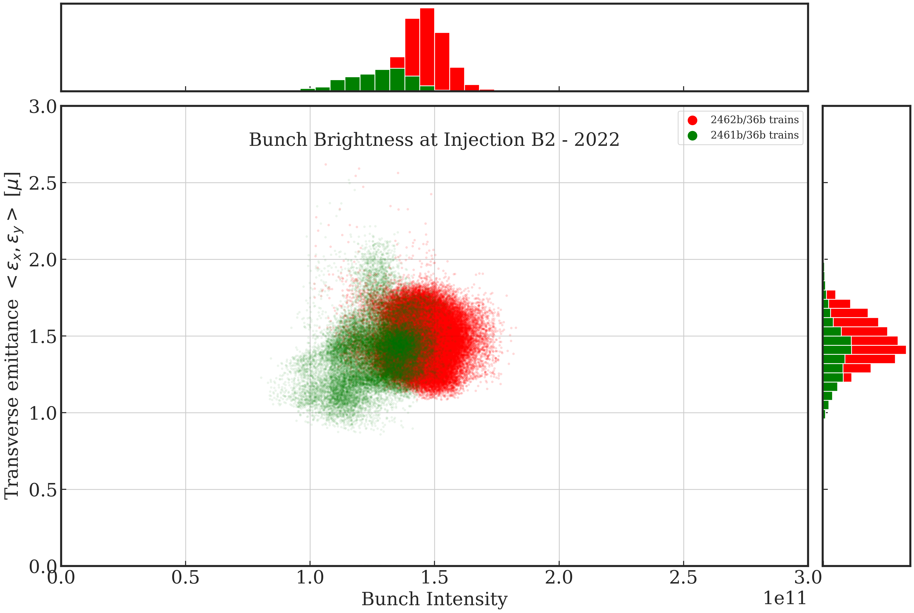
Emittance @ injection
Summary 2022 fills
LHC B2
B1-inj 2022 | Bunch Intensity | Emittance [μm]
2462b/36b trains | 1.46re11 | 1.47
2361b/36b trains | 1.23e11 | 1.39
+8-15% increase
in SPS acceleration and
transmission to LHC

Slide 11
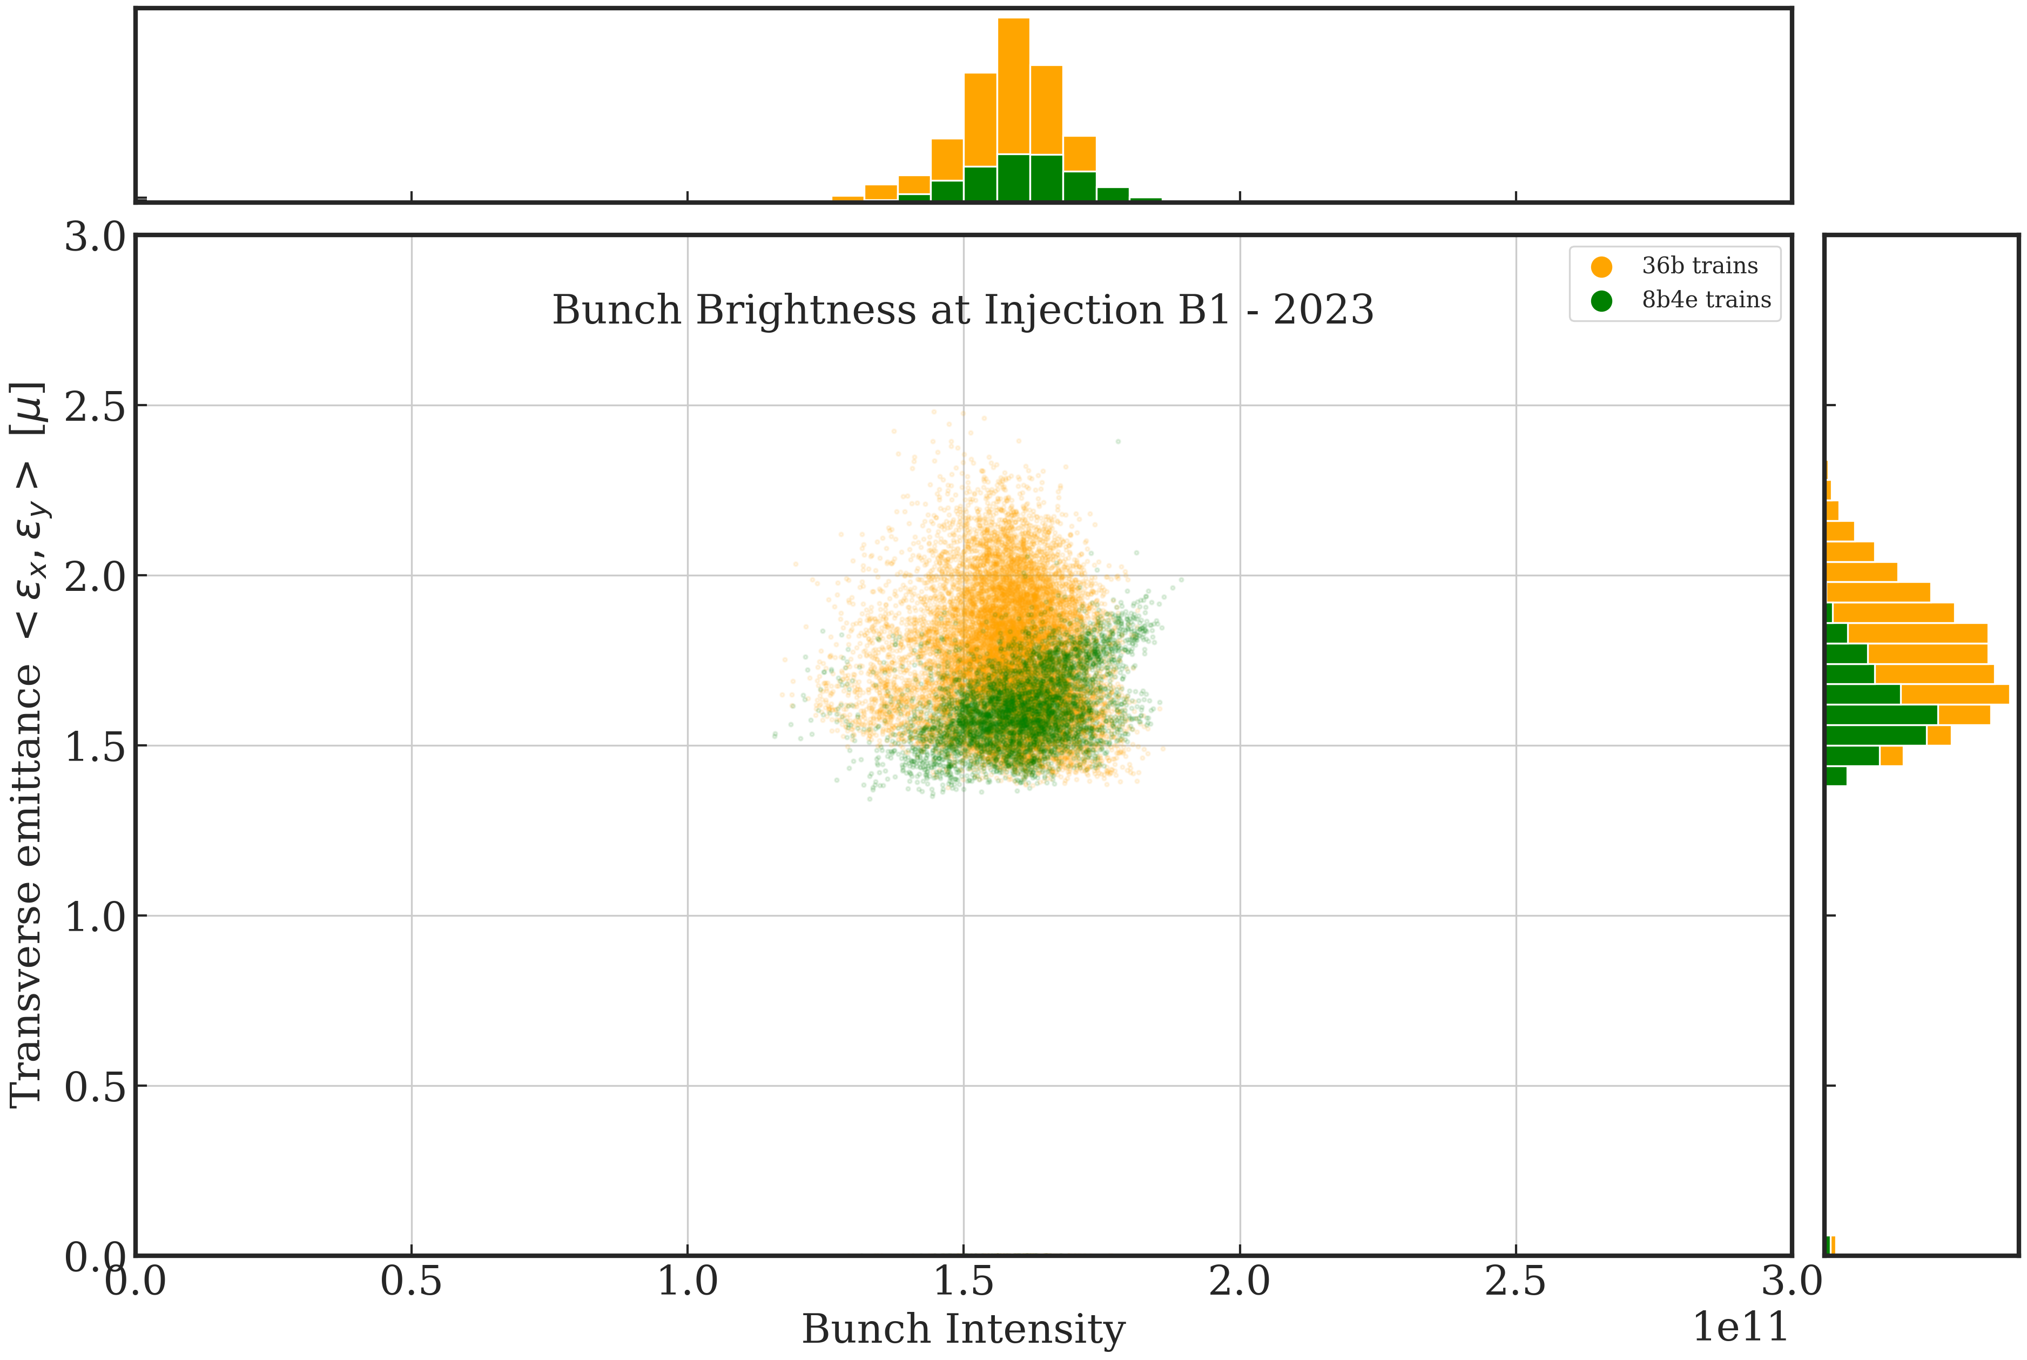
Emittance @ injection
Summary 2023 fills
LHC B1
Injection brightness B1 - 2023
B1-inj 2023 | Bunch Intensity | Emittance [μm]
8b4e trains | 1.60e11 | 1.59
36b trains | 1.57e11 | 1.74
+10-20% increase
in SPS acceleration and
transmission to LHC

Slide 12
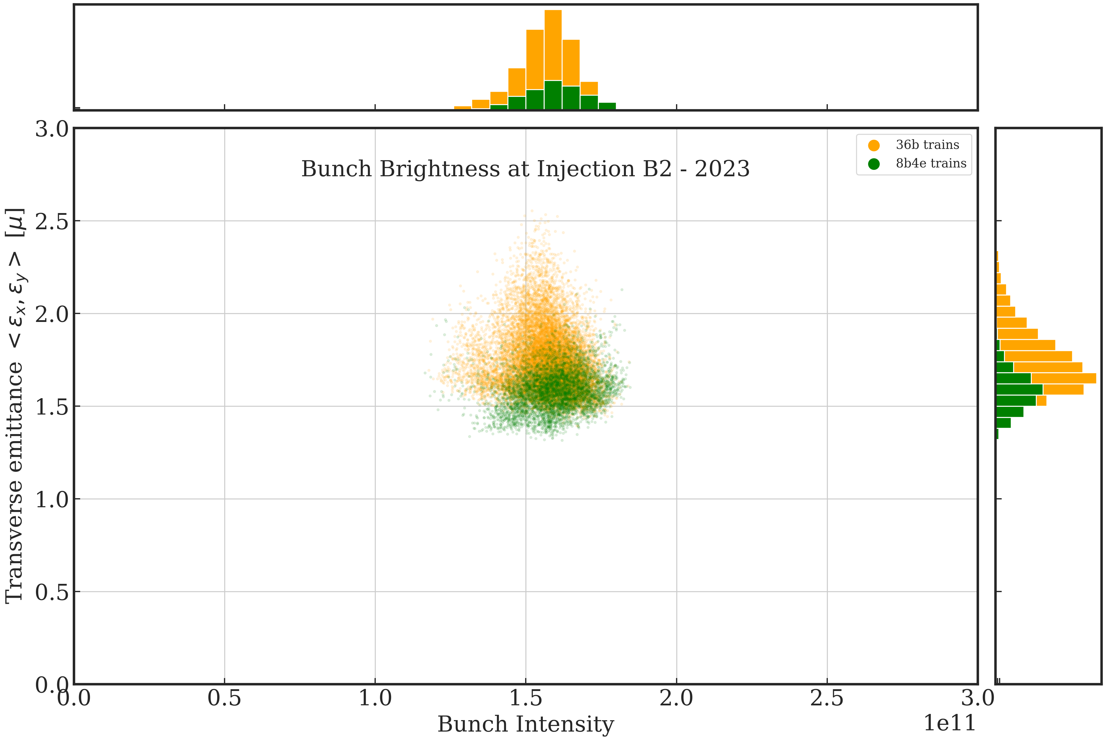
Emittance @ injection
Sumary 2023 fills
LHC B2
Injection brightness B1 - 2023
B2-inj 2023 | Bunch Intensity | Emittance [μm]
8b4e trains | 1.59e11 | 1.58
36b trains | 1.56e11 | 1.77
+9-22% increase
in SPS acceleration and
transmission to LHC

Slide 13
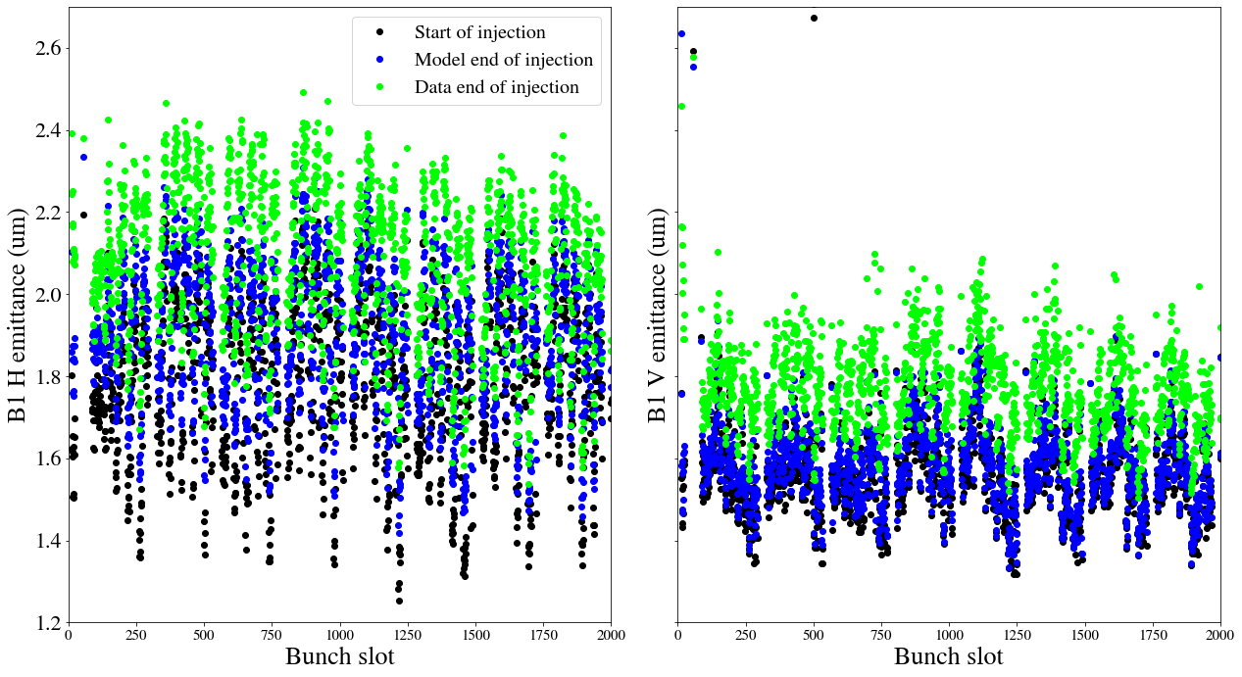
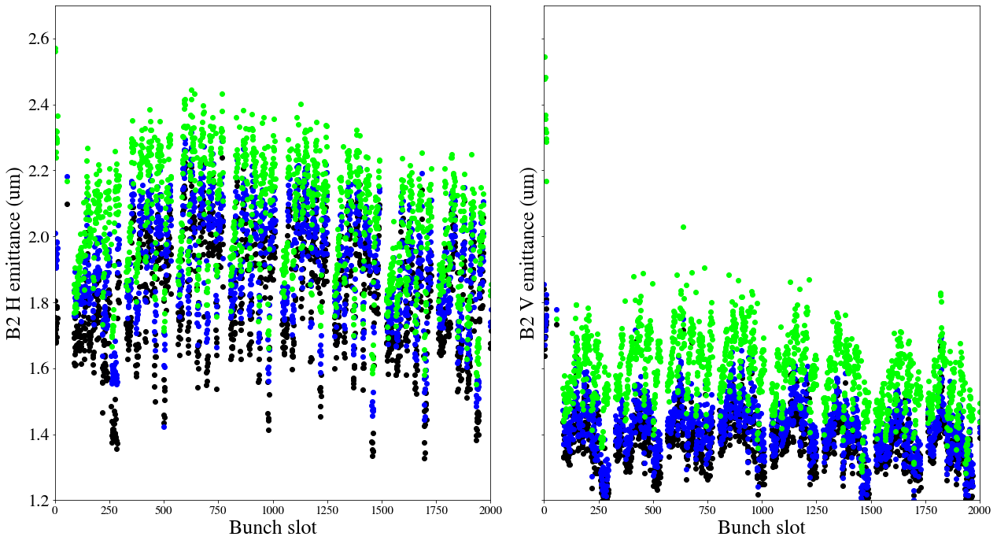
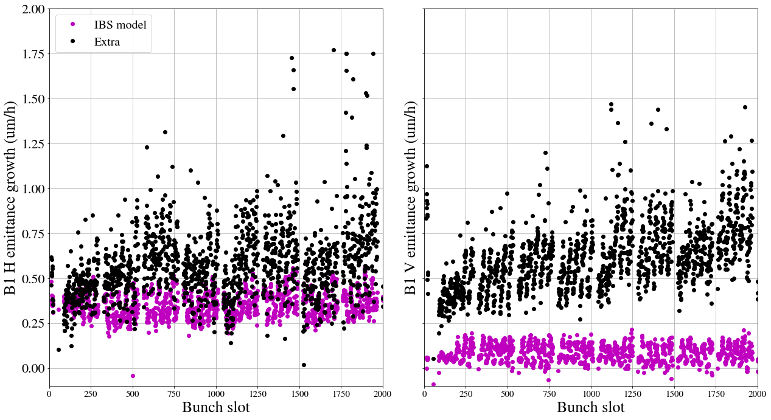
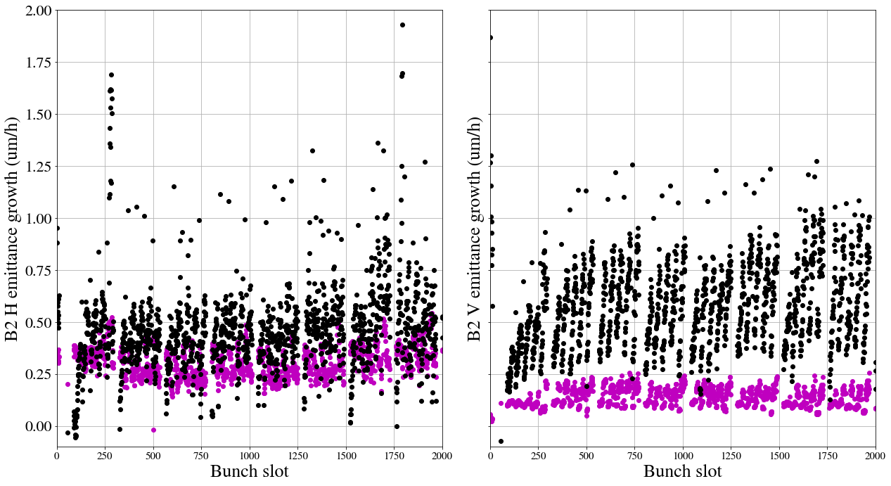
Emittance growth at injection energy (FB)
Compare with Model – example 2022 fill
B1H
B1V
B2H
B2V
Extra growth on top of the model (IBS + coupling) mainly for the V-plane
extra B1H 0.50 μm/h
extra B1V 0.5 μm/h
extra B2H 0.40 μm/h
extra B2V 0.5 μm/h
Adding noise and coupling to the model we expect to partially explain the discrepancy, as in Run 2 _{2bdone}
extra growth
0.5θμm/h
model growth

Slide 14
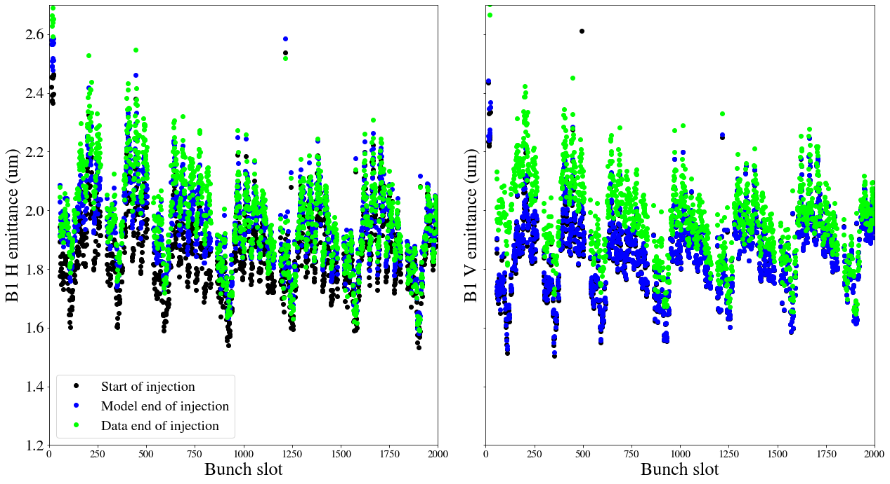
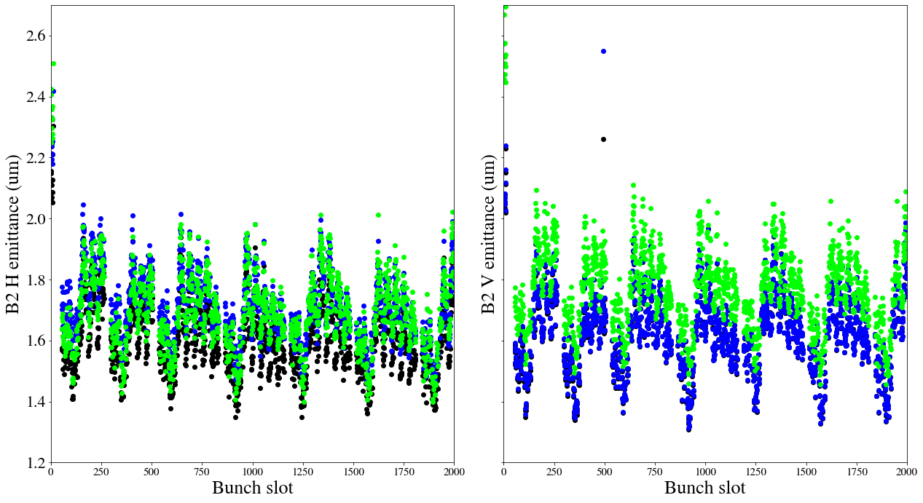
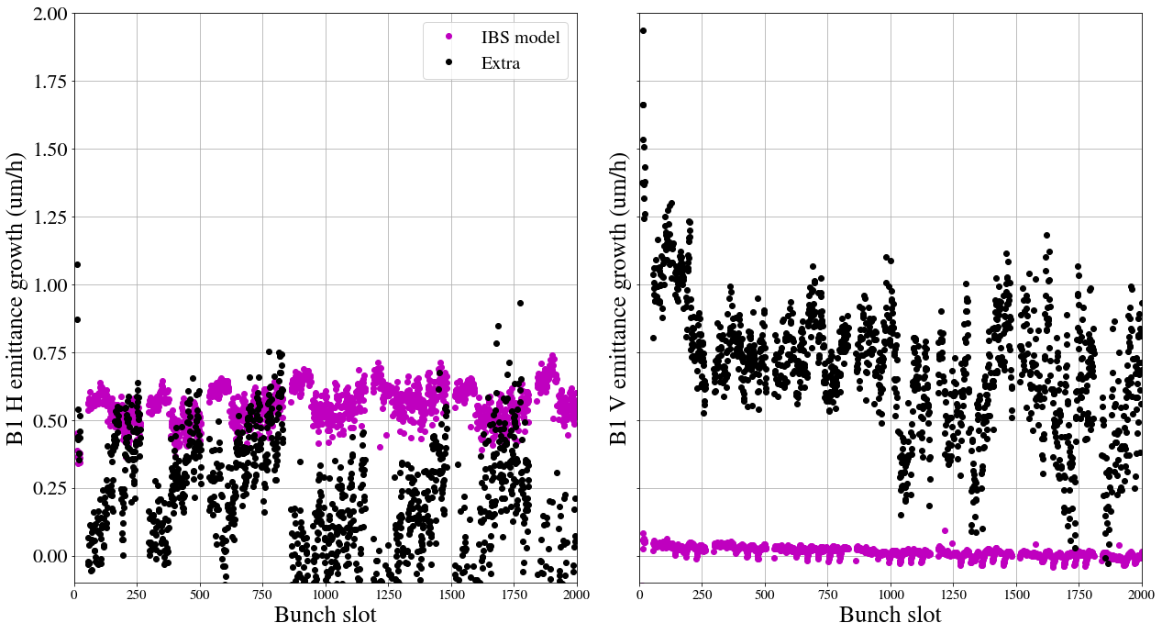
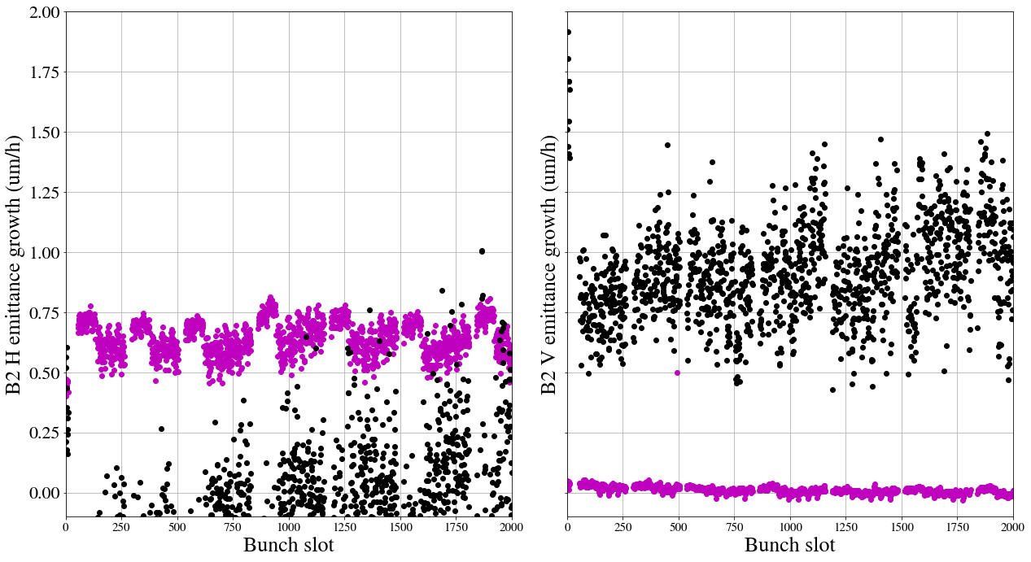
Emittance growth at injection energy (FB)
Compare with model – example 2023 fill
1.49E+11
B1H
B1V
B2H
B2V
extra B1H 0.25 μm/h
extra B1V 0.75 μm/h
extra B2H 0.0 μm/h
extra B2V 0.75 μm/h
0.5θμm/h
???
Notes:
Extra growth in FB in Run 2:
B1H 0.34um/h,
B1V 0.64 um/h
B2H 0.41 um/h
B2V 0.61 um/h
Adding noise or coupling could help to partially mitigate this discrepancy

Slide 15
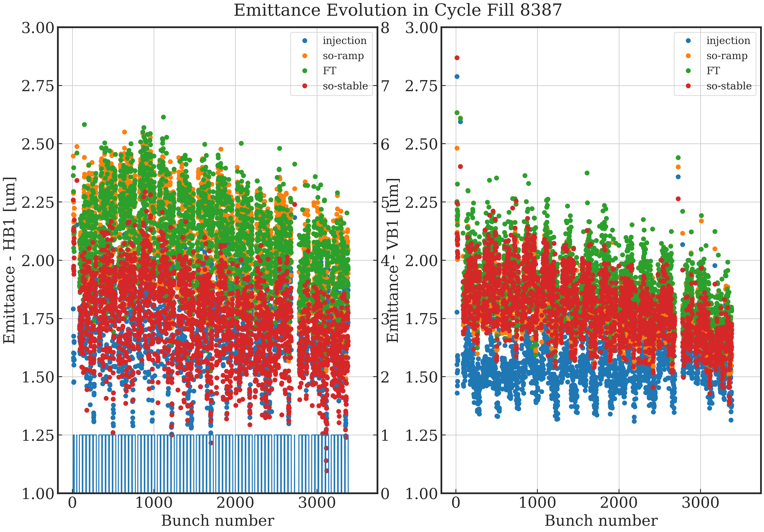
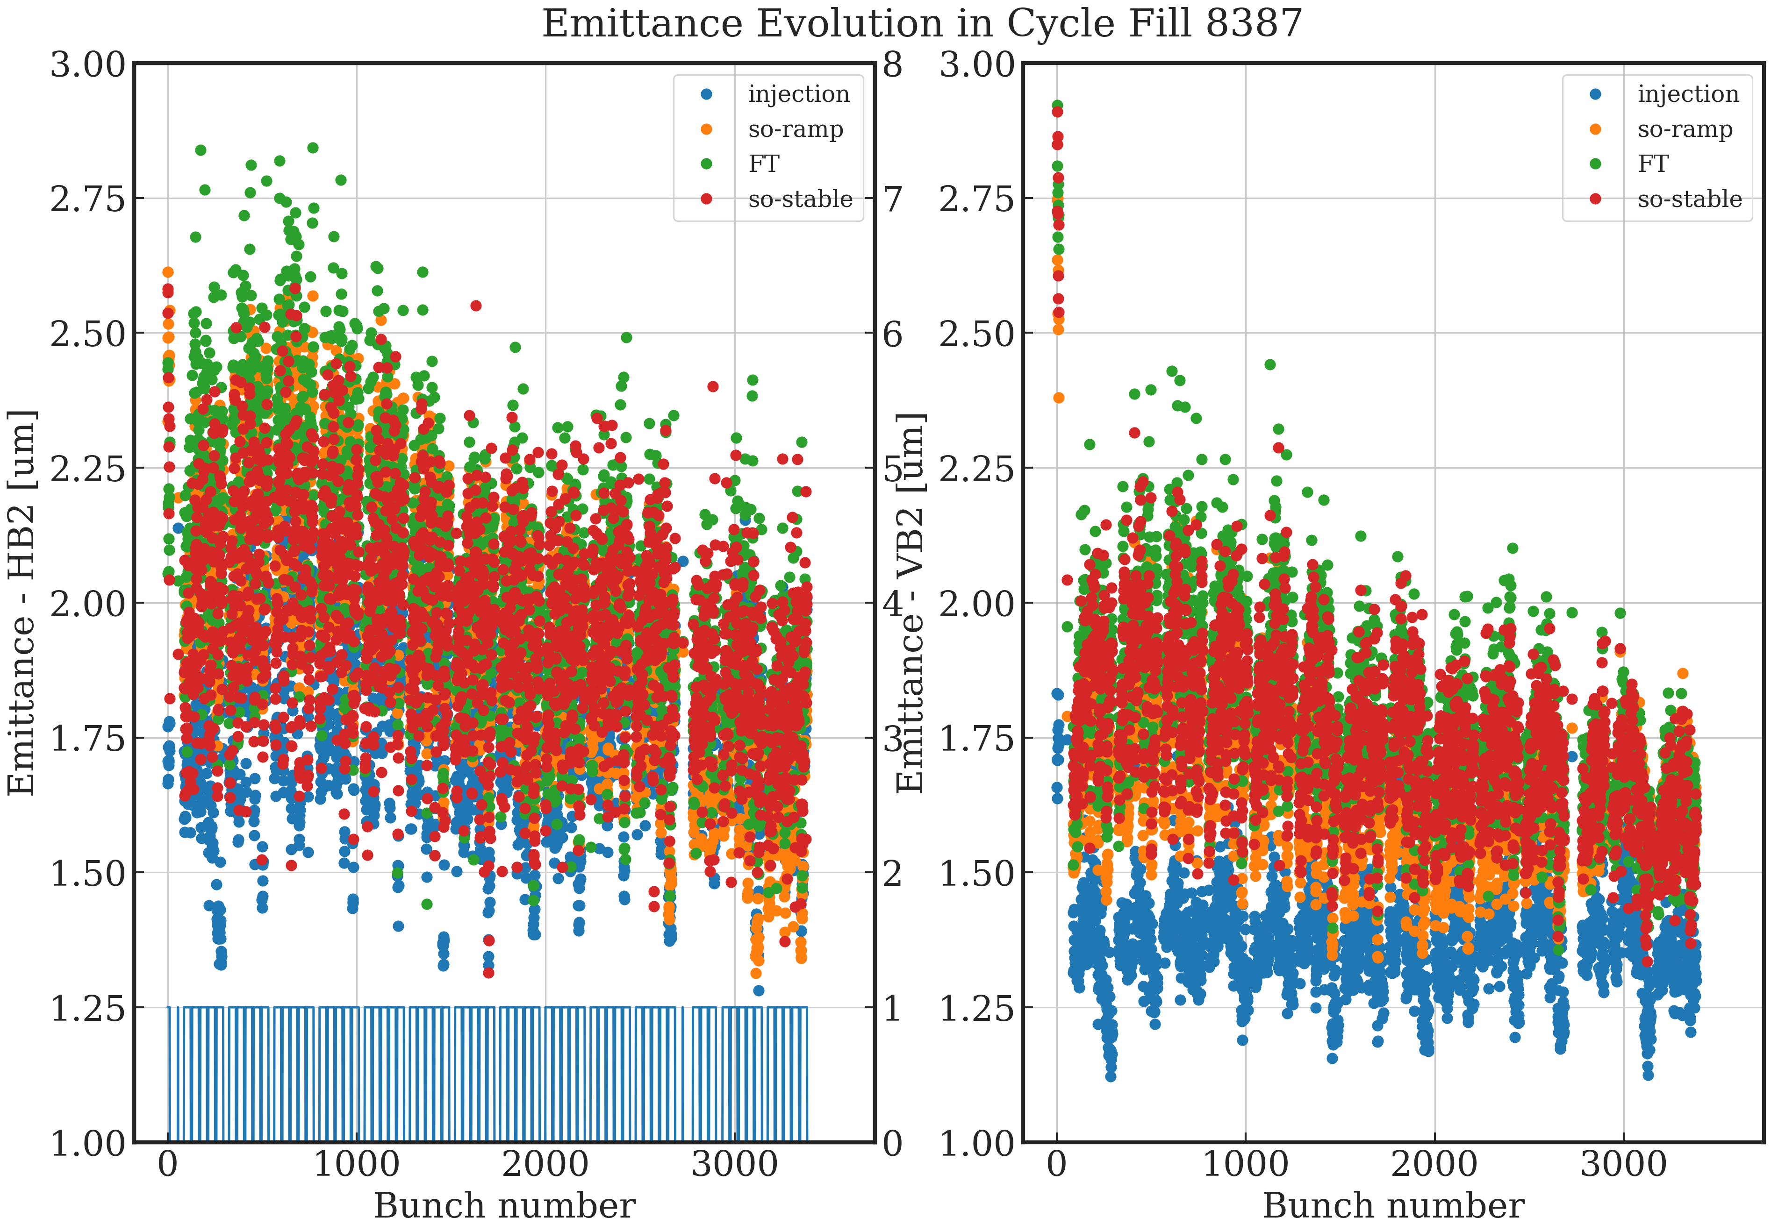
Emittance evolution in the cycle from injection to collisions – example 2022 fill
Observations: slope from FB preserved during acceleration – train structure from injection also preserved
B1H
B1V
B2H
B2V

Slide 16
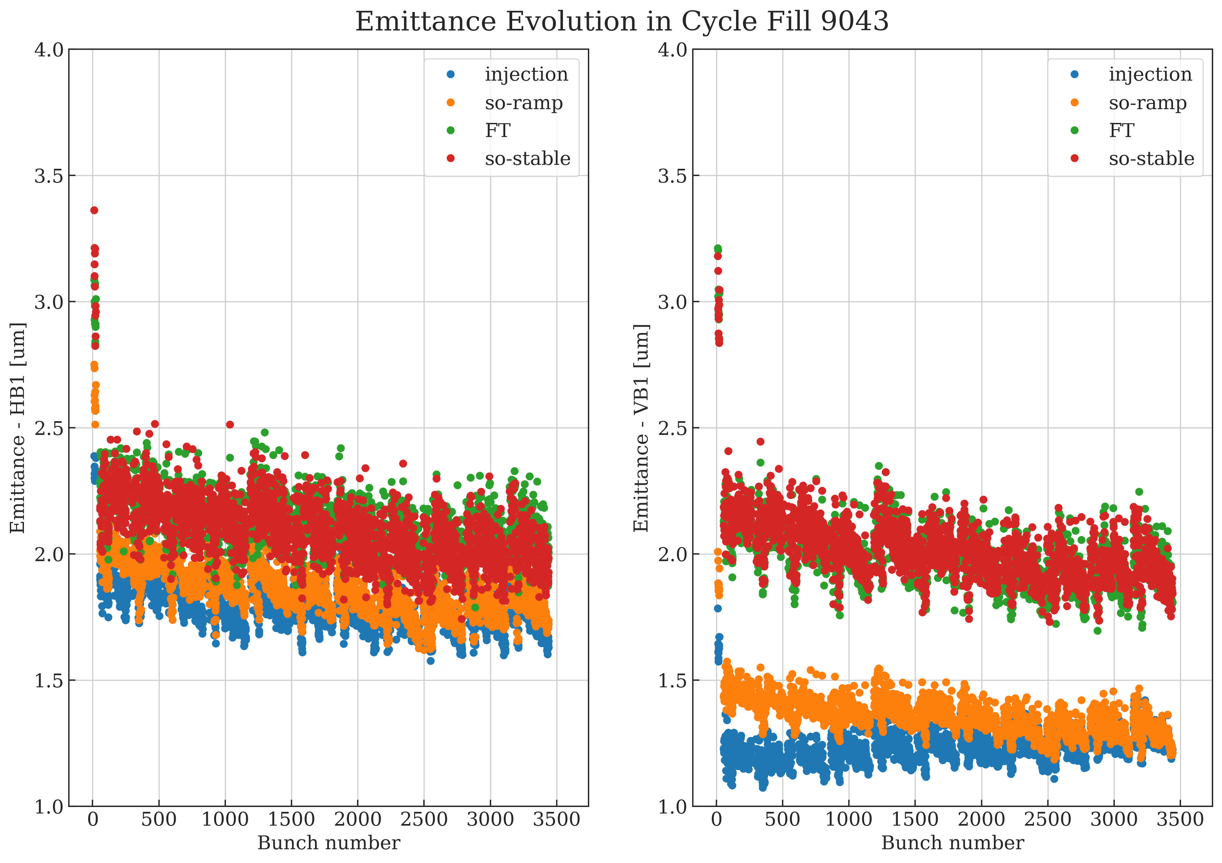
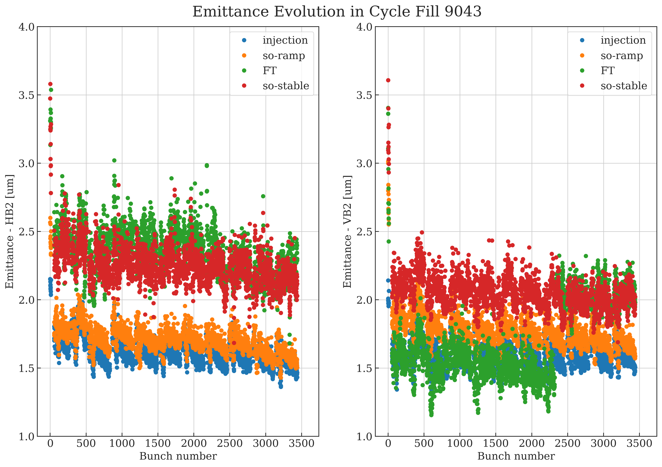
Emittance evolution in the cycle from injection to collisions – example 2023 fill
Observations: slope from FB preserved during acceleration – train structure from injection also preserved
B1H
B1V
B2H
B2V
?

Slide 17
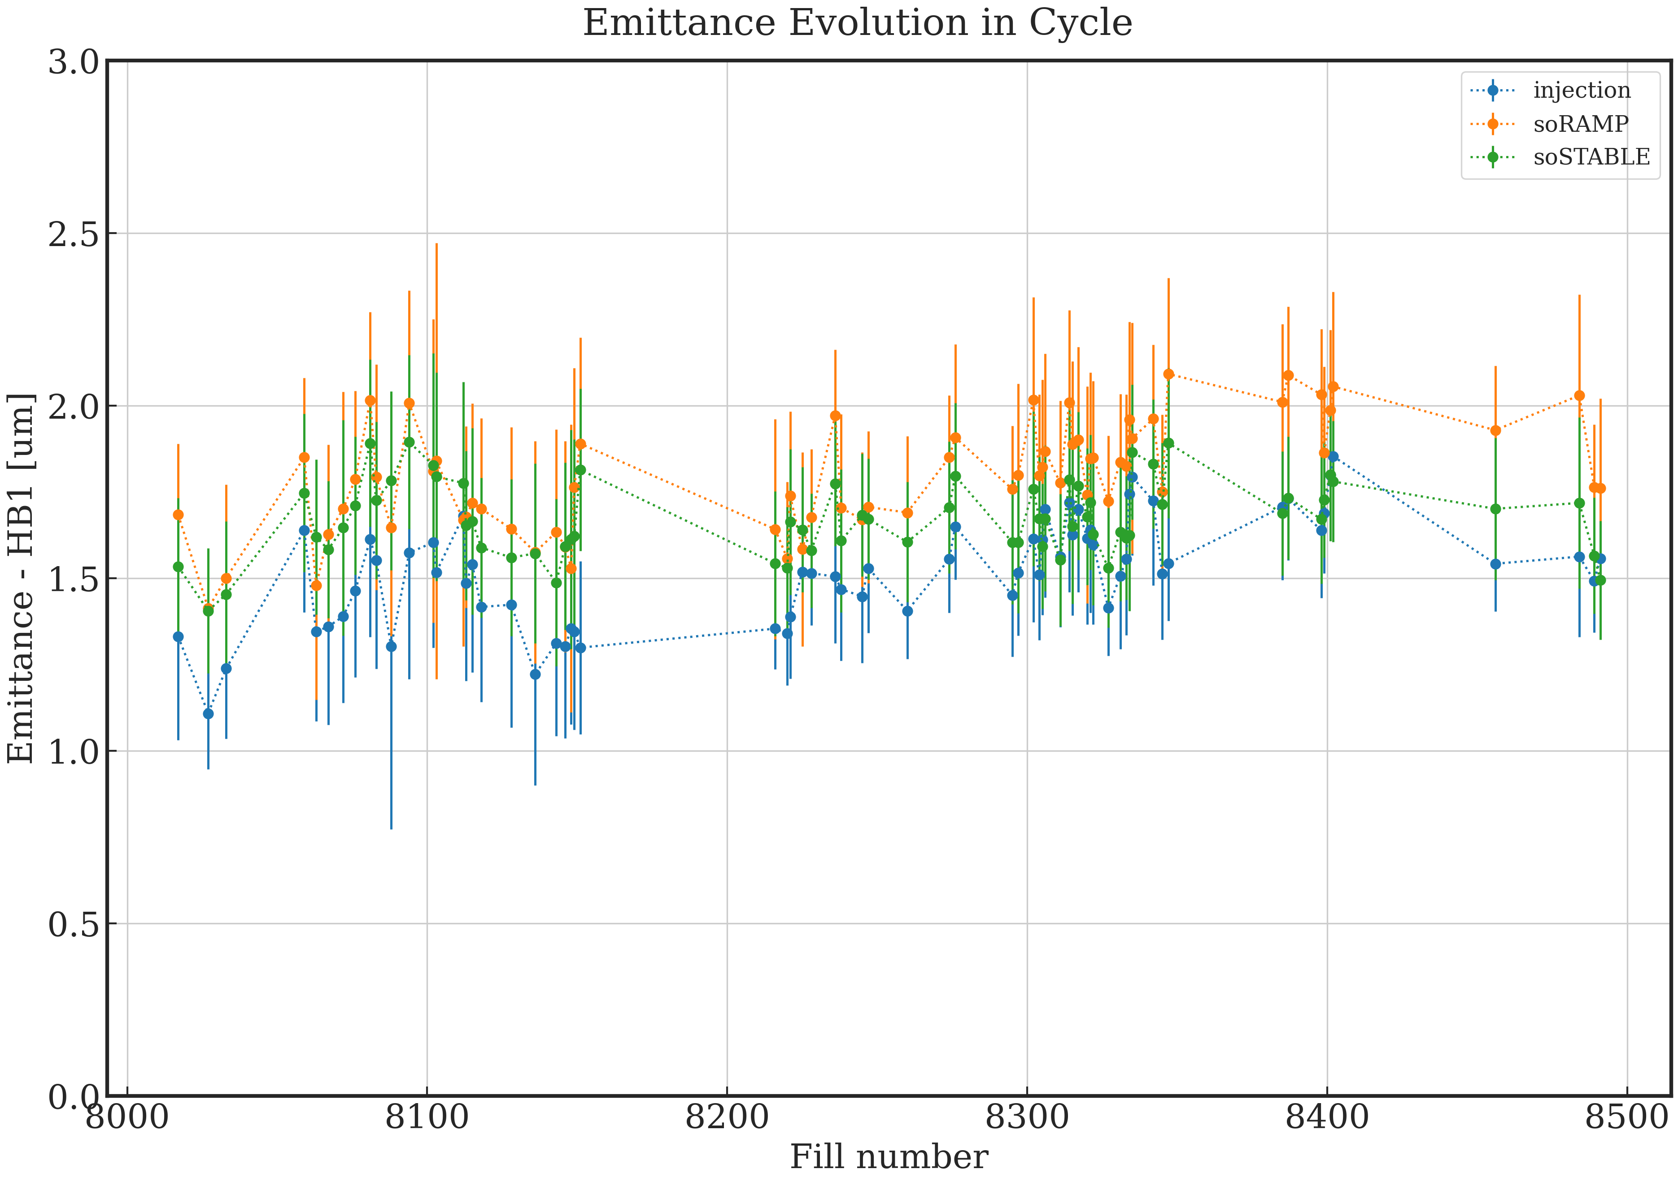
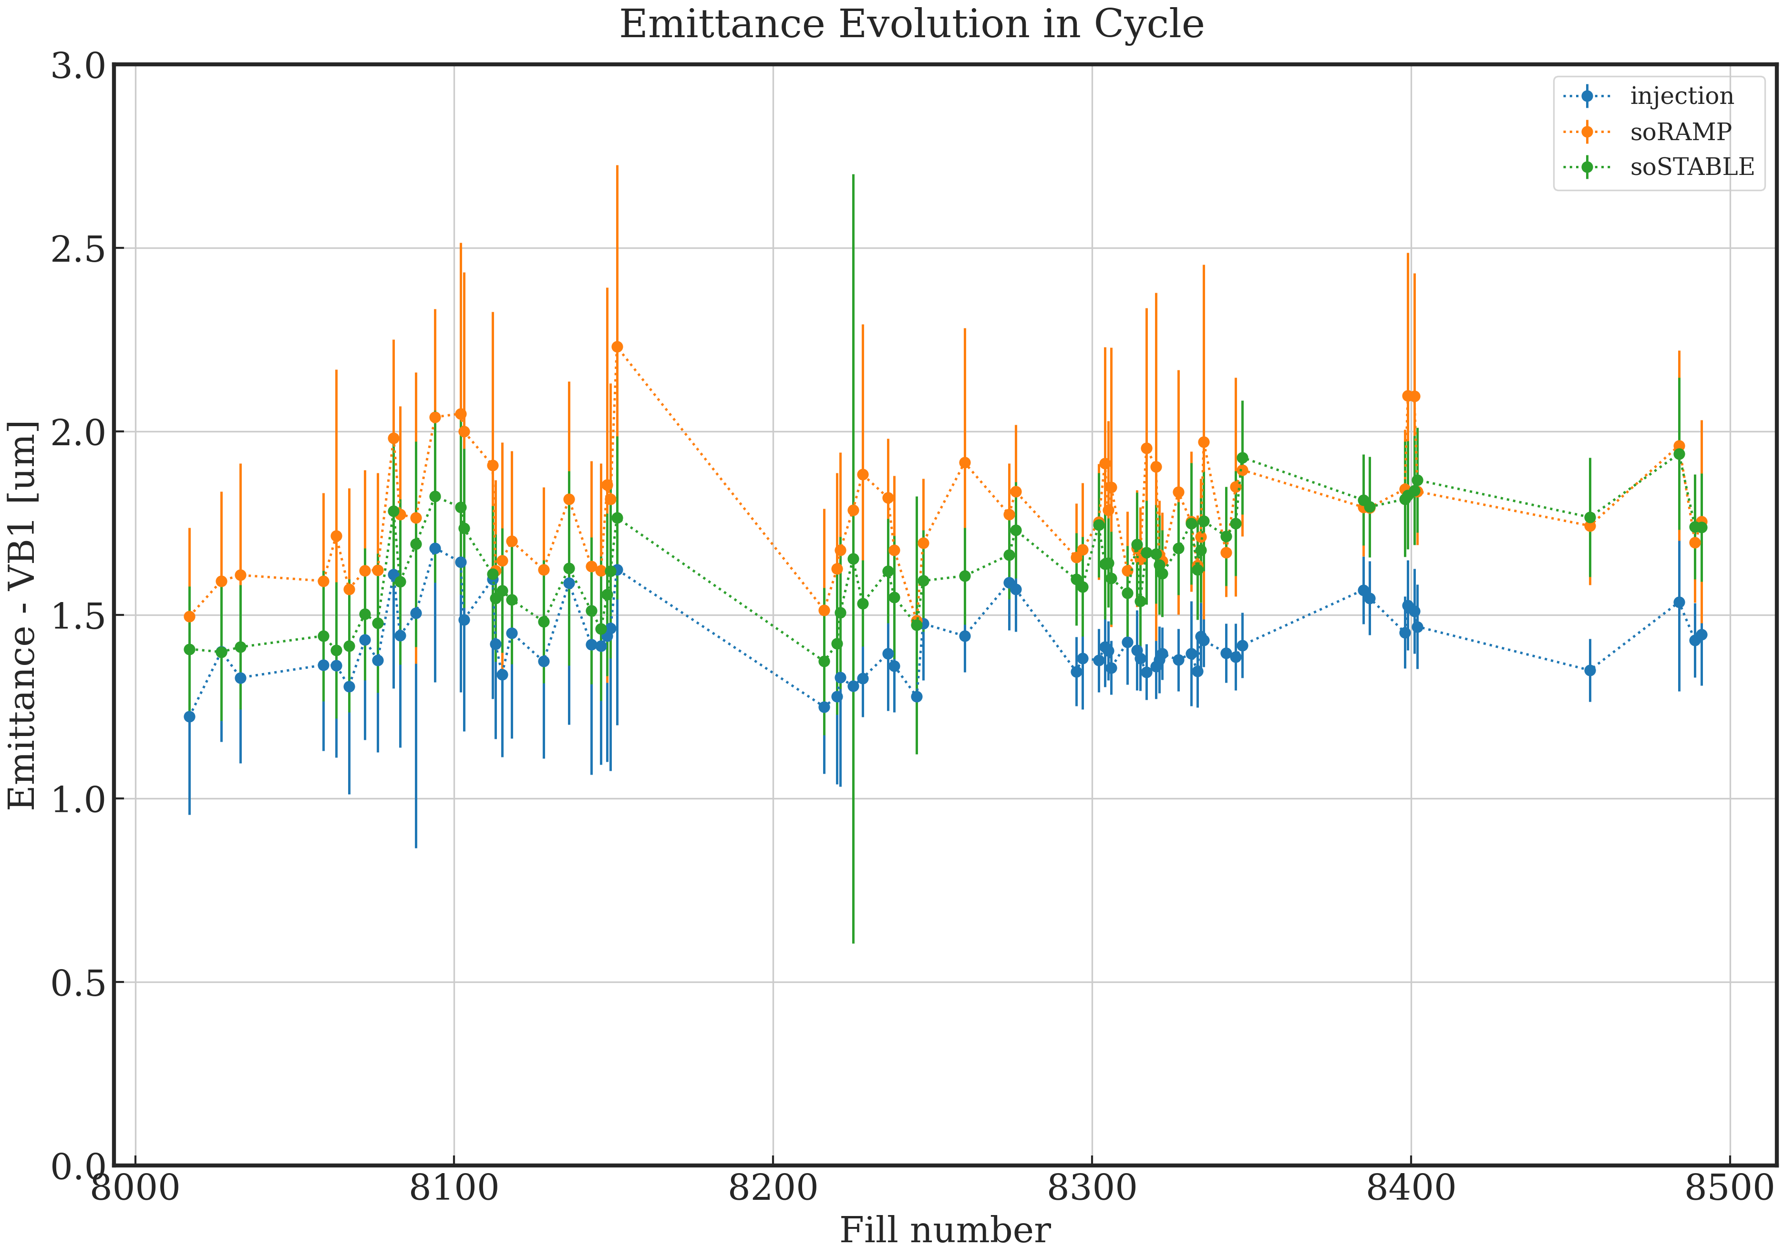
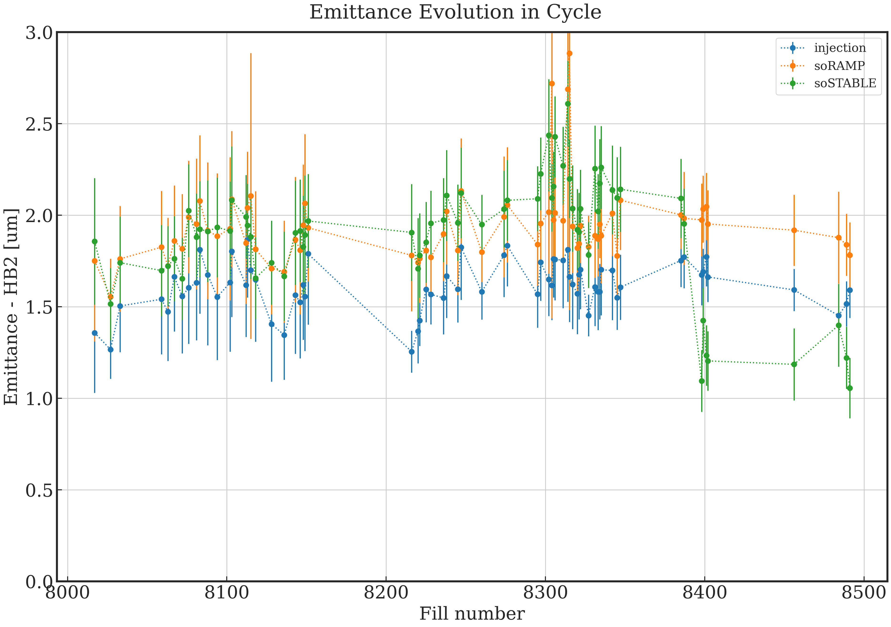
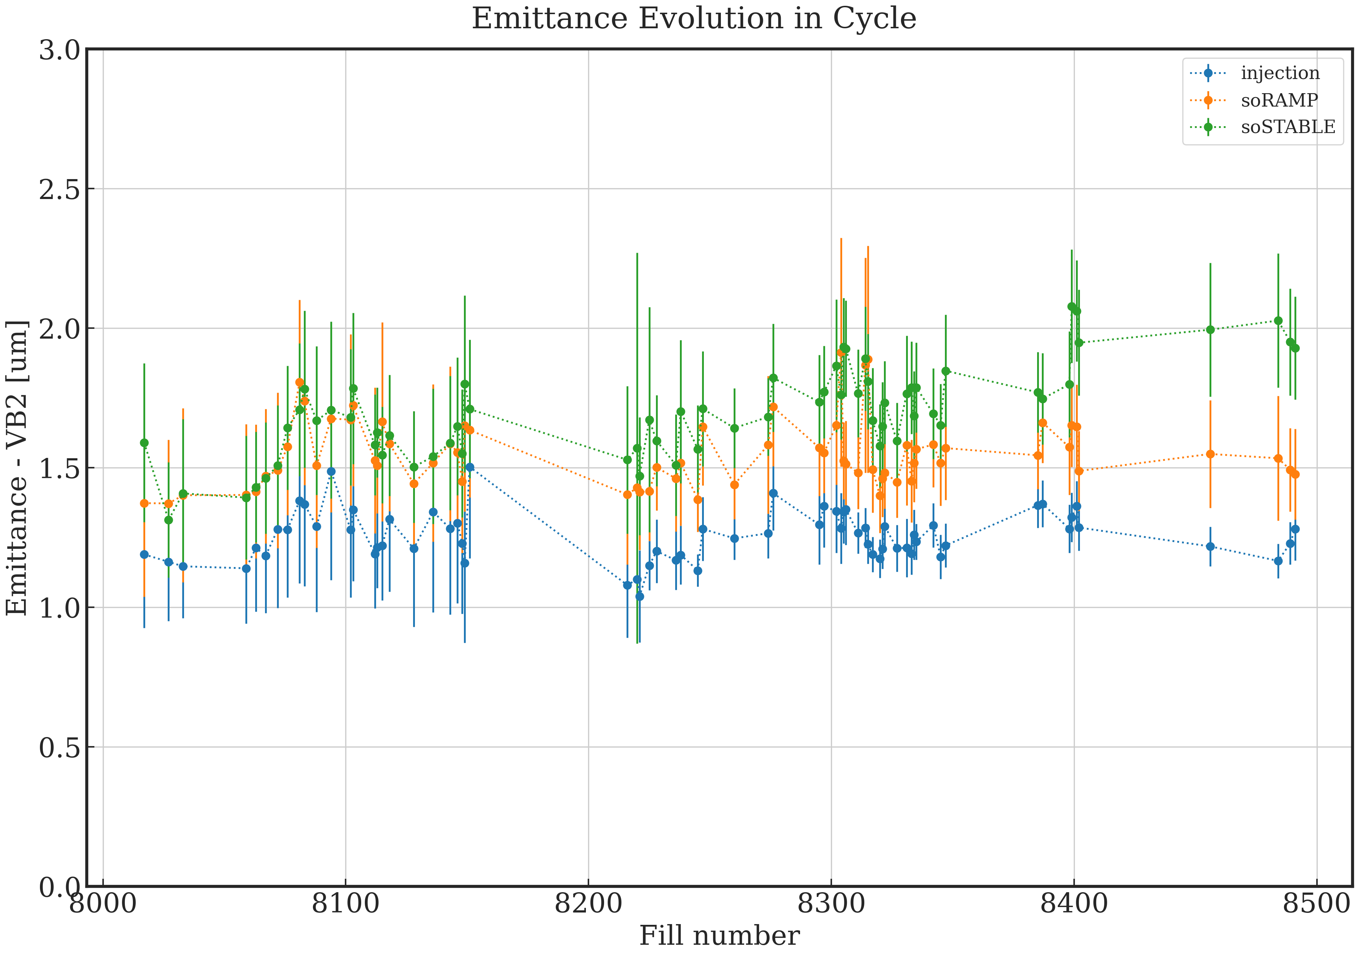
Emittance evolution in the cycle from injection to collisions – all 2022 fills
B1H
B1V
2022 fills | B1H | B1V | B2H | B2V
Injection | 1.52 | 1.62 | 1.42 | 1.25
Start of Ramp | 1.79 | 1.94 | 1.77 | 1.55
Start of SB | 1.67 | 1.89 | 1.63 | 1.70
B2H
B2V
Average @ SB :
1.72 μm for 1.3e11 ppb

Slide 18
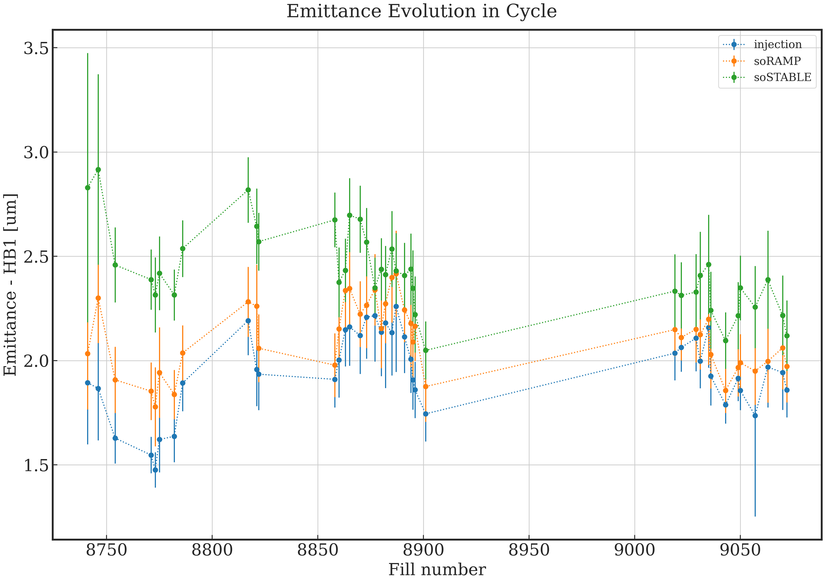
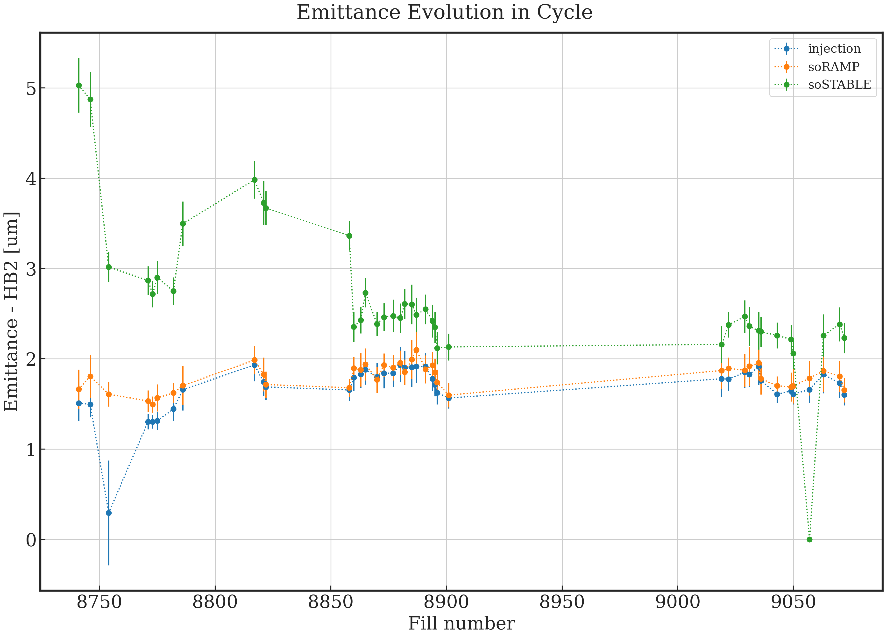
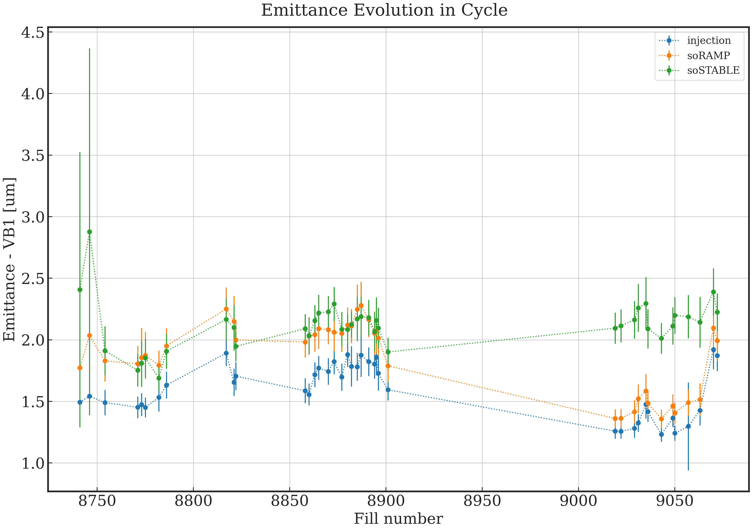
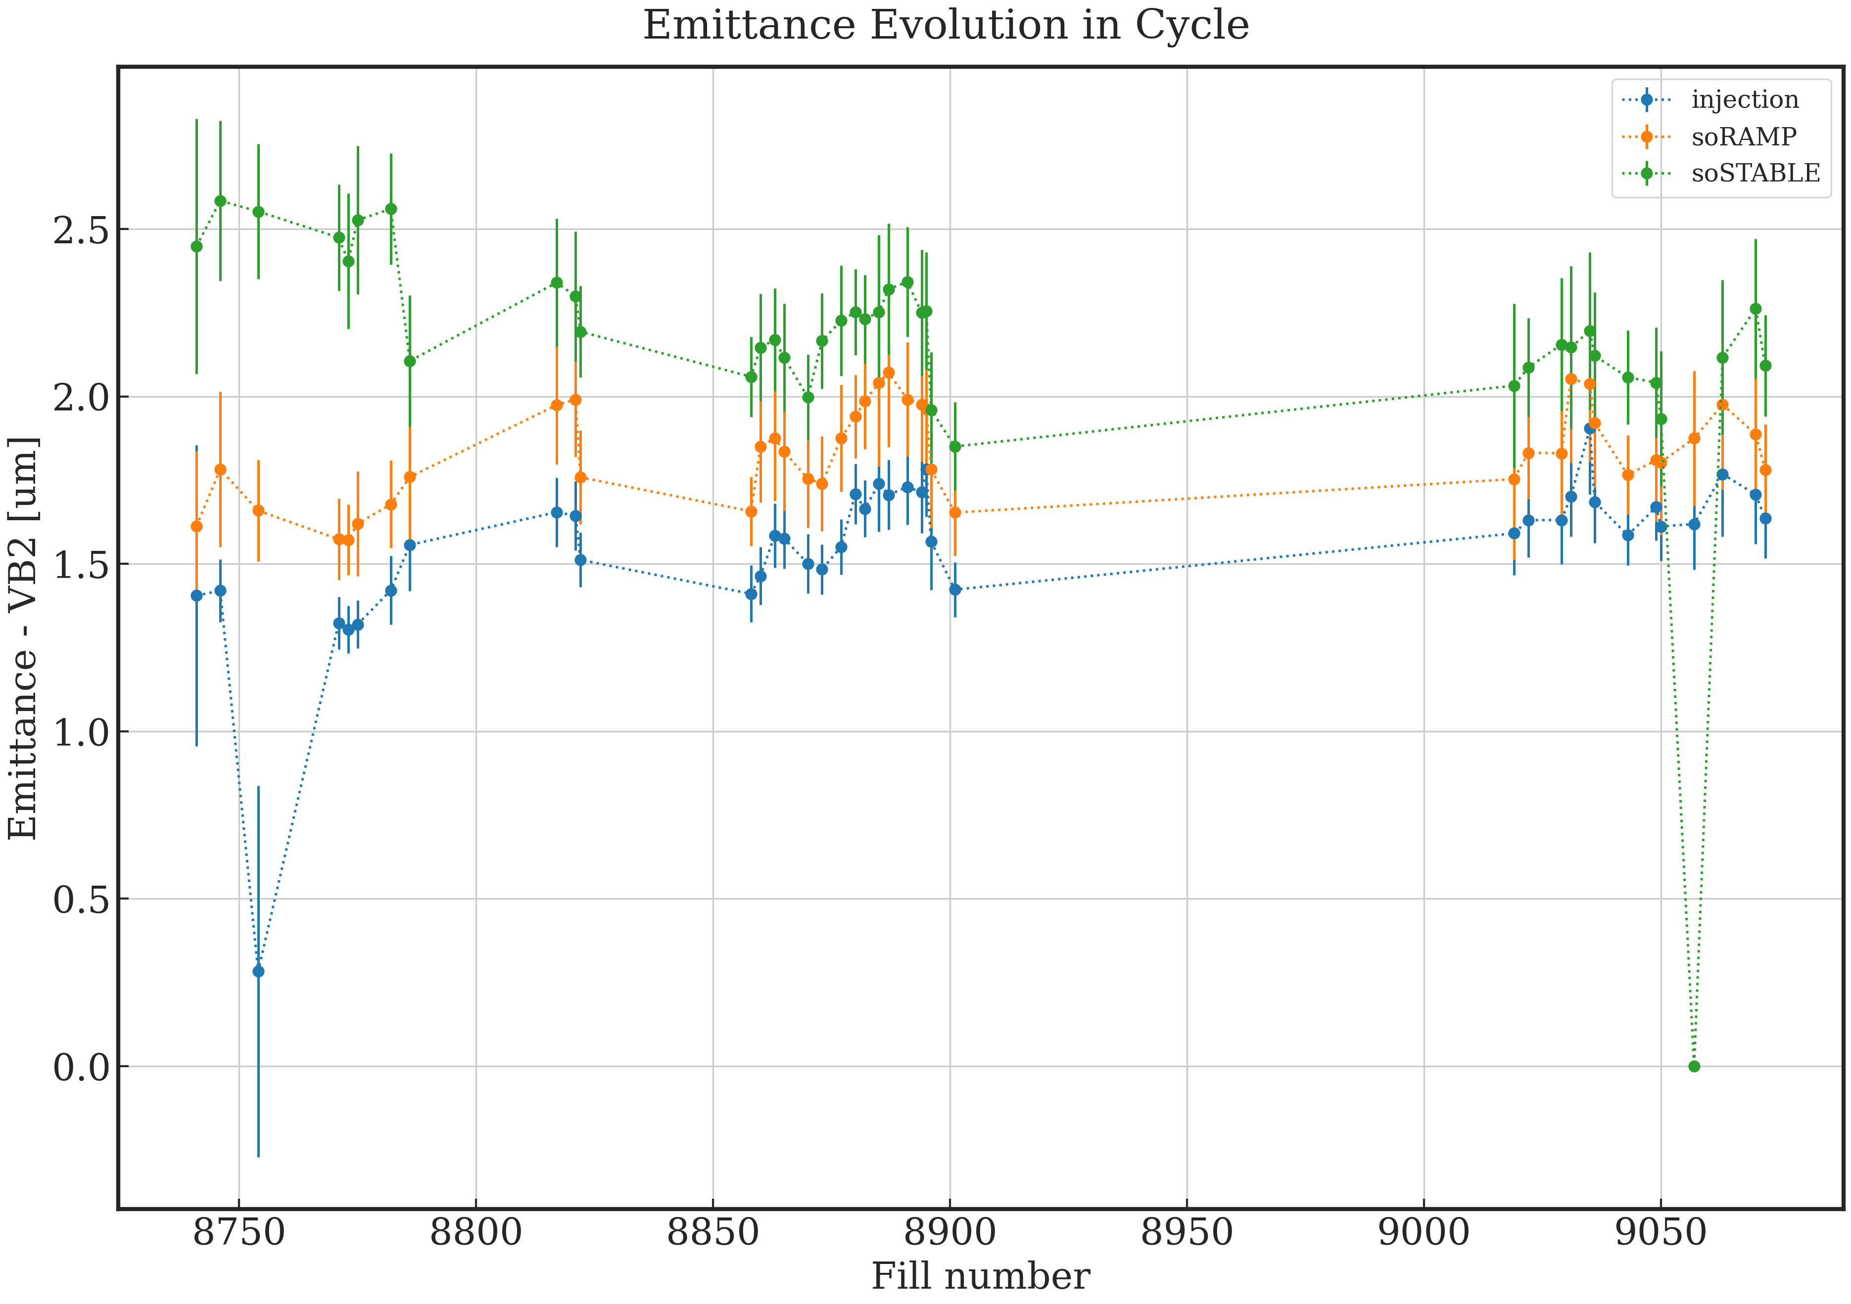
Emittance evolution in the cycle from injection to collisions – 2023
1.7575
1.7575
Fills >8800 | B1H | B1V | B2H | B2V
Injection | 2.02 | 1.60 | 1.78 | 1.63
Start of Ramp | 2.14 | 1.84 | 1.84 | 1.87
Start of SB | 2.37 | 2.15 | 2.40 | 2.14
B1H
B1V
29%
17%
Average @ SB
2.26 μm for 1.49e11 ppb
Fills > 9000 | B1H | B1V | B2H | B2V
Injection | 1.95 | 1.41 | 1.74 | 1.67
Start of Ramp | 2.04 | 1.54 | 1.81 | 1.87
Start of SB | 2.29 | 2.18 | 2.28 | 2.10
B2H
B2V
30%
21%
Average @ SB
2.21 μm for 1.49e11 ppb
~+10% from scale with intensity wrt 2022 data

Slide 19
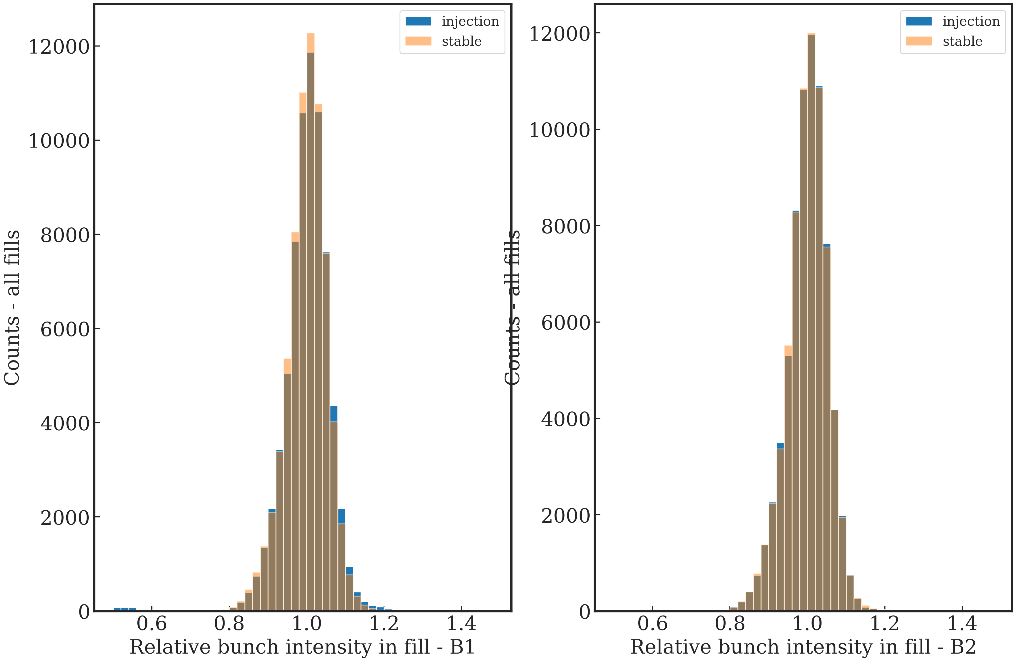
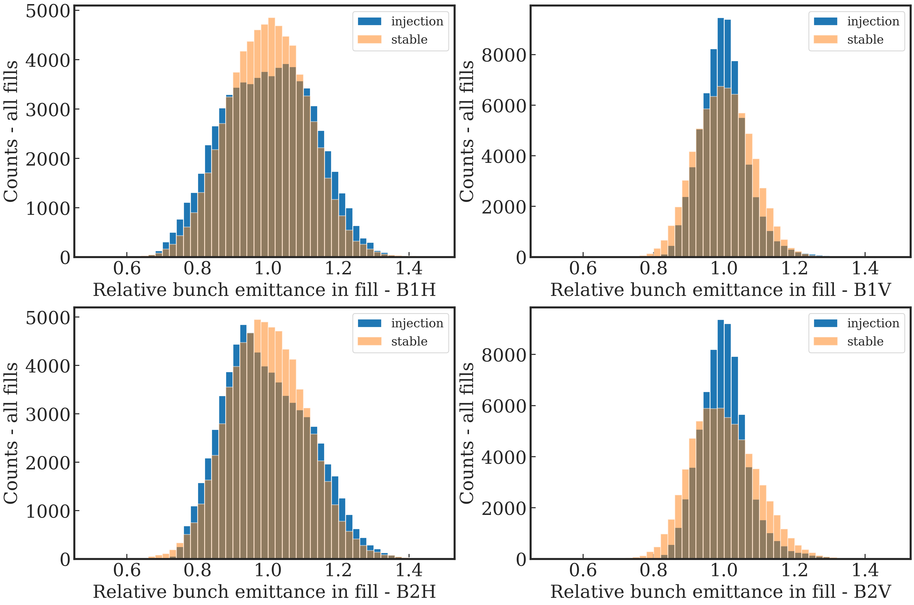
Bunch Fluctuations
Emittance and Intensity bbb variations - 2022
Intensity - all fills
Emittance - all fills
B1
B1H
B1V
B2
B2H
B2V
Intensity 2022 | B1 | B2
Injection | 6.32% | 5.18%
Stable | 5.20% | 5.19%
Emittance 2022 | B1H | B1V | B2H | B2V
Injection | 12.77% | 7.04% | 12.02% | 7.00%
Stable | 11.31% | 8.00% | 11.17% | 9.39%
These would translate to >10% b2b luminosity fluctuation!
Notes:
Replace graphs to bars

Slide 20
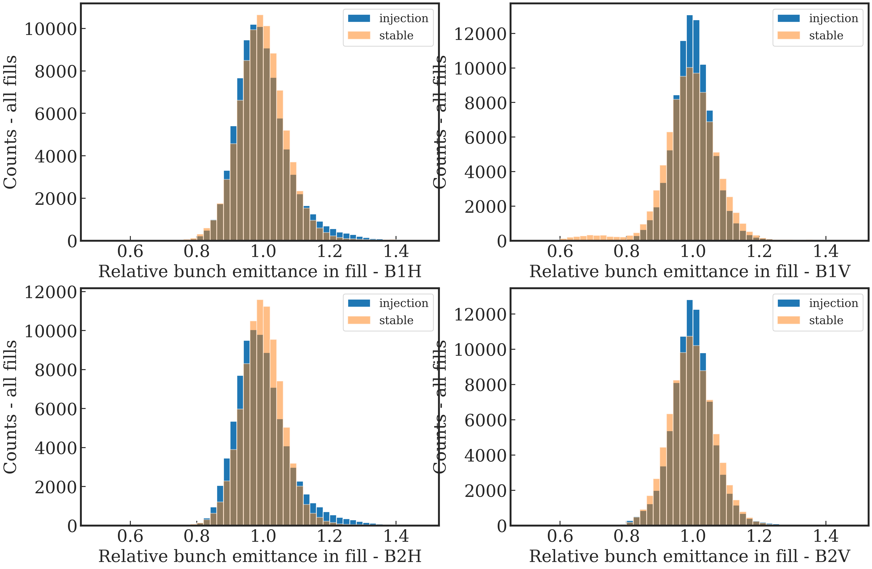
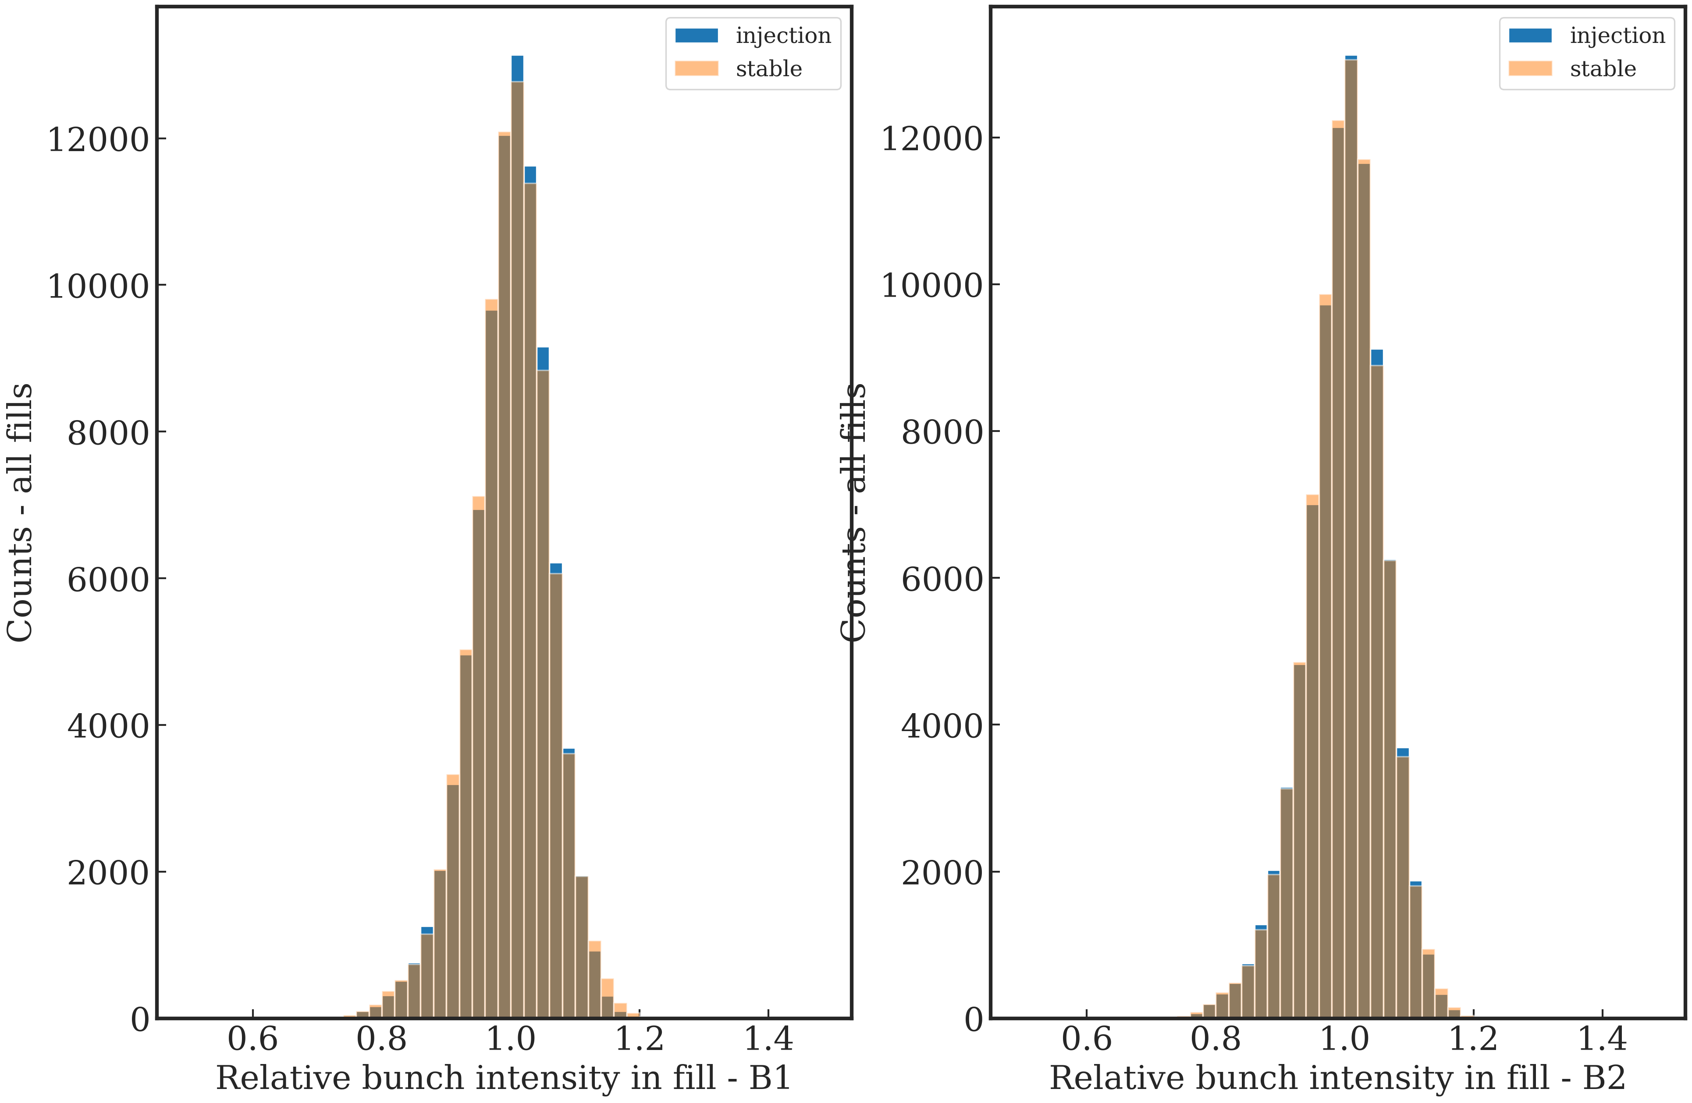
Bunch Fluctuations
Relative emittance and Intensity bbb variations - 2023
Intensity - all fills
Emittance - all fills
B1H
B1V
B1
B2
B2H
B2V
Intensity 2023 | B1 | B2
Injection | 6.00% | 6.00%
Stable | 6.15% | 6.00%
Emittance 2023 | B1H | B1V | B2H | B2V
Injection | 8.17% | 5.95% | 8.19% | 7.89%
Stable | 7.77% | 12.75% | 6.41% | 7.07%
Notes:
Replace graphs to bars

Slide 21
Emittance evolution in the cycle
Acceleration ramp
From the data, ~half of the emittance blow up form injection to collisions is happening during the acceleration ramp.
Analysis of BSRT calibration data
set of single bunches with variable emittances
can help to distinguish between single bunch and train effect contributions.
WS data for the full cycle
Result : the blow-up is it is clearly present in the bunches that have similar emittance as in normal fills and of similar amplitude
B1H
B2H
B1V
B2V

Slide 22
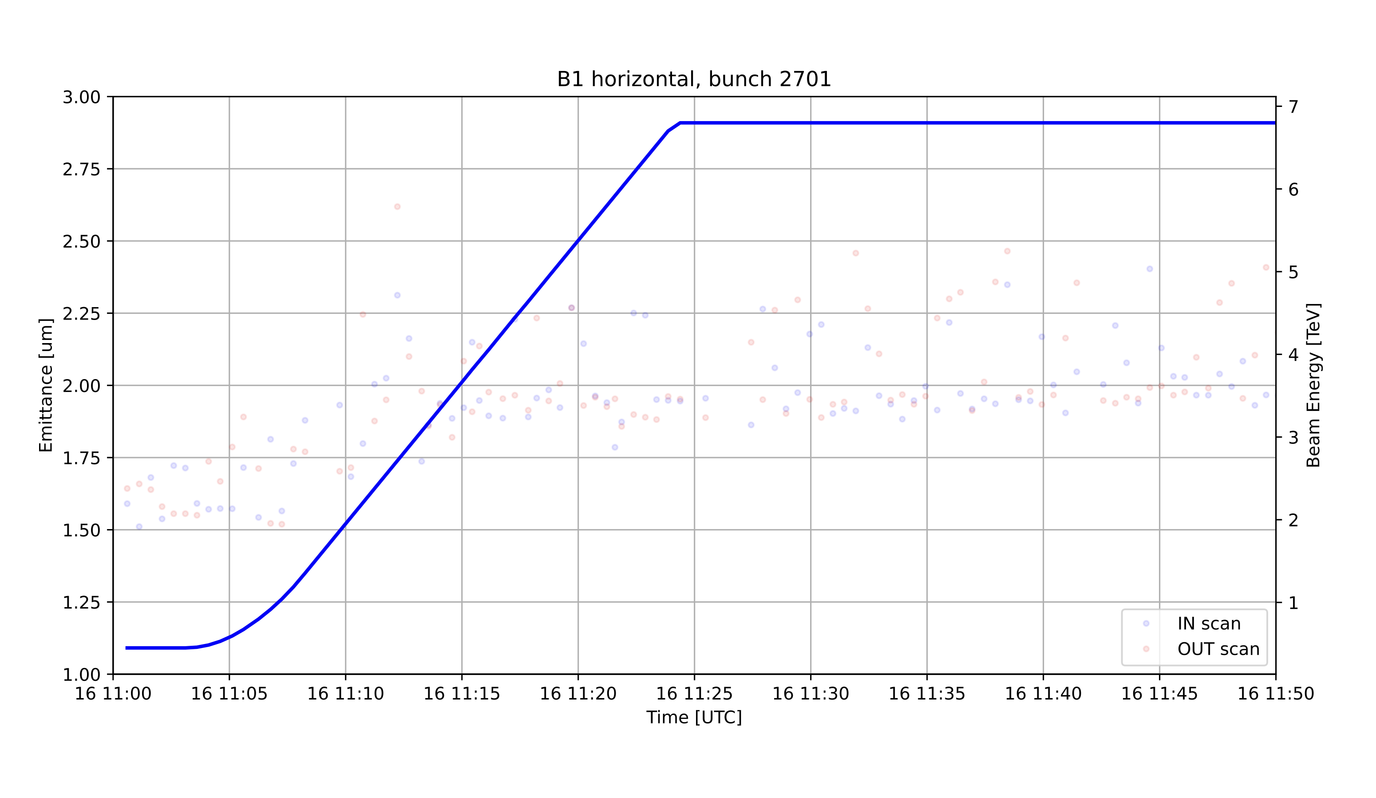
Emittance evolution in the cycle acceleration ramp
Can we localize the blow-up on a particular part of the ramp?
It seems mainly to develop between 0.45 and 3.5 TeV
~0.4μm – +30%

Slide 23
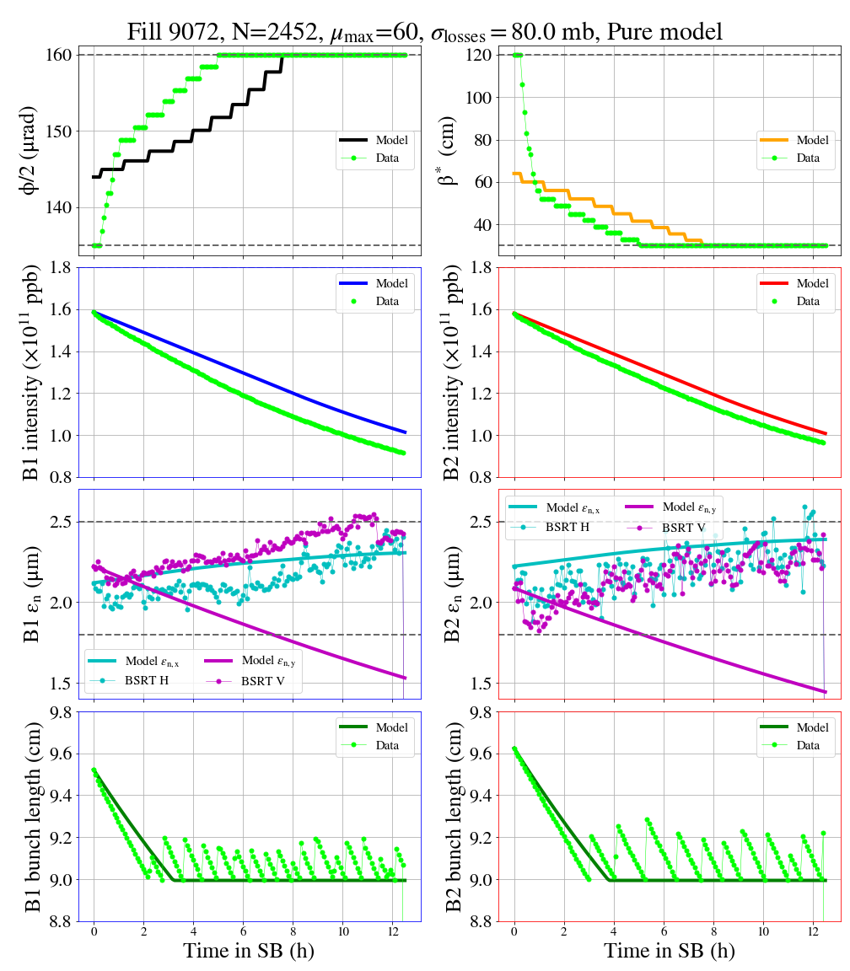
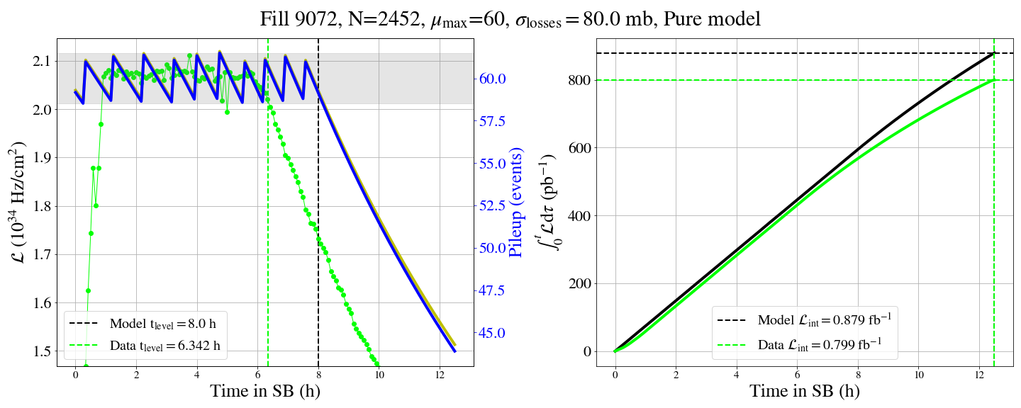
Emittance evolution in collisions
Compare data with the model - 2023
Case 1 Pure model : emittance and intensity calculated by the model – step 1
Model components
base (*) | Yes
Burn-off | 80 mb
Coupling | No
Noise | No
ε-growth from burn-off | No
Extra emittance growth | No
  β*
ε-H good for start/end points(!) not the evolution
ε-V the model predicts dumping!
crossing angle
intensity B1
intensity B2
2023 | soSB | eoL | 10h
B1H | 2.2 | 2.25 | 2.3
B1V | 2.3) | 2.45 | 2.5
B2H | 2.0 | 2.2 | 2.3
B2V | 2.0 | 2.2 | 2.3
emittance B1
Integrated luminostiy
emittance B2
bunch length B1
bunch length B2
Luminosity

Slide 24
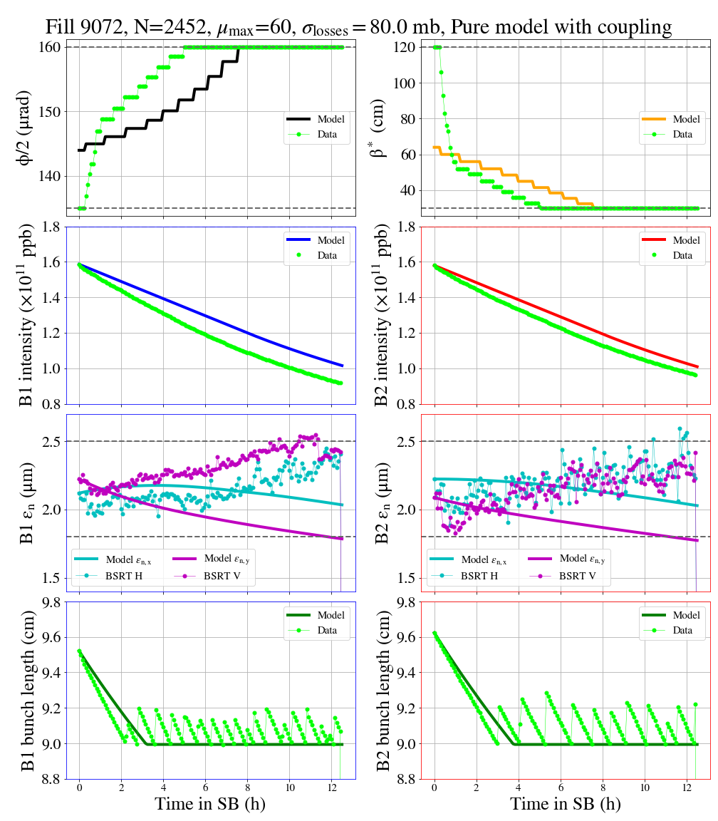
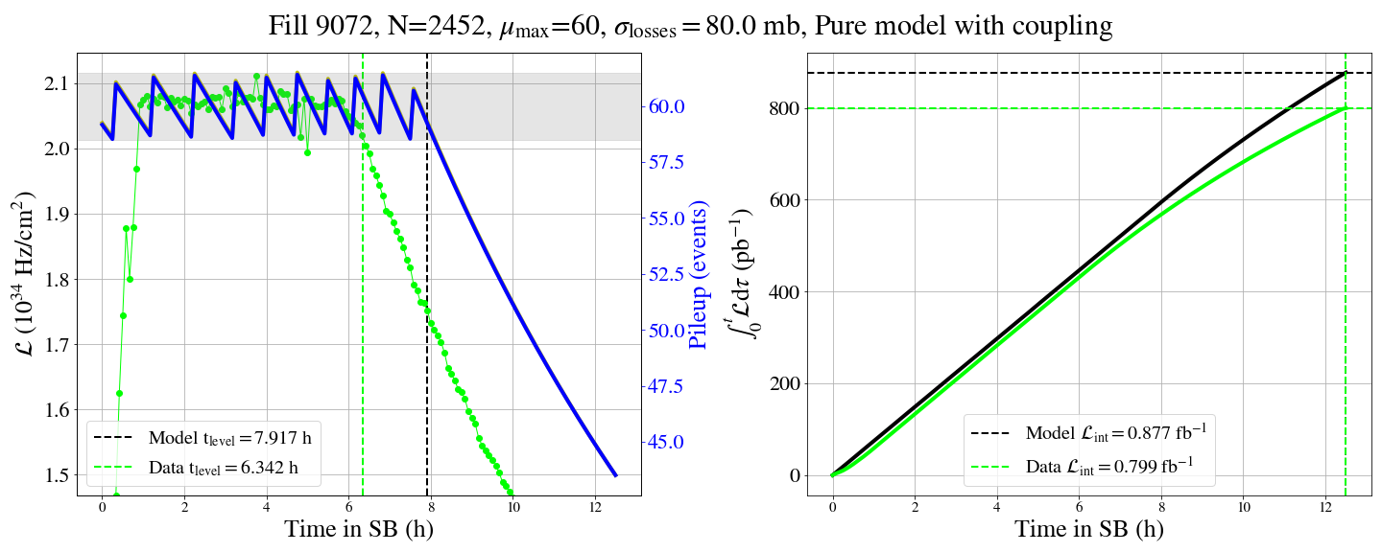
Emittance evolution in collisions
Compare data with the model - 2023
Case 1 Pure model : emittance and intensity calculated by the model – step 2
Model components
base (*) | Yes
Burn-off | 80 mb
Coupling | Yes
Noise | No
ε-growth from burn-off | No
Extra emittance growth | No
ε-H worse prediction – blow-up shared with V-plane
ε-V some blow-up but not sufficient

Slide 25
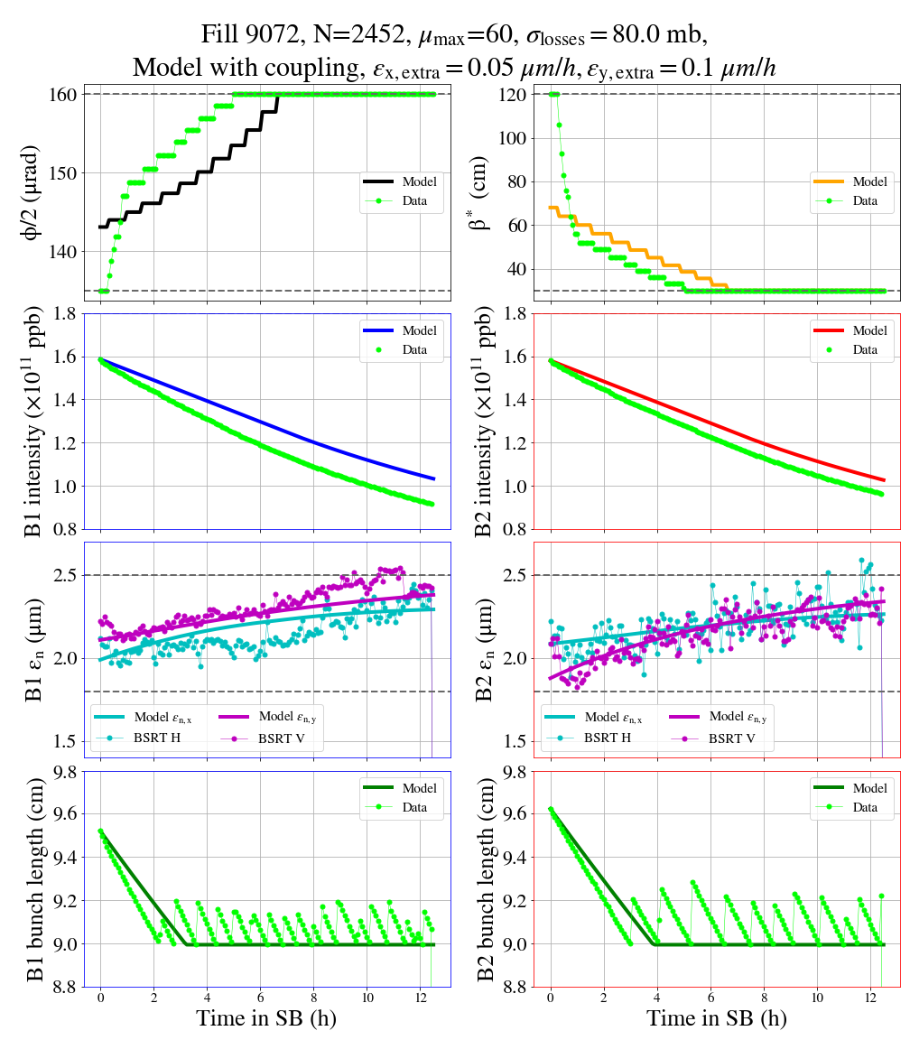
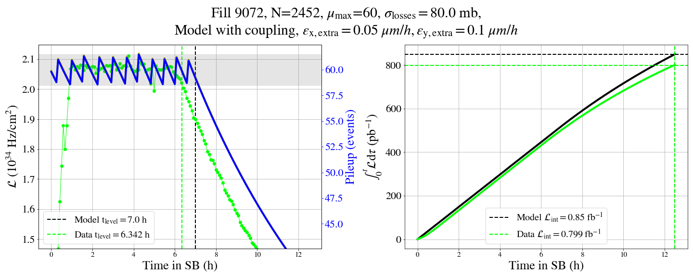
Emittance evolution in collisions
Compare data with the model - 2023
Case 2 Data driven : intensity from the model, extra emittance growth
Model components
base (*) | Yes
Burn-off | 80 mb
Coupling | Yes
Noise | No
ε-growth from burn-off | No
Extra emittance growth | Yes
Extra emittance growth adjusted to best match the data :
    ε_{H} ➝ 0.05 μm/h
    ε_{V}➝ 0.1 μm/h

Slide 26
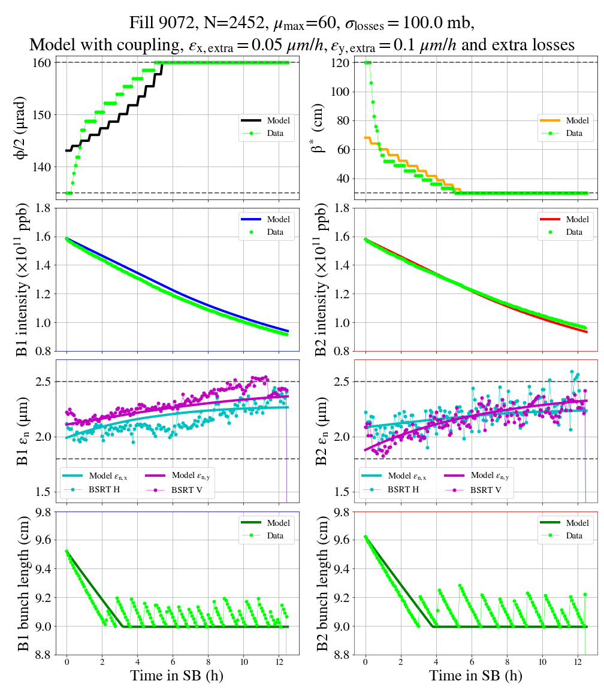
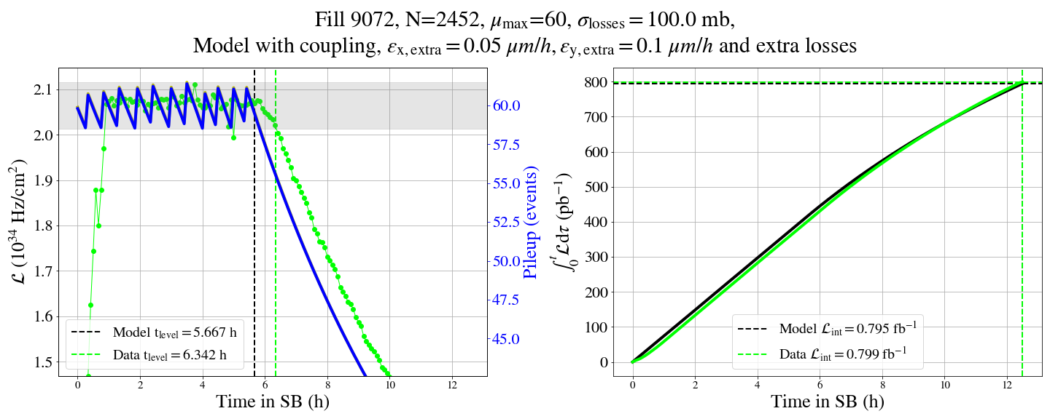
Emittance evolution in collisions
Compare data with the model - 2023
Case 3 Data driven: increased burn-off, extra emittance growth
Model components
base (*) | Yes
Burn-off | 100 mb
Coupling | Yes
Noise | No
ε-growth from burn-off | No
Extra emittance growth | Yes
Emittances : good agreement for B2 H&V, B1 still off in the final values but also during evolution
Intensity : well matched to the data

Slide 27
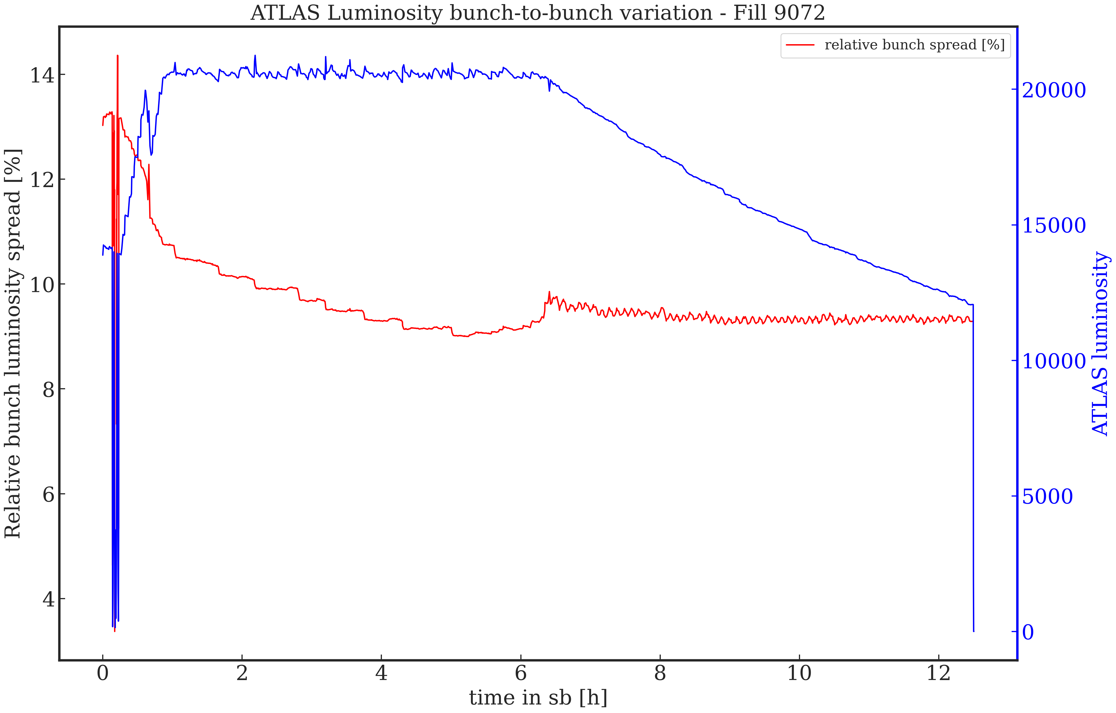

Beams in collision
Bunch-to-bunch variations – 2023
Luminosity bunch-to-bunch variations – example fill 9072
Initial bunch-to-bunch luminosity fluctuations ~13%
Reduced fast at start of collisions to ~11% at start of levelling
B2B fluctuations further reduced during levelling, and constant during the luminosity decay
For the moment the values are below the natural fluctuations due to PU
$$\frac{1}{\sqrt{N}}=\frac{1}{\sqrt{60}}=13\%$$
but certainly not compatible with future HL-LHC requirements with increased PU
Do a Better plot

Slide 28


Beams in collision
Beam lifetime – effective cross section
Example 2022 fill
Extra losses at start of collisions, but no loss spikes during leveling steps to 30cm β*
Example 2023 fill
Extra losses during leveling steps, correlated with the β* and beam length changes(?)
levelling
levelling
4h
4h

Slide 29


Beams in collision
Beam lifetime – effective cross section
2022 fill – bunch-by-bunch data
large initial losses, no sign of correlation with β* changes
e-cloud pattern in the trains

Slide 30


Beams in collision
Beam lifetime – effective cross section
2023 fill – bunch-by-bunch data
losses correlated with β* changes and BBLR interactions(?)
loss pattern similar to the Λ-shape observed at injection ?
late trains in injection seem to have more loses !

Slide 31



Beams in collision
Beam lifetime – effective cross section
Estimate impact of extra losses to integrated luminosity : 3% for 10mb extra losses, 4% for extra blow-up for the same intensity
Pure model
1.6e11 ppb – 90mb
Model
1.6e11 ppb – 100mb
Model
1.6e11 ppb – 100mb – ε-growth :0.1V, 0.05H
1.299 fb⁻¹/day
1.266 fb⁻¹/day
1.212 fb⁻¹/day
-2.6%
-.6.7%
Notes:
Let's discuss this slide

Slide 32


Emittance evolution in collisions
Beam intensity ⟺ integrated luminosity
Gain of 5% for 6.2% (1.6e11 to 1.7e11), and +9.5% for 12.5% (1.6e11 to 1.7e11) increase of intensity
+5.2%
+9.5%

Slide 33





Transverse Stability
To mitigate electron cloud instabilities, talk by K.Paraschou@this workshop, the chromaticity target was increased from 10-15 to 20 units at top energy in Run 3
→ Reduced need for octupole if the chromaticity can be controlled to ±2 units (requires further development)
→ In 2023, the octupole current was kept ‘high’ (395A) to account for noise effects and allow for uncontrolled chromaticity variations
Fill 8784
Few instabilities of the witness bunches were observed and remain not understood.
Nevertheless, they are stabilised by emittance blow-up featuring negligible amount of beam losses → Not an issues for operation
There is no showstopper for operation with 1.8·10¹¹ p/b and 1.8 μm

Slide 34
Summary
The findings from an initial study on the emittance evolution in Run 3 were presented, including information from 2022 and 2023 fills
On the injected emittances from SPS, an increase by 15-20% compared to the values measured at SPS FB is found. But more importantly, a structure is visible along and within the trains, enhanced for the 2023 beams.
These structures, are maintained through the LHC cycle, correlated to the pattern of losses during levelling
At start of collisions, a ~10% net increase in the bunch emittances is observed for the 2023 beams compared to 2022.
During the cycle (injection + acceleration), a 30% blowup in the emittances is observed with about half of it during the ramp

Slide 35
Summary
The model is updated for the Run 3 configuration (optics, levelling) and is used to optimization studies. Still work ahead to further improve it and further include beam (compared to bunch)-related effects, and fully tune it to the Run 3 data
From the results so far, the extra emittance blow-up at injection and top energy is similar with the Run 2 data. Namely, 0.5 μm/h at injection energy and 0.05(0.1) μm/h for H(V) in collisions.
For the 2023 beams, we observe a substantially higher level of extra losses during collisions, correlated to the changes in conditions during levelling.
Using the model, we could evaluate the impact of losses (effective cross section) and intensity on the integrated luminosity: reducing by 10mb the extra losses, assuming the same emittance blow up in collisions, results in a gain of ~4% integrated luminosity, comparable to the gain of going from 1.6e11 to 1.7e11 in intensity.
We want to correlate the extra losses to the increased emittances at soSB – further work is needed to fully quantity this.
Thus, understanding and possibly reducing the losses during collisions is vital to optimally operate LHC for the rest of Run 3, and should go along with the efforts to increase the bunch intensity

Slide 36
Outlook
The emittances at soSB have two components:
  The injected emittances to LHC
  The emittance blow-up in the ramp.
For the first, we propose for 2024 a comparative test is done between the BCMS and STANDARD type beams
  Most likely hybrid filling schemes need to be maintained so we should test both in same conditions
  Tests of few (2-3 fills) with both configurations and stable beam conditions in LHC and injectors
    Should be transparent for the experiments
    This implies work to commission both schemes in the injectors but the potential gain in integrated luminosity will pay well the effort
For the second, we could further investigate with MDs and profit from the new BSRT fills

Slide 37



Begin at the beginning,” the King said, very gravely, “and go on till you come to the end: then stop
Alice – Lewis Carroll
Thank you!

Slide 38
Backup slides

Slide 39


Emittance @ Injection
Example 2022 fill
Observations:
structure correlated with time in SPS – an Λ-shape, most likely due to e-cloud within the train
LHC B1
structure correlated with time in SPS
Notes:
I would add a legend that slide 11 is for B1 and slide 12 is for B2 otherwise it is not visible from the label

Slide 40


Emittance @ injection
Example 2022 fill
Observations: H-plane worse than vertical, small trend with number of injections
LHC B2
Notes:
I would add a legend that slide 11 is for B1 and slide 12 is for B2 otherwise it is not visible from the label

Slide 41

Instability of witness bunches
Few witness bunches became unstable during STABLE BEAM, no clear correlation with the optics, e-cloud or beam-beam
  Important to note that we operate with 395 A in the octupoles, whereas in MD (fast octupole scan) the threshold is only 50 A
Fill | Plane | beam | β*[cm] | Bunches | LR IP1 / 5 | HO* IP2 | LR IP2 | HO* IP8 | LR IP8
8784 | V | 1 | 45 | Few last of 12b | ~8 | 1 | ~31 | 0 | ~12
8786 | V | 1 | 45 | Few last of 12b | ~8 | 1 | ~31 | 0 | ~12
8807 | V | 1 | 120 | INDIV | 1 | 1 | 0 | 1 | 27
8850 | V | 1 | 100 | Few first of 12b | 12 | 0 | 24 | 1 | ~32
8850 | V | 2 | 64 | Few first of 12b | ~8 | 1 | 27 | 1 | ~20
8858 | V | 1 | 33 | Few last of 12b | ~8 | 1 | ~25 | 0 | 0

Slide 42

Instabilities during high beta run
Instabilities were observed during the high beta run, though the beams were colliding
→ Possible explanation: Larger beam size and cut tails tend to ‘linearise’ the head-on beam-beam force, thus reducing Landau damping
→Instabilities no longer observed once B1 quality was restored (to the level of B2)

