Slide 1
BLM thresholds and beam losses for protons and ions
JAP23 Session 5 “LHC configuration and experiment specific”
06/12/2023
Sara Morales on behalf of SY-BI-BL and BLMWTG
Special thanks to B.Salvachua, A.Lechner, colleagues from OP-LHC, Collimation, ABT and MPP

Slide 2
Outline of presentation
1. BLM thresholds and losses for protons in 2023
  BLM threshold strategy for protons
  Changes of BLM thresholds during the proton Run
  Beam losses and margin to dump for various scenarios
    Minimum beam lifetime and maximum beam power loss analysis
    Beam dumps from beam losses
2. BLM thresholds and losses for ions in 2023
  BLM threshold strategy for ions (changes on top of the proton BLM thresholds)
  Changes of BLM thresholds during the ion Run
  Beam losses and margin to dump for various scenarios
    Minimum beam lifetime and maximum beam power loss analysis
    Beam dumps from beam losses
  Lessons learnt for next Ion Run

Slide 3
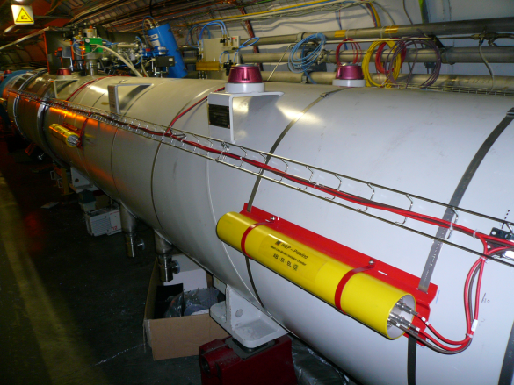
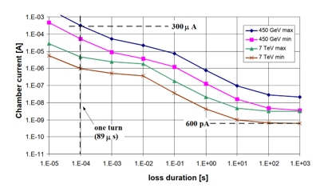
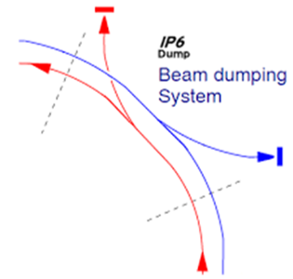
LHC BLM System
Continuous detection and monitoring of beam losses
Comparison of measured losses with predetermined thresholds
Beams extraction if losses above the thresholds
LHC -> 〜 4000 BLM detectors placed downstream the most likely loss locations
The main function of the BLM system is to protect actively the machine against energy deposition from beam losses

Slide 4
BLM thresholds
- Master thresholds selected according to different expected loss scenarios and damage/quench limits
- BLMs grouped in master thresholds families, each BLM with a different monitor factor (MF)
32 energy levels (EL), ranging from 0 GeV to 7.9 TeV
12 integration times or Running Sums (RS), ranging from 40us to 84s
From 0 to 1
$$\text{AppliedThresholds}\text{(}\text{E}\text{, }\text{t}\text{) = }\text{MasterThreshold}\text{(}\text{E}\text{, }\text{t}\text{) }×\text{MF}$$
Each BLM thresholds family will have implemented values for each RS (12) and each EL (32), making it a total of 384 values

Slide 5
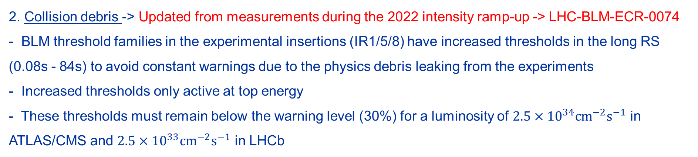
BLM thresholds strategy for protons
No changes with respect to 2022 -> Described in LHC-BLM-ECR-0073
Cold magnets->
- Dust particles (UFOs) dominant source of transient beam loss events in the LHC arcs and DS
- Best machine availability if UFO-induced BLM dumps are avoided and quenches tolerated
Master thresholds at 3x the quench level in short RS (40us – 2.5ms), and MF = 0.333
Thresholds reduced at selected arc/DS locations which are (possibly) affected by a hardware non-conformity: 2 magnets with one less quench heater and 35 magnets with a possible non-conform bypass diode
2. Collision debris -> Updated from measurements during the 2022 intensity ramp-up -> LHC-BLM-ECR-0074
- BLM threshold families in the experimental insertions (IR1/5/8) have increased thresholds in the long RS (0.08s - 84s) to avoid constant warnings due to the physics debris leaking from the experiments
- Increased thresholds only active at top energy
- These thresholds must remain below the warning level (30%) for a luminosity of $2.5×{10}^{34}{\text{cm}}^{−2}{\text{s}}^{−1}$ in ATLAS/CMS and $2.5×{10}^{33}{\text{cm}}^{−2}{\text{s}}^{−1}$ in LHCb

Slide 6
BLM thresholds strategy for protons
3. IR7 collimators and leakage -> New IR7 collimator threshold model applied in 2022 -> LHC-BLM-ECR-0072
- BLM thresholds adjusted to the damage limits in collimators from losses in the entire IR7 collimation system
  BLM response (expected BLM signal per proton lost in the collimator system) from lossmaps
    Updated values in 2023 from 2022 lossmaps -> LHC-BLM-ECR-0076
- Initial MF=0.4 for 2023 operation, was later changed to 0.6 (1.0 for TCP.B and TCP.C B1)
- IR7 warm and Q6 magnets are sensitive to IR7 collimation leakage
  BLM thresholds aligned to the IR7 collimation BLM thresholds in the long RS (RS08-RS12) at the end of the ramp and at top energy -> LHC-BLM-ECR-0073 and LHC-BLM-ECR-0074
 | Duration | Master thresholds | Applied thresholds (MF=0.4) | Applied thresholds (MF=0.6)
RS09 | 1.31 s | 500 kW | 200 kW | 300 kW
RS10 | 5.24 s | 500 kW | 200 kW | 300 kW
RS11 | 20.97 s | 239 kW | 96 kW | 143 kW
RS12 | 83.89 s | 100 kW | 40 kW | 60 kW

Slide 7
BLM thresholds strategy for protons
6. Changes during the Run
BLMQI.03L1.B2E30_MQXA dumps in RS10 (5.2s) due to conditioning 4L1
Dumps in ADJUST RS12 (84s) MQTL 6R7
Dump in ADJUST RS08 (655ms) MQW L7
TCP.C and TCP.B limiting at injection RS01 (40us)
IR7 collimators limiting in RS12 in ADJUST
Update of collimation model with 2022 lossmap data. Set MF=0.4 for all collimator families
Update of BLM Master thresholds in IR7 for Warm magnet MQW, Q6 MQTL
Temporal increase of MF of BLMQI.03L1.B2E30_MQXA from 0.166 to 0.25
Increase of MF from 0.4 to 0.6 in MQTL 6R7
Increase of MF from 0.4 to 0.6 in all IR7 families
Increase of MF from 0.6 to 1 for TCP.C and TCP.B for Beam 1
26 March
28 April
12 May
17 May
26 May
31 May

Slide 8
Protons: Beam losses and margin to dump during Injection
Losses in IR7 dumping during injection (see talk by Y. Dutheil in JAPW Session 2) with 236b trains in B1
Fast losses in RS01 (40us) reaching the BLM maximum electronics limit of 23 Gy/s at the B1 primary horizontal and skew collimator BLMs (TCP.C and TCP.B)
Losses analyzed and studied correlation with multiple factors, see (see B.Salvachua in BLMTWG #97 and F.Velotti in LBOC #152)
Simple calibration to obtain the number of
lost protons at the moment of injection
Known from BLM latency tests that a pilot
lost at the TCPs reaches the BLM saturation limit

Slide 9
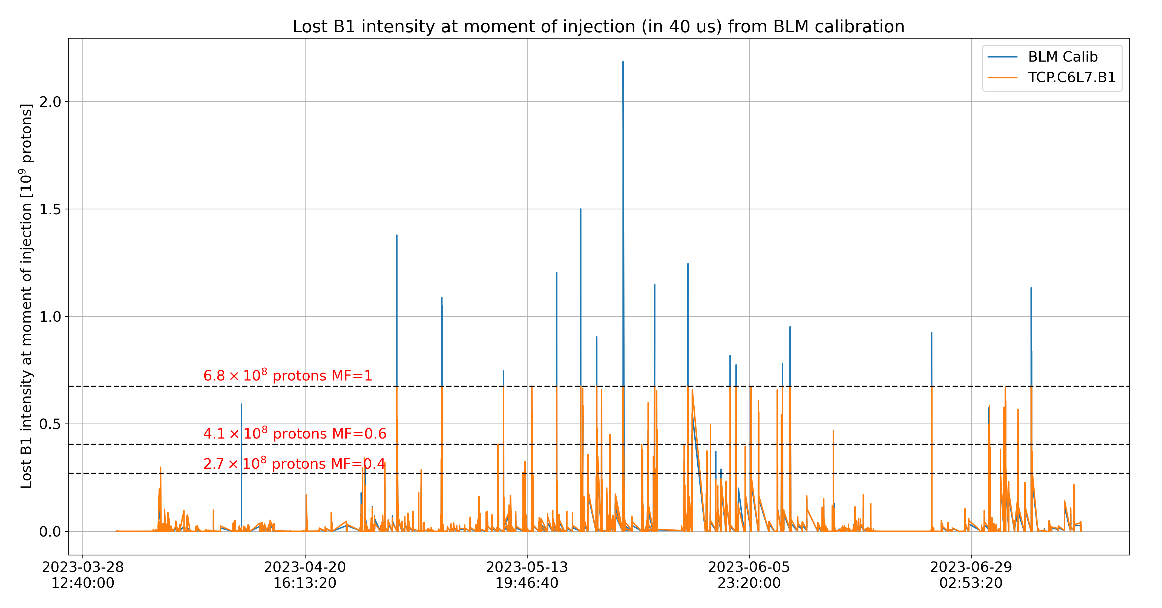
Protons: Beam losses and margin to dump during Injection
Results from BLM calibration RS01 (40us)
MF=0.4
MF=0.6
MF=1
38 B1 dumps from losses on TCP.C
Saturation level 6.8e8 protons

Slide 10
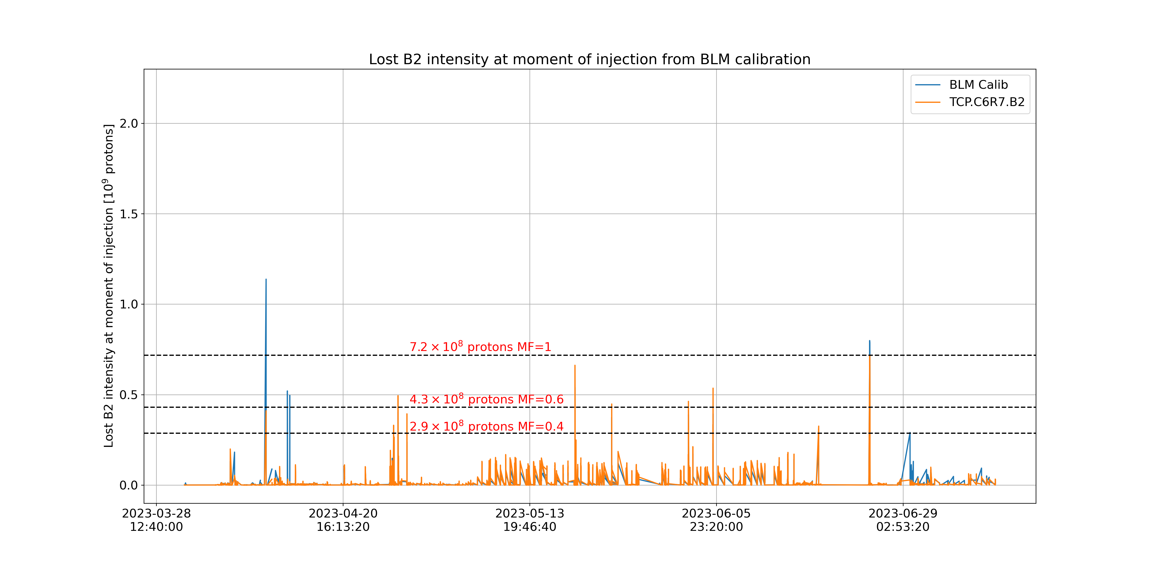
Protons: Beam losses and margin to dump during Injection
Results from BLM calibration RS01 (40us)
MF=0.4
MF=0.6
MF=1
4 B2 dumps from losses on TCP.C
Saturation level 7.2e8 protons

Slide 11
Protons: Beam losses and margin to dump during Injection
Different options for mitigations:
  Blindable BLMs in IR7
    Blinding functionality not designed for IR7 BLMs
    Current implementation would blind all BLMs in IR7 collimators -> Not acceptable risk
      Modification of the functionality requires changes in LSA, FW, SW and GUIs -> not before LS3
    Need to assess impact for combined fast failure scenarios
    Blinding functionality will be commissioned for IP2/8 for IP2/8 injection regions in 2024
      Common FW in all crates, i.e., will be available for IR7 if needed and approved

Slide 12
Protons: Beam losses and margin to dump during Injection
Different options for mitigations:
  Use of Little Ionization Chambers (LIC) detectors
    Replace all SEM detectors by LIC -> Full deployment not before LS3, discussions ongoing
    Interlock during injection or fast losses on LICs (less sensitive)
      Would need to assess their stability first
      First analysis shows linearity between IC and LIC BLM signals
    Proposal to replace the SEMs at TCPs with LIC detectors monitoring Beam 1 during this EYETS (as is already the case for Beam 2 since LS1)
    B.Salvachua in BLMTWG #97

Slide 13
Protons: Beam losses and margin to dump during Injection
Different options for mitigations:
  Add “displaced” BLMs to catch less loss showers
    Enough with a factor ~2 to reach the same level as other limiting BLMs
    Need FLUKA estimates of optimal new positions
    Addition of extra BLMs in new optimal positions downstream of the TCPs
      New BLMs will not be interlocked during commissioning
      Allows comparison of response factors, and if response factors are the ones expected:
      Change of database settings to become part of the protection BLMs
    Preferred option
      Currently investigating the availability of spare channels in the network and necessary cabling for possible installation during this EYETS

Slide 14
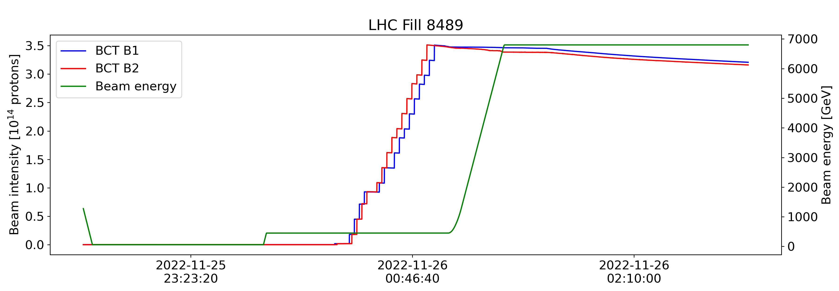
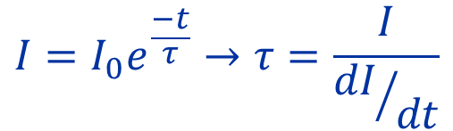
Protons: Beam losses and margin to dump
SQUEEZE
RAMP
ADJUST
STABLE
INJPHYS
FLATTOP
IR7 losses disentangled from luminosity losses thanks to BLM calibration! In ADJUST and STABLE
RAMPDOWN
SETUP
INJPROB
PRERAMP
Beam lifetime and power loss analyzed across the cycle using BLM calibration with RS09 (1.3s)
Other RS studied when necessary
$$I=I_{0}e^{\frac{−t}{τ}}→τ=\frac{I}{{dI}/{dt}}$$

Slide 15
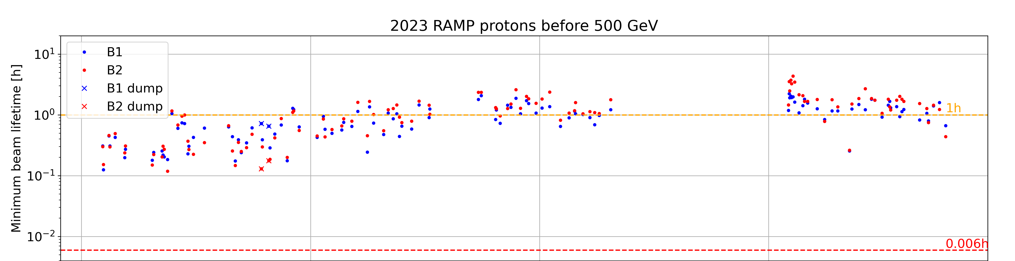
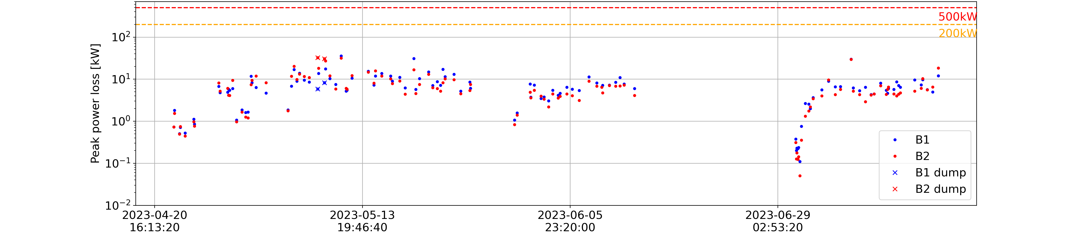
Protons: Beam losses and margin to dump during start of RAMP
Mainly off-momentum losses in IR3 TCPs at start of RAMP, can be quantified with BLM calibration
Beam lifetime drop of 0.006h tolerated at start of RAMP (off-momentum at 450GeV)
Q6 L3 RS10
2 dumps in Q6 L3 in RS10 (5.2s)
“after remaining a long time in injection”
Maximum beam power loss (in IR3 primary colls) below the limits

Slide 16
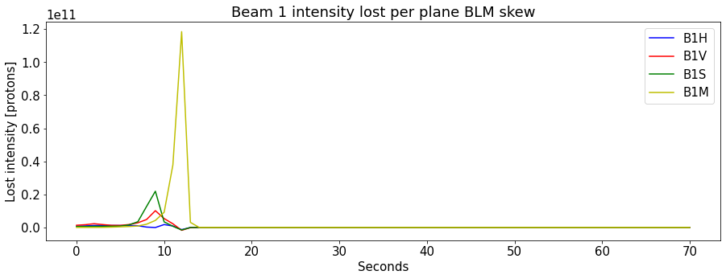
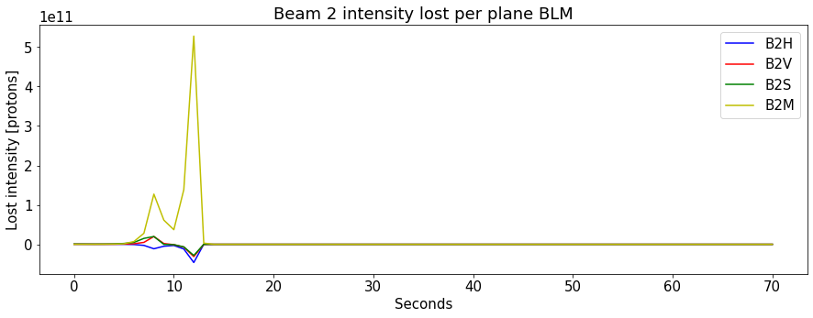
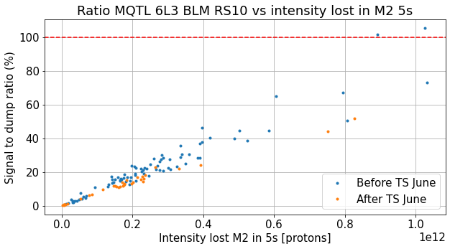
Protons: Beam losses and margin to dump during start of RAMP
RS09 (1.3s)
RS09 (1.3s)
Signal to dump ratio of most limiting BLM vs off-momentum losses integrated 5s ->
Limit around 0.8-1e12 protons lost over 5s in IP3
Main limitation in RS10 (5.2s) as off-momentum losses happen over several seconds
These losses also discussed in Birk’s talk in this session

Slide 17
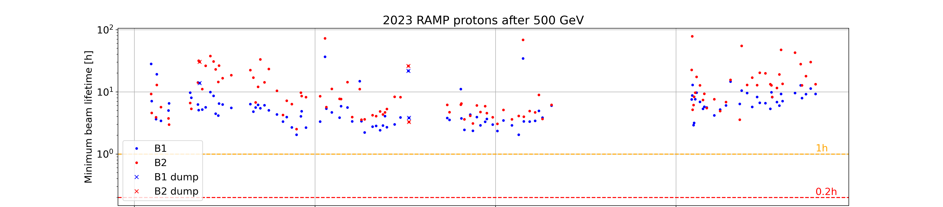
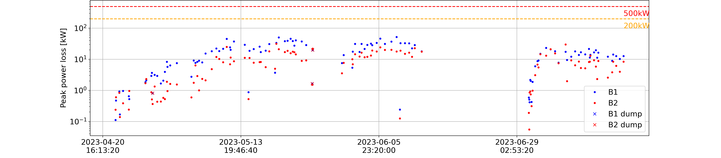
Protons: Beam losses and margin to dump during end of RAMP
1 dump due to UFO in L4
Minimum beam lifetime well above the limits
2 dumps in Q3 L1 RS10 (5.2s) due to losses during 4L1 conditioning, MF raised
Q3 L1 (vacuum)
UFO L4
Maximum beam power loss below the limits

Slide 18
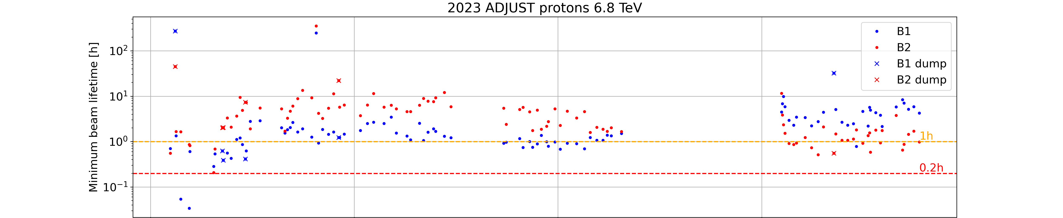
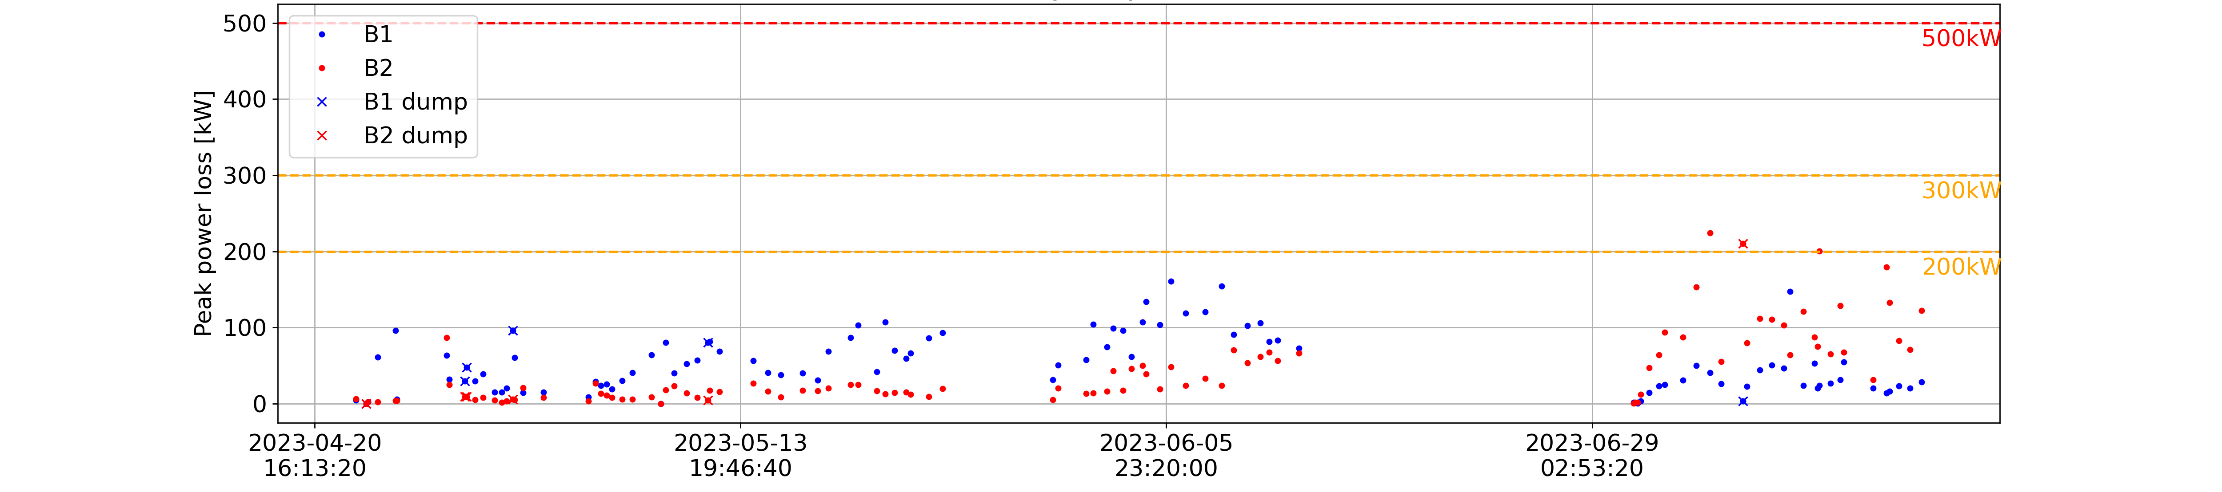
Protons: Beam losses and margin to dump during ADJUST
Low minimum beam lifetime during intensity ramp-up, B1 below 1h warning before TS June, switches with B2 after
Intensity ramp-up
Maximum beam power loss overall below the limits
1 dump due to UFO in R5
MF = 0.6
TCSG A6R7
MF = 0.4
Q6 R7
TCLA D6R7
MQW L7
UFO

Slide 19
Protons: Beam losses and margin to dump during ADJUST
Fills | Date | BLM | BLM threshold then (Gy/s) | BLM threshold now (Gy/s) | RS | Losses in IR7 (kW)
8680 | 28-04-2023 20:18:18 | BLMQI.06R7.B1E10_MQTL | 0.00067 | 0.00089 | RS12 | 12
8681 | 28-04-2023 22:30:41 | BLMQI.06R7.B1E10_MQTL | 0.00067 | 0.00089 | RS12 | 17.5
8694 | 01-05-2023 10:52:43 | BLMTI.06R7.B1E10_TCLA.D6R7.B1 | 0.0025 | 0.0038 | RS12 | 31.7
8749 | 12-05-2023 01:21:35 | BLMQI.05L7.B1E10_MQWA.D5L7 | 0.11 | 0.28 | RS08 | 135.3
9040 | 07-07-2023 07:37:04 | BLMTI.06R7.B2I10_TCSG.A6R7.B2 | 1.8 | 1.8 | RS08 | 308.6
4 dumps at lower beam power loss than targeted (before main thresholds changes), last dump well aligned

Slide 20
BLM thresholds strategy for Pb ions
Changes applied on top of the existing proton BLM master thresholds in cases where there could be operational limitations -> All changes described in LHC-BLM-ECR-0079
IR7 collimators
- Crystal collimation used for operation with Pb ions for the first time
  Completely different loss pattern in LSS7
  Goal is to provide the necessary machine protection without limiting beam performance both when crystals are operating in optimal channeling (operational scenario) or in amorphous
- 2022 lossmaps at injection and top energy used as input to prepare the first proposal of BLM thresholds changes
- 2023 lossmaps with the final configurations not performed until the night of 26th to 27th of September
  Verification of thresholds and changes implemented on the 28th of September

Slide 21
BLM thresholds strategy for Pb ions
Changes applied on top of the existing proton BLM master thresholds in cases where there could be operational limitations -> All changes described in LHC-BLM-ECR-0079
IR7 collimators
- The maximum beam power loss allowed for each scenario was:
  Channeling: 50 kW
  Amorphous: 15 kW
- At least 2 monitors per beam to cover H/V planes for the channeling case and 1 for amorphous case
- Different scale factors at top and injection, implemented as a step function at 2 TeV
Cold magnets -> Collimation leakage
- BLMs in the DS sensitive to collimation leakage
- Some BLMs in the DS showed signals above the thresholds during the 2015 quench test without quenching
  Increase thresholds in these BLMs in the slow RS (RS08-RS10)

Slide 22
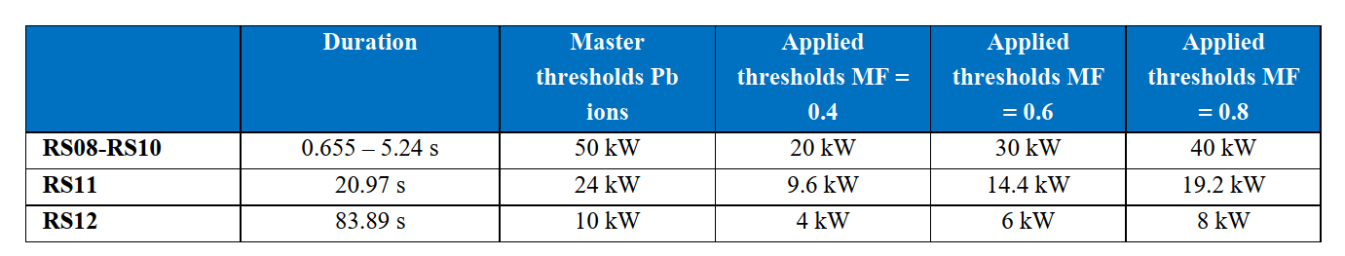
BLM thresholds strategy for Pb ions
Changes applied on top of the existing proton BLM master thresholds in cases where there could be operational limitations -> All changes described in LHC-BLM-ECR-0079
IR7 collimators and cold magnets -> MF strategy
- Same strategy followed for IR7 collimators and DS:
  Collimators start with MF=0.4 -> 20kW in channeling
  DS up to cell 13 start with MF=0.333 -> 35kW in channeling
  Increase in steps of 10kW if needed
  If a quench is observed, the MF will be reduced for the next fill

Slide 23
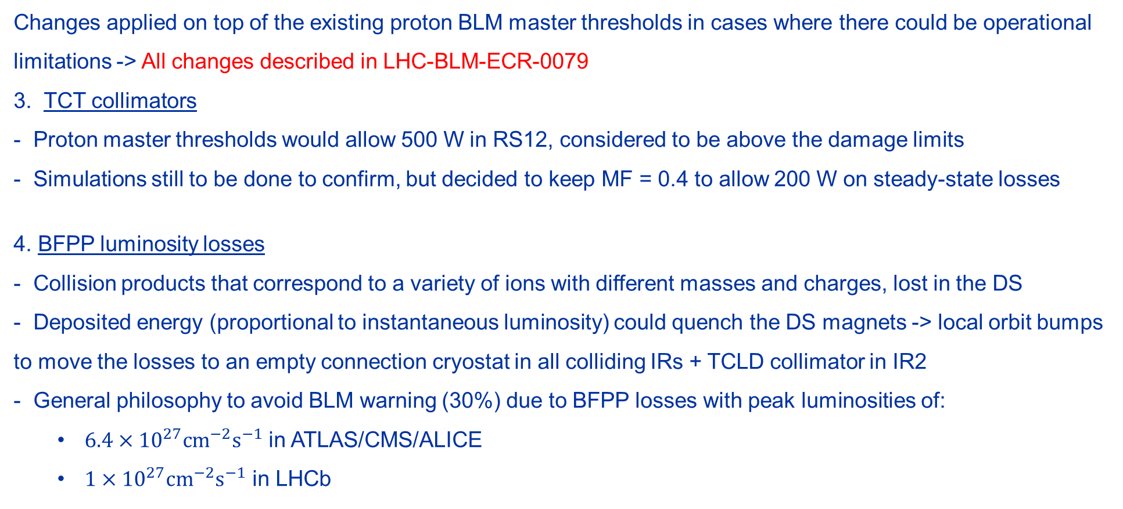
BLM thresholds strategy for Pb ions
Changes applied on top of the existing proton BLM master thresholds in cases where there could be operational limitations -> All changes described in LHC-BLM-ECR-0079
3. TCT collimators
- Proton master thresholds would allow 500 W in RS12, considered to be above the damage limits
- Simulations still to be done to confirm, but decided to keep MF = 0.4 to allow 200 W on steady-state losses
4. BFPP luminosity losses
- Collision products that correspond to a variety of ions with different masses and charges, lost in the DS
- Deposited energy (proportional to instantaneous luminosity) could quench the DS magnets -> local orbit bumps to move the losses to an empty connection cryostat in all colliding IRs + TCLD collimator in IR2
- General philosophy to avoid BLM warning (30%) due to BFPP losses with peak luminosities of:
  $6.4×{10}^{27}{\text{cm}}^{−2}{\text{s}}^{−1}$ in ATLAS/CMS/ALICE
  $1×{10}^{27}{\text{cm}}^{−2}{\text{s}}^{−1}$ in LHCb

Slide 24
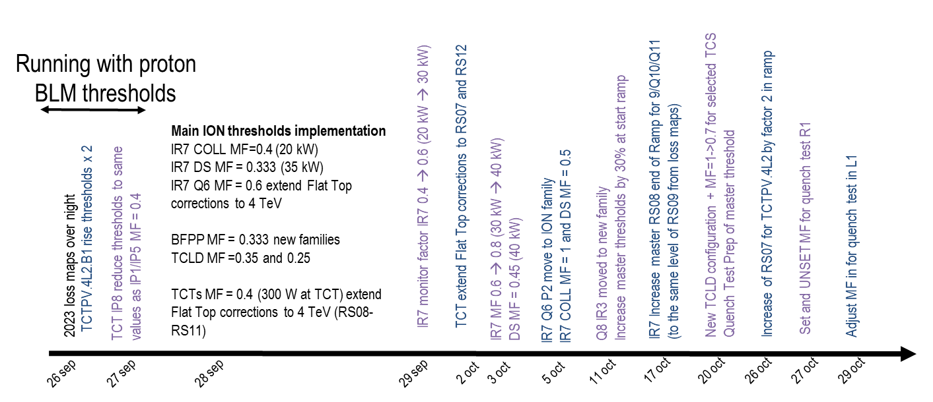
BLM thresholds strategy for Pb ions
5. Changes during the Run
R.Bruce in LMC #475

Slide 25
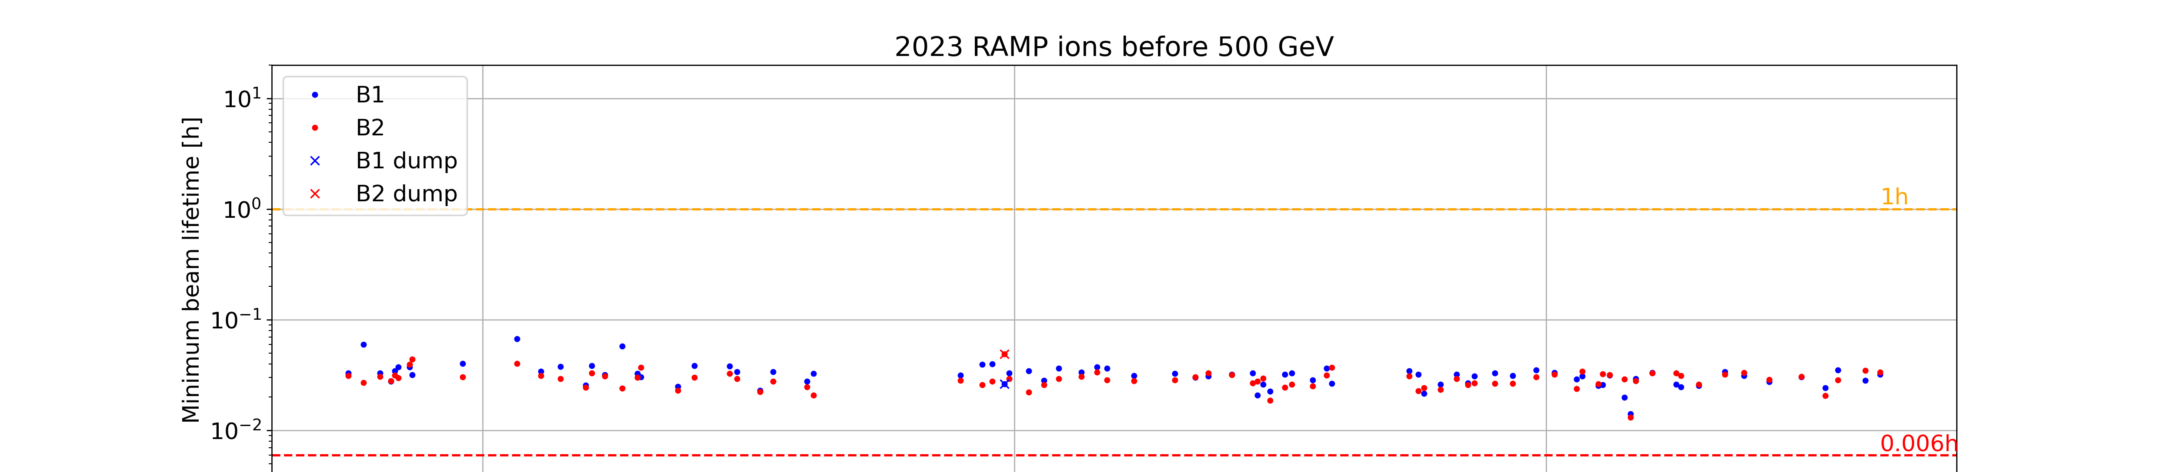
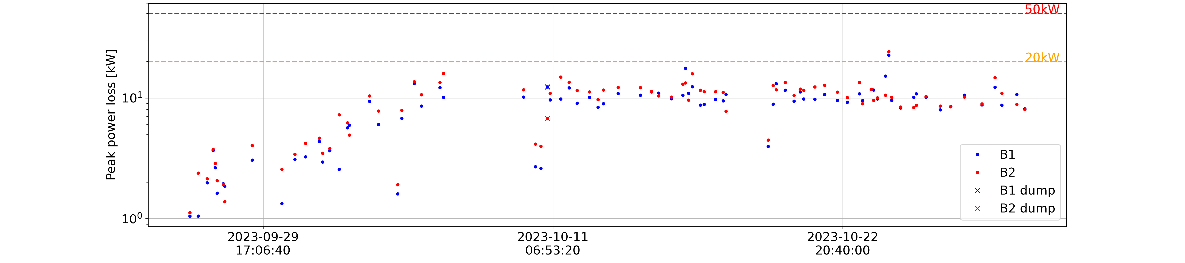
Pb ions: Beam losses and margin to dump during start of RAMP
From BCT, no BLM calibration for off-momentum losses at injection energy
Beam lifetime drop of 0.006h tolerated at start of RAMP (off-momentum at 450GeV)
1 dump in Q8 R3 in RS09 (1.3s) -> Master thresholds raised
Q8 R3
Maximum beam power loss (in IR3 primary colls) below the limits

Slide 26
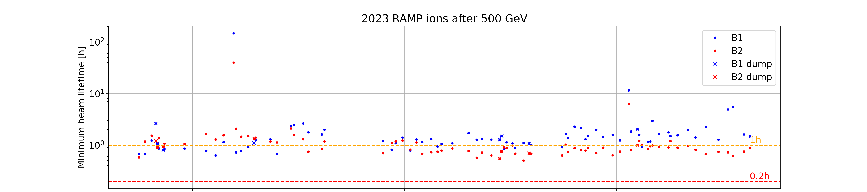
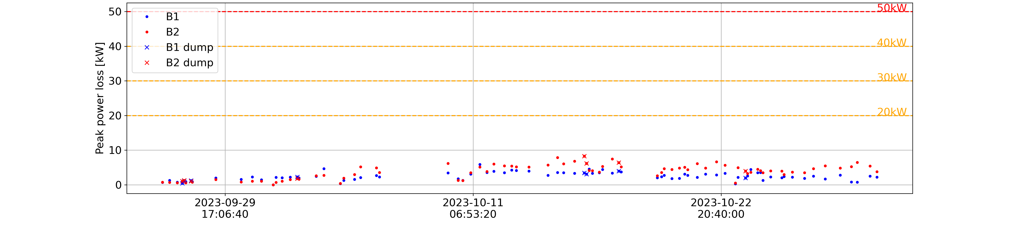
Pb ions: Beam losses and margin to dump during end of RAMP
Minimum beam lifetime consistently around the warning value
8 beam dumps at different BLM and RS, 10Hz loss structure present in all, crystal seems to go out of channeling
Maximum beam power loss below the limits (for channeling)
MF = 0.8
MF = 0.6
MF = 0.4
Q11 L7
Q6 R7
Q6 R7
Q6 R7, TCTPH L1

Slide 27
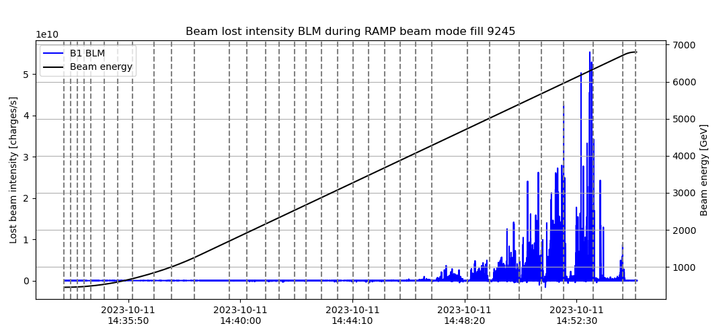
RS06 100Hz data
Pb ions: Beam losses and margin to dump during end of RAMP
Dashed lines: optics matched points
Lots of effort in understanding these 10Hz loss events, more information on LBOC #157 and #158

Slide 28
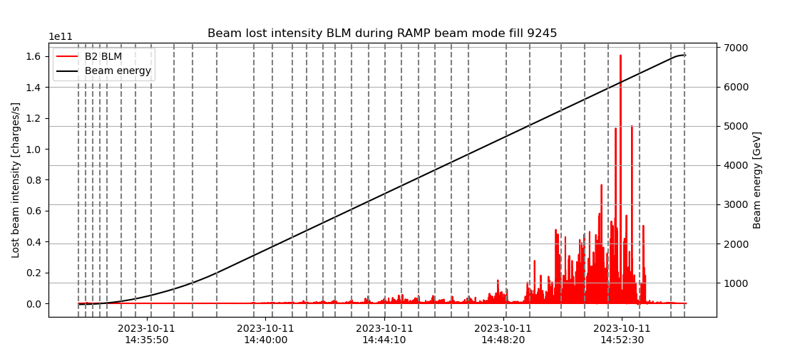
RS06 100Hz data
Pb ions: Beam losses and margin to dump during end of RAMP
Dashed lines: optics matched points
Lots of effort in understanding these 10Hz loss events, more information on LBOC #157 and #158

Slide 29
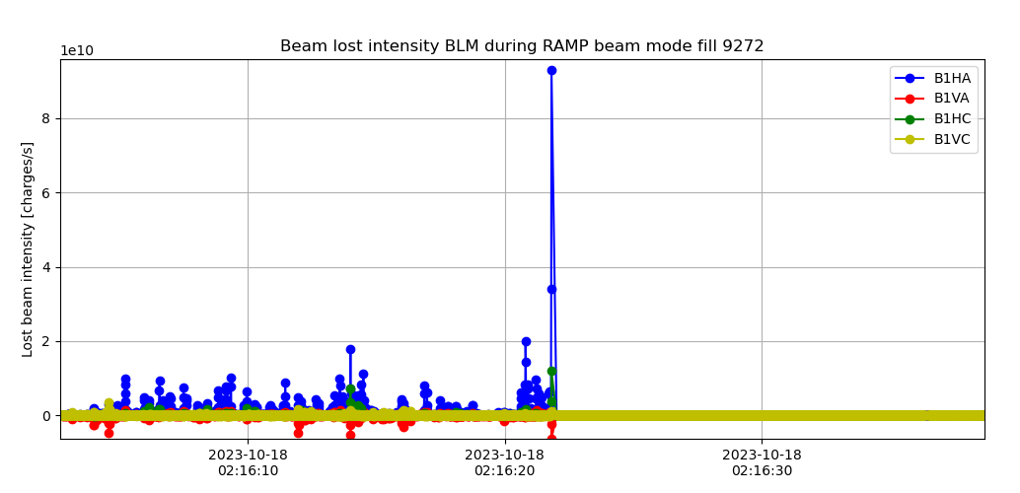
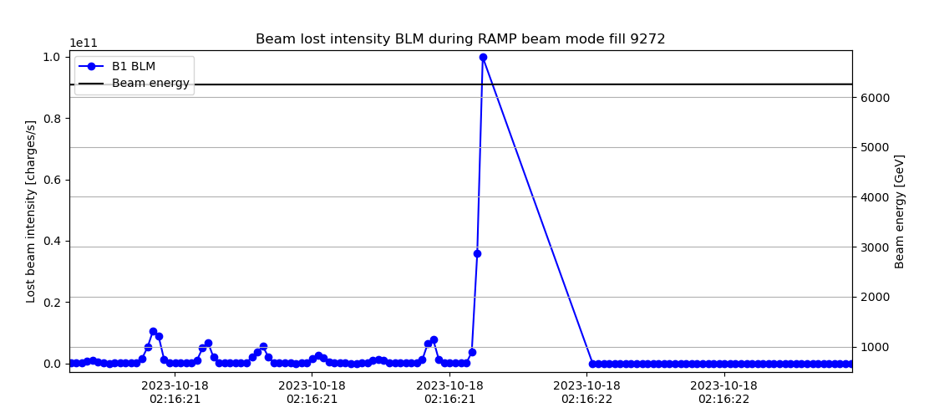
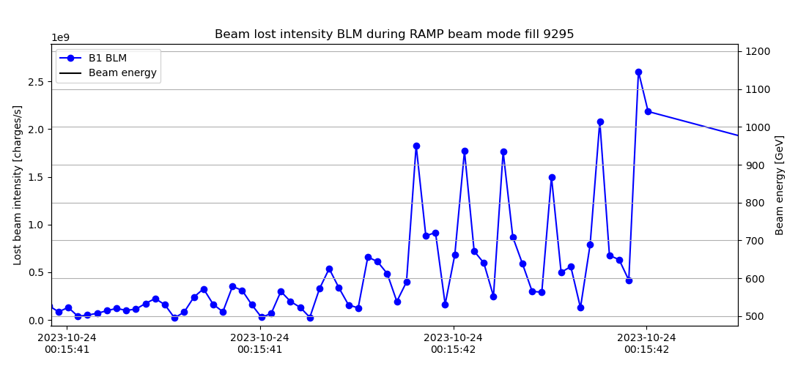
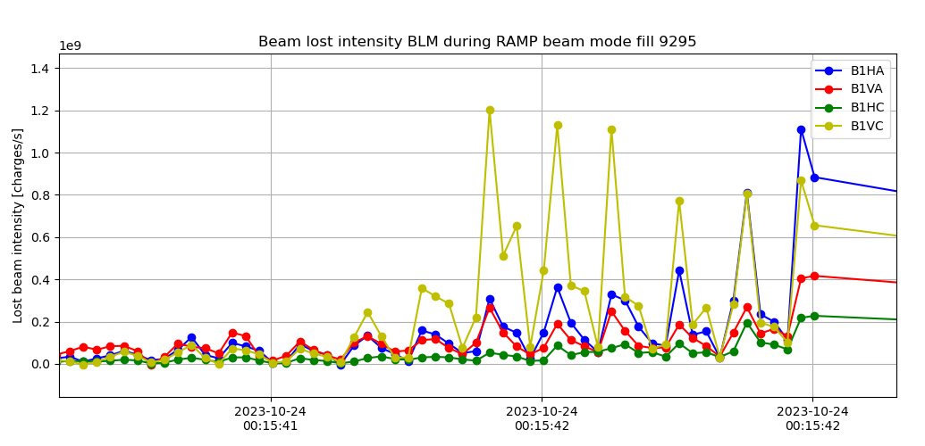
Pb ions: Beam losses and margin to dump during end of RAMP
RS06 100Hz data

Slide 30
Pb ions: Beam losses and margin to dump during end of RAMP
Fills | Date | BLM | BLM threshold then (Gy/s) | BLM threshold end (Gy/s) | RS | Losses IR7 (kW) | Energy (TeV)
9195 | 27-09-23 17:38:16 | BLMQI.06R7.B1E10_MQTL | 0.00026 0.00018 | 0.014 0.014 | RS10 RS11 | 0.20 10Hz AM | 5.6
9196 | 27-09-23 19:42:17 | BLMTI.04L1.B1I10_TCTPH.4L1.B1 | 0.00044 | 0.0058 | RS08 | 2 10Hz AM | 6.3
9199 | 28-09-23 03:15:53 | BLMTI.04L1.B1I10_TCTPH.4L1.B1 | 0.00028 | 0.0058 | RS09 | 1.2 10Hz AM | 6.3
9219 | 03-10-23 02:16:10 | BLMQI.06R7.B1E20_MQTL | 0.0011 | 0.0027 | RS08 | 4.4 10Hz AM | 6.3
4 dumps at lower beam power loss than targeted (for channeling and amorphous), thresholds raised

Slide 31
Pb ions: Beam losses and margin to dump during end of RAMP
Fills | Date | BLM | BLM threshold then (Gy/s) | BLM threshold end (Gy/s) | RS | Losses IR7 (kW) | Energy (TeV)
9265 | 16-10-23 11:50:26 | BLMQI.11L7.B2I10_MQ | 0.0051 | 0.0076 | RS08 | 11.5 10Hz AM | 6.2
9266 | 16-10-23 14:16:38 | BLMQI.11L7.B2I10_MQ | 0.0060 | 0.0090 | RS08 | 12.1 10Hz AM | 6.0
9272 | 18-10-23 02:16:21 | BLMQI.06R7.B1E10_MQTL | 0.11 | 0.11 | RS06 | 99.3 10Hz AM | 6.2
9295 | 24-10-23 00:15:42 | BLMTI.04L2.B1E10_TCTPV.4L2.B1 | 0.0057 | 0.01 | RS07 | 2 10Hz AM | 6.7
3 dumps at targeted beam power loss for amorphous, some thresholds raised;
1 beam dump at lower beam power loss

Slide 32
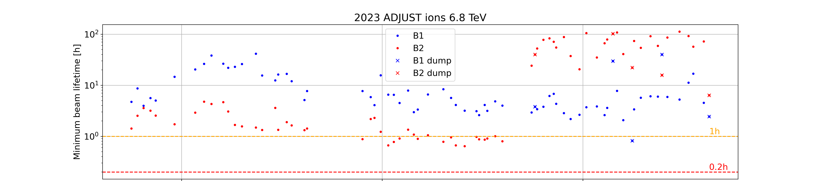
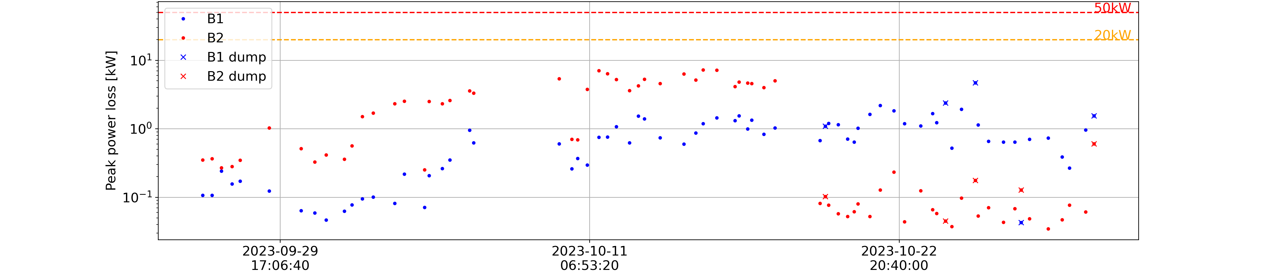
Pb ions: Beam losses and margin to dump during ADJUST
Minimum beam lifetime degrading for Beam 2, improved after ALICE polarity change
3 beam dumps at RS06 (1ms), 10Hz loss structure present in all, crystal seems to go out of channeling
Q6 R7
TCLD
Quench test
Maximum beam power loss below the limits
Circuit breaker issue

Slide 33
Pb ions: Beam losses and margin to dump during ADJUST
Fills | Date | BLM | BLM threshold (Gy/s) | RS | Losses in IR7 (kW)
9280 | 20-10-23 02:32:12 | BLMTI.11R2.B1I10_TCLD.A11R2.B1 | 0.021 | RS06 | 6 10Hz AM*
9299 | 24-10-23 14:17:57 | BLMQI.06R7.B1E10_MQTL | 0.10 | RS06 | 145 10Hz TR*
9304 | 25-10-23 17:05:18 | BLMQI.06R7.B1E10_MQTL | 0.10 | RS06 | 100 10Hz TR*
*Events studied by D.Mirarchi, presented on LBOC #158
1 beam dump at a lower power loss but on the TCLD, settings changed;
2 beam dumps on Q6 R7 from violent 10Hz loss events
NO THRESHOLDS CHANGED

Slide 34
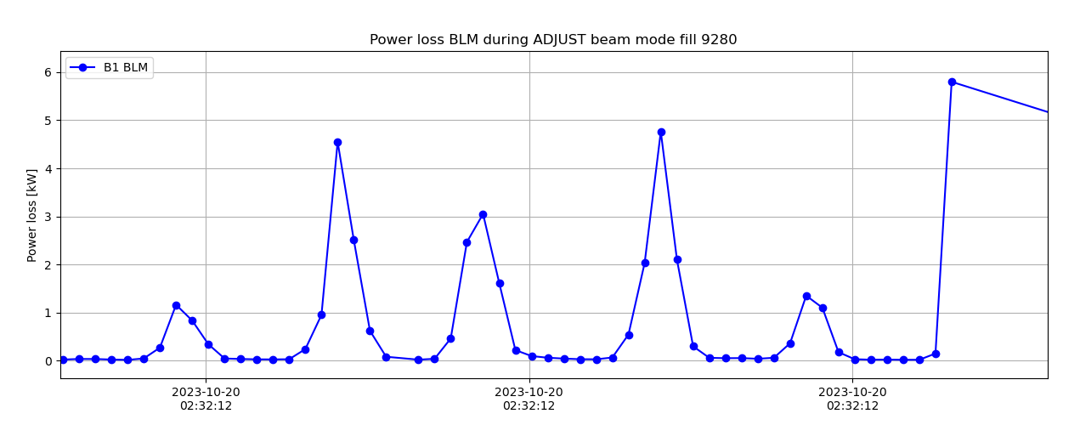
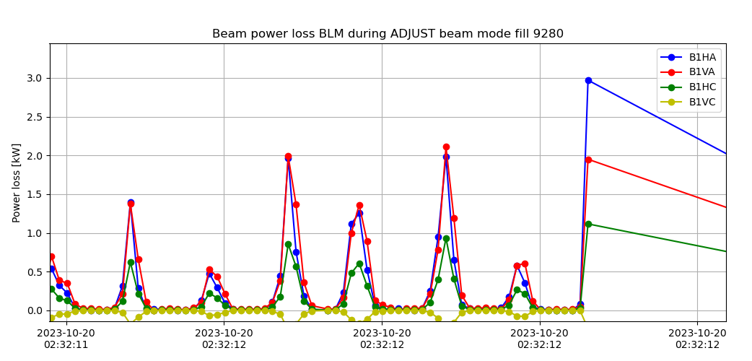
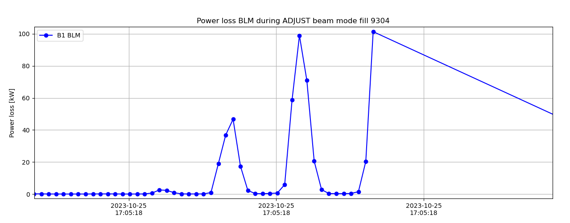
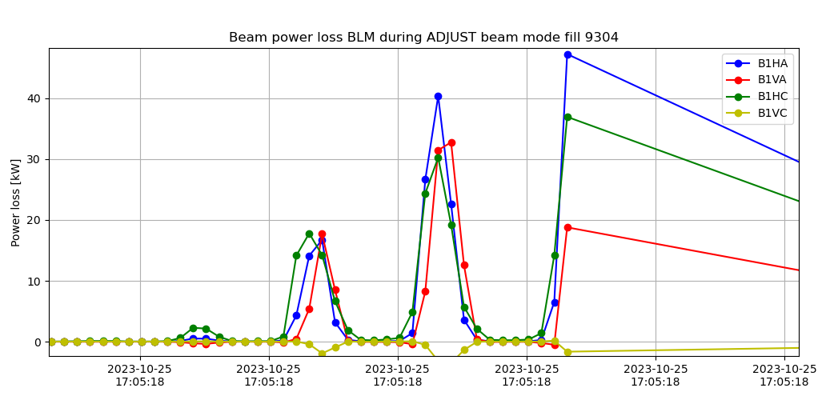
Pb ions: Beam losses and margin to dump during ADJUST
RS06 100Hz
TCLD dump
Q6 R7 dump

Slide 35
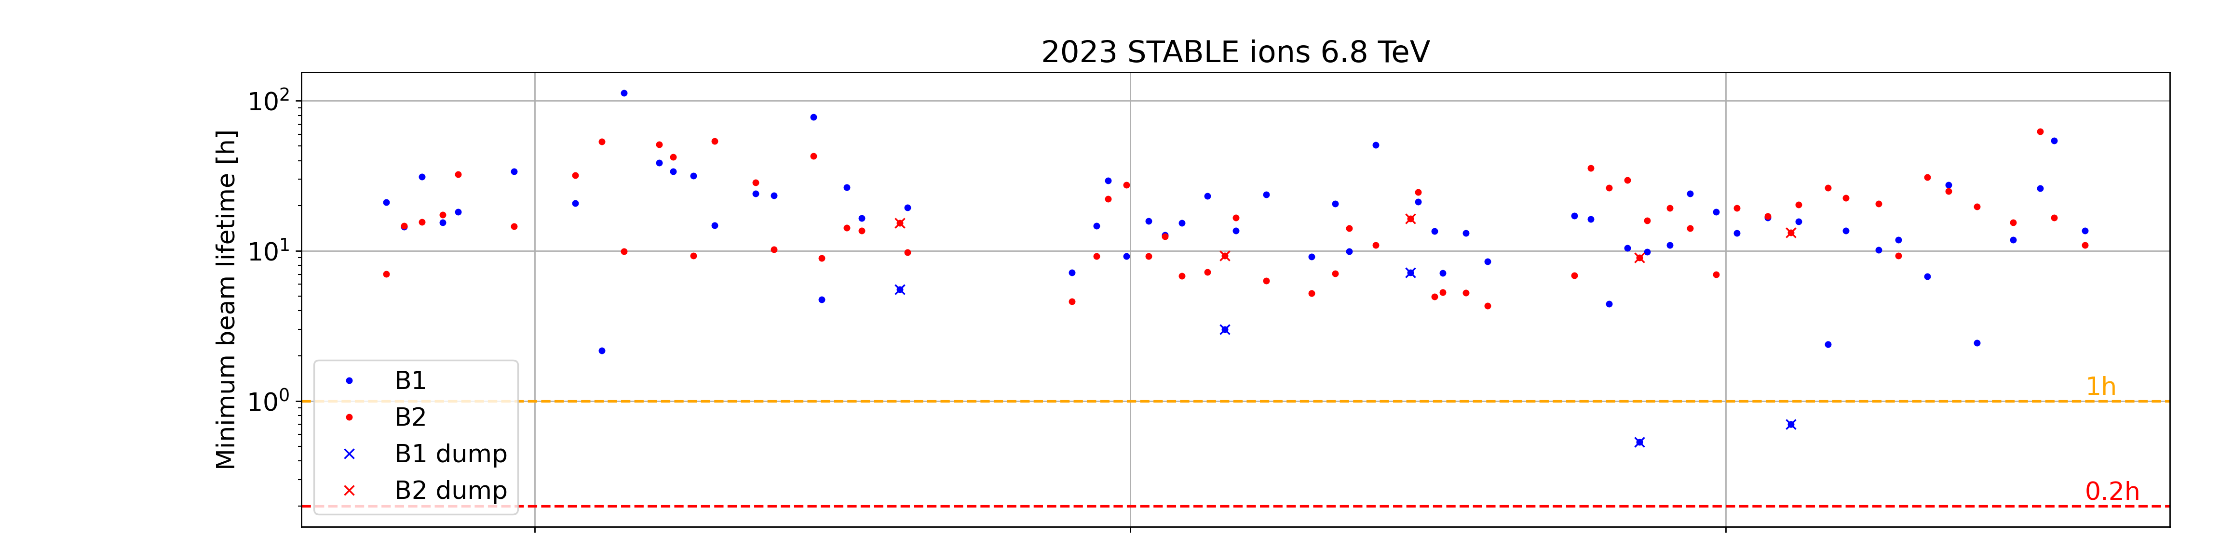
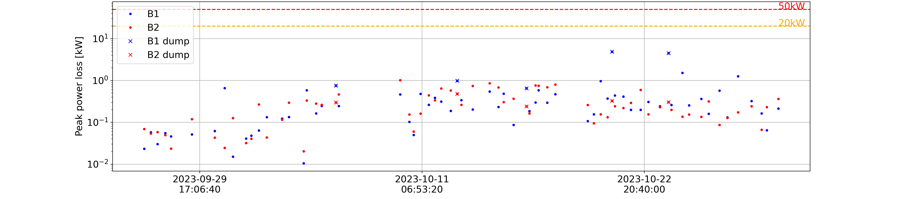
Pb ions: Beam losses and margin to dump during STABLE
Minimum beam lifetime overall above the limits
5 beam dumps at RS06 (1ms), 10Hz loss structure present in all, crystal seems to go out of channeling
Q6 R7
Q6 R7
TCLD
TCLD
TCLD
Maximum beam power loss below the limits

Slide 36
Pb ions: Beam losses and margin to dump during STABLE
Fills | Date | BLM | BLM threshold (Gy/s) | RS | Losses in IR7 (kW)
9234 | 06-10-23 19:32:02 | BLMTI.11R2.B1I10_TCLD.A11R2.B1 | 0.021 | RS06 | 15 10Hz VR*
9251 | 13-10-23 05:10:16 | BLMTI.11R2.B1I10_TCLD.A11R2.B1 | 0.021 | RS06 | 10 10Hz AM*
9267 | 16-10-23 18:14:47 | BLMTI.11R2.B1I10_TCLD.A11R2.B1 | 0.021 | RS06 | 13.3 10Hz AM*
9284 | 21-10-23 05:31:02 | BLMQI.06R7.B1E10_MQTL | 0.101 | RS06 | 15 10Hz TR*
9296 | 24-10-23 04:02:07 | BLMQI.06R7.B1E10_MQTL | 0.101 | RS06 | 44.3 10Hz TR*
*Events studied by D.Mirarchi, presented on LBOC #158
3 beam dumps on the TCLD at power losses comparable with amorphous, settings changed;
2 beam dumps on Q6 R7 from 10Hz loss events
NO THRESHOLDS CHANGED

Slide 37
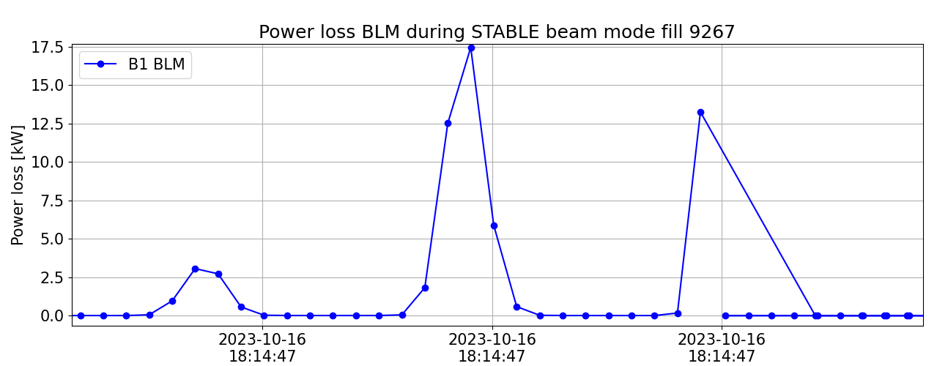
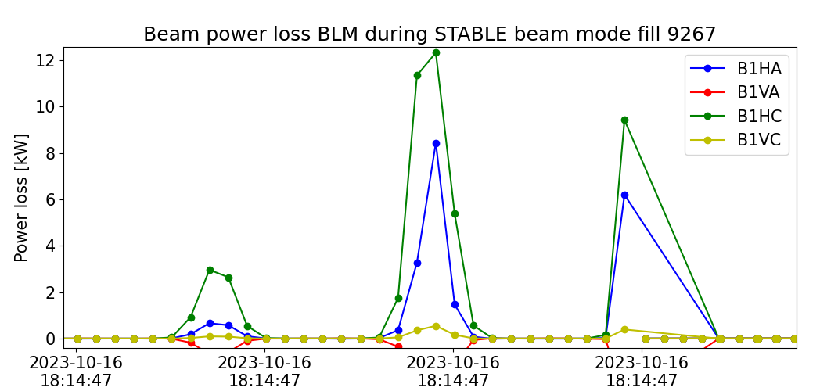
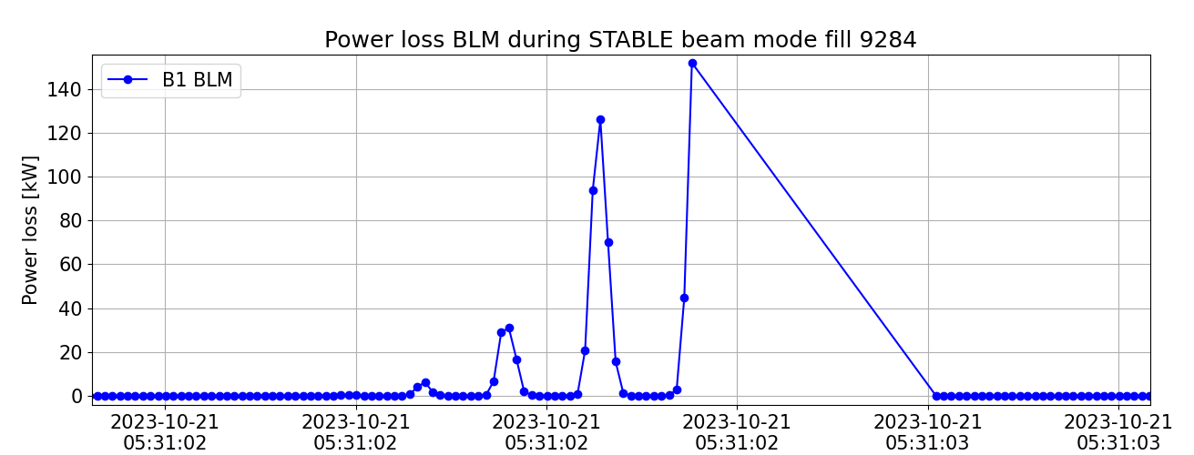
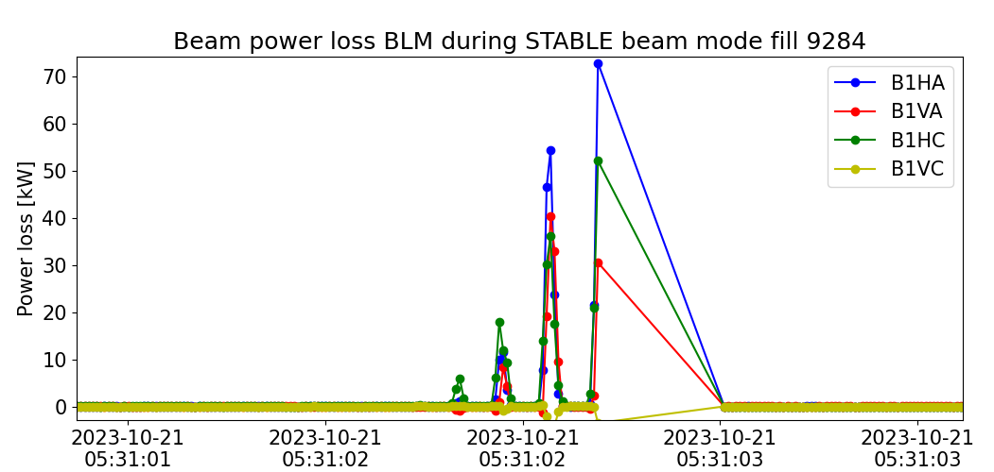
Pb ions: Beam losses and margin to dump during STABLE
RS06 100Hz
TCLD dump
Q6 R7 dump

Slide 38
Lessons learnt for the next Ion Run
1. Operation with crystal was efficient but some improvement is needed in order to maintain the crystals in channeling, in particular during the energy RAMP -> See more in R.Cai’s talk in this session
Crystal operation in channelling, amorphous or volume reflection has a big impact on BLM signal pattern
  Additional margin for these cases is needed for next ion Run
3. Control of 10Hz losses will significantly improve
Loss maps as early as possible are essential, even if not in the full final configuration
  First set of thresholds done with 2022 loss maps was important to advance the work

Slide 39
Summary
- Beam lifetime and beam power loss analyzed for the proton and ion 2023 Runs
- Proton Run:
  Injection losses in particular of Beam 1 could pose a limitation for 2024 -> Several options to increase the margin of beam loss measurements in RS01 are under consideration.
  Limitations in BLM thresholds during ADJUST understood and mitigated -> Running regularly with minimum beam lifetime of ~1h, equivalent to 100 kW maximum power loss on average, with peaks up to 230kW (300kW in RS08, 655ms)
- Ion Run:
  New beam loss pattern in IR7 due to the novel crystal collimation operation -> Many BLM thresholds were needed to adapted for this new scenario, but overall, the strategy was correct
  For next Run, we will study how to overcome the limitations found during the RAMP, when crystal channelling could not be maintained
  ADJUST and STABLE beam lifetime drops dominated by 10Hz loss events

Slide 40
Backup slides

Slide 41
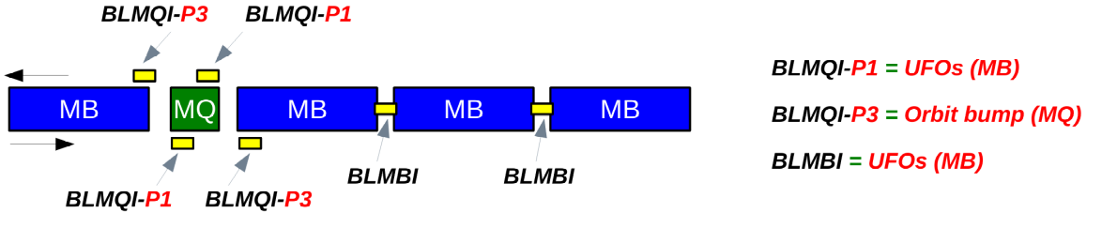
BLM thresholds strategy for protons
No changes with respect to 2022 -> Described in LHC-BLM-ECR-0073
Cold magnets->
- Dust particles (UFOs) dominant source of transient beam loss events in the LHC arcs and DS
- Best machine availability if UFO-induced BLM dumps are avoided and quenches tolerated
Master thresholds at 3x the quench level in short RS (40us – 2.5ms), and MF = 0.333
Standard BLM layout in a LHC arc half-cell
Thresholds reduced at selected arc/DS locations which are (possibly) affected by a hardware non-conformity: 2 magnets with one less quench heater and 35 magnets with a possible non-conform bypass diode

Slide 42
BLM thresholds strategy for protons
6. Changes during the Run
- Rise of MF MQTL 6R7 after dumps in ADJUST RS12 (84s) before IR7 MQW, Q6 MQTL master thresholds update
- Rise of MF all IR7 families to give more margin to RS12 without changing the collimation model
- Rise of MF in B1 TCP.C and TCP.B to give more margin for injection losses RS01 (40us)
- Rise of MF in BLMQI.03L1.B2E30_MQXA to give more margin during conditioning to the high losses in 4L1
Update of collimation model with 2022 lossmap data. Set MF=0.4 for all collimator families
Update of BLM Master thresholds in IR7 for Warm magnet MQW, Q6 MQTL
Increase of MF from 0.6 to 1 for TCP.C and TCP.B for Beam 1
Temporal increase of MF of BLMQI.03L1.B2E30_MQXA from 0.166 to 0.25
Increase of MF from 0.4 to 0.6 in all IR7 families
Increase of MF from 0.4 to 0.6 in MQTL 6R7
26 March
28 April
12 May
17 May
26 May
31 May

Slide 43
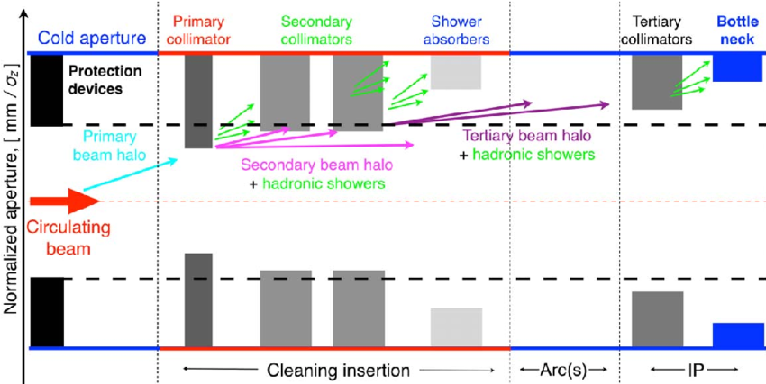
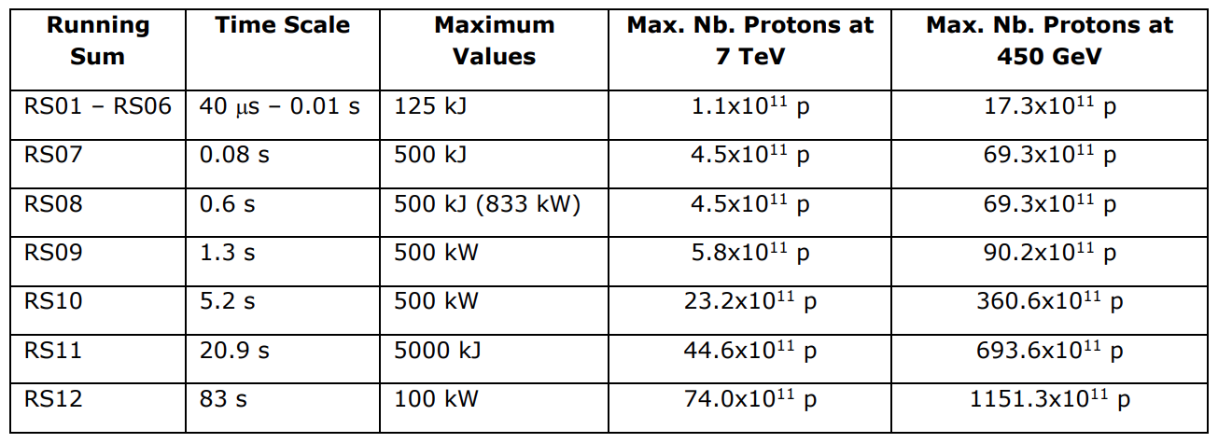
BLM thresholds strategy for protons
2. IR7 collimators -> New IR7 collimator threshold model applied in 2022 -> LHC-BLM-ECR-0072
- BLM thresholds adjusted to the damage limits in collimators from losses in the entire IR7 collimation system
  Damage limits from recent measurements and simulations at injection and top energy
  Adjusted interpolation of proton loss rate for intermediate energies -> Same allowed power loss
https://www.researchgate.net/figure/Key-elements-of-the-LHC-multistage-collimation-system-IP-interaction-point_fig12_306186620

Slide 44
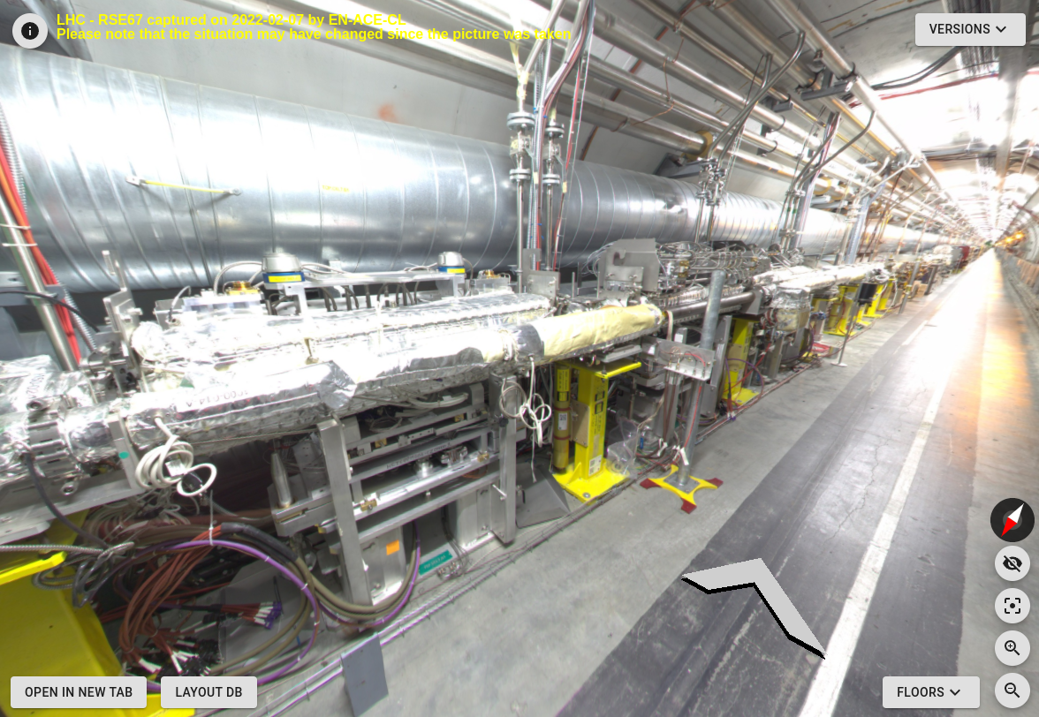
Protons: Beam losses and margin to dump during Injection
TCP.C
TCP.D
TCP.C
BLM
TCP.D BLM

Slide 45
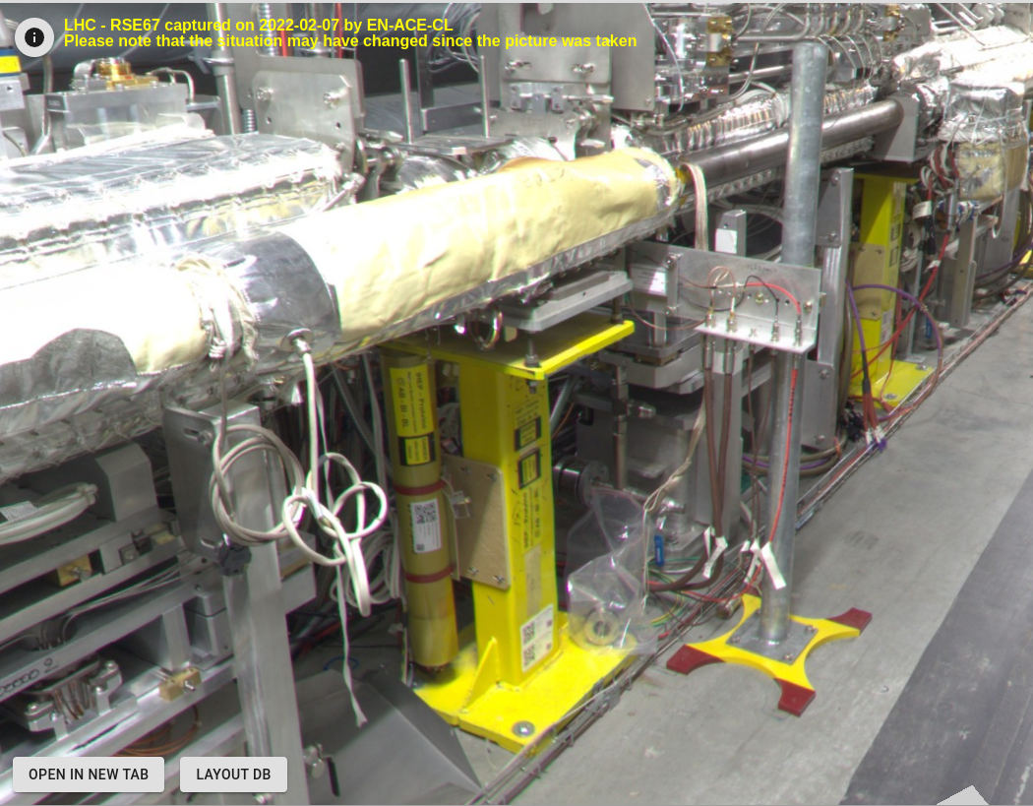
Protons: Beam losses and margin to dump during Injection
TCP.C
BLM
TCP.D BLM

Slide 46
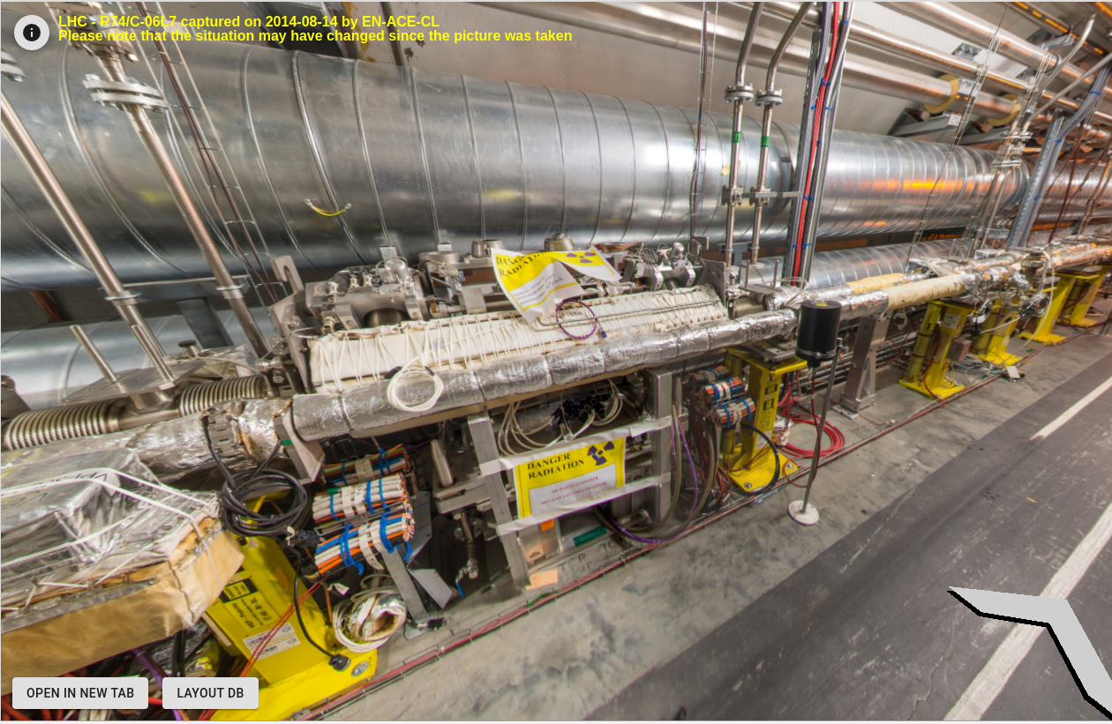
Protons: Beam losses and margin to dump during Injection
TCP.B
TCP.B BLM
TCP.C BLM

Slide 47
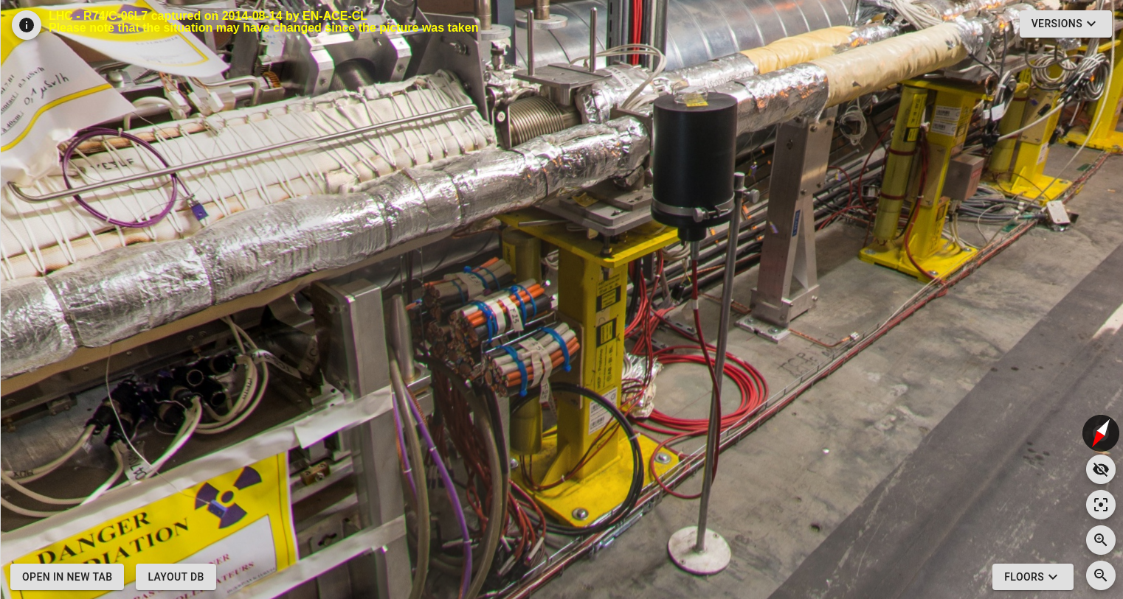
Protons: Beam losses and margin to dump during Injection
TCP.B
TCP.B BLM

Slide 48
Protons: Beam losses and margin to dump during start of RAMP
Fills that dumped:
- 8735: Dumped 1490b due to losses at the beginning of the ramp (BLMQI.06L3.B2E10_MQTL, 5.2s RS) after remaining a long time at injection energy. Losses in R3, R7. Higher than usual losses in IR6 due to high AG population of 8.2e10 (B1) and 6.3e10 (B2). No relevant orbit changes.
- 8737: Dumped fill of 1800b due to losses at the beginning of the ramp due to debunched beam (BLMQI.06L3.B2E10_MQTL, 5.2s RS). Losses in R3, R7. Higher than usual losses in IR6 due to high AG population of 6.6e10 (B1) and 4.1e10 (B2). No relevant orbit changes. Similar event as on 08-MAY-2023 20h29.

Slide 49
Protons: Beam losses and margin to dump during end of RAMP
8683 - Dumped during the ramp with 400b. UFO signature in 16/17L4. Losses in L4 as well as L5, IR6, L7 (Beam 1). Dumped on losses in RS04 at BLMAI.05R6.B1E10_DFBLB. Quench of MB A17L4. No visible orbit changes.
8828 - Dumped on losses during the ramp on BLMQI.03L1.B2E30_MQXA (5.2s RS). High vacuum activity in L1 before the dump. Asymmetric losses in IR7 (higher in R7). Usual AG losses in IR6. Orbit changes below <15 um (still in the ramp).
8829 - Dumped on losses in the ramp on BLMQI.03L1.B2E30_MQXA (5.2s RS). High vacuum activity in L1 before the dump. Asymmetric losses in IR7 (higher in R7). Usual AG losses in IR6. Orbit changes below <15 um (still in the ramp).

Slide 50
Protons: Beam losses and margin to dump during ADJUST
8643: Dump of 75b fill due to losses at TCL.6R5.B1 (RS01/02) caused by UFO when moving the TCL. High losses in R5 and asymmetric losses in IR7 (higher for L7). Otherwise clean dump. No relevant orbit changes.
8680: Issue in B1H with bad lifetimes leading to slow losses which dump in RS12. Clean dump
8681: Dump due to cleaning issue in B1H with slow losses in IR7 (RS12). Clean dump
8694: Dump of 900b physics fill due to losses at BLMTI.06R7.B1E10_TCLA.D6R7.B1 in RS12 when going into collisions (B1 lifetime issue). No relevant orbit change. Usual AG losses in IR6.
8749: Dump of 2400b physics fill due to beam losses in IR7 (lifetime dip) when going into collisions (BLMQI,05L7.B1E10.MQWA.D5L7, 655ms RS). Losses in L7, usual AG losses in IR6. Orbit changes < 10um RMS.
9040: Dumped on losses in IR7 when going into collisions ( TCSG.A6R7.B2 - RS08). Losses in R7. Usual AG losses in IR6. No relevant orbit change.

Slide 51
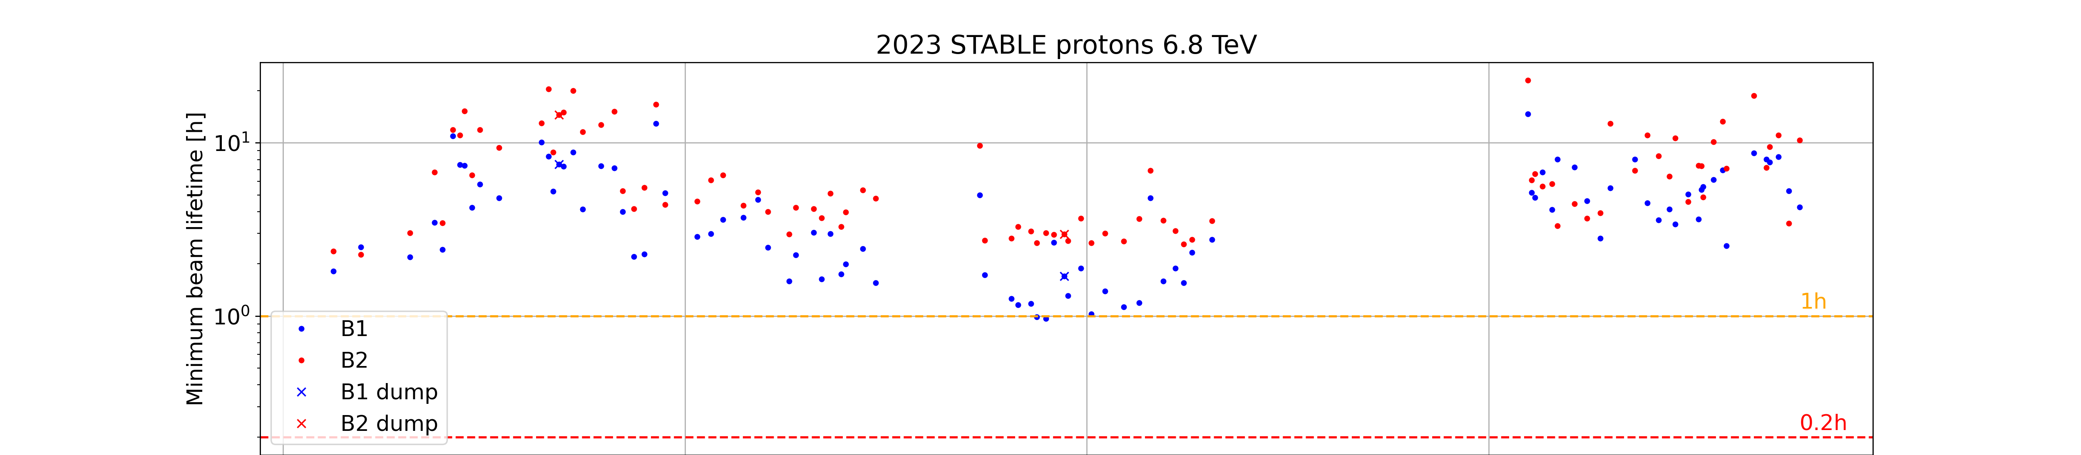

Protons: Beam losses and margin to dump during STABLE
Minimum beam lifetime overall above the limits
Losses in IR3
UFO L2
Maximum beam power loss below the limits

Slide 52
Protons: Beam losses and margin to dump during STABLE
Reasons to dump:
8728: Dump of ~1200b fill at beta*=39cm due to BLMs in IR3. No relevant orbit change. Clean dump with usual AG losses in IR6.
8872: Dumped on UFO-like losses in IR2, first detected by ALICE BCM. Losses in ~400us visible in IR2 before the dump. Highest losses on BLMEI.01L2.B1B10_BKGD_BCM. Usual AG losses in IR6. No relevant orbit changes.

Slide 53

BLM thresholds strategy for Pb ions
Changes applied on top of the existing proton BLM master thresholds in cases where there could be operational limitations -> All changes described in LHC-BLM-ECR-0079

Slide 54

BLM thresholds strategy for Pb ions
5. Changes during the Run
- Fast losses at end of RAMP -> TCTs FT corrections extended, increased IR7 MF
- 10Hz events also observed at top energy, crystals going out of channeling
- Q8 IR3 thresholds increased by 30% at start of RAMP

Slide 55
Ions: Beam losses and margin to dump during start of RAMP
- Fill 9241: Dumped on losses just at the start of the ramp with 1240b in IR3 (BLMQI.08R3.B1I30_MQ, RS09). Likely unbunched beam. H orbit changes <30um RMS for B1/B2 (start of the ramp). High losses in IR3 and IR6.
Fills | Date | BLM | BLM threshold (Gy/s) | BLM threshold end (Gy/s) | RS | Losses IR3 | Energy (TeV)
9241 | 27-09-23 17:38:16 | BLMQI.08R3.B1I30_MQ | 0.0039 0.006 | 0.005 0.0081 | RS09 RS08 | 12kW 1.75e11 charges | 450GeV

Slide 56
Ions: Beam losses and margin to dump during end of RAMP
- 9195: Fill with 395b dumped in the ramp due to losses above threshold for BLMQI.06R7.B1E10_MQTL (RS10/11). No relevant orbit changes. Moderate AG losses in IR6.
- 9196: Fill with 339b dumped on losses at BLMTI.04L1.B1I10_TCTPH.4L1.B1 (RS08). H Orbit changes <25um (still in the ramp). Relatively low AG losses in IR6.
- 9199: Fill with 283b dumped on losses at BLMTI.04L1.B1I10_TCTPH.4L1.B1 (RS09). H Orbit changes <20um (still in the ramp). Moderate AG losses in IR6.
- 9219: Dump of 675b fill in the ramp due to losses at BLMQI.06R7.B1E20_MQTL (RS08). Orbit change of ~20 um rms in B1H and B2H before dump. Strange excursions of ~200 um visible in BPM data in L6 for B2 H and V appearing 2 turns before the dump. Moderate AG losses in IR6.
- 9265: Dump on "10Hz losses" towards the end of the ramp. Losses triggered by BLM in 11L7.B2. Oscillatory pattern visible and also seen in IR3 and IR7. Pattern loosely visible on the BBQ data.
- 9266: 10Hz like losses during the ramp. Triggered on BLM in 11L7.B2. Pattern visible in IR3 and IR7 for B2. Otherwise, clean dump.

Slide 57
Ions: Beam losses and margin to dump during end of RAMP
- 9272: Dump on losses during the ramp (1240b) with 10Hz-like loss pattern (BLMQI.06R7.B1E10_MQTL, RS06). H orbit oscillations <10um RMS visible. Losses in IR7 and IR3. Relatively low AG losses in IR6.
- 9295: Dump of 1080b physics fill on beam losses (BLMTI.04L2.B1E10_TCTPV.4L2.B1, RS07) at the end of the ramp. Higher than usual losses in L7 and at TCTPV.L2.B1. Usual AG losses in IR6. Oscillating loss pattern before the dump (~20 Hz). Some orbit oscillation visible in H RMS orbit but with very low amplitude (5um RMS).

Slide 58
Ions: Beam losses and margin to dump during ADJUST
- 9280: Physics fill with 960b dumped on losses in ADJUST. TCLD.A11R2.B1 triggered in RS06. 10Hz loss pattern visible already 1s before the dump in IR7 and in R2. No obvious losses in IR3. Slightly higher than usual AG losses in IR6. H orbit oscillations <10um RMS for B1H and B2H.
- 9299: Physics fill with 960b dumped in Adjust due to losses in IR7. 10Hz loss pattern visible before the dump. Losses in IR7, IR3, and at TCTPV.4L2. H orbit increase up to 20 um (B1) and 10 um (B2) RMS before the dump.
- 9304: Physics fill with 960b dumped in Adjust due to losses in IR7. 10Hz loss pattern visible before the dump. Losses in IR7, IR3, and at TCTPH.4L1. H orbit oscillations of ~50um amplitude in B1 and ~20 um in B2 building up before the dump.

Slide 59
Ions: Beam losses and margin to dump during STABLE
- 9234: Physics fill with 1240b dumped on losses at BLMTI.11R2.B1I10_TCLD.A11R2.B1 (RS06). Losses at TCLD.R2 start to increase ~10ms before the dump. Smaller loss peak visible ~100ms before the dump. Losses also visible in IR7. Relatively high AG losses. Some H orbit movements visible but with amplitudes <20um.
- 9251: "10Hz dump" of 1240b ion fill. 10 Hz signature clearly visible in BLM signals. Dump on losses on TCLD.A11R2.B1. Clean dump.
- 9267: 10Hz event in stable beams. Dump triggered by losses on BLM TCLD.A11R2.B1. Pattern visible in IR3 and IR7 for B2. Orbit oscillations are visible. Otherwise, clean dump.
- 9284: Physics fill with 960b dumped due to losses in IR7 (Q6R7, RS06). 10Hz loss pattern visible before the dump. Losses in IR7 and IR3. Slightly higher AG losses. H orbit oscillations with ~40um amplitude RMS for B1H and ~15um for B2H. Same orbit oscillations in V but with much smaller amplitude (<5um).
- 9296: Physics fill with 1080b dumped due to losses in IR7 (Q6R7, RS06). 10Hz loss pattern visible before the dump. H orbit oscillations with ~35um amplitude RMS for B1H and ~10um for B2H. Losses in IR7 and IR3. Relatively low AG losses.

