Slide 1
HiRadMat and AWAKE feedback & outlook for 2024
A. Goillot on behalf of the HiRadMat team
M. Turner, G. Zevi Della Porta on behalf of the AWAKE collaboration
6st December 2023 - JAPW 2023

Slide 2


Outline
Facility and Plans
2023 Physics Highlights
2023 Beam Feedback
2024 Beam Requests
Facility and Plans
2023 Physics Highlights
2023 Beam Feedback
2024 Beam Requests

Slide 3
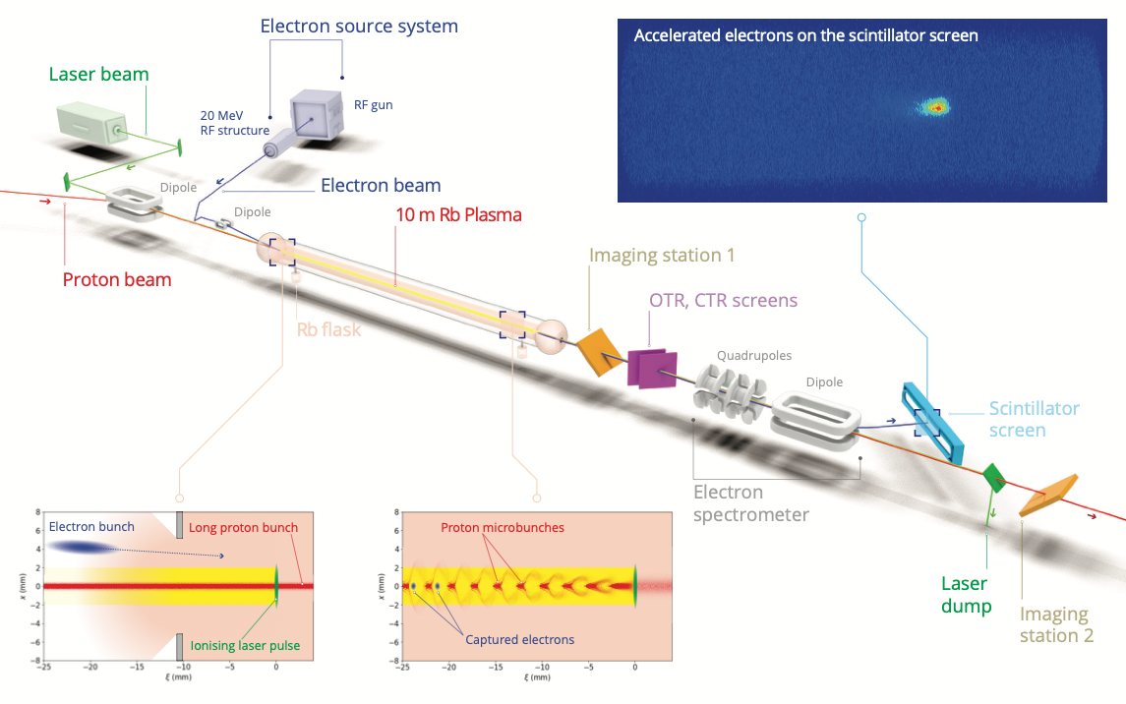
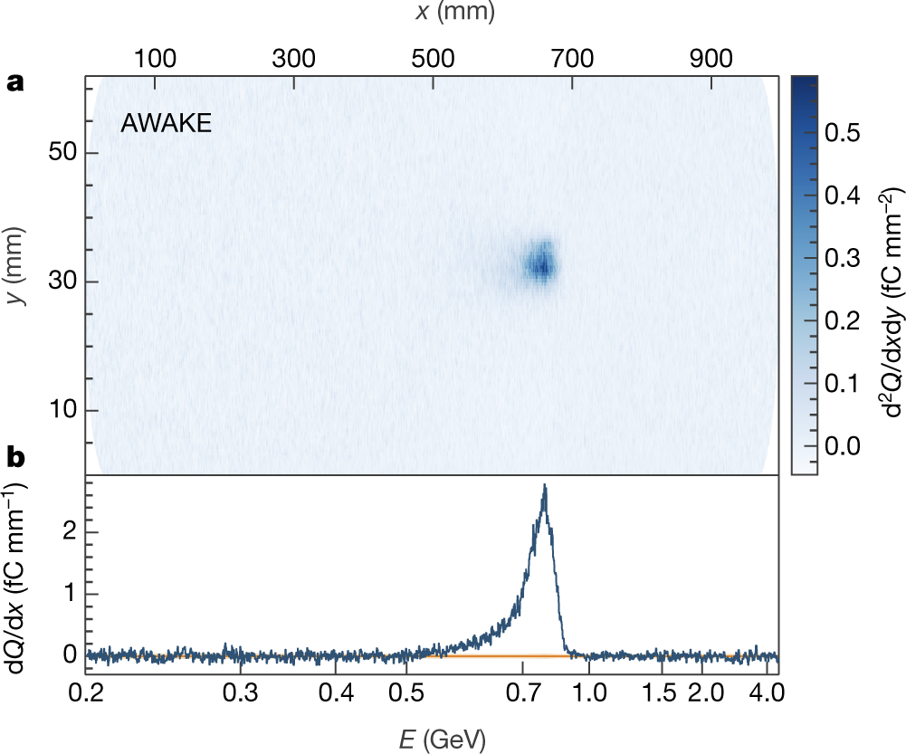
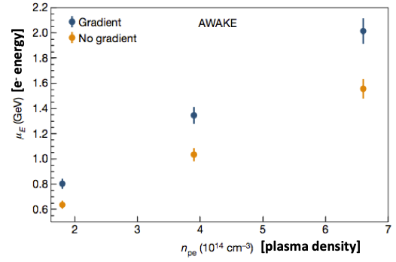
AWAKE Facility
AWAKE Run 1: Proof of principle
Proton-driven plasma wakefield acceleration of electrons
2016-17: first seeded self-modulation of proton bunch
→ Demonstration that SPS bunch can be used for acceleration
  Laser ionizes Rb vapor, forming a plasma
  Rb plasma creates micro-bunches in the proton beam
  Micro-bunched proton beam excites plasma wakefields
  Wakefields accelerate and focus electrons
AWAKE Collaboration, PRL 122, 054802 (2019)
2018: acceleration from 19 MeV to 2GeV
AWAKE Collaboration, Nature 561, 363 (2018)

Slide 4
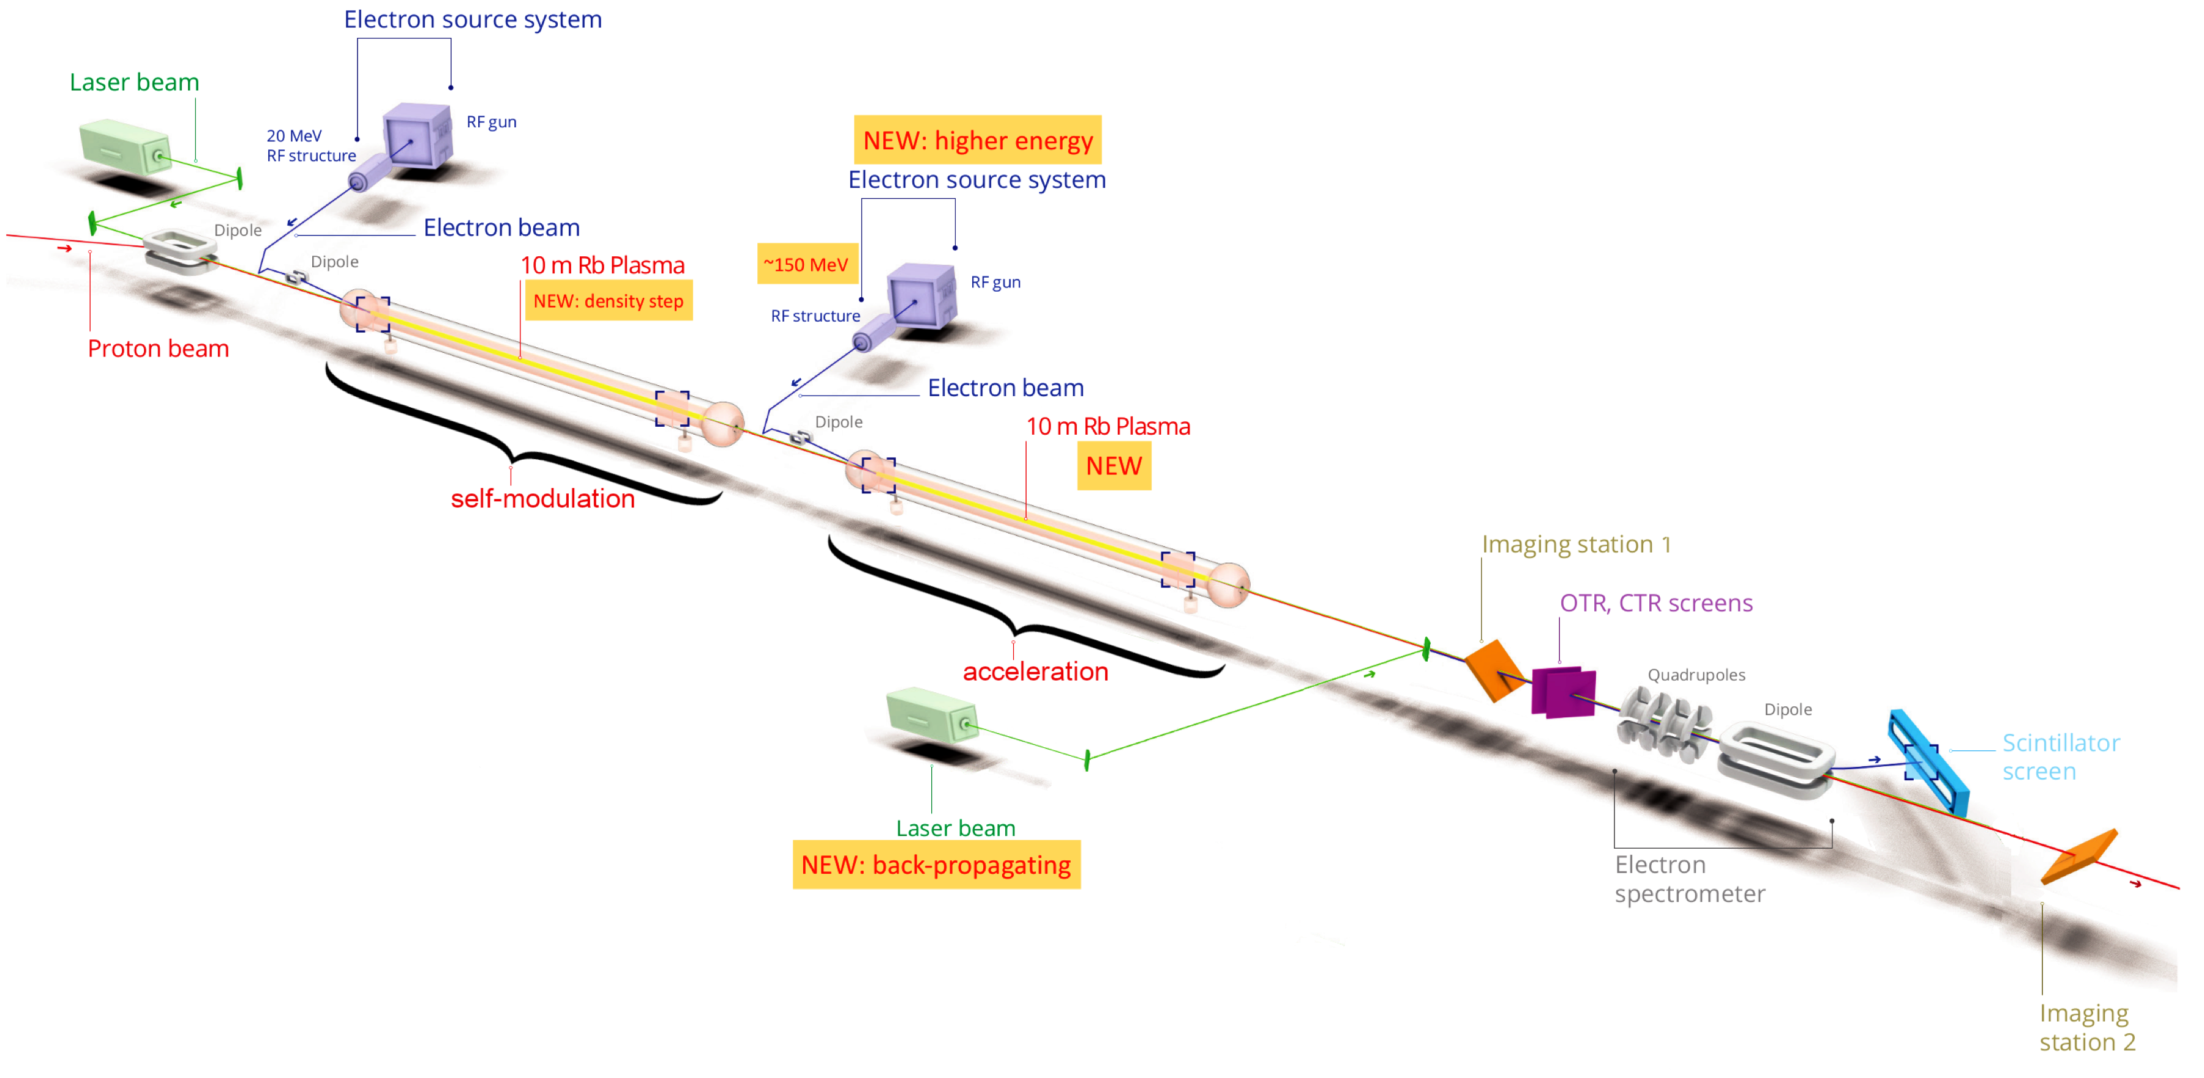
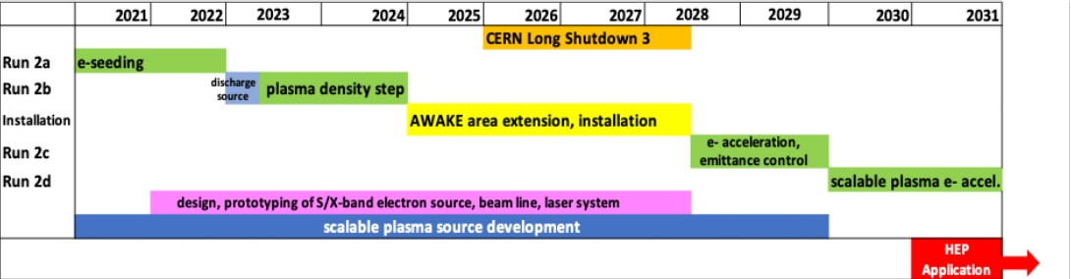
AWAKE Run 2 (2021 – 2030): Towards an Accelerator
  Run 2a (2021/22): demonstrate the seeding of the self-modulation of the entire proton bunch with an electron bunch
  → Run 2b (2023/24):
  maintain large wakefield amplitudes over long
  plasma distances using a step in the plasma density
  CNGS dismantling and installation of Run 2c (2025/26/27)
Potential to reach 200 GeV
Milestones for AWAKE Run 2
K V Lotov and P V Tuev, 2021 Plasma Phys. Control. Fusion 63 125027
  Run 2c (after LS3, 2028/29): demonstrate electron acceleration and emittance control of externally injected electrons
  Run 2d (2029/30..): development of scalable plasma sources to hundreds of meters length
  → Propose first applications for particle physics experiments with 50-200 GeV electron bunches!

Slide 5
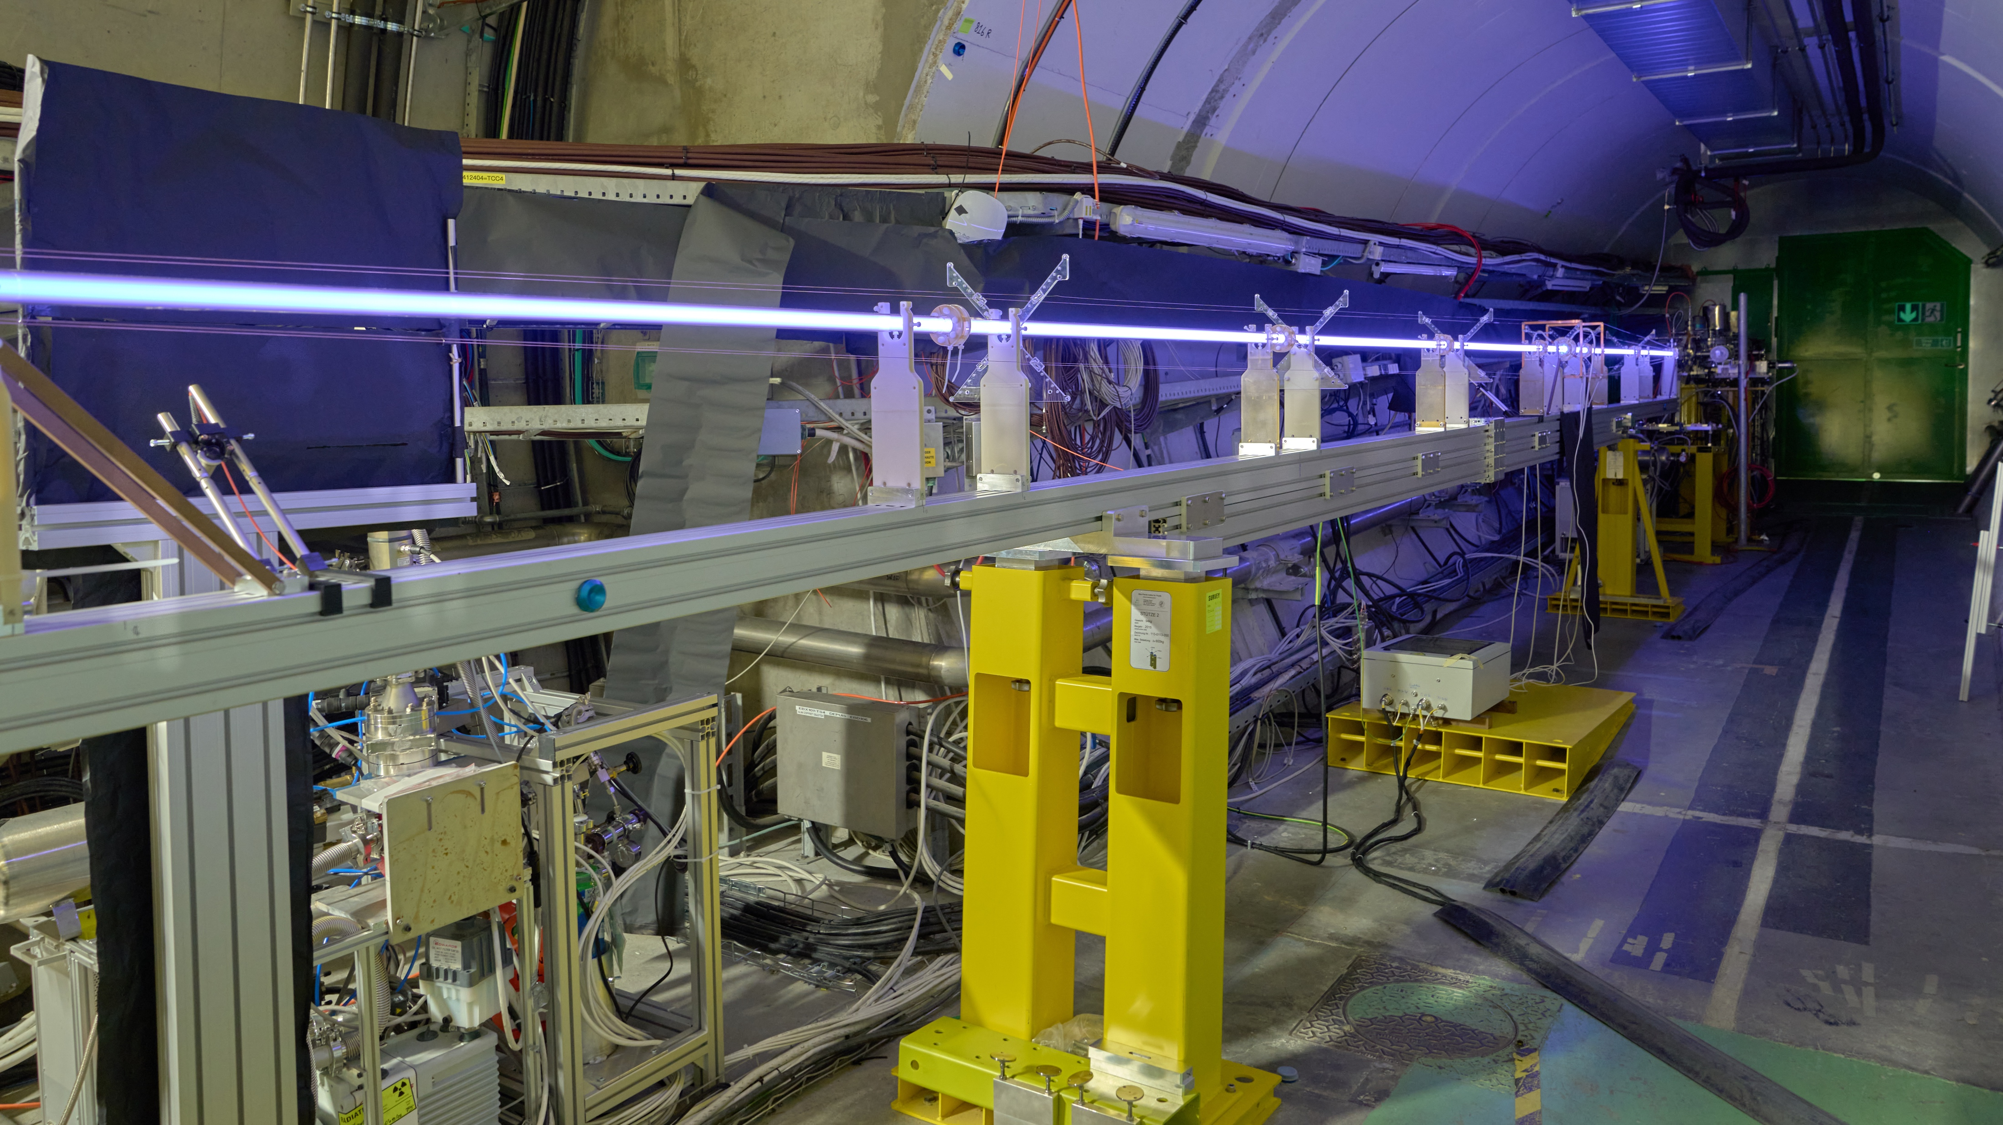
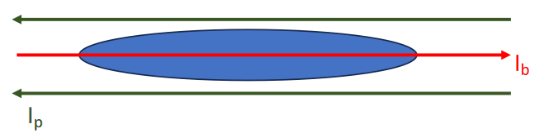
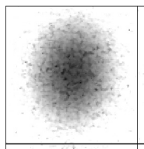
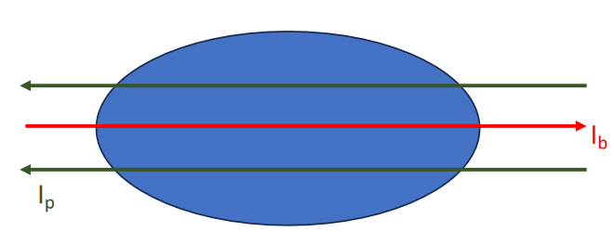
AWAKE 2023: Discharge Plasma Source (DPS)
  3-week test of a scalable plasma technology (candidate for Run 2d)
    Successful operation of 10 m source: self-modulation over a range of plasma densities
    Unique physics program: Ion Motion, Plasma Light, Transverse filamentation
Developed dedicated p⁺ optics (wide bunch) to study transverse filamentation in high-density plasma
    Gas-filled glass tube + electric discharge
Plasma Off
Proton bunch transverse size (σ_{r}) larger than plasma skin depth
Plasma ON
PRELIMINARY
L. Verra (AWAKE Collaboration)

Slide 6
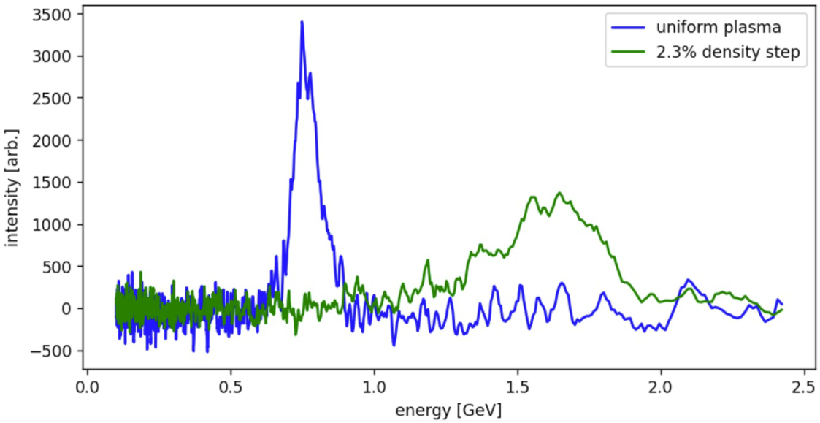
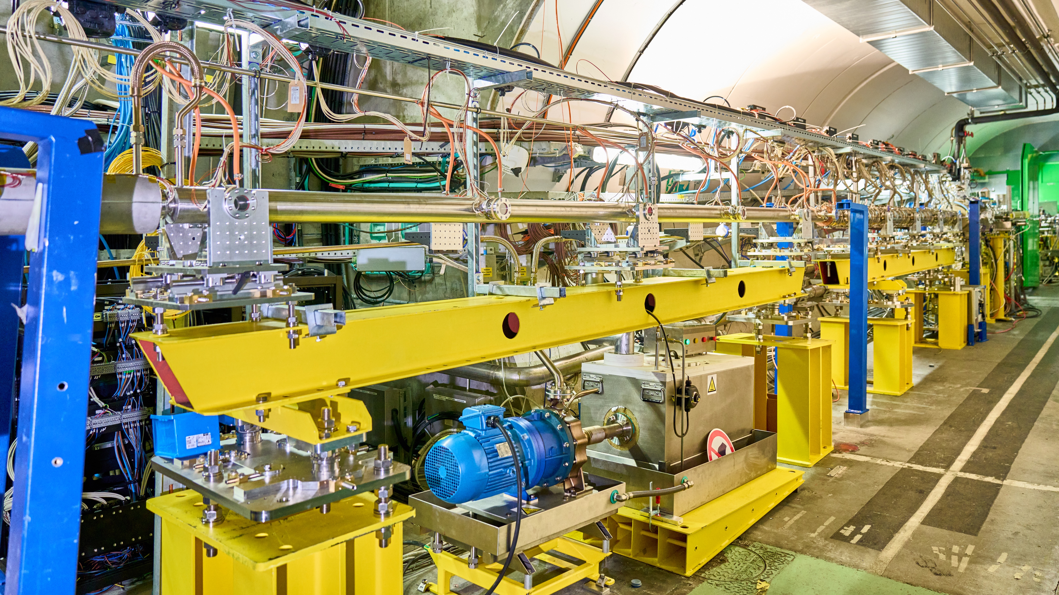
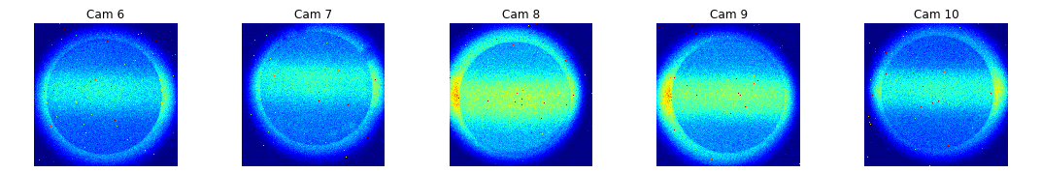
AWAKE 2023: Density Step Plasma Source
Density step simulation
  Study the effect of a density step on wakefields at long distances
  Successful operation : variable step position (0-5 m) and height (0-10%)
  New diagnostics: measure Plasma Light enhancement by wakefields
  Use Plasma Light and Acceleration to optimize density step
    Rubidium vapor source with Density Step + laser
uniform
Energy of accelerated electrons
Preliminary
stepped-up
Plasma Light
F. Pannell, UCL
5.5 m
6.5 m
7.5 m
8.5 m
9.5 m
M. Turner, CERN

Slide 7
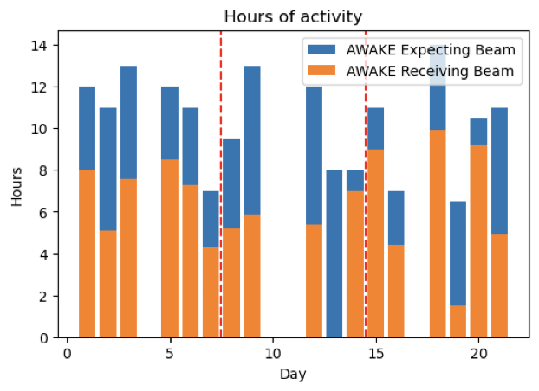
AWAKE: Feedback for 2023
Hours of beam in May Run
AWAKE is very happy of the support from all technical groups involved in the experiment infrastructure and from the SPS operation team!
Run for 2 out of 3 shifts. Only in supercycle when needed
  After injector issues, LHC fills and AWAKE interventions, we receive
  between 6 and 10 hours of beam per day (600-1200 extractions)
Only recurring p⁺ beam issue: unstable longitudinal profiles
  Occasional event-to-event and day-to-day changes in length/shape of proton
  bunch, even after days of stable running
  Require tuning by SPS RF, while monitoring by AWAKE
    AWAKE streak camera is more sensitive than BQM
    Improved monitoring (PS cavities, SPS BQM at injection) planned
    See dedicated summary and proposals by I. Karpov at SPS MPC: https://indico.cern.ch/event/1349652/
Avg. bunch z profile: Oct 19 and Oct 21
Bunch z profile changing from event to event
t [ps]
SPS Extraction #

Slide 8
AWAKE: Progress on 2022 Feedback/Requests
Progress on desiderata from 2022 JAPW
  Speed up fine alignment of proton beam
    FE Interlock threshold increased to avoid losing supercycles after every correction
  Stable beam with higher repetition rate in dedicated periods
    Agreement in principle, but only for pre-defined periods set days in advance. Difficult to plan.
    High repetition mode used successfully when NA was out of commission
  Continue maintaining availability of laser and electron beams during YETS
    Added to official injector schedule. Worked smoothly thanks to detailed coordination w.r.t. YETS activities
  [LS3] Upgrade of power converter to reduce proton beam jitter for Run 2c (2028+)
    Upgrade TT40/41 converters and MSE expected to increase usable extractions in Run 2c from 3% to 30%
    Improvement in jitter observed after LS2: AWAKE is continuing dedicated data-taking for jitter measurements to pinpoint the most relevant power converters

Slide 9
AWAKE Outlook and Requests for 2024
2024 will be the last year of AWAKE data taking until the end of LS3
  No protons expected in 2025 in baseline planning: CNGS dismantling (1.5 years), LS3, then Run 2c
2024 will be a “production” year: few hardware interventions
  Aim for stable Electron and Laser beams in collaboration with relevant CERN groups: BE-ABT, SY-STI
  Expect stable and reproducible performance from proton beam
  Day-to-day stability in bunch shape needed for precision measurements over multiple days
Interested in testing new RF configuration for shorter beam
  Developed by SPS RF team. Not necessary for 2024 physics goals, but potentially useful for Run 2c
Further improvements in communication: automated flag for “usable beam”
  Communication with CCC on SPS issues has greatly improved, but AWAKE often discovers injector issues (SPS or upstream) while looking at physics plots, before operators notice
  Develop (SPS+AWAKE) a “usable beam” flag: combine diagnostics+status to quickly spot known issues

Slide 10
Outline
Facility and Plans
2023 Physics Highlights
2023 Beam Feedback
2024 Beam Requests
Facility and Plans
2023 Physics Highlights
2023 Beam Feedback
2024 Beam Requests

Slide 11
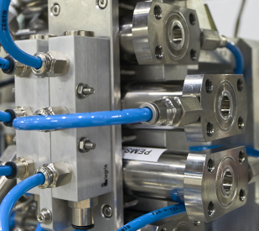
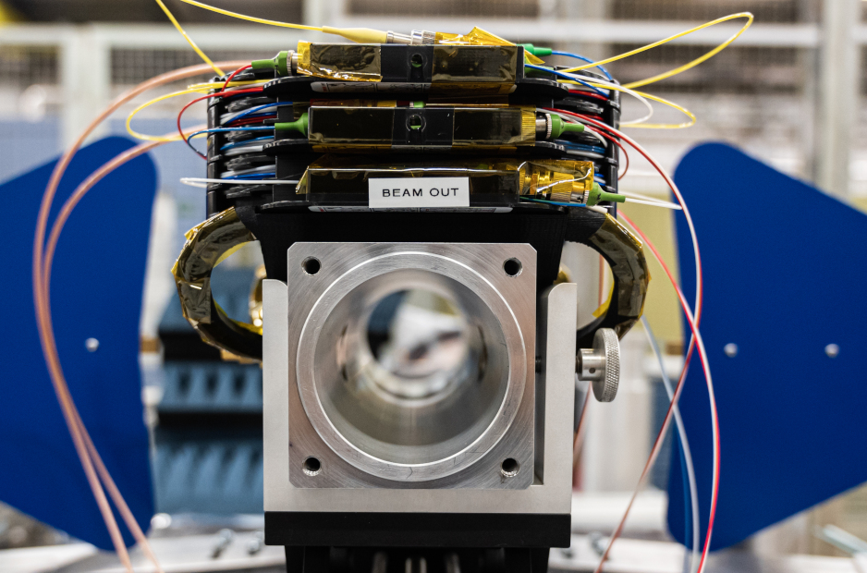
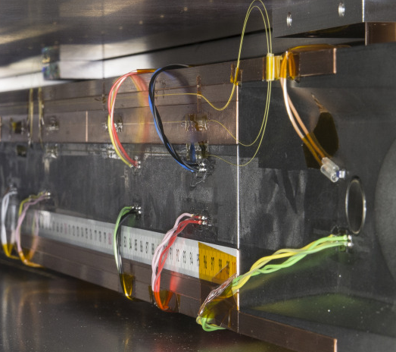
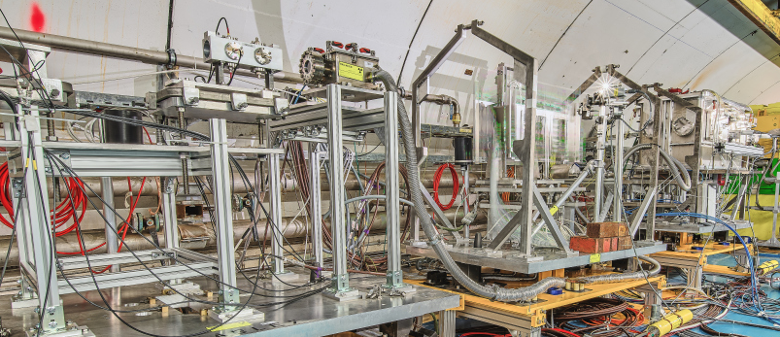
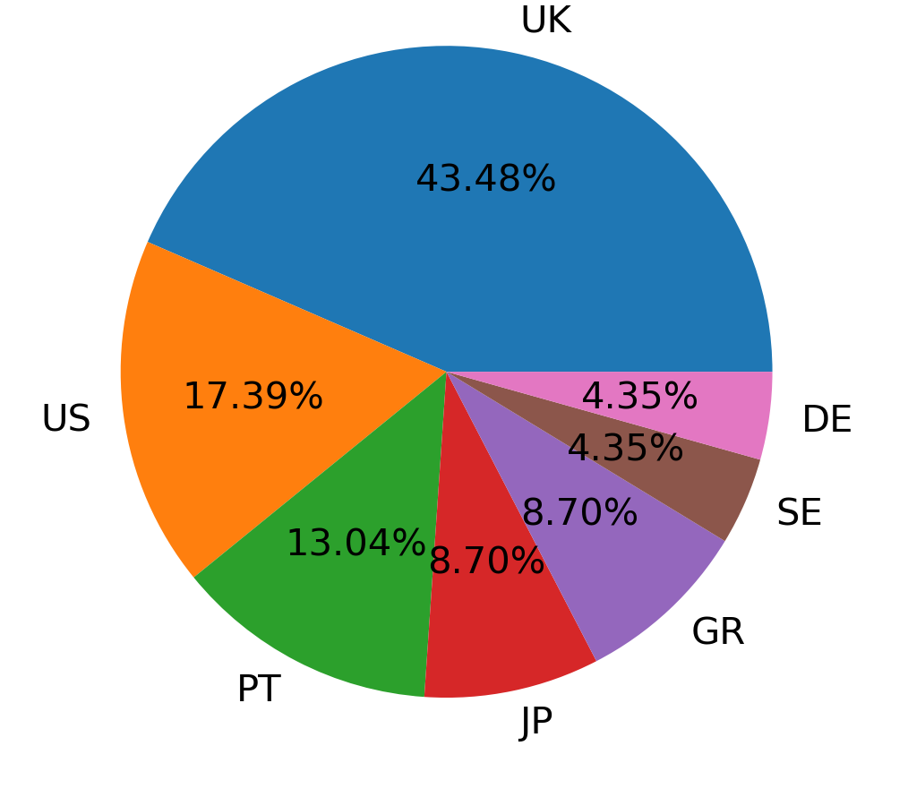

HiRadMat Facility
Short-pulse high-energy proton irradiation facility
AD targets
HL-LHC EO-BPM prototype
LHC collimators
LHC-like Beam Parameters
Up to 288 bunches, ≤1.6×10¹¹ protons per bunch
≤4.6×10¹³ protons per pulse at 440 GeV/c (3.2 MJ)
~1.5 ns long bunches, 25 ns bunch spacing
Beam size at target: ≥0.25 mm (1 σ)
Targetry | Beam diagnostics | Beam intercepting devices
Superconducting magnets, Particle detectors, Plasma physics
Experiments
Maximum flexibility to accommodate many requests
Completed a total of 44 experiments since 2012
Supported more than 20 external users during 240 days of transnational access during one operational year
HiRadMat TNC Target Area
GB
Beam Diagnostics
Transverse spot size
Bunch-to-bunch beam position
Beam losses
Test Stands
Remote plug’n’play
~300 signal connections
Cooling water, vacuum, press. air

Slide 12
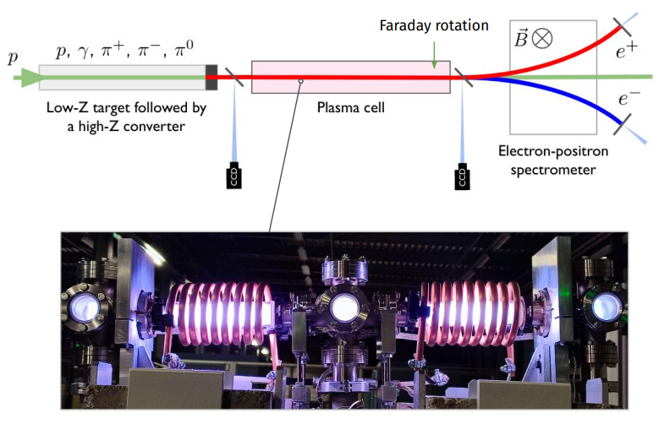


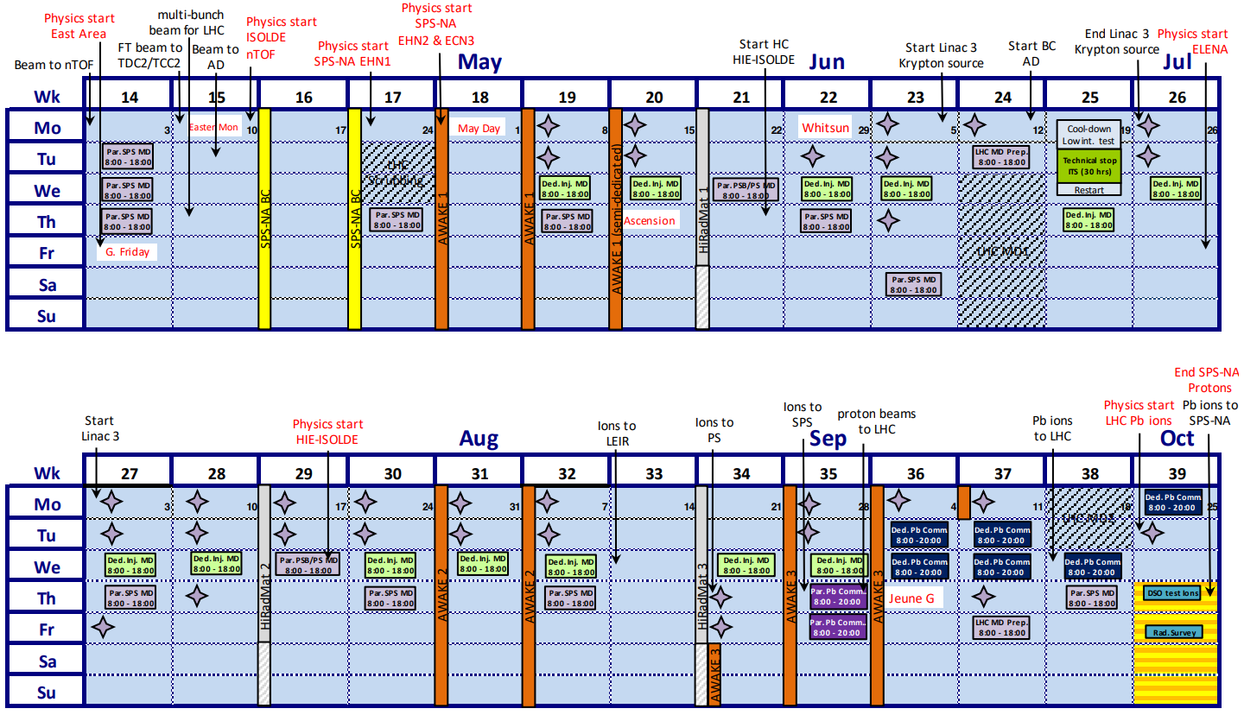
HiRadMat Highlights 2023
HRMT62 FIREBALL – Uni. of Oxford
  Reproduce electron-positron enriched astrophysical jet in lab
  Nature physics paper submission
  https://home.cern/news/news/experiments/fireball-hiradmat
HRMT58 ATLAS-ITk – JSI, EP-UAT
  Initial test of ATLAS-ITk BCM prototype with LHC-like beams
HRMT25 TPSG4 - SY/ABT
  Test the MSE protection element (diluter) in case of accident scenario in HL-LHC and validate the simulations
HRMT55 BLM3 – ESS, GSI/FAIR, SY-BI
  Qualification of production BLMs for CERN, ESS, GSI/FAIR
HRMT59 SMAUG follow-up exp – TE-VSC, SY-STI, BE-EA
  Assessment of Si₃N₄ 1µm thick beam windows
Completed
First test completed, development ongoing
Completed
HRMT62
Ongoing
HRMT58
HRMT25
Completed

Slide 13
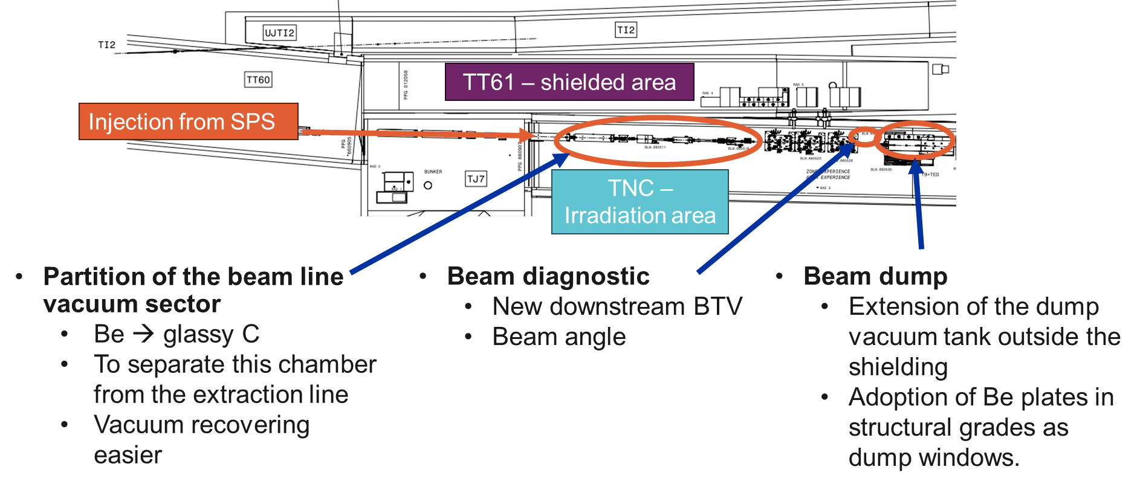
HiRadMat Upgrade Study Group
Goal: Identify necessary upgrades to safely deliver LIU beam intensities to HiRadMat with the same minimum beam spot size that is available today.
Study group involves all stakeholders, support teams and users:
  BE-EA, SPS-OP, SY-ABT, SY-BI, HSE-RP, BE-CEM, TE-VSC, SY-STI, EN-MME
2023
Decision on and implementation of HiRadMat upgrades
2023/24
Works
2024
LIU beams at HRMT
3 Experiments waiting
2024++
Standard operation with LIU beams

Slide 14
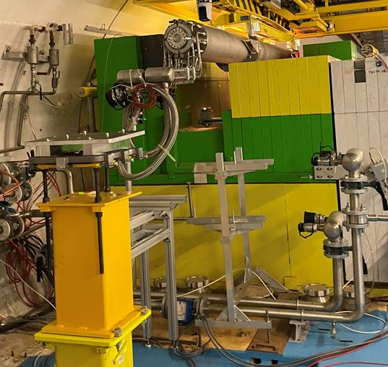
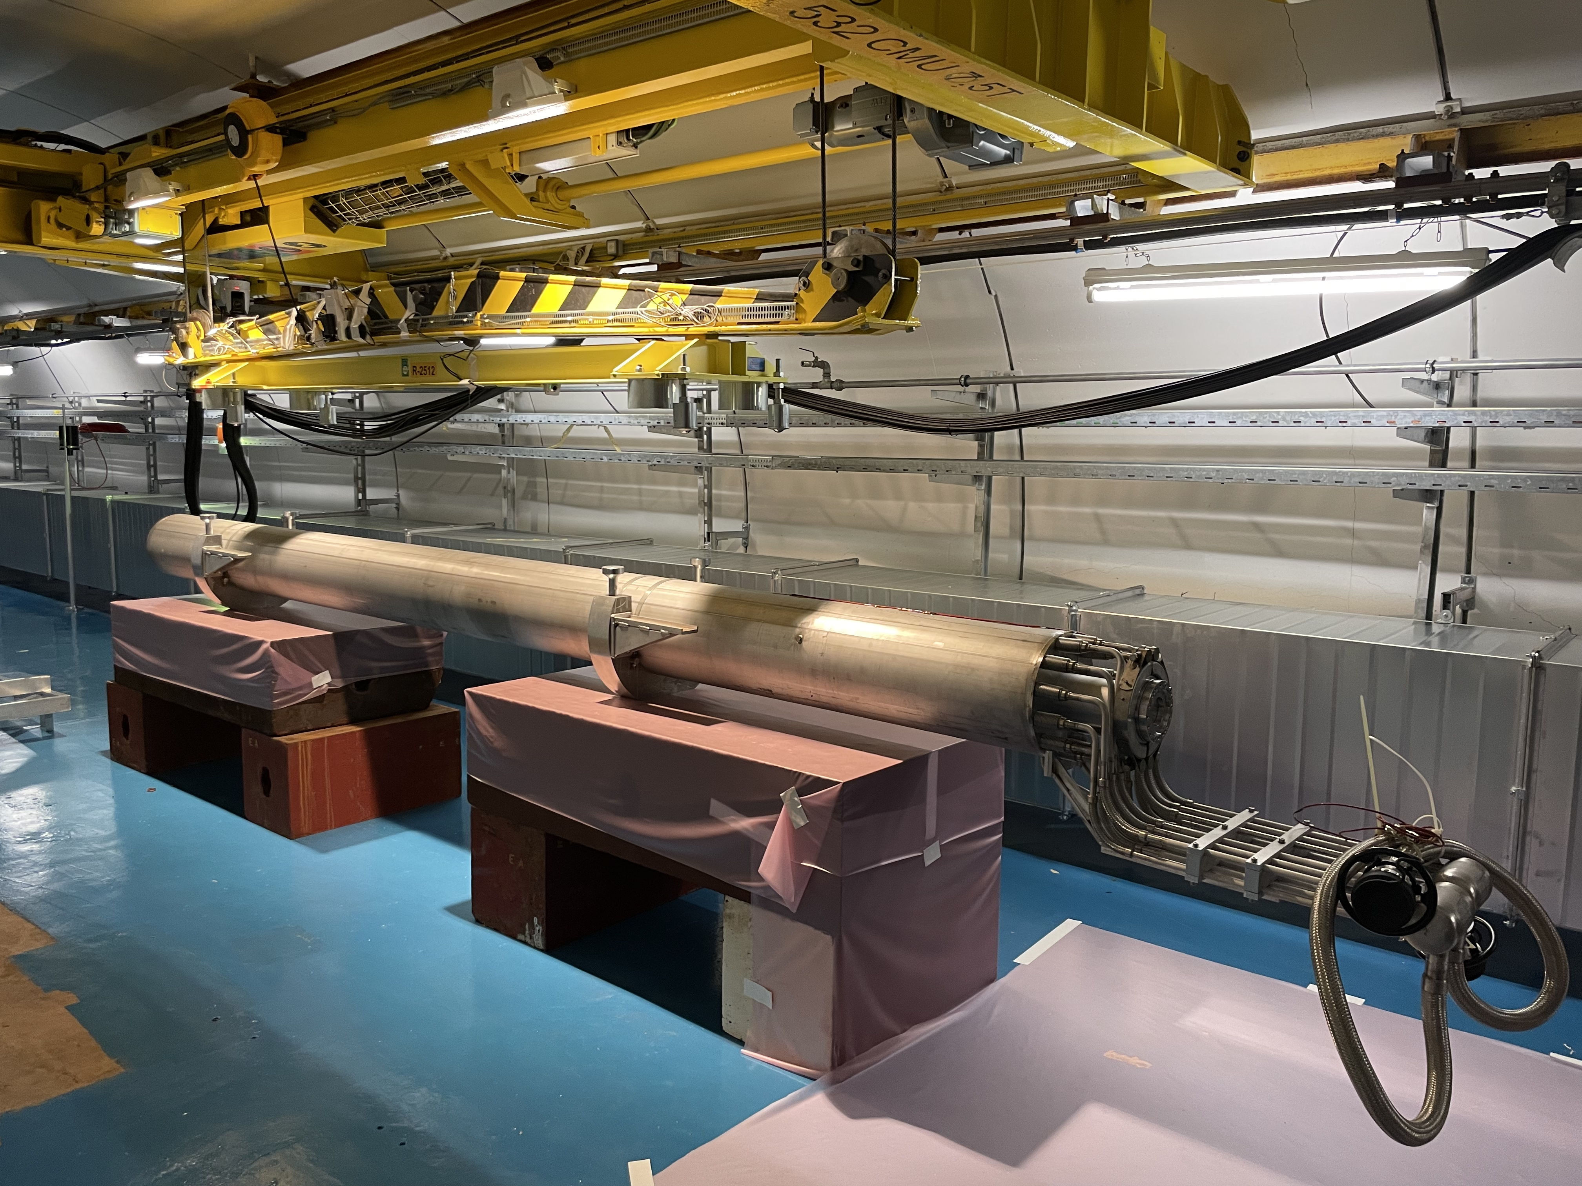
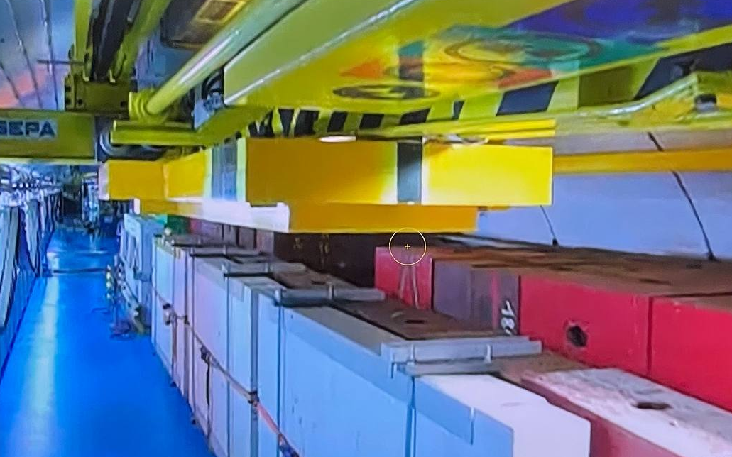
HiRadMat dump upgrade
Courtesy: N. Solieri (SY/STI)
With the aim to modify the dump to:
Avoid the failures
Make fixing easier
… dump handling …
… until storage place
Shielding dismantling …

Slide 15
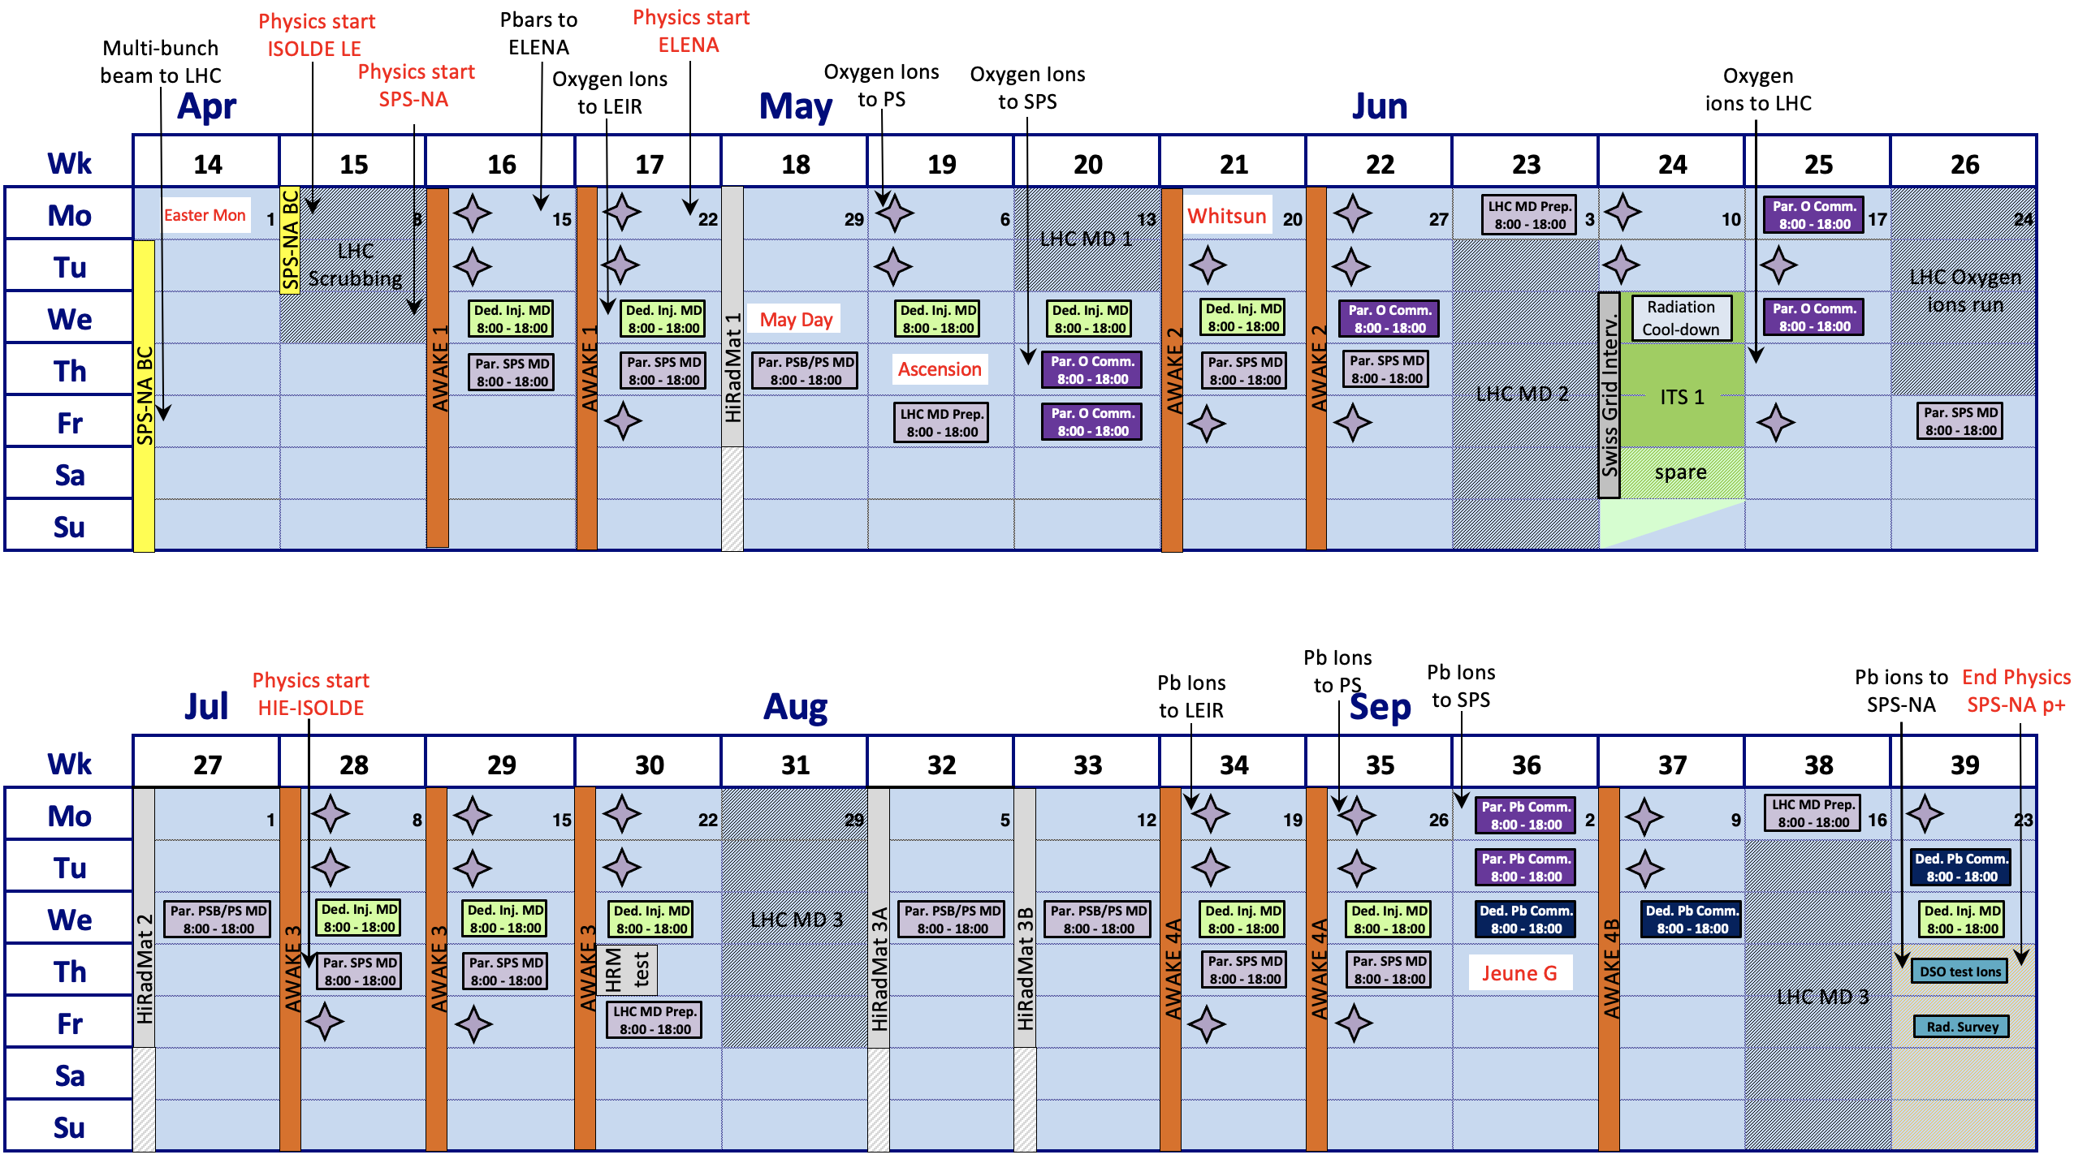
HiRadMat Outlook for 2024+
FIREBALL2
5 experiments for 2024 (Schedule refinement still ongoing)
HRMT64 FIREBALL2 – Univ. of Oxford
  Electron/positron pair beam-driven plasma filamentation instabilities
HRMT65 HL-TDE – SY-STI
HL-LHC dump material qualification
Two weeks of run
HRMT66 SMAUG-2 – TE-VSC, SY-STI, BE-EA
Verification of HRMT LIU beam window designs
HRMT55 BLM3 – ESS, GSI/FAIR, SY-BI
  Qualification of production BLMs for CERN, ESS, GSI/FAIR
ATLAS-ITk – JSI, EP-UAT
Continued test of ATLAS-ITk BCM prototype with LHC-like beams
To be confirmed/parasitic
HL - TDE
SMAUG2
HL - TDE
LIU beam requests
2025 – Experiments
CRY3 – SY-STI, INFN
Robustness of pre-irradiated Si crystals for beam steering
RaDIATE2 – Fermilab
Mitigate radiation damage to accelerator materials
ScCoils – TE/MPE
Identify damage mechanisms in multilayer, impregnated coils due to instantaneous beam impact.
DPA – J-PARC/KEK, TE-MPE
Displacement damage cross-section measurements at 440 GeV/c
LIU beam requests

Slide 16
HiRadMat Operational Feedback 2023
HiRadMat runs in 2023 very smooth thanks to:
  Excellent communication with BE-OP to anticipate stable beam conditions (PSB, PS, SPS), and LHC for coordination concerning filling and accessing
  Running without parallel activities extremely beneficial
All experiments finished before the end of the scheduled week, all weekends returned to physics, AWAKE & MDs also recuperated days from the HiRadMat weeks
  Large appreciation from the experiments for this flexibility of the injector complex
Nonetheless, operation of HiRadMat is anything but routine
  Stakes are high: experiments need to complete their program within one week and have no contingency.
    Typical preparation time for HiRadMat experiment : at least a year in advance

Slide 17
Flashback of HiRadMat Desiderata in 2022
AWAKE beam parameters available at HiRadMat (3×10¹¹ ppb, 1 ns bunch length)
  Necessity for HRMT62 experiment in 2023!
Better understanding of the beam uncertainties
  Enhance understanding of uncertainties of HiRadMat optics
  From 2024: Tolerances on the beam parameters to be defined in advance by the experimental teams in collaboration with BE/OP and SY/ABT depending on the experiment criticality.
Faster change-over between HiRadMat cycles and faster SPS SC changes in general
  Increase efficiency, reduce amount of non-extracted HiRadMat cycles to benefit other users as well
Extraction with momenta < 440 GeV/c but same time structure
  A small taskforce has been established (BE-EA, SY-ABT & BE-OP) and tests are to be scheduled ideally before LS3.
New request:
Pre-commissioning of available optics a few hours the week before the actual experiment, in case of challenging optics or configurations → week 32/33 in 2024
Achieved

Slide 18

A big thank you to all the groups along the ATS sector for their dedication and help in the operation of HiRadMat facility since 2011!
SY-ABT
BE-OP
EN-HE
BE-EA
TE-MPE
BE-GM
BE-CEM
HSE-RP
SY-STI
EN-MME
SY-BI
BE-ASR

Slide 20

Long Term: Trajectory jitter for AWAKE after LS3
IEFC 2021
Proton trajectory jitter acceptable for current physics objectives, but not for Run 2c
  2026+ much stricter requirements for Electron/proton alignment
  Key parameter to avoid electron charge loss and emittance growth in the acceleration phase
Main source of jitter are the magnet power converters
  Only 3% usable shots if not improved by Run 2c
Discussions and preliminary studies underway, countermeasures proposed
  Upgrade of converters output filters to reach Class 3 performance
  Upgrade of all Control Electronics in TT41/TT41 to FGC3
  Upgrade of MSE: synergy with LHC and NA in the context of SPS-CONS project
    Perform upgrades already during LS3?
~15%
~30% usable shots

Slide 21
HiRadMat Requests
Pre-commissioning of available optics a few hours the week before the actual experiment, in case of challenging optics or configurations → week 32/33 in 2024
User feedbacks:
High intensity 2.3e11 ppb & 228 bunches
FIREBALL2
SMAUG2
HL - TDE
HL - TDE

