Slide 1

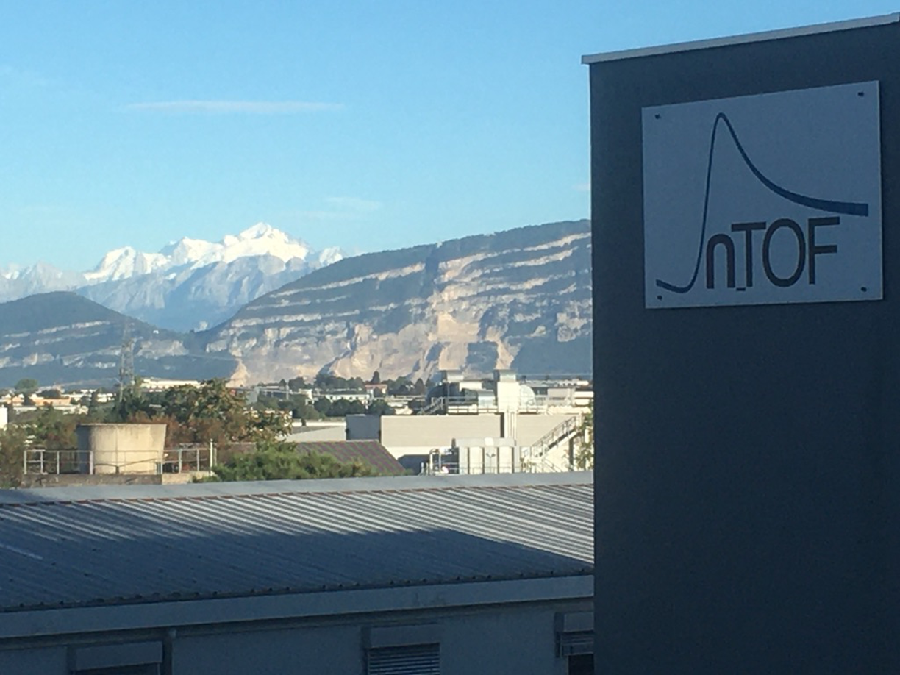

Feedback from n_TOF on 2023 Operation and Outlook
Joint Accelerator Performance Workshop, Montreux, 5-7/12/2023
Nikolas Patronis
n_TOF Physics Coordinator
CERN & Univ. of Ioannina

Slide 2
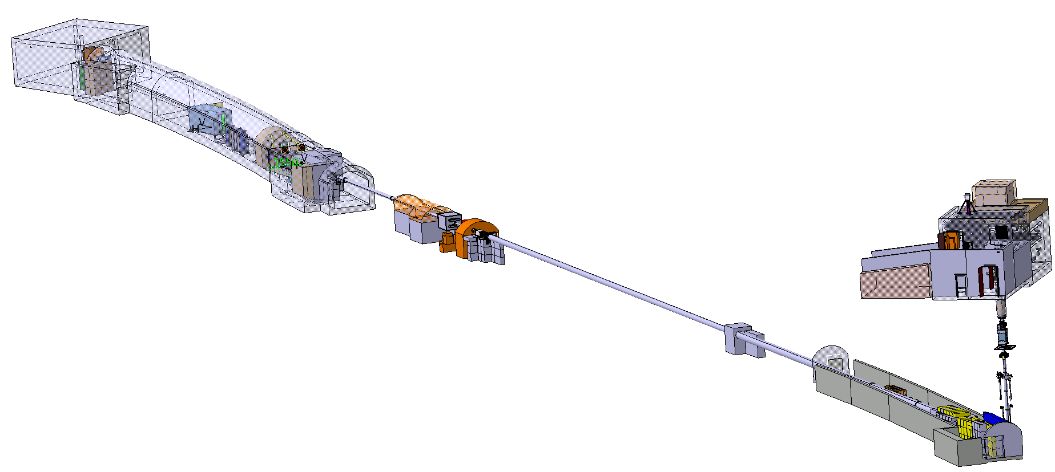
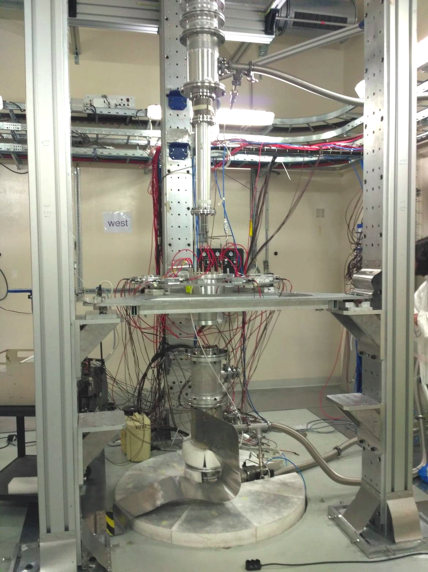
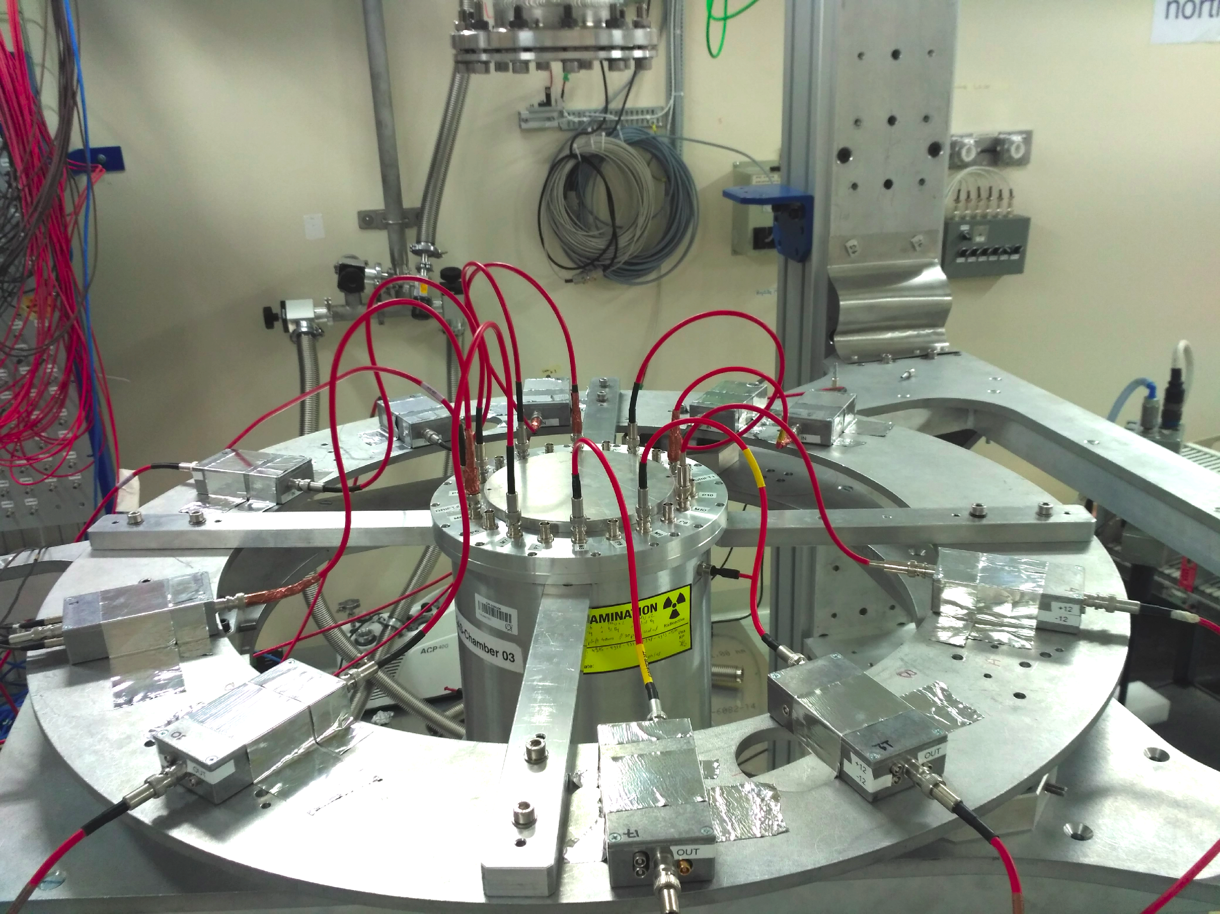
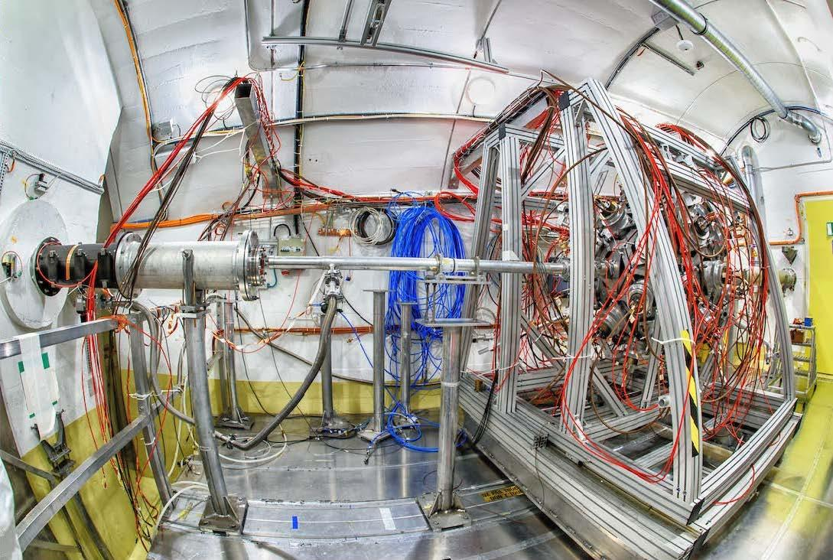
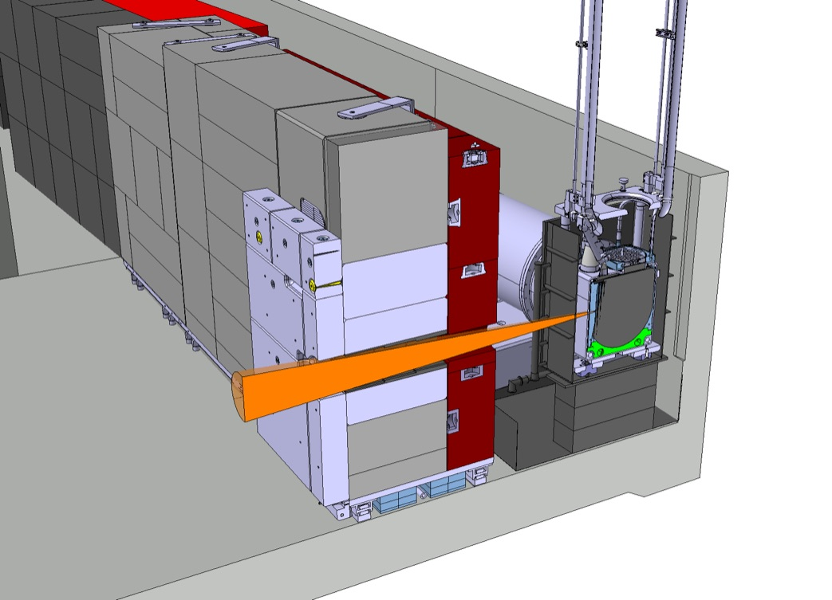
The n_TOF facility: EAR1 + EAR2 + NEAR
For intro to n_TOF & ISOLDE see Karl Johnston talk on IEF-2021
Three experimental areas (EAR)
Horizontal flight path: EAR1 at 200 m
Vertical flight-path: EAR2 at 20 m
NEAR at 3m distance: activation measurements
140 researchers
40 research institutions/teams
20 PhD students/year
NEAR
20 GeV proton beam from the PS

Slide 3
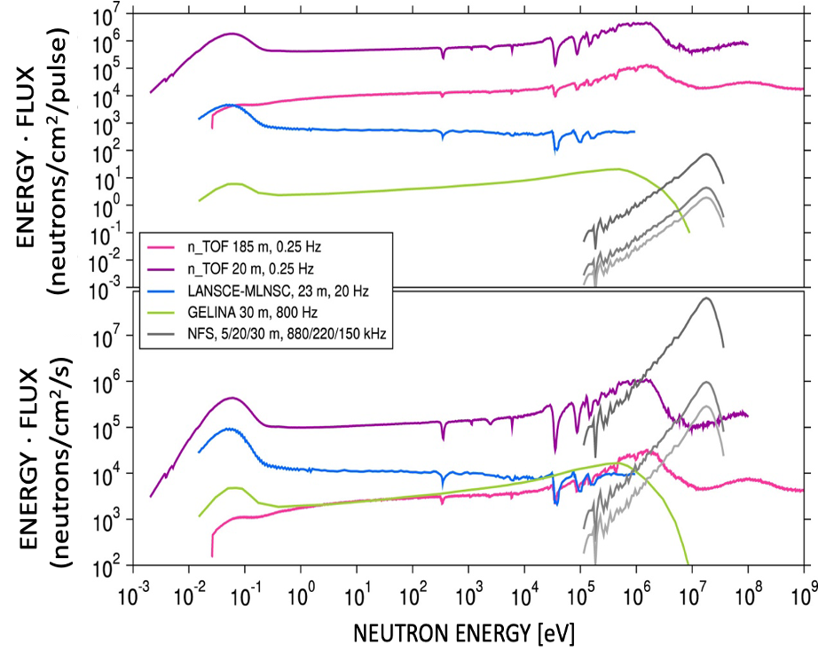
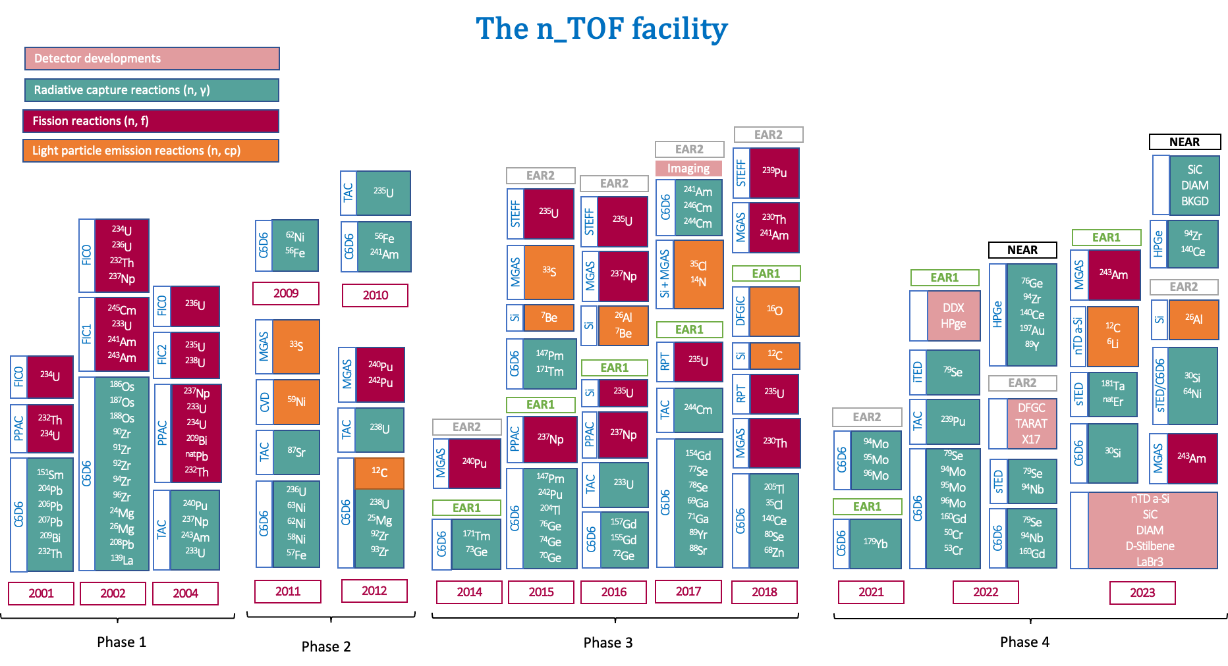
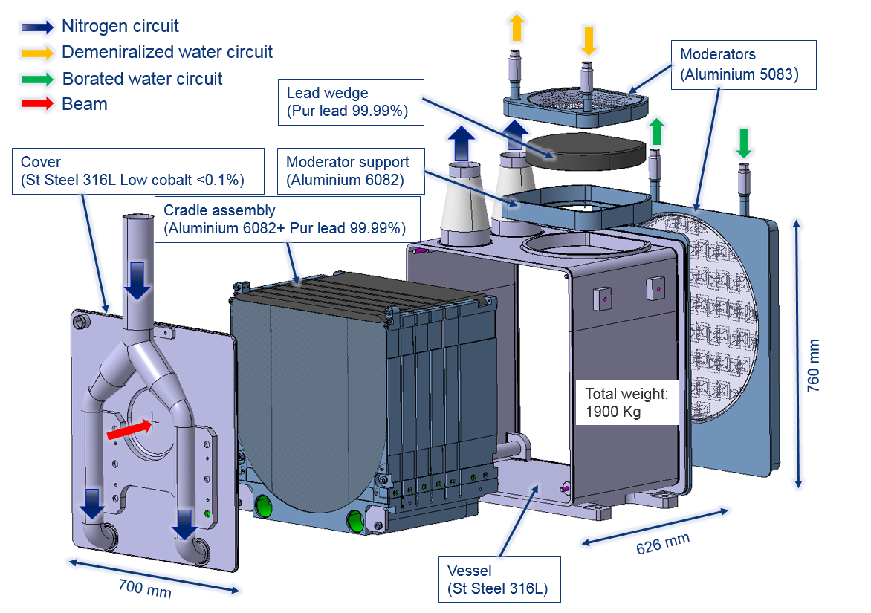
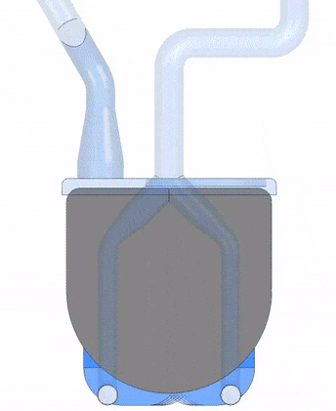
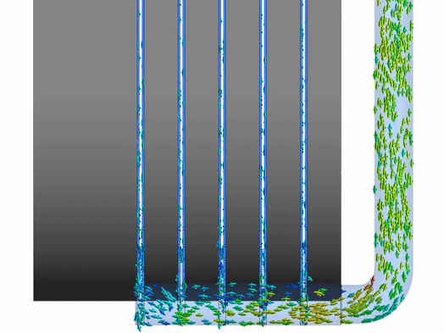
n_TOF: a unique neutron TOF facility
Excellent time/energy resolution:
  total pulse width 4σ = 28 ns
  EAR1 0.03%@1 eV, 0.5%@1MeV
  EAR2: 0.4%@1 eV, 4%@1MeV
Extended energy range (experimental XS data for neutron energies covering 11 orders of magnitude): meV to GeV
High instantaneous flux along with low background exp. areas
  EAR1 ~ 0.5E6 n/puse (18 mm aperture)
  EAR2: ~1E7 n/pulse (23 mm aperture)
  Excellent signal to background conditions
  Measurements with samples of extreme specific radioactivity are feasible
Excellent (and stable) neutron production conditions thanks to our NEW G3 spallation target

Slide 4
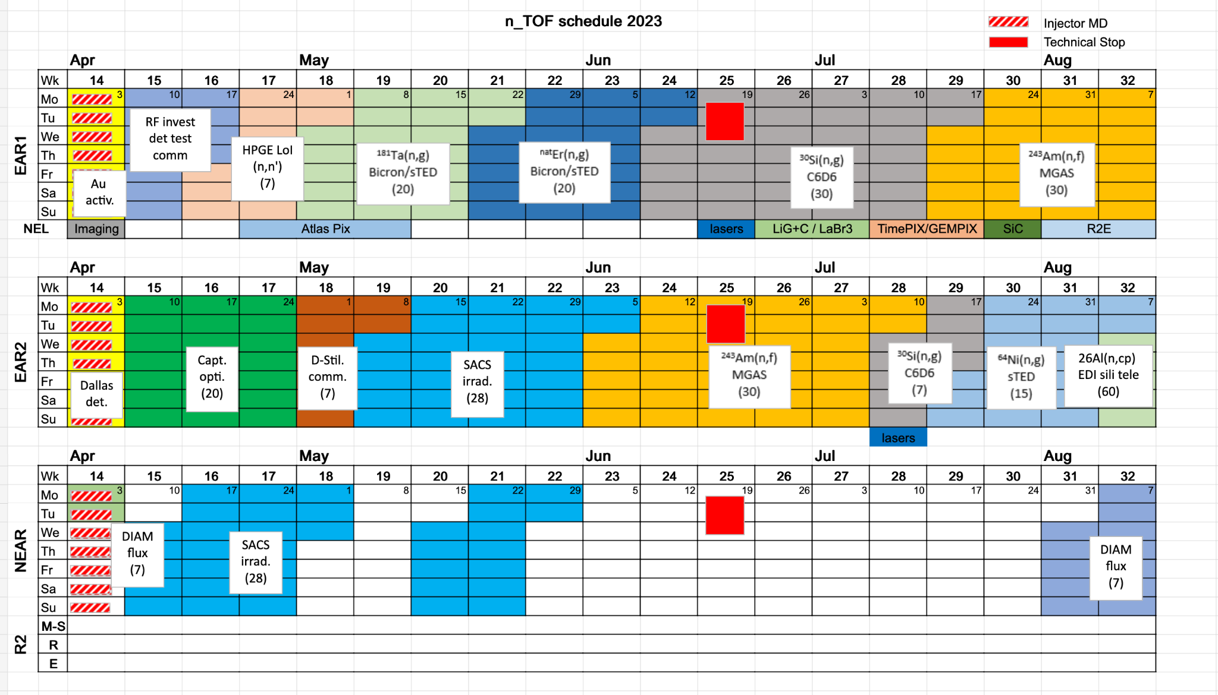
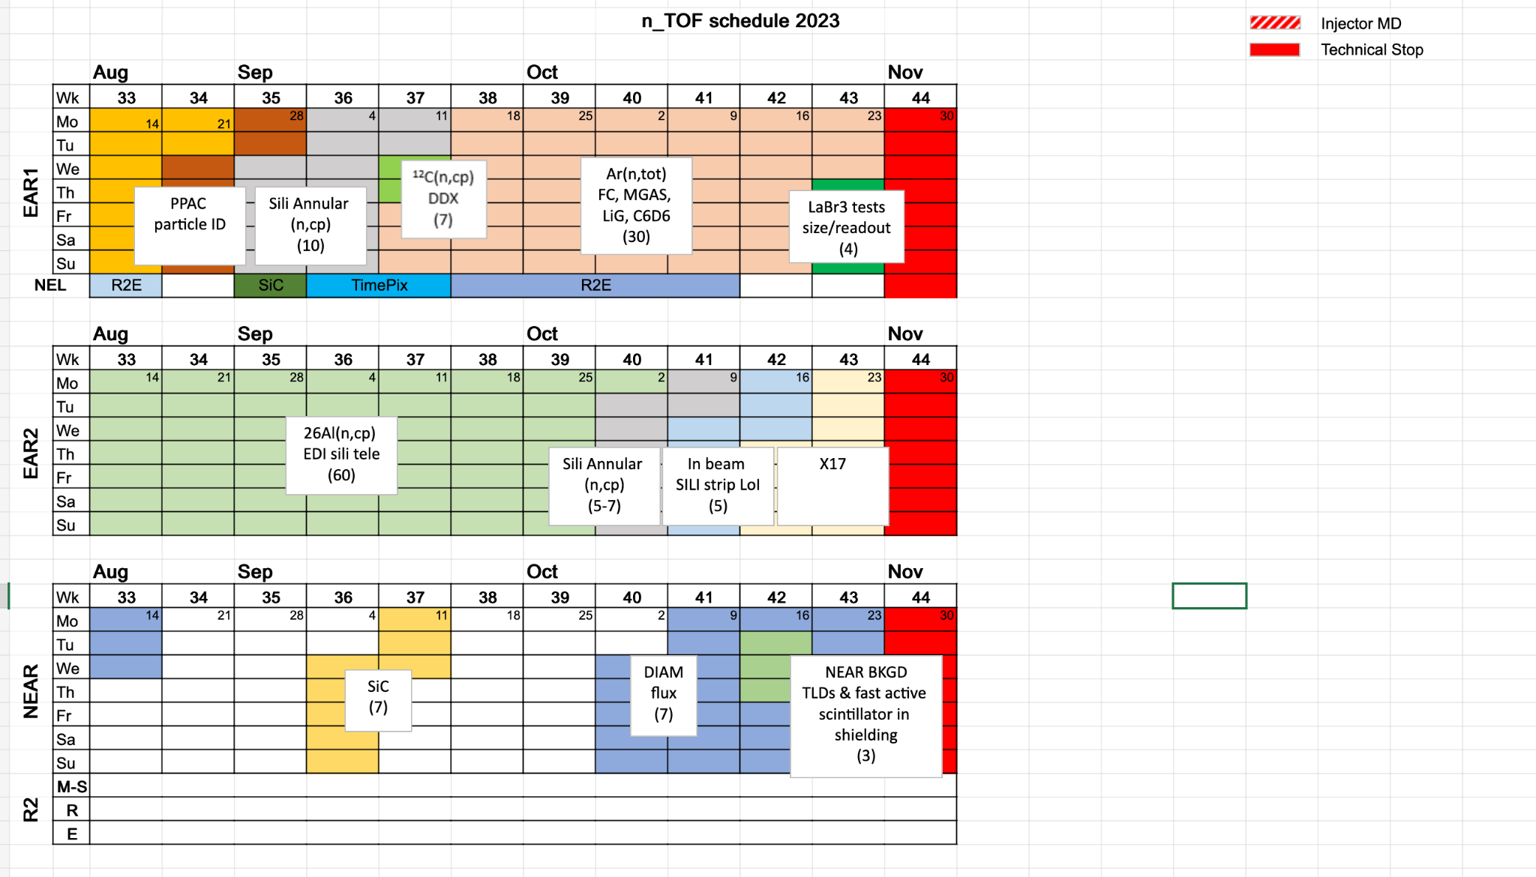
Highlights of the 2023 n_TOF campaign
EAR1 | EAR2 | NEAR
HPGe test ¹⁸¹Ta(n,γ) ^{nat}Er(n,γ) ³⁰Si(n,γ) ²⁴³Am(n,f) ¹²C(n,p/d/a) SADR ¹²C(n,p/d/a) DDX Ar-transmission | (n,γ) optimization study d-stilbene test ¹⁹⁷Au(n,γ) with 1cm & 2cm B4C ⁷⁶Ce(n,γ) with 1cm & 2cm B4C ²⁴³Am(n,f) ³⁰Si(n,γ) ⁶⁴Ni(n,γ) ²⁶Al(n,p/a) (n,p/d/a) SADR Si det. test for (n,cp) X17 2nd part of in-beam test | ¹⁹⁷Au(n,γ) ¹⁴⁰Ce(n,γ) ⁹⁴Zr(n,γ) Diamond det. test SiC Background
4 neutron capture reactions
2 (n,cp) reactions
²⁴³Am fission study covering 11 orders of magnitude of neutron energies
2 neutron capture reactions have been (further) studied at NEAR and EAR2 with different B4C filter configurations; Activation technique; MACS for different stellar temperatures;
NEAR beam profile, flux and background measurements
9 detector development projects have been accomplished successfully
First transmission measurement at n_TOF was realized

Slide 5
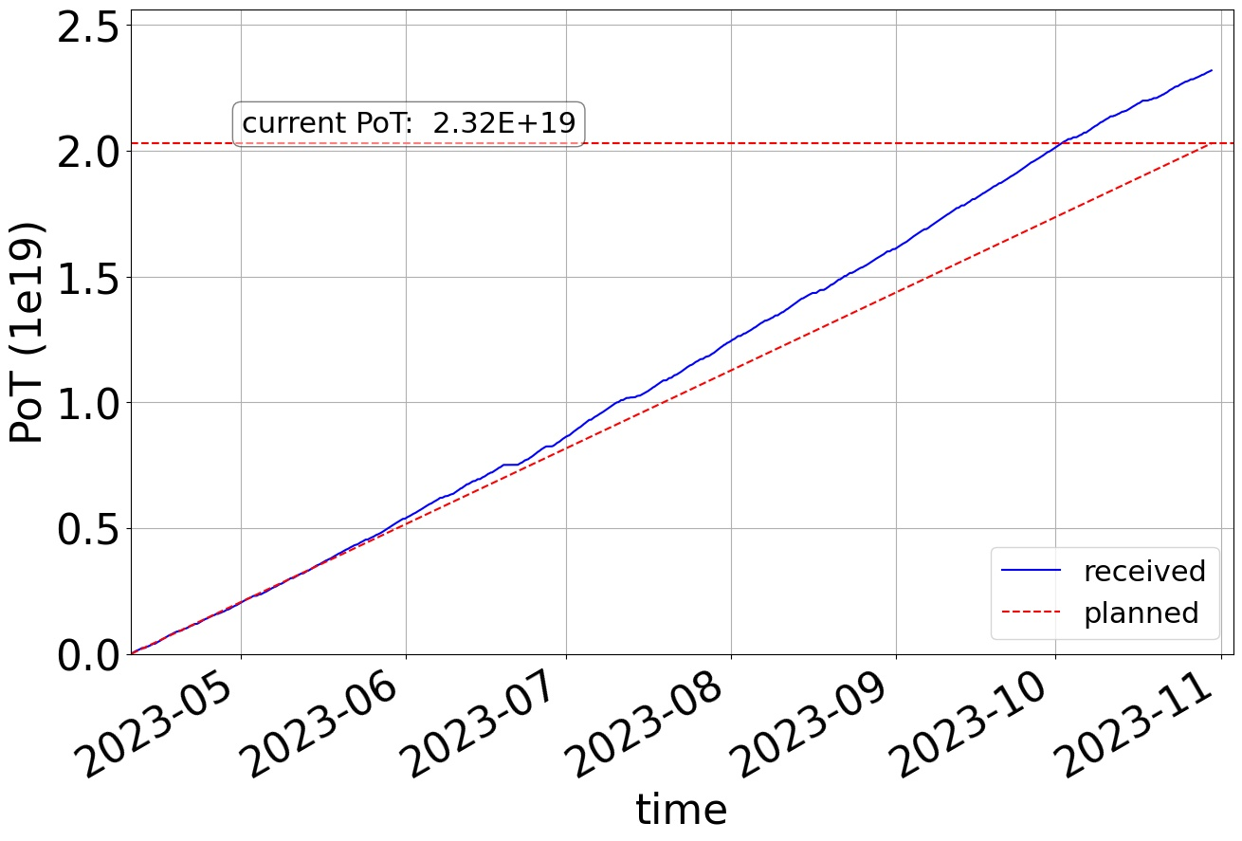
PoT status
We received (=2.3E19) more protons than expected (=2.
2.03E19) = 1.14E17 p/day
All experimental campaigns received the approved number of protons
Flexibility on the pulse intensity
Many thanks to the PS teams!

Slide 6
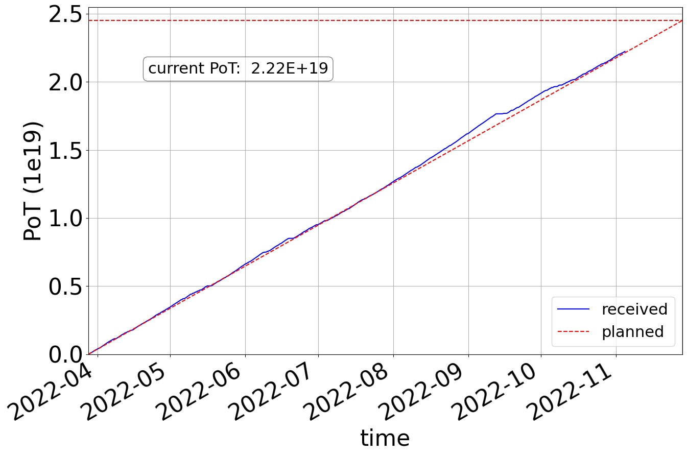
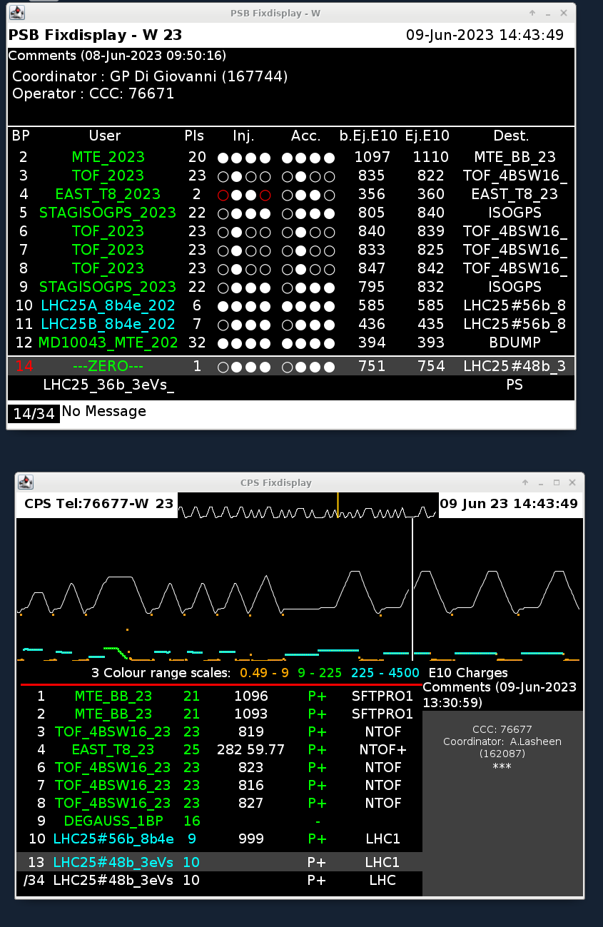
PoT status
2022
2023
Average proton beam intensity upper limit: 167E10pps -> 220E10pps; 09.06.2023
Many thanks to SY-STI, RP, and PS teams!

Slide 7
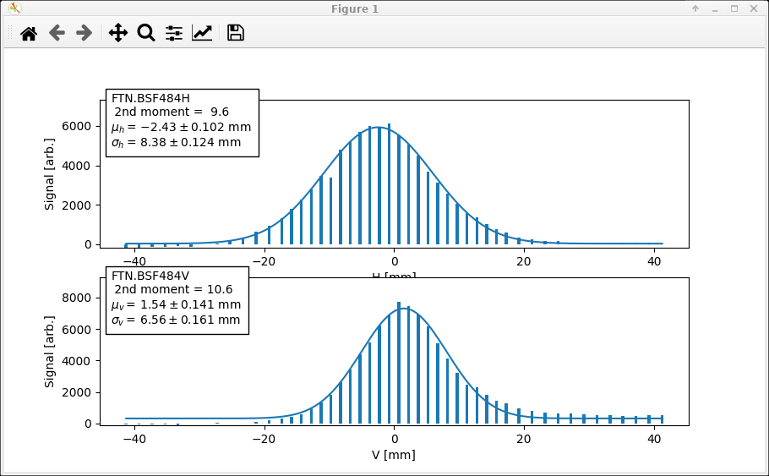
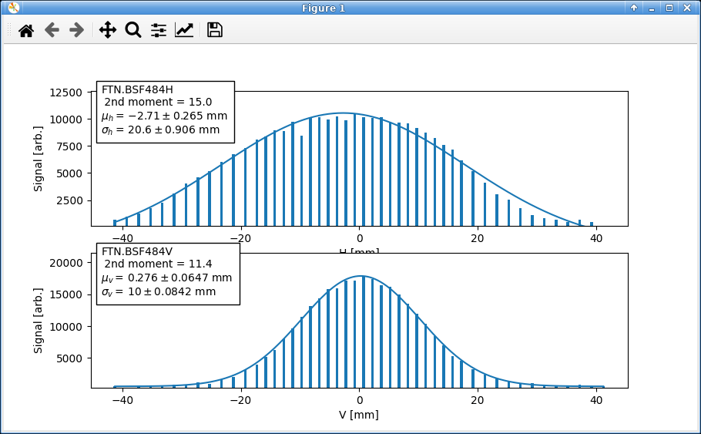
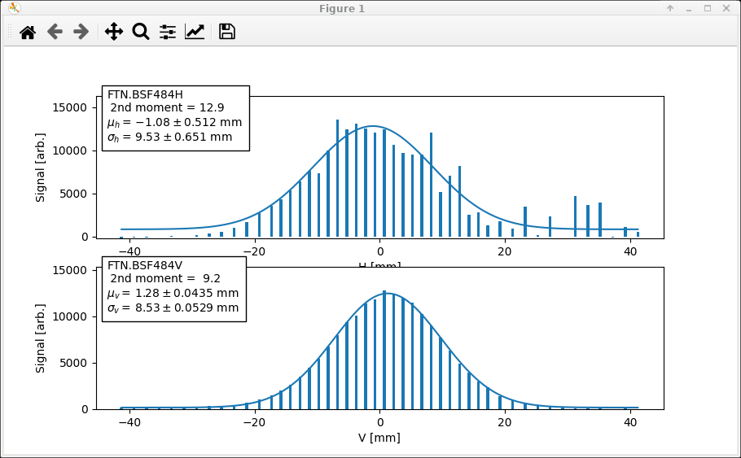
Issues during the 2023 campaign
Beam start at 03.04.2023 - FTN line commissioning
2022
2023 after going back to the previous SEM grid el. chain
Start of 2023 campaign when ppp>400E10
YETS 2023-24: Installation of new SEM grid detector head (larger aperture, more channels)

Slide 8
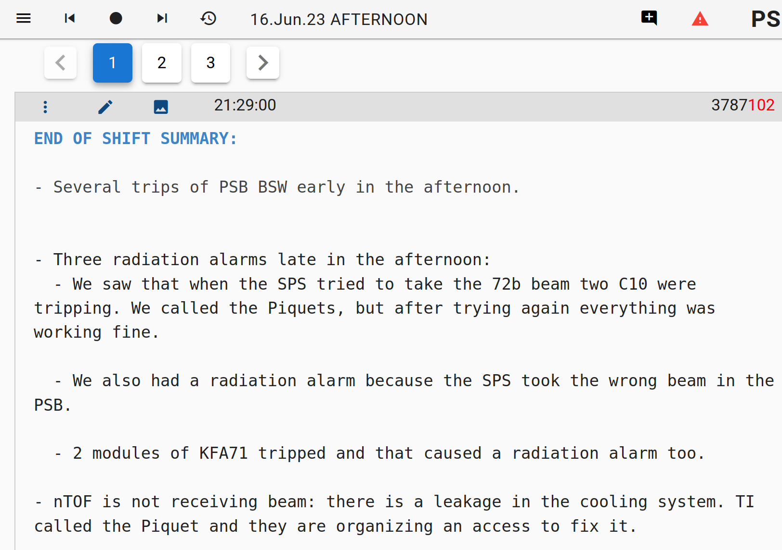
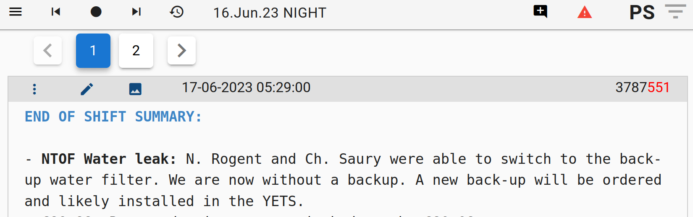
Issues during the 2023 campaign
n_TOF target borated water filter leak on 16/6/2023: Thankfully a backup filter was available!
Many thanks to: Ch. Saury, N. Roget, Cl. Pruneau for the successful intervention!
YETS 2023-24: Cooling station upgrade (extend confinement to the entire station + additional retention vessels for the moderator skids, as requested by the tripartite)

Slide 9
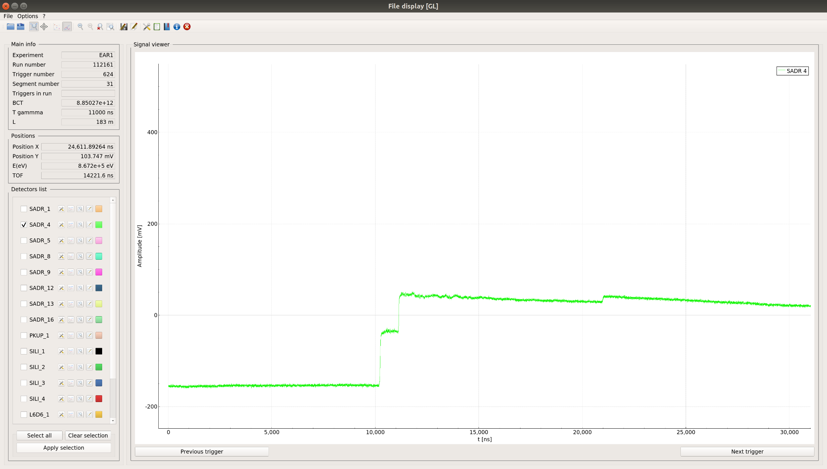
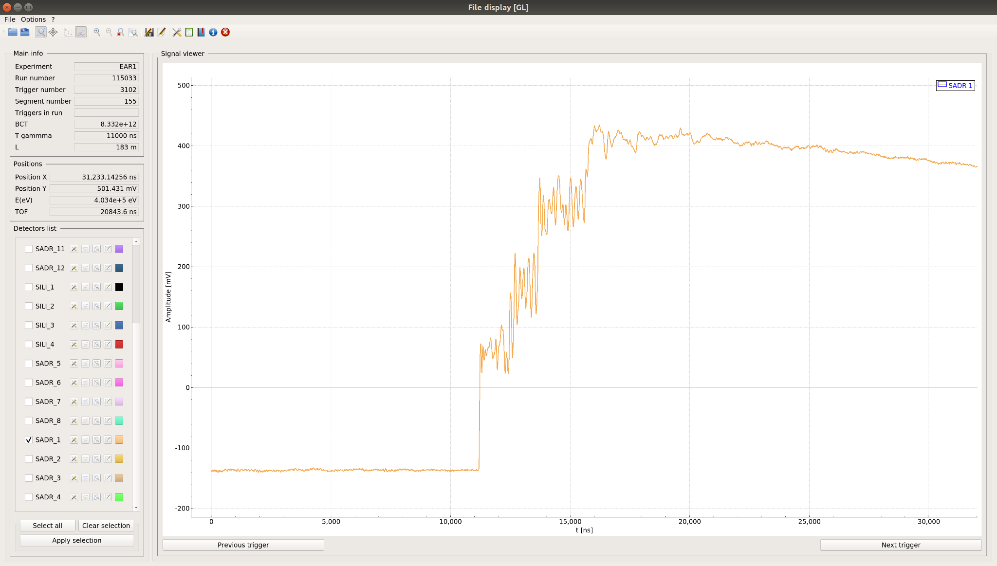
Issues during the 2023 campaign
The ringing problem is still there!
This is a beam related problem appeared in EAR1 during 2022 onwards
For some detectors the problems is solved for others the mitigation is not possible
Detailed investigation is needed (antenna scanning, cabling improvement, …)
2021
2022

Slide 10
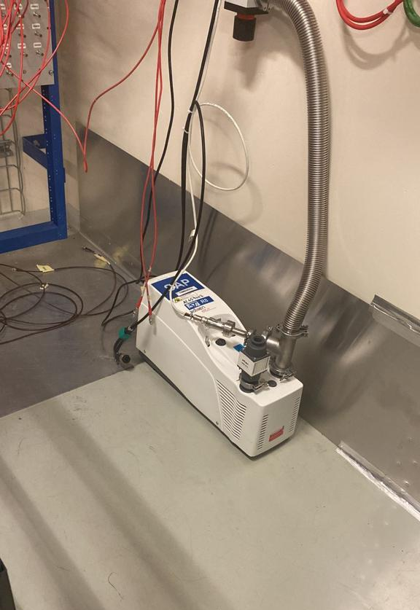
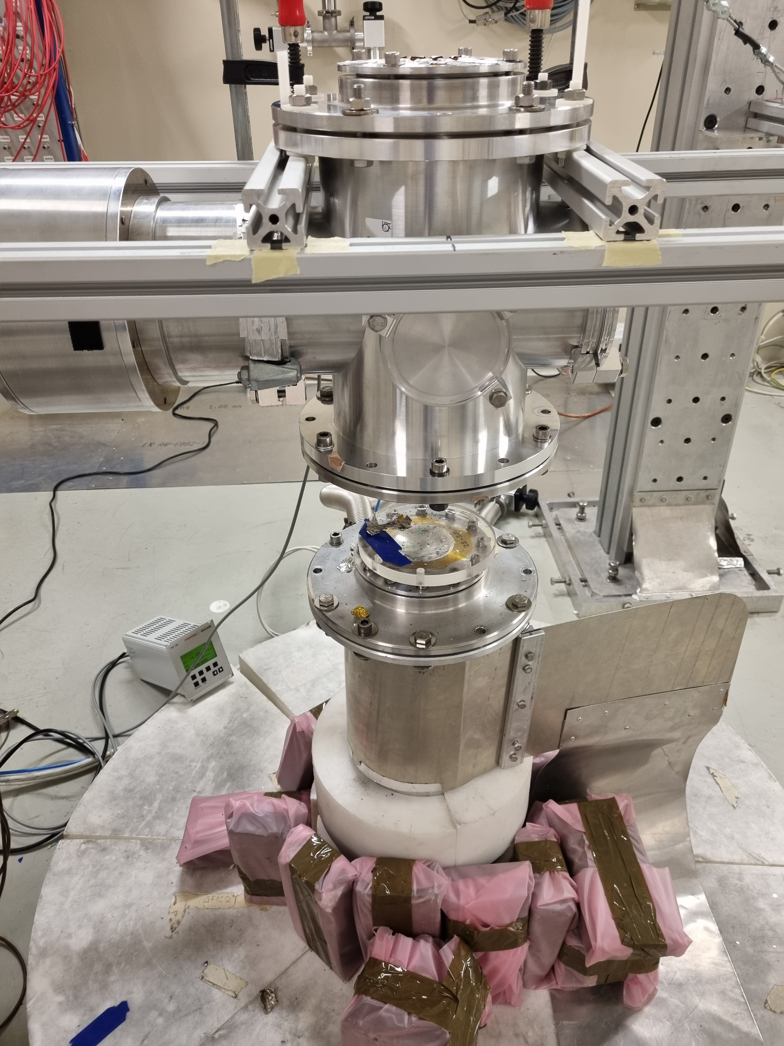
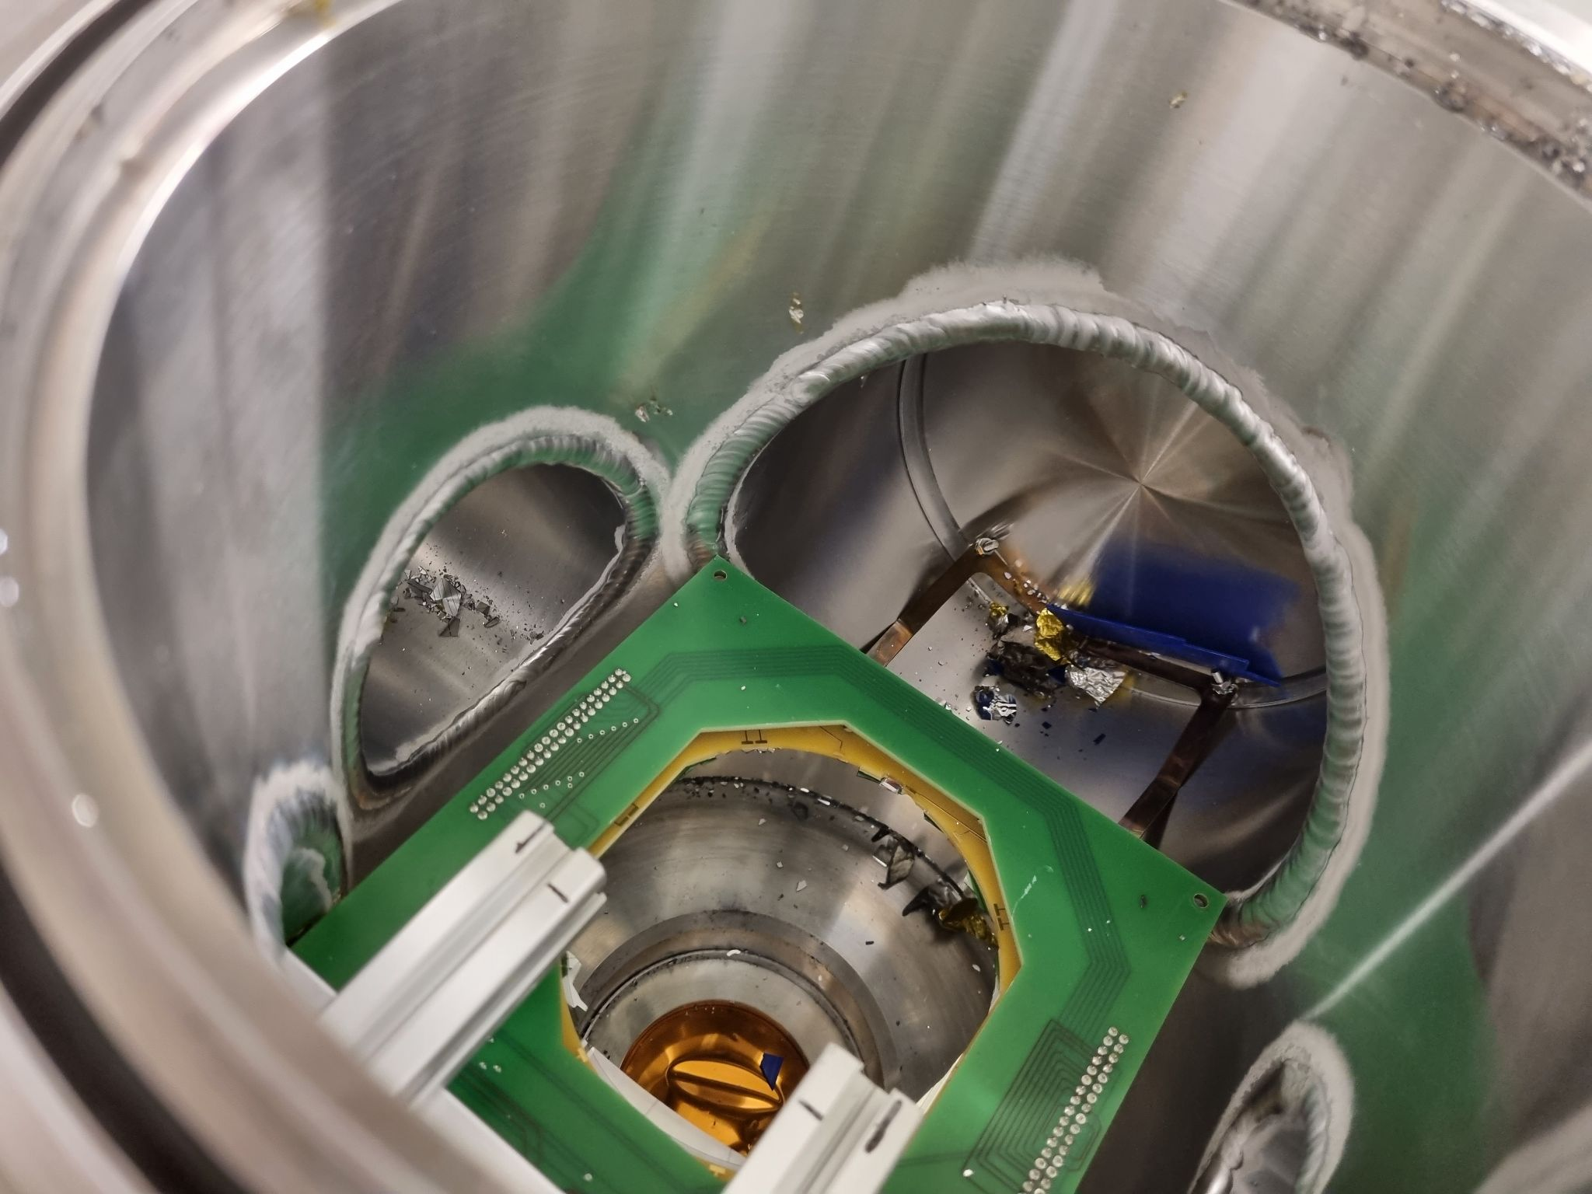
Issues during the 2023 campaign
(on the Experiment side)
https://edh.cern.ch/Document/General/IncidentDeclaration/9967462
Vacuum window failure
Vacuum pump failures
Vacuum window failure

Slide 11
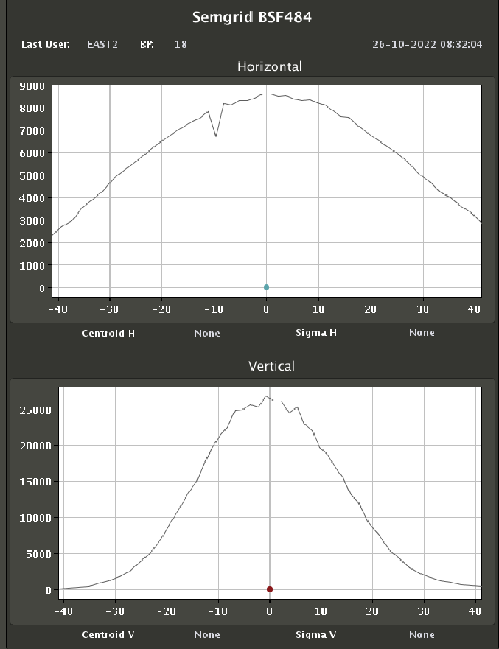
n_TOF desiderata for the 2024 operation
2024 Beam for n_TOF (our request: 217E17 or 1E17* protons/day)
  18.03.2024 - for hardware commissioning (7days)
  25.03.2024 - Physics Start
  28.10.2024 - beam off (217 days of physics)
Pulses of different intensities
  High intensity (dedicated): 8.5E12 ppp
  Low intensity (parasitic): 4.5E12 ppp
“Fixed” impact point on the lead target for both pulses
  ± 5 mm horizontal (centroid)
  ± 3 mm vertical (centroid)
Same (as 2022) spatial profile dimensions of the beam
Proton beam intensity: 200-220e10 p/s
Pulse time length: 28 ns (σ ~ 7ns) without “tails” and pre- pulses
For 2024 proton budget will be fully optimized, as every year, by running INTC approved experiments in parallel in three EARs
* This is a “reasonable” request that takes into account the foressen 2024 demands.

Slide 12
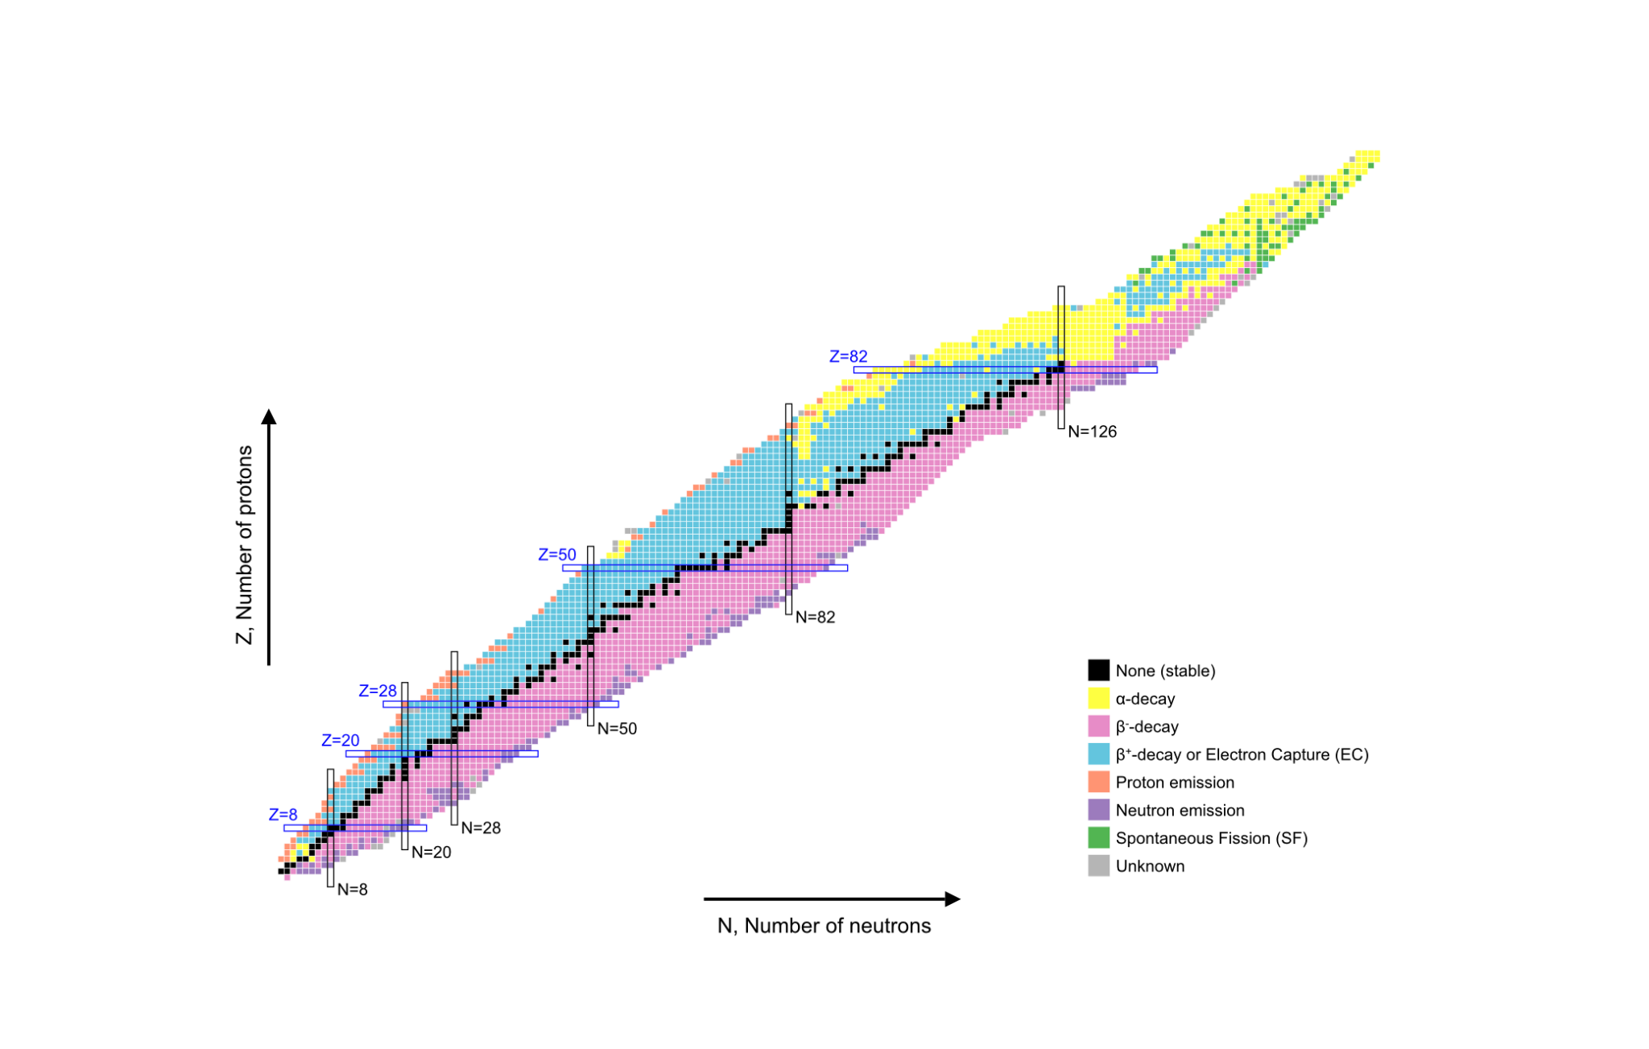
n_TOF future (LS4: High Power target #4)
Fission reaction studies are important for the role of fission recycling in nucleosynthesis as well as for the ongoing n_TOF research plan in energy applications
Even more interesting physics cases (especially for astrophysics: i-process) is there and waiting for us! We have to extend our abilities to isotopes 2 or 5 mass units outside the valley of stability. That means less sample mass will be available.
i-process

Slide 13
n_TOF future (LS4: High Power target #4)
With a target able to accept higher proton beam intensity (x10) we can:
Extend significantly the abilities of both TOF experimental areas. Measurements ~10 times lower sample masses become feasible
  Detection efficiency:
    x2 or x3 in gamma detection
    x6 in particle detection
  Average neutron flux for TOF measurements: x2 (or more) (Maintaining the nice single bunch parameters for TOF measurement)
  Potential increase single bunch intensity x2 or x3 -> important improvement in S/N ratio!
Extend significantly the abilities of both NEAR: SACS measurements with ~100 times lower sample mass become feasible
  Detection efficiency: x10 thanks (!) to Spanish HPGe Clover funding
  Average neutron flux: x10 (or more) by reducing single bunch properties and increase the average power on target (e.g. by directing to FTN all 4 PSB pulses)

Slide 14
Thank you!

Slide 16
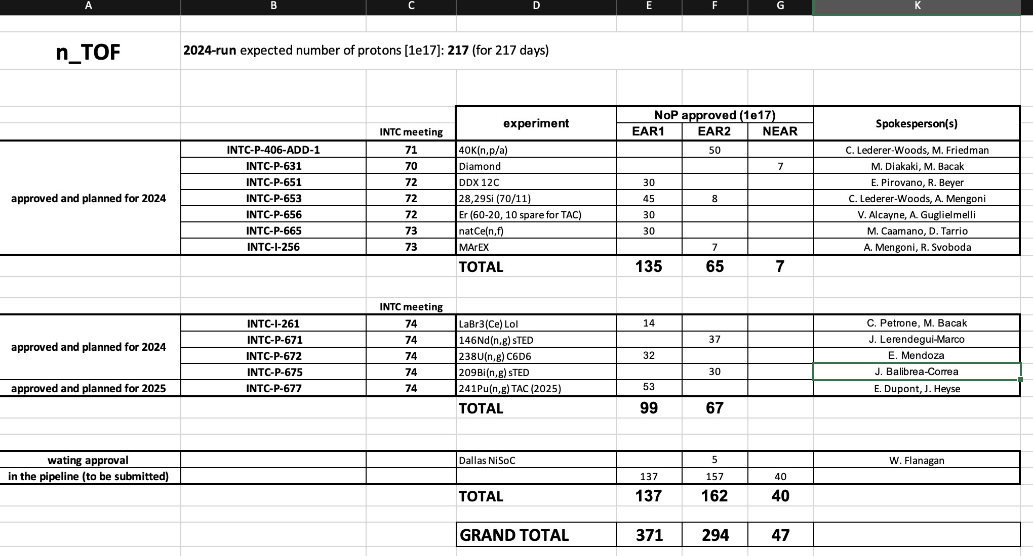

Slide 17
n_TOF so far…

Slide 18
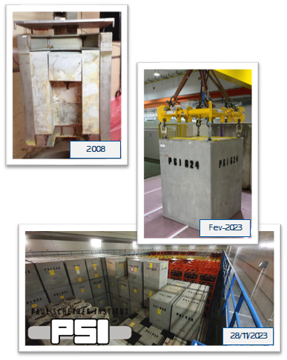
Target #1
The first n_TOF spallation target served the facility up to 2008.
On 28/11/2023 the n_TOF target #1 at PSI (final storage)
Many thanks to SY-STI for the good care of all stages of this demanding task!

