Slide 2


Status Update from ISOLDE
J. Alberto Rodriguez on behalf of
ISOLDE operations and other technical teams

Slide 3
Outline:
Introduction to the ISOLDE facility and the 2023 Physics campaign.
The REX/HIE-ISOLDE post-accelerator.
What do the users of the facility request?
  Variety and purity of the beams.
  Beam intensity and number of shifts dedicated to Physics.
  Beam energy.
  Beam time structure.
  Transverse and longitudinal emittances and beam stability.
Summary.
J. Alberto Rodriguez – JAP Workshop 2023, Montreux – 07.12.2023

Slide 4
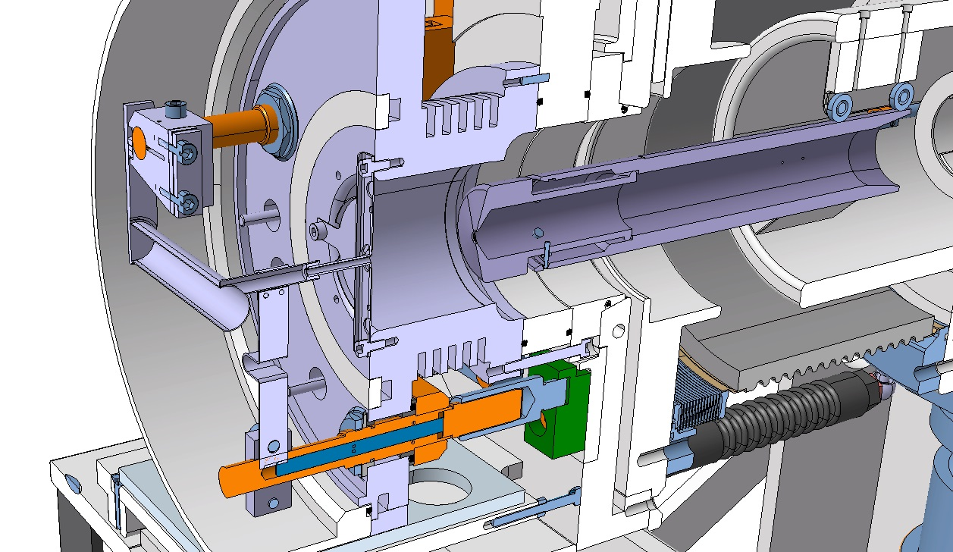
Introduction to the ISOLDE facility and the 2023 Physics campaign:
ISOLDE is the Radioactive Ion Beams (RIBs) production facility at CERN.
ISOLDE receives ~ 50 - 70 % of the protons produced in the complex.
RIBs are produced when 1.4 GeV protons from the PSB are transferred to the facility via the BTY line and impinge in one of the two targets.
The just-created radioactive isotopes diffuse out of the target when it is heated to ~ 2000 C.
They are ionized using different mechanisms (surface, plasma, laser).
They are extracted out of the target unit that is floating at 30-60 kV.
Protons
Radioisotopes
Ions
Vacuum
Air
J. Alberto Rodriguez – JAP Workshop 2023, Montreux – 07.12.2023

Slide 5
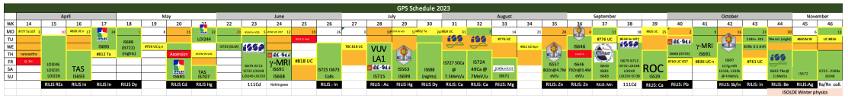
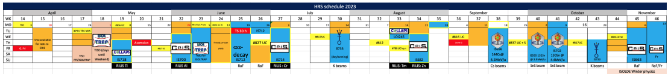
Introduction to the ISOLDE facility and the 2023 Physics campaign:
ISOLDE is able to produce and deliver ~1500 different isotopes with a very large range of beam intensities (i.e. often difficult beam characterization and optimization).
Nuclear chart and production yields at ISOLDE
More than a hundred different beams delivered to complete
the 59 experiments scheduled in 2023.
Experiments last 1 day - 1 week and are scheduled sequentially alternating target positions (although solid state physics normally done in parallel).
Each experiment generally requires a different target (multiple target changes every week), ionization mechanism and/or beam characteristics (i.e. dedicated “mini-commissioning” and machine set-up for every experiment).
2023 Physics Schedule (K. Johnston, H. Heylen). Experiments in green for GPS and in blue for HRS
J. Alberto Rodriguez – JAP Workshop 2023, Montreux – 07.12.2023

Slide 6
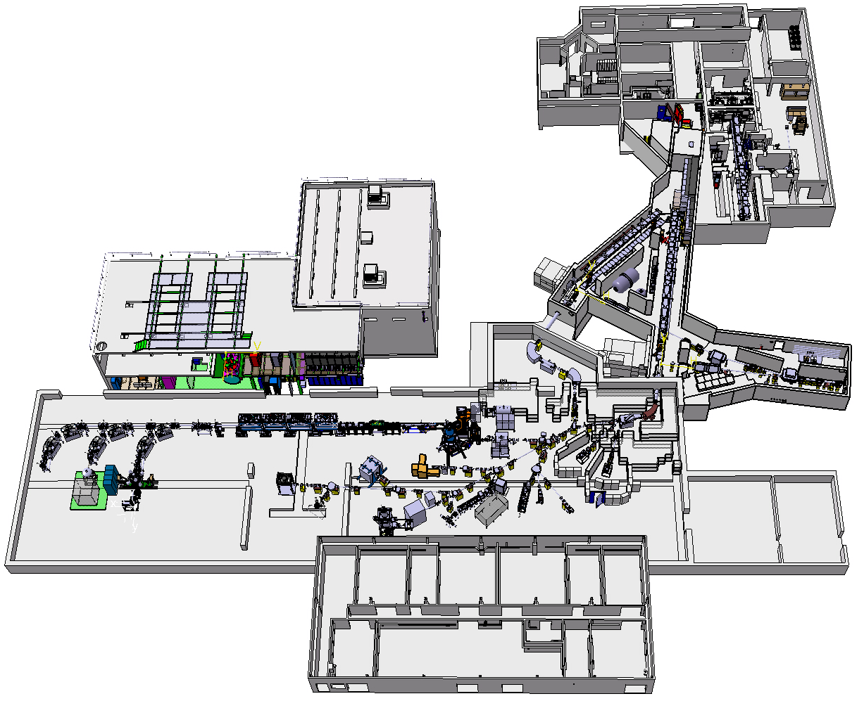
Introduction to the ISOLDE facility and the 2023 Physics campaign:
Isotopes extracted from one of the two front-ends are transported using electrostatic elements to a separator (GPS or HRS) where the RIB of interest is selected. A beam switch yard is used to distribute the beam.
MEDICIS facility
Nanolab
The RIB of interest is transported to one of the experimental stations either directly or after being accelerated in the REX/HIE-ISOLDE post-accelerator.
Cryoplant
Water plant
HRS separator
Target stations
REX/HIE-ISOLDE
post-accelerator
BTY line
GPS separator
High energy experimental stations:
Miniball
ISS
SEC
Low energy experimental stations:
IDS
ISOLTRAP
CRIS
COLLAPS
SSP stations
VITO
MIRACLS / PUMA
WISARD
Control room
User labs
J. Alberto Rodriguez – JAP Workshop 2023, Montreux – 07.12.2023

Slide 7
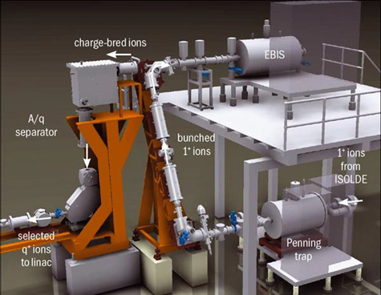
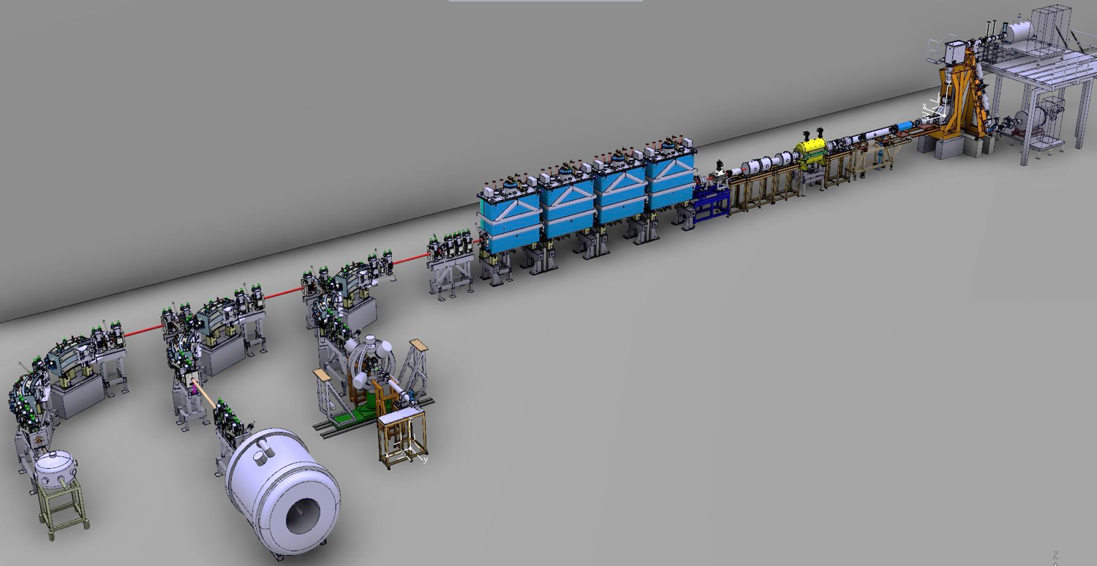
The REX/HIE-ISOLDE post-accelerator:
Ions are accumulated and transversely cooled in the REX-TRAP and charge bred in the REX-EBIS.
The charge state of interest is selected in the REX separator before injection into the REX/HIE-ISOLDE linac for acceleration.
REX-EBIS
REX-TRAP
REX Separator
J. Alberto Rodriguez – JAP Workshop 2023, Montreux – 07.12.2023

Slide 8
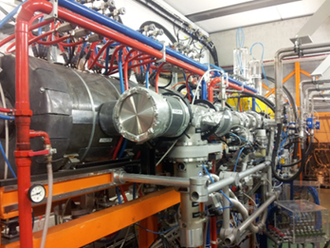
The REX/HIE-ISOLDE post-accelerator:
The REX room temperature linac:
Beam from the charge breeder with 5 keV/u energy is accelerated to 2.8 MeV/u.
Cavities: Seven RF structures: f = 101.28 MHz (except for 9gap at 202.56 MHz) up to 10% duty cycle.
Nominal charge state acceptance: 2.5 < A/q < 4.5. Operational 2023: 1.75 < A/q < 4.0
Beam instrumentation: 3 diagnostic boxes (FCs, silicon detectors, beam attenuators and collimators).
REX-EBIS
RF structure | E_{f} [MeV/u] | β_{f} [%] | P [kW] for A/q=4.0 | A/q acceptance
RFQ | 0.3 | 2.5 | 29 | < 5.5
Buncher | 0.3 | 2.5 | 1.3 | > 2.5
IHS | 1.2 | 5.1 | 40 | < 4.5
7gap1 | 1.55 | 5.7 | 60 | > 2.5
7gap2 | 1.88 | 6.3 | 60 | > 2.5
7gap3 | 2.2 | 6.8 | 60 | > 2.5
9gap | 2.85 | 7.8 | 71 | > 2.5
REX linac
REX separator
REX-TRAP
J. Alberto Rodriguez – JAP Workshop 2023, Montreux – 07.12.2023

Slide 9
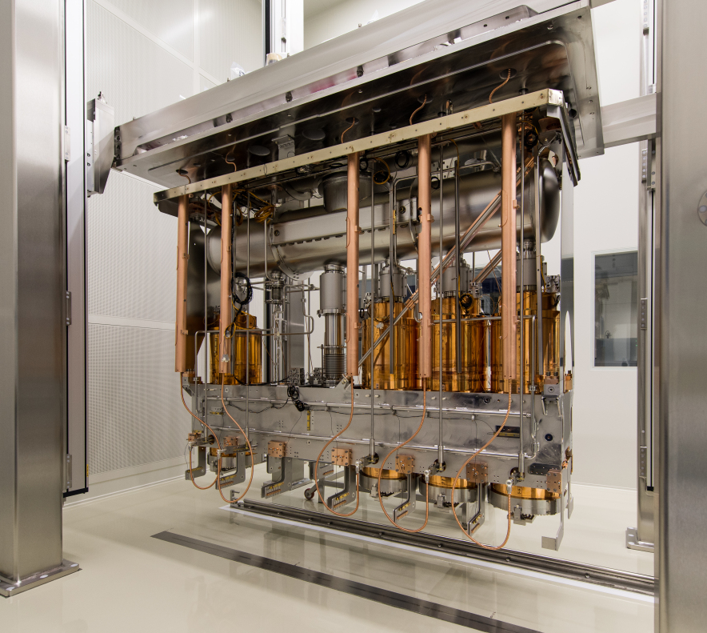
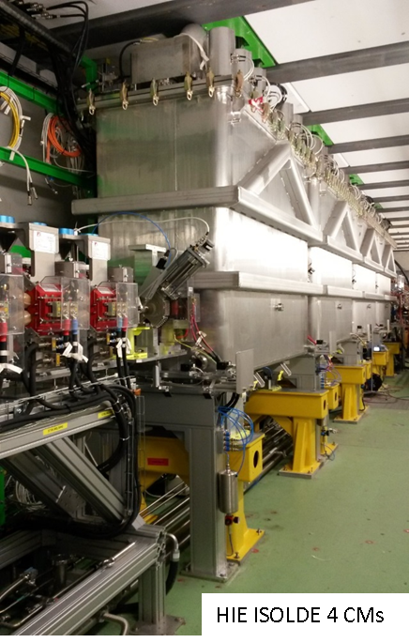
The REX/HIE-ISOLDE post-accelerator:
The HIE-ISOLDE superconducting linac and HEBT lines (project completed in 2018):
Cavities: Quarter Wave Resonators (QWR) made of a copper substrate with sputtered niobium.
Cryomodule: one SC solenoid and 5 QWR that can be phased independently.
Nominal energy: 9.2 MeV/u (A/q = 4.5), 14.2 MeV/u (A/q = 2.5). Operational 2023: ~7.2 MeV/u (A/q = 4.5).
Diagnostics: scanning slits, collimators, stripping foils, silicon detectors and FCs.
REX-EBIS
REX linac
HIE-ISOLDE linac
REX separator
REX-TRAP
2016
2015
2017
2018
f [MHz] | 101.28
Geometrical beta (β_{g}) | 10.3
E_{acc} [MV/m] | 6
Quality factor (Q_{o}) at E_{acc} | 5∙10⁸
Active length [m] | 0.3
Beam aperture [cm] | 2
Max. Transit Time Factor (TTF) | 0.9
SEC
Miniball
ISS
J. Alberto Rodriguez – JAP Workshop 2023, Montreux – 07.12.2023

Slide 10
What do the users of the facility request?
Variety and purity of the beams.
Beam intensity and number of shifts dedicated to Physics.
Beam energy.
Beam time structure.
Transverse and longitudinal emittances and beam stability.
…
J. Alberto Rodriguez – JAP Workshop 2023, Montreux – 07.12.2023

Slide 11
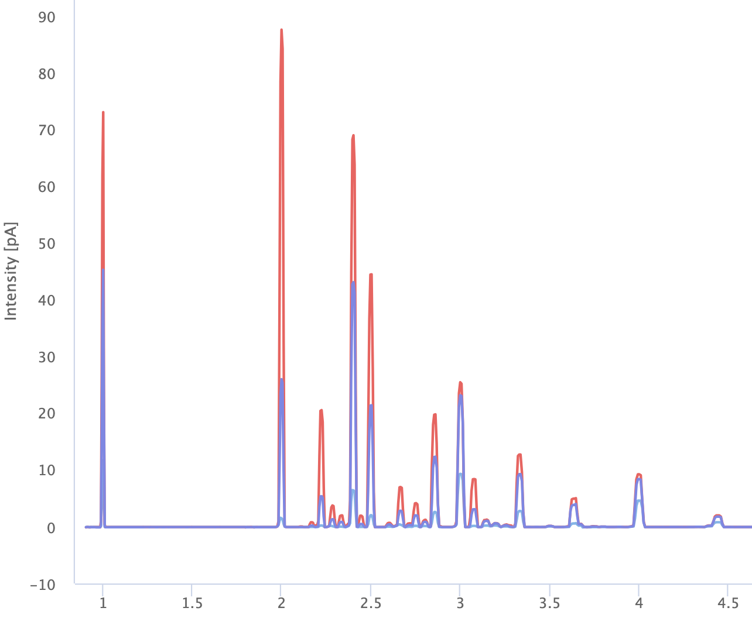
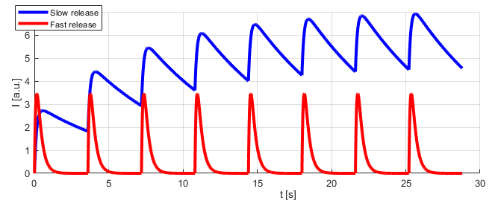
Nuclear chart and production yields at ISOLDE
Variety and purity of beams:
New regions of the nuclear chart → Additional Physics!
Short half-life. Not a lot we can do. Intrinsic limitation of ISOL facilities. Diffusion of isotopes out of target takes > few milliseconds.
Mass resolving power not enough to separate isobaric contaminants. Some experimental stations equipped with a MR-ToF. But no plans to redesign the GPS or HRS separators at this time.
Excellent work by SY/STI developing new targets and ionization mechanisms to increase the variety and purity of the RIBs. (e.g. LIST targets, RILIS new ionization schemes, molecular beams…)
A/q spectrum out of the REX-EBIS
Stable beam contaminants due to ionization of residual gas in the REX-EBIS charge breeder greatly reduced during after LS2 thanks to the excellent vacuum level. Stripping foils in HEBT lines available and used for low A beams when needed.
Beam gates system (system to start/stop the transport of beams outside the separator zones):
Fast release
Period
  In combination with supercycle structure, they can be used to improve beam purity.
  Supercycle structure kindly accommodated by PSB colleagues.
  Issues with the hardware since LS2. Work-around in place.
  Meeting to address this problem planned for next week.
Slow release
Pulsing beam gates to change contaminant ratios if release times are different
J. Alberto Rodriguez – JAP Workshop 2023, Montreux – 07.12.2023

Slide 12
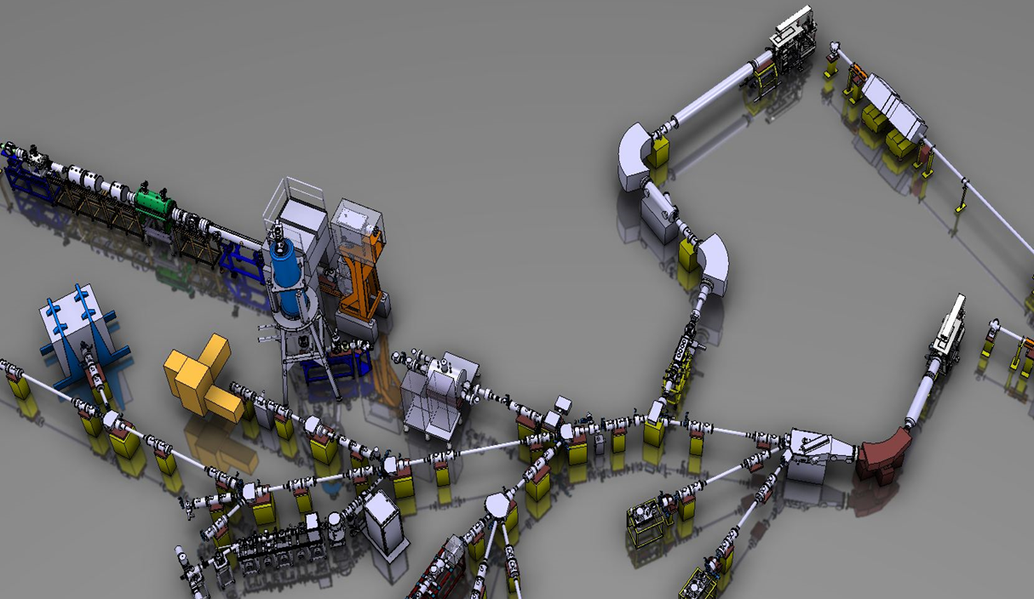
Beam intensity and number of shifts dedicated to Physics:
Higher RIBs intensities → “New” isotopes and more experiments in a year!
Beam intensity for all RIBs proportional to proton beam intensity. Up to a factor x5 higher intensity for multiple RIBs expected with 2 GeV proton energy. Keeping the 1.4 GeV option needed.
  Linac4 and PSB high-intensity MDs extremely valuable and very welcome by the user community.
  Beam dumps consolidation and 2 GeV upgrade of the BTY line needed (hopefully during LS3).
  Additional target (and possibly front-end) developments may be needed to cope with the new p beam.
  In the meantime: 1.7 GeV p to GPS target will be used for physics and higher than 2 uA p current may be occasionally requested (RP and SY-STI assessment to define authorized beam power limit).
Improved operational efficiency (BE-OP, SY-STI-RBS/LP). Despite the shorter Physics campaign:
  59 experiments in 2023 compared to 52 experiments in 2022.
  Comparable number of protons to ISOLDE in 2023 and in 2022.
  Note: Even though is not sustainable in the long-term and a correction to a reasonable middle point will be needed in 2024, it is still a remarkable achievement by all ISOLDE technical teams.
  In the long-term: Development and validation of
  optics model for low-energy beam lines (SY-ABT),
  adoption of LSA, EPA project and additional software
  applications to automate tasks.
Pulsing of the central line.
  With the notable exception of the SSP experiments, the central line blocks simultaneous beam delivery from GPS and HRS separators.
  Pulsing this line will reduce the effective set-up time and increase the number of Physics shifts.
Central line
J. Alberto Rodriguez – JAP Workshop 2023, Montreux – 07.12.2023
SSP experimental stations

Slide 13
Beam energy:
Higher beam energies increase the cross-section of some reaction and it is required for many high-energy experiments.
Maximum nominal (orange) and operational (blue) beam energy for different A/q ratios
Accelerating gradient of superconducting cavities limited in average to ~70 % of the nominal 6 MV/m. In addition, it is degrading over time (believed to be caused by the yearly thermal cycles).
In the short-term:
  Experimental proposals may be rejected by the TAC or not scheduled.
  Pushing accelerating gradient. Consequences: Additional trips. Downtime increases quickly!
  Boosting the charge state of the beam. Possible only because of the excellent performance of the new electron gun developed by BE-ABP during LS2. Consequences: Longer breeding time reducing repetition rate and worsens the time structure of the beam. In some cases, saturation of the REX-TRAP.
In the long-term:
  Keeping the cryomodules cold during the YETS. Under investigation by
  SY-RF and TE-CRG.
  Additional cryomodule (hopefully, shortly after LS3). Major effort by SY-RF, TE-VSC and other groups.
  Consolidation of existing cryomodules. Major effort (i.e. clean room in SM18). Cannot be done during a normal YETS without impact on the Physics campaign unless an additional cryomodule is used as a “hot” spare.
J. Alberto Rodriguez – JAP Workshop 2023, Montreux – 07.12.2023

Slide 14
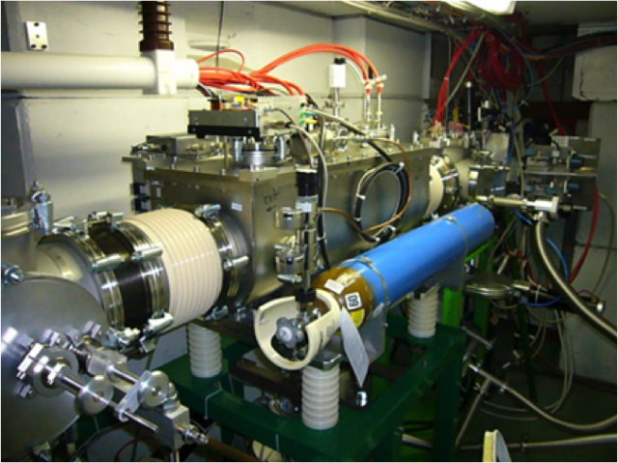
Beam time structure:
Low-energy users often require bunched beams.
The time structure of the beam defined by the supercycle structure, the RIB release time and the configuration of the beam gates.
The ISOLDE cooler/buncher in the HRS separator is required to bunch and change the time structure.
Even though the situation has improved significantly after LS2 (e.g. remote He gas injection system, new RF amplifiers…), some issues remain (e.g. possible misalignment of extraction system, limited RF power, hysteresis in gas supply…)
In the longer term, removing the HRS one and adding dedicated cooler/bunchers for each experimental station that needs them should be studied.
ISOLDE cooler/buncher
High-energy users generally request the highest possible average beam intensity with the lowest possible peak intensity to avoid pile-up in their DAQ.
Non-optimal time structure. A/q acceptance limited to 4.0 (compared to nominal 4.5) because of instabilities of REX RF systems at high peak powers. In addition, RF pulse lengths limited to ~ 1.2 ms due to the average power limit in the 9gap.
In the short-term: Limiting Physics with heavy isotopes,
pushing the REX-EBIS (possible only because of the
excellent performance of the new electron gun developed
by BE-ABP during LS2), slow extraction (~1 ms long
pulses) from the REX-EBIS.
In the long-term: New solid-state RF amplifiers and
digital LLRF system (LS3). In my view, a study (beam
dynamics and RF EM designs) to replace some of the
REX RF cavities should also be launched.
Slow-extracted beam pulse from REX-EBIS
J. Alberto Rodriguez – JAP Workshop 2023, Montreux – 07.12.2023

Slide 15
Transverse / longitudinal emittances and beam stability:
Users need small transverse & longitudinal emittance beams.
Jitter due to faulty power converter visible in beam profile.
Instabilities of the aging electrostatic power converters result in effective emittance growth (electrostatic benders are excellent energy spectrometers).
Phase and field instabilities of the REX RF and SRF systems result effective growth of both longitudinal and transverse emittance (after HEBT dipoles).
In the long-term:
Consolidation of electrostatic and HRS dipoles power converters (SY-EPC) over the next few years.
Development of optics model for low-energy beam lines (SY-ABT) should help improving quality of beam set-ups and reducing growth effective emittance.
New solid-state RF amplifiers and digital LLRF system (LS3).
Other possible improvements:
Trips of the target and line heating. Slow ramping to limit thermal stresses in target units. Significant source of downtime. Root cause not clear. Difficult diagnosis.
Beam characterization. Excellent consolidation work by SY-BI since LS2. Dozens of devices already replaced or added (FCs, scanning wires, linac slits and attenuators…). Several others (e.g. BTY SEMgrids, low-energy slits systems) planned for the coming years.
Limited support for some critical systems. Day-time support for the REX RF systems and best effort for the front-end HT may result in loss of an experiment if the system fails during afterhours. Improving the level of support would be greatly appreciated by OP and the user community.
J. Alberto Rodriguez – JAP Workshop 2023, Montreux – 07.12.2023

Slide 16
Summary:
Very demanding but successful 2023 Physics campaign:
More experiments than in 2022 and comparable number of protons despite the shorter length.
Several work-arounds in place to deal with aging equipment.
Multiple systems consolidated and improved since LS2:
Target front-ends.
Tape station.
REX and low-energy beam instrumentation.
REX-EBIS electron gun.
Lots of improvements planned or being evaluated for the coming years:
Consolidation of the beam dumps.
2 GeV upgrade of the BTY line.
Consolidation of the electrostatic and HRS dipoles power converters.
Pulsing of the central line.
Development of the optics model of the low-energy beam lines.
New solid-state amplifiers for REX.
New digital LLRF system for REX.
Consolidation of SRF cavities.
Additional cryomodule.
System of keep SRF cavities cold during the YETS.
Consolidation of several BTY and low-energy lines beam instrumentation.
RILIS lab extension and upgrade.
J. Alberto Rodriguez – JAP Workshop 2023, Montreux – 07.12.2023

