Slide 1
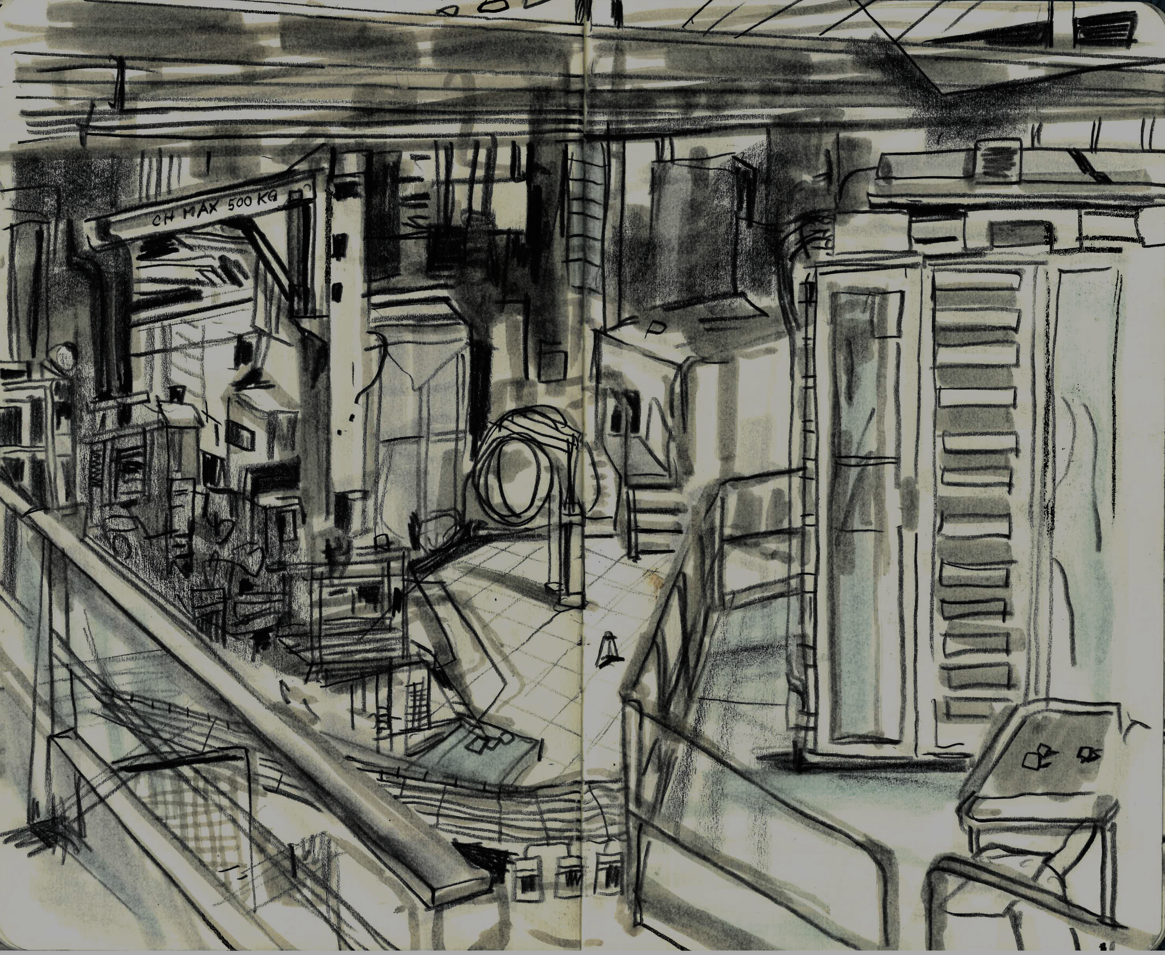


Status update from AD/ELENA and APOC WG
D. Gamba, Y.Dutheil, L.Ponce for the AD/ELENA team
JAPW2023 – 07/12/2023
Background by Theres Rütschi, Instagram: papermoon_32
Notes:
- status of the performance of this year compared to last year (e.g. one slide)
- discussion about long term consolidation/upgrade plans for the facility, including power supplies, horn(?), …
- issue with QFC54 at startup: example to stress importance of consolidation of magnets. In principle, this is getting to an end with a more or less well defined path.
- radiation levels: improvement in shielding of AEGIS area allowed to reach un-precedent pbar intensities
- rings instrumentation status/outlook: AD IPM being hopefully fixed during YETS 23/24, intensity measurements now much more under control, BCCCA still delicate instrument, work to better understand scraper measurements, …
- requisite for long term reference collection for efficient restart
- s-cooling improvements thanks to improved diagnostics/references/tools: report on work of RF colleagues
- effort being put in place to better understand pbar production: report on work chaired by ABT colleagues
- example: reduced pulsing rate of DI power supplies.
- example: auto-steering of beam on target.
- General: effort in looking at “percent-level” optimisation and good understanding of our machine
- example: recover 80% of intensity after issue with horn at the end of the year
- ...

Slide 2
Outline
AD/ELENA Overall Performance
User wishes and how we tackle them
  Intensity and its stability
  Repetition rate and availability
  Beam characteristics
Long term sustainability
Conclusions

Slide 3
Outline
AD/ELENA Overall Performance
User wishes and how we tackle them
  Intensity and its stability
  Repetition rate and availability
  Beam characteristics
Long term sustainability
Conclusions

Slide 4
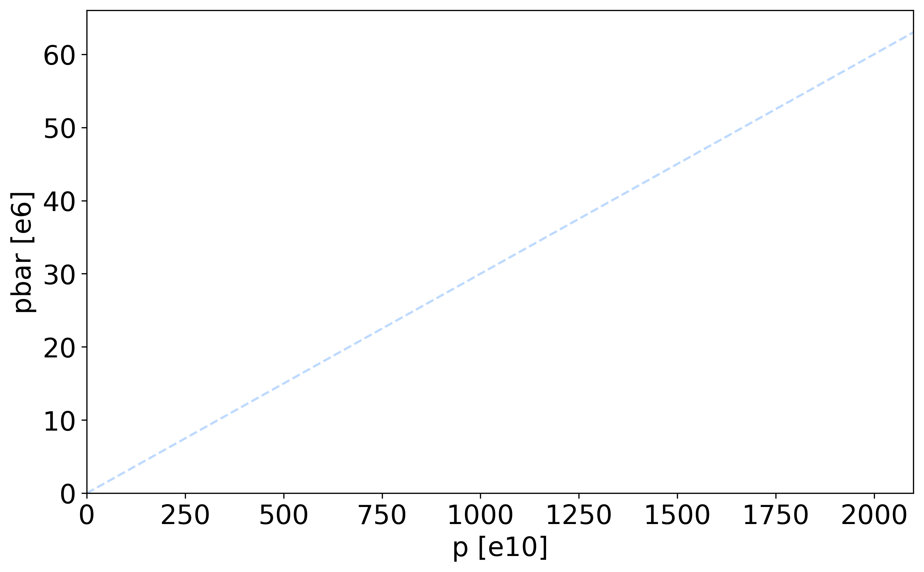
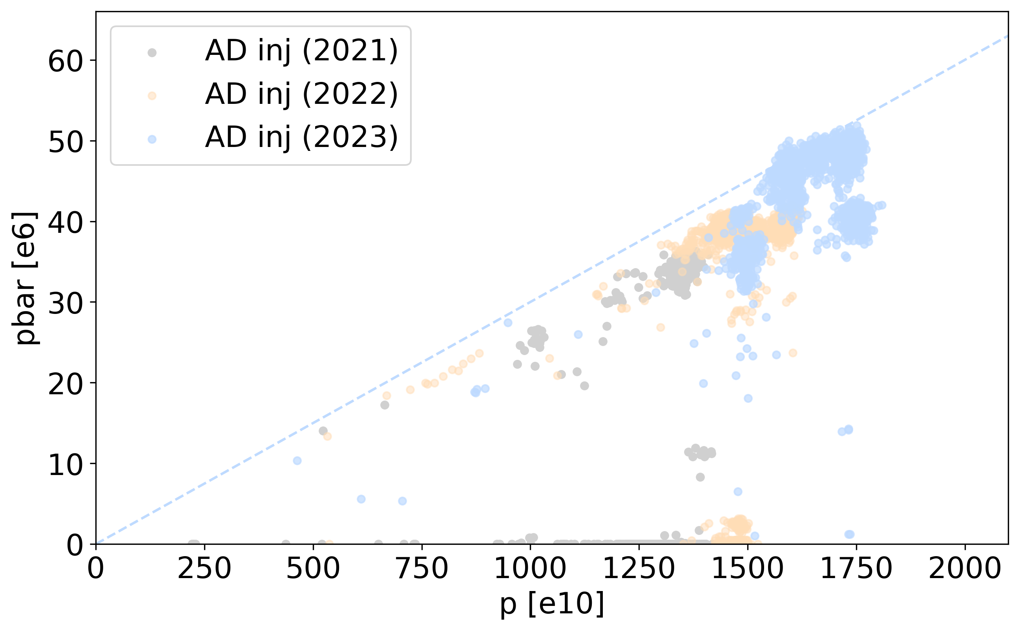
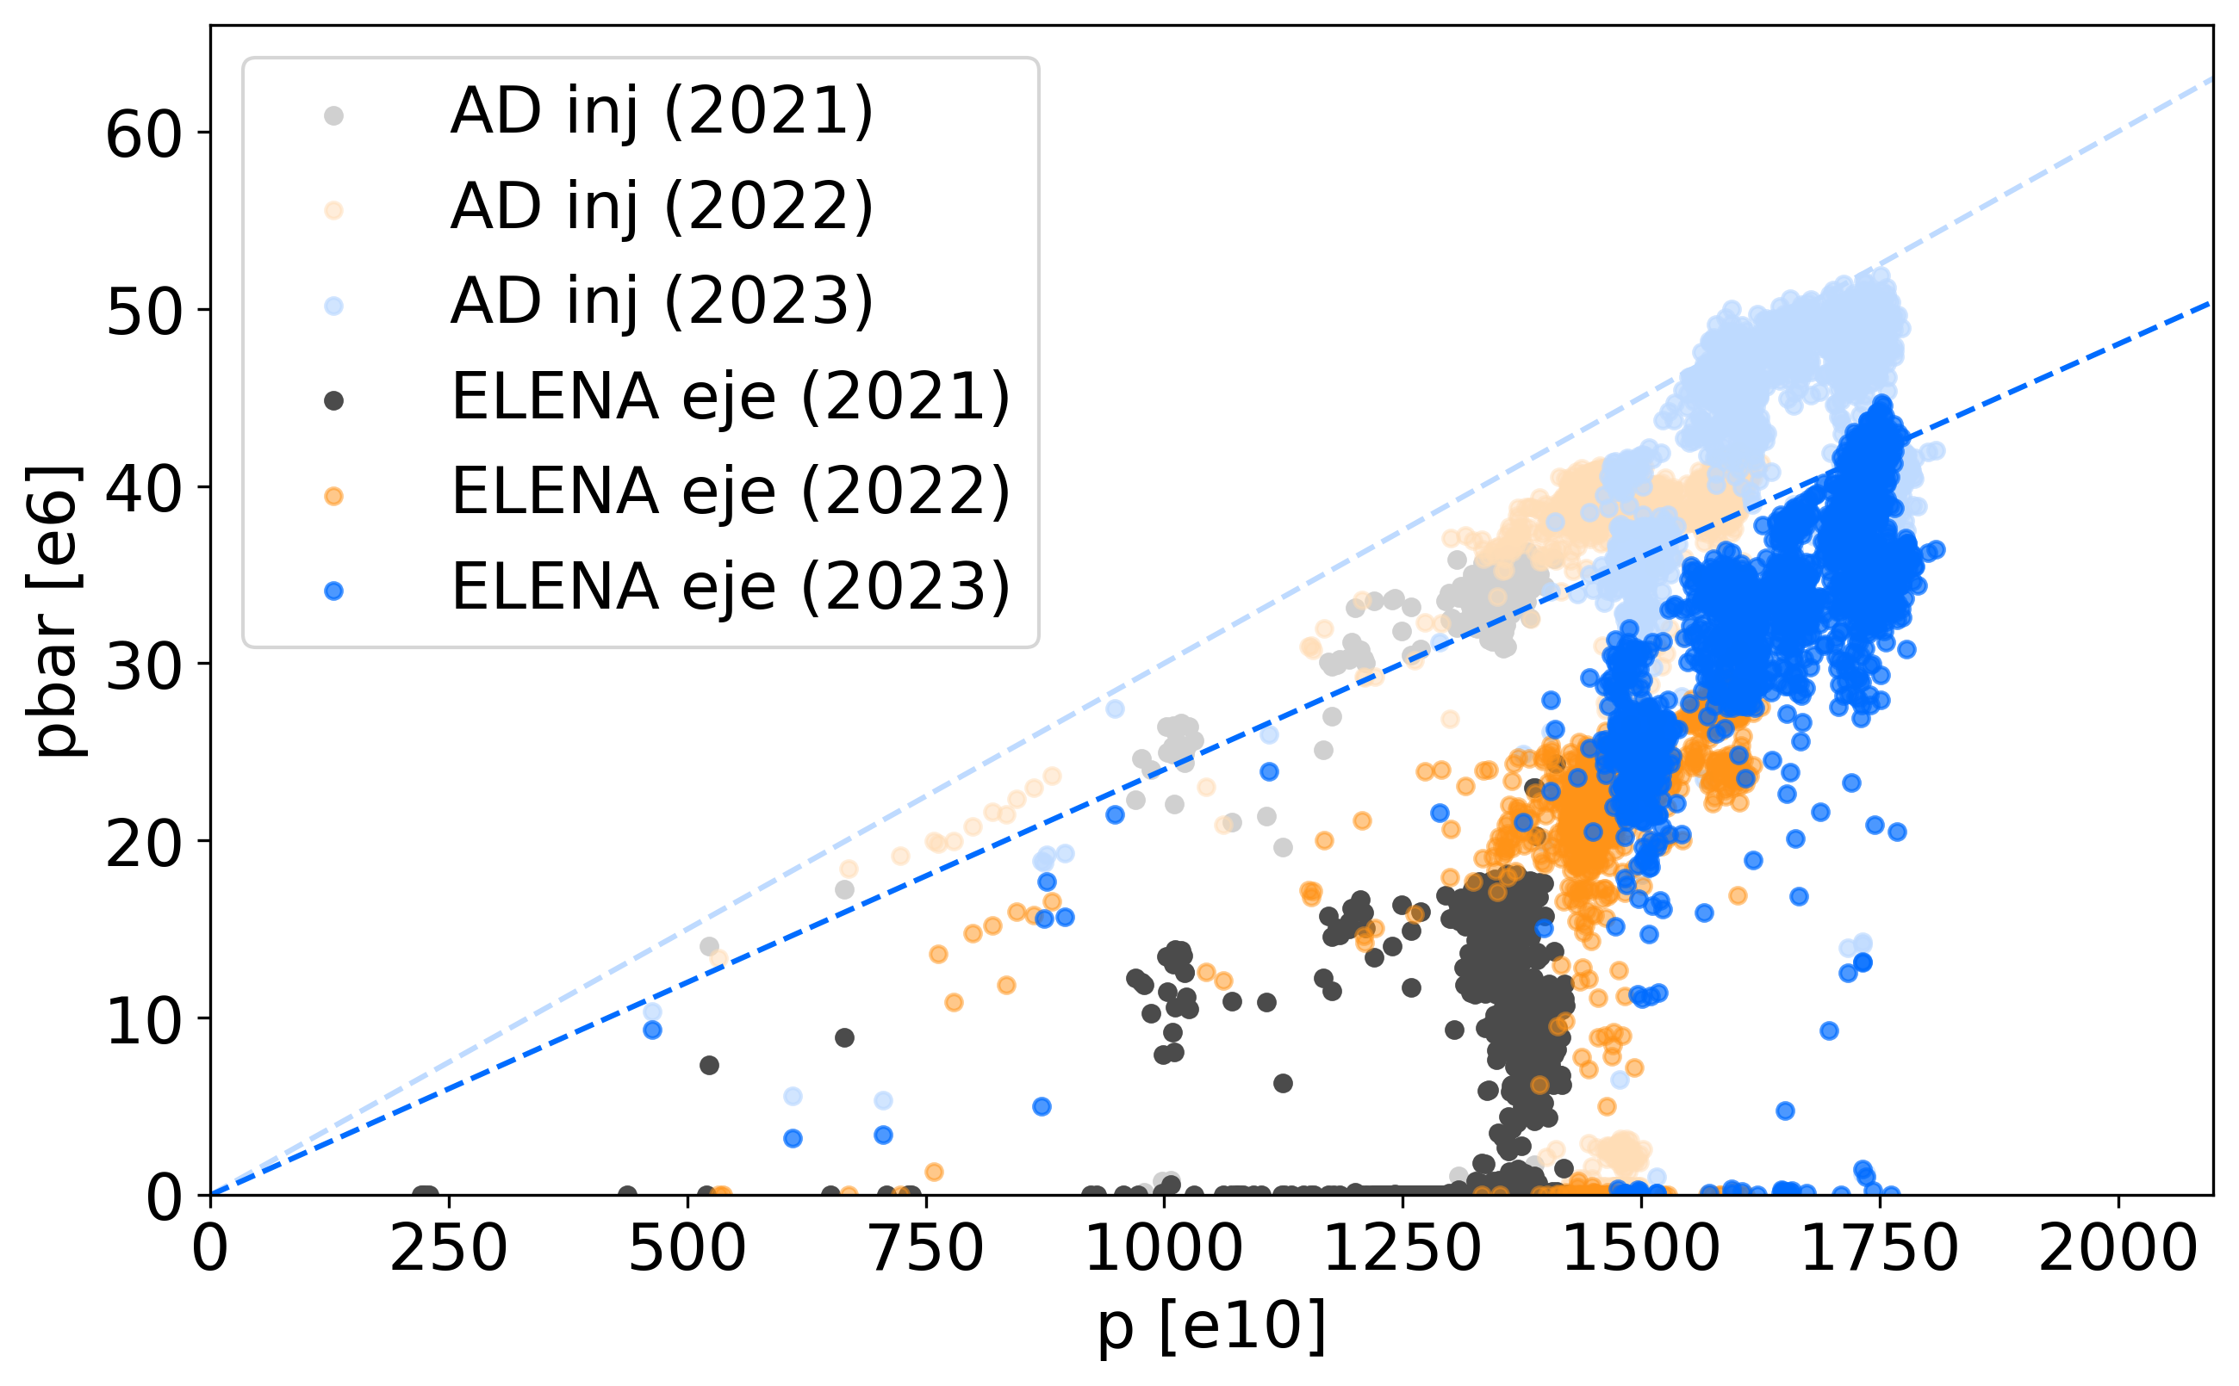
AD/ELENA Overall Performance
Overall performance can be expressed as pbars vs protons on target
  Showing 1 cycle every 50 starting from 1st of July till end-of-physics in 2021, 2022 and 2023
PS￫AD Pre-LS2
3e-6 pbar/p
80% AD+ELENA
transmission
ELENA Design
Overall: another excellent year for AD/ELENA with performance improvements!

Slide 5
Outline
AD/ELENA Overall Performance
User wishes and how we tackle them
  Intensity and its stability
  Repetition rate and availability
  Beam characteristics
Long term sustainability
Conclusions

Slide 6
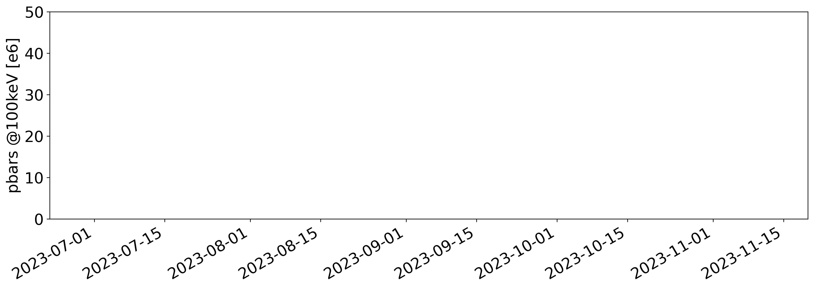
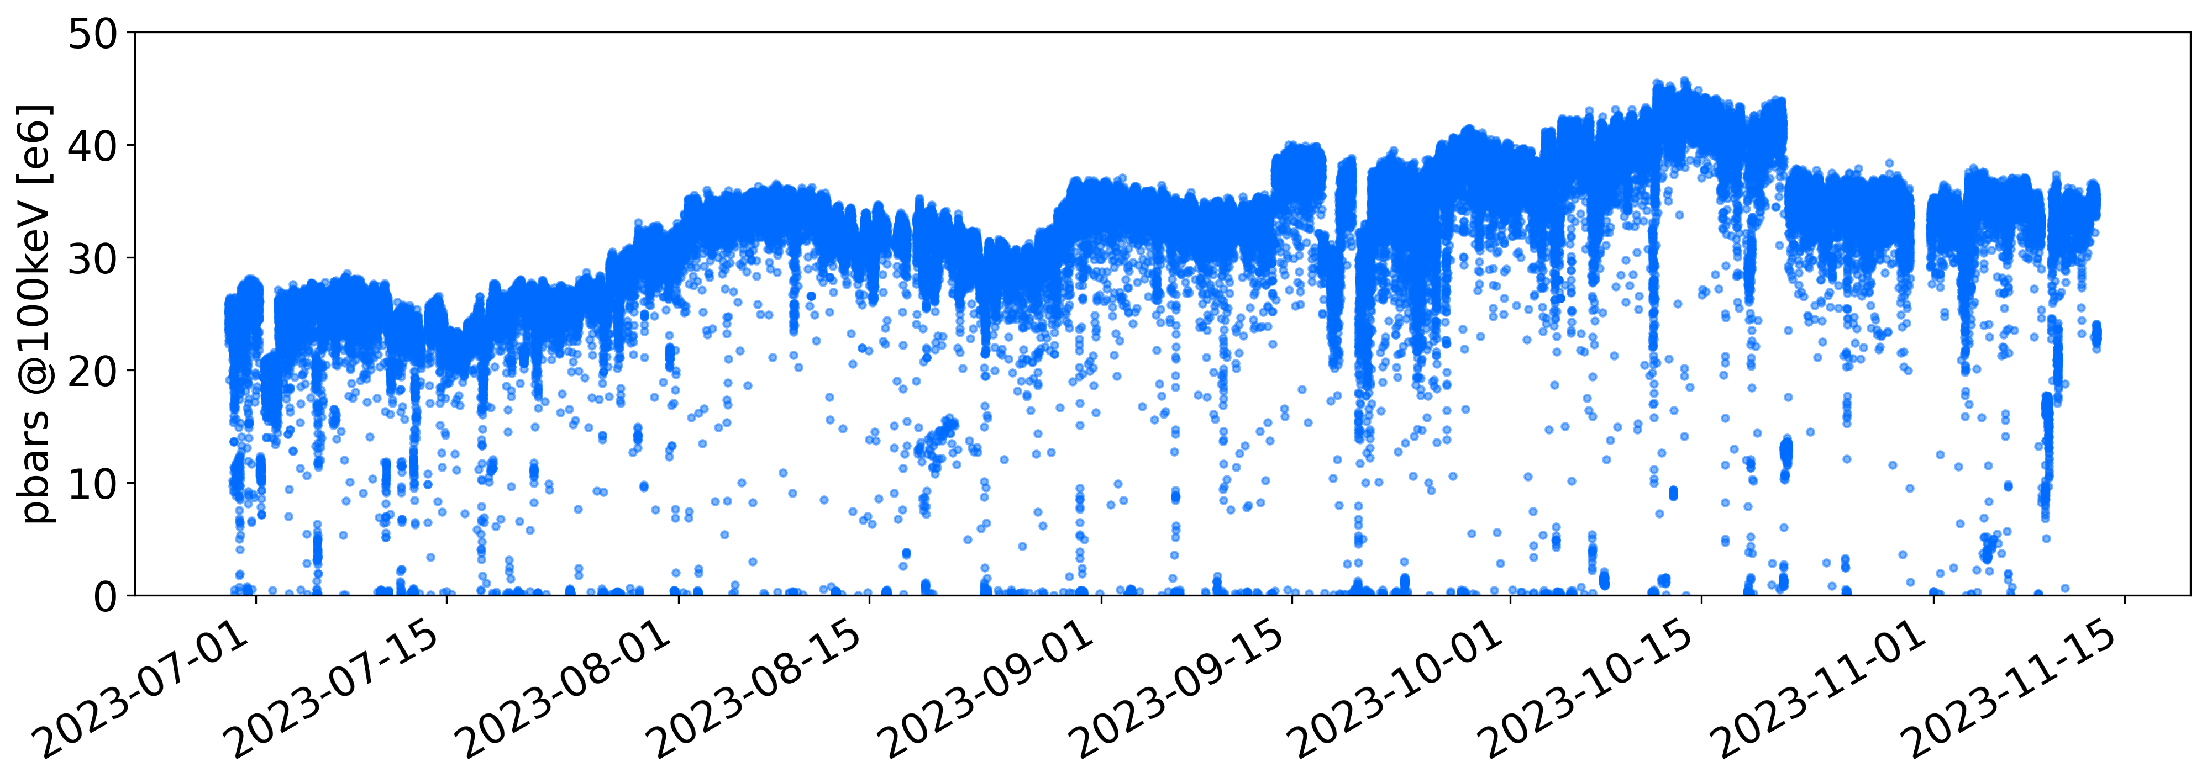
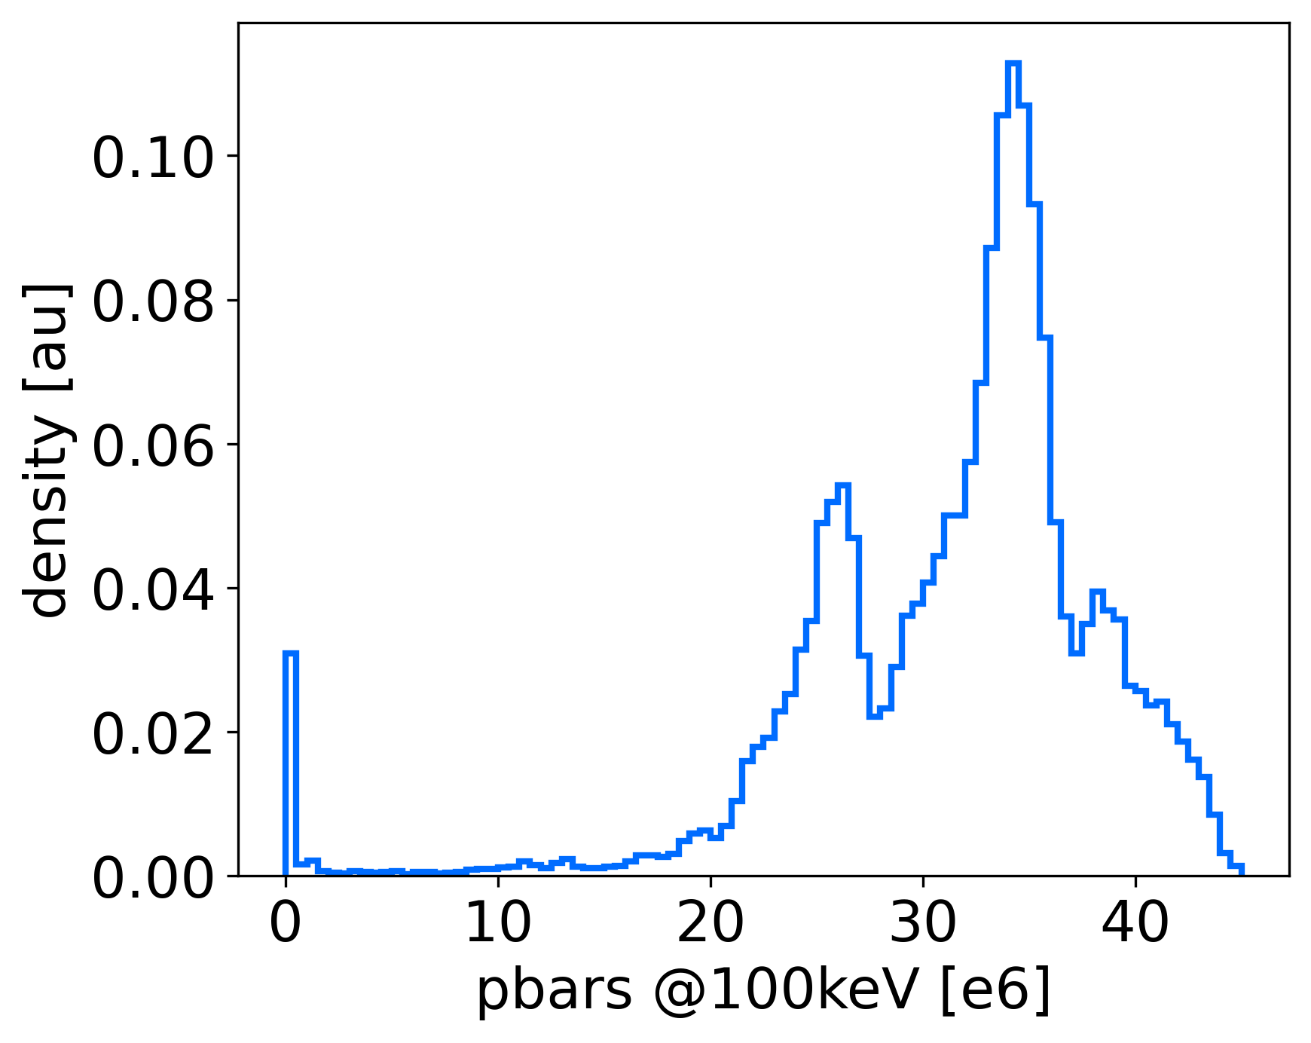
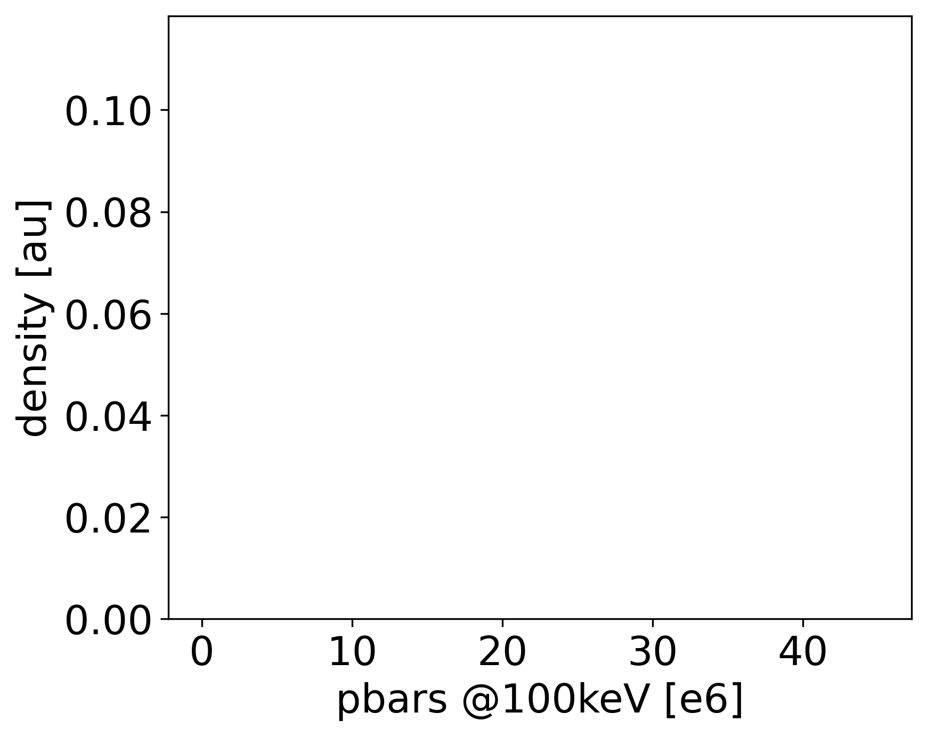
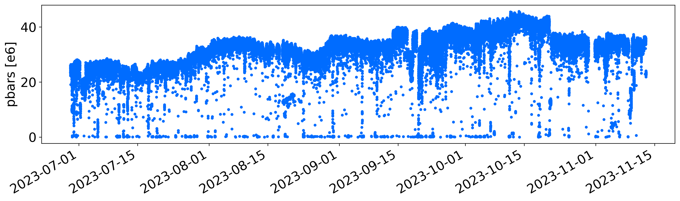
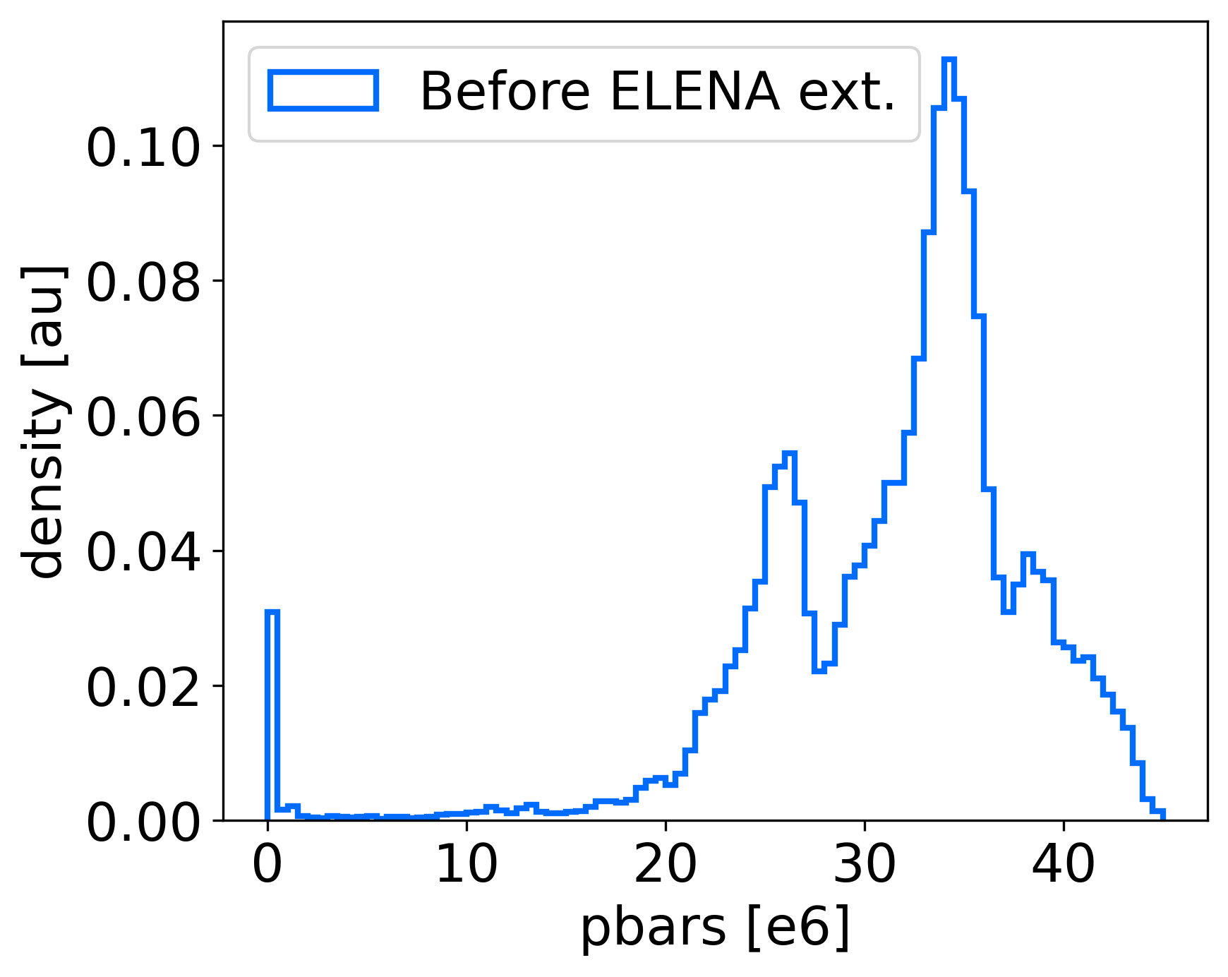
What our (typical) users want: stable intensity
As part of follow up action from JAPW2022, the AD/ELENA mini-workshop
was organised in March 2023
A small survey was organized to ask for “user wishes” :
  Request: stable intensity of more than 2.5e7 pbar divided in 4 equal bunches
    Typically, the more, the better….
    Acceptable to have slow drifts over time scales of days/weeks
Ideal case
“Acceptable”
In practice, quite some intensity variation/fluctuation (>20%!) over the year
  Slow improvements thanks to motivated operation team
  Slow/fast degradations due to natural drifts and hardware faults/issues
  Shot-to-shot flucuations due to non-reproducibility of several sub-systems
See also presentation by B. Holzer

Slide 7
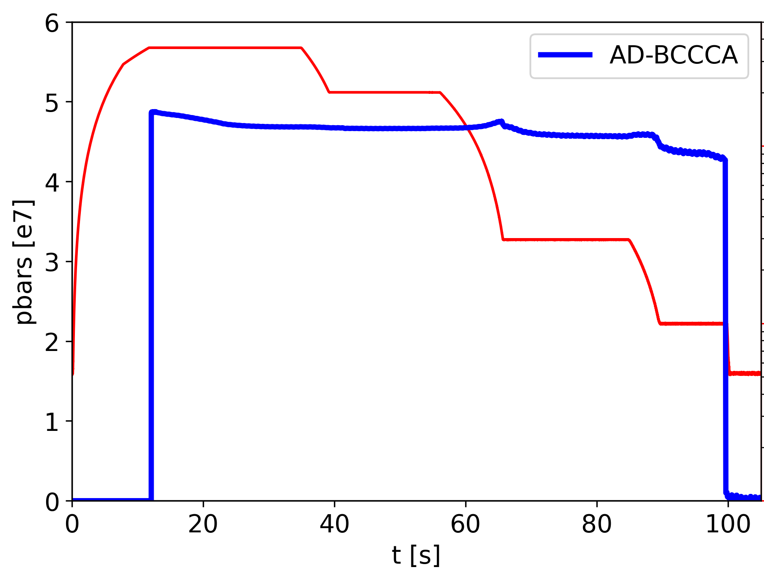
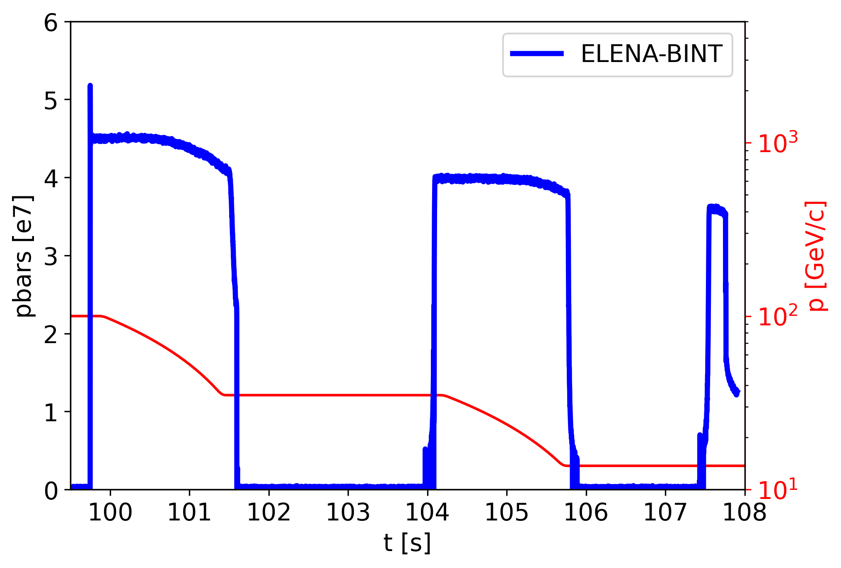
Note: AD/ELENA Cycles
Magnetic cycles basically un-changed in length since 2022
To simplify, the deceleration process can be divided (arbitrary choice) in
macro-steps linked to underling “production” or “cooling” mechanisms
  Disclaimer: transmission along one step might depend on beam quality from previous one…
p from PS
p-pbar yield
to 300 MeV/c
~ AD s-cooling
to 35 MeV/c
~ AD e-cooling
to 13.7 MeV/c
~ ELENA e-cooling
to users
p
AD s-cooling
ELENA e-cooling
AD e-cooling
PS eje
FTA9053
(AD target)
TT2/FTA
AD
ELENA

Slide 8
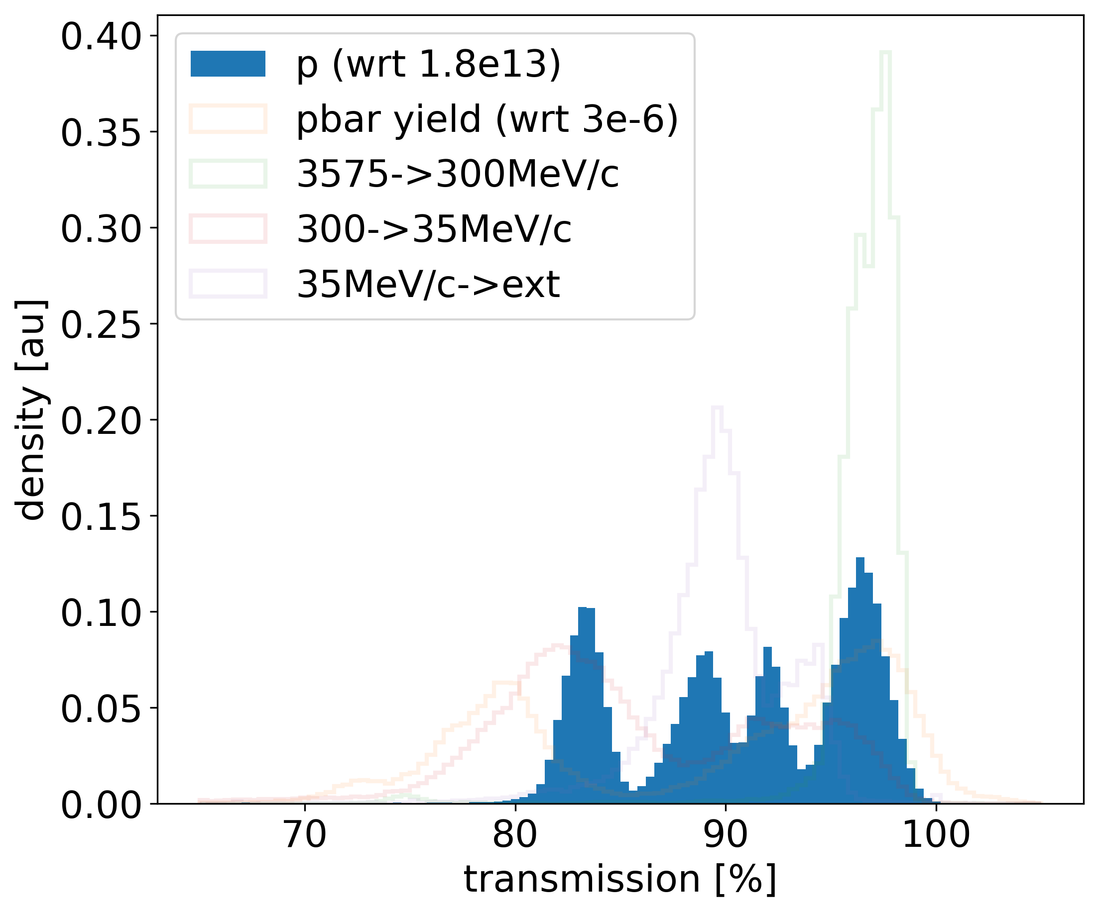
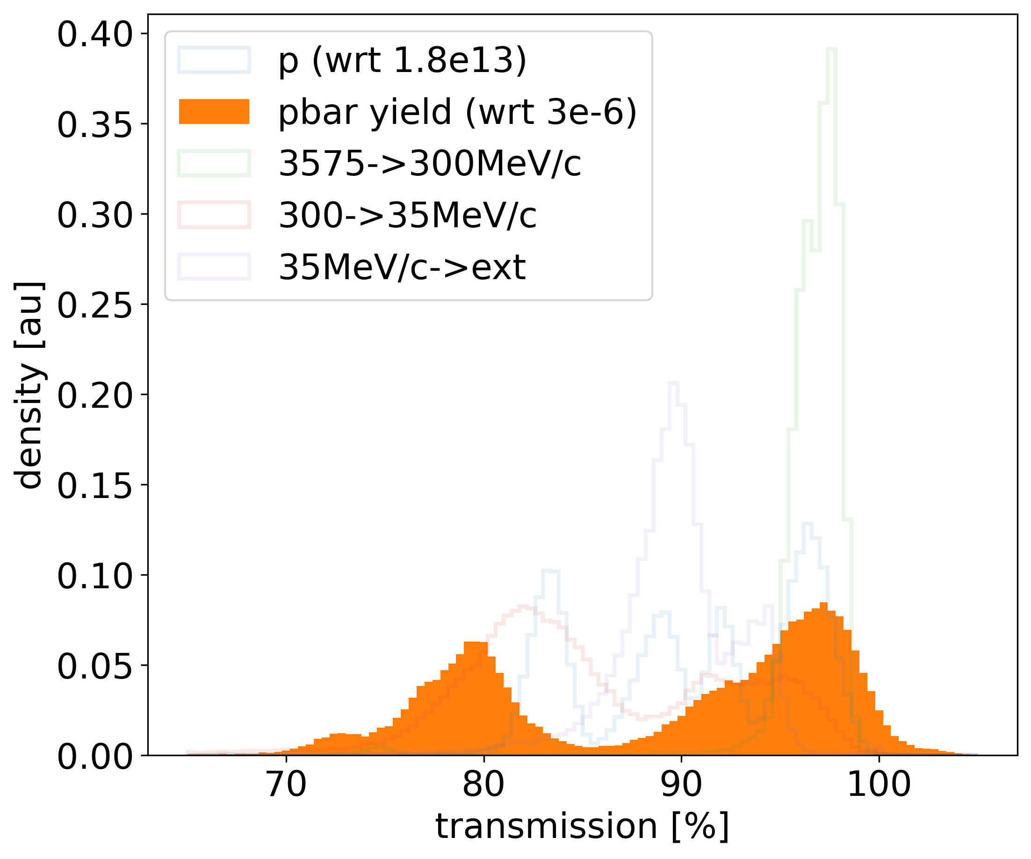
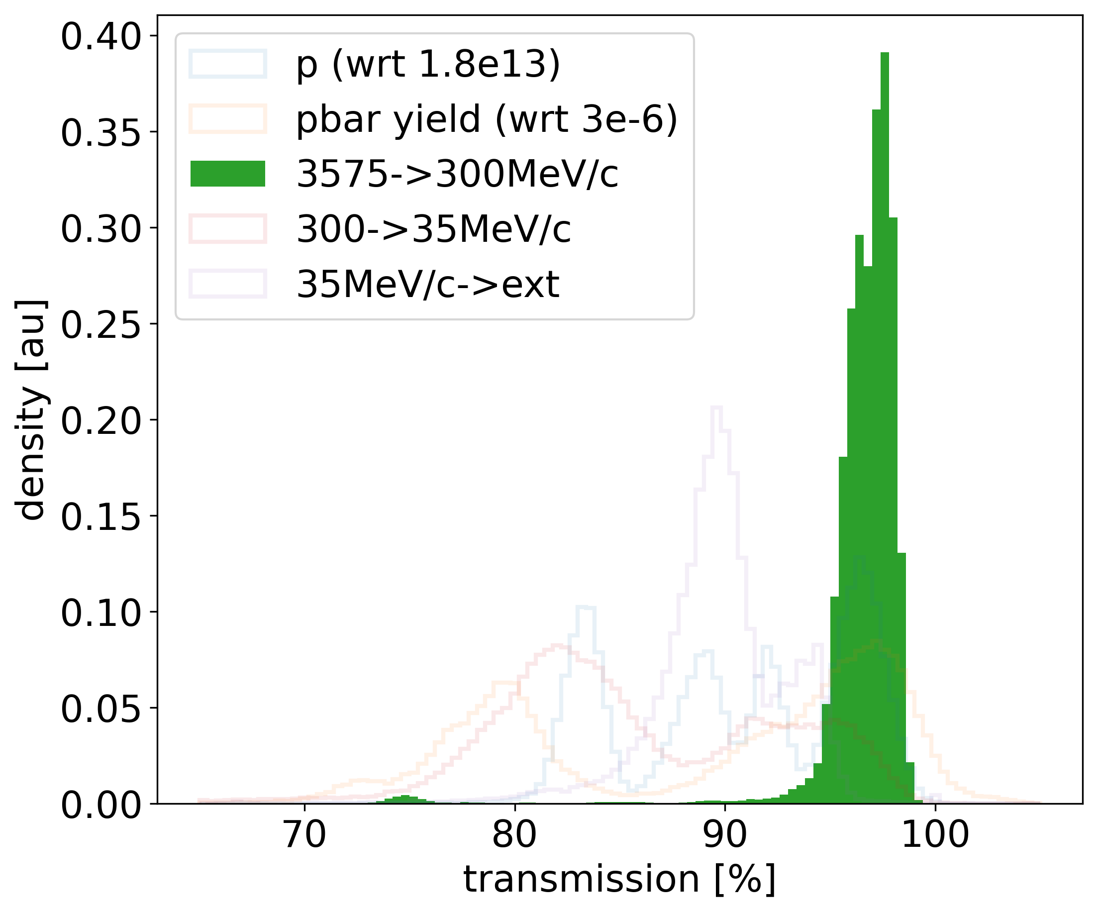
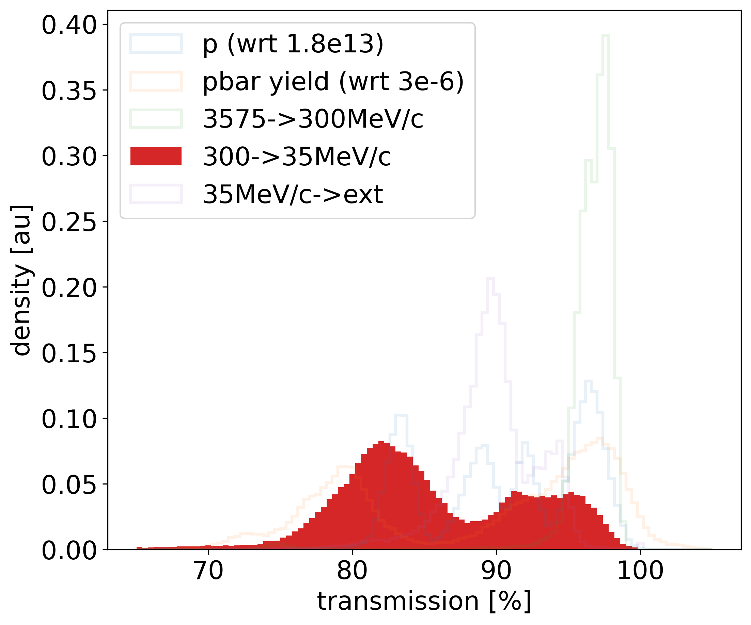
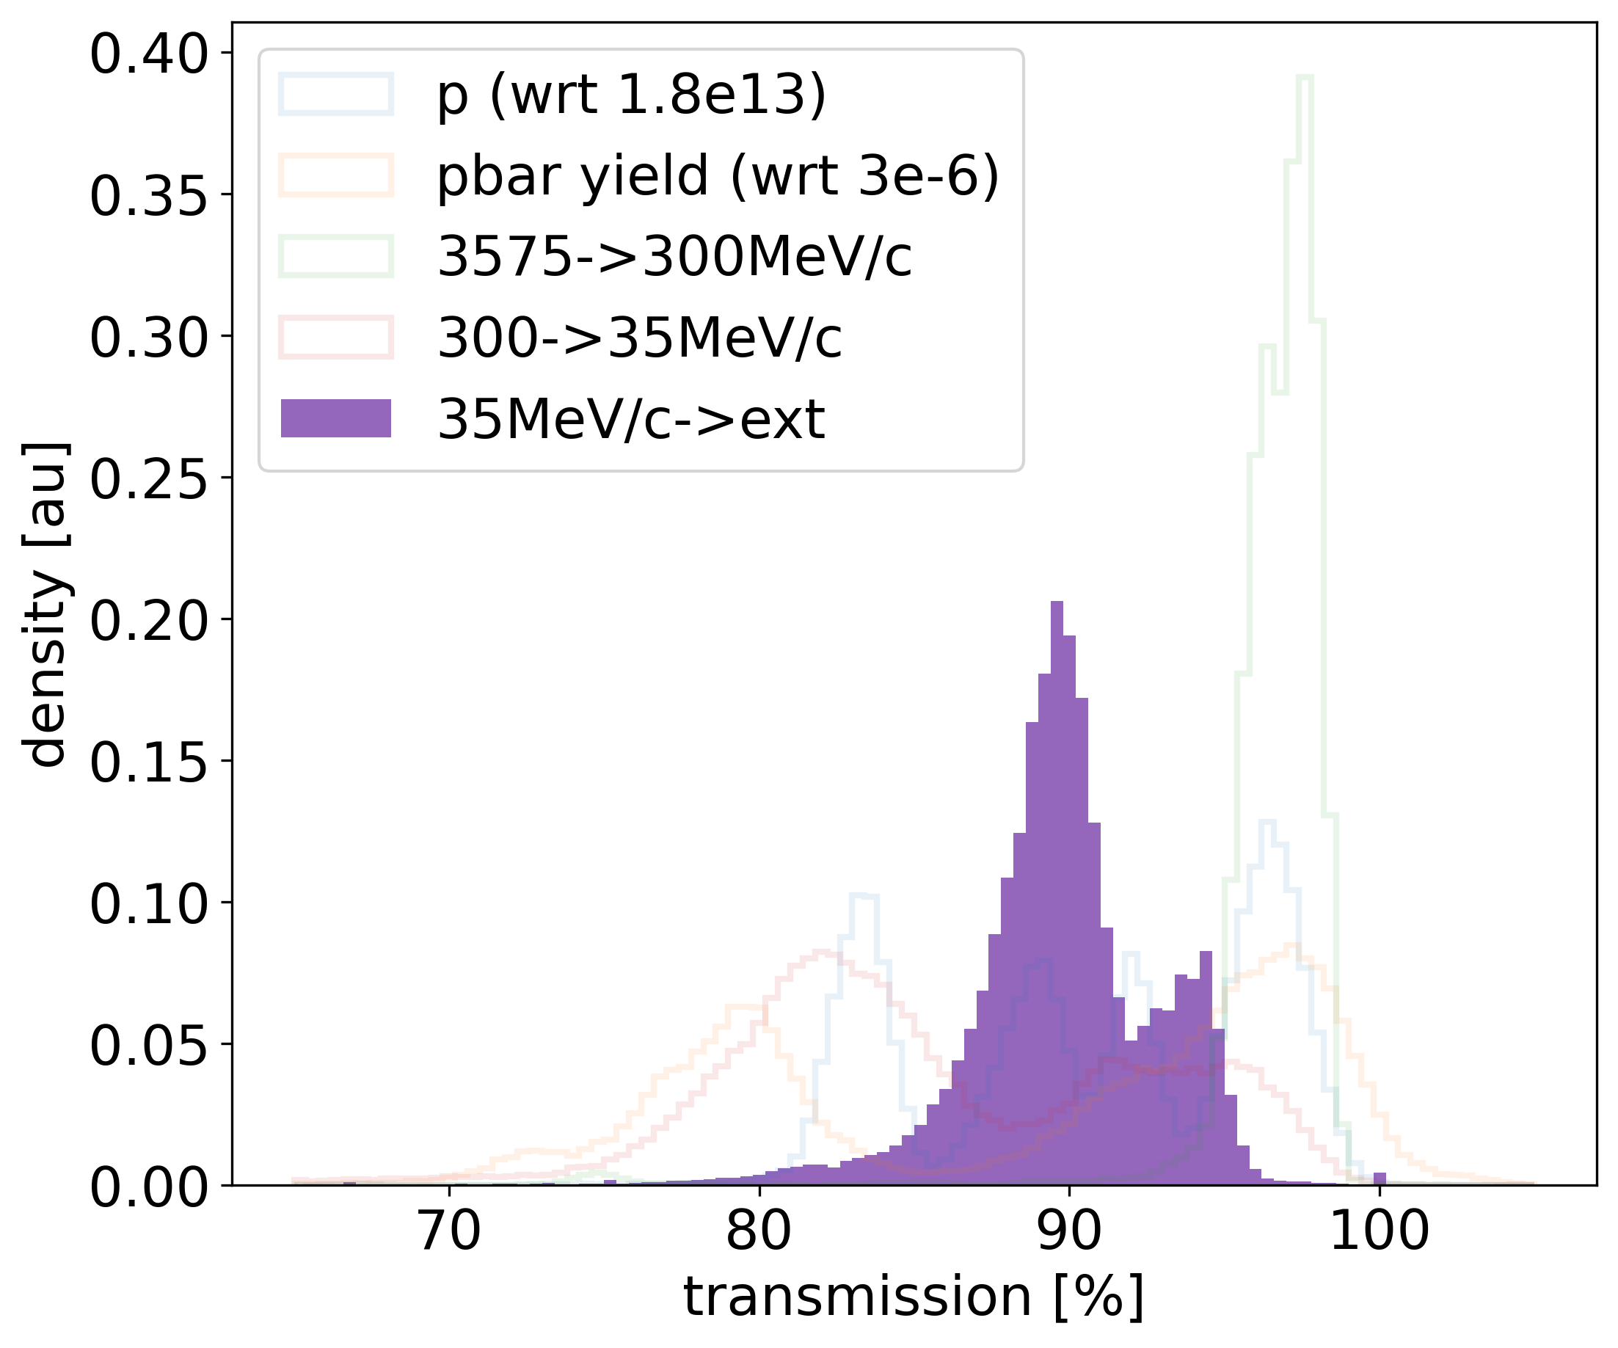
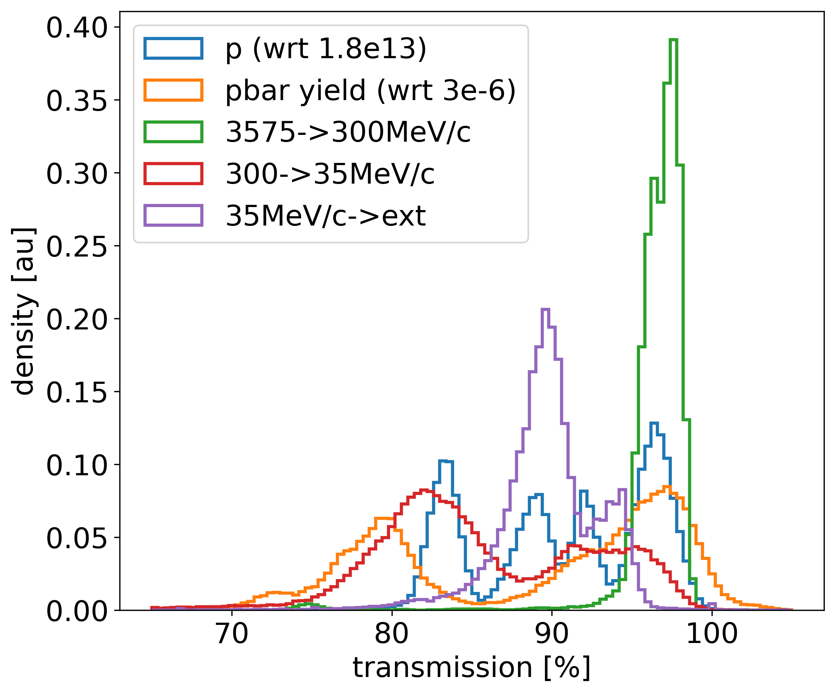
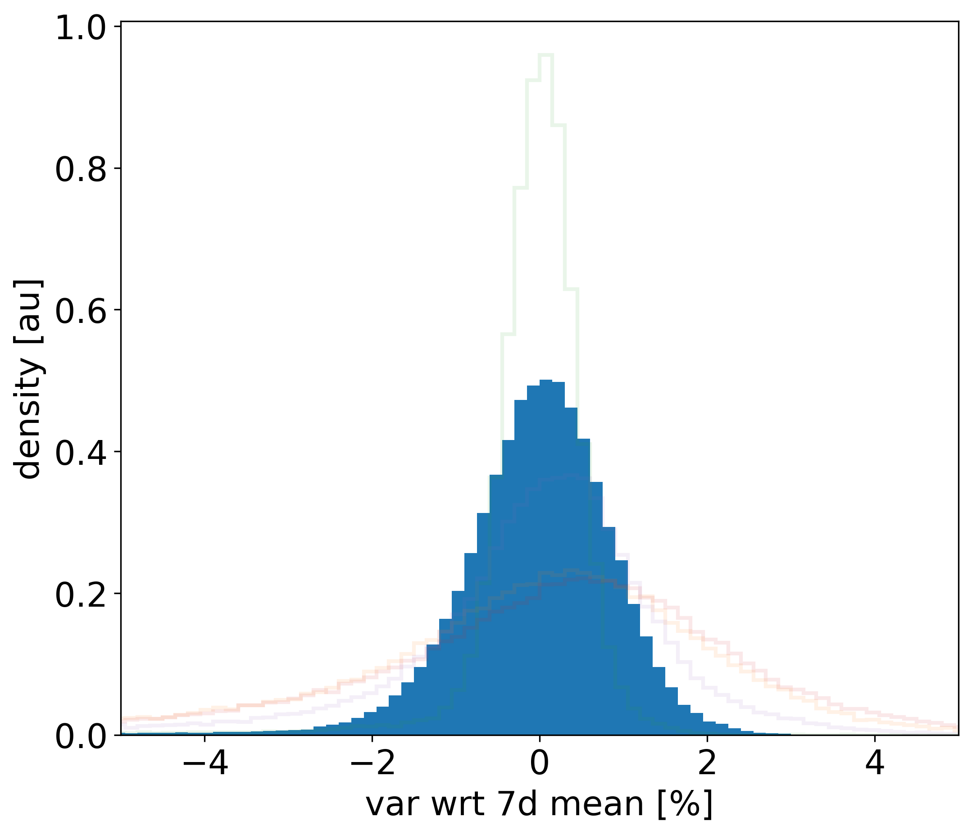
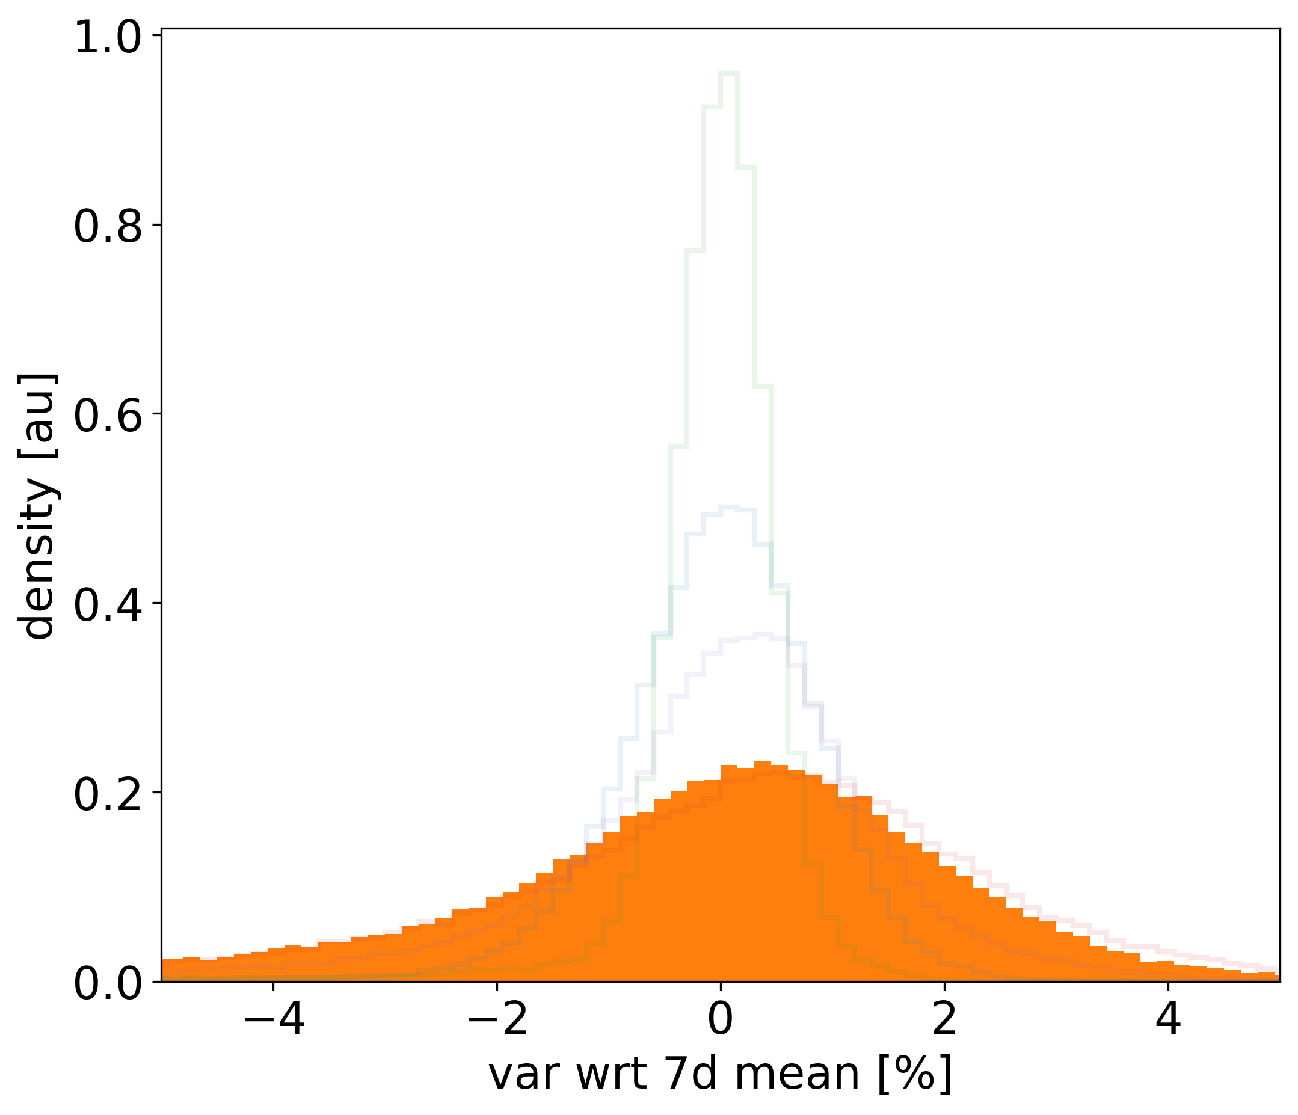
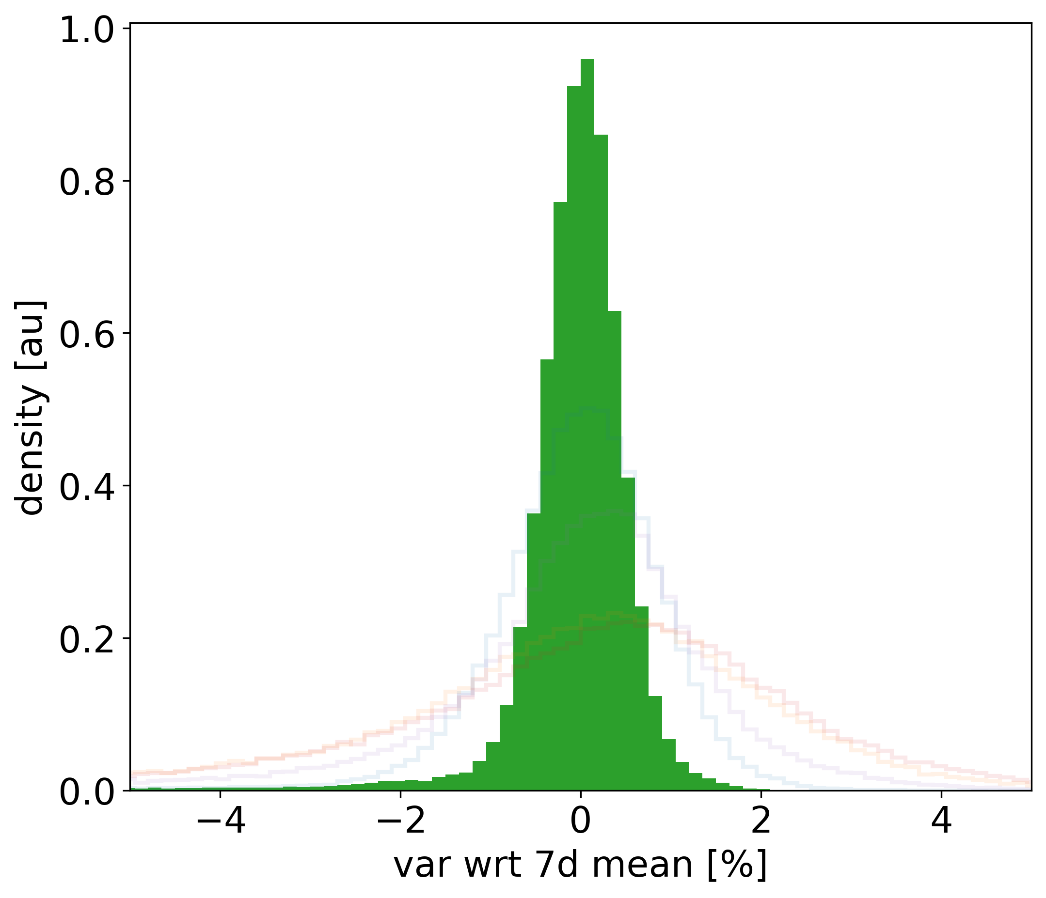
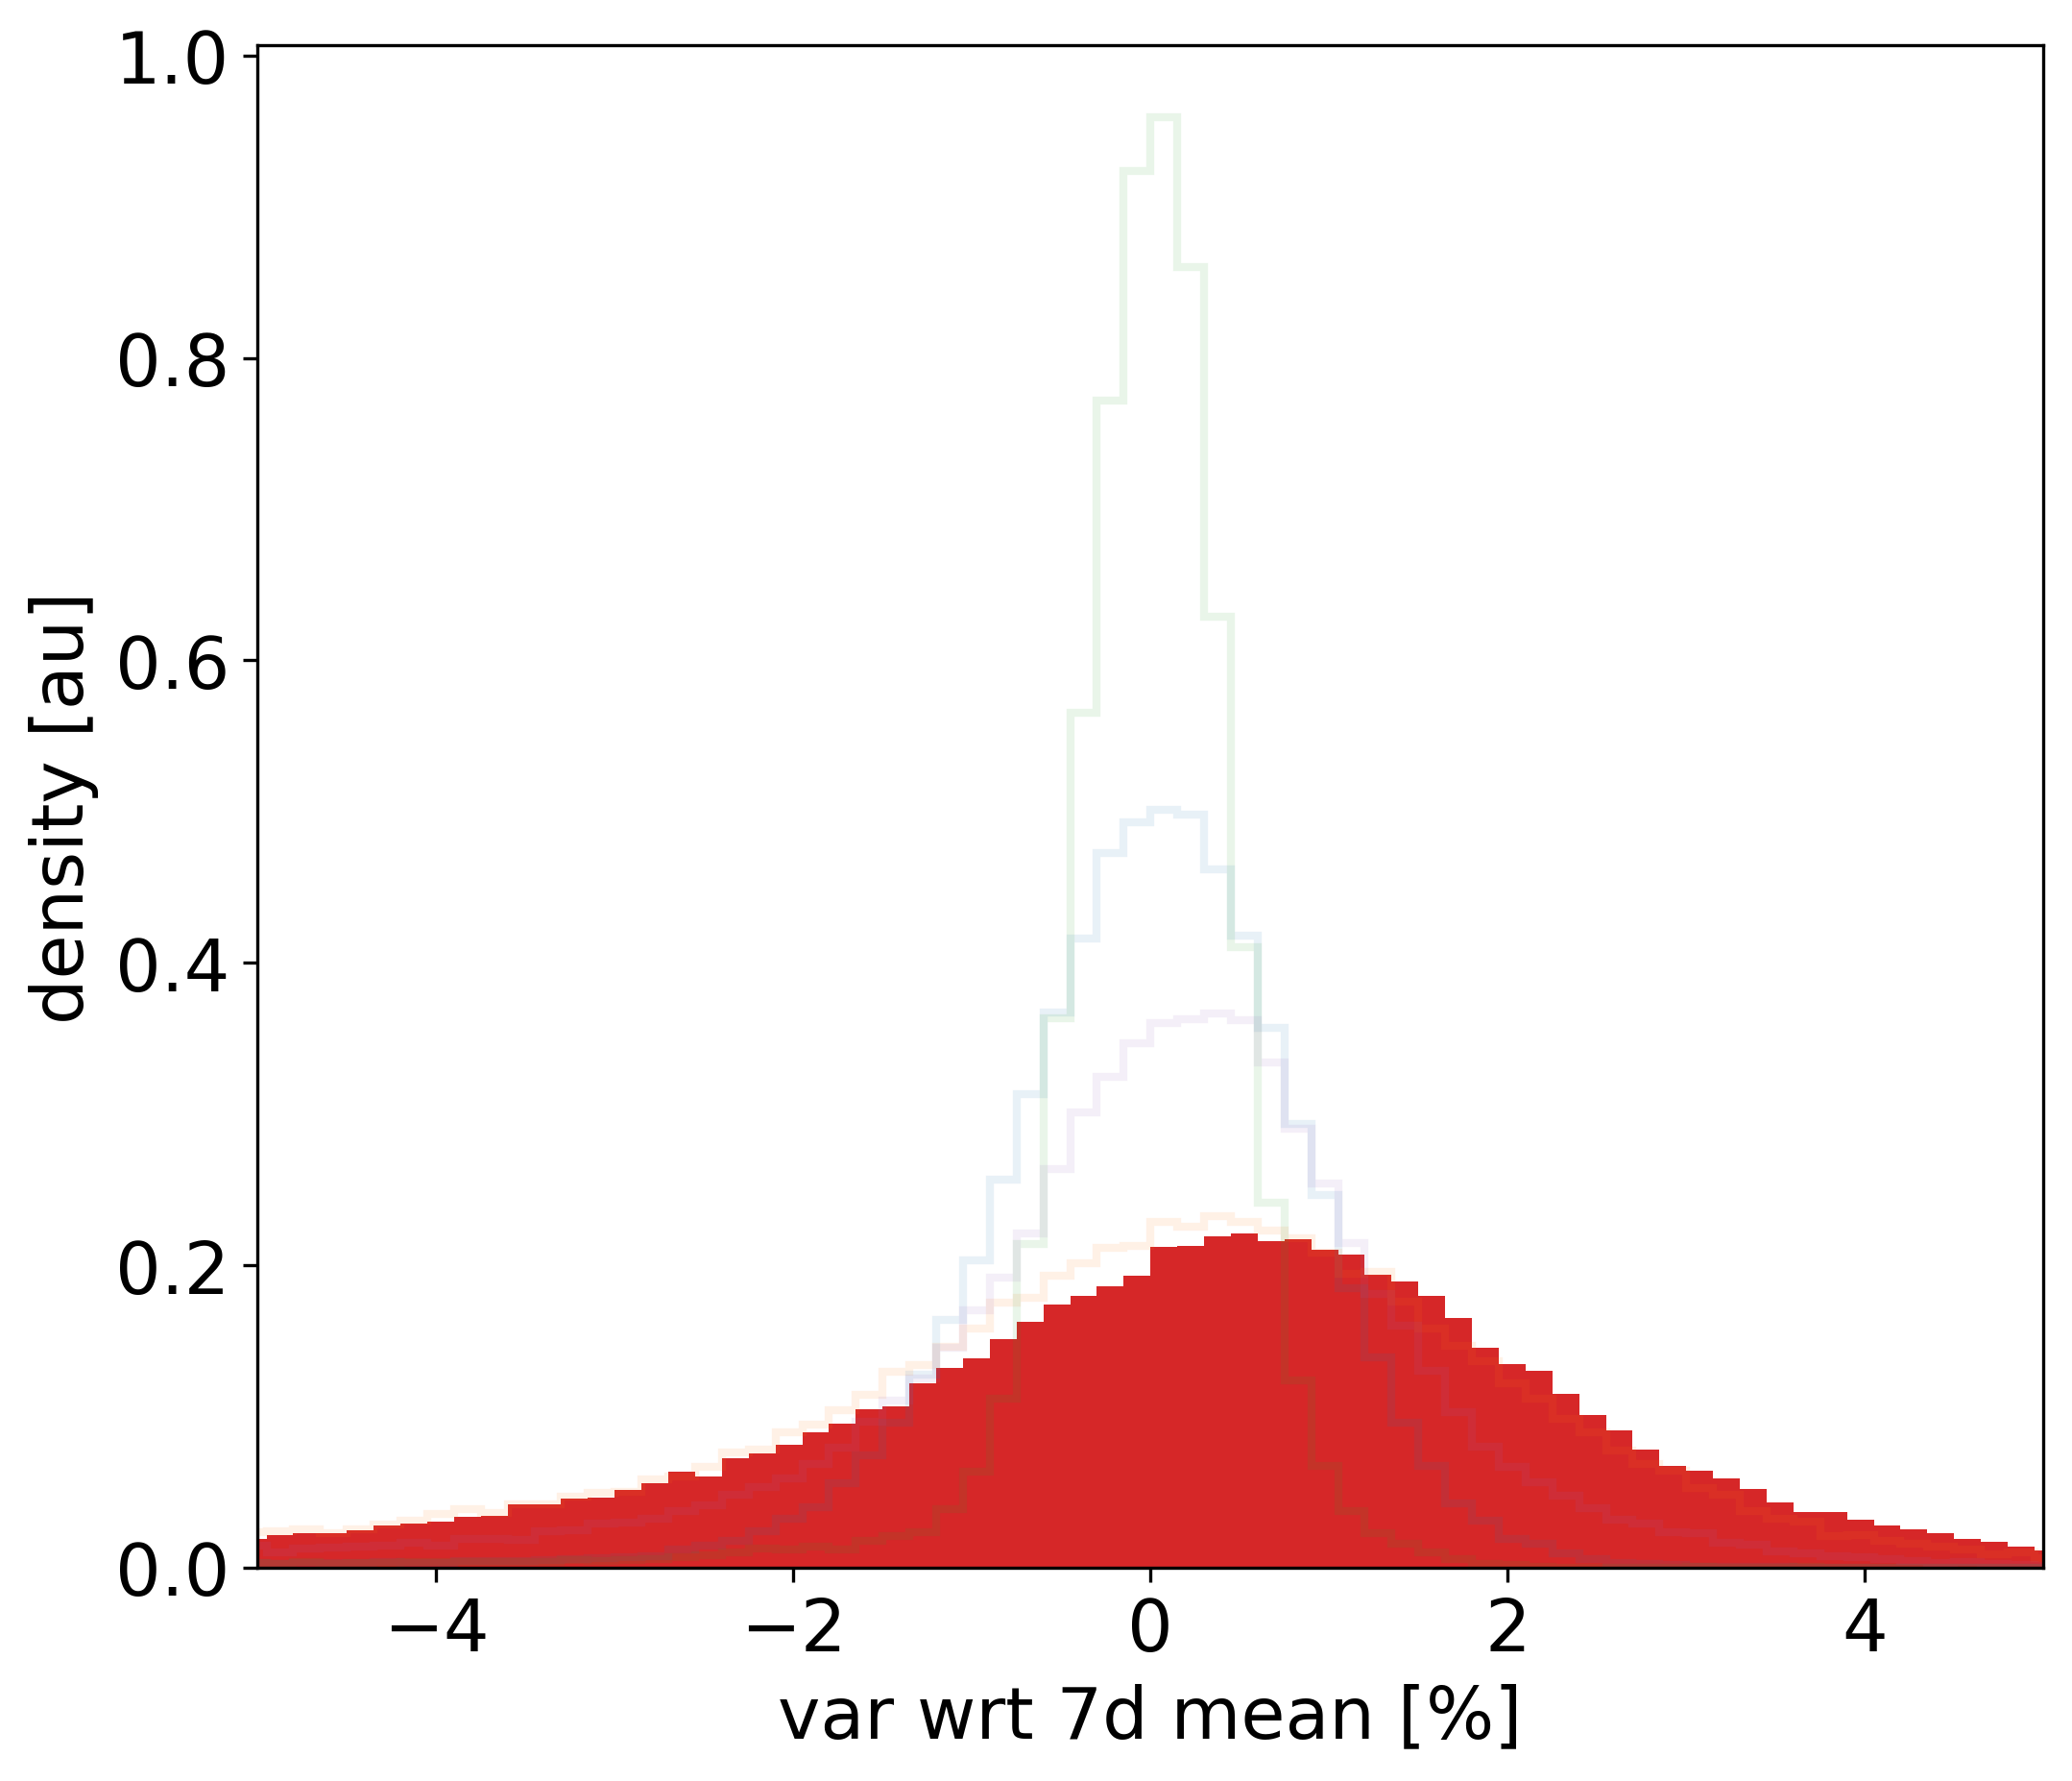
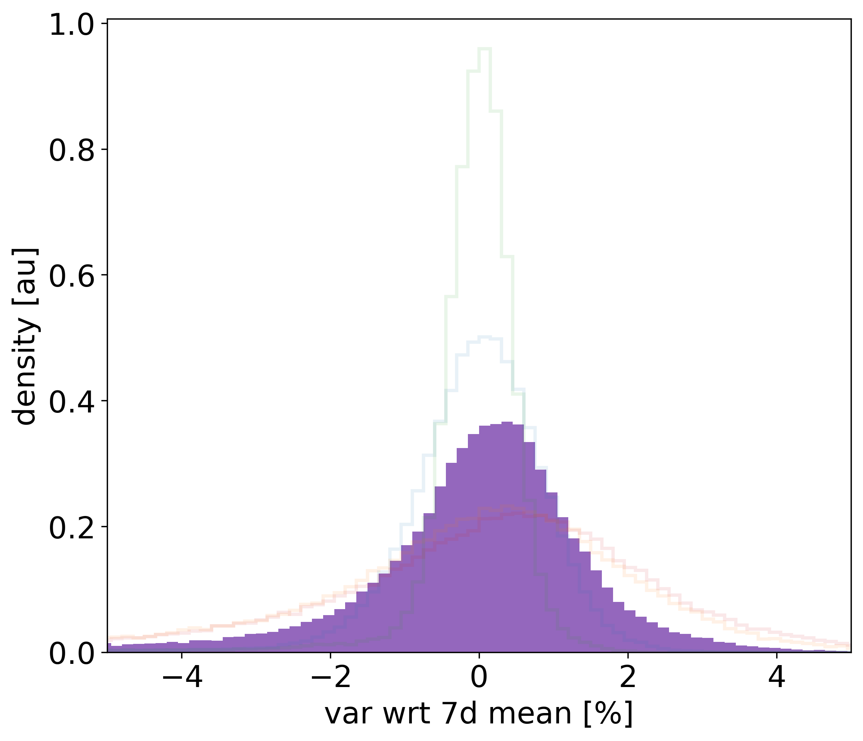
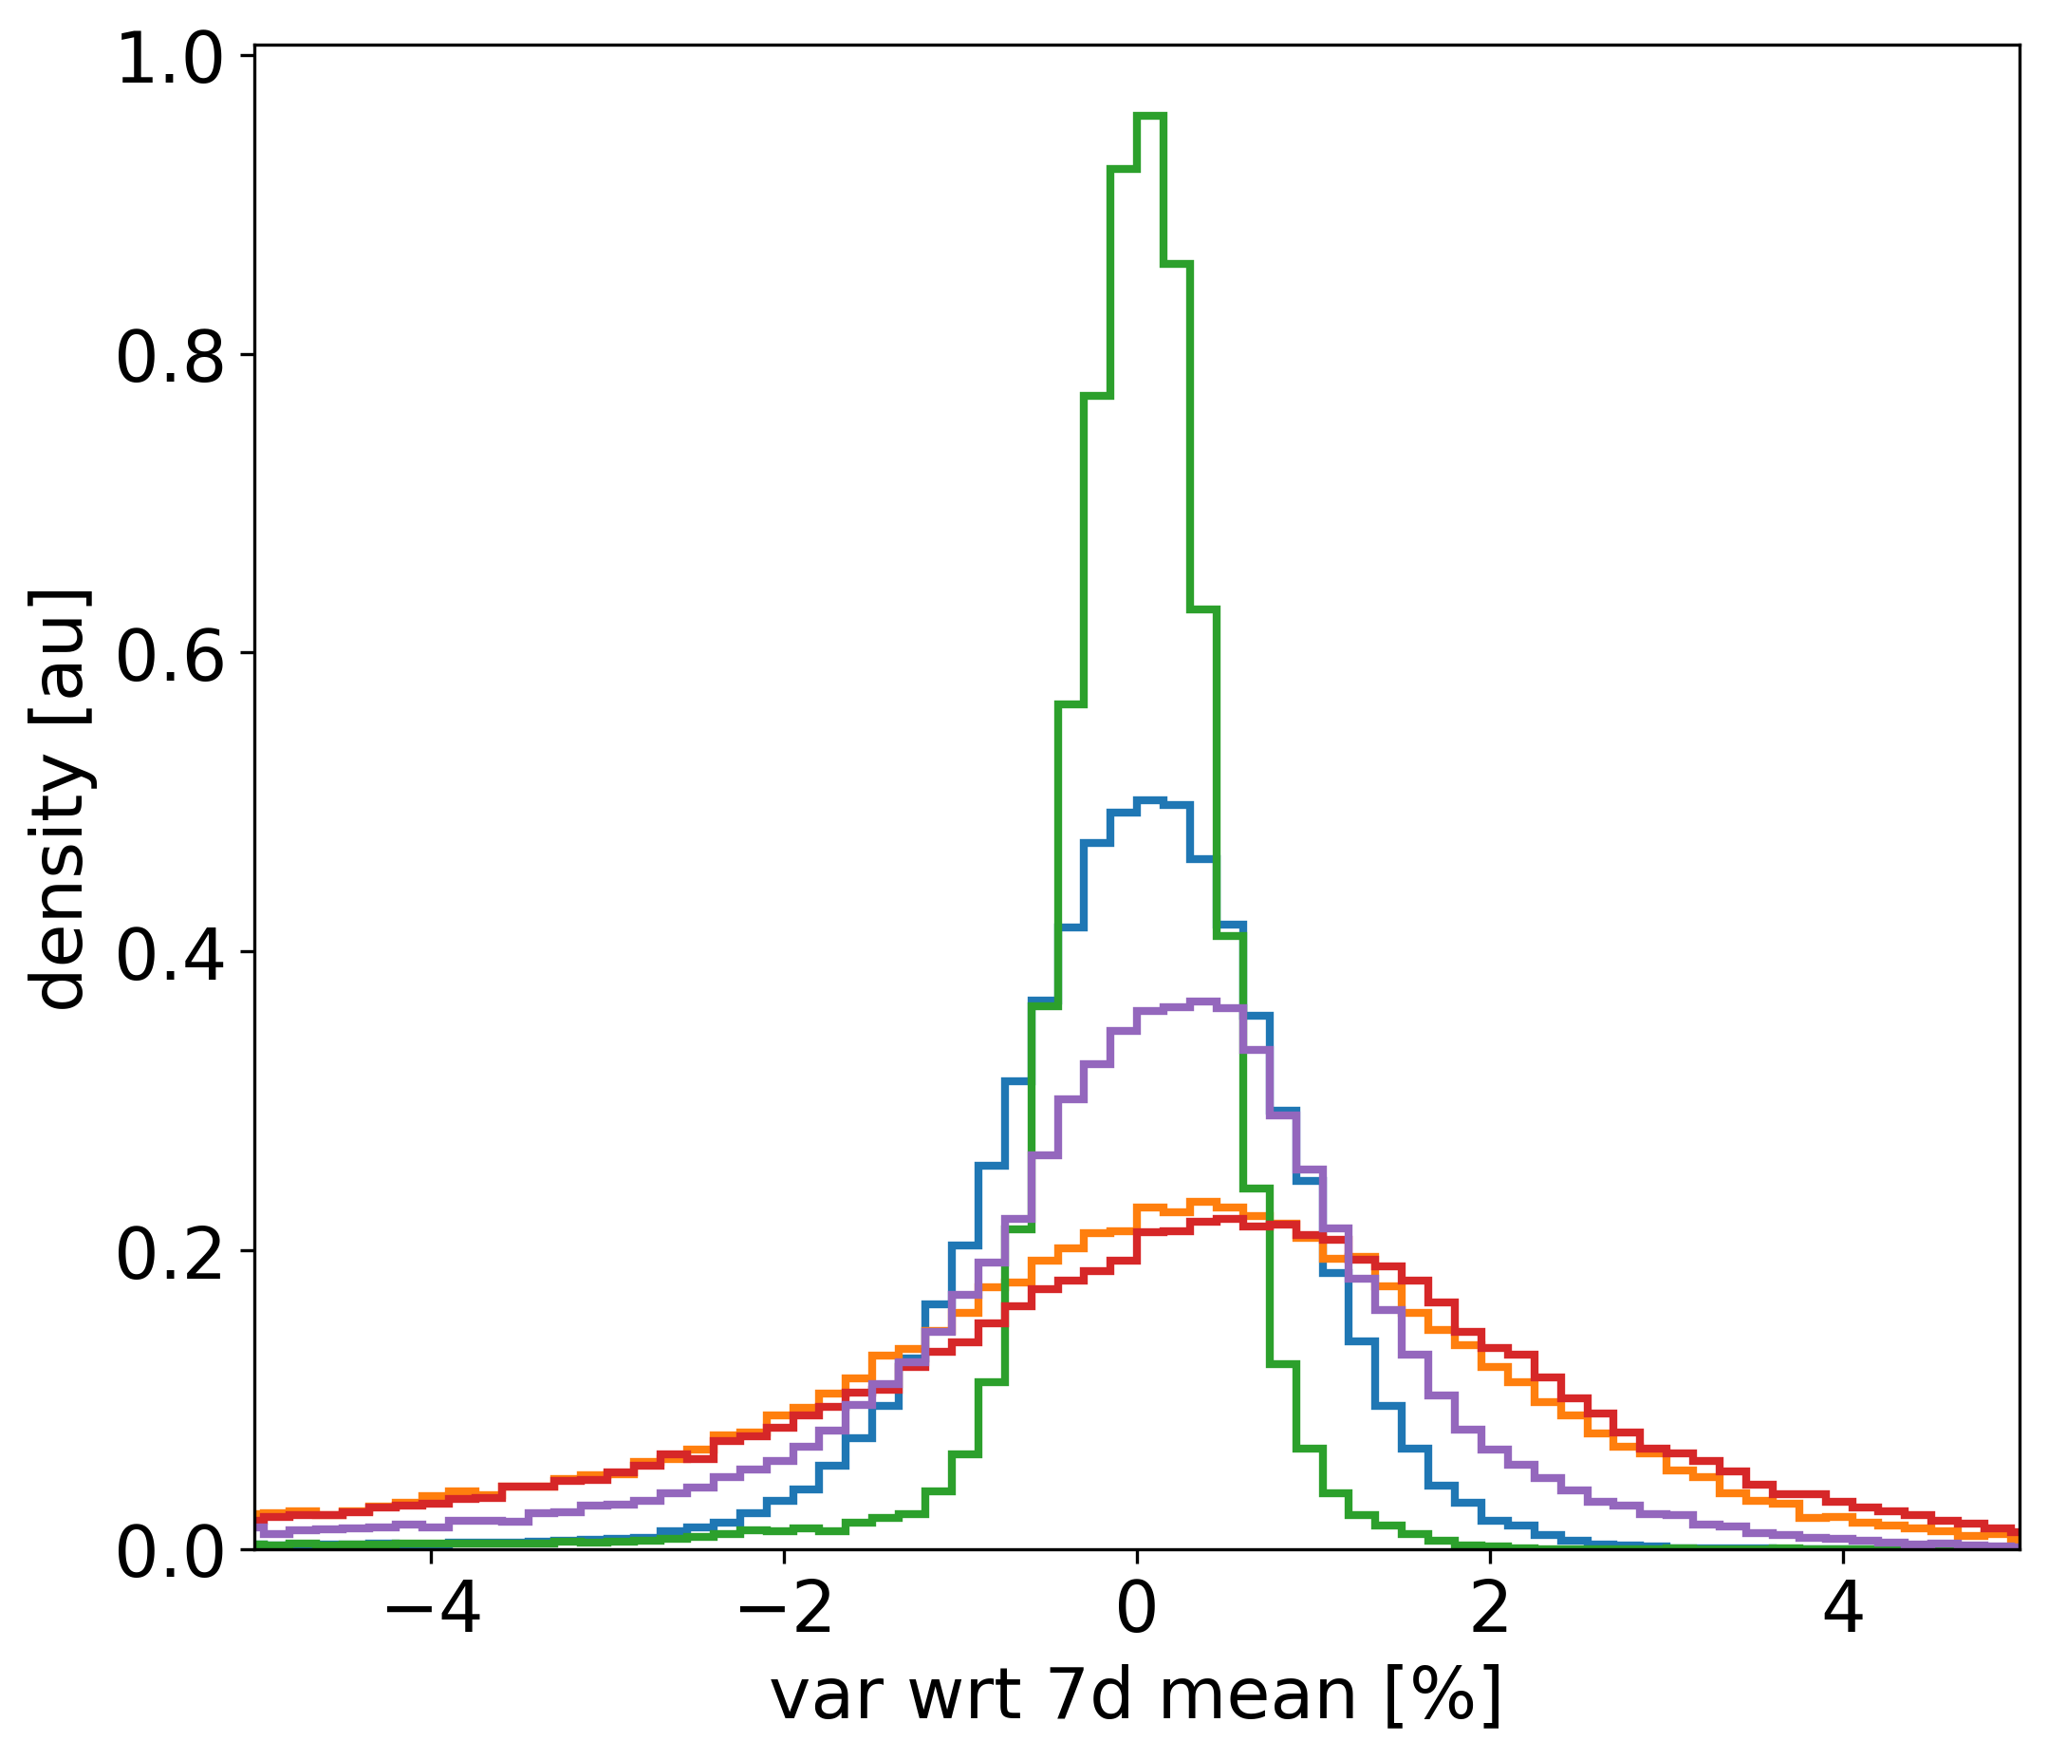
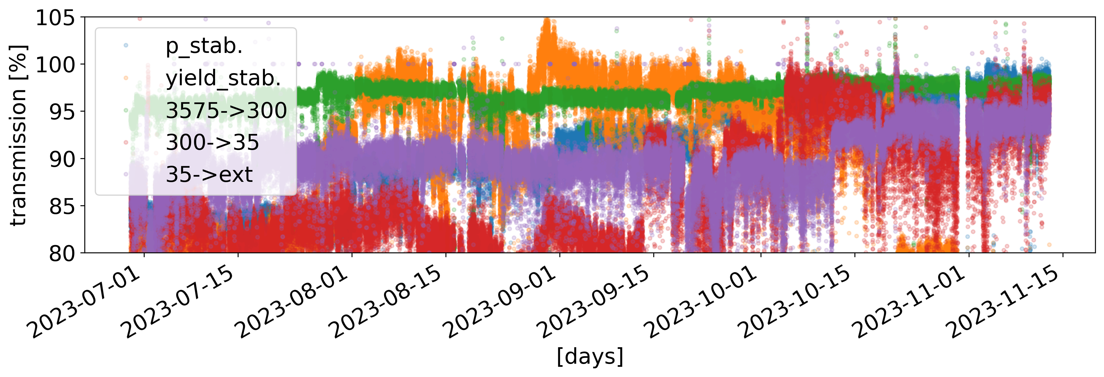
More Details about Intensity, and its Stability…
Proton intensity on target (BCT9053):
  Stepwise increase thanks to 5-bunch setup by PS in 2022 and thanks to improved shielding of AEgIS area
  Sizeable short-term variation (see next slide)
“p-on-target to pbar-in-AD-ring yield:
  Step due to horn flashovers (being addressed during YETS)
  Large short-term variation subject of study of the APOC WG led by Y. Dutheil (ABT) (see following slides)
From AD injection to 300 MeV/c plateau:
  Excellent performance of s-cooling and AD at high p
From AD@300 MeV/c to ELENA@35 MeV/c:
  Large variation of overall performance, linked to:
    AD e-cooler performance/stability
      Looking forward for a new e-cooler after LS3!
    AD ejection oscillation
      Investigation ongoing led by L. Bojtar (OP)
From ELENA@35 MeV/c to extraction:
  Low performance linked to e-cooling and space-charge effects
  Indication that we need to spend some more time on ELENA, and not only on keeping AD up and running…

Slide 9
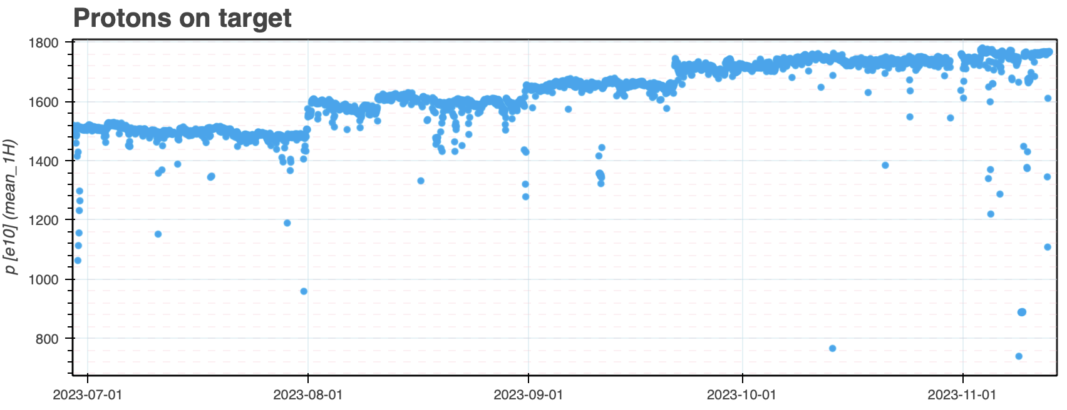
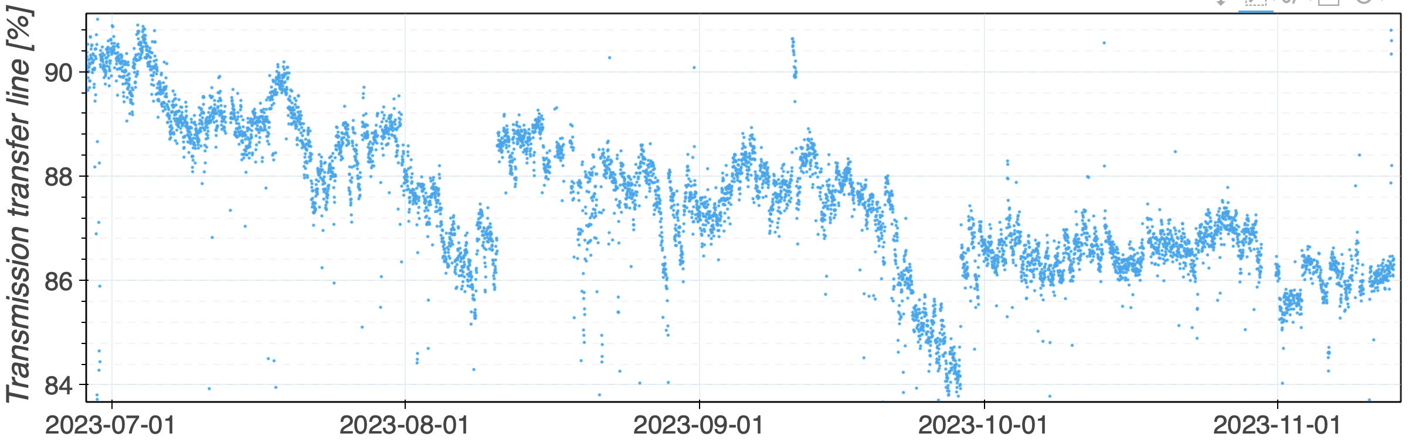
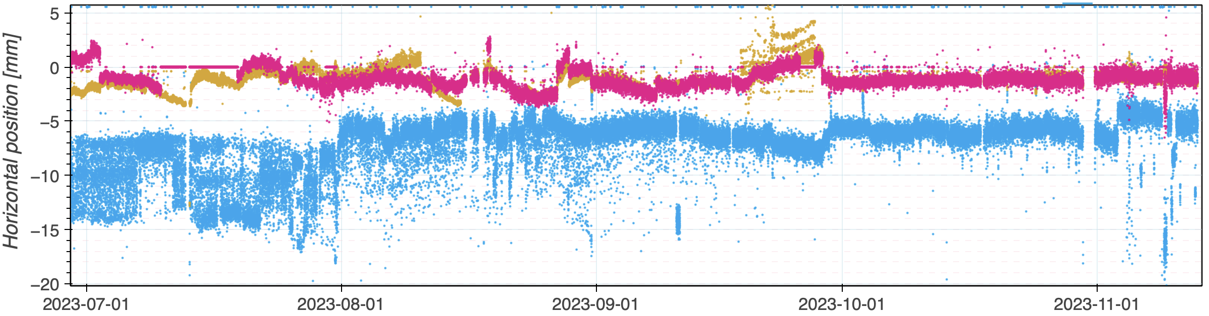
From PS to AD: Protons Transmission
Excellent stability of proton production up to PS last turn! (see T. Prebibaj)
~90% PS-to-AD-target transmission, still below what it was (maybe) pre-LS2 :
  BCTs gating not always accurate?
  BLMs not always consistent with BCT readings?
  Tests with pencil beam planned, if time allows, in 2024 by Y. Dutheil
Transmission variation/drift might also be linked to steering in TT2/FTA?!:
  Possibility to stabilize TT2/FTA already presented last year, to be automatized
  No BPMs in FTA: see request in presentation by M. Van Dijk
  Some “alarm-like” detection drift/degradation would probably help operation?!
PS-to-9053
TT2 BPMs

Slide 10
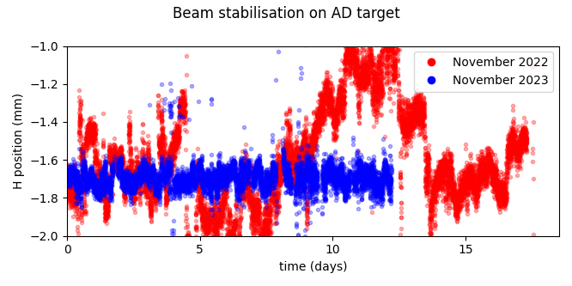
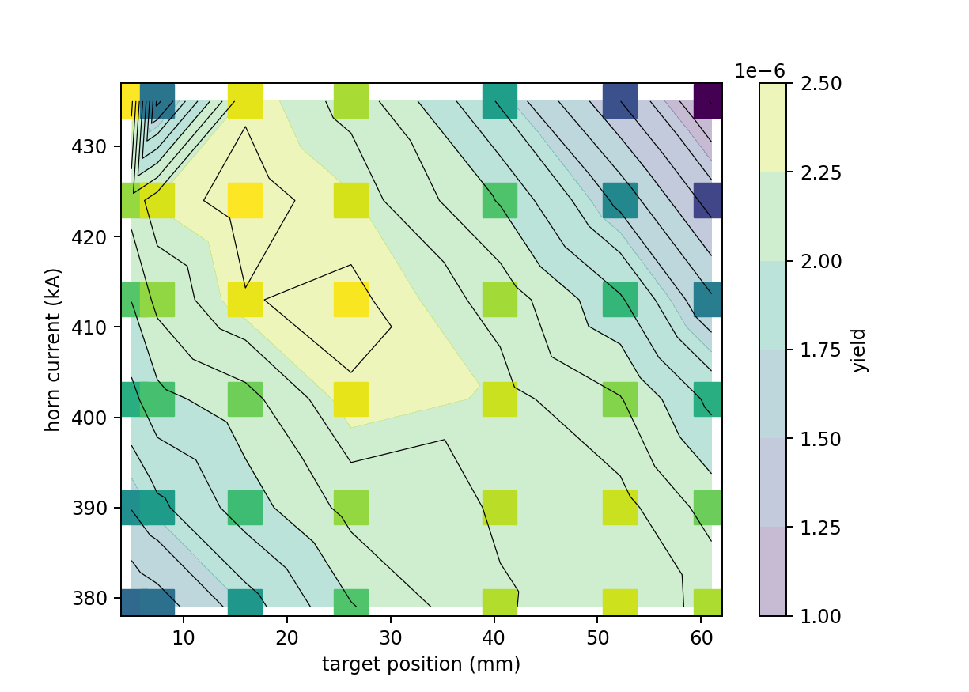
Antiproton Production/Optimisation: APOC WG
Put in place as a follow-up action from JAPW2022
  General + topical zoom meeting since July
    usually 2-5 participants (OP, ABP, STI and ABT)
  Indico category can be found here
2023 progress:
  Beam stabilizer to maintain the position of
  the proton beam on the antiproton target
    Target is only 3mm in diameter
    while beam rms beam size ~1mm
    Hundreds of manually adjustments in 2022,
    completely automatized since August 2023
  Antiproton yield mapping
    Mapping of horn-strength Vs target
    position optimum: study started in 2022
    Allowed to quickly compensate for degradation
    of horn hardware in Oct/Nov 2023!
      Good example demonstrating the
      importance of this kind of studies!
Reducing yield due to horn flashovers
Notes:
Slide 6: for the beam stabiliser, maybe you could highlight some words in green, as this was really a very nice improvement? (might also apply to the coming slides)

Slide 11
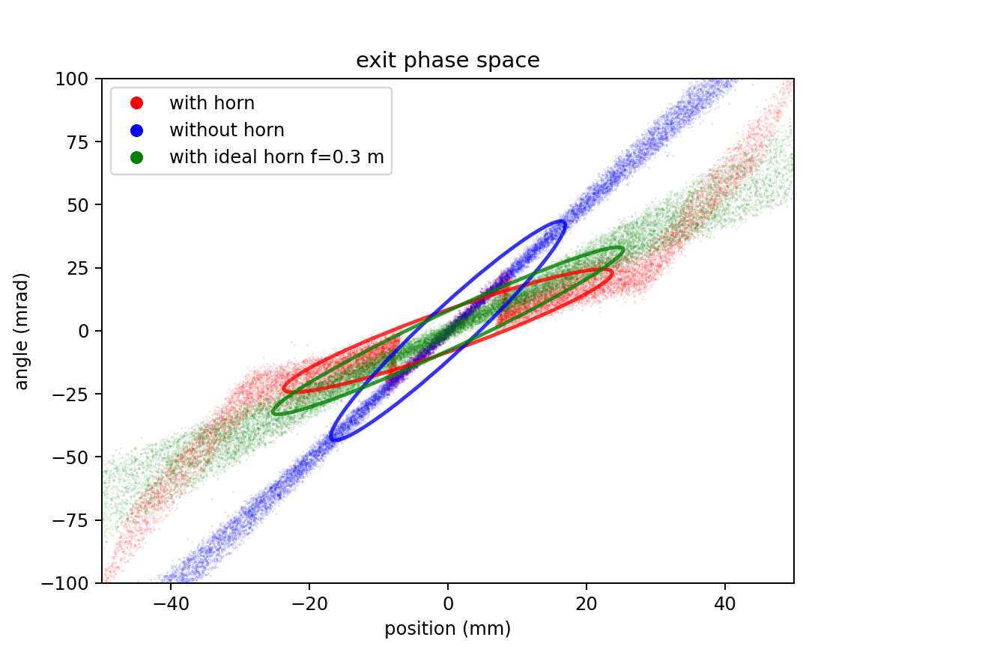
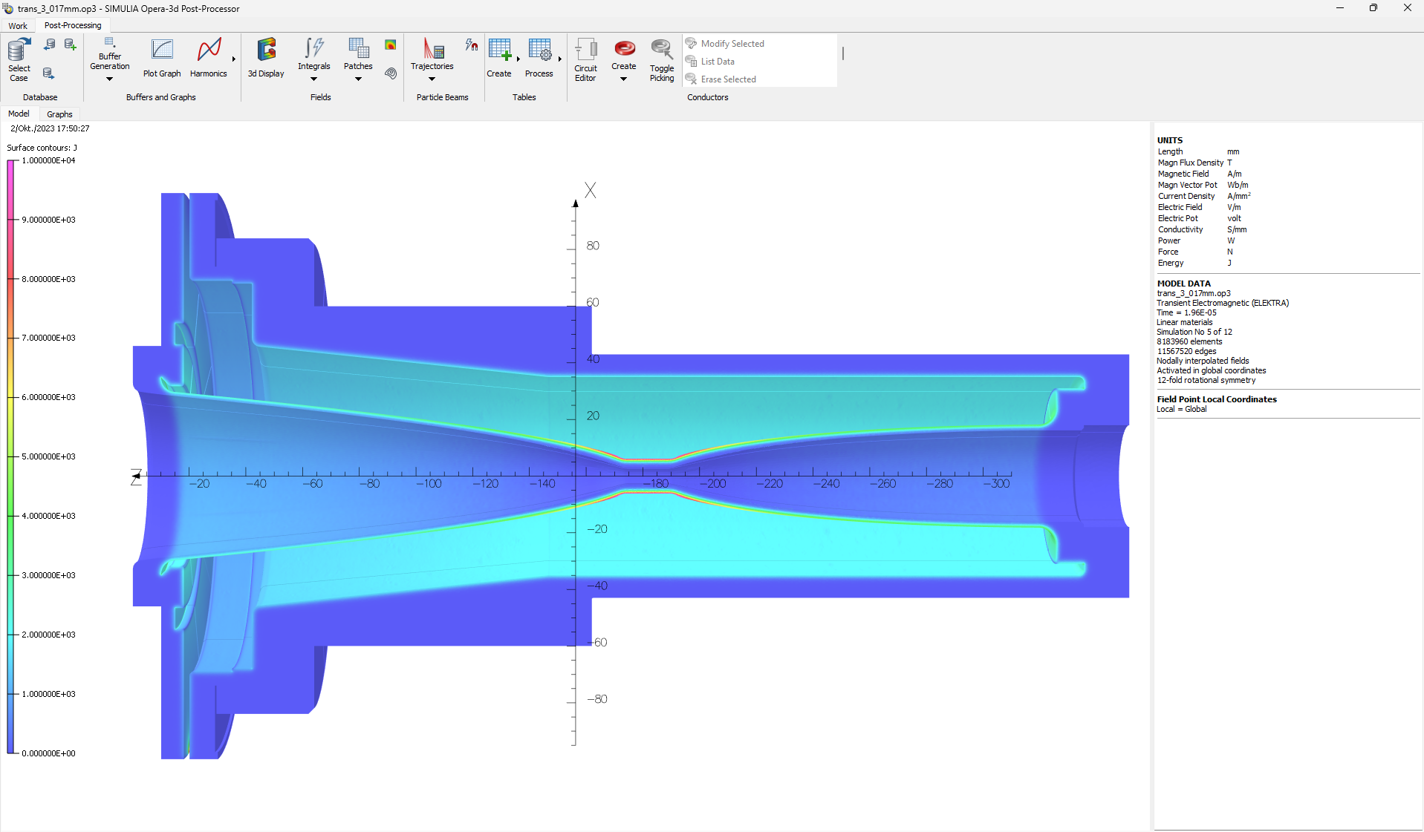
APOC WG: progress and prospects
Progress on modelling of AD target and its horn:
  Horn magnetic finite element model and magnetic field map computed by ABT-PPE (J. Ruf, Y. Dutheil, see #3)
  Antiproton distribution from STI using FLUKA
  Toward model-guided setting up and optimization!
    Hopefully allowing to study the expected yield with various target designs and materials
Reducing pulsing rate of DI magnets to extend equipment lifetime
  This turned out to have a negative impact on pbar yield stability
  Measuring the DI.BHZ24&25 powering system and magnetic properties during the YETS
    Thanks to EPC and MSC colleagues! See also dedicated meetings #1, #2 & #3
  Working on joint magnets+power converters consolidation (See ECR 2953934)
Many other subjects being investigated, for example:
  Improved FTA control with magnets logicals and UCAP-hosted BTV screen fitting
  New methods for AD injection steering optimisation
    Using ring BTV for injected and circulating beam position measurement (see 5th BIFT)
    First turn trajectory measurement under investigation with BI

Slide 12
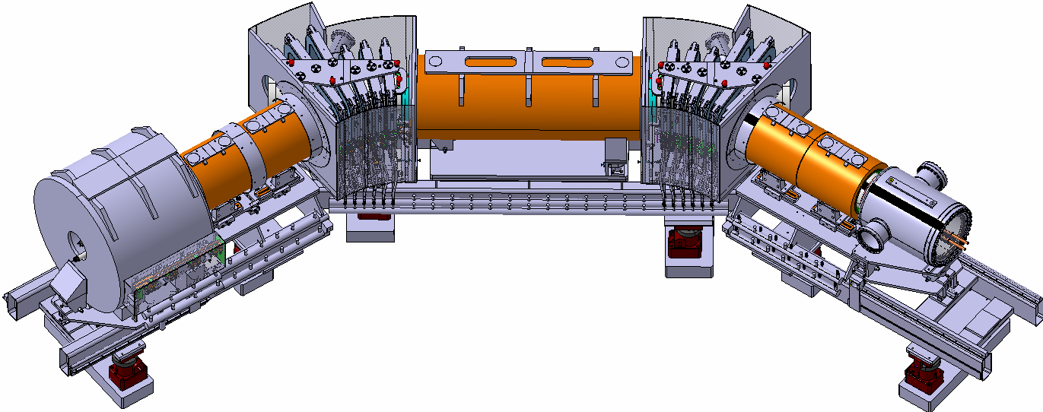
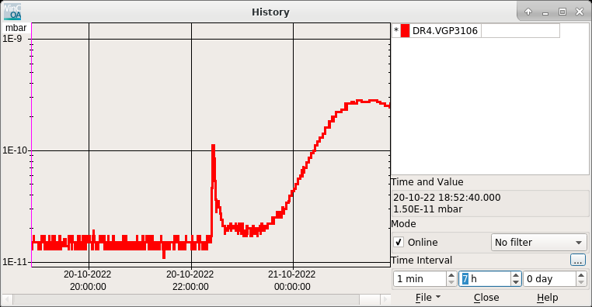
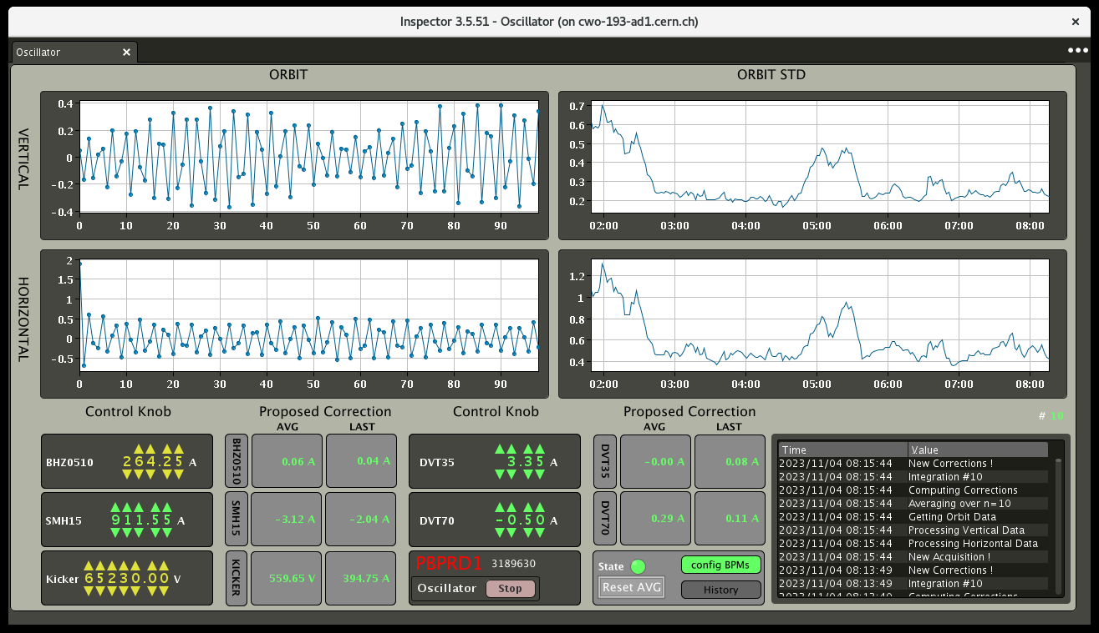
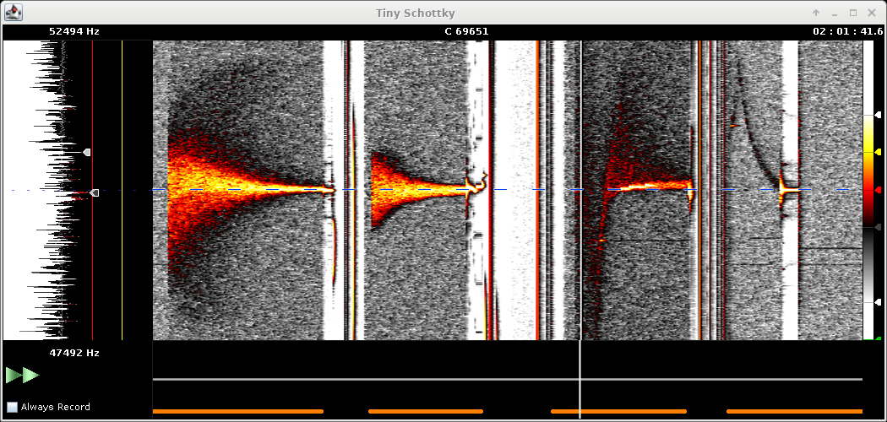
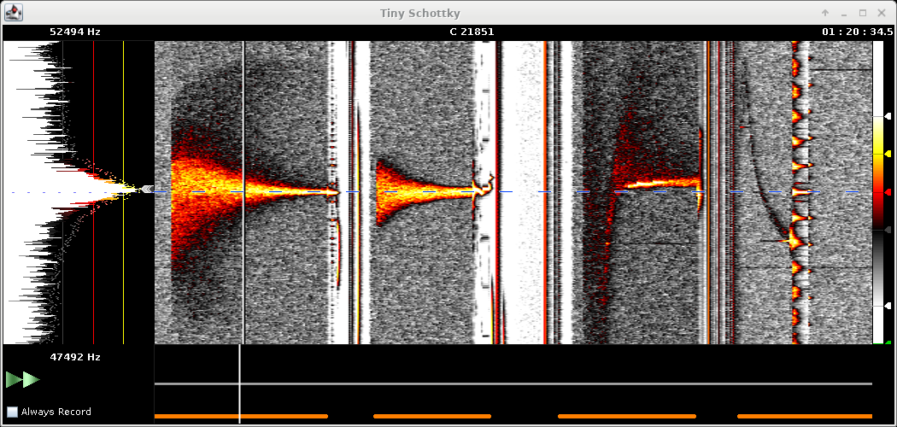
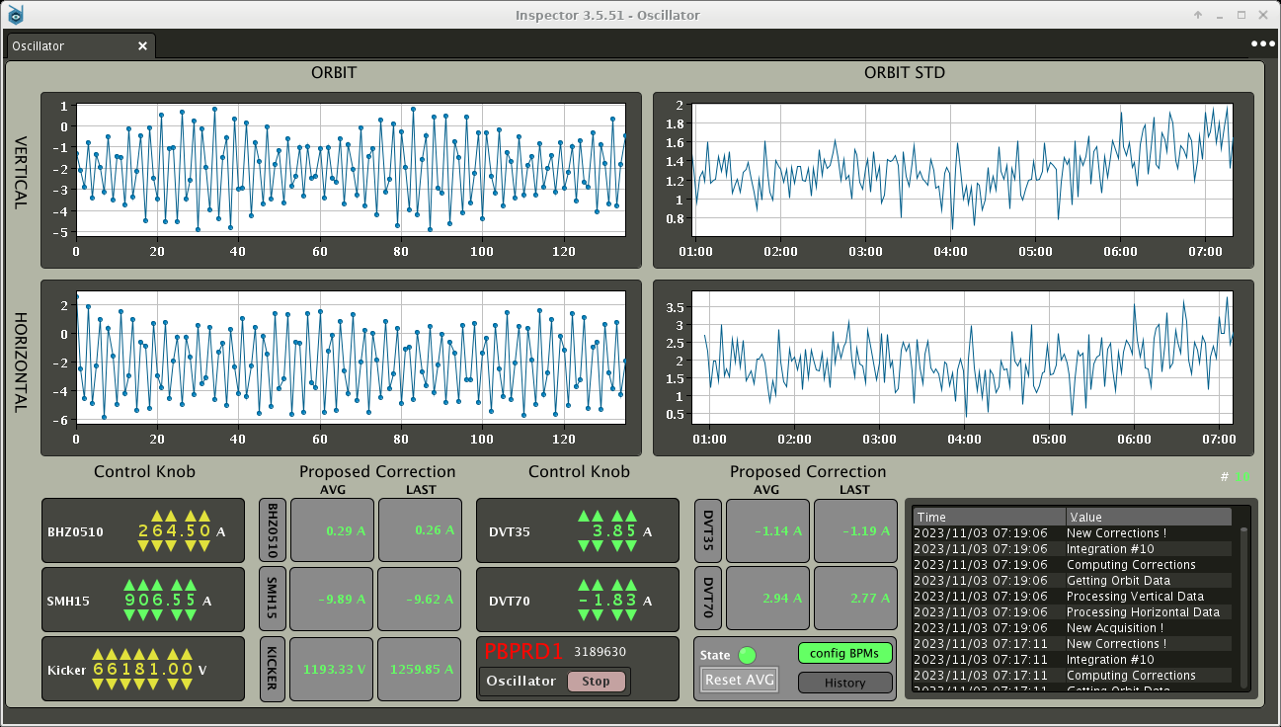
Sources of AD “low energy” Transmission Degradation
From N. Chritin
AD EC Proc. Readiness Review – June2023
Regular observation of vacuum activity that trigger instability of AD e-cooler
  It might be possible to develop software slow-feedback to stabilise it…
  … hope in the new AD e-cooler
    See status at review in June2023
    and presentation at COOL23
Power converter/field instabilities
  E.g. QUAD-TRIM3 suddenly providing only
  half the current despite normal acquisition…
    … consolidation “wanted”!
Trajectory instability at AD ejection
  Traced back to AD ejection septa
    Investigations ongoing to cure it…
  Impact on AD-to-ELENA transport and deceleration to 35 MeV/c
    Developed on-demand correction of ELENA injection oscillation to be converted in a (slow) feedback
300 MeV/c
100 MeV/c
300 MeV/c
100 MeV/c
t
t
H injection oscillation – t-b-t data
Amplitude (std) of H injection oscillation during a night
Notes:
See logbook 21/10/2022:
-0.001kV on 300MeV FT ECooler V Cathode
+0.003kV on 100MeV FT Ecooler V Cathode

Slide 13
Other Known Issues and Successes
AD S-Cooling
  Toward a clear understanding of the present implementation and efficient setup strategy with modern tools: see S. Rey at COOL2023
  Must pursue this effort to have a solid consolidation/upgrade plan of the system
HLRF + LLRF + C10
  Overall, no major issues, but C10 in critical status: consolidation plans being discussed…
    Need for better observables: see presentation by S. Albright
  ObsBox online, and development/improvement still ongoing
    We need to start profiting of this system...
B-Train
  Not ideal simulated b-train for AD
  Still using LLRF test feature in ELENA…
  Injector-wide strategy being discussed. See for example IPP in Oct. 2023
Beam Instrumentation Characterization/Consolidation/Upgrade
  See, for example, work on scraper measurement understanding by G. Russo at HBWS2023, and presentation by M. Van Dijk
  Discussions ongoing at different forums about IPM, Intensity, Schottky Measurements, …
    Need to draft a coherent plan for better/new instrumentation
Radiation Levels Reduction
  Thanks to additional shielding installed during YETS22/23 and better monitoring

Slide 14
Outline
AD/ELENA Overall Performance
User wishes and how we tackle them
  Intensity and its stability
  Repetition rate and availability
  Beam characteristics
Long term sustainability
Conclusions

Slide 15
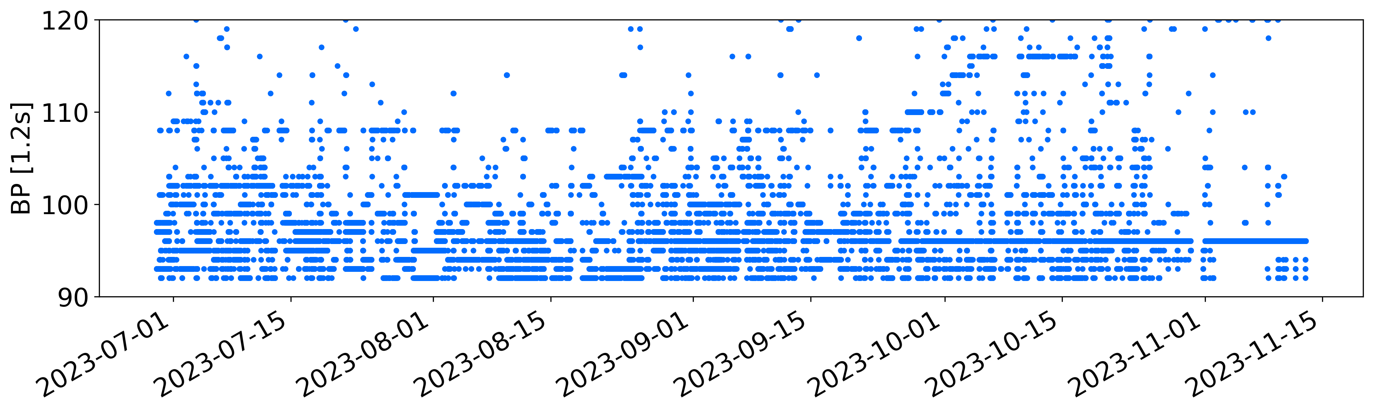
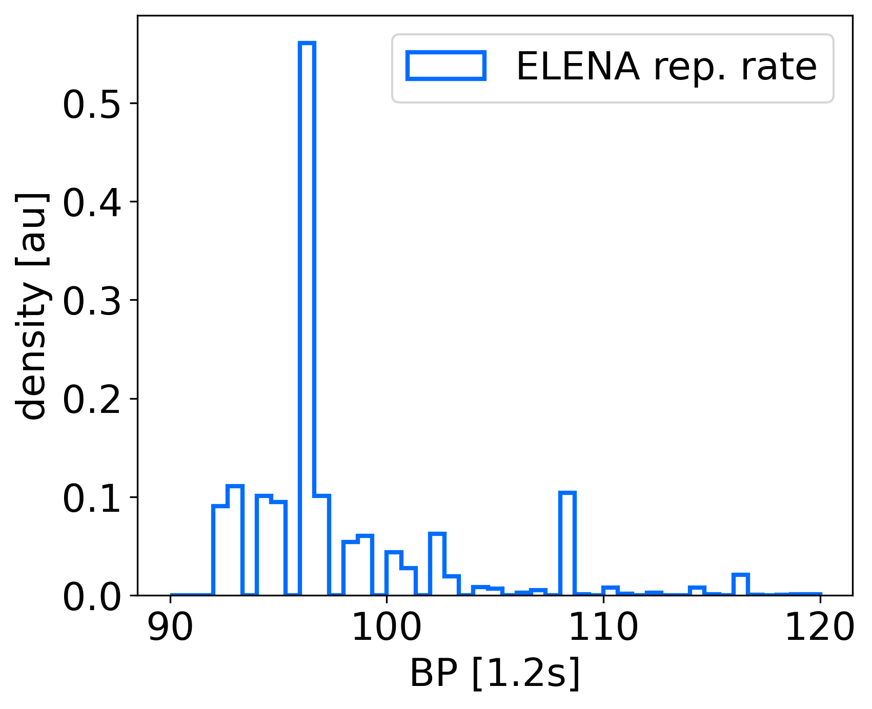
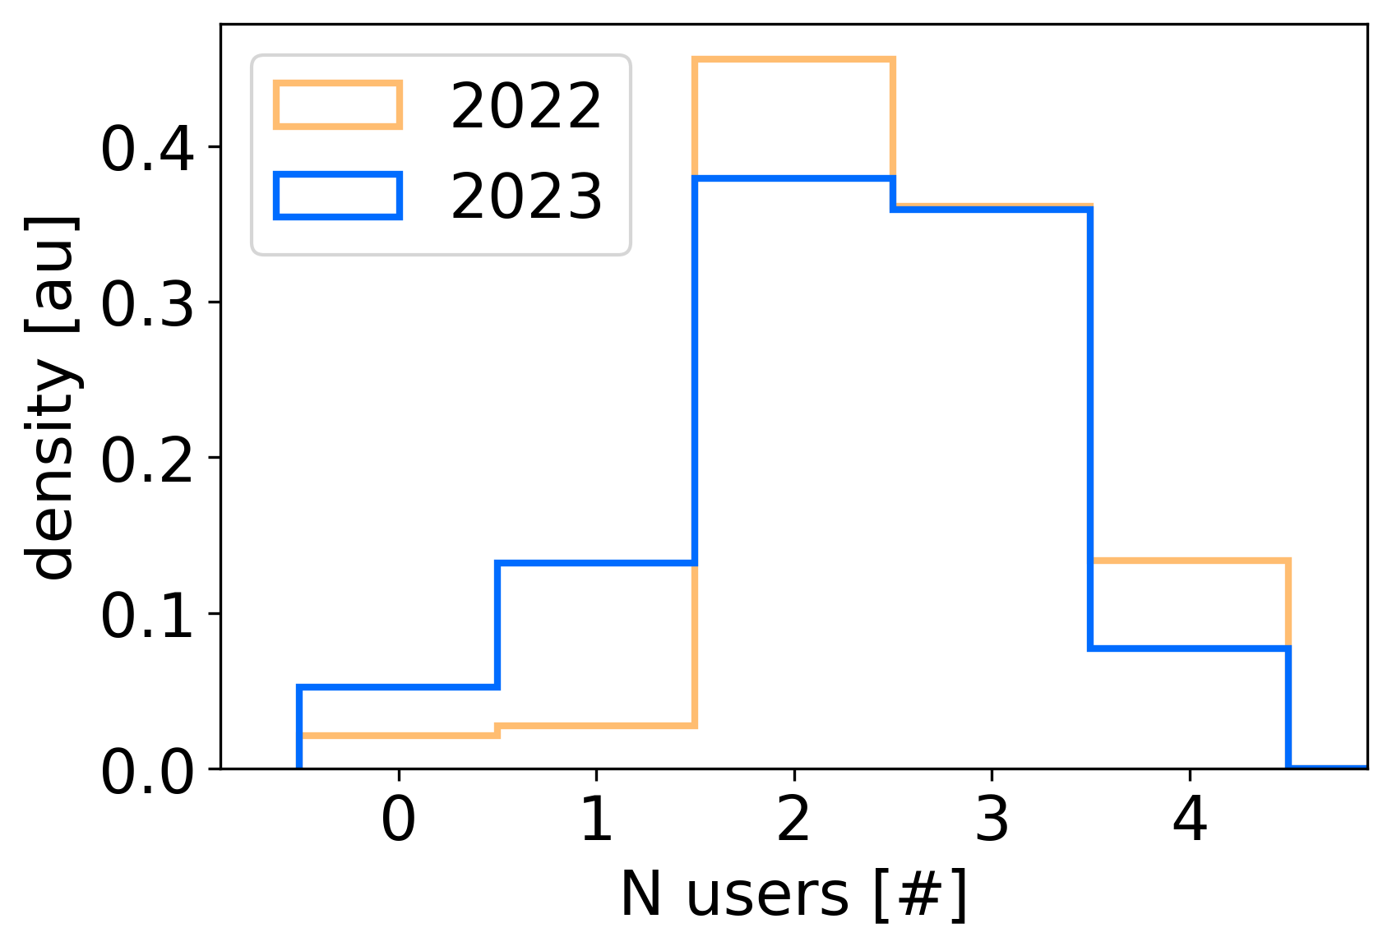
What our (typical) users wants: stable rep rate
User request: stable (order of 5% over ~1 week) repetition period (~110 s)
Usual repetition rate variation driven by PS sypercycle composition and strategy
  Some punctual improvement, but not much we can do (but cycle the injectors only for AD…)
Time between two AD cycle
Beam request handling not always optimal
  E.g. some users (e.g. ALPHA) would benefit of
  being certain to receive one bunch every N cycles
  Only less than 10% of the time with 4 users taking beam simultaneously :
    One could think of reducing the number of bunches to 3, but complex problem…
  …to be discussed with the users!
Notes:
Bettina: concerning the repetition rate, maybe you could add here that finally at the end of the year with dedicated AD running certain underlying issues of the synchronisation have been understood and should be solved by CSS for the restart?

Slide 16
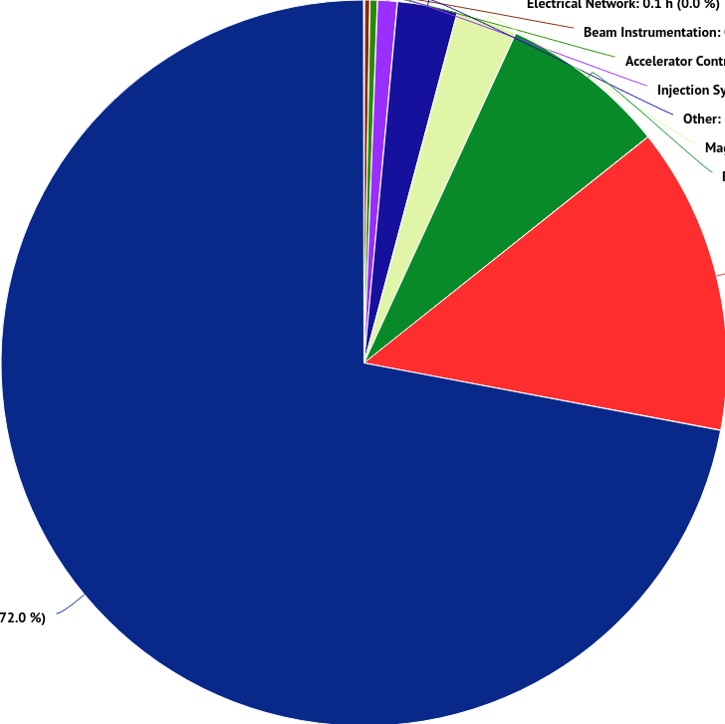
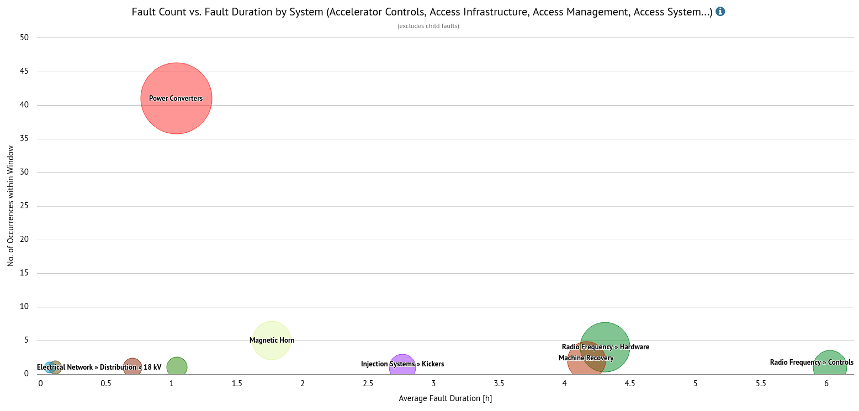
Hardware Faults During Physics – any Trend?
AD average availability (without injector faults) is 97.5%
  With injector faults, this would drop to about 90%!
  ELENA not considered here, but no big issues to report
  Initial issue with QFC54 not considered: this alone corresponds to about 10% loss of physics time with respect to initial plan
  See also L. Ponce-RAWG2023 and M.E.Angoletta-RF OP Review2023
Others 4%
Horn 3%
RF
7%
Power Converters
14%
50
Injector Complex
72%
(L4:18%, PSB:15%, PS:39%)
40
Several occurrences of the same fault
on DR.QUAD circuit
Being addressed during YETS
30
No. of Occurences within Window
20
Many single/rare failure of single equipment and difficult/long recovery time:
Age of equipment (continue consolidation)
Long debugging/recovery time (continuous effort for better instrumentation/references)
10
0
0
2
Average Failure Duration [h]
4
6

Slide 17
Outline
AD/ELENA Overall Performance
User wishes and how we tackle them
  Intensity and its repeatability
  Repetition rate and availability
  Beam characteristics
Long term sustainability
Conclusions

Slide 18
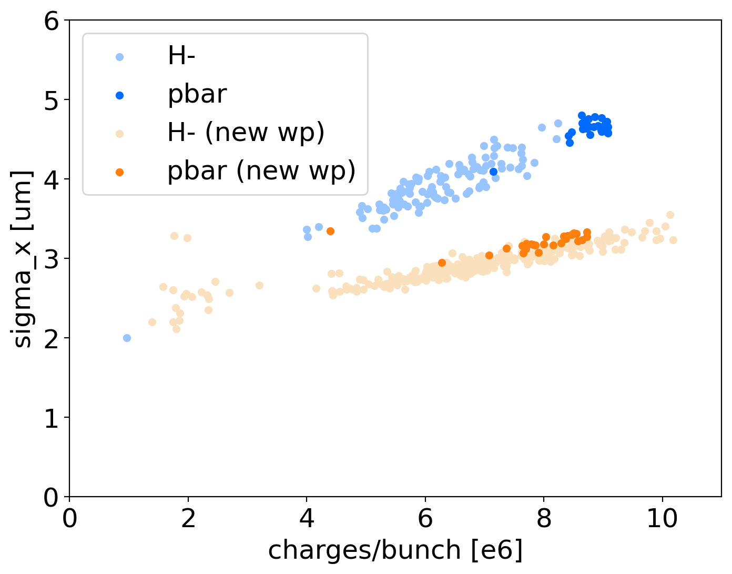
What our (typical) users wants: bunch quality
  User request: keep present beam characteristics
  Extraction energy of 100 keV:
    Present user hardware designed for this energy
  bunch-length <150 ns FWHM
    GBAR asking for <100 ns FWHM, routeinly achieved with bunch rotation
  Emittance < 2um
  only parameter not meeting ELENA design value (< 1.2 um)
  This might be a limitation for some user
  like GBAR
  Investigation with H⁻ showed that using a
  different working point could be beneficial
    Observation confirmed with a few
    pbar cycles!
    Another example of the importance
    of keeping the ELENA H⁻ source
    operational!
  Plan to start 2024 run with the new working point
About x2 emittance reduction!
ELENA Design

Slide 19
Outline
AD/ELENA Overall Performance
User wishes and how we tackle them
  Intensity and its stability
  Repetition rate and availability
  Beam characteristics
Long term sustainability
Conclusions

Slide 20
Mid- to Long-Term Sustainability of the Facility
AD is aging! … and soon ELENA will as well…
  Example: issue with QFC54 at startup: important to finalize magnets consolidation
  Example: long term strategy for SEM in ELENA transfer lines being discussed
  Plans to establish a test facility for low-intensity, low-energy (pbar/H⁻) beam instrumentation and components testing (see TELMAX proposal, EDMS 2975107)
  Usual concerns for liquid helium distribution, water cooling, cranes, powering during YETS, …
…many hardware/infrastructure topics not discussed here…
Working on a long-term Consolidation/Upgrade plan for the facility
  Will need to include power supplies, s-cooling, instrumentation, infrastructure, …
  It requires input from physics community (maybe at SPSC in 2024 or 2025?)
  Main aim: provide inputs to CERN management such to obtain a clear statement on the long-term (beyond LS4) lifetime of the complex
  See also IEFC of 7th July 2023 and ADTC of 14th Sep. 2023

Slide 21
Outline
AD/ELENA Overall Performance
User wishes and how we tackle them
  Intensity and its stability
  Repetition rate and availability
  Beam characteristics
Long term sustainability
Conclusions

Slide 22
Conclusions
Generally, yet another excellent year for AD/ELENA!
  Despite several reliability issues and bad surprises
  Thanks to determined and motivated AD/ELENA teams with invaluable support from uncountable colleagues…
  In 2023, we probably reached the peak performance of the facility with present hardware (and manpower)
  Investments into new tools and machine understanding have paid off on several occasions!
Projections for 2024 and beyond:
  Work on performance stabilisation and faster recovery time, e.g.:
    Stabilise proton reproducibility and pbar yield
    Cure sources of fluctuations observed in DI line and AD ejection
    Continue to collect references and procedures
  Invest more time on ELENA pbar performance
    E.g., close the chapter of higher emittances than design…
  Work on a coherent plan for a bright long-term future of the facility
as in JAPW2022!
2023
2024+++

Slide 23
Thanks!
C. Ahdida, S.Albright, M.E. Angoletta, L. Bojtar, F. Butin, C. Carli, F.S. Carlier, J. Cenede, B. Dupuy, Y. Dutheil, A. Frassier, P. Freyermuth, T. Giles, W. Hofle, S. Jensen, L.V. Joergensen, G. Khatri,
Be. Lefort, C. Machado, O. Marqversen, B. Ninet, S. Pasinelli, L.Ponce, S.F.Rey, S. Reignier,
G. Russo, G. Tranquille…
… and the many more colleagues to whom I apologies for not mentioning their name, but without whom AD/ELENA would not give us so much satisfaction (i.e. troubles) and anti-physics!
Background by Theres Rütschi, Instagram: papermoon_32

Slide 24
User wishes
Based on survey sent to users for 2023 AD/ELENA mini ws
Repetition time and stability:
  ~110s (mainly driven by BASE: shorter cycles can be a problem for them!)
  Ideally requiring back-to-back cycles (optimum for stability and intensity flux).
    If not (as today) we should aim for 5% rep-rate stabilty
Delivered bunch properties:
  >7.5e6 pbars/bunch (driven by AEgIS design)
  Rms emittance <2um. No strong desire for lower (but GBAR, short term)
  Rms dp/p <1e-3. No strong desire for lower
  Trajectory stability <0.1 mm
  100 ns FHWM bunch length
    Today’s 150 ns FWHM without bunch rotation sufficient for most experiments, but GBAR.
  100 keV fixed extraction energy
    But keep open the possibility to explore 50-500 keV (up to 5.3 MeV for ASACUSA1)
Beam availability:
  Present yearly schedule (days of pbar physics) and injectors availability typically good enough
    Both could be improved with equal importance
  4 bunches extracted from ELENA all the time seems to statisfy most use cases
    More dynamic scenarios don’t seem to be interesting

Slide 25
Possible plan from 2023 AD mini ws
(from a beam perspective)
Optimise for quality/stability of delivered pbar bunches
  100 ns FHWM bunch length, 1e-3 rms dp/p,
  Try to solve the “large emittance issue”, aiming at ~1 um rms emittances
  Work on intensity measurement accuracy and beam trajectory stabilisation
  Work on “performance recovery” procedures (e.g. e-cooler drifts, trajectory drifts due to stray fields, …), including ring optics studies
Aim at ~100s-long, regular cycles
  Insist on more careful super-cycle composition (short term) and/or “on demand” beam request from PS (long term) – (worth up to 10% higher pbar flux at fixed rep-rate)
  Insist on higher availability from injectors – (worth up to 10% higher pbar flux)
  Reduce AD cycle length where possible, but no need to insit too much (already close to 100s)
Aim at 4 x 1e7 bunches extracted from ELENA
  Exploit maximum AD target capabilities
    highest proton intensity (toward 2e13 p/pulse)
    Pbar yield optimisation (including styding of DI optics and AD injection)
  Aim at 80% transmission from AD injection to ELENA ejection
  Test of h=3 instead of h=4 at ELENA ejection? (to be discussed)
long term/nice to have (to be discussed):
  Open the possibility for higher-energy and lower-energy extraction from ELENA?
  Possibility to inject/decelerate antideuteron in AD?

Slide 26
AD/ELENA Improvement Project Timeline
June 2011: ELENA
project approved
Oct. 2023
ACC-CONS day
Old/new AD-related
consolidation requests
ACC-CONS project
AD-CONS project
Feb. 2025?
SPSC
Sep. 2025?
MTP
2010: Start of
ACC-CONS
AD-IMP(?) project(?)
2009: Start of
AD-CONS
2015 AD-CONS
under ACC-CONS
Collect, adjust, specify, prioritize consolidation/improvement requests
The SPSC has recommend the Research Board for a call for proposal for new experiments (probably in 2024 or more likely in 2025)
On our side, drafting a document to describe how the facility could be “improved”
  Main aim: we need to provide inputs to CERN management such to obtain a clear statement on the long-term (beyond LS4) lifetime of the complex
Notes:
Sub-documents like the ones prepared in the past - e.g. EDMS 1159784: Functional Specification Beam Instrumentation Needs for the AD in the ELENA Era.

Slide 27
Overview of Beam Instrumentation Needs
Target BTV:
key for p beam control
DE.BCT7049:
AD/ELENA scrapers:
Complementary to IPM
Special use for AD injection setup?
LNE BCTs
FTA BTVs
Better BTVs?
BPMs?
BLMs?
AD BCCCA
AEGIS
DI BCTs and BTVs
How to fully profit of those?
FTA.BCT9053 et al.
STEP
BASE
ELENA neutrals profile monitor:
how to use it?
probably limited use (only H⁻)
GBAR
PUMA
SEM(?) in LNE lines:
Missing/broken/long term reliability
What about adding BPMs?
AD IPM (or similar):
Might be a breakthrough in how we operate.
Long plan to have one in ELENA as well?
ELENA ring intensity measurement
Additional topics to be discussed:
AD/ELENA Schottky
AD/ELENA BPMs
E-cooler BPMs:
Still some questions
on accuracy
Notes:
(see BI/TB Feb 2022 and IPP Apr 2022)

Slide 28
From PS to AD: Protons Transmission
Linked to proton intensity increase?
  Not so sticking... Surely not the whole picture…
PS-to-9053
TT2 BPMs

Slide 29
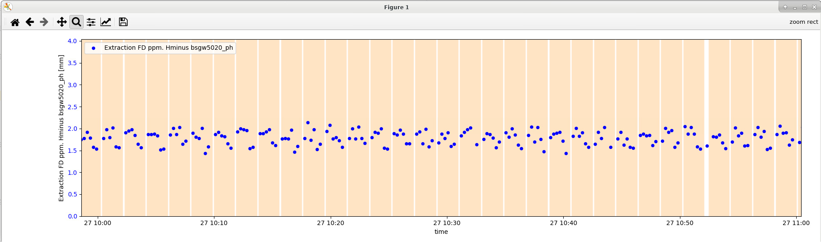
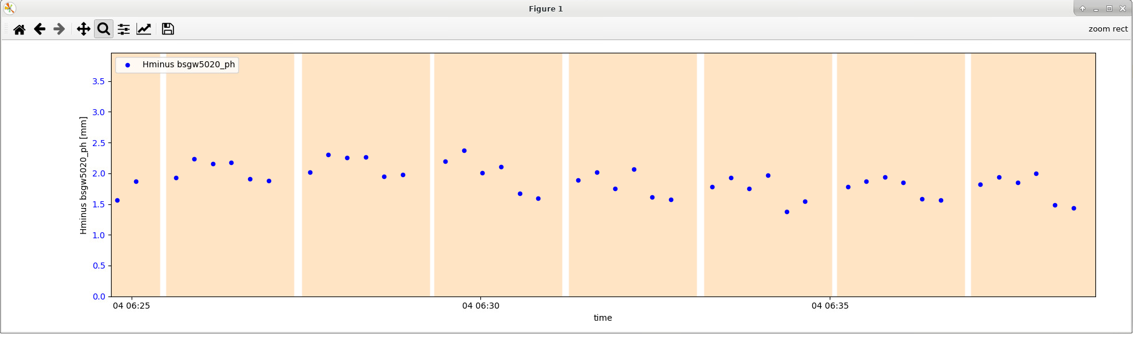
LNE Trajectory Stability
Investigation on trajectory stability and impact of AD cycle
  Some correlation with AD cycle, but not very clear (at least in LNE50 at this time)
By S. Pasinelli

Slide 30
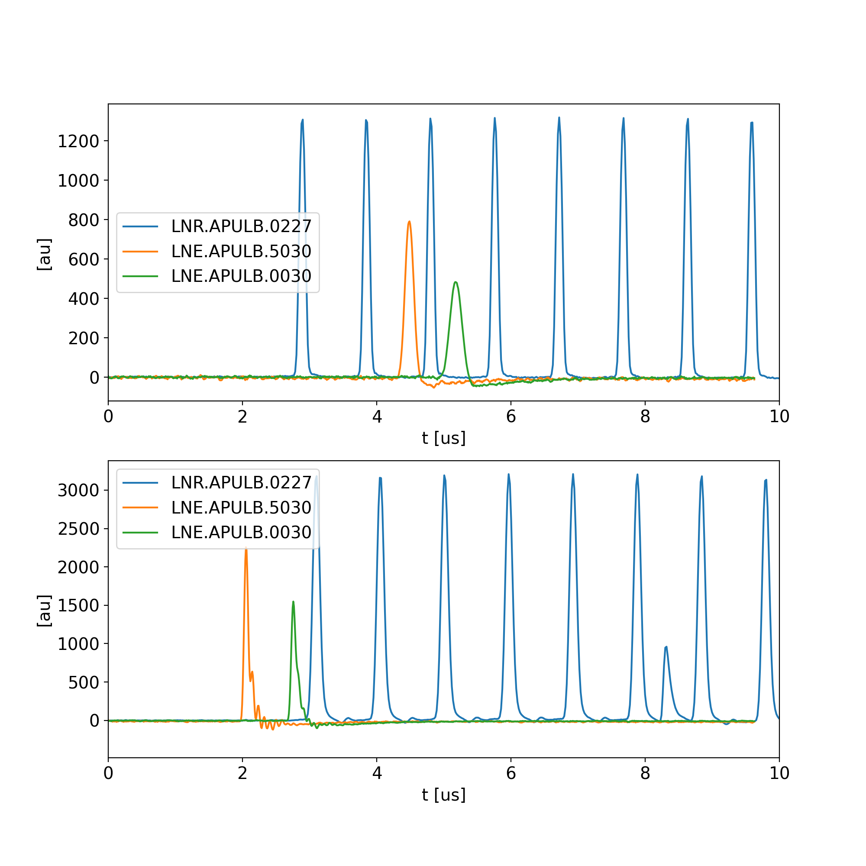
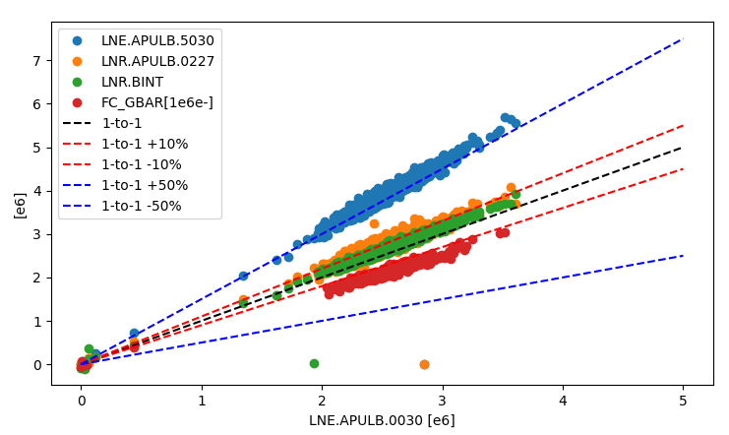
ELENA Single Pass Intensity
Based on BI-TRIC system on
LF LPU design of ELENA ring
Till early 2023, several doubts about calibration
  Long lasting investigation by BI and RF teams, including adding a not-foreseen TRIC system + surface amplifiers for Ring LF LPU
  “Solved” by using a 1 nF calibration capacitor in TRIC (as in DE.BCT7049)
  Details in BIIQ-548
Ch1 signals
Using a BPM
Bunch “shortened” with bunch rotation
Ch2 signals
Using Ring LF LPU
Using 10nF capacitor
Calibration pulse in between two turns…
LNE.APULB0030
Estimate from GBAR user (F-cup)
LNR.APULB0227
AEGIS
Using 1nF capacitor
STEP
LNE.APULB5030
BASE
GBAR

Slide 31
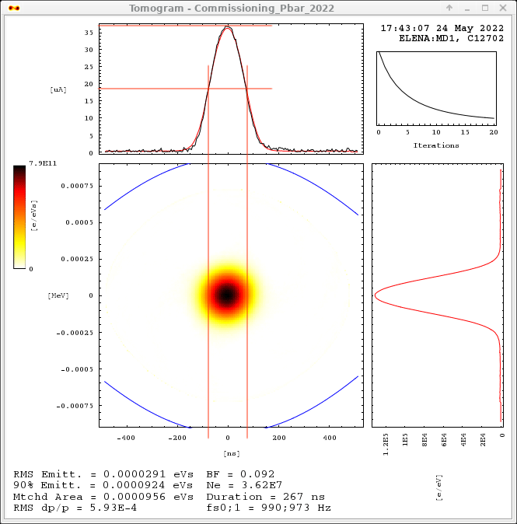
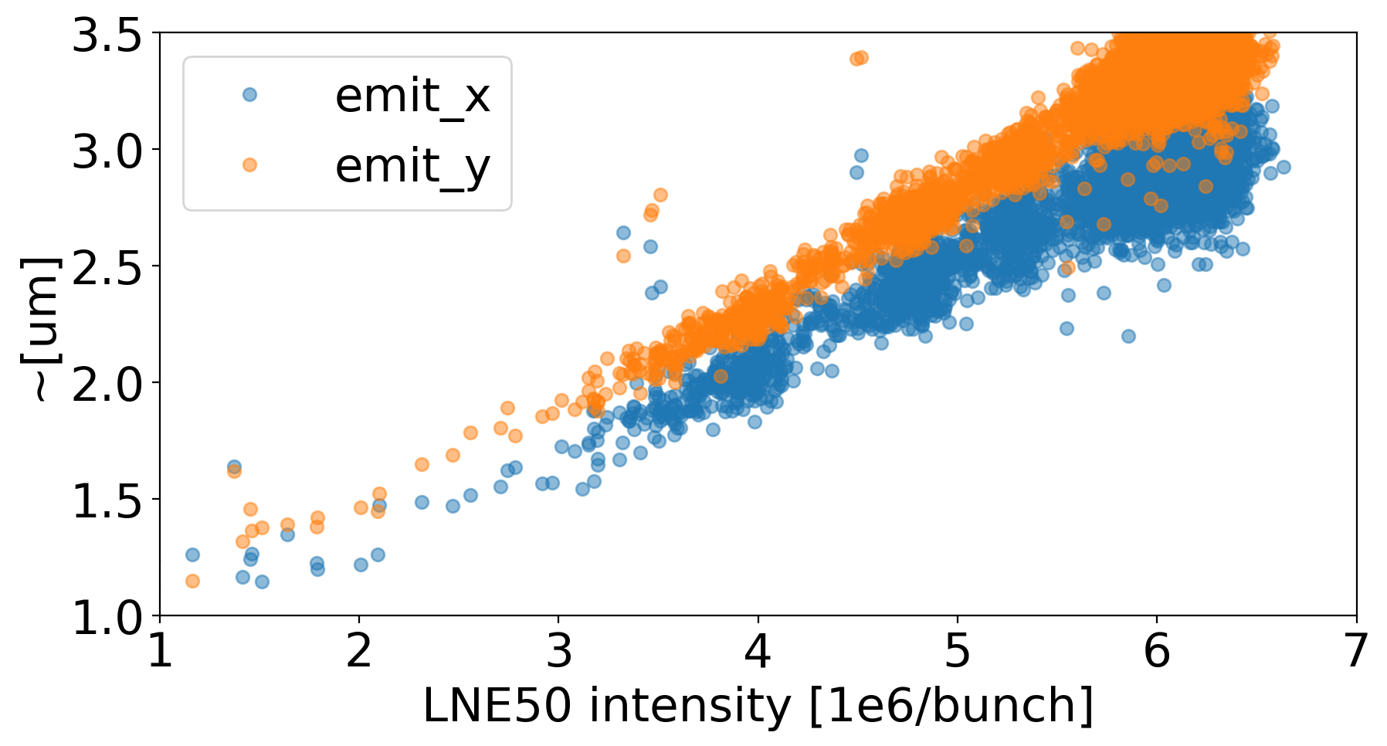

Properties of beams delivered to users
In longitudinal, normally meeting user needs
  Thanks to flexibility provided by bunched beam cooling, and bunch rotation
Transverse emittances too large (Typically ~2.5 um)!
  ~linear dependance with beam intensity
    i.e. higher intensity will bring even larger emittances…
  Some hints for improvement looking at electron temperature and/or vacuum levels and/or e- energy control… or pbar optics to be investigated
Note: users do not seem to have strong requirements on emittance and/or energy spread (but GBAR, at least on the short term)
Without bunch rotation:
150 ns-long FWHM, 6e-4 RMS dp/p
Not accurate values!
With bunch rotation:
100 ns-long FWHM, 9e-4 RMS dp/p

Slide 32






Exploring a New Working Point for Smaller 𝜖
Plots assuming beta_x = 7.7 m and betay = 1.3 m irrespectively from working point => big assumption! Optics is actually diffferent
Present tune spread intercept third order resonance….
Moving below third
order resonance
requires to change
whole ELENA cycle…
Tested first with H-
  Clear reduction of beam size observed for equivalent bunch length
  (Another example of the importance of keeping
  the ELENA H⁻ source operational…)
Promising preliminary results confirmed with pbar (but losses along the cycle to be cured)
Present wp assuming:
1e7 pbars
100 keV
65 ns rms
2 um rms
Up to 4th order resonance
About x2 emittance reduction!

Slide 33

The ELENA cycle
Running with two (magnetically-equal) ~15-second-long pbar/H- cycles
Second H⁻ injection to increase beam intensity @100 keV before extraction
n bunches extracted on demand by users
h=1
h=4
h=4
h=1
E-cooling
E-cooling
E-cooling
We are providing 4 equal bunches to serve 4 experiments in contemporary
Margin of improvement:
  Transmission: today up to ~20% losses,
  Cycle length: not important if we run in the shadow of AD (baseline), but relevant if we wait for ELENA extraction before restart AD (as today!)
Repetition rate is very slow for any study/setup with pbar
  Good news: No H- lifetime degradation observed with e-cooling! We can use H- for most studies!
  Bad news: H- source reliability questionable, known to be prone to hardware faults…
  Bad news: H- lifetime strongly affected by vacuum levels in the ring (typically 10⁻¹¹ mbar)

