Slide 1
JAPW workshop
Fixed target program – Beams and Areas
Instrumentation issues & requests
M. van Dijk (with input from many)
Resulting requests added to slides in red text

Slide 2
BPMs for FTN and FTA
Both FTN (from PS to nTOF) and FTA (from PS to AD) are limited by apertures
  FTN requires large beam size at new air-cooled target,
  FTA requires very small beam size at target (requiring large beam in the line)
Lines are currently instrumented with mostly BTVs
  Cannot be used for continuous monitoring and affect the beam substantially
  Further optics optimization would require precise and continuous monitoring using non-intercepting detectors
Upgrade would allow optics optimization leading to loss and activation minimization
  Could be used as input for YASP, possibly leading to automatic steering and drift compensation
Request for FTN: Five monitors providing continuous beam position measurement
  Suggested locations 400, 414, 434, 454 and 465, possibly using BPMs
Request for FTA: Four monitors providing continuous beam position measurement
  Suggested locations 9009, 9019, 9039, 9047, possibly using BPMs
Currently being followed in the BIFT meeting
  Activity not in MTP (currently no resources / budget), cost estimate being prepared

Slide 3
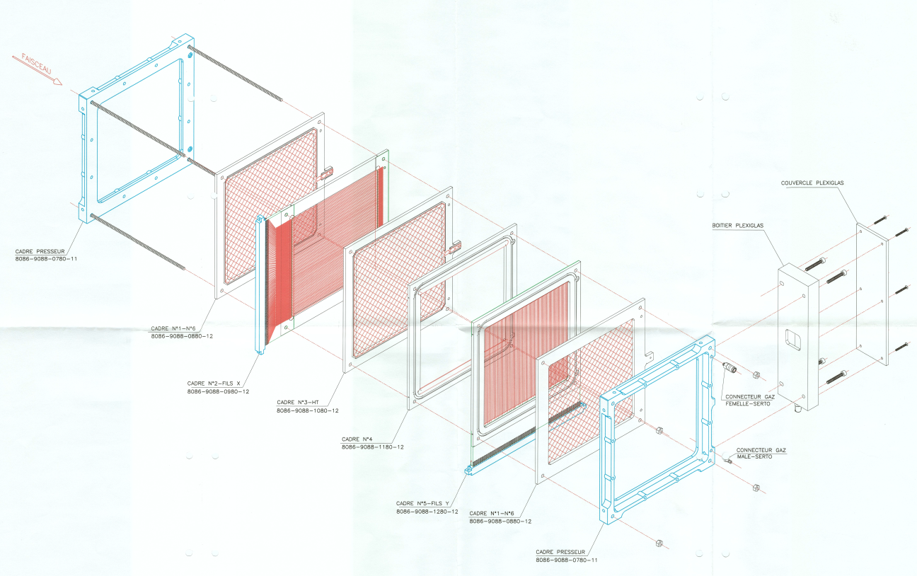
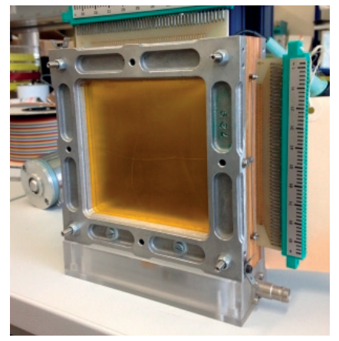
XBPF for NACONS and radiation hard profile monitors
Multi-wire Proportional Chamber Refurbishment
  Critical number of spare XWCM & increasing failure rate
  On-going MWPC refurbishment to ensure operation until LS3
NACONS Phase 1 – design and R&D
  Design of new North Area XBPF & production of 8 full (large) units for EHN1
    Urgent new requests for upcoming NA-CONS C&S Review 2024:
      Initiate procurement of XBPF parts for Phases 1 & 2 to optimise resources
      Production of 8 large area XBPFs for Drell-Yan physics program in M2 beamline
  R&D on a radiation-hard profile monitor for M2 and K12
    Extensive prototyping on-going. Completion of final design during LS3.
NA-CONS Phase 2 – complete consolidation
    Production of rest of XBPFs ~ 40 units
    Production of radiation-hard monitors.
Request 1: Accelerate timeline for XWCA/M replacement (BI)
Request 2: Production of large-area XBPFs for downstream part of M2 (BI)

Slide 4
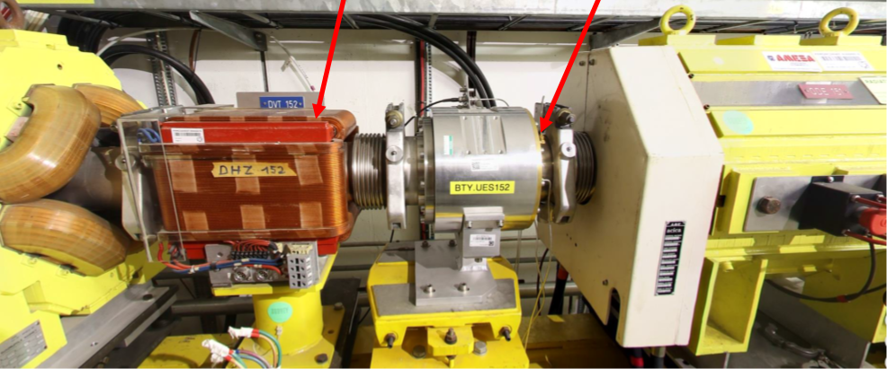
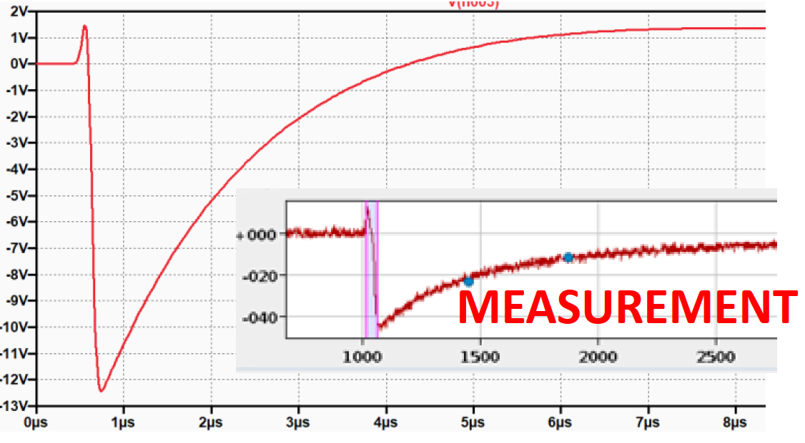
BTY line BPM issue
BTY.BPM152 in BTY line (from Booster to ISOLDE) suffers from electromagnetic pickup
  Problematic only in GPS cycles
  (for HRS, magnet current not enough to cause issues)
  Good qualitative agreement between observed issue
  and SPICE simulation of pickup
Further steps are clear
  MSC team will measure stray field in YETS
  EMI – fix: Reducing interference by grounding / shielding
  Possible OP-side mitigation: Steer upstream so that
  this corrector can be used at low current
No request – follow issue to completion
SIMULATION

Slide 5
CEDAR issues
Some open issues remain (see backup slides for closed issues)
  H2 Difficult (noisy) opening of gas electrovalves June 2023
  H2/H6 PMTs not 100% efficient with fully open diaphragm Summer 2023
  H2 Unstable pressure August 2023
  H6/M2 Diaphragm movement precision not adequate Summer 2023
  M2/H2/H6 X-Y table movement precision not adequate Summer 2023
Program ongoing to address general ageing issues – selected issues, details in backup
  PMTs are becoming obsolete – model is going out of production
    Mitigation: Buy PMTs of new model and modify CEDARs as soon as possible
  Pressure sensors are losing precision, and no spares are available
    Mitigation: Software modification to deal with current level of precision and deploy new pressure sensor
Consolidation budget likely to be advanced from NACONS Phase 2 to NACONS Phase 1
  To be approved at next NACONS Cost and Schedule Review (2024) – details in backup slide
Request: Follow to completion the remaining open issues (BI + EA)

Slide 6
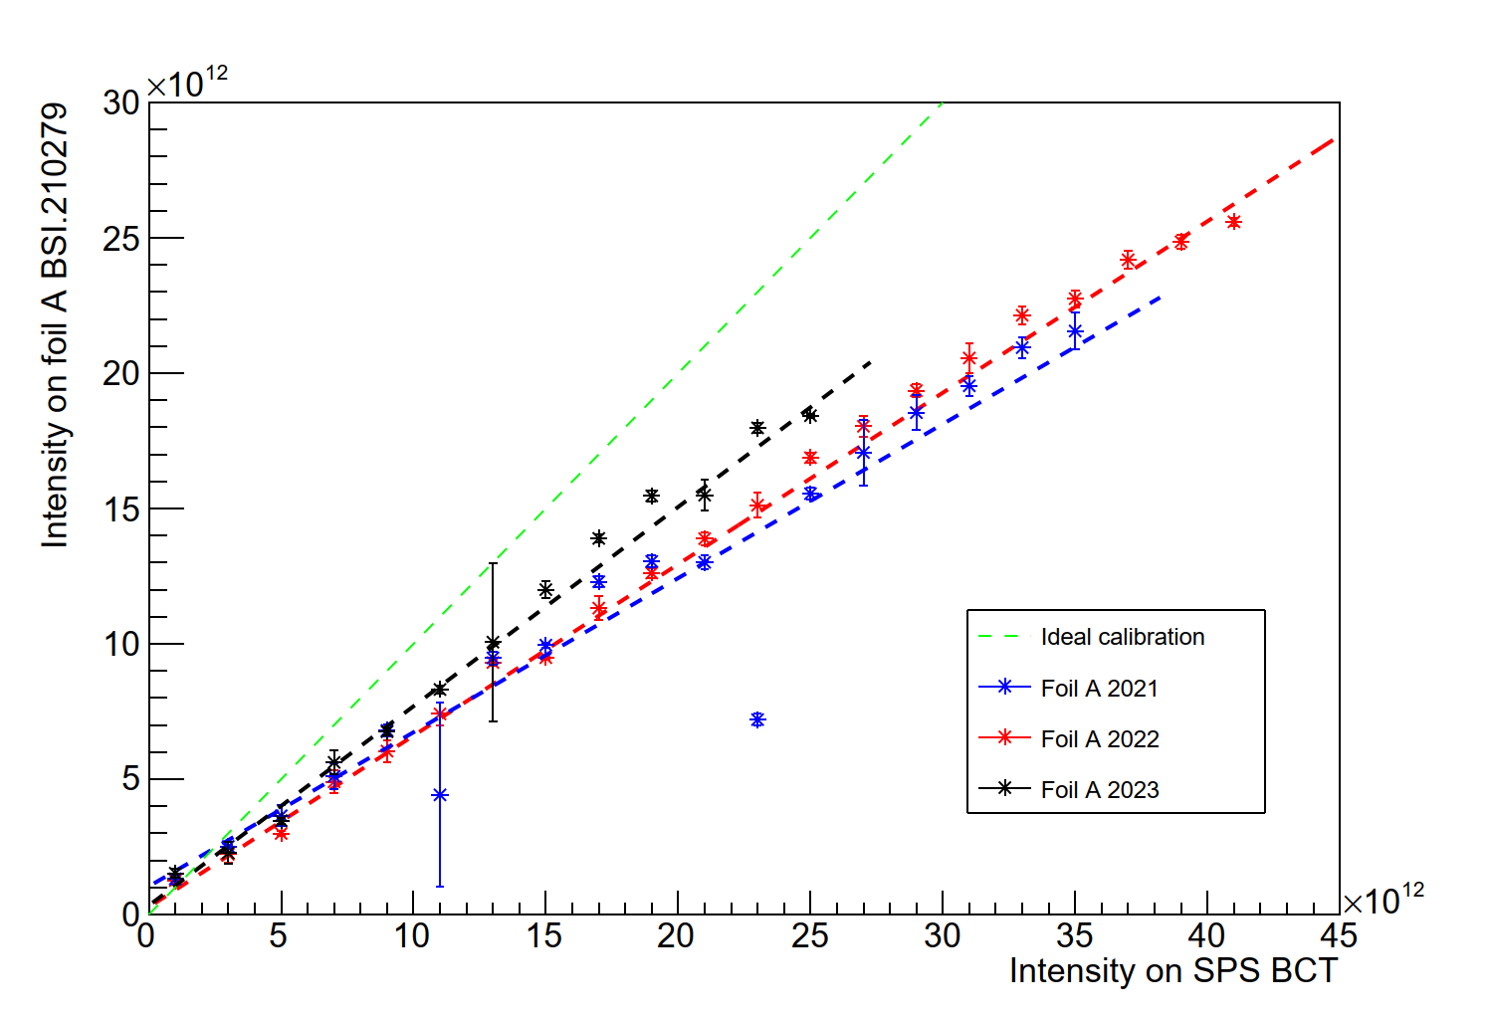
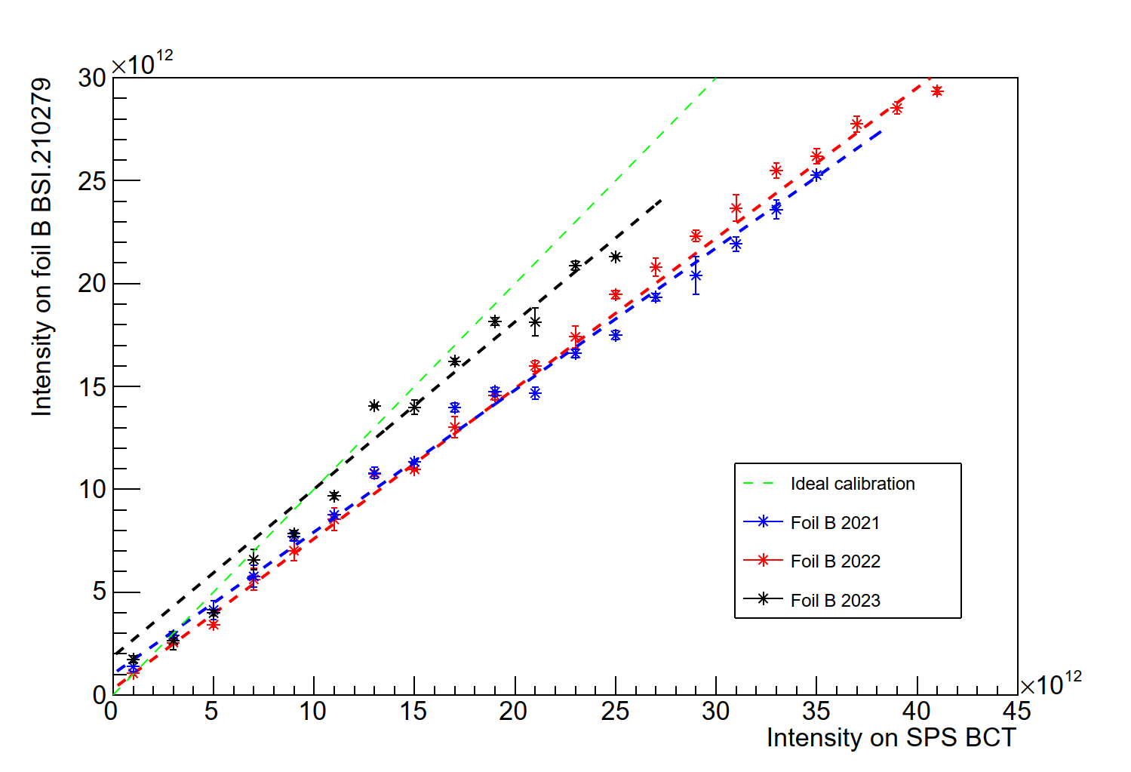
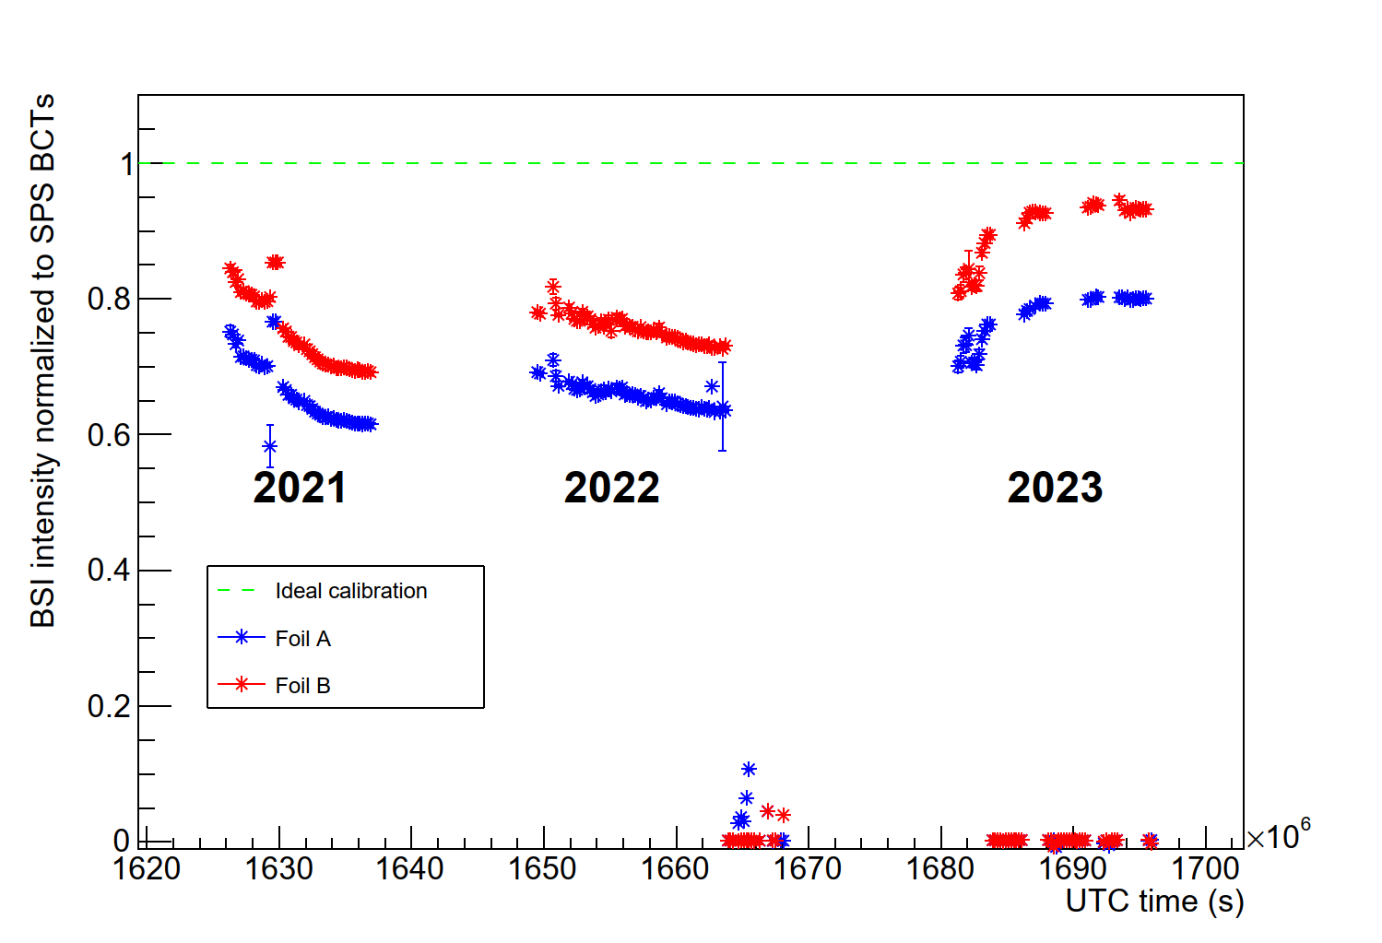
BSIs and the difficulty of absolute intensity
Foil A
Foil B
Long-standing uncertainty on NA intensity
  Last calibration >20 years ago (?)
  Start with a request for calibration from NA62
  Expected ~10%, to have a few % would be good
Observed since many years
  BSI intensity != SPS BCT intensity
  Unstable over year and from year to year
  Not clear what part is the monitor and what part is losses
  Displayed most upstream monitor in TT20 (210279, two foils)
Gathering experience in diagnostics
  Analyze data from all BSI monitors in North Area
  Compare monitors with each other
  Develop the diagnostics that will lead to
  a strategy for addressing the issues
 | Slope foil A | Slope foil B
2021 | 0.569 +/- 0.005 | 0.690 +/- 0.004
2022 | 0.634 +/- 0.003 | 0.731 +/- 0.003
2023 | 0.736 +/- 0.005 | 0.814 +/- 0.005

Slide 7
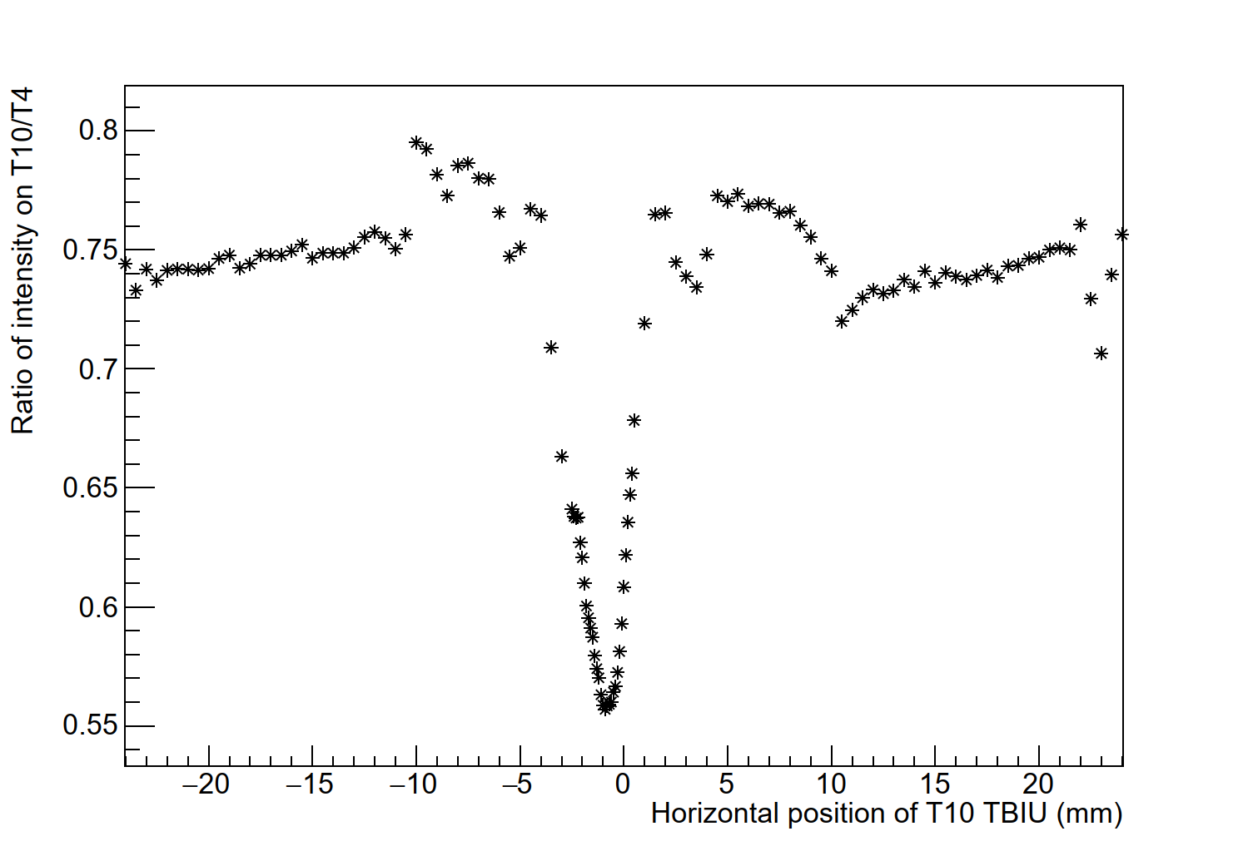
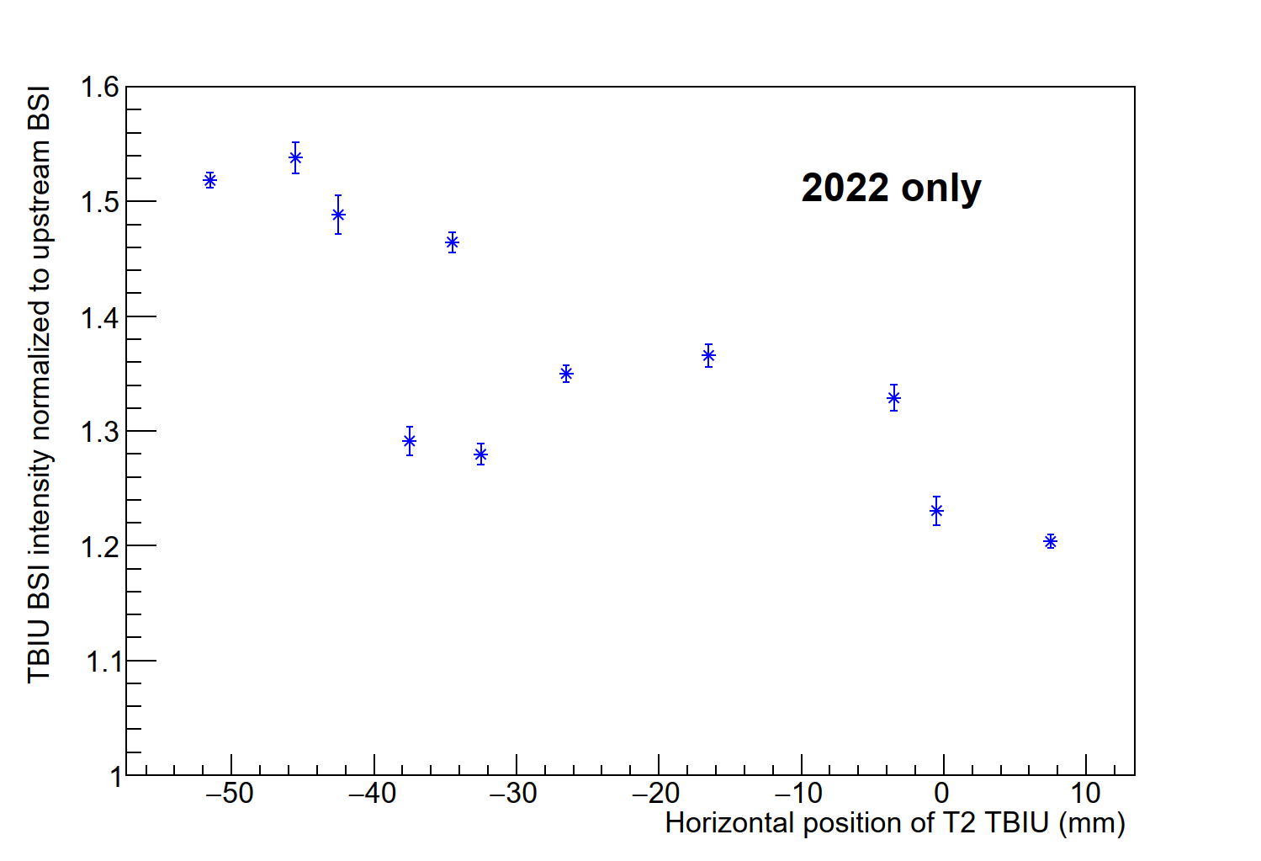
Damage to BSI foils
T10 target TBIU scan
Year to year, the sensitivity of the foils
seems to change
  Likely caused by small differences in hit position
  Each part of the foil has a different history
BSI in TBIUs is too far (>12cm) from BSP
  Different wobbling has different horizontal angle on target
  Changing wobbling horizontally displaces beam on BSI
  Movement on BSI due to wobbling change can be ~2mm
  Spotsize on T4 has σ_{x} ~0.4mm (T2 likely similar)
The BSIs in the target areas are likely giving
an accurate assessment of intensity
  Foils in TBIU more problematic than upstream
  due to small spotsize (damage scales with area)
    I am not yet certain of beam size in upstream region
  SPS page 1 intensities could be wrong by >20%
T2 target TBIU (2022)

Slide 8
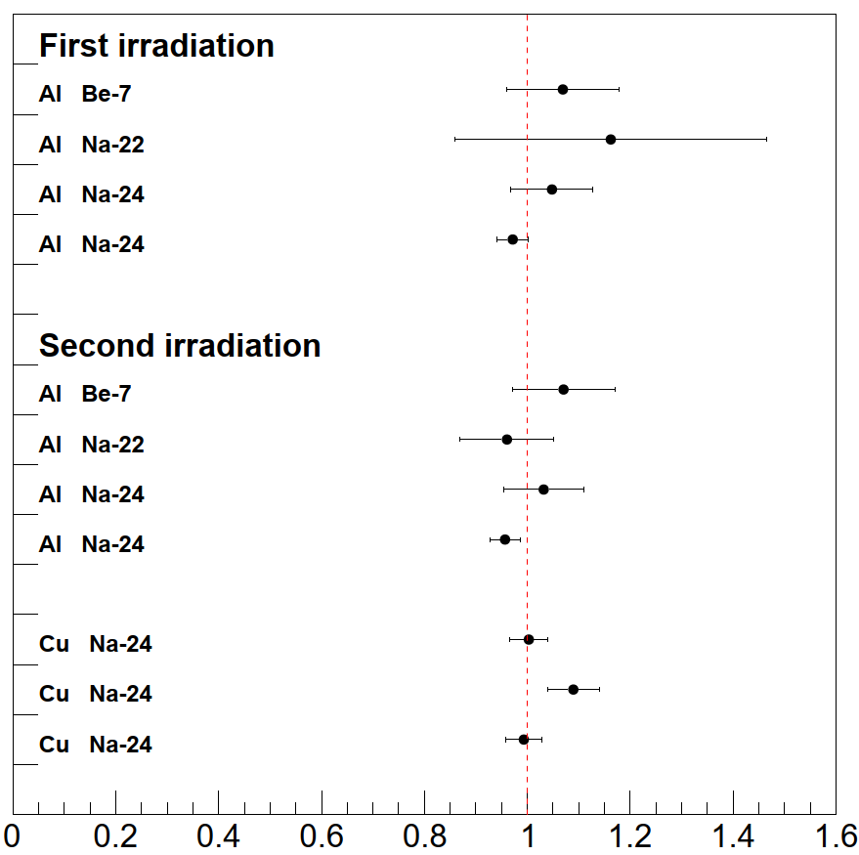
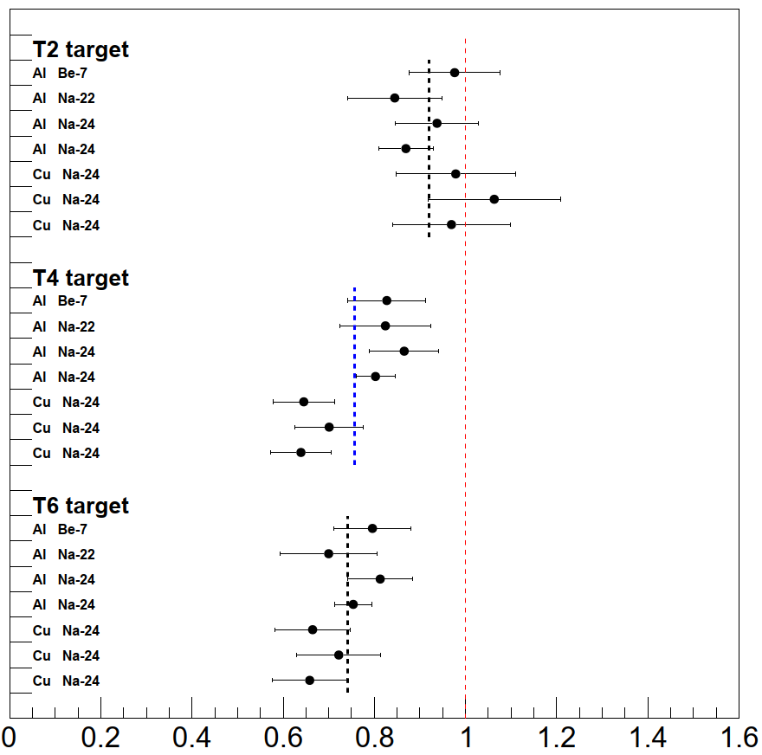
Calibration of BSIs in North Area
Valuable experience gained in 2022 and 2023
  Put aluminium / copper foils in line (in this case, near target)
  Expose to beam (~100-200 shots), sum up BSI signals
  Divide activity by cross-section, and compare to BSI sum
First set of calibrations done with T10 target
Second set of calibrations done for T2+T4+T6
  Measured fewer POT in activation foil than on BSI
Third set of foils measured in HiRadMat
  Not consistent with (inferred) cross-sections from T10
Aluminium foils can give different results than copper
  Implies impact of neutrons through auxiliary process
  Present in both TCC2 and HiRadMat measurements – probably
Still preliminary

Slide 9
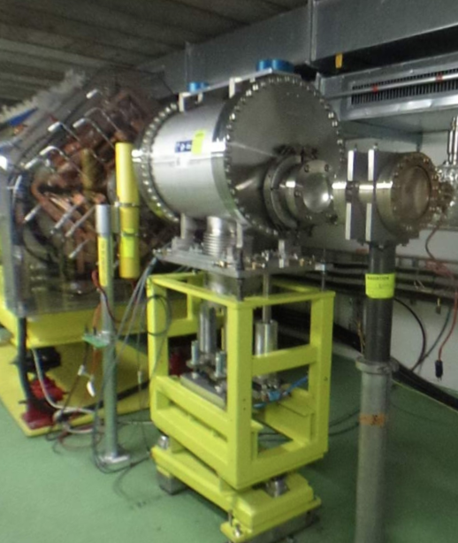
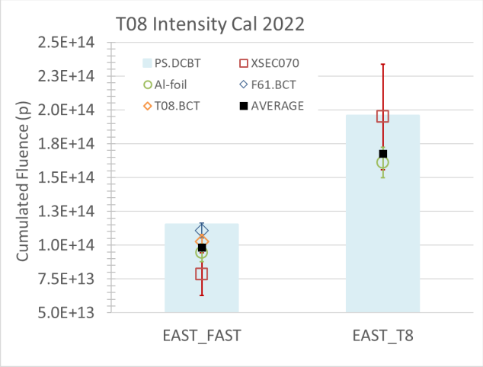
Calibration of XSECs in East Area
The XSECs are SEM-based intensity monitors
  Initial comparison between fast BCT and foil activity (2022)
    Measurement based on single isotope (²⁴Na in aluminium foils)
    Compared with fast extracted beam (few 10s of ns) onto fast BCT
    Methods agree with absolute difference of 9.3%
  Second irradiation with slow extracted beam (2022)
    Measure XSEC signal & compare it with foils activity
    XSEC signal calibration based on resulting measurement
  Data collected also with copper foils in 2023
    Analysis ongoing
Intensity calibration of T9/T10 primary lines not yet performed
  Possibly the factors of T8 can be reused – similar / same detectors
  Will be assessed further once analysis of T8 foils is completed
F. Ravotti, EP-Tech-Note-2022-001

Slide 10
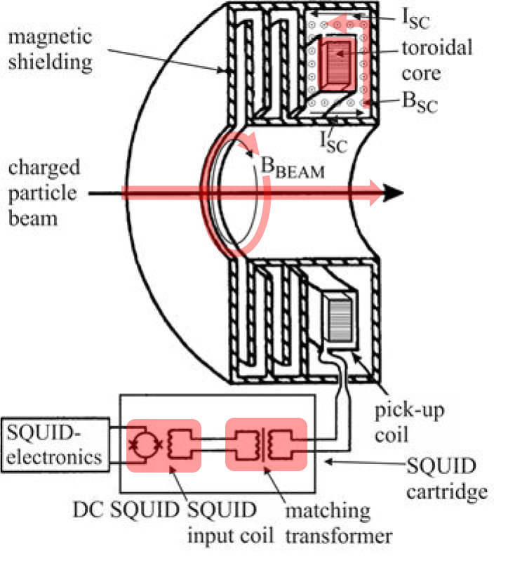
Intensity of DC beams in North and East – options
Three possible technologies under consideration: SEM, BCT and CCC
Secondary Emission Monitors are the currently implemented technology
  BSI foils in North Area seem to get substantially damaged by beam – possibly even over a single run-year
  Coupled to movement of the beam and vacuum history this gives a large (but slow) variations
Beam Current Transformers have been considered (but mostly ruled out)
  Ideally, measurement is “short” (1ms or less) – but even fast-pulsed slow extraction to TT20 is 10-20ms
  Current lowest current is ~200µA in a ~200µs pulse (end of LINAC3)
  Regular slow extraction is 4.8s (equivalent to 1.3µA with 4 10¹³ protons) – unfeasible
  Fast extraction (using kickers) is limited in intensity allowed to be extracted to North Area
Cryogenic Current Comparator is an excellent candidate
  Magnetic field of beam induces screening current in superconducting shielding
  Current is picked up by SQUID through pick-up coil and transformer
  CCC’s features: non-intercepting & absolute current monitor, ~5nA resolution
  Prototype deployed in the AD (cycle length 110s) and operational since Run 3

Slide 11
Next step for calibration of the BSIs
Request for annual calibration plus
1-2 follow-ups in 2024 (~12h beamtime each)
Observation: Continuous degradation of BSI monitors
  Consequence: uncertainty of 20% up to 50%, will grow in the future
  Full impact on beam operation to be assessed
Available data far from fully analyzed
  Finalize, compare to simulation, condense into strategy
Study in more depth the BSI signals
  Archived data, and TBIU and “upstream” BSI scans in commissioning
Plan for the future – follow-up at BIFT
  BSIs are difficult, BCT not (very) possible, CCC for Run4 is technically feasible
    Follow CCC also from NACONS perspective if and when fully justified
  Continue calibration efforts until full consensus found, monitor degradation
  Fast foil exchange is crucial for the activation foil calibrations
  Investigate mitigation: motorize BSIs? (stepping motors instead of in/out)
  Investigate mitigation: adapt BSI design for easier calibration?
Request for
further study
and additional personpower

Slide 12
Other issues
AD & ELENA
  AD – Ionization profile monitor (IPM) undergoing repairs (one plane not functional)
    Will be operational for 2024
  AD – Work ongoing for scraper (transverse profile measurement)
    Further development of signal analysis is progressing well
  ELENA – ring intensity measurement now fully established (~5%)
  ELENA – SEM profile monitors will be installed in transfer lines
    Missing monitors/spares and long-term maintainability are being addressed by BI with an
    in-house program to produce new BPMs
  Main facility instrumentation is now operational, opportunities for further improvement are present in most detectors
Request for support of development and long-term consolidation/upgrade of the facility instrumentation
XCETs of North and East Area: rescoping from NACONS under discussion (see backup)
Number of new BLMs for North Area covered under NACONS (see backup)

Slide 13
Collection of requests
FTN/FTA Request for 9 total BPMs
XBPF Accelerate timeline for XWCA/M replacement (BI)
Production of large-area XBPFs for downstream part of M2 (BI)
CEDAR Follow to completion the remaining open issues (EA/BI)
BSI calibration Annual calibration plus 1-2 follow-up measurements in 2024 (EA/BI)
Additional personpower to pursue study and calibrations (EA/BI)
AD/ELENA Request for long-term support for various instruments (BI)

Slide 14
Closing thoughts
Significant issues raised in many locations
  Goal is to identify the best path towards a good solution
Many thanks to the people who contributed, both to this talk and to future solutions!
D. Banerjee, A. Baratto Roldan, J. Bernhard, M. Bozzolan, M. Brugger,
N. Charitonidis, S. Deschamps, W. Devauchelle, G-P. Di Giovanni, Y. Dutheil,
L. Dyks, S. Erhard, M.A. Fraser, D. Gamba, M. Gasior, N. Menaa, L. Nevay,
I. Ortega Ruiz, L. Parsons França, P. Podlaski, B. Rae, F. Ravotti,
F. Roncarolo, J. Tan, F. Velotti.

Slide 15
Backup slides

Slide 16
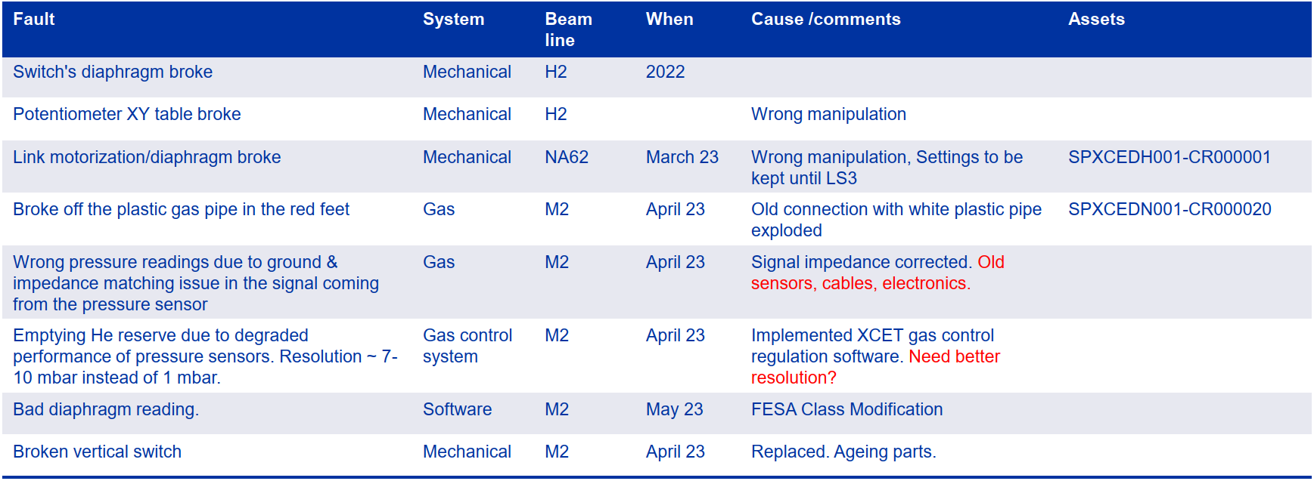
CEDARs – closed issues

Slide 17
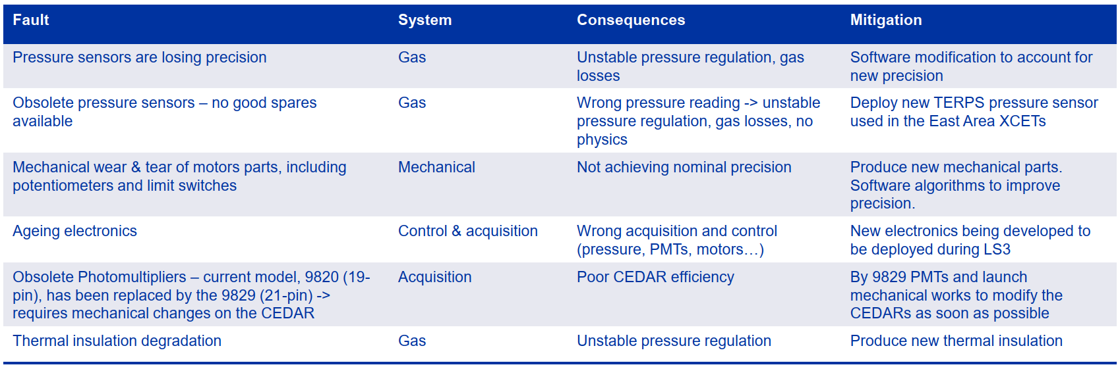
CEDARs – general ageing issues

Slide 18
CEDAR advancement to NACONS Phase 1
Advancement of budget for consolidation from Phase 2 to Phase 1 will be discussed at the next NACONS Cost and Schedule Review (February 2024)
  Full details in EDMS 2742855
Brief overview of works under discussion
  Design of the new diaphragm motorisation, new thermal housing, gas control system or more general integration studies connected to beamline layout and/or specific test set-ups
  Maintenance of the supports (supports + XY tables + jacks) starting with two unused sets in Phase I
  Two sets of spare N and W optics would be produced during Phase I
  Replace obsolete or damaged diaphragm system
  Supply of 8 PMTs plus voltage dividers for one XCED spare
  Design and supply of prototype thermal insulation
  Design and supply of prototype gas system
  Refurbishing of clean room for assembly works

Slide 19
XCET advancement to NACONS Phase 1
XCET is the family of Cherenkov Threshold Counters used in the North and East areas
Advancement of budget for consolidation from Phase 2 to Phase 1 will be discussed at the next NACONS Cost and Schedule Review (February 2024)
  Full details in EDMS 2802361

Slide 20
BLMs for North Area under NACONS
Roll-out of BLMs foreseen for primary lines
  20 units to be exchanged by new units in TT20
  13 new positions in TT23/TT24/TT25
  13 units already installed in P42, 19 remaining units to be installed by LS3
  1 longitudinal BLM in LSS2 + 1 in TDC2 + 2 in TCC2

Slide 21
The intensity monitors of the North Area
BSI is a beam intensity monitor
  More versions available that do various jobs (BSG, BSP, BSM, ….) but here focus on intensity
  Monitor needs to give an ABSOLUTE number – so calibration is extremely important
  Basic operational mechanism is “Secondary Emission” – a small chance that a proton impinging on a metal foil will kick out a low-energy electron that you can collect, leading to a small current for a large beam
L. Parsons Franca
BSI (Al or Ti Plate)
P+
Signal
BIAS
BIAS
e-

Slide 22
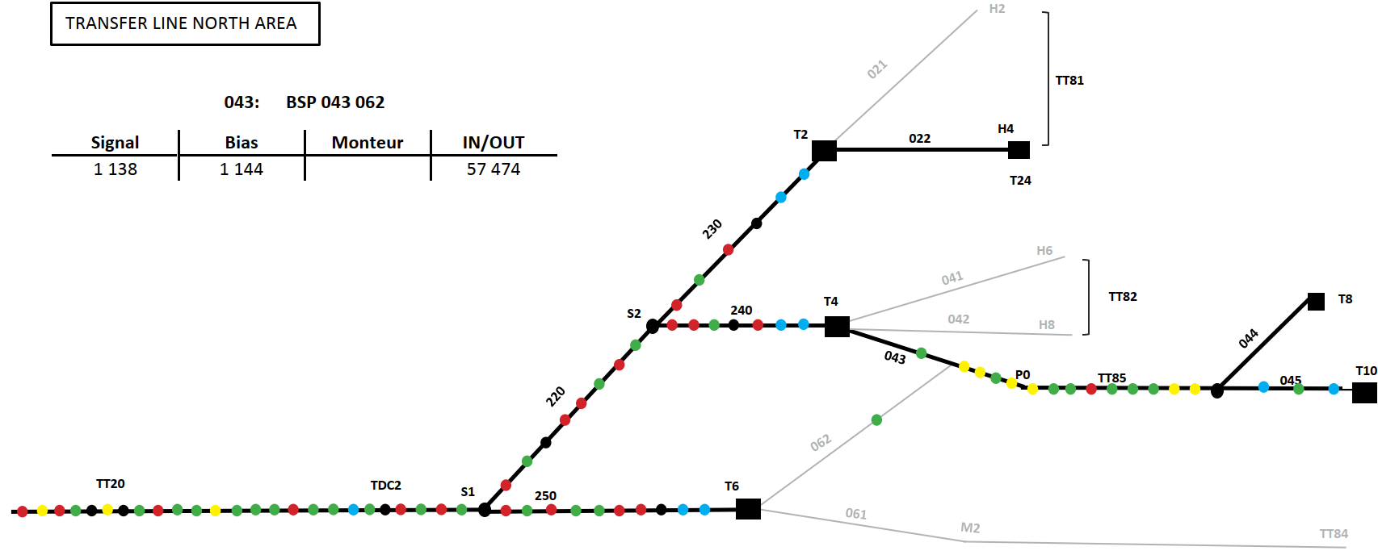
Map of SEM detectors in North Area
Labels given only for the BSIs
BSM(H,V) – beam position
BSP(H,V) – beam position
BSG(H,V) – beam profile/position
BBS(H,V) – beam profile/position
BSI – beam intensity
230705
230949
230950
240610
220412
241149
241150
210216
210279
211626
251010
043282
045769
045914
251247
251248

Slide 23
BSIs at the TCC2 targets (T2, T4, T6, T10)
Each target station has three BSI monitors associated
    1x “Upstream”
    2x target instrumentation (just before and after)
      T10 has no TBID
The intensity reported on “page 1”
comes from the “upstream” BSI
  230705(T2), 240610 (T4), 251010 (T6)
  For T10, the page 1 intensity comes from
  the TBIU (045914)
If all goes well, the ratio TBIU / upstream = 1
    Upstream monitors are only ~40-50m upstream
230705
230949
230950
240610
241149
241150
251010
045769
045914
251247
251248

Slide 24
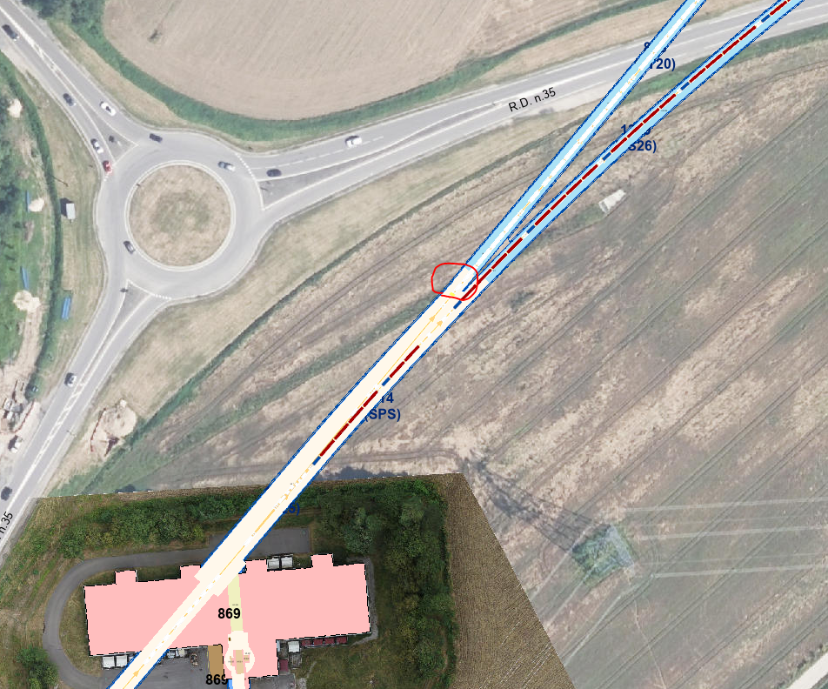
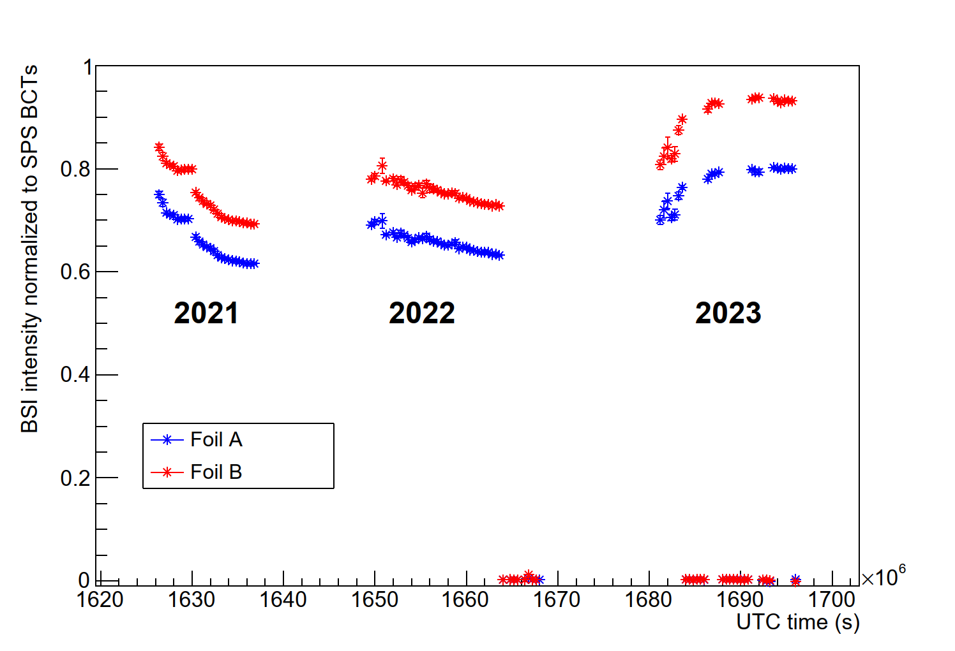
Monitor BSI.210279 (two foils)
Monitor had some issue over part of 2023
TT20
SPS ring
Monitor
BSI.210279

Slide 25
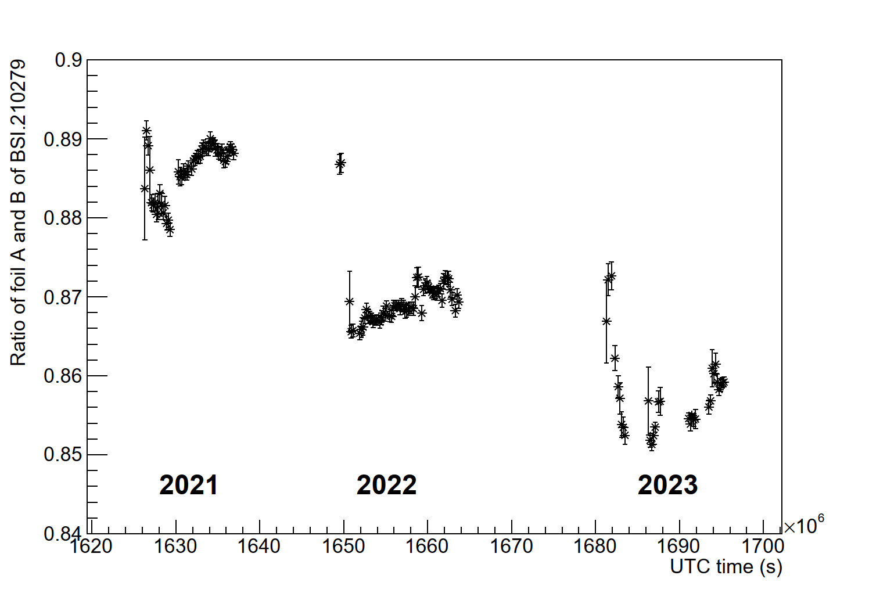
Monitor BSI.210279 (two foils)
Ratio of two foils in the same location

Slide 26
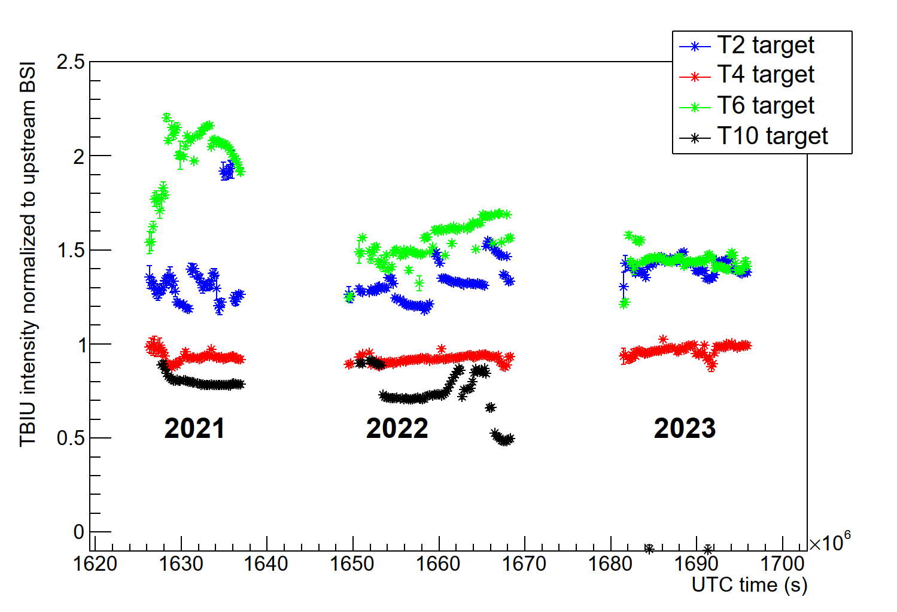
Comparison TBIU and upstream BSI – T2, T4, T6, T10
Use ratio (TBIU / upstream BSI) as an indicator of stability
  Indication of good calibration: value equal to 1
  Indication of stability: line is flat
Upstream monitor of T10 had some issue in 2023 (?)

Slide 27
Additional notes to the BSI monitors
Monitor 210216 signal not accessible: “Utilisé par Ewald (…)”
Monitor 210279 has two foils (referred to as A and B)
Two additional sets of monitor signals found in data (210272 and 210278) not listed in documentation that are four-foil test tanks (type BSTL)
Data taken from TIMBER
  Seems to be by and large equivalent to direct data from NXCALS
  Data available as giant “SEM-concentrator-TT20:intensity” signal or a subset as individual signals
    For some variables there is also a dedicated variable
    In some cases, these have different values and calibrations – not clear why
    Follow advice from F. Roncarolo: use SEM-concentrator values

Slide 28
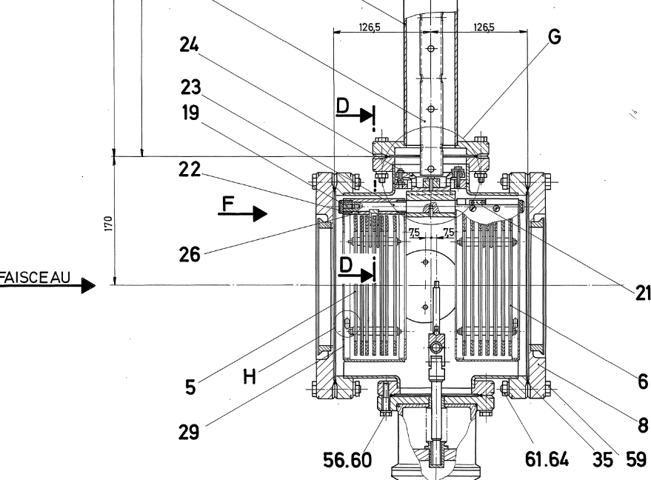
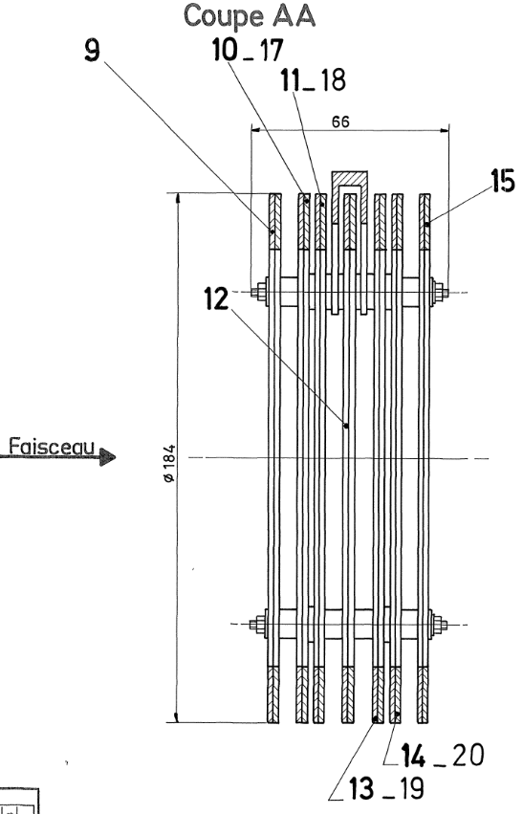
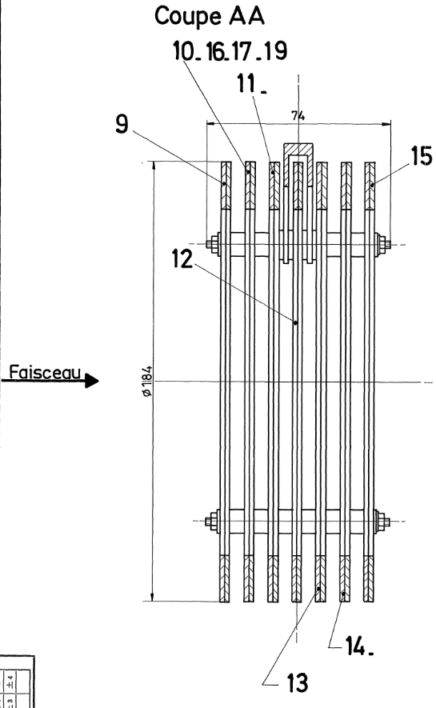
Layout of the TBIU
It was observed at the T10 target that the foils
get damaged
  Scales with size of beam – more protons per mm2
TBIU has two “heads”, A and B
  Beam steering (symmetry) happens on two BSPs
  Both of these are located in head A
  Assume beam is centered perfectly on those
  However, the BSI is located in head B
  Distance between the two is around 12.5cm
BSPs
BSI

Slide 29
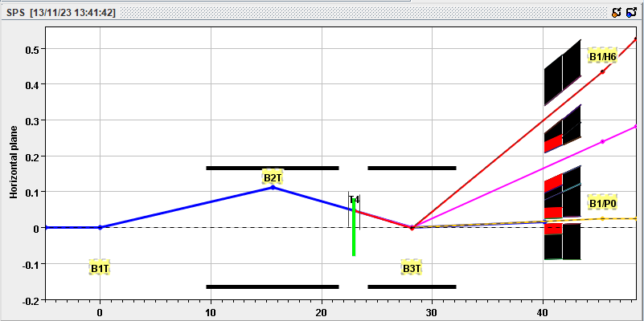
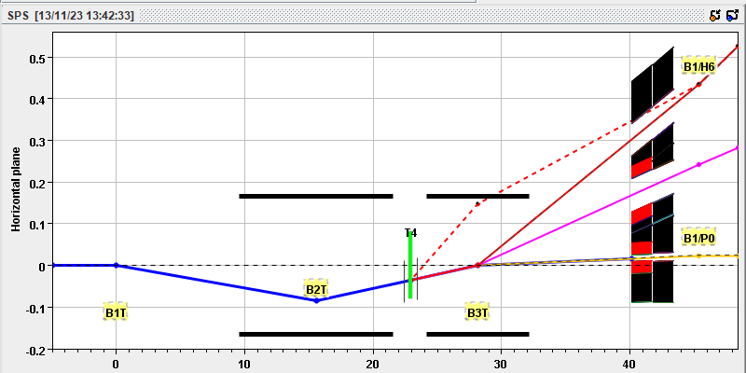
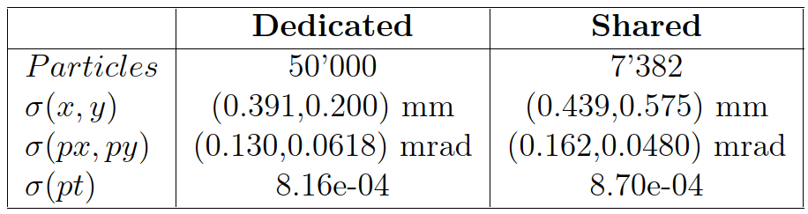
Movement of the beam
(example at T4)
T4 standard wobbling
Different wobbling settings give a different angle
on the target
  The TBIU and TBID stations move with the wobbling setting
  The beam is then steered using the BSP settings
  However, lever arm of 12.5cm means beam is displaced
  on the intensity monitor
  Total difference (for two calculated wobblings) is ~15.7 mrad
  Absolute displacement of almost 2mm
Combine with beam size at T4 target
  In short, beam moves five sigma between these two settings
H8 (-300), H6 (-120), P42 (+400)
Primary beam size T4 (G. Mazzola)

