Slide 1
Recurring Faults in the Injectors
Evolution over the Years and Plans
JAPW ’23, Montreux 5th – 7th of December 2023
R. Alemany Fernandez, T. Argyropoulos, A. Asko, F. Boattini, G.P. Di Giovanni, L. Felsberger,
J. Heron, A. Lasheen, K. Li, B. Mikulec, R. Scrivens, P. Skowronski, R. Wegner.

Slide 2
Introduction
Machine availability is the primordial KPI for the users in the injector complex:
  Direct correlation (almost causation) with users’ experience satisfaction.
  Is it the only one? Of course not.
    Machine performance is for instance an essential one. But more uptime allows for more optimization.
    Ongoing effort to track periods of degraded mode.
How to correctly evaluate machine availability?
  Establish common metrics.
  Capture information from equipment and operation.
End goals:
  Identify strengths and weakness in today’s machines.
  Identify areas to address for the future (resources allocation, CONSolidation, new projects).
The overall orchestration, including regular reviews of the data as well as the long-term strategies for the data exploitation
fall under the umbrella of the Reliability and Availability WG (https://indico.cern.ch/category/9071/).
  Good quality data are a crucial ingredient!

Slide 3
Data Capture
Accelerator Fault Tracking (AFT) inherited from the LHC since 2017 (outcome of Chamonix ’16).
More than 10k faults recorded and reviewed in 2023 (LHC included) → Automation necessary
  Significant effort done by OP in integrating the machines of the CERN complex.
  The data automatically/manually stored are first reviewed by the coordinators/supervisors of the week.
  Weekly fault reviews throughout the year, driven by Lukas/Jack.
AFR operational
East Area
AFR in development
ISOLDE
AD
ELENA
Linac4
PSB
AFR possible long-term
PS
N_TOF
North Area
LINAC3
LEIR
AFR new development
CLEAR
Awake
SPS
AFR passive
HiRadMat
No AFT
LHC

Slide 4
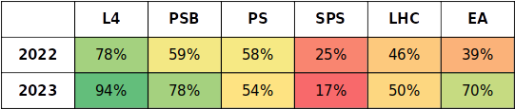
Support
Accelerator Fault Tracking (AFT) inherited from the LHC since 2017 (outcome of Chamonix ’16).
More than 10k faults recorded and reviewed in 2023 (LHC included) → Automation necessary
  Significant effort done by OP in integrating the machines of the CERN complex.
  The data automatically/manually stored are first reviewed by the coordinators/supervisors of the week.
  Weekly fault reviews throughout the year, driven by Lukas/Jack.
A major goal for this year was to raise expert review rate and participation by increasing:
  Experts’ awareness and notification mechanisms on fault existence.
  Clarify responsibility throughout the systems in the accelerator complex
  Make UI/UX better for the experts.
  Great effort from Anti/Lukas
User Training and Onboarding:
Multiple demos have been given to different expert groups

Slide 5
Culture
Accelerator Fault Tracking (AFT) inherited from the LHC since 2017 (outcome of Chamonix ’16).
More than 10k faults recorded and reviewed in 2023 (LHC included) → Automation necessary
  Significant effort done by OP in integrating the machines of the CERN complex.
  The data automatically/manually stored are first reviewed by the coordinators/supervisors of the week.
  Weekly fault reviews throughout the year, driven by Lukas/Jack.
A major goal for this year was to raise expert review rate and participation by increasing:
  Experts’ awareness and notification mechanisms on fault existence.
  Clarify responsibility throughout the systems in the accelerator complex
  Make UI/UX better for the experts.
Cultural shift:
  AFT is not a blaming machine.
  Industrial approach necessary when looking at the data both for equipment groups and management:
    Could resources be diverted to teams to address short-medium term issues which have a quantified impact?

Slide 6
2023 in a Glance
Slide presented by Rende
at the OP group meeting
in Dec. 2023
Facility | Destination | ‘21/‘22 Overall [%] | Achieved 2023 |  | Period
Facility | Destination |  | Overall [%] | Per destination [%] | Period
LINAC4 | PSB | 96.7/97.1 | 98.0 | 98.0 | 03.03.2023 – 12.11.2023
PSB | PS | 94.4/95.1 | 96.1 | 96.4 | 10.03.2023 – 12.11.2023
 | ISOLDE |  |  | 96.6 | 17.03.2023 – 30.10.2023
PS | SPS | 88.6/88.7 | 91.6 | 92.7 | 17.03.2023 – 30.10.2023
 | East Area |  |  | 93.5 | 27.03.2023 – 01.11.2023
 | nTOF |  |  | 92.8 | 03.04.2023 – 30.10.2023
 | AD |  |  | 93.9 | 12.06.2023* – 12.11.2023
ELENA | AD-Hall |  | 90.4 | 90.4 | 12.06.2023* – 12.11.2023
SPS | LHC | 74.5/73.3 | 86.4 | 94.8 | 27.03.2023 – 30.10.2023
 | North Area |  |  | 87.3 | 24.04.2023 – 30.10.2023
 | AWAKE |  |  | 98.4 | 01.05.2023 – 22.10.2023
 | HiRadMat |  |  | 99.0 | 22.05.2023 – 27.08.2023
Cumulative availability
In the injectors overall
very good availability
Better than in previous years
Overall includes the whole period and all other beams such as MD etc.
You are doing GREAT!
*Revised AD start date following quadrupole water leak

Slide 7

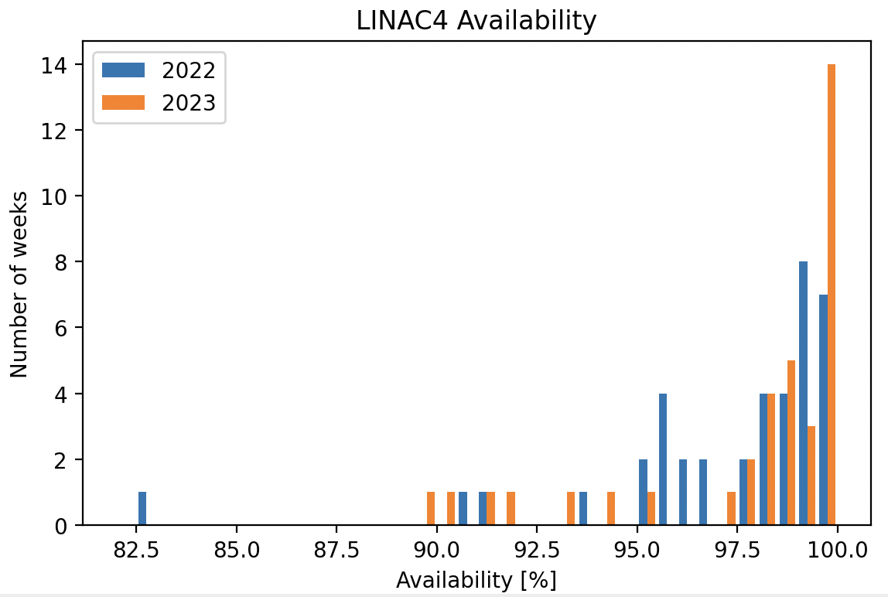
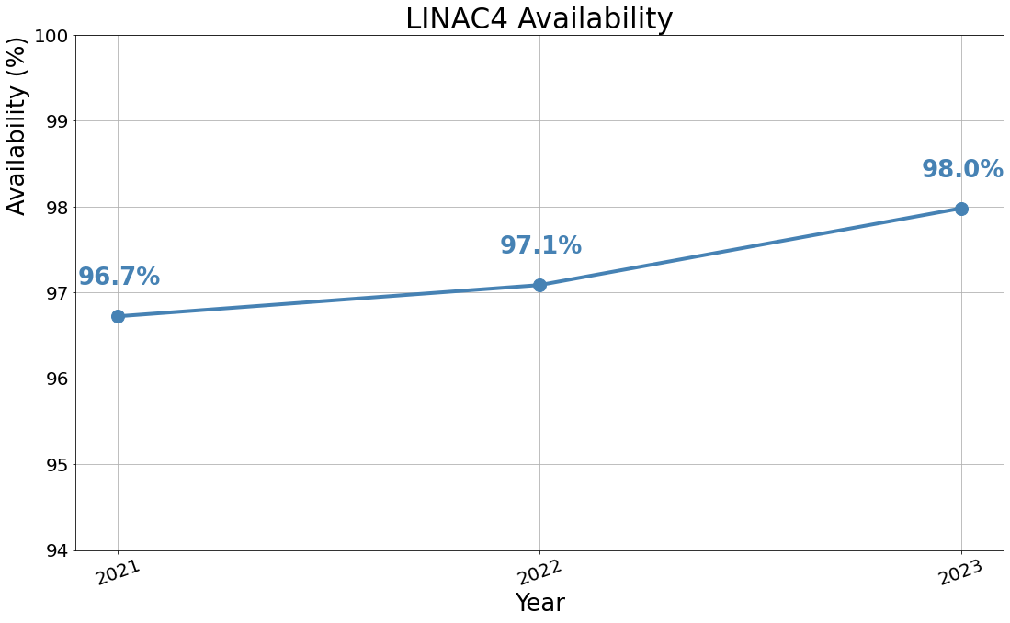


Linac4 in a Nutshell
  Excellent performance, availability increasing over time.
    Experts continue solving issues which repeatedly cause downtime at the source, when possible.
  Machine is still relatively new, and we (still) do not see many aging effects:
    Reduced the number of faults, in particular the major ones, i.e., longer than 2h.
    Excellent support and collaboration within the groups.
    Increasing (and keeping the) experience also plays a role.

Slide 8
Linac4
RF is the main (>70% of the) equipment, and by far the most challenging system,
so it must be the main downtime contributor:
  Still an impressive availability of 98.8%!
Modulators are power supplies that deliver above 100 kV voltage for klystrons.
De facto, they are integral part of RF powering system:
  They interlock with fast abort if RF lines stop.
  They suffer from any high voltage sparking in the modulator-klystron systems.
  Therefore, it is not a surprise that they are the 2nd contributor to the downtime.
Implemented several improvements throughout the years. Only in 2022:
  Contained sparking in modulator-klystron interface.
    Minimized modulator voltages and layout modifications.
  Extended cavity break down protection across LINAC4.
  Chopper trips from 2022 addressed:
    PLC FW & interlock logic update.
    Chopper dump alignment line and better steering in MEBT.
  DTL1 klystron exchanged in EYETS22/23.
  Source valve validation in test stand and modification the gas injection system for a faster valve exchange.

Slide 9
Linac4
Date | Equipment | Downtime
Mar 15 | PIMS1112 | 9 hours
Apr 15 | PIMS0102 | 8 hours
Apr 28 | Source | 5 hours
Jun 27 | Multiple | 7 hours
Jun 1 | CCDTL1 | 4.5 hours
Jun 12 | CCDTL1 | 13.5 hours
Oct 17 | CCDTL7 | 10.5 hours
Nov 2 | Pre-chopper | 4.5 hours
2x burned connector on focus circuit:
  Other connectors were verified during iTS.
  Consolidation during YETS.
Hydrogen valve in the source.
Aftermath of LEIR 18 kV circuit breaker fault.
Card measuring filament current (interlock).
Water pressure sensor (interlock).
Card measuring focus current (interlock)
+ difficulties in the system restart.
Sensor checking socket connection (interlock).
4 out of 7 are related to faulty sensors interlocking the machine (being followed-up by experts)

Slide 10
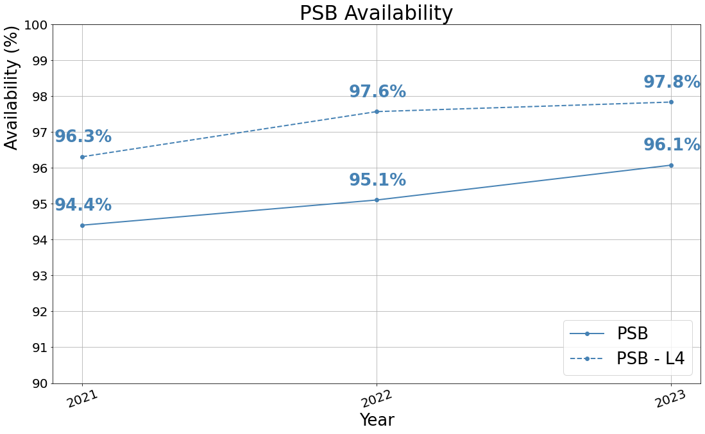
PSB in a Nutshell
PSB only availability is comparable to Linac4 (~98% in 2023!).
  Even more impressive counting that PSB extracted the same # of protons in 2022 with ~20% less days.
PSB is a mix of new (LIU) and LEGACY equipment.
Some of the equipment is still > 50y, e.g. the main magnets, …
Excluding the single event in 2022 of a vacuum leak caused by an arc in a RF bypass in 16L1 R2 (intensity push) the pattern of downtime is generally the same:
Linac4.
Magnets issues (mainly water leaks).
BI.BSW water leaks and equipment replacement.
Power converters (every POPS-B trip takes at least 20 mins to recover from).
Electo-valve failures in recombination septa/losses on extraction septa.

Slide 11
PSB in a Nutshell
PSB only availability is comparable to Linac4 (~98% in 2023!).
  Even more impressive counting that PSB extracted the same # of protons in 2022 with ~20% less days.
PSB is a mix of new (LIU) and LEGACY equipment.
Some of the equipment is still > 50y, e.g. the main magnets, …
Excluding the single event in 2022 of a vacuum leak caused by an arc in a RF bypass in 16L1 R2 (intensity push) the pattern of downtime is generally the same:
Linac4.
Magnets issues (mainly water leaks).
BI.BSW water leaks and equipment replacement.
Power converters (every POPS-B trip takes at least 20 mins to recover from).
Electo-valve failures in recombination septa/losses on extraction septa.

Slide 12
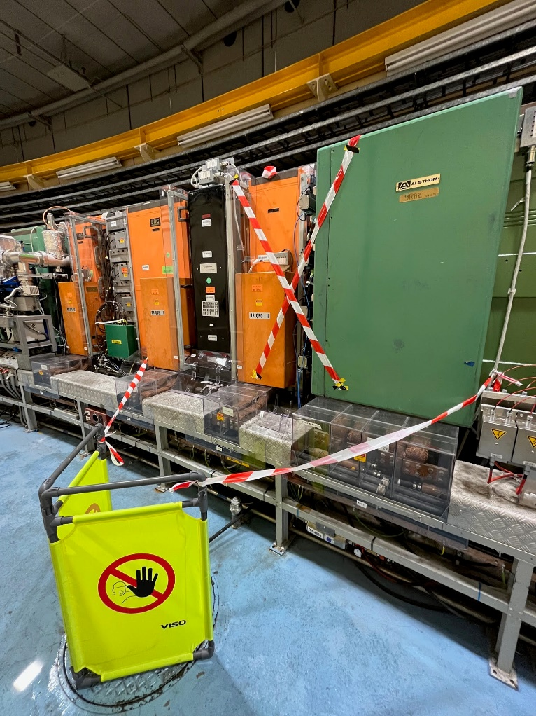
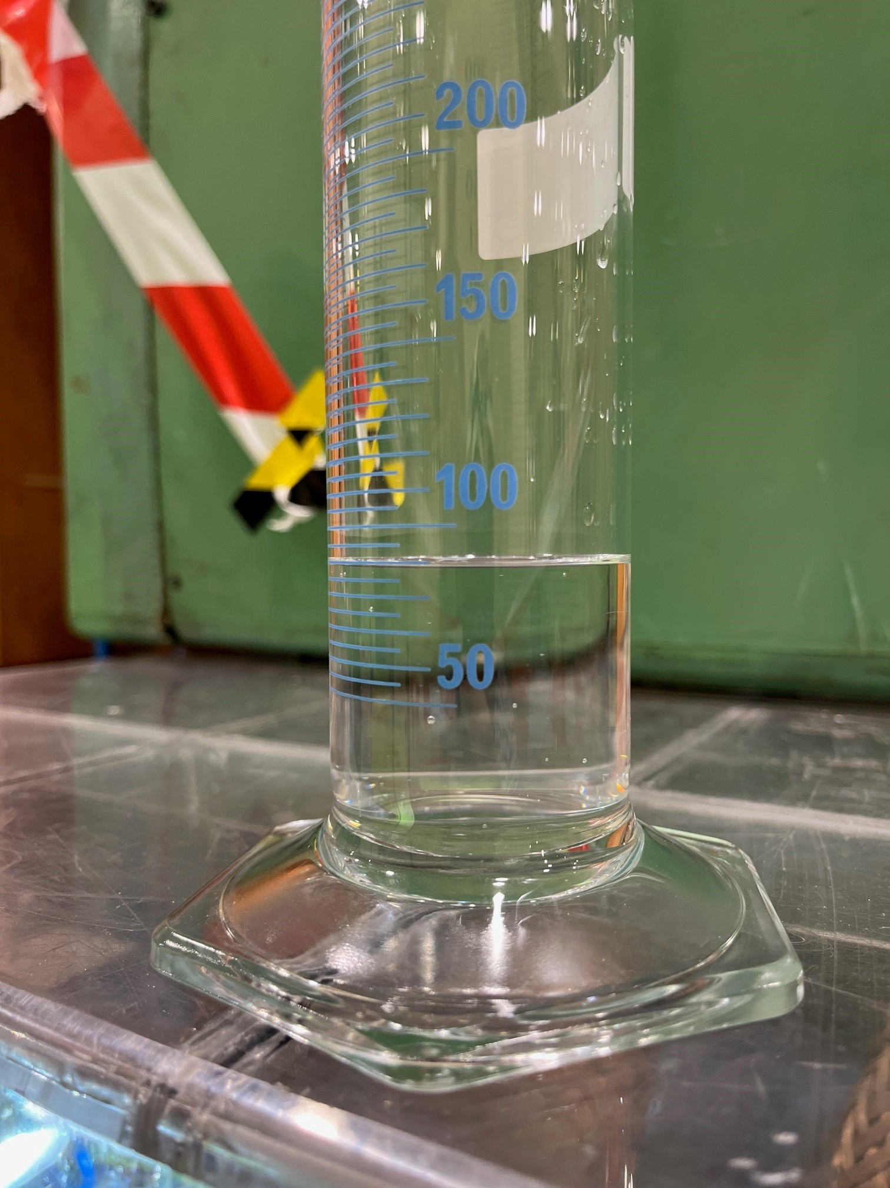
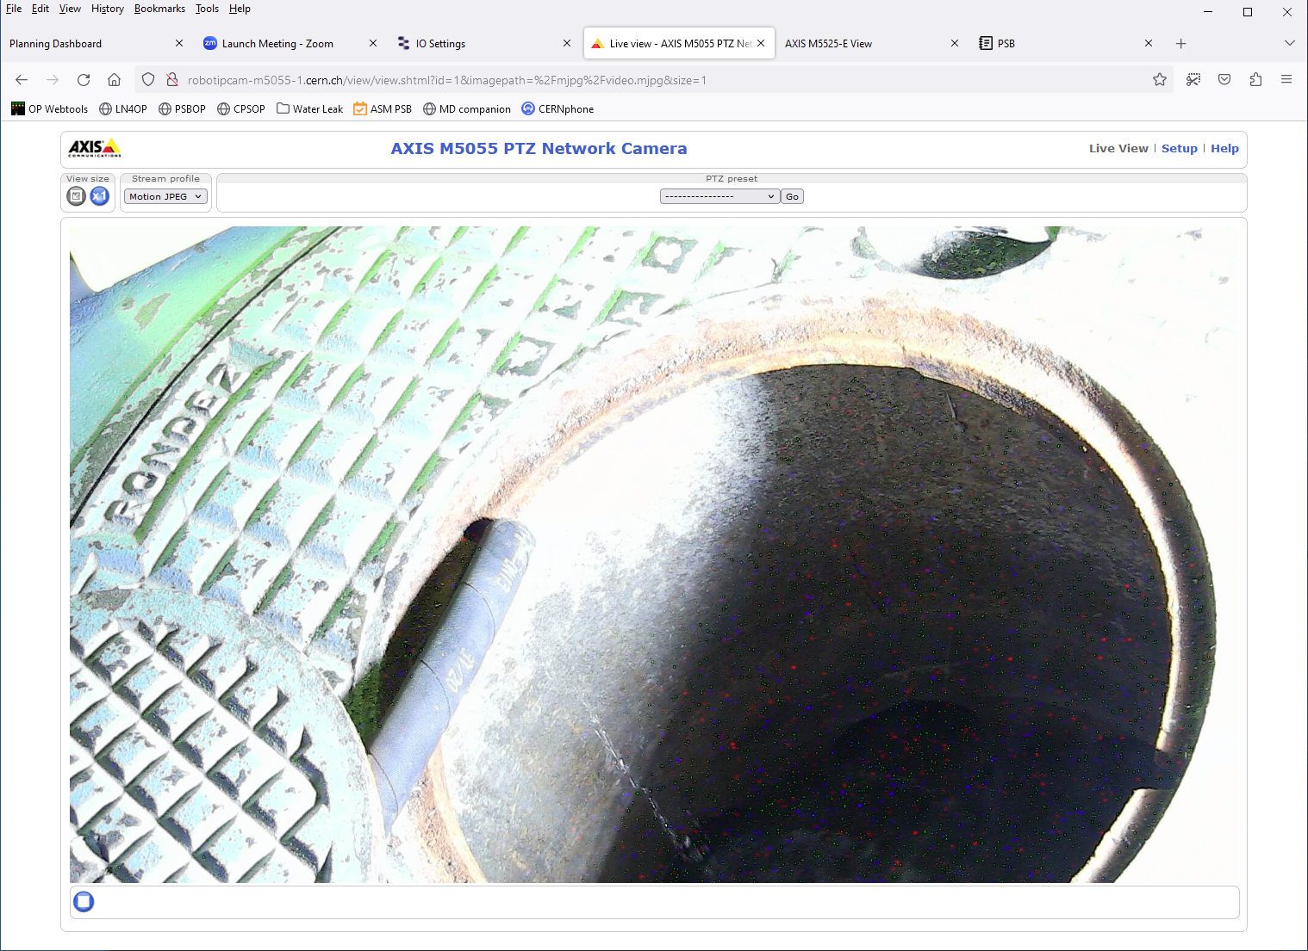
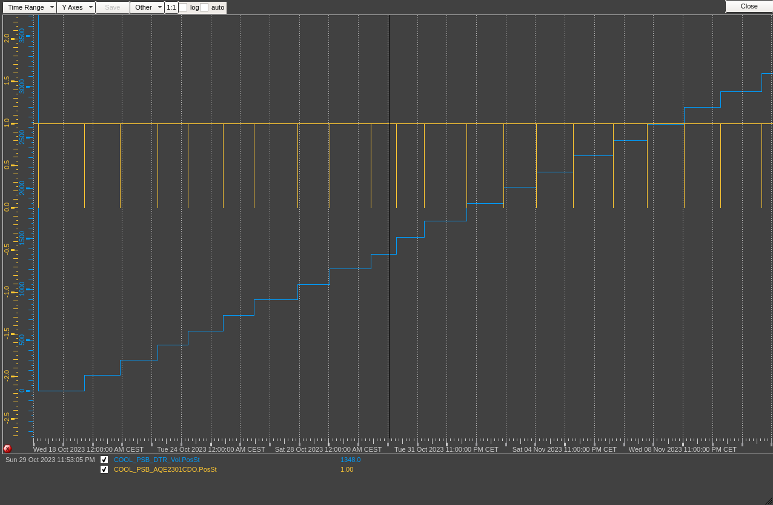
PSB Main Magnets
Water leaks in the PSB main magnets:
  2 leaks in 2021, 3 leaks in 2022, 1 (and so far, only 1!) in 2023.
  This is legacy equipment (1972) and expected to pulse +200M times by 2040.
  A task force built to investigate and mitigate the issue, see here
  Source of the leaks due to galvanic corrosion which attacks the brazed joints.
  In the short-term future, we could experience more leaks. Options are:
    Patching the magnet in situ and regularly monitor.
    Replacing the leaking magnet.
  Q: In the future could we early detect leaks without access?
  BR.QFO11 fencing, regular measurements, remote monitoring (cameras).
  PSB water refills monitoring (EN-CV).

Slide 13
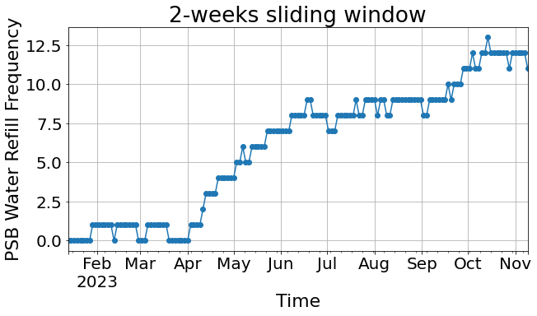
PSB Main Magnets
Water leaks in the PSB main magnets:
  2 leaks in 2021, 3 leaks in 2022, 1 (and so far, only 1!) in 2023.
  This is legacy equipment (1972) and expected to pulse +200M times by 2040.
  A task force built to investigate and mitigate the issue, see here
  Source of the leaks due to galvanic corrosion which attacks the brazed joints.
  In the short-term future, we could experience more leaks. Options are:
    Patching the magnet in situ and regularly monitor.
    Replacing the leaking magnet.
  Data indicates that in 2023 lucky to spot the leak during a shadow
  access and the MSC team creative to patch it in situ.
  It could have been a showstopper.
  BR.QFO11 fencing, regular measurements, remote monitoring (cameras).
85 ml/min
70 ml/min
60 ml/min
50 ml/min
Leak
discovered
90 ml/min
40 ml/min

Slide 14
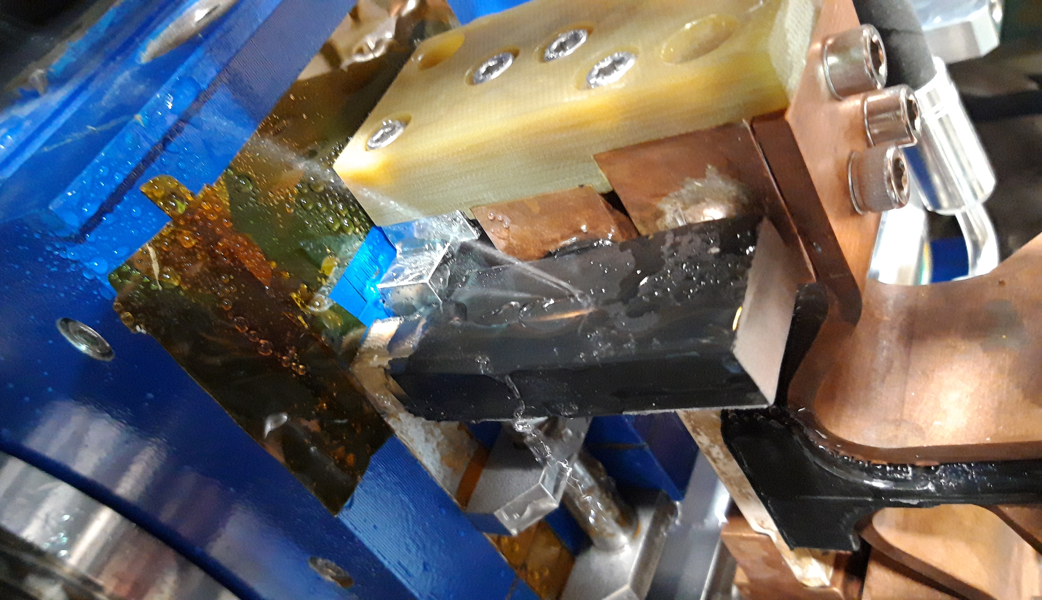
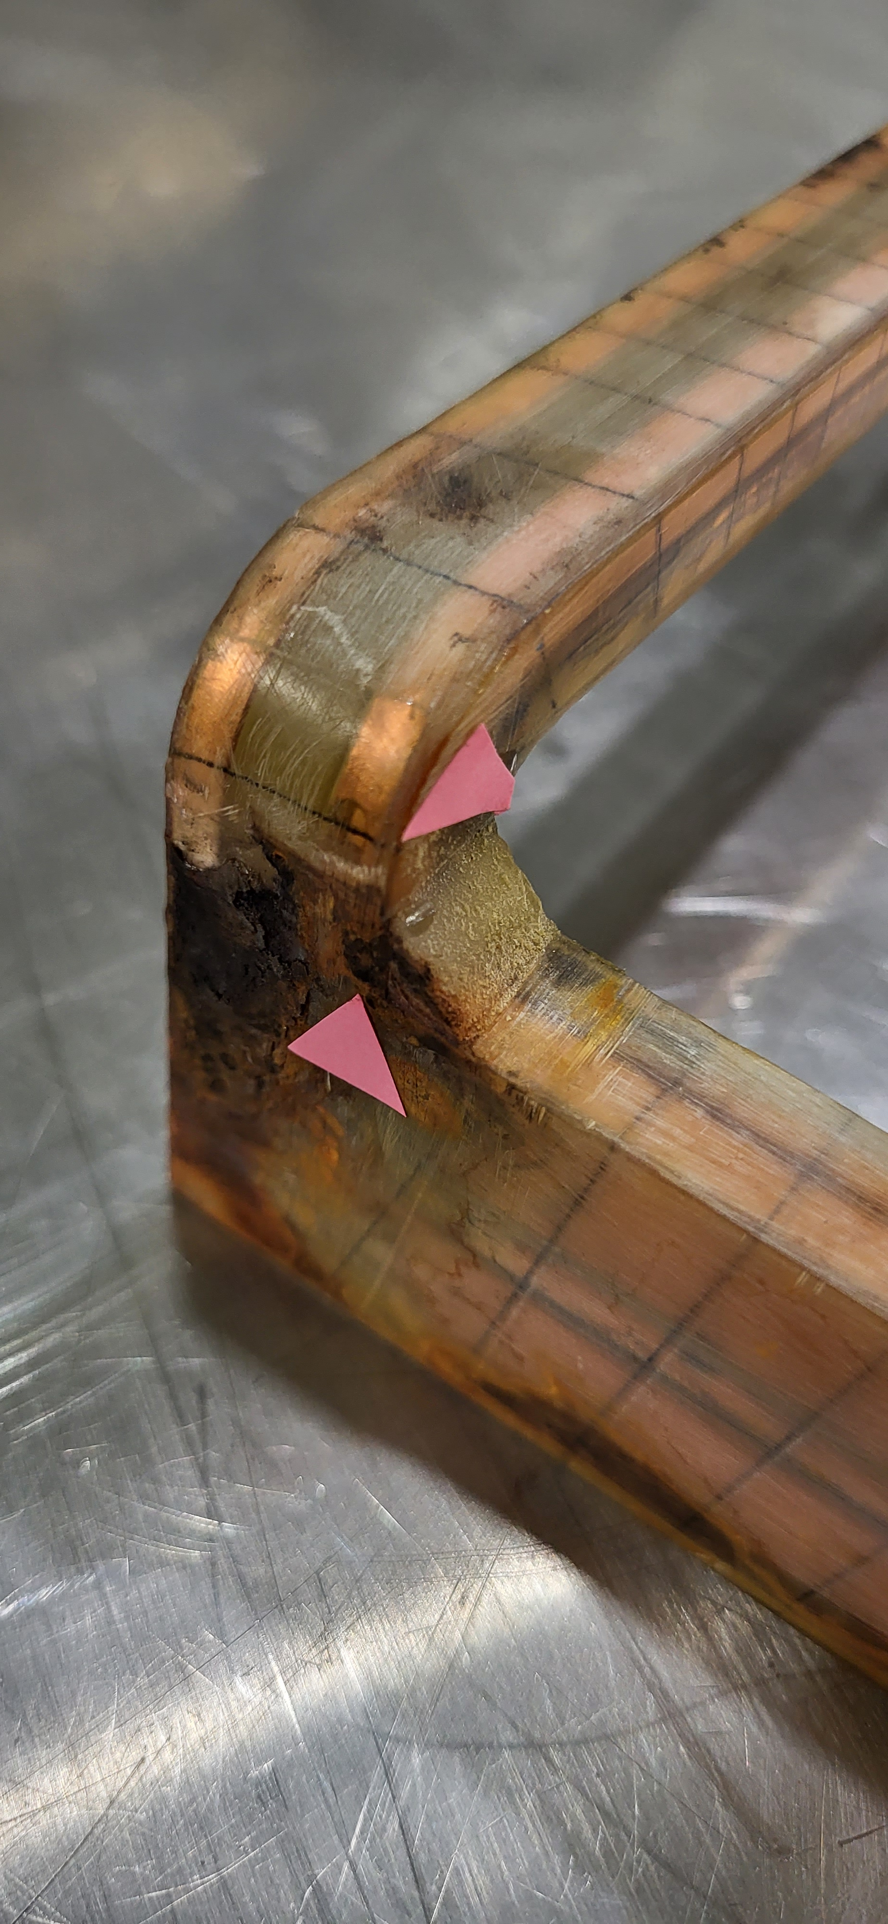
PSB BI.BSW
09-2020
BI.BSW coil failure, 7 since 2020 (16 bumpers in injection, 4 per ring).
This is LIU equipment, so brand new.
Account of the history and mitigation measures (reinforced coils) presented at IEFC
Coil reinforced and upgraded, still leak this year on BI1.BSW1L1.4 was latest failure was on the upgraded braze,
but too early to draw conclusions.
Downtime breakdown in 2023:
  First issue identified on BI1.BSW1L1.4 during iTS1. Replacement during iTS (30h) so additional 4h30m without beam and ~10h in degraded mode (no R1).
  Second event on the same BI1.BSW1L1.4 on 14th of August → 11h for the intervention. Beam to beam in all rings.
  After that 5 access, once every 2 weeks to monitor for a total of ~4h30m downtime.
Mitigate mechanical stresses: ongoing study (IEFC endorsed) to review the interlock strategy.
BI3.BSW1L1.1
06-2023
BI1.BSW1L1.4

Slide 15
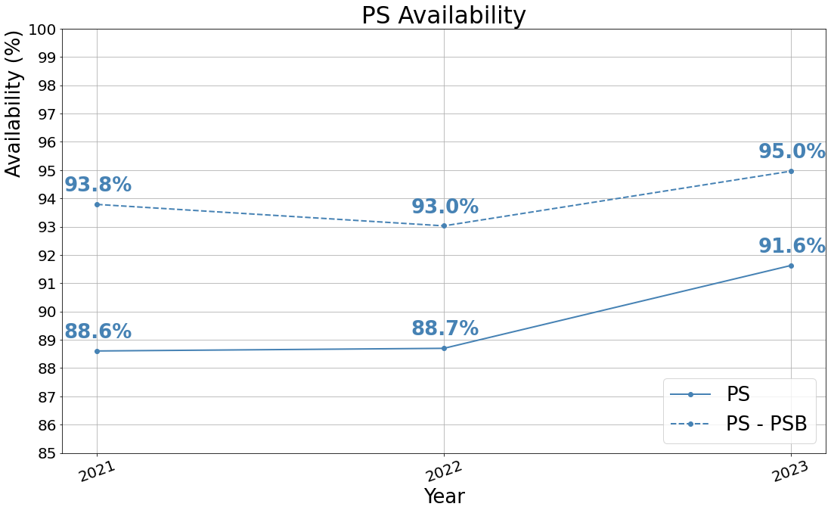
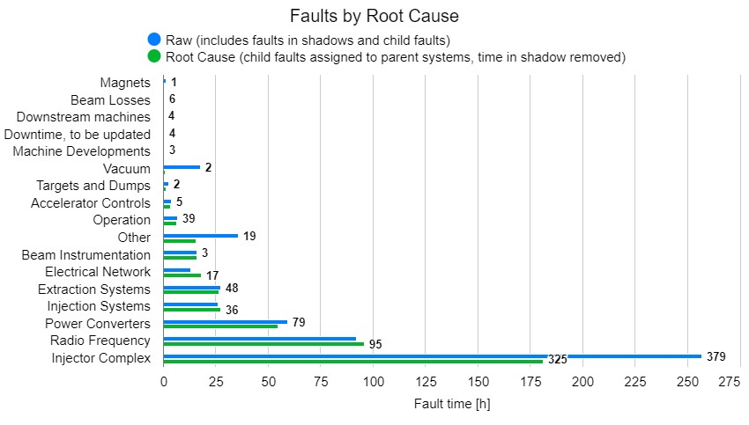
PS in a Nutshell
Destination availability in 2023 between ~92% (SPS) - 94% (AD).
Clear improvement since LS2.
Availability above pre-LS2 value (90.7% in 2018).
Mostly standard maintenance in YETS23/24:
  No high expectations to improve availability in 2024.
Several improvements planned for LS3 (POPS+, HL+LLRF, PCs…).
2023
Besides injector faults, longest root downtime due to:
  Radio-frequency.
  Power converters.
  Injection/extraction systems.
In the following slides we will analyse the trend in reverse order.

Slide 16
PS – Injection/Extraction Systems
Longest fault duration moved from 2d in 2021 (SMH57 condensation on cables, replacement affecting EA) to ~7h30m in 2023 for ion injection kicker KFA28 burnt transformer (and power outage following smoke formation in B362).
The year 2023 was a difficult one for extraction kicker KFA71/79, which does not really show up in AFT.
  Recurrently, missing pulses leading to radiation alarms (beam lost at FT), but quick resets.
  Staggered consolidation of 3 generators every YETS.
  Lessons learnt in 2023 to improve reliability in 2024.
A few faults on KFA13 affecting SPS NA (MTE).

Slide 17
PS – POPS
Increase of “Power Converters faults“ in 2022 due to
POPS communication issues between FGC and main controller:
  Massive effort throughout the year and EPC piquet solicited
  Issue understood at the end of October: the replacement of crate power supplies to 3 independent power supplies made the ripple disappear.
  Benefit of the modification visible in 2023.
Worth mentionining that a few POPS trip in 2023 were due to new demanding cycles: TOF double-extraction, special low-energy cycles, degaussing of pole-face windings etc.
Feedback from operational years to be used for POPS+ (LS3), i.e. improved diagnostics, etc, etc
Improve HW reliability with additional AD/DC and DC/DC converters (one per type).
Notes:
Put image on the burnt kicker?

Slide 18
PS – RF Systems
Percentage of RF faults seems increasing over time:
  Carefully monitored by the RF team, see here
  RF is working on better classification to more effectively identify
  which part of the systems to focus on.
  Some faults affect beam quality, so are not automatically recorded.
PS is CERN’s most complex/flexible accelerator in the RF domain!
Much of the RF system has been upgraded since LS1:
  Steady but gradual move to a fully digital LLRF system.
  Digital beam control upgrade under preparation, MDs in 2024.
  From 2024 all cavity controllers will be digital (except 200 MHz).
  HLRF upgrades to improve direct feedback and remote control/monitoring.
  More to come in LS3: Tuning PSUs, driver amps, LLRF…

Slide 19
PS – RF Systems
Over 2000 faults in 2023 on 10 MHz system:
  Gap relay. Short reset or switch to spare if available.
  Ring access for 9 gap relays and 8 amplifiers replacements.
  RF tubes of the 10 MHz driver amplifiers obsolete and not on the market
  anymore. Renovation needed in LS3 (CONS). Prototype tests in 2024.
  10 MHz power converters:
    Old, CONSolidation by SY-EPC prepared for LS3.
  Tuning power converter for the 10 MHz cavities:
    Old, CONSolidation by SY-EPC prepared for LS3.
Over 1000 faults in 2023 on 40/80 MHz systems:
  Easily resettable. Mostly affecting beam quality and can remain unnoticed.
  EPC fixed issue with PC but should be CONSolidated.
Longest downtime:
  Non-conforming (prototype design) bypass in SS03 caused 16h of downtime. Fixed for 2024 and no bypass of this type left in the machine.
In 2023 intermittent issues on the H16 barrier bucket prototype controller causing the controller to crash and not distributing the rev. Frequency:
  FESA class modification in August fixed the issue.
Large # of interlock signals per year
but few are equipment disorders
Notes:
Put image on the burnt kicker?

Slide 20
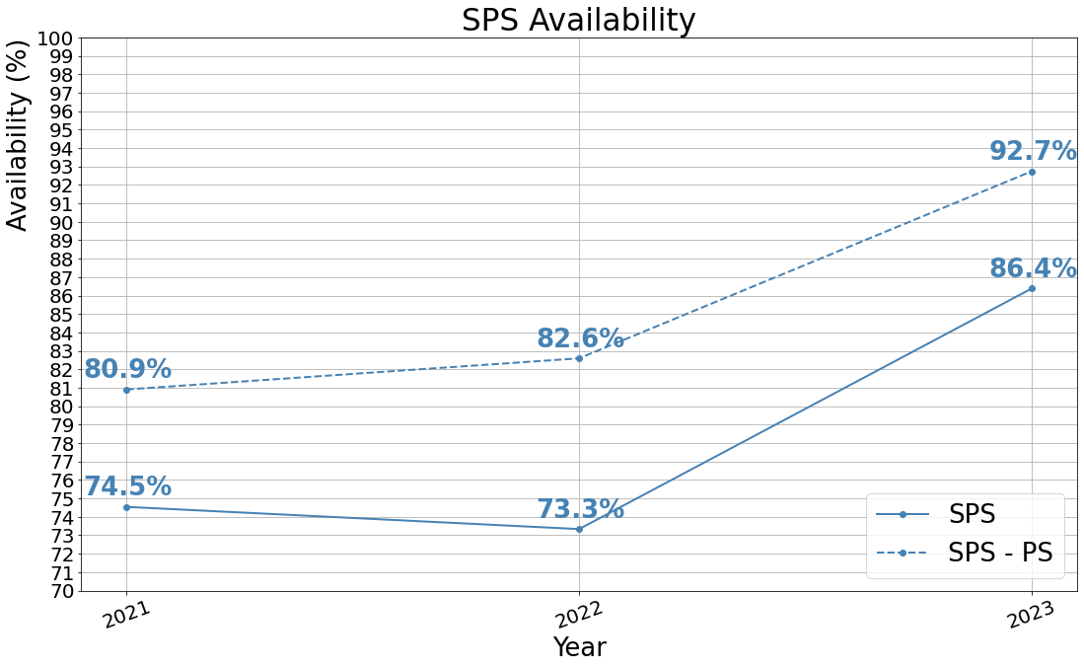
SPS in a Nutshell
Context:
  2021, a commissioning year.
  2022, running at the highest intensities (SPS NA).
  2023, post-commissioning and running at standard intensities.
+ Positive trend over the years
  Faults maximum downtime moved from mulitple days in 2021/2022 to max 1d in 2023
  (excluding the MSN.X0220031 as it is EA).
- The SPS remains an RP challenging environment:
  Equipment interventions require long RP cool-down time and careful planning (ALARA).
Do not expect major improvements for 2024.
  Availability should improve with the NA CONS,
  but not in the immediate future.

Slide 21


SPS in 2021
Several single event upset (SEU) like events.
A couple of vacuum system issues due to corrosion.
Dump kicker MKDV1: weak high voltage behaviour due to broken insulating ceramic spacer.
Arcing in transmission lines for RF cavities.
And design issues for access system crates (radiation):
  Mitigated in 2022 adding a shielding in front.
All these issues have been addressed and
did not recur in the following years.
Notes:
NA CONS > get from Nikos >

Slide 22
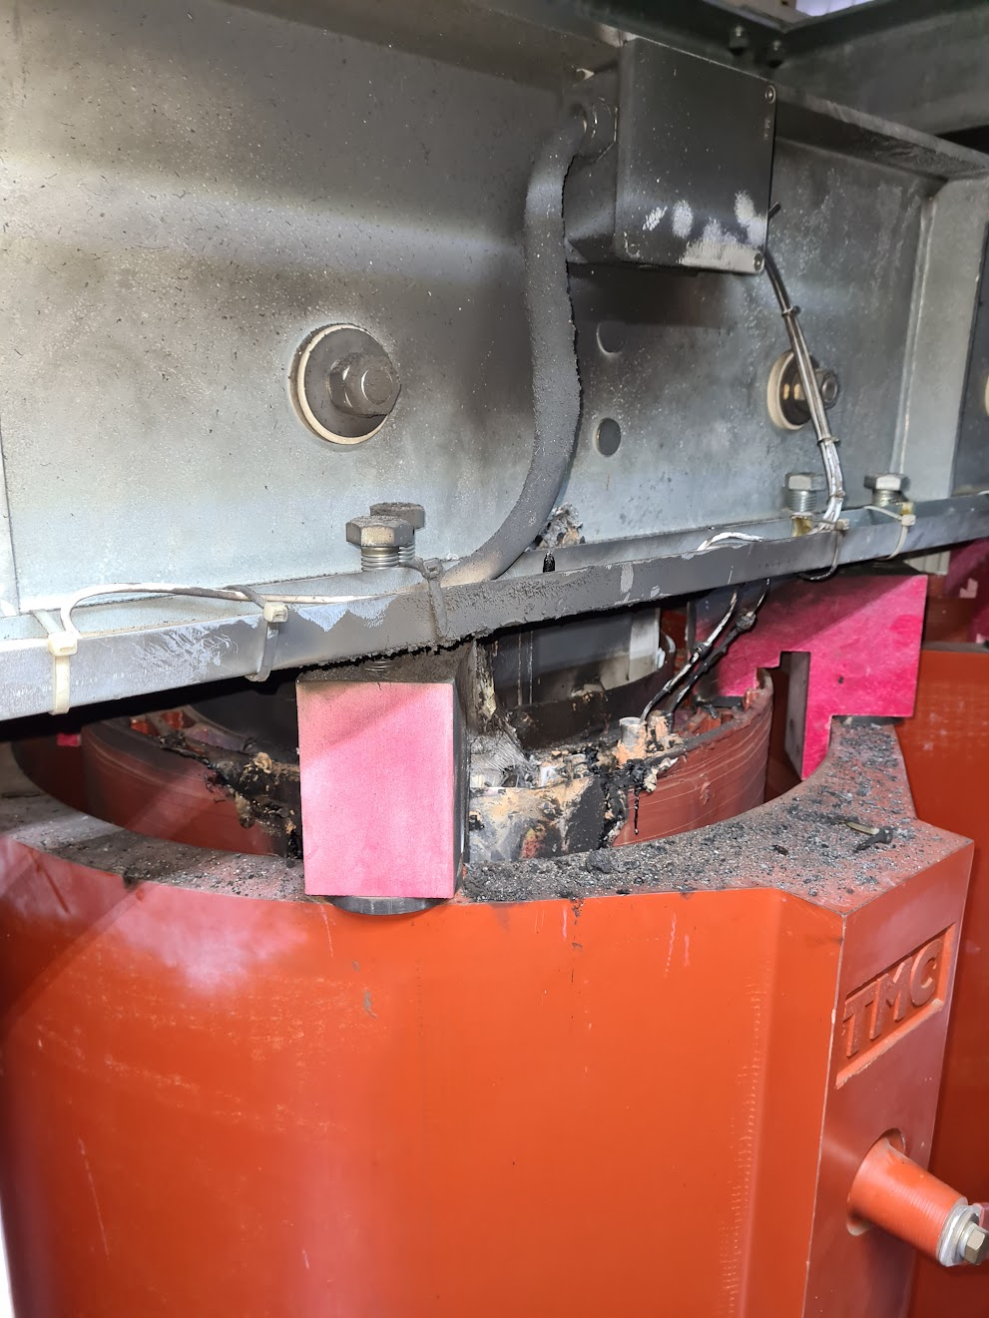
SMD Transformers
In February 2021, LV insulation failure on a BA2 transformer.
  It happened during HWC, so not registered as downtime.
LV winding
HV winding
Damaged area RMT123-1/A2 (BA2)
Notes:
NA CONS > get from Nikos >

Slide 23
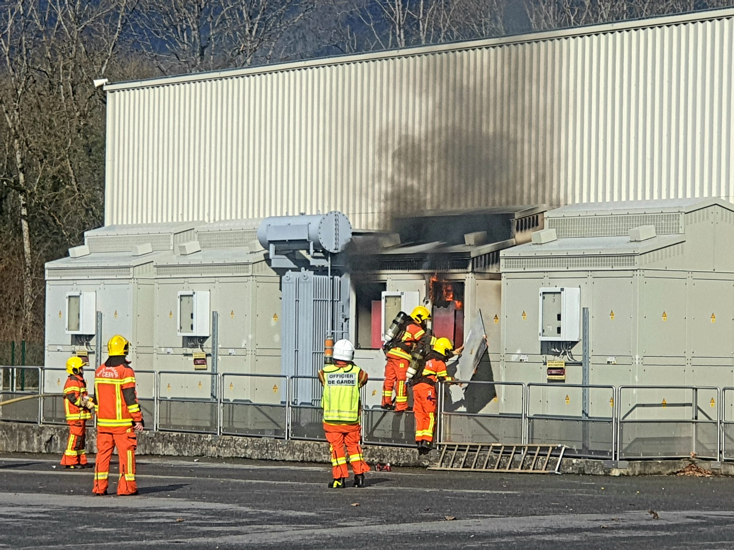

SMD Transformers
In February 2021, LV insulation failure on a BA2 transformer.
  It happened during HWC, so not registered as downtime.
In March 2023 a second failure of another BA2 transformer.
  This time causing a fire.
  It happened during HWC, so not registered as downtime.
RMT123-3/A2 – BA2
Notes:
NA CONS > get from Nikos >

Slide 24
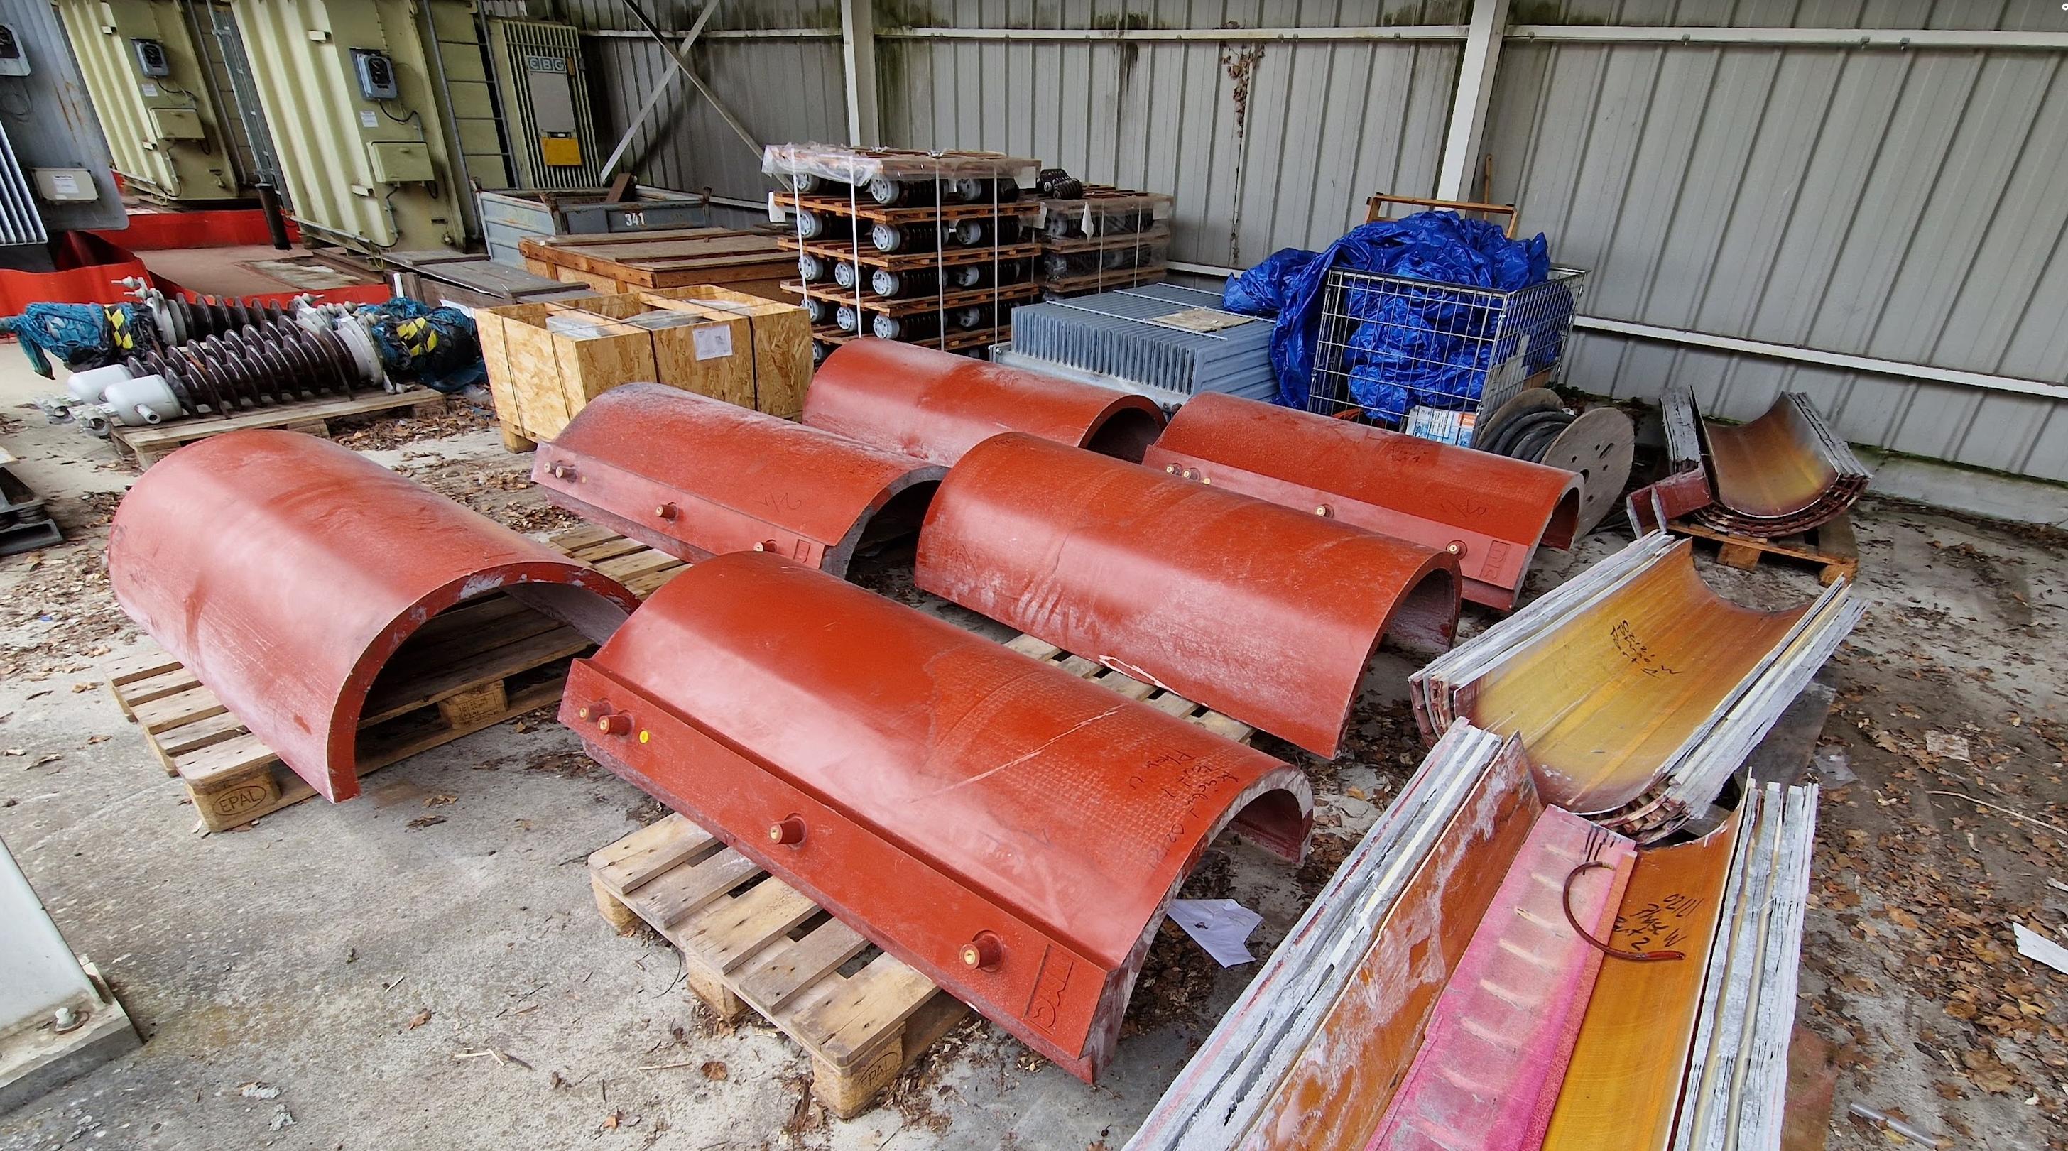
SMD Transformers
In February 2021, LV insulation failure on a BA2 transformer.
  It happened during HWC, so not registered as downtime.
In March 2023 a second failure of another BA2 transformer.
  This time causing a fire.
  It happened during HWC, so not registered as downtime.
SY-EPC spent signifcant effort on analysing the faulty transformers:
  Comprehensive investigations have been done already, but no obvious cause stood out.
  The possibility of systematic failures cannot be excluded as of today.
  Strategy focuses on early detection, e.g. advanced temperature monitoring systems.
  Spare strategy in place to mitigate machine downtime:
    No fire risk for BA building → All cast resin transformers are Fire Class F1.
    Eased the access and procedure updated.
  Full report at the IEFC #335
Transformers cut and analysed.
Notes:
NA CONS > get from Nikos >

Slide 25
SPS in 2022
April: Water leak on TCSC. SPS NA beam stopped for ~9d
May: MBB22090 inter-turn short (~2d)
June: ZS ion trap bottom voltage fault (>5d integrated)
  High sparking rate for some weeks followed by further degradation.
  Device not able to keep the voltage on the ZS2 bottom anymore.
  • Long cool-down time and several accesses needed.
  • Finally, issue with the 4 cables of the ZS1 and ZS2 circuits
    Root cause not yet clear, high dose rates in-situ.
    Did not reoccur in 2023.
July: T2 TIBU vacuum leak (~6d):
  Wobbling magnet in T2 tripped, followed by TBIU pressure rise.
  Replaced (plug-&-play) + time for cooldown

Slide 26
SPS in 2023
Good availability. No systems or major faults
The faults assigned to operation are setting-up and are not strictly
speaking faults, as this time was scheduled:
  Is a less invasive integration of the SPS ions activities possible?
  (see K. Li’s talk)
Worth mentioning:
  September: MBB.43550 inter-turn shorts.
  October: MSN.X0220031 magnet on fire (inter-turn short).
  October: Fire alarm long which took time to reset.
    BIW returned false fire alarm in SPS Ring (BA5).
    Bypassed following risk assessment.
    Third-party piquet could not intervene during the night.
      Being followed up.

Slide 27
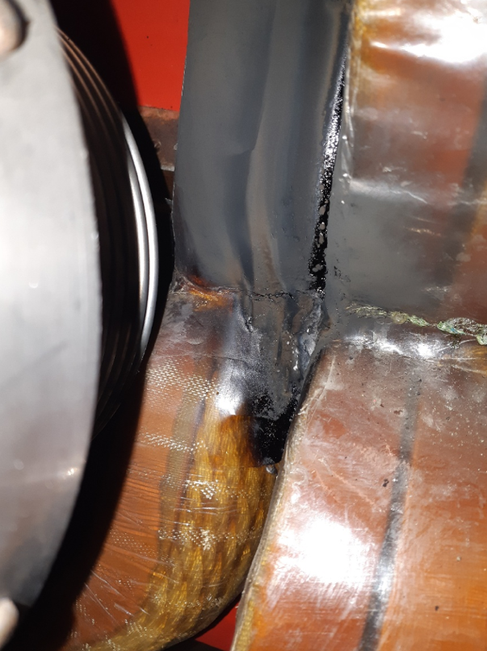
SPS Magnets Inter-Shorts
Increasing failure rate of SPS main bending coils. → Spare stock is being depleted.
  Statistics presented at IEFC #331 (and to be updated with 2 failures in 2023).
Concerns coils produced by Lintott on MBB (249/385 in the SPS).
Inter-turn shorts seem due to poor internal brazing quality.
Difficulty of finding industrial suppliers to produce small series of large coils.
Set-up of a larger coil production facility within TE-MSC:
  Dedicated space in B181.
  R&D activities are already ongoing.
  Main components are now under procurement.
  Prototyping should start in mid-2024.
  Budget and resources have been defined and secured.
  Possible future knowledge transfer to industry.

Slide 28
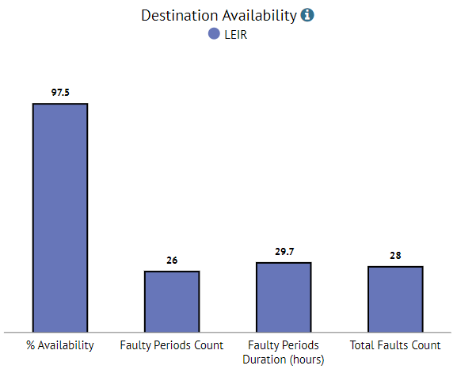
Linac3
The year 2021 was a commissioning year for Linac3 and LEIR.
The year 2022 included 2 weeks of physics run for SPS NA during which 2 days of LHC tests with Pb ions.
The year 2023 included ~5 weeks of LHC physics and 4 weeks of SPS NA + 2d extension for CHIMERA.
Outside of physics periods Linac3 (and LEIR) operation is only during daytime and is not followed up systematically with AFT:
  It makes sense to analyse the availability only during the physics runs.
2023
Global Availability in 2023: 97.5% (7 weeks)
A high availability:
  2018: 92.7% (5 week physics run).
  2022: 97.3% (2 week physics run).

Slide 29
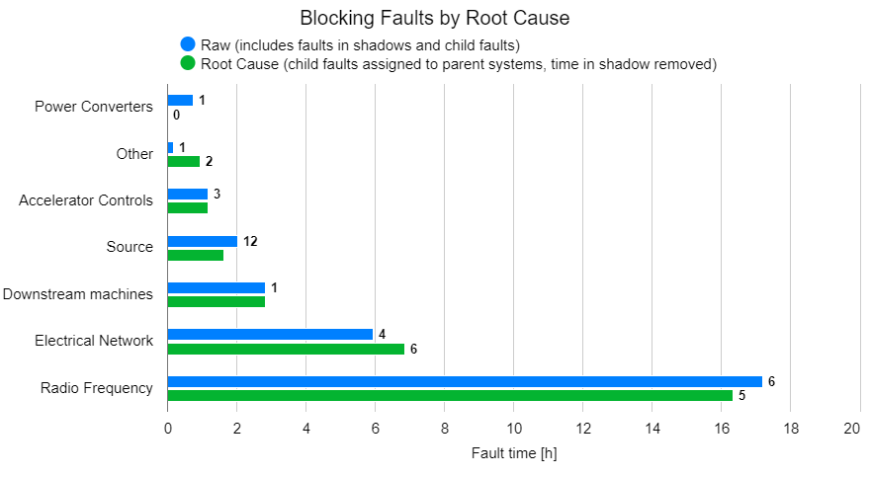
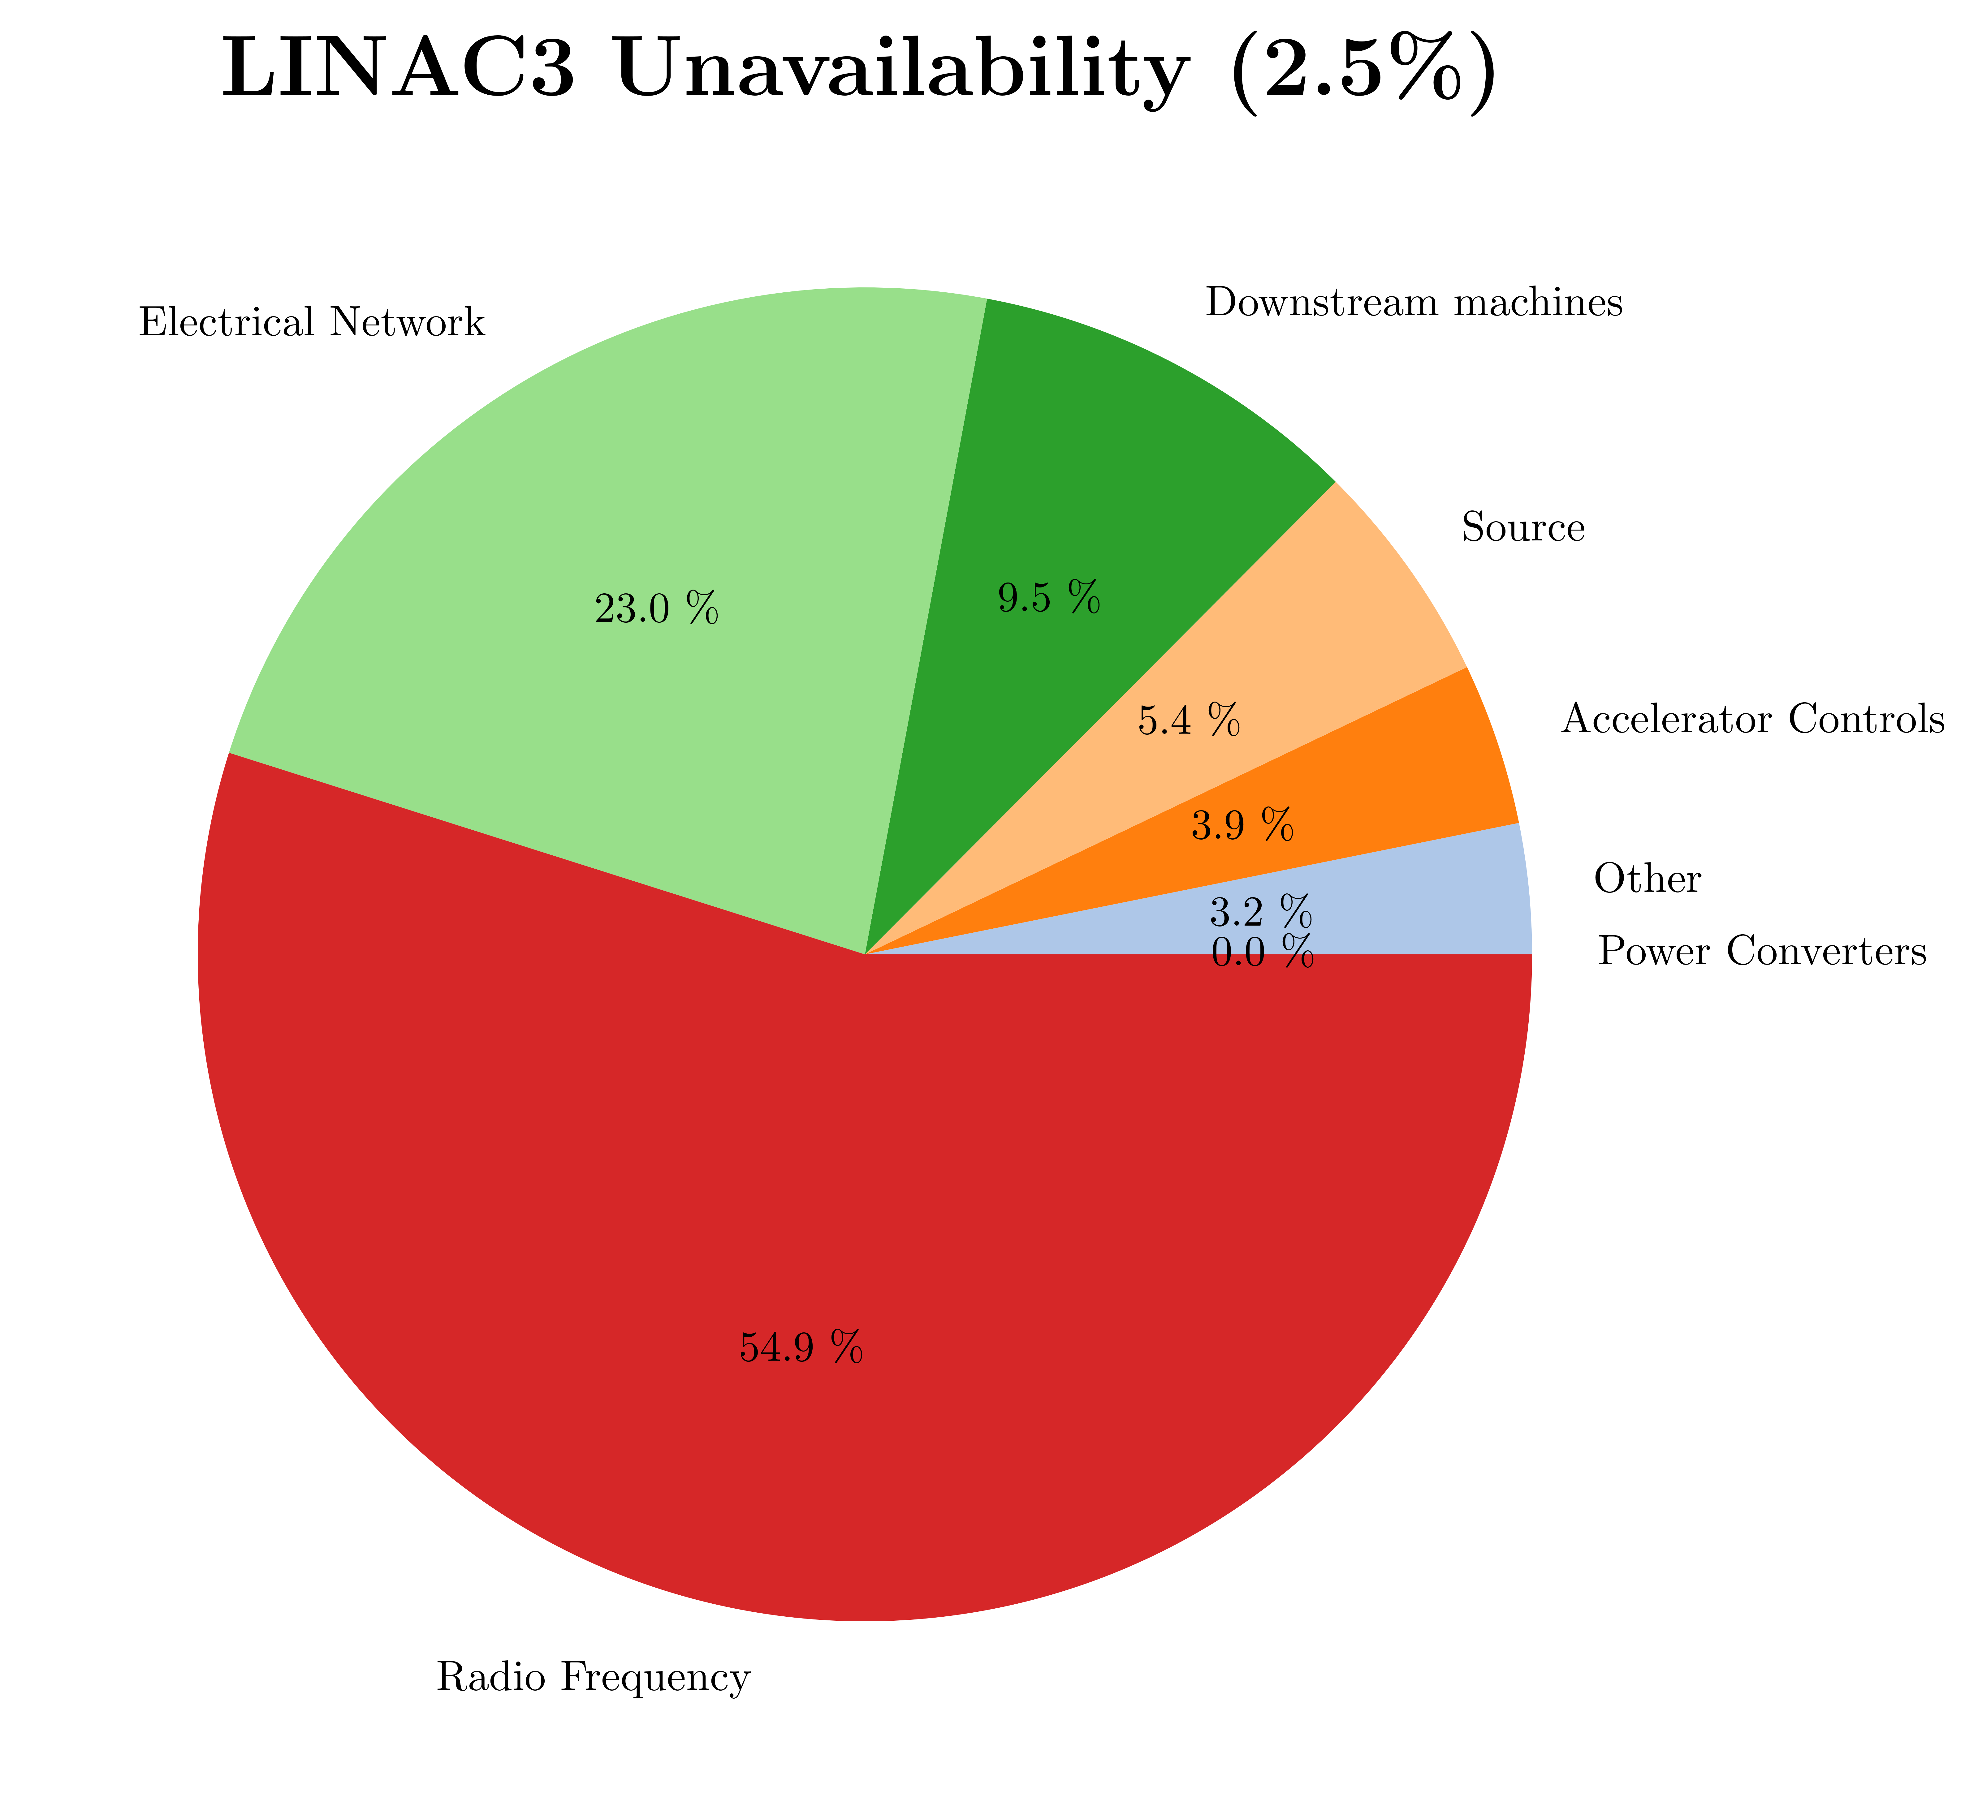
Linac3 in 2023
No equipment displayed faults demonstrating long term issues.
Most of RF downtime caused by issues with sequencing/interlock:
  Learning from experience → Expected modifications during EYETS23-24.
  No major hardware issues with new amplifier in RFQ and Cavity1.
Source:
  Excellent year.
  Experienced unstable periods of 5-10 minutes, recovering without intervention.
  Oven refills extended from 2 weeks in 2018 to 4 weeks post LS2, with
  improved design of the oven to reduce Pb-oxide build up.
  Oven refills not counted as downtime (included as planning activities).
  No diagnostics to quantify the Pb still available in an oven. First sign of running out can be an unstable beam which cannot be recovered. Trying to push to longer than 4 weeks between refills increases the risk of needing an unexpected refill that leads to longer downtime.

Slide 30
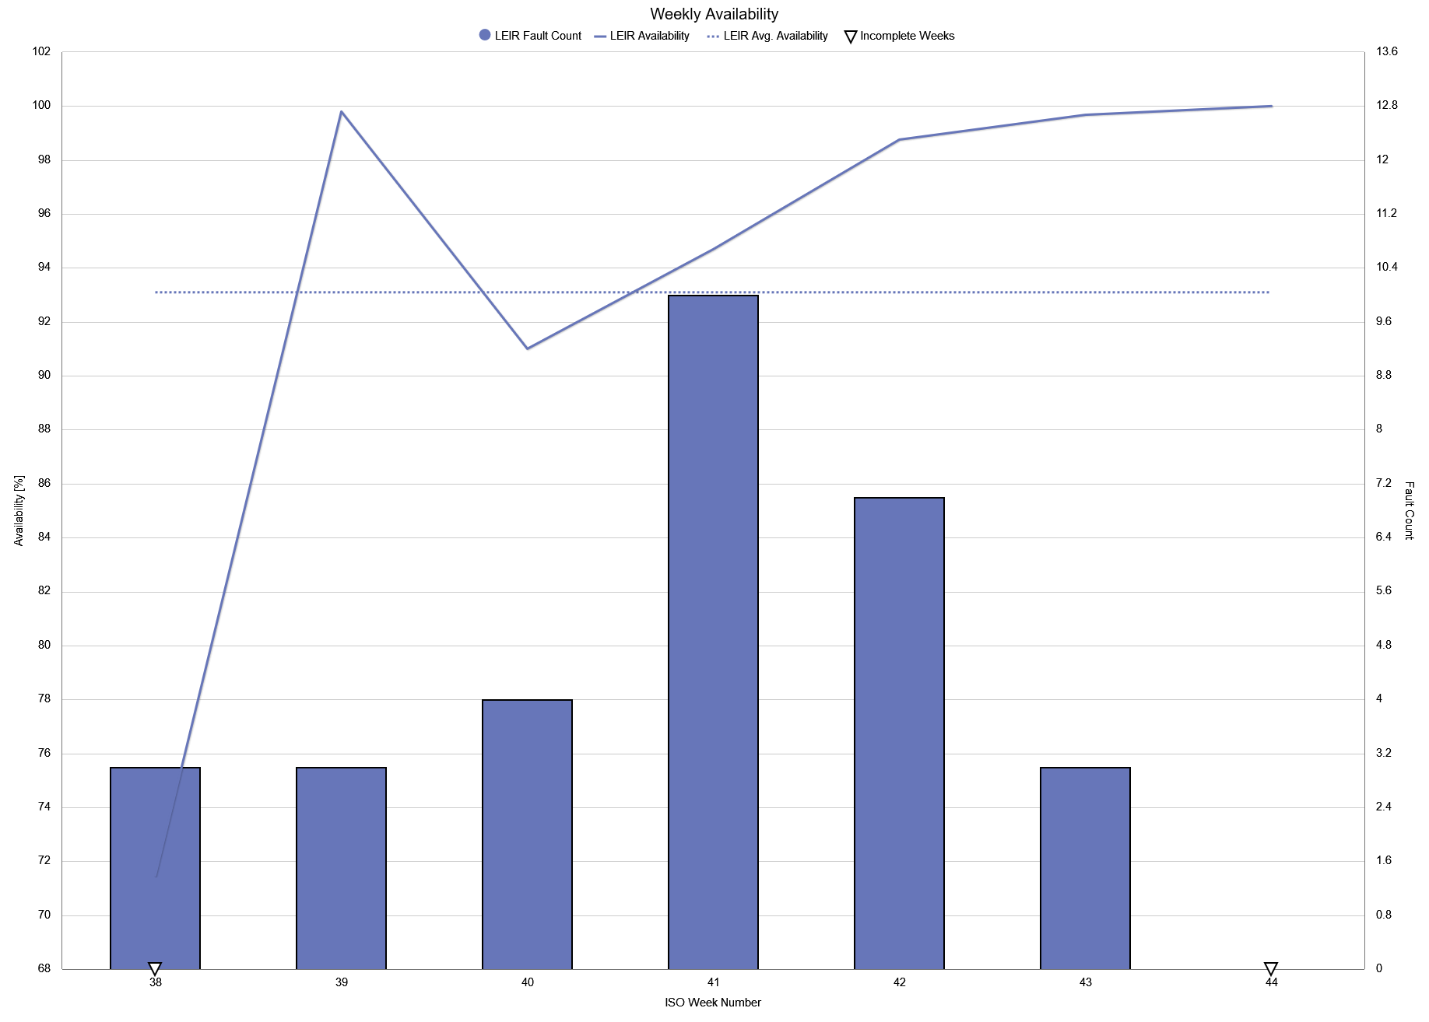


LEIR
Just looking at AFT LEIR is a rather solid machine!
2022: 95.7% (97.8% excluding Linac3 downtime):
  Availability compatible with Linac3.
  A few power converters issues (<1h to fix).
2023: 93.1% (95.6% excluding Linac3 downtime)
High availability apart from week 38!
  Major event: fault of the 18kV breaker and the consequent recovery of other equipments and beam performance.
    Several outdated electronics cards (PowM1553) which needed to be replaced (CONSolidation).
  Remaining (minor) issues with power converters tripping.
Fault of 18kV transformer
LINAC3 Cavity 1
Looking beyond the mere statistics:
  A few equipment missing a spare or even spare components.
  Ions program currently scheduled until 2043 (as long as HL-LHC):
    We must ensure long term reliability of LEIR.

Slide 31
Summary
Data in AFT are currently widely accepted at CERN, as result of a common effort!
  Teams working improved diagnostics, automatic resets and fault recording.
Virtuous feeback loop among teams to address machine‘s issues at the source.
  Long term strategy/needs for recurrent issues followed-up within the IEFC framework.
As a result the machines are performing rather well:
  General feeling is that we will not be able to easily improve the 2023 figures before LS3.
  We need strike a balance between pushing the performance to the limit and the machine reliability.
  Personal suggestion to document yearly the machine availability, observations, expectations, etc, etc...
RAWG surveying the usage of AFT with the equipment groups to define the next steps:
  AFT data quality/categorization to be improved → automation should help.
  Agree on a way to exploit captured data to improve performance – definition of complexity and consolidation.
  AFT is currently a container isolated data:
    Correlate the data with external databases, e.g. RP, losses, beam/cycle types, API to NXCALS missing.
  The exciting news is that there is so much potential in the tool which could be exploited.
    Ongoing EPA effort, e.g. WP 8, could be a force multiplier to the AFT growth.

Slide 33
BI.BSW Coil Failure History
Time / cycles | Magnet | Observation | Root cause | Down time [h]
28/09/’20 ~ 1*10³ | BI3.BSW1 | Brazing alloy blockage of cooling tube: Repaired by re-drilling, but damaged copper tube | Repair damage | LS2
21/4/’21 ~ 1*10⁶ | BI4.BSW1 | Fatigue damage with microcrack on cooling tube | Fatigue crack cooling pipe | TS
7/12/’21 / ~ 21*10⁶ | BI3.BSW4 | Brazing failure – hydraulic connector 2 water block | Brazing joint | YETS
13/1/’22 ~ 21*10⁶ | BI3.BSW4 | Brazing failure - hydraulic connector 2 water block | Brazing joint | YETS
17/1/’22 ~ 21*10⁶ | BI1.BSW3 | Brazing failure – Coil 2 water block | Brazing joint | YETS
21/6/’23 ~ 44*10⁶ | BI1.BSW4 | Fatigue damage with microcrack on cooling tube | Fatigue crack cooling pipe | TS+14h
14/8/’23 ~ 4*10⁶ | BI1.BSW4 | Brazing failure – Coil 2 water block | Brazing joint | 11h

