Slide 1
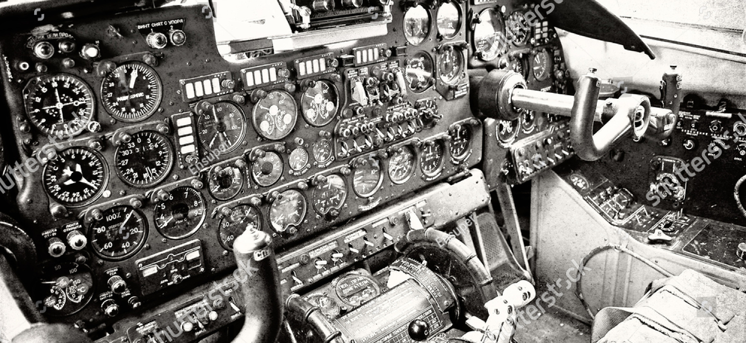

How to further improve commissioning?
Plans for 2024 and beyond…
Kevin Li with input from A. Akroh, D. Cotte,
G.P. Di Giovanni, A. Huschauer, E. Mahner, B. Mikulec, L. Ponce, J. Ridewood, A. Rodriquez, R. Scrivens,
P. Skowronski , J. Wenninger
Joint Accelerator Performance 23 Workshop (JAP23)
5 to 7 December 2023

Slide 2

Commissioning introduction
Every year, after the JAP WS, Christmas, New Year’s Eve and Chamonix, when the snowdrops start peaking through the thin snow blankets and the snow begins to melt in increasingly warm sunrays, the CERN accelerator complex starts awakening from its hibernation; in technical terms, we call this period the “(re-)commissioning phase” of the accelerator complex…

Slide 3
Commissioning introduction
Every year, after the JAP WS, Christmas, New Year’s Eve and Chamonix, when the snowdrops start peaking through the thin snow blankets and the snow begins to melt in increasingly warm sunrays, the CERN accelerator complex starts awakening from its hibernation; in technical terms, we call this period the “(re-)commissioning phase” of the accelerator complex…
Over the decades, this period has taken many shapes and trends; in recent years, from the experience of the LHC, is has underwent a large level of rejuvenation and optimization
  LHC traditionally very structured and organized approach – necessary, to a large extent, due to sheer size and complexity of the machine, it’s self-termination capabilities and the very large number of expert teams needed!
  Since post-LS2 adopted LHC-type of approach – fixed schedule, detailed planning, structured and organized commissioning periods → is there still room for improvements? What can we propose as next steps?
  Since post-LS2 commissioning typically categorized into individual system tests (IST), hardware commissioning (HWC) and beam commissioning (BC)

Slide 4
Commissioning introduction
Every year, after the JAP WS, Christmas, New Year’s Eve and Chamonix, when the snowdrops start peaking through the thin snow blankets and the snow begins to melt in increasingly warm sunrays, the CERN accelerator complex starts awakening from its hibernation; in technical terms, we call this period the “(re-)commissioning phase” of the accelerator complex…
Over the decades, this period has taken many shapes and trends; in recent years, from the experience of the LHC, is has underwent a large level of rejuvenation and optimization
  LHC traditionally very structured and organized approach – necessary, to a large extent, due to sheer size and complexity of the machine, it’s self-termination capabilities and the very large number of expert teams needed!
  Since post-LS2 adopted LHC-type of approach – fixed schedule, detailed planning, structured and organized commissioning periods → is there still room for improvements (yes, there always is…; cost-benefit analysis advised)? What can we propose as next steps?
  Since post-LS2 commissioning typically categorized into individual system tests (IST), hardware commissioning (HWC) and beam commissioning (BC)
Charge:
Commissioning length, procedures, equipment expert needs
  AccTesting / EPA WP7 for HW commissioning
Commissioning as test phase for new implementations
What OP can do during night shifts and weekends?
Ions: how to optimize the ion commissioning to have less impact on other physics?
  E.g., cycles ready and debugged without beam at beginning of year

Slide 5
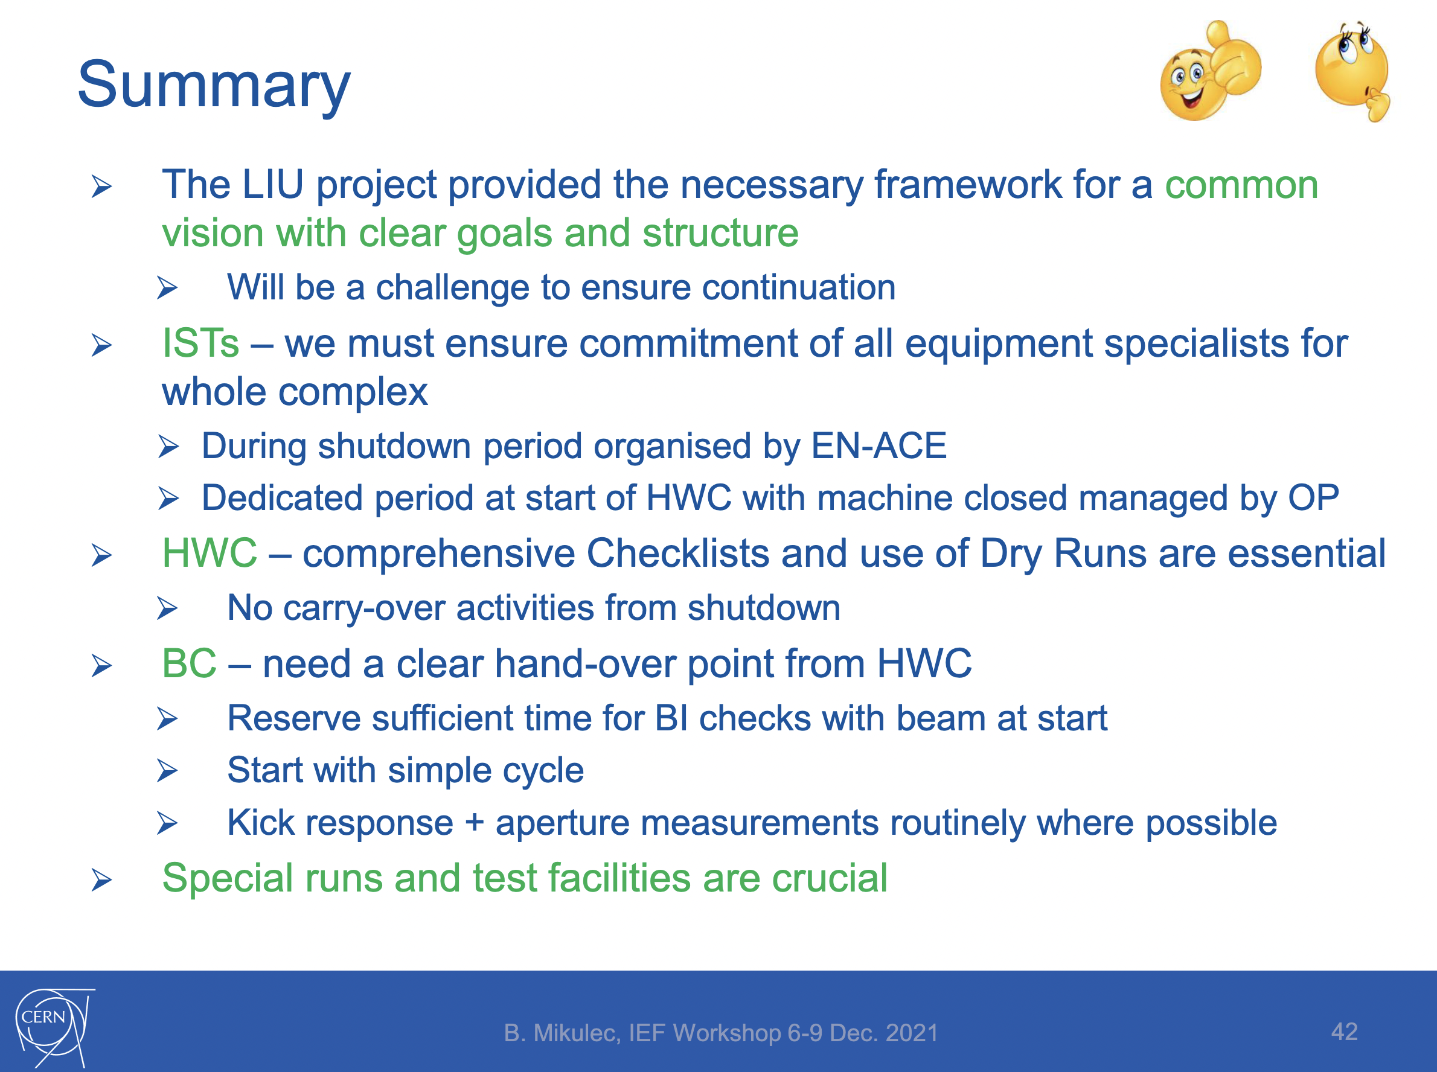
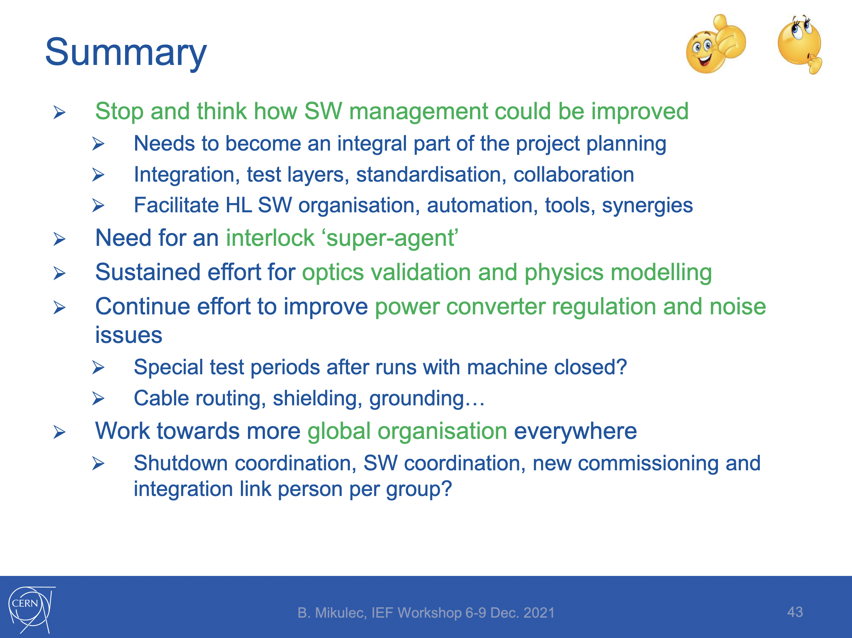
Commissioning – how to further improve?
This topic has already extensively been scrutinized over the last 2 years:
  Bettina Mikulec et al.: Commissioning – post-LS2 lessons learned – IEF WS ‘21
  Piotr Skowronski et al.: Aggressive hardware and beam commissioning in the injectors – JAP WS ’22
  With the same regularity that we recommission, we also have a talk on how to better recommission ;)! (might give the impression we are not re-commissioning well; here I want to object…)
✔︎
✔︎
✔︎
✔︎
✔︎
✔︎
✔︎
✔︎

Slide 6
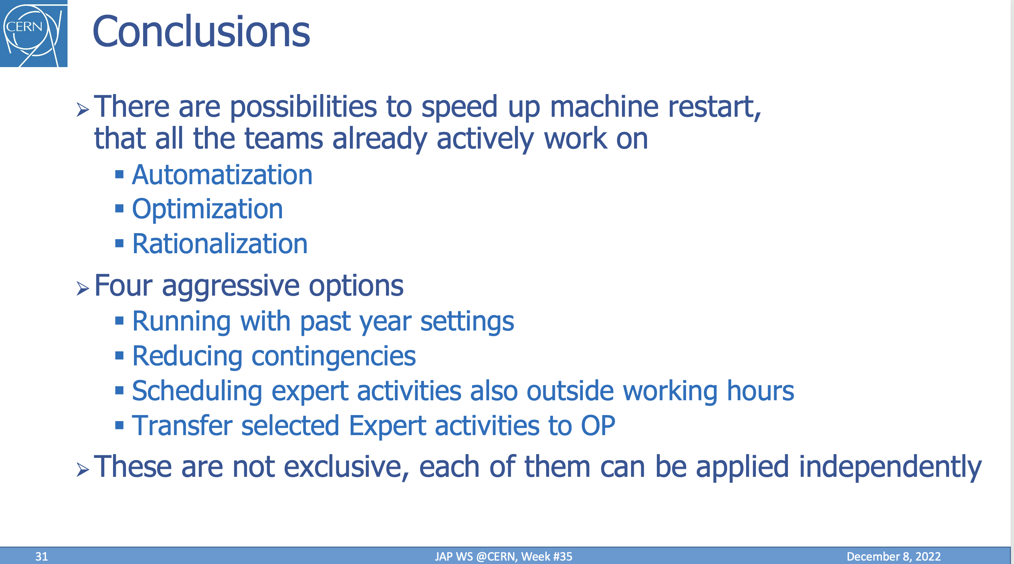
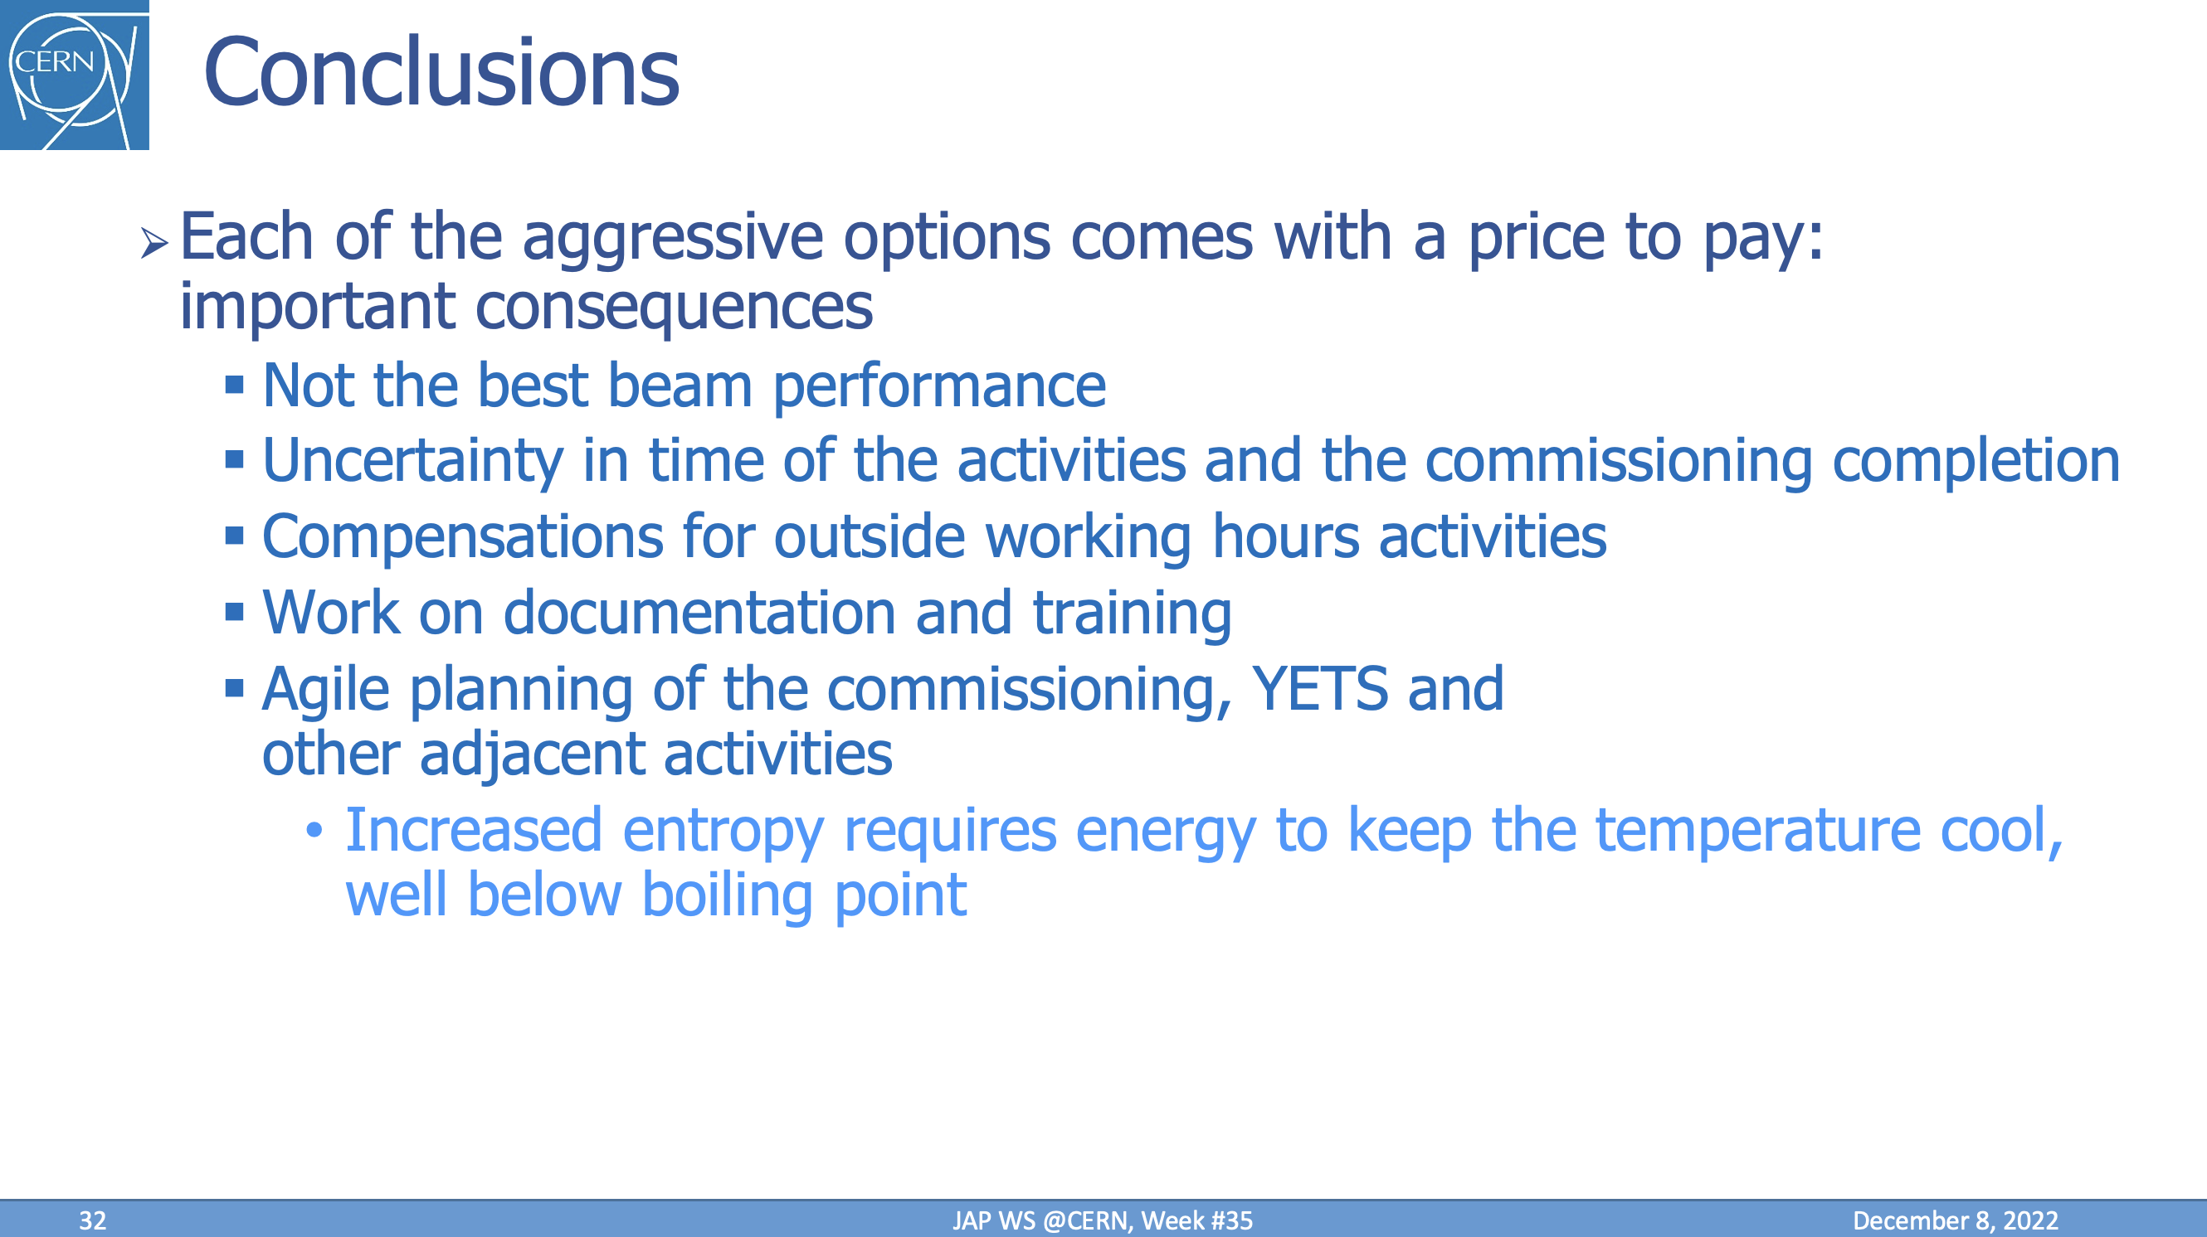
Commissioning – how to further improve?
This topic has already extensively been scrutinized over the last 2 years:
  Bettina Mikulec et al.: Commissioning – post-LS2 lessons learned – IEF WS ‘21
  Piotr Skowronski et al.: Aggressive hardware and beam commissioning in the injectors – JAP WS ’22
  With the same regularity that we recommission, we also have a talk on how to better recommission ;)! (might give the impression we are not re-commissioning well; here I want to object…)
→ Automation works progressing – EPC tests already optimized for new FGCs,…

Slide 7

Commissioning – how to further improve?
This topic has already extensively been scrutinized over the last 2 years:
  Bettina Mikulec et al.: Commissioning – post-LS2 lessons learned – IEF WS ‘21
  Piotr Skowronski et al.: Aggressive hardware and beam commissioning in the injectors – JAP WS ’22
  With the same regularity that we recommission, we also have a talk on how to better recommission ;)! (might give the impression we are not re-commissioning well; this is not quite…)
With the same regularity that we recommission, we also have a talk on how to better recommission ;)! (might give the impression we are not re-commissioning well; this is not quite true…)

Slide 8
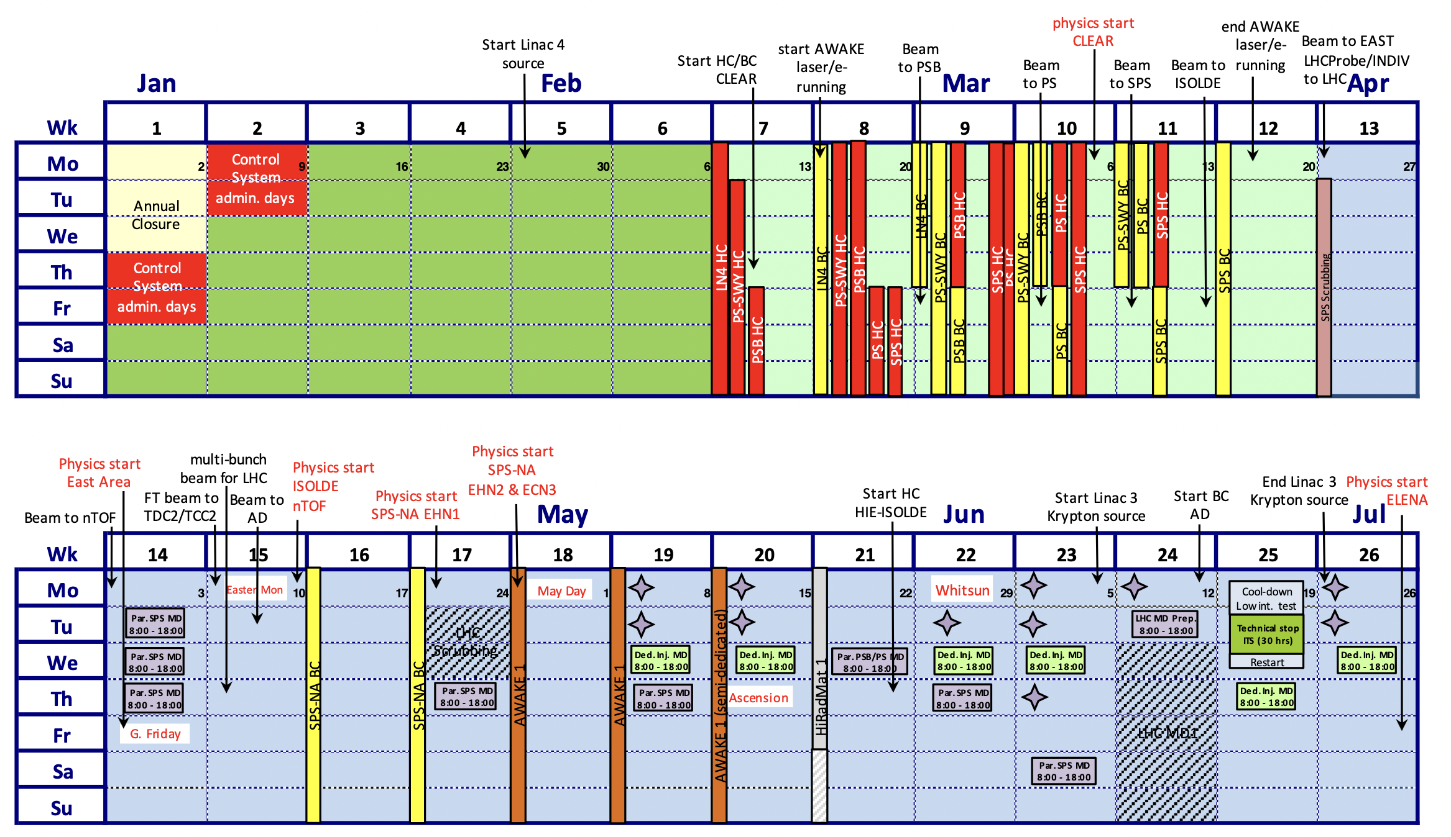
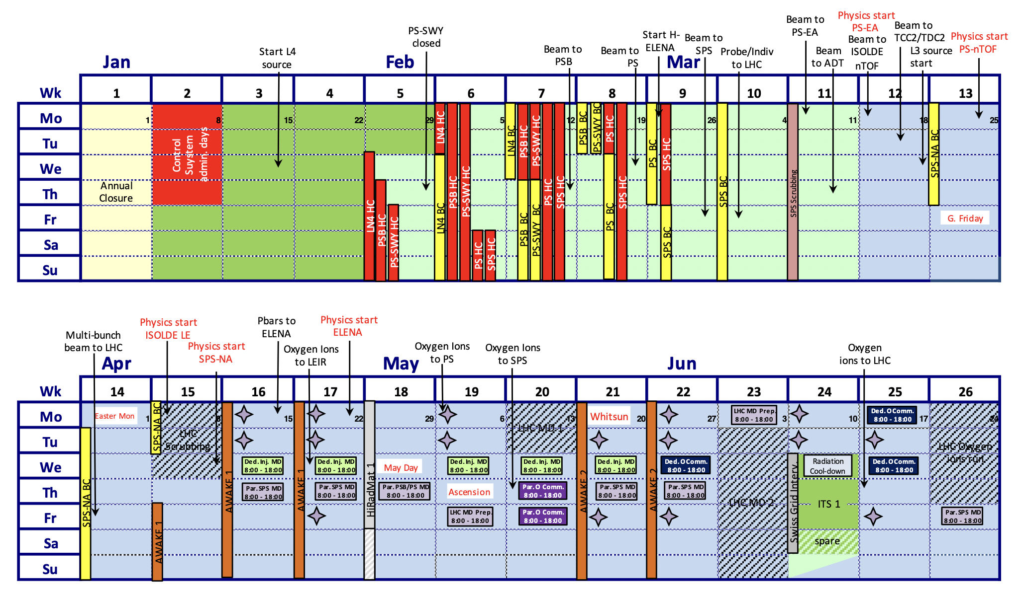
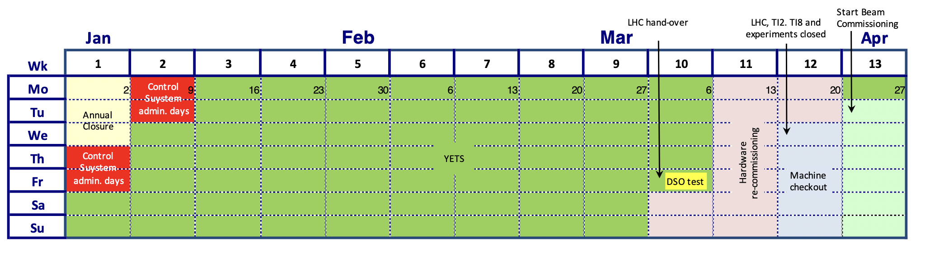
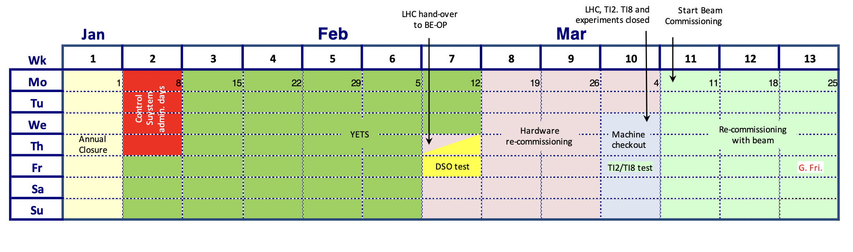
Traditional post-LS2 commissioning schedules
2023 2024
LHC

Slide 9
Traditional post-LS2 commissioning schedules
2023 2024
LHC
Landscape some time after the “immediate” post-LS2 commissioning for the injectors – after IST period:
  Injectors commissioning period very complex due to multi-parallel activities across complex – commissioning for the ‘own’ machine plus preparation for downstream machines and facilities, many dependencies, much less predictable
  Usually, a few weeks before delivery to EA and/or start of physics
    → critical period to accommodate scrubbing, beam development and optimization as well as tests of new equipment, tools and procedures!

Slide 10
Traditional post-LS2 commissioning schedules
2023 2024
Landscape some time after the “immediate” post-LS2 commissioning for the injectors – after IST period:
  Injectors commissioning period very complex due to multi-parallel activities across complex – commissioning for the ‘own’ machine plus preparation for downstream machines and facilities, many dependencies, much less predictable
  Usually, a few weeks before delivery to EA and/or start of physics
    → critical period to accommodate scrubbing, beam development and optimization as well as tests of new equipment, tools and procedures!
  Staged “coming online” of machines has proven valuable in terms of resource allocations and expert availabilities
  There is always a “ladies’ and gentlemen’s” agreement, that beam can be sent if ready earlier and useful for downstream machines → good level of flexibility retained
LHC

Slide 11
Commissioning – how to further improve?
As a result of previous work, optimization and accumulated post-LS2 experience in commissioning the injectors complex, from own experience and gathered from interviews across the accelerator chain:
  Excellent performance achieved, and very positive feedback received during and after commissioning throughout the entire complex; not that much more to squeeze out in terms of optimizations
  When analyzing, some open points can be still identified:
    Overall, an incredible development from the early days; performance gradient positive since post-LS2 start-up; difficulties encountered:
      ‘21: Post-LS2 recommissioning year → delays and some loss of physics (SPS)
      ‘22: Flawless commissioning and no delays
      ‘23: Ions commissioning spot on and no delays → may want to give some margin to relax stress levels
      ‘23: Scrubbing needs much larger than expected – solved with new scrubbing tools and strategies → may want to retain
    Beam commissioning improvements – how to make best use of the later stages before experimental areas are ready? Ions or MDs preparations?
    Hardware commissioning improvements – what can still be squeezed out
    ISTs – can we still improve anything?
    ISOLDE, AD/ELENA are still left somewhat aside → routinely leads to problems, i.e., expert availability conflicts

Slide 12
ISTs – what can be improved?
With meanwhile 2.5 years of post-LS2 experience and cross-complex optimizations in place, we can recapitulate:
  ISTs – can we still improve anything:
    Mostly now very well planned and followed up, adopted by all groups and mostly executed with great care and detail; cases with room for improvement for quality control can be sorted out on a case-by-case basis
    “Hybrid” period with tunnel open but restricted access works very well for localized tests (i.e., kickers or RF), but is difficult to manage for distributed tests (i.e., EPC) → mitigated by integrating a separation of the two types of ISTs
    Most recent optimization implemented by adding complementary IST period at the end of the year
    ISOLDE & AD/ELENA also have their ISTs and planning, even using the EN-ACE infrastructure; coordination meetings take place as ITC and ADTC but outside of the EN-ACE coordination framework:
      Nevertheless, the schedules are still somewhat separate as the planning is not fully integrated such as for the LHC injectors
      Still can lead to conflicts in case of delays and schedule drifts as they are not dynamically accommodated – is a tighter link to EN-ACE conceivable?
→ Little room for optimization – better integration of remaining facilities into EN-ACE framework?

Slide 13

HWC – what can be improved?
With meanwhile 2.5 years of post-LS2 experience and cross-complex optimizations in place, we can recapitulate:
  HWC – what can still be squeezed out:
    Time to save → not much: large fraction still made up of EPC testing – lateral activities integrated to parallelize as much as possible; OP verification of EPC tests could be economized (see P. Skowronski – JAPW ‘22), gain limited
    Coordination to improve → punctual: sometimes conflict in “fuzzy areas”, i.e., Ti2 / Ti8 HWC from SPS vs. tests in LHC; also, conflicts in ISOLDE, AD/ELENA, which are still somewhat aside of the EN-ACE integrated planning and, hence, risk to run into a lack of experts
    Automation uses cases existing → yes: many tests that could profit from automation a la AccTesting in the LHC; got this feedback across the injectors chain for movable devices, interlocks, vacuum, current functions,… → use case exist for extended AccTesting framework

Slide 14
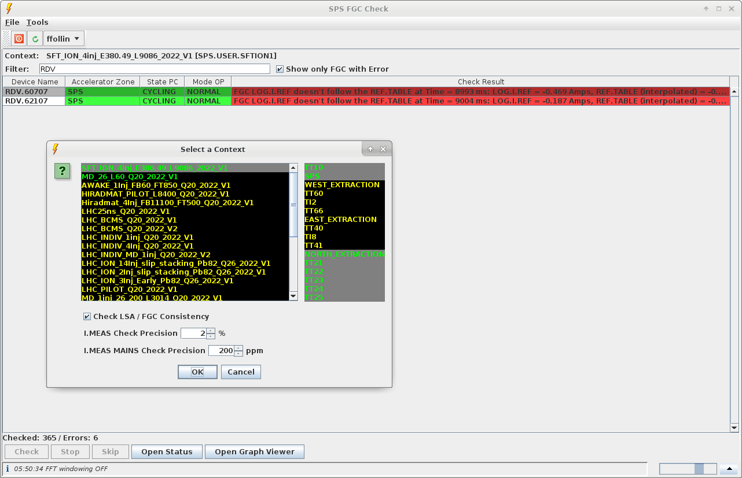
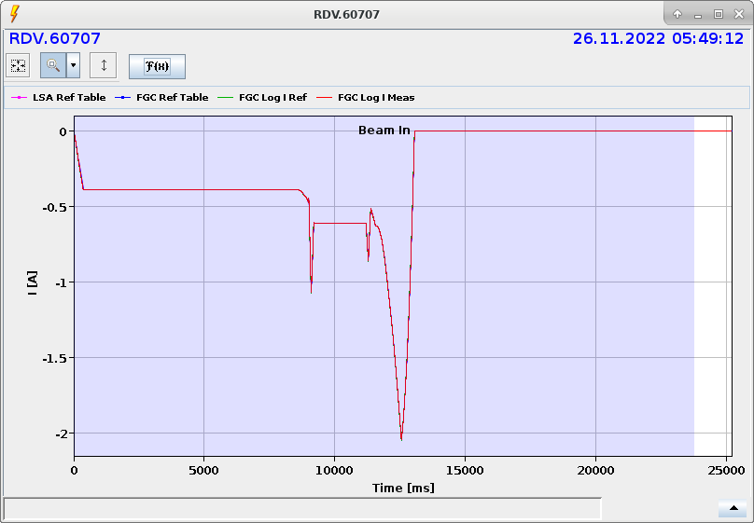
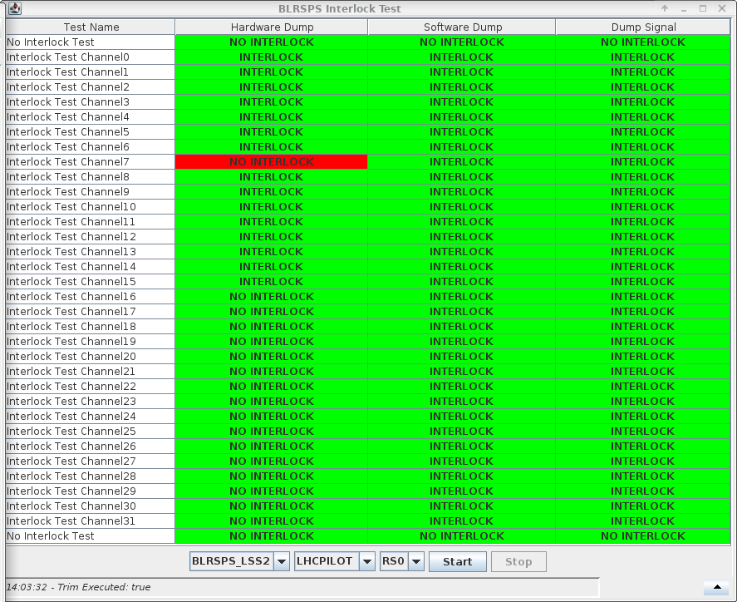
HWC – what can be improved?
With meanwhile 2.5 years of post-LS2 experience and cross-complex optimizations in place, we can recapitulate:
  HWC – what can still be squeezed out:
    Time to save → not much: not that much more time to save on the OP side: a large fraction made up of EPC testing – lateral activities integrated to parallelize as much as possible; OP verification of EPC tests could be economized (see -----), but would not bring that much gain
    Coordination to improve → perhaps for terminal facilities: detailed planning and close coordination between EN-ACE, BE-OP and equipment groups in place across the injectors complex → schedules, co-activities and expert availabilities usually well managed; BUT, this does not seem to be the case for terminal facilities, i.e., ISOLDE and AD/ELENA, which frequently suffer from a lack of experts (already mentioned in -----)
    Automation uses cases existing → yes: many tests that could heavily profit from a certain level of automation, similar to what is done with AccTesting in the LHC; got this feedback across the injectors chain for movable devices, interlocks, vacuum, current functions,… → use case there for extended AccTesting framework
Some levels of automation in the injectors already in place today:
  Example SPS: FGC Check (F. Follin)
  Example PS: sequencer used for more automatic HWC for power converters

Slide 15
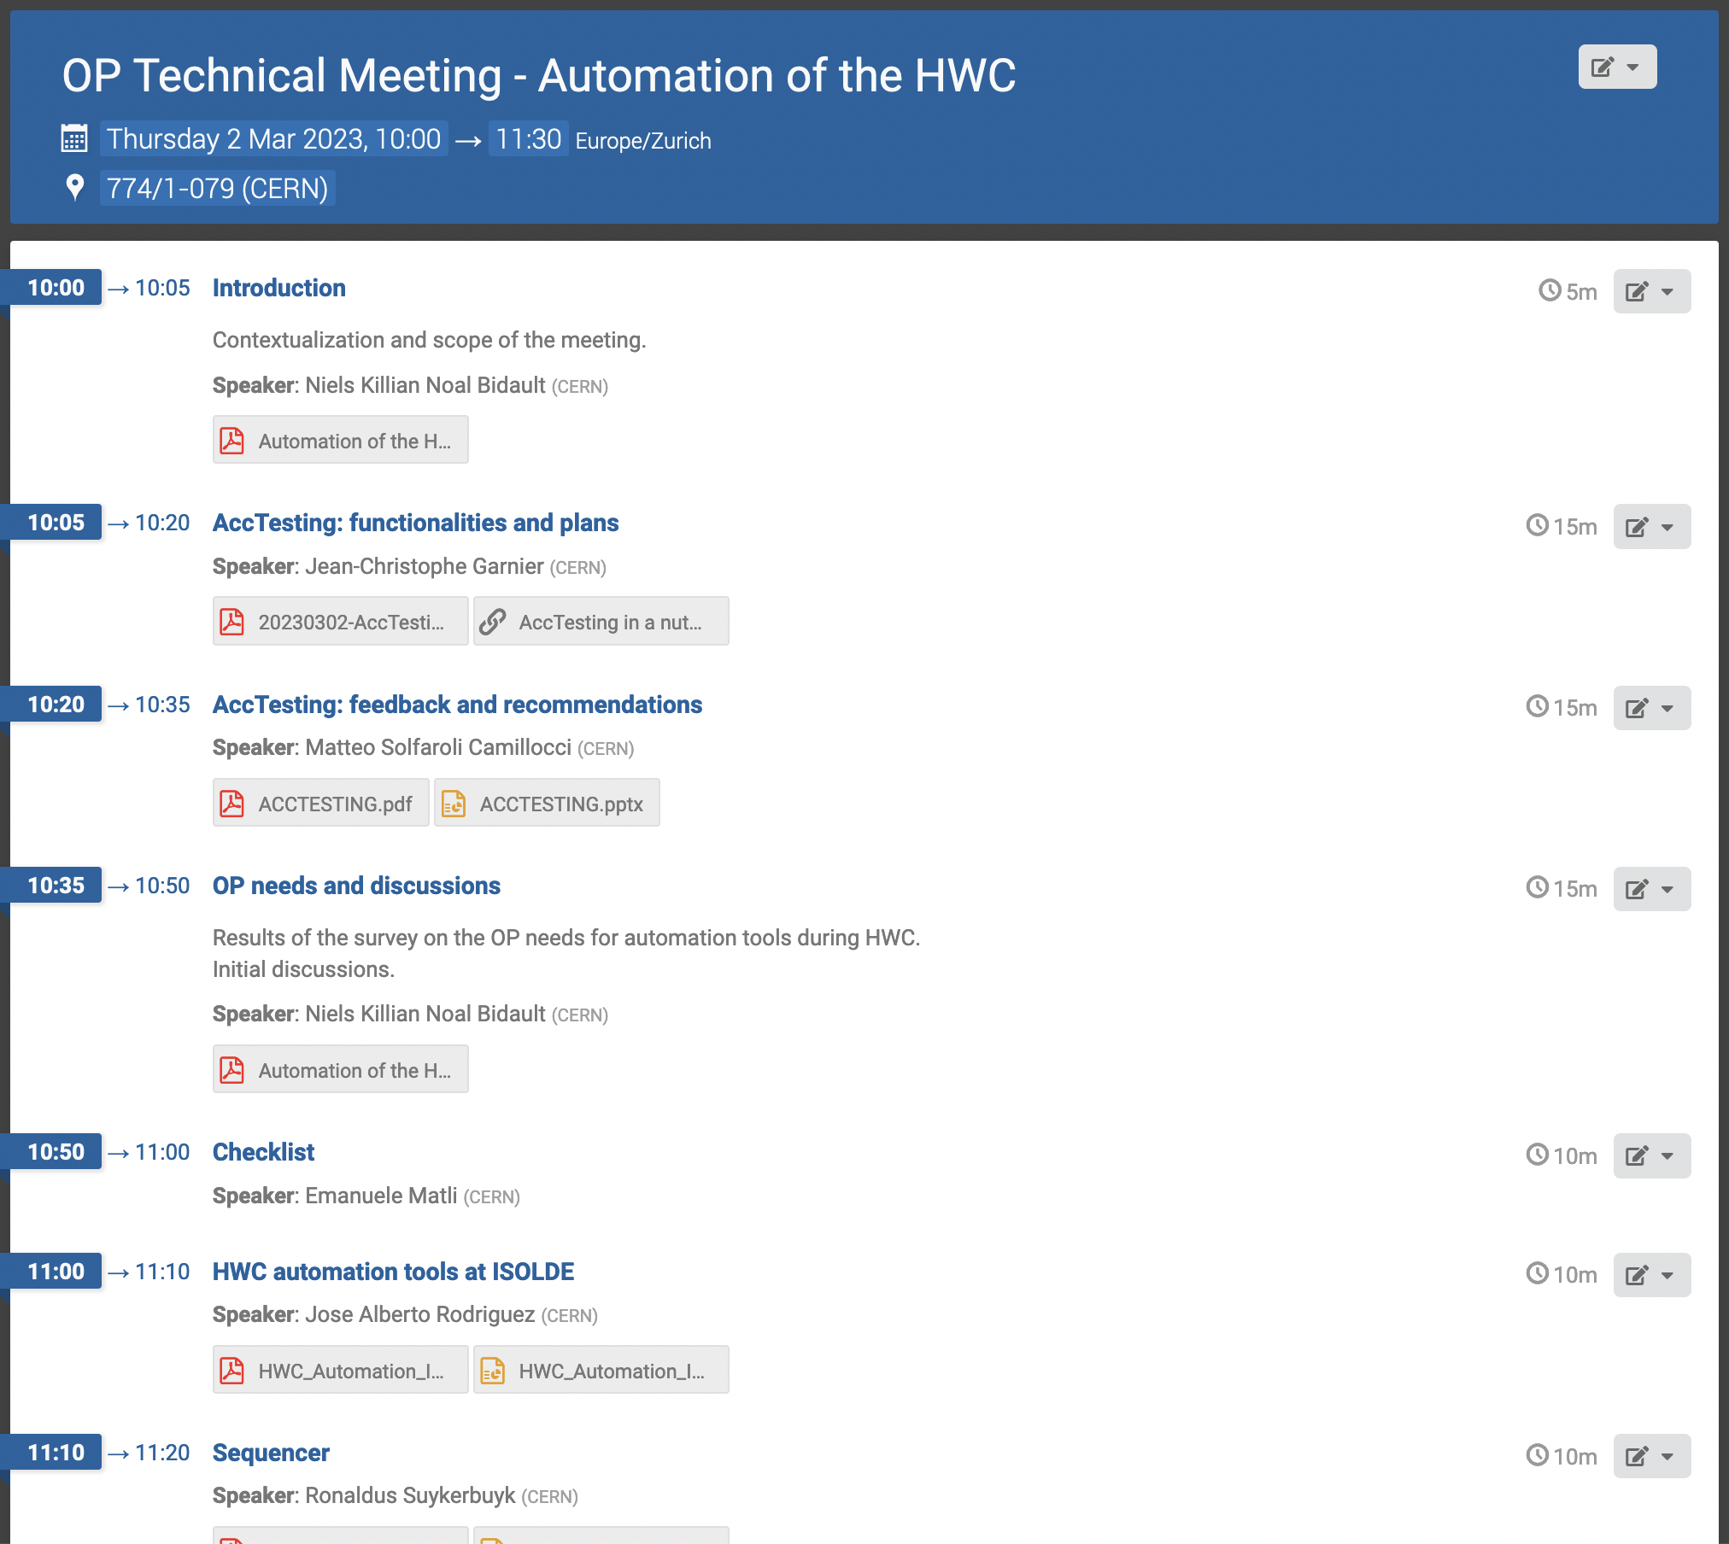
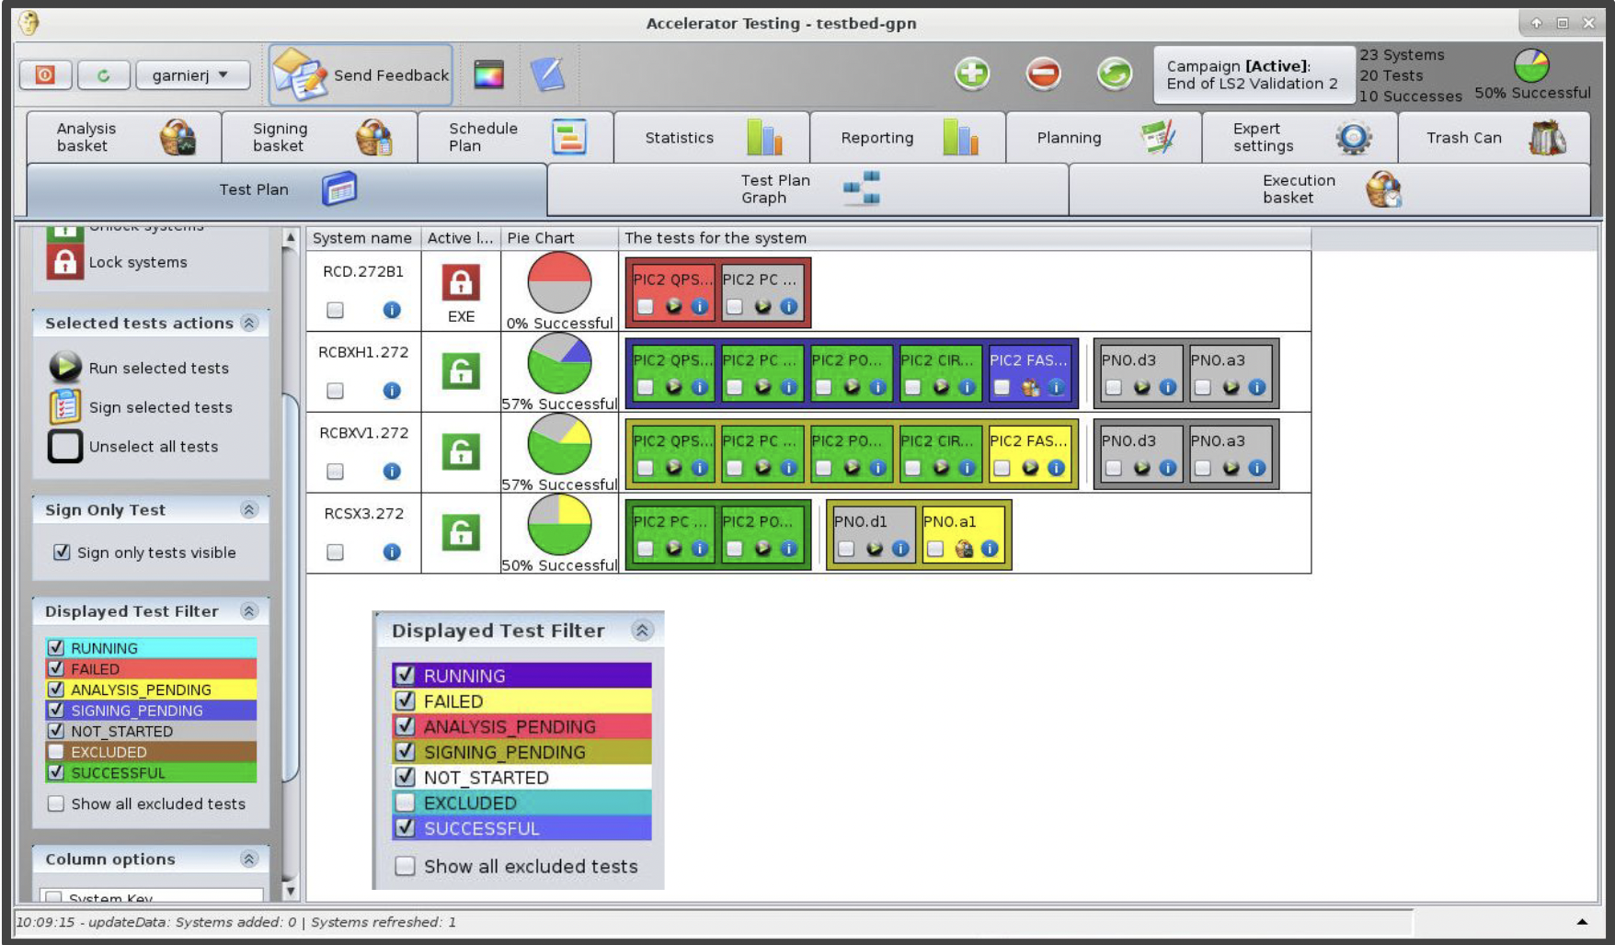
HWC – what can be improved?
With meanwhile 2.5 years of post-LS2 experience and cross-complex optimizations in place, we can recapitulate:
  HWC – what can still be squeezed out:
    Time to save → not much: not that much more time to save on the OP side: a large fraction made up of EPC testing – lateral activities integrated to parallelize as much as possible; OP verification of EPC tests could be economized (see -----), but would not bring that much gain
    Coordination to improve → perhaps for terminal facilities: detailed planning and close coordination between EN-ACE, BE-OP and equipment groups in place across the injectors complex → schedules, co-activities and expert availabilities usually well managed; BUT, this does not seem to be the case for terminal facilities, i.e., ISOLDE and AD/ELENA, which frequently suffer from a lack of experts (already mentioned in -----)
    Automation uses cases existing → yes: many tests that could heavily profit from a certain level of automation, similar to what is done with AccTesting in the LHC; got this feedback across the injectors chain for movable devices, interlocks, vacuum, current functions,… → use case there for extended AccTesting framework
Some levels of automation in the injectors already in place today – example FGC Check (F. Follin) in the SPS
AccTesting framework as ideal platform for integrating exactly these (and other) types of tests for an extended automated testing framework and platform compatible both for the LHC and the injectors complex (including ISOLDE and AD/ELENA)
→ Little room for optimization – AccTesting across the complex generally welcomed with a great potential!

Slide 16
BC – what can be improved?
With meanwhile 2.5 years of post-LS2 experience and cross-complex optimizations in place, we can recapitulate:
  BC – open points:
    With the last LIU implementations finalized in the SPS during LS2 and post-LS2 commissioning and the consolidation of all upgrades across the injector chain, we have come a long way in terms of optimization

Slide 17

BC – what can be improved?
With meanwhile 2.5 years of post-LS2 experience and cross-complex optimizations in place, we can recapitulate:
  BC – open points:
    With the last LIU implementations finalized in the SPS during LS2 and post-LS2 commissioning and the consolidation of all upgrades across the injector chain, we have come a long way in terms of optimization
Lessons learned:
  Acknowledge that scrubbing, testing of new procedures and tools as well as training should be an integral part of BC
  Very good feedback from common commissioning periods; would also be useful for other facilities, i.e., AWAKE
  OP tasks during nights and weekends: not so much a problem
    We do have activities and procedures that can be carried out by OP once machines are running (apertures, kick responses, general cycle setting up, complementary hardware tests, scrubbing,…);
    Where this is not possible, rather invest in procedures and tools, such that they can be carried out by OP
    Turning on and off the machine every day would be highly inefficient

Slide 18

BC – what can be improved?
With meanwhile 2.5 years of post-LS2 experience and cross-complex optimizations in place, we can recapitulate:
  BC – open points:
    With the last LIU implementations finalized in the SPS during LS2 and post-LS2 commissioning and the consolidation of all upgrades across the injector chain, we have come a long way in terms of optimization
Lessons learned:
  Acknowledge that scrubbing, testing of new procedures and tools as well as training should be an integral part of BC
  Very good feedback from common commissioning periods; would also be useful for other facilities, i.e., AWAKE
  OP tasks during nights and weekends: not so much a problem
    We do have activities and procedures that can be carried out by OP once machines are running (apertures, kick responses, general cycle setting up, complementary hardware tests, scrubbing,…);
    Where this is not possible, rather invest in procedures and tools, such that they can be carried out by OP
    Turning on and off the machine every day would be highly inefficient
Remaining issues:
  Expert dependencies – some items and systems still need intense expert support, e.g.:
    RF setting up: harvest the chances that come with system renovations and focus on hardware abstraction and operational integration!
    LHC: still often expert driven, thus, potential lack of exploiting flexibility provided by OP shifts
  Ion commissioning – potential anxiety when having commissioning allocated during physics and/or so closely to required beam delivery date!
  MDs preparation still sometimes an issue, especially for exotic configurations (special beams, modes, equipment)

Slide 19
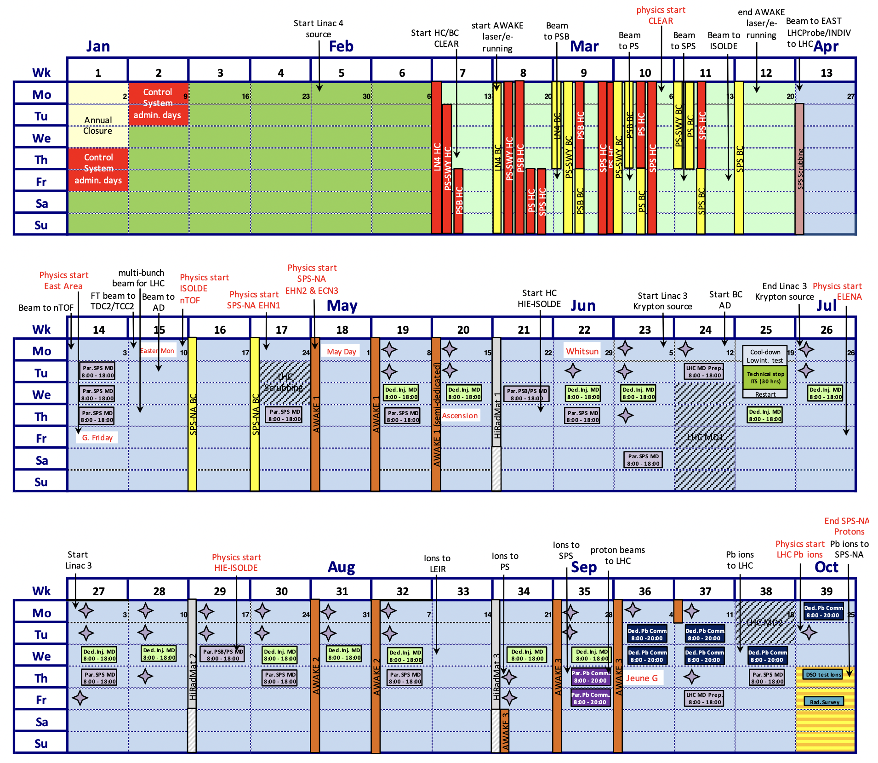
Ion commissioning problematics
Example of an ion commissioning using a representative schedule in 2023
  Ion commissioning start ~July – ion run start ~November
  Commissioning time: 6 weeks source / LINAC3 + 1 week LEIR + 1 week PS + 8 days SPS
Advanced ion commissioning implications per machine – knock on effects:
  SPS:
    Likely possible – set up cycles and assume machine will come back in same state half a year later → by experience reasonable assumption
  PS:
    Commissioning expected to be more efficient with lessons learned (start with nominal)
  LEIR:
    Potential conflict with start-up of AD/ELENA as the facilities share the same pool of experts!
  LINAC3 + SOURCE:
    full re-commissioning is assumed to be needed → +6 weeks supplemental work; choice to be made

Slide 20
Ion commissioning problematics
Example of an ion commissioning using a representative schedule in 2023
  Ion commissioning start ~July – ion run start ~November
  Commissioning time: 6 weeks source / LINAC3 + 1 week LEIR + 1 week PS + 8 days SPS
YETS ions:
  Maintenance and start up of LINAC3 + LINAC4 + SOURCES need to shift from sequential (today) to parallel with resources shared; this extends over several departments (BE, SY, EN,…) → identified as actual problem
  YETS ‘24 already fully optimized and scheduled → identified as not implementable for run ’24
  DSO tests, etc. not necessarily a problem, inclusive
Other ions need to be developed
→ Cost: 6 weeks extra + resource doubling during YETS (and potential collision with AD/ELENA commissioning) to gain ~2 days of NA physics – can we get this cheaper?

Slide 21
Ion commissioning problematics
Example of an ion commissioning using a representative schedule in 2023
  Ion commissioning start ~July – ion run start ~November
  Commissioning time: 6 weeks source / LINAC3 + 1 week LEIR + 1 week PS + 8 days SPS
YETS ions:
  Maintenance and start up of LINAC3 + LINAC4 + SOURCES need to shift from sequential (today) to parallel with resources shared; this extends over several departments (BE, SY, EN,…) → identified as actual problem
  YETS ‘24 already fully optimized and scheduled → identified as not implementable for run ’24
  DSO tests, etc. not necessarily a problem, inclusive
Other ions need to be developed
→ Cost: 6 weeks extra + resource doubling during YETS (and potential collision with AD/ELENA commissioning) to gain ~2 days of NA physics – can we get this cheaper?
2.5 alternative options addressing different issues:
  Advance start of physics by 1 week to mitigate loss of physics; recover the week needed for ion commissioning close to where the ion beam will be needed → + 1 week earlier in the year, - 1 week later for ion commissioning
  Advance MDs into the beam commissioning period to free up slots, or at least make MDs more efficient later in the year – caution not to cluster MDs too much as some require to be distributed throughout the year
  Start up ions complex outside of the beam commissioning period, but still earlier; in particular early enough, to be ready with ions beams few weeks in advance to accommodate for potential issues and delays – maintain the very useful beam commissioning period as is

Slide 22
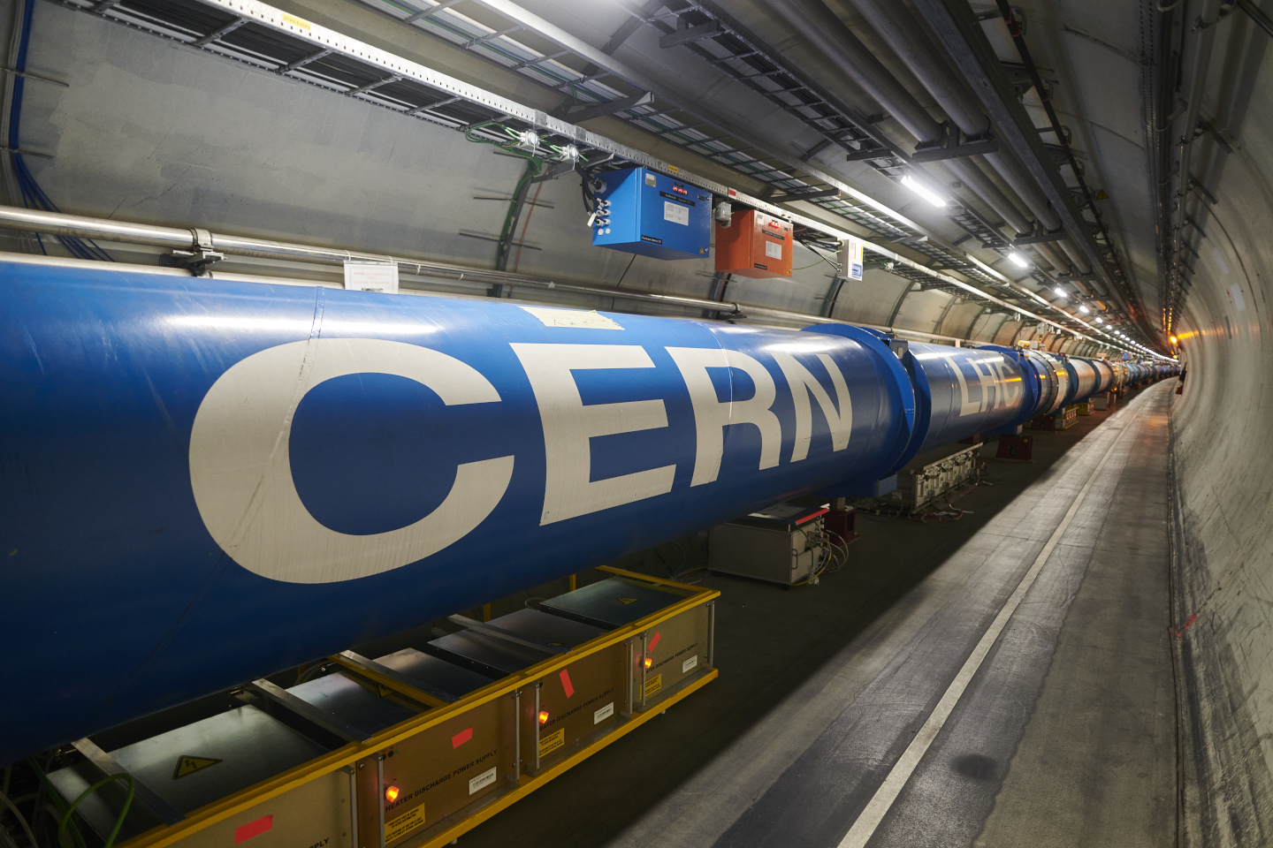
LHC specific items
Hardware commissioning – making heavy use of AccTesting; appreciating extension of this framework as well
  SPS HWC Ti2 / Ti8 vs. LHC still in access has led to problems; will be tried next year during LHC powering tests when machine closed
Beam commissioning – with high availability of OP team due to shifts, could gain more flexibility by offloading expert activities to OP tasks
  Optics: effort to orient OMC tools towards OP, start in 2024 with optics measurements launchable by OP – less optics changes helps of course
  Collimators: alignment & validation (validation, loss maps, etc. already automated, same for crystal alignment, OP measurements followed by expert validation); collimator alignment also automated, but still needs supervision of experts, same for aperture scans → can this be taken to the next level?
  Transfer lines: injection setting up & collimator alignment – tools prepared and developed in collaboration with OP; can we automate this further?
A summary on feedback for beam commissioning – overall already discussed extensively in David’s talk

Slide 23
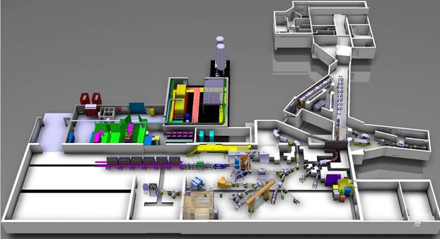
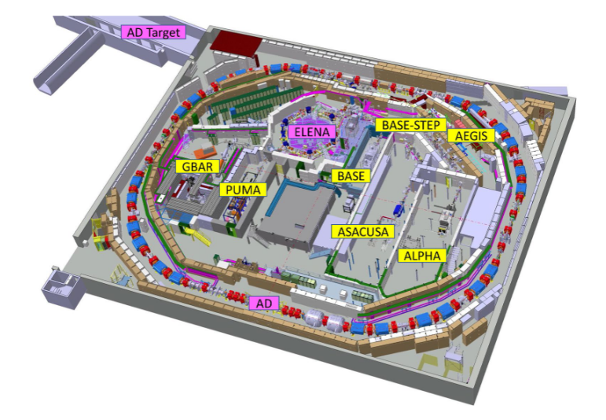
ISOLDE & AD/ELENA specific items
Feedback from both terminal facilities:
  ISTs and HWC planned within OP and isolated from rest of the complex outside of a global framework
  Usually need to plan around expert availability constraints; conflict of priorities can be a recurring issue
  Priority conflicts require allocation of large time windows to ensure expert availability
  Concrete examples:
    ISOLDE: since 2015 every year major HW change with certain time allocated for commissioning; since post-LS2 no more significant HW upgrades; still, same amount of time is needed for commissioning…? What can be gained by complex-coherent settings management (LSA)?
    AD/ELENA has many overlapping expert teams with LEIR – simultaneous startup with LEIR leads to lack of equipment experts
    Would clearly benefit being integrated in a global planning a la EN-ACE

Slide 24
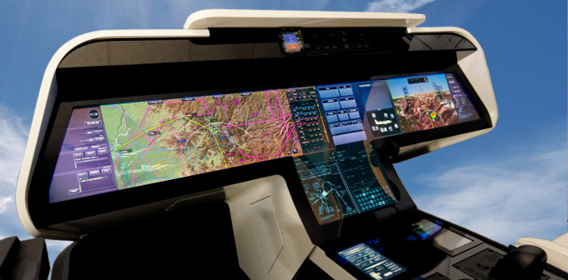
Conclusions
Today, injectors complex (re-)commissioning already very well optimized
  Clear structures put in place
  Usually good cross-complex coordination and planning
  Frameworks for tests scheduling, execution and validation deployed
  Idea to establish preparation and planning as part of the FOM before startup (check ISTs, HWC and BC with resource allocations and identification of potential conflicts)
Feedback from different periods across machines
  IST – little room for optimization; better integration of ISOLDE & AD/ELENA into EN-ACE framework?
  Hardware commissioning – little room for optimization; AccTesting across the complex clearly welcomed with a great potential!
  Beam commissioning – make most efficient use of time window between first beam and start of physics program; some options presented
Final word:
Beam commissioning is a unique development and training period
Advanced tools, procedures and automation are powerful utilities to enhance operational efficiency, reliability and reproducibility
From beam commissioning onwards OP can provide resources for 24/7 coverage – integration of these tools during this period should help making machines more accessible and operations to become more effective

