Slide 1
QDS R2E events during 2023 LHC ion run
'z'
Jens Steckert, Jelena Spasic, Tomasz Podzorny, Reiner Denz – TE-MPE-EP
Thanks to R2E and RadWG

Slide 2
Content
Radiation data
Event Overview
R2E event classes of the QDS during 2023 ion Run
Mitigation measures

Slide 3
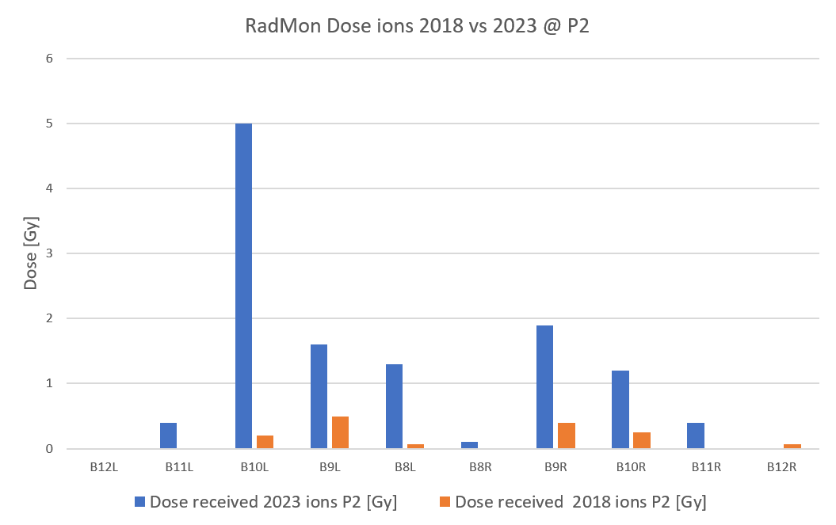
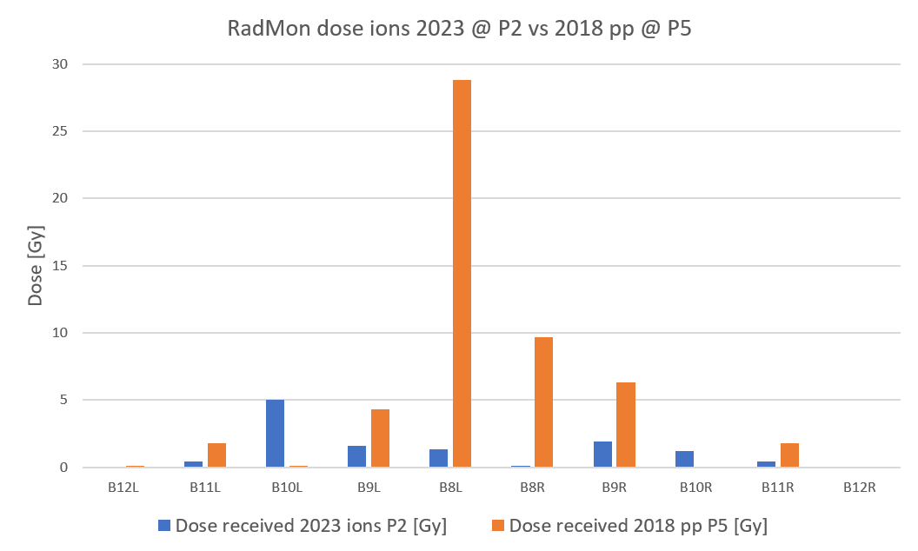
Setting the scene – Doses 2023 vs 2018
During 2023 ions, dose recorded by RadMons is 10x higher than in ions 2018 while luminosity increased only by a factor of 2
Compared to 2018 pp in P5, doses in P2 ions 2023 is 5x smaller
Based on received dose and in comparison to previous runs we did not expect so many R2E events (expected x2 compared to 2018 ions)

Slide 4
Event Type Overview
Class | Equipment | Fault mechanism | Consequence | # events 2023 ions | # events 2018 ions
1 | DQQDL (MB) Base layer QD | SEU bit flip in digital isolator | Mitigated | 188 | 129
2 | DQQBS (bus bar splice detector) | SEU in microcontroller (uC) | Fast power abort (FPA) | 5 | 2
3a | DQQDL (MQ) Base layer QD | SEL in op amp (non-destructive) | FPA & Quench MQ remote power cycle | 1 | 0
3b | DQQDL (MQ) Base layer QD | SEL in op amp (destructive) | FPA & Quench MQ access to replace quench detector | 1 | 0
4a | DQAMC (com board) | SEL in uC (destructive) | Loss of communication Access for board exchange | 1 | 0
4b | DQAMGS | SEL in uC (destructive) | Com loss, FPA, access | 2 | 0
4c | DQAMGS | SEL in uC (destructive) | Com loss, FPA, Quench MB, access | 2 | 0
Class1 & Class 2 were known and (to a certain extent) expected
Class 3 & Class 4 did not happen before
  DQQDL (MQ) was only installed in LS2 but was tested in CHARM
  One Class 4b event during 2018 pp and one Class 4c during 2022 pp run but were not recognized as such at that time

Slide 5
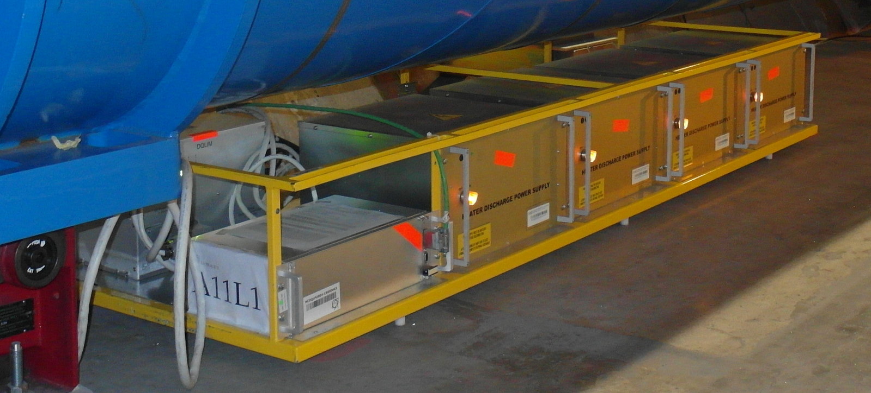
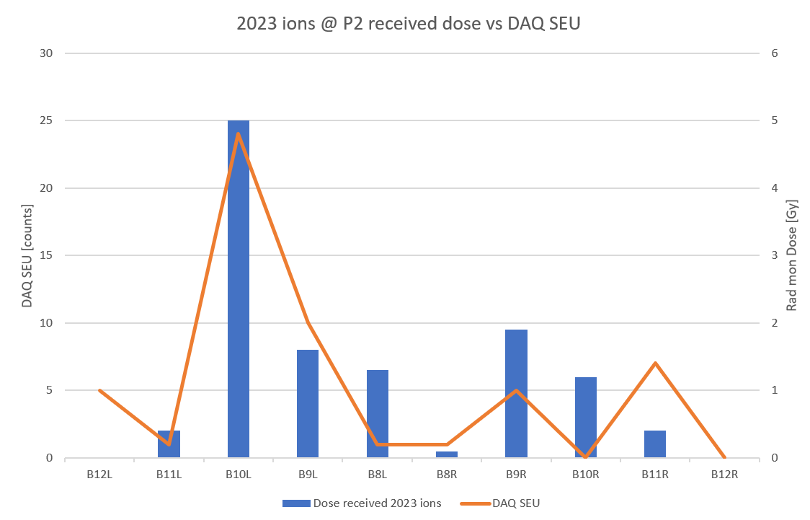
Class 1 events – DAQ triggers (mitigated)
Known R2E issue of the base layer QDS for dipoles
Digital isolator changes logic level due to SEU
Mitigated in firmware since many years
Used as a “radiation detector:
Rack 10L2 is in reverse orientation to R2, cannot be moved due to other equipment
(slight mitigation by changing sequence of modules could “win” 1-2m)

Slide 6
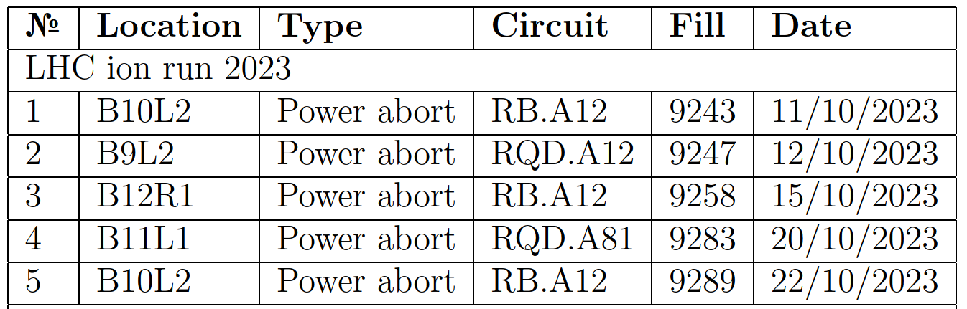
Class 2 events – DQQBS triggers
Well known issue, happens also sporadically during high intensity PP runs
2018 pp run with modified TCL settings provoked 6 of these events
DQQBS is based on ADuC834, a uC with integrated sigma delta ADC. SEU in this microcontroller lead to a spurious FPA
Comparison 2023 vs 2018:
Year | Run type | Events | Integrated Lumi
2023 | pp | 1 | 30 1/fb
2023 | ions | 5 | 2.16 1/nb
2018 | pp | 6 | 66 1/fb
2018 | Ions | 2 | 0.905 1/nb
Statistics is low, but class 2 events seem to scale
with P2 integrated luminosity for ions
For pp, 2018 had more losses per lumi
due to TCL settings and hence more class 2 events

Slide 7
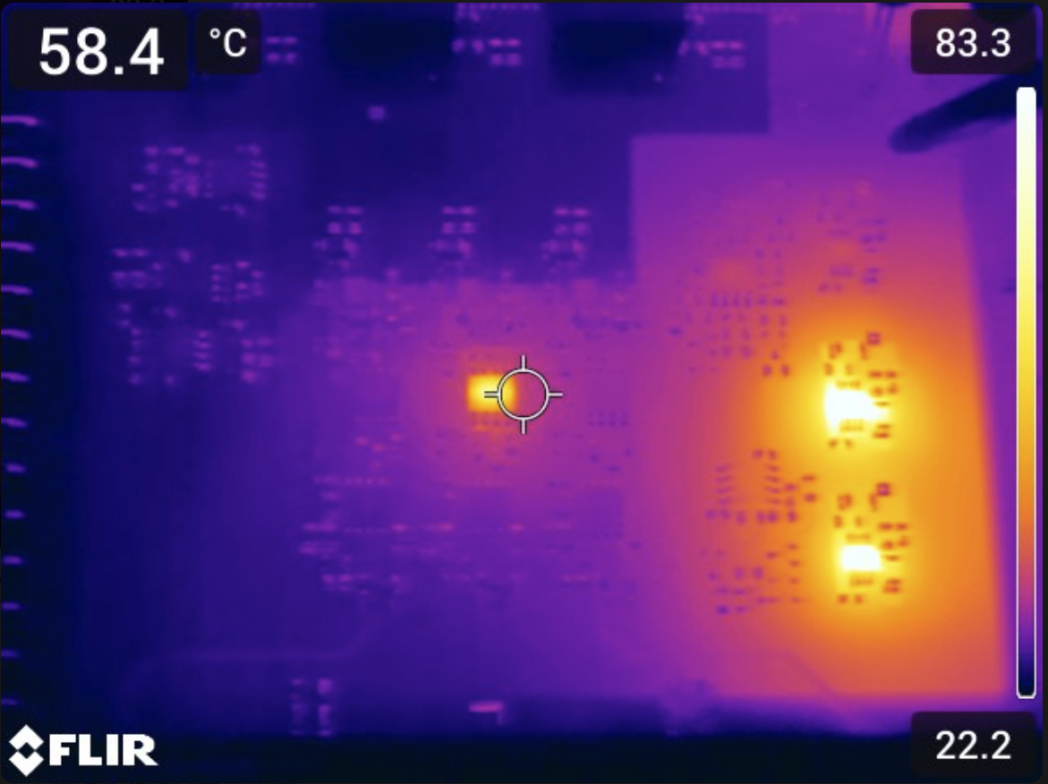
Class 3 events – DQQDL (MQ) SEL, FPA + HDS trigger
2 Events at Oct 14 and Oct 15, symmetrically around P2: A12L2 / A12R2
  1st event, MQ11L2: one ADC channel saturated, isolated power supply indicates out of spec. voltages.
  Power cycle un-latched component and device resumed normal operation
  2nd event, MQ11R2: One complete isolate domain (3 ADC channels) saturated values, indication of bad isolated power. Power cycle did not restore function → piquet intervention to change card
Analysis on damage board found Single Event latch up in OPA2192 operational amplifier of the DQQDL for quadrupoles
After replacing this opamp, DQQDL was fully functional again
Crate A12L/R was already moved to be further away from
empty cryostat
This error did not show up during CHARM test
No further event recorded after Oct. 14th/15th

Slide 8
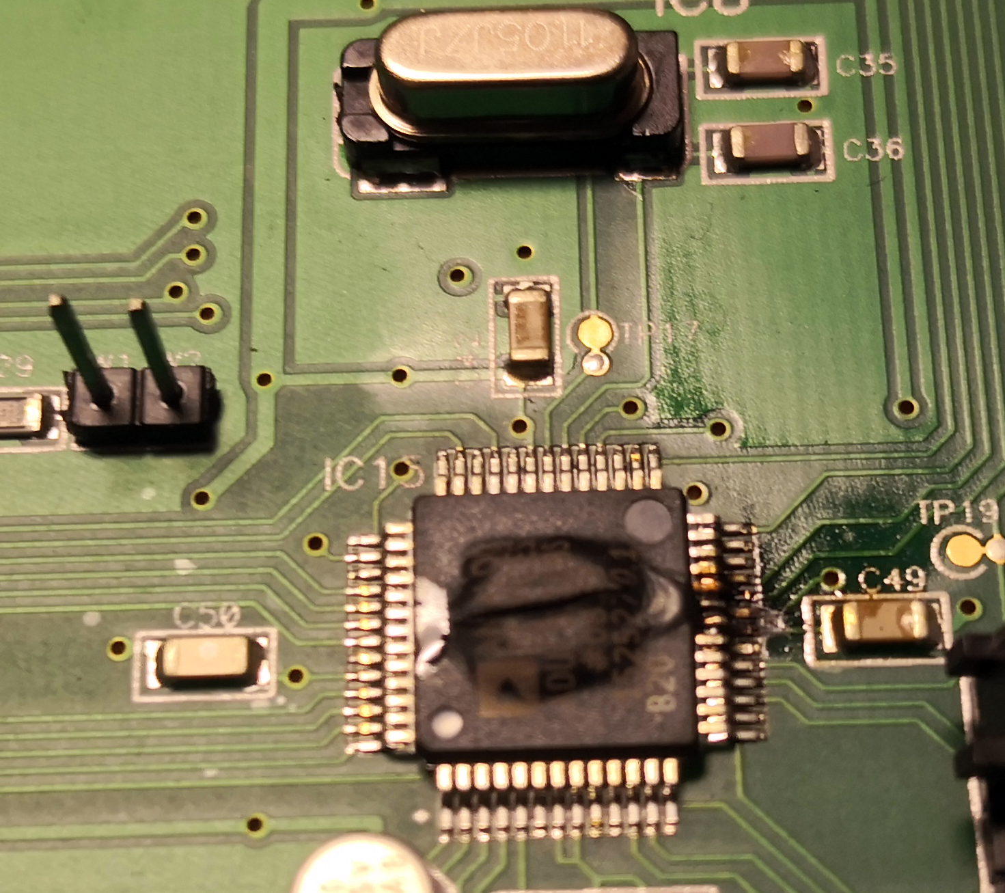
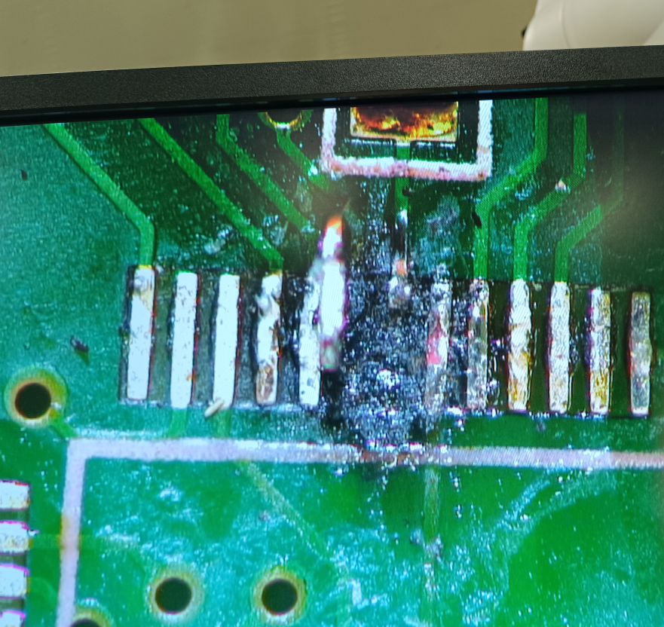
Class 4 events – nQPS FPA and HDS firing on 3xMB
Loss of communication to the nQPS (DQLPU-S) crate
Instantaneous or delayed FPA and/or trigger of quench heaters by symmetric quench detection card, DQQDS
Crate controller’s microcontroller (ADuC831) physically destroyed by destructive SEL
Quench detectors worked properly but in a cascade of events, fault of ADuC can cause:
→ Loss of communication (4a)
→ Loss of communication & Fast power abort (4b)
→ Loss of communication &
Fires heaters, quenching magnet (4c)

Slide 9
Ion run 2023 – R2E Event overview
Date | Location | Event class | Consequence
Oct 5 | B10L2 | 4b | FPA (precycle required)
Oct 7 | B9R2 | 4c | FPA, Heater discharge MB (quench)
Oct 11 | B10L2 | 2 | FPA (precycle required)
Oct 12 | B9L2 | 2 | FPA (precycle required)
Oct 12 | B8L5 | 4b | FPA (precycle required)
Oct 13 | B12R2 | 4c | FPA, Heater discharge MB (quench)
Oct 14 | A12L2 | 3a | FPA, Heater discharge MQ (quench)
Oct 15 | A12R2 | 3b | FPA, Heater discharge MQ (quench)
Oct 15 | B12R1 | 2 | FPA (precycle required)
Oct 20 | B11L1 | 2 | FPA (precycle required)
Oct 22 | B10L2 | 2 | FPA (precycle required)
Oct 29 | A10R2 | 4a | Loss of communication (access)
In 2023 ion run we saw 12 unmitigated R2E events leading to FPA or worse
6 of the 12 events were destructive failures, requiring the exchange of a board
Year | Run type | Events/destructive
2023 | pp | 1 / 0
2023 | ions | 12 / 6
2022 | pp | 1 / 1
2018 | pp | 7 / 1
2018 | Ions | 2 / 0

Slide 10
Events compared to previous runs
Year | Run type | Luminosity delivered a point | Peak RadMon dose @ point | Events/destructive
2023 | Ions | P2: 2.16 1/nb | P2: 5 Gy (B10L2) | 12 / 6
2018 | Ions | P2: 0.905 1/nb | P2: 0.49 Gy (B9L2) | 2 / 0
2023 | pp | P5: 30 1/fb | P5: 0.8 Gy (B11L5) | 1 / 0
2022 | pp | P5: 41 1/fb | P5: 0.4 (B8R5) | 1/1 (at dose of 0.3Gy)
2018 | pp | P5: 66 1/fb | P5: 28.8 Gy (B8L5) | 7 / 1
If we look at peak RadMon Doses and delivered luminosities we find:
Total number of events does not scale with delivered Lumi comparing same species runs
  Ions 23 vs 18: twice lumi vs. 6x R2E events
  pp: 23 vs. 18: half the lumi, 1/7x of R2E events → TCL settings in 2018 lead to more losses in QDS
What made 2023 ions so “toxic” ?

Slide 11
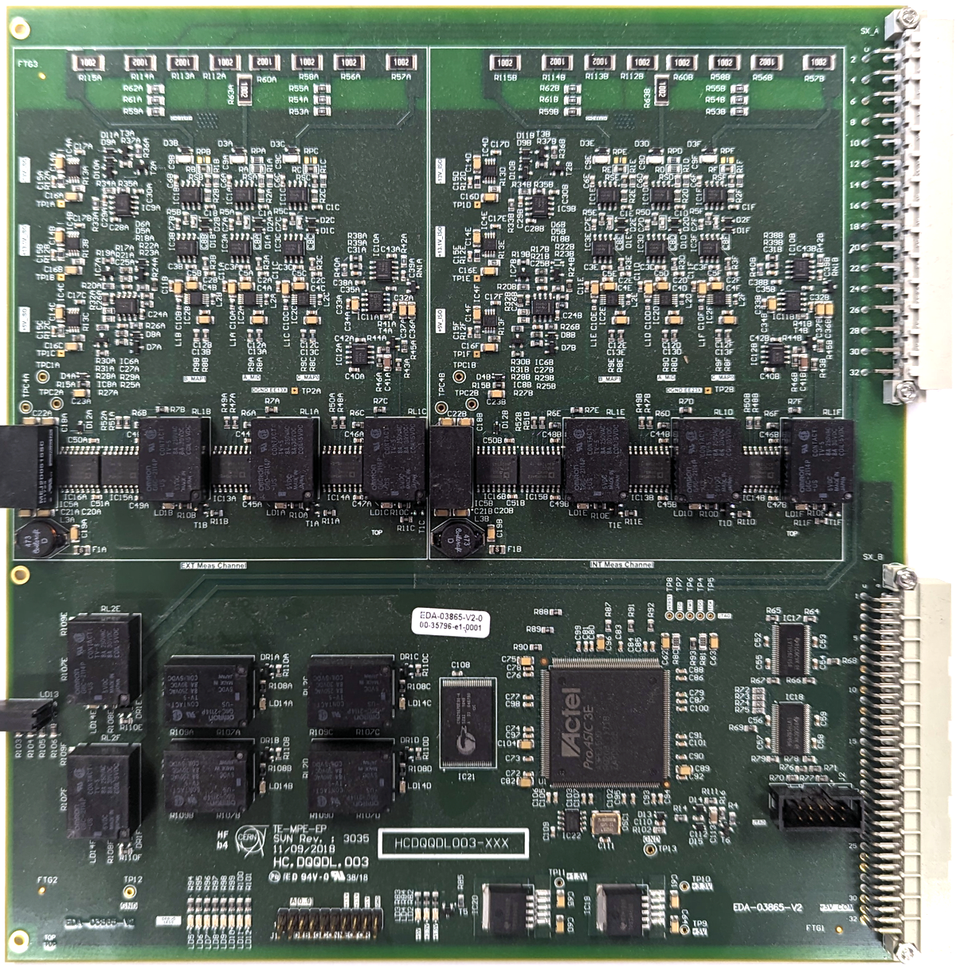
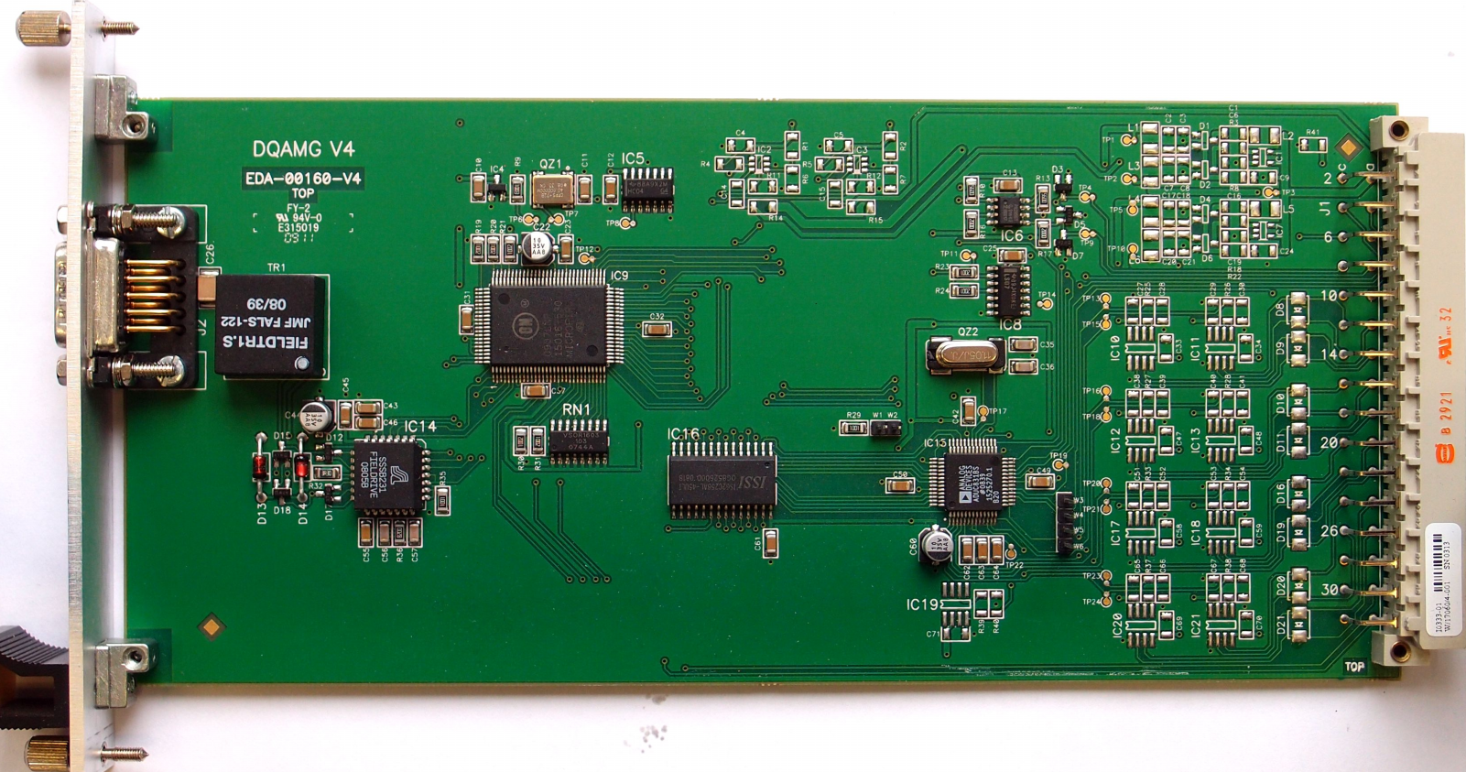
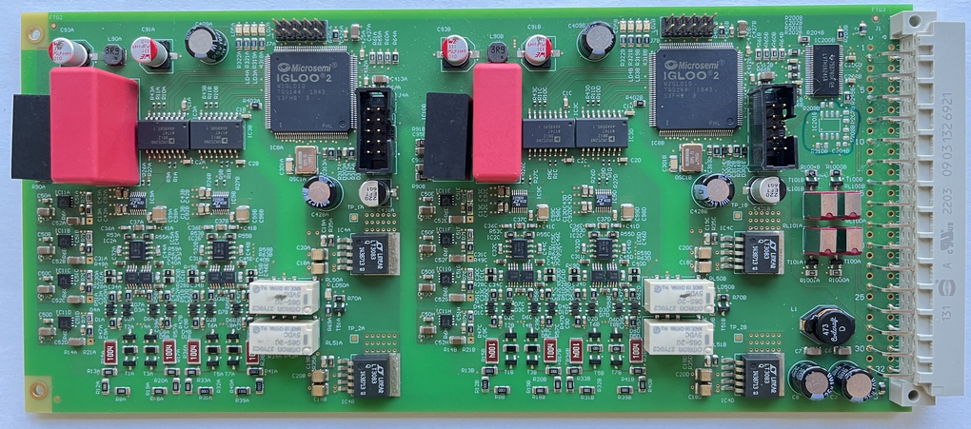
Mitigation
Class | Element | Mitigation | Time frame / Status
Class 2 | DQQBS | New implementation of DQQBS with FPGA and rad tol SAR ADC. Already tested in CHARM and good to 700 Gy Produce 200 boards & Install around P1, P2, P5 | End of EYETS 2023/2024 Plan “B”: install in TS Production launched with BE-CEM-EPR
Class 3 | DQQDL (MQ) | Replace op amp by compatible type in different technology on 4 DQQDL and 2 DQCSU in racks A12 L2 & R2 (if possible also in P1 & P5) | EYETS 2023/2024 (boards already in preparation)
Class 4 | DQAMGS | Produce new version with enhanced latch up protection (resettable fuse) ~ 30 Boards to be installed around P2, P1 & P5 | End of EYETS 2023/2024 Plan “B”: install in TS
DQQBSv2
DQAMGS
DQQDL

Slide 12
Conclusion
2023 ion run lead to an overproportional amount of radiation induced events in the QDS compared to the delivered lumi
Only frequency of class 2 events scaled with P2 integrated luminosity during ion run
Two of the four error classes (3 and 4) were unknown so far, and not expected at all.
CHARM testing strategy (system level qualification) seems not sufficient anymore
Mitigation measures for the three un-mitigated event classes are underway, completion foreseen until end of EYETS (or in TS if late)
A potential 2024 ion run would confirm the effectiveness of the mitigation methods

