Slide 1
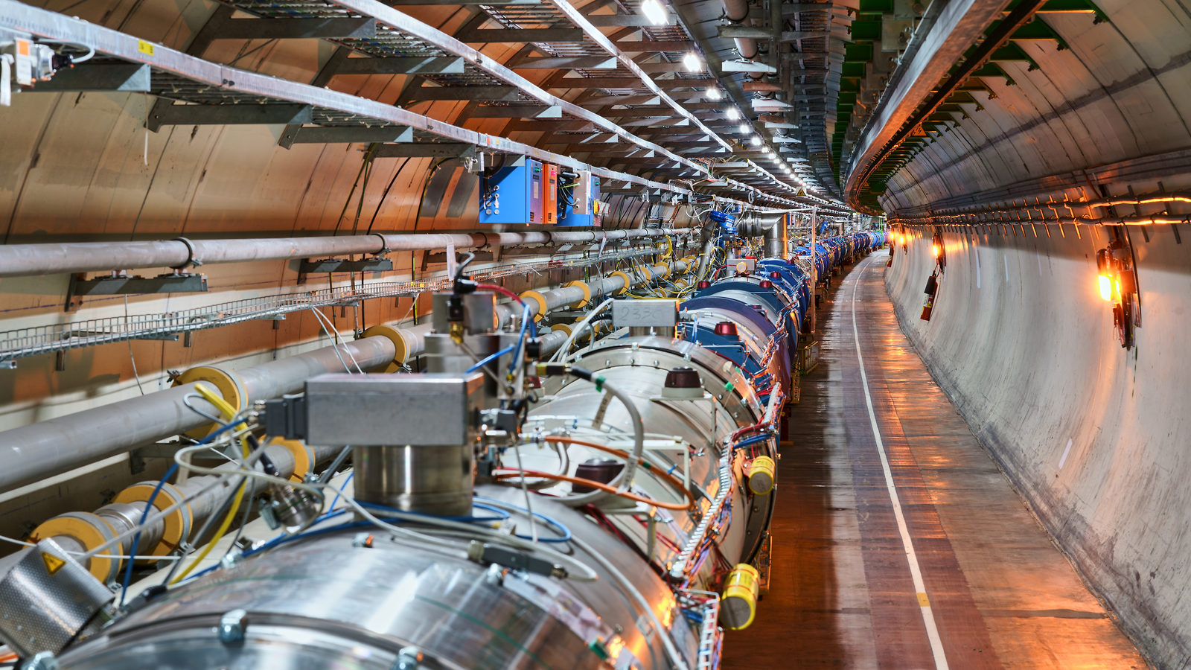
CERN, Accelerators, and Perspectives
Mike Lamont

Slide 2

Science for peace
CERN was founded in 1954 with 12 European Member States
CERN’s annual budget
is 1300 MCHF (equivalent
to a medium-sized European university)
23 Member States
Austria – Belgium – Bulgaria – Czech Republic
Denmark – Finland – France – Germany – Greece Hungary – Israel – Italy – Netherlands – Norway
Poland – Portugal – Romania – Serbia – Slovakia Spain – Sweden – Switzerland – United Kingdom
As of 31 December 2022
Employees:
2658 staff, 900 fellows
Associates:
11 860 users, 1516 others
3 Associate Member States
in the pre-stage to membership
Cyprus – Estonia – Slovenia
7 Associate Member States
Croatia – India – Latvia – Lithuania – Pakistan
Türkiye – Ukraine
6 Observers
Japan – Russia (suspended) – USA
European Union – JINR (suspended) – UNESCO
Around 50 Cooperation Agreements
with non-Member States and Territories
Albania – Algeria – Argentina – Armenia – Australia – Azerbaijan – Bangladesh – Belarus – Bolivia
Bosnia and Herzegovina – Brazil – Canada – Chile – Colombia – Costa Rica – Ecuador – Egypt – Georgia – Honduras
Iceland – Iran – Jordan – Kazakhstan – Lebanon – Malta – Mexico – Mongolia – Montenegro – Morocco – Nepal
New Zealand – North Macedonia – Palestine – Paraguay – People's Republic of China – Peru – Philippines – Qatar
Republic of Korea – Saudi Arabia – Sri Lanka – South Africa – Thailand – Tunisia – United Arab Emirates – Vietnam
Notes:
The speaker can highlight CERN’s second mission as stated when it was established: to foster peaceful collaborations between nations that had recently been at war.
Additional information (OPTIONAL)
More than 40% of CERN’s budget is returned to industry through materials, utilities and services

Slide 3
A laboratory for people around the world
Distribution of all CERN Users by the country of their home institutes as of 31 December 2022
Geographical & cultural diversity
Users of 110 nationalities
19.4% women
Member States 7147
Austria 85 – Belgium 129 – Bulgaria 43 – Czech Republic 244 Denmark 49 – Finland 90 – France 844 – Germany 1225 Greece 119 – Hungary 73 – Israel 64 – Italy 1527
Netherlands 169 – Norway 79 – Poland 305 – Portugal 100 Romania 109 – Serbia 33 – Slovakia 70 – Spain 383
Sweden 103 – Switzerland 406 – United Kingdom 898
Associate Member States
in the pre-stage to membership 69
Cyprus 15 – Estonia 30 – Slovenia 24
Associate Member States 382
Croatia 38 – India 132 – Latvia 16 – Lithuania 14 – Pakistan 35
Türkiye 122 – Ukraine 25
Observers 2991
Japan 216 – Russia (suspended) 873 – United States of America 1902
Non-Member States and Territories 1271
Algeria 2 – Argentina 13 – Armenia 8 – Australia 21 – Azerbaijan 2 – Bahrain 4 – Belarus 18 – Brazil 122
Canada 199 – Chile 34 – Colombia 21 – Costa Rica 2 – Cuba 3 – Ecuador 4 – Egypt 20 – Georgia 32
Hong Kong 15 – Iceland 3 – Indonesia 5 – Iran 11 – Ireland 5 – Jordan 5 – Kuwait 4 – Lebanon 13 – Madagascar 1
Malaysia 4 – Malta 1 – Mexico 49 – Montenegro 4 – Morocco 19 – New Zealand 5 – Nigeria 1 – Oman 1
Palestine 1 – People’s Republic of China 333 – Peru 2 – Philippines 1 – Republic of Korea 147 – Singapore 2 South Africa 52 – Sri Lanka 10 – Taiwan 45 – Thailand 17 – Tunisia 2 – United Arab Emirates 7 – Viet Nam 1
Notes:
THIS SLIDE WILL INCLUDE THE NUMBER OF MEMBERS OF PERSONNEL OF THE VISITORS’ COUNTRY OF ORIGIN

Slide 4
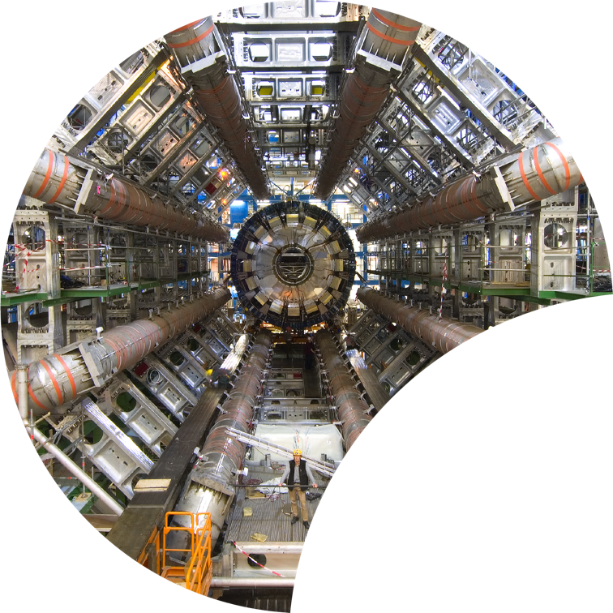
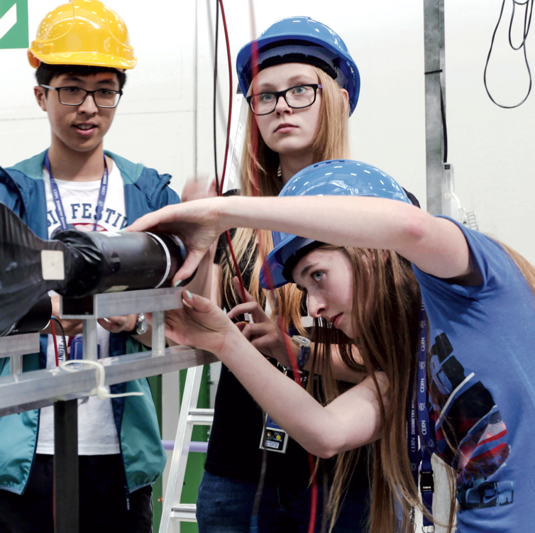

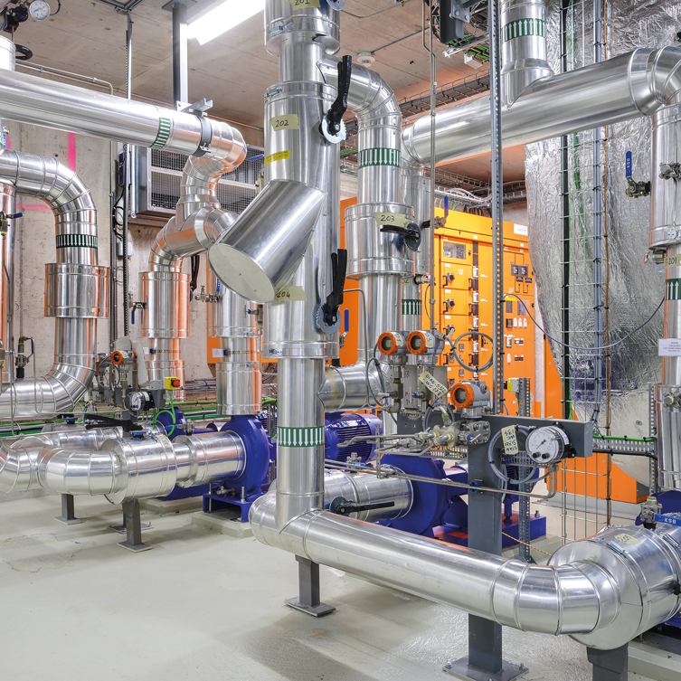

Four pillars underpin CERN’s mission
RESEARCH
EDUCATION
& TRAINING
COLLABORATION
TECHNOLOGY
& INNOVATION
Notes:
This slide introduces the four pillars that underpin CERN’s mission:
Research: To perform world-class research in experimental and theoretical particle physics; and to provide the particle physics community a range of accelerators that enable that research
Collaboration: To unite people from all over the world in the common goal of advancing the frontiers of human knowledge, in a spirit of equal collaboration and openness
Innovation: To push the technology underpinning accelerators, detectors and computing, to drive innovation in order to transfer knowledge to other scientific and technological areas, for the benefit of society
Education and Training: To train future physicists and engineers, to promote careers in science and engineering, and to foster citizens’ engagement in particle physics and in fundamental research.
FROM THIS POINT FORWARD, THE PRESENTATION IS DIVIDED INTO FOUR SECTIONS: ONE SECTION PER PILLAR

Slide 5
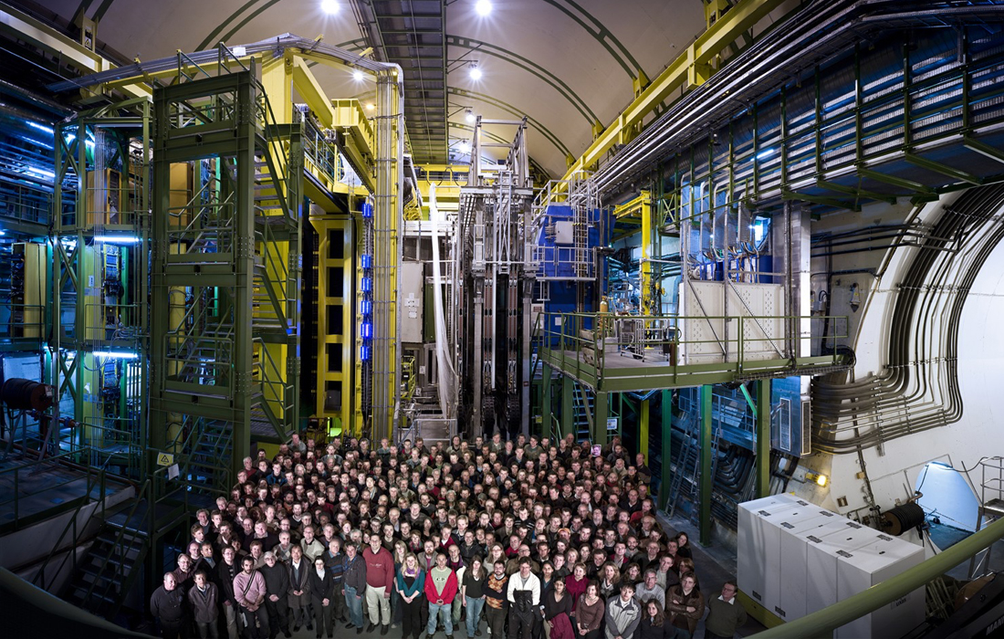
Our goal is to understand the most fundamental particles and laws of the universe.

Slide 6
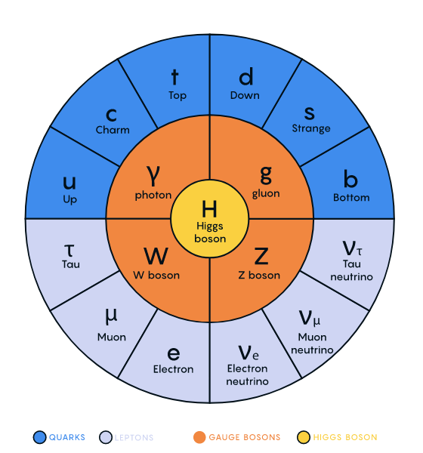

Slide 7
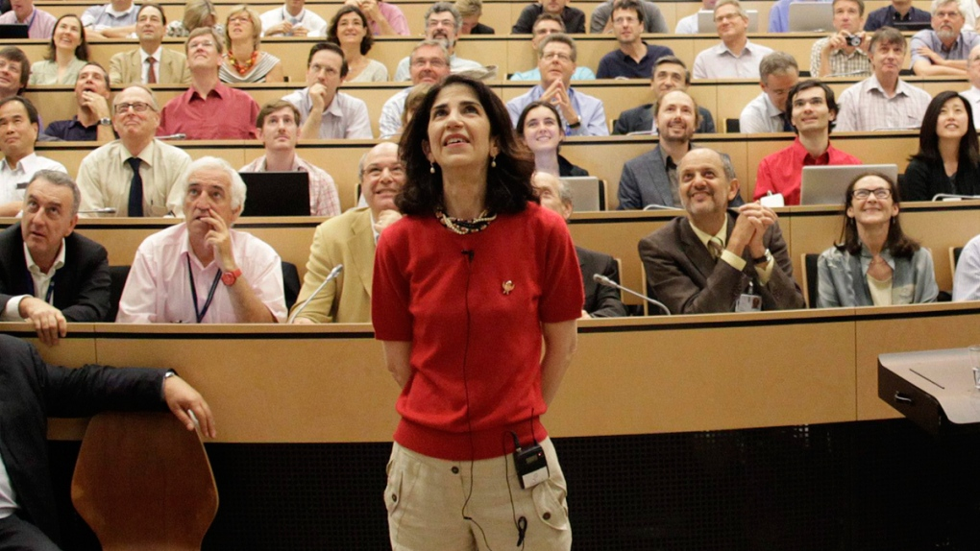

Slide 8

Hitoshi Murayama

Slide 9
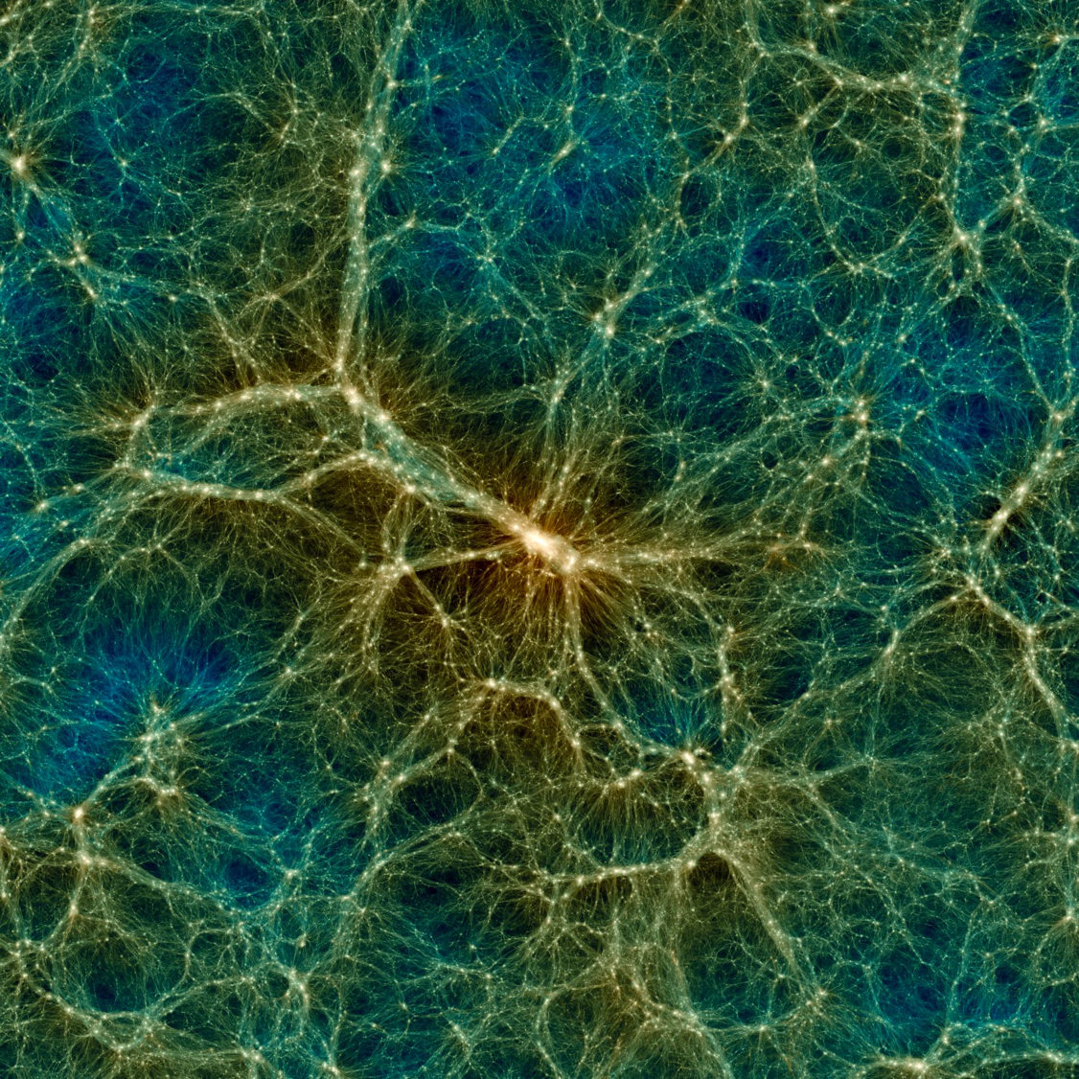
Cosmic web of Dark Matter Decorated by Stars
Simulation of the large-scale structure of the universe, showing dense clusters of galaxies, filaments, galactic walls and voids.
Credit: Uchuu project.

Slide 10
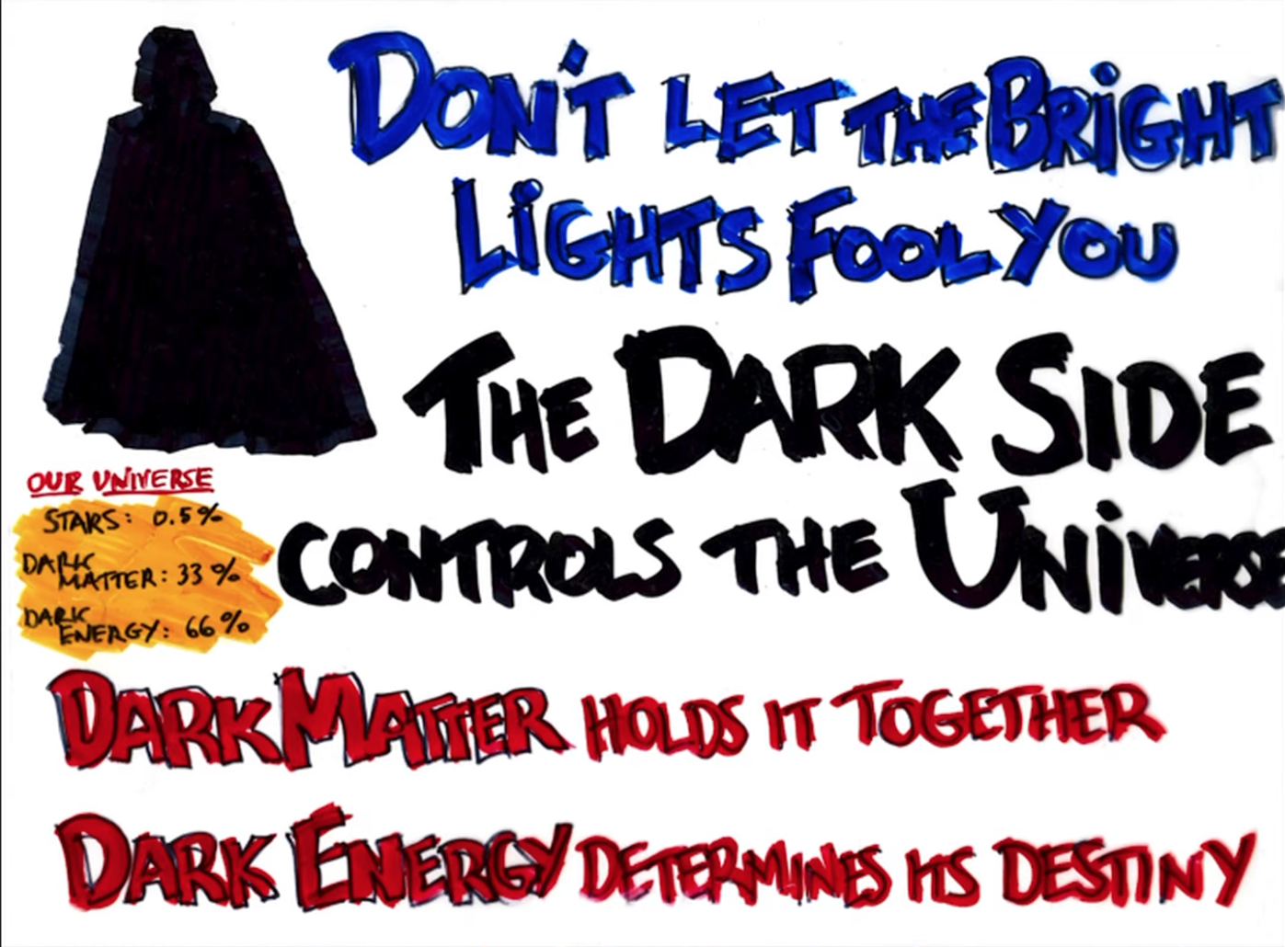
Michael Turner

Slide 11
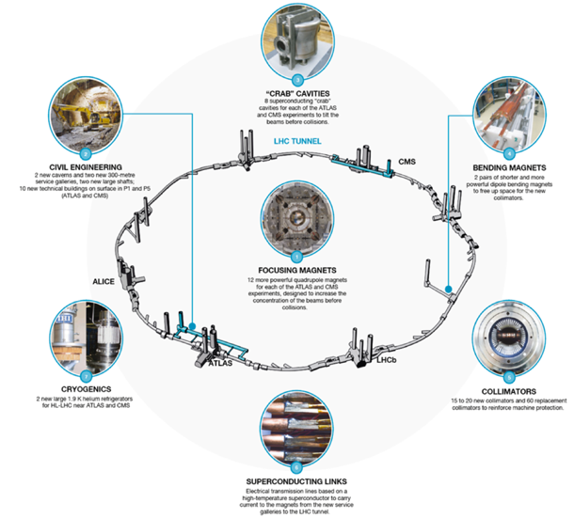
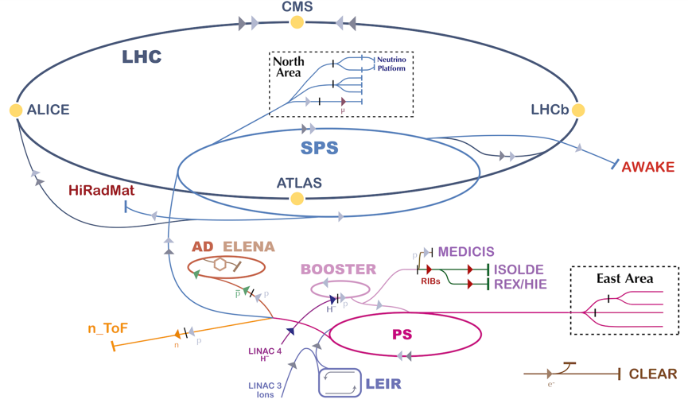
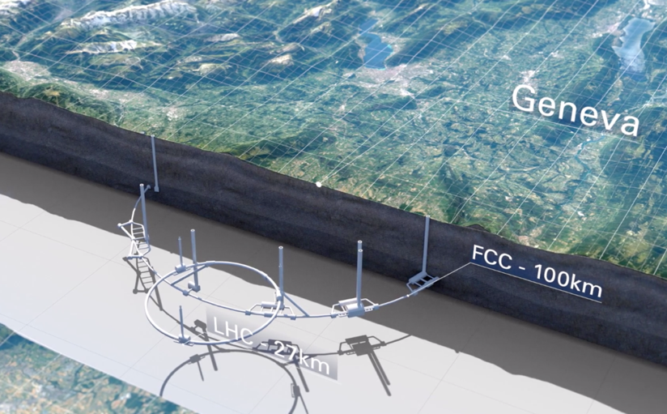
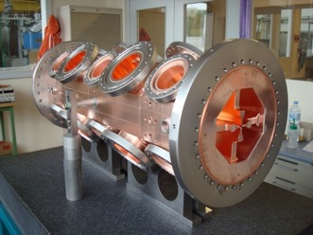
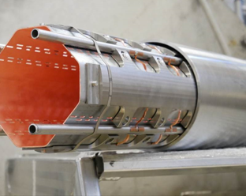
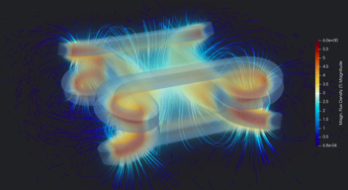
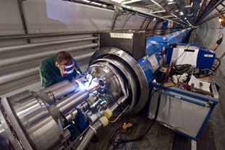
Exploitation
HL-LHC
Future Options
Technology/Engineering/R&D

Slide 12
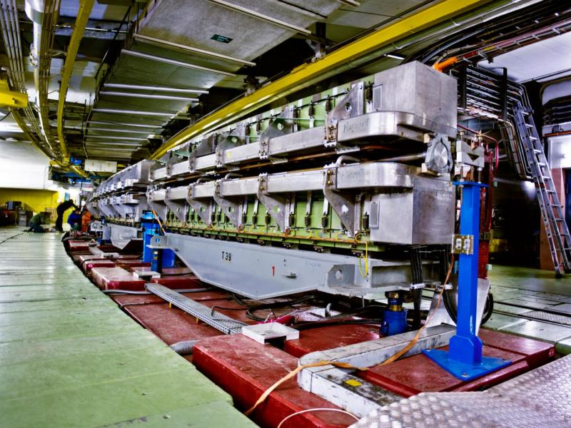
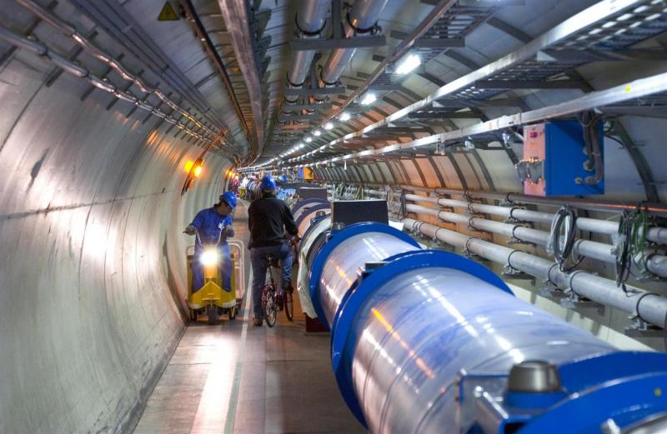
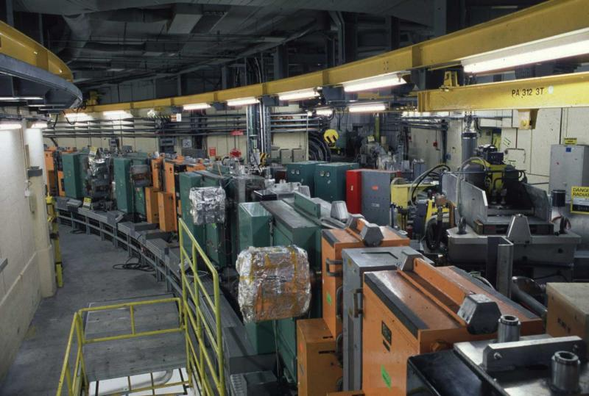
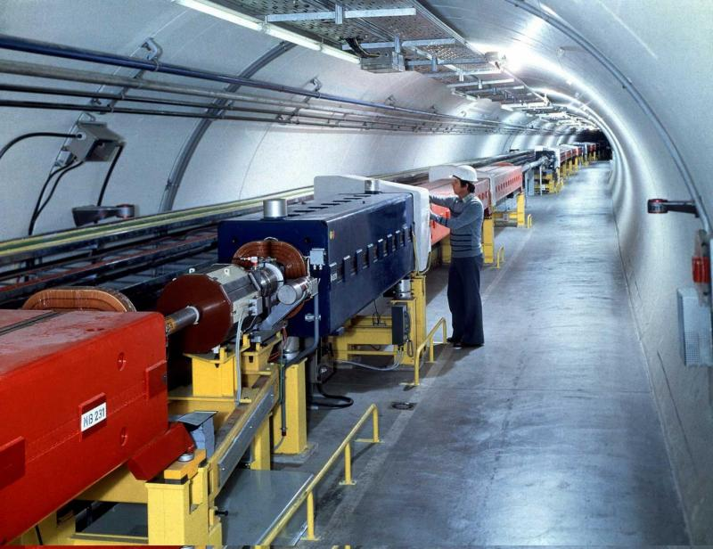
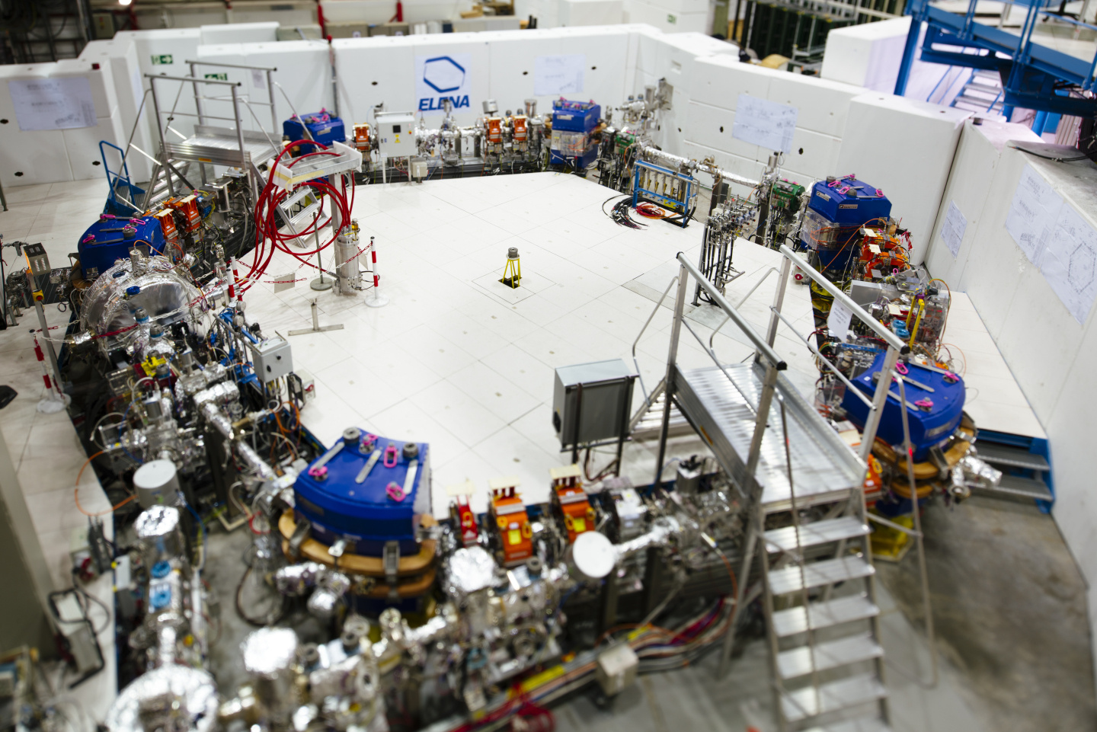
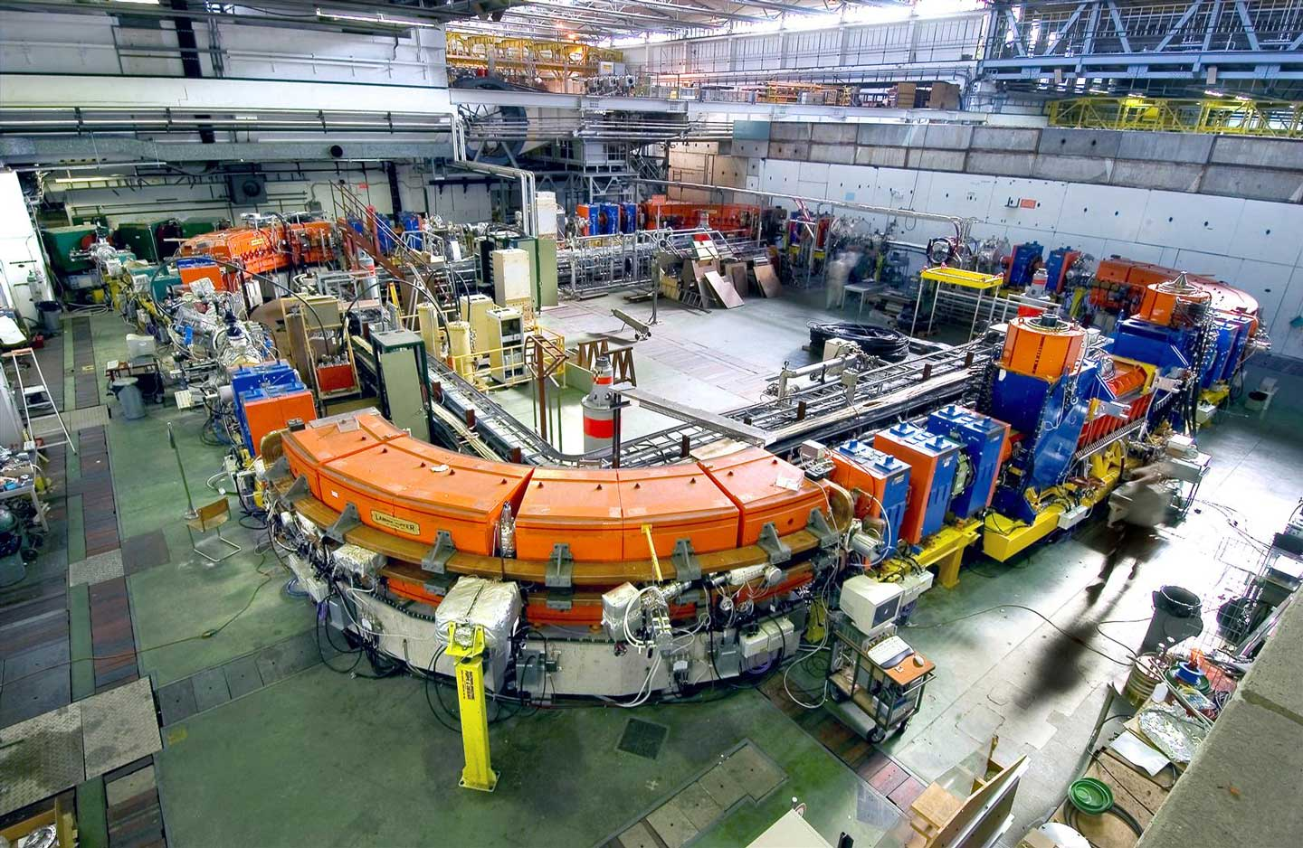
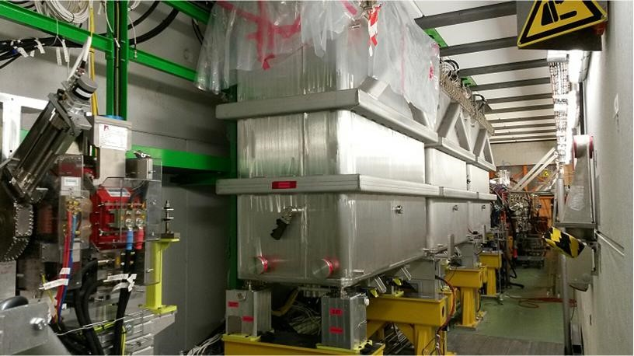
The CERN Accelerator Complex

Slide 13
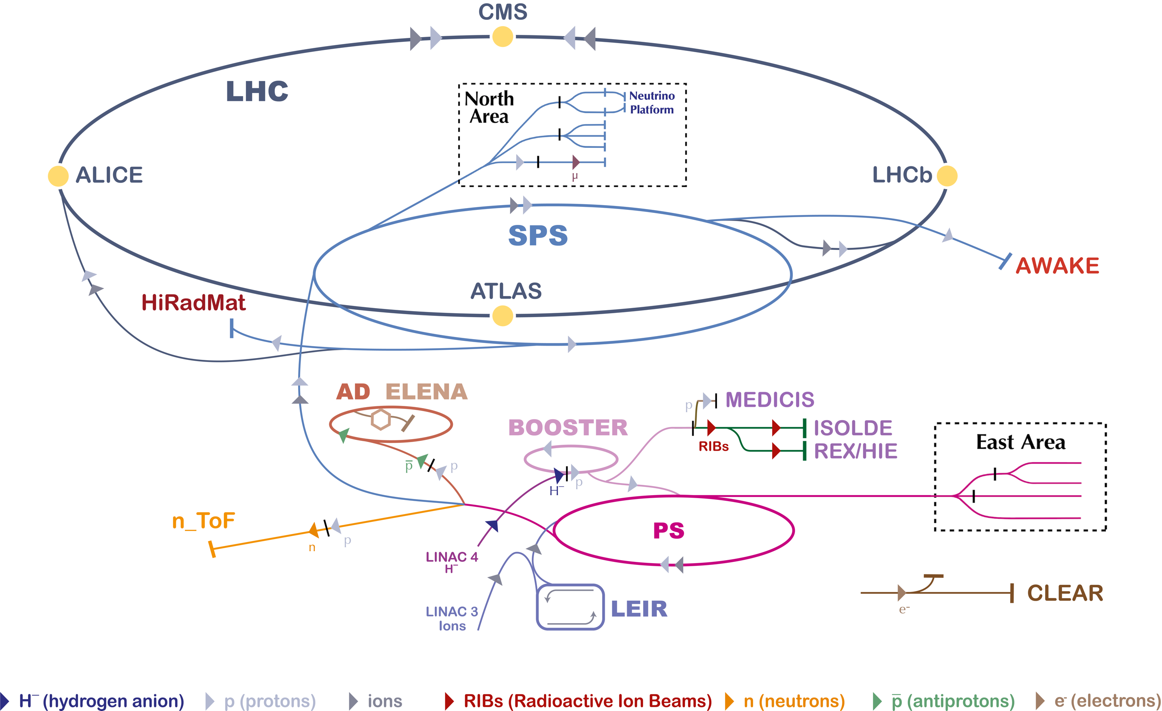
Wide range of secondary hadron/lepton beams
Primary p and ions,
secondary beams of hadrons, leptons
Antiprotons
Radioactive
Ion Beams
Neutrons
Electrons

Slide 14
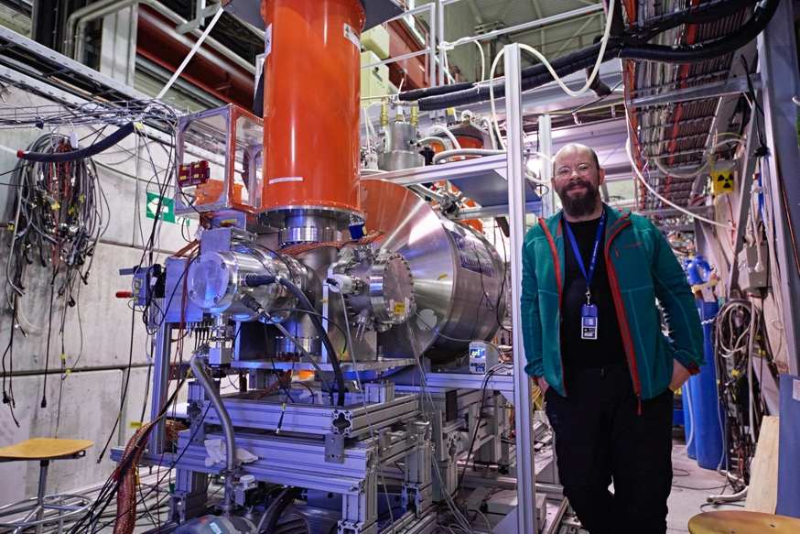
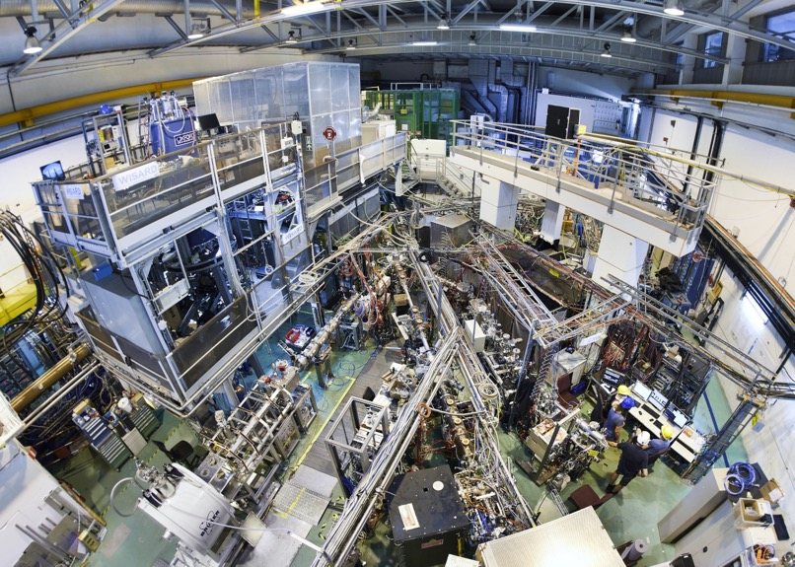
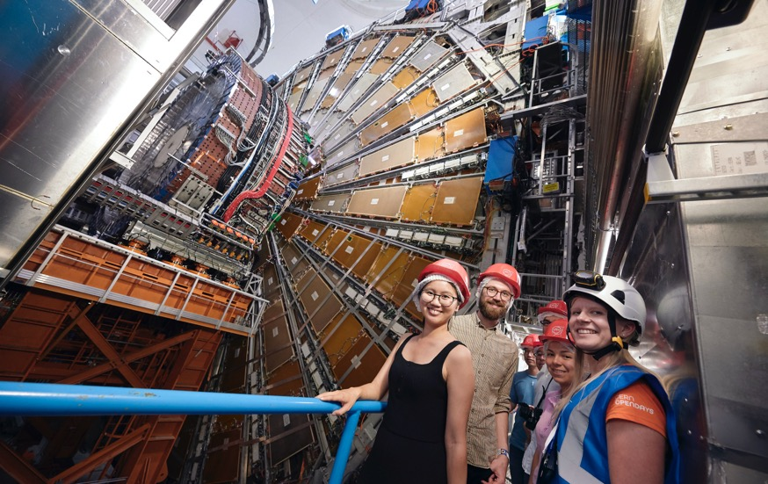
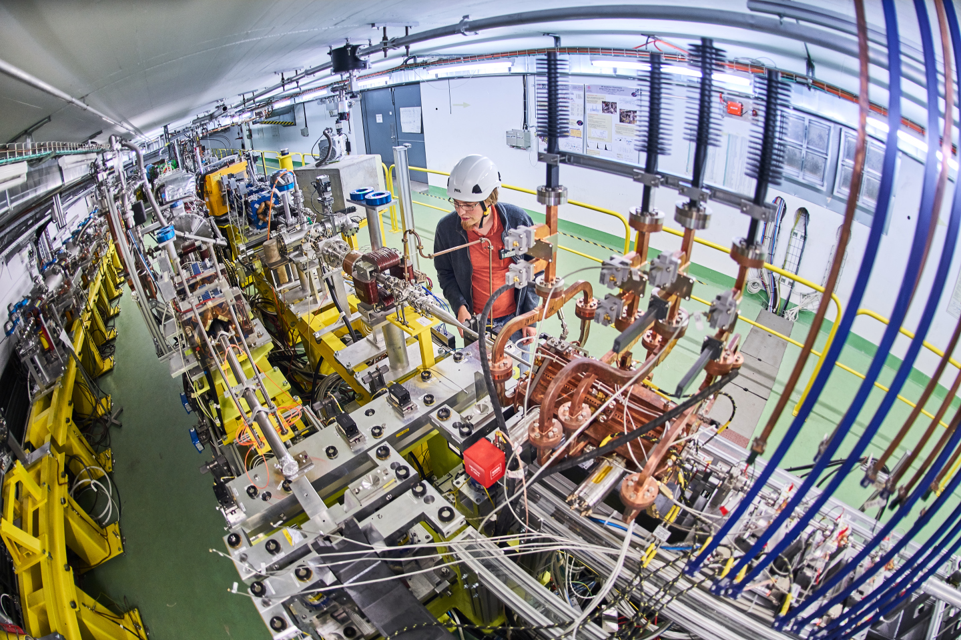
Antiprotons
Radioactive ion beams
Protons
Electrons
Notes:
Particle accelerators are key to CERNs research
Accelerators boost beams of particles to high energies before the beams are made to collide with each other or with stationary targets.
This slide shows a few examples of CERNs experimental facilities.

Slide 15
IONS

Slide 16
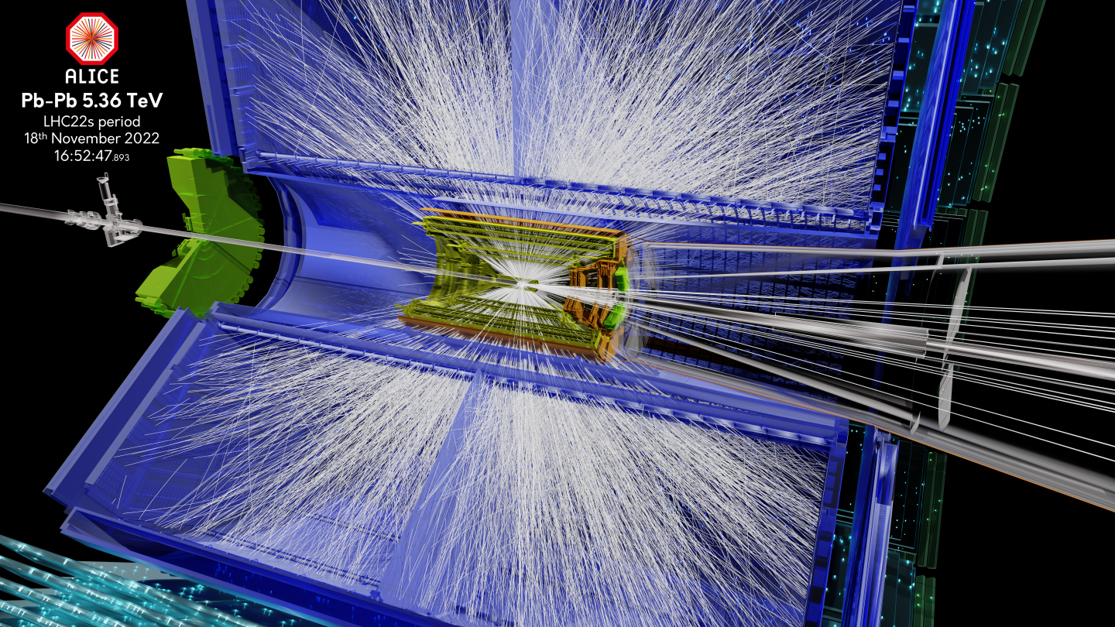
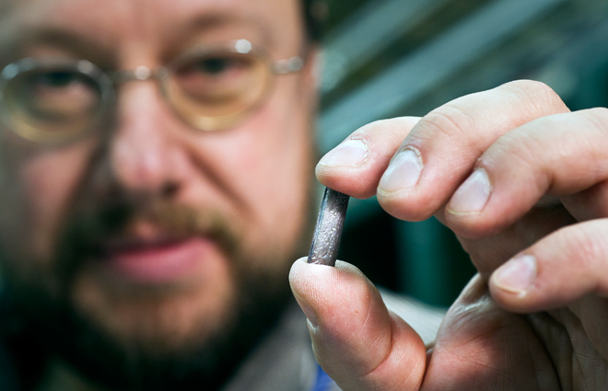
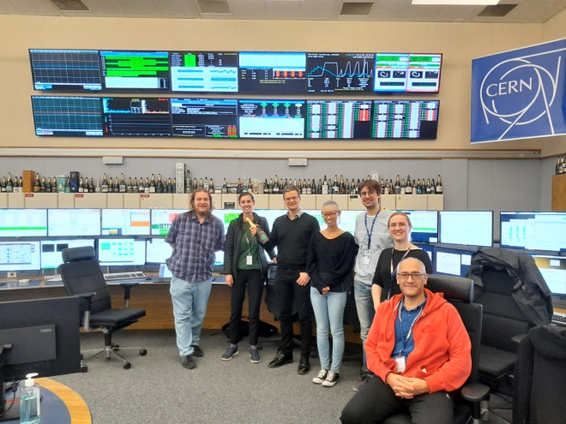
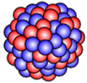

Slide 17
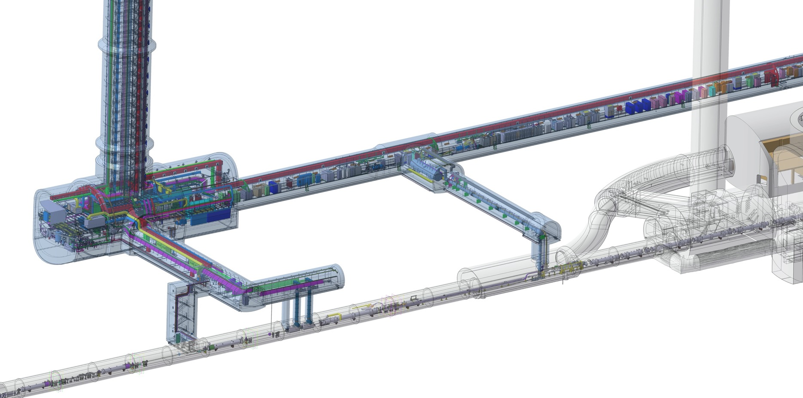
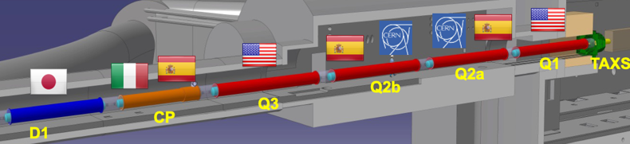
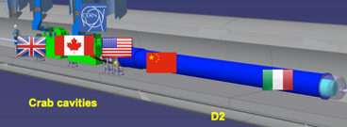
High Luminosity LHC
Prepare the machine for operation beyond 2025 and up to ~2041
Operation scenarios for a total integrated luminosity of 3000 fb⁻¹
QDS
UR55
Warm Diodes
CLIQ
PIC,BIS
CDBs
OC EE
Valve box
DFHX
D2 OC PCs
DFHM
US57
D2 PC
D1 PC
OC PCs
UW57
PC IT
PCs IT Trims
CDBs
DSHX
D2 OC EE
UL57
Cold box
DSHM
UA57
D1
CP
Q3
Q2B
Q2A
Q1
RF Powering
DFM
DCM
Cooling and Ventilation
DFX
UPR57
Cold Diodes
TAXN
Crab
Cavities
D2
DQHDS
Q4
Q5
Q6

Slide 18
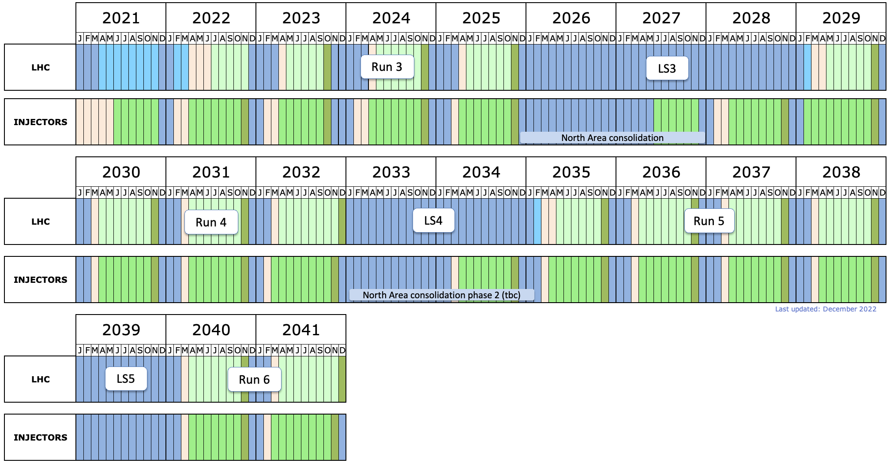
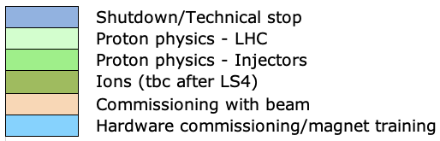
Indicative timeline - full and diverse physics programme
LS3: HL-LHC installation
LHCb-II, ALICE3 upgrades (tbc)

Slide 19

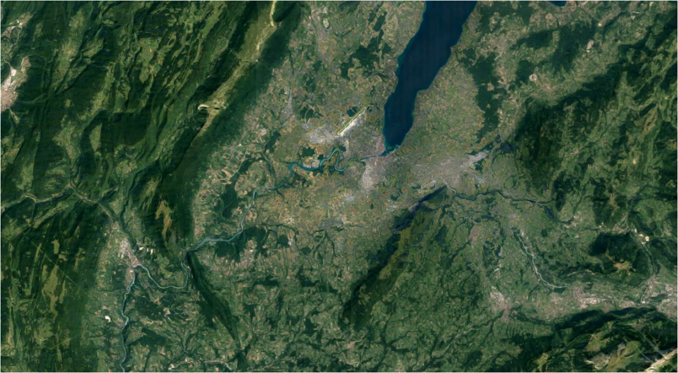


LEGEND
CERN ExistingLHC
LHC
FCC
Muon Collider
CLIC
FCC
CLIC
Muon Collider ring
Muon Acceleration ring

Slide 20
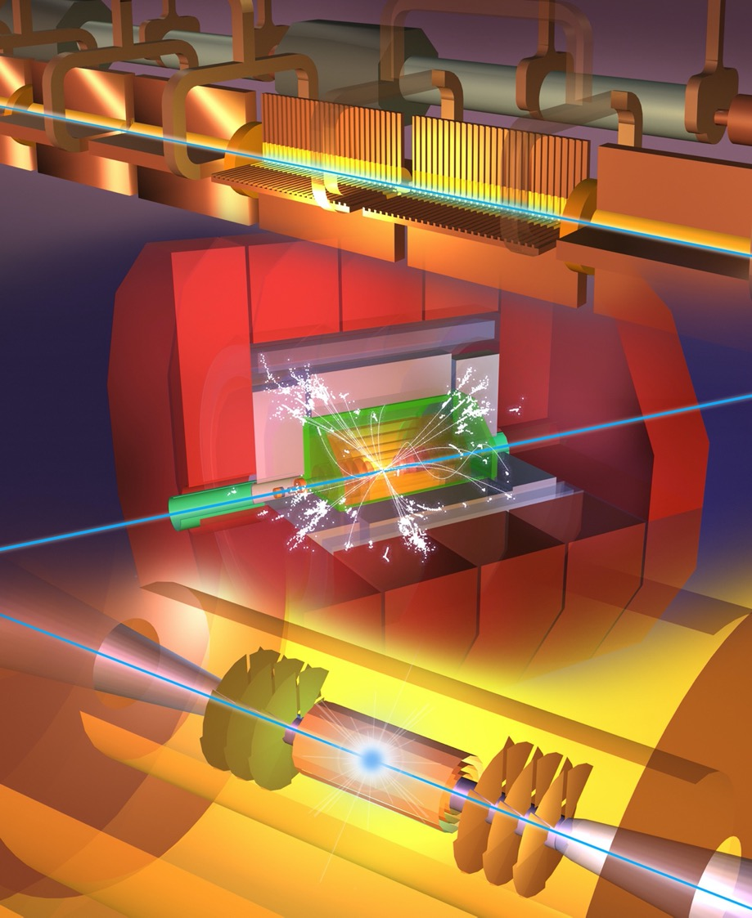
Options at CERN
Within specified timeframe (start ops. ~2045)
FCC-ee
CLIC-380
(ILC-250, LEP3, LHeC, HE-LHC)
Outside specified timeframe
FCC-hh (natural follow-on to FCC-ee)
Muon Collider
Options possibly in timeframe not at CERN: ILC, CEPC, C³

Slide 21
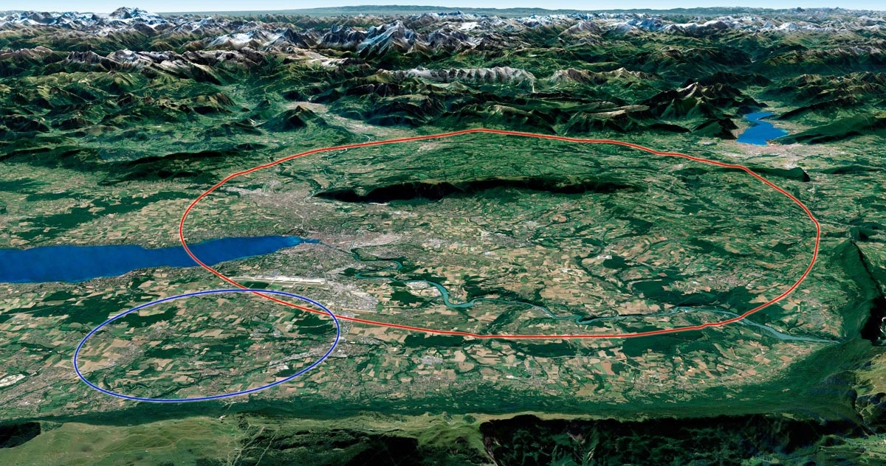
FCC

Slide 22

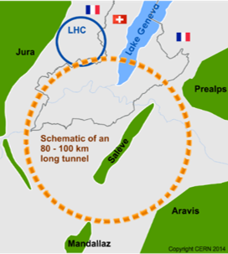
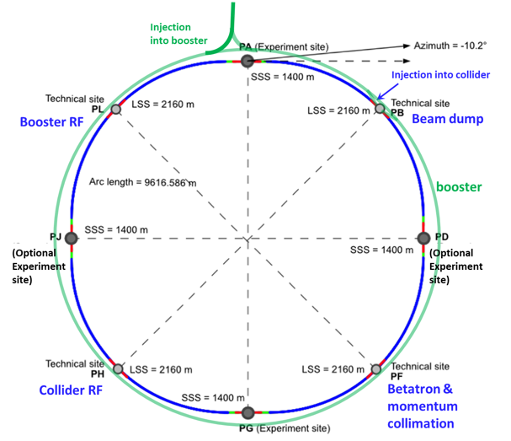
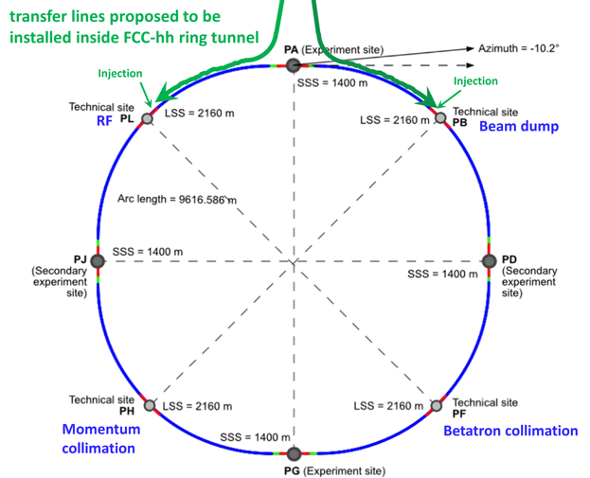
FCC integrated program: inspired by LEP- LHC
Comprehensive long-term program maximizing physics opportunities:
Stage 1: FCC-ee (Z, W, H, $\text{t}\overline{\text{t}}$) as Higgs factory, electroweak & top factory at highest luminosities
Stage 2: FCC-hh (~100 TeV) as natural continuation at energy frontier, with ion and eh options
FCC-ee
FCC-hh
2020 - 2040
2045 - 2063
2070 - 2095

Slide 23
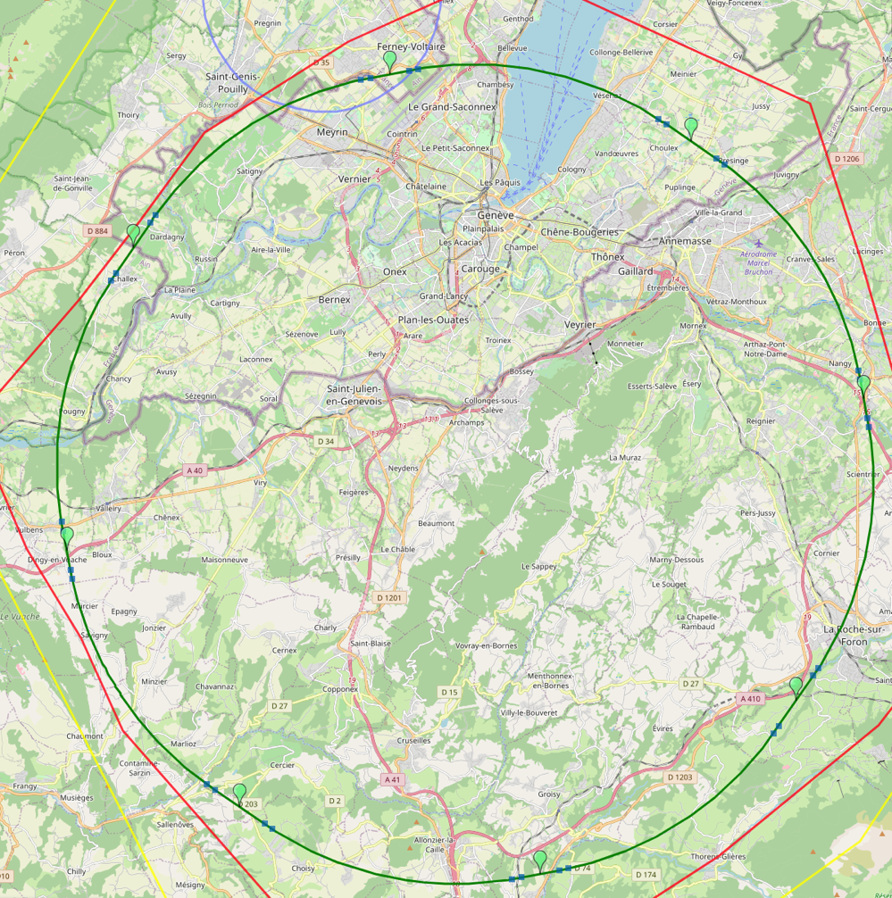
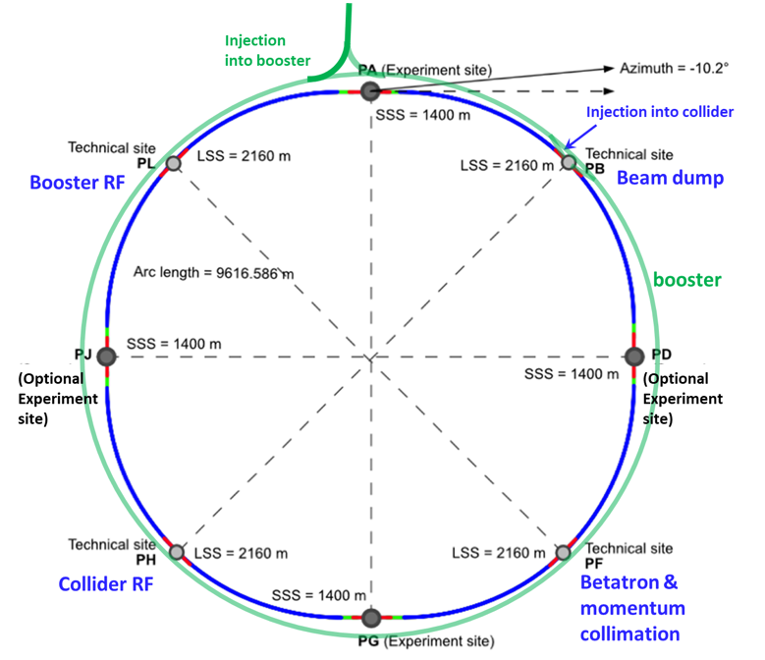
Feasibility study (2021 – 2025) ongoing
Major achievement: optimization of the ring placement
Layout chosen out of ~100 initial variants, based on geological,
urban, environmental & infrastructure constraints.
PA: Experiment
PB: technical
Lowest-risk baseline: 90.7 km ring, 8 surface points
Whole project now adapted to this placement
PL: technical
Number of surface sites | 8
LSS@IP (PA, PD, PG, PJ) | 1400 m
LSS@TECH (PB, PF, PH, PL) | 2032 m
Arc length | 9.6 km
Sum of arc lengths | 76.9 m
Total length | 90.7 km
PD: experiment
PJ: experiment
PF: technical
PH: technical
23
PG: experiment

Slide 24
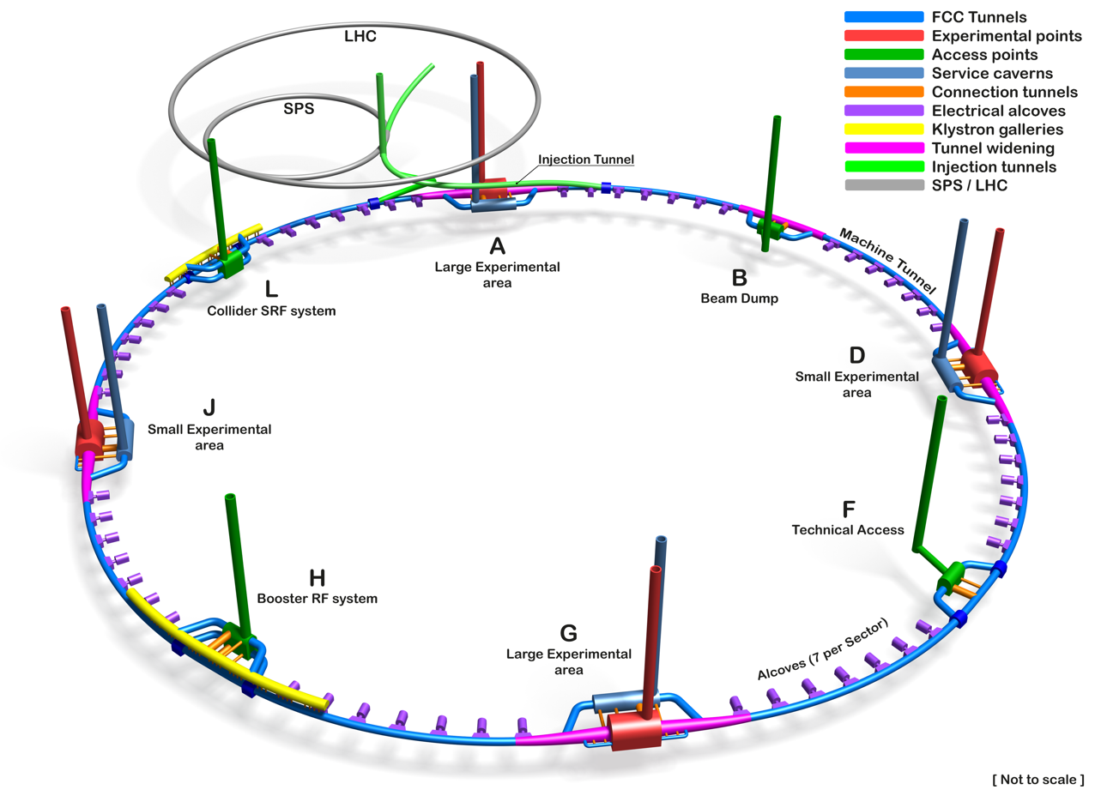
FCC Underground Civil Engineering Schematic
5 June 2023 / FCC Week
Timothy WATSON
Tunnel Circumference: 90.7 km
Excavated vol: 6.2 Mm³ (in the ground)
Access shafts: 12
Construction shafts: 1
Large experiment areas: 2
Small experiment areas: 2
Technical points: 4
Deepest shaft: 400 m
Average shaft depth: 243 m
FCC feasibility study (2021 – 2025) ongoing

Slide 25
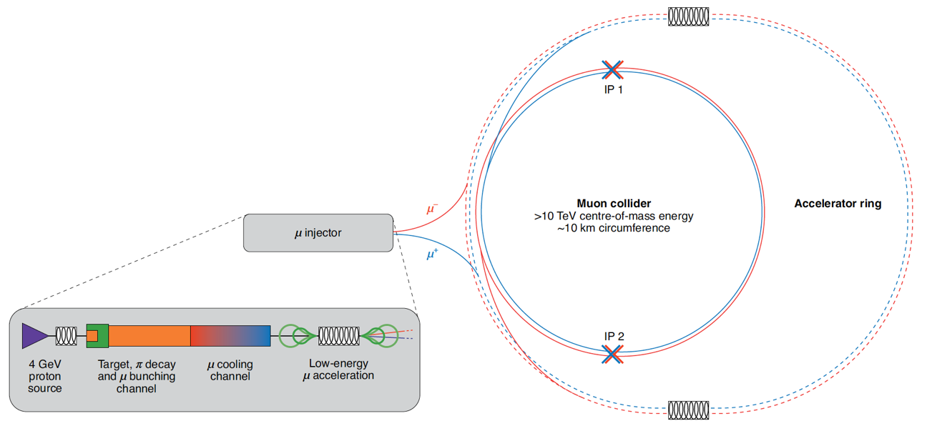
Muon Collider
International Muon Collider Collaboration hosted at CERN
Large mass (207 m_{e}) suppresses synchrotron radiation => circular collider
Fundamental particle yields clean collisions & requires less energy than protons
But lifetime at rest is only 2.2 μs (fortunately increases with energy)!
Steady state
6. Collide them
Steady state
1. Produce muons
5. Accelerate them
2. Capture them
3. Cool them
4. Accelerate them

Slide 26
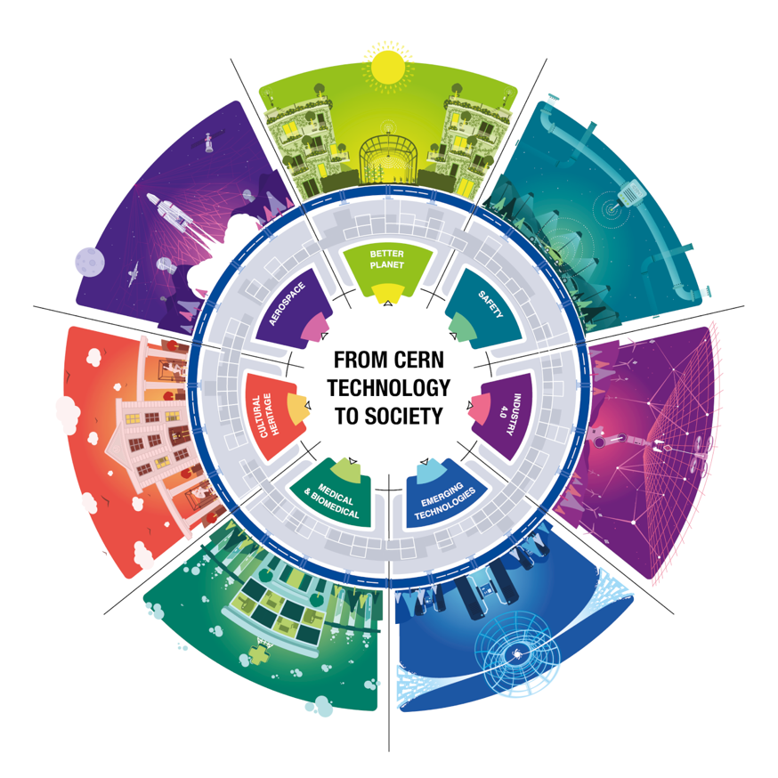
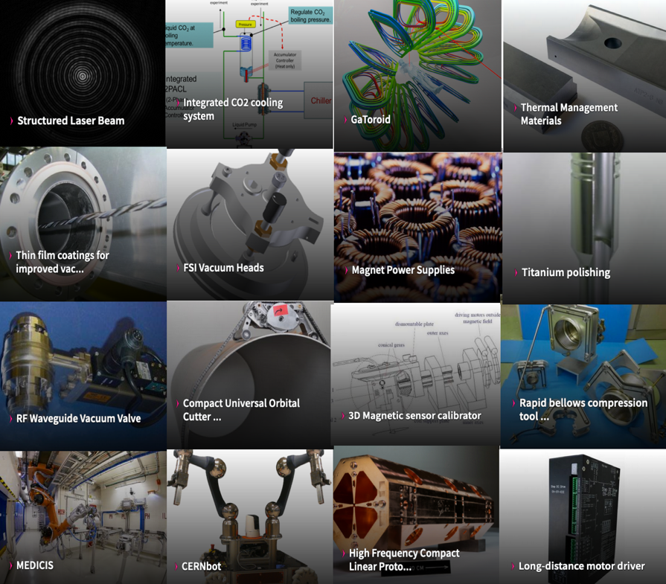
“Places like CERN contribute to the kind of knowledge that not only enriches humanity, but also provides the wellspring of ideas that become the technologies of the future”
Fabiola Gianotti

Slide 27

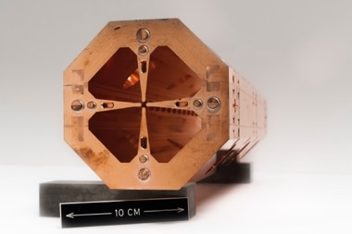








Knowledge Transfer
Medical Applications
Compact high-frequency RFQ
Compact Helium Synchrotron
Compact Gantries (HITRIplus, SIGRUM)
Sustainability
FLASH
Horizon
I.FAST | Fostering Innovation in Accelerator Science and Technology
RADNEXT | Radiation facility network
PRISMAP | European Medical Isotope programme
HITRIplus | Heavy Ion Therapy Research Integration
FCC-IS | FCC Innovation Study
EURO-LABS | European Labs for Accelerator Based Sciences

Slide 28


