Slide 1
DQ web display: reference-replacement functionality in jsROOT
Petronel POSTOLACHE
Alexandru Ioan Cuza University of Iasi (RO)
Technical Supervisor: Rohin NARAYAN

Slide 2
Qualification Task for P.Postolache
Implement the reference-replacement functionality in jsROOT for the DQ web displays.

Slide 3
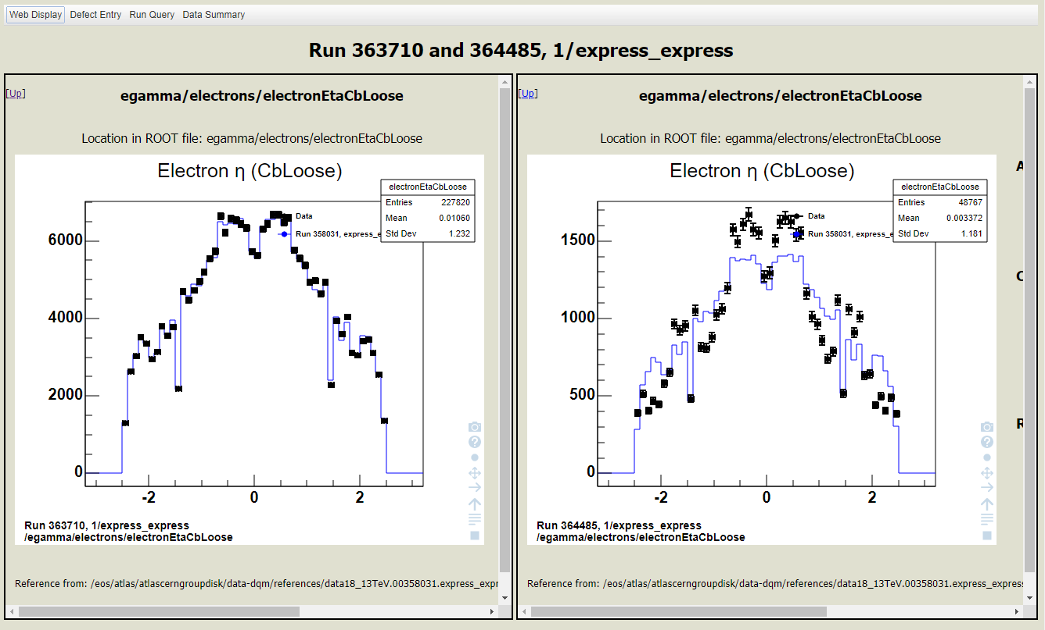
What was requested
A functionality to be able to replace the reference with data from another run.
There was a side-by-side comparing functionality already implemented but we need the data on same graph (superimposed)

Slide 4
How I did it
Webdisplay uses jsRoot to provide interactive graphics in the web browser.
I’ve investigated two options:
  Clientside: generate two .json files and replace the reference from first one with the data from the second one (all this done in javascript)
  Serverside: generate the superimposed .json file with reference data replaced from Python/C++

Slide 5
How I did it
.json file format it is dependent on the graph type, it is hard to make a javascript function that will work on every case.
I’ve run some test and the time it take for the server to generated two .json files is about the same to the time to generate a superimposed .json

Slide 6
How I did it:
Two new route paths were added in seed_devel.py
Two new functions were added in webdisplay.py file. Depending on the url, superimpose_png or superimpose_json functions are called.
This functions are parsing the parameters and call get_hist_image_superimposed from xmlrpc/han_extractor.py
JSON file or PNG image are generated using the saveHistogramToFileSuperimposed from libDataQualityUtils library (C++)

Slide 7
How I did it:
If the url has “.../run_xxxxx-run_xxxxx/…..” then a variable: multirun is set true and the page is modified to display the superimposed graph using jsROOT. The data for jsROOT is generated by the server in JSON format.
I’ve made changes to libDataQualityUtils library (C++) to rescale the graphs and generate the JSON file.
Some changes were made to the file static/js/rundetail2-devel.js so that we can still show and browse the ROOT tree on the left side of the page.
If we want to go back to the normal webdisplay, just click on the top left link: “Disable Superimposing”

Slide 8
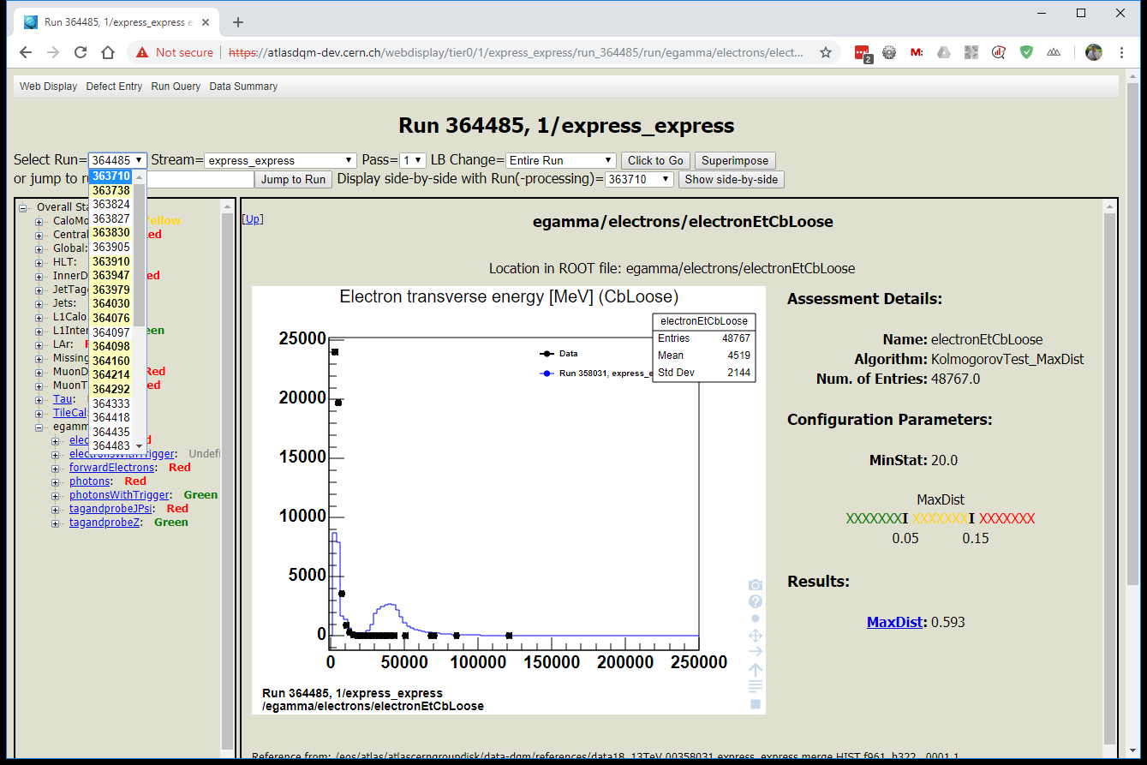
Replace reference data with another run

Slide 9
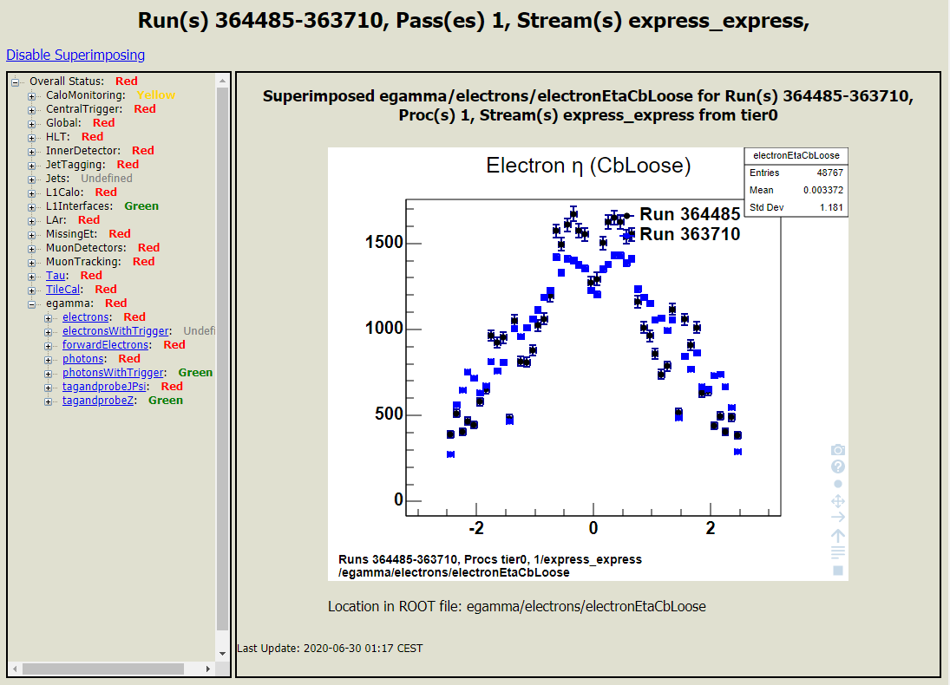
Data from two runs are superimposed

Slide 10
Changes to the code
Athena / DataQualityUtils commit 0e675d1d
  https://gitlab.cern.ch/atlasdqm/athena/-/commit/0e675d1db56dd56d6a8934634fb59b408115e808
CheryPy webserver commit 870219b9
  https://gitlab.cern.ch/atlas-dqm-core/cherrypy/-/commit/870219b92523ecac42b8d37c6c0b4ae706f2aabd

Slide 11
Conclusions
Good knowledge of Python and C++ programming language was required.
Use of the web technologies like Javascript, JSON.
Linux experience and use of development process (git for atlas/Athena project).
Understanding of the CherryPy python webserver.
Learning and understanding the jsRoot package.

