Slide 1
Romanian Students Internship Programme 2023
https://indico.cern.ch/event/1337923

Slide 2
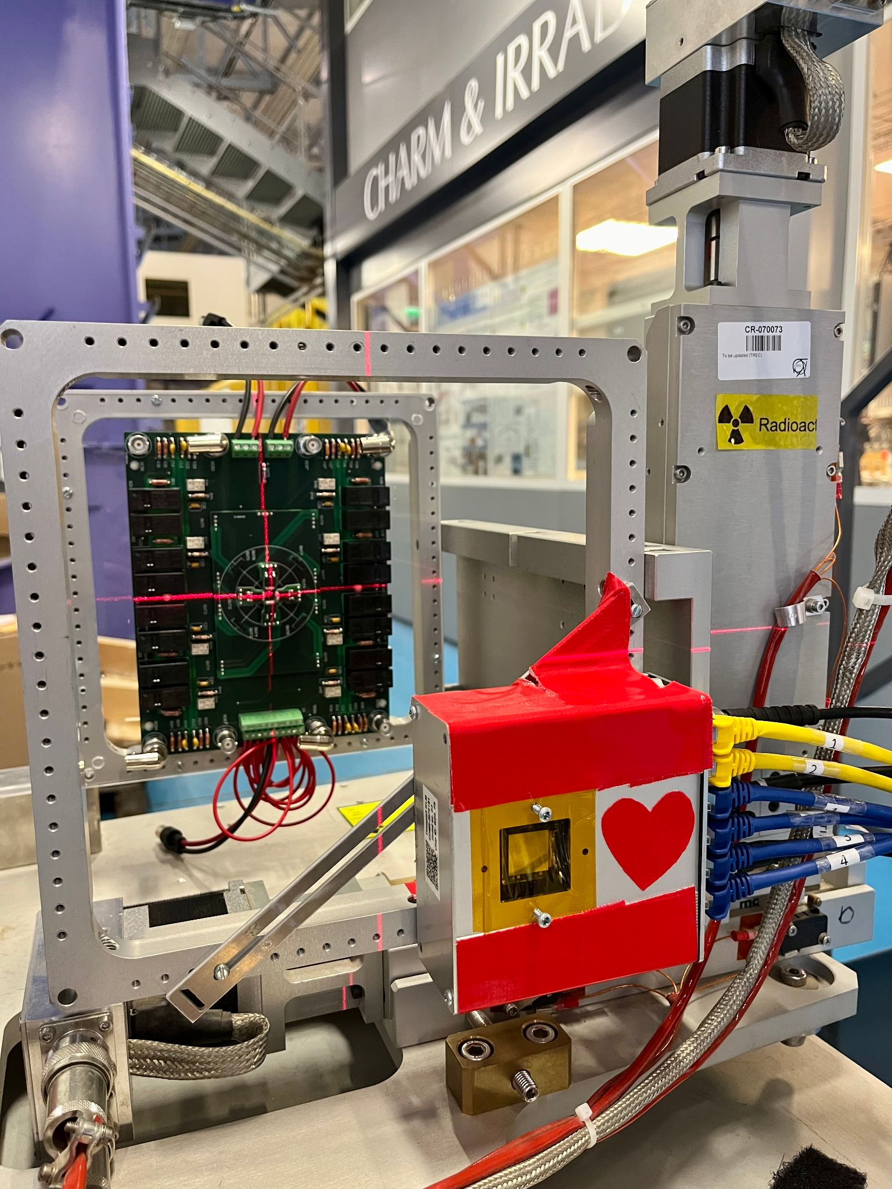
Radiation Monitoring R&D at the CERN Accelerator Complex
Daniel Prelipcean
2023.11.21

Slide 3
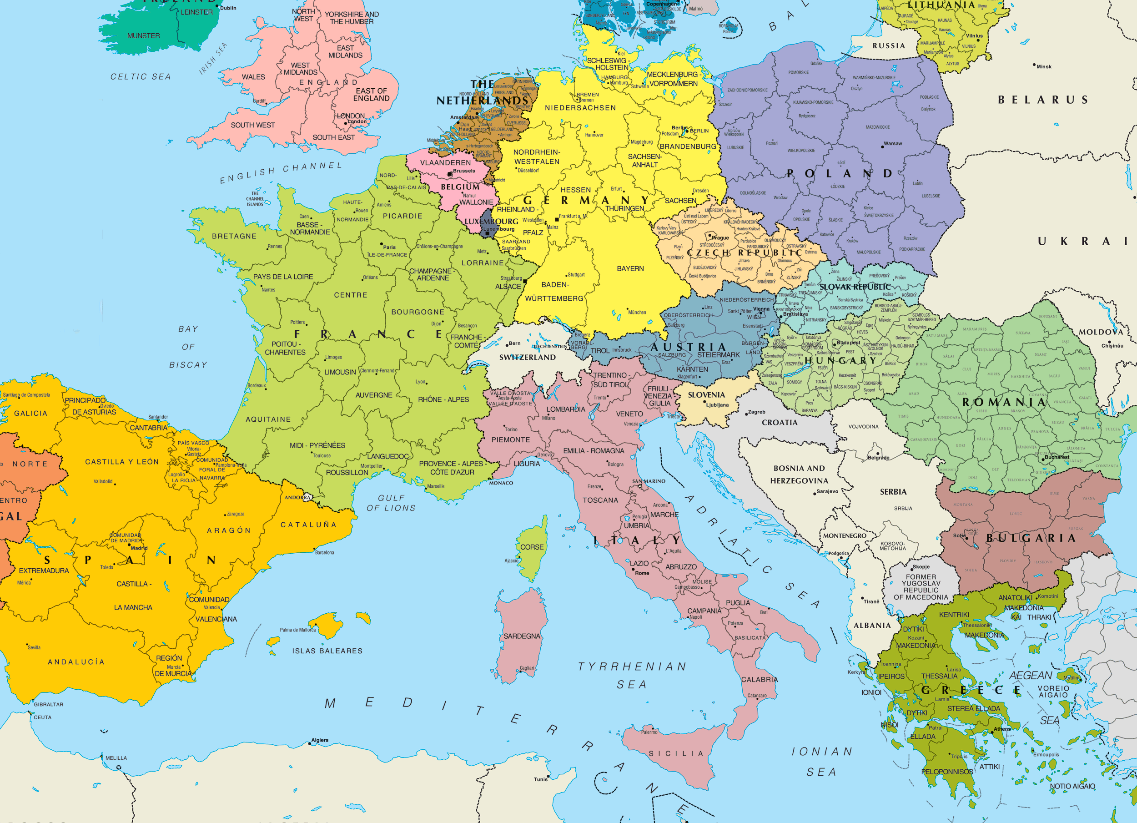
Personal Bio:
Colegiul Național Eudoxiu Hurmuzachi Rădăuți (‘11 -> ‘15)
Profil Științele Naturii
Jacobs University Bremen (‘15 -> ‘18)
Licență în Fizică și Matematică
Technische Universität München
Master în Fizică Aplicată (‘18 -> ‘21)
Doctorat (‘21 -> ‘24)
CERN
Summer Student (‘19)
Dizertația de Master (‘20->‘21)
Doctorat (‘21->‘24)
Universitatea
Ștefan cel Mare Suceava (‘20 ->?)
Asistent de cercetare

Slide 4
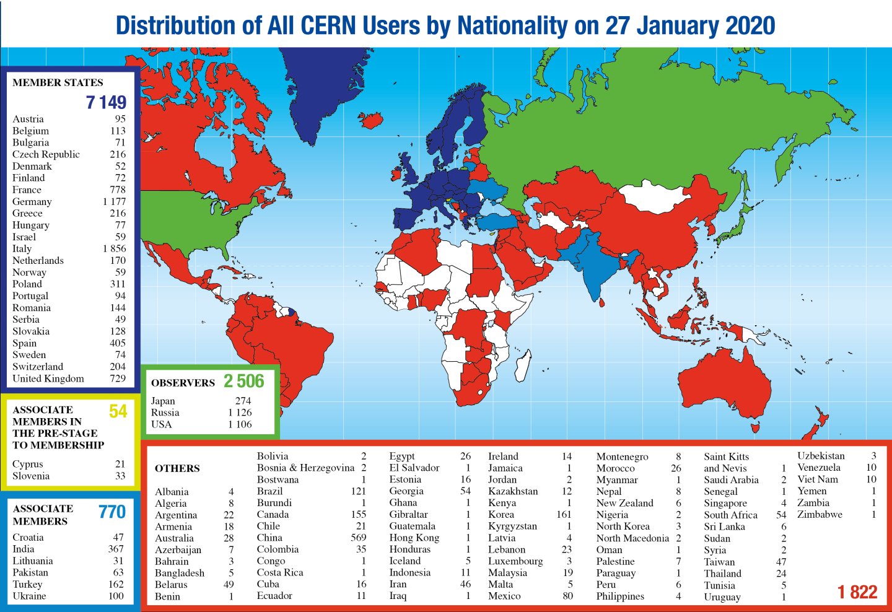

Slide 5
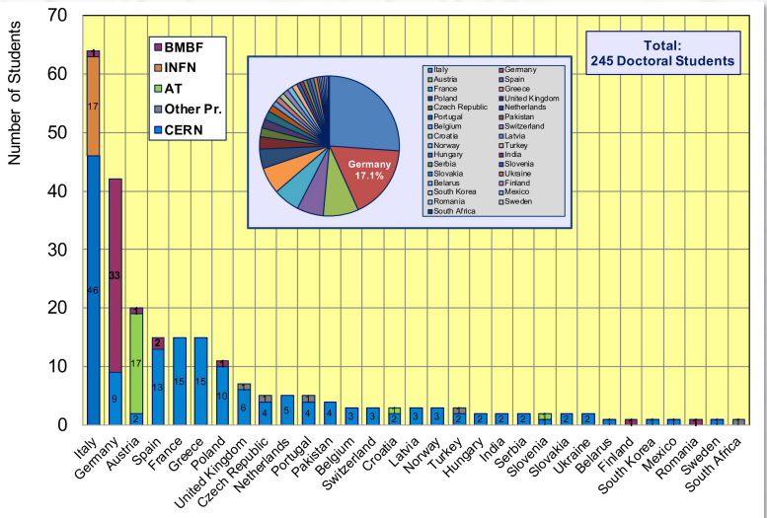
CERN Doctoral Students
Programe de finanțare dedicate:
Italia
(64 students, 26.1%)
Germania
(42 students, 17.1%)
Austria
(20 students, 8.14%)
https://indico.cern.ch/event/1002599/

Slide 6
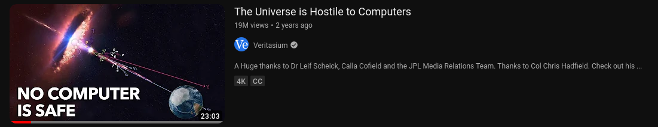
Outlook
Radiation levels at the
CERN accelerator complex
Why Radiation to Electronics (R2E)
Radiation Monitoring R&D
Special thanks and credits to the entire R2E team and SY-STI-BMI section at CERN. These slides are a compilation of a collective effort.

Slide 7
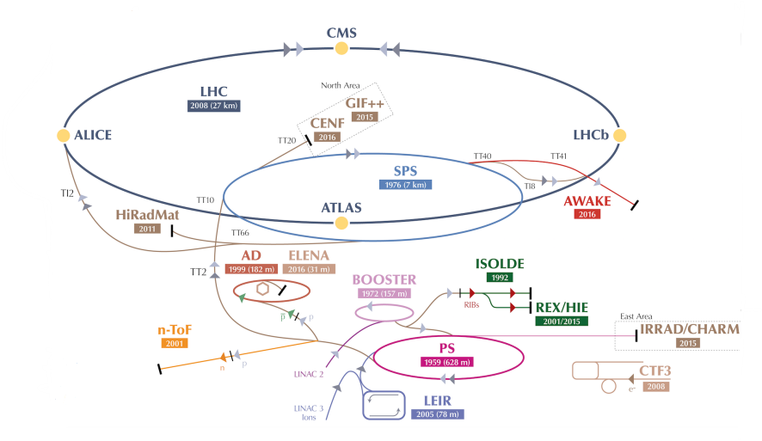
The LHC accelerator complex
Long sequence of accelerators and transfer lines to reach the LHC, for proton and ion operation.
Energy increase by a factor ≈30 at each step.
Four LHC Interaction Points (ATLAS, CMS, ALICE and LHCb detectors).
Many experiments and facilities (e.g. CHARM test facility, discussed later).
Daniel Prelipcean | Radiation Monitoring R&D at the CERN Accelerator Complex

Slide 8
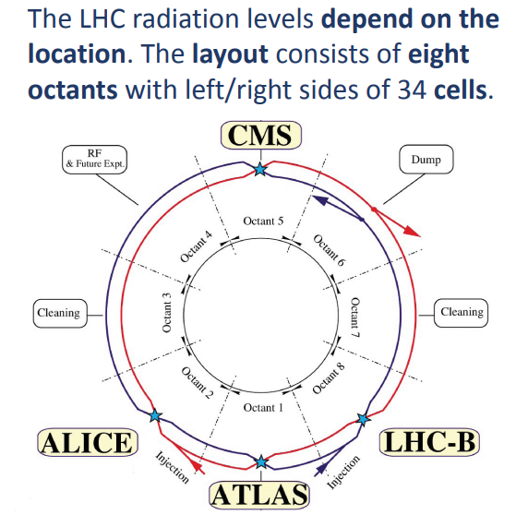
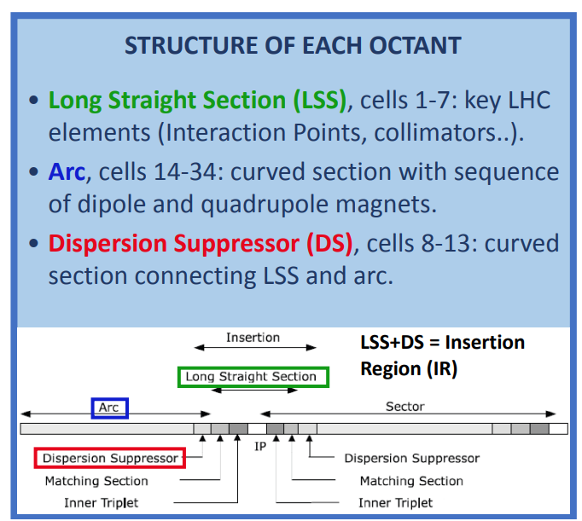
Layout of the LHC
Daniel Prelipcean | Radiation Monitoring R&D at the CERN Accelerator Complex

Slide 9
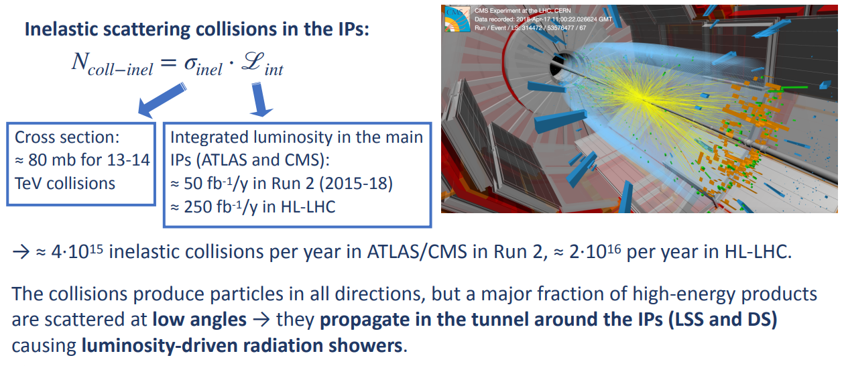
Sources of radiation: LHC collisions
Daniel Prelipcean | Radiation Monitoring R&D at the CERN Accelerator Complex

Slide 10
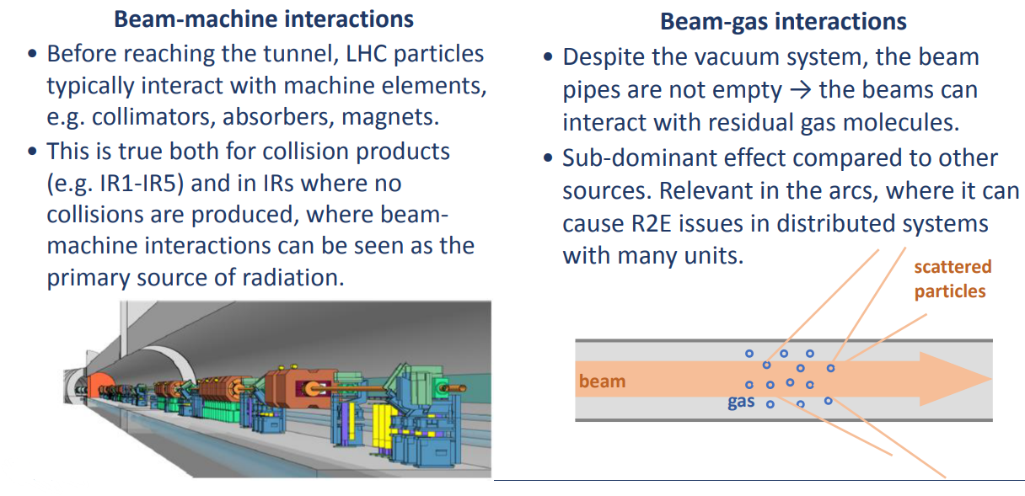
Sources of radiation: beam-machine and beam-gas interactions
Daniel Prelipcean | Radiation Monitoring R&D at the CERN Accelerator Complex

Slide 11
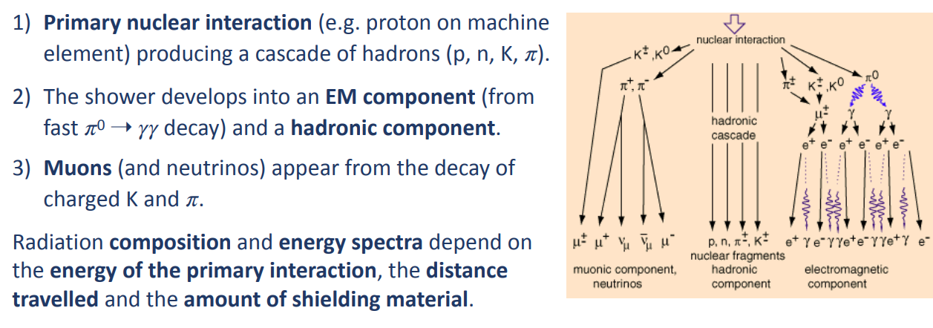
LHC radiation showers
Daniel Prelipcean | Radiation Monitoring R&D at the CERN Accelerator Complex

Slide 12
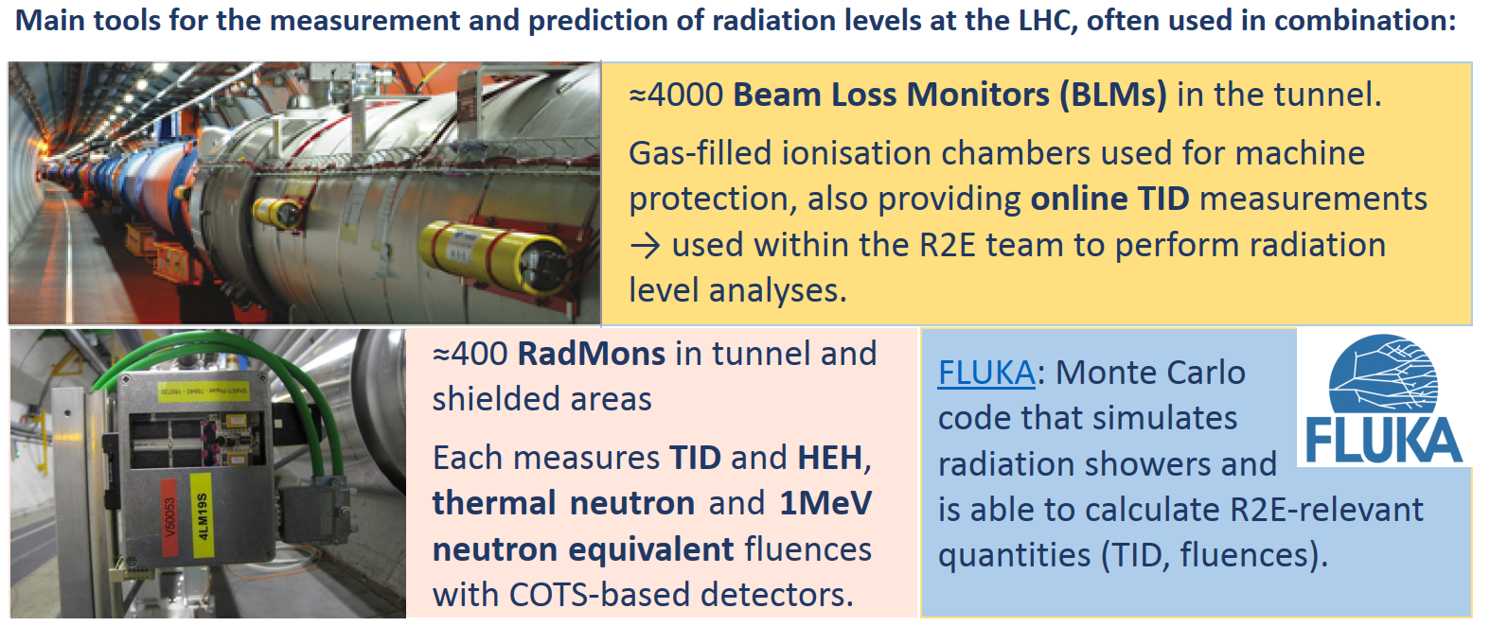
Monitoring and calculation tools
Daniel Prelipcean | Radiation Monitoring R&D at the CERN Accelerator Complex

Slide 13
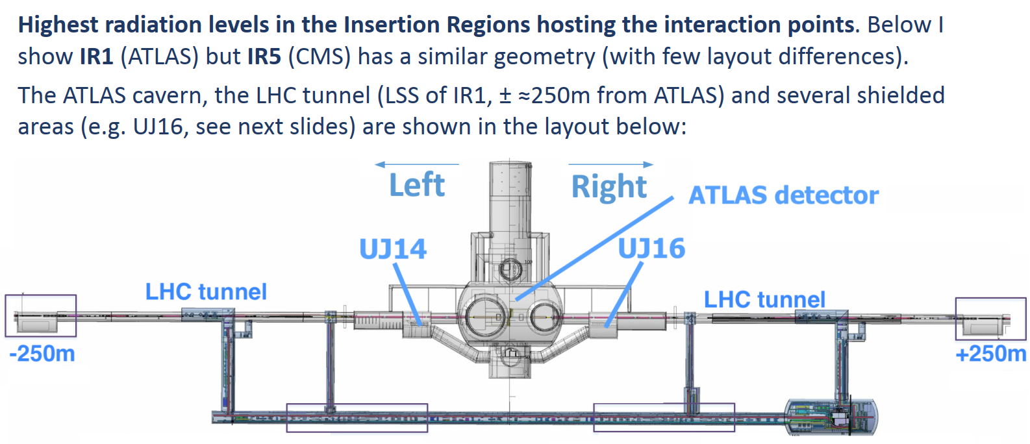
The ATLAS Insertion Region (IR1)
RR13
RR17
Daniel Prelipcean | Radiation Monitoring R&D at the CERN Accelerator Complex

Slide 14
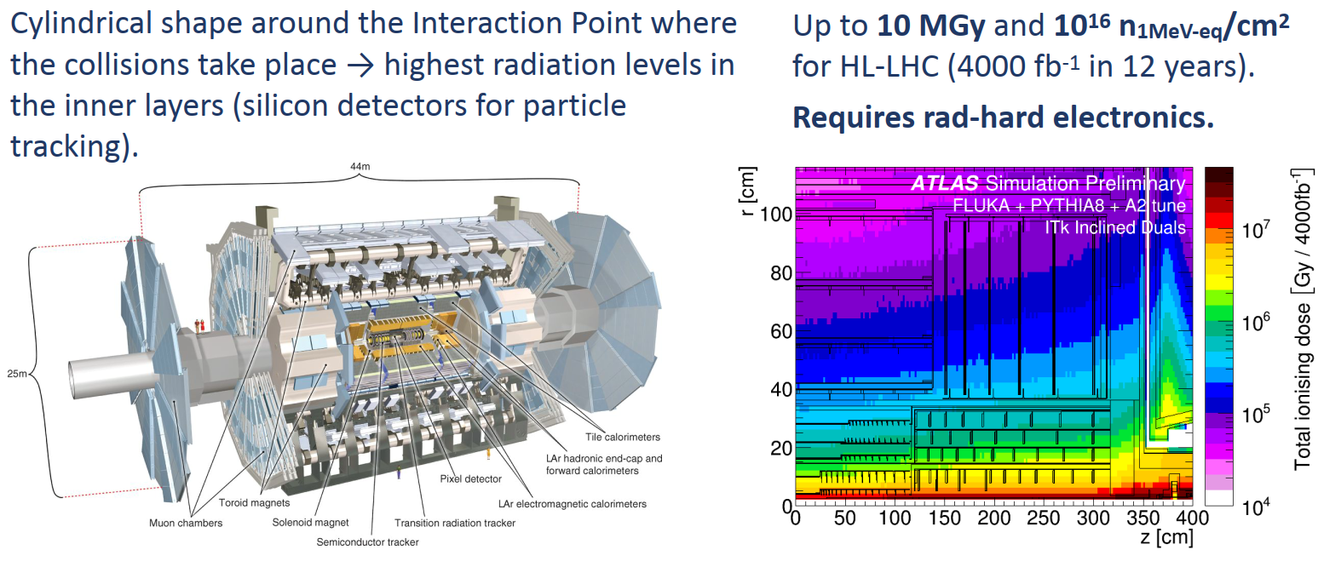
Radiation levels in the ATLAS detector
Daniel Prelipcean | Radiation Monitoring R&D at the CERN Accelerator Complex

Slide 15
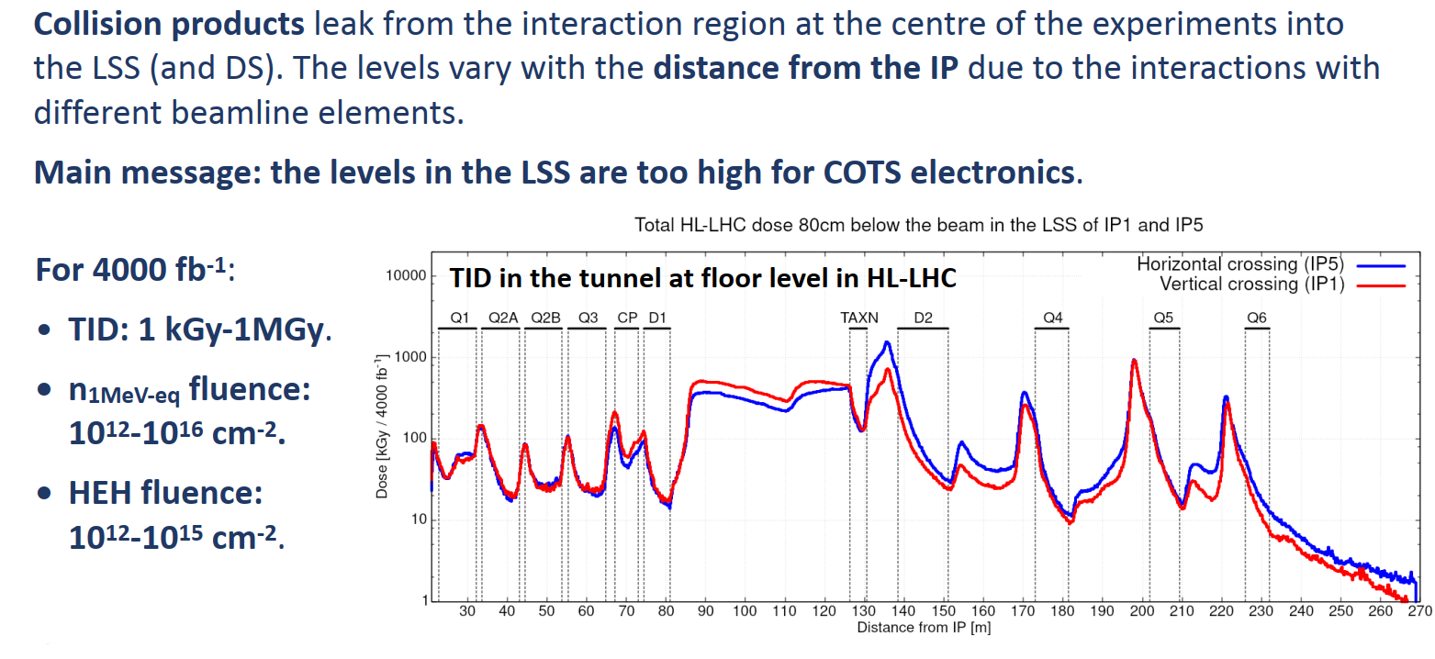
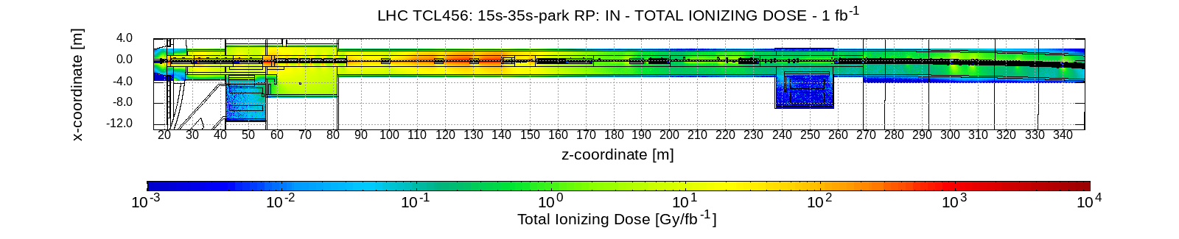
IR1 (ATLAS) and IR5 (CMS) Long Straight Sections (LSS)
D. Prelipcean, Master thesis:
Comparison between measured radiation levels and FLUKA simulations at CHARM and in the LHC tunnel of P1-5 within the R2E project in Run 2
Daniel Prelipcean | Radiation Monitoring R&D at the CERN Accelerator Complex

Slide 16
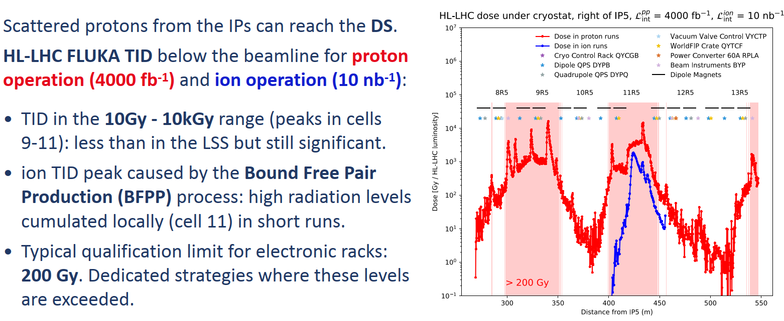
IR1 and IR5 Dispersion Suppressor (DS): TID
Courtesy of: M. Sabate-Gilarte on behalf of of HL WP 13
Daniel Prelipcean | Radiation Monitoring R&D at the CERN Accelerator Complex

Slide 17
Why R2E

Slide 18
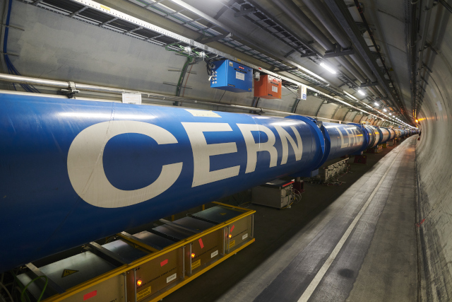
Key point: “unavoidable” radiation exposure of critical accelerator systems

Slide 19
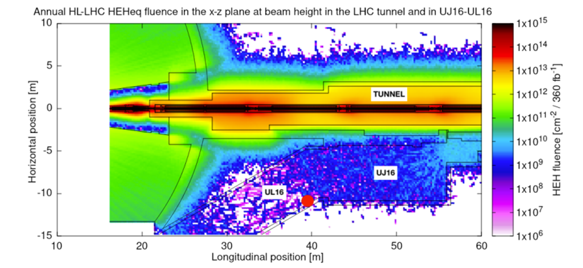

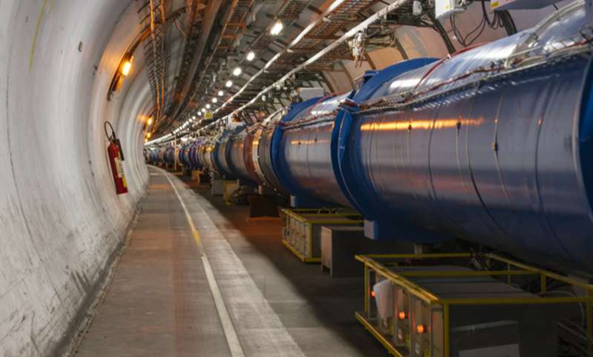
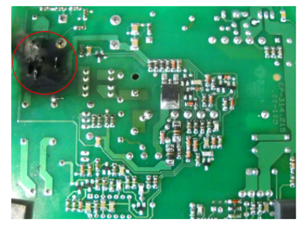
The “Radiation to Electronics” (R2E) challenge in high-energy accelerators
High-energy accelerators are subject to beam losses and hence generate prompt radiation in their vicinity
Part of the accelerator equipment needs to be installed near the machine itself, and is therefore subject to a complex and challenging radiation environment
Such equipment is critical for the successful operation of the accelerator, and uses microelectronic components which are sensitive to radiation
Expected HL-LHC radiation levels around the ATLAS interaction point (IP1), as simulated in FLUKA
Tens of thousands of electronic boards in the LHC (and millions of individual components), all capable of negatively affecting its operation through radiation effects
R2E mandate: to ensure the successful operation of CERN accelerators in view of radiation effects on electronics
Daniel Prelipcean | Radiation Monitoring R&D at the CERN Accelerator Complex

Slide 20
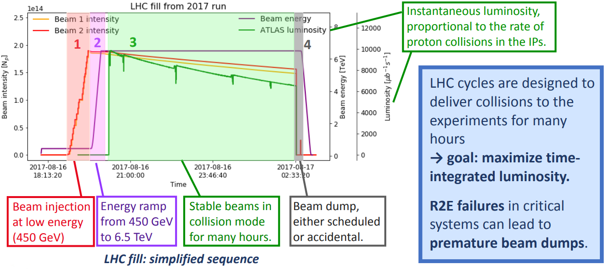
Focusing on the LHC: a typical cycle
Daniel Prelipcean | Radiation Monitoring R&D at the CERN Accelerator Complex

Slide 21
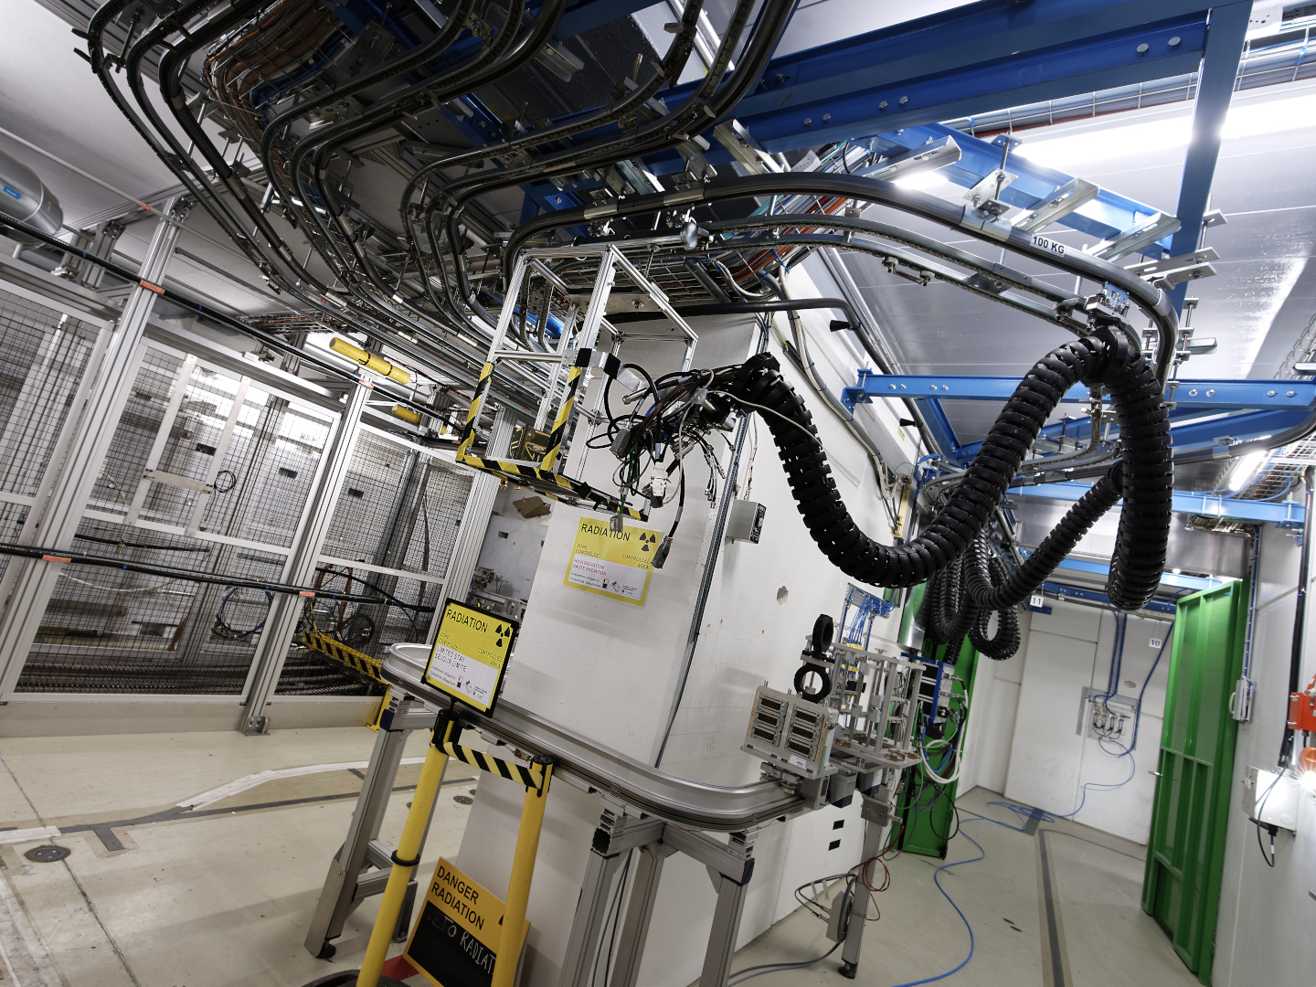
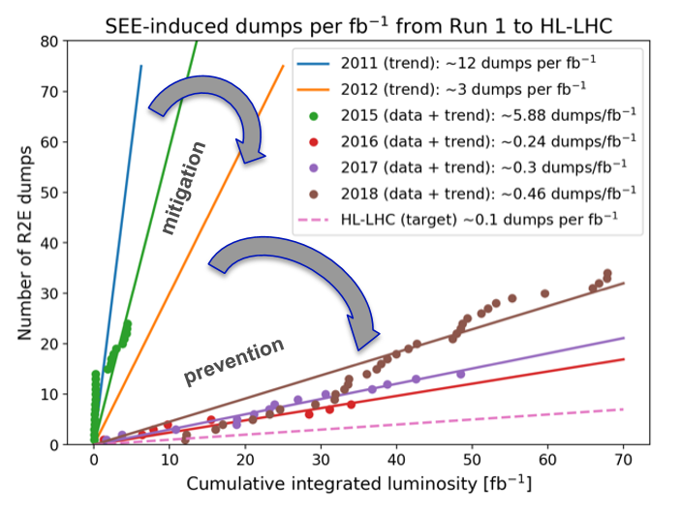
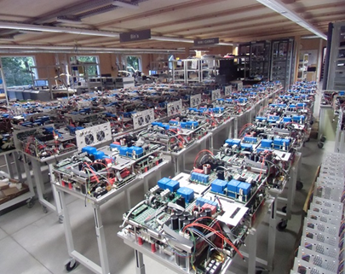
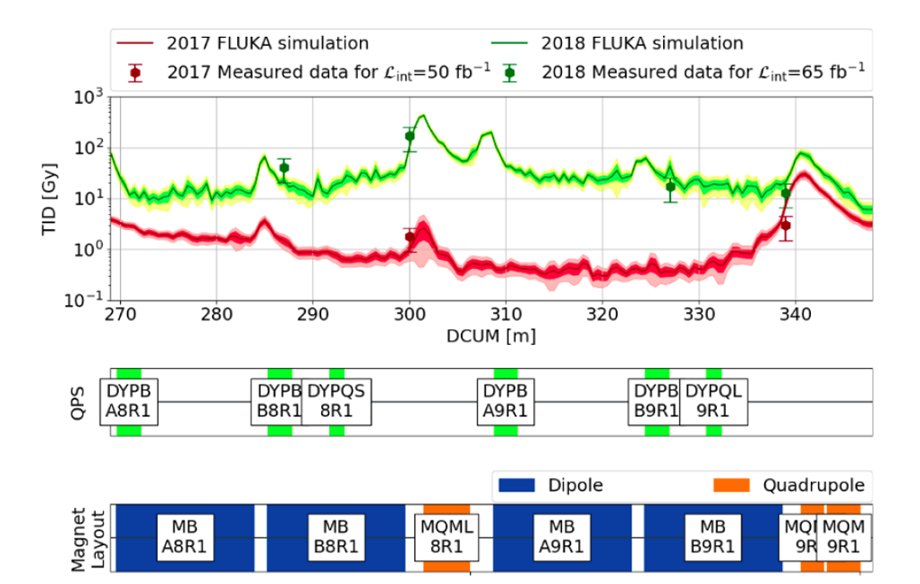
Radiation Hardness Assurance at CERN
Radiation effects facilities and tests
Radiation tolerant design and production (standards, guidelines, quality assurance, reviews…)
Follow-up and mitigation of radiation effects impact on operation; mission-critical also for HL-LHC objectives
Radiation environment simulation and monitoring
Daniel Prelipcean | Radiation Monitoring R&D at the CERN Accelerator Complex

Slide 22
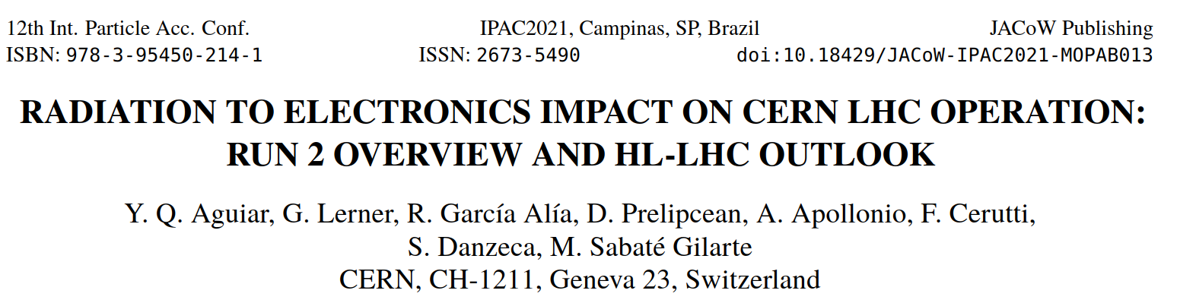
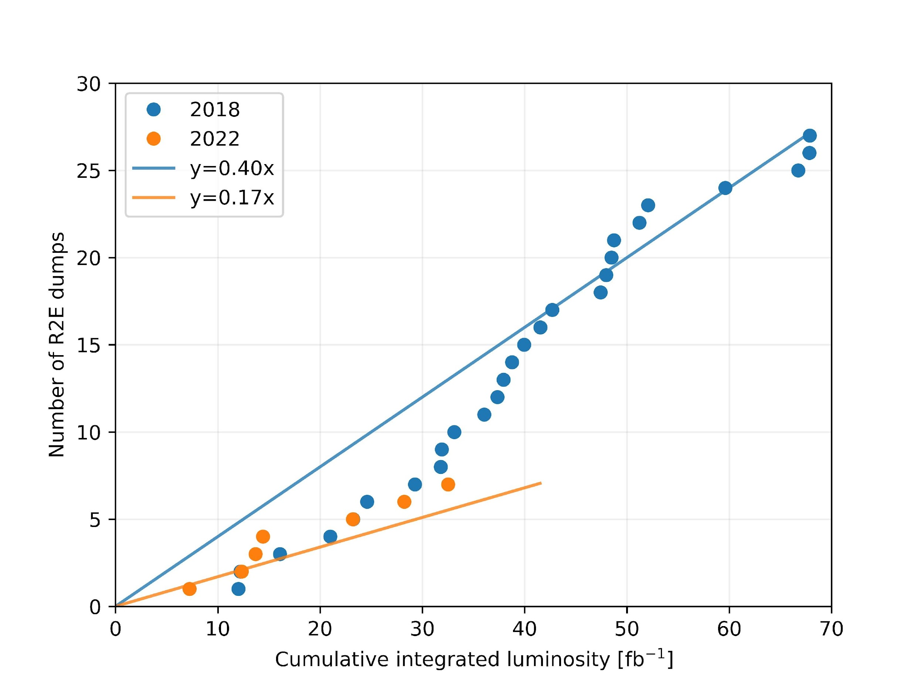
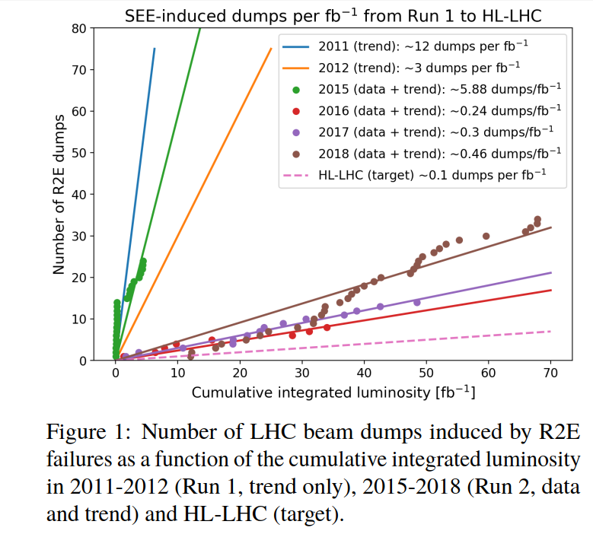
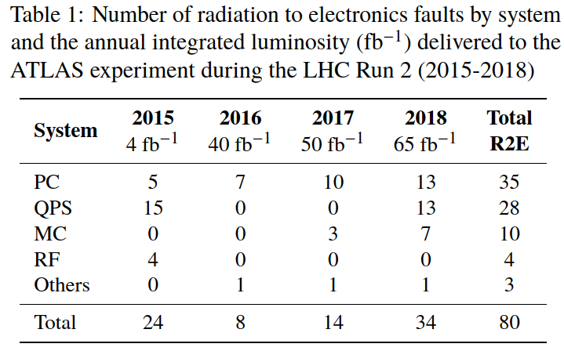
Improvement in 2022 versus 2018 mainly due to:
(a) reduced Point 1 & 5 DS levels and
(b) R2E power converters in RRs

Slide 23
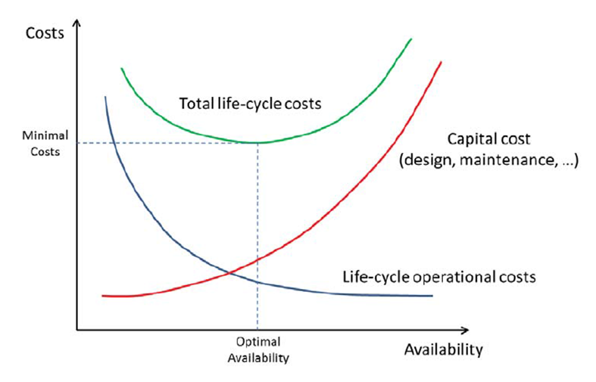
LHC approach: from mitigation to prevention
Radiation tolerant design based on qualified COTS
No information about radiation levels and sensitivity of critical components and systems to radiation
Use of purely commercial modules and systems in radiation areas, even if radiation tested
Active electronics operating only in radiation safe areas (e.g. shielding, relocation)
Rad-hard-by-design components
Daniel Prelipcean | Radiation Monitoring R&D at the CERN Accelerator Complex

Slide 24
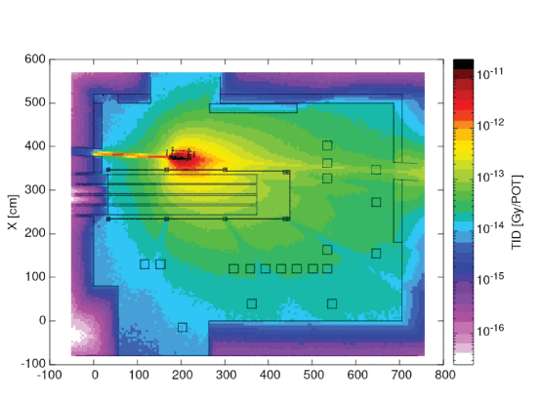
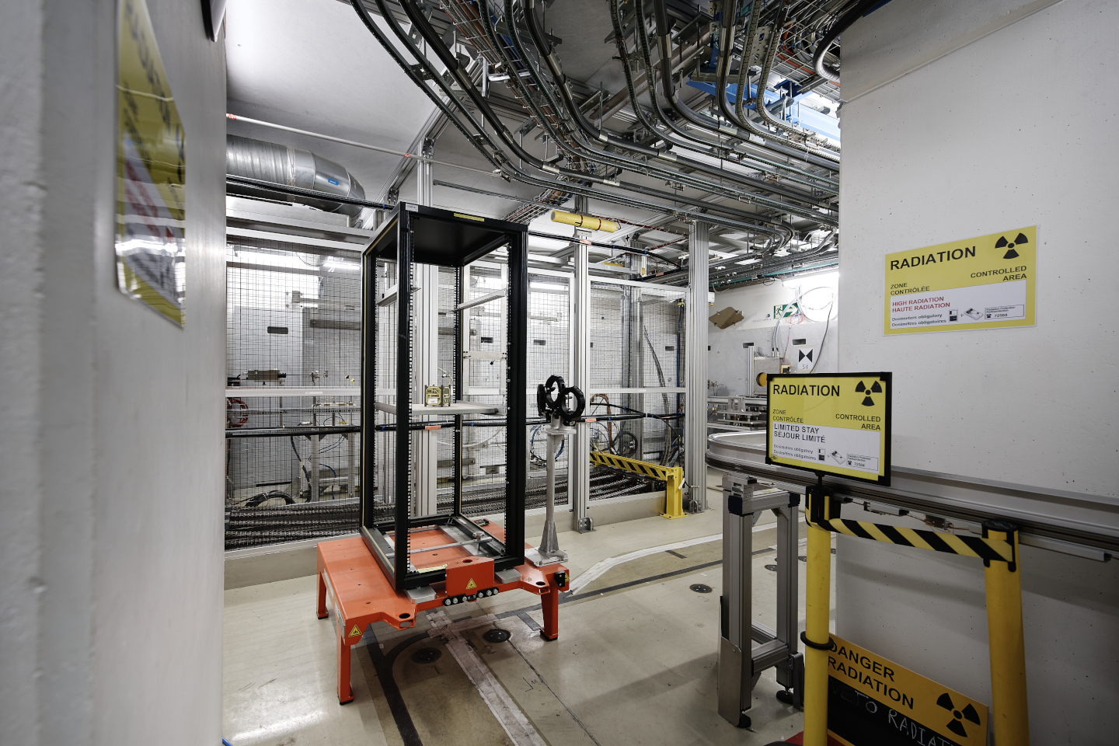
Importance of CHARM for system level testing(*)
(*) As final Radiation Hardness Assurance step, after radiation levels and tolerance requirement definition, architecture selection (including radiation effects mitigation solutions), component selection (based mainly on device level radiation effects testing), etc.
D. Prelipcean et al., "Benchmark Between Measured and Simulated Radiation Level Data at the Mixed-Field CHARM Facility at CERN,"
in IEEE Transactions on Nuclear Science, vol. 69, no. 7, pp. 1557-1564, July 2022, doi: 10.1109/TNS.2022.3169756.

Slide 25
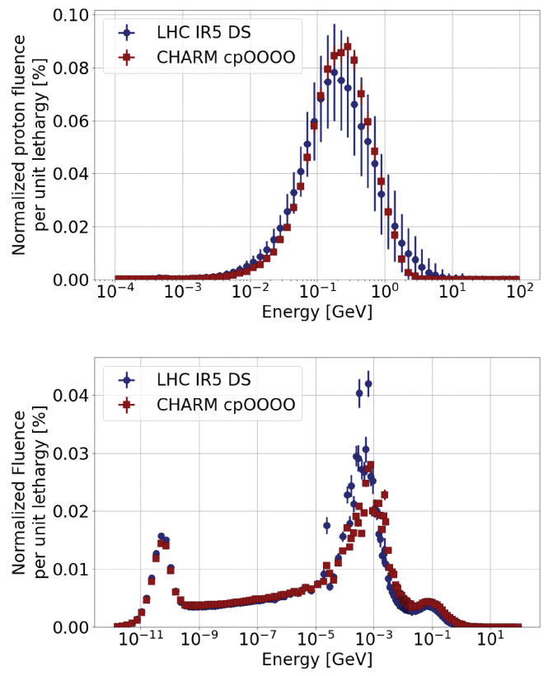
Mimicking the hadron accelerator environment in CHARM
Radiation field composition in selected locations of the LHC can be almost perfectly replicated in the CHARM irradiation facility.
Slightly higher energy particles at the LHC, and none above 24 GeV (beam energy) at CHARM.
D. Prelipcean et al., "Benchmark Between Measured and Simulated Radiation Level Data at the Mixed-Field CHARM Facility at CERN,"
in IEEE Transactions on Nuclear Science, vol. 69, no. 7, pp. 1557-1564, July 2022, doi: 10.1109/TNS.2022.3169756.
Daniel Prelipcean | Radiation Monitoring R&D at the CERN Accelerator Complex

Slide 26
Radiation Monitoring R&D

Slide 27
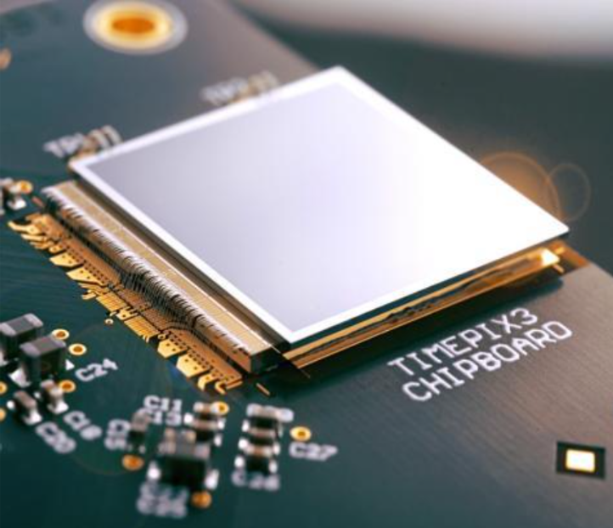
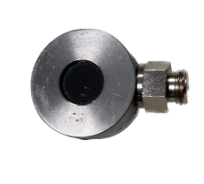
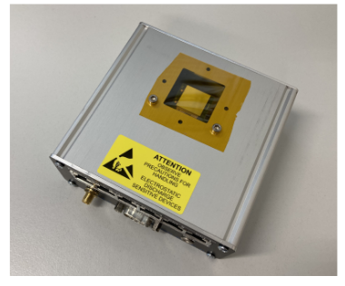
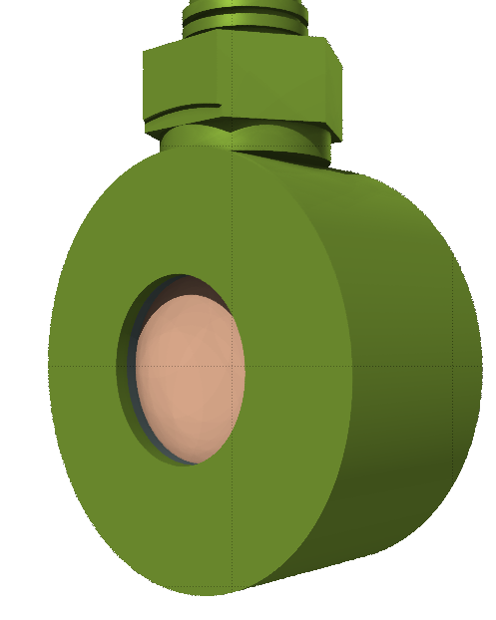
Radiation Monitoring R&D
Diode
Timepix3
In parallel to existing deployed radiation monitors, new technologies are tested to assess their suitability for R2E usages, in particular:
Material: Si
Thickness (full bias): 300 μm
Exposed area: 0.5 cm²
Energy threshold: about 600 keV
Timing resolution: 1 ns
Single pixel
Material: Si
Thickness (full bias): 300 μm
Exposed area: 2.4 cm²
Energy threshold: about 8 keV
Timing resolution: 1.25 ns
Pixel array (256 x 256),
pixel pitch: 55 μm
Daniel Prelipcean | Radiation Monitoring R&D at the CERN Accelerator Complex

Slide 28
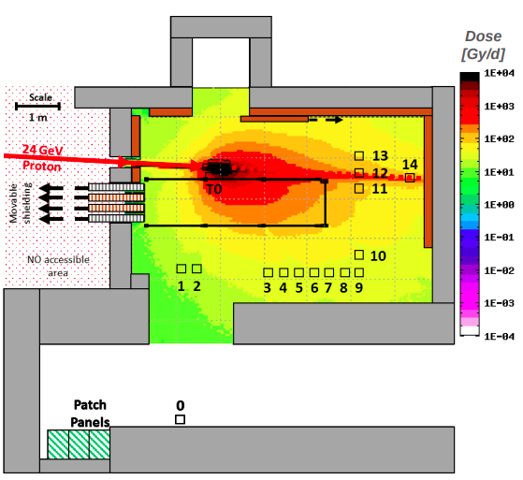
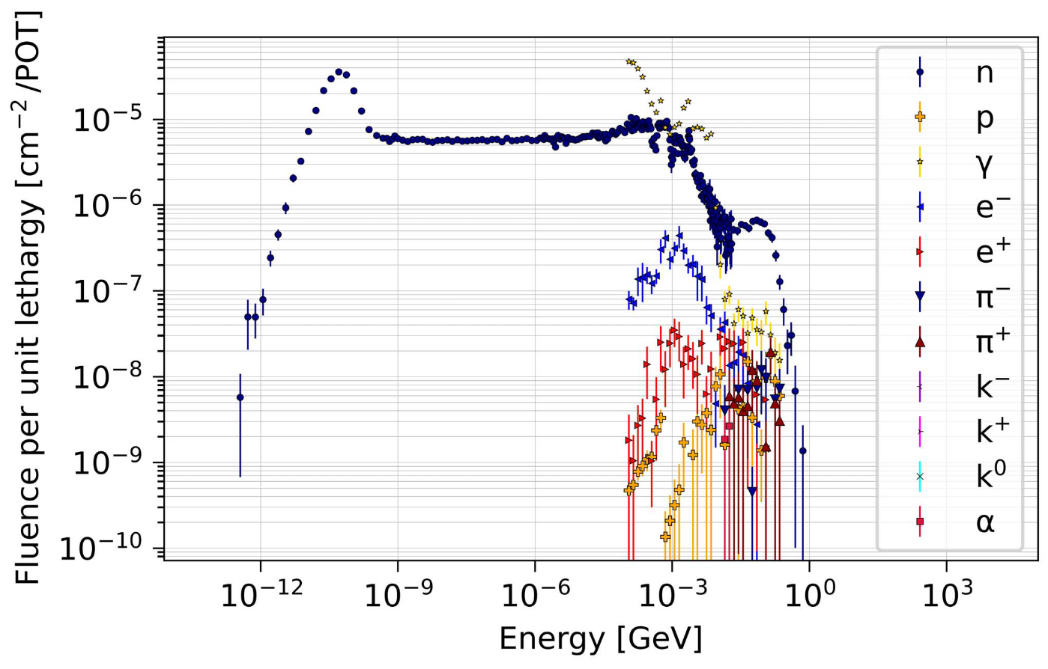
CHARM example
Mixed radiation field on a single diode.
First Step
Second Step

Slide 29
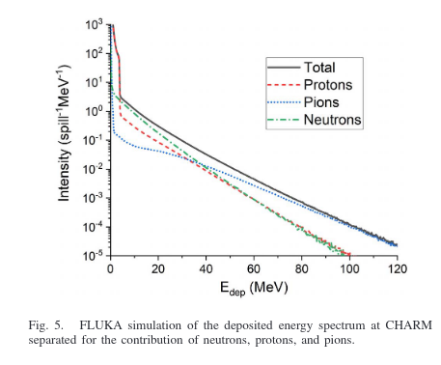
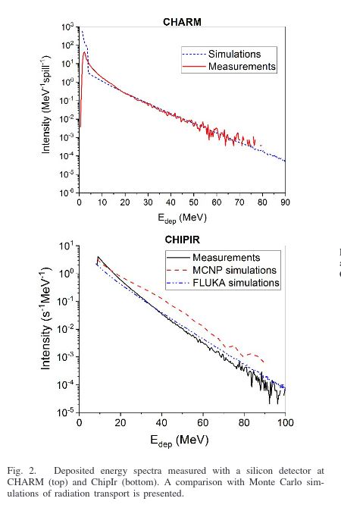
Diode results - 2020
[1] Carlo Cazzaniga et al
Study of the Deposited Energy Spectra in Silicon by High-Energy Neutron and Mixed Fields (2020)
DOI: 10.1109/TNS.2019.2944657
Diode measurements at G0.
Good agreement at higher energies (>20 MeV).
G0 position

Slide 30



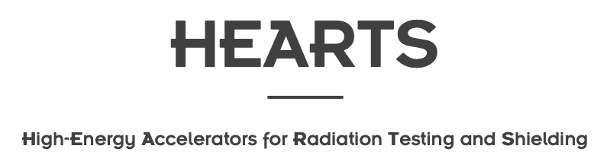


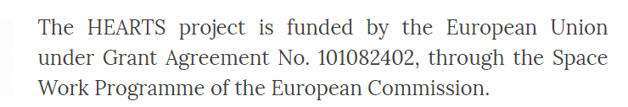
The HEARTS project
Facilities
Partners
aims at developing and establishing a European infrastructure for research and industrial access to high-energy heavy ion facilities for the fields of radiation effects in electronics, shielding and radiobiology.
Notes:
This benchmark dosimetry method and the development of a VHE ion beam line are covered within the HEARTS project.
To ensure the European non-dependency for access to space.
HEARTS brings together the two main high-energy ion accelerator infrastructures (CERN and GSI) as well as the two main space companies in Europe (Airbus Defence and Space and Thales Alenia Space) and a top-level academic institution (Università degli Studi di Padova)

Slide 31
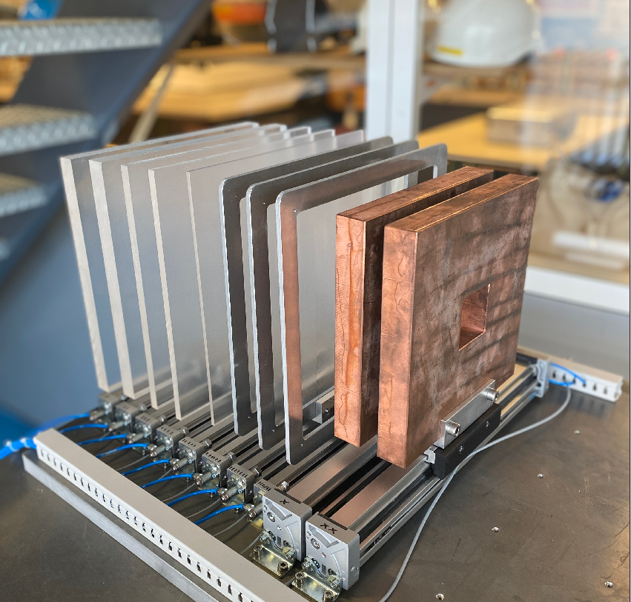
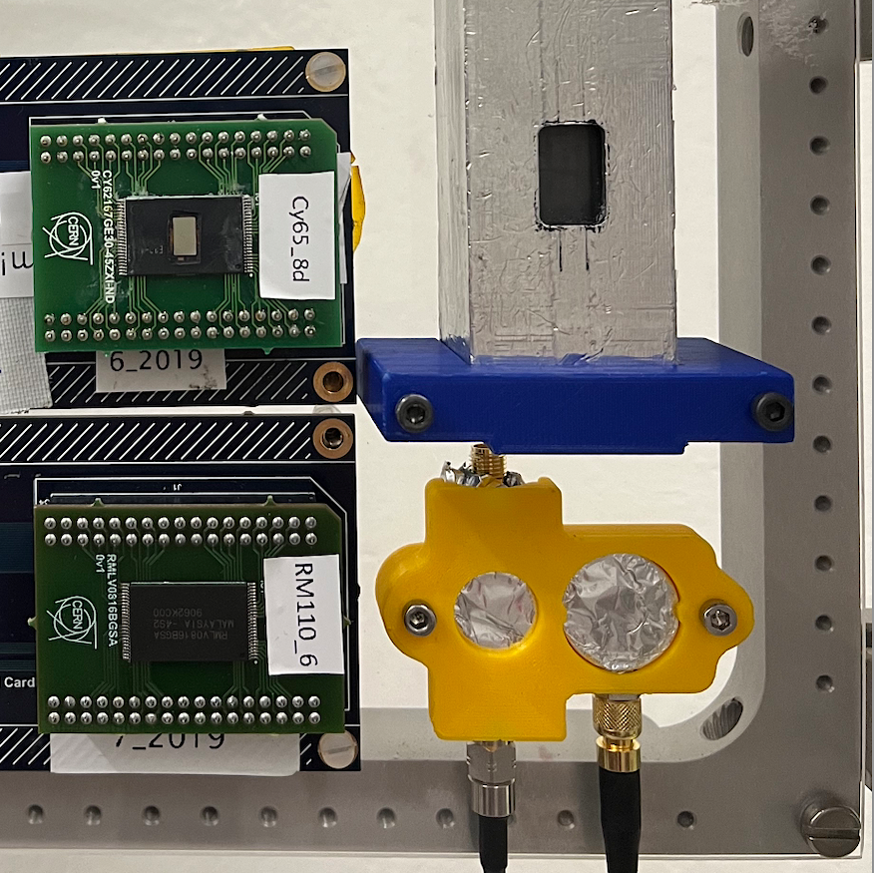
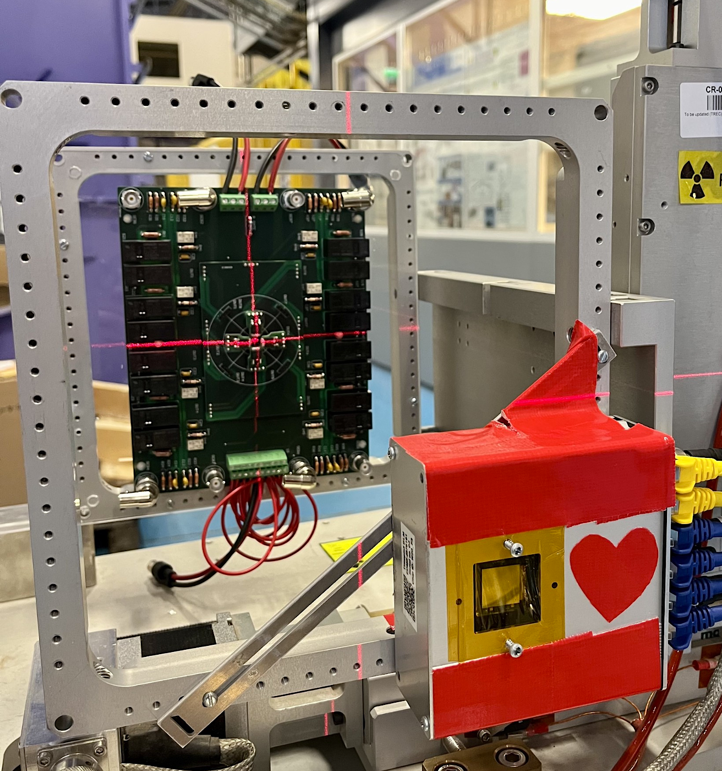
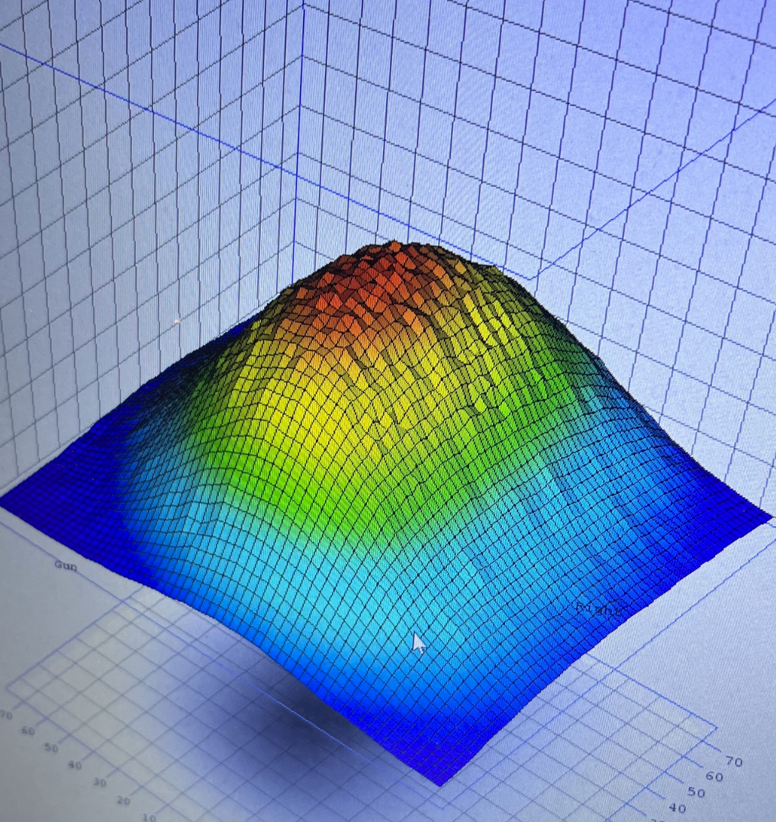
Heavy ion activity at CERN
Ongoing challenges in CERN’s heavy ion activity addressed within the HEARTS project under different work packages:
    Dosimetry and knowledge transfer with GSI (WP4)
    Beam line simulations of key beam properties, e.g. transmission, beam composition, beam size, detector response (WP3)
    Development of T08 beam line at CERN for radiation effects testing (WP7)
  Recent two-week HEARTS@CERN ion run, finished (17-Oct – 1-Nov, 2023), full of beam development and exploitation activities, including welcoming our GSI, UniOldenburg, PTW and UniWollongong partners.
Notes:
There are many challenges in the VHE ion beam line development, of which implementing a proper dosimetry method is one

Slide 32
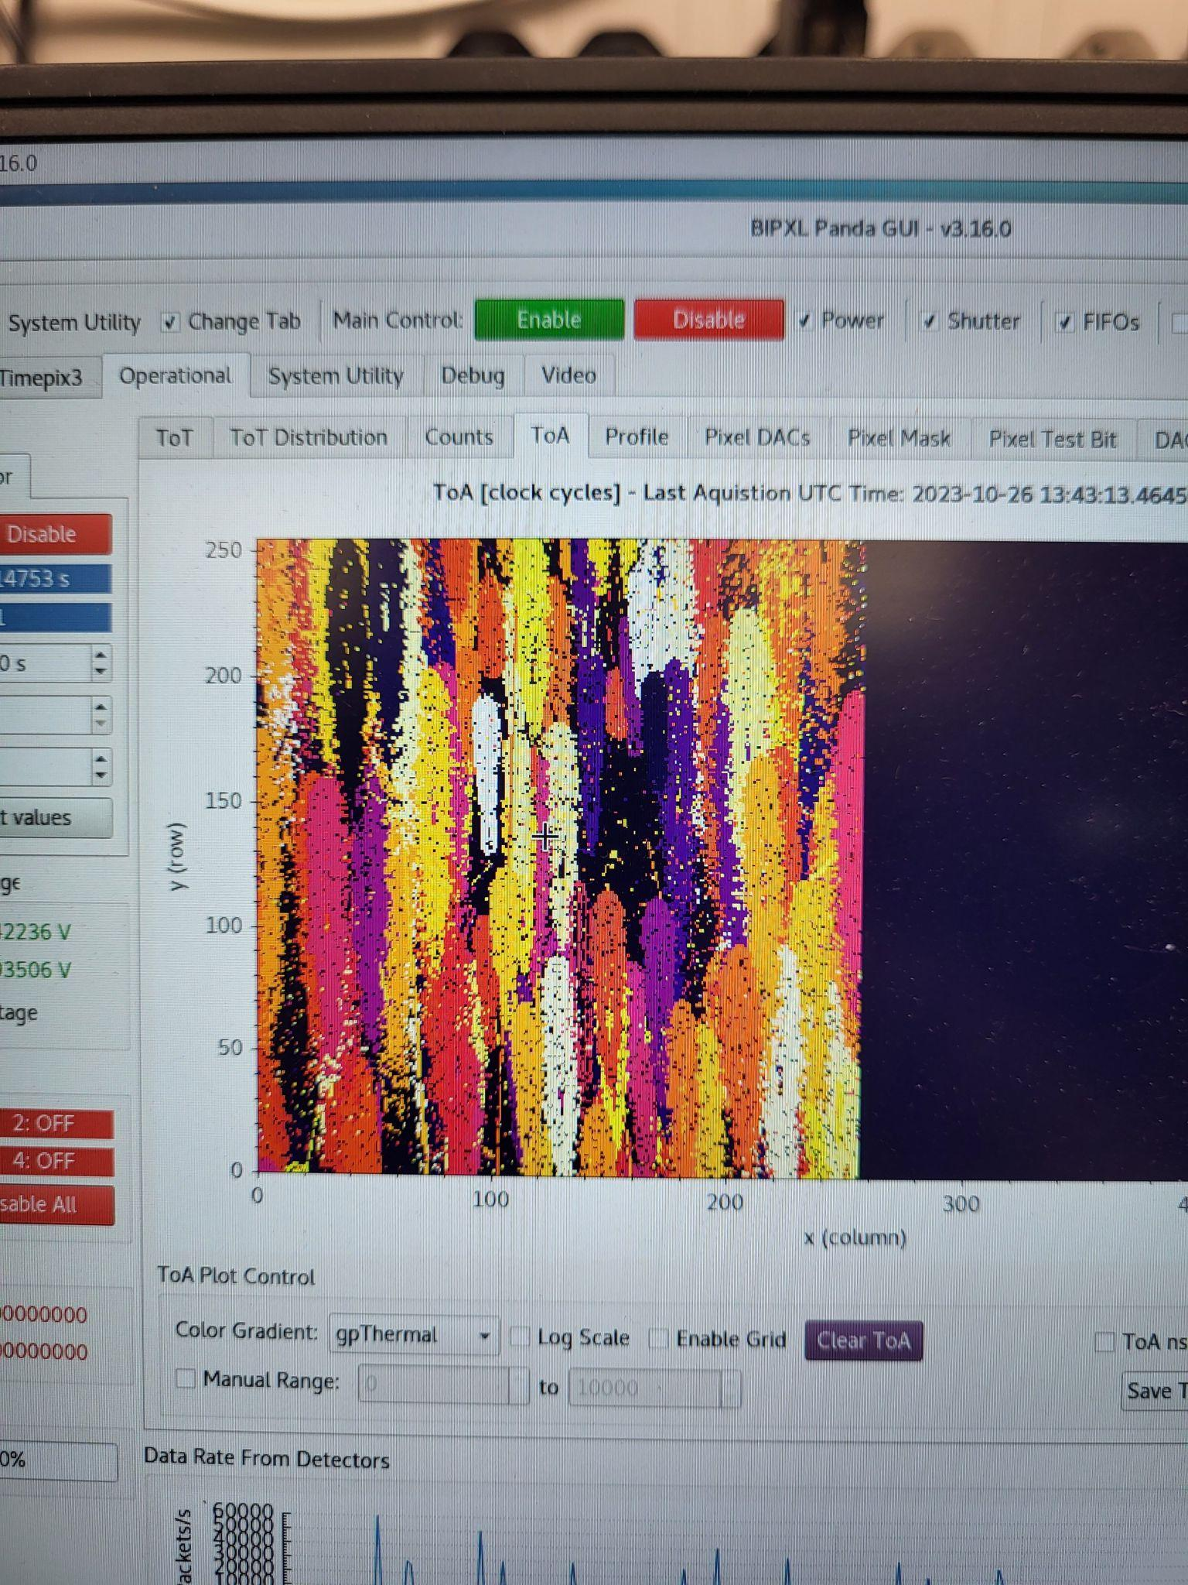
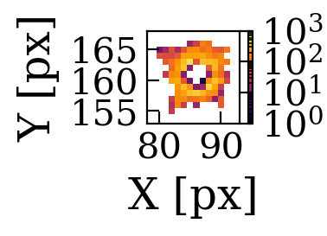


Autumn has come to its end

Slide 33

Physics Beyond Colliders (PBC)
Slide from
C. Vallee,
Physics Beyond Colliders at CERN,
in Academic Training Lecture Regular Programme
indico.cern.ch/event/1334121/
You might recognize FASER from Brian Petersen’s talk
indico.cern.ch/event/1337923/
contributions/5652649
But i will talk about CODEX-B

Slide 34


Scope
Quantify if the muon flux is higher during luminosity production at LHCb/IP8 as compared to the background at LHCb in the D1 shielded area, the foreseen location of the CODEX-b experiment.
Detector installed at the same level with the IP, at a 15 deg angle wrt. the perpendicular to the beamline.

Slide 35


Transversal muon rate measurements at LHCb
Signal identification based on irradiation geometry (tracks with 2 to 4 pixel length along detector’s x axis)
Result agrees with FLUKA simulations, but not with previous measurements [1] ->
authors have identified a faulty trigger in their setup.
Comparison with previous results and FLUKA simulations
Full signal
[1] Biplab Dey, Jongho Lee, Victor Coco and Chang-Seong Moon, Background studies for the CODEX-b experiment: measurements and simulation

Slide 36
Conclusions
Simplified overview of key ingredients to a successful operation of critical electronics in radiation areas:
detailed knowledge of radiation environment:
    measurement
    simulations
  radiation effects on electronics (not touched upon here)
experienced radiation testing service
Moreover:
R&D for future monitoring and calculation tools.
Detectors can have complementary usages.
Daniel Prelipcean | Radiation Monitoring R&D at the CERN Accelerator Complex

Slide 37


