Slide 1
The standard model.
Achievements and challenges
Presentation made by Adelina Avram

Slide 2

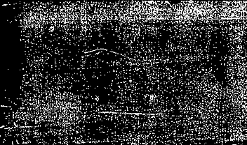

introduction

Slide 3

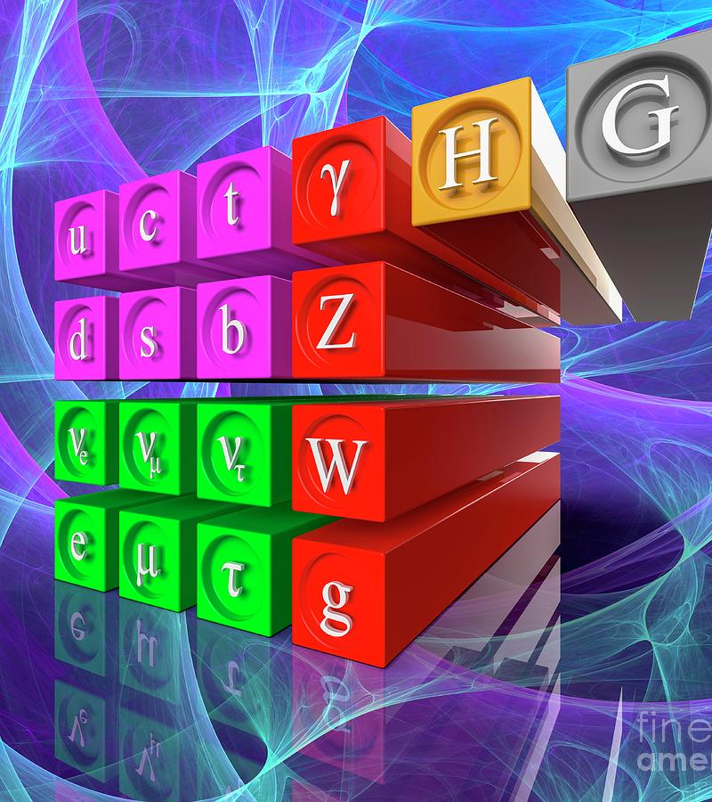

the standard model
The development of the Standard Model of particle physics started in the early 1970s.
It sorts elementary particles according to their respective charges and describes how they interact through fundamental interactions:
  particles with an electric charge are influenced by the electromagnetic interaction (quantum electrodynamics, or QED)
  particles with a weak charge are influenced by the weak interaction (quantum flavour dynamics or QFD)
  particles with a colour charge are influenced by the strong interaction (quantum chromodynamics or QCD).

Slide 4
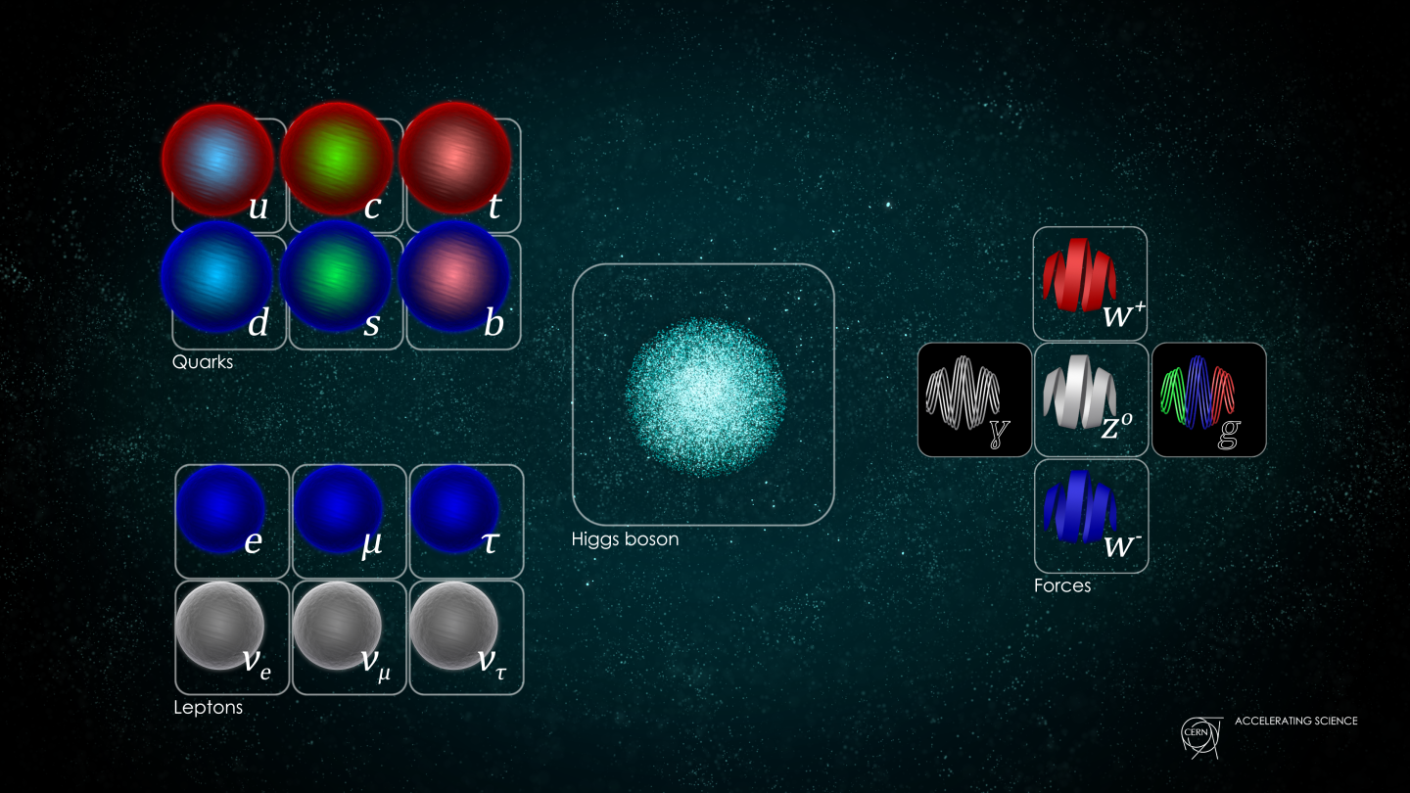
PARTICLES OF The STanDard Model

Slide 5
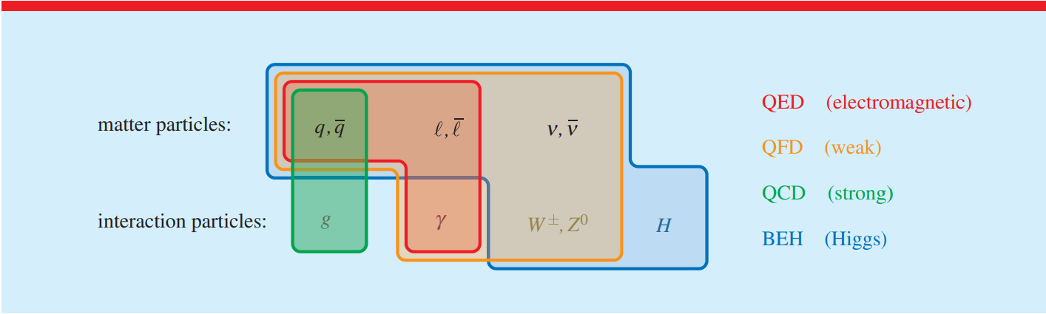
interactions

Slide 6
achievements

Slide 7
Higgs mechanism
The Higgs mechanism was proposed in 1962 by Philip Warren Anderson, following work in the late 1950s on symmetry breaking in superconductivity.
The Higgs mechanism is essential to explain the generation mechanism of the property "mass" for gauge bosons. Without the Higgs mechanism, all bosons would be considered massless, but measurements show that the W⁺, W⁻ and Z⁰ bosons actually have relatively large masses of around 80 GeV/c²
The mechanism adds a quantum field (the Higgs field) which permeates all of space to the Standard Model. Below some extremely high temperature, the field causes spontaneous symmetry breaking during interactions. The breaking of symmetry triggers the Higgs mechanism, causing the bosons it interacts with to have mass.

Slide 8
Electroweak theory
Although electromagnetism and the weak interaction appear very different at everyday low energies, the electroweak theory models them as two different aspects of the same force.
Above the unification energy, on the order of 246 GeV (or if the temperature is high enough – approximately 10¹⁵ K) they would merge into a single, combined electroweak force.
Sheldon Glashow, Abdus Salam and Steven Weinberg were awarded the 1979 Nobel Prize in Physics for their contributions to the unification of the weak and electromagnetic interaction between elementary particles, known as the Weinberg–Salam theory.

Slide 9
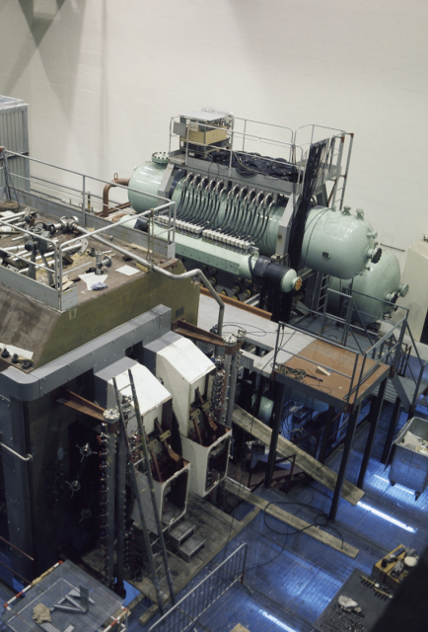
GARGAMELLE
Gargamelle was a heavy liquid bubble chamber detector in operation at CERN between 1970 and 1979. It was designed to detect neutrinos and antineutrinos, which were produced with a beam from the Proton Synchrotron (PS).
Weak neutral current interactions are one of the ways in which subatomic particles can interact by means of the weak force (the only force apart from gravity which interact with neutrinos). These interactions are mediated by the Z boson.
Gargamelle is famous for being the experiment where neutral currents were discovered in 1973, proving the existence of the Z boson.

Slide 10
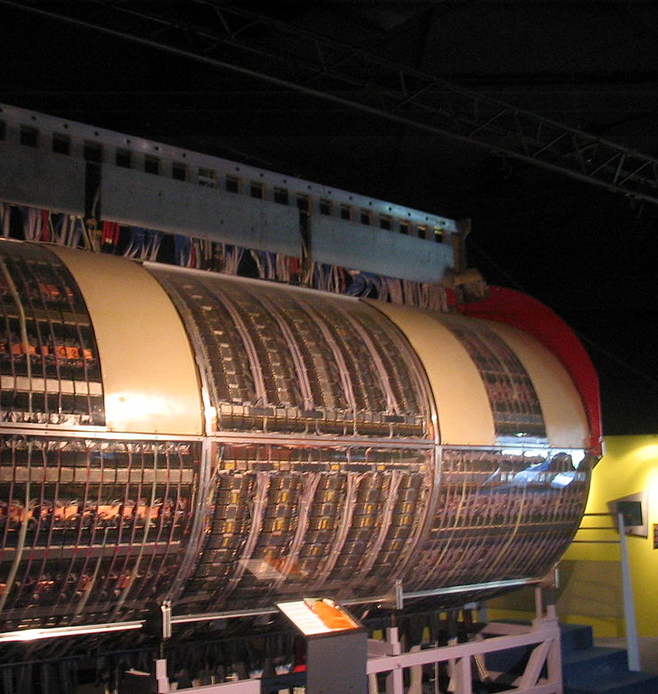
UA1 and UA2 collaboration
UA1 and UA2 (UA stands for Underground Area) were two high energy physics experiments that ran at CERN's Proton-Antiproton Collider, a modification of the one-beam Super Proton Synchrotron (SPS).
The two experiments succeeded in discovering the W and Z bosons in 1983.
Carlo Rubbia and Simon van der Meer were awarded the Nobel Prize for physics for this discovery in 1984.

Slide 11
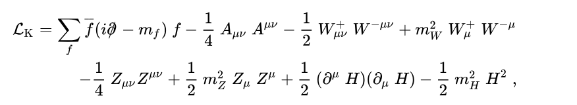



LAgrangian
After electroweak symmetry breaking: SU(2) × U(1)y to U(1)em

Slide 12

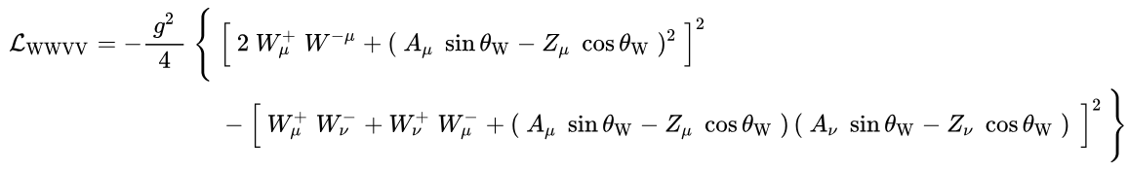

lagrangian

Slide 13
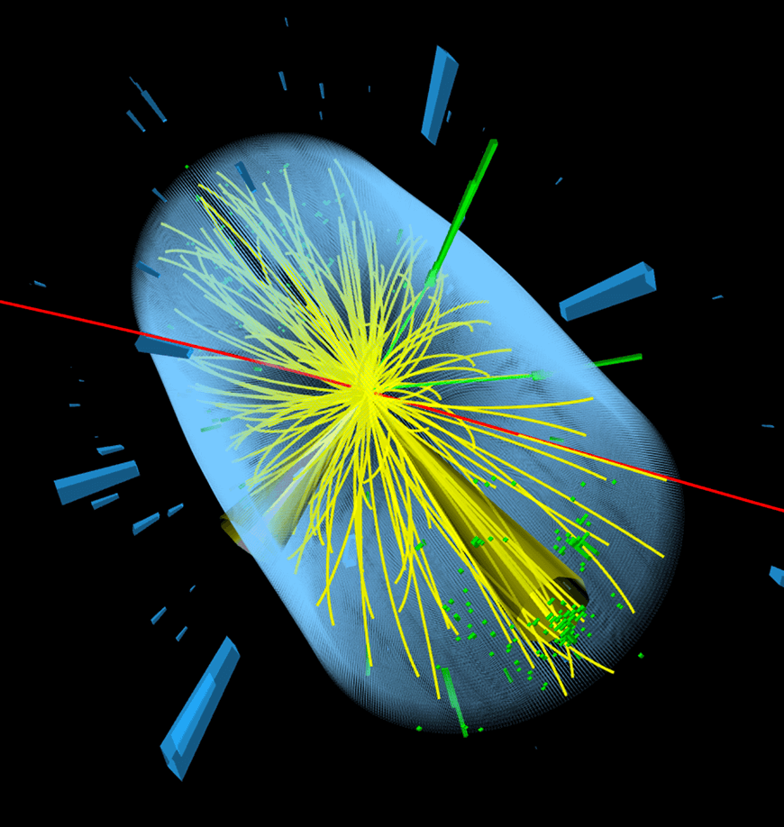
THE HIgGS BOSON
The Higgs boson is a massive scalar boson with zero spin, even parity, no electric charge, and no colour charge that couples to mass, produced by the quantum excitation of the Higgs field.
After a 40 year search, it was discovered in 2012 by the ATLAS and CMS experiments at the Large Hadron Collider (LHC) at CERN.
Peter Higgs and François Englert were awarded the Nobel Prize in Physics in 2013 for their theoretical predictions.

Slide 14
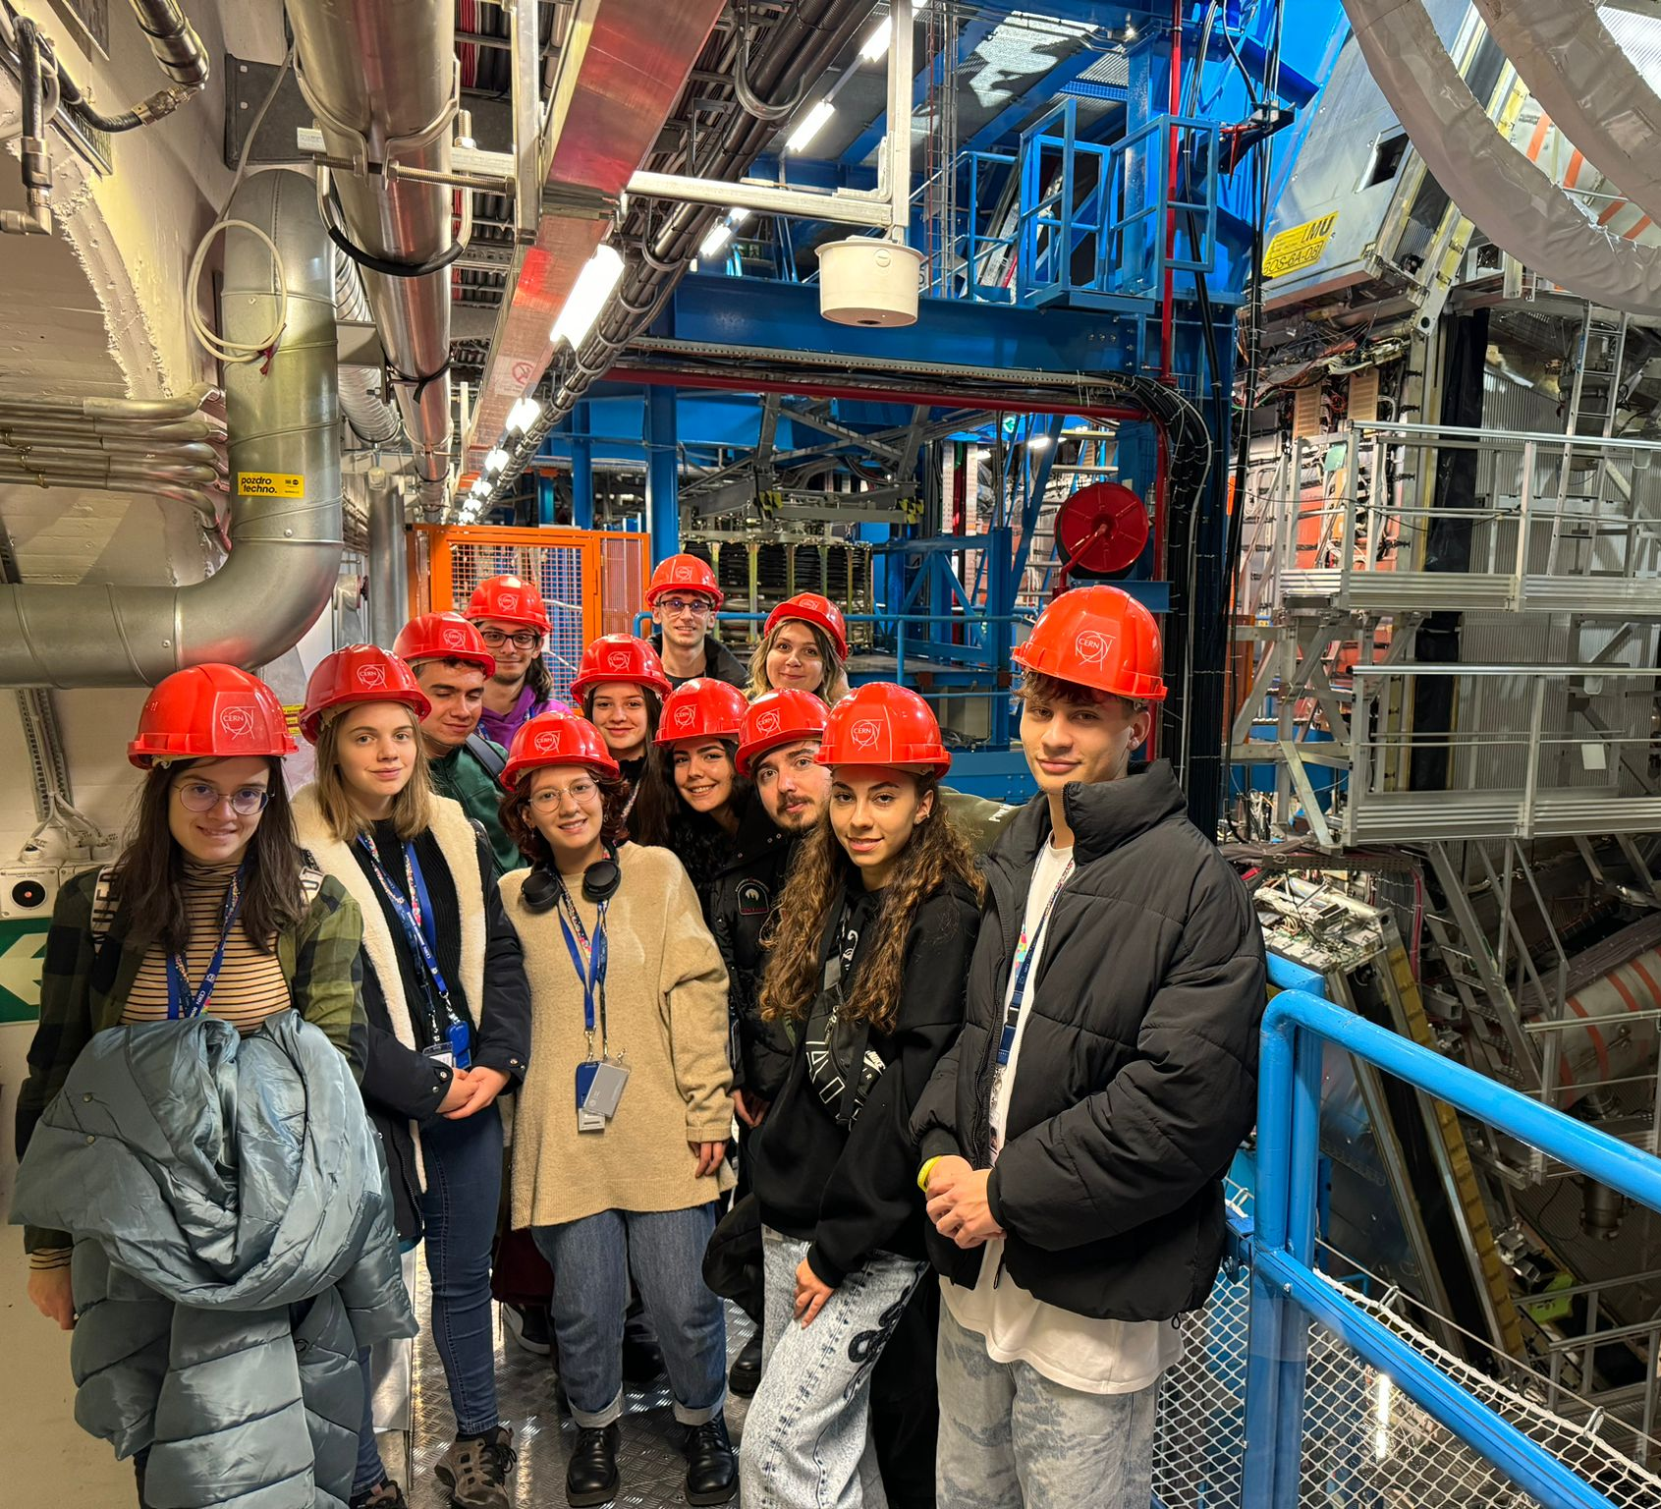
Atlas visit
Group Picture:
Romanian Students Internship Programme 2023

Slide 15

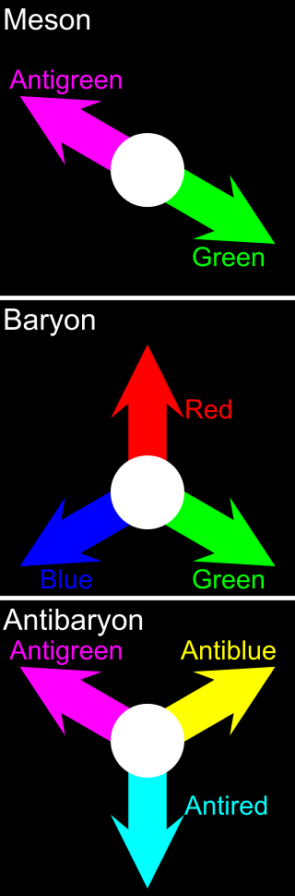
quarks
The quark model was independently proposed by physicists Murray Gell-Mann and George Zweig in 1964, who posited that hadrons were not elementary particles, but were instead composed of combinations of quarks and antiquarks.

Slide 16
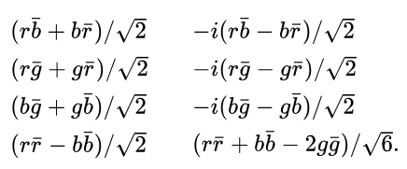
gluons
In 1964–65, Greenberg and Han–Nambu proposed that quarks possess an additional SU(3) gauge degree of freedom, later called color charge. They noted that quarks might interact via an octet of vector gauge bosons: the gluons.
The color octet (equivalent to the Gell-Man matrices):

Slide 17
challenges

Slide 18
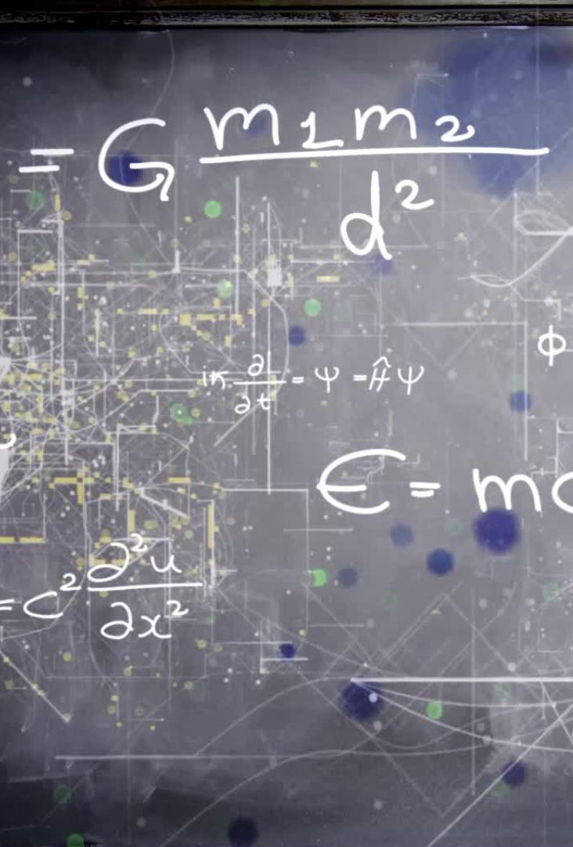
gravity
The quantum theory used to describe the micro world, and the general theory of relativity used to describe the macro world, are difficult to fit into a single framework. No one has managed to make the two mathematically compatible in the context of the Standard Model.
Although when matter is in bulk, at the scale of the human body or of the planets, the effect of gravity dominates, for particle physics, when it comes to the minuscule scale of particles, it is negligible, so it can be overlooked.

Slide 19
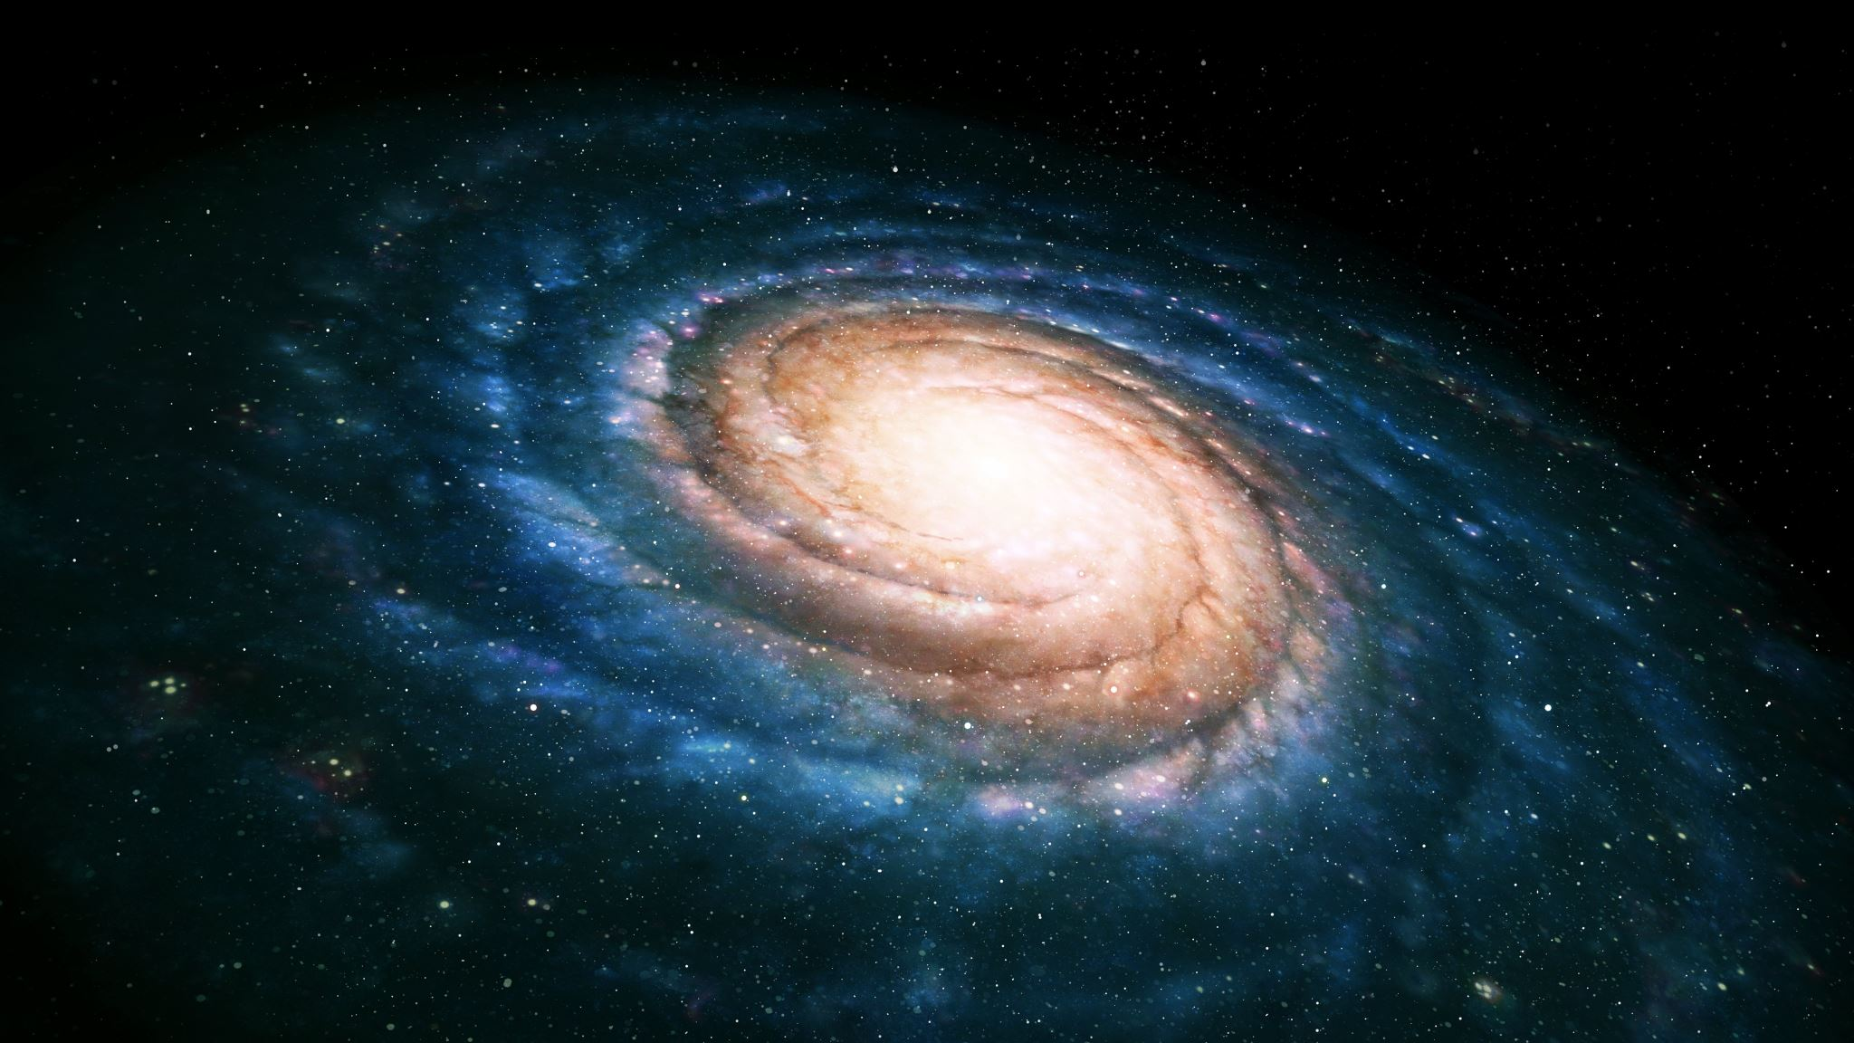
Dark matter
The Standard Model does not include a candidate for dark matter. Observations at various scales, from galactic rotation curves to the cosmic microwave background, indicate the presence of unseen mass that interacts gravitationally but not via electromagnetic forces.
Dark matter must be stable on cosmological timescales, and it interacts weakly with ordinary matter. While the Weakly Interacting Massive Particle (WIMP) has been proposed as a potential dark matter candidate, its existence and properties are yet to be confirmed.

Slide 20

Matter-antimatter asymmetry
Scientists suppose that when the universe was formed in the Big Bang, matter and antimatter should have been produced in equal parts. However, some mechanism kept the matter and antimatter from their usual pattern of total destruction, and the universe around us is dominated by matter. The Standard Model cannot explain the imbalance.

Slide 21
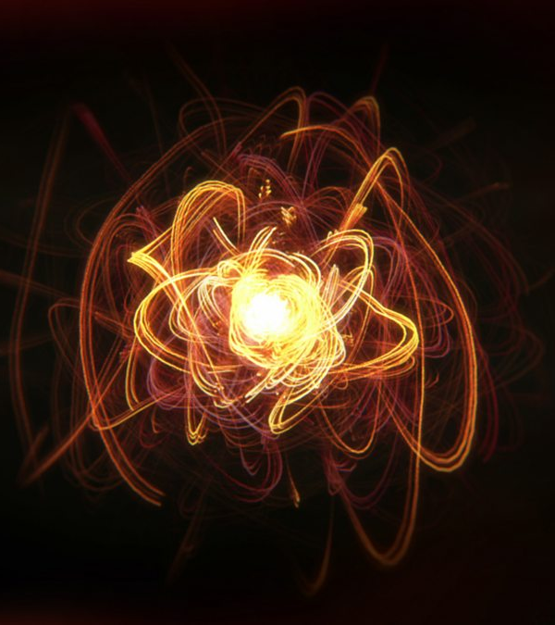
NEUTRINOS
The Standard Model assumes that neutrinos are massless, but experimental evidence, such as the fact that neutrinos oscillate or transform into one another, indicates that they have non-zero masses.
The Standard Model must be extended to accommodate these observations, and understanding the origin of neutrino masses is an active area of research.

Slide 22
supersymmetry
Supersymmetry is a theoretical framework in physics that suggests the existence of a symmetry between particles with integer spin (bosons) and particles with half-integer spin (fermions). It proposes that for every known particle, there exists a partner particle with different spin properties.
There have been multiple experiments on supersymmetry that have failed to provide evidence that it exists in nature. If evidence is found, supersymmetry could help explain certain phenomena, such as the nature of dark matter and the hierarchy problem in particle physics.

Slide 23

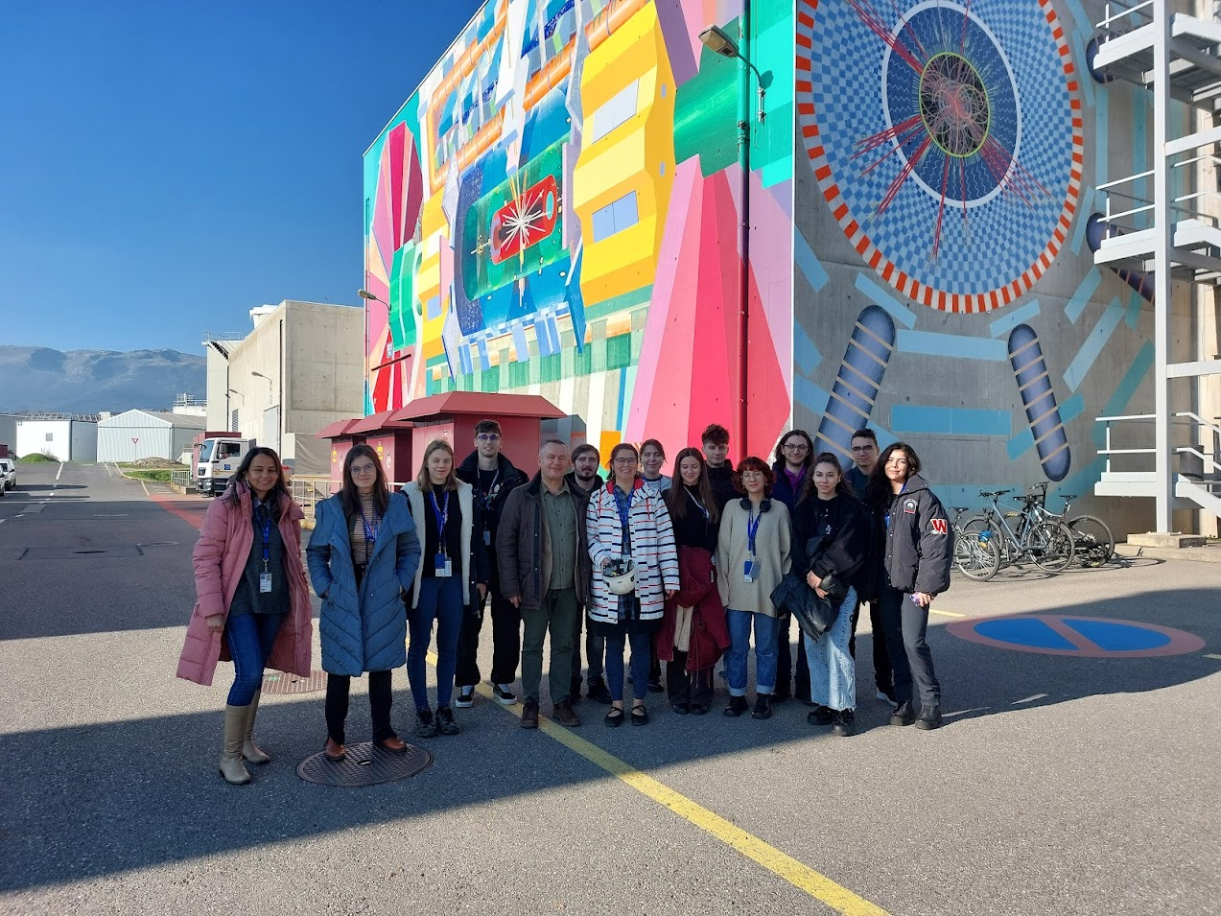
Thanks for your attention!

