Slide 1
Neutrino platform
-An INtroduction
Boca George Alexandru

Slide 2
NEUTRINO’S-What’s up with that?
The neutrino was postulated first by Wolfgang Pauli in 1930 to explain how beta decay could conserve energy, momentum, and angular momentum (spin).
He considered that the new particle was emitted from the nucleus together with the electron or beta particle in the process of beta decay and had a mass similar to the electron

Slide 3

In Fermi's theory of beta decay, Chadwick's large neutral particle could decay to a proton, electron, and the smaller neutral particle (now called an electron antineutrino)

Slide 4

First detections
In 1942, Wang Ganchang first proposed the use of beta capture to experimentally detect neutrinos.
In 1956 Francis B. "Kiko" Harrison, Herald W. Kruse, and Austin D. McGuire published confirmation that they had detected the neutrino, a result that was rewarded almost forty years later with the 1995 Nobel Prize.

Slide 5
Known properties
Neutrinos have half-integer spin ( 1 /2ħ); therefore they are fermions and leptons.
Weak interactions create neutrinos in one of three leptonic flavors: electron neutrinos ,muon neutrinos, or tau neutrinos .
They have a very tiny mass(0.09ev/c*c)

Slide 6
Where now?
Altough we have come a long way in regards to understanding the neutrino, many questions still remain, therefore it is a highly important field of study regarding nuclear physics.

Slide 7
D.U.N.E.
More than 93 years after being proposed, we have come to C.E.R.N. to get a glimpse into the next phase of neutrino resarch, the D.U.N.E. experiment.

Slide 8
Primary objectives of D.U.N.E
Investigation of neutrino oscillations to test CP (time-reversal symmetry) violation in the lepton sector, which explores why the universe is made of matter.
Determination of the ordering of the neutrino masses.
Studies of supernovae and the formation of a neutron star or black holes.
Search for proton decay, which has never been observed but is predicted by theories that unify the fundamental forces

Slide 9
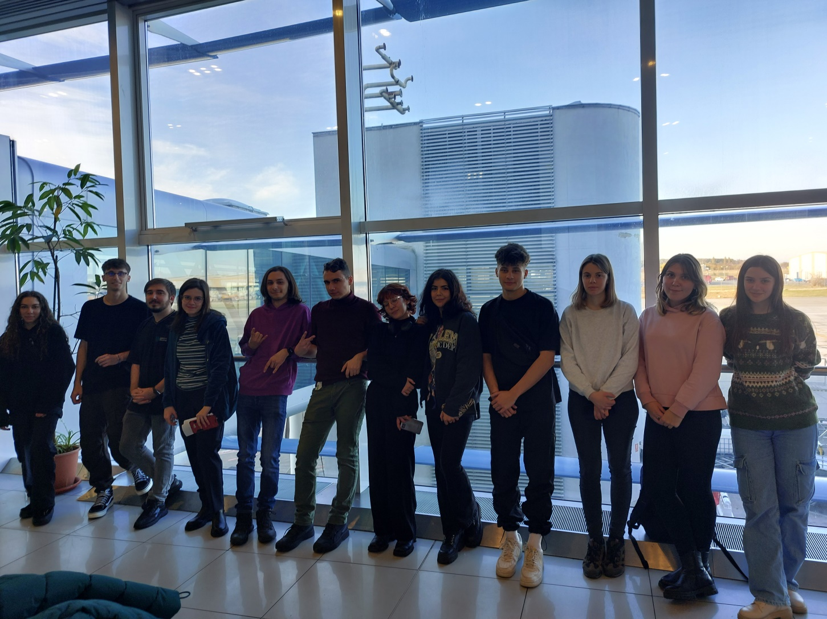
And so our story begins…

Slide 10
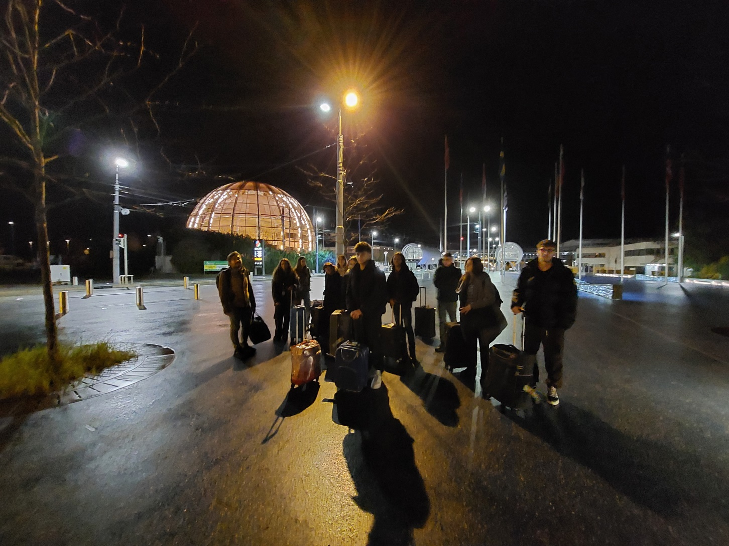
After a long and grueling filght we arrive at CERN…

Slide 11
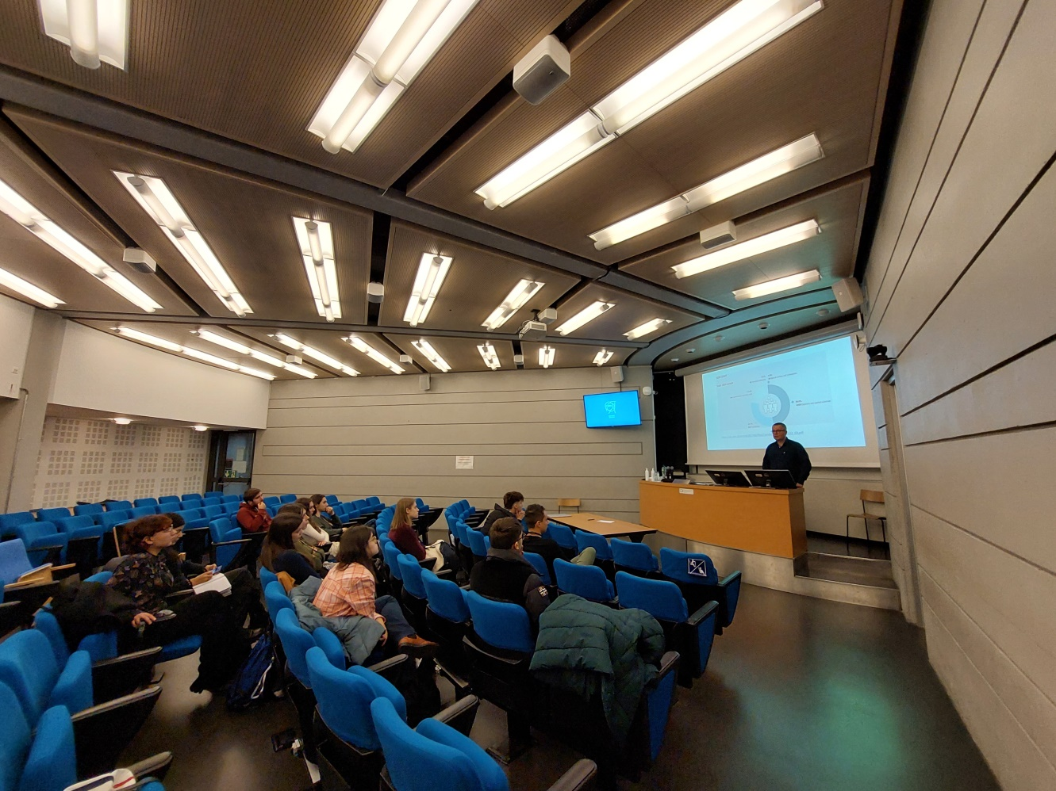
Learining the fundamentals of particle physics in our fist course..

Slide 12
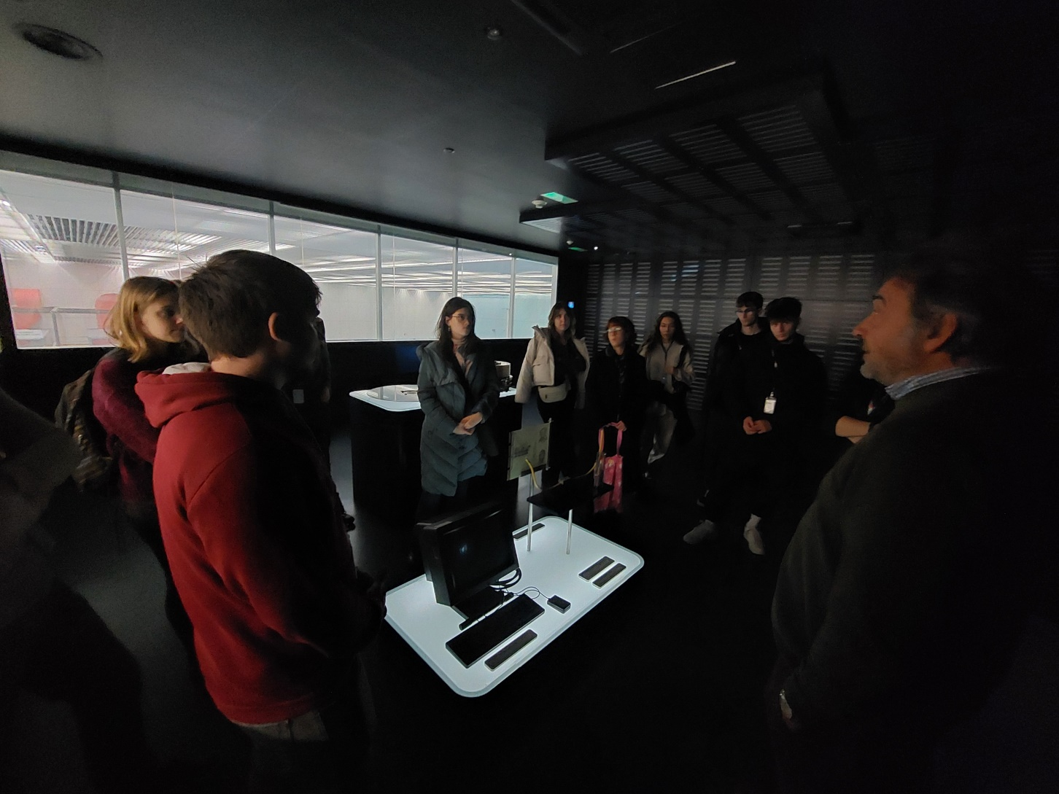
And our first visit…

Slide 13
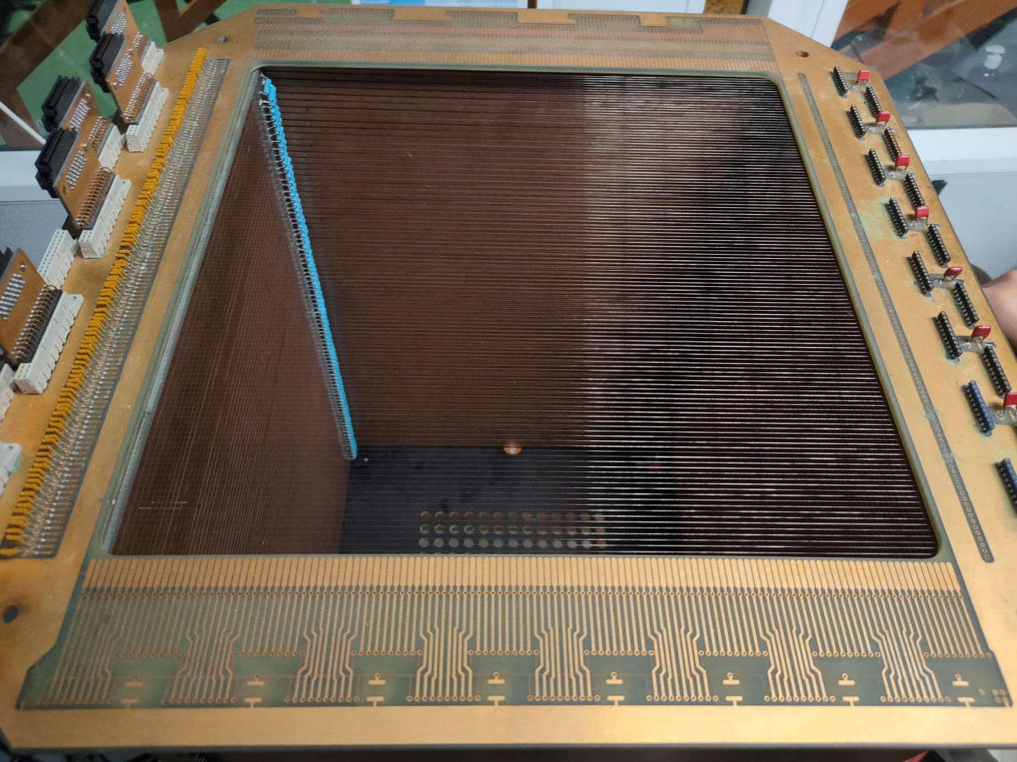
We start small before we go BIG

Slide 14
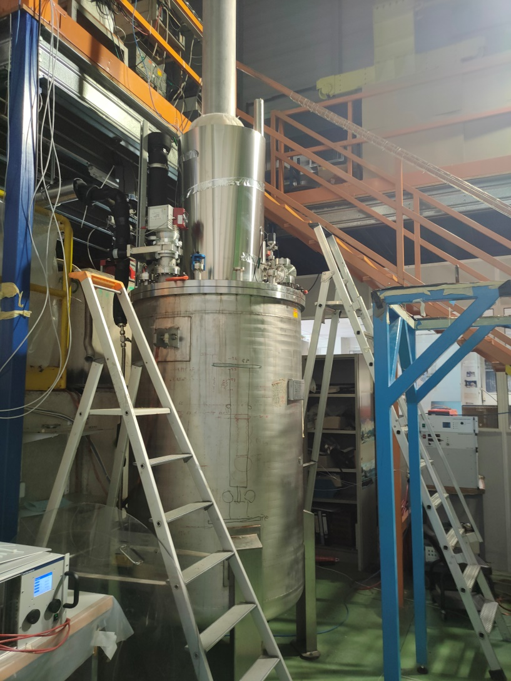

Slide 15
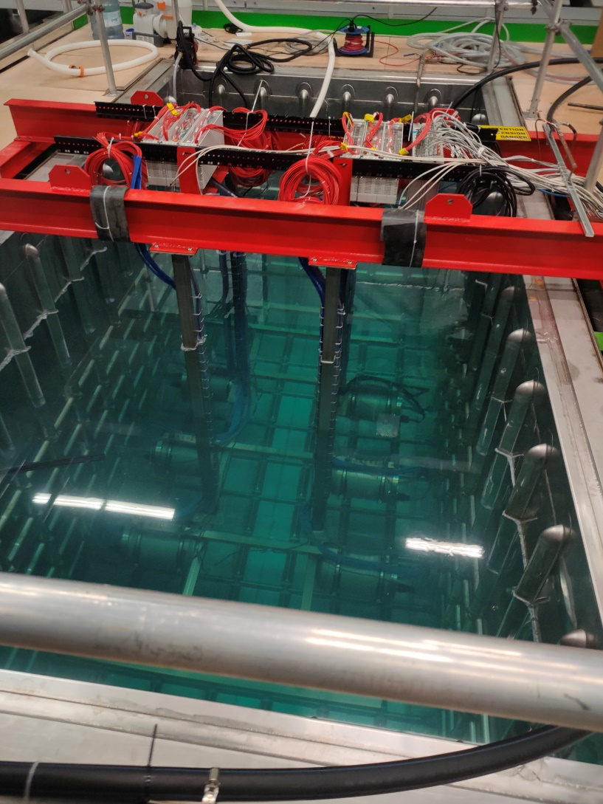

Slide 16
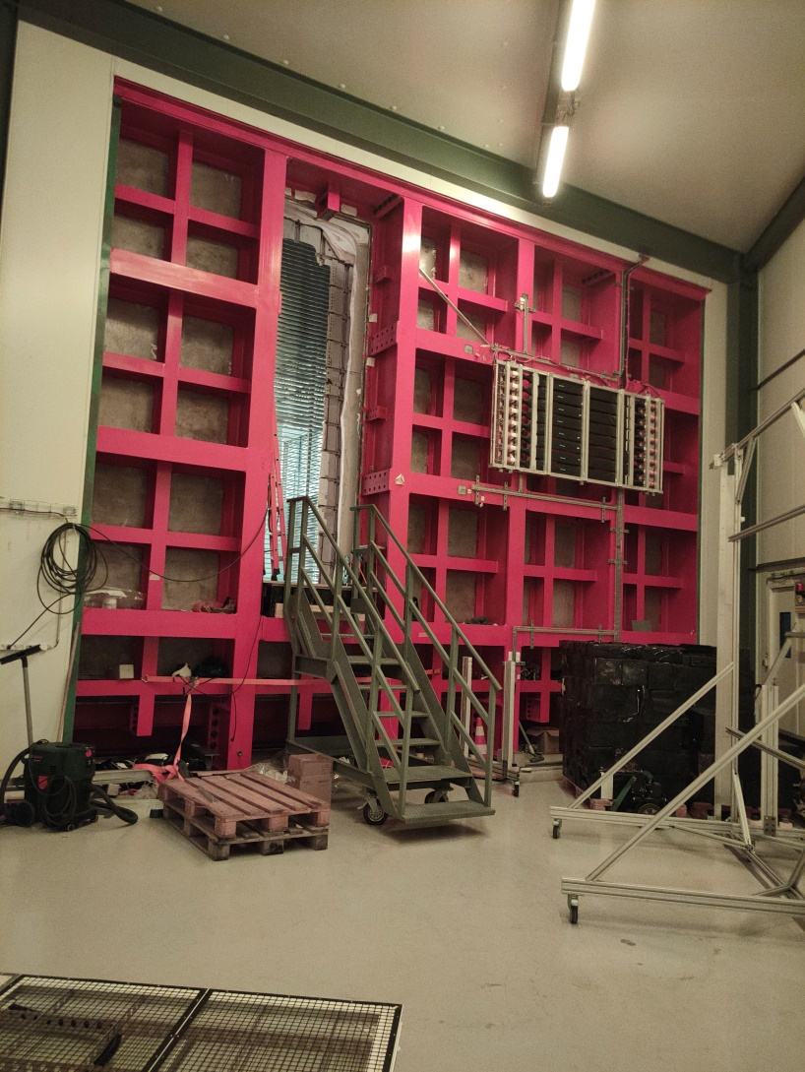
Then we go bigger… But not the biggest

Slide 17
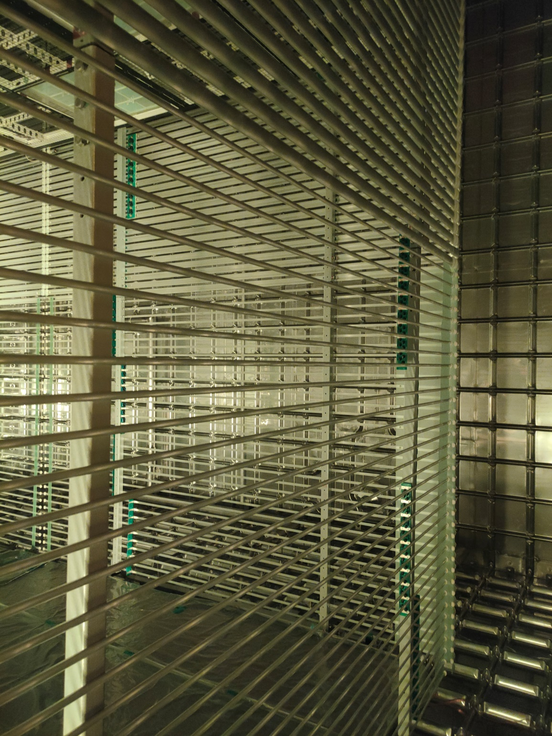

Slide 18
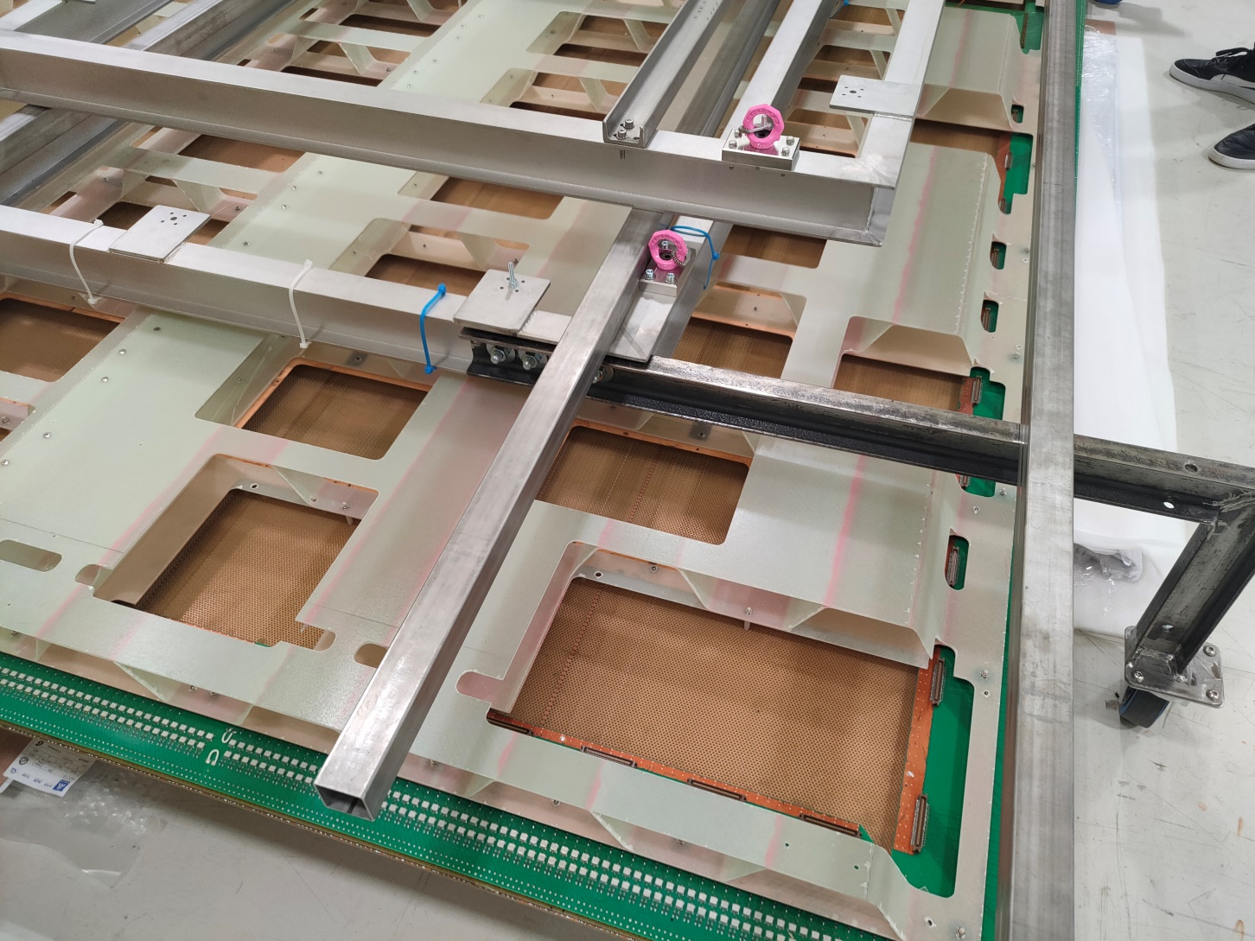
And last but not least the detectors

Slide 19
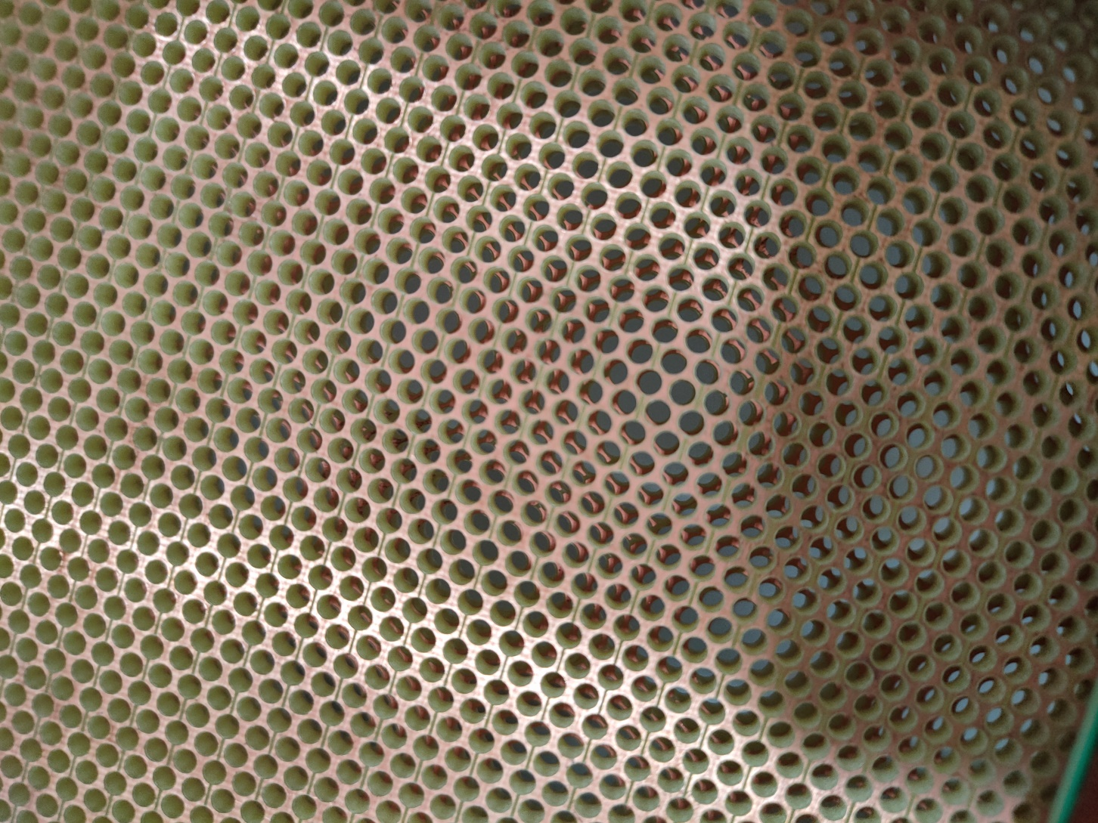

Slide 20
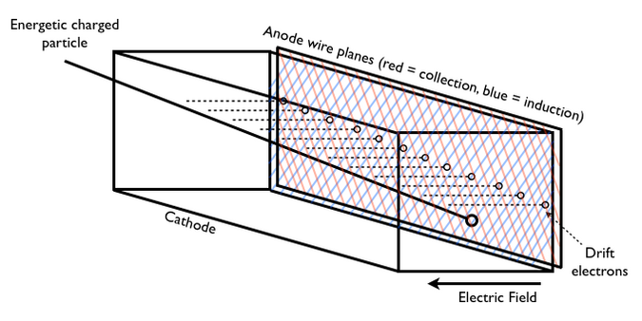

Slide 21
And so, so much more…
In no particular order, here are some of the other things we learned and places we visited whilst here

Slide 22
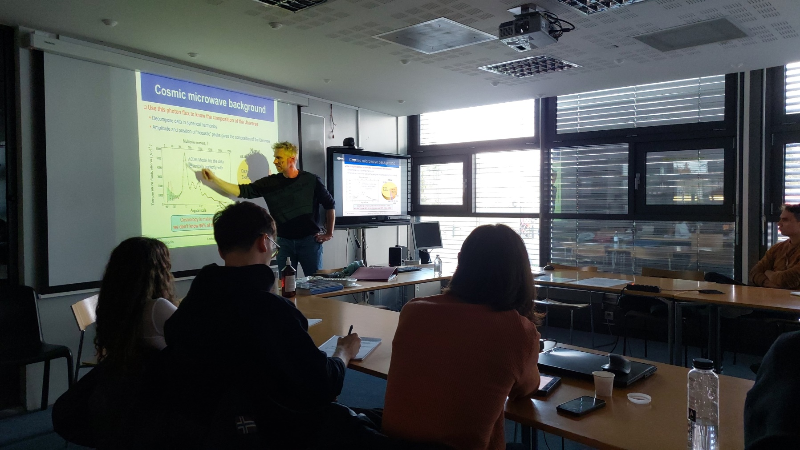

Slide 23
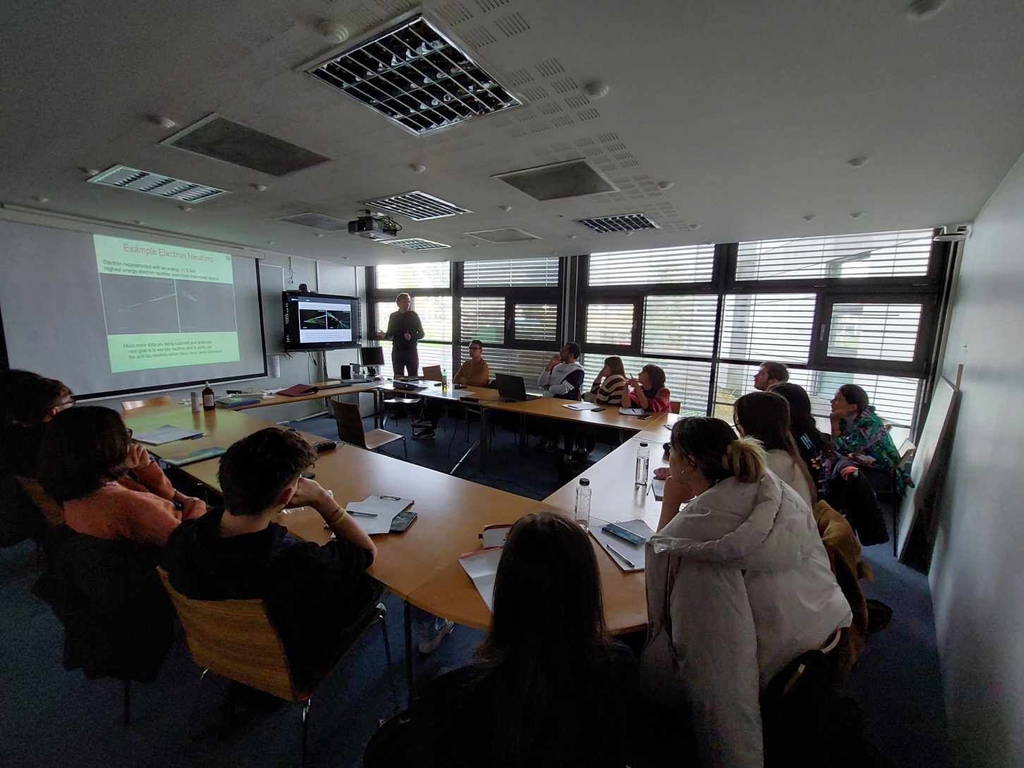

Slide 24
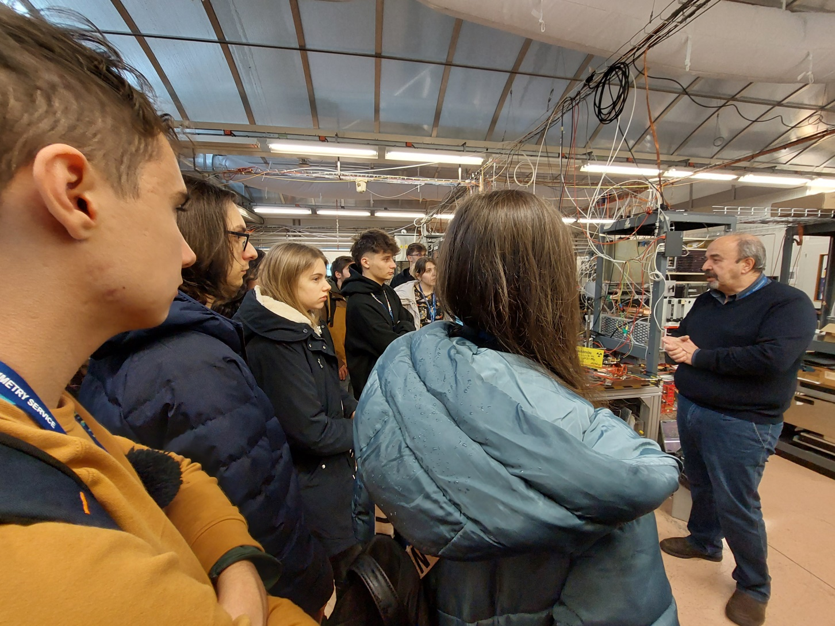

Slide 25
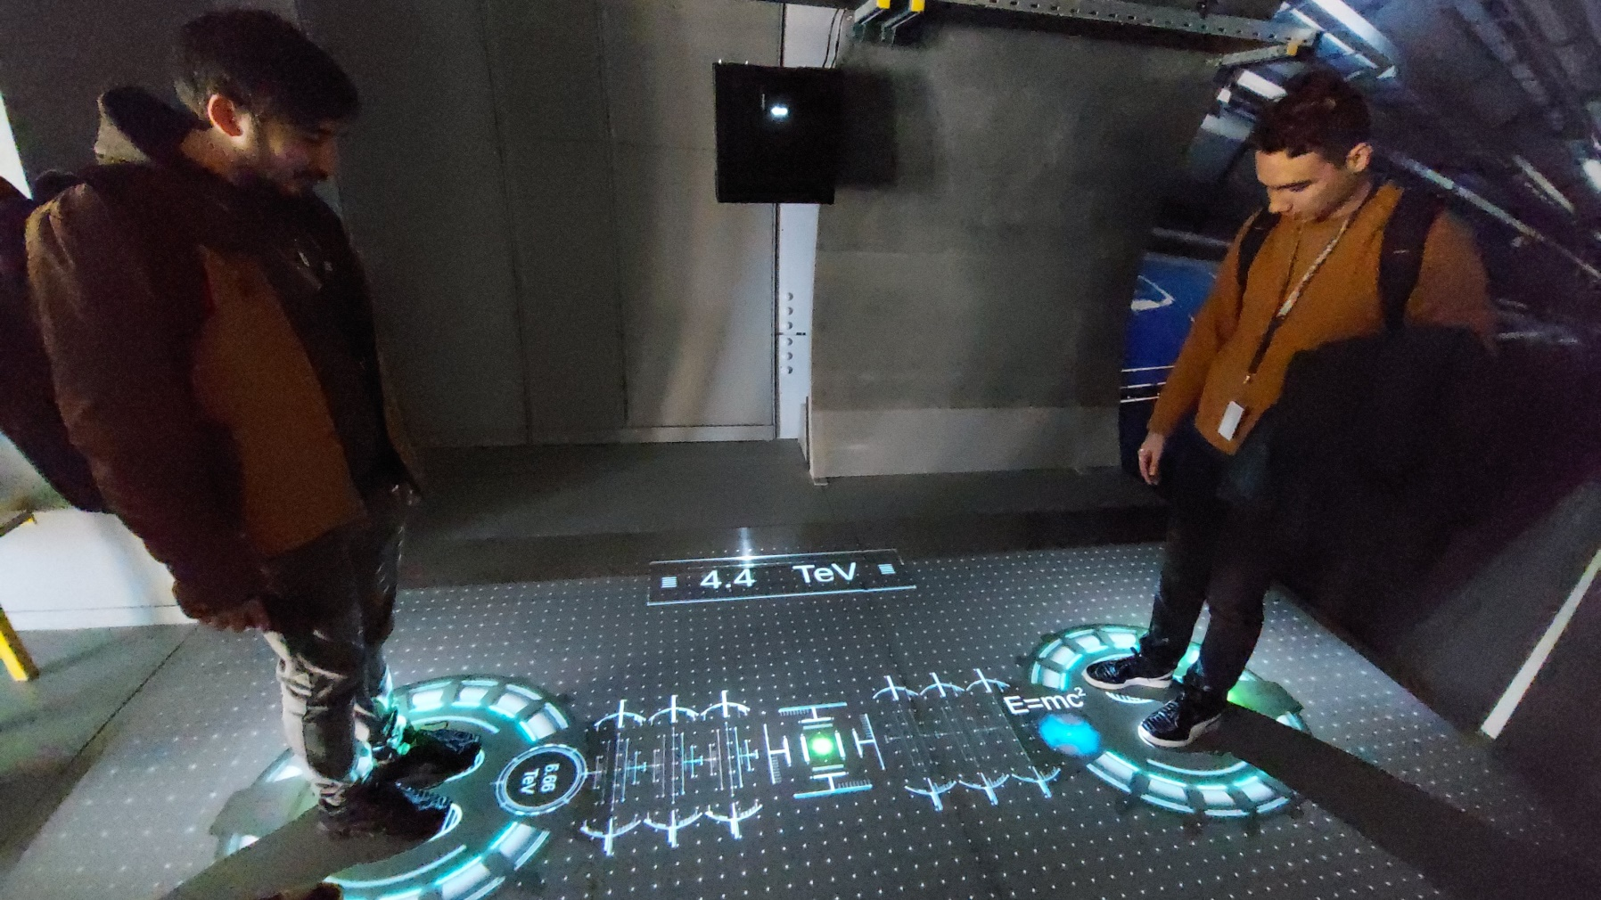

Slide 26
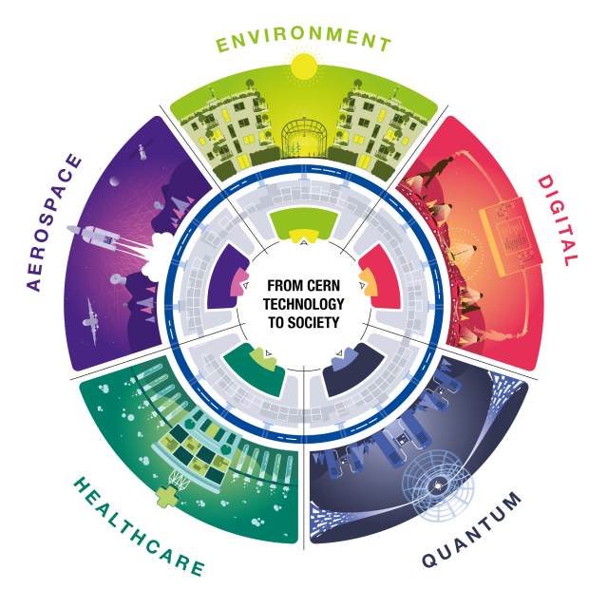
All this time and effort, but why?

Slide 27
Not to mention the other breakthroughs
1973: The discovery of neutral currents in the Gargamelle bubble chamber
1983: The discovery of W and Z bosons in the UA1 and UA2 experiments
1989: The determination of the number of light neutrino families at the Large Electron–Positron Collider (LEP) operating on the Z boson peak;
1995: The first creation of antihydrogen atoms in the PS210 experiment;
1995–2005: Precision measurement of the Z lineshape, based predominantly on LEP data collected on the Z resonance from 1990–1995;
1999: The discovery of direct CP violation in the NA48 experiment;
2000: The Heavy Ion Programme discovered a new state of matter, the Quark Gluon Plasma.
2010: The isolation of 38 atoms of antihydrogen;
2011: Maintaining antihydrogen for over 15 minutes;
2012: A boson with mass around 125 GeV/c2 consistent with the long-sought Higgs boson.

Slide 28

And something that is intrinsic to everyday life nowadays…

Slide 29

But let’s not forget what it prevented…

Slide 30
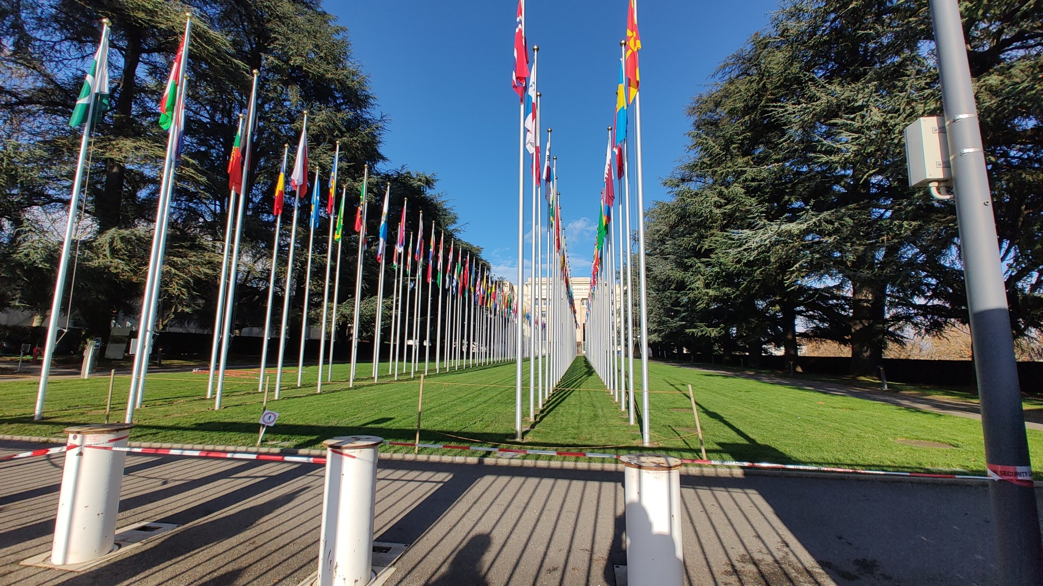
…And what it strives to achive

Slide 31

And why bringing people here is so, so important…

