Slide 1
Grid computing in data analysis
Ţiuleanu Ana-Maria

Slide 2
Contents:
3. Applications and WLCG
1. Introduction
4. Conclusions
2.
Grid computing architecture

Slide 3
1. Introduction
Grid computing concept and data analysis

Slide 4
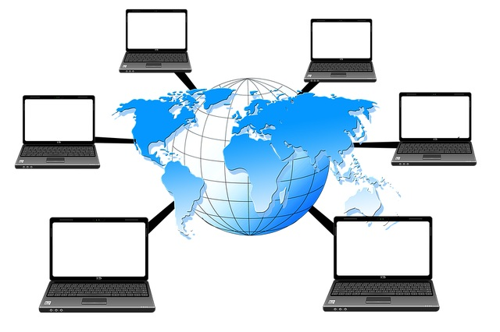
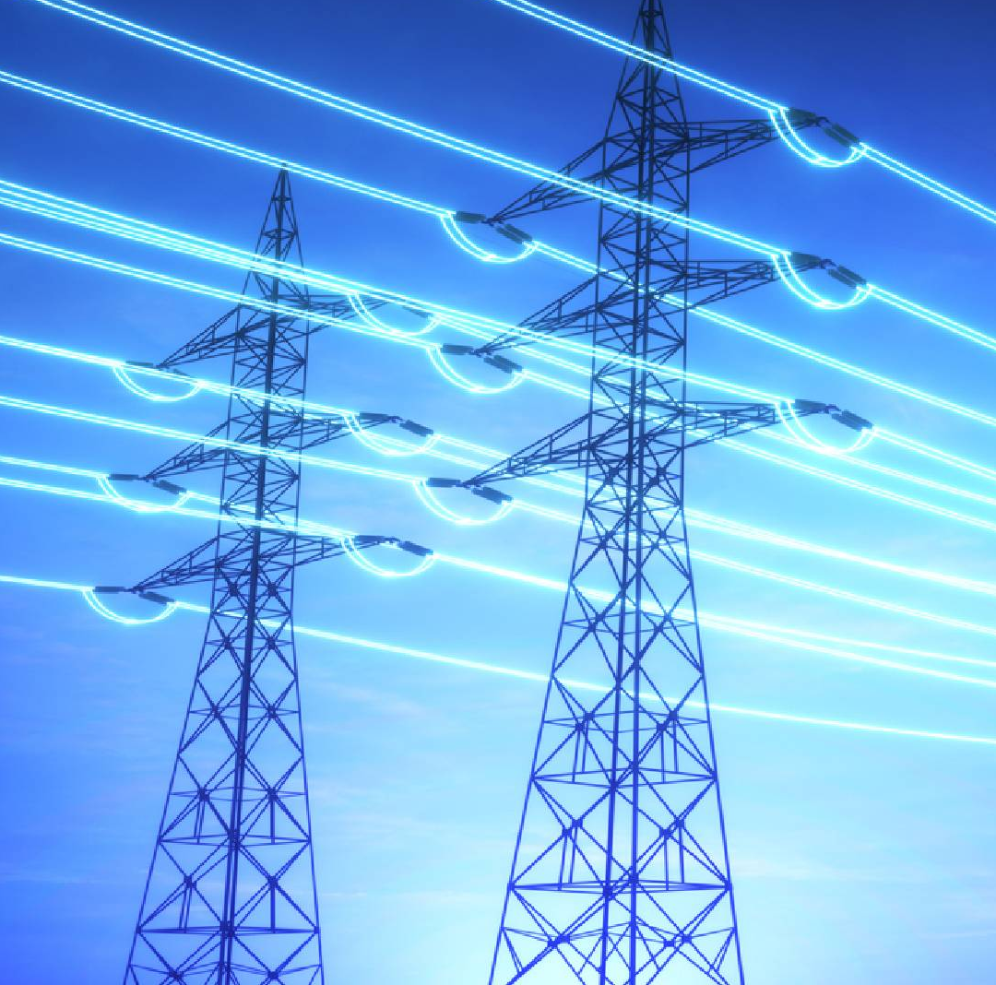

What is Grid computing?
“Computing power from a plug in the wall”
Large number of (heterogeneous) compute units connected via a fast network that share storage, power
Great focus on large, trans geographical sclaes

Slide 5

Data analysis challenges
Data Storage and Management
Computational Resources
Data Transfer, colaboration
Distributed Storage
Parallel Processing
Horizontal Scalability
Virtual Organizations

Slide 6
2. Architecture
Grid architecture

Slide 7


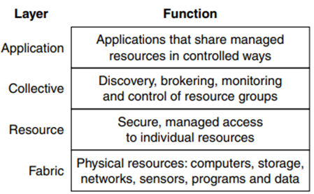
3.Grid architecture
1.Control Node / computing element
2. Storage elements
3. Working elements
4. User
+Middlewear

Slide 8
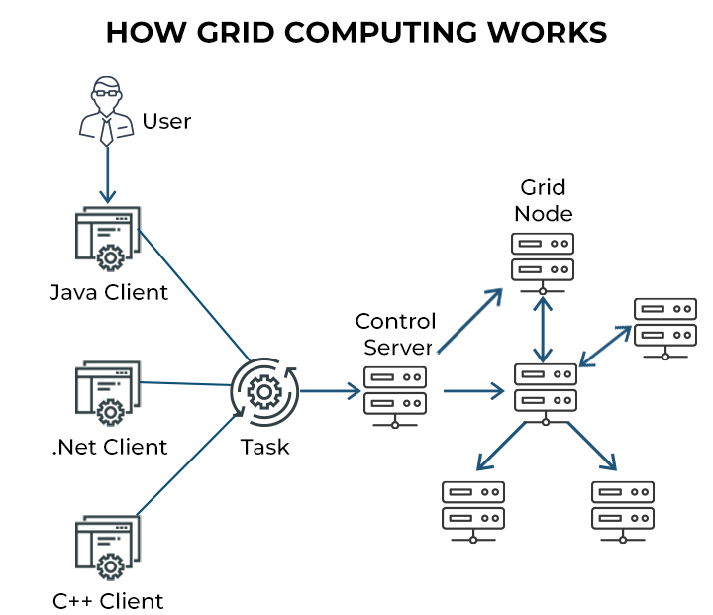

Slide 9
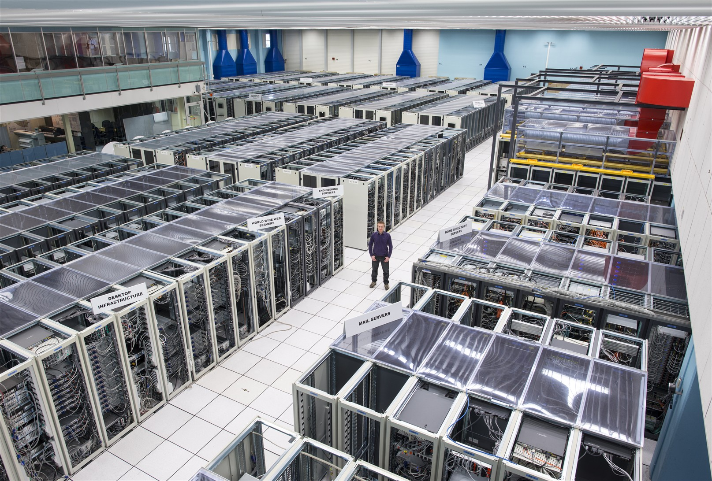
3.Applications and
WLCG
CERN data center

Slide 10
Applications
Storing and analyzing patient data, imaging
Healthcare
Entertainment
Engeneering
Scientific research
Storing and analizing experiment data
Film
Grid applications
Gaming
Modeling, design optimization

Slide 11
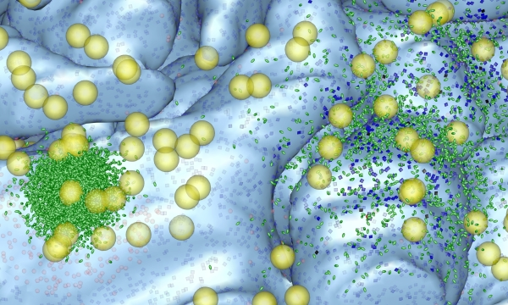
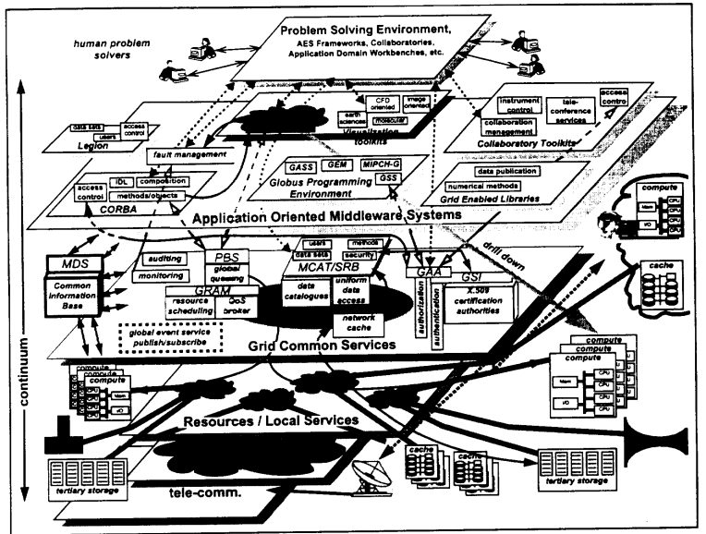
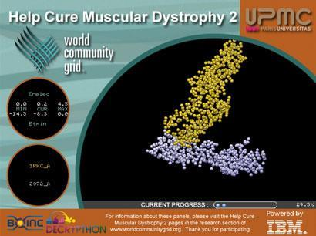
Examples :
MCell project
NASA Information Power Grid (NASA IPG)
World Community Grid
Worldwide LHC Computing Grid
……….

Slide 12
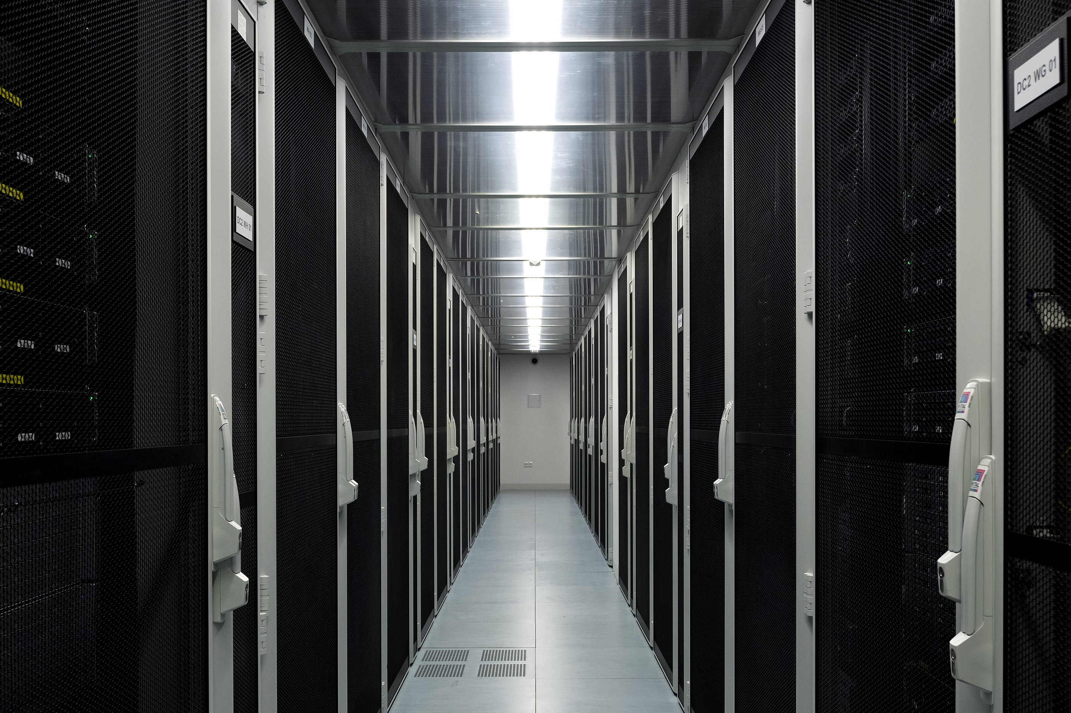
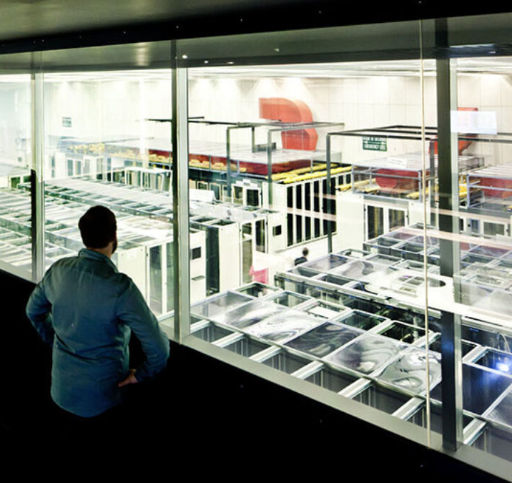
Worldwide LHC(Large Hadron Collider)
Computing Grid
- 170 computing centers
- 40 countries
~ 200 petabytes of data analyzed yearly

Slide 13
Sctructure of WLCG:
Tier 0
Tier1
Tier 2
Tier 3
1 data center at CERN, stores raw data, first reconstruction
13 data centers, store proportional parts of raw data, large scale reconstruction
Universities and institutes that can store sufficient
data and provide computing power forspecific
analysis, ex: Monte Carlo
Individual scientists

Slide 14
Advantages/ Disadvantages:
Advantages:
Decentralized
Easy collaboration
Cost efficient
Easily improved
Eficient hardware usage and parallel comuping
Disadvantages:
Trouble in the control node can come to halt in the whole network.
Grid computing involves the sharing of resources over a network, raising security concerns.
Complexity of instalation

Slide 15
Conclusion:
The term Grid refers to distributed, high performance computing and data handling infrastructure that incorporated geographically and organizationally dispersed, heterogeneous resources.
Standard computing is no longer feasible technology for large data analysis
Exploring a couple examples we’ve seen the potential and the power Grit has, particularly to process and analyze vast amounts of information

Slide 16
Thank you!

