Slide 1
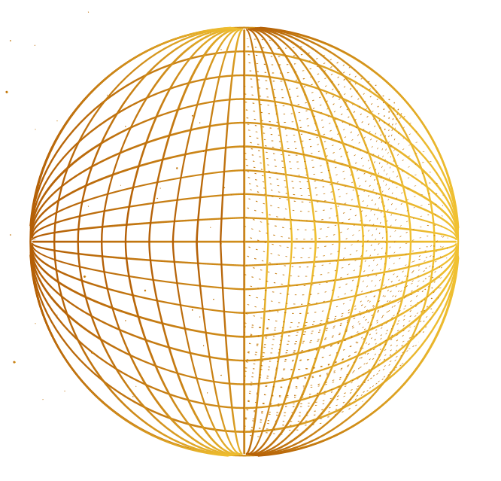


DARK MATTER
PRESENTED BY :
DUBALARU GABRIELA

Slide 2

TABLE OF CONTENTS
01.
02.
03.
04.
INTRODUCTION TO DARK MATTER
Brief history
WHAT DO WE KNOW?
Characteristics. Theory background
CANDIDATES FOR DARK MATTER
Main candidates and about them
CONCLUSIONS
Research and predictions
05.
MY EXPERIENCE

Slide 3
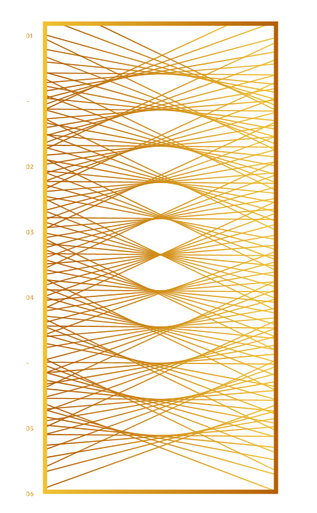
01.
INTRODUCTION TO
DARK MATTER

Slide 4
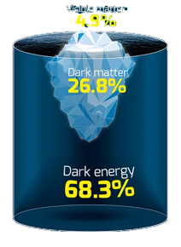
WHAT IS DARK MATTER ?
Dark matter makes up more than 26% of all the energy in the Universe. This mysterious substance doesn’t interact with the electromagnetic radiation (heat, light, radio) that we rely on to see the Universe, so it is invisible and is only detectable by the gravitational influence it has on the stuff we can see.
Scientists have not yet observed dark matter directly, because it is pretty much impossible to detect with current instruments.

Slide 5

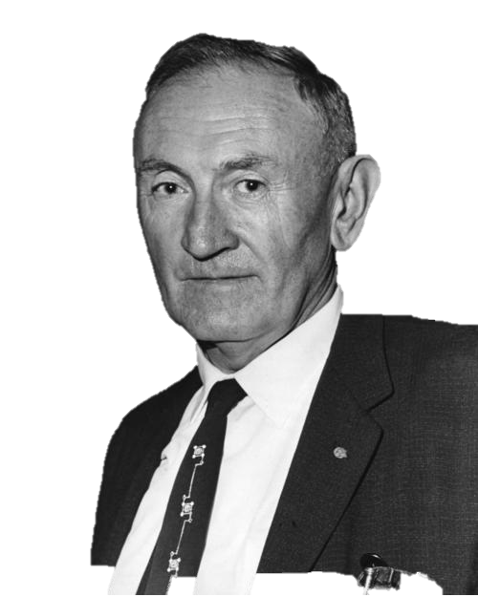
How was dark matter “discovered” ?
In 1933, Fritz Zwicky had analyzed the Doppler velocities of whole galaxies within the Coma cluster. He found that the individual galaxies within the cluster are moving so fast that they would escape if the cluster were held together only by the gravity of its visible mass.

Slide 6

How was dark matter “discovered” ?
Vera Rubin realized that she had discovered compelling evidence for Zwicky’s dark matter. The stars far from the centers of galaxies, in the sparsely populated outer regions, were moving just as fast as those closer in. This was odd, because the visible mass of a galaxy does not have enough gravity to hold such rapidly moving stars in orbit.
Her calculations showed that galaxies must contain about ten times as much “dark”
mass as can be accounted for by the visible stars. In short, at least ninety
percent of the mass in galaxies, and therefore in the observable universe,
is invisible and unidentified.

Slide 7

WHAT DO WE
KNOW ABOUT IT ?
02.

Slide 8
Or actually what we know it is NOT :
NORMAL MATTER
ANTIMATTER
BLACK HOLES
T
1
Doesn’t reflect or block light, which allows us to see them
They are much too powerful to account for the effects we can measure
Annihilation of matter and antimatter produces γ rays, e+, ν –> the space is not flooded with that

Slide 9
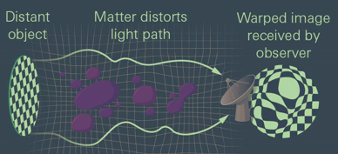
HOW WAS THE COMPOSITION OF THE UNIVERSE MEASURED?
Gravitational lensing occurs when light travels near a massive object – such as a galaxy or a clump of dark matter.
Cosmic microwave background – ancient light emitted when the Universe was in its infancy. The gravitational fields of the massive objects (star, galaxies) influenced the path of CMB light.
Light captured by Atacama Cosmology Telescope was used to produce a CMB lensing mass map, a visualization of all the matter in the path of the CMB light. This gives us one of the most precise matter map to date.

Slide 10
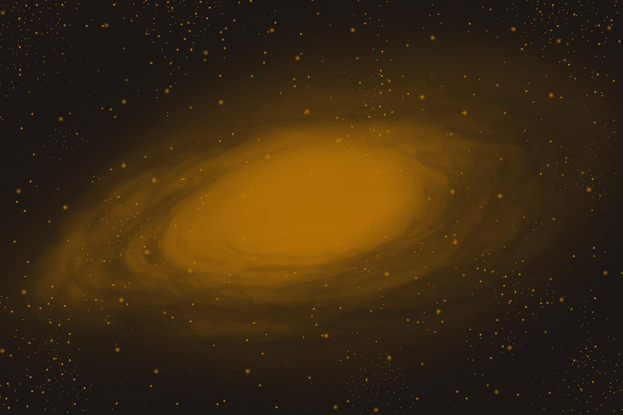
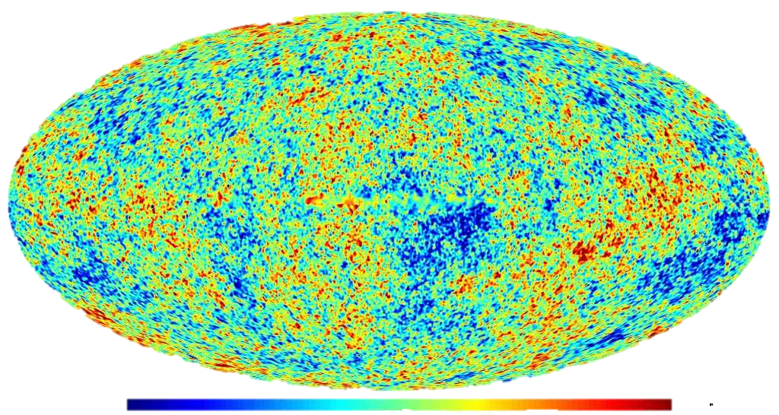
-200 μK
200 μK

Slide 11

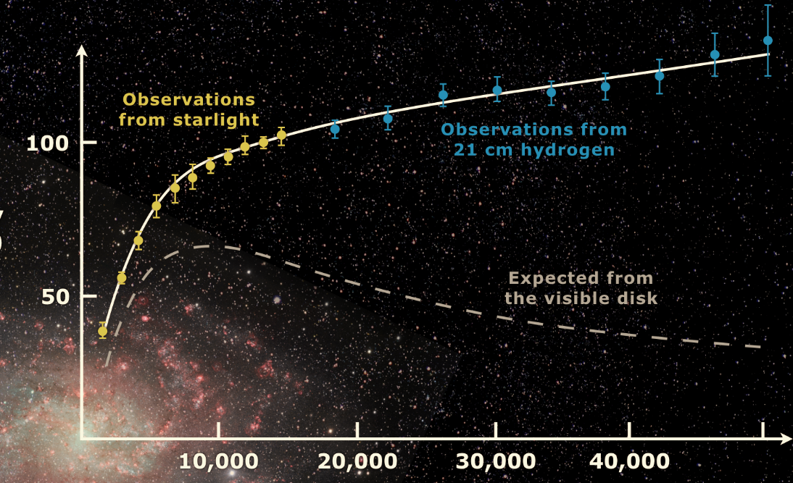
Galaxy rotation curve
The orbital velocities of planets in planetary systems and moons orbiting planets decline with distance according to Kepler’s third law. When you look at the orbital speed of stars in the Milky Way galaxy, you find that almost all stars are orbiting at the same speed - about 200 kilometers per second. And most other galaxies seem to show the same general trend.
This reflects the mass distributions within those systems. The mass estimations for galaxies based on the light they emit are far too low to explain the velocity observations.
A significant discrepancy exists between the experimental curves observed, and a curve derived by applying gravity theory to the matter observed in a galaxy.
A solution to this conundrum is to hypothesize the existence of dark matter and to assume its distribution from the galaxy's center out to its halo.
VELOCITY (km/s)
Mass, unlike luminosity, is not concentrated near the center of the spiral galaxies. The light distribution in a galaxy is not a guide to mass distribution.
DISTANCE (lightyears)

Slide 12
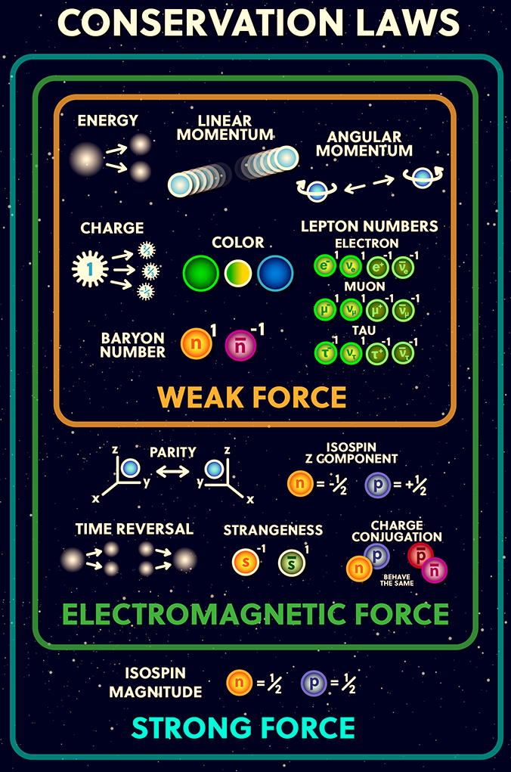

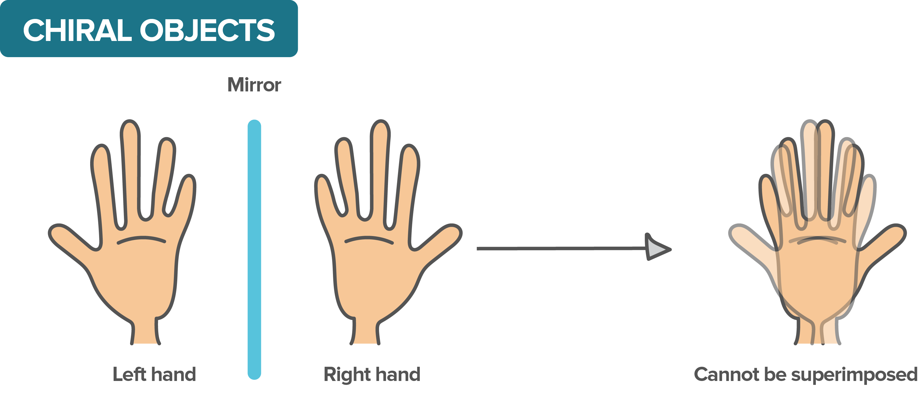
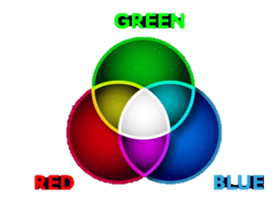

PARTICLE PHYSICS
Chirality
Chirality is Lorentz invariant, but is not a constant of motion. Any Dirac field can thus be projected into its components by acting with the projection operators
QUARKS
Ex : For an electron
Left $e=\frac{1}{2}\left(1−γ^{5}\right)e$
Right $e=\frac{1}{2}\left(1+γ^{5}\right)e$
GAUGE BOSONS
LEPTONS
Color charge
Particles are defined by their mass, spin, chirality and charges

Slide 13
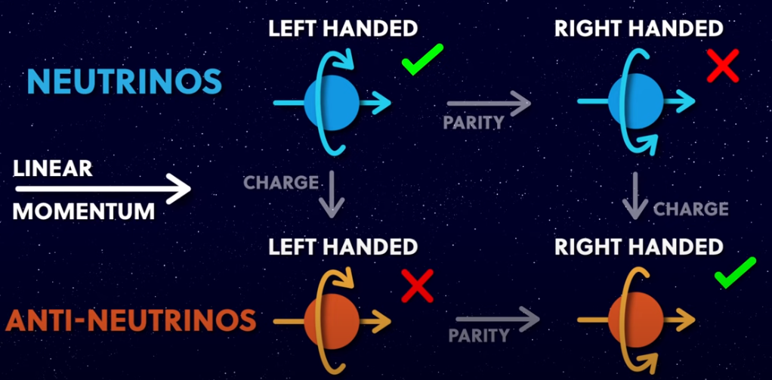
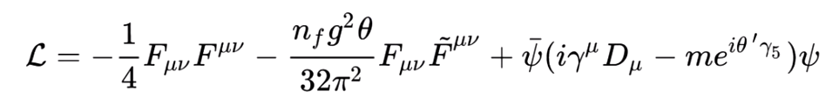
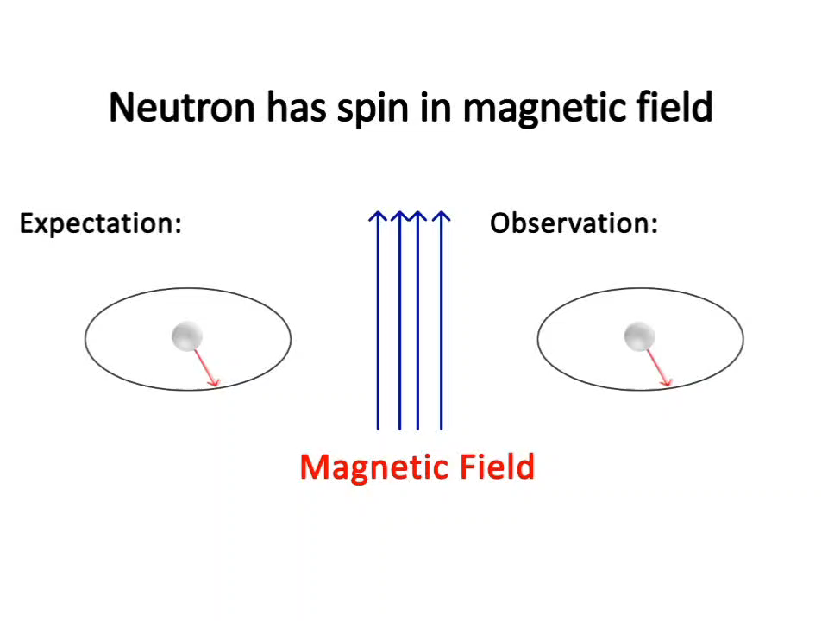
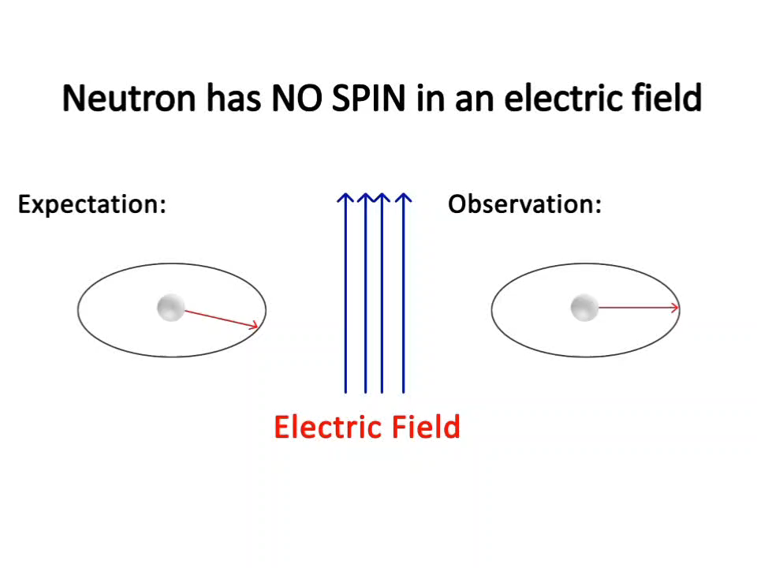
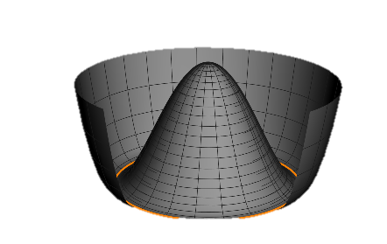
Breaking the symmetry
P
C
T
Charge
Space
Time
C
H
I
R
A
L
I
T
Y
P
C
CP
The lack of spin, it turns out, is dependent on one of the
fundamental constants of nature, called "theta." This theta has to be zero, or close to zero for this observation of no spin of neutrons to happen. This is one of the constants, like the gravitational constant. This seems to be a huge fine-tuning coincidence! -> Not enough!
X
CP
1977 Roberto Peccei, and Helen Quinn proposed a theory to solve the strong CP problem, by creating a new field for theta instead of it being just a fundamental constant. Fields seek the lowest possible energy state, then theta would also seek to be – zero . If theta is a field, it means that it will have a particle associated with an excitation of the field. This particle of the theta field is called the Axion.

Slide 14
03.
CANDIDATES FOR
DARK MATTER

Slide 15

CHARACTERISTICS WE LOOK FOR
Must be dark
Must be cold
It does not emit any
light and doesn't interact with anything to emit light, or any electromagnetic radiation
It is not moving at very high speeds -> slow down to form halos around galaxies
Weakly interacting
Interacts through gravity
It must not interact at all or very weakly with
Itself -> doesn’t clump
Like normal matter
Stable and Neutral
It cannot be a zero rest mass particle
It does not decay in 13.8 billion years -> remains in large quantities

Slide 16
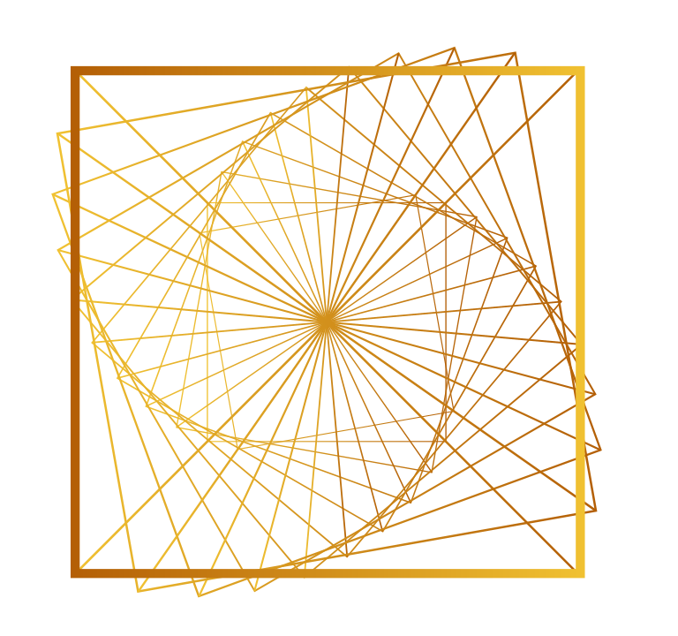
WIMP
Weakly interacting
Theory Background
Supersymmetry predicts this particle. It came naturally in string theory.
Interactions only through the weak nuclear force and gravity
Indirect Detection
Heavy mass
Refers to the
observation of
annihilation or decay products of WIMPs far away from Earth.
A new particle in the 100 GeV mass range that interacts only through the weak nuclear force and gravity
Direct Detection
It’s the observation of the effects of a WIMP-nucleus collision. Liquid Xe / Ar TPC, using prompt scintillators are now leading the race

Slide 17
AXION
weakly interacting with SM and itself
Non-relativistic
Have a low mass, so moves at speeds much lower than the speed of light -> cold
It wouldn’t be so spread out , if it interacted with itself
Tiny mass
Properties from symmetry breaking
Due to the nature of
the θ field, the Axion is predicted to have an extremely low mass. A much lighter cousin
of the Higgs boson (1μeV-1meV)
Also, doesn’t require the existence of supersymmetry
Solution to CP problem
Was invented to solve a problem having to do with something called the charge conjugation and parity symmetry problem with the strong nuclear interaction.

Slide 18

CONCLUSIONS
04.

Slide 19
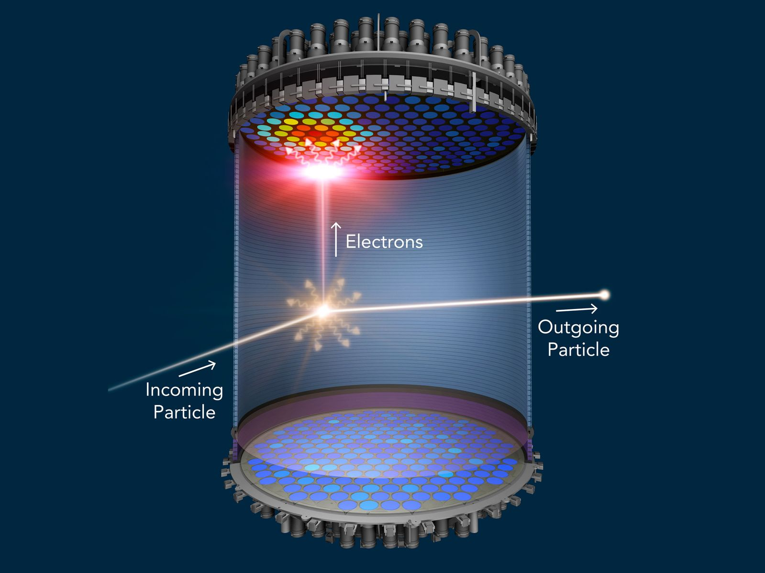
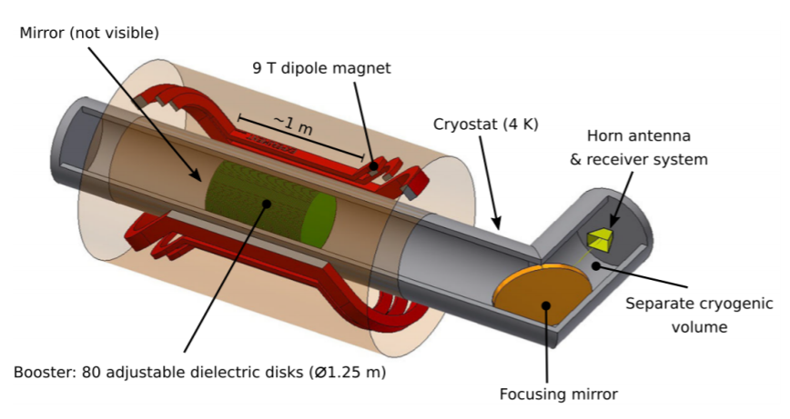
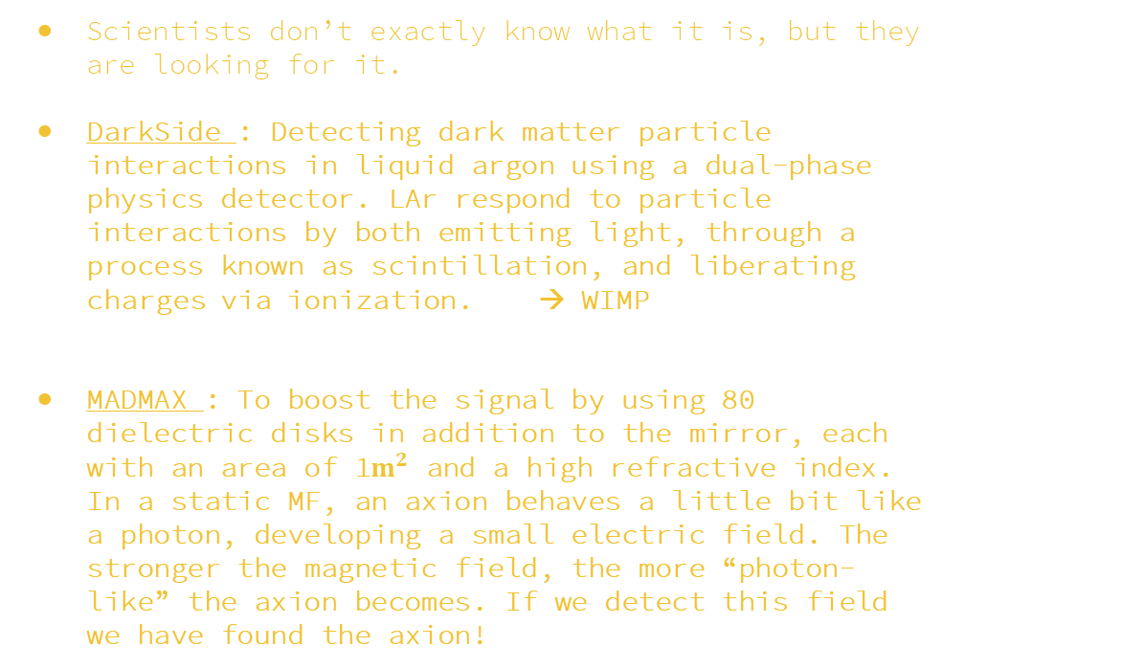
ACTIVE RESEARCH & EXPERIMENTS
Scientists don’t exactly know what it is, but they are looking for it.
DarkSide : Detecting dark matter particle interactions in liquid argon using a dual-phase physics detector. LAr respond to particle interactions by both emitting light, through a process known as scintillation, and liberating charges via ionization. → WIMP
MADMAX : To boost the signal by using 80 dielectric disks in addition to the mirror, each with an area of 1$m^{2}$ and a high refractive index. In a static MF, an axion behaves a little bit like a photon, developing a small electric field. The stronger the magnetic field, the more “photon-like” the axion becomes. If we detect this field we have found the axion!

Slide 20
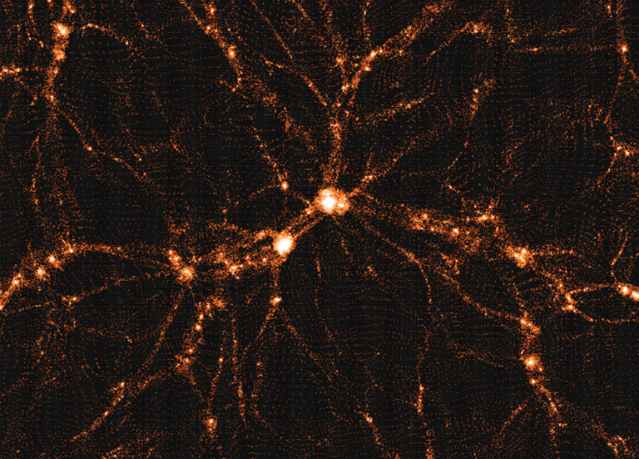
Large discovery potential in the next 10 years !
WIMP and Axion are two hypothetic particles, very well motivated by particle physics with the required dark matter properties.

Slide 21
05.
MY EXPERIENCE

Slide 22
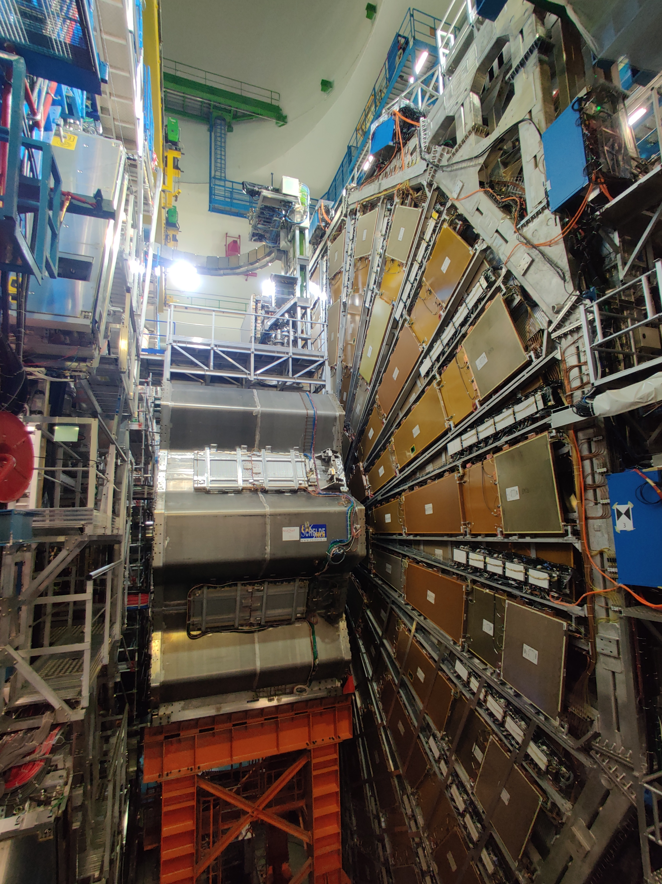
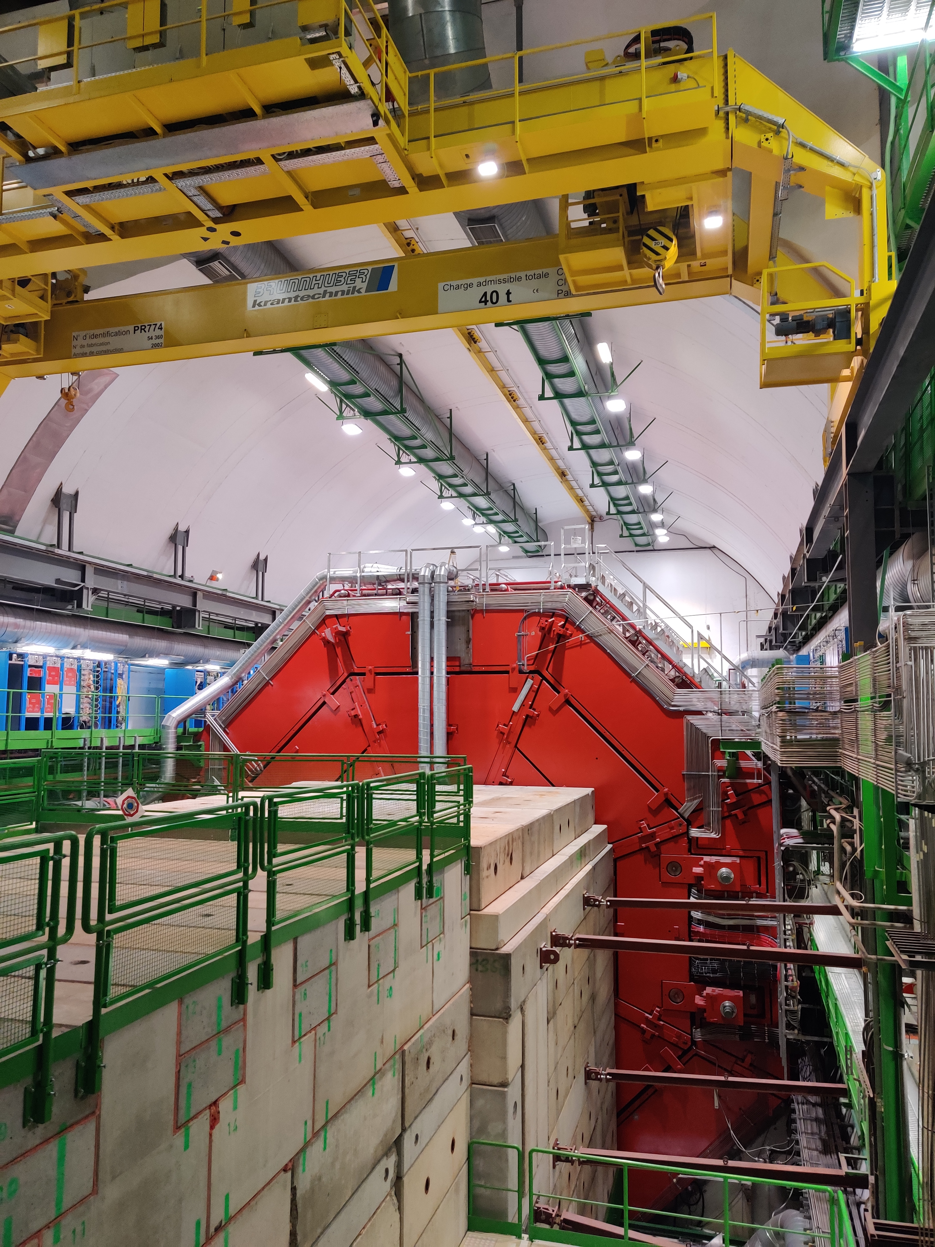
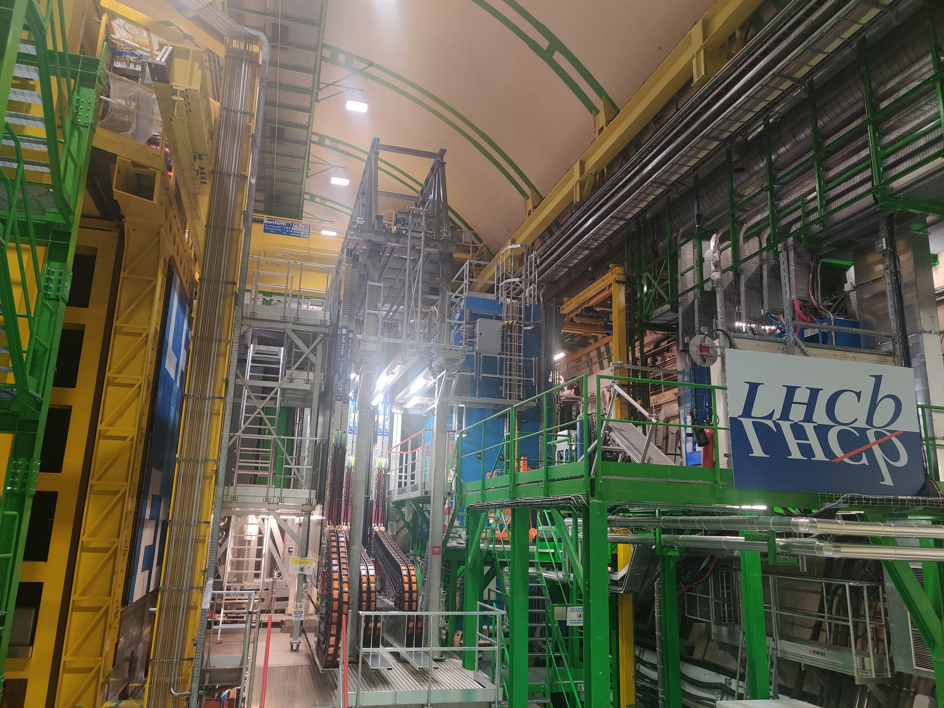
Obviously, the most incredible part
was visiting :
ATLAS
ALICE
LCHb

Slide 23


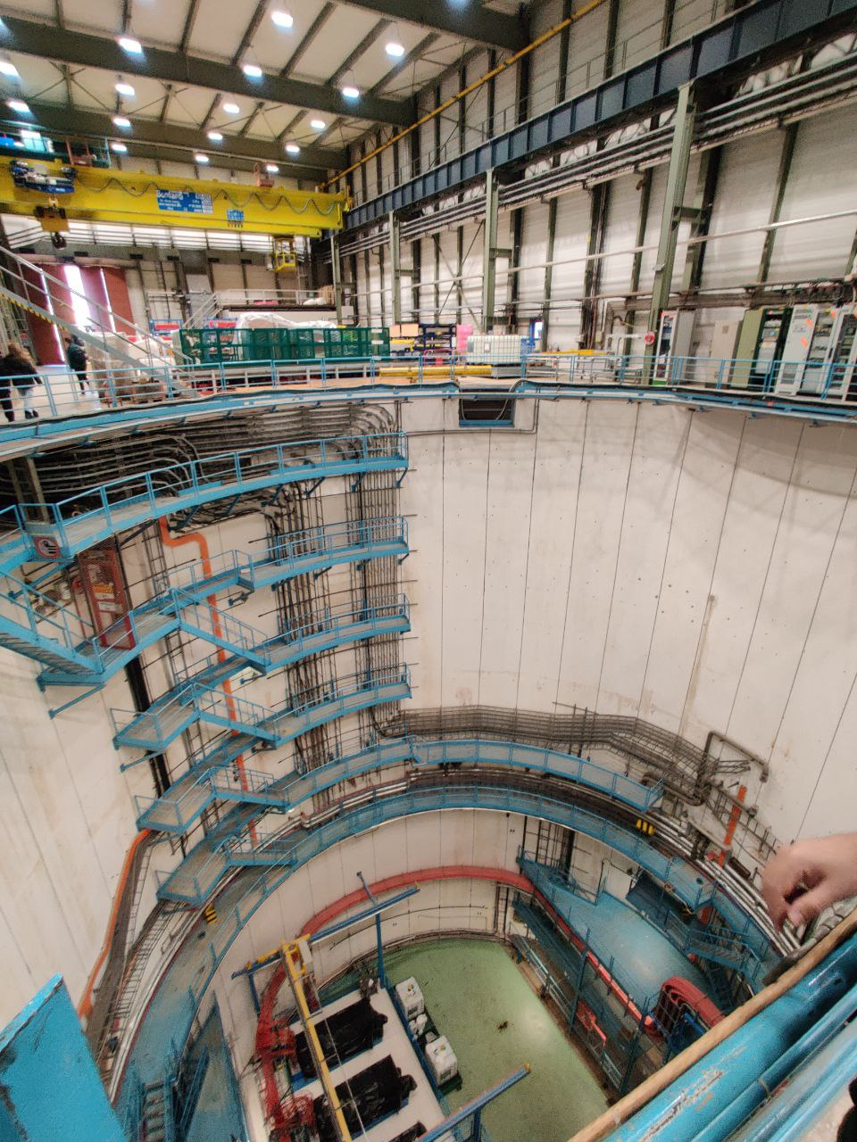
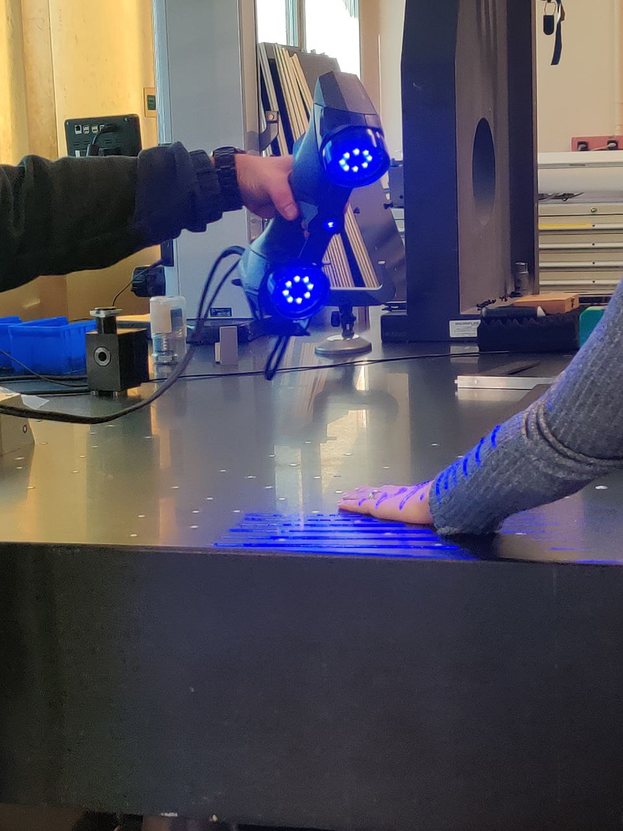
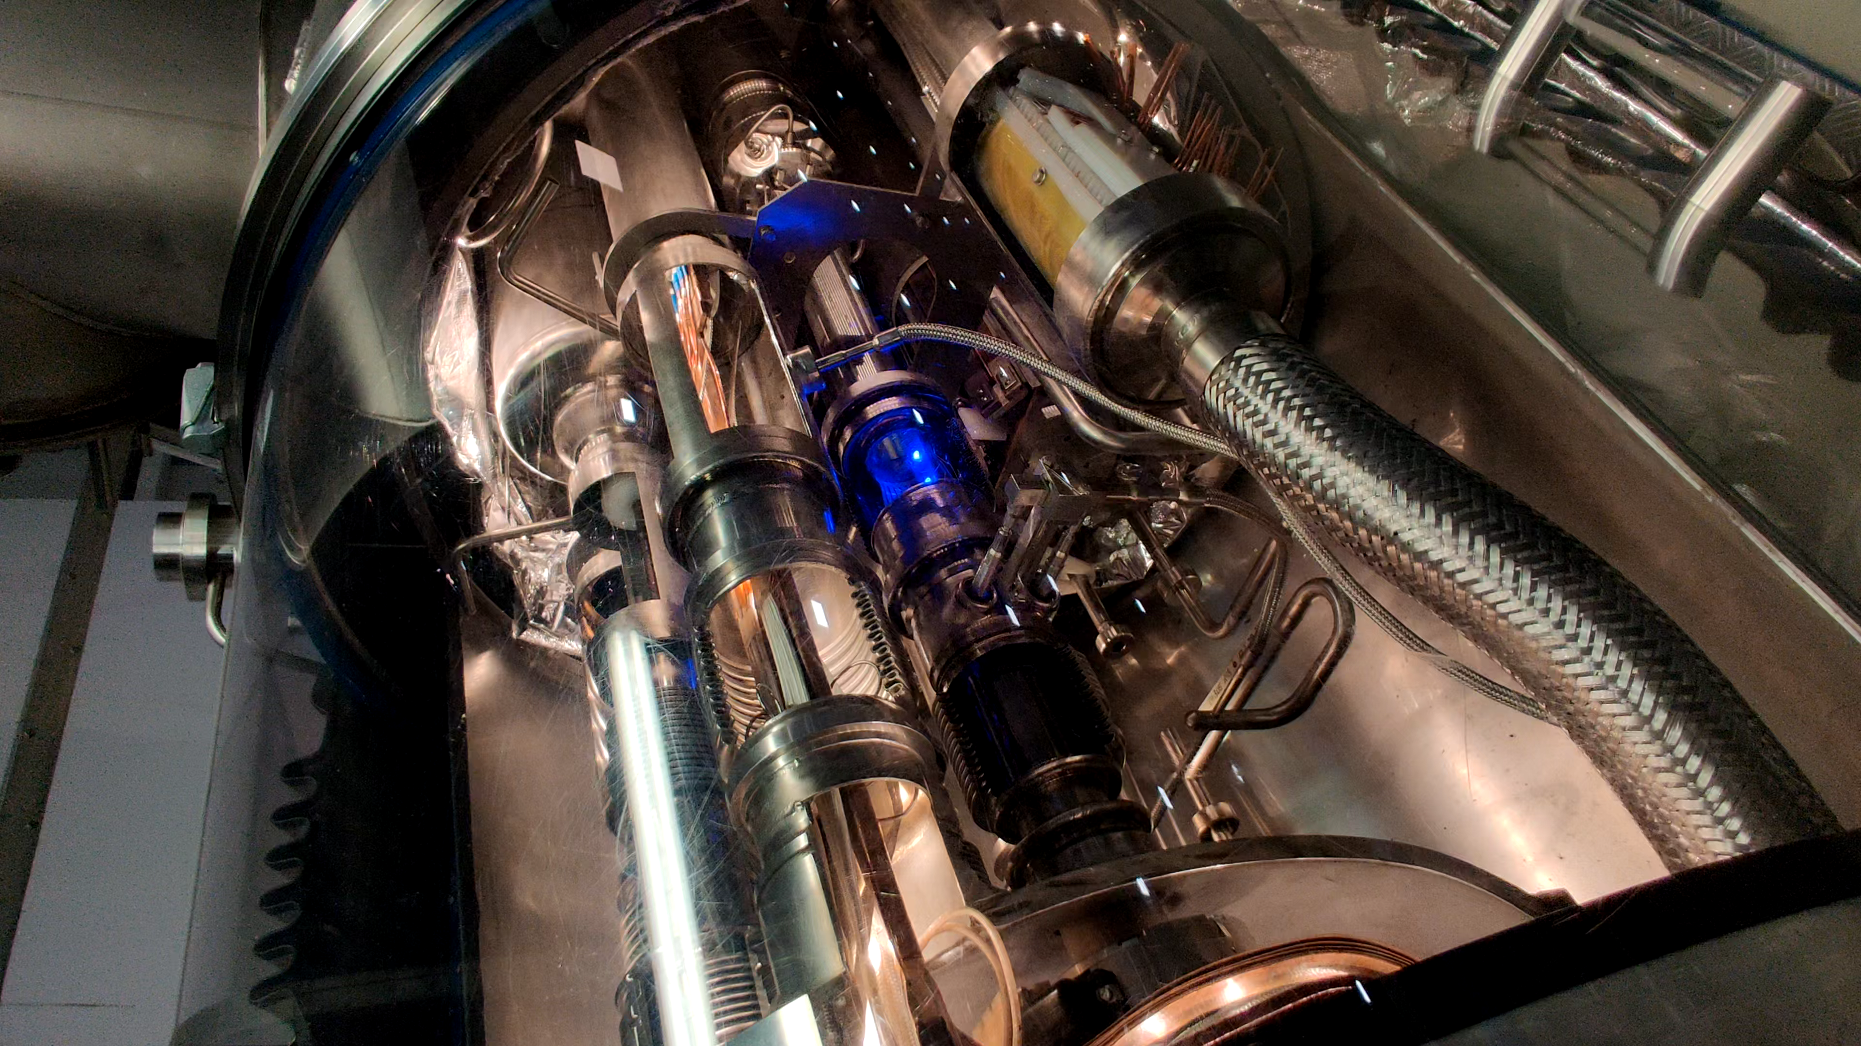
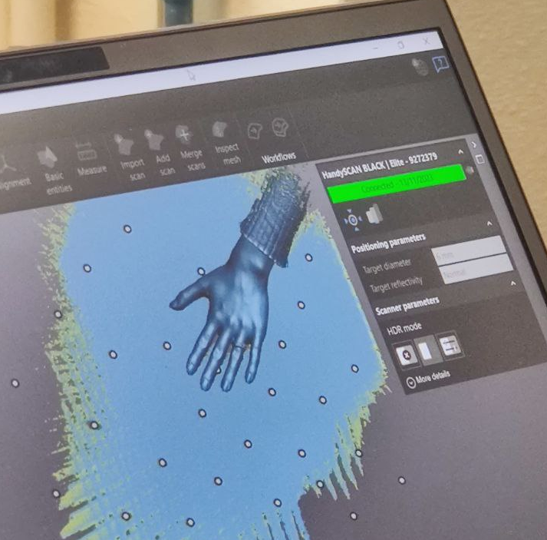
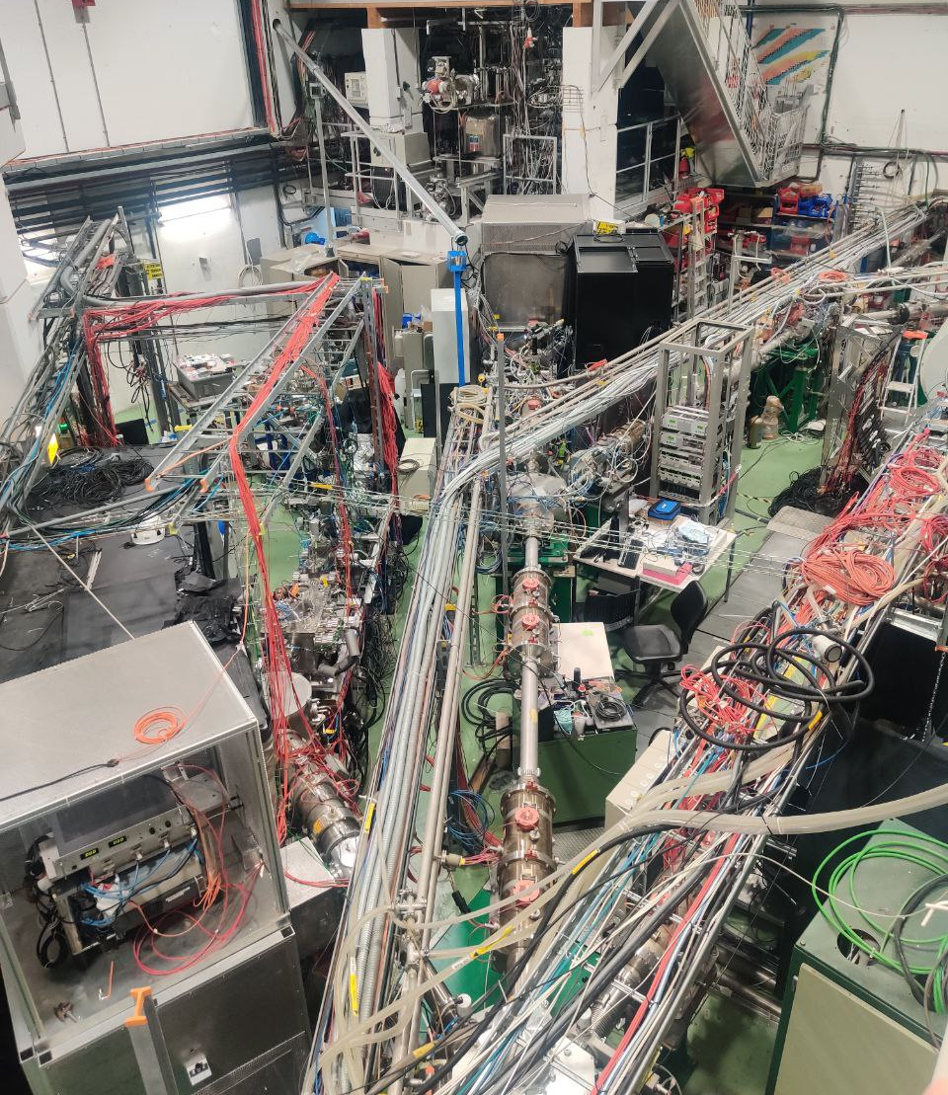
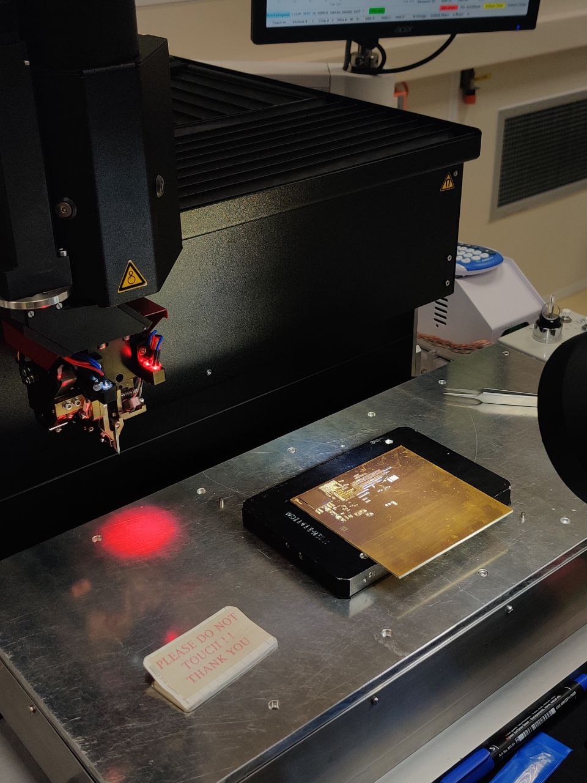
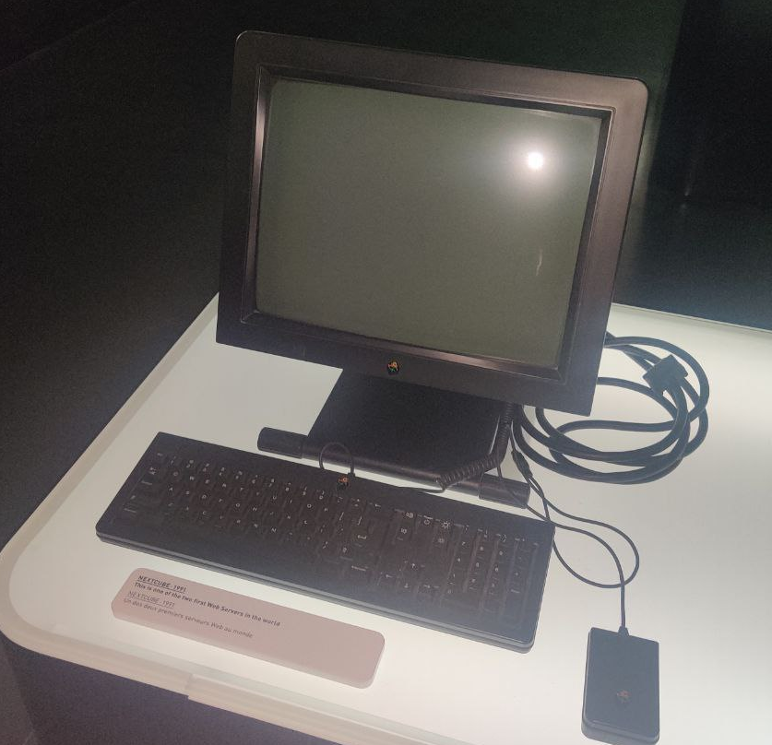
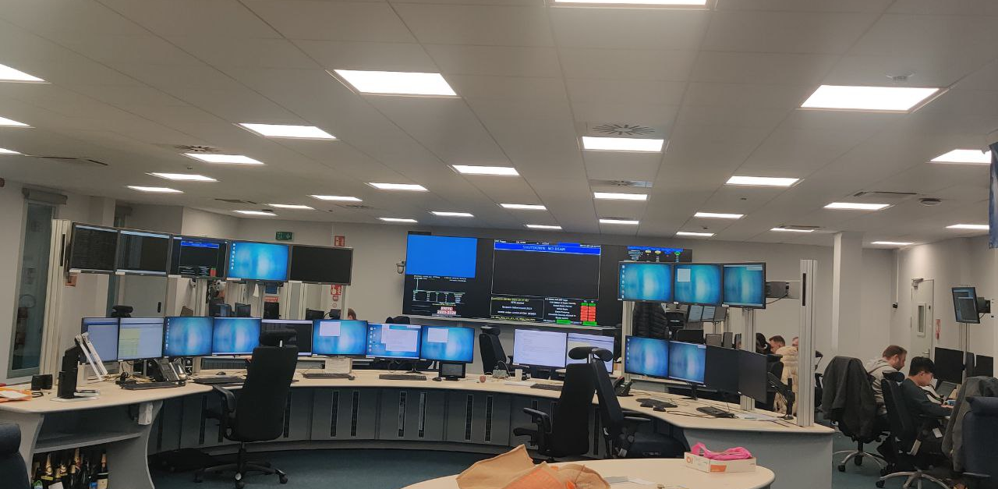
But I would also like to mention some more visits :
Metallurgy lab
Science Gateway
BB5 laboratory
Large Magnet Facility
BONDLAB
LHCb Control Room
Data Center
ISOLDE

Slide 24

THANK YOU !

