Slide 1
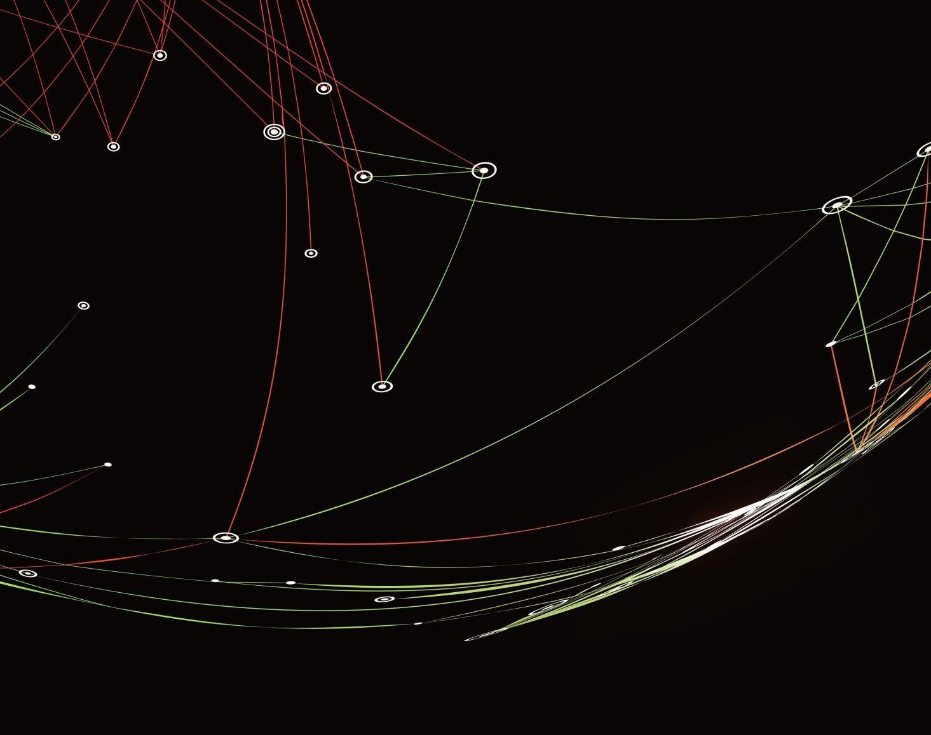
Neutrino Platform
Project DUNE (Deep Underground Neutrino Experiment)

Slide 2
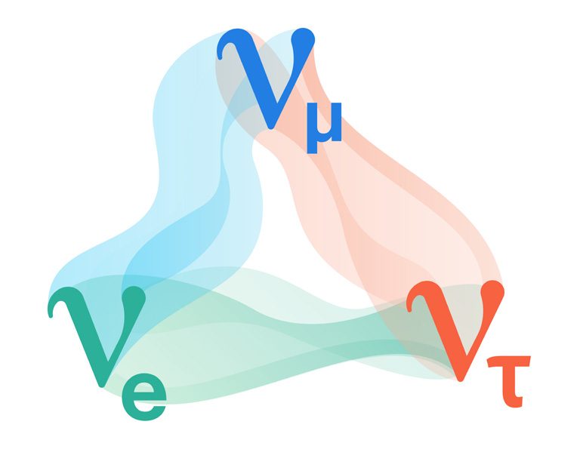
What is a Neutrino…And Why Do They Matter?
“They’re almost nothing at all, because they have almost no mass and no electric charge…They’re just little whisps of almost nothing.” - John Conway, a professor of physics at University of California

Slide 3
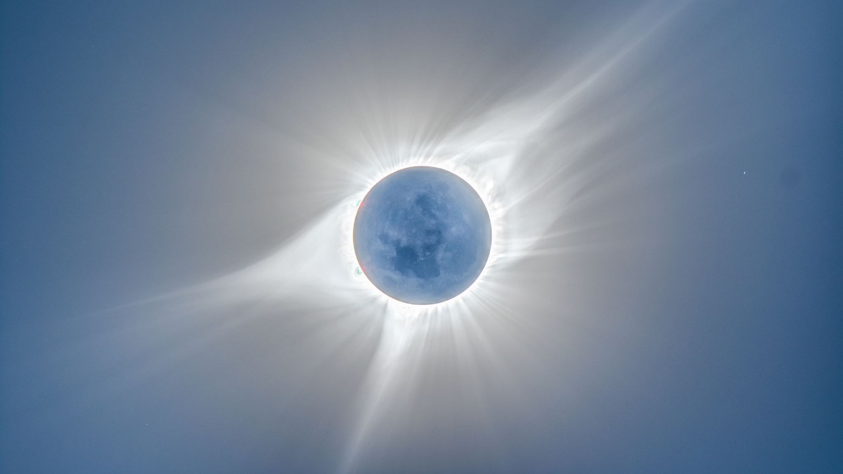
Natural neutrino sources
The Sun
The proton-proton chain reaction:
4p + 2e⁻ → ⁴He + 2ν_{e} + 26.7 MeV
Only 7×10¹⁰ ν_{e}/cm²/s reach the earth’s surface

Slide 4

Atmospheric neutrinos
Are produced through the decay of secondary cosmic ray particles
The pions (kaons) subsequently give rise to (anti)neutrinos
p + A_{air} → n + π⁺ + X
n + A_{air} → p + π⁻ + X

Slide 5
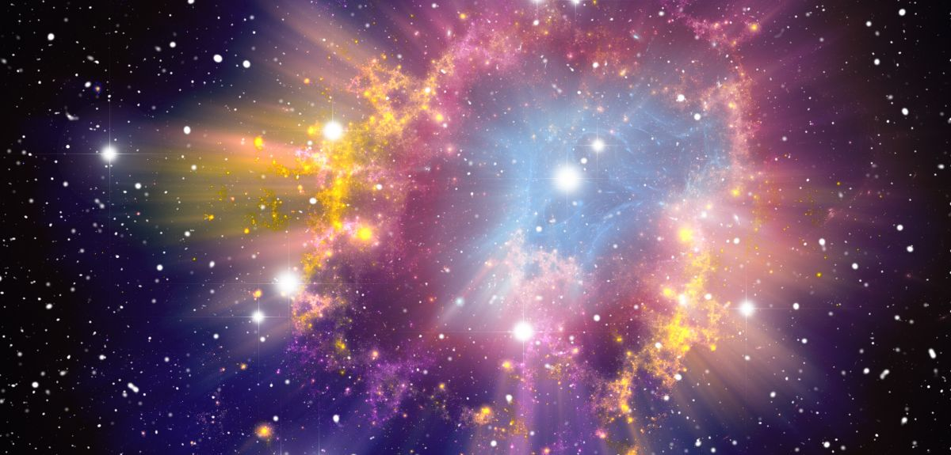
Supernova neutrinos
Supernova neutrinos are produced during the death phase of a massive star
The energy released in a supernova explosion is the difference in the binding energy of the parent star and a neutron star
Such explosions give rise to about 10⁵⁸ ν and ν¯ in a few tens of seconds of time, carrying out almost 99% of the gravitational binding energy of a dying star

Slide 6
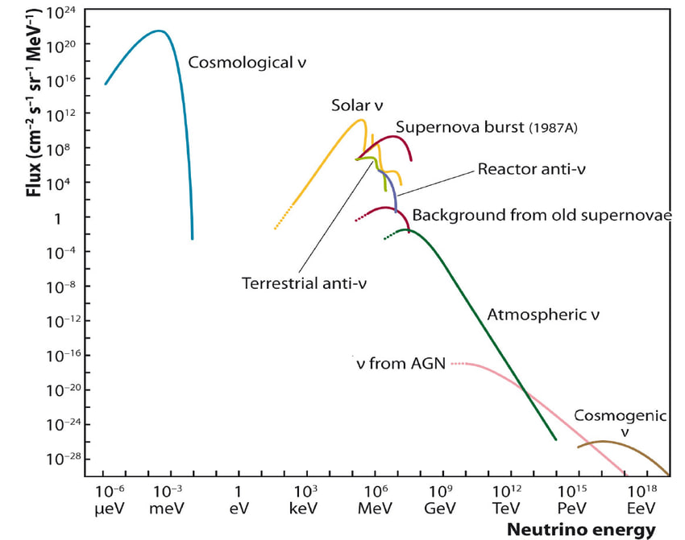
Particle fluxes of neutrinos from different sources on earth
The neutrinos from the sun are indeed neutrinos, while those from the earth’s interior and from nuclear reactors are antineutrinos. All other sources contain about as many neutrinos as antineutrinos.

Slide 7
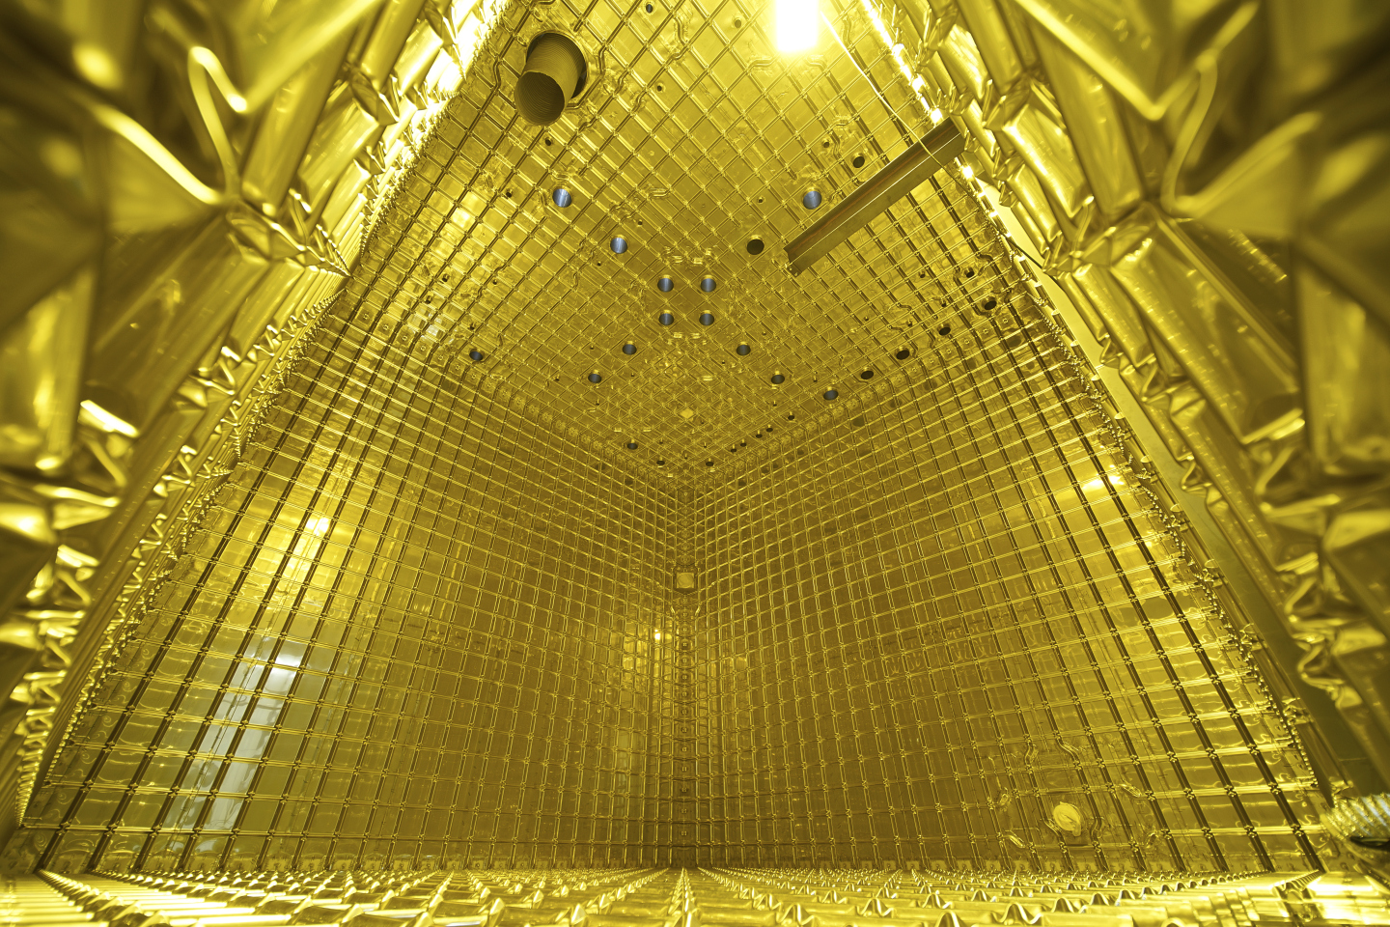
Project DUNE
(Deep Underground Neutrino Experiment)

Slide 8
Abstract
The Deep Underground Neutrino Experiment (DUNE) is a long-baseline neutrino experiment designed to:
Measure the difference between neutrino and antineutrino
Determine the neutrino mass
Investigate the possible proton decay
Study supernova physics over low-energy

Slide 9

DUNE collaboration
The DUNE collaboration comprises more than 1,400 collaborators from over 200 institutions in over 35 countries plus CERN. The collaboration works closely with the Long-Baseline Neutrino Facility project team to ensure the coordinated development of facilities and detectors for the DUNE physics program.

Slide 10
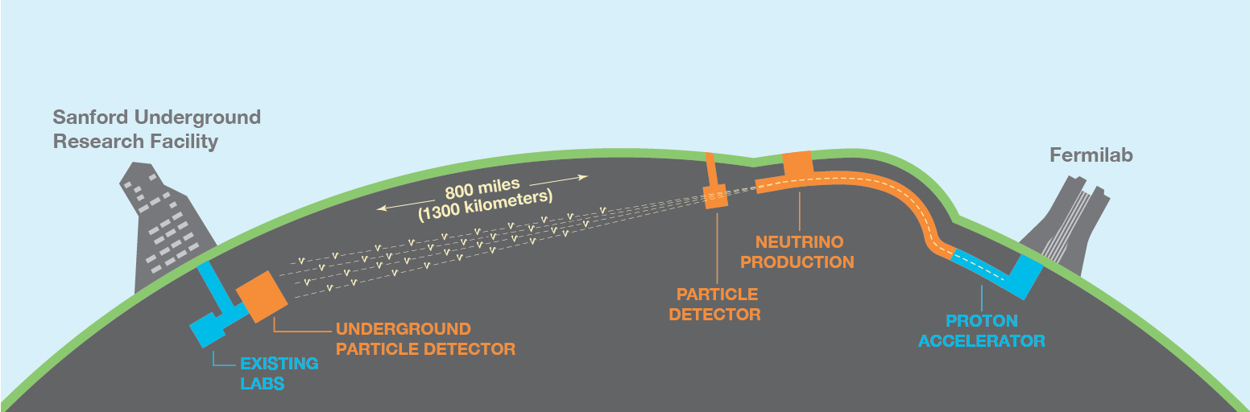
An International Experiment for Neutrino Science

Slide 11
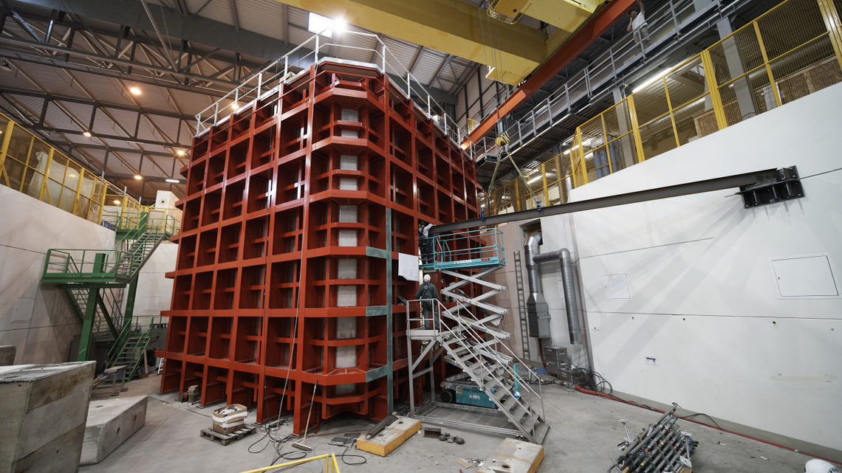
DUNE Mini Detectors
Primary objectives of CERN prototypes:
Validate the functionality of the detection system.
Assess the capabilities of the large detector.
Experiment with new technologies for sustaining the detector.

Slide 12
Cold box
The cold box consists of three components:
Metal framework
Thermal insulation material
Metal plates that prevent the flow of liquid argon

Slide 13
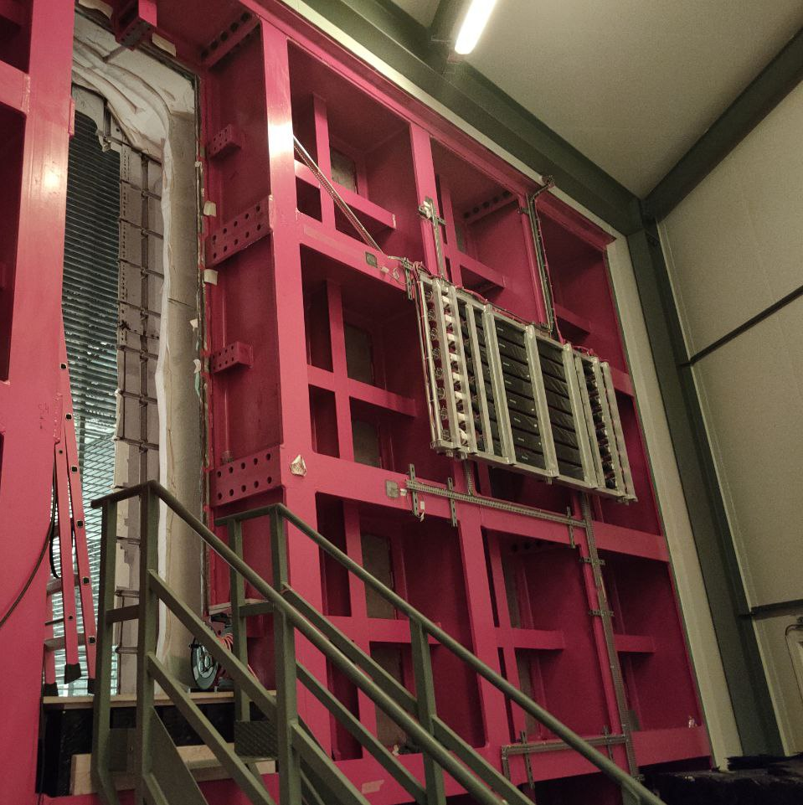
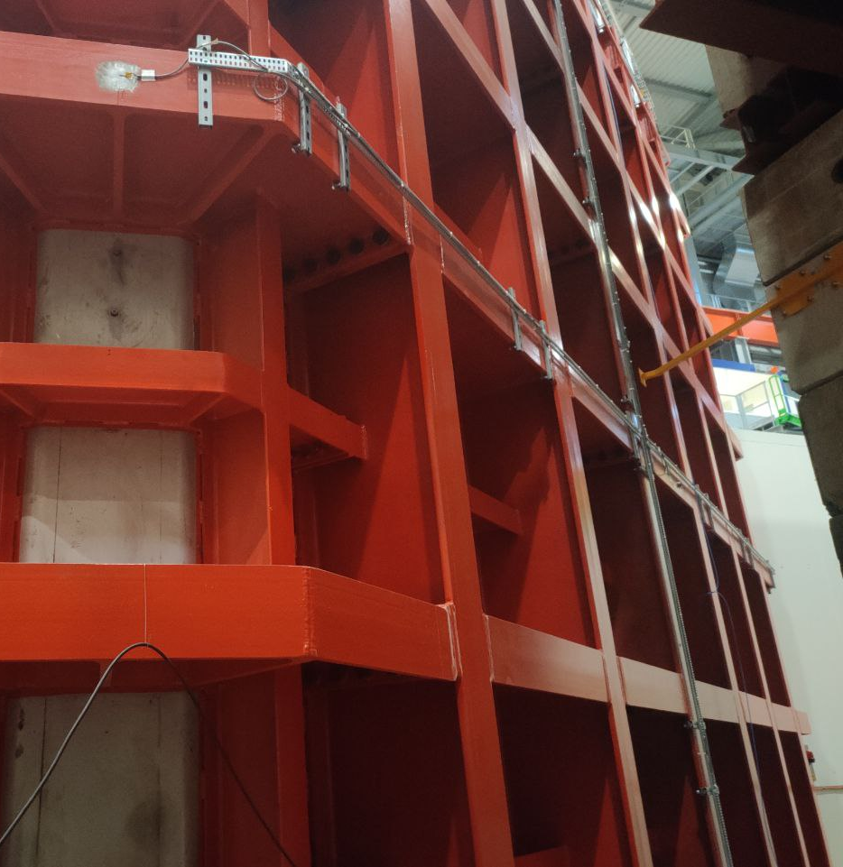
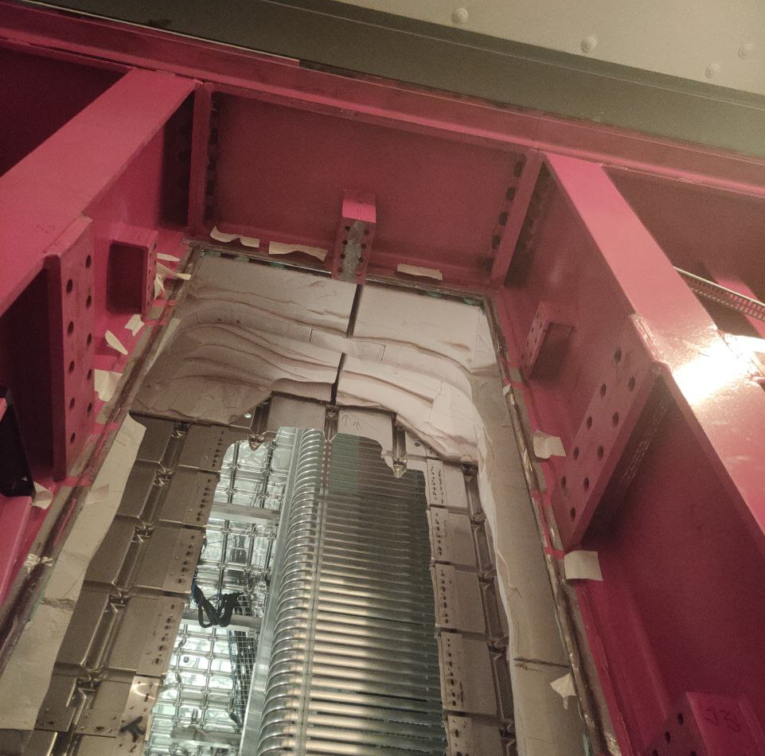

Metal framework

Slide 14
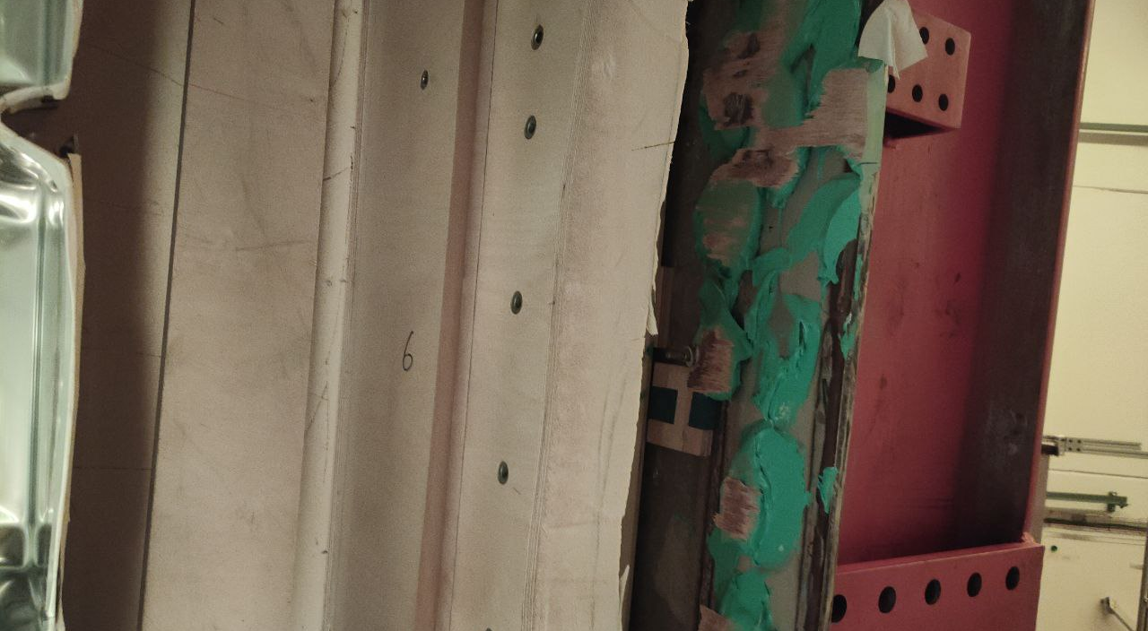
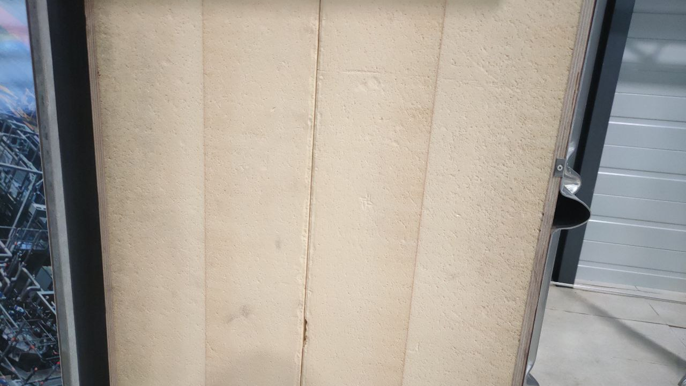
Thermal insulation material

Slide 15
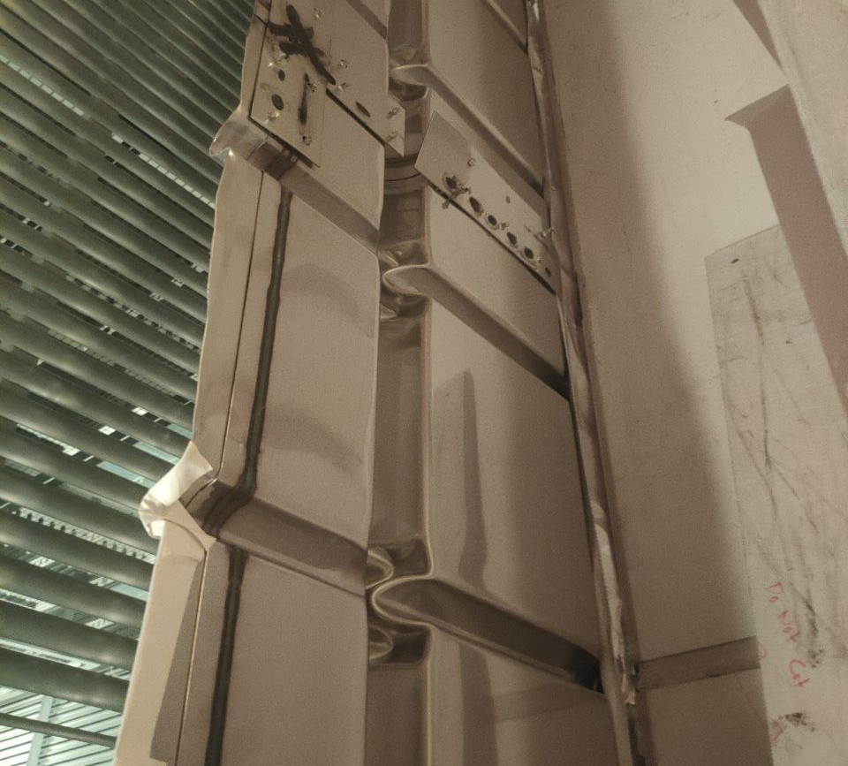
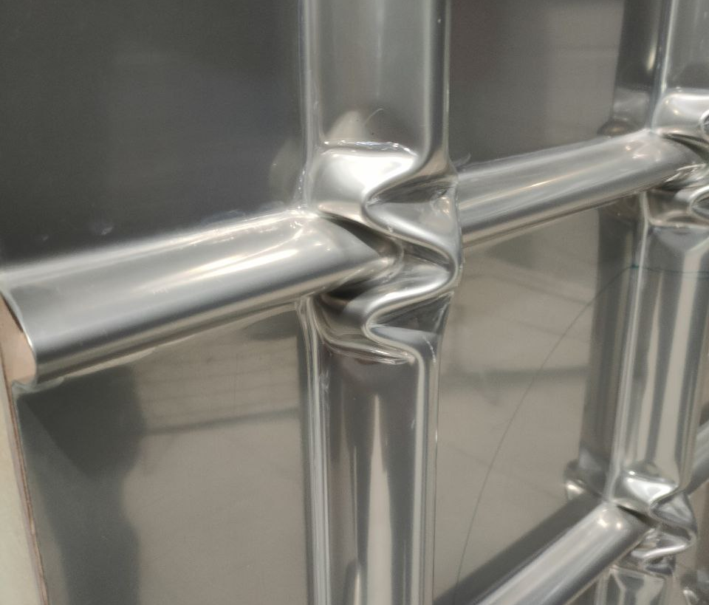
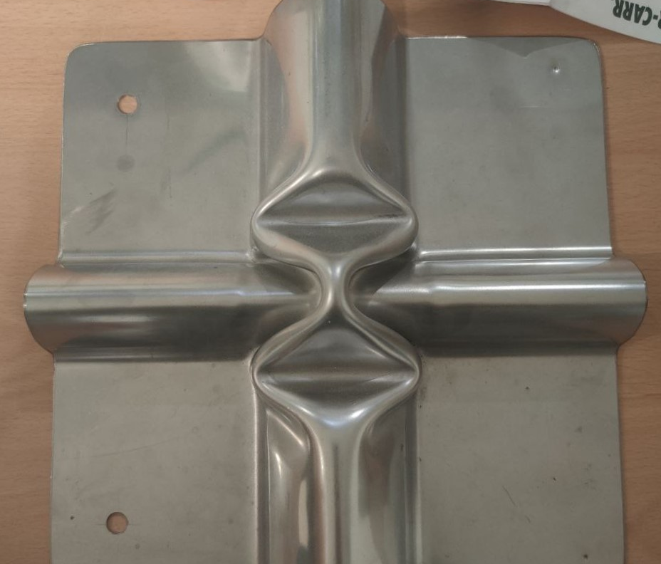
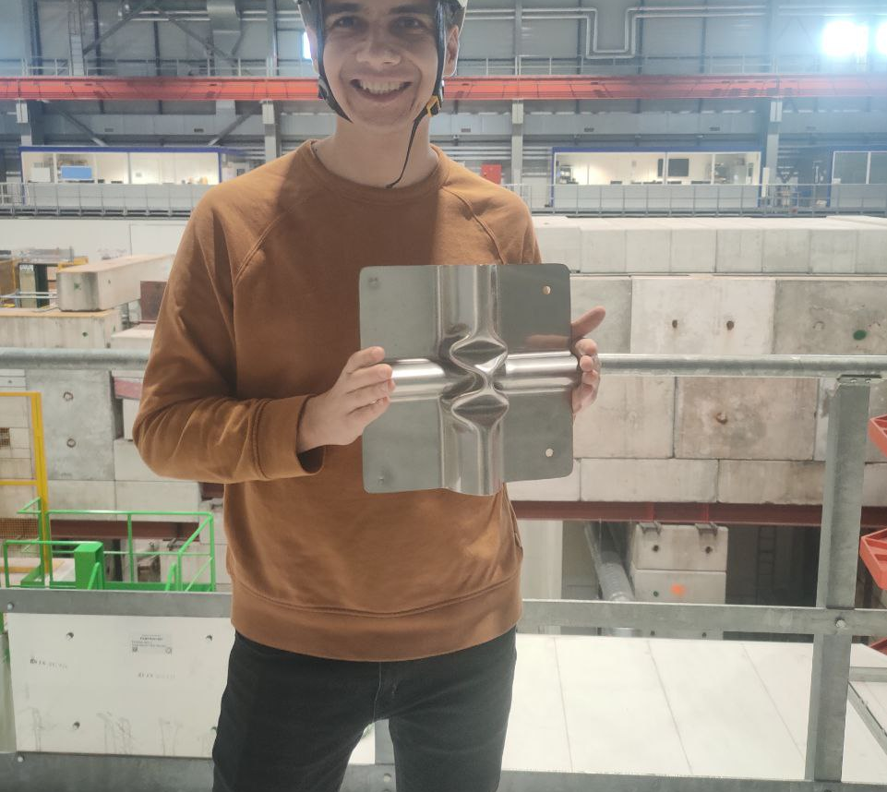
Metal plates

Slide 16
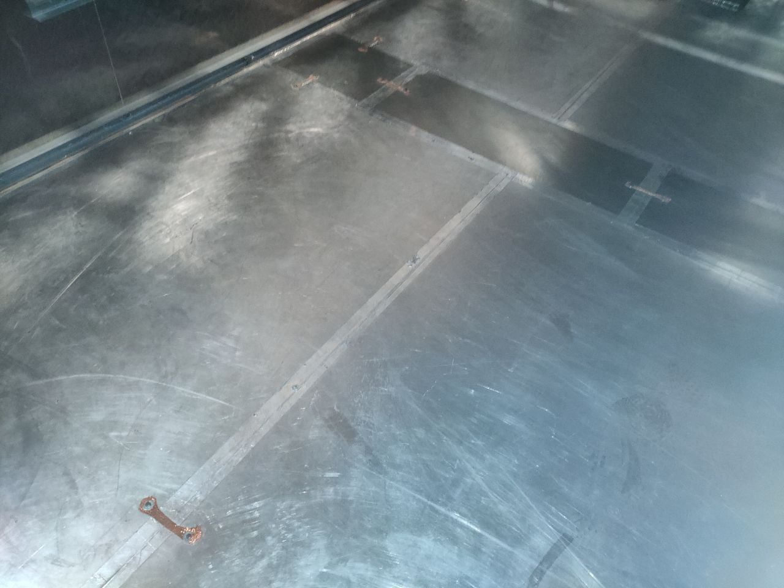
Other components
Purification system
Cooling system
Power supply

Slide 17

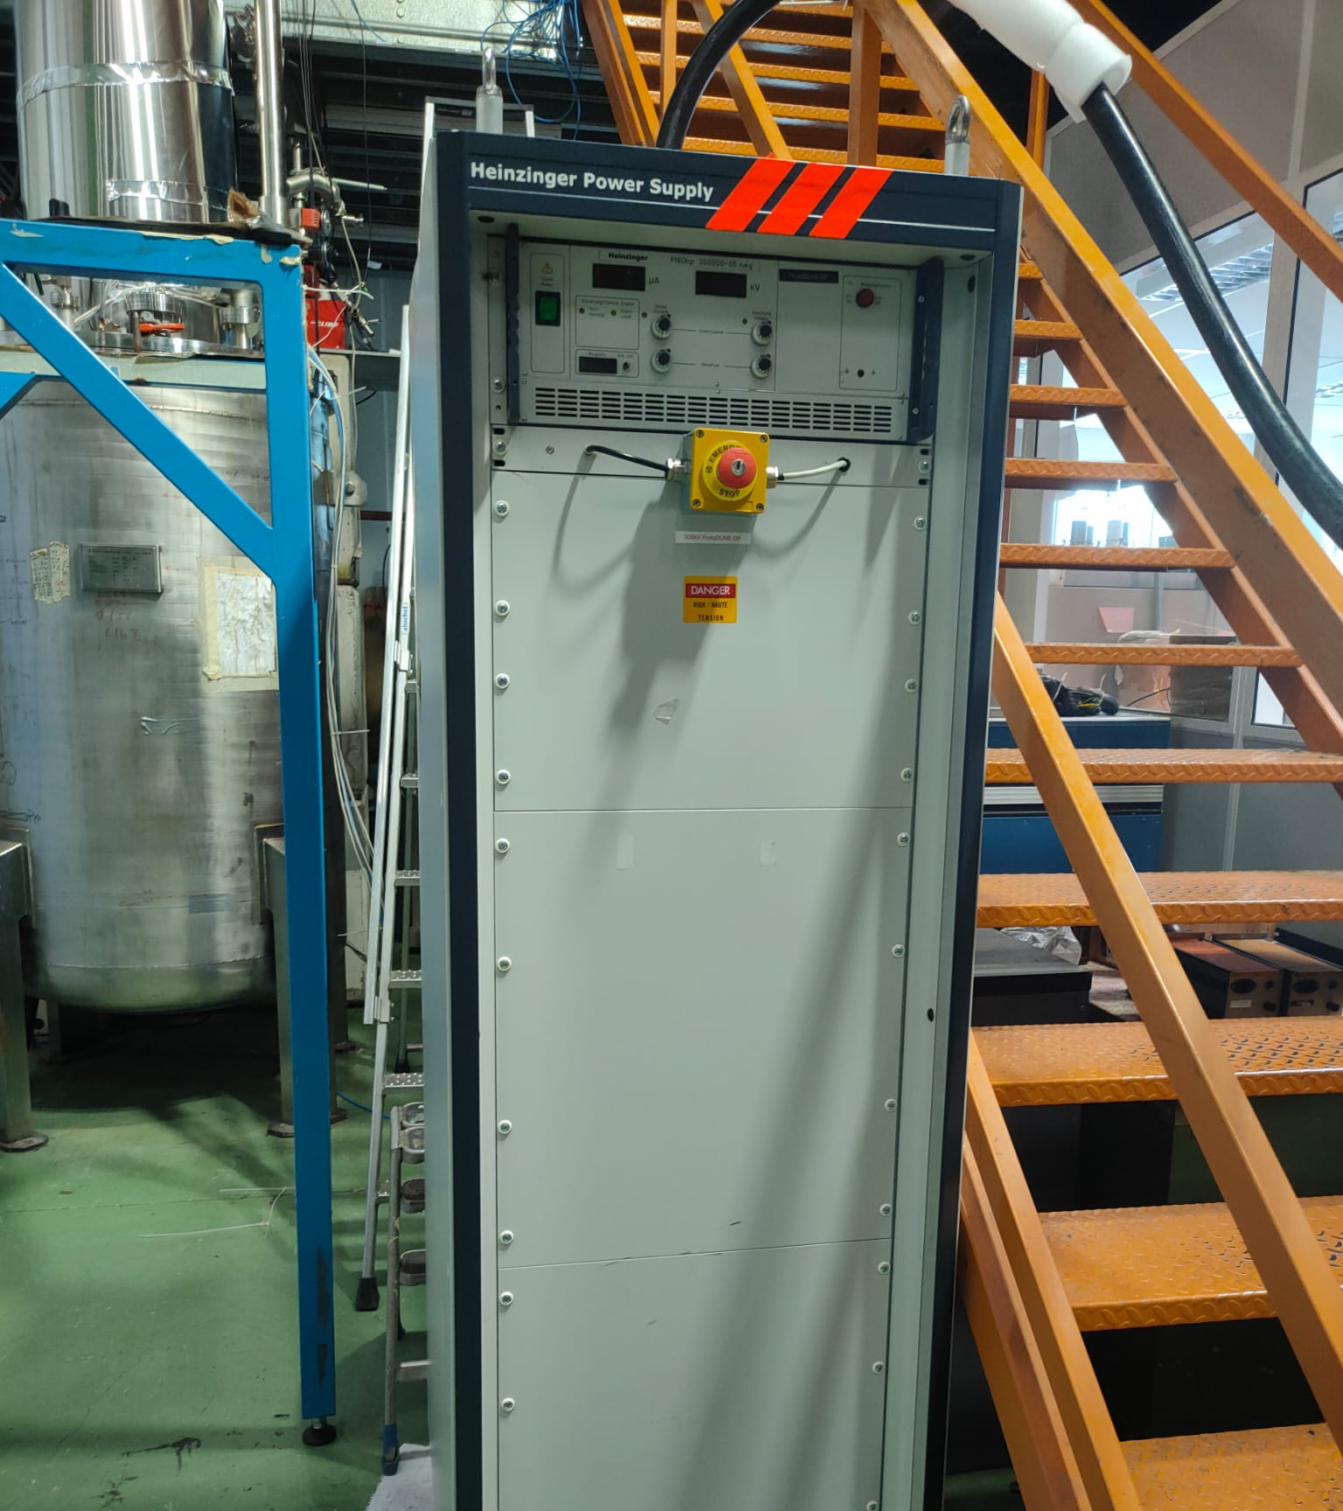
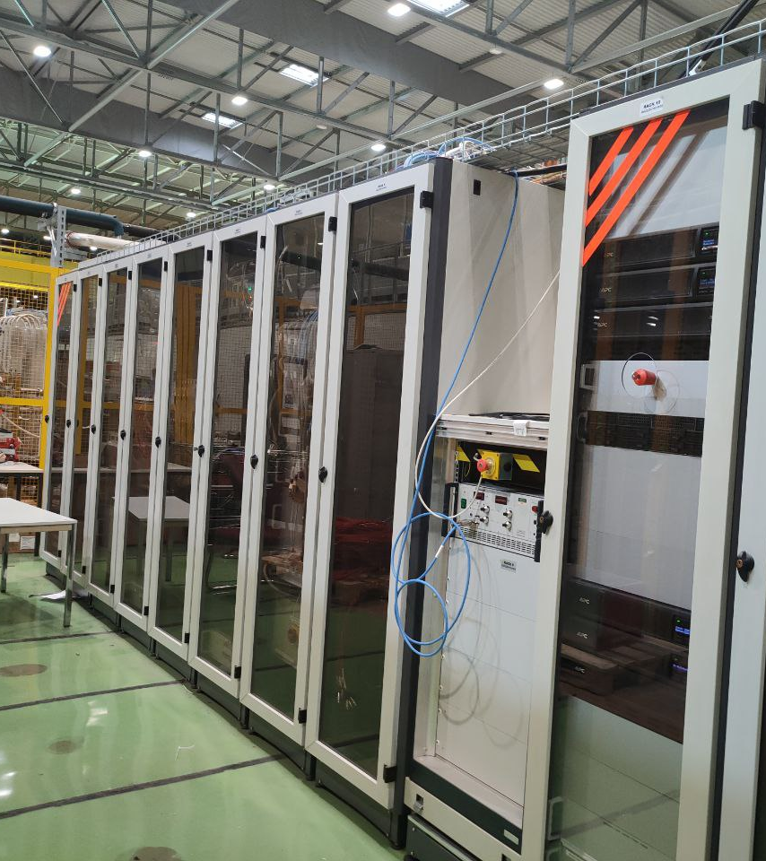
Power supply

Slide 18
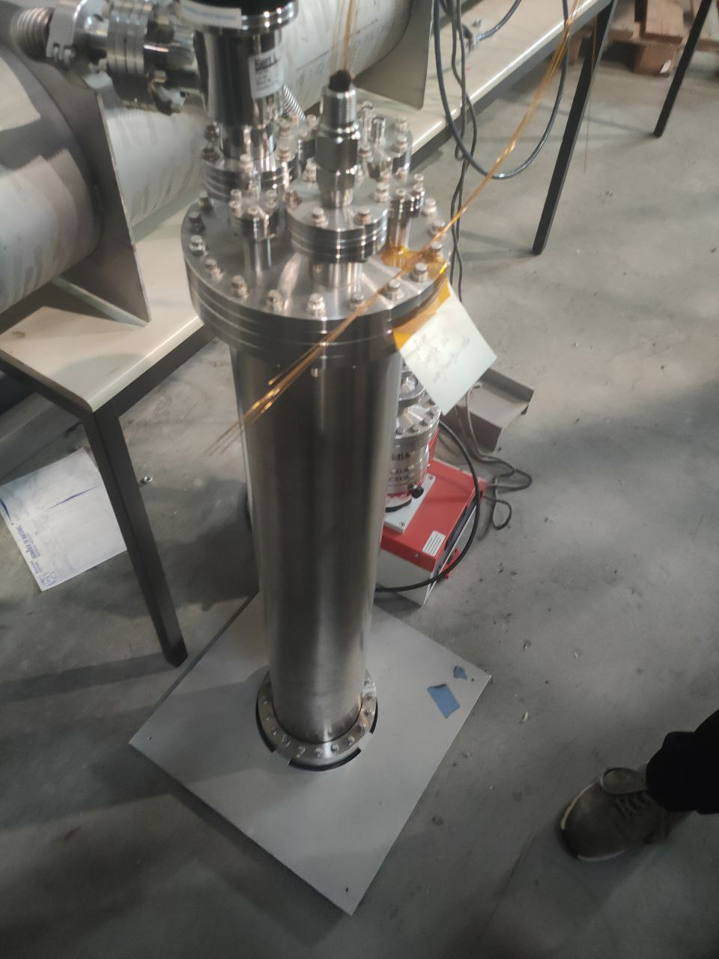
Purification system

Slide 19
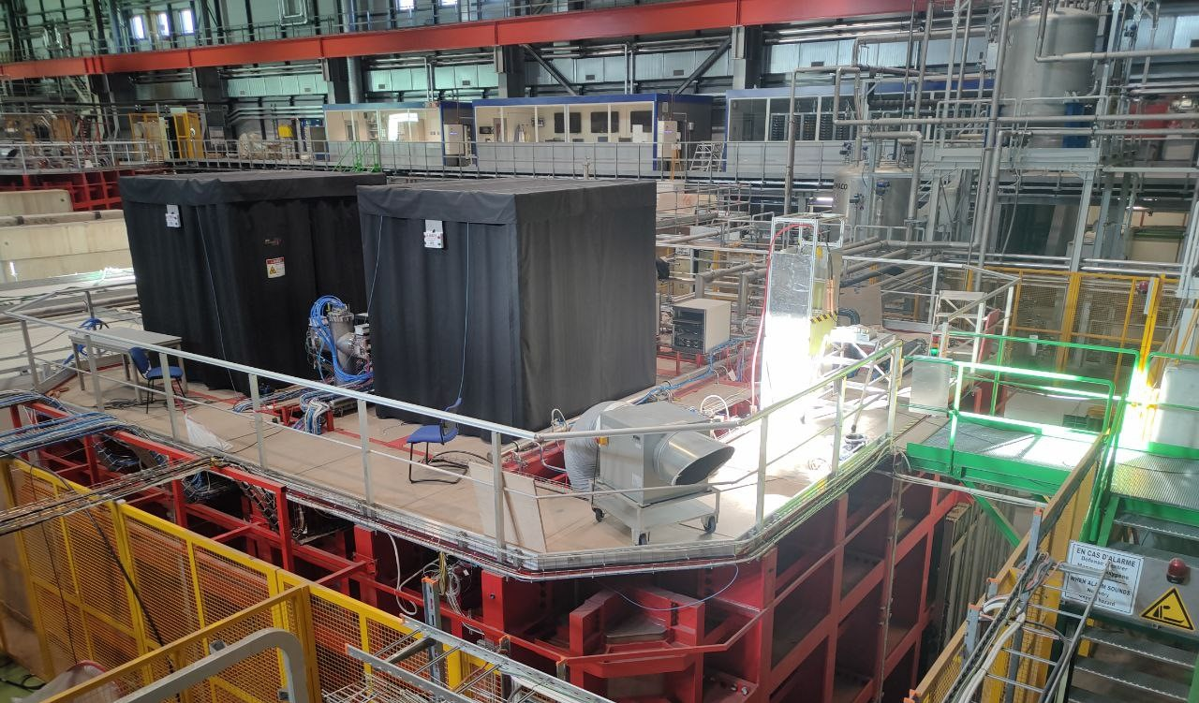

Slide 20
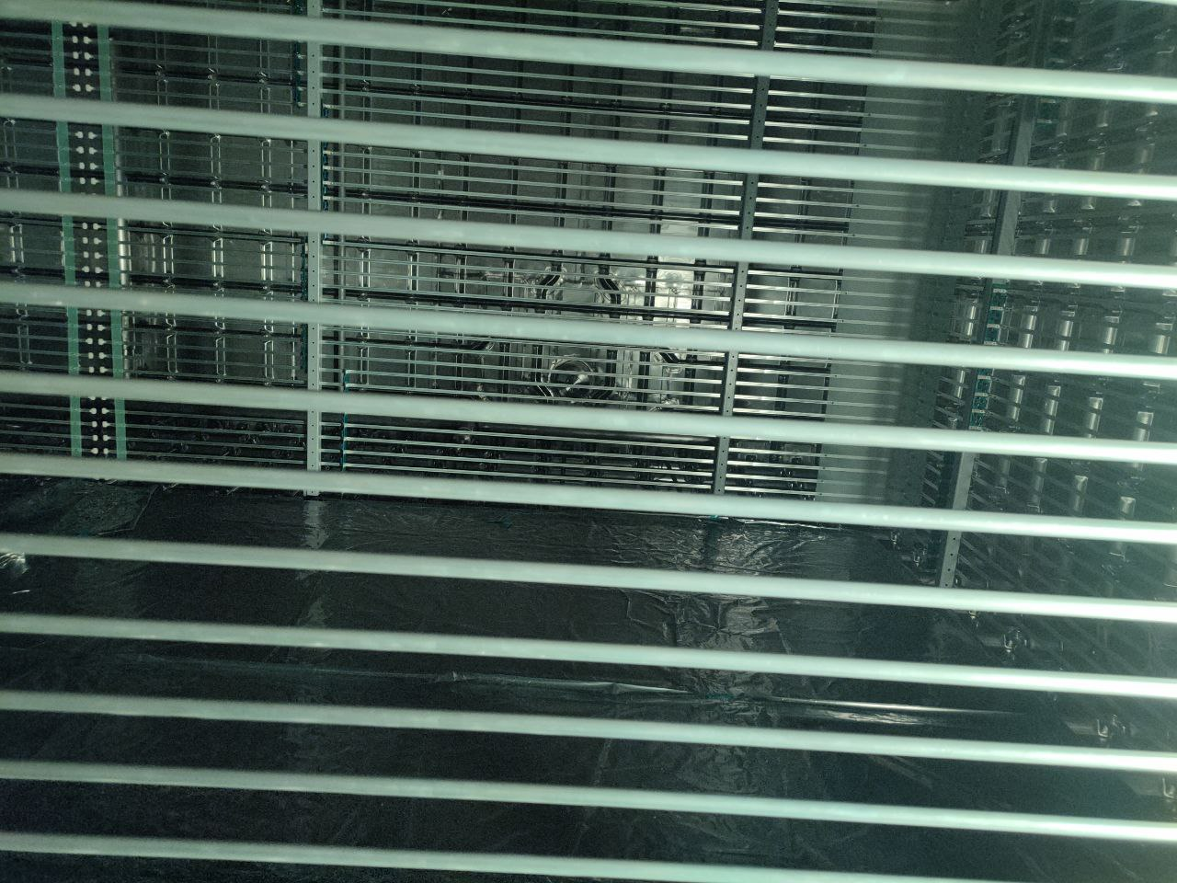
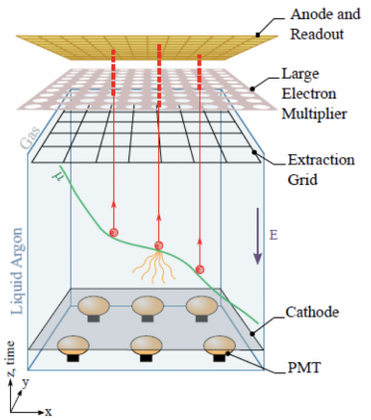
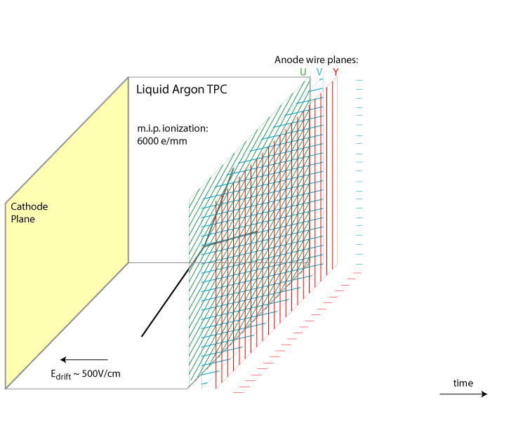
LArTPC
(Liquid Argon Time Projection Chamber)

Slide 21
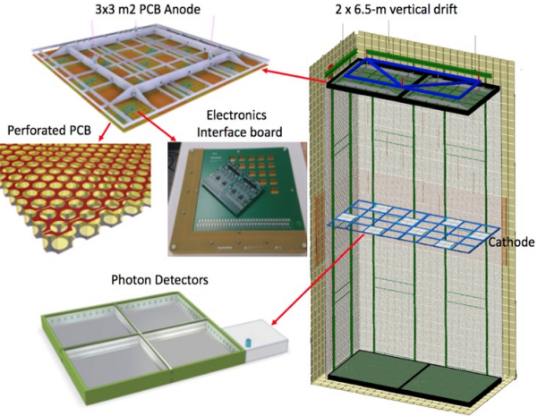
The Vertical Drift „concept”
It benefits from the advantages of the dual phase ProtoDUNE design while eliminating the complexity introduced by the liquid-gas interface.
Anode consists of stacked segmented and perforated printed circuit boards (PCBs) with etched electrodes, which are mechanically robust and modular for easy assembly, and mass producible.

Slide 22
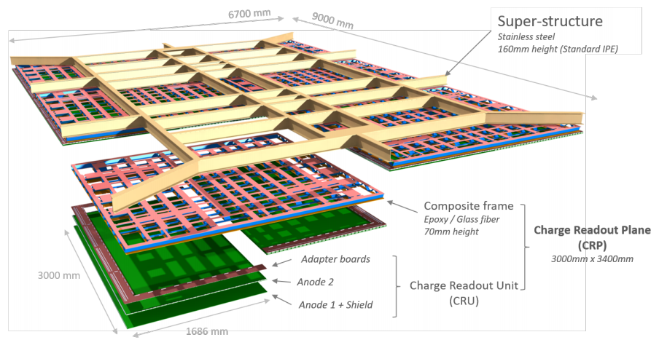

Slide 23
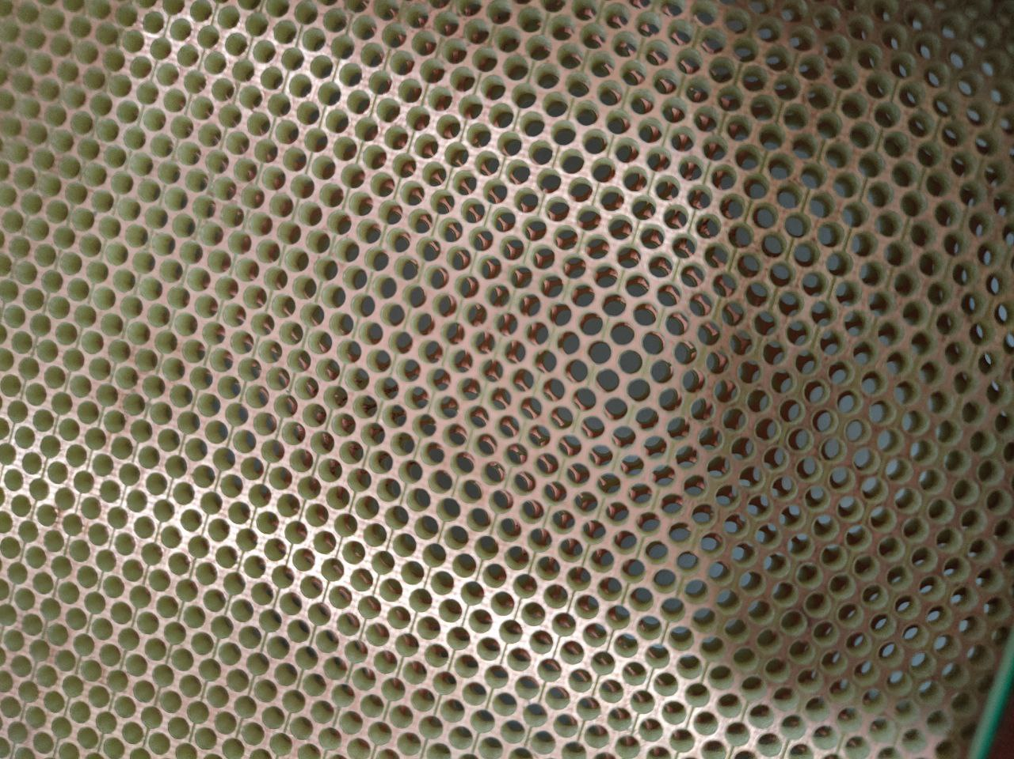
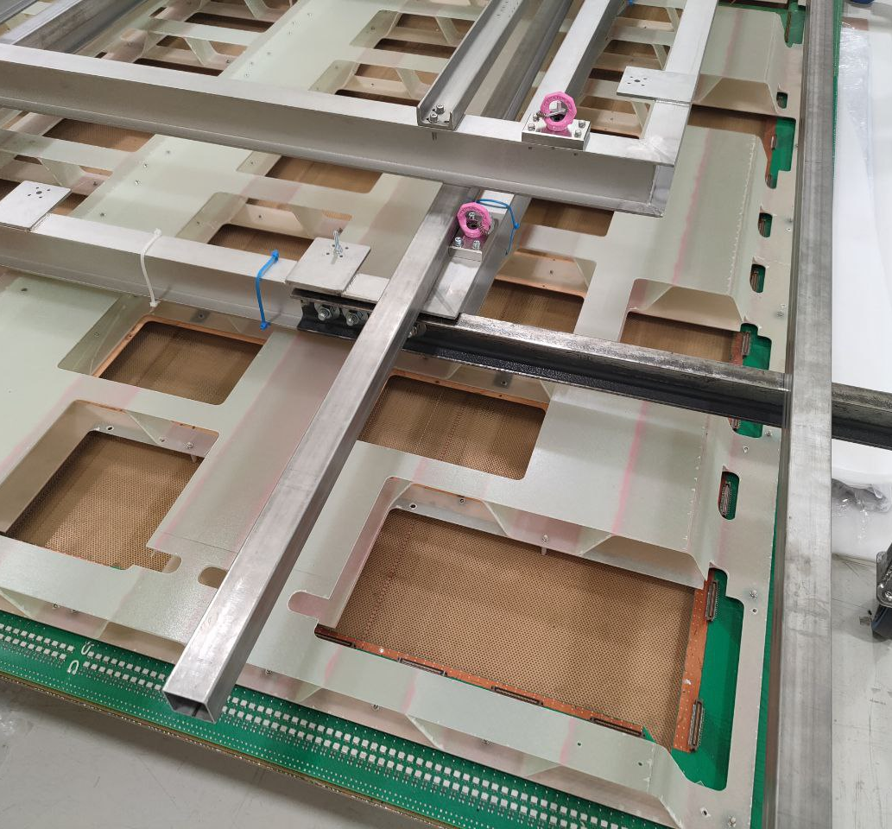
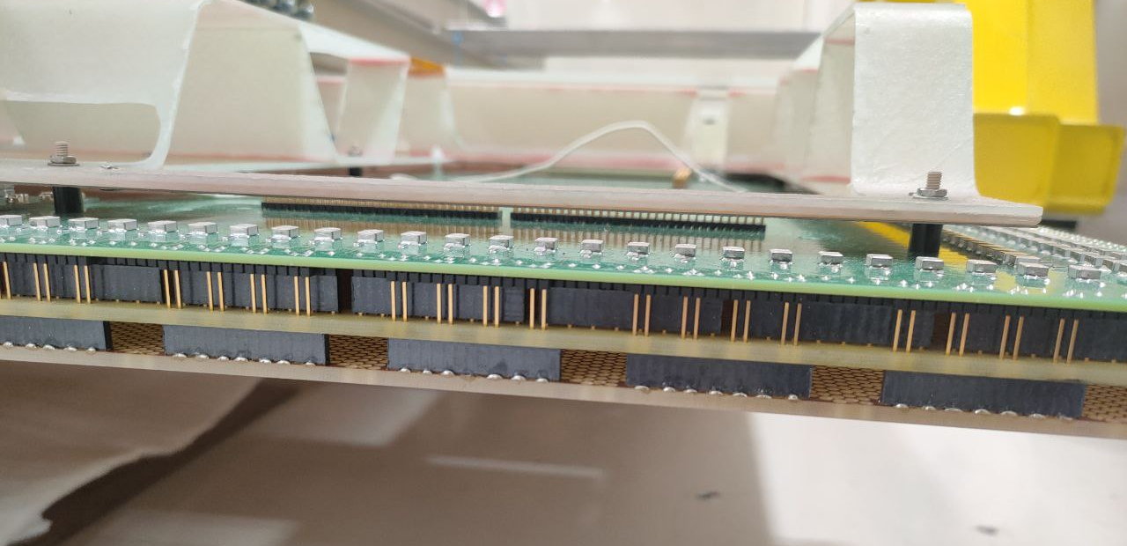
Charge Readout Plane (CRP)
Each CRP consists of two Charge Readout Units (CRUs), each consisting of two anode planes.
These anode planes are connected via edge connectors to the adapter boards.

Slide 24
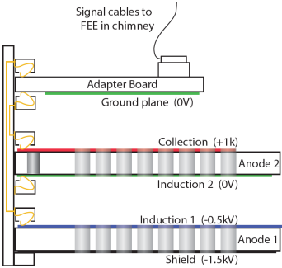
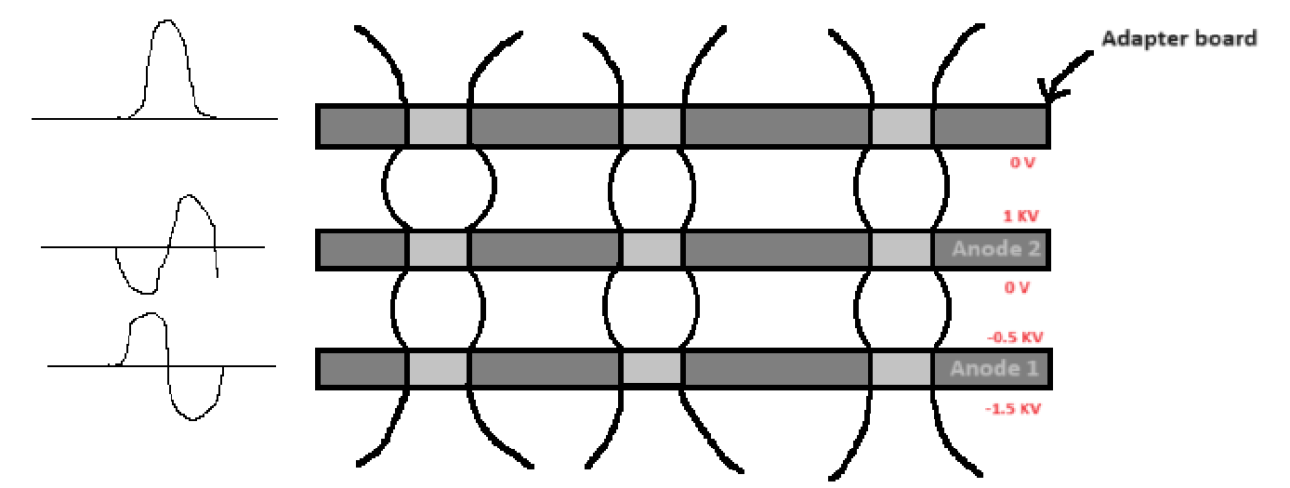
A side-on view of the PCB stack

Slide 25
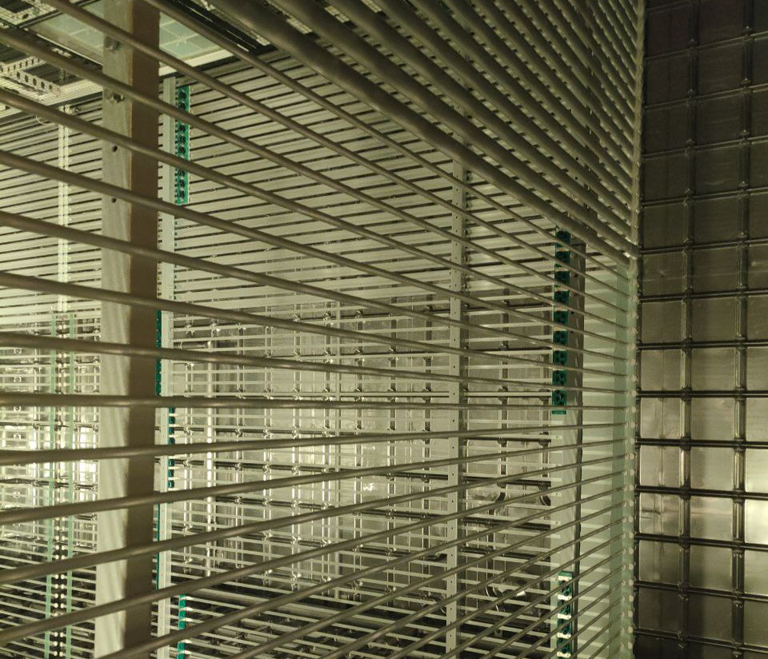
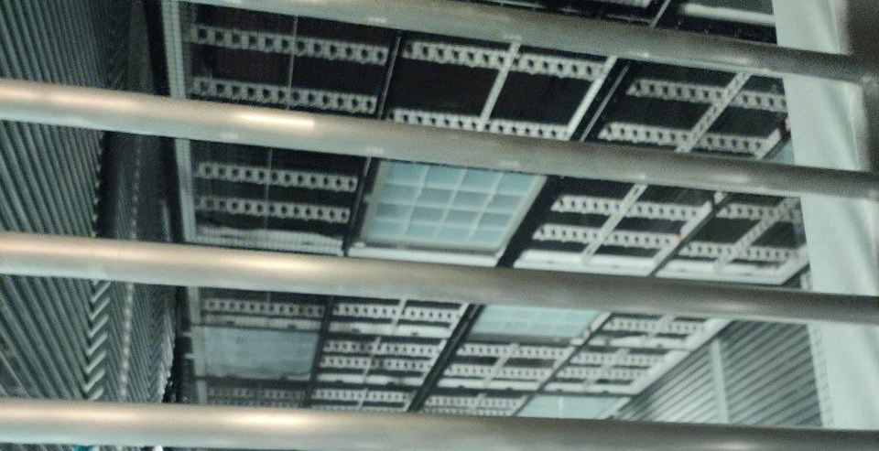
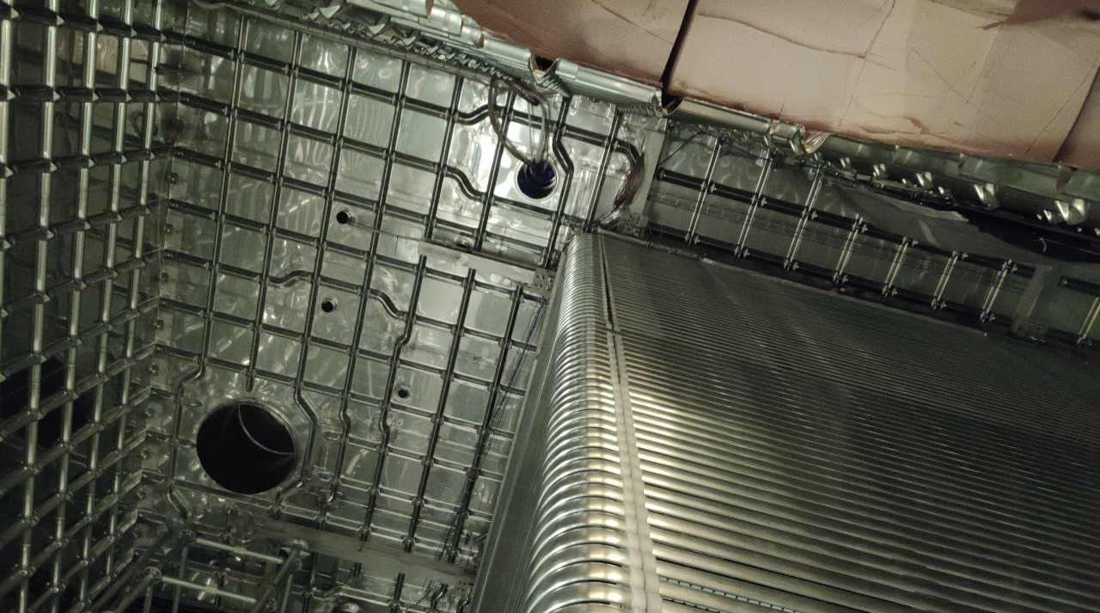

Slide 26
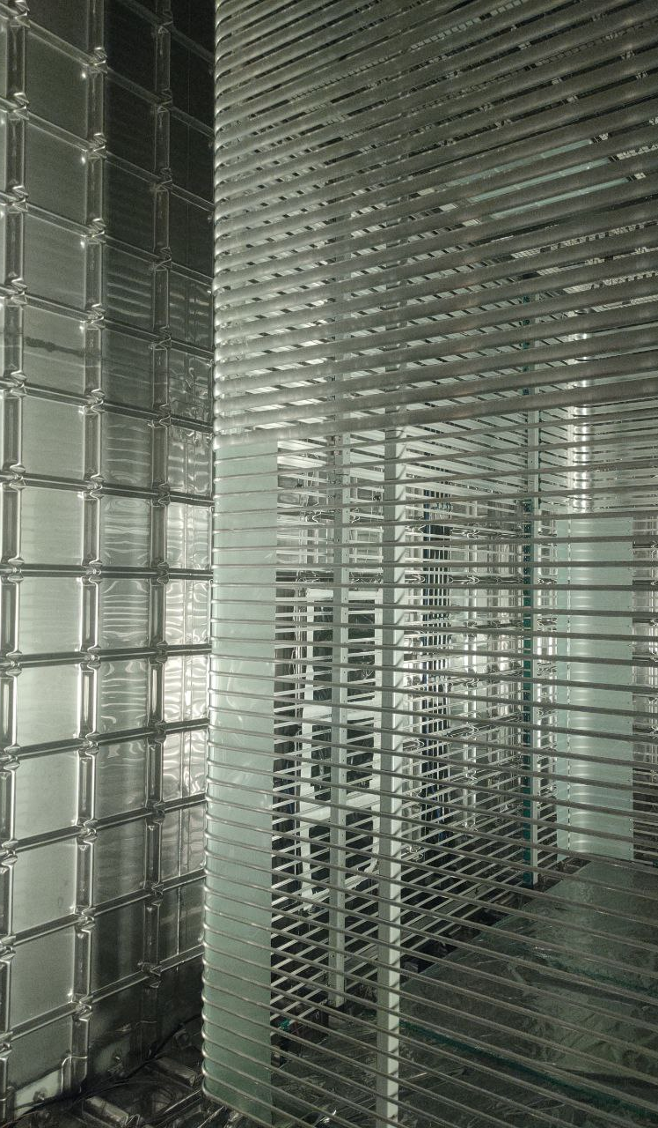
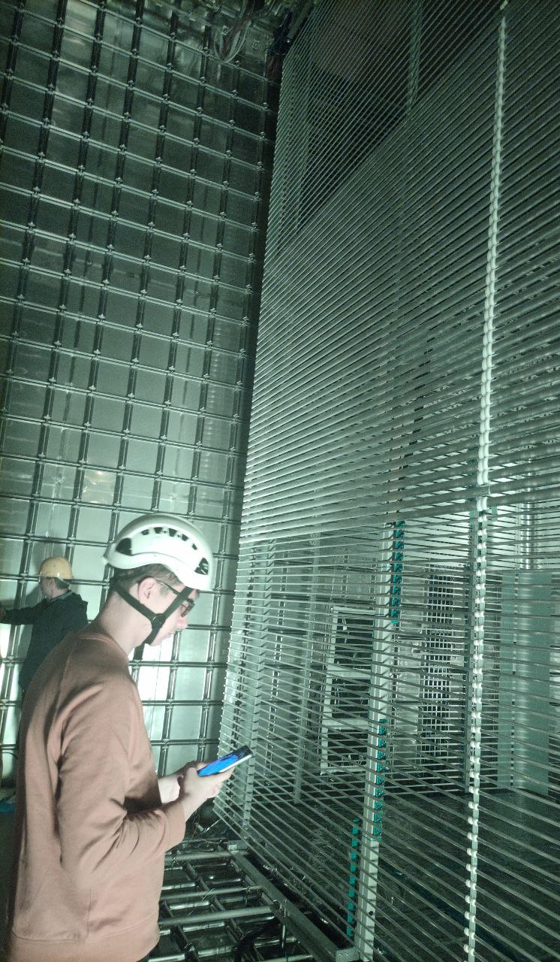
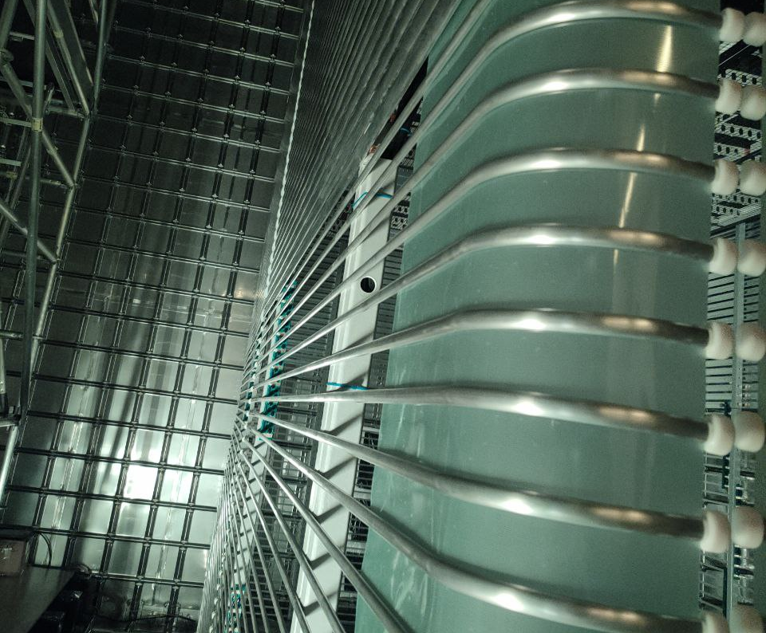
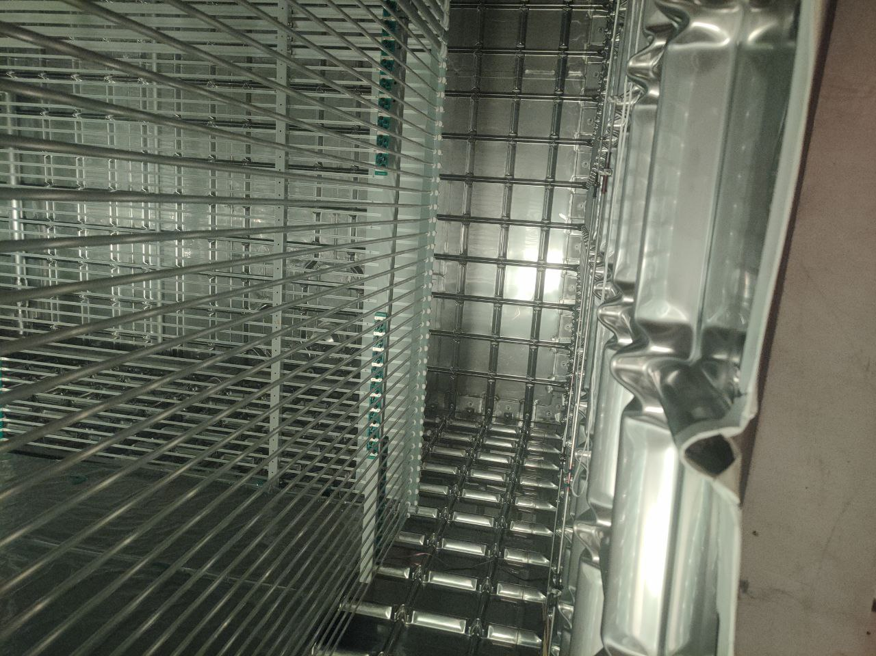

Slide 27
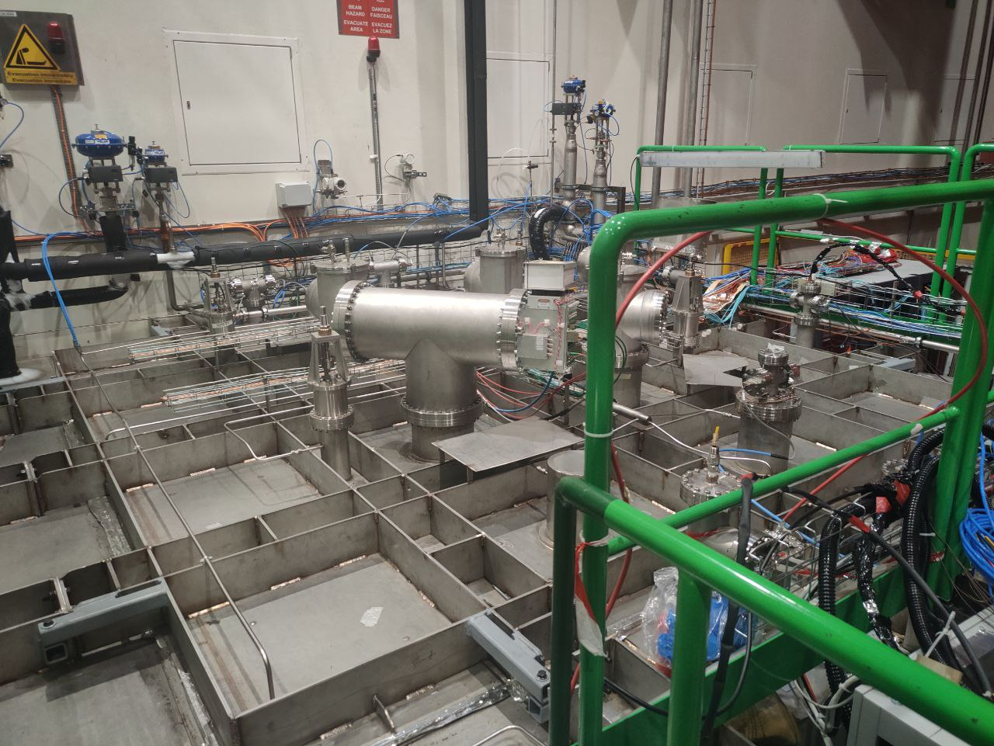
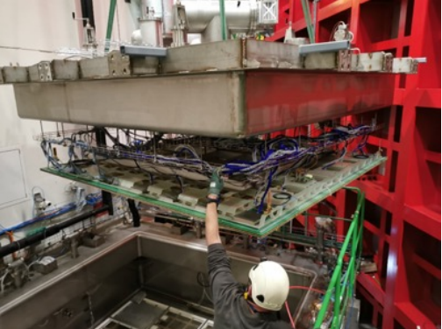
The 50 litre TPC

Slide 28
Sources
Why DUNE? Searching for the origin of matter | Sanford Underground Research Facility (sanfordlab.org)
[2211.11339] The DUNE vertical drift TPC (arxiv.org)
CERN’s neutrino success story | CERN (home.cern)
DUNE collaboration finalizes the blueprint for the ultimate neutrino detector (fnal.gov)
Detectors and computing – DUNE at LBNF (fnal.gov)
[2002.02967] Deep Underground Neutrino Experiment (DUNE), Far Detector Technical Design Report, Volume I: Introduction to DUNE (arxiv.org)

