Slide 1
HL-LHC Crab-Cavities LLRF project
LLRF Integration
G. Hagmann
HL-LHC CC LLRF project, December 11, 2023

Slide 2
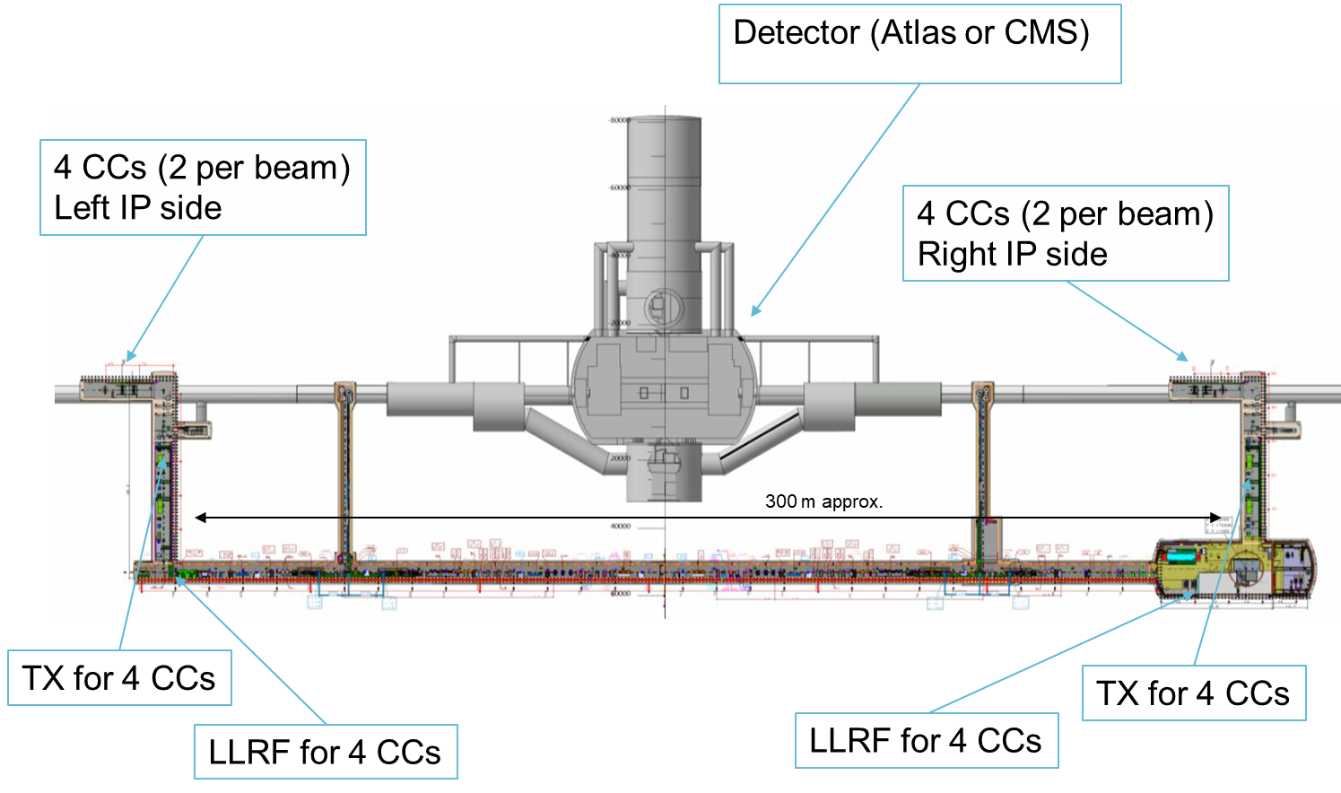
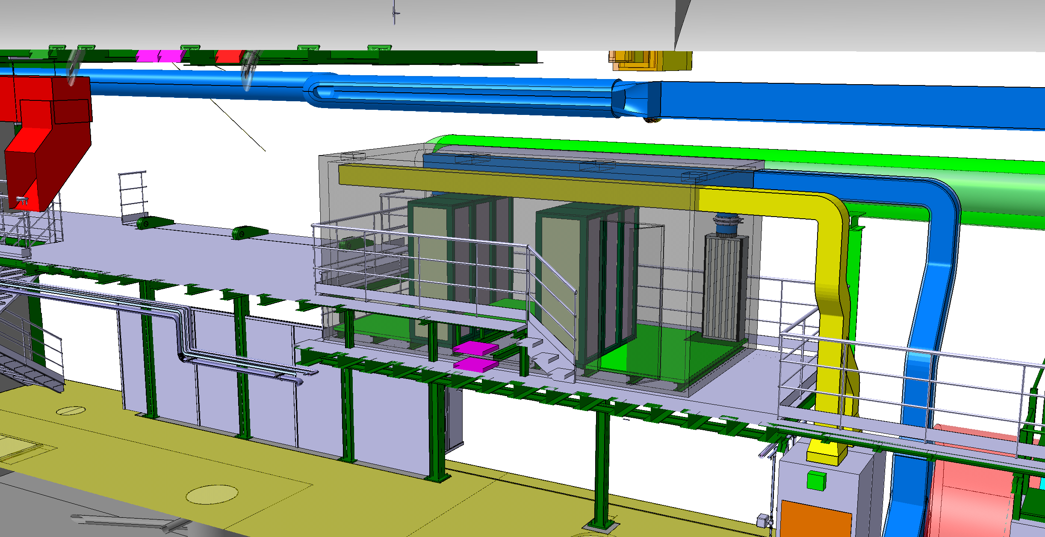
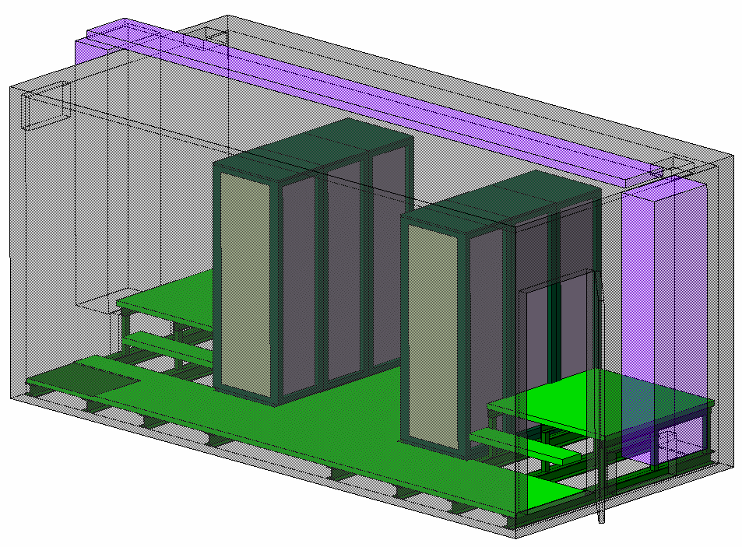
Crab-Cavities underground layout
USx7 Faraday cage
URx5 Faraday cage
ULX3
ULX7
UAX7
UAX3
URX5
USX7
Fig – HL-LHC point 1 or 5 underground layout. Top view, Courtesy S. Maridor

Slide 3
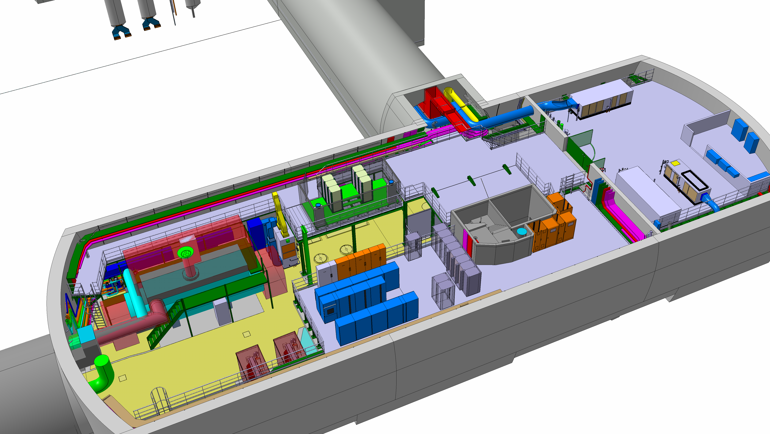
US17 or US57 gallery
Access from the stairs to the platform /FC
Faraday cage
6 racks
Fig – HL-LHC USx7 gallery, Courtesy S. Maridor

Slide 4
Patch panel – USx7 faraday-cage
Faraday cage
6 racks
Two patch panels required
  Missing Fiber-feed through
  Missing N-type connectors
  (new cable request from Andy)
  Reasonnable amont of spare required
Or extension possible
  Final spec to be discussed with FC supplier.
Space reservation is important today
Fig – HL-LHC USx7 gallery, Courtesy S. Maridor
New patch AJFC02
Existing patch AJFC01

Slide 5
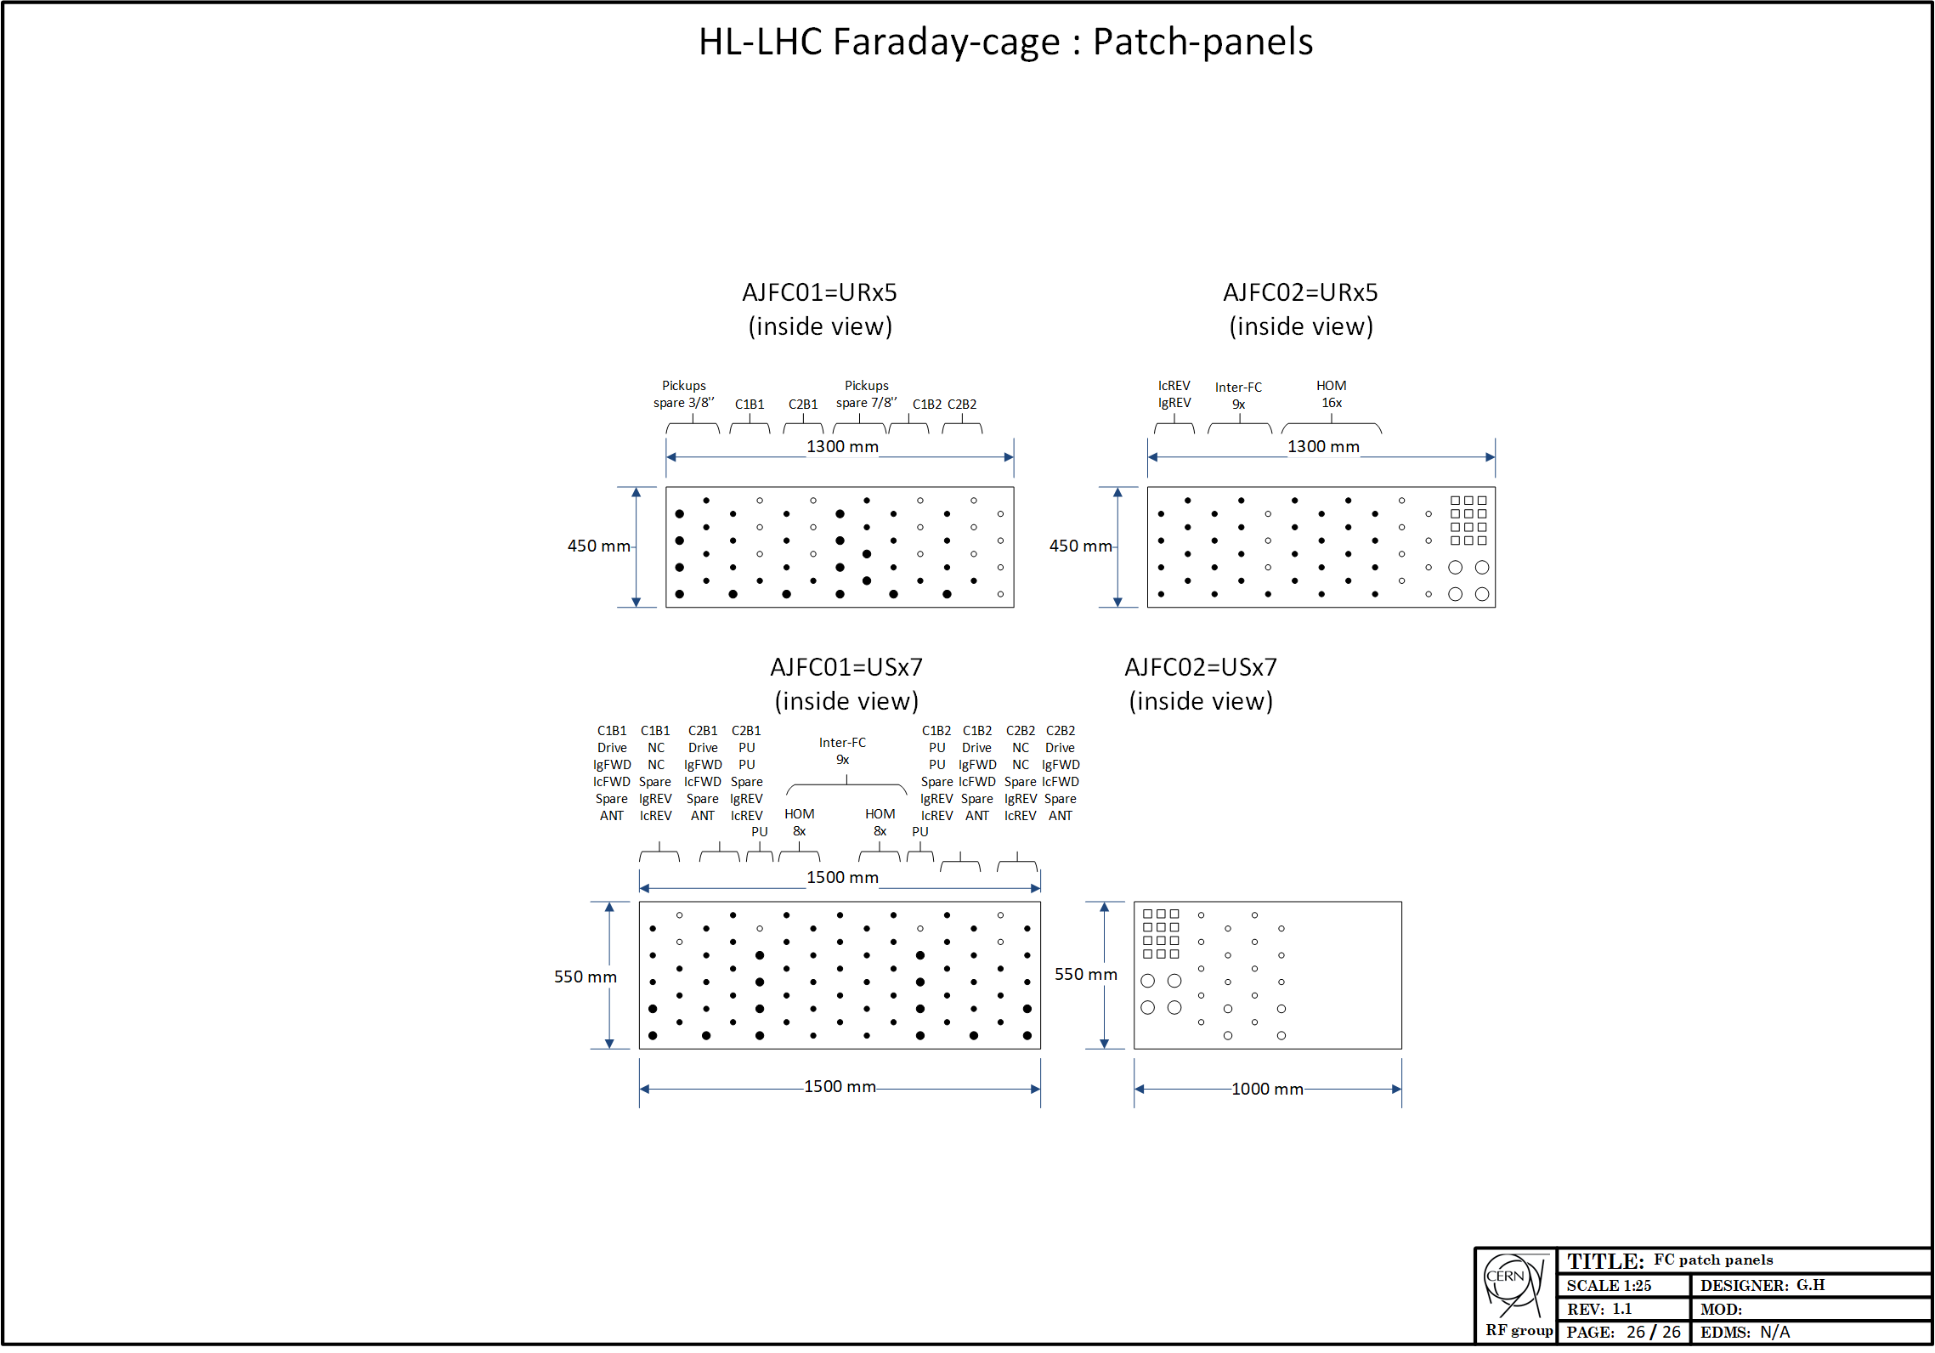
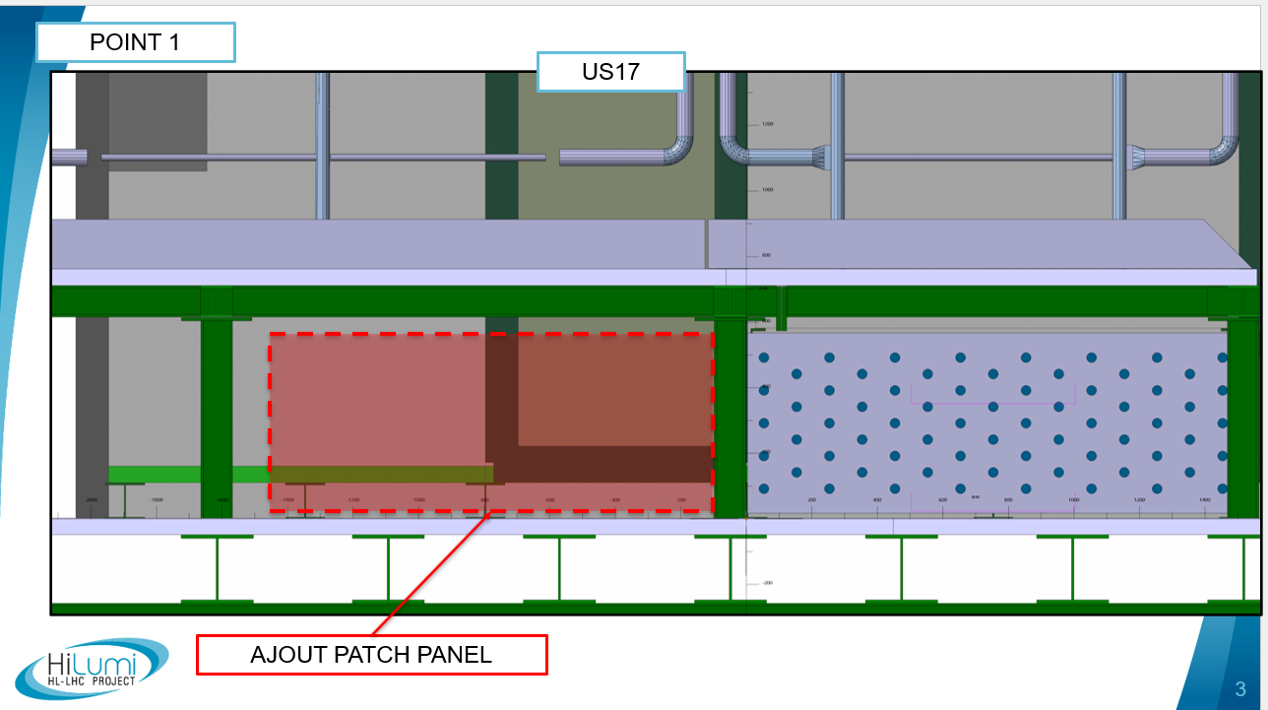
Patch panel – USx7 faraday-cage
Current design
  550x1500mm
  75 N-type connectors
    69 signals, 6 spare
Second patch panel required
  AJFC01: 550x1500mm (unchanged)
    75 coaxial connectors
    61x N type
    14x 7/16 type (for 7/8’’: pickup, ANT, spare)
    69 signals, 6 spare
  AJFC02: 550x ~1000mm
    N type
    4 fiber feed-throughs
    EMI multi-conductors with remaing space
    Space reservation of 1500mm
  Cable allocation might still changed
Fiber feed-throughs
Fig – HL-LHC USx7 patch panels

Slide 6
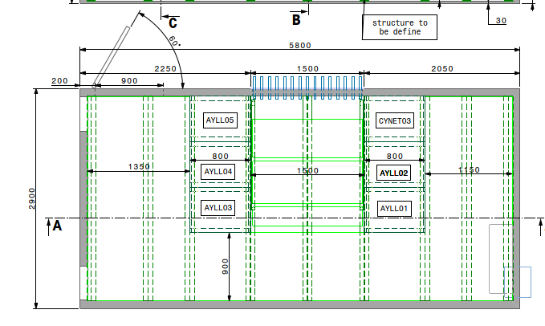
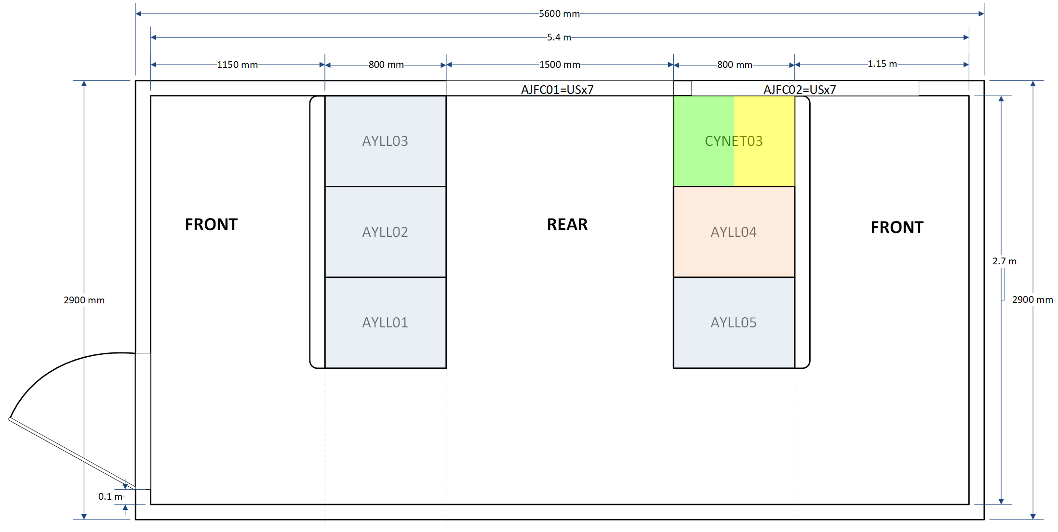
USx7 Faraday cage layout
Current design (v5)
  5800x2900mm
  (proposal from the issue of the staires outside)
Final design
  Back to 5600x2900mm
  Door at 250mm
  Door moved at the same place than in UR
  Uniformization of the FCs between UR/US
Fig – HL-LHC USx7 FC drawing V5, Courtesy S. Maridor
5600mm
2900mm

Slide 7
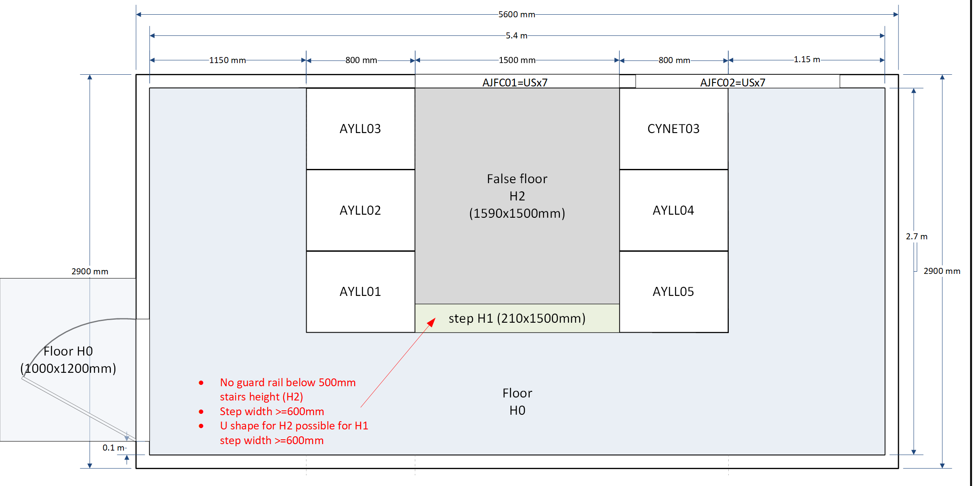
USx7 Faraday cage False-floor
after correction
12.12.2023
External Platform required
  Height H0=250mm
  Area > door open at 90°
  Door : 900mm
H0 False floor:
  Height H0=250mm
  FC bottom structure not even
  Protection of FC floor
H2 false floor
  Height H2 = H0+450mm
  Behind the racks
  For cables from patch panel AJFC01 to the racks
  One step required (H1=H0+225mm)
New size: 5600mm
Single step of 250mm
Ok for HSE

Slide 8

USx7 Faraday cage Racks allocation
New allocation
(optimized for cabling)
after correction
12.12.2023

Slide 9
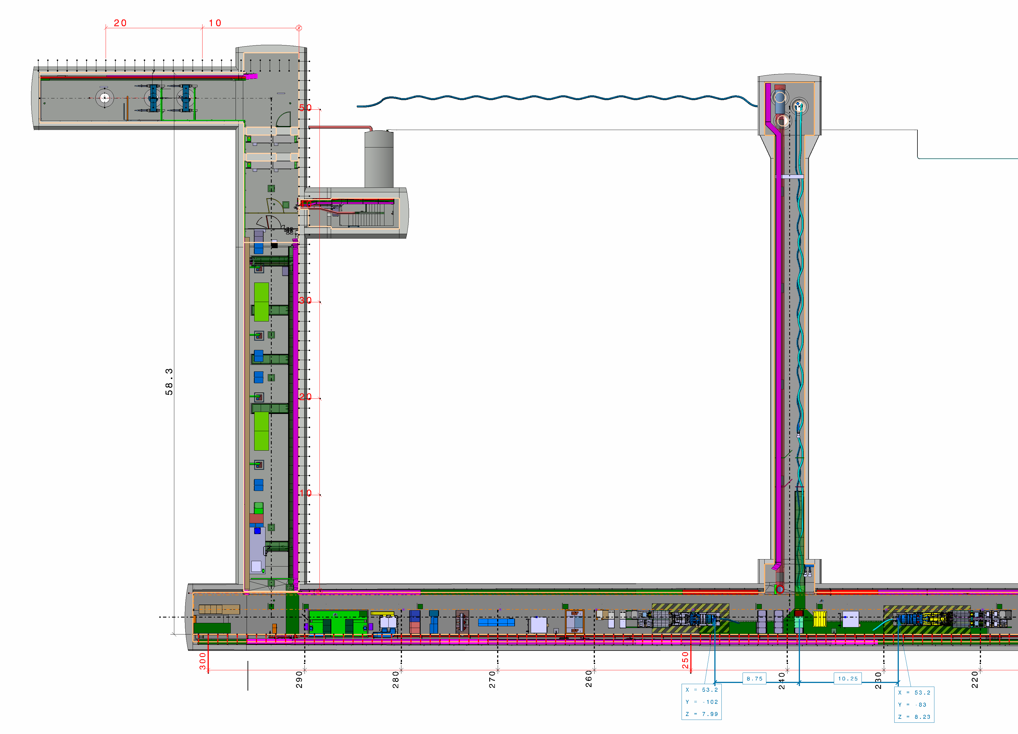
UR15 or UR55 gallery
UL13
UA13
Faraday cage
6 racks
UR15
Fig – HL-LHC URx5 gallery, Courtesy S. Maridor

Slide 10
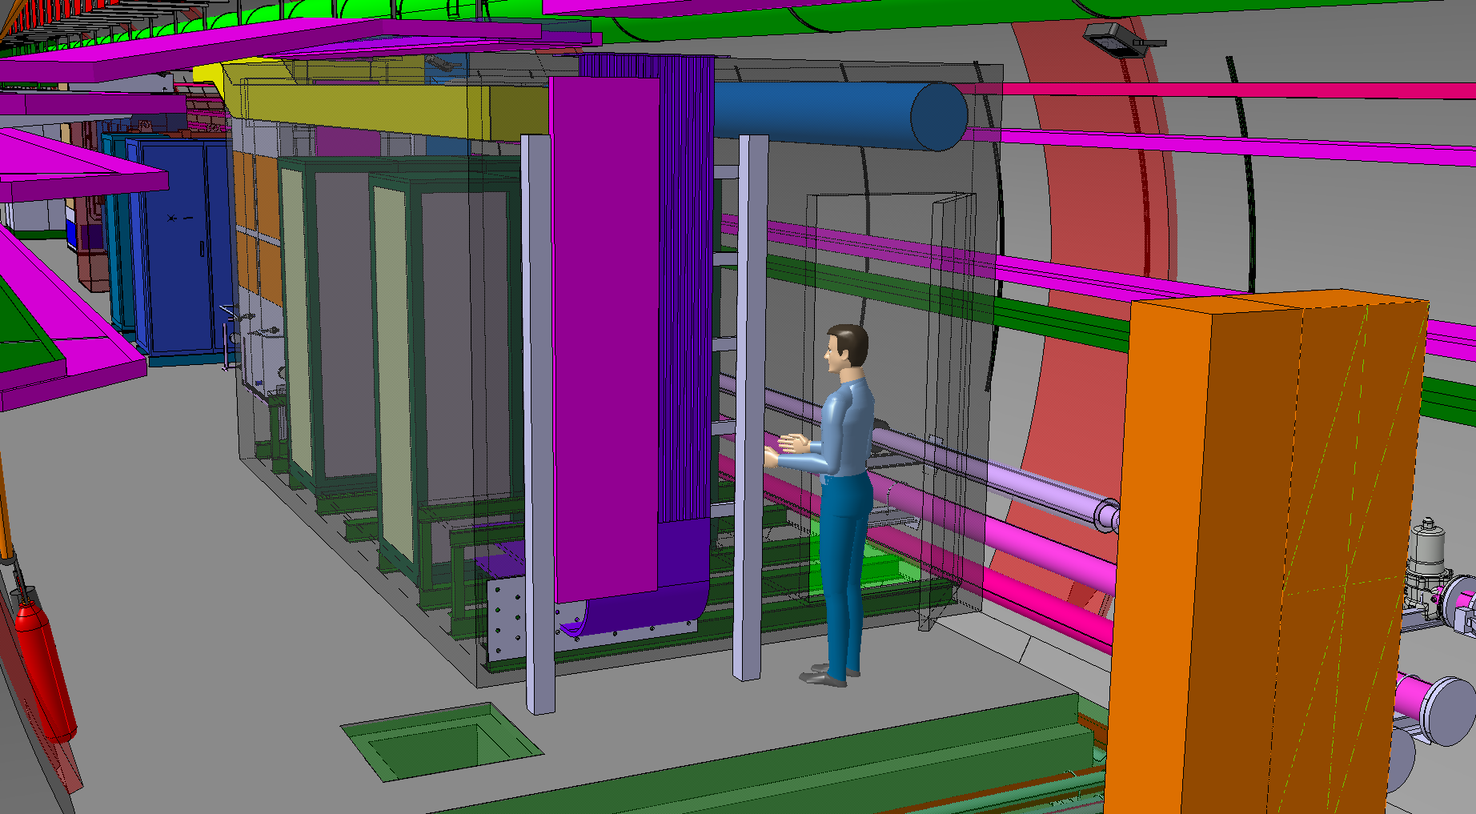
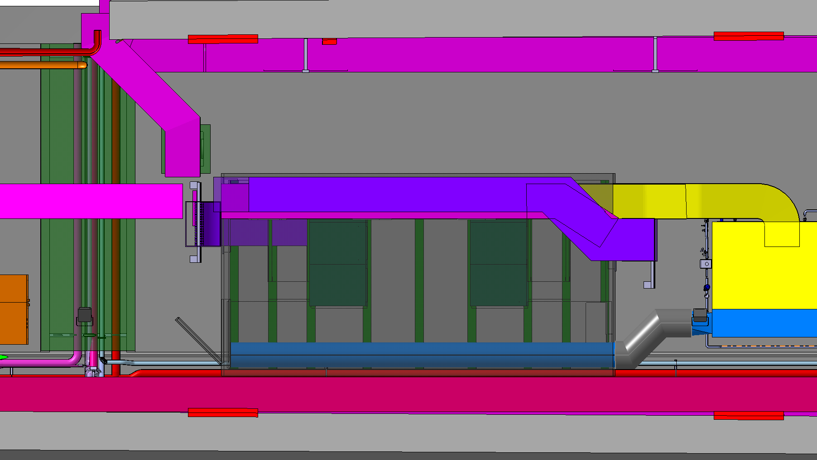
Patch panel – UR faraday-cage
Faraday cage
6 racks
Patch panel
  New size: 450x1300mm
  N connectors
  7/16 connectors (for critical signal to minimize réflexion)
  Fiber-optics feedthrough (AJFC02)
  multi-conductors EMI feedthrough (AJFC02)
  Distribution depending on the destination inside FC
patch panel
AJFC01
Fig – HL-LHC URx7 FC, Courtesy S. Maridor
patch panel
AJFC02

Slide 11
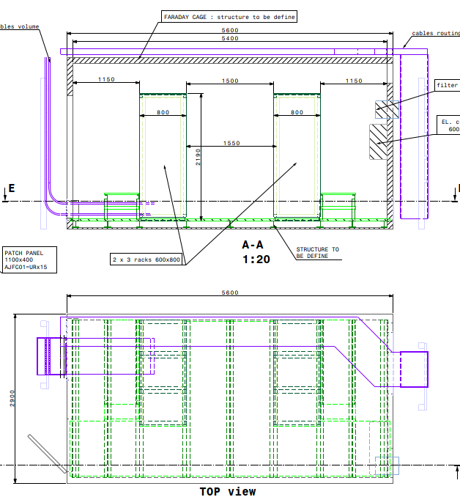
URx5 Faraday cage layout
Current design
  Size 5600x2900mm (no change)
Final design
  Door at 250mm
5600mm
2900mm
Fig – HL-LHC URx5 FC drawing V5, Courtesy S. Maridor

Slide 12
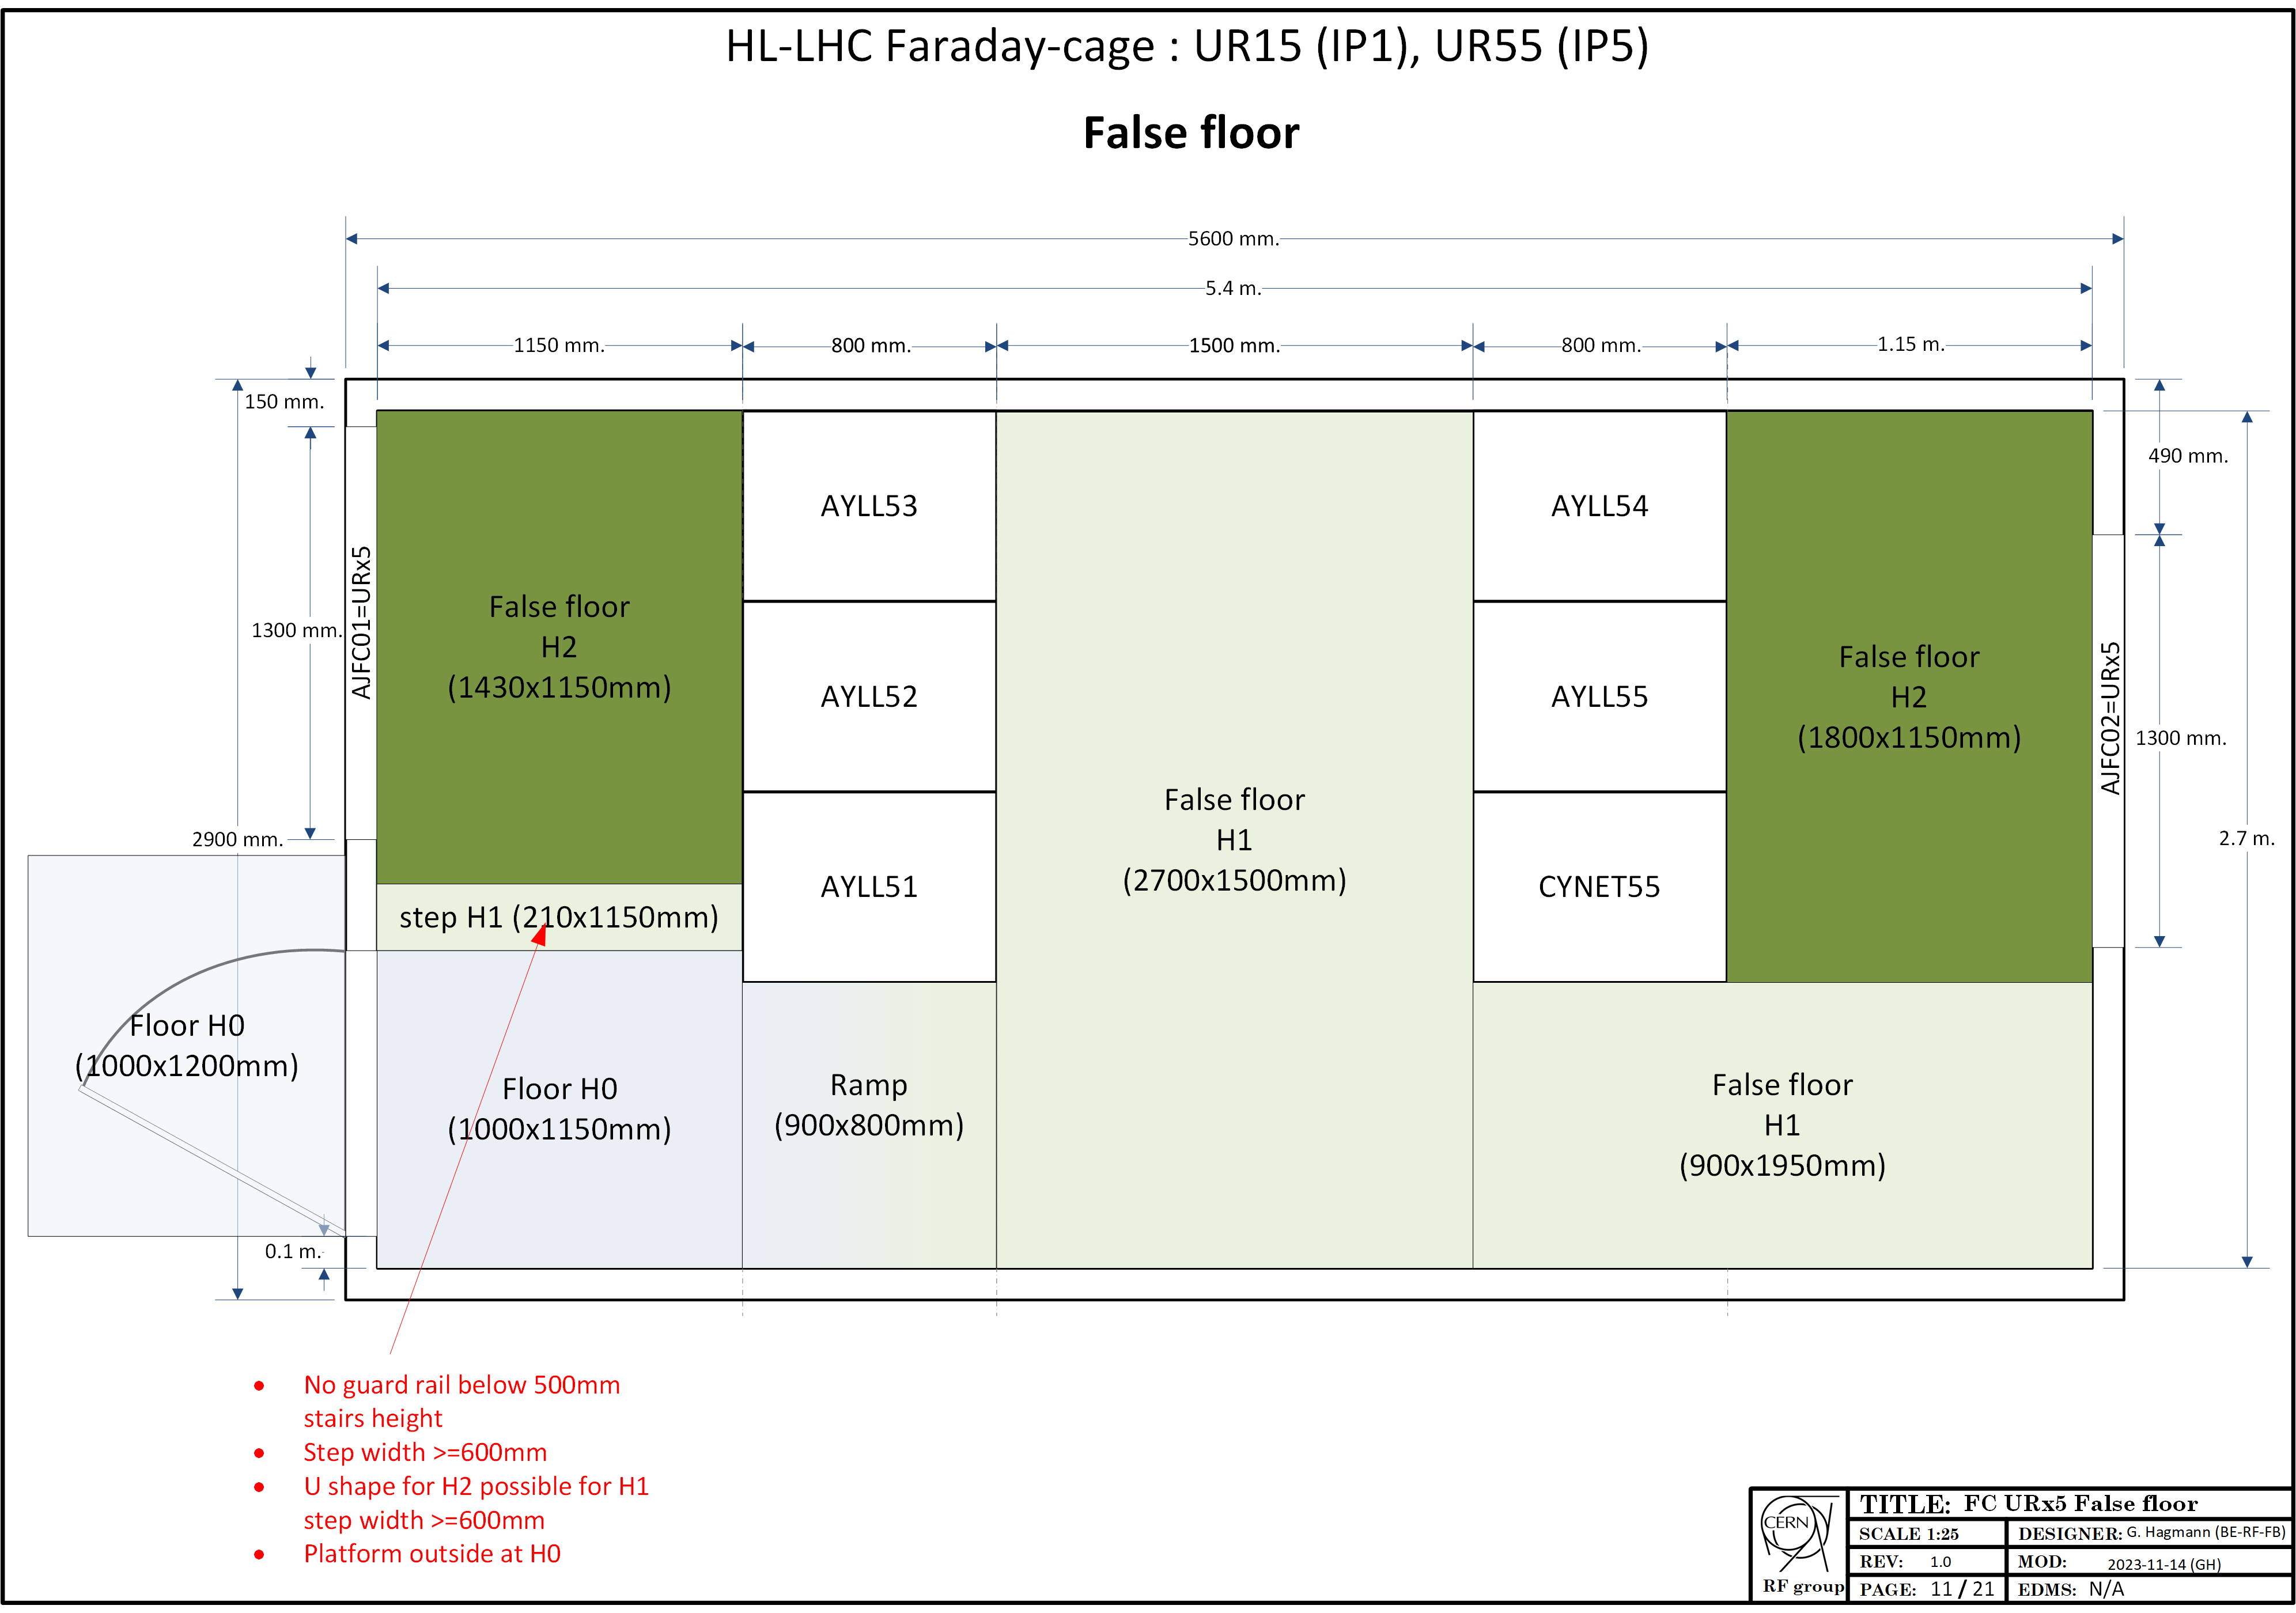
UR15 & UR55 Faraday cage False-floor
External Platform required
  Height H0=250mm
  Area > door open at 90°
  Door : 900mm
H0 False floor:
  Height H0=250mm
  FC bottom structure not even
  Protection of FC floor
H1 False floor
  Height H1=H0+225mm
  For cables from patch panels to the racks
H2 false floor
  Height H2=H1+225mm
  Behind the racks
  For cables from patch panels to the racks
  One step required (H1)
225mm
800mm
Ramp slope: 16 deg (28%)
Ok for HSE
Single step of 250mm
Ok for HSE

Slide 13
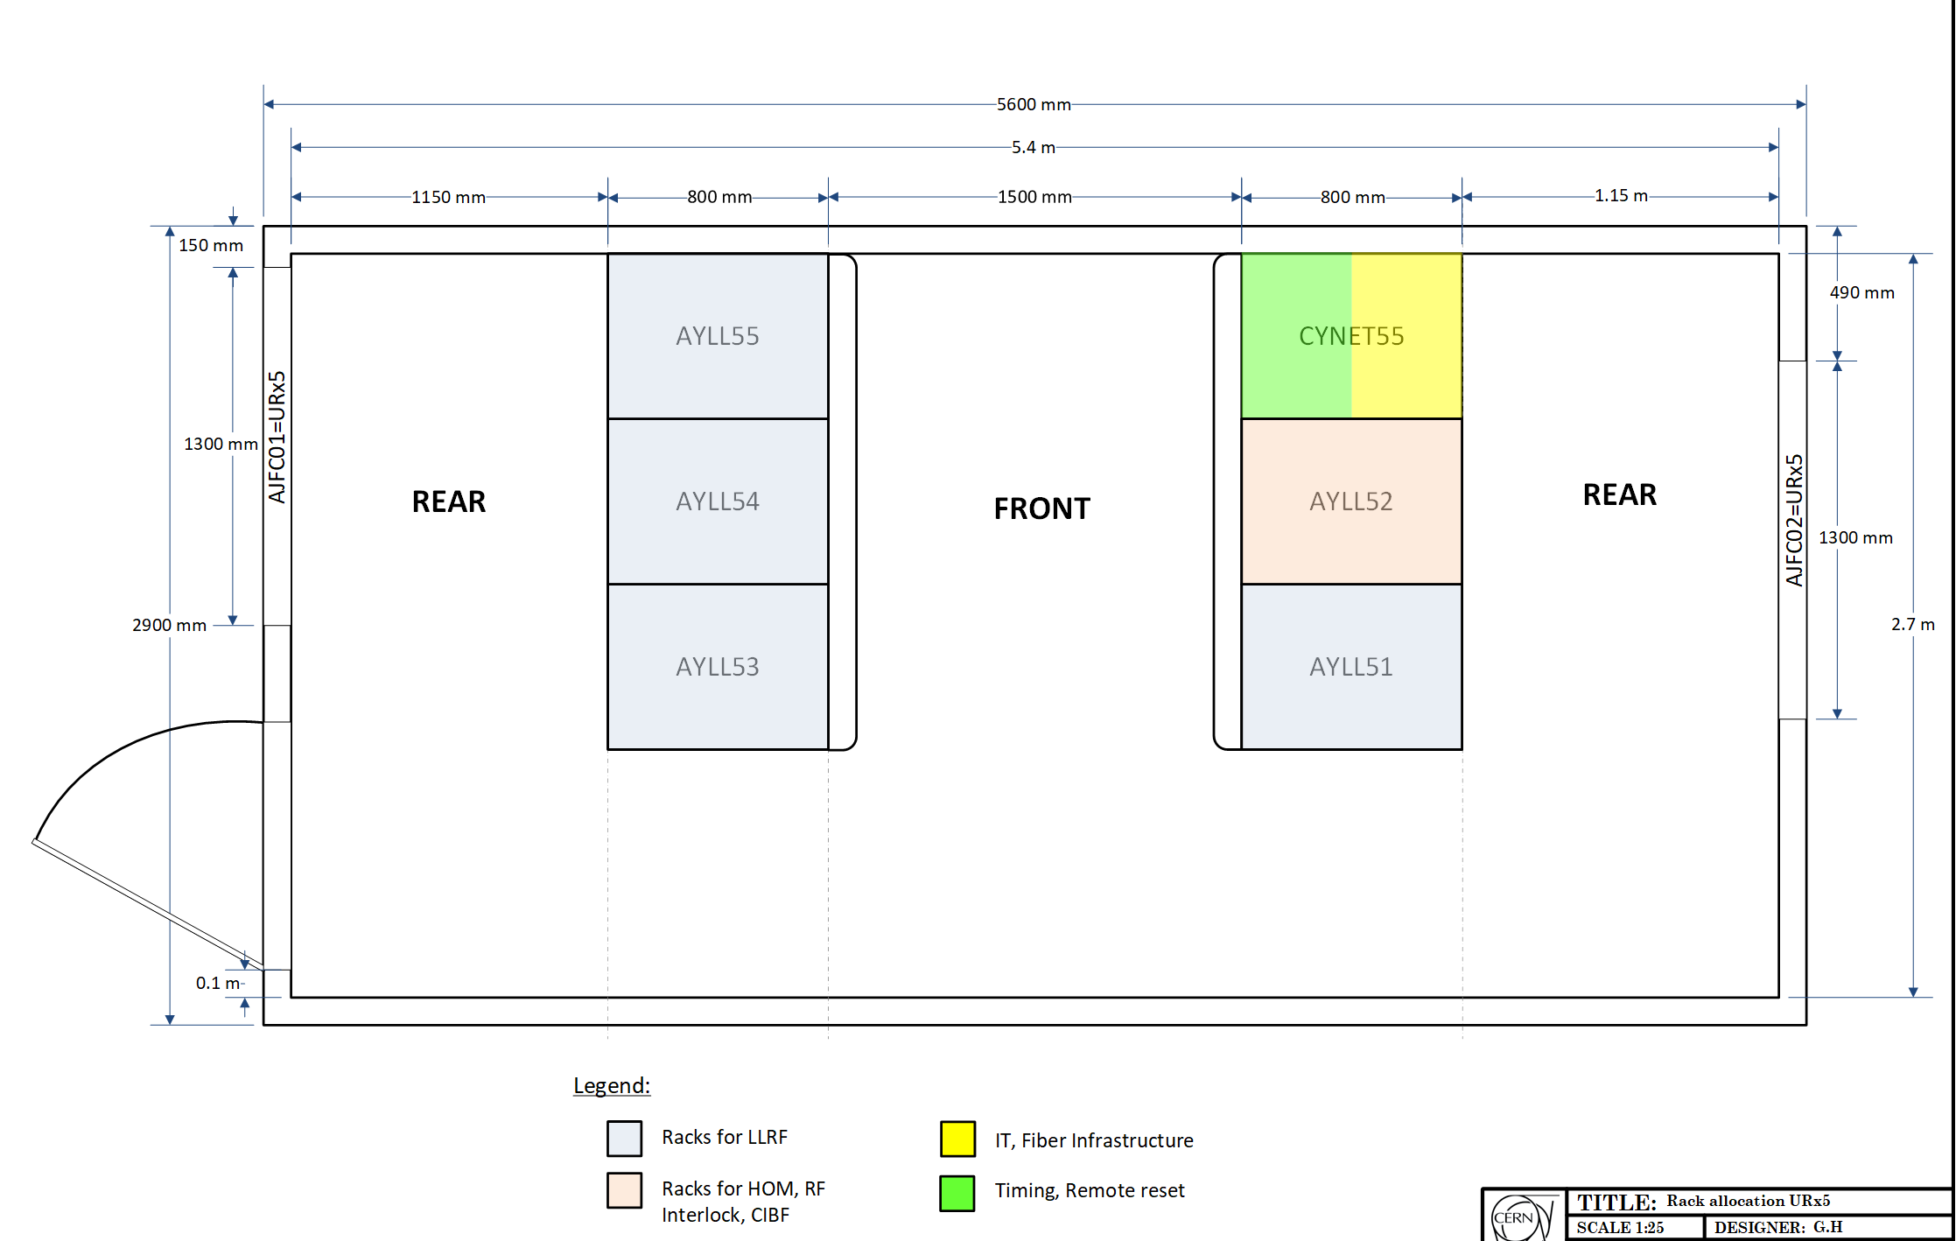
URx7 Faraday cage Racks allocation
New allocation
(optimized for cabling)
after correction
12.12.2023

Slide 14
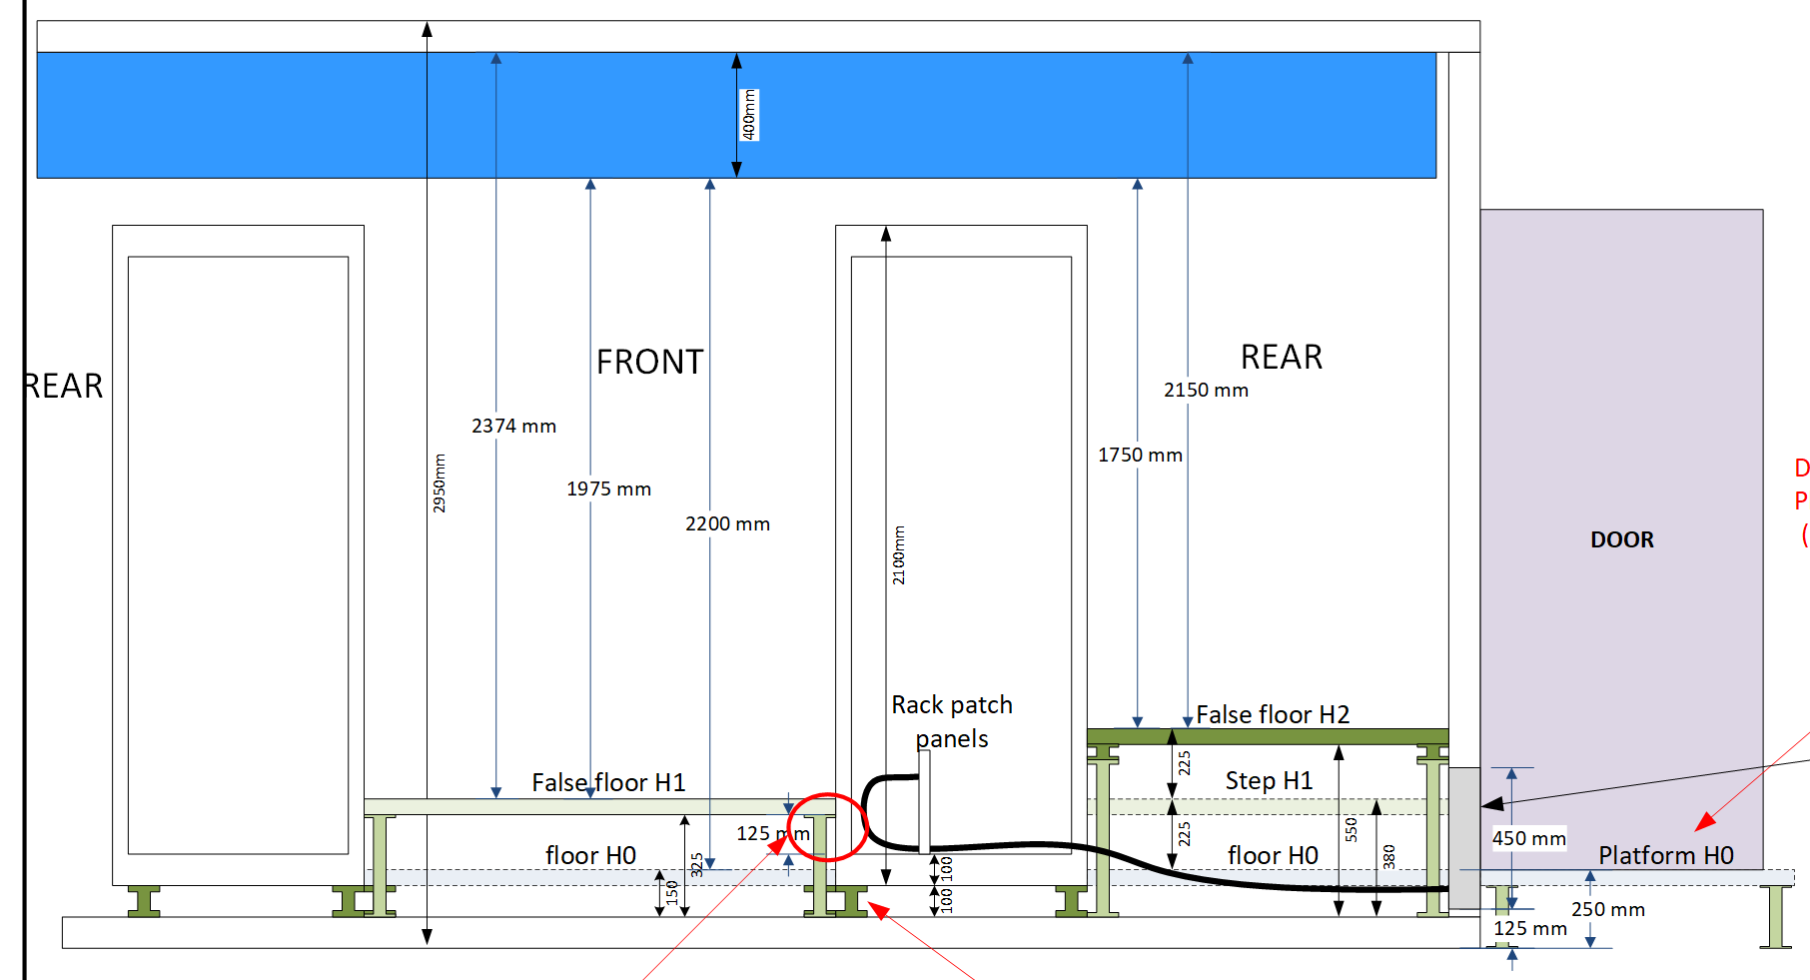
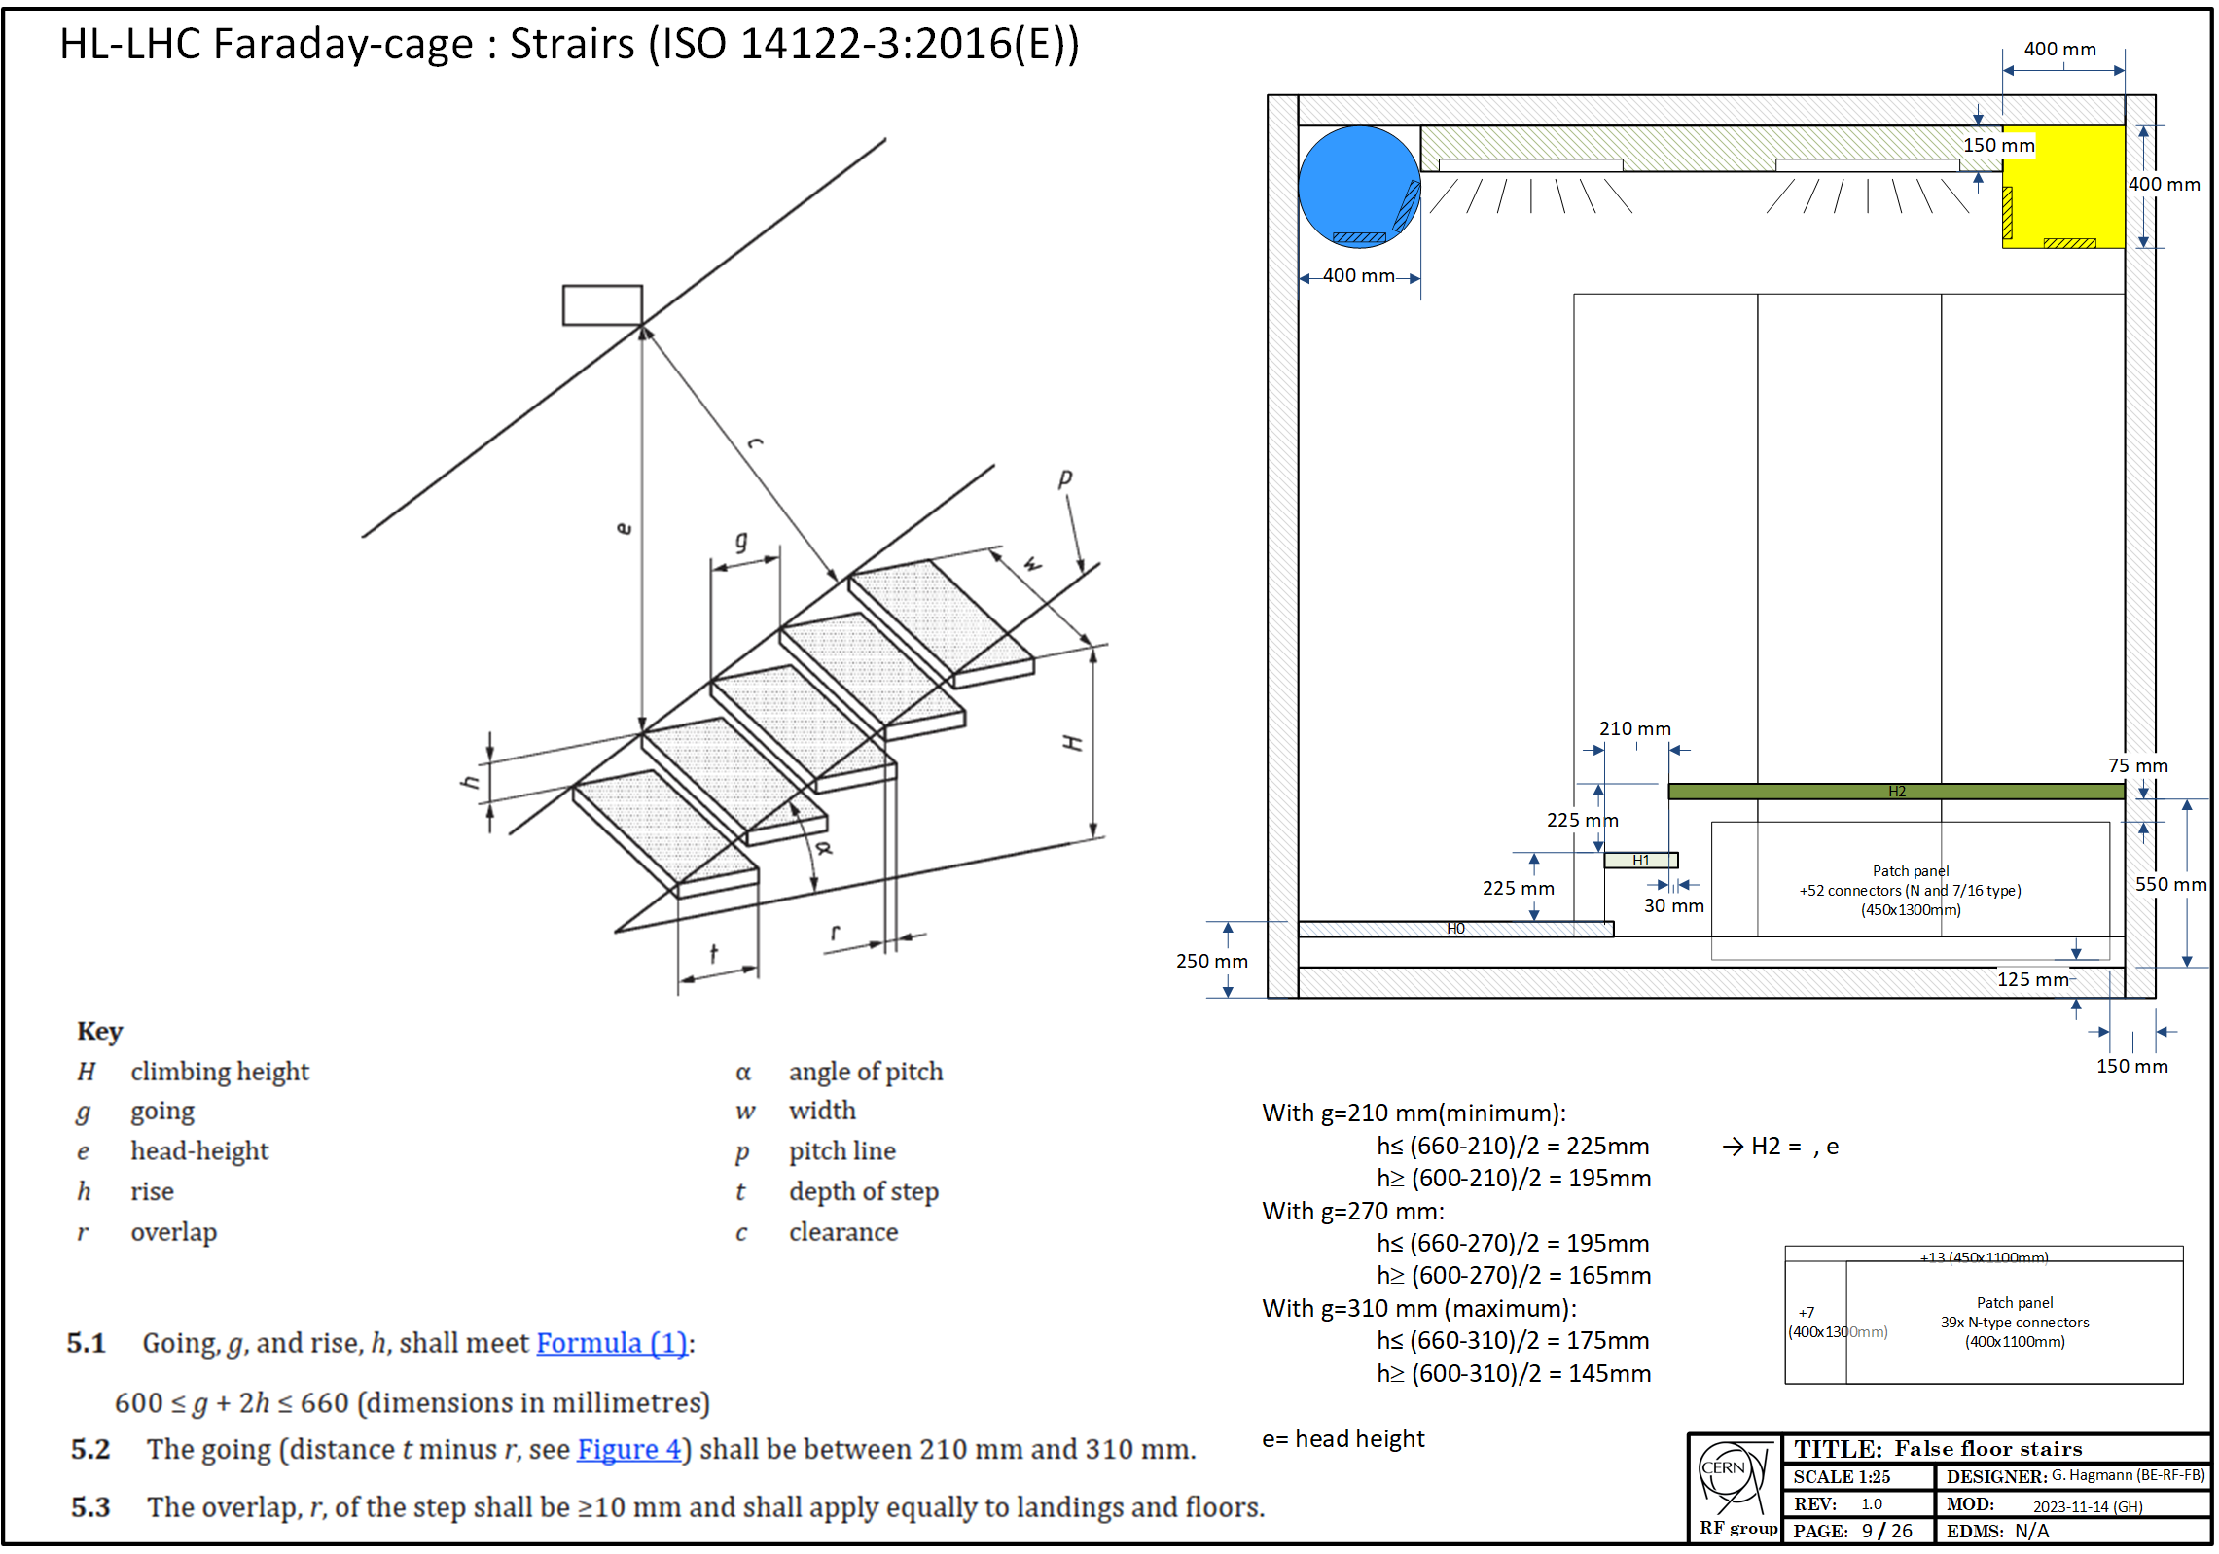
False floors - Stairs
False floor stairs
  ISO 14122-3:2016(E)
  Height h: 225mm (max)
  Going g: 210mm
  Overlap r: 30mm
H0=250mm
(door height)
OK for HSE
External platform to be approved by integration

Slide 15
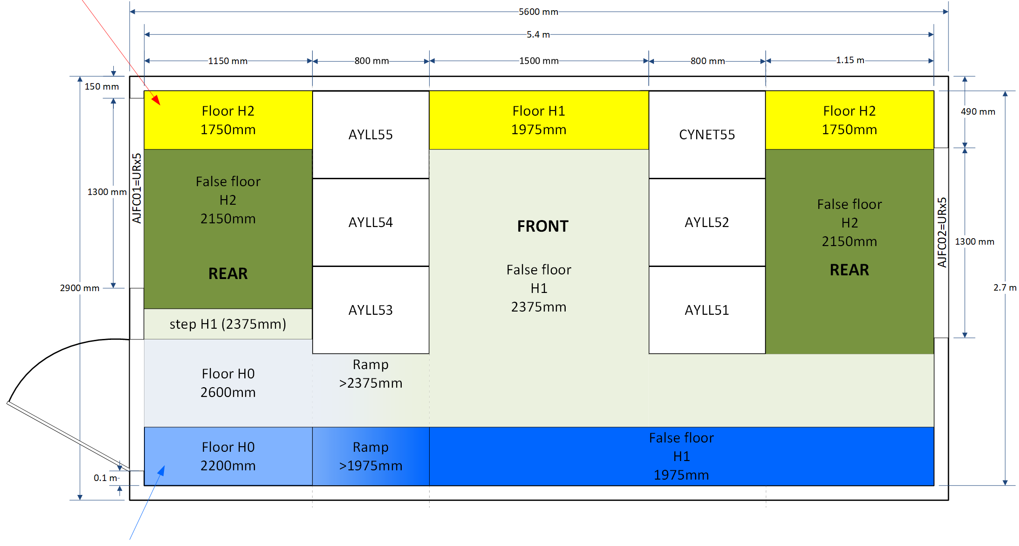
Head room – UR faraday-cage
Rounded air dict (blue, 400mm)
Rectangle air duct (yellow , 400mm)
H0=250mm
OK for HSE
HSE recommendations:
  Reduce size of air duct
  (H2 false floor)

Slide 16
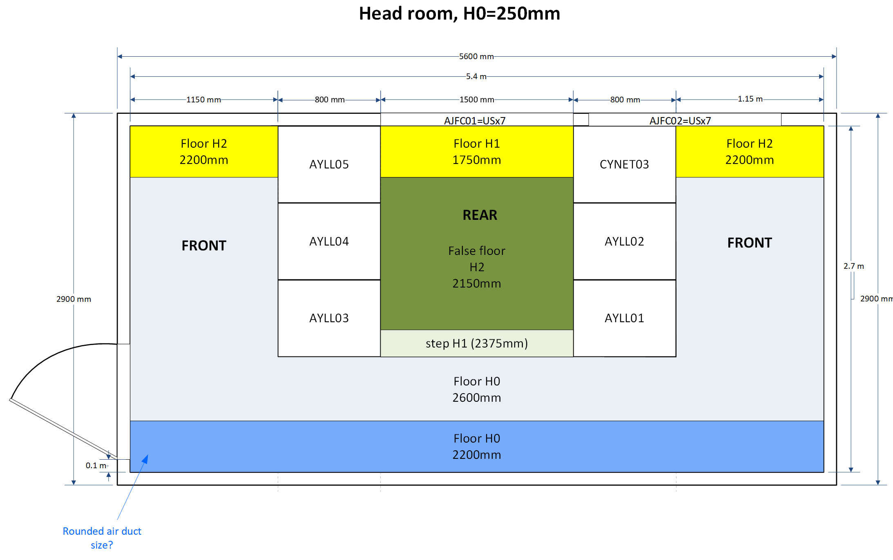
Head room – US faraday-cage
Rounded air dict (blue, 400mm)
Rectangle air duct (yellow , 400mm)
H0=250mm
OK for HSE
HSE recommendations:
  Reduce size of air duct
  (H2 false floor)

Slide 17
Head room – CV
Air ducts size
  Assuming 400mm
  400mm height from FC hard ceiling?
lighting, false-ceiling
  150mm space needed for
Space needed for cable tray at the top of the racks
Positioning of the aeration grid:
  Lower than 150mm
  at the bottom?
Can we reduce air duct height?
(HSE)

Slide 18
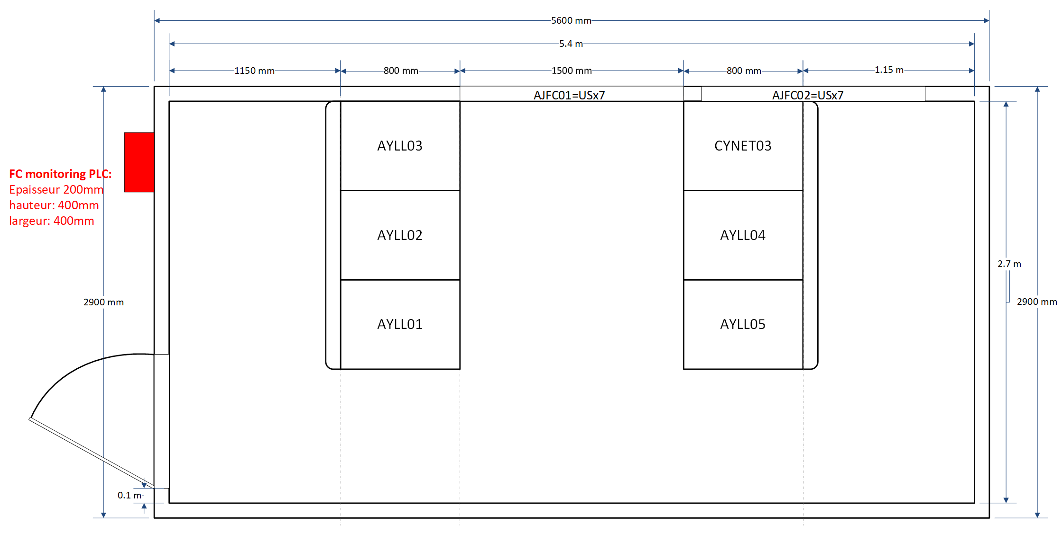
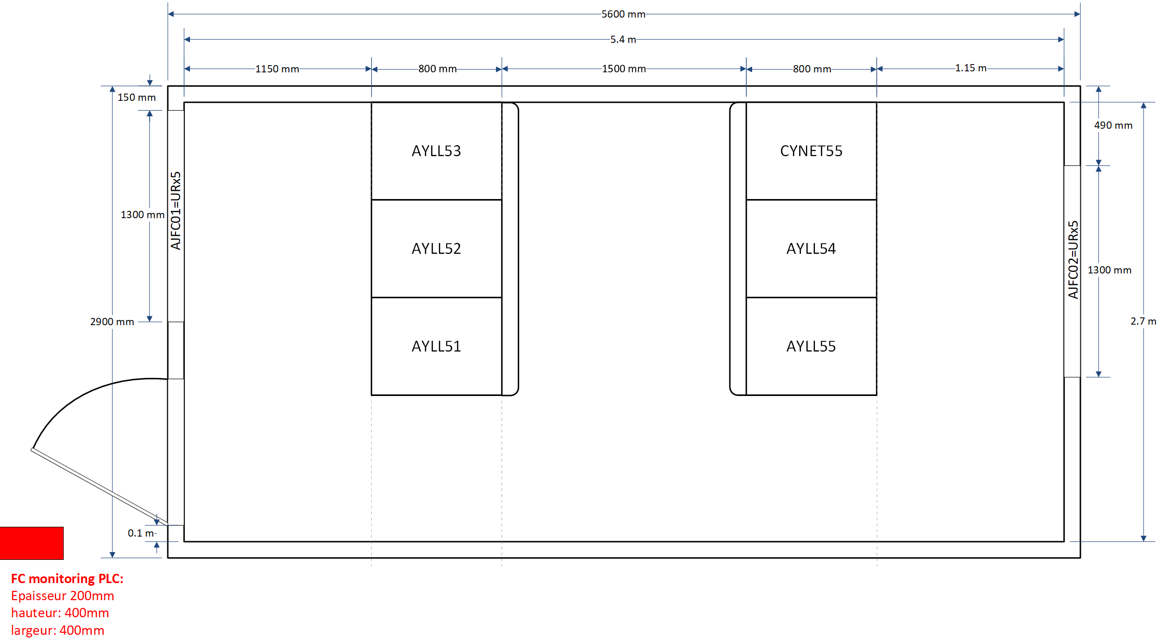
FC monitoring
FC environnement monitoring
  Space reservation needed
  400x400x200mm
USx7
URx5

Slide 19
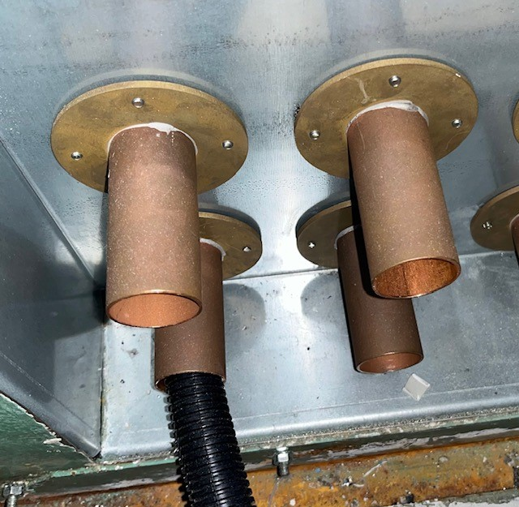
Fiber feed-throughs
For fiber-optics
Dimensions
  L=120mm (80mm outside)
  inner diameter=30mm
  Outer diameter=36mm
4x feed-throughs in AJFC02
Fig – SPS BA3 fiber feed-throughs

Slide 20
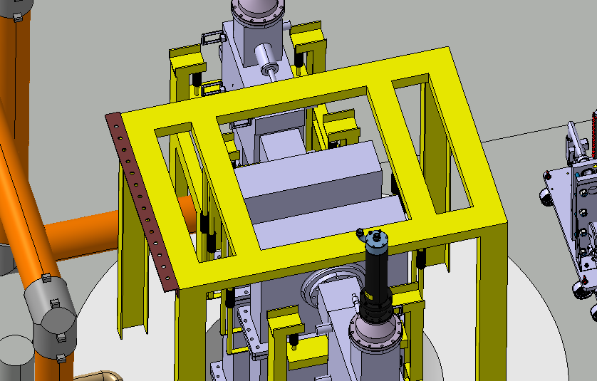
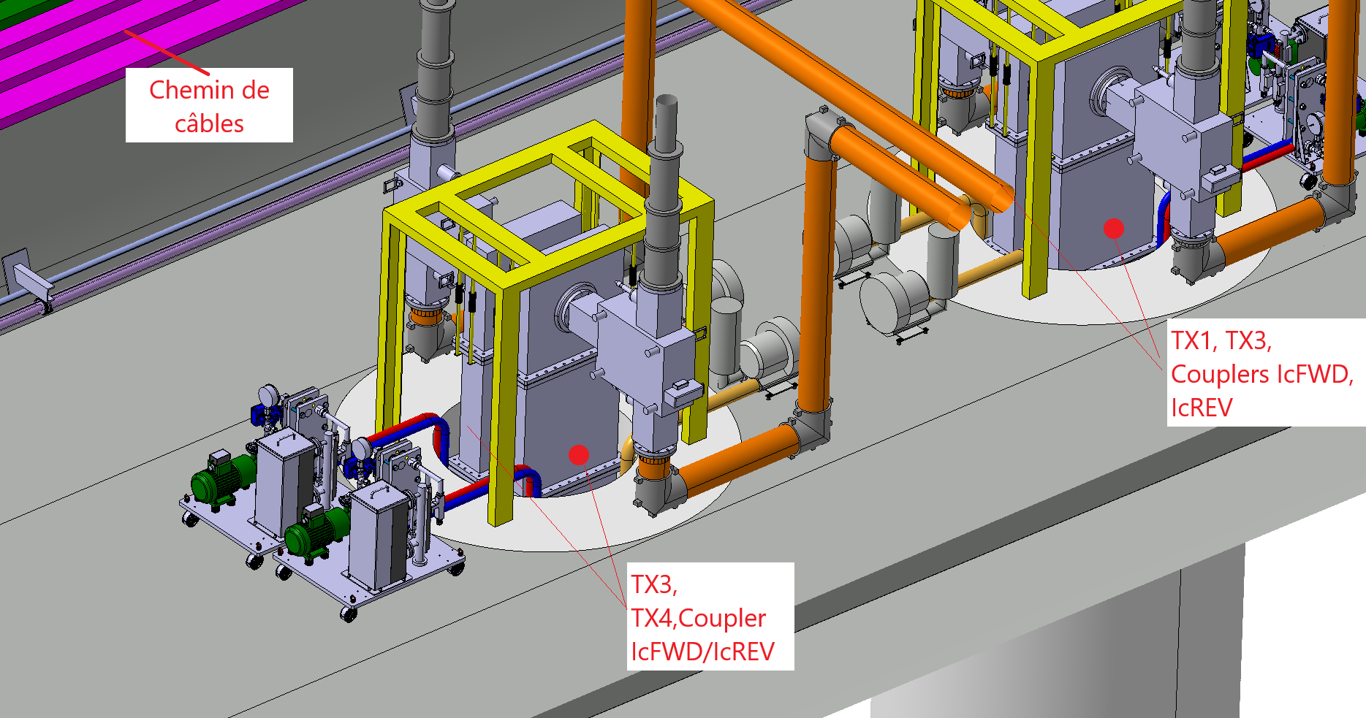
Cabling - Couplers Patch panel
Patch panel
New patch panels on Circulator guirder
14x N type connectors/ patch
1 patch / girder (2 patchs / UA)
Missing patch panel name
Cable tray layout?
8x LLRF signal per UA (4x LLRF signals / patch):
2x IcFWD (CGN50B, 7/8’’)
2x IcREV (CD50A, 3/8’’)
Under SY-RF-AC responsability
(design & fabrication)
Fig – HL-LHC UA gallery, Circulator and patch panel, Courtesy L. Ciampo

Slide 21
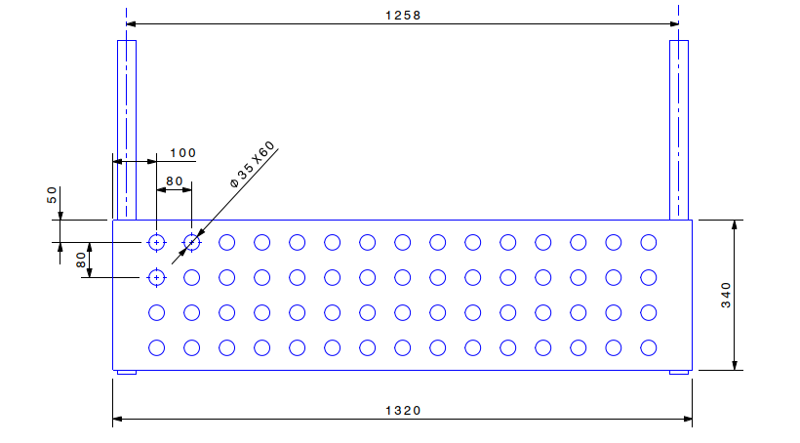
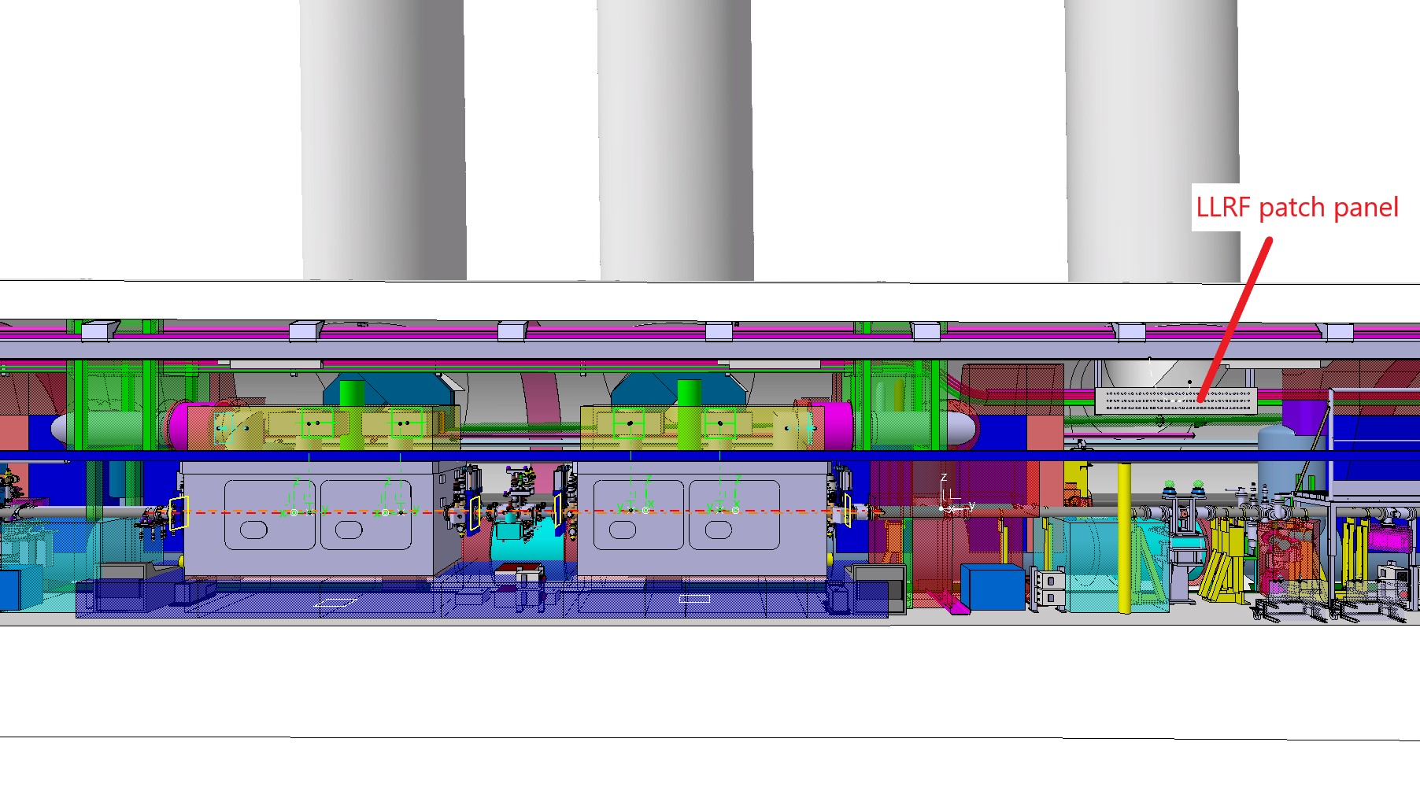
Cabling - Tunnel patch panel
Patch panel
44 RF cables (assuming RF cables only)
  36 LLRF signals
  8x HLRF signals
Currently 60x connectors
  Connector spacing (currently 80mm) can be optimized to ease the cabling?
ANT, PU cables (extension)
  16x 7/8’’ cables => Same length
  7/16 connector type on PP side
  N connector type on PU/ANT side
HOM cable (extension)
  16x 3/8’’ cables (CD50A) for HOM
  N connector (both side)
Fig – HL-LHC Crab-cavity, tunnel patch panel, Courtesy N. Bruti
Fig – HL-LHC Crab-cavity, tunnel patch panel, , Courtesy S. Maridor

Slide 22
Cabling - Tunnel patch panel
Cable tray required from patch-panel to
  Pickup, Cavity antenna, HOM (extension)
High radiation area
  Access required for cables exchange campaign
  150kGy after 10 years expected
Pickup
  Last 2.5m: SIO2 cables provided by BI
  Situation unknown for RF loads
HOM
  3/8’’ cables directly connected to the RF port.
LLRF Cavity antenna
  Below the cryostat (1 per cavity)
  Last centimeters with RF semi-rigid patch cable
Fig – HL-LHC Crab-cavity, tunnel patch panel, , Courtesy S. Maridor

Slide 23
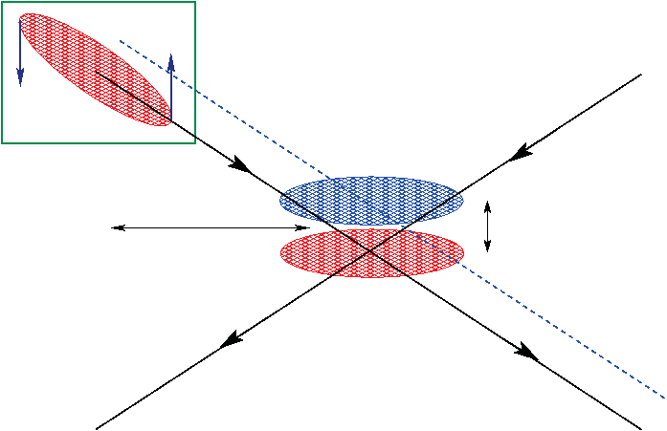
Specifications for LLRF
Crabbing closure
  Cavity phase on bunch core. Phase offset → transverse displacement (Δx or Δy) of bunch core
  Coherent phase shift Requirement: <100ps phase error (14.4°) [1] (2% peak luminosity reduction)
  In Coherent phase shift Requirement : <15ps phase error (2°) [1] (1% peak luminosity reduction)
  Precise crabbing-uncrabbing voltage (V∑)
  Counter-phasing on both side of the IP during filling/ramping (V∑=0)
Fig – Phase offset leading to transverse displacement on one beam only [16]

Slide 24
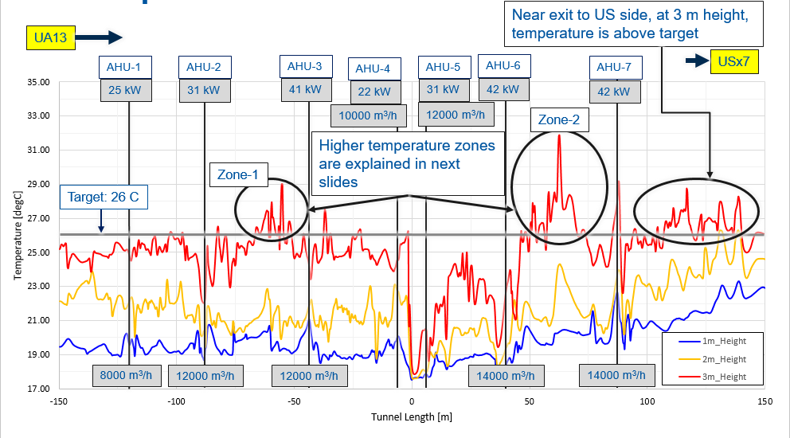
Underground temperature
Thermal simulation in UR
High temperature gradient
  1m height: ~19°C
  3m height: ~25°C
Fig – Steady temperation profile UR tunnel, Phase modulation of LHC ACS cavities along the batch for 2.2⋅10¹¹ [5]

Slide 25
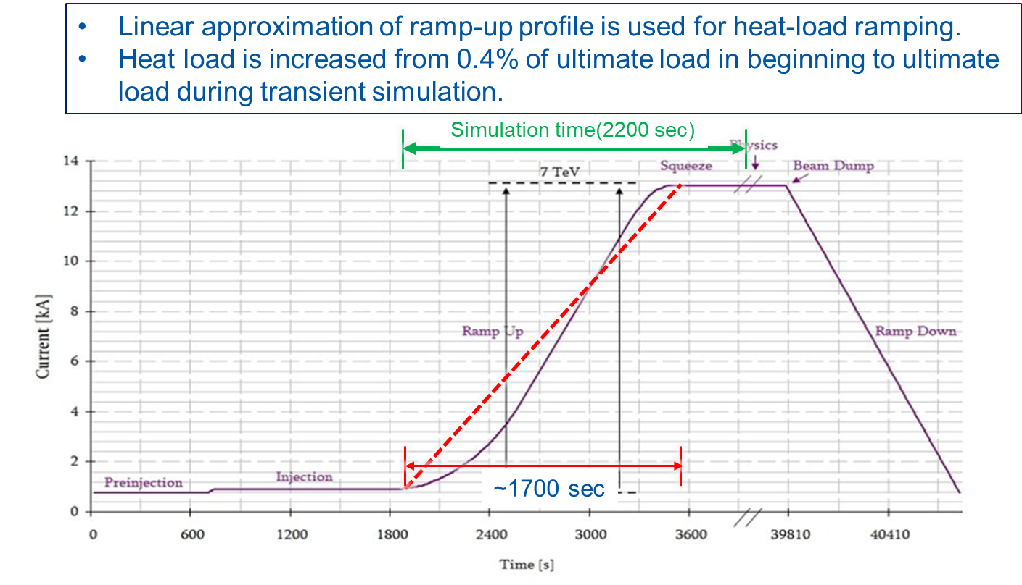
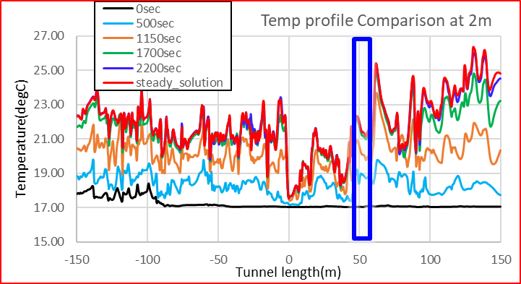
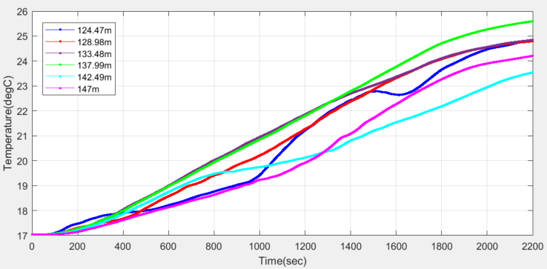
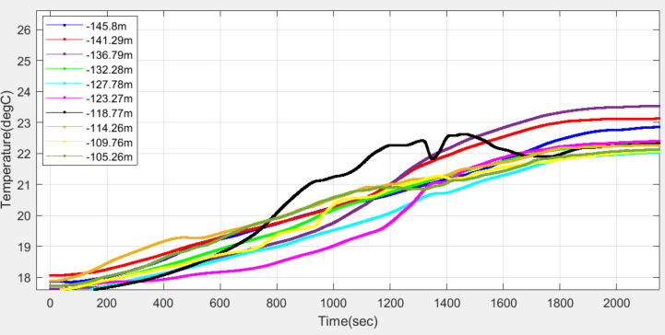
Underground temperature
Tunnel ΔT=±1.5°K
8°K daily variation in UR [5]
No simulation available in UA
Operational scenario of RF heat load variation in UA?
Heat load varying with LHC cycle
(WP6b, WP7, WP17.2)
8°K
5°K
Figs – Transient temperature at 2m height [3, 5]

Slide 26
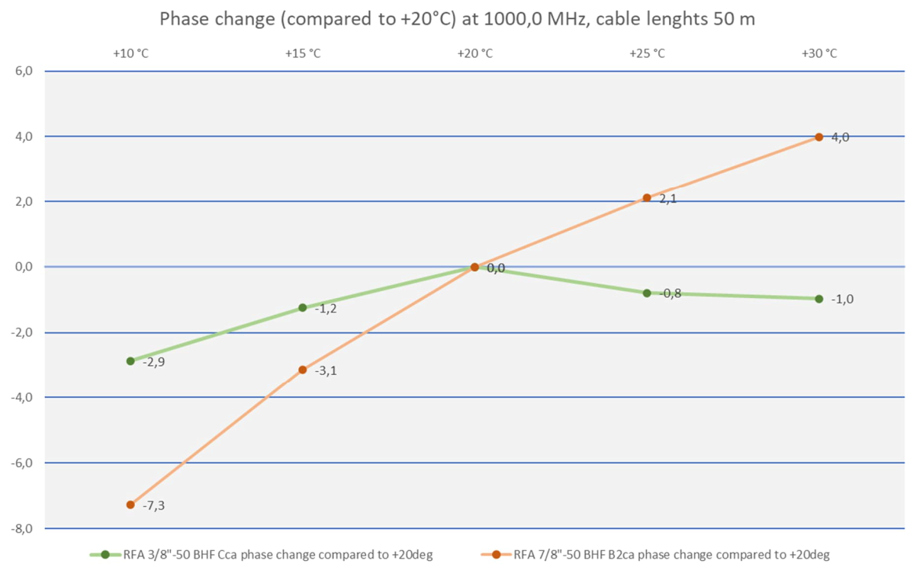
Cables
Tunnel PP to faraday-cage PP
  Draka cables (93m)
    CGN50B : 7/8’’ : 0.0042 RFdeg / °K / m
    CD50A: 3/8’’ : 0.0016 RFdeg / °K / m
  CGN50B example:
    L=93m for 8K => 3.12 RFdeg
    (spec 2RFdeg)
  tentative budget
    0.1 RFdeg (10%)
    8°K for 3m => 0.1RFdeg
Budget also for
  Cable inside FC, in the tunnel
±1.5
Fig – Draka phase stability wrt Temperature, 7/8’’, 3/8’’

Slide 27
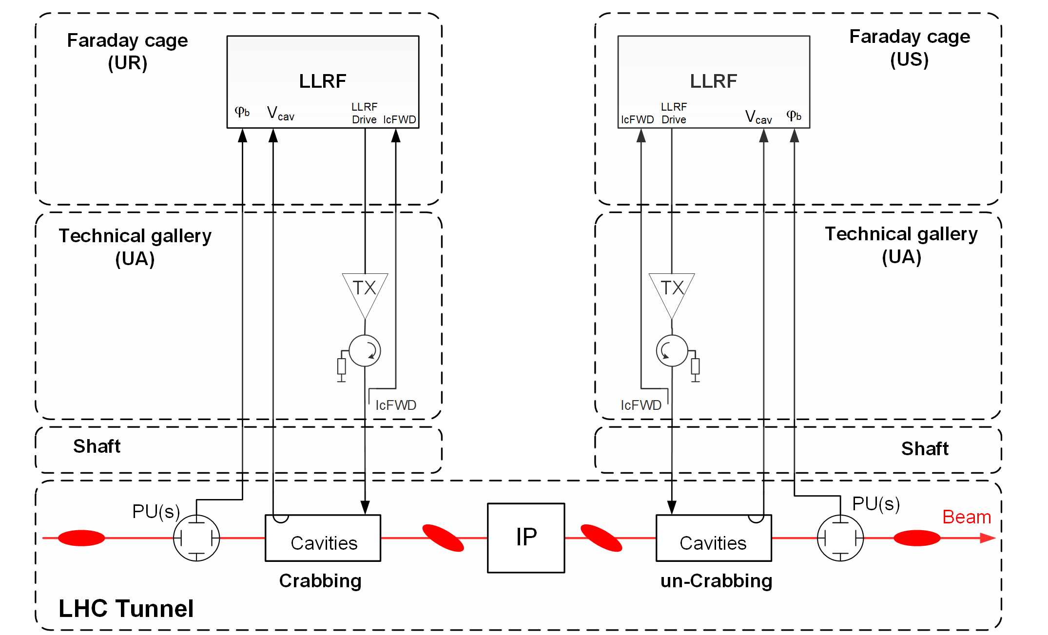
Cabling
Differential measurement with pickup-cavity
Same cable type/ length
Fig – LLRF differential measurement

Slide 28
Cabling
Drive, IgFwd, IgREV, Spare
IcFWD, IcREV
PU
ANT
SPARE HOM
Cabling rules required
  Same cable type (CGN50B), length, routing for PU (12x 7/8’’), ANT(4x 7/8’’), IcFWD, IcREV and SPARE (4x 7/8’’).
    Dedicated cable tray for these temperature sensitive cables.
    Keep same temperature variation for all cables (Simulation required?)
    identical cable drum preferred
  From FC to amplifiers: cables as short as possible per cavity (no cable length matching), optimize for latency
  HOM cables (3/8’’) on a different cable tray than PU, ANT, IcFWD and SPARE (Fc to Tunnel)
after correction
12.12.2023

Slide 29
Fire detection
Pending issue
  Electrical power supply switch off in case of fire detection?
Concern for Machine protection and HSE
  Possible damage in the machine in case of CC voltage uncontrolled
  Beam-dump within 3-turns
Current status
  Request pending to HSE
  Machine protection to be contacted

Slide 30
References
[1] T. Mastoridis et al., Cavity voltage phase modulation to reduce the high-luminosity Large Hadron Collider rf power requirements, PRAB Oct 2017 Phys. Rev. Accel. Beams 20, 101003 (2017) - Cavity voltage phase modulation to reduce the high-luminosity Large Hadron Collider rf power requirements (aps.org)
[2] E. Yamakawa et al., Luminosity reduction caused by phase modulations at the HL-LHC crab cavities, NIMA 2018, https://www.sciencedirect.com/science/article/pii/S0168900218310325
[3] Rahul, CFD Results of the Transient Thermal analysis of UR15 Gallery, HL-MCF Meeting # 87, CERN 2021, https://indico.cern.ch/event/1053324/
[4] SMB/SC, Technical Description 19” Instrument Rack , EDMS 1967612
[5] F. Dragoni, A. Mejica, P. Pepinster, WP17.3 - COOLING AND VENTILATION USERS’ REQUIREMENTS FOR P1 AND P5, EDMS EN-CV-2018-081, Doc N°1572976
[6]H. Schönbacher, M. Tavlet, Absorbed doses and radtion damage during the 11 years of LEP operation, CERN-TIS-2002-010-DI-PP, CERN, Geneva 2002 DOI: 10.1016/j.nimb.2003.09.034
[7] https://edms.cern.ch/ui/file/2669584/LAST_RELEASED/SSI-FS-2-1_EN.pdf

