Slide 1
Damage Mechanisms in High-Temperature Superconducting (HTS) Tapes
Results from beam-induced and current-discharge heating experiments
Delphine Domange, Marco Bonura, David Gancarcik, Cedric Hernalsteens, Carmine Senatore, Daniel Wollmann
With contributions from Andreas Oslandsbotn, Andreas Will, William Martin Sorensen, Jannik Lassen, Anne Kirstine Herskind
MPE-CB Section meeting – 26/10/2023

Slide 2
Outline
Overview and motivations
The HiRadMat-37 experiment: beam-induced heating on HTS tapes
Capacitive current discharge heating experiment
Conclusions and next steps

Slide 3
Outline
Overview and motivations
The HiRadMat-37 experiment: beam-induced heating on HTS tapes
Capacitive current discharge heating experiment
Conclusions and next steps

Slide 4
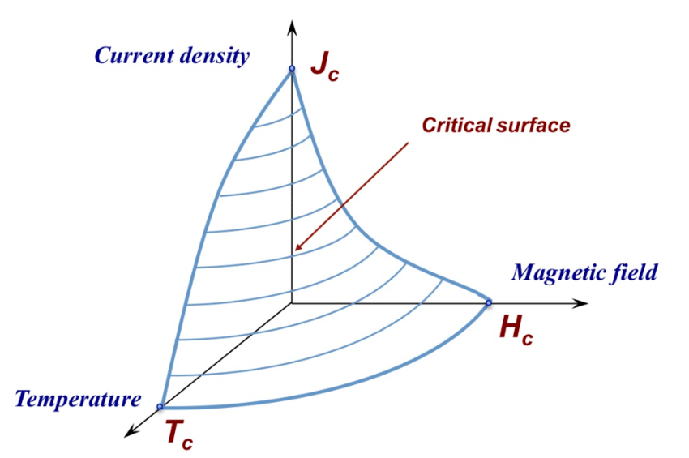
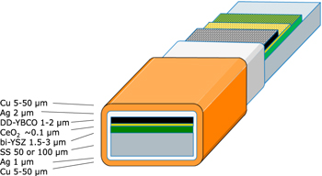
Overview and motivations
Superconductivity
Operation below the critical surface → No resistance
Typically implies cryogenic temperature operation
Used in accelerator magnets to provide high magnetic fields
  NbTi used on LHC magnets
  Nb₃Sn used for the new HL-LHC triplet quadrupoles
Newly developed materials provide
  High-Temperature Superconductors (HTS) (if T_{c} ≥ 77K)
  Room temperature superconductors [1]
HTS REBCO Tape
Operation at 77K or at 4K with higher external magnetic field
0.2mm thick multilayer tape
Considered for future colliders
[1] S. Lee and al., The First Room-Temperature Ambient-Pressure Superconductor, 2023 https://doi.org/10.48550/arXiv.2307.12008

Slide 5
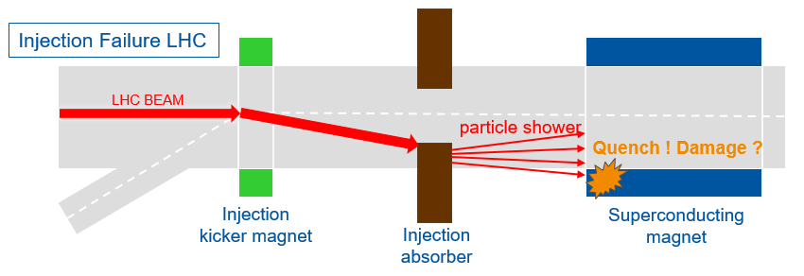
Overview and motivations
Accelerator failure scenarios
Beam losses: quenches → Availability issue
Failure scenarios: possible long-term degradation of magnet coils? → Machine protection issue
Courtesy V. Raginel
A large experimental campaign was started to assess the damage mechanisms and to quantify the damage limits of the different superconductors: LTS and HTS

Slide 6
Outline
Overview and motivations
The HiRadMat-37 experiment: beam-induced heating on HTS tapes
Capacitive current discharge heating experiment
Conclusions and next steps

Slide 7
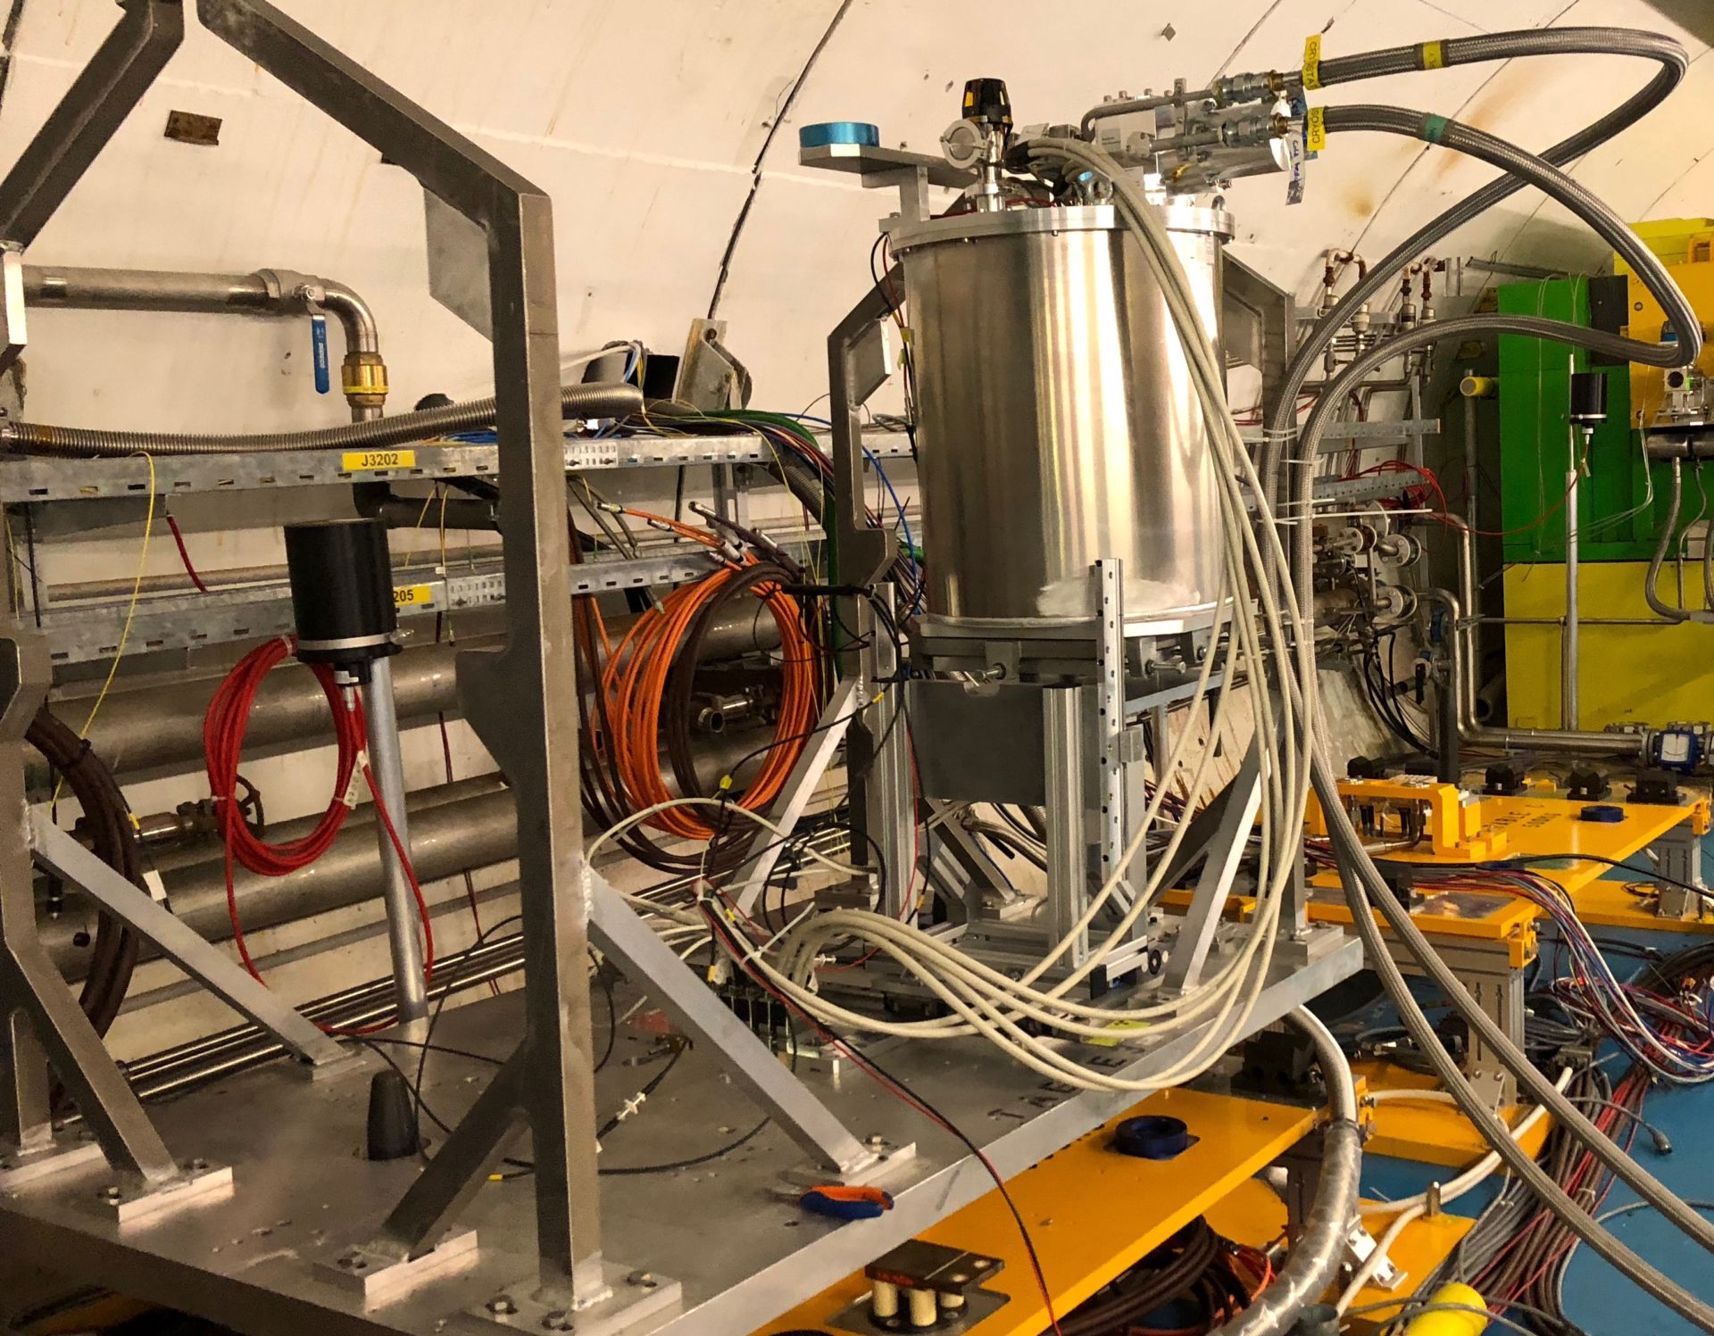
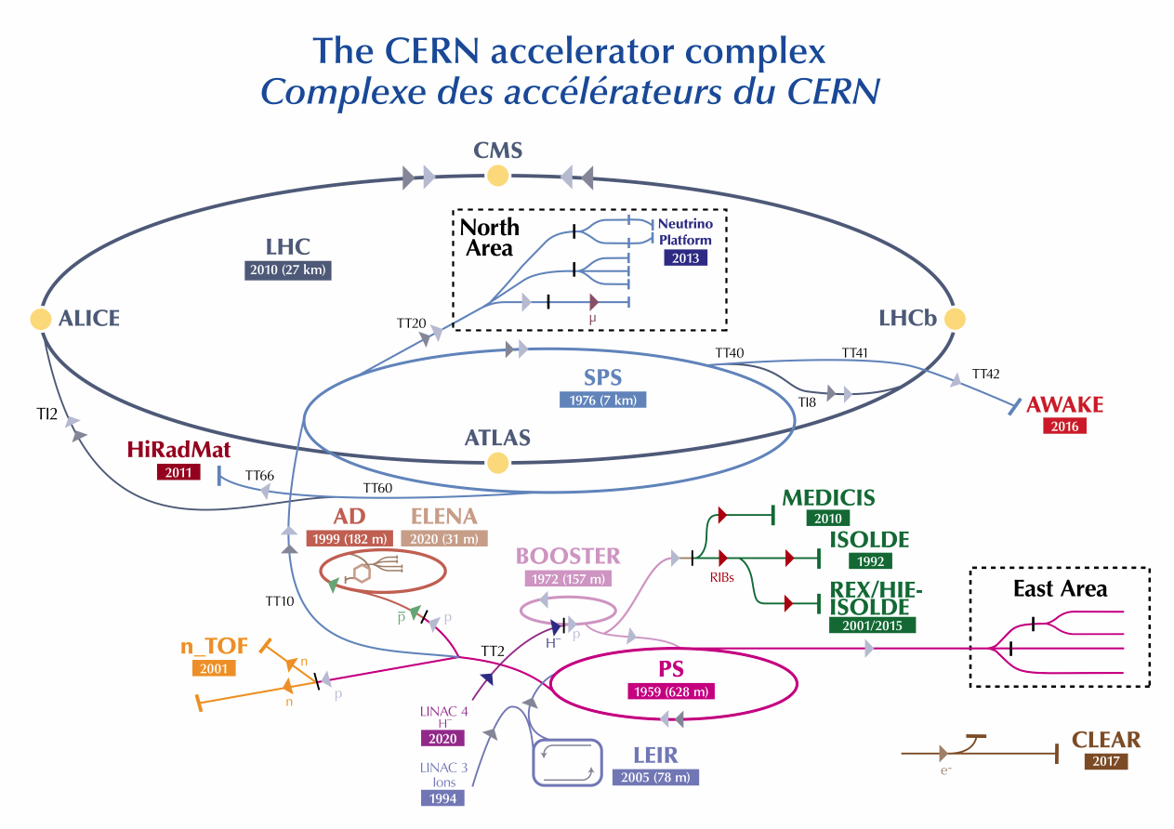
The HiRadMat-37 experiment
Experimental table setup in the
HiRadMat tunnel
P+

Slide 8
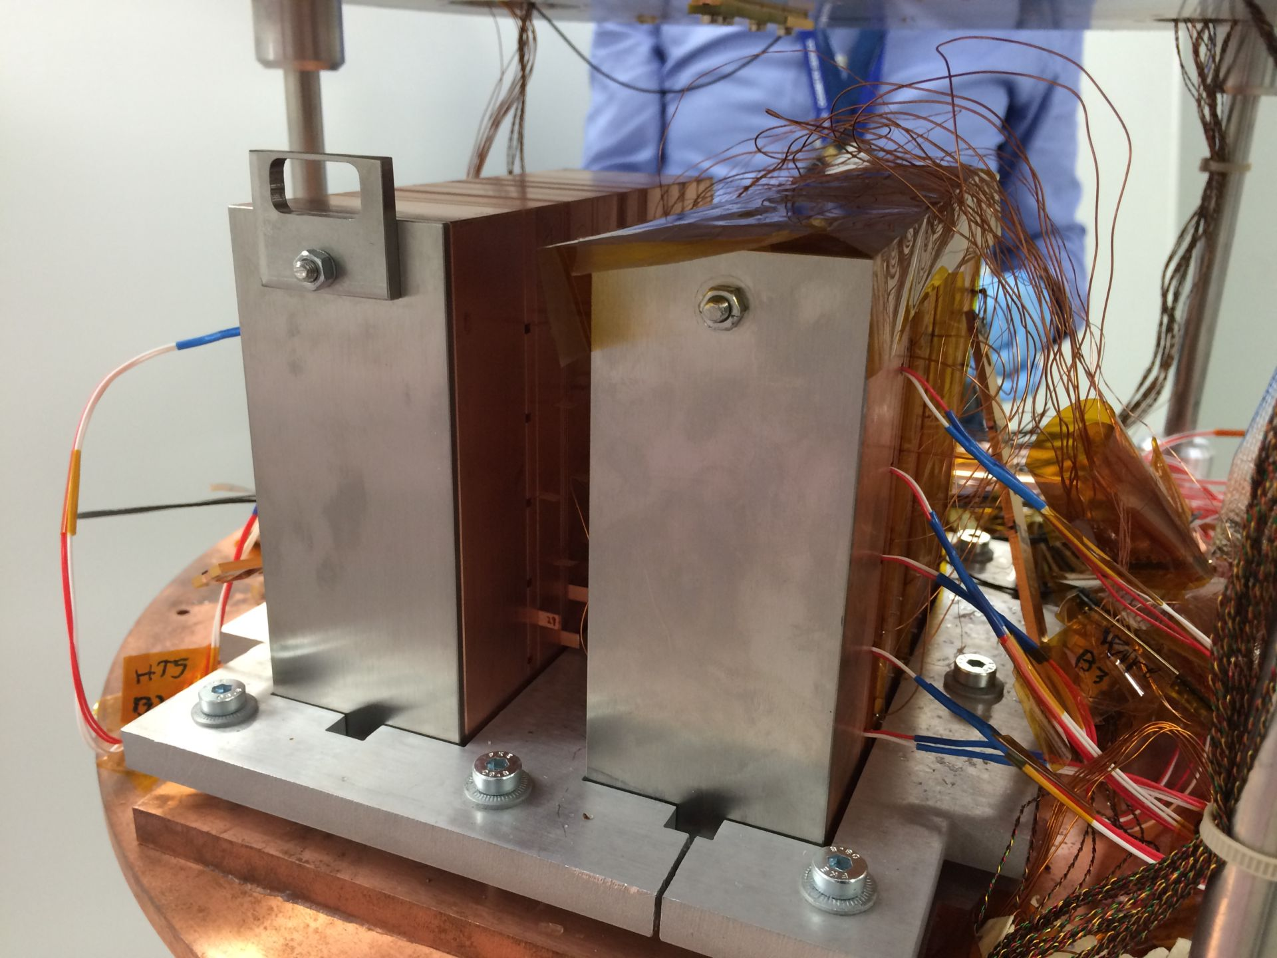
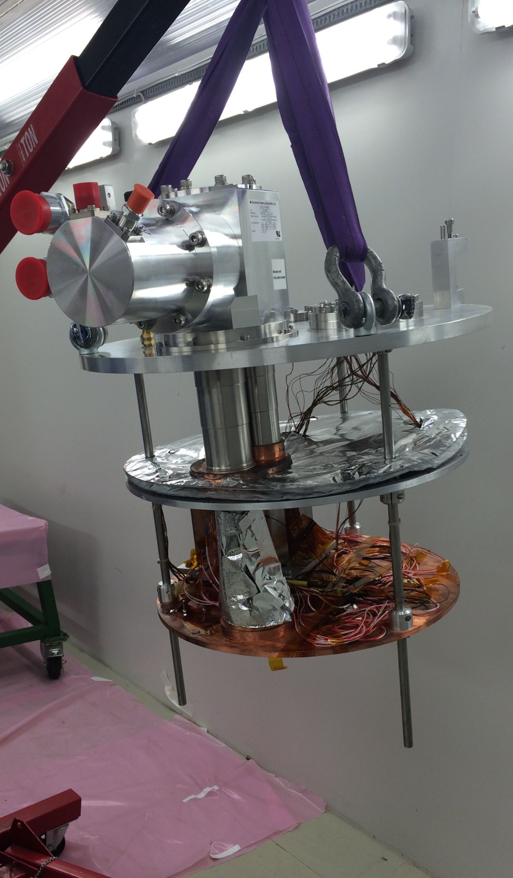
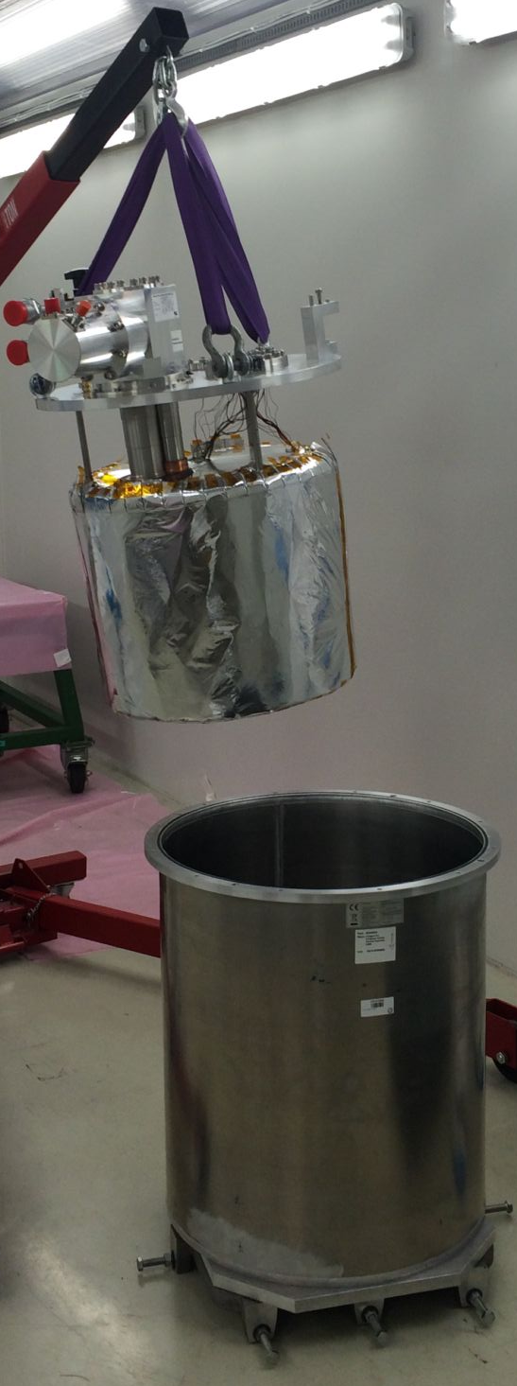
The HiRadMat-37 experiment
Cryostat
Second layer removed
Sample holders placed on the cryostat
HTS
LTS

Slide 9
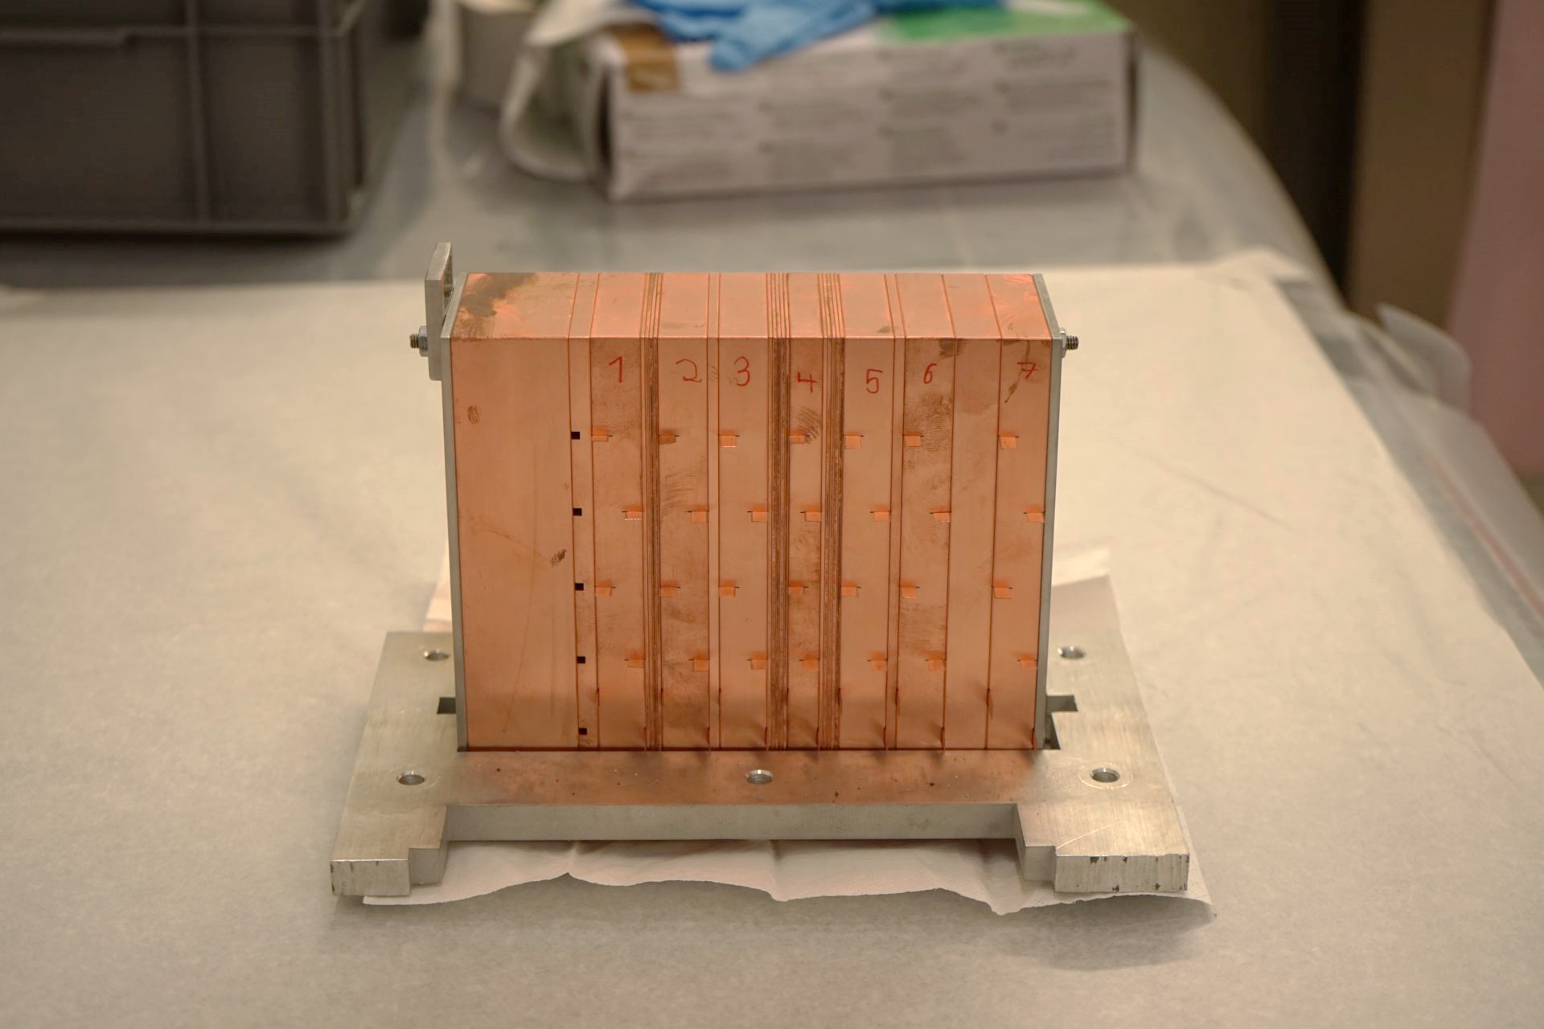
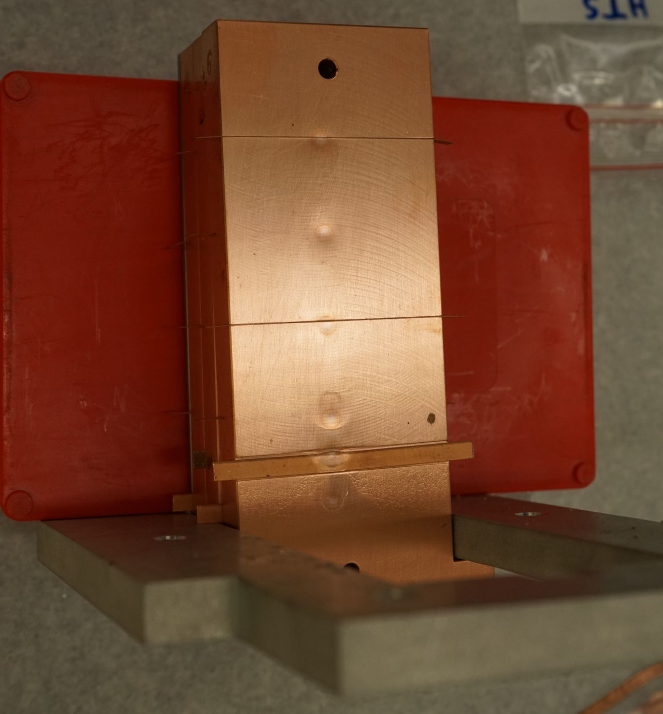
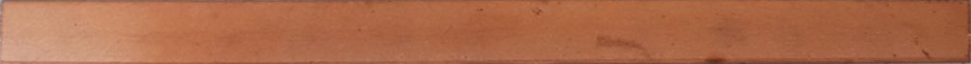
The HiRadMat-37 experiment
HTS samples holder
6 batches of 7 samples
HTS samples holder after beam impact
HTS tape
Dimensions:
  Length: 60mm
  Width: 4mm
  Thickness: 0.2mm
S1
S2
S3
S4
S5
S6
S7
B1
B2
B3
Horizontal tape: Batch 1 - 4
B4
B5
B6
Vertical tape: Batch 5 - 6

Slide 10
HiRadMat-37: Post-beam-impact analysis
Study physical characteristics during the experiment
Beam position
Beam size
Beam intensity
Temperature inside the cryostat
Determination of thermal conditions reached in the tapes
Monte Carlo simulation
Energy → Temperature
Hotspot and gradient
HiRadMat-37
Tapes impacted
Tapes removed from the sample holder
First visual inspection
Study superconducting characteristics degradation
Measurement of critical current at the University of Geneva
Comparison and analysis
Assessment of damage mechanisms and quantitative analysis of damage limits

Slide 11
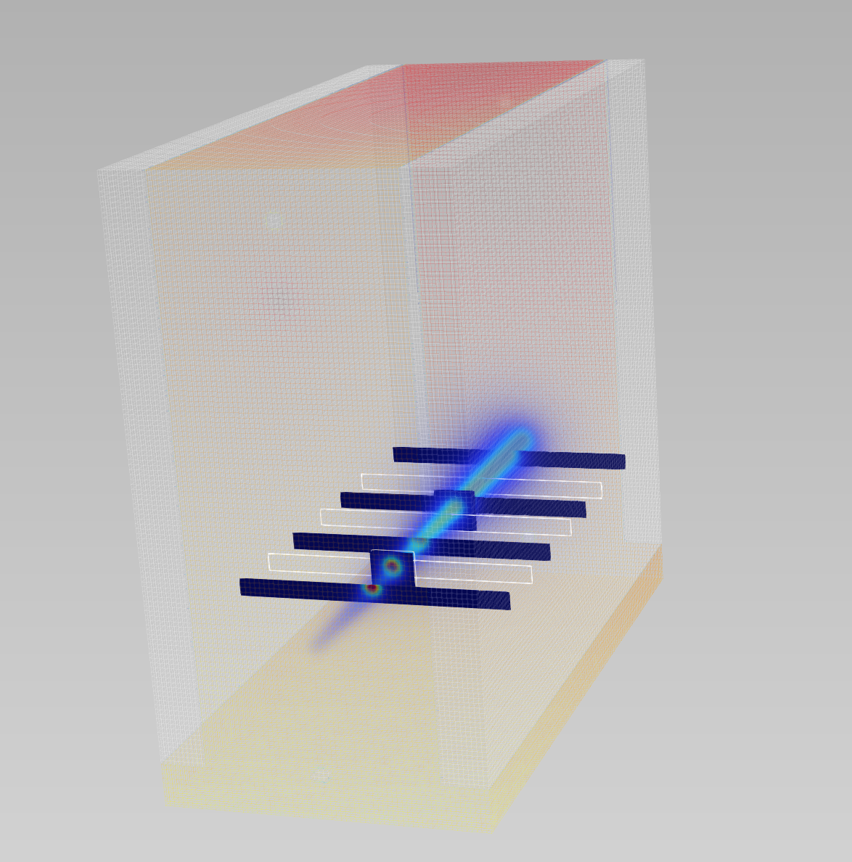
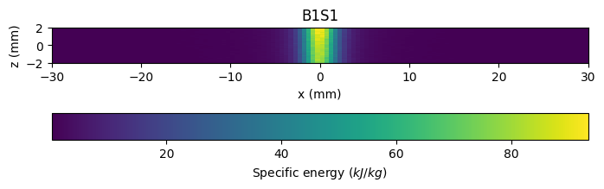
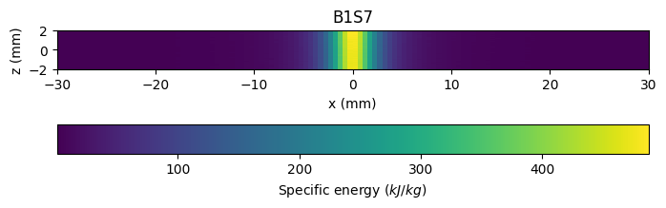
HiRadMat-37: Monte Carlo simulation

Slide 12
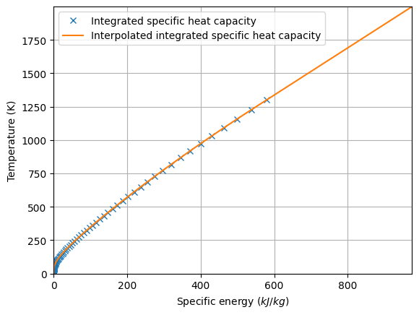
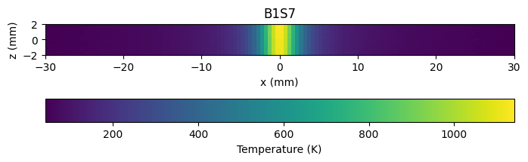
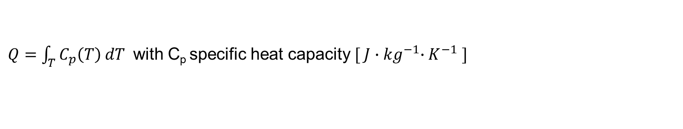
HiRadMat-37: Monte Carlo simulation
From specific energy to temperature
$Q=\int_{T}^{ }{C_{p}\left(T\right) dT}$ with C_{p} specific heat capacity $[ J{∙kg}^{−1}{∙K}^{−1} ]$

Slide 13
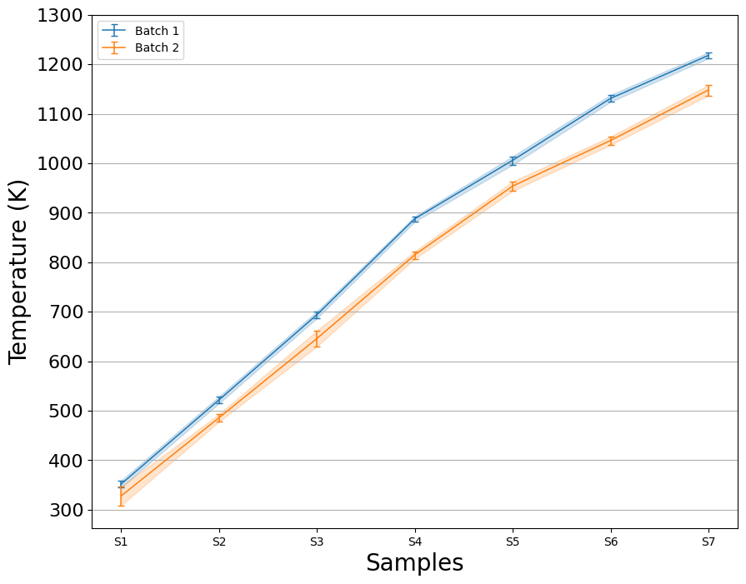
HiRadMat-37: Monte Carlo simulation
Hotspot values for Batch 1 and Batch 2
Sample | Hotspot Temperature | Relative error
Sample ID | [K] | - | +
B1S1 | 352 | 1.99% | 1.99%
B1S2 | 522 | 1.34% | 1.34%
B1S3 | 694 | 1.01% | 1.01%
B1S4 | 888 | 0.68% | 0.56%
B1S5 | 1006 | 0.89% | 0.80%
B1S6 | 1131 | 0.62% | 0.62%
B1S7 | 1218 | 0.49% | 0.49%
B2S1 | 328 | 5.79% | 5.79%
B2S2 | 486 | 1.65% | 1.44%
B2S3 | 646 | 2.48% | 2.48%
B2S4 | 815 | 0.98% | 0.86%
B2S5 | 954 | 1.05% | 0.94%
B2S6 | 1046 | 0.86% | 0.76%
B2S7 | 1148 | 0.96% | 0.87%

Slide 14
HiRadMat-37: Post-beam-impact analysis
Study physical characteristics during the experiment
Beam position
Beam size
Beam intensity
Temperature inside the cryostat
Determination of thermal conditions reached in the tapes
Monte Carlo simulation
Energy → Temperature
Hotspot and gradient
HiRadMat-37
Tapes impacted
Tapes removed from the sample holder
First visual inspection
Study superconducting characteristics degradation
Measurement of critical current at the University of Geneva
Comparison and analysis
Assessment of damage mechanisms and quantitative analysis of damage limits

Slide 15
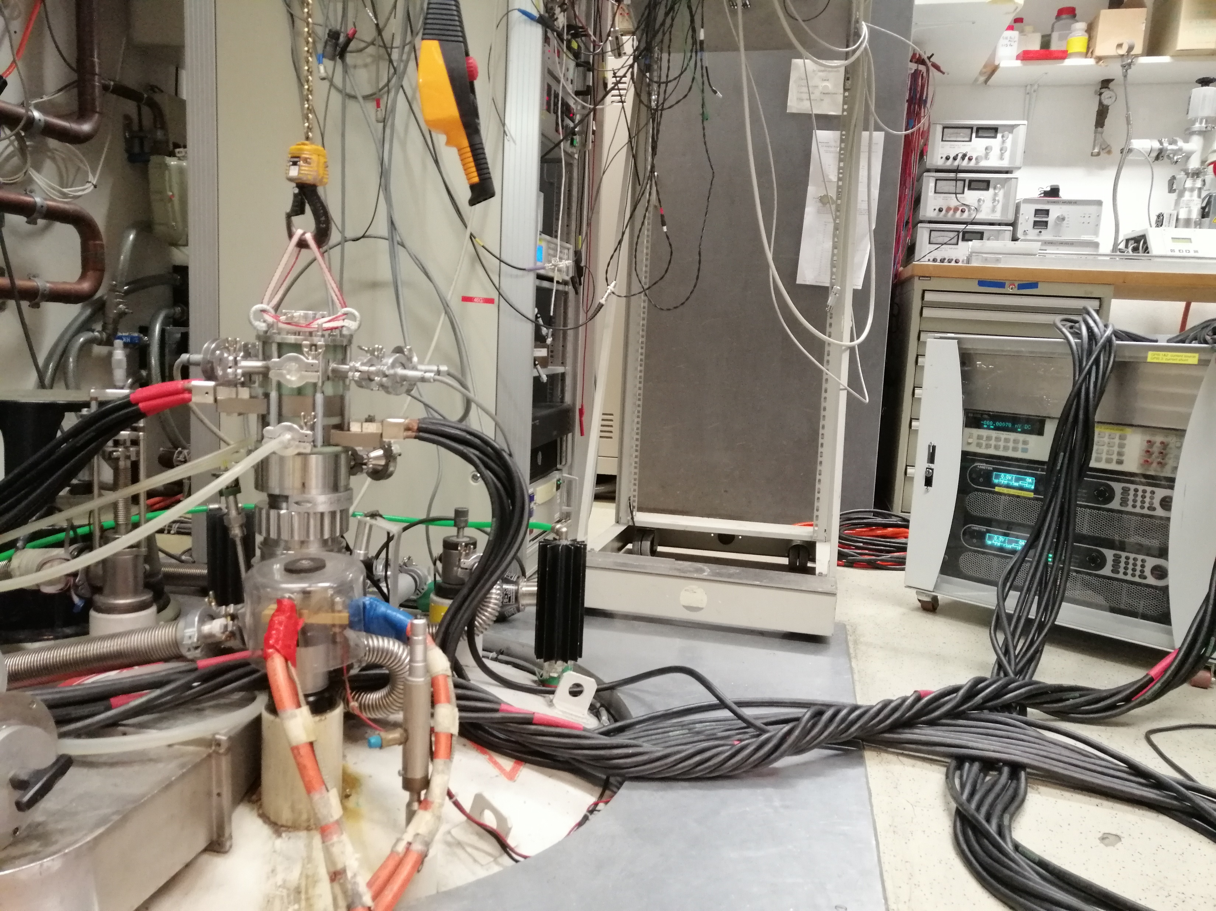
Critical current measurement
Setup of the University of Geneva Lab
Removable tube on which the sample is fixed
Current supply
Electro-magnet
for the external magnetic field
Cryostat with liquid helium:
Measure at 4K or 77K

Slide 16
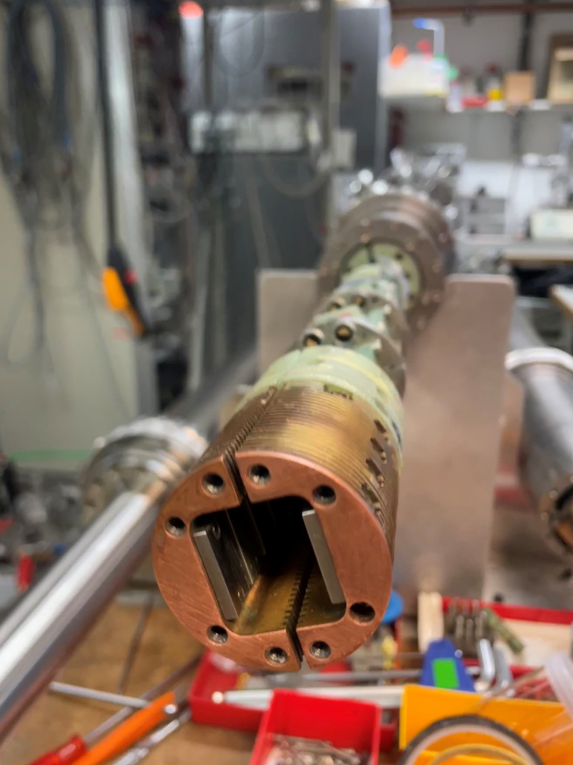
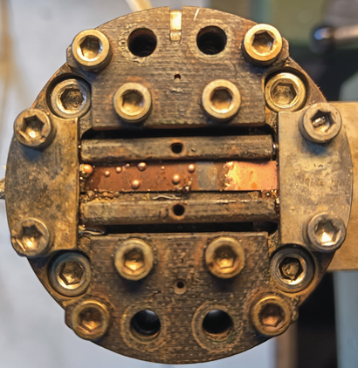
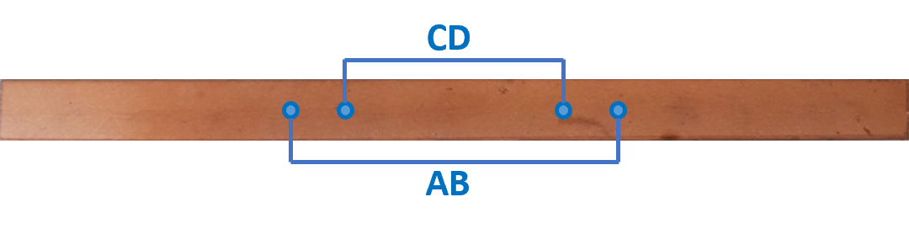
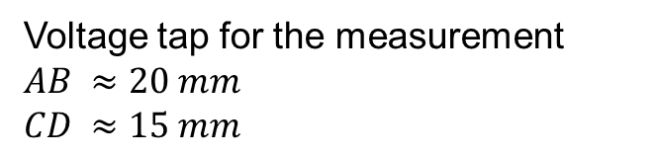


Critical current measurement
Removable tube on which the sample is fixed via the sample holder
Sample holder
$$I$$
HTS tape
$$I$$
Voltage tap for the measurement
$$AB ≈20 mm$$
$$CD ≈15 mm$$

Slide 17
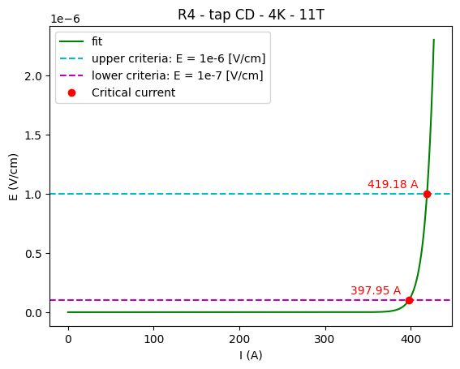
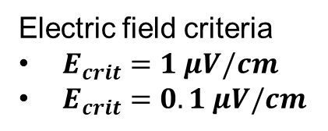
Critical current measurement
Critical current determination
Measured samples
Qualification samples | Batch 1 | Batch 2
R1 | B1S1 | B2S1
R2 | B1S2 | B2S2
R3 | B1S3 | B2S3
R4 | B1S4 | B2S4
 | B1S5 | B2S5
 | B1S6 | B2S6
 | B1S7 | B2S7
Measured
Not measured
Stuck in samples holder
Electric field criteria
$E_{crit}=1 μV/cm$
$E_{crit}=0.1 μV/cm$

Slide 18
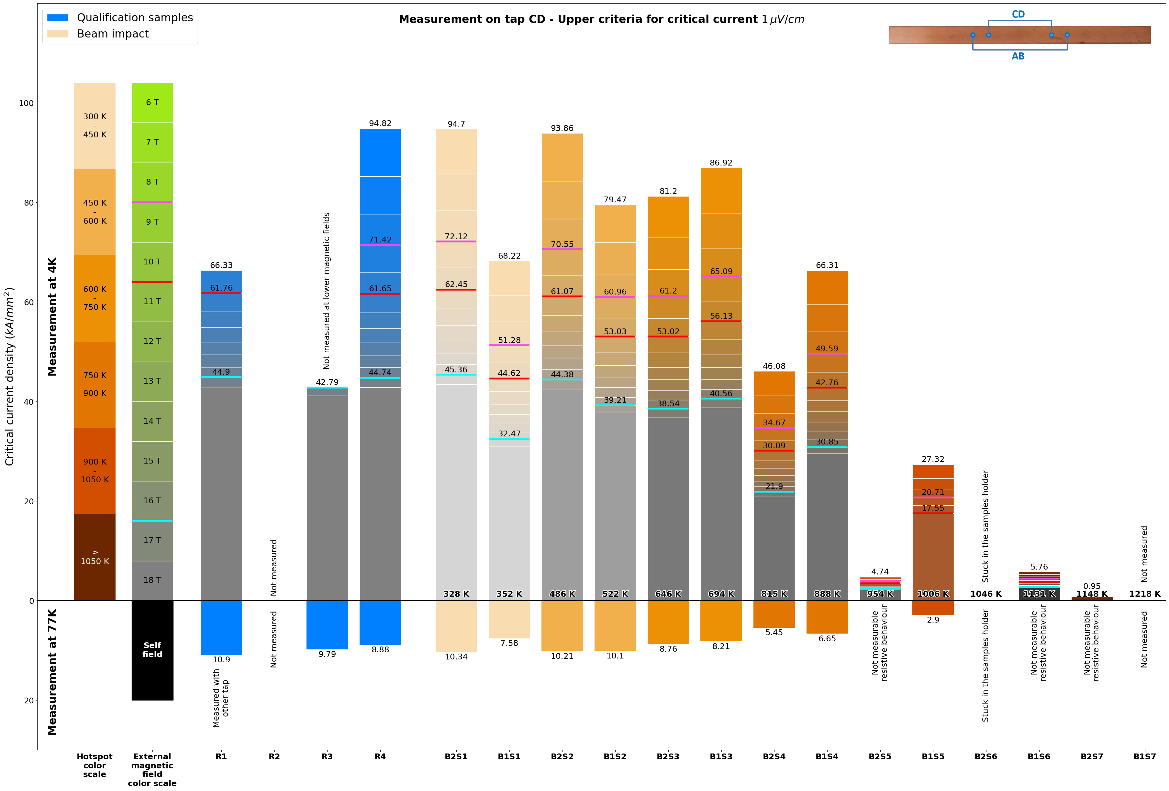
Critical current measurement

Slide 19
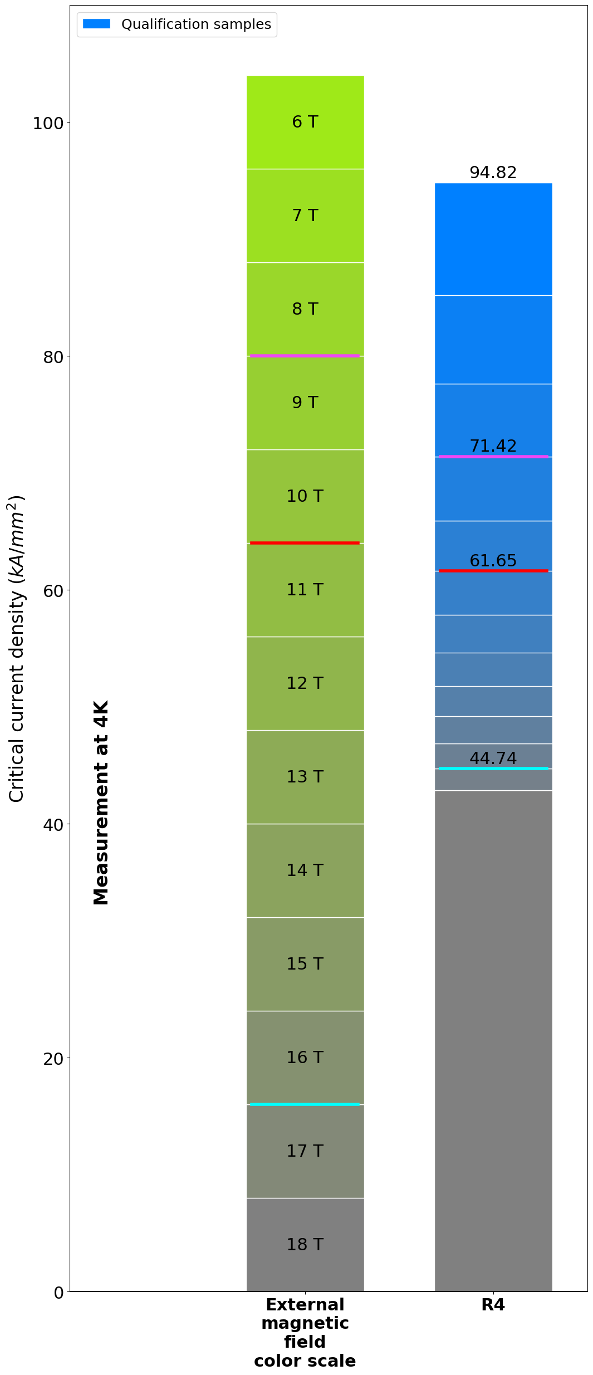
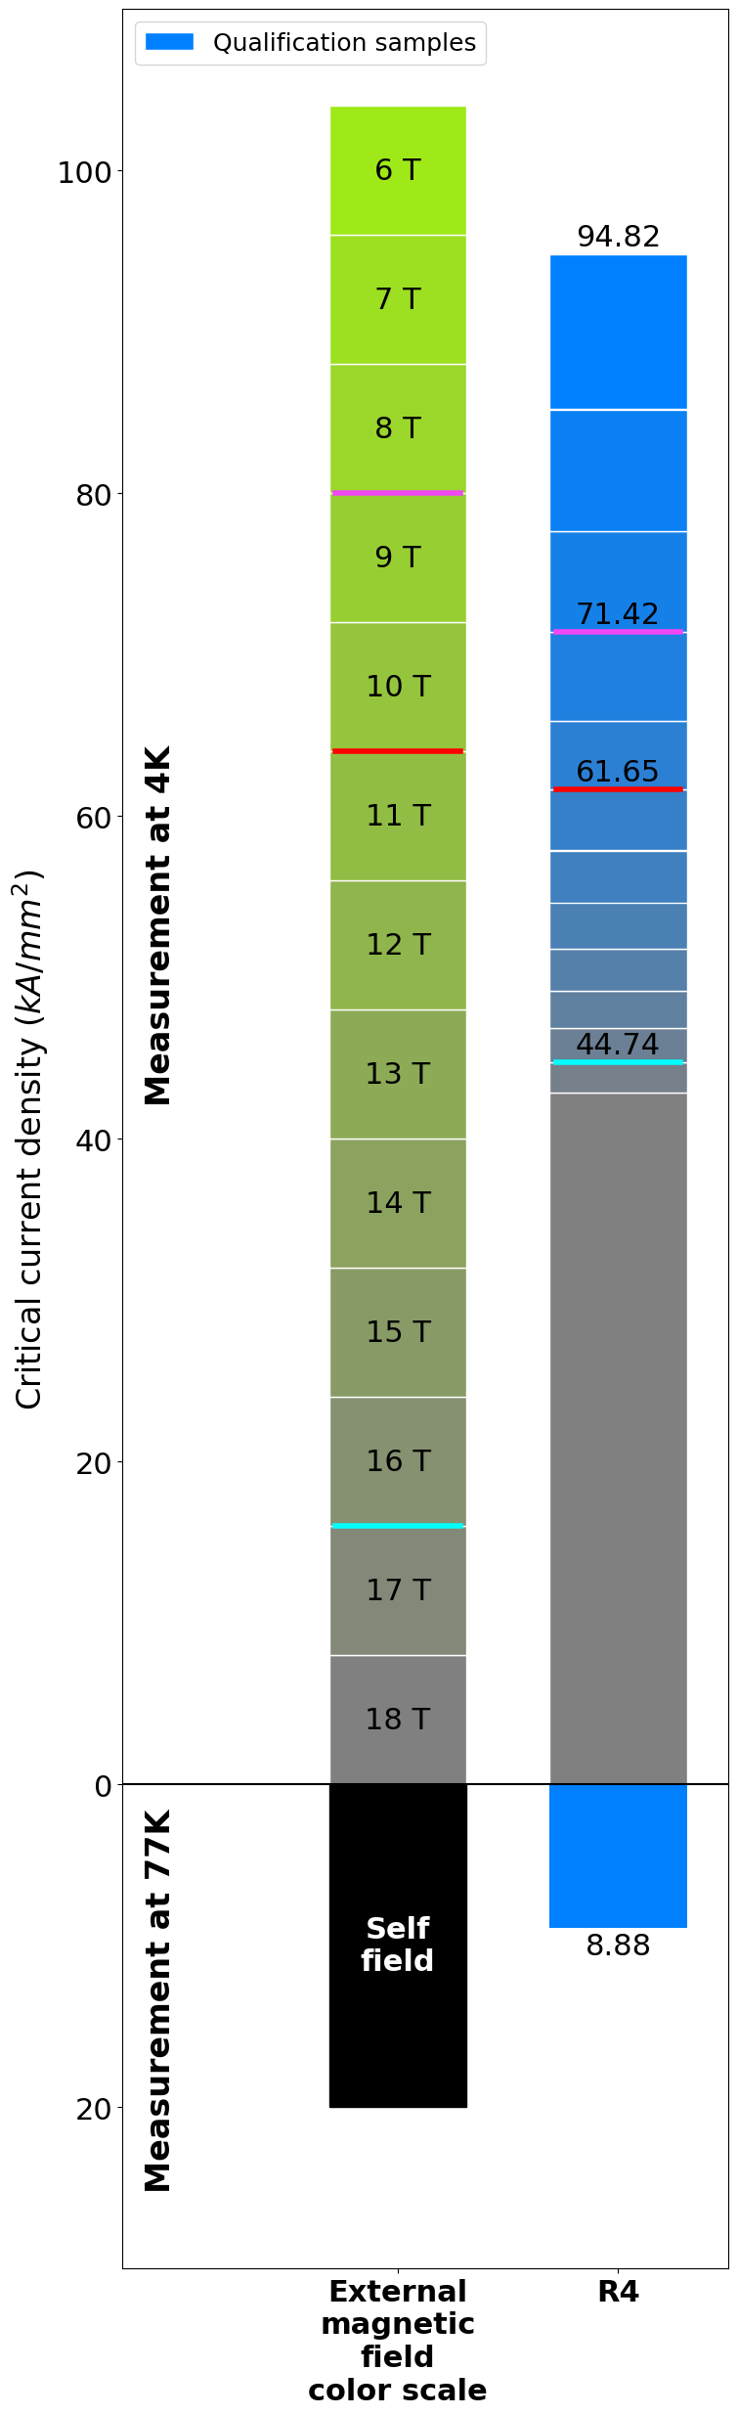
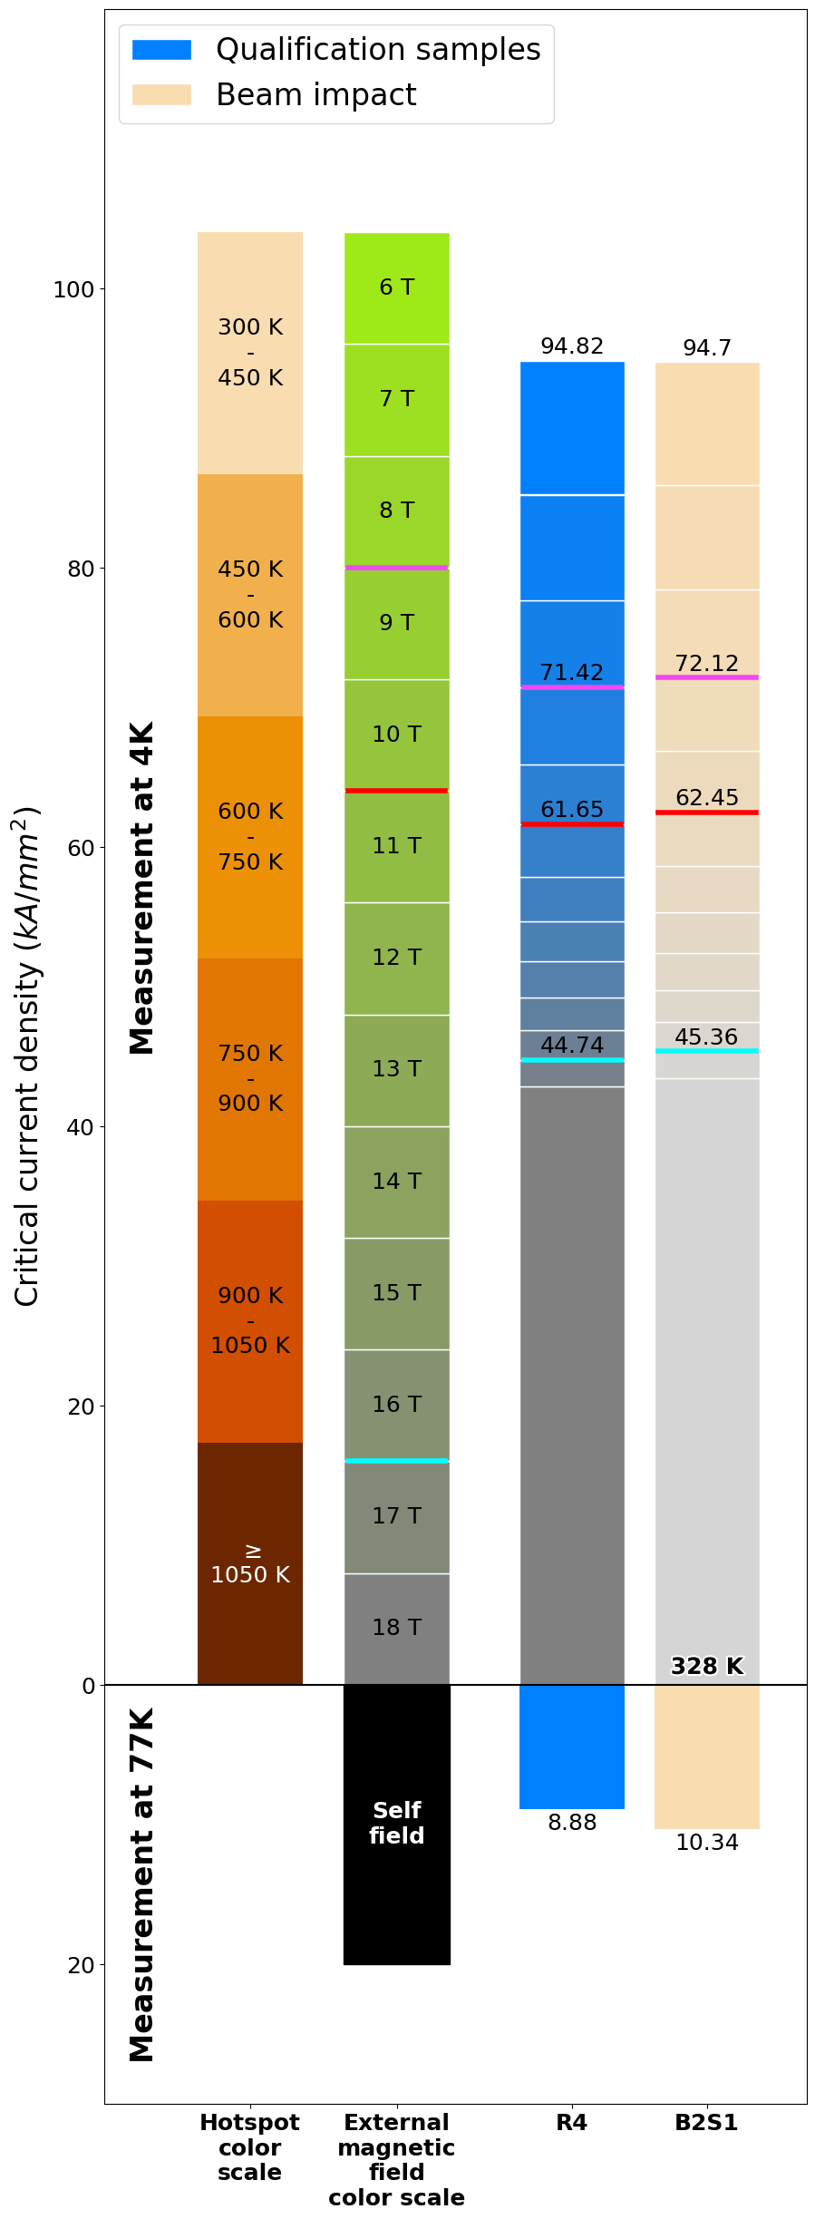
Critical current measurement

Slide 20
Critical current measurement
> 700-800 K
> 900-1000 K

Slide 21
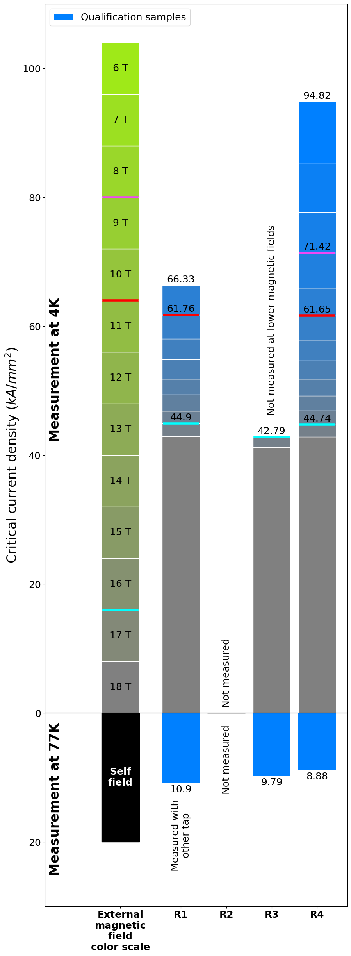
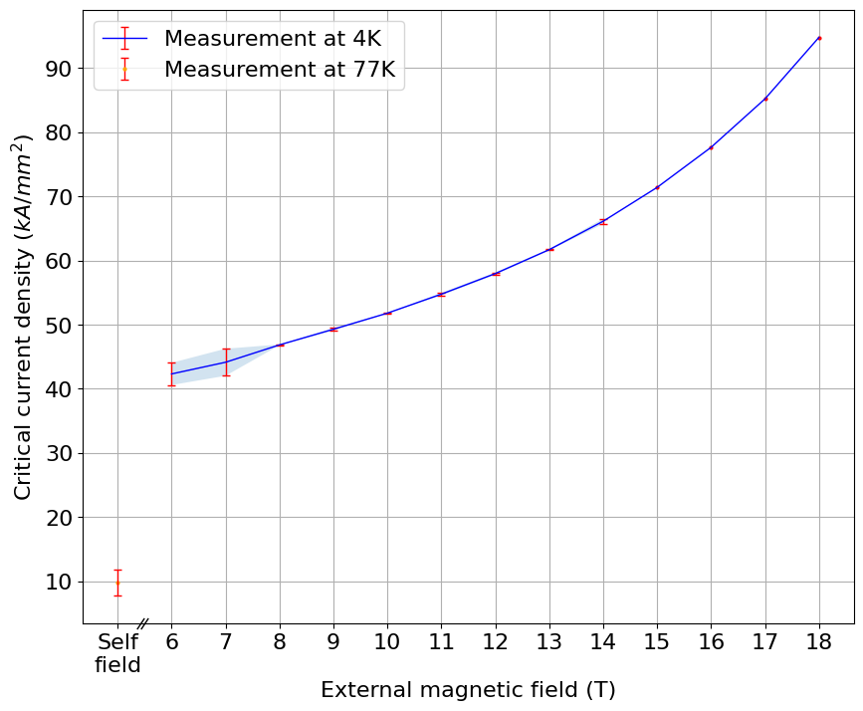
Critical current measurement
Critical current density values of the qualification samples
Larger deviation value
± 2 kA/mm²

Slide 22
Critical current measurement
Minor degradation
Bad quality? Other damage mechanisms?
No degradation
Two steps of degradation
B1 ≠ B2 → Mechanical damage ?
Broken

Slide 23
HiRadMat-37: next steps
Mechanical analysis
Critical current measurement
  Batch 3 and 4: increase size of available dataset
  Batch 5 and 6: to allow comparison with “horizontal tapes”

Slide 24
Outline
Overview and motivations
The HiRadMat-37 experiment: beam-induced heating on HTS tapes
Capacitive current discharge heating experiment
Conclusions and next steps

Slide 25
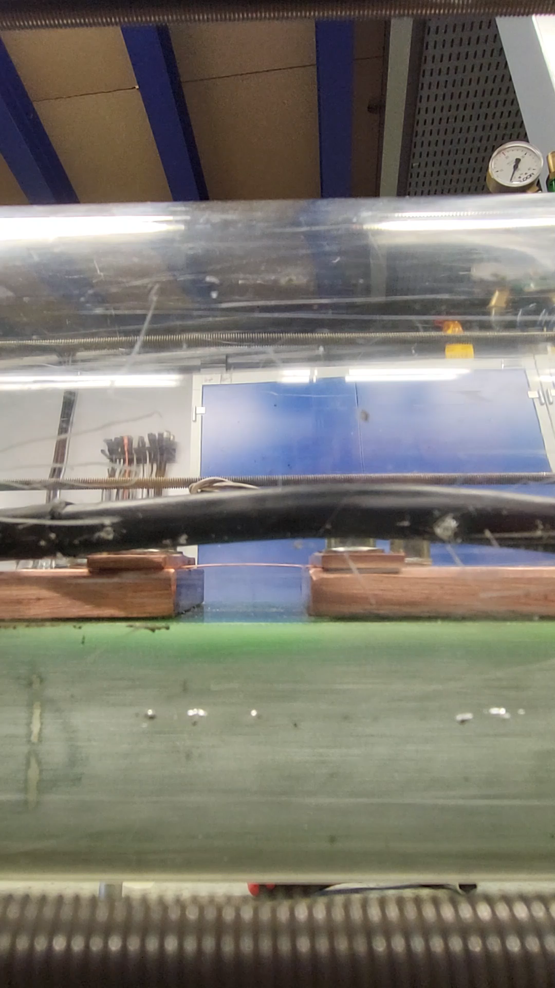
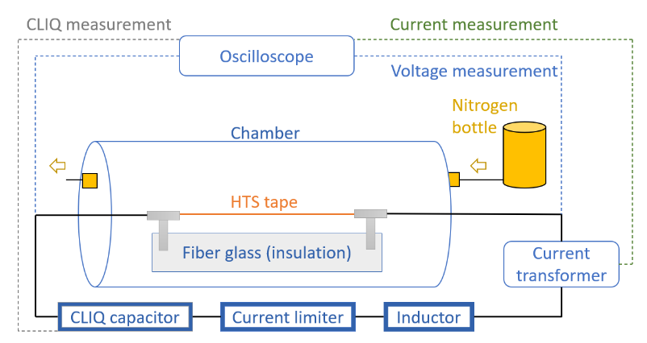
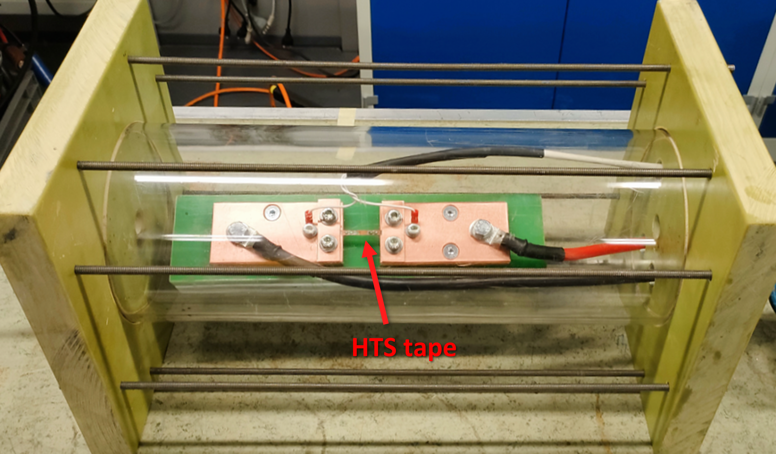
Capacitive current discharge heating experiment
Hundreds of milliseconds heating damage on HTS tape
No significant mechanical effect on the tape
Experimental setup
Courtesy W. Sorensen

Slide 26


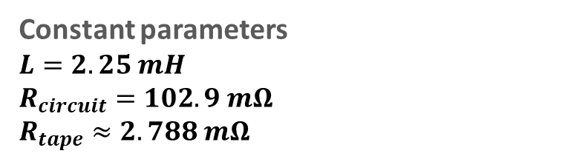



Capacitive current discharge heating experiment
$$C$$
Equivalent electric circuit
$$V_{C}$$
Constant parameters
$L=2.25 mH$
$R_{circuit}=102.9 mΩ$
$R_{tape}≈2.788 mΩ$
$$R_{circuit}$$
$$L$$
$$R_{tape}$$
Determination of the variable circuit parameters based on target temperatures
Samples | Target | CLIQ Parameters |  | Simulated maximum values
 | Temperature (K) | V_{C} (V) | C (mF) | Temperature (K) | Current (A) | Short current(A)
R1 | 420 | 200 | 30 | 415.7 | 549.5 | 552.6
B1S1 | 500 | 300 | 20 | 494.4 | 706.9 | 710.3
B1S2 | 600 | 500 | 10 | 603.1 | 890.9 | 894.1
B2S1 | 640 | 300 | 30 | 638.8 | 824.2 | 828.9
B2S2 | 740 | 400 | 20 | 732.7 | 942.4 | 947
R4 | 820 | 300 | 40 | 816.5 | 914.4 | 920.3
R2 | 1040 | 300 | 50 | 1037.1 | 988 | 995
Courtesy W. Sorensen

Slide 27
Capacitive current discharge heating experiment
Validation of modelling hypotheses
Tape resistance
Thermal mechanisms modelling
Evaluation of uncertainties
Determination of thermal conditions reached by the tapes
Heat generated inside the tape
Heat → Temperature
Discharge experiment
Results of the design-stage simulations
Current and voltage measurements during the experiment
Study of critical current degradation
Measurements of critical current at the University of Geneva
Comparison and analysis
Assessment of damage mechanisms and quantitative analysis of damage limits

Slide 28
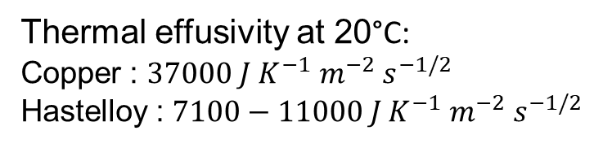
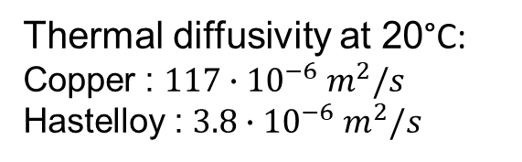
Modelling hypotheses
Heat flow during the experiment
Q
Thermal diffusivity at 20°C:
Copper : $117∙{10}^{−6}{ m}^{2}/s$
Hastelloy : $3.8∙{10}^{−6}{ m}^{2}/s$
Thermal diffusivity = Speed of the heat transfer on a material
→ Heat produced in the tape remains in the tape due to the low Hastelloy thermal diffusivity
Thermal effusivity at 20°C:
Copper : $37000 J{ K}^{−1}{ m}^{−2}{ s}^{−1/2}$
Hastelloy : $7100−11000 J{ K}^{−1}{ m}^{−2}{ s}^{−1/2}$
Thermal effusivity = Speed of the heat absorption of a material
→ Copper clamps absorb the heat produced in the contact region

Slide 29
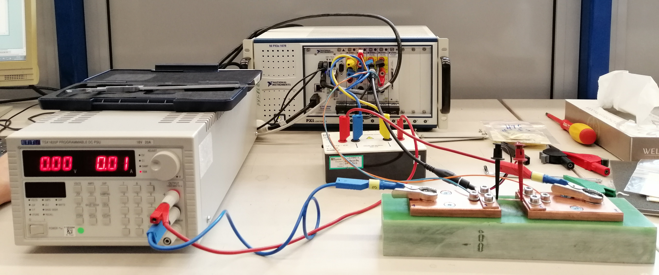
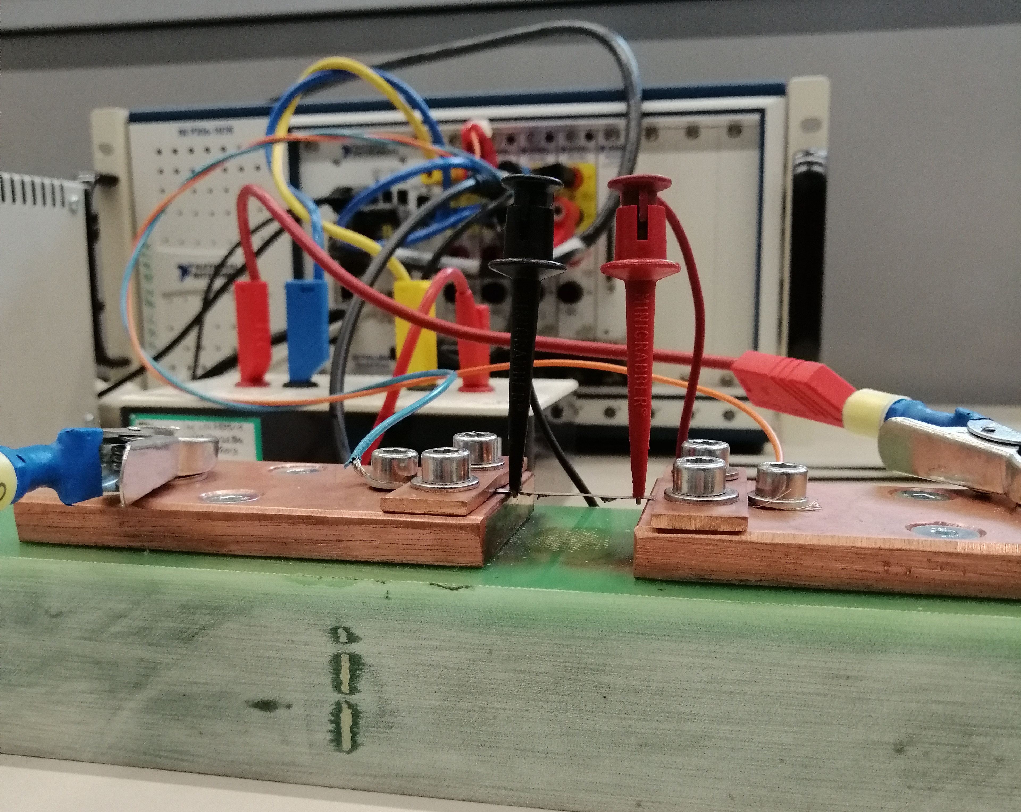
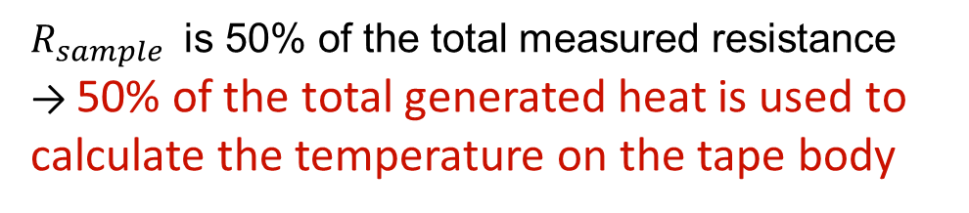



Modelling hypotheses
I
Resistance of the tape
and contacts
I
$$V_{contact −}$$
$$V_{sample}$$
$$V_{contact +}$$
$R_{sample}$ is 50% of the total measured resistance
→ 50% of the total generated heat is used to calculate the temperature on the tape body

Slide 30
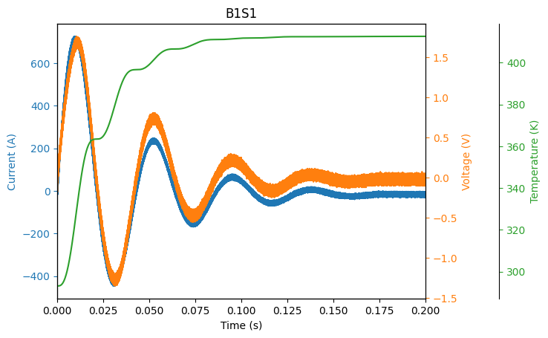
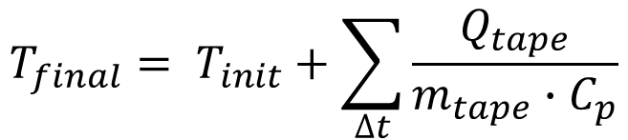
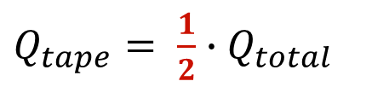

Measurement analysis
$$Q_{total}= V∙I∙ ∆t$$
$Q_{tape}= \frac{1}{2}∙$ $Q_{total}$
$$T_{final}= T_{init}+\sum_{∆t}{\frac{Q_{tape}}{m_{tape}∙C_{p}}}$$

Slide 31
Measurement analysis
Results of the experiment
Samples | Target | CLIQ Parameters |  | Simulated maximum values |  |  | Measured maximum value
 | Temperature (K) | V_{C} (V) | C (mF) | Temperature (K) | Current (A) | Short current(A) | Temperature (K) | CLIQ current(A) | Rog current (A) | Tape voltage (V)
R1 | 420 | 200 | 30 | 415.7 | 549.5 | 552.6 | 363 | 553.7 | 585 | 1.2
B1S1 | 500 | 300 | 20 | 494.4 | 706.9 | 710.3 | 412 | 713.9 | 725.6 | 1.8
B1S2 | 600 | 500 | 10 | 603.1 | 890.9 | 894.1 | 481 | 930.2 | 964.4 | 2.3
B2S1 | 640 | 300 | 30 | 638.8 | 824.2 | 828.9 | 540 | 832.5 | 886.2 | 2.9
B2S2 | 740 | 400 | 20 | 732.7 | 942.4 | 947 | 602 | 959.5 | 1013 | 3.4
R4 | 820 | 300 | 40 | 816.5 | 914.4 | 920.3 | 681 | 910.6 | 983.9 | 3.8
R2 | 1040 | 300 | 50 | 1037.1 | 988 | 995 | 1079 | 974.1 | 1072 | 10
Hotspot values lower than the target values but still relevant to analyse the degradation of the HTS tapes critical current

Slide 32
Capacitive current discharge heating experiment
Validation of modelling hypotheses
Tape resistance
Thermal mechanisms modelling
Evaluation of uncertainties
Determination of thermal conditions reached by the tapes
Heat generated inside the tape
Heat → Temperature
Discharge experiment
Results of the design-stage simulations
Current and voltage measurements during the experiment
Study of critical current degradation
Measurements of critical current at the University of Geneva
Comparison and analysis
Assessment of damage mechanisms and quantitative analysis of damage limits

Slide 33
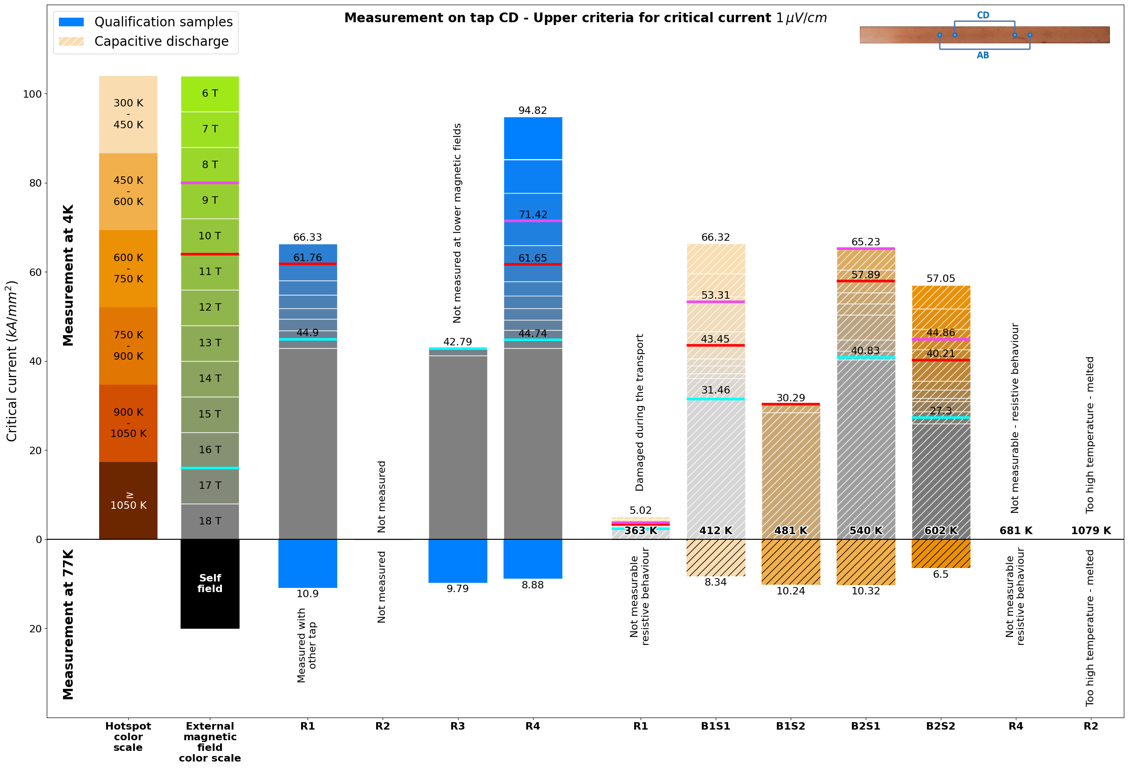
Critical current analysis
No degradation
Completely degraded → transport issue
Minor degradation
Issue during measurement ?
Broken
No degradation

Slide 34
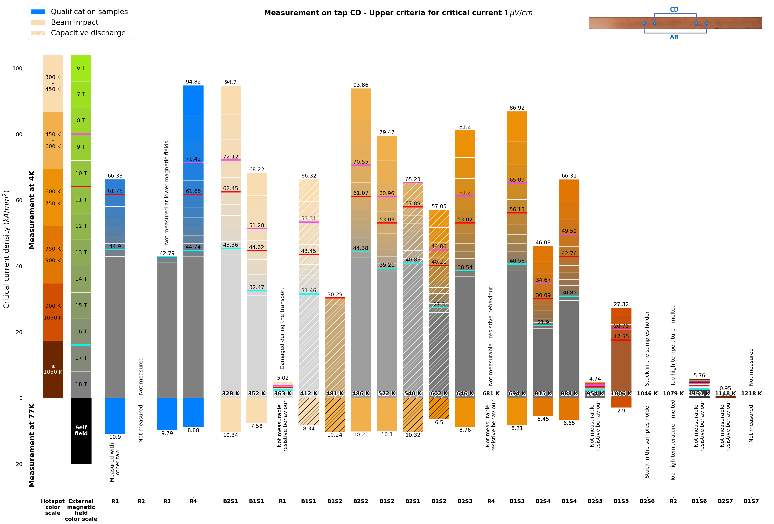
Critical current analysis

Slide 35
Outline
Overview and motivations
The HiRadMat-37 experiment: beam-induced heating on HTS tapes
Capacitive current discharge heating experiment
Conclusions and next steps

Slide 36
Conclusion and next steps
The HiRadMat-37 experiment
  Two approximate threshold temperatures for critical current degradation → Performing I_{C} measurements on the remaining batches is required to draw definitive conclusions
  Possible mechanical effect to explain the observed degradation → Analysis to be done using ANSYS simulation
Capacitive current discharge heating experiment
  Interesting experiment to allow a comparison of time scale and with less mechanical effect
  Lots of external factors lead to big uncertainties on the values of critical current after the experiment → Good learning for further experiments: Minimize the dependency factors
Results based on detailed analysis of I_{C} variations (pre-irradiation, post-irradiation, post-discharge)

Slide 37
Thanks for your attention

Slide 38
HiRadMat-37: Post-beam-impact analysis
Batch | Beam intensity | x offset position | y offset position
B1 | 3.15e+12 | -1.12 mm | -0.11 mm
B2 | 3.06e+12 | -1.17 mm | -0.08 mm
B3 | 3.08e+12 | -1.26 mm | -0.08 mm
B4 | 3.10e+12 | -1.16 mm | -0.02 mm
B5 | 3.16e+12 | -1.27 mm | -0.07 mm
B6 | 3.05e+12 | -1.36 mm | -0.01 mm
y
S1
S2
S3
S4
S5
S6
S7
B1
B2
B3
B4
B5
B6
z
Beam intensity slightly different for the different batches
Offset along axis x due to misalignment of the sample holder
Offset along axis y can be due to different reasons*
x
* More details in Internal note: Beam Impact on Superconductor short samples of Nb3Sn, Nb-Ti and YBCO, https://edms.cern.ch/document/2068064/1

Slide 39
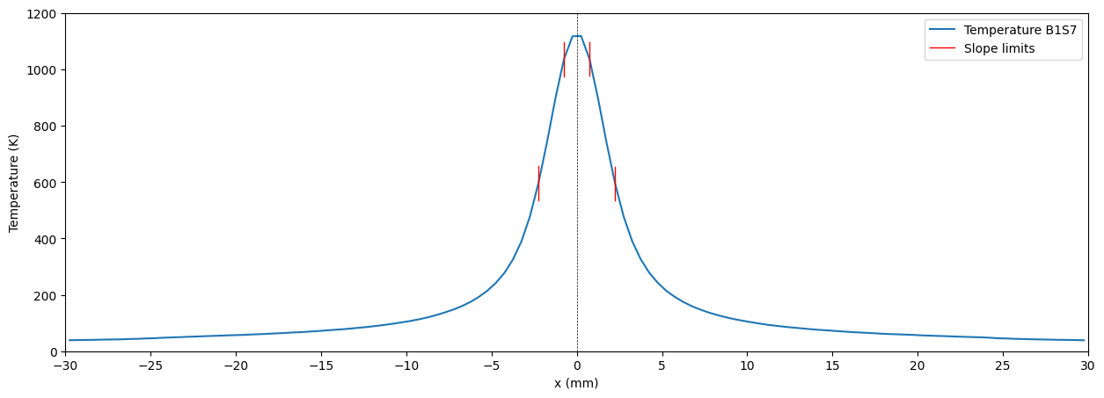
HiRadMat-37: Monte Carlo simulation
Temperature gradient along x axis

Slide 40
HiRadMat-37: Monte Carlo simulation
Sample | Hotspot Temperature | Temperature gradient
Sample ID | Hotspot Temperature | Negative x | Positive x
 | [K] | [K/mm] | [K/mm]
B1S1 | 352 | 89.15 | 88.32
B1S2 | 522 | 135.02 | 134.83
B1S3 | 694 | 182.76 | 179.36
B1S4 | 888 | 231.68 | 227.65
B1S5 | 1006 | 259.01 | 255.55
B1S6 | 1131 | 279.76 | 278.48
B1S7 | 1218 | 295.88 | 296.38
B2S1 | 328 | 83.3 | 83.83
B2S2 | 486 | 124.96 | 125.25
B2S3 | 646 | 166.5 | 167.77
B2S4 | 815 | 182.92 | 183.78
B2S5 | 954 | 241.89 | 241.55
B2S6 | 1046 | 263.52 | 263.02
B2S7 | 1148 | 277.86 | 279.68

