Slide 1


CERN OSPO OSSC
Software @CERN
Victoria Huisman Sigcha
hello.victoria@outlook.ie
22 OCTOBER 2024

Slide 2

VHS presenting.
12-months tech. student @CERN
Fruit of labour …
the OSPO logo
OSPO promo. Material
OSPO catalogue
Thanks for being here. ☺
🇧🇷
🇪🇨
🇳🇱

Slide 3
AGENDA for today.
01
02
03
background
details
conclusion
Brief reminder of the OSPO.
The design of the catalogue, in more detail.
Summary and answering questions.
CHEP2024
3

Slide 4
01
BACKGROUND
Axel Naumann spoke of the OSPO, 21 OCT.

Slide 5
WHO: CERN’S OSPO
PROJECT EXPOSURE
Embrace projects and bring attention to them – Be it soft- or hardware.
BEST PRACTICES
Train CERN’s community on best practices, tools, licenses, strategies…
DUE DILIGENCE
Facilitate due diligence on Open Source dissemination.
GUIDANCE & ADVICE
Provide guidance and recommendations on implementations.
CHEP2024
5

Slide 6
”… the OSPO is mandated to provide a catalogue of CERN’s open source that is accessible, and guide interested (external) parties to opportunities, projects, and experts through the public catalogue …”
CERN OSPO mandate
30/05/2023
CHEP2024
6

Slide 7
GOALS of the catalogue.
APPROACH
OBJECTIVE
Developing an public, searchable catalogue for CERN’s open-source software projects.
1
2
3
front-end
back-end
database
User-centred, accessible UI.
Simple to maintain, least effort.
Remains relevant for the long-term.
CHEP2024
7

Slide 8
02
DETAILS
What makes up the catalogue?

Slide 9
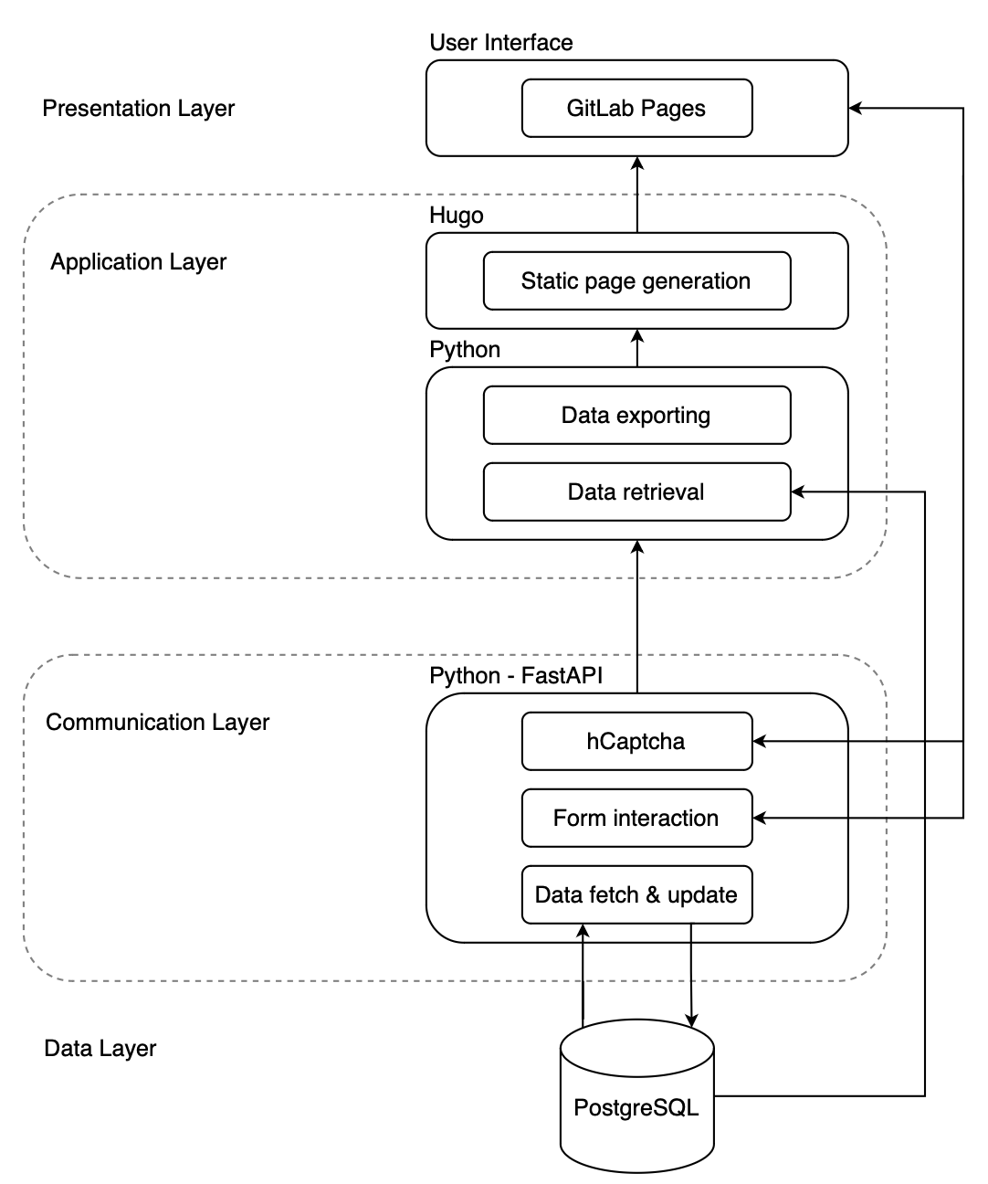
CATALOGUE overview
Complete
overview of
the catalogue.
CHEP2024
9

Slide 10

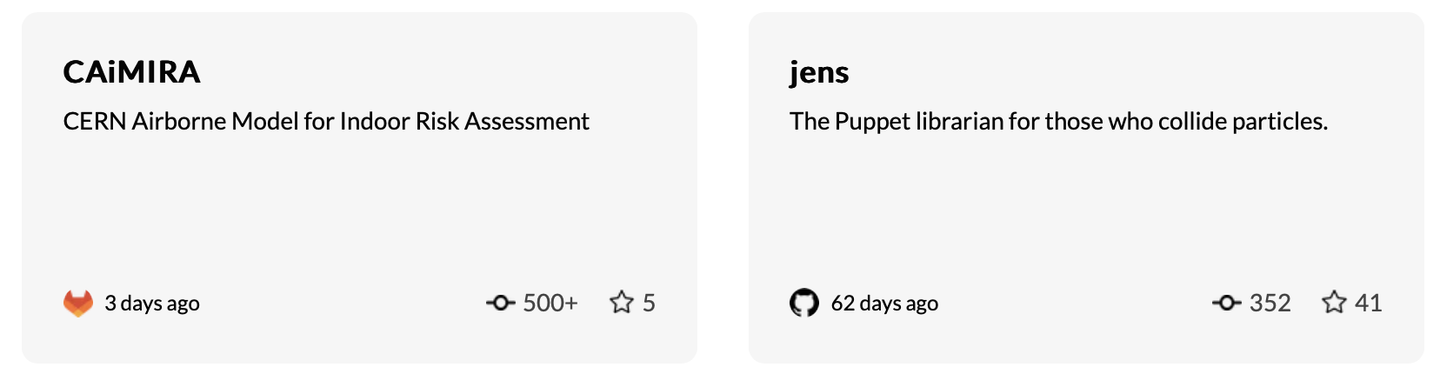
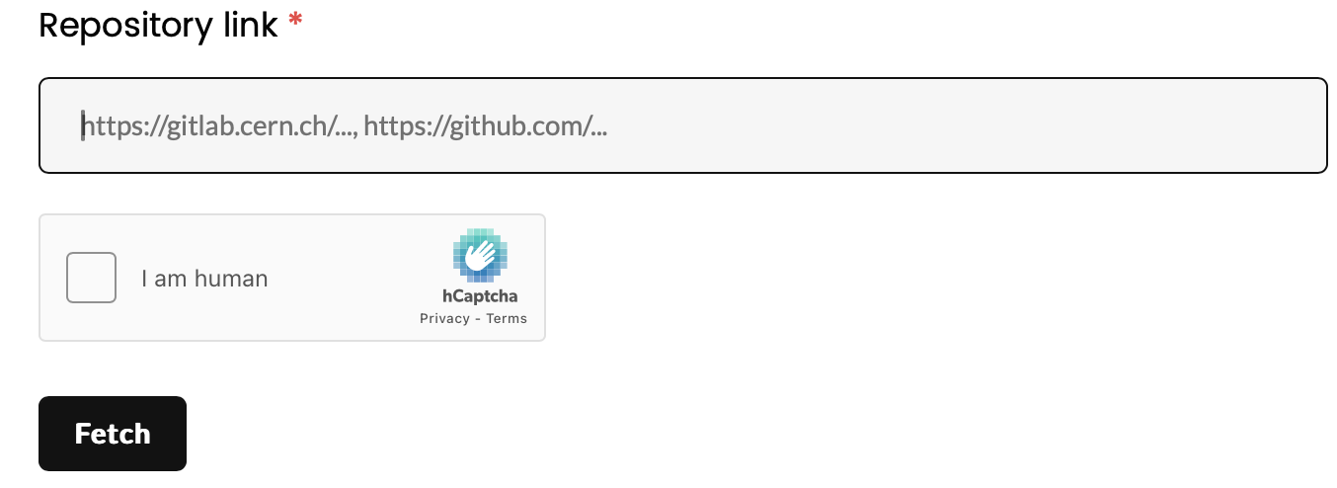
the FRONT-END
search, filter, tags
essential info.
OBJECTIVE
submission forms
content managing
Jupiter is a gas giant and the biggest planet in the Solar System
CHEP2024
10

Slide 11

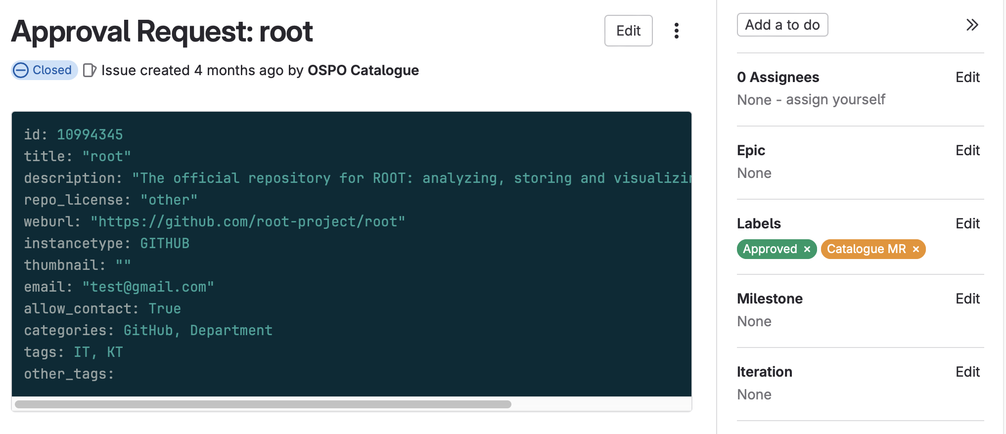
the ISSUE
>>
Project ready? Submit it!
An issue is created. The OSPO reviews it. And…
CHEP2024
11

Slide 12
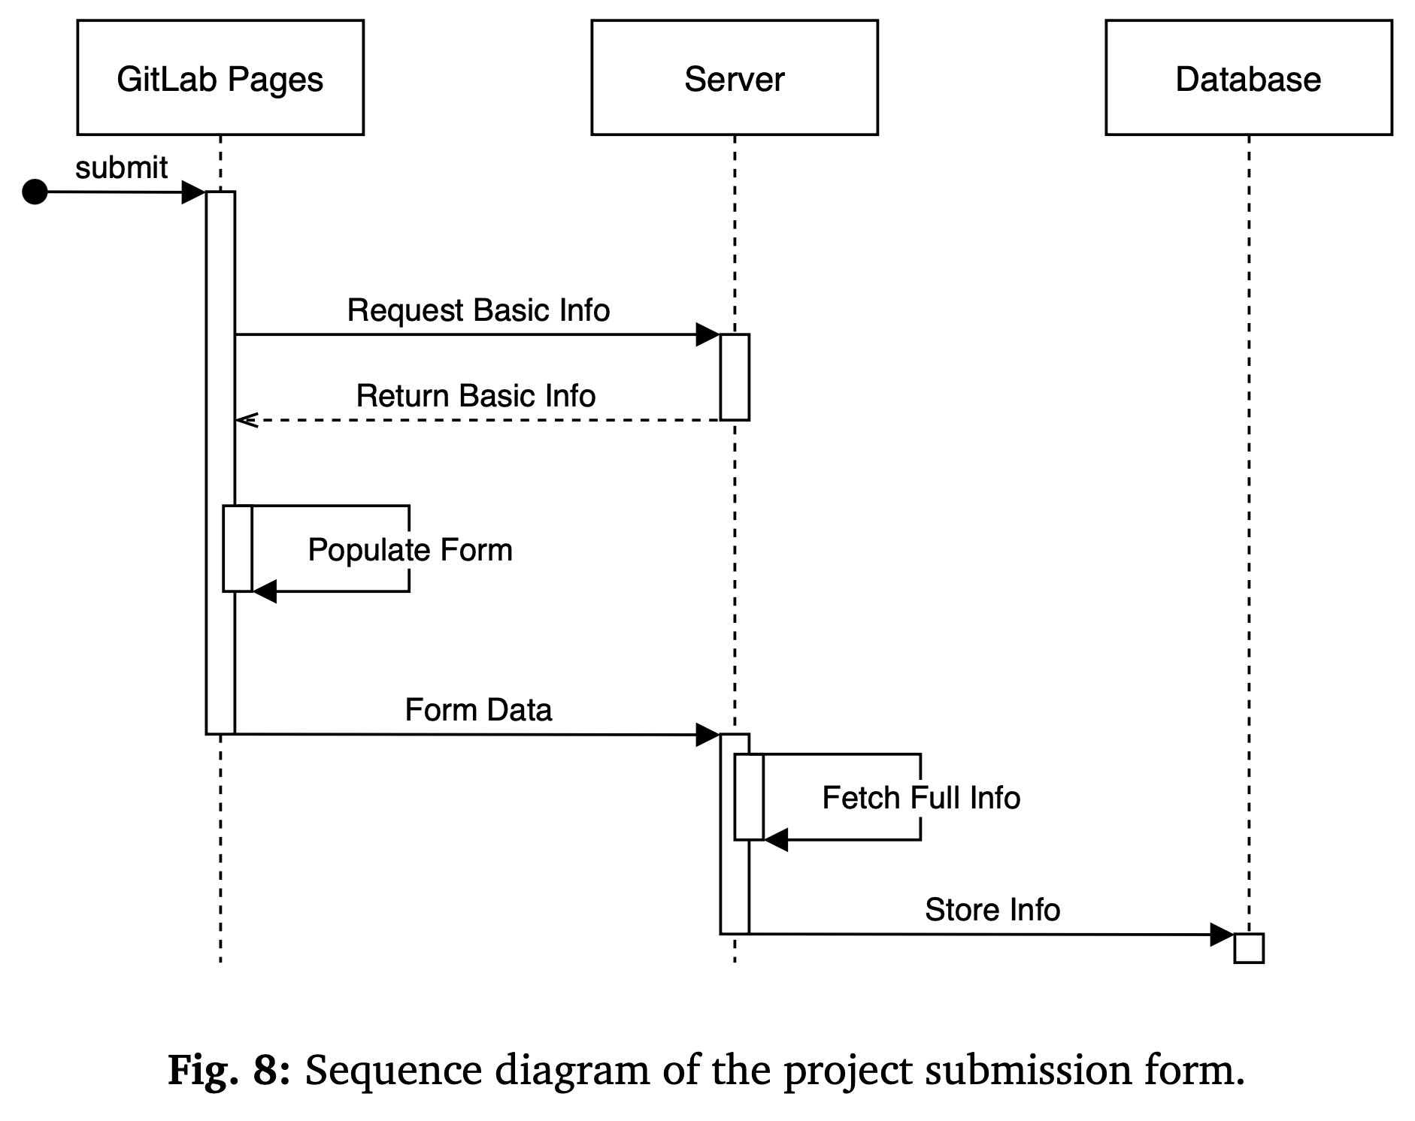
FRONT-END lifecycle
Fetching
information to-
and-from
database to a
static webpage.
CHEP2024
12

Slide 13
the BACK-END
1
API integration
Interactions between the client/UI and the API server.
2
GitLab & GitHub data handling
DataHandler classes for each instance required to retrieve and update any information for display.
3
usage of CI/CD
Pipelines help in keep code integrity and keep data fresh & up to date.
CHEP2024
13

Slide 14
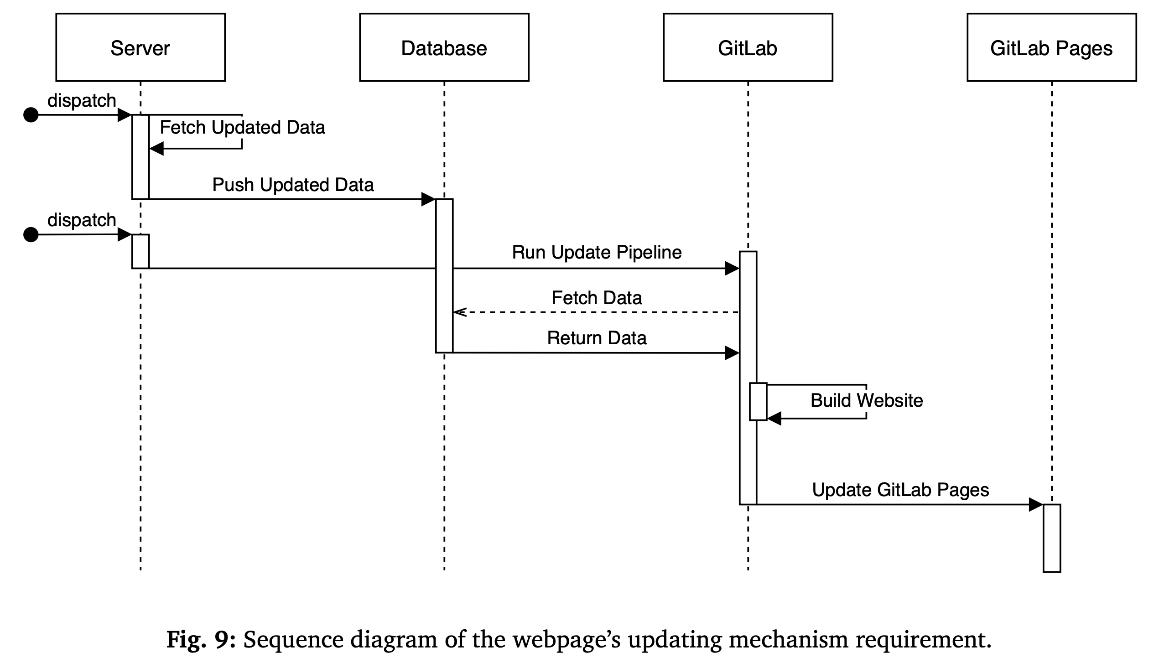
BACK-END lifecycle
Keeping all
information
on the catalogue
fresh & up-to-
date.
CHEP2024
14

Slide 15
03
CONCLUDING
Wrapping up, time for questions.

Slide 16
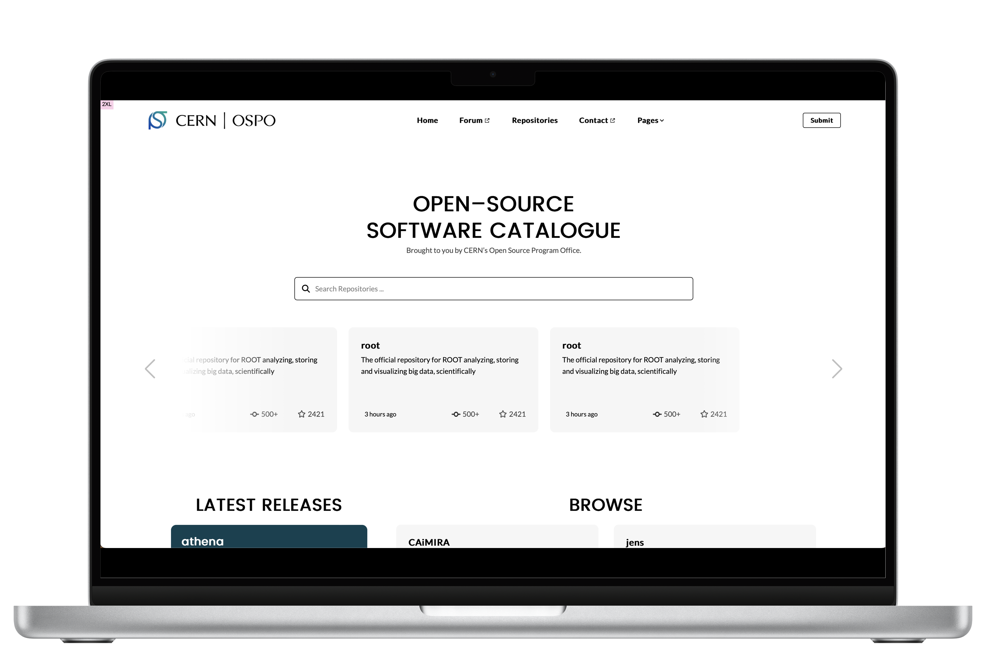
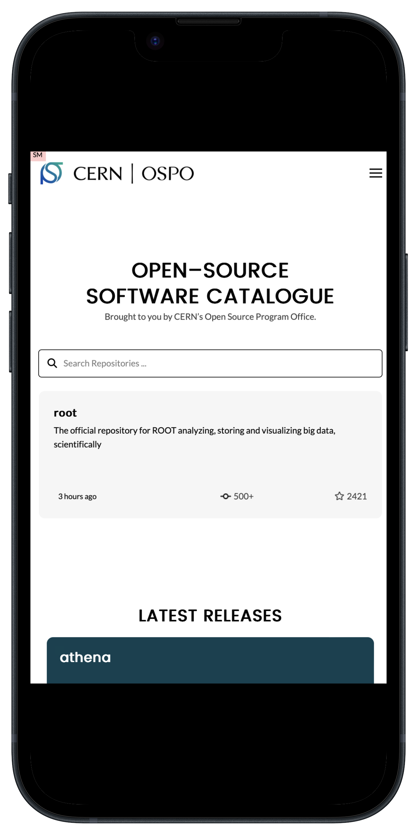
view on ANY DEVICE.
CHEP2024
16

Slide 17
what the catalogue IS
a.
A platform to bring exposure to your projects.
Consult the OSPO to get your project out there for the world to see.
b.
A place to find similar projects, to build collaboration.
Build a better idea together – multiple minds have infinitely more potential than one.
c.
A guide for external parties to find an interesting project.
To fund, to follow the development of, or to apply to their work.
CHEP2024
17

Slide 18
what the catalogue IS NOT
a.
A public library of all existing open-source in the world.
Made in CERN, for CERN. All projects go through the CERN OSPO.
b.
A holder of projects that exist in plentiful supply.
The OSSC holds criteria for the projects that could be uploaded.
c.
Version control platform.
Unlike GitHub or GitLab, the catalogue holds a copy (or card) of the source project.
CHEP2024
18

Slide 19
”… the OSPO is mandated to provide a catalogue of CERN’s open source that is accessible, and guide interested (external) parties to opportunities, projects, and experts through the public catalogue …”
CERN OSPO mandate
30/05/2023
CHEP2024
19

Slide 20
THANKS!
QUESTIONS?
… contact the CERN OSPO
Open.Source@cern.ch
https://opensource.web.cern.ch
OSPO forum (CERN log-in)
… contact me
hello.victoria@outlook.ie

