Slide 1



Comparative efficiency of (HEP) codes across languages and architectures
Sam Skipsey
with
Graeme Stewart, the JuliaHEP community

Slide 2
Performance Matters…
Suitability to language
Compiler performance
Accessibility of science goals
NetZero / Energy Efficiency
Depends on:
  Efficiency of algorithm
  Suitability to programming language
  Compiler / interpreter performance (optimisations)
  CPU features – SIMD extensions, cache hierarchy
Algorithm efficiency
CPU features (SIMD, cache width)

Slide 3
C++, Julia, (Python?)
Recently, most “performance” code in HEP has been written in C++
Other languages are available…
Julia seems to be a particularly good candidate for HEP
  “C21st Language features”
    (inferred) typing with rich expressive type system
    integrated package management
    post-Class-based “object orientation” models
  Performance [thanks to JIT] close to C, C++, Fortran
  Expressiveness close to (and sometimes better than) Python
I will assume you were convinced by the Plenary this morning…

Slide 4
Benchmarking @ GLA
For the past few years, Glasgow has been benchmarking systems as part of our energy efficiency goals.
Systems include [and also in production @ Glasgow], all Alma 9
X86
  H16 - 2x Intel Xeon 8-core E5-2630 v3 2.4GHz
  H17 - 2x Intel Xeon 10-core E5-2630 v4 2.2GHz
  D22 - 2x AMD EPYC 32-core 7513 2.6Ghz
ARM
  A23 – 2x Ampere Altra 80-core Q80-30 3.0GHz
  M24 - Ampere Altra Max 128-core M128-30 3.0GHz
RISC-V
  ….
No RISC-V target for Julia yet [in progress] so not tested here

Slide 5

CPU-bound trivial benchmarks – Julia²
Generate Julia set for the Newton’s(Raphson-Seki,et al) method convergence of x³ - 1 = 0 , over 10k x 10k grid of points.
Large array to also test allocations – bigger than stack size, penalises intermediate arrays and frequent dynamic array resizing.
Benchmarked code does not write to disk (not interested in IO benching)
No “clever” optimisations, just idiomatic code.

Slide 6
CPU-bound trivial benchmarks
x64, C more performant
ARM, Julia more performant!

Slide 7
Looking deeper – assembly output
It’s trivial to inspect generated code for any function in Julia with @code_native macro
On ARM, clang seems to generate less efficient loops for our impl than Julia does (despite both being LLVM backed)…
and Julia inlines almost all its complex math (although that should affect both architectures)
bl __muldc3
fmov d2, d0
fmov d3, d1
b .LBB0_2
.LBB0_5:
fnmul d3, d4, d3
fmov d0, d2
str d1, [sp, #24] // 8-byte Folded Spill
str d2, [sp, #8] // 8-byte Folded Spill
ldr d1, [sp, #24] // 8-byte Folded Reload
ldr d2, [sp, #8] // 8-byte Folded Reload
bl __muldc3
C assembly with complex math calls
(inlined in Julia output)

Slide 8
Looking deeper – assembly output
cmp x19, #20
b.ne .LBB0_5
mov w0, #1
b .LBB0_10
.LBB0_5: // %L77
fcmp d1, #0.0
b.gt .LBB0_8
mov d0, v1[1]
fcmp d0, #0.0
b.gt .LBB0_9
mov w8, #4
csinc w0, w8, wzr, mi
b .LBB0_10
.LBB0_8:
mov w0, #2
b .LBB0_10
.LBB0_9:
mov w0, #3
.LBB0_10
cmp w8, #20
b.ne .LBB0_8
mov w0, wzr
b .LBB0_13
.LBB0_8:
fcmp d9, #0.0
b.le .LBB0_10
mov w0, #1 // =0x1
b .LBB0_13
.LBB0_10:
fcmp d8, #0.0
b.le .LBB0_12
mov w0, #2 // =0x2
b .LBB0_13
.LBB0_12:
mov w8, #3 // =0x3
csel w0, w8, wzr, mi
.LBB0_13
It’s trivial to inspect generated code for any function in Julia with @code_[lowered|warntype|llvm|native] macros
On ARM, clang seems to generate less efficient branches for our impl than Julia does (despite both being LLVM backed)…
Julia sample
C sample

Slide 9
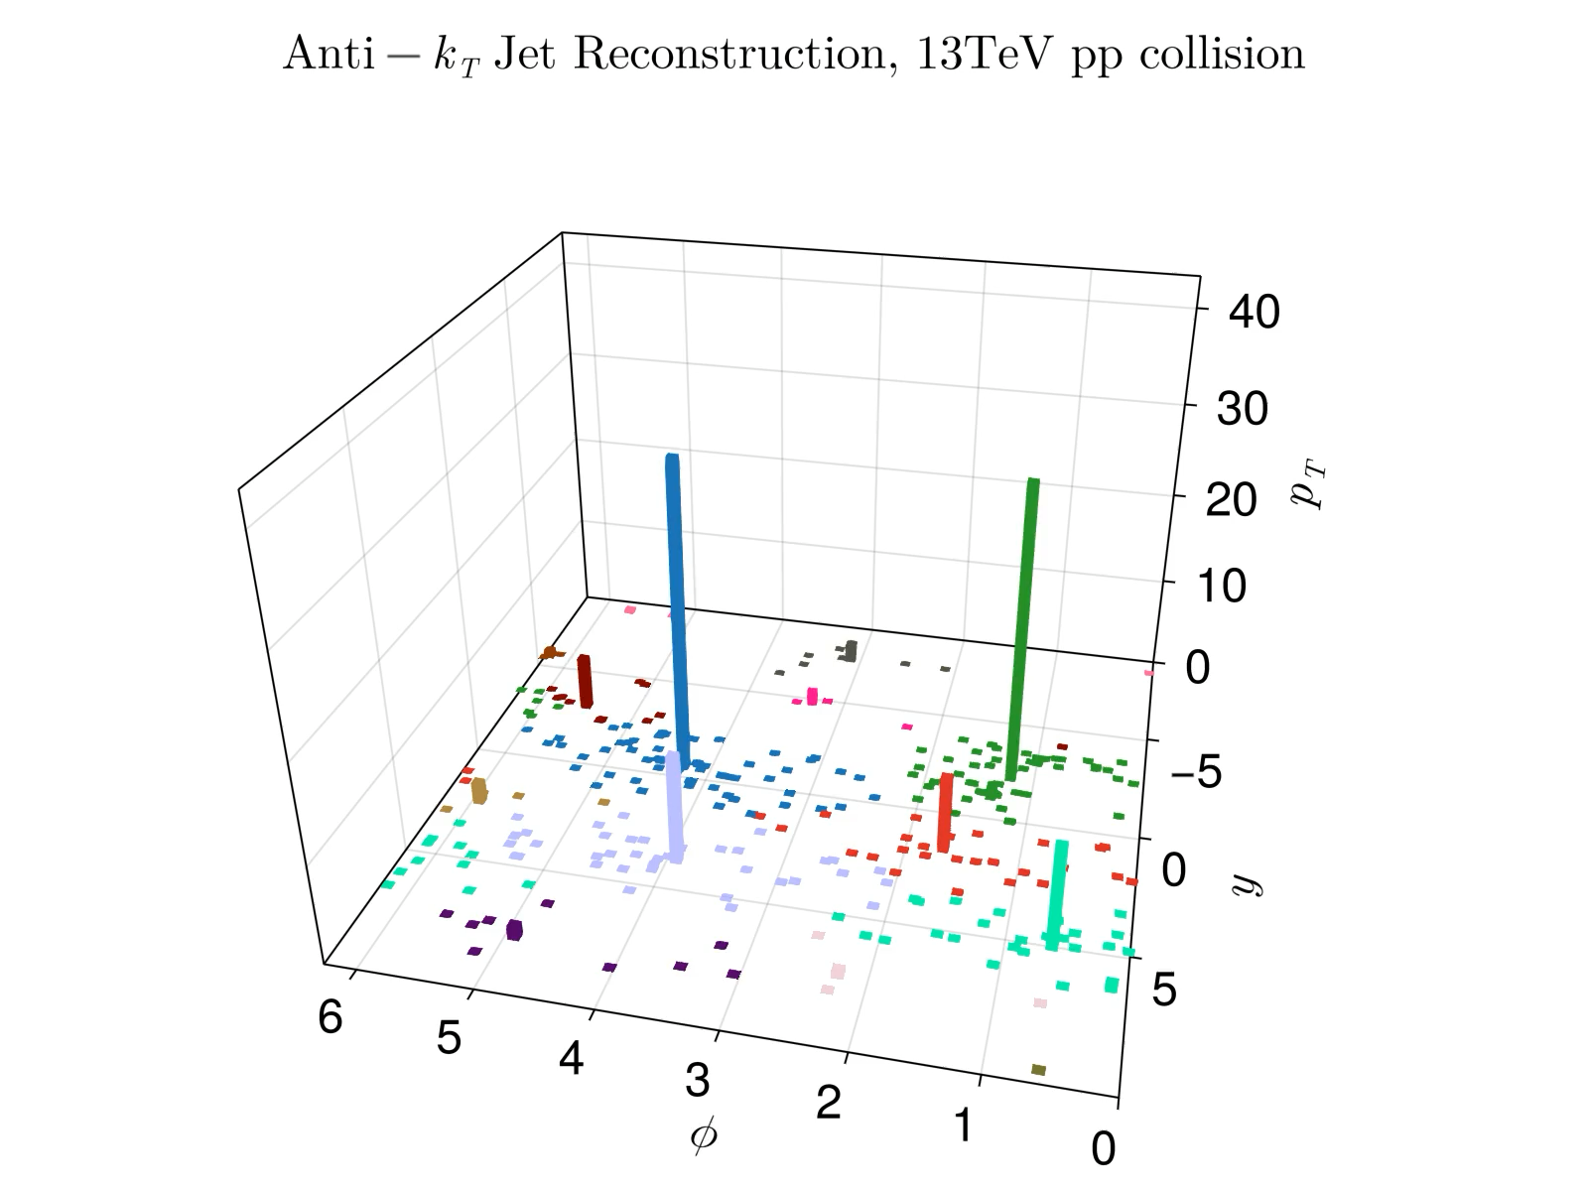
JetReconstruction.jl
Implementation of clustering algorithms for… jet reconstruction in Julia.
Directly comparable to FastJet, the best in class C++ implementation.
Optimised Julia - @simd for targeted vectorisation, cache-friendly data structures etc
  But still work in progress – more can be done.
See Graeme Stewart’s talk: Fast Jet Reconstruction in Julia (Wed, 1330)

Slide 10
OLD Release – CPU specific behaviour
JetReco performance since improved by ~1.5x by moving from
Vector{PseudoJet} => Vector{T} where T :< PseudoJet
Now beats FastJet in all systems (see later slides)
Vector of concrete type T, which must be a subtype of abstract type – all elements are same type, no indirection just a “C array” in memory
Vector of abstract type – each element can be any concrete subtype, so this like a Rust dyn Trait, requires pointer indirection
AMD Ryzen 7
(and every other ARM and x86 system I tested)
Apple Silicon (M2 Pro)
Move to Array-of-Structs from Struct-of-Arrays… only improved performance on M2 Pro
Apple Silicon has relatively huge L2 Cache, and low cache latency…

Slide 11
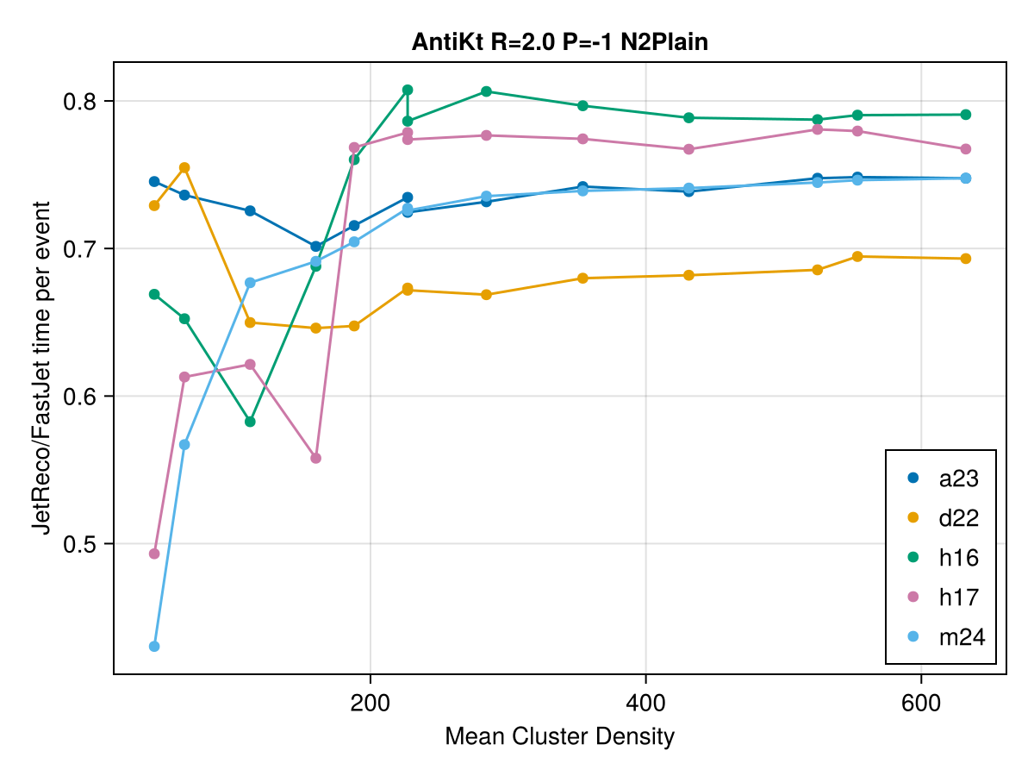
CURRENT - Benchmarks, by system v FastJet
Plain strategy
(processes whole geometry as one)
Note significant variance on results for small clusters
(this is mostly from FastJet…)
Newer x86 have wider SIMD registers -> advantage to Julia’s easy @simd macro
e+e- events

Slide 12
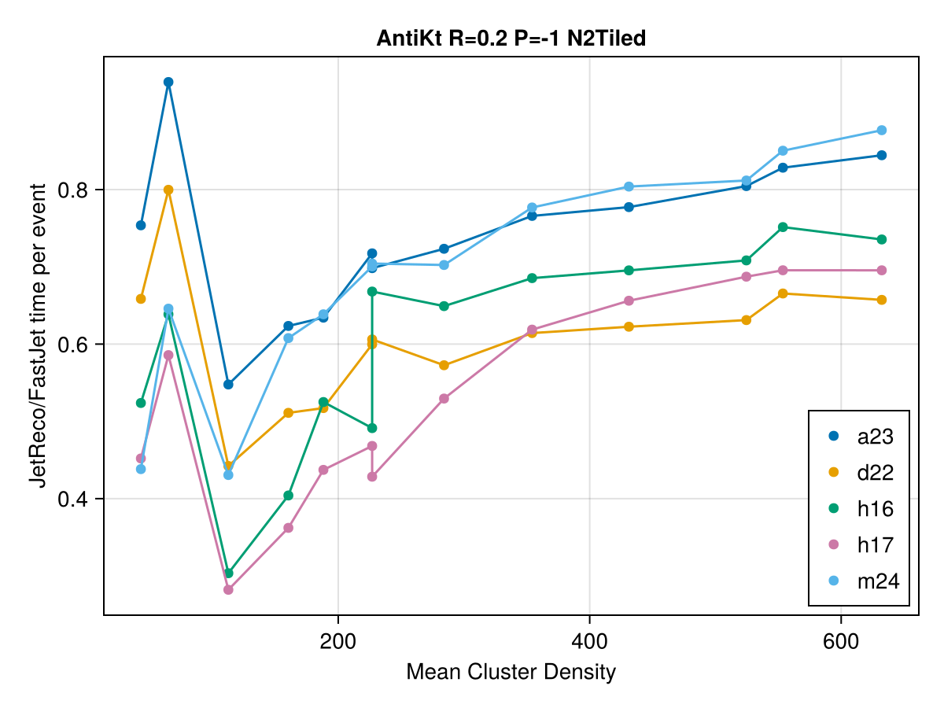
CURRENT - Benchmarks, by system v FastJet
Tiled strategy (segments space before clustering)
At small R
ARM 15% faster than FJ
x86 25% faster!
Upward trend for ARM results…
e+e- events

Slide 13
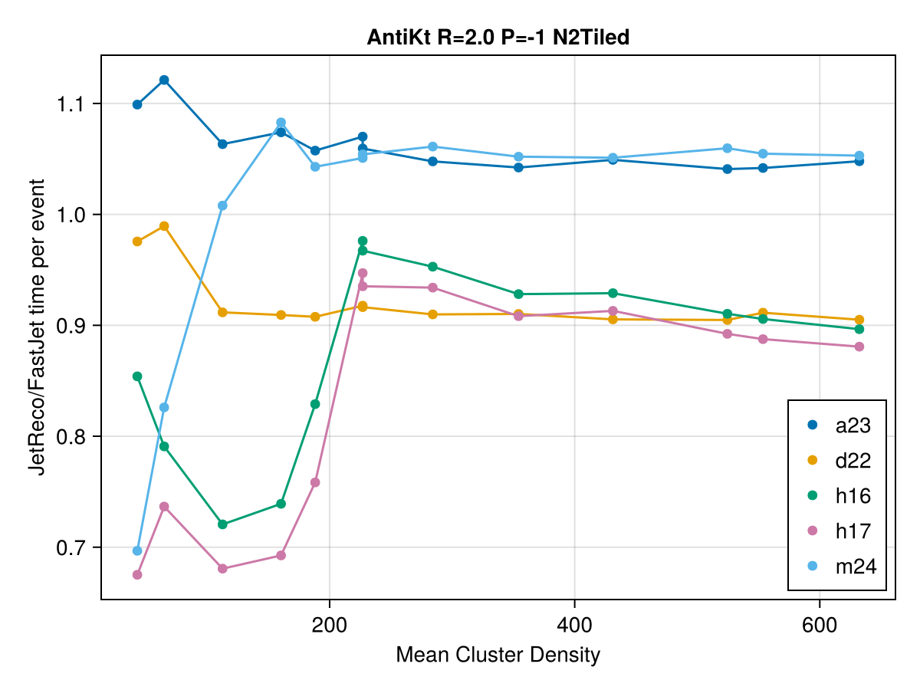
CURRENT - Benchmarks, by system v FastJet
Tiled strategy (segments space before clustering)
At large R
ARM 5% slower than FJ
x86 10% faster!
FastJet uses fine-grained memory barrier control, which almost certainly helps with ARM’s weaker memory model.
m24 suffers from worse cache than a23 for small events where cache significant?
e+e- events

Slide 14
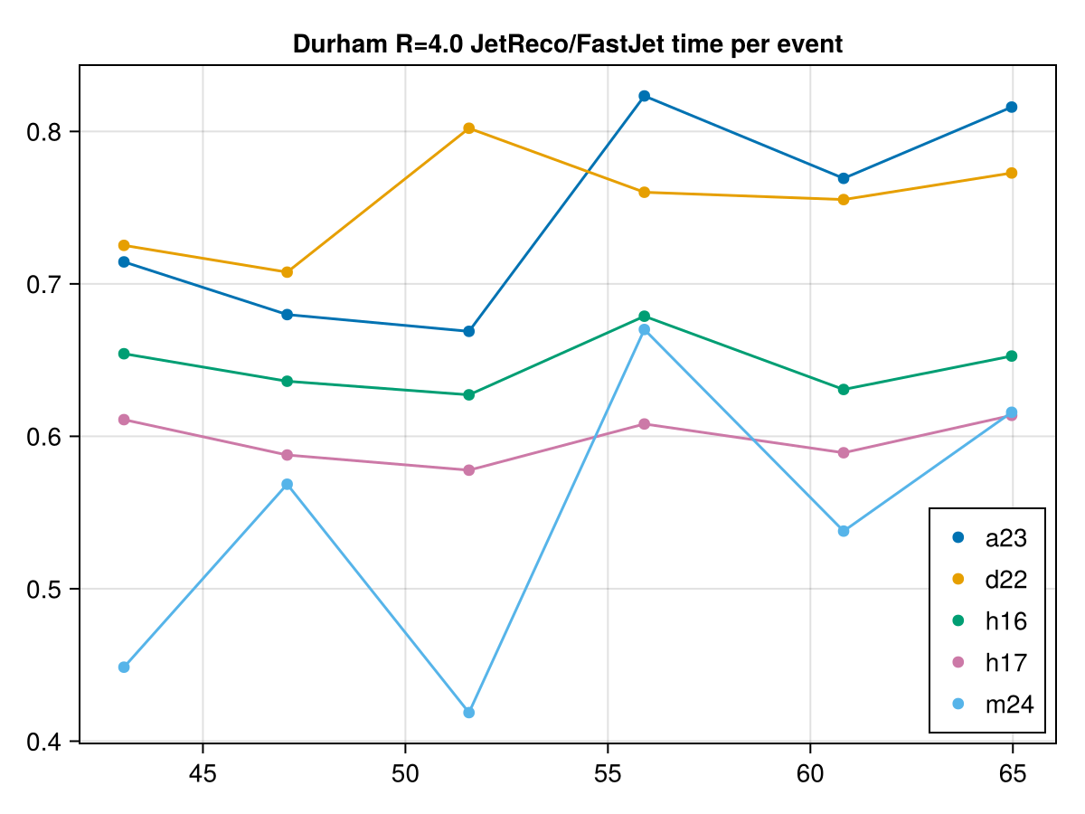
CURRENT - Benchmarks, by system v FastJet
Durham algorithm, e+e-
Again, a trend that CPUs with less cache have better JetReco performance relative to FastJet

Slide 15
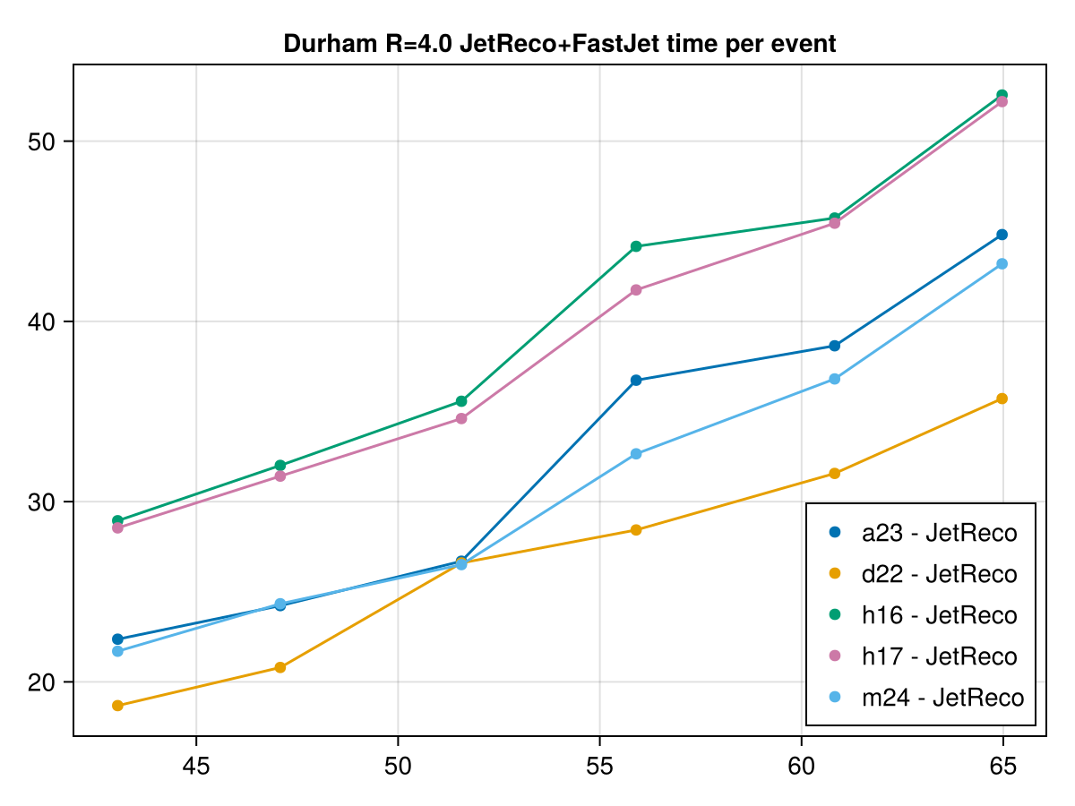
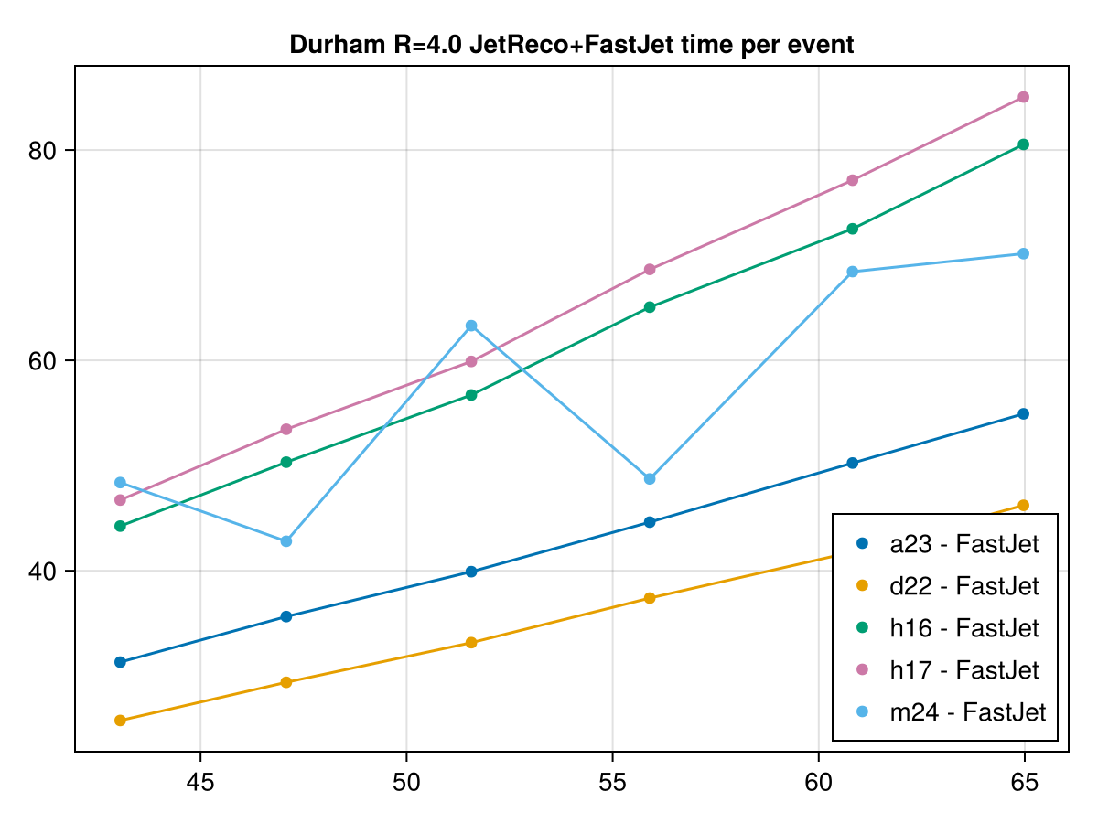
CURRENT - Benchmarks, by system v FastJet
a23 and m24 have very similar HEPSCORE/core – but scaling with FastJet is quite different
m24 also has a lot more variance…

Slide 16
Conclusions
Code generation from a given backend is influenced by many factors, and not consistently.
  Some strategies are likely dependent on CPU-dependant properties like L2 cache size.
For a non-trivial benchmark, Julia and C++ codes show comparable efficiency, on both architectures
  (Generally, in this case, in Julia’s favour...)
Further talks on benchmarking + energy efficiency:
  Taking on RISC for Energy-Efficient Computing in HEP (Wed, ~4:50pm)
  Heterogeneous Computing and Power Efficiency in HEP (Wed, ~5pm)
  Simulating the Carbon Cost of Grid Sites (Thurs, Plenary)
Further Julia talks:
  BAT.jl, the Bayesian Analysis Toolkit in Julia (Wed, ~5pm)

Slide 17
Backup

