Slide 1
Advancing Large Scale Scientific Collaborations with Rucio
Hugo González Labrador on behalf of the Rucio project
CERN | IT Department
CHEP 2024 | 21st October | Kraków

Slide 2
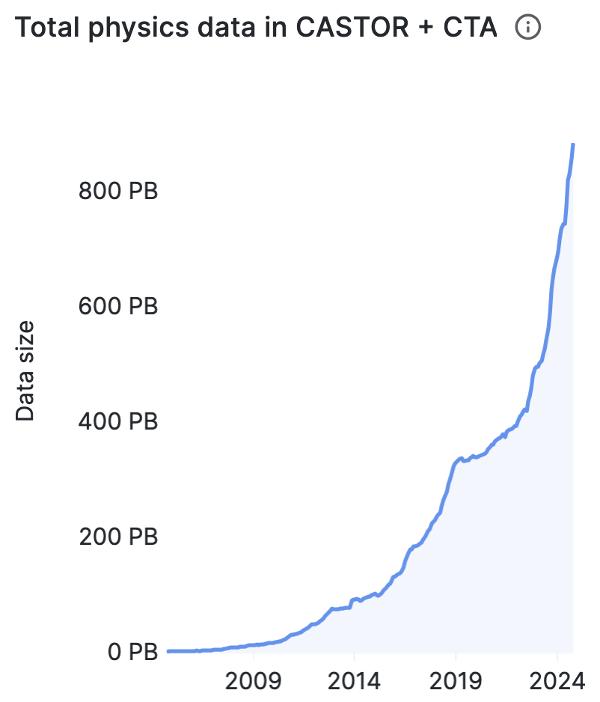
Taming the data deluge
Big complex machines produce vast amounts (Exabytes) of data
  CERN experiments have generated more data in the last ~2 years than ever before
New instruments will be ready by the end of the decade with rising storage needs (peaking at EBs/year):
  HL-LHC, SKA, KM3NET, DUNE, …
A formal solution is required to tame these data volumes
2x
Notes:
In the last decade we have observed an exploitation in the synergy between instruments and computes, that assmas vast amount of data.
Particle detectors and astrophysics telescopes are just an example of such powerful instruments.
For example, in the LHC, the amount of stored data in the last 5 years is equivalent to decades worth of dat

Slide 3



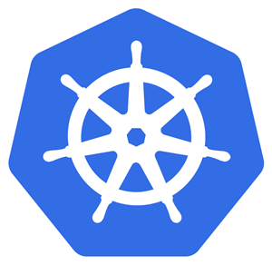

Rucio in a nutshell
Rucio provides a mature and modular scientific data management federation
Seamless integration of scientific and commercial storage and their network systems
Data is stored in global single namespace and can contain any potential payload
Facilities can be distributed at multiple locations belonging to different administrative domains
Designed with more than a decade of operational experience in very large-scale data management
Rucio is location-aware and manages data in a heterogeneous distributed environment
Creation, location, transfer, deletion, annotation, and access
Orchestration of dataflows with both low-level and high-level policies
Rucio is free and open-source software licenced under Apache v2.0
Open community-driven development process

Slide 4





What I like about Rucio
Reduce human operations to manage the data by expressing what you want, not how you want it
e.g., "Three copies of this dataset, distributed across MULTIPLE CONTINENTS, with at least one copy on TAPE"
e.g., "One copy of this file ANYWHERE, as long as it is a very fast DISK"
Provide another level of indirection through a scalable catalog of data that abstract the underlying:
Protocols: S3, WebDAV, XROOTD, …
Technologies: dCache, EOS, CTA, Storm ,...
New great technologies
New great technologies
New great technologies

Slide 5
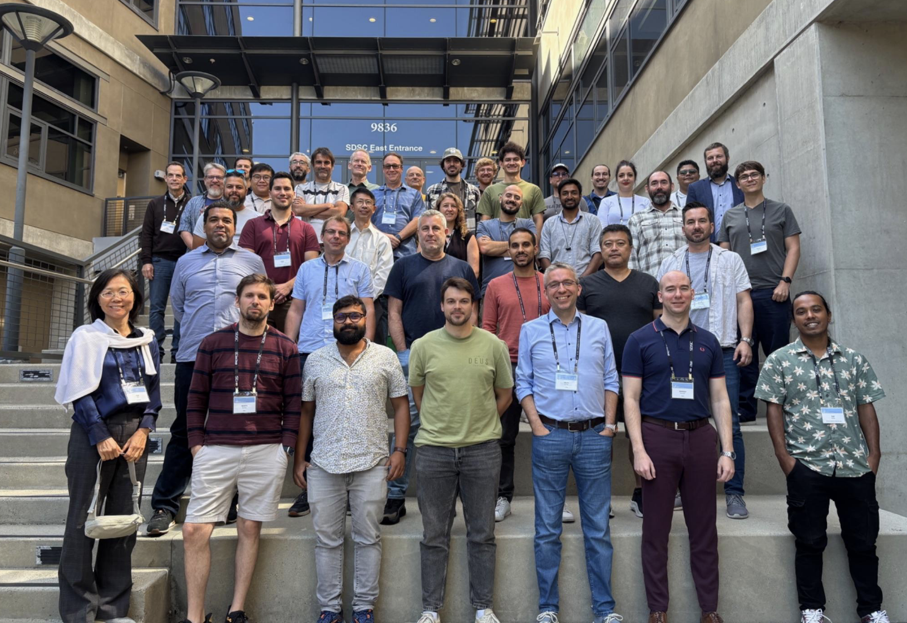
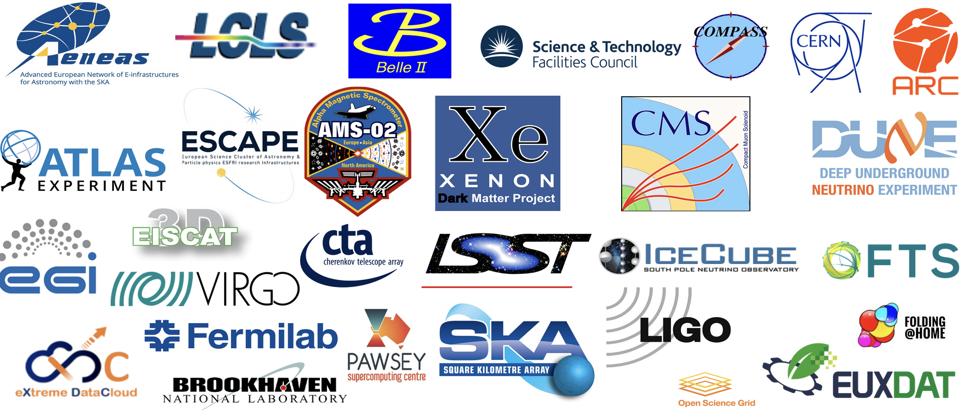
Where is Rucio being deployed?
Rucio is used in 20+ scientific collaborations
  De-facto scientific data management tool for HEP and other sciences
  Used by CERN (participating) experiments: ATLAS, CMS, Neutrino Platform (DUNE, ICARUS), …
  Others: Belle II, LIGO/VIRGO, CTAO, Vera Rubin Observatory, …
  NEW: SKA, KM3NET, IHEP, XENONnT…
Rucio manages over 2 Exabytes of data across all its community deployments
Rucio proven to work to very challenging data environments

Slide 6
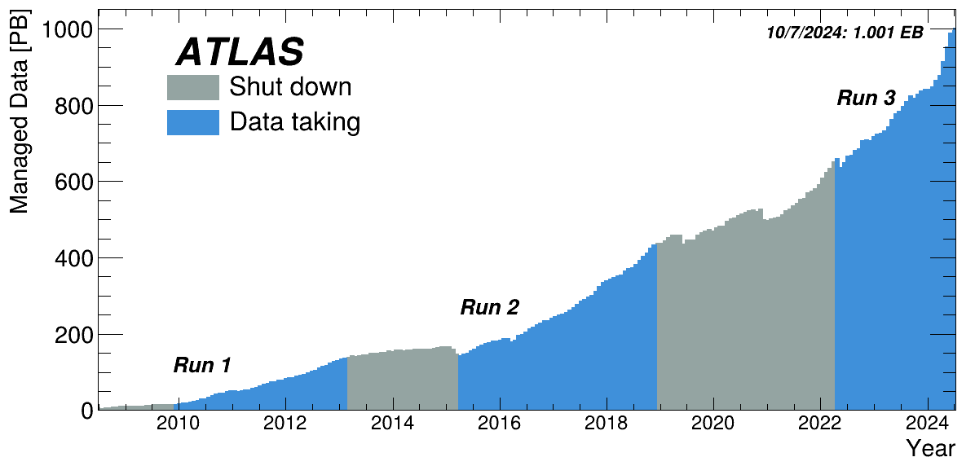
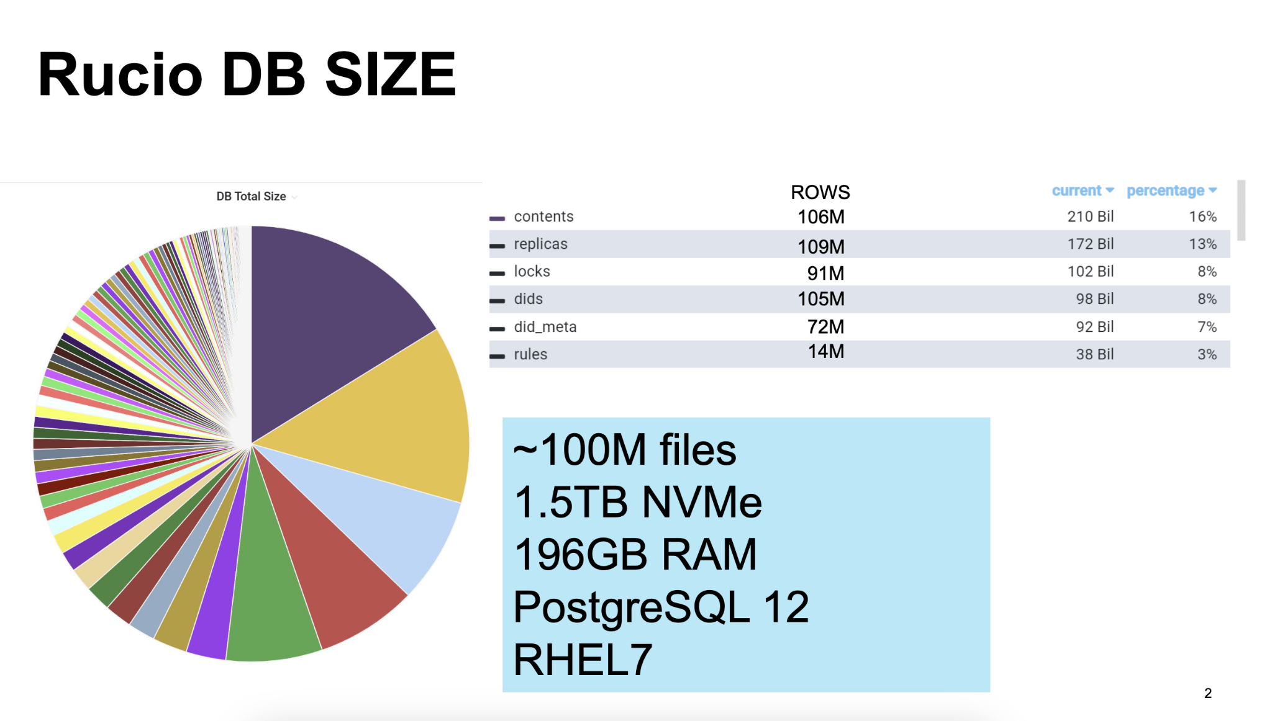
Proven to work in very challenging environments
Rucio@ATLAS: 1+ Exabyte, 120 data centres
Rucio@Belle2: ~100M files on PostgreSQL
Rucio for ATLAS Computing, Mario Lasnigg, 7th Rucio Workshop
PostgreSQL operation for RUCIO service at BN, Hinori Ito, 7th Rucio Workshop
Rucio@CMS, see talk: “Recent Experience with the CMS Data Management System” | 23 Oct 2024, 13:30

Slide 7
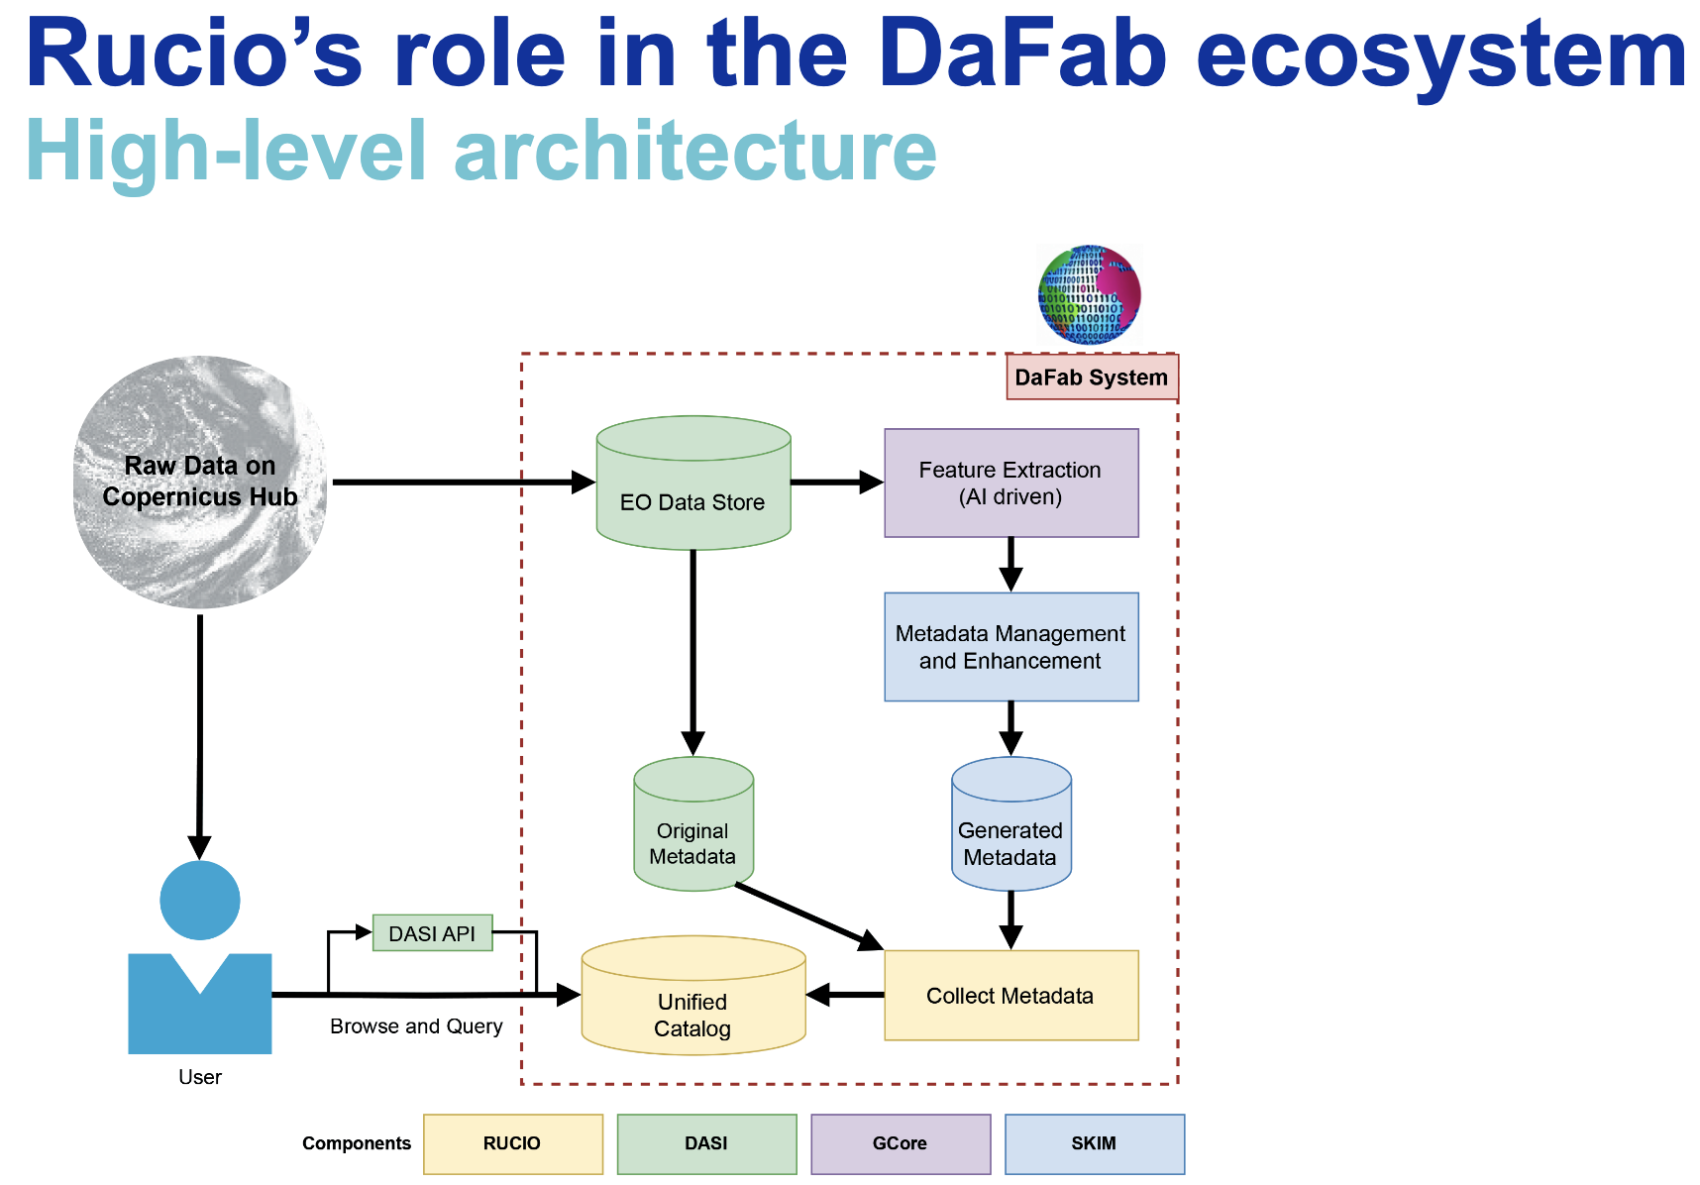
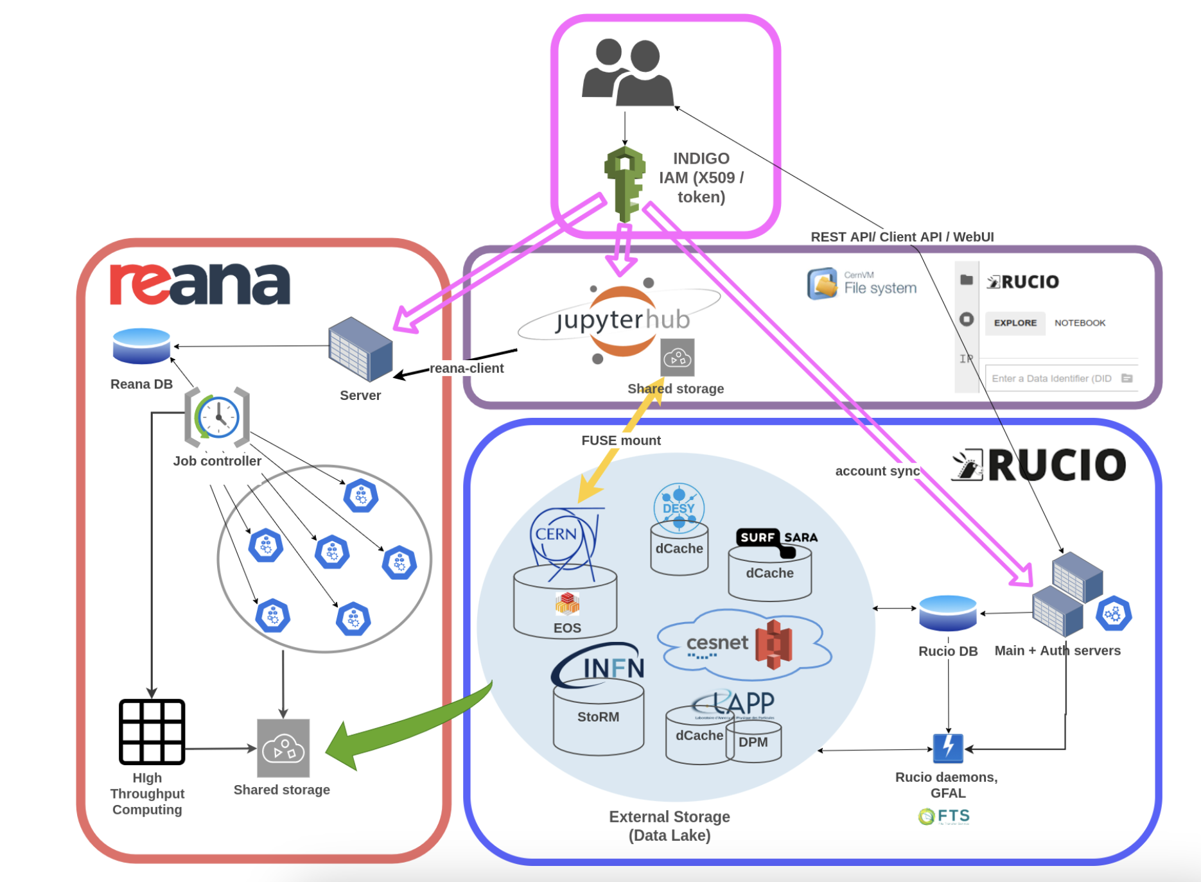
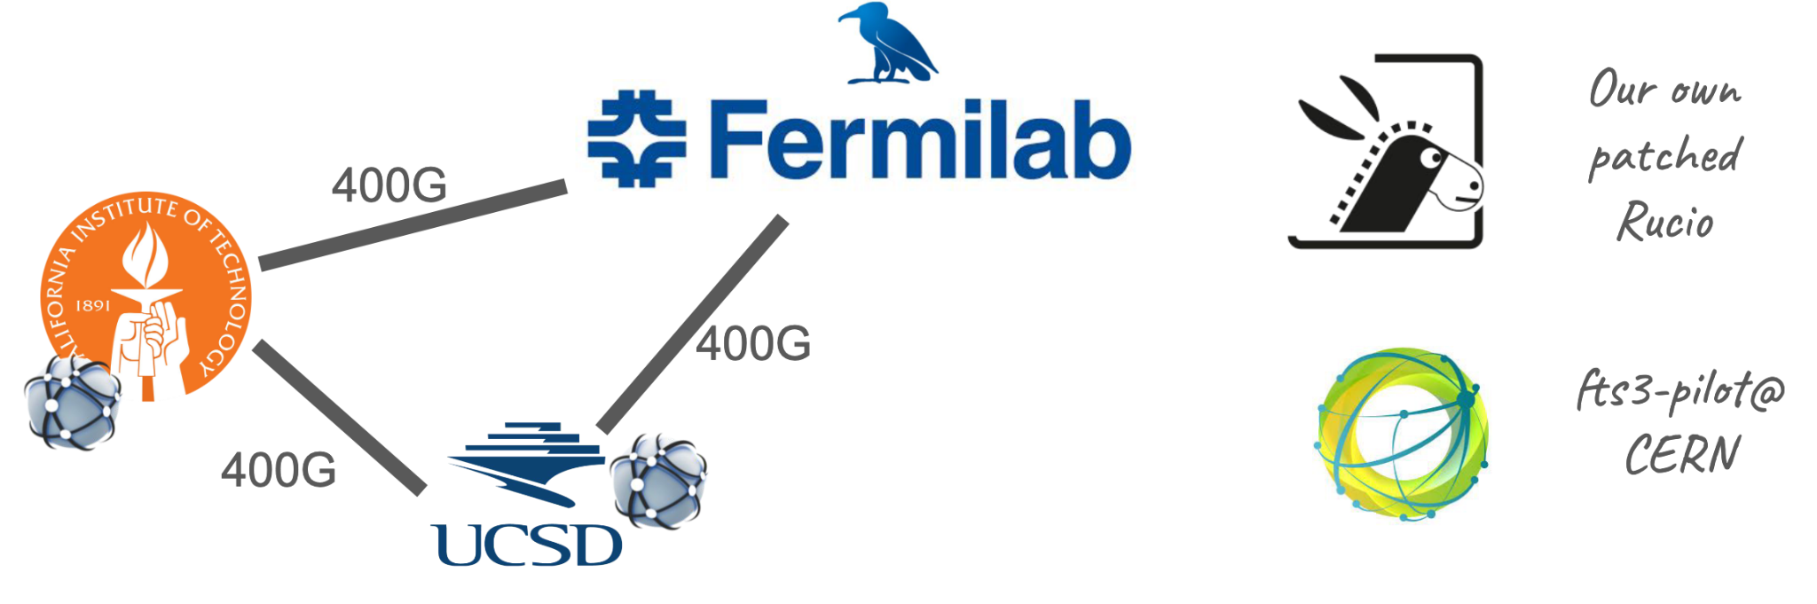
Breeding ground for innovation
Rucio is an enabler technology in various EU and US scientific projects, for example:
Integration between Rucio and Sense, Diego Davila, 7th Rucio Workshop
DaFab: Extending Rucio for Enhanced Earth Observation Data Management, Dimitris, 7th Rucio Workshop
Data discovery, analysis and reproducibility in Virtual Research Environments, Enrique, CHEP 2024

Slide 8
Challenges and opportunities
Authentication: mix of x509/Macaroons/”Tokens”:
Requires smooth transition as it affects many other interlinked systems (transfer tools, RSEs,…)
DC2024 was a good first battle ground. Refer to “The WLCG Data Challenge” plenary tomorrow
Integration with workflow management solutions: For significant deployments, it may be beneficial to automate the transfer of the data to the closest computing facility where the user launches the jobs. Dirac interware may be the best candidate as it’s already proven to work for Belle2
Integration with external catalogues: While Rucio provides an scalable catalog for metadata, often times the experiments have their own catalogues (pre-Rucio) and a synchronization job needs to be added

Slide 9
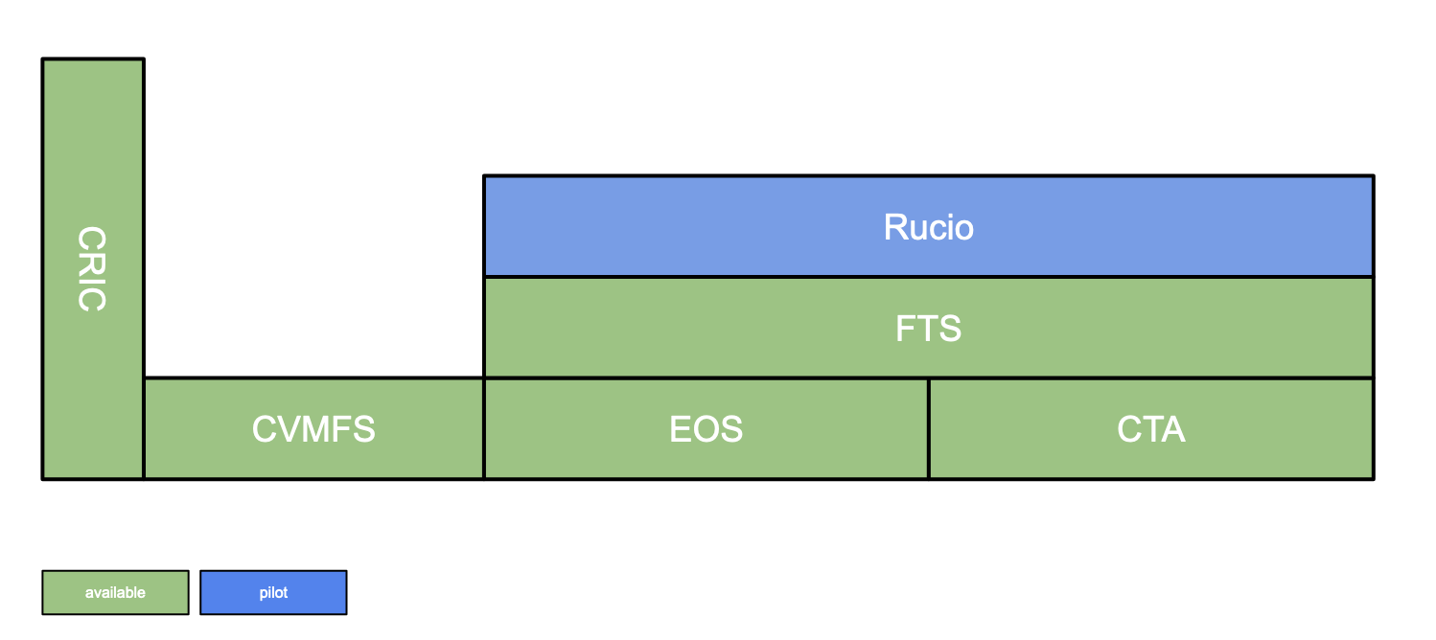
Increasing cooperation in the Rucio community
The CERN IT department is a new member of the Rucio community since early 2024, giving a hand in 3 axis:
Code development
DevOps for ATLAS and CMS
Managed Rucio service for Small and Medium Experiments (pilot)
“From experiment requirements to concrete service delivery”

Slide 10
Summary
Rucio is an open, reliable, and efficient data management system
Supporting the world's largest scientific experiments, but also a good match for smaller sciences
Extended continuously for the growing needs and requirements of the sciences
Strong cooperation between physics and multiple other fields
Diverse communities have joined, incl. astronomy, atmospheric, environmental, …
Mutually supportive community
Benefit from advances in both scientific computing and industry
Lower the barriers-to-entry by keeping control of data in scientist hands
Seamless integrations with scientific infrastructures and commercial entities
Detailed monitoring capabilities and easy deployment have proven crucial

Slide 11



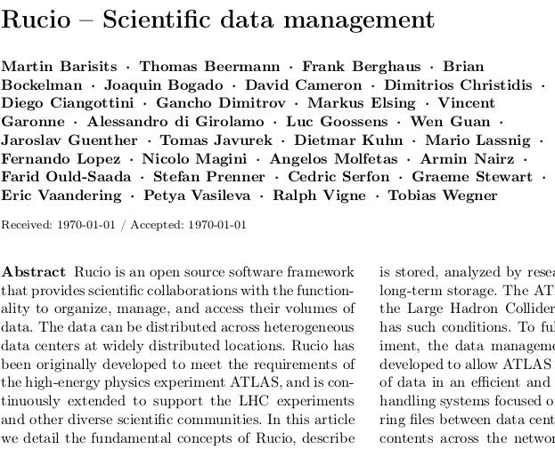

Additional information
Website
Documentation
Repository
Images
Online support
Developer contact
Journal article
Twitter
http://rucio.cern.ch
https://rucio.cern.ch/documentation
https://github.com/rucio/
https://hub.docker.com/r/rucio/
http://rucio.cern.ch/doc../join_rucio_mattermost/
rucio-dev@cern.ch
https://doi.org/10.1007/s41781-019-0026-3
https://twitter.com/RucioData

Slide 12

Hugo González Labrador
hugo.gonzalez.labrador@cern.ch

