Slide 1

Enhancing XRootD
Load Balancing for
High-Throughput transfers
Jyothish Thomas, James Walder, Thomas Byrne, Guilherme Amadio
jyothish.thomas@stfc.ac.uk, james.walder@stfc.ac.uk, tom.byrne@stfc.ac.uk

Slide 2



The RAL Tier-1 Setup
Notes:
The abstract pattern can be removed or repositioned if required. Be careful to ‘Send to Back’ so that it does not obscure any important information.

Slide 3
The RAL Tier 1 disk storage setup
RAL has a large Ceph object store disk pool (Echo)
Echo is accessed through a set of XRootD server gateways
Clients contact a single DNS endpoint, behind which is a pair of XRootD redirectors that balance the load between the servers
Servers are equivalent in functionality, i.e, all servers access the same storage backend, hence the load balancing only needs to consider the load on the server
Servers have a constant stream of traffic, averaging 5GB/s between Aug-Sep 2024, with some periods of higher traffic.

Slide 4
The RAL tier 1 setup
Client
Client
Client
Client
Client
Client
Client
Client
…
DNS Endpoint
Load Balancing
XRootD Gateway
XRootD Gateway
XRootD Gateway
XRootD Gateway
XRootD Gateway
XRootD Gateway
…
Ceph Cluster (ECHO)

Slide 5
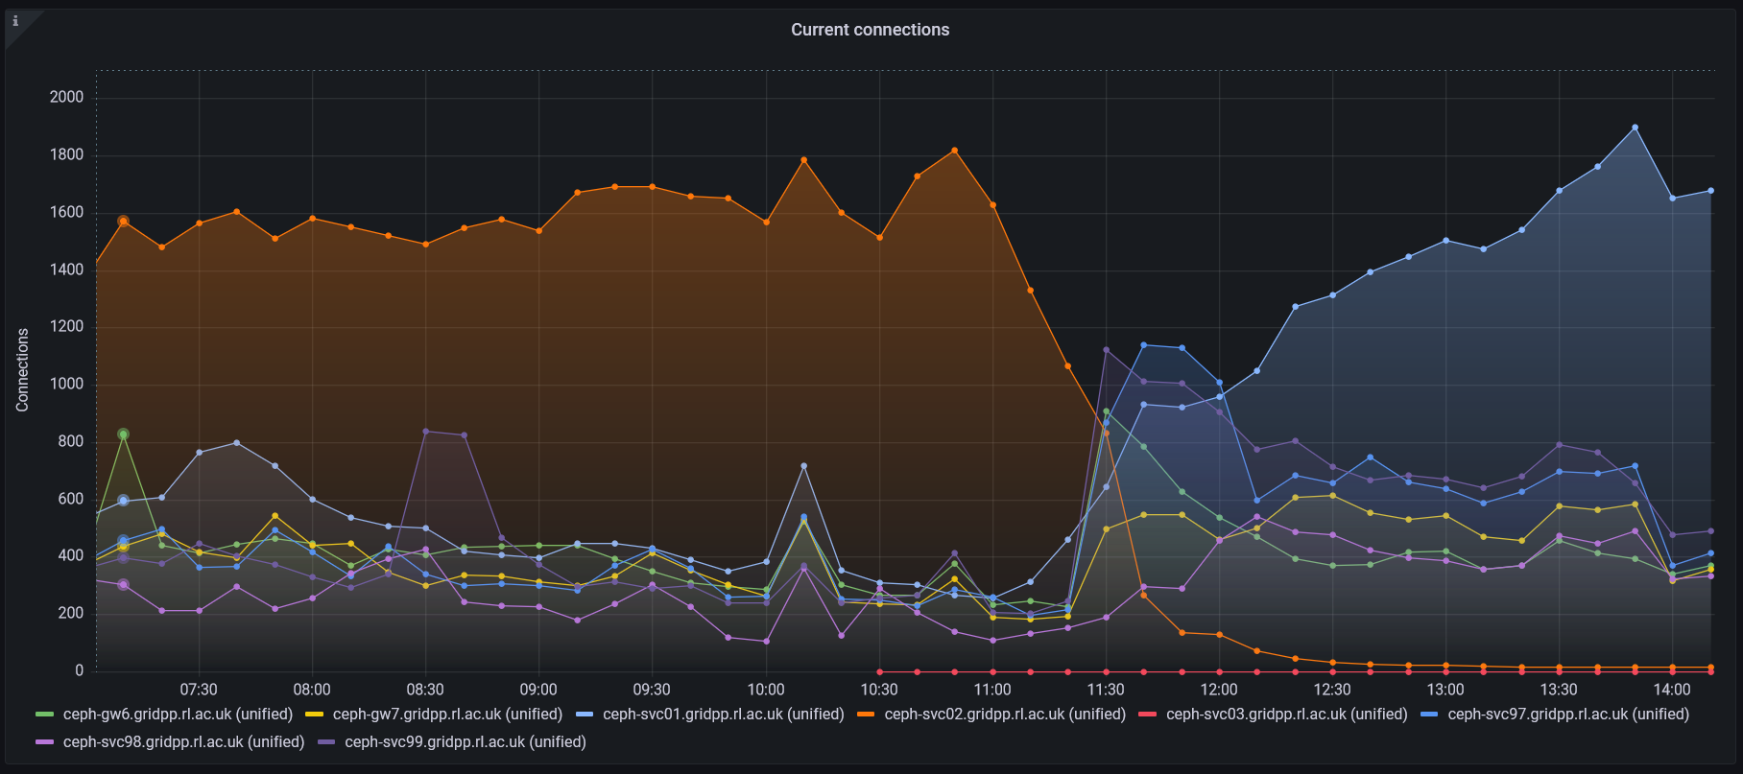
DNS Round Robin limitations
Relying on clients (and DNS servers) to choose randomly (and often) for an even distribution
Not actually loadbalancing
  Slower gateways will end up with more active transfers
  No backoff mechanism to allow overloaded gateway to recover
(RAL specific) No direct control over our DNS, requests via central IT helpdesk made hardware interventions very time consuming
Occurrences of gateway hotspotting tracked down to DNS server configuration at another site

Slide 6

XRootD Cluster Management
Notes:
The abstract pattern can be removed or repositioned if required. Be careful to ‘Send to Back’ so that it does not obscure any important information.

Slide 7
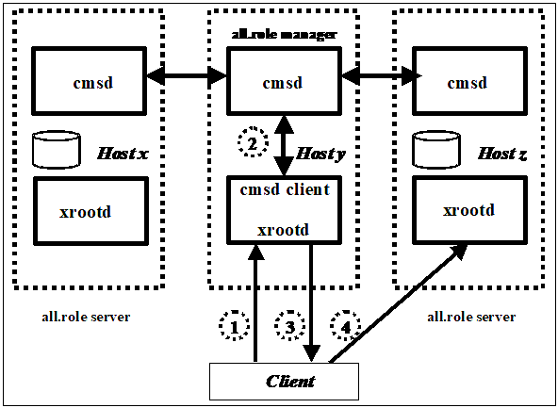
XRootD Cluster Management
XRootD has a native Cluster Management Service Daemon (CMSD)
This adds an XRootD manager
that manages a cluster of XRootD
servers
The manager has a load balancing
component that can distribute load
according to a user defined
weighted sum of server
reported metrics (io,sysload,
memory load,etc..)
XRootD Cluster Management Service Configuration Reference (5.7)

Slide 8
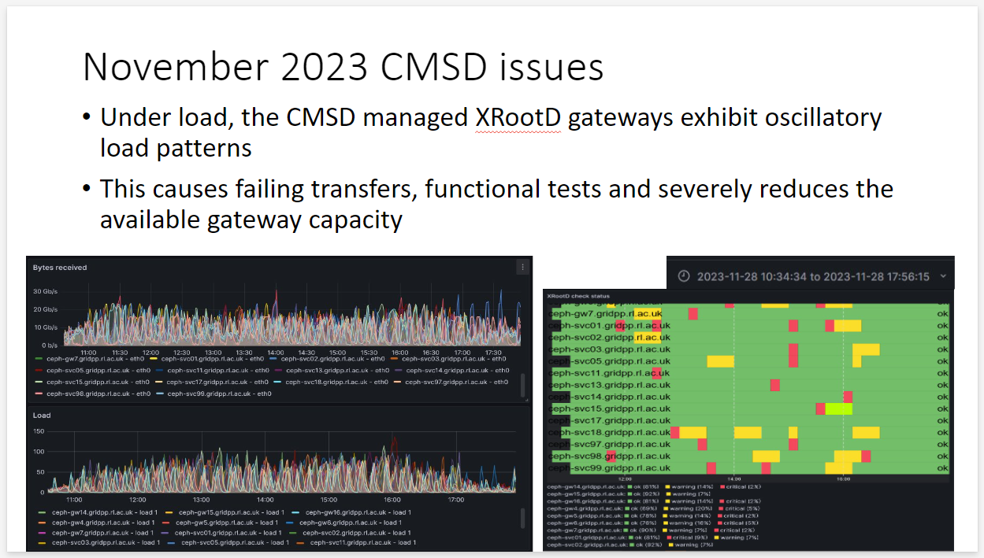
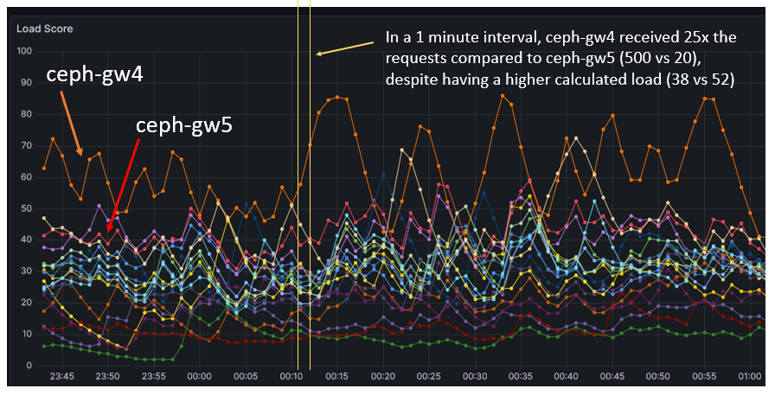
XRootD CMSD experiences
Although a major improvement compared to DNS RR, we observed some odd behaviours at high load
  Load and connection oscillation
  Unexpected placement decisions
Investigations lead to tuning which helped, but only to a point.

Slide 9

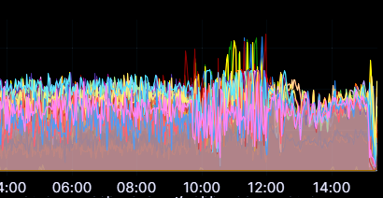
Observations under high load
The CMSD load balancing algorithm assigns the incoming transfers to the least loaded server and any servers with a load within the configured fuzz value
This works well under normal conditions but when all servers are at close to full capacity, it results in server instability as the load keeps moving between subsets of servers
XRootD load balancing to RR (bytes received)
Round Robin was performing better when all
servers were at near maximum capacity

Slide 10
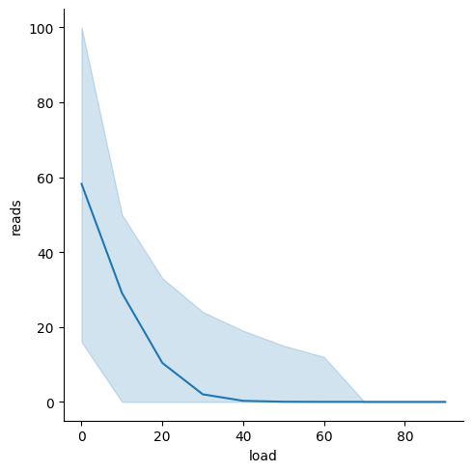
Studying the CMSD load balancing algorithm
Investigation into the CMSD SelByLoad algorithm revealed selection had a very wide standard deviation on assignment distributions when the server order is randomized (seen right).
The algorithms efficient single-pass nature made it hard to select servers in a way that wasn't biased by order (as shown on the next slide)
Server with lowest load received between 100% and ~10% of reads
Server with highest eligible load could receive as many reads as lowest loaded server!
Distribution of 100 requests over 10 servers with load scores 0,10,…,90. The test was repeated 10,000 times with the internal server order shuffled each time.

Slide 11
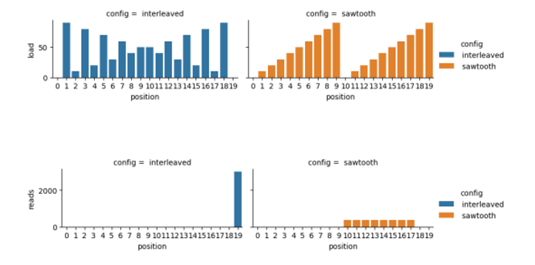
Problematic patterns
XRootD CMSD SelByLoad Analysis, Thomas Byrne 2024

Slide 12
New load balancing algorithm

Slide 13
Aims
Aim | Explanation
Use all available server capacity | Load reporting is asynchronous to the load balancing, so the reported loads have some latency. Prevent load hopping
The decision algorithm should be fast | RAL sees an average request frequency of 50Hz , with peaks of 220Hz and the load balancing decision should not impact the other components of the CMSD
Load distribution should be sensible, not perfect | As the assignment decision is timebound, the main concern is to distribute load evenly within a timeframe, not necessarily optimizing every individual transfer
The algorithm should be resilient | Overloaded servers should be able to join back with no manual intervention
The algorithm should be ordering agnostic | The order the servers login should not affect the load balancing decision

Slide 14
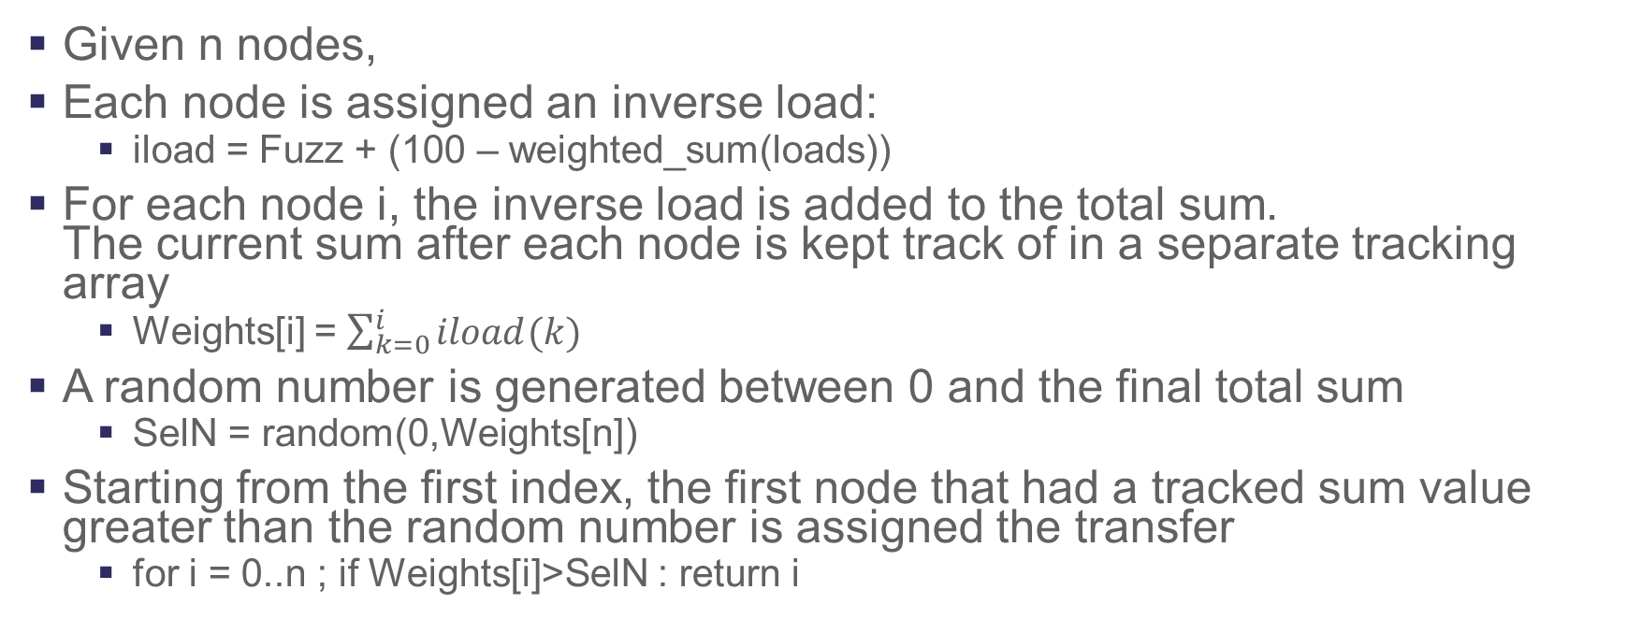
Weighted Random Selection algorithm
Given n nodes,
Each node is assigned an inverse load:
  iload = Fuzz + (100 – weighted_sum(loads))
For each node i, the inverse load is added to the total sum.
The current sum after each node is kept track of in a separate tracking array
  Weights[i] = $\sum_{k=0}^{i}{iload(k)}$
A random number is generated between 0 and the final total sum
  SelN = random(0,Weights[n])
Starting from the first index, the first node that had a tracked sum value greater than the random number is assigned the transfer
  for i = 0..n ; if Weights[i]>SelN : return i

Slide 15
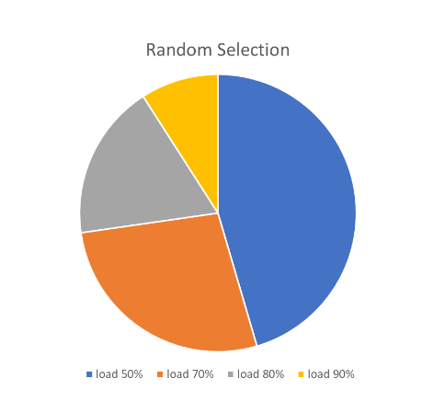
How the new algorithm works
The basic principle of this algorithm is a random weighted selection. An easy way to picture it is as follows:
For a set of 4 servers with loads of:
  50%
  70%
  80%
  90%

Slide 16
How the new algorithm works
If a node is unreachable or cannot be used by the cluster manager, it has an effective slice size of 0, meaning it will never be selected.
A fuzz value allows an even distribution if all nodes are overloaded and provides a baseline for each slice size, allowing some tuning adjustments for a more even distribution.
For example, a fuzz of 20 on the same values above will result in this wheel:

Slide 17
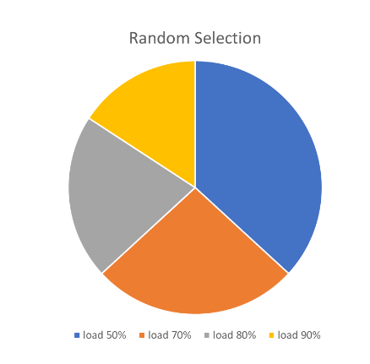
How the new algorithm works

Slide 18
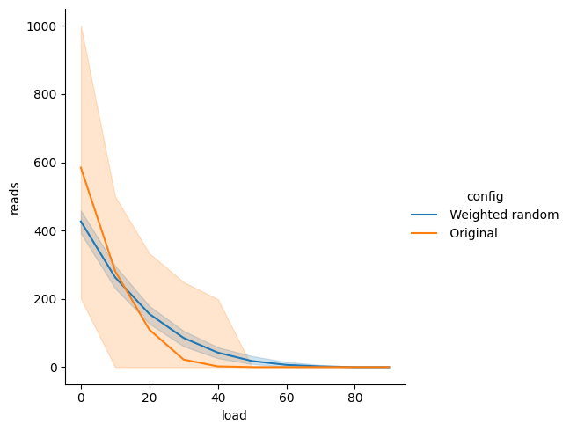
Results
The new algorithm has a smaller
deviation from the mean selection
when the order of loads is shuffled
(right plot)
The aims set out by the algorithm
were accomplished

Slide 19
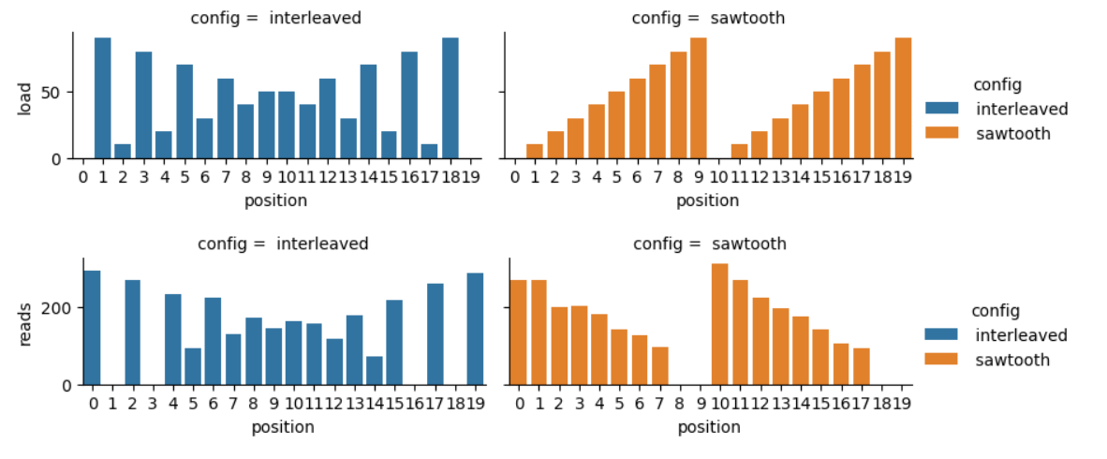
Problematic patterns – new algorithm
XRootD CMSD SelByLoad Analysis, Thomas Byrne 2024

Slide 20
Results
Aim | Explanation
Use all available server capacity | All available servers will have a chance to be selected
The decision algorithm should be fast | The algorithm performed well even under very high loads and full network saturation of all our servers. It has O(n) time and space complexity
Load distribution should be sensible, not perfect | The load distribution was kept even throughout the available servers. Simulations of 10 million decisions resulted in 10 maximum consecutive selection of the same server.
The algorithm should be resilient | As servers get more transfers and get more loaded, the chance of getting selected decreases. As the transfers free up and the load decrease, the reverse happens
The algorithm should be ordering agnostic | The geometry of this algorithm makes it order agnostic by nature

Slide 21
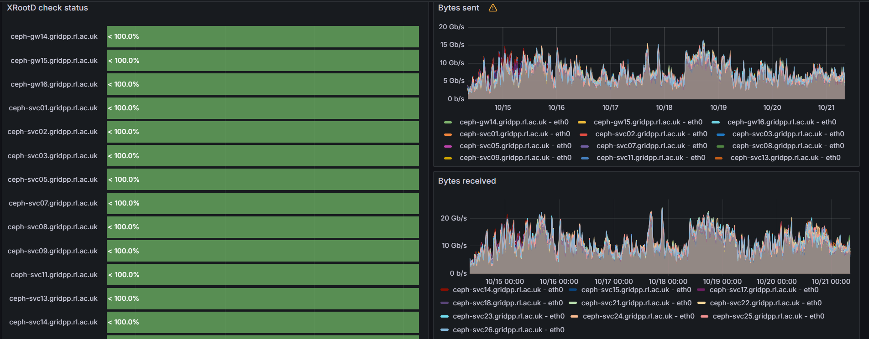
In Production

Slide 22
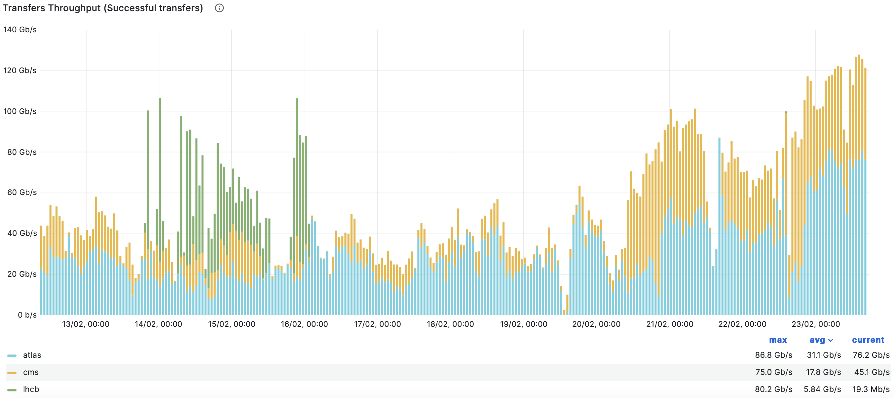
In Production
Net tuning
Further Net tuning
New Algorithm

Slide 23
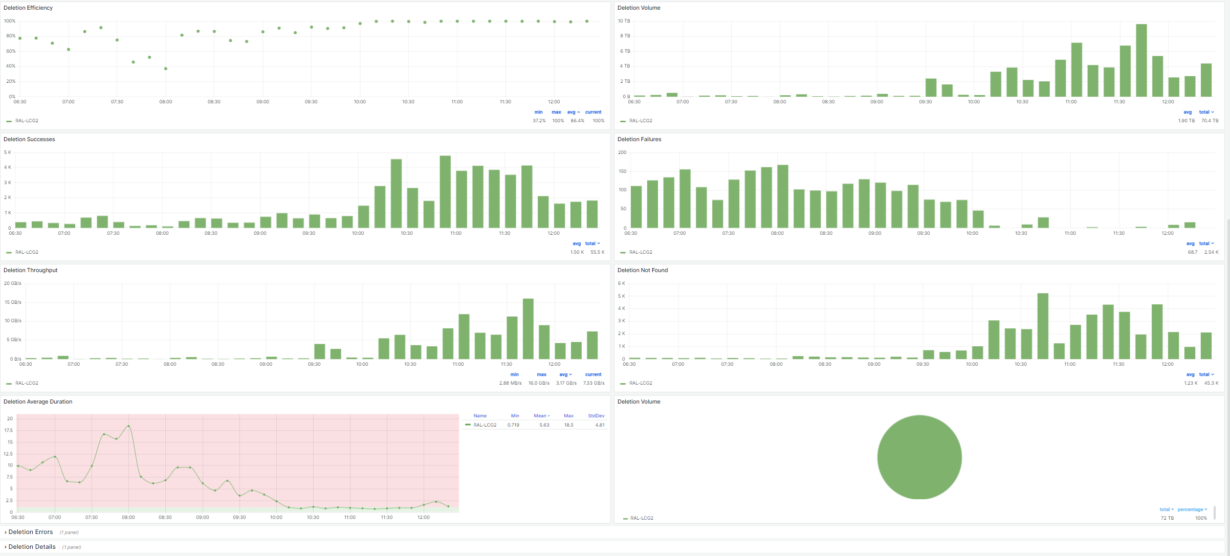
Additional Benefits(RAL): deletion efficiency

Slide 24
Thank You

