Slide 1



Madgraph5_aMC@NLO
on GPUs and vector CPUs:
towards production
The 5-year journey to the
first LO release CUDACPP v1.00.00
Andrea Valassi (CERN)
on behalf of the MG5AMC CUDACPP development team
CHEP2024, Krakow, 23rd October 2024
https://indico.cern.ch/event/1338689/contributions/6015964

Slide 2



The collaborating teams (summer 2024)
SYCL plugin (also Intel GPUs)
WIP: integration into CUDACPP
Taylor Childers
Nathan Nichols
(ANL)
CUDACPP plugin core development (NVidia and AMD GPUs, vectorized C++ on CPUs)
Stephan Hageboeck*
Daniele Massaro*
Stefan Roiser*
Zenny Wettersten*
Jorgen Teig* (2023)
Filip Optolowicz (2023)
(CERN IT-GOV-INN)
Olivier Mattelaer*
(UCL Louvain)
Andrea Valassi*
(CERN IT-GOV-ENG)
CMS integration tests
See Jin’s poster for details!
Jin Choi
(Seoul National University)
Saptaparna Bhattacharya
(Wayne State University)
Robert Schoefbeck
(HEPHY Vienna)
*CUDACPP plugin AUTHORS
Focus of this CHEP2024 talk: first release of the CUDACPP plugin
  will give only minimal details about the parallel work on the SYCL plugin
  will show work done for CMS – but see Jin’s poster for details on the work in CMS!

Slide 3
Motivation and overview

Slide 4
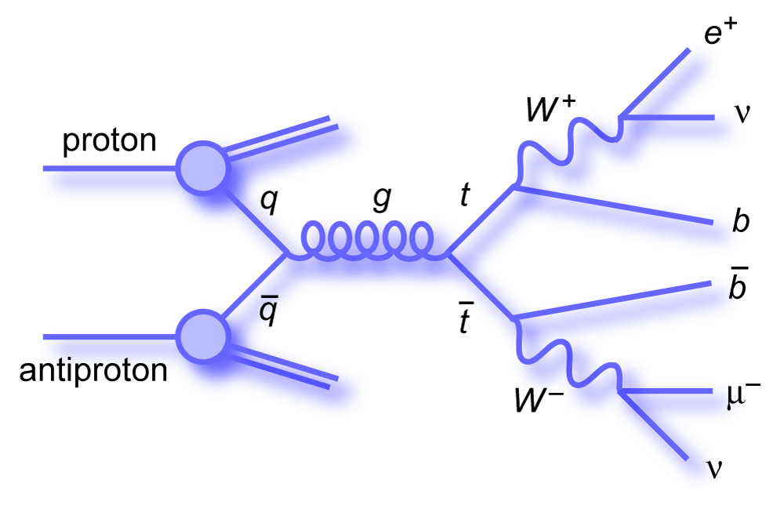
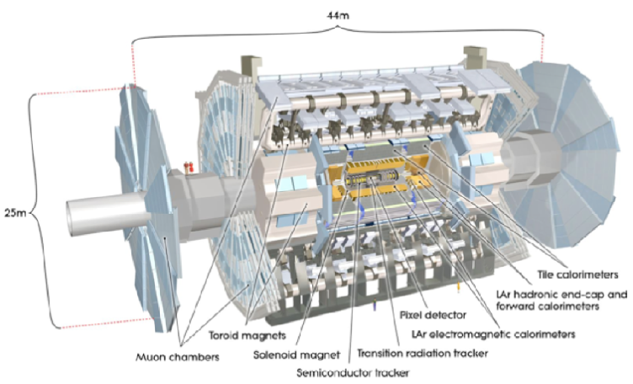
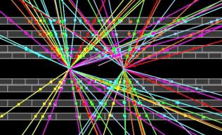
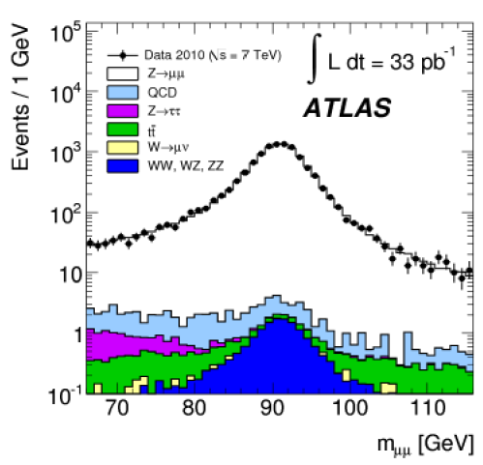
Event generators: the first step in the HEP simulation chain
Theoretical physics (Feynman diagrams)
Monte Carlo methods (random numbers)
SIMULATED DATA PROCESSING
(“MONTE CARLO”)
MC EVENT GENERATION (MC DATA)
Simulate physics process in beam collisions
Output: particles produced in beam collision
MC SIMULATION + DIGITIZATION (MC DATA)
Simulate interaction of collision products with detector
Output: simulated electronic signals
REAL DATA PROCESSING
RECONSTRUCTION (REAL DATA)
Translate electronic signals to
particles passing through the detector
RECONSTRUCTION (MC DATA)
Translate electronic signals to
particles passing through the detector
ANALYSIS
Compare real data and MC data with statistical methods – measure parameters, search for new processes

Slide 5
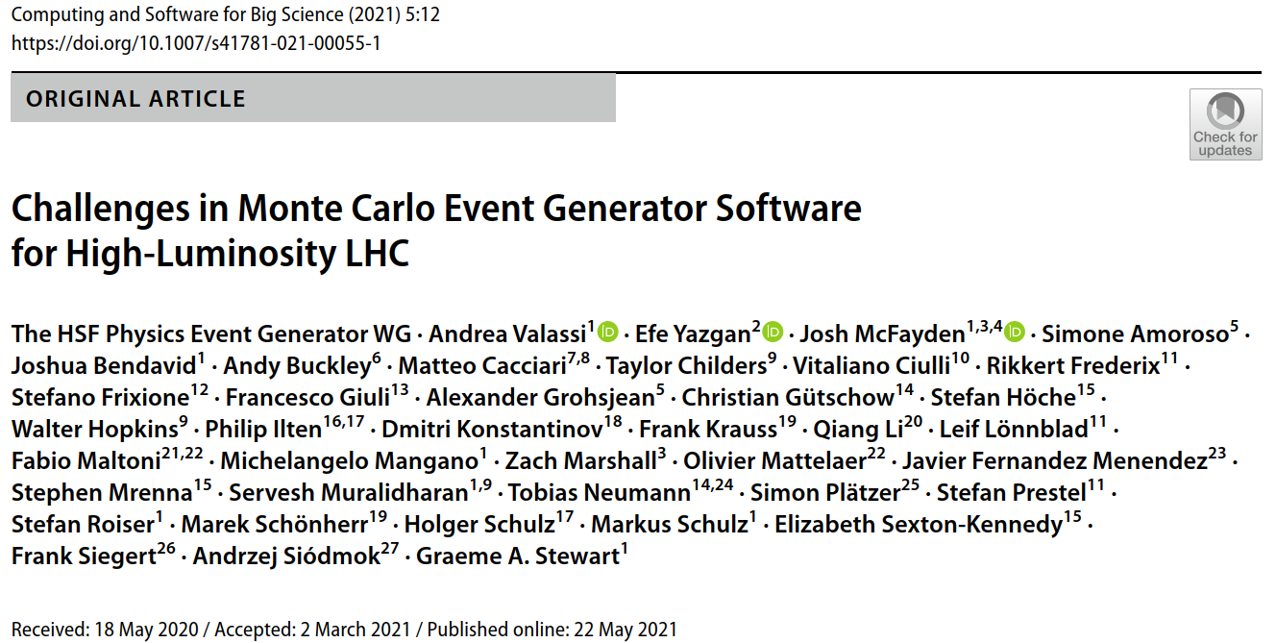
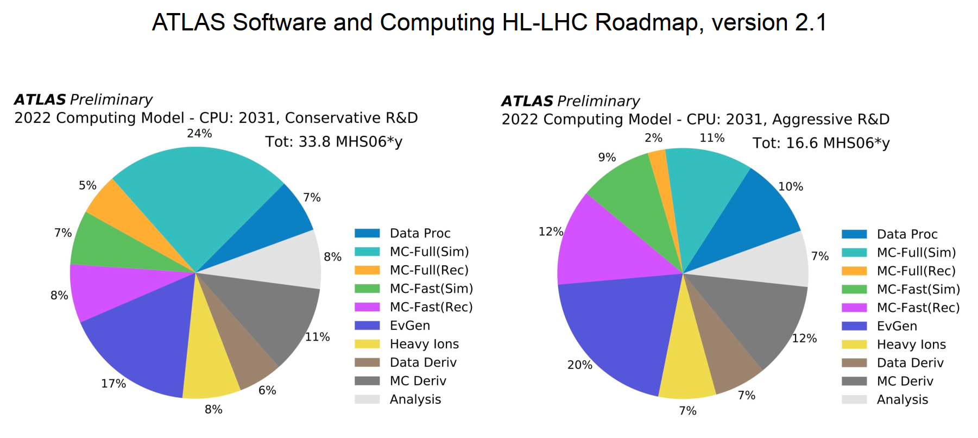
Event generators (1): why accelerate them?
Around 10-20 % of LHC computing CPU costs (hence: important to speed them up!)
See also
Olivier Mattelaer's plenary talk
on Thursday
CERN-LHCC-2022-005

Slide 6
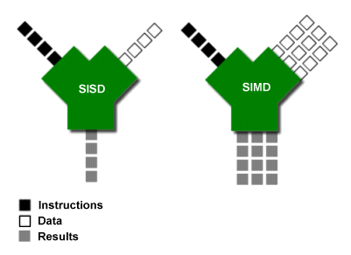
Sequential processing vs. Data-parallel processing
Data-parallel processing
(lockstep processing)
Single Instruction Multiple Data:
N inputs and N outputs per cycle
for the same instruction
Two hardware implementations
of essentially the same concept:
Sequential processing
Single Instruction Single Data:
1 input and 1 output per cycle
for a given instruction
Ars Technica (March 2000)
GPUs – “SIMT”
~Easier to code (CUDA)
SOAs not strictly needed
Tolerate lockstep <100%
Vector CPUs – SIMD
More difficult to code (C++)
SOAs strictly needed
Need strict 100% lockstep
In our work on MG5AMC “CUDACPP” we have targeted
data parallelism on both vector CPUs and GPUs
from the very beginning!
Note: task parallelism (multi-threading, multi-processing) differs from data parallelism: it exploits a different dimension
of hardware parallelism (many CPU cores, many nodes...)

Slide 7
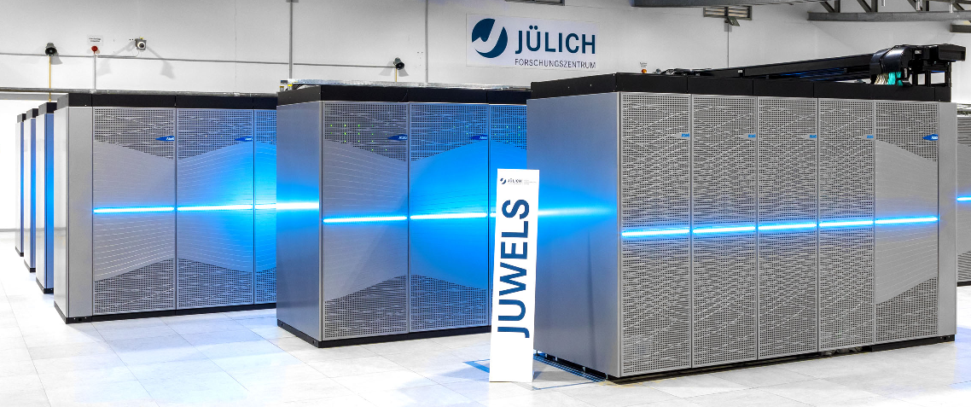

Event generators (2): why CPU vectorization and GPUs?
See also
Andrea Sciabà's plenary talk
on Thursday
Vector CPUs and GPUs are widely available to HEP now...
  All of the CPUs in our computing Grid have SIMD (most have at least AVX2)
  GPUs are becoming more and more available to us especially at HPC centers
... but they are generally very difficult to exploit in most HEP software ☹
  Example: Monte Carlo detector simulation has a lot of stochastic branching (makes lockstep processing difficult)
However: matrix element event generators are ideal software workflows for SIMD and GPUs!
  Monte Carlo sampling of many data points → Data parallelism with near-perfect lockstep processing!
INPUT
SAME CALCULATION ON DIFFERENT DATA!
(No if-then-else blocks, i.e. no branching)
Lockstep processing
Good for GPUs (SIMT) and vector CPUs (SIMD)
OUTPUT

Slide 8
What is a MC ME generator? A simplified computational anatomy
Monte Carlo sampling: randomly generate and process
MANY different events (“phase space points”)
For each event:
1. RANDOM NUMBERS
Output: random numbers
2. PHASE SPACE SAMPLING
Input: random numbers
Output: particle 4-momenta
3. ME CALCULATION
Input: particle 4-momenta
Output: Matrix Element (ME)
CPU BOTTLENECK
(NB: “Matrix Element” is an
element of the scattering matrix... not a linear algebra concept!)
MC MATRIX ELEMENT GENERATOR (e.g. MG5aMC)
PSEUDO RANDOM
NUMBERS
PHASE SPACE
SAMPLING
SHOWERING AND HADRONIZATION GENERATORS
(e.g. PYTHIA)
+ optional event cuts
MATRIX ELEMENT
CALCULATION
PARTON SHOWERS
PHASE SPACE
SAMPLING OPTIMISATION
WEIGHTED EVENTS {EVT_i , W_i}
HADRONISATION
AND DECAY
CUDACPP: speed up the ME calculation using GPUs and SIMD
MONTE CARLO
INTEGRATION
MONTE CARLO
UNWEIGHTING
PARTICLE FILTERING
AV – vCHEP2021
DETECTOR SIMULATION
CROSS-SECTIONS etc...
(AVG W_i, MAX W_i)
UNWEIGHTED EVENTS {EVT_i , W_i=1}
(GEANT4)
(FOR LATER!) Physics output: cross-section and LHE event file

Slide 9
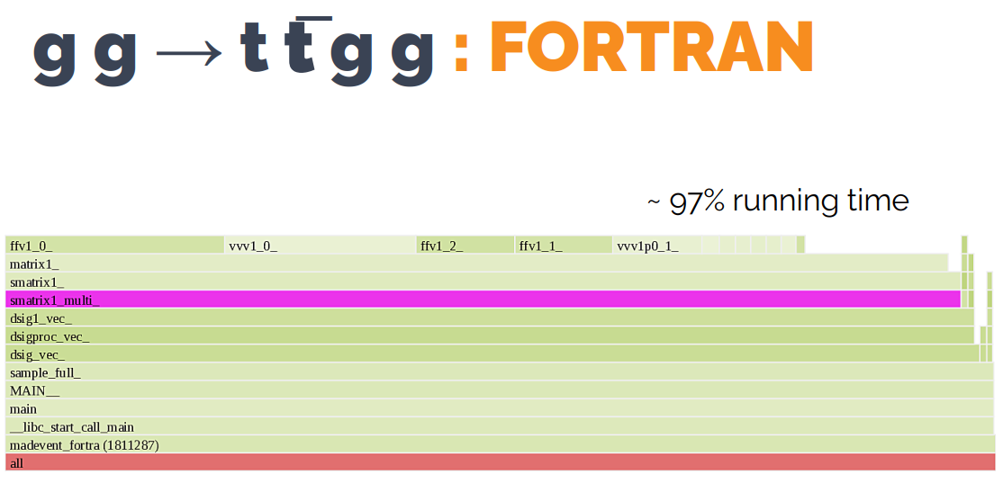
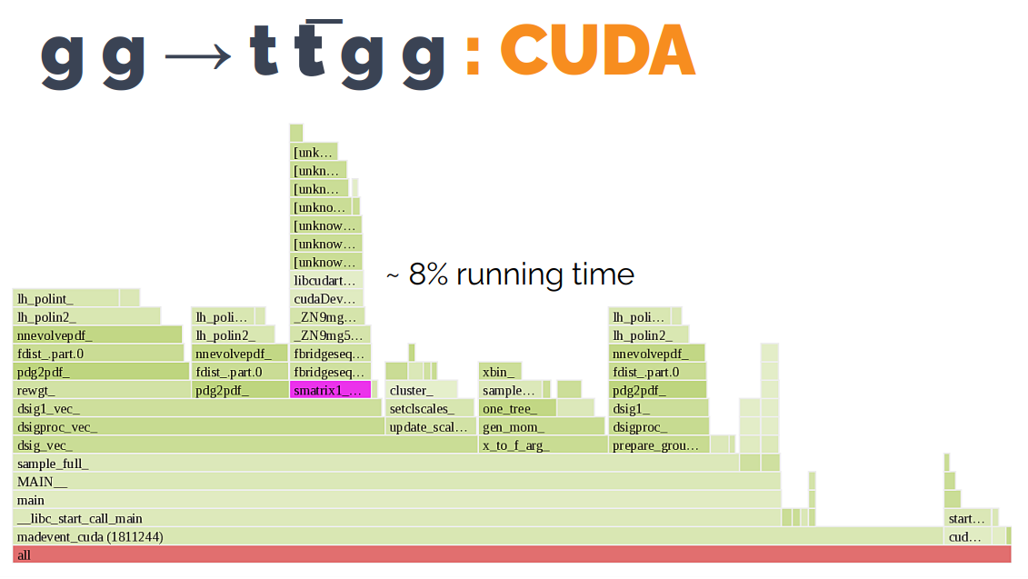
In a nutshell: we speed up the “matrix element” (ME) calculation
Matrix Elements:
97%
Daniele Massaro – ESC2024
In the old Fortran implementation, the ME calculation was the bottleneck
Using GPUs/SIMD we speed up MEs so much that previously unimportant components become the bottleneck!
  Phase space sampling, pdf’s, ...
  As predicted by Amdahl’s law (later...)
Matrix Elements:
8%

Slide 10
Architecture overview

Slide 11
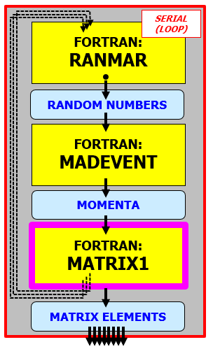
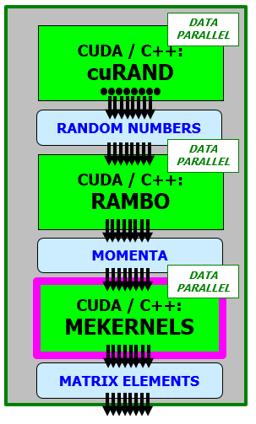
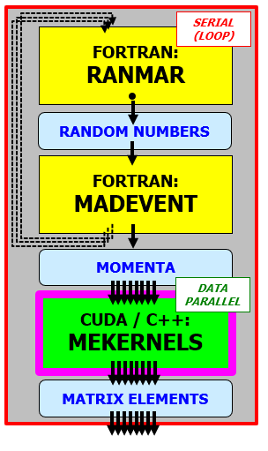
MG5AMC: from single-event to multi-event APIs
OLD madevent APPLICATION
SINGLE-EVENT MEs
(< 2020 or < MG 3.6.0)
Then we modified the existing
all-Fortran madevent application
to use multi-event APIs,
and we injected CUDACPP MEs into it (to replace Fortran MEs)
First we developed
the new ME engines in
standalone applications
1. STANDALONE
(TOY) APPLICATION
MULTI-EVENT MEs
(2020-2021)
2. NEW madevent
APPLICATION
MULTI-EVENT MEs
(2022)
SCALAR: NEW BOTTLENECK
(Amdahl’s law)
PARALLEL:
MUCH FASTER!
MATRIX ELEMENT: CPU BOTTLENECK
IN OLD madevent

Slide 12
Do's and dont's - two simple lessons learnt for any MC generator
(1) Design computational units using re-entrant functions with well-defined inputs and outputs!
  Beware of hidden inputs and outputs from common blocks and static data...
(2) Keep data parallelism in mind from the start: move from single-event APIs to multi-event APIs!
  Well-defined input array of many events, well-defined output array of many events
If you design a new Monte Carlo from scratch, these are MUST's, not SHOULD's!
"IN" ?
STATEFUL FUNCTION
"OUT" ?
/COMMON/...
/COMMON/...
IMO, within MG5AMC this remains an important issue that complicates the porting to GPU/SIMD
of non-ME components like phase space sampling...
static ...
static ...
IN
REENTRANT FUNCTION
(NO STATE! THREAD SAFE!)
OUT
1 IN
PROCESS ONE EVENT
1 OUT
An additional technicality: prefer Structure-of-Array (SOA) memory layouts for the inputs and outputs!
[Strictly needed only internally for SIMD and useful for GPUs, but good to have also in the API of the function]
PROCESS N EVENTS
N IN
N OUT

Slide 13
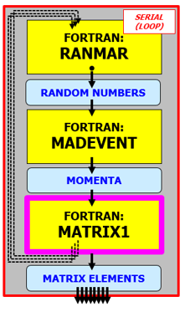
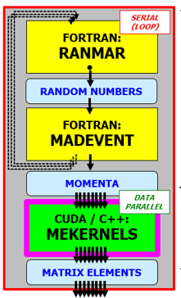
From single-event to multi-event APIs: some specific examples
1. MG5AMC at LO: the work described in this talk!
  This was the work necessary on the madevent Fortran framework (to interface to the CUDACPP “bridge”)
2. MG5AMC at NLO: the ongoing work described in the next talk by Zenny!
  The general idea (and possibly the interface of the CUDACPP “bridge”) remains the same at NLO as at LO
3. POWHEG + MG5AMC: the work we plan to collaborate with!
  This is the work the POWHEG team would need to do on their framework (to interface to the MG5AMC CUDACPP “bridge”)
1 IN
PROCESS ONE EVENT
1 OUT
PROCESS N EVENTS
N IN
N OUT

Slide 14
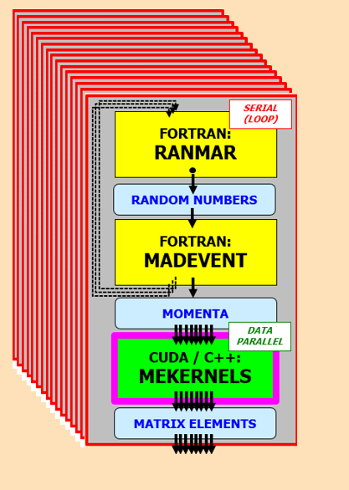
MG5AMC: CUDA/C++, Fortran, bash, python...
4. FULL WORKFLOW
./bin/mg5_aMC
install cudacpp;
generate...; output...; launch
(2024)
Initially (2020-2022) we focused on individual applications
In the last two years (2023-2024) we focused more and more on the full workflow orchestrating many applications
- testing/optimizing the sharing of work in many processes
- integrating the full user workflow including installation
3. MANY madevent
APPLICATIONs
./bin/generate_events
(2023)
1. ONE STANDALONE
TOY APPLICATION
(2020-2021)
2. ONE madevent
APPLICATION
(2022)
PYTHON/ BASH orchestration
PYTHON/ BASH orchestration
PYTHON/ BASH code generation (from the CUDACPP plugin)

Slide 15
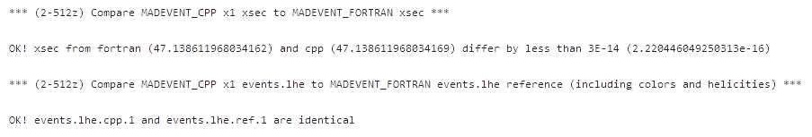
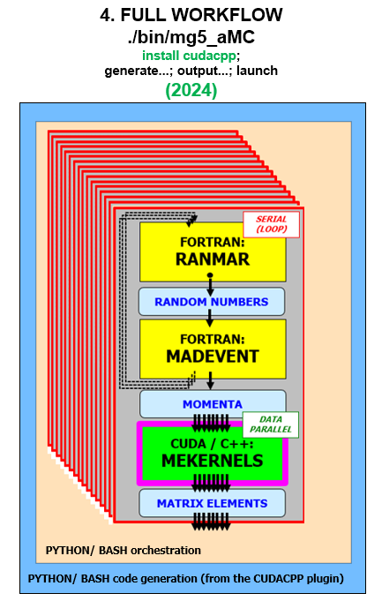
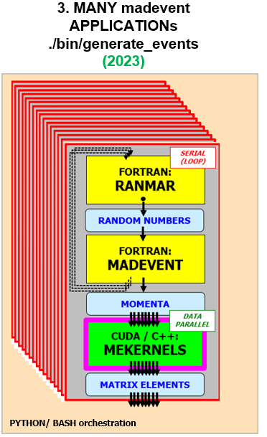
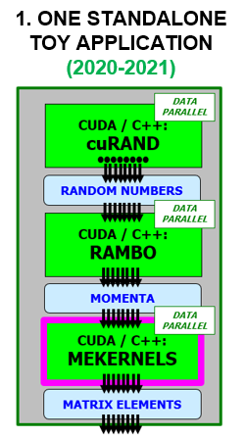
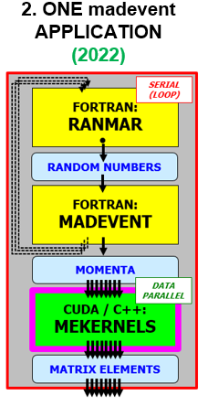
Test driven development
I personally think that writing tests is as important as (more important than?) writing implementation code!
At each stage of development we have been adding new tests – and we still run them (manually and/or in the CI)
  One standalone application: use hardcoded random seeds, compare momenta and MEs to reference files (googletest)
  One madevent application: use same random seeds, compare cross sections and LHE files for Fortran/C++/CUDA MEs
    Require ~bit-by-bit equal results (within numerical precision), this is much more than statistical comparisons!
    This test has been essential for identifying and later fixing a large number of important bugs
  New (2024): the two tests above are now in the CI for many physics processes, including automatic code generation in the CI
  Under development: full workflow with many madevent applications, compare overall cross sections and LHE files as above
Test a large phase space of development environments!
- Different physics processes
- Different vectorization scenarios
- Different floating point precisions
- Different compilers and O/S
- ...
Ideally, we will try to port all these ad-hoc manual tests to the CI

Slide 16
Some results and new developments

Slide 17
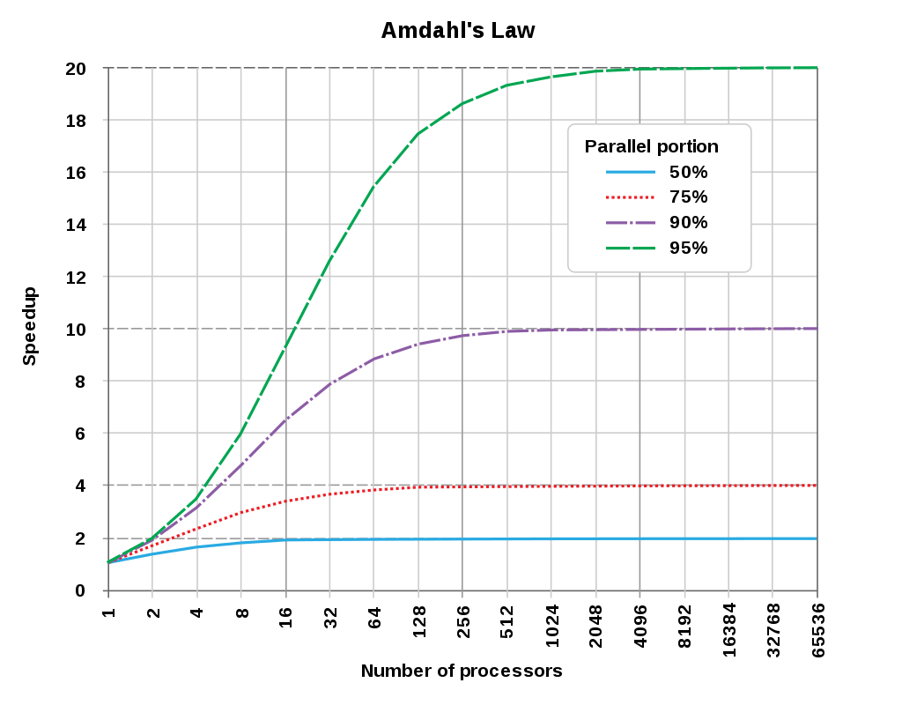

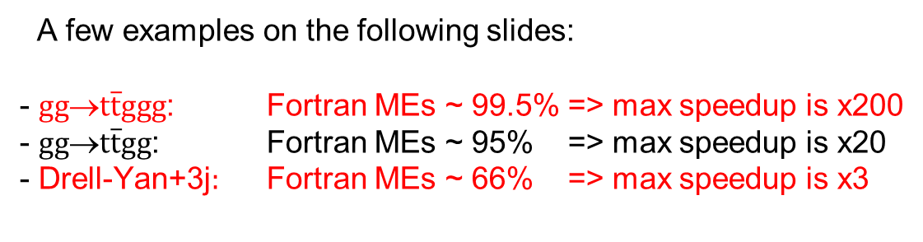
Amdahl’s law – not a theoretical possibility, we see it all the time!
The matrix element (ME) calculation was the bottleneck >95% for many processes in Fortran Madgraph
  But non-ME part <5% HAS become the bottleneck after we managed to accelerate MEs by factors O(10-1000)!
Amdahl’s law: if the parallelizable part takes a fraction of time p, the maximum speedup is 1/(1-p)
  If the non-ME part takes 5%, the maximum speedup is limited to x20 even when the ME speedup is infinite!
"Complex" physics process
MEs remain the bottleneck
Useful to further speedup the MEs
A few examples on the following slides:
- $gg$→$t\overline{t}ggg$: Fortran MEs ~ 99.5% => max speedup is x200
- $gg$→$t\overline{t}gg$: Fortran MEs ~ 95% => max speedup is x20
- Drell-Yan+3j$:$ Fortran MEs ~ 66% => max speedup is x3
https://en.wikipedia.org/wiki/Amdahl%27s_law
"Simple" physics process
MEs are no longer the bottleneck
Need to speed up the non-ME part

Slide 18
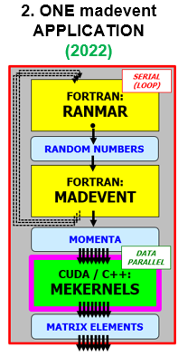
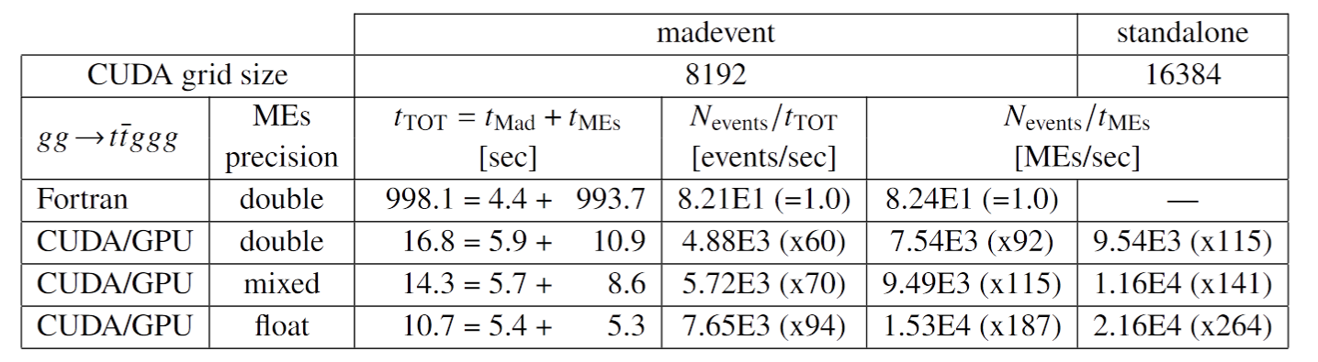
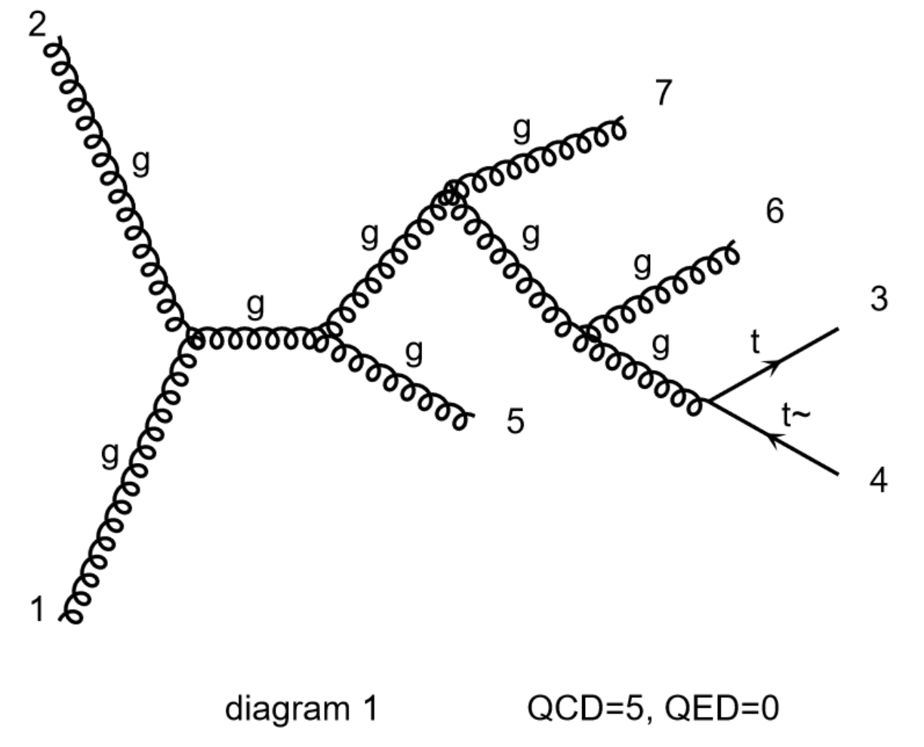
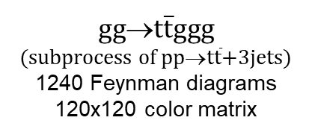
Results for $gg$→$t\overline{t}ggg$ from CUDA on NVidia V100 GPUs
Results refer to
a single CPU core
AV – CHEP2024
Amdahl's law: Overall speedup < ME speedup
Overall speedup x60 (double) and x90 (float)
with GPU MEs over scalar Fortran
ME speedup x90 (double) and x180 (float)
with GPU MEs over scalar Fortran
$gg$→$t\overline{t}ggg$
(subprocess of $pp$→$t\overline{t}$+3jets)
1240 Feynman diagrams
120x120 color matrix
This is a "complex" physics process
Even after GPU acceleration, MEs remain the bottleneck (11s out of 17s in double precision)
Trying to further optimise the ME calculation is still useful to obtain further overall speedups
Example: increase the GPU grid size (requires work on Fortran too), smaller kernels, etc...

Slide 19
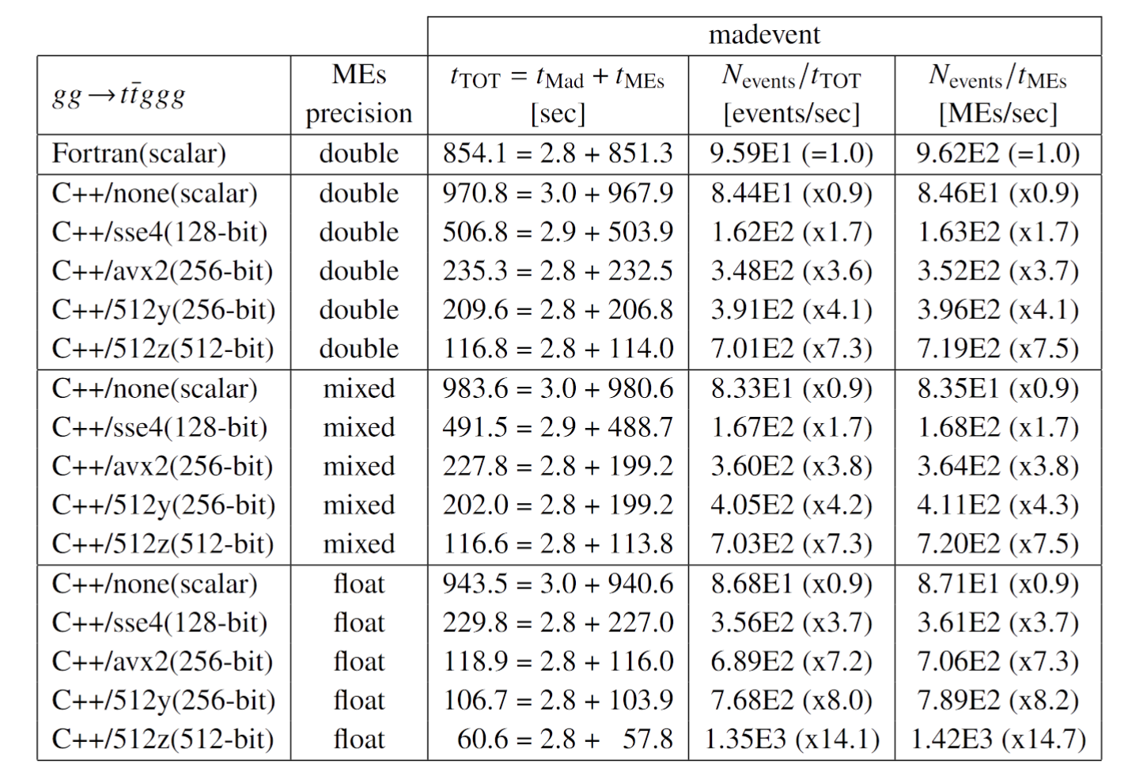

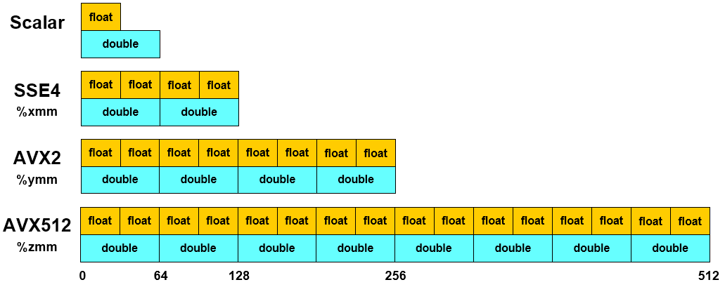
Results for $gg$→$t\overline{t}ggg$ from vectorized C++ on Intel Gold CPUs
Intel Xeon Gold 6326
(2 FMA units for AVX512)
Results refer to
a single CPU core
512y = AVX512, ymm registers
512z = AVX512, zmm registers
The latter is only better on
nodes with 2 FMA units
(here an Intel Gold 6326)
ME speedup x8 (double) and x15 (float)
with AVX512 MEs over scalar Fortran
Our ME engine reaches the
maximum theoretical SIMD speedup!
This is because we have perfect lockstep
during most of the ME calculation!
AV – CHEP2024
Amdahl's law: Overall speedup < ME speedup
Overall speedup x7 (double) and x14 (float)
with GPU MEs over scalar Fortran

Slide 20
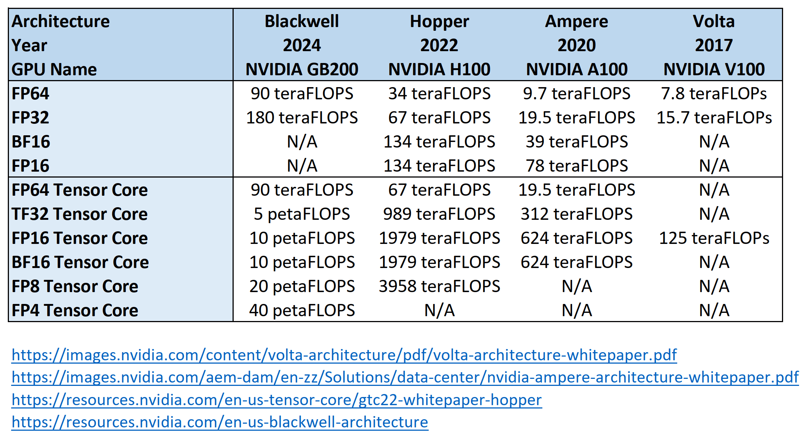
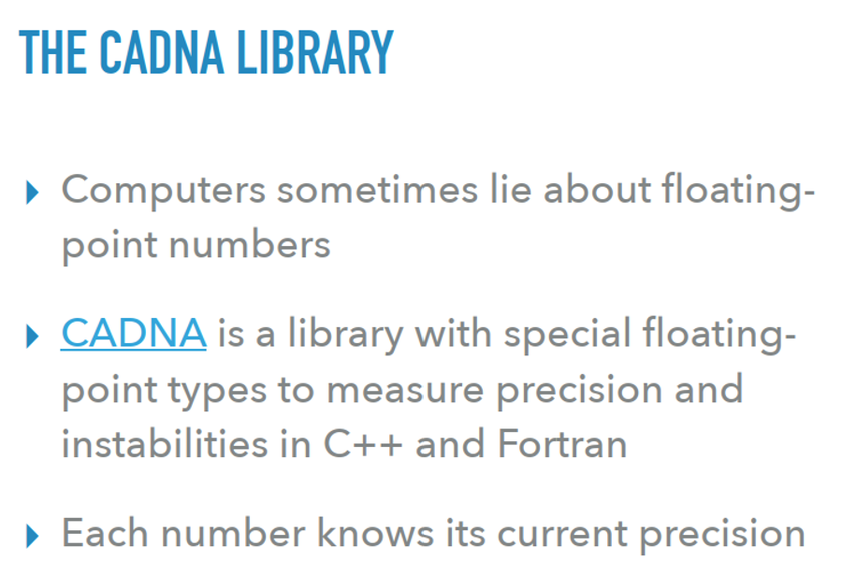
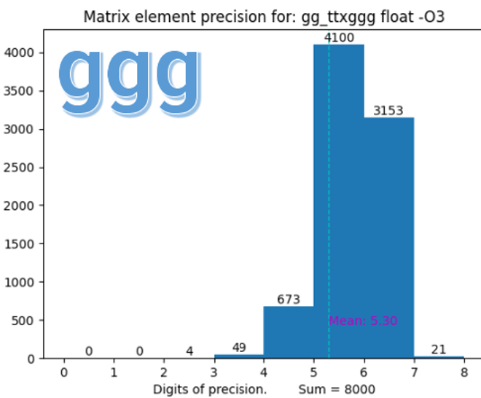
Floating point precision → constraints on GPU hardware
Previous slides: if we could use floats instead of doubles, our MEs would be a factor 2x faster!
  Our vectorized C++ is 2x faster on CPU (e.g. AVX512: a 512-bit register holds 16 floats but only 8 doubles)
  Our CUDA is 2x faster on V100's (on NVidia data-centre GPUs, the FP64 FLOPs are x1/2 the FP64 FLOPs)
But we need double precision for Feynman diagrams (single precision gives numerical instabilities)
  This means that we cannot use consumer-grade GPUs (on T4's, the FP64 FLOPs are x1/32 the FP32 FLOPs)
  Also: GPUs for AI like Blackwell GB200 do have (a lot of!) FP64, but what you pay are FP4 tensor core FLOPs!
    (En passant: in CUDACPP we do NOT use tensor cores at all – these require a different software API than CUDA cores)
We did switch to floats where possible – “mixed-precision”: double for Feynman, float for color matrix
  This is the default in CUDAPP v1.00.00 (even if the speedup over double is limited and still to be improved)
  We also had a closer look at the source of numerical instabilities with the CADNA tool
Stephan Hageboeck
Filip Optolowicz
AV – CHEP2024

Slide 21
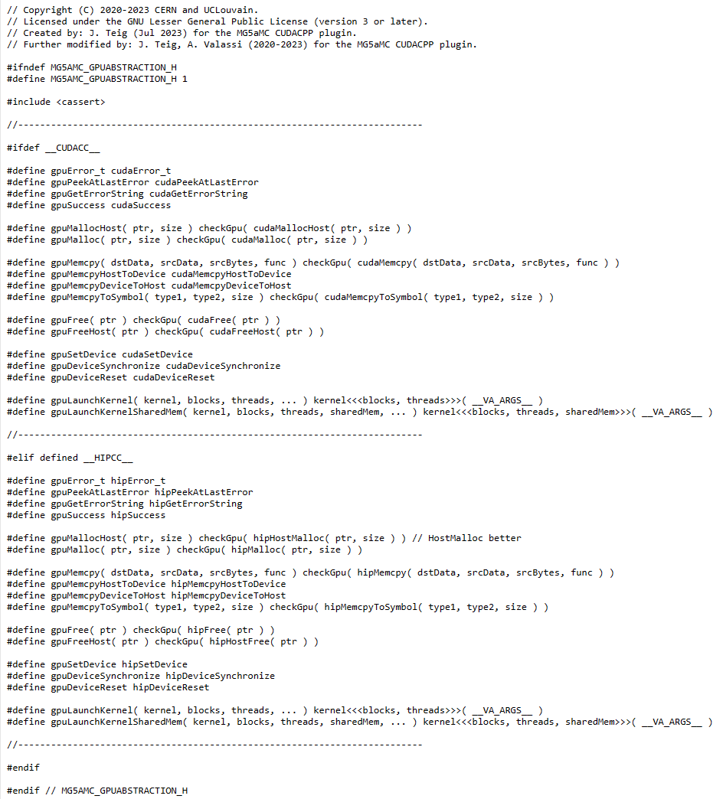
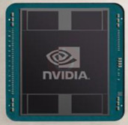
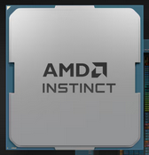
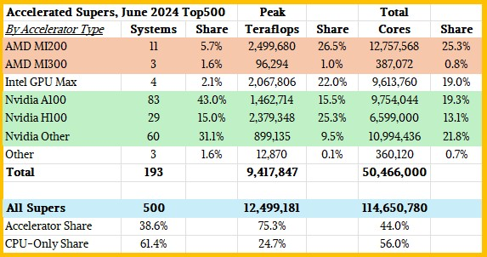
Beyond NVidia GPUs
NEW in 2024!
Joergen Teig, AV
The CUDACPP plugin uses a single source-code approach for CPUs (C++) and NVidia GPUs (CUDA), based on #ifdef’s
  The few CUDA calls are encapsulated by design in GPU classes
  We do not use any vendor-specific features (e.g. Streams) yet
CUDACPP v1.00.00 includes support for AMD GPUs through HIP, using the same #ifdef approach
  This was inspired by the LHCb approach to GPUs
  NVidia and AMD provide ~80% of the GPU power in top500 HPCs
Our Argonne colleagues are working on extending this to Intel GPUs via SYCL (based on their earlier work on a SYCL plugin)
CUDA
HIP
https://www.nextplatform.com
(13 May 2024)
GPU Teraflops by GPU family
(HPCs in June 2024 Top500)
- NVidia GPUs 50.3%
- AMD GPUs 27.5%
- Intel GPUs 22.0%

Slide 22
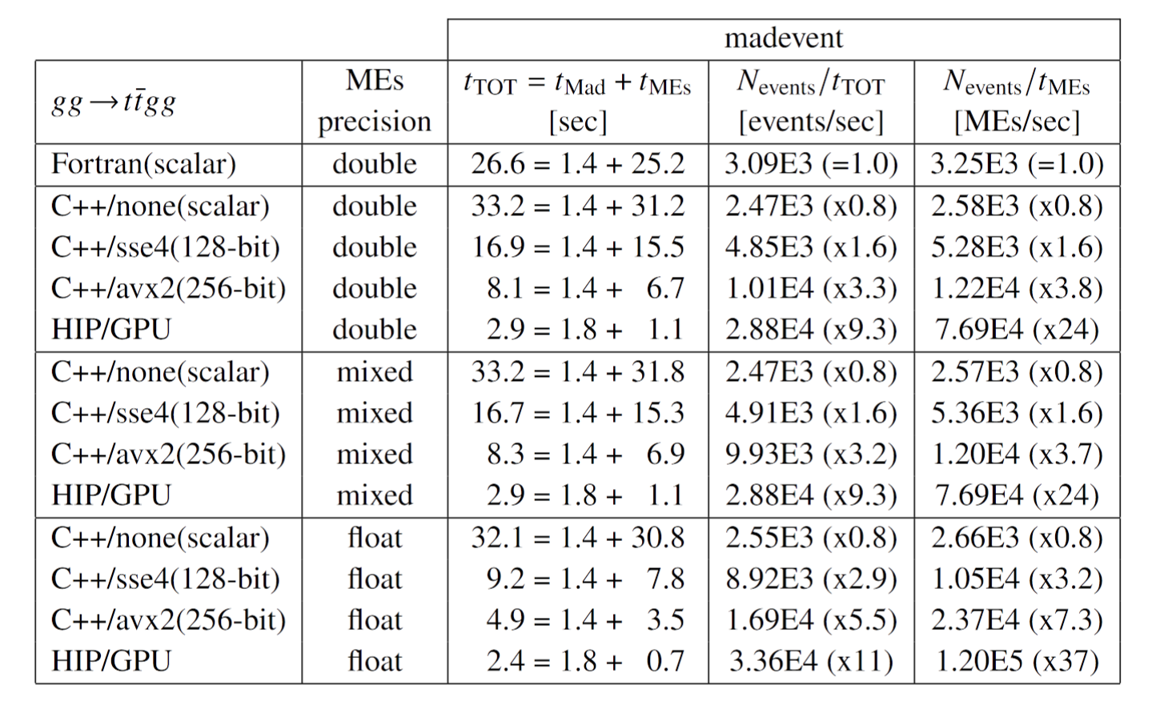
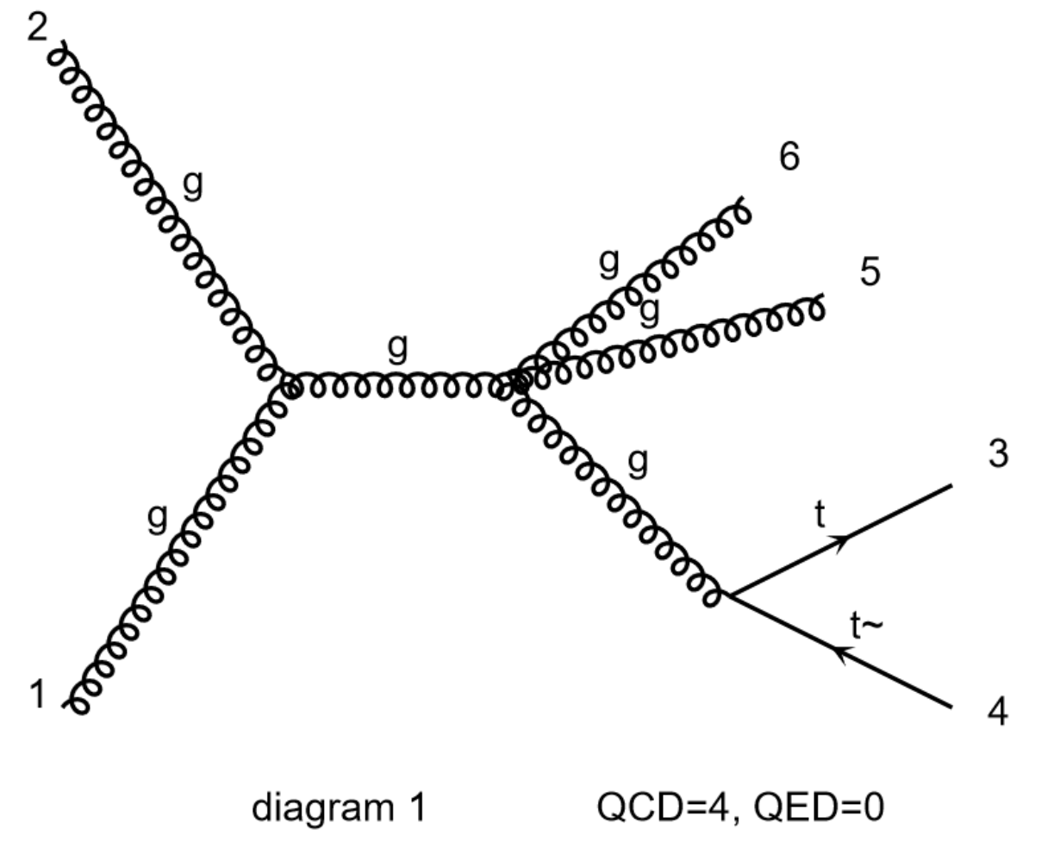
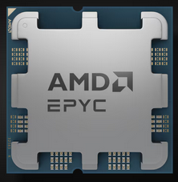
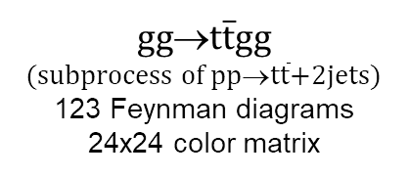
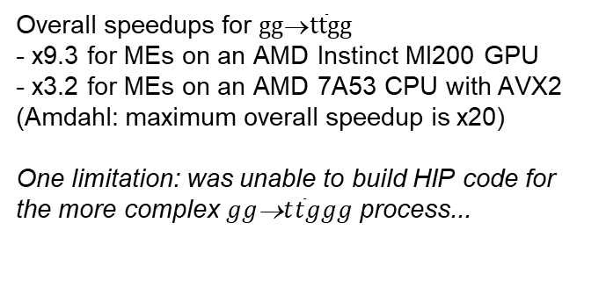
Beyond NVidia GPUs: results with AMD GPUs at LUMI
NEW in 2024!
$gg$→$t\overline{t}gg$
(subprocess of $pp$→$t\overline{t}$+2jets)
123 Feynman diagrams
24x24 color matrix
Overall speedups for $gg$→$t\overline{t}gg$
- x9.3 for MEs on an AMD Instinct MI200 GPU
- x3.2 for MEs on an AMD 7A53 CPU with AVX2
(Amdahl: maximum overall speedup is x20)
One limitation: was unable to build HIP code for the more complex $gg$→$t\overline{t}ggg$ process...
AV – CHEP2024
We kindly acknowledge the use of LUMI HPC resources under project 465001114
(“CERN / HEPiX Benchmarking GPU WP” EHPC-BEN-2024B04-053) to produce these results

Slide 23
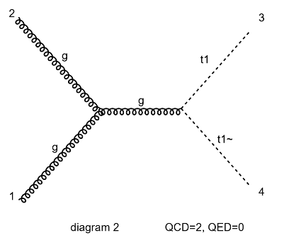
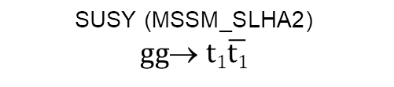
Beyond Standard Model physics in MG5aMC CUDACPP
NEW in 2024!
CUDACPP v1.00.00 includes support for several BSM processes (at LO): SUSY, HEFT, SMEFT
Motivation: speed up large productions of BSM processes at LO (for many SM processes NLO is required)
  Need event samples exploring a large parameter space (by event generation or by event reweighting)
Technical challenge (with respect to SM): non-standard parameters and couplings
  debugged/fixed non-standard code to propagate the running of the QCD coupling α_{s} to these BSM parameters and couplings
  (reminder: for each event, α_{s} scale is computed in Fortran and passed to cuda/c++ that computes α_{s}-dependent parameters)
$$\text{SUSY}\text{ (}\text{MSSM}\text{_}\text{SLHA}\text{2)}$$
$gg$→ $t1\overline{t1}$

Slide 24
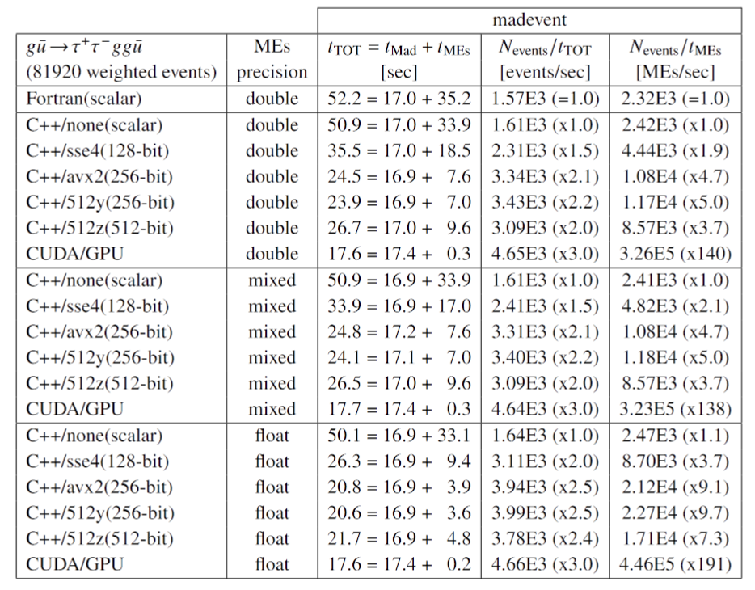
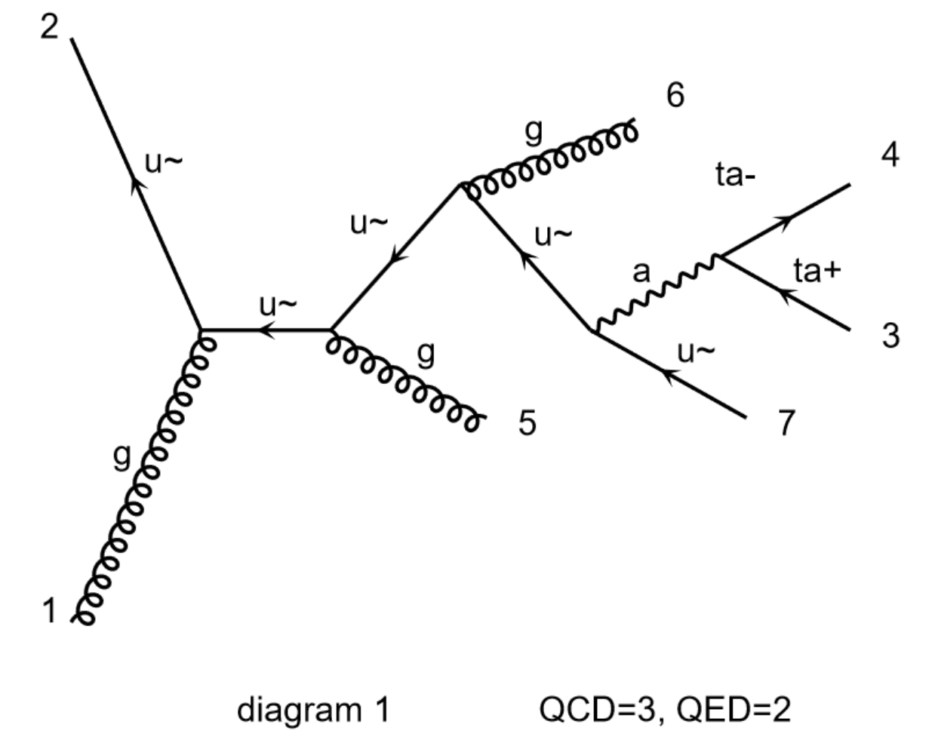

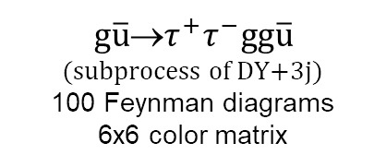
Studies with CMS: understanding Drell-Yan+3jets speedups (1)
CMS have been the first early adopters of CUDACPP – an extremely useful, mutually beneficial, collaboration!
  See the details of all the studies performed by/within CMS in Jin Choi’s poster
One of many issues we discussed with CMS: what is the speedup we can achieve from cudacpp in DY+jets?
$g\overline{u}$→$τ^{+}τ^{−}gg\overline{u}$
(subprocess of DY+3j)
100 Feynman diagrams
6x6 color matrix
For one typical subprocess of DY+3jets:
Fortran MEs ~ 67% of the total time
=> Max overall speedup is x3 (Amdahl)
Achieved speedups (mixed FP precision):
- x3.0 on GPU (NVidia V100)
- x2.2 on SIMD ("512y" on Intel Silver)
AV – CHEP2024
NVidia V100 GPU
Intel Xeon Silver 4216
(1 FMA unit for AVX512)

Slide 25
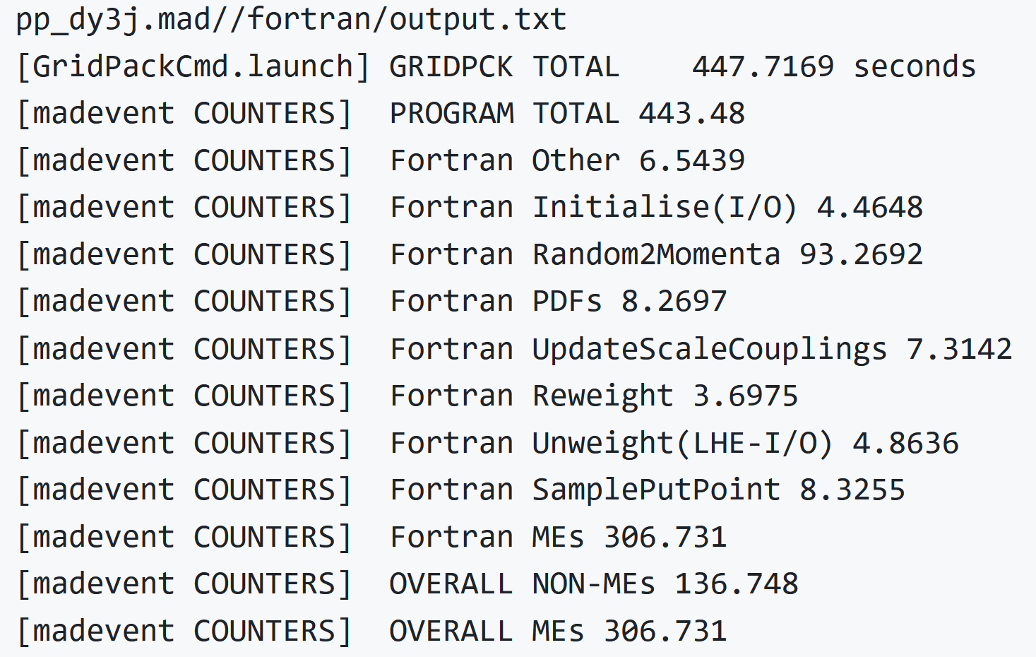
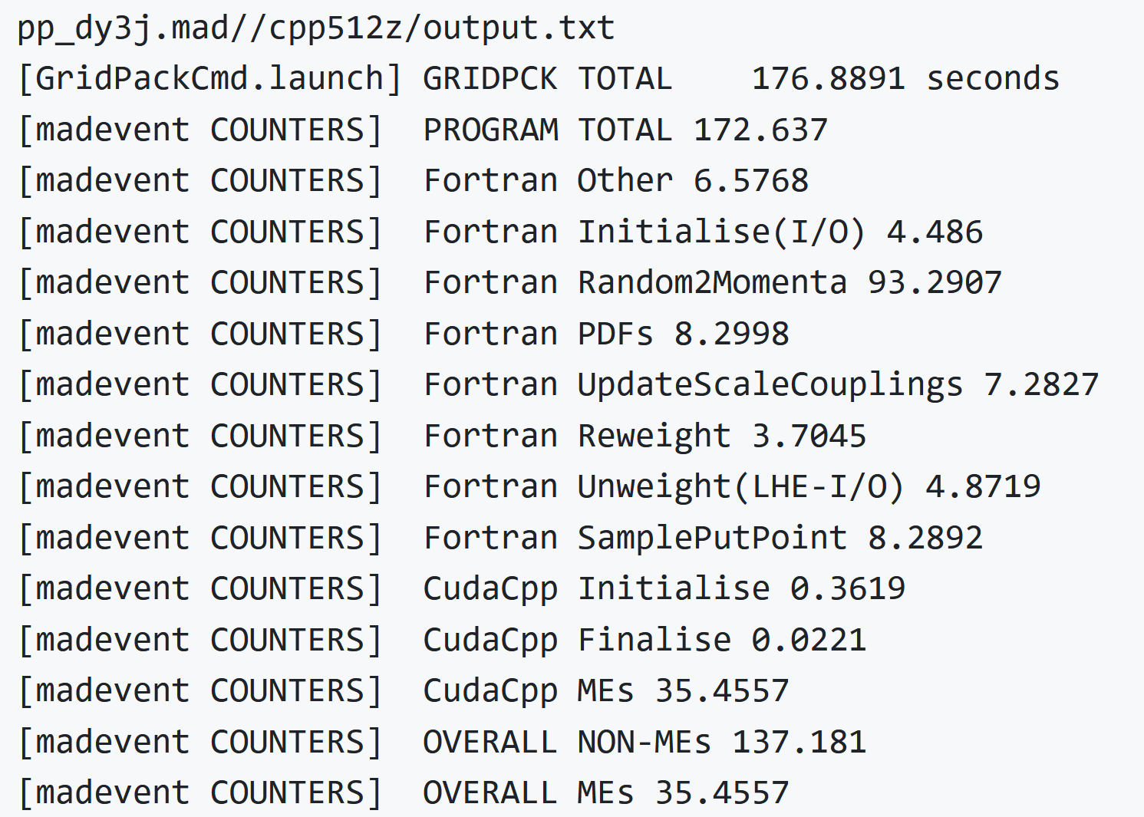
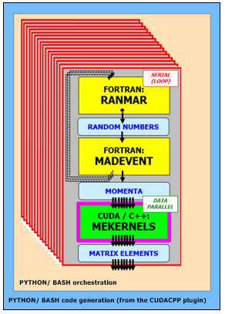
Studies with CMS: understanding Drell-Yan+3jets speedups (2)
Non-ME is 33% of overall Fortran time (max speedup x3): what exactly takes time? => Profiling!
  The answer is: Fortran phase space sampling is now the bottleneck for DY+3j (93s out of 177s overall with C++ MEs)
Profiling above is via code instrumentation (complementary to perf/flamegraph sampling profiling)
  Inserted low-overhead rdtsc counters in madevent internal fortran calls (still being tuned!)
  Keep, parse, aggregate all madevent logs from many processes in the python/bash orchestrator
  Not yet merged in mg5amcnlo or cudacpp but might be added in upcoming versions
Overall:
- Fortran 447s
- C++ 177s (speedup x2.5)
Matrix elements:
- Fortran 307s
- C++ 36s (speedup x8)
Non-ME (overall - ME):
- (Same for Fortran/C++)
- Total non-ME 140s
- Phase space sampling 93s
FORTRAN
C++
AVX512
AV – preliminary!

Slide 26
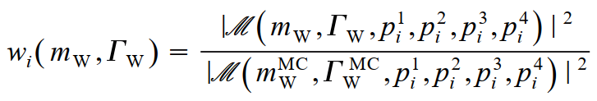





Reweighting
Old technique, renewed interest!
1. Generate signal sample at θ_{ref}, with w_{i}(θ_{ref})=1
(By definition, background does not depend on θ)
2. Full detector simulation
(MC truth event properties x_{i}^{(true)} → observed event properties x_{i})
3. Reweight each event by matrix element ratio
Two advantages: lower costs (no detector simulation), fewer statistical fluctuations
  Interest in CMS for EFT studies (exploration of large space of model parameters)
In practice for MG5AMC: read in LHE file, add weights, write back modified LHE file
  Reweighting using the new ME engine in CUDA/C++ provides O(x10) speedups!
  Zenny's "tREX" is essentially ~ready to be included in an upcoming CUDACPP v1.01
One further possible application: weight derivatives in parameter measurements
  My suggestion: save weight derivatives (w.r.t measured parameter) in LHE files
  Use them to compute ideal measurement error or for weight derivative regression
  See https://doi.org/10.1051/epjconf/202024506038 and https://zenodo.org/records/11120823
Zenny Wettersten

Slide 27
A tale of two repositories
Our work of the last 5 years is mainly here!
mg5amcnlo
https://github.com/mg5amcnlo/mg5amcnlo
the MG5AMC repo (previously launchpad)
python framework, fortran codegen
permissive NCSA-style license
Users download this repository
Users install cudacpp as a tarball
(A specific commit is in madgraph4gpu)
madgraph4gpu (will be moved and renamed!)
https://github.com/madgraph5/madgraph4gpu
the CUDACPP plugin (cuda/c++ codegen)
(legacy stuff – code, logs... – to be removed)
more restrictive LGPL license
(Developers download this repository)
Release tags are packaged as tarballs
(Developers find mg5amcnlo as a git submodule)
For more details:
  Our wiki: https://github.com/madgraph5/madgraph4gpu/wiki/Working-with-cudacpp-v1.00.00-(October-2024)
  Our bi-weekly development meetings: https://indico.cern.ch/category/12586

Slide 28












The long journey to the v1.00.00 CUDACPP release – some steps
First commit! (Feb 2020) SR
NVidia / AMD GPU abstraction
(2023-2024) JT/AV
Inject CUDA/C++
into Fortran
(2021-2022)
AV/OM/SR
Tarball install. Release tag!
(Oct 2024) AV/OM
AOSOA, SIMD vectorization (Dec 2020) AV
Set up a github CI (Jan 2021) SH
2020
2021
2022
2023
2024
2018
2019
2025?
Inception:
HSF Workshop (Nov 2018),
HSF paper (2019-2020),
LHCC review (2020-2021)
Code
generation
(Oct 2021) AV/OM
Test x-sections and LHE files Fortran vs Cudacpp (2022-2024) AV
Running couplings
(Apr 2022) OM/SR/AV
BSM (2024) AV
Memory buffers
Memory access
Kernel launchers
(Jan 2022) AV

Slide 29

Conclusions
The first release of the MG5AMC CUDACPP plugin for LO processes has been delivered!
We speed up the matrix element (ME) calculation via data parallelism with excellent lockstep processing
  On NVidia and AMD GPUs in the order of x100 to x1000
  On vector CPUs we achieve the theoretical speedup limit of x8 for AVX512 SIMD in double precision
We achieved overall speedups between x3 and x70 (for DY+3j and $gg$→$t\overline{t}ggg$) depending on the physics process
  For many processes (like DY+3j) we speed up the ME so much that the bottleneck is the non-ME component
Many opportunities for further speedups, especially in the non-ME components (phase space sampling, PDFs...)
  WIP to profile the largest residual bottlenecks and to identify speedup strategies (with/without data parallelism)
We need double precision (FP64) in the majority of floating-point operations
  Using single precision (FP32) would allow a further speedup of MEs by a factor ~x2 but leads to numerical instabilities
  WARNING: in the latest GPUs targeting AI like NVidia Blackwell, what you pay for is mainly FP4/FP8/FP16 instead!
Mutually beneficial collaboration with CMS to test our software in production-like environments
  See the details in the poster by Jin Choi on Thursday
The techniques and software used in the LO release were designed with NLO in mind and most can be reused!
  See the details in the next talk by Zenny Wettersten
  More generally, two lessons learnt for any MC: use reentrant functions with well-defined inputs/outputs, use multi-event APIs

Slide 30

Thanks Krakow!
Thanks to the organizers of this conference
Thanks Staszek
and the whole KORALW/YFSWW team
for everything I learnt from you
about Monte Carlo’s

Slide 31
BACKUP
SLIDES

Slide 32
Benchmarking GPUs (CUDA cores or tensor cores? Which FP precision?)
On data-centre NVidia GPUs, in CUDA cores
the FP32 FLOPs are 2x the FP64 FLOPs
Blackwell GPUs do have many more FP64 FLOPs in CUDA cores than Hopper or Ampere or Volta...
...but what you really pay for in Blackwell GPUs are the FP4/FP8/FP16 tensor core FLOPs for AI!
NB: CUDA cores and tensor cores are two different types of processors on the same chip!
You must develop two different types of software!
(In MG5AMC we do not use tensor cores yet...)
AV – CHEP2024

Slide 33


Speeding up PDF’s
Daniele Massaro – ESC2024

Slide 34


Slide 35


Slide 37


Scientific Computing and Software Collaborations
(or: working on the bridge between different units and communities)
in the cracks
A big lesson learnt from porting MG5AMC to GPUs: you need collaborations with a mix of skills!
Developing Monte Carlo generator software: which kind of job is this? In which box should it be?
  A scientist’s job? A theorist’s job? An experimentalist’s job? (A computing engineer’s job?)
  Do we need dedicated Scientific Computing units in our labs and universities?
  Do we need to have dedicated career paths similar to Research Software Engineers?
The challenge: attracting, training, retaining people with the right competencies and interests
  Can we attract and motivate young theorists to work on software and computing optimizations?
    A theorist colleague I was recently talking to: “We had an opening for working on software optimizations for our Monte Carlo generator. The only suitable candidates were two theorists. But they were concerned that working on software optimizations would harm their future careers as theorists and refused the job. In the end, we did not hire anyone.”
  Can we attract and motivate young software engineers to work with us instead of tech or finance companies?
I am only reporting a problem here... I do not have a magic-wand solution ☹

Slide 38

Helicity amplitudes – same code in CUDA and in vectorized C++
Old slide! The new code is different, the idea is the same!
Formally the same code for CUDA and scalar/vector C++
  hide type behind a typedef
  add a few missing operators
SIMD in CUDA/C++ uses compiler vector extensions!
Flexible design: being reused also in the vectorized SYCL implementation
Automatically generated!

Slide 39


C++ vectorization in CUDACPP: overview
Implementation is based on compiler vector extensions (CVEs): explicit vectors of floating point types
  Supported by all of the gcc, clang and (through clang) Intel icpx compilers
  Powerful but easy to use (no debugging auto-vectorization!), intuitive (they force you to design code for vector types!)
Routinely build and compare five vectorization levels on Intel CPUs (and similar features on AMD or ARM CPUs)
none 1xD, 1xF (scalar)
sse4 2xD, 4xF(128-bit xmm registers, “nehalem” SSE4.2 instruction set)
avx2 4xD, 8xF (256-bit ymm registers, “haswell” AVX2 instruction set)
512y 4xD, 8xF (256-bit ymm registers, “skylake-avx512” AVX512 instruction set)
512z 8xD, 16xF (512-bit zmm registers, “skylake-avx512” AVX512 instruction set)
Float: ~x2 faster than double
(x2 larger vector of FP values
in CPU SIMD vector registers)

Slide 40


MG5aMC data parallelism: design for lockstep processing!
In MC generators, the same function is used to compute the Matrix Element for many different events
  ANY matrix element generator is a good fit for lockstep processing on GPUs (SIMT) and vector CPUs (SIMD)
  Data parallelism strategy in madgraph4gpu is event-level parallelism (many events = many phase space points)
PSEUDO RANDOM
NUMBERS
PHASE SPACE
SAMPLING
See the NVidia Volta whitepaper
MOMENTA
GPU SIMT
MATRIX ELEMENT
CALCULATION
CPU SIMD
MATRIX ELEMENTS
GPU SIMT (Single Instruction Multiple Threads)
Lockstep: all threads in a warp follow the same branch
Minimum parallelism: 32 threads in a warp (NVidia)
CPU SIMD (Single Instruction Multiple Data)
Lockstep: same op for all data in a vector register
Minimum parallelism: 2 to 16 (SSE/AVX2/AVX512...)

Slide 41



Lockstep? MC generators (lucky!) vs MC detector simulation (unlucky)
Monte Carlo methods are based on drawing (pseudo-)random numbers: a dice throw
From a software workflow point of view, these are used in two rather different cases:
Data parallelism (NB: MULTI-EVENT API !)
MC SAMPLING
ME event generators* (before ME calculation):
MC integration (cross sections)
MC generation (event samples)
INPUT
INPUT
MC DECISIONS
Detector simulation (Geant4)
Particle/matter interaction (when? how?)
Particle decays (when?)
Event generators*
(after ME calculation):
MC unweighting (keep/reject) Parton showers (PS)
Fragmentation and decays
SAME CALCULATION
ON DIFFERENT DATA!
DECISION
DIFFERENT CALCULATIONS
ON DIFFERENT DATA!
OUTPUT
OUTPUT
Lockstep processing
Good for SIMT/SIMD
Stochastic branching
Bad for SIMT/SIMD
*NB: the CPU-intensive ME calculation comes before PS, fragmentation, detector simulation

Slide 42




ME throughput in C++ for $gg$→$t\overline{t}gg$ (on all the cores of a CPU)
gg→$t\overline{t}$gg
(float)
gg→$t\overline{t}$gg
(float)
Previous tables for SIMD speedups on C++ were for a single CPU core
Large SIMD speedups are also confirmed when all CPU cores are used
  AVX512/zmm speedup of x16 over no-SIMD for a single core slightly decreases to ~x12 on a full node (clock slowdown?)
  Overall speedup on 32 physical cores (over no-SIMD on 1 core) is around 280 (maximum would be 16x32=512)
  Aggregate MEs throughput from many identical processes using the standalone application
    (HEP-workload Docker container from the HEPIX Benchmarking WG)
(This addresses the question by Liz earlier this afternoon)

Slide 43

Our internal Fortran-to-C++ interface: multi-event and stateless!
This outputs the squared sum of amplitudes (real number)
As discussed with Simon, for HERWIG and other generators it may be useful to also expose an API that gives the partial amplitude (complex number) for a given colour structure

Slide 44



Reweighting and weight derivatives in parameter estimation
AV
Weight derivative: event-by-event sensitivity to the measured parameter
First: makes it possible to determine the limit error with an ideal detector, and how much (0 to 1) we do worse
  with a given luminosity at a FCC-ee, what is the best theoretically achievable measurement on Higgs couplings?
Second: can be used as a basis for an “improved optimal observable” ML method
Knowing one’s limits: maximum achievable
information with an ideal detector
- Ideal acceptance, select all signal events S_{sel}=S_{tot}
- Ideal resolution, measured γ_{i} is that from MC truth
(implies ideal rejection of background events, γ_{i}=0)
Data observable
event properties x_{i}^{(DATA)}
Fit WDR regressor
q_{i}^{(DATA)} = q( x_{i}^{(DATA)} )
q_{i}^{(MC)} = q( x_{i}^{(MC)} )
Weight Derivative
Regression
γ_{i}^{(MC truth)} ~ q( x_{i}^{(MC)} )
https://doi.org/10.1051/epjconf/202024506038
https://zenodo.org/record/3715951

Slide 45

Memory layouts – AOS, SOA, AOSOA
MOMENTA
CUDA/C++:
MEKERNELS
Matrix element calculation (simplified example)
  inputs[4*Npar*Nevt] = (x,y,z,E)-momentum of Npar particles for Nevt events (n-dim array, substructure)
  outputs[Nevt] = matrix element for Nevt events (1-dim array, no substructure)
  Example: Npar=6 particles for the 2→4 process $gg$→$t\overline{t}gg$
MATRIX ELEMENTS
We have experimented with three possible memory layouts for momenta
(1) Array-of-Structures AOS: momenta[Nevt][Npar][4]
(2) Structure-of-Arrays SOA: momenta[Npar][4][Nevt]
(3) AOSOA: momenta[Npag][Npar][4][Nepp] with Nevt = Npag (“pages”) * Nepp (“events per page”)
We are using AOSOA’s as the current default – but this is still largely configurable
For CPU vectorization, AOSOAs (or SOAs) are absolutely mandatory!
  We use an AOSOA with Nepp equal to the SIMD vector size NeppV – and an aligned malloc is needed too!
  For performance comparison we also build a no-SIMD mode with Nepp=1, which is effectively an AOS
For GPUs (1 event per thread), AOSOAs are faster (fewer memory accesses) but not strictly necessary
  We use Nepp=4(8) for doubles(floats) so that each page is 32 bytes (the “sector” size, or L2 cache line size)
  For a given number of “requests”, AOS uses 4 times more “sectors” (transactions) than AOSOA with Nepp=4
Coding for SIMD is more complex than coding for GPUs...

Slide 46


Monitoring GPU memory access – NSight Compute
Explicitly collect two relevant profiler metrics in NSight Compute
  “requests” : l1tex__t_requests_pipe_lsu_mem_global_op_ld.sum
  “sectors” (i.e. transactions, network roundtrips): l1tex__t_sectors_pipe_lsu_mem_global_op_ld.sum
  this is from old tests in August 2020 (issue #16), the profiler metrics names may have changed since then
Profile AOS against the AOSOA baseline
  same number of “requests” in AOS and AOSOA
  AOS needs 4 times as many “sectors” as AOSOA (which fits 4 doubles in a 32-byte cache line)
  in other words: AOSOA provides coalesced memory access, AOS does not
  for what it is worth (not much!), the actual slowdown in this $e^{+}e^{−}$→$^{+}^{−}$example was only 7% however

Slide 47





Inside the ME calculation: Feynman diagrams, colors, helicities
Given the momenta $\vec{p}$ of initial+final partons in one specific event
Sum over all helicity combinations λ of initial+final partons
Sum over all color combinations c of initial+final partons
Include all Feynman diagrams d allowed for the given λ and c
In practice in MG5aMC: use helicity amplitudes and QCD color decomposition
1. (for each helicity λ) compute partial amplitudes J^{f} for each color ordering permutation f (sum diagrams relevant to f)
2. (for each helicity λ) compute the sum over colors as the quadratic form JCJ* using the constant color matrix C
3. sum over helicities [Example for $gg$→ $t\overline{t}ggg$: 128 helicities (before and after filtering)]
Each step computes many events $\vec{p}$in parallel! CPU: 1 SIMD event-vector at a time. GPU: 1 event per thread.
Example for $gg$→ $t\overline{t}ggg$: 1240 Feynman diagrams (using helicity amplitudes)
This takes ~40% of the CPU time for this process
Example for $gg$→ $t\overline{t}ggg$: 120 color ordering permutations, 120x120 matrix
This takes ~60% of the CPU time for this process

Slide 48
C++ vectorization – why choose Compiler Vector Extensions?
Portable – available in gcc, clang, icpx (from clang) with minimal differences
  Do not require any external libraries or tools (VC, VCL, VecCore, xSIMD, UME::SIMD, or SYCL...)
Powerful, but easy to use
  No need to debug auto-vectorization when it does not vectorize
  As powerful as intrinsics, but much easier to write (higher-level abstractions)
Intuitive – CVEs force you to think in terms of vector types!
Minor disadvantage – no vector complex type out of the box
  But it was easy to write it in our case (RRRRIIII memory layout) as we only need + - × ÷
  A few extensions for Boolean vector masks were needed, too
One technical detail: we malloc a standard (aligned!) fptype* and reinterpret_cast as fptype_v*...
HUGE THANKS TO SEBASTIEN PONCE for his Practical Vectorization lectures mentioning CVEs!

Slide 49



Monitoring lockstep – GPU NSight compute, CPU disassemble
GPU: explicitly collect one profiler metric in NSight Compute
  “branch efficiency” : sm__sass_average_branch_targets_threads_uniform.pct
  old test (May 2021 issue #25) comparing two code bases: no-divergence baseline has 100% efficiency, alternative with minor forced divergence has 96% efficiency (and is 20% slower)
CPU: the best lockstep metric IMO is the speedup over a no-SIMD case (reach theoretical maximum!)
  but is also useful to disassemble the object using objdump and categorize SIMD intrinsics symbols...
# Symbols in .o | SSE4.2 (xmm) | AVX2 (ymm) | AVX512 (ymm) | AVX512 (zmm)
Build type
Scalar | 4534 | 0 | 0 | 0
SSE4.2 | 12916 | 0 | 0 | 0
AVX2 | 0 | 10630 | 0 | 0
256-bit AVX512 | 0 | 10366 | 12 | 0
512-bit AVX512 | 0 | 1267 | 60 | 9910
ACAT2022
4a90ec2 $gg$→$t\overline{t}gg$

Slide 50
Code generation: from many “epochs” to a single evolving “epoch”
... and beyond
OLD MODEL
(2020- early 2021)
(1) MG5AMC Python framework, Fortran templates:
“upstream” https://github.com/mg5amcnlo/mg5amcnlo
(2) CUDACPP plugin, post-generation patches,
generated CUDA/C++ physics processes:
our https://github.com/madgraph5/madgraph4gpu
Code generation infrastructure
- Python framework and “cudacpp” plugin
- Fortran, C++, CUDA templates
- Post-generation patches (temporary...)
WIP to-do before a release: full port from madgraph4gpu to mg5amcnlo (remove post-generation Fortran patches, add CUDACPP upstream)
A.V.
(3) re-generate
Automatically generated code
- Fortran framework (Madevent)
- CUDA/C++ Matrix Elements
Stefan Roiser
NEW MODEL
(since end 2021)
(1) develop on top of auto-generated code
(2) backport immediately to code generation infrastructure

Slide 51

What about loops? And how many are N events?
You will still need to loop over multiple sets of N events
  And the internal implementation of N-event processing may still involve some loops!
N should be at least as big as the minimum number of events for which strict lockstep is required
  On a CPU: number of variables in a vector register (most complex case: 16 floats in a 512-bit AVX512 register)
  On a GPU: strictly speaking, number of threads (typically: 32) in a GPU “warp”
    Our present implementation: number of threads to “fill” the GPU (typically: 16k, up to 500k)
NB: I focus on event-level parallelism, but other options exist
  In MG5AMC we will investigate using 1 GPU thread per helicity per event...
PROCESS N EVENTS
(N x M EVENTS)
LOOP OVER 1...M
N IN
N OUT
...one more item on our to-do list for next year...
(also because so many events may lead to biases)
"Process N events": three implementation examples (there can be more!)
1. CPU scalar: internally loop over N events, process each one individually
2. CPU vector: hold the events in a SIMD vector of size N,
3. GPU kernel: each of the N events is processed by one of N GPU threads

Slide 52



Why focus on complex processes? Compute >> memory!
We are lucky: the more complex the physics process, the less relevant is the cost of GPU-CPU data copies!
  Similarly (later): the more complex the process, the less relevant is the overhead from scalar Fortran in madevent!
  And the fewer events in flight needed to fill the GPU...
In this talk I mainly give performance numbers for complex processes like $gg$→$t\overline{t}gg$ or $gg$→$t\overline{t}ggg$
e⁺e⁻→μ⁺μ⁻
$gg$→$t\overline{t}gg$

Slide 53


Some ideas for heterogeneous processing
Nvidia V100 GPU
Silver 4216 4-core CPU
Throughput variation as a function of GPU grid size (#blocks * #threads)
This is the number of events processed in parallel in one cycle
To further reduce the relative overhead of the scalar Fortran MadEvent - parallelize it on many CPU cores?
Blue curve: one single CPU process using the GPU
  For gg→$t\overline{t}$gg, you need at least ~16k events to reach the throughput plateau
Yellow, Green, Red curves: 2, 4, 8 CPU processes using the GPU at the same time
  Fewer events in each GPU grid are needed to reach the plateau if several CPU processes use the GPU
  The total Fortran RAM would remain the same, but the CPU time in the Fortran overhead would be reduced
  (Why total throughput increases beyond the nCPU=1 plateau is not understood yet!...)

Slide 54
Lockstep beyond event-level parallelism
Efficient data parallelism (lockstep processing) requires the same function computed for different data
  This is true in MG5AMC at the event level (different events i.e. different phase space points)
  But it is also true at the sub-event level (different helicities within the same event)
We are evaluating the move to a different data parallelism strategy on GPUs
  Currently: one event (sum over all helicities) per GPU thread
  In the future: one helicity of one event per GPU thread?
Advantages:
  You can fill the GPU with much fewer “events in flight” – more balanced sampling/integration in MadEvent
  This is a prerequisite for moving the color matrix to externally-launched cuBLAS and tensor cores
  This is also a prerequisite if we want to evaluate much smaller kernels
    From all Feynman diagrams in one kernel to one Feynman diagram per kernel?
    Which might decrease register pressure and increase kernel occupancy, but would require more global memory access

Slide 55









CUDACPP MEs
PF MEs
95% common code + a few #ifdef's for CUDA vs C++
Designed for NVidia GPUs (so far: will add HIP/AMD)
  Full feature support, e.g. tensor cores, streams, graphs
Designed upfront for SIMD speedups on vector CPUs
WIP on CPU multithreading and heterogeneous modes
Write code once for many CPU/GPU vendors
Support NVidia, AMD and Intel GPUs out-of-the-box
  Limited support for vendor-specific features
SIMD added via SYCL in Jan 2023, analysing results
CPU multithreading out of the box
For the moment: we plan to continue development in parallel using both approaches – comparisons are very useful!
Two goals: not only production releases, but also aim to provide useful feedback to HEP about usability of PFs

Slide 56
CUDACPP vs. Portability Frameworks – recap
CUDAPP (our initial implementation) is where we add new features first
The SYCL implementation of MG5aMC is now almost at the same level, the KOKKOS one somewhat behind
The ALPAKA implementation of MG5aMC is no longer maintained
Backend | ME code generation | Standalone application | Actively maintained | MadEvent application | Latest dev code base
CUDACPP | ✓ | ✓ | ✓ | ✓ | ✓
SYCL | ✓ | ✓ | ✓ | ✓ | ~ ✓
KOKKOS | ✓ | ✓ | ~ ✓ | WIP | WIP
ALPAKA (CUPLA) | ✓ | ✓ | ✗ | ✗ | ✗

Slide 57


CUDACPP vs PFs - GPU ME throughputs (standalone application)
Variable GPU-grid size (throughput scan)
Fixed GPU-grid size (throughput plateau)
INTEL
AMD
NVIDIA
(gg_ttgg) 16k
The performances of the SYCL and Kokkos implementations of MG5aMC seem comparable to direct CUDA
  Further comparisons are in progress, performance scales differently with more jets for different backends (next slide)
SYCL and Kokkos run out of the box also on AMD and Intel GPUs
  They also run out of the box on CPUs (performance under investigation)
Xe-HP is a software development vehicle for functional testing only - currently used at Argonne and other customer sites to prepare their code for future Intel data centre GPUs
XE-HPC is an early implementation of the Aurora GPU

Slide 58








CUDA vs SYCL on NVidia A100
PRELIMINARY!
N. Nichols, T. Childers (SYCL)
J. Teig (tests/plots)
CUDA < SYCL
$gg$→$t\overline{t}$
SYCL and CUDA implementations have ~similar performances but
  SYCL seems better for less complex processes
  CUDA seems better for more complex processes
These are very recent results, which are still being digested (WIP!)
  It will be very interesting to understand more in detail what goes on
We plan to also compare more systematically the CUDACPP and SYCL performances on CPUs (vectorization, multi-core), but it will take time and optimization tweaks... WIP!
CUDA < SYCL
$gg$→$t\overline{t}g$
CUDA > SYCL
$gg$→$t\overline{t}gg$
CUDA > SYCL
$gg$→$t\overline{t}ggg$

Slide 59
MORE BACKUP
SLIDES

Slide 60

Code generation: how did we bootstrap the project?

Slide 61

Filling the GPU – minimum number of threads (events in flight)
https://doi.org/10.1051/epjconf/202125103045 (vCHEP 2021)
We are lucky, again: the more complex the process, the fewer the events in flight needed to fill the GPU
But even 16k events is a lot: it results in imbalanced phase space sampling, and high RAM in Fortran
  Eventually, maybe: one helicity per kernel (fewer events in flight, spread each event across many kernels)?
  Eventually, maybe: many CPU cores/processes in parallel (fewer events in flight per CPU core/process)?
  Eventually, maybe: different channels in parallel (fewer events in flight in a single channel)?

Slide 62


Numerical precision: CADNA
(can we use floats instead of doubles?)
F. Optolowicz, CERN EP-SFT meeting 21 Aug 2023
https://indico.cern.ch/event/1264290/
S. Hageboeck, Gargnano meeting 18 Sep 2023
Application to MG5AMC CUDACPP:
  assess precision of the ME calculation (when using floats: down to 3 significant digits in gg to ttggg)
  understand where in the code the precision is lost (typically, cancellations subtracting large terms, one example being heavily suppressed helicities)

Slide 63

All MadEvent functionalities have been integrated over time
Most of these required some changes to the input/output API of our Fortran-to-CUDA/C++ “Bridge”
Helicity filtering – at initialization time, compute the allowed combinations of particle helicities
  This is computed in CUDA/C++ using the same criteria as in Fortran
“Multi-channel” – single-diagram enhancement of ME output
  This is the specificity of the MadEvent sampling algorithm (Maltoni Stelzer 2003)
Event-by-event running QCD coupling constants α_{s}(Q²)
  The scale is currently computed in Fortran from momenta and passed to the CUDA/C++ for each event
Event-by-event choice of helicity and color in LHE files
  Pass two additional random numbers per event from Fortran to CUDA/C++, retrieve helicity and color
  NEW (January 2023)! This was the last big missing physics functionality (showstopper to a release)
    We now get the same cross section AND the same LHE files (within numerical precision) in Fortran and CUDA/C++

Slide 64
Benchmarking – Madgraph and the HEP-SCORE project
HEPscore: the new HEP benchmark for compute resources, replacing HepSpec06
  Based on reproducible HEP workloads (GEN, SIM, DIGI, REC...) within docker containers
  The first version HEPscore23 should become production in April 2023 for (x86 and ARM) CPUs
The aim is to benchmark a fully loaded server: all CPU cores, and eventually all associated GPUs
  (and ideally measure how well an application is doing compared to the theoretical power of the server...)
  fill all CPU cores by a combination of application multi-threading and/or several identical copies/processes
A first container based on our Madgraph-on-GPU has been prepared
  Very useful because it gives the same physics results on CPU and GPU: may compare them to each other!
  And eventually may be used to evaluate heterogeneous processing on CPU+GPU...
The plots on the next slides are based on this HEPscore container: several identical copies/processes
  (A multi-threaded CUDACPP version exists but not optimized yet – SYCL and Kokkos also provide MT)

Slide 65


MG5AMC is not alone – SHERPA on GPU (BlockGen)
Note: unlike MG5aMC, based on Feynman diagrams, SHERPA uses ~Berends-Giele recursion relations
  Allows computations with more final-state jets
No ongoing effort on CPU vectorization (yet)
Planned Les Houches project: a detailed comparison of software performances of MG5AMC and SHERPA
  Tentative process list: pp to tt(0-3jets) or Z(0-3jets)
  Previously, an old wish of the HSF generator WG
  (NB: not a comparison of physics results or distributions)
From http://dx.doi.org/10.21468/SciPostPhysCodeb.3
More recent results were presented in June 2023
in Les Houches by Max Knobbe

Slide 66
EVEN MORE BACKUP
SLIDES

Slide 67

OM, mgongpu dev meeting
22 Jun 2020

Slide 68

OM, mgongpu dev meeting
22 Jun 2020

Slide 69

SH, mgongpu dev meeting
30 Nov 2020

Slide 70


Slide 71


Slide 72


Slide 73


Slide 74


Slide 75


Slide 76


Slide 77


Slide 78


Slide 79


Slide 80

OM, mgongpu dev meeting
7 Jun 2021

Slide 81

OM, mgongpu dev meeting
7 Jun 2021

Slide 82

OM, mgongpu codegen workshop
16 Sep 2021

Slide 83


Slide 84


Slide 85


Slide 86


Slide 87


Slide 88


Slide 89


Slide 90


Slide 91


