Slide 1

Task3 of the mmWG:
Present Status of the study and results
F. Boattini M. Breschi
30.October.23

Slide 2
Organization of the presentation
Accelerator Power and Energy: general frame
Magnet analysis results: present status
Ideas for the full power-converters/magnets system
Proposal of the subjects to analyze

Slide 3
Ultimate goal of Task3
In one sentence:
  Design and cost evaluation of the dipole/quadrupole resistive magnet and powering system for the full RCS accelerator chain;
Methodology:
  Parametric models is the keyword as several interaction with RF, lattice and vacuum chamber design are to be foreseen;
  Simple models to be realized in Python and based on more detailed FEM 2D-3d models;

Slide 4
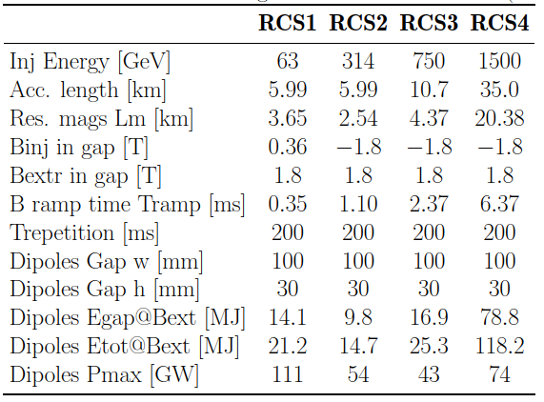
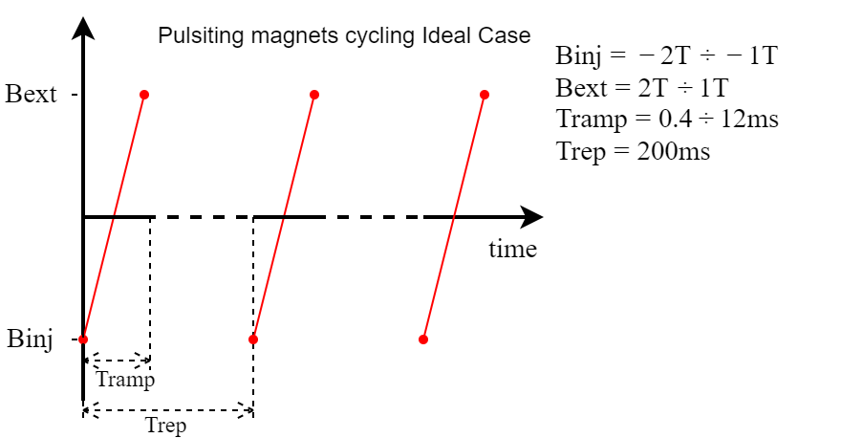

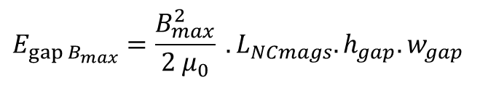
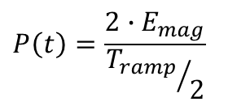
Accelerator Power and Energy: a general frame
RCS values from excel sheet
F. Batsch, H. Daimerau.
  $$E_{{gap B}_{max}}=\frac{B_{max}^{2}}{2 μ_{0}} . L_{NCmags}.h_{gap}.w_{gap}$$
  $$E_{mag}≈1.5∙E_{{gap B}_{max}}$$
  $$P_{ }\left(t\right)=\frac{{2∙E}_{mag}}{{T_{ramp}}/2}$$
Approximate calculations for the magnetic circuit, show that the total mmf is about 40 ÷ 50 kAturns with an inductance of about 4.5 ÷ 6.5 uH/m with a single series conductor.
The correspondent inductive voltage for the four RCS would be:
 | RCS1 | RCS2 | RCS3 | RCS4
Inductive Voltage of the power supply with a single turn | 670 [V/m] | 420 [V/m] | 200 [V/m] | 70 [V/m]
Total magnet voltage | 2.4 [MV] | 1.07 [MV] | 0.9 [MV] | 1.5 [MV]
High voltage and power must be divided into several sectors

Slide 5
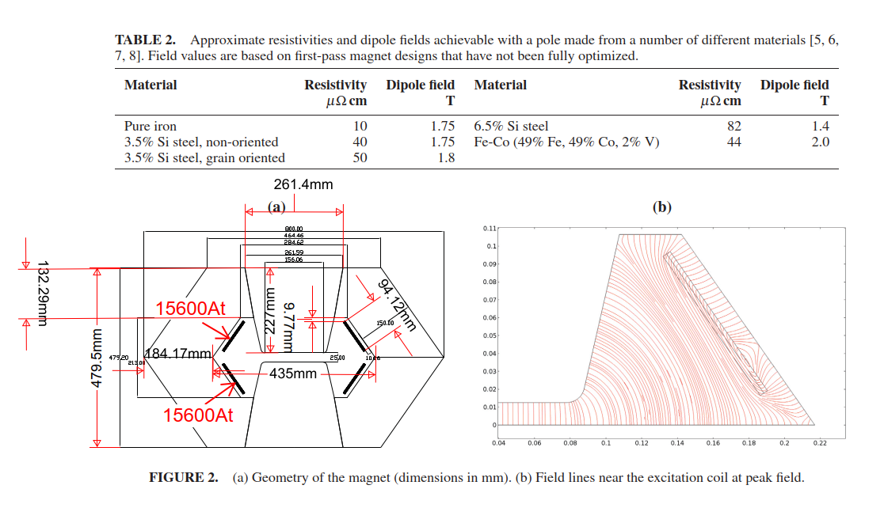
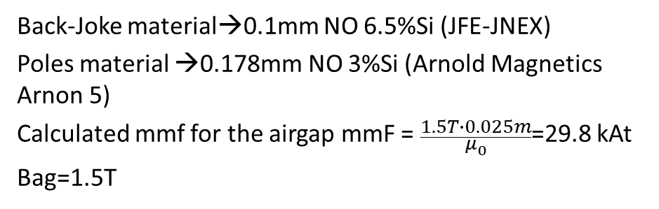
MAP dipole study (https://doi.org/10.1063/1.4965683)
Back-Joke material→0.1mm NO 6.5%Si (JFE-JNEX)
Poles material →0.178mm NO 3%Si (Arnold Magnetics Arnon 5)
Calculated mmf for the airgap mmF = $\frac{1.5T∙0.025m}{μ_{0}}$=29.8 kAt
Bag=1.5T
Map Dipole | MAP | CERN (Maxwell2D)
External Dimensions [mm x mm] | 800 X 480 | 800 X 480
Bgap [T] | 1.5 | 1.5
Gap size [mmxmm] | 156 x 25 | 156 x 25
Mmf [kAt] | 31.2 | 31.2
Iron losses (joke) [J/cycle-m] (*) | ≅1.1E6/(2200x15)=33 | 59085x2x0.001=59 (pole and Joke have the same material M235-35A)
Iron losses (pole) [J/cycle-m] (*) | ≅2.1E6/(2200x15)=63 | 61167x2x0.001=61
Coil Losses [J/cycle-m] (*) | ≅0.55E6/(2200x15)=16 | 4*(3174+5106)x0.001=33
Total losses [J/cycle-m] (*) | 112 | 153
Stored energy (total / gap) [J/m] | 4200 / 3490 | 4900 / 3490
(*) with 1kHz sinus

Slide 6
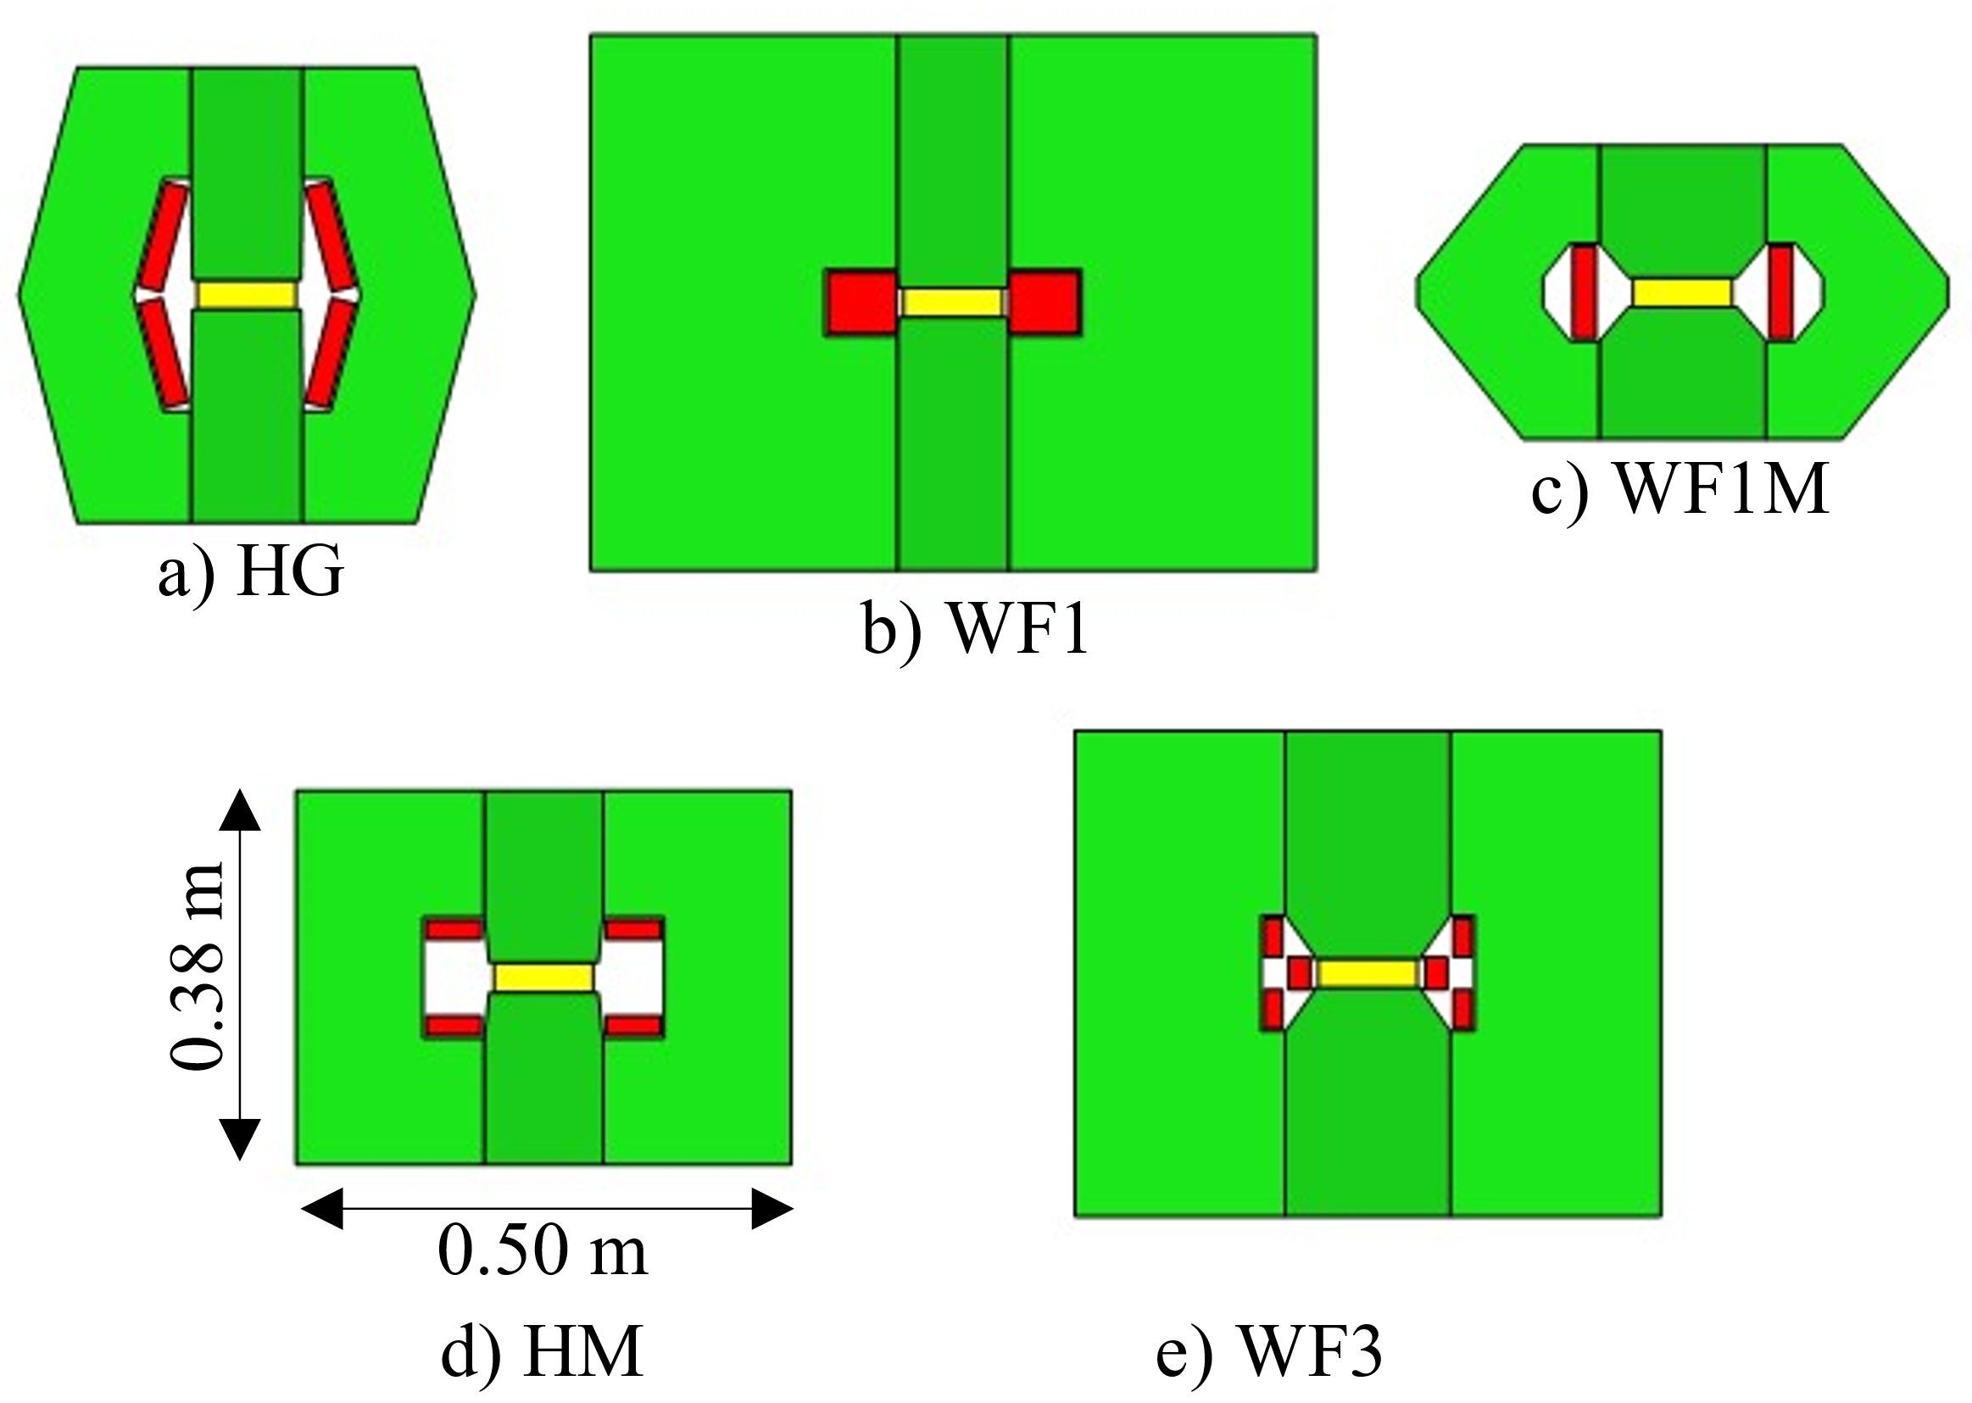
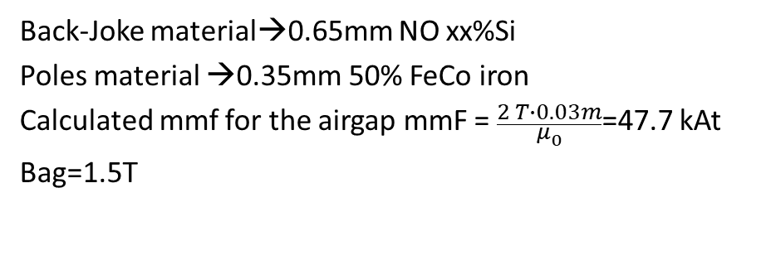
UNIBO dipole study
Back-Joke material→0.65mm NO xx%Si
Poles material →0.35mm 50% FeCo iron
Calculated mmf for the airgap mmF = $\frac{2 T∙0.03m}{μ_{0}}$=47.7 kAt
Bag=1.5T
Map Dipole | MAP | UNIBO HM
External Dimensions [mm x mm] | 800 X 480 | 500 x 380
Bgap [T] | 1.5 | 2 (1.8 is the design value)
Gap size [mmxmm] | 156 x 25 | 100 x 30
Mmf [kAt] | 31.2 | 47.8
Iron losses [J/cycle-m] | ≅1.1E6/(2200x15)=96 @1kHz | 128 @ 500Hz
Coil Losses [J/cycle-m] | ≅0.55E6/(2200x15)=16 @1kHz | 295 @ 500Hz
Total losses [J/cycle-m] | 112 | 423
Stored energy (total / gap) [J/m] | 4200 / 3490 (1.2) | 5740 / 4775 (1.2)

Slide 7
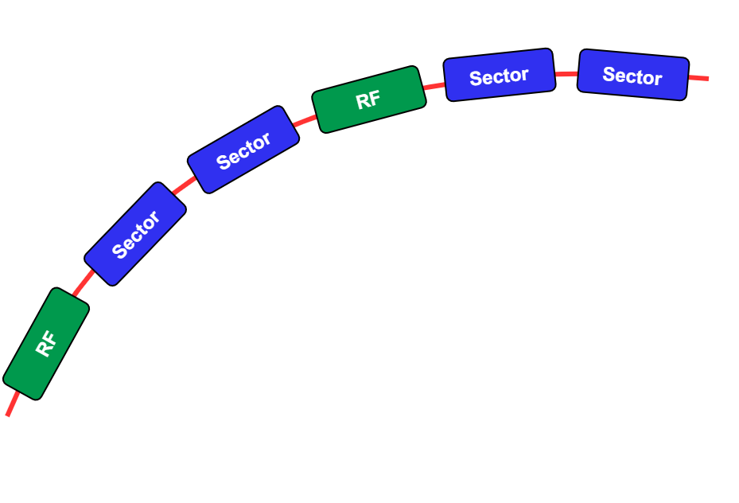
Ideas for the full power-converters/magnets system
Note: this is only an example. The models developed at this stage should be parametric for as much as it is possible
The RCS is divided in 48 sector (to match with 24 RF sectors)
Each sector consists of:
8 parallel circuits with 8 series power cells each
Magnet’s coils are eight times interleaved to balance circuit’s impedances => each parallel branch has the same magnet’s parameters over the 8 sections
In each sector super and normal conductive dipoles and quadrupoles are interleaved.
Power cell
Power cell
Power cell
Power cell
Magnet 1 coil 1
Magnet 2 coil 2
Magnet 3 coil 3
Magnet 4 coil 4
Power cell
Power cell
Power cell
Power cell
Magnet 8 coil 8
Magnet 7 coil 7
Magnet 6 coil 6
Magnet 5 coil 5
Power cell
Power cell
Power cell
Power cell
Magnet 1 coil 8
Magnet 2 coil 1
Magnet 3 coil 2
Magnet 4 coil 3
Power cell
Power cell
Power cell
Power cell
Magnet 8 coil 7
Magnet 7 coil 6
Magnet 6 coil 5
Magnet 5 coil 4

Slide 8
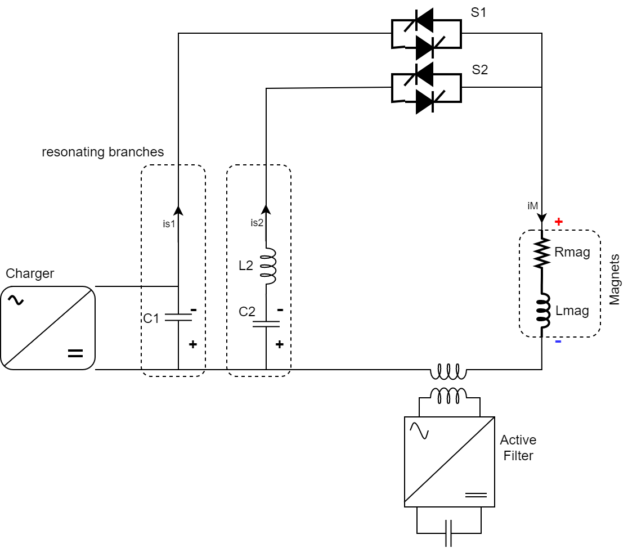
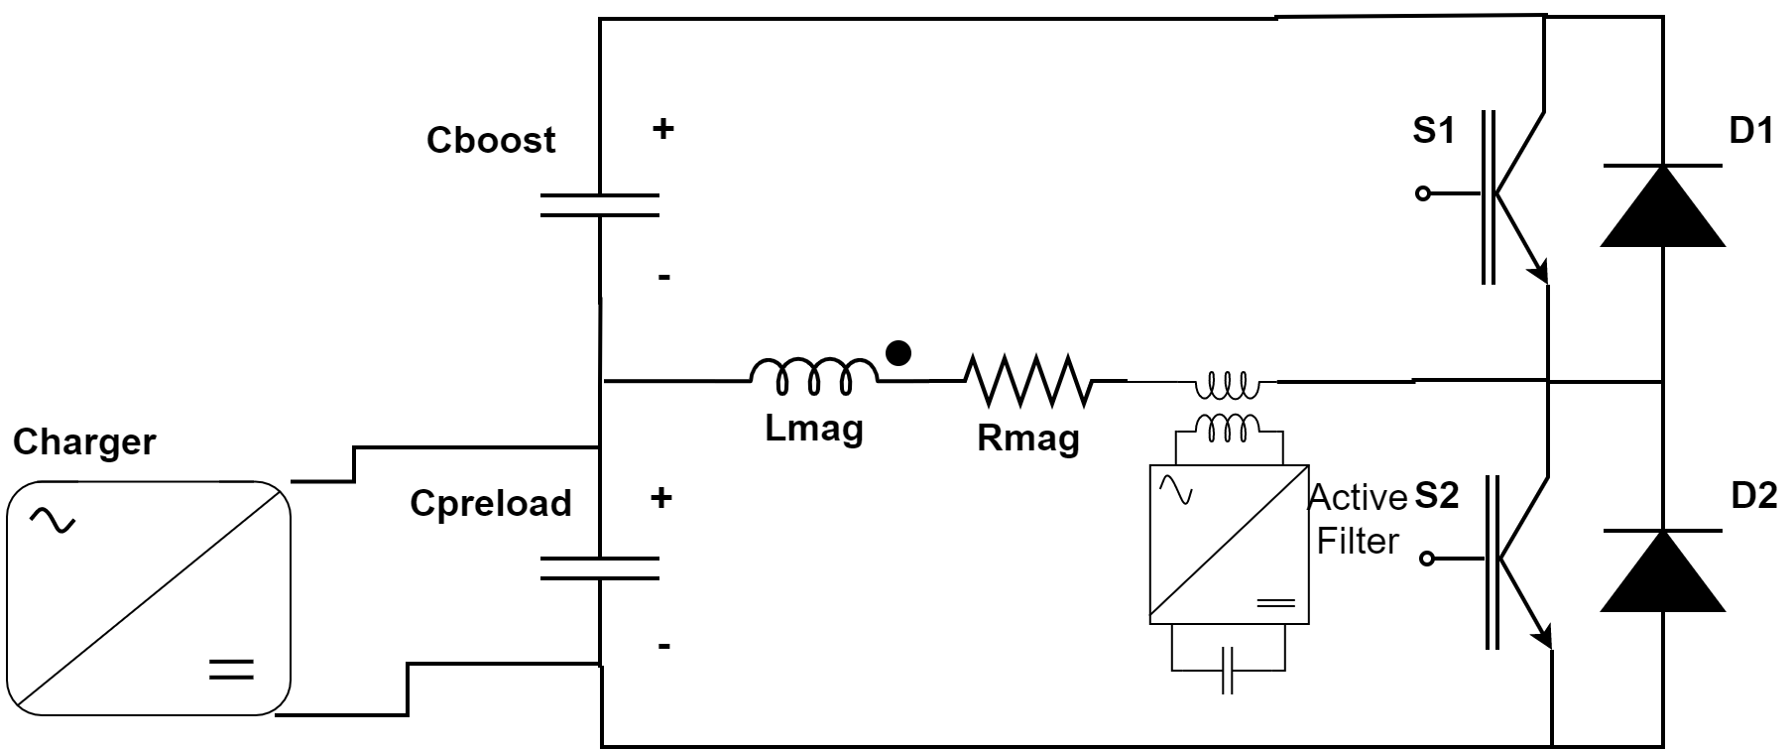
Ideas for the full power-converters/magnets system
What is a power cell: two concepts are considered here:
Full wave resonance
Switched resonance
2 Harmonics add to shape the current / magnetic field in the magnets.
Multi-resonance evolves until current is zero again
Limited flexibility to change working conditions
Simpler power electronics
The discharge evolves in two phases:
Magnets are preloaded to the injection Bfield, and quickly switched onto field rapid step up.
Increased flexibility to change working conditions
Power electronics more complicated

Slide 9
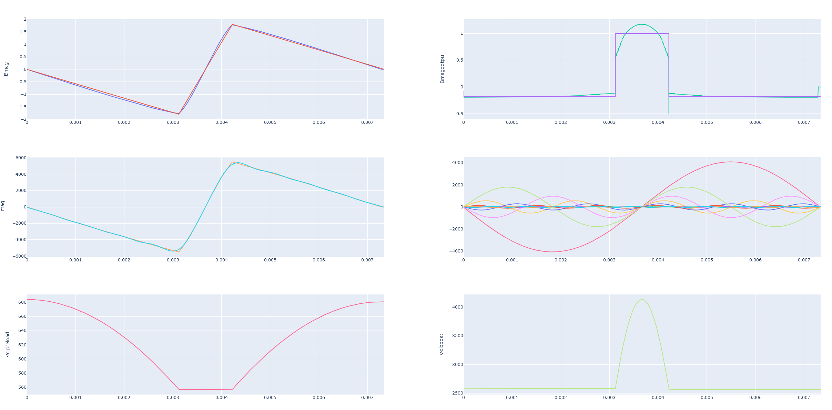
Ideas for the full power-converters/magnets system
Switched resonance power cell
Different sizing of the Cboost and Cpreload can be tested and the Bdot max changed accordingly
Here Bdot max is 1.17pu
Preload and boost voltages

Slide 10
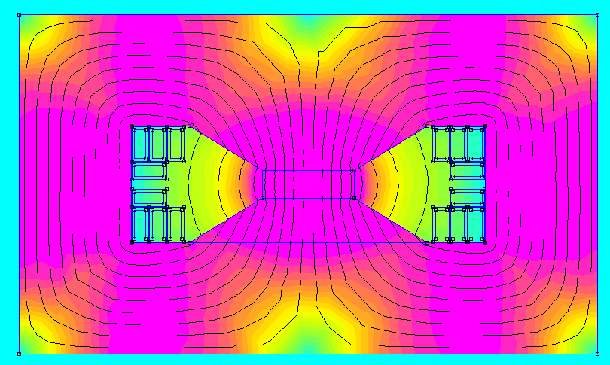
Ideas for the full power-converters/magnets system
0.64m
0.019m
0.039m
Sc=0.003m
Sigmarms=5A/mm2
Sigmapk=18A/mm2
0.37m
Hollow water-cooled conductors
Single turn with straight conductors connecting magnet to magnet via the power cell (or directly)
Map Dipole | MAP | UNIBO HM | Hollow conductors
External Dimensions [mm x mm] | 800 X 480 | 500 x 380 | 640 x 370
Bgap [T] | 1.5 | 2 (1.8 is the design value) | 1.8
Gap size [mmxmm] | 156 x 25 | 100 x 30 | 100 x 30
Mmf [kAt] | 31.2 | 47.8 | 44.9
Iron losses [J/cycle-m] | ≅1.1E6/(2200x15)=96 @1kHz | 128 @ 500Hz | 133 @454Hz
Coil Losses [J/cycle-m] | ≅0.55E6/(2200x15)=16 @1kHz | 295 @ 500Hz | 125 @ (Fourier of current)
Total losses [J/cycle-m] | 112 | 423 | 258
Stored energy (total / gap) [J/m] | 4200 / 3490 (1.2) | 5740 / 4775 (1.2) | 7630 / 3867 (1.97)

Slide 11
Proposal for the subjects to analyze
3D model of MAP (flat conductors) and hollow conductor type dipole to check critical quantities: Losses, magnetic effects at the ends, eddy currents etc… Also H and HG type comparison;
Eddy current effects in vacuum chamber: Losses, distortion, delay…
Thermal analysis of the two cases: Hollow and flat conductors
Transfer function (V to I) computation of the dipoles/quadrupoles
2D transient model for losses analysis and voltage-current relation with real current shapes and computation of transfer function.
Simplified Python models of Quadrupole magnets
Activities on the powering system are not mentioned
Priorities and additional subjects to be discussed

Slide 12
END
Questions

Slide 13
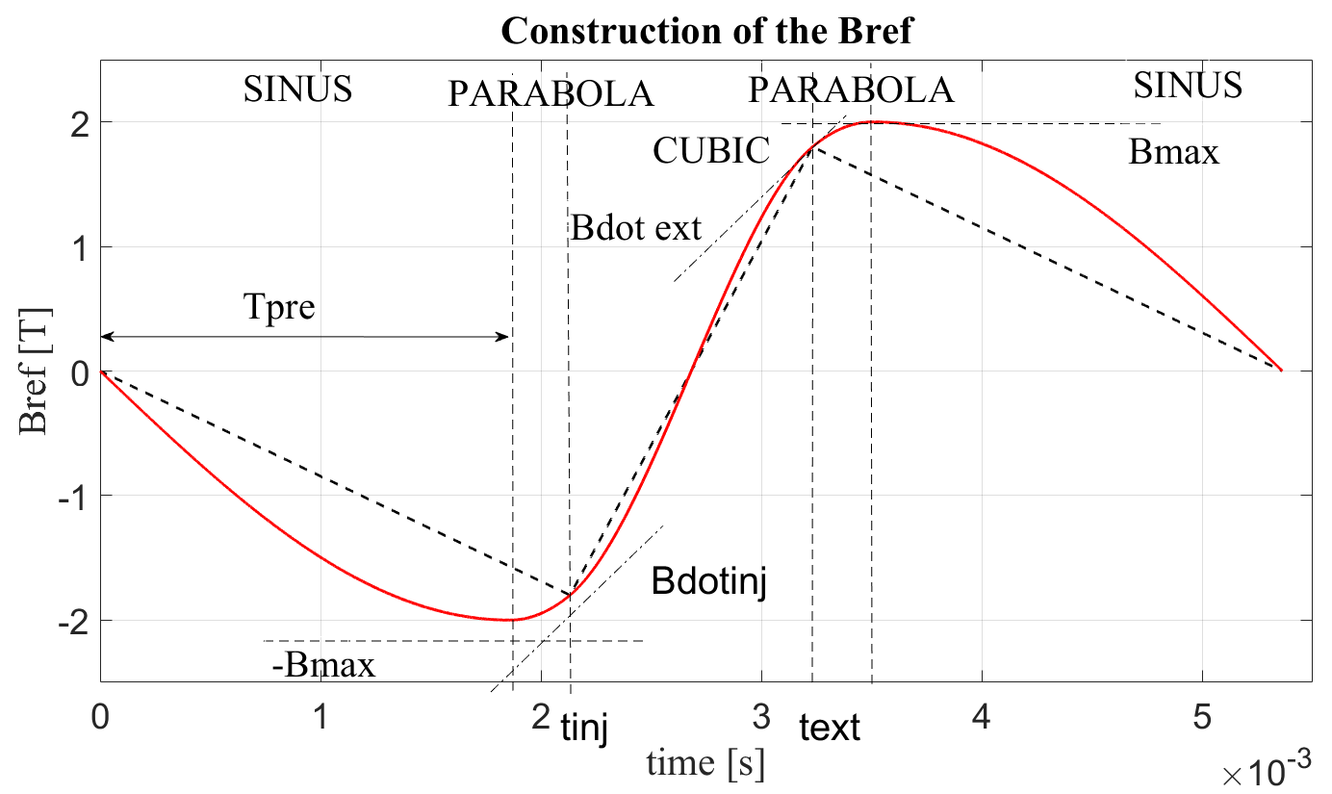
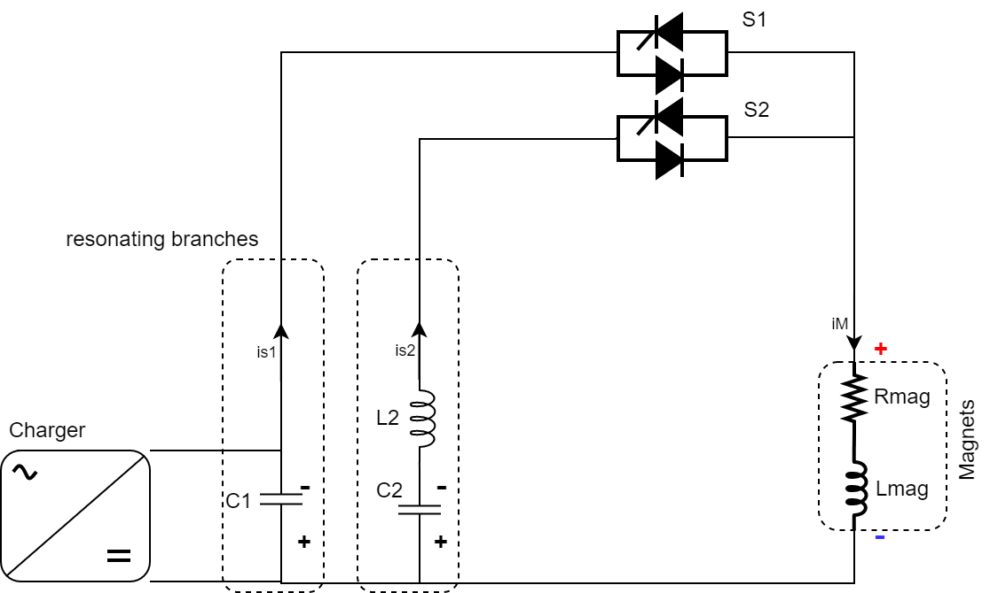
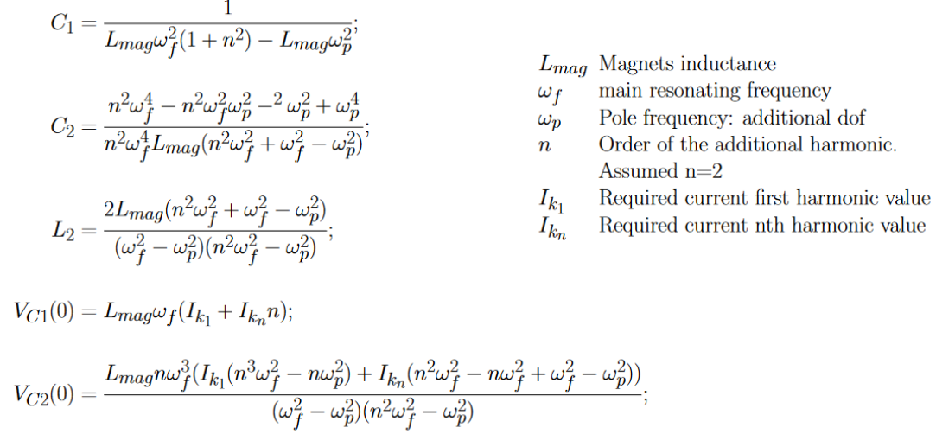
Overview of the powering circuits: Full Wave resonance
Each harmonics allows better approximation to the linear Bref profile. Case RCS2
Resonating parameters are very interlinked. Uncertainties in the circuit parameters cannot be corrected. Additional bulky hardware is required.

Slide 14
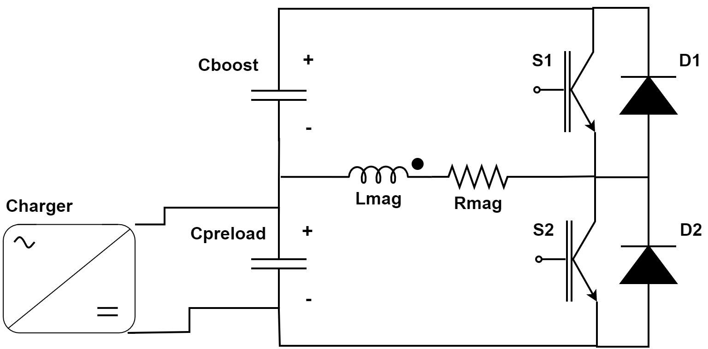
Overview of the powering circuits: Switched resonance
Cpreload is discharging
Cpreload is charging
Cboost is charging
Cboost is discharging
Simpler resonance principle. Voltages of Cboost and Cpreload can be used for regulation (pulse to pulse).

Slide 15
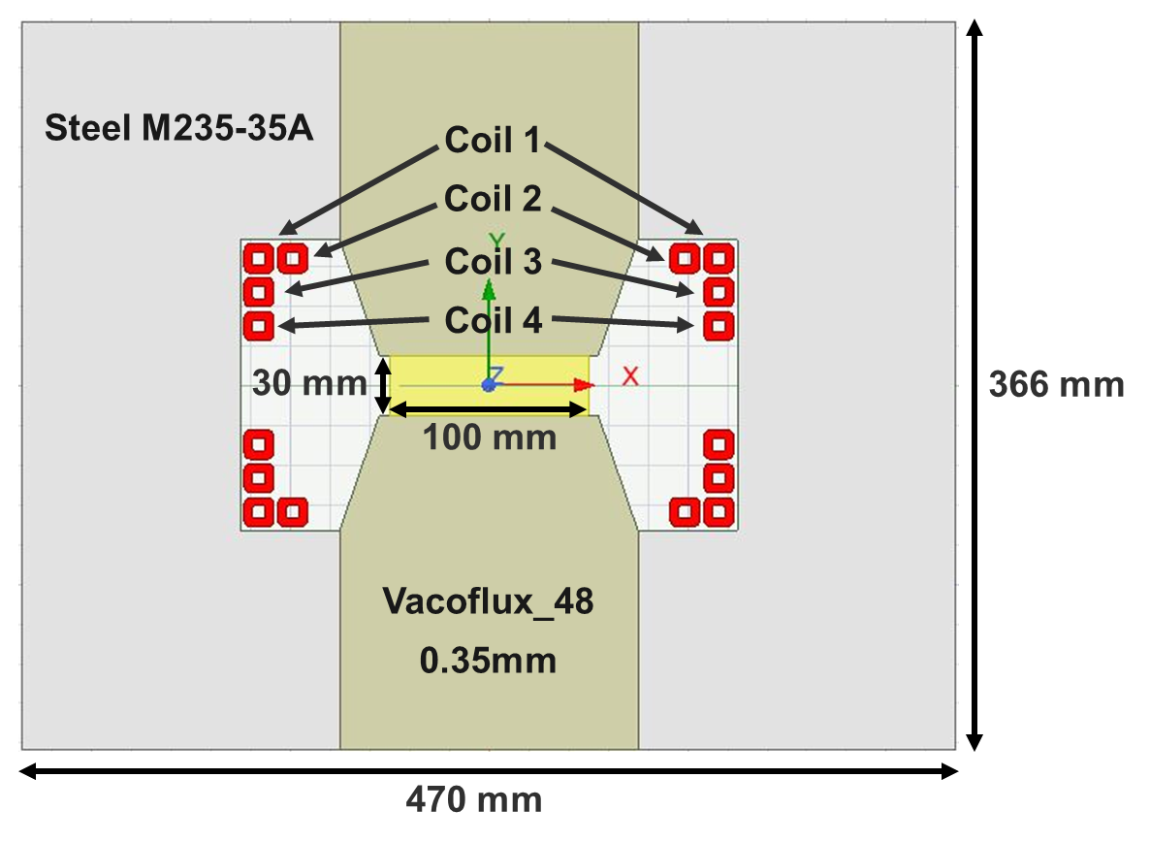
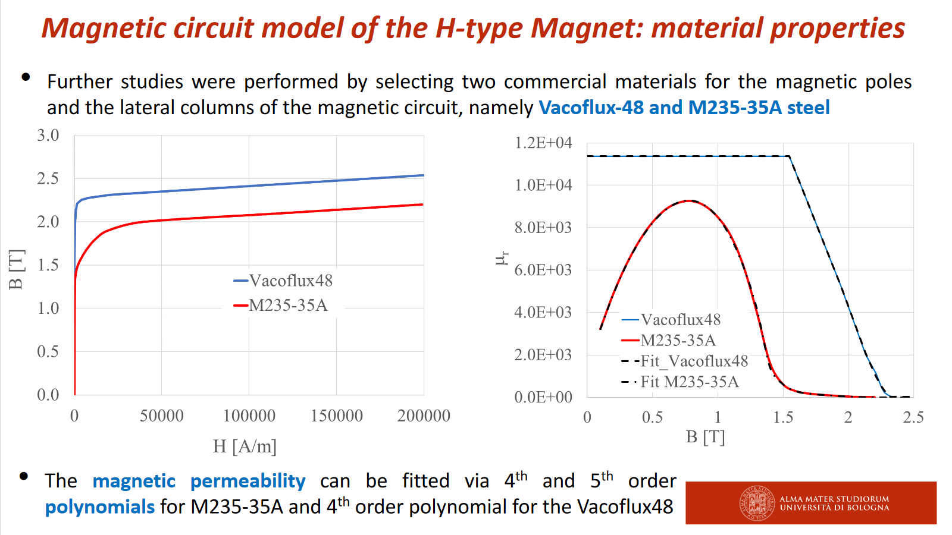
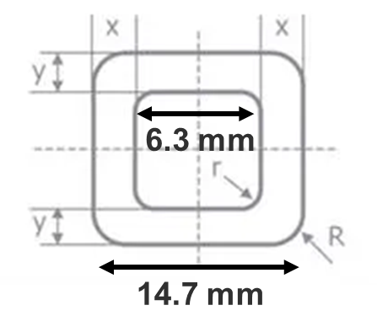
Overview of the magnet (dipole) model
Normal Steel M235-35A 0.35mm for the joke
Vacoflux (Iron-cobalt 48%) 0.35mm for the poles
Courtesy of UNIBO
8 copper coils that are fed by 8 parallel circuits
Copper coils are actively water cooled in the inside (* Luvata https://www.luvata.com/products/hollow-conductors)
x = y = 4.2 mm
R = 3 mm
r = 1 mm
A_{CU} = 170 mm²
A_{H2O} = 38.83 mm²
Inner Perimeter = 23.48 mm

Slide 16
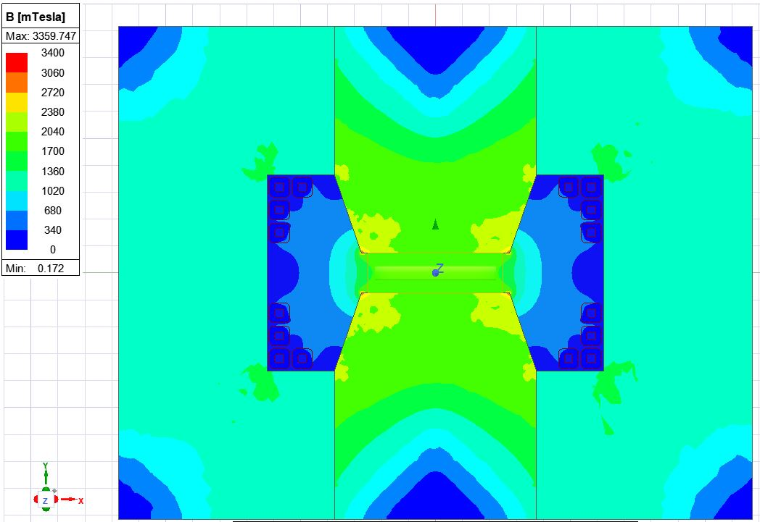
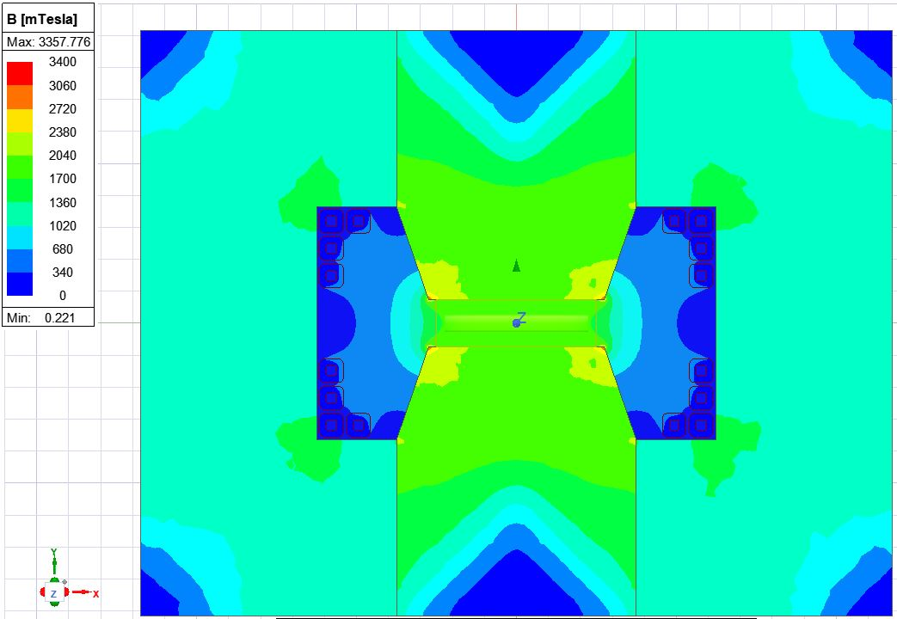
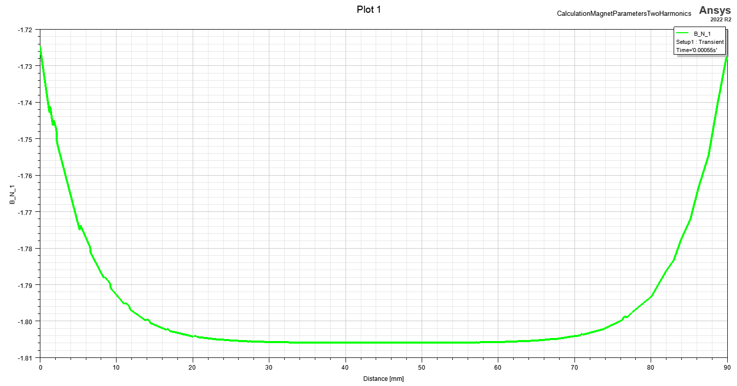
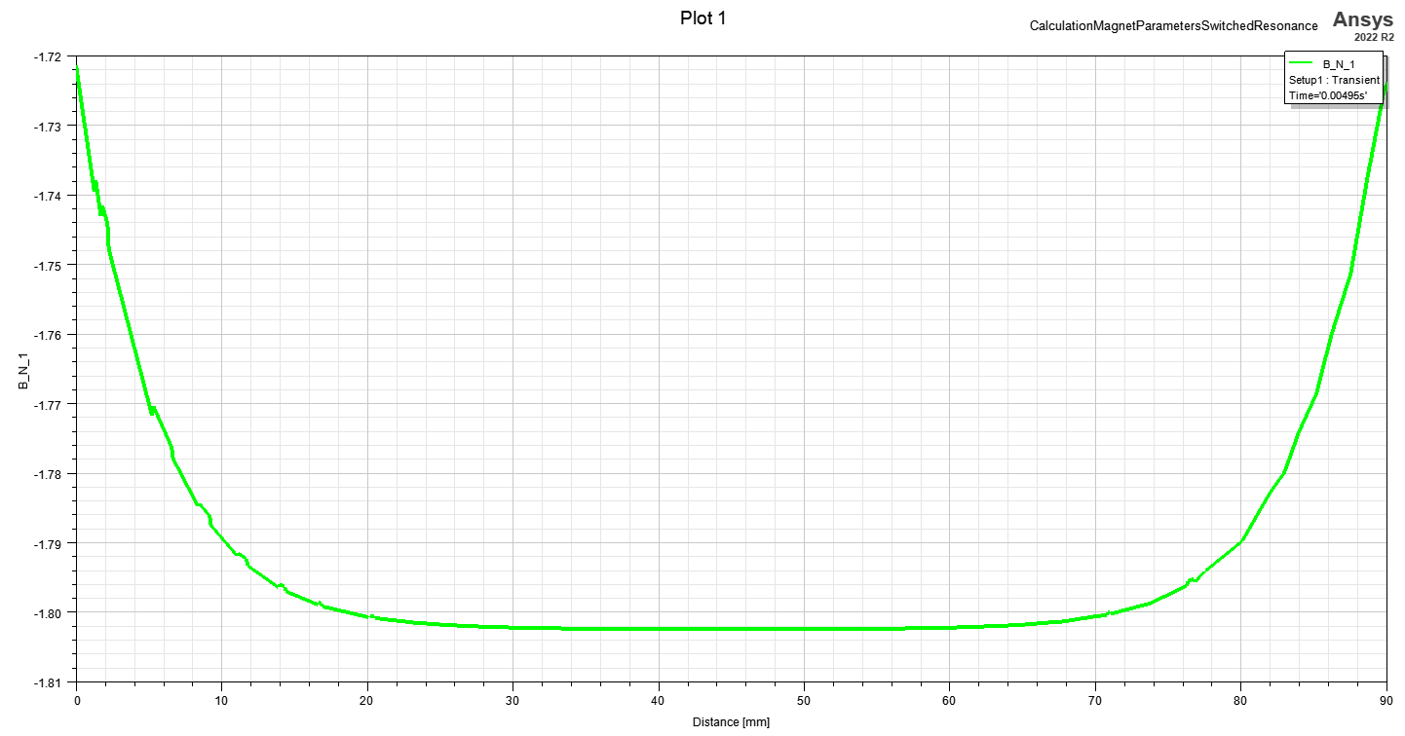
Overview of the magnet (dipole) model: field map
Full resonance
Switched resonance
B_{N,max} = -1.725 T
B_{N,max} = -1.721 T
B_{N,min} = -1.806 T
@injection:
B_{N,ref} = -1.8 T
B_{N,min} = -1.802 T
Although the current is the same in both cases, the normal magnetic flux density differs.
Hypothesis: Eddy currents act against the reduction of the magnetic field. (In the two harmonic circuit, the current has an overshoot before the injection.)

Slide 17
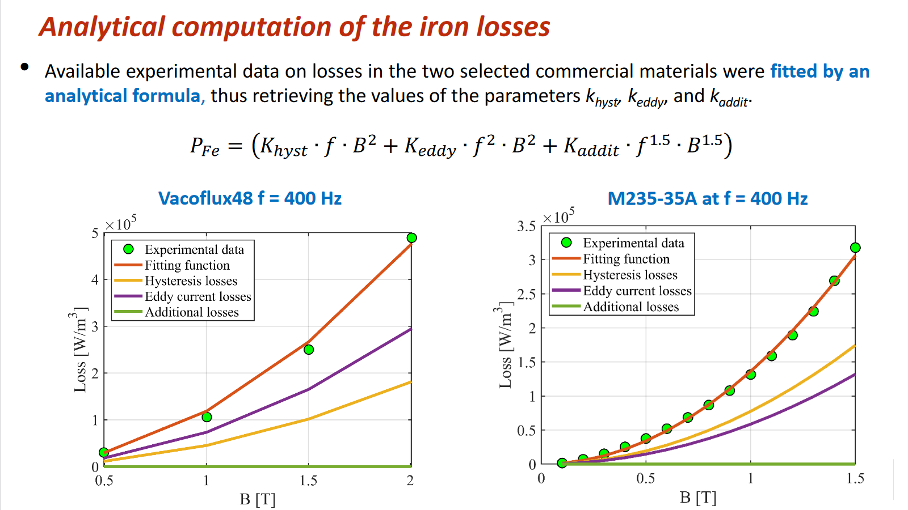
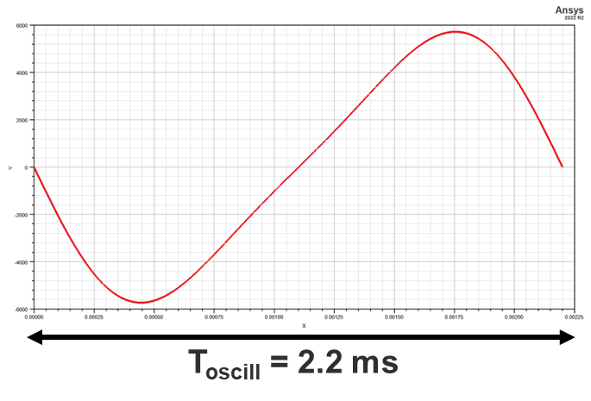
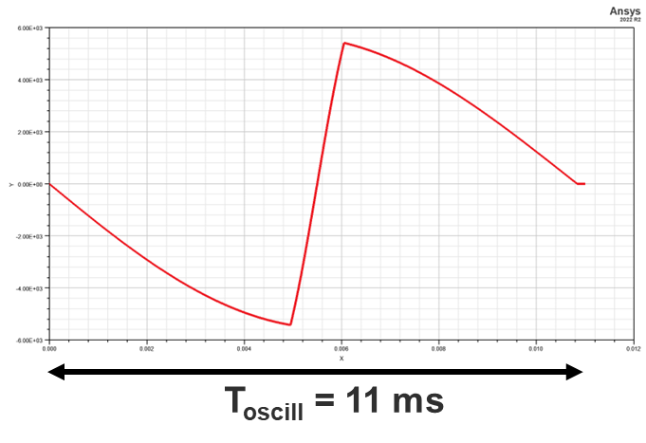
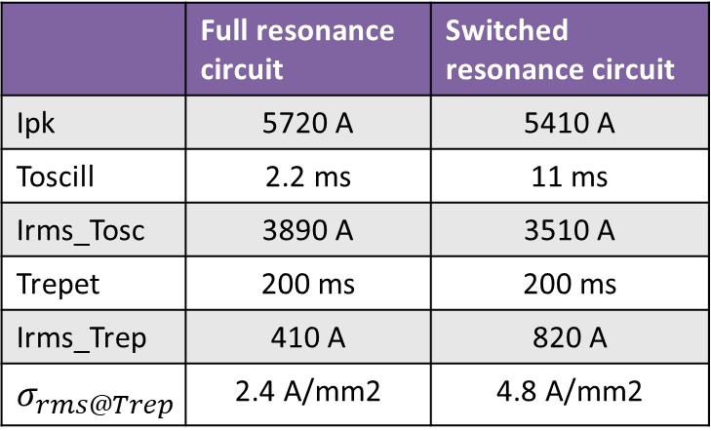
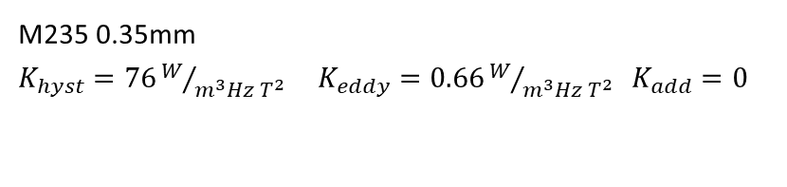
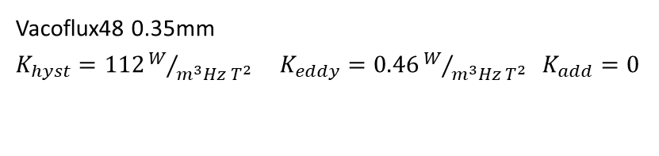
Overview of the magnet (dipole) model:Losses calculation
Iron Losses:
Vacoflux48 0.35mm
$K_{hyst}=112W/{m^{3}Hz T^{2}}$ $K_{eddy}=0.46W/{m^{3}Hz T^{2}} K_{add}=0$
Courtesy of UNIBO
M235 0.35mm
$K_{hyst}=76W/{m^{3}Hz T^{2}}$ $K_{eddy}=0.66W/{m^{3}Hz T^{2}} K_{add}=0$
Analysis with 2D FEM magneto-transient solver (Ansys Maxwell)
Copper Losses:
Current profile input to each conductor. Analysis with 2D FEM magneto-transient solver
Full resonance
 | Full resonance circuit | Switched resonance circuit
Ipk | 5720 A | 5410 A
Toscill | 2.2 ms | 11 ms
Irms_Tosc | 3890 A | 3510 A
Trepet | 200 ms | 200 ms
Irms_Trep | 410 A | 820 A
$$σ_{rms@Trep}$$ | 2.4 A/mm2 | 4.8 A/mm2
A_{CU} = 170 mm²
Switched resonance

Slide 18
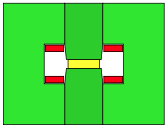
Overview of the magnet (dipole) model: Losses calculation
 | Full resonance circuit |  | Switched resonance circuit
 | Energy lost [J/cycle/m] | Avg Magnetic Energy [J/m] | Energy lost [J/cycle/m] | Avg Magnetic Energy [J/m]
Iron Joke | 58.2 | 90.2 | 26.4 | 12.3
Iron poles | 33.2 | 122.5 | 16.5 | 23.0
Total Iron | 91.4 | 212.7 | 42.9 | 35.3
Air Gap | 0 | 2003.9 | 0 | 1645.3
Stray field | 0 | 1148.8 | 42.9 | 964.6
Coil1 | 13.2 | 0 | 36.9 | 0
Coil 2 | 40.2 | 0 | 78.3 | 0
Coil 3 | 36.0 | 0 | 68.9 | 0
Coil 4 | 59.7 | 0 | 95.4 | 0
Total Cu | 149.1 | 0 | 322.4 | 0
Total | 240.5 | 3365.4 | 365.3 | 2645.2
Courtesy of
UNIBO:
 | Energy lost [J/cycle/m]
Total Iron | 128.1
Total Cu | 294.8
Total | 422.9
Sinus with 500 Hz and 2 T peak

Slide 19
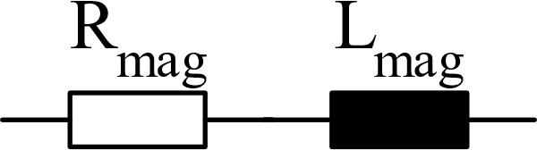
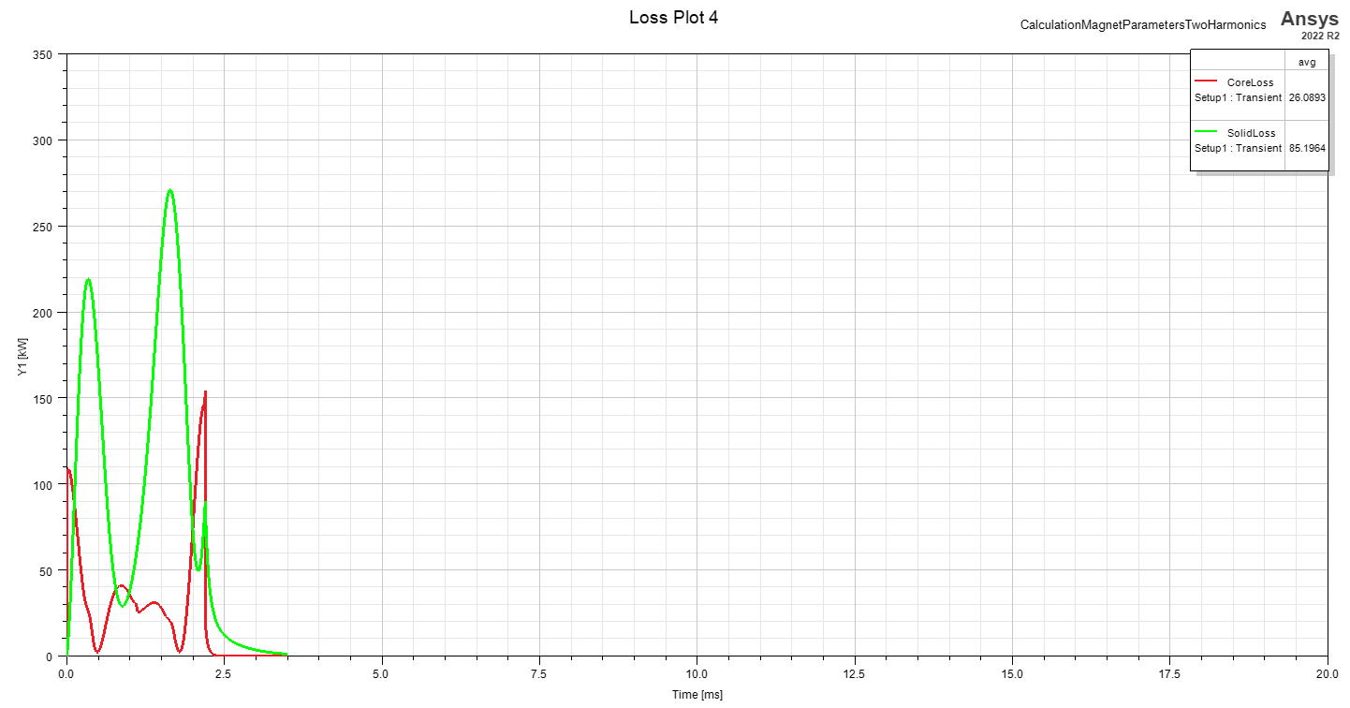
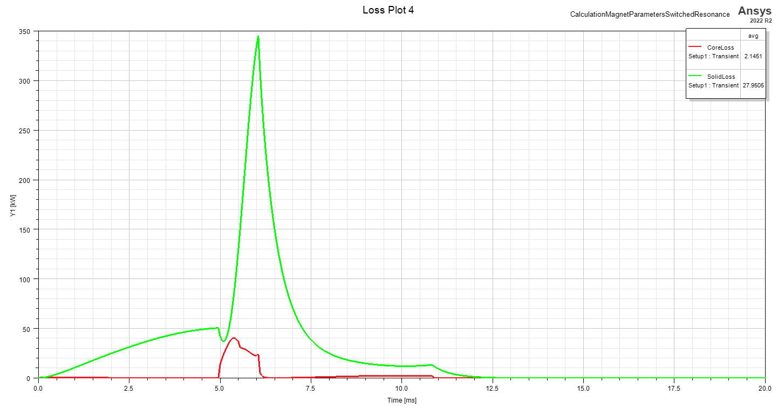
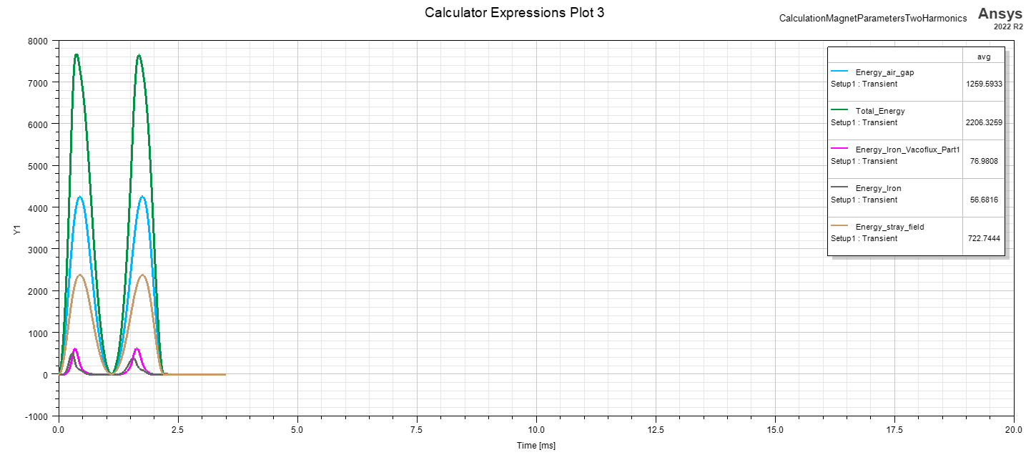
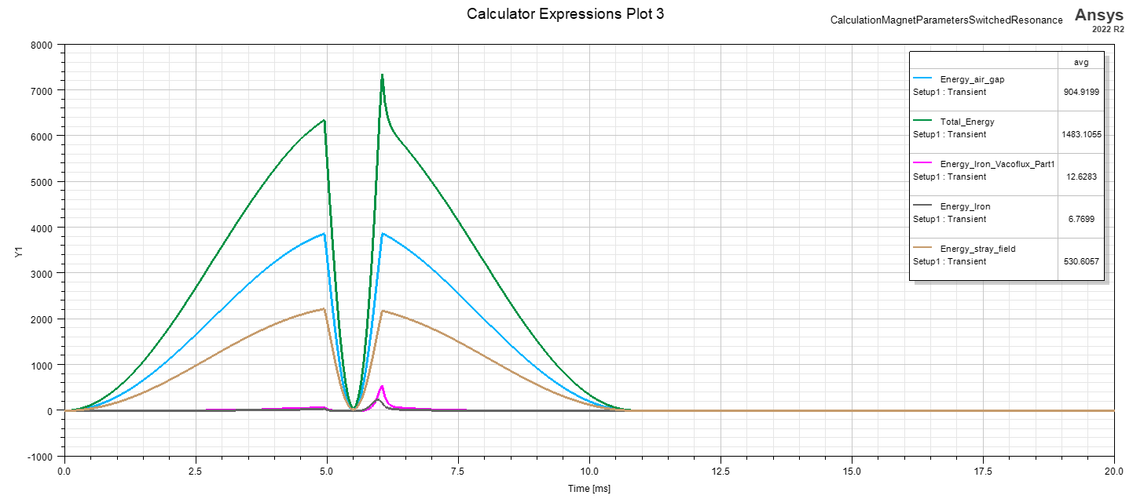




Overview of the magnet (dipole) model: Circuit parameters
Rmag:
$$R_{mag}=\frac{E_{loss,mag}}{\int{i_{mag}^{2}} dt}$$
Magnetic losses of the magnet (Ansys)
Total current in all coils
(current profile from circuit)
Derivation:
$$E_{loss,mag}=\int{P_{loss,mag}} dt≝E_{loss,R}=\int{R_{mag}}⋅i_{mag}^{2} dt$$
Full resonance
Losses as function of time (Yaxis 350W/m)
Lmag:
$$L_{mag}=\frac{2⋅E_{mag}}{i_{mag}^{2}}$$
Magnetic energy of the magnet (Ansys)
Switched resonance
$$E_{mag}≝E_{ind}=\frac{1}{2}⋅L_{mag}⋅i_{mag}^{2}$$
Derivation:
 | Full resonance circuit | Switched resonance circuit
Peak Iron losses | 154.54 kW/m | 40.6 kW/m
Avg Iron losses (Trepet) | 0.29 kW/m | 0.12 kW/m
Peak Cu losses | 270.81 kW/m | 345.03 kW/m
Avg Cu losses (Trepet) | 0.94 kW/m | 1.54 kW/m
Rmag | 182.82 µΩ/m | 69.26 µΩ/m
Lmag_avg | 7.25 µH/m | 6.83 µH/m
Energy as function of time (Yaxis 8000J/m)
Full resonance
Switched resonance

Slide 20
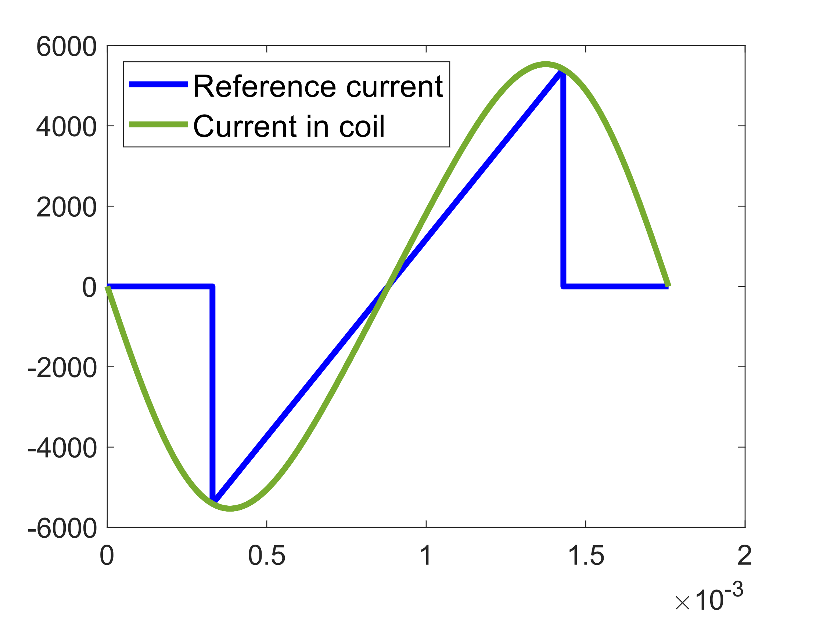
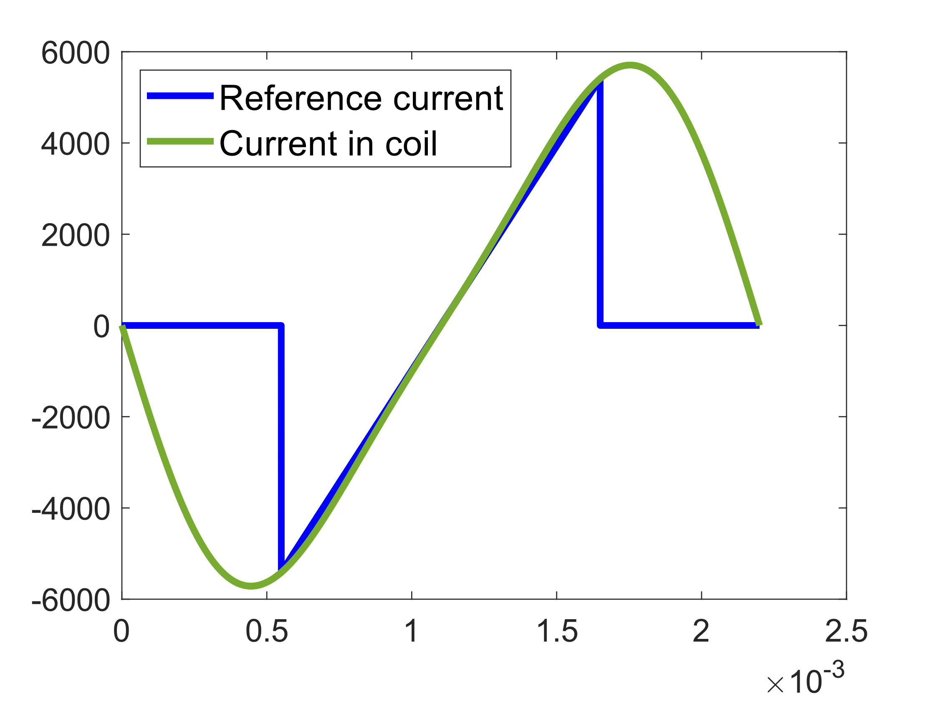
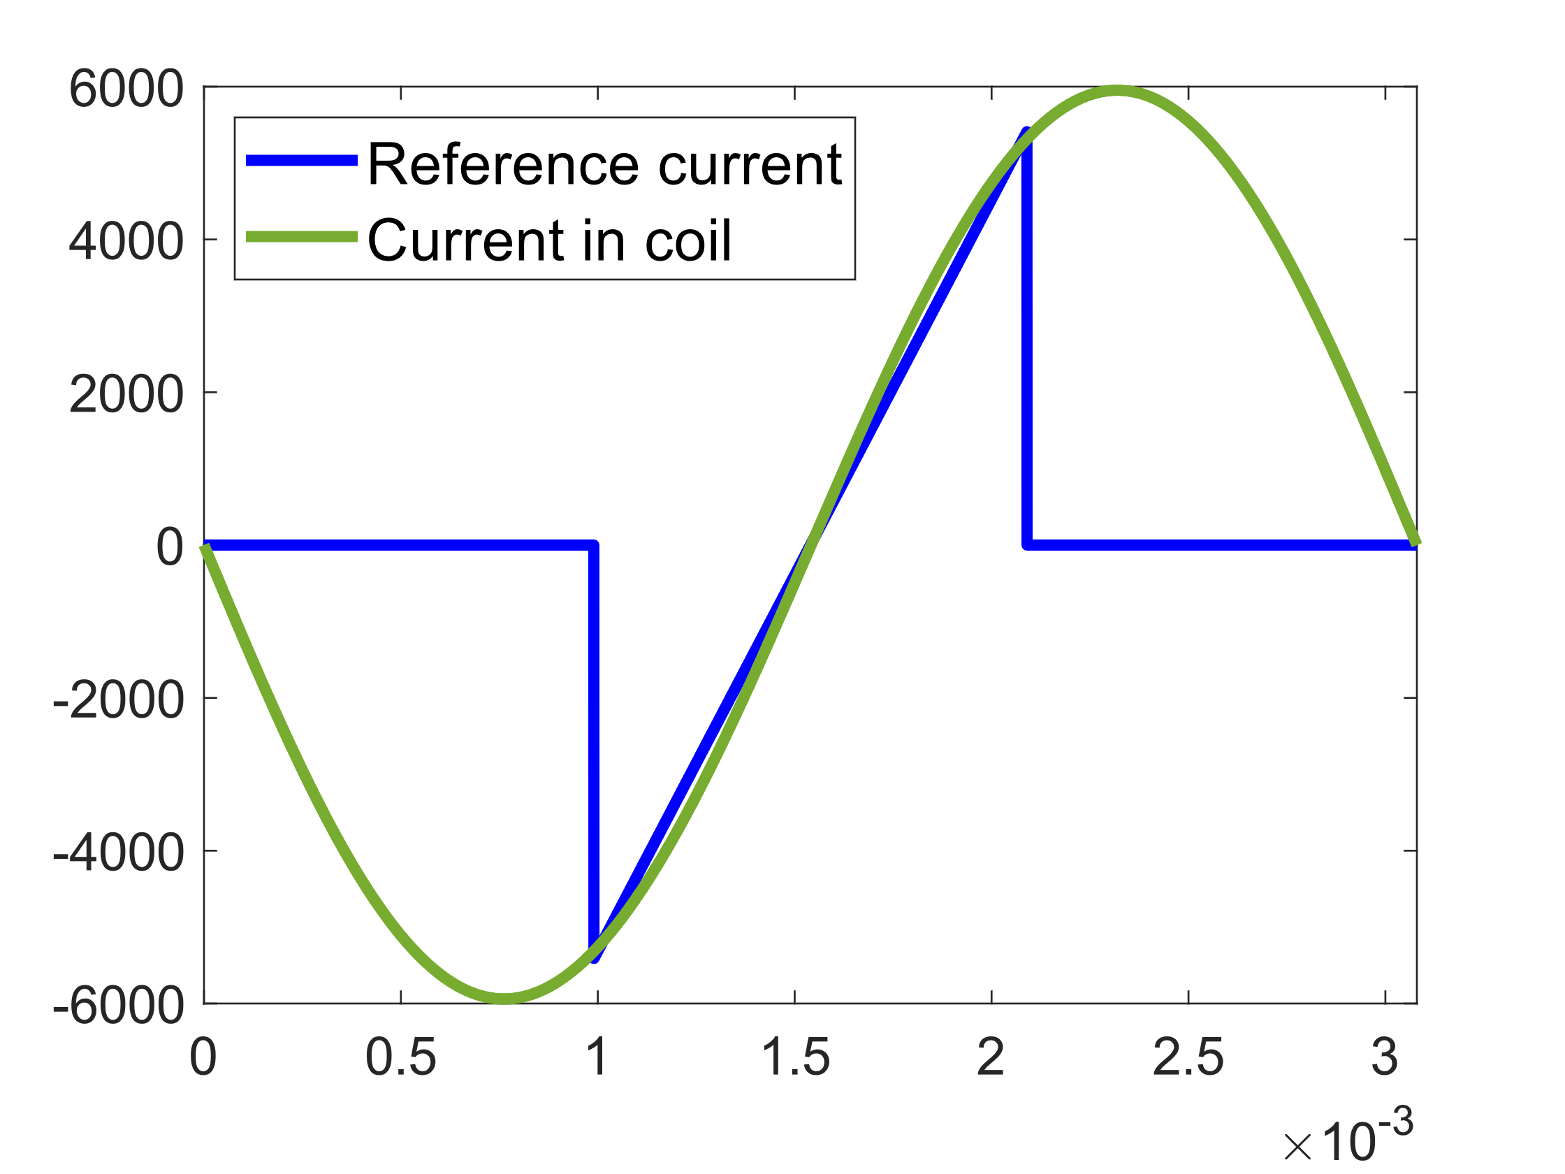
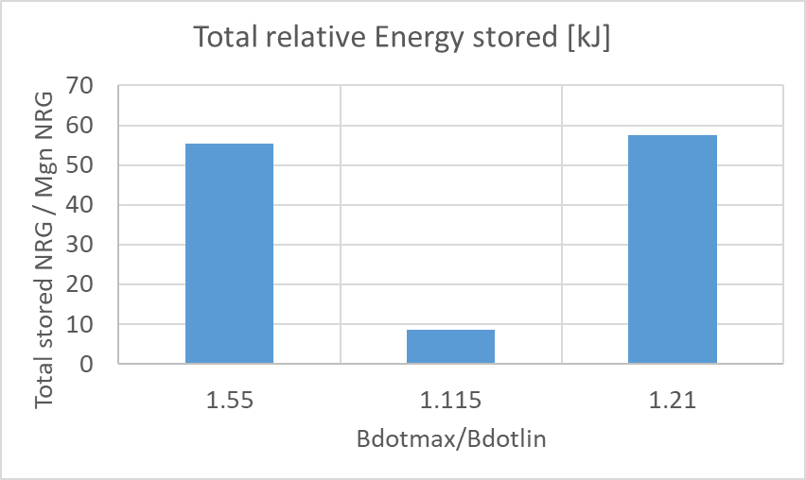
Impact of the ramp shape on the Circuit: Full wave resonance
Case1
Case2
Case3
Different combinations lead to mixed results depending upon the optimization criteria.

Slide 21
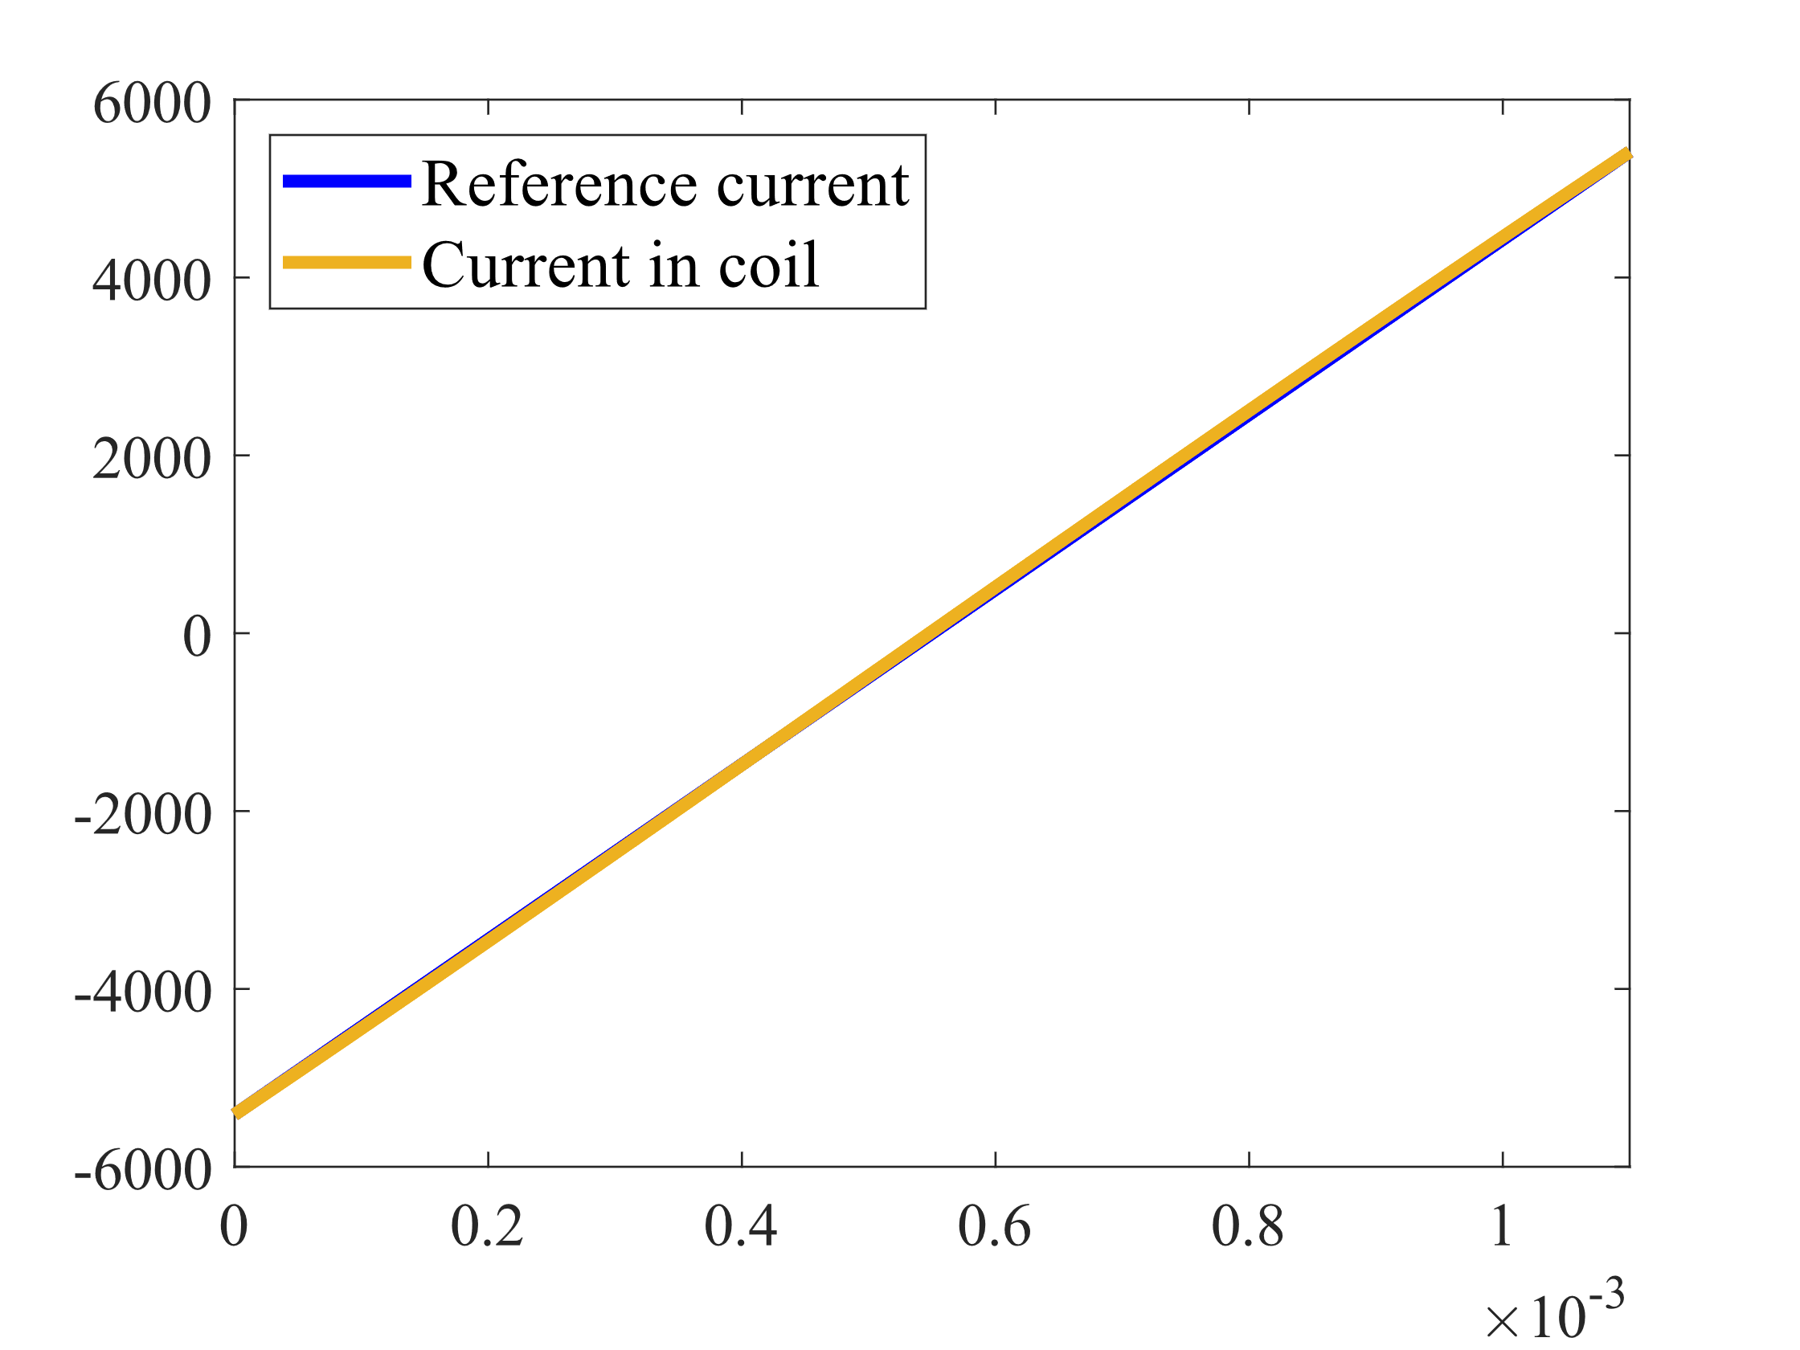
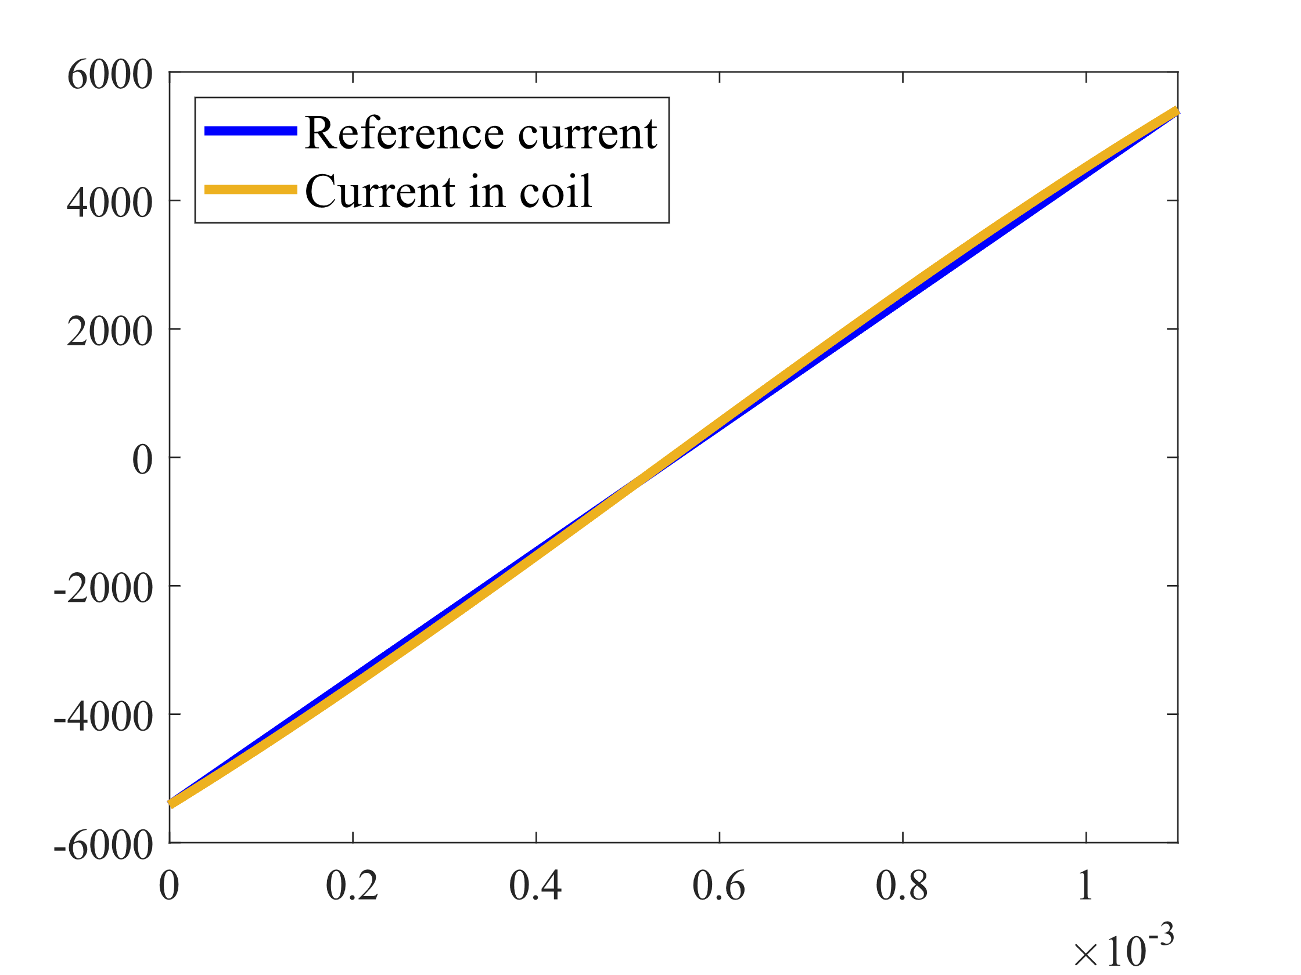
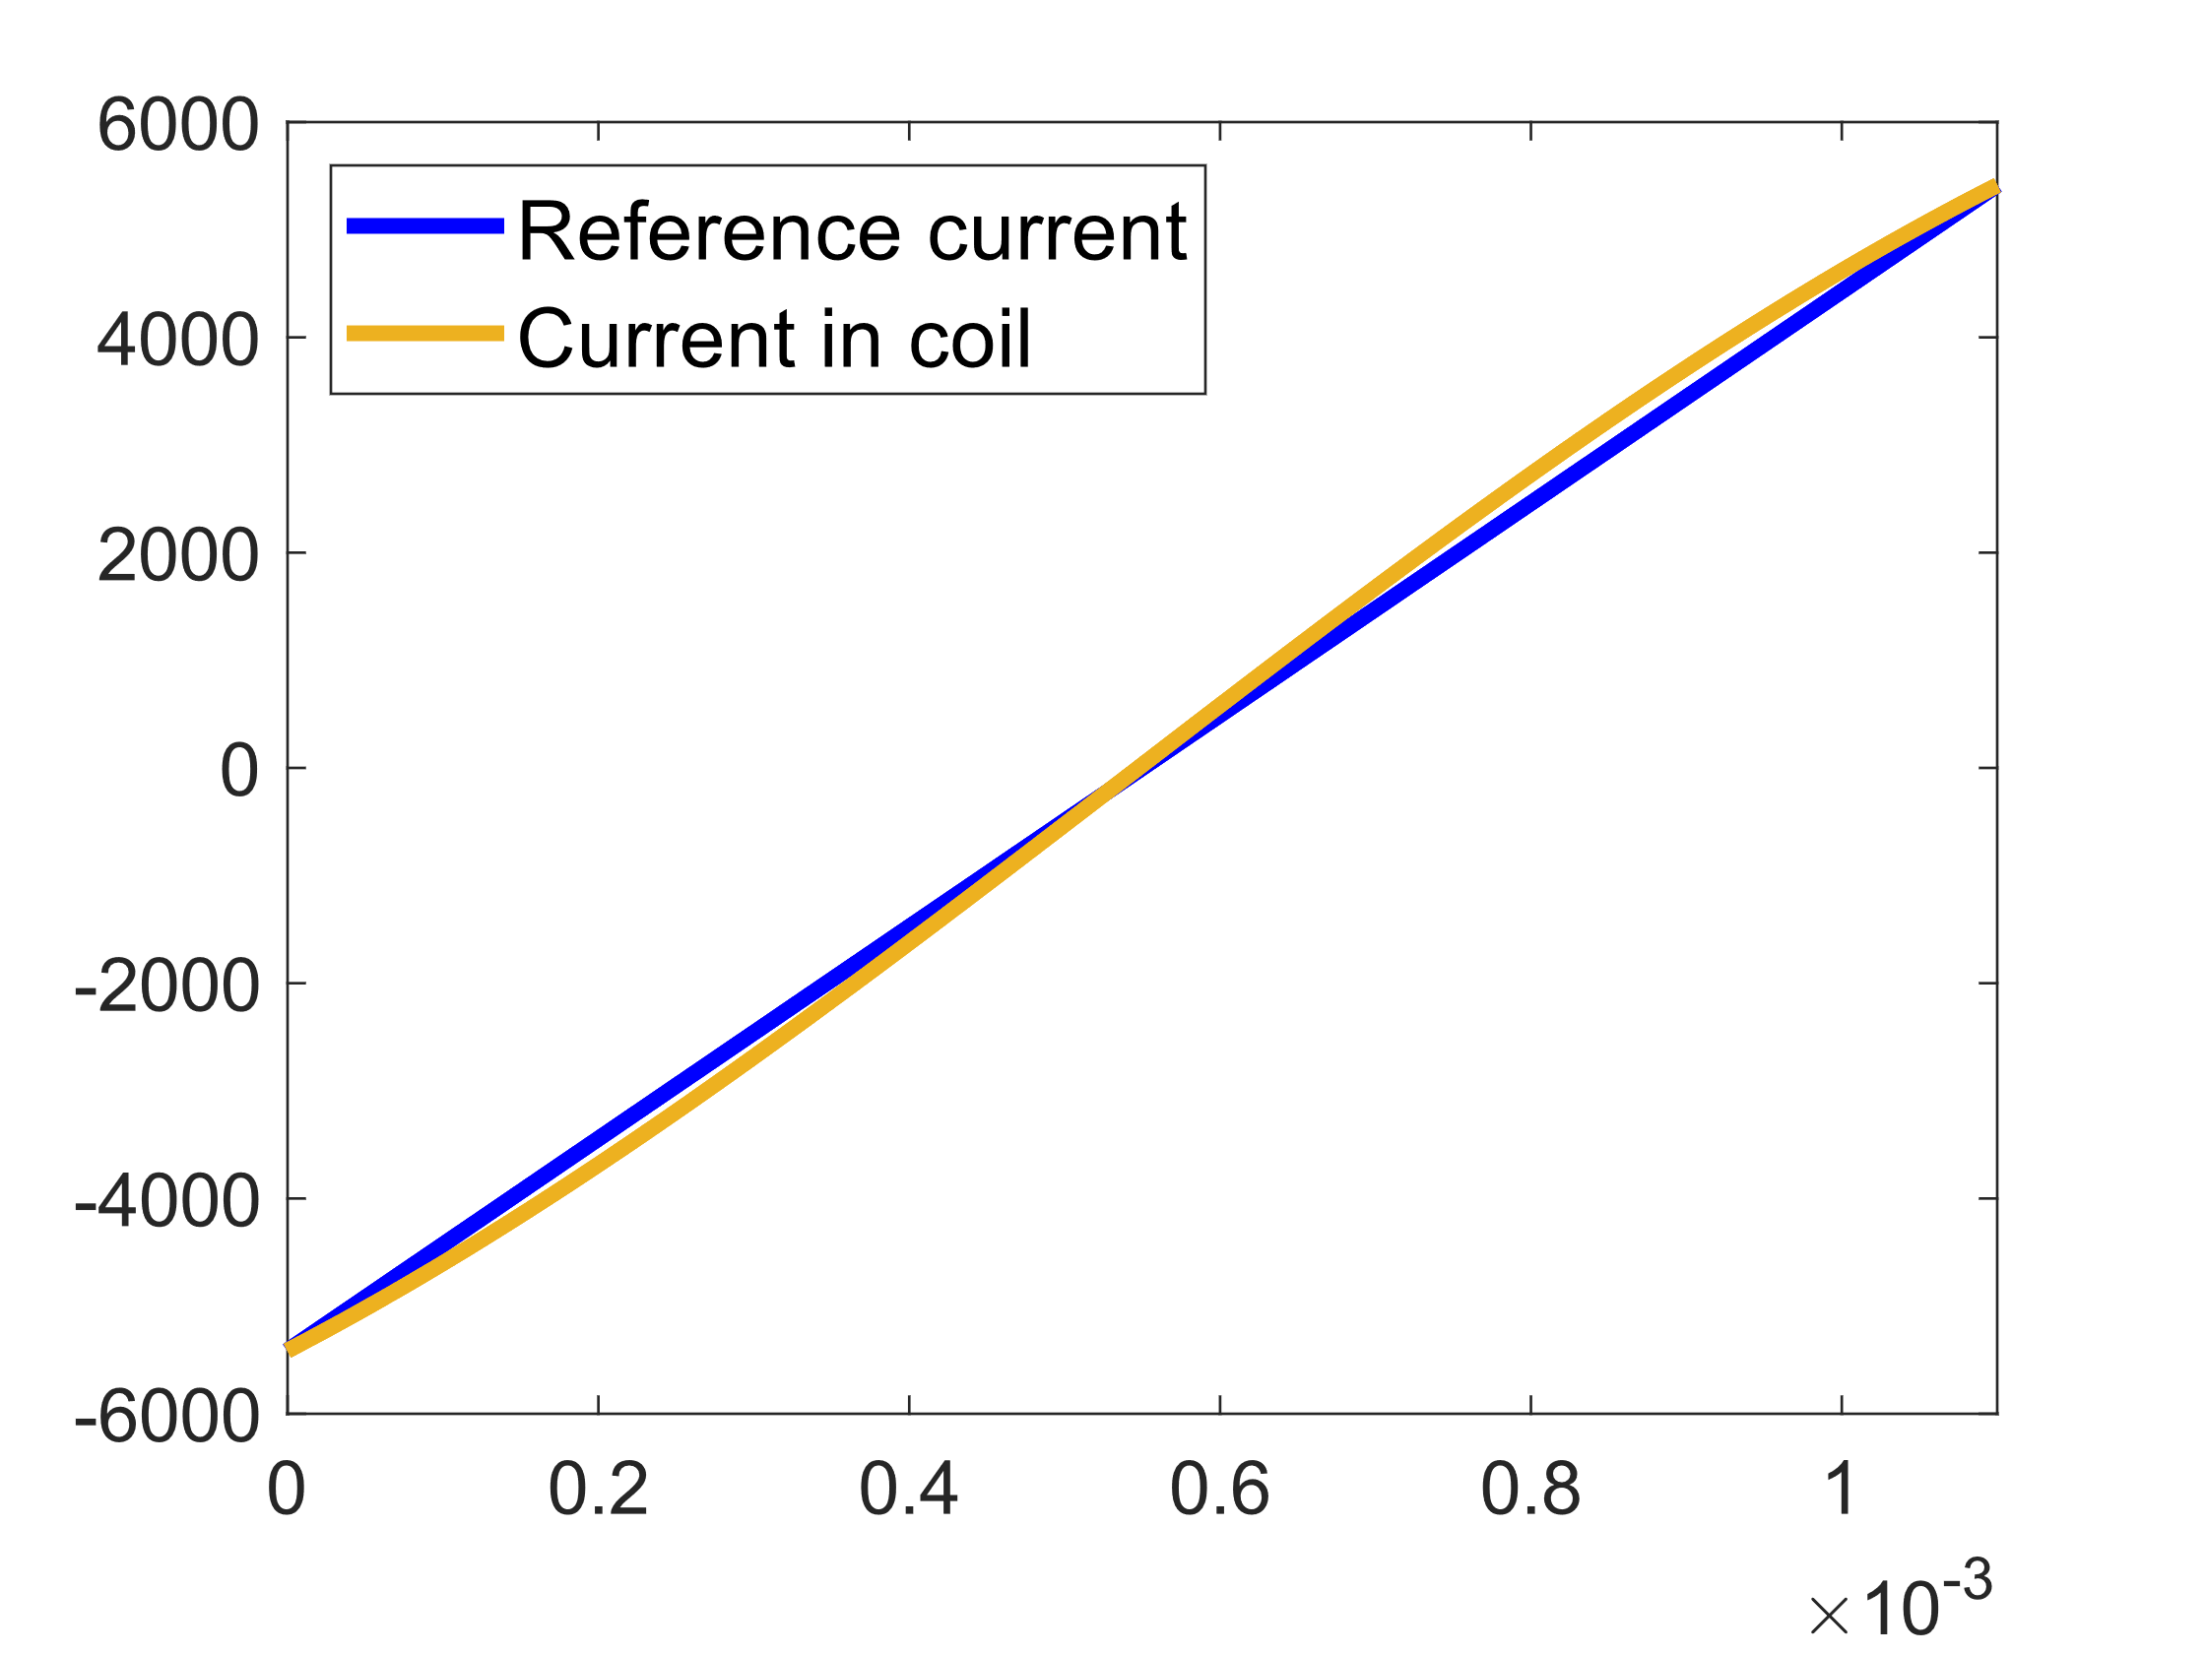
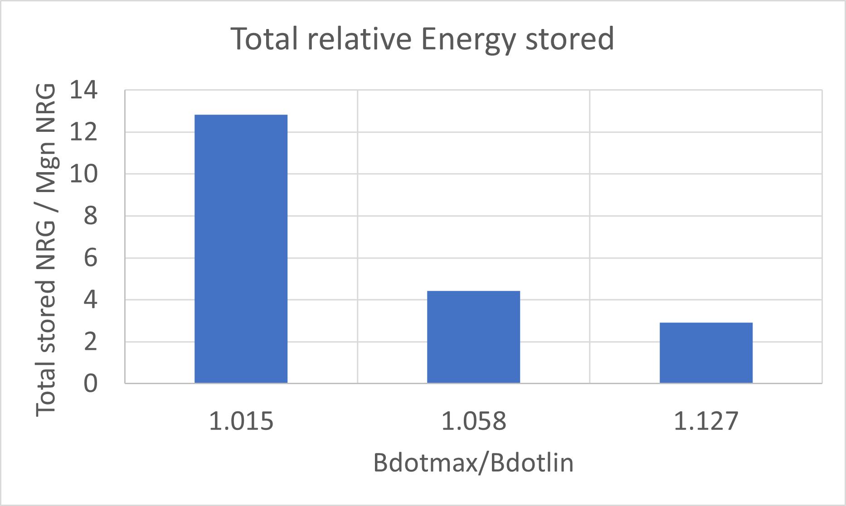
Impact of the ramp shape on the Circuit: Switched resonance
Case1
Case2
Case3
Restrictions of the maximum capacitance of the capacitors lead to different results (maximum derivative, total energy).

Slide 22
Impact of the ramp shape on the Magnets
Full wave resonance (case2)
Switched resonance (case3)
Bdotmax/Bdotlin = 1.115
Bdotmax/Bdotlin = 1.127
Ramp shape is almost the same but power dissipation in the magnet differs significantly.
The overall shape of the current profile is more relevant.
Optimization of the overall current profile is needed. Power dissipation is higher with a shorter oscillation time, but the overall losses can be smaller.
 | Full resonance circuit | Switched resonance circuit
Avg Iron power diss (Toscill) | 26.09 kW | 2.15 kW
Avg Cu power diss (Toscill) | 85.20 kW | 27.95 kW
Losses in Iron | 91.4 J | 42.9 J
Losses in Cu | 149.1 J | 322.4 J

Slide 23
Thank you for your attention

