Slide 1
Katharina Henjes-Kunst
The future of Astroparticle Physics in Europe: Embedding Astroparticle Physics
Brussels, 7th of December 2023

Slide 2
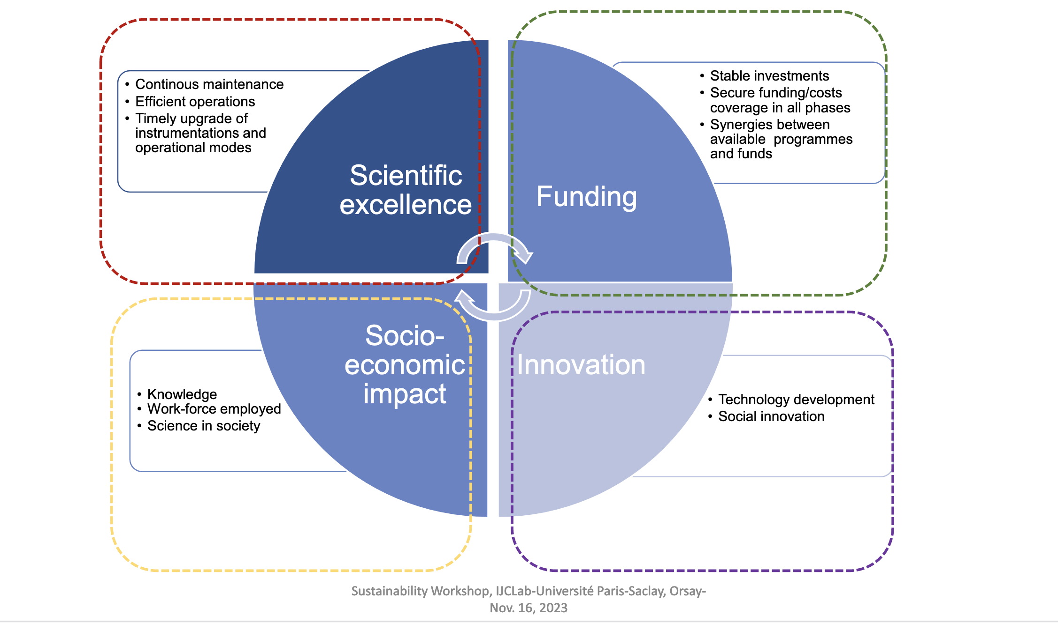
Scientific Excellence, but what more?

Slide 3
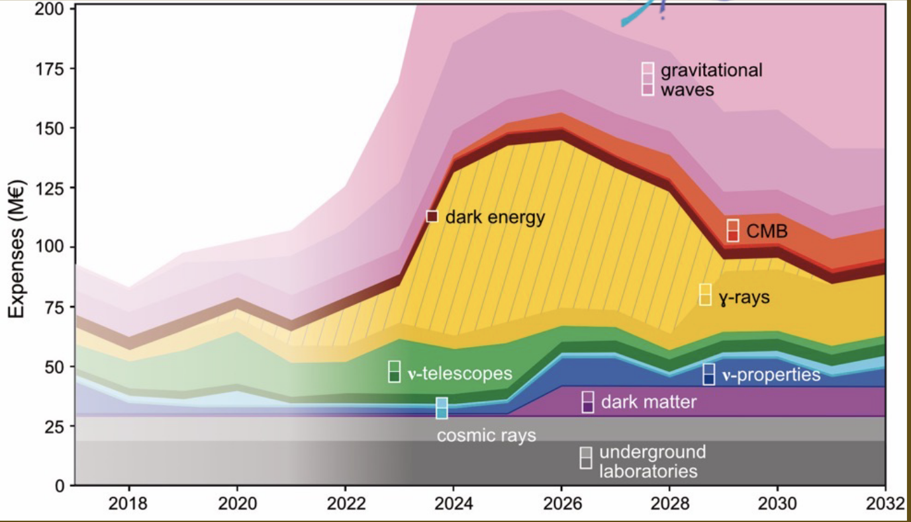
Funding
Stable funding is needed, but so is effective governance and planning.
We need to use APPEC to lobby for funding opportunities for astroparticle physics and beyond
HE Strategic Plan 2025-27 under discussion until mid-December
FP10 preparation is approaching
We want and have to collaborate with neighbouring fields and within Europe
  synergies!

Slide 4
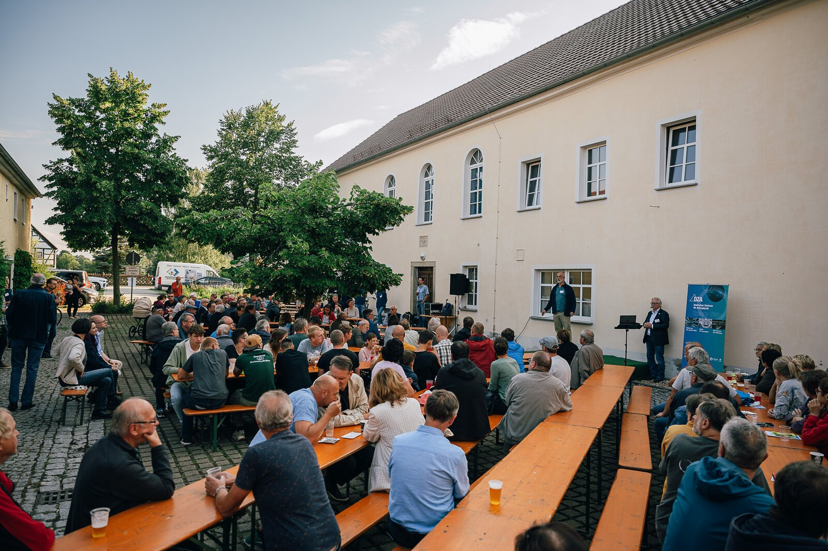
Socio-Economic Impact
Scientific excellence is interesting to us - but what about the others?
People of all ages need to understand the benefits of basic research for society - so we need to learn how to show and communicate them!
Bringing these benefits into the society-policy-science dialogue

Slide 5
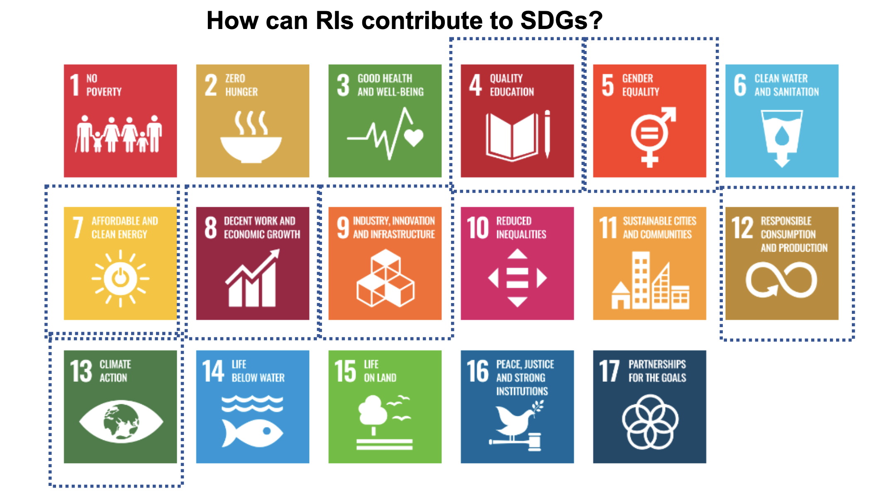
Innovation
  Basic research and research infrastructures play a crucial role in Europe's ability to generate new knowledge and innovation and to understand and address the environmental, societal and economic challenges we face.
  But: We must take into account the environmental and climate footprint of our research.
  We can do it together!
Notes:
ASTRONET Roadmap – interaction between the fields, strategic
EuCAPT
to increase the exchange of ideas and knowledge;
to coordinate scientific and training activities;
to help scientists attract adequate resources for their projects;
to promote a stimulating, fair and open environment in which young scientists can thrive
Coordination of Deep Underground Labs (DULs)

