Slide 1



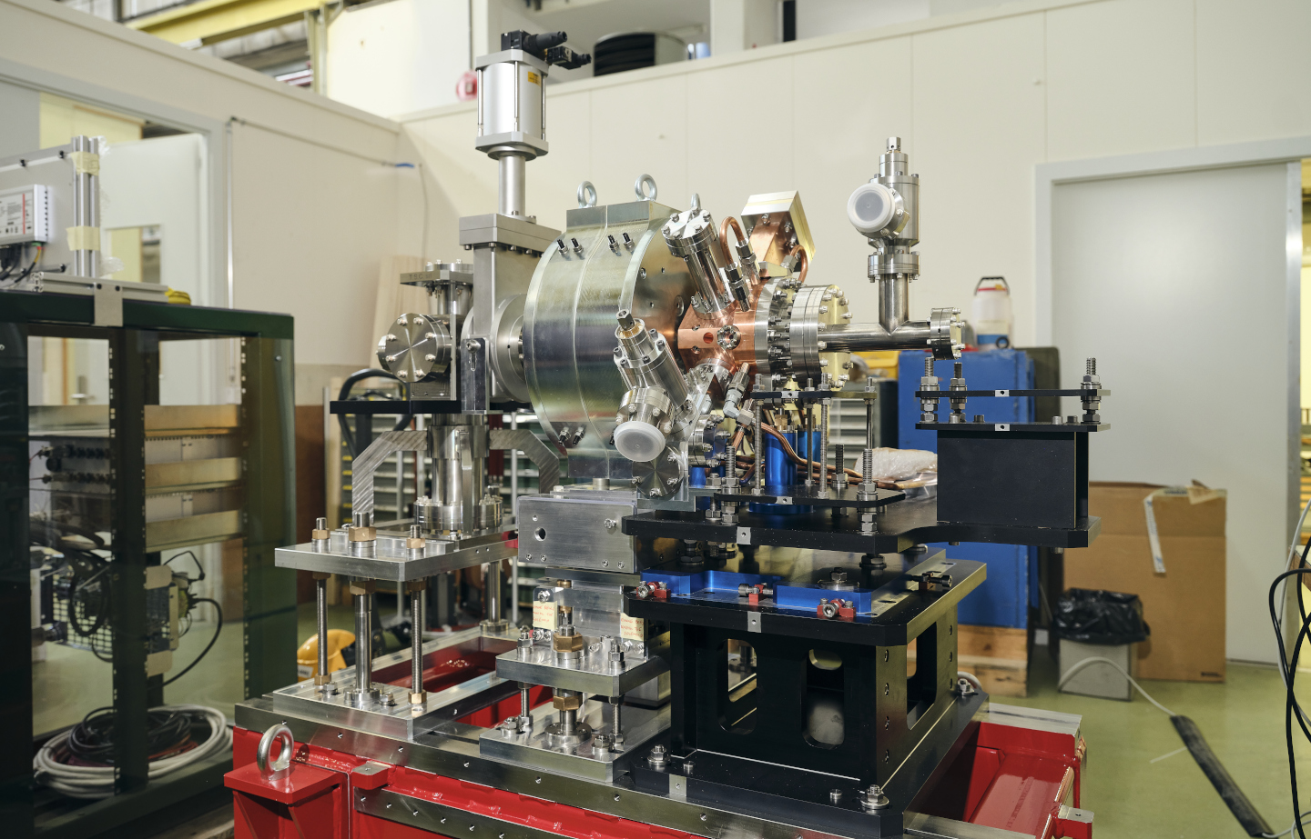
CTF2 experimental results
Vlad Musat, Andrea Latina, Eduardo Granados, Alexander Malyzhenkov, Steffen Döbert

Slide 2
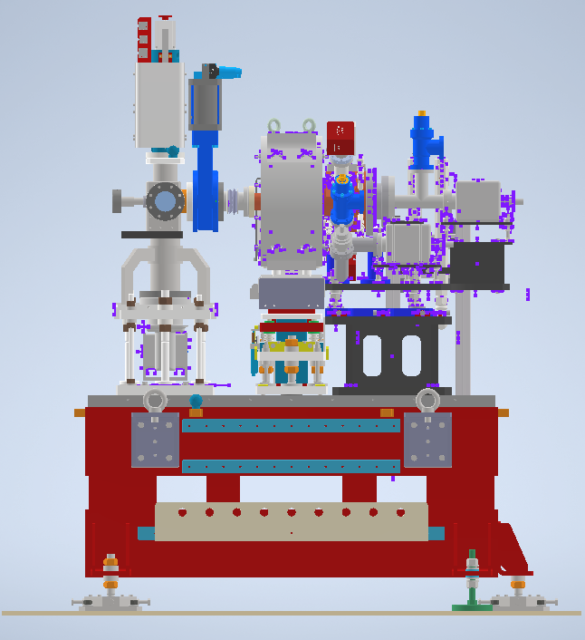
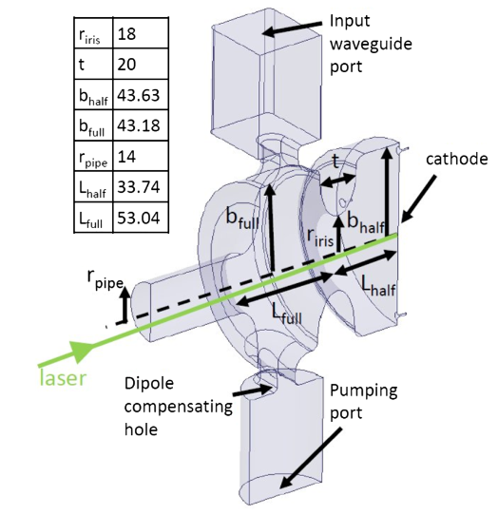
CTF2 gun
0.75 m
0.5 m
S-band standing wave 1.5 cell RF-gun intended for the new AWAKE injector.
Prototype constructed by INFN-Frascati and commissioned at CTF2.

Slide 3
Commissioning steps
Laser alignment on cathode
Alignment of solenoid
Obtaining a high-quality beam (on-crest, stable in offset and beam size)
Obtain small spot size in viewport chamber

Slide 4
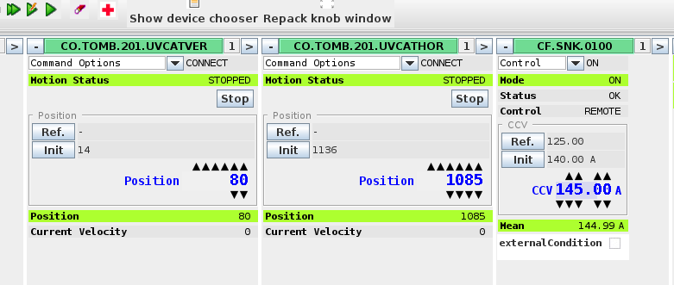
Controls
UV laser beam: UVCAT
X and Y position on cathode
Intensity on cathode
Beam size
Klystron (not controllable remotely, for now): MKS
RF phase
RF gradient
Solenoid magnet: SNK
Solenoid strength
Position and angle (connected to movers)

Slide 5
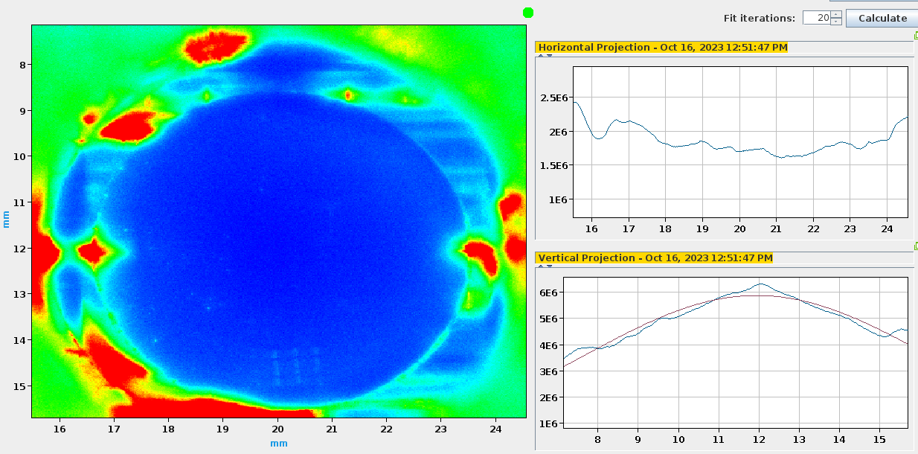
Camera calibration
Used backlight from camera, and knowing that the camera aperture is 11 mm
Camera spatial calibration was adjusted (calibration factor increased by 50%)

Slide 6
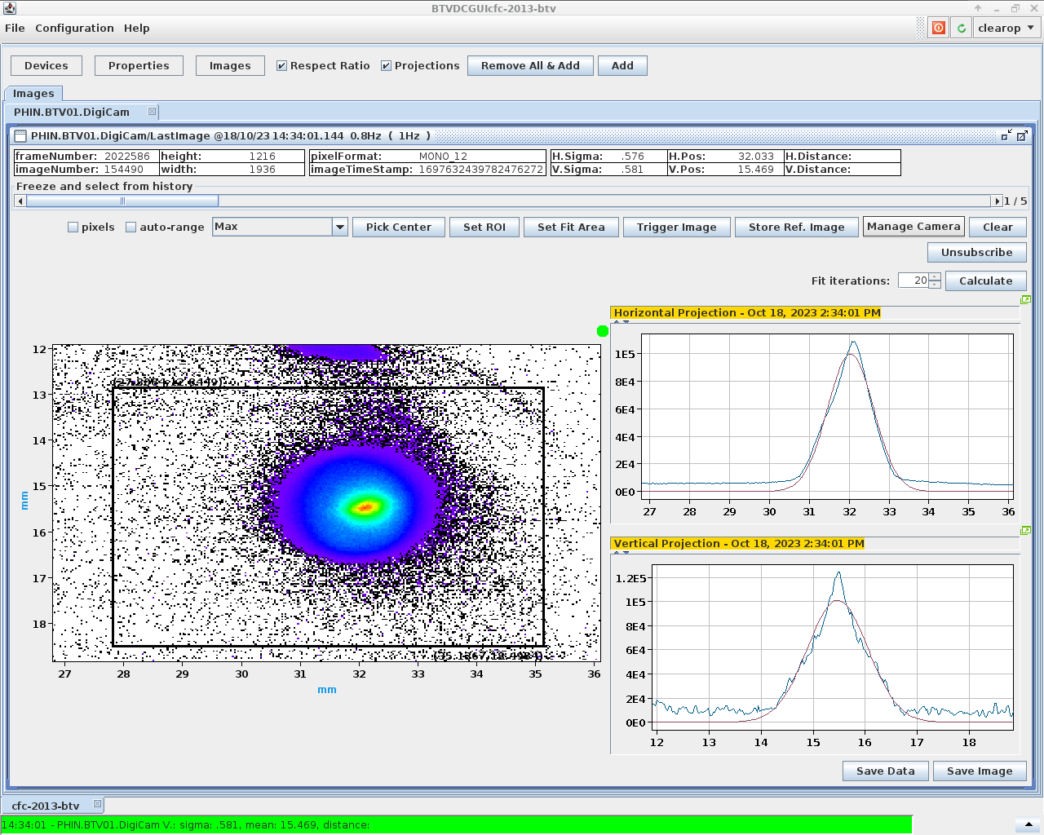
Beam imaging
RMS beam size: 600 µm
Electron beam is stable and reproducible under input parameters (laser position on cathode and solenoid strength)
Scripts were written to:
image the beam
compute a Gaussian fit on its projection
monitor the beam offset and sigma beam size

Slide 7
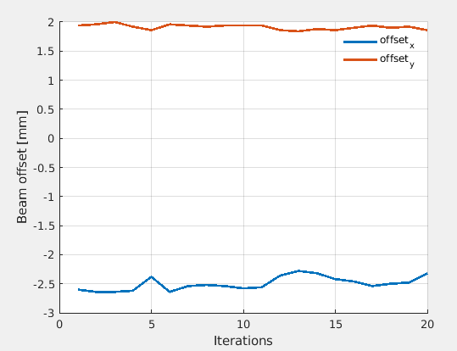
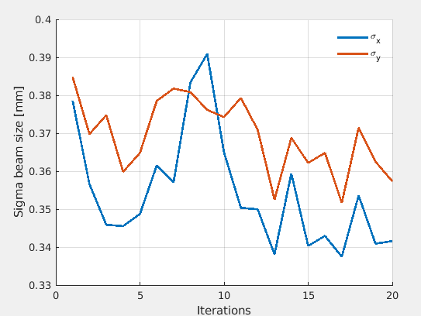
Beam stability
Beam offset
Beam RMS size

Slide 8
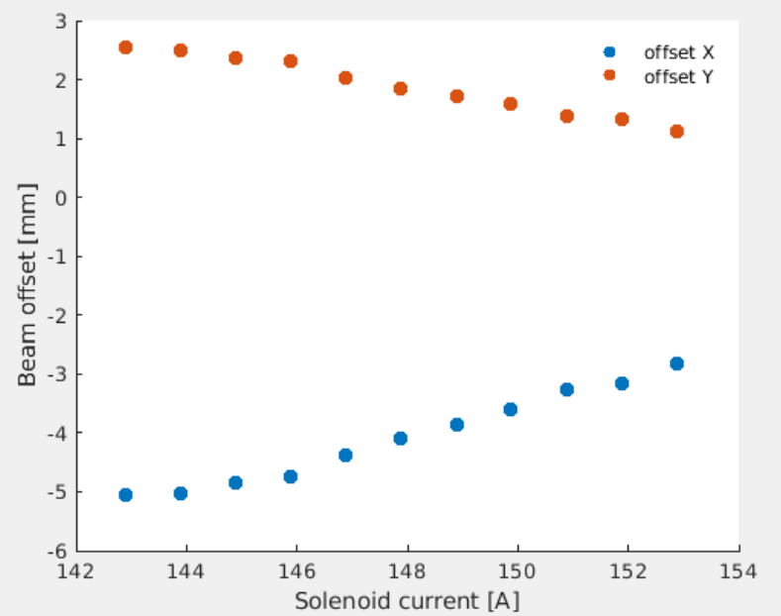
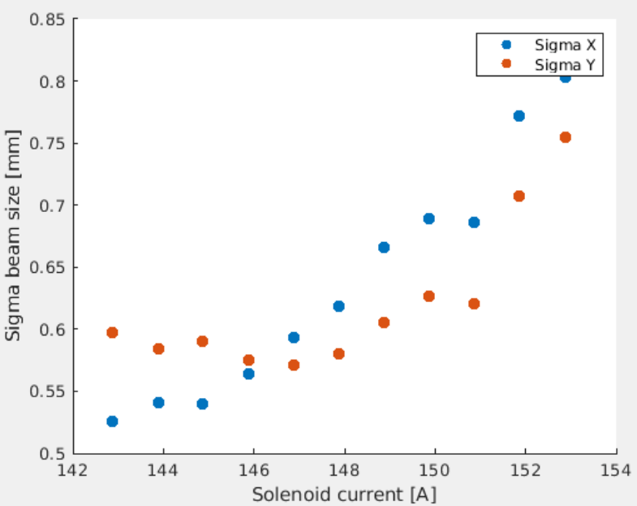
Solenoid strength scan
Beam offset
Beam RMS size

Slide 9
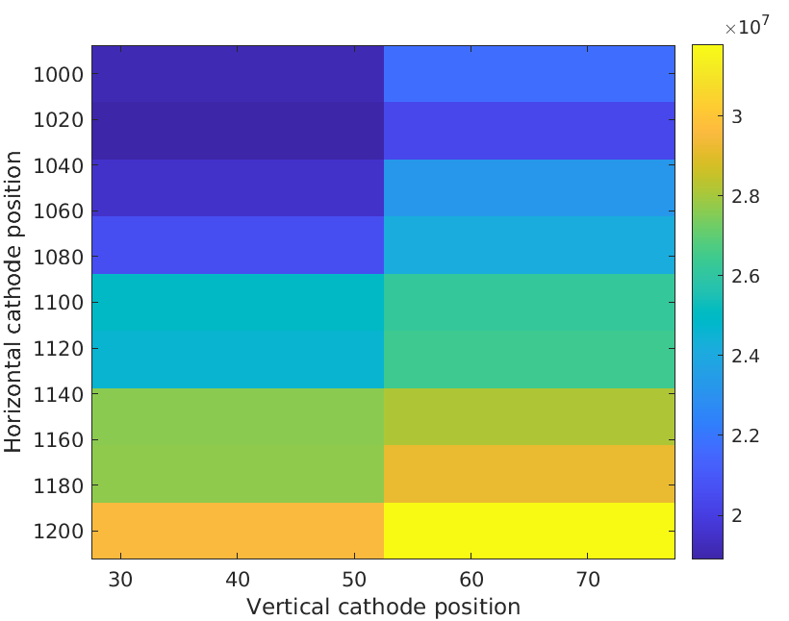
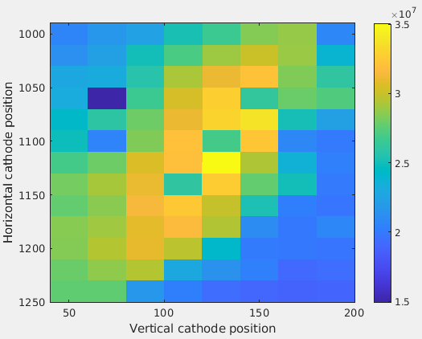
Beam relative intensity from BTV
To get a relative measure of the charge, scan the laser position and sum the pixels of the signal (solenoid strength: 148 A)
Can identify the coordinate range for which the laser is on the cathode.

Slide 10
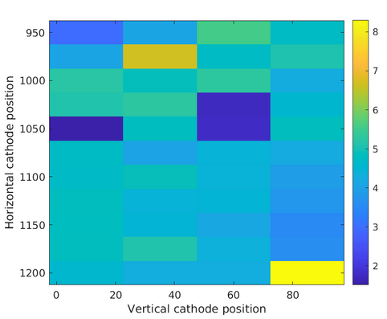
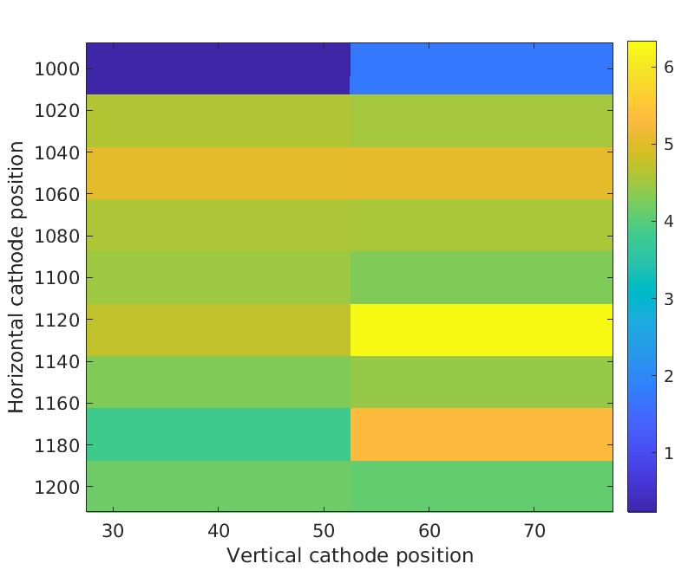
Laser cathode alignment: 2D solenoid scan
Scan the UV beam position in 2D, and for each point, vary the solenoid strength and record the sum of the registered beam offset. Centre of cathode corresponds to smallest offset.
Need to investigate repeatability

Slide 11
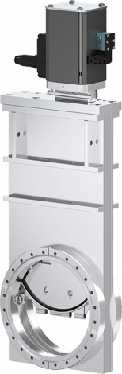
Vacuum considerations
Add gate valve
Gun + Solenoid
Interaction chamber + spectrometer
Detection chamber + Faraday cup
Want to reduce time needed to release the detection chamber from vacuum, in case of necessary adjustments. Also want to prevent contamination of cathode.
Implement a gate valve with interlock between the interaction chamber and the detection chamber.
Vacuum under 1e-9 mbar in the detection chamber.
Which vacuum expert for the detection chamber?
Description
Flange | CF63
Actuator | Pneumatic, double acting - with solenoid valve - with position indicator
Feedthroughs | Bellows
10.8 UHV Gate Valve CF63 (10836-CE44)

Slide 12
Conclusions
First experimental results for the commissioning of the CTF2 were shown.
The electron beam is repeatable with respect to the input laser and solenoid parameters.
Next steps comprise the alignment of the laser on the cathode, and of the solenoid.

Slide 14
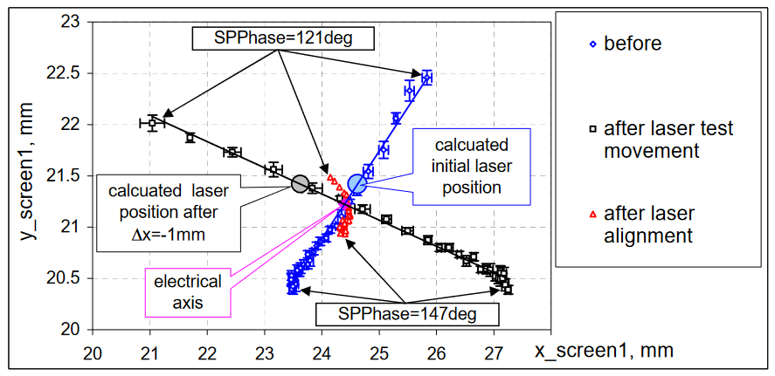
Laser cathode alignment: considerations
The presently used method is sensitive to the misalignment of the solenoid.
To remove the contribution from the solenoid, the following methods are proposed:
Compute the total intensity from the camera (as a relative charge measurement)
Make a 2D map of the charge obtained from the Faraday cup against the position of the laser on cathode
Perform two 1D scans of the RF for two different positions of the laser on the cathode. The point of intersection of the linear fit of the electron beam offset is the centre of the cathode. (as explained in 10.1109/PAC.2005.1590627)

Slide 15
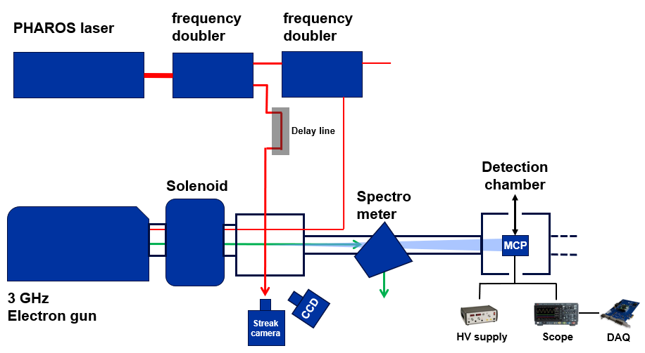
Experimental set-up
2.1 mJ, 1030 nm, 0.17 ps
Laser beam
Electron beam
X-ray beam
5 MeV, 400 pC

Slide 16
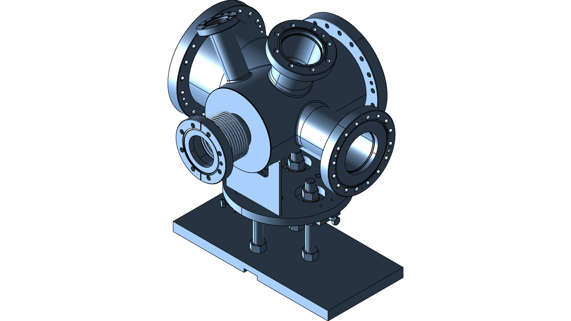
Vacuum equipment
For vacuum test:
Blank flanges: two CF160, one CF100
Standard viewport: CF63
Vacuum pumping: penning gauge + vacuum pump
Gate valve to separate detection chamber from rest of beamline to cathode (with interlock)
For MCP test: turbo/ion pump (need 1e-6 mbar)
Vacuum chamber drawings: https://plm.cern.ch/prod/?StartItem=Part:DF9089C312D74E85AF0B49D1C4501A8E

Slide 17
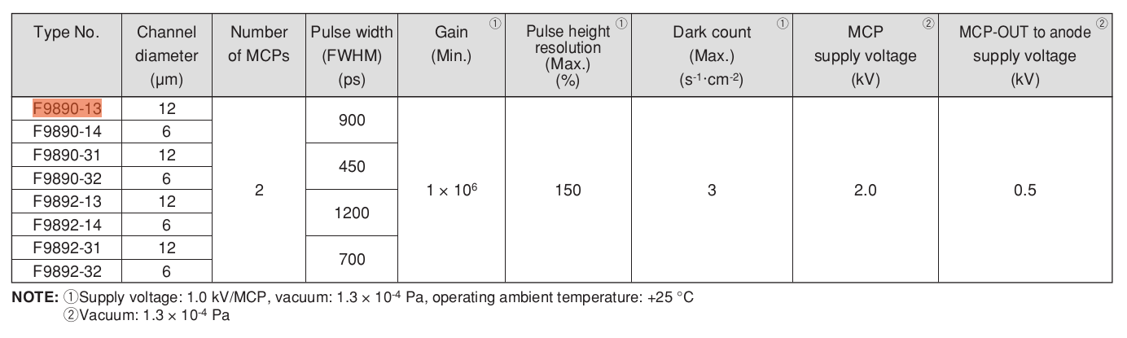
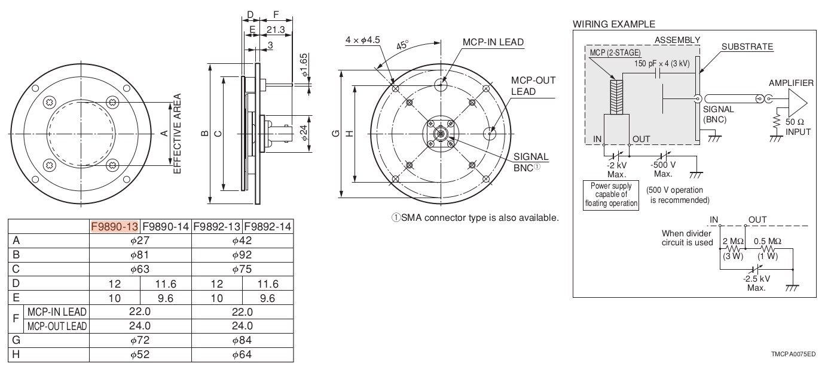
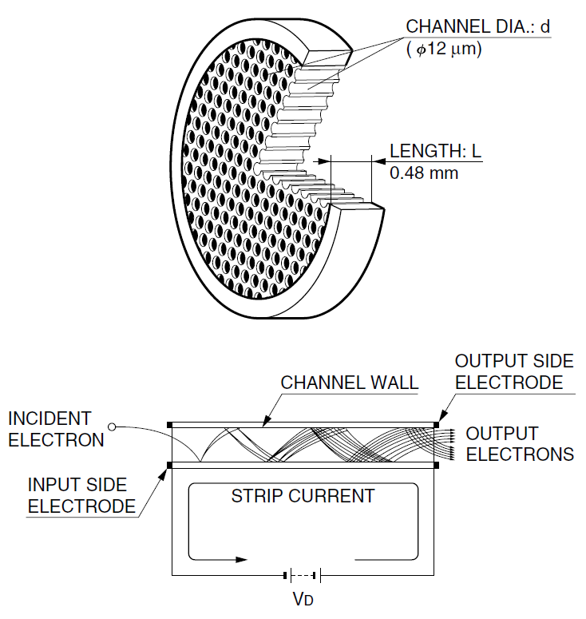
The MCP detector (F9890-13)
Max dimensions: 81 by 36 mm
Operated in vacuum (< 1.3e-4 Pa)
Electrical feedthrough: HV power supply and oscilloscope
Provides 10⁶ gain with a 27 mm effective diameter

Slide 18
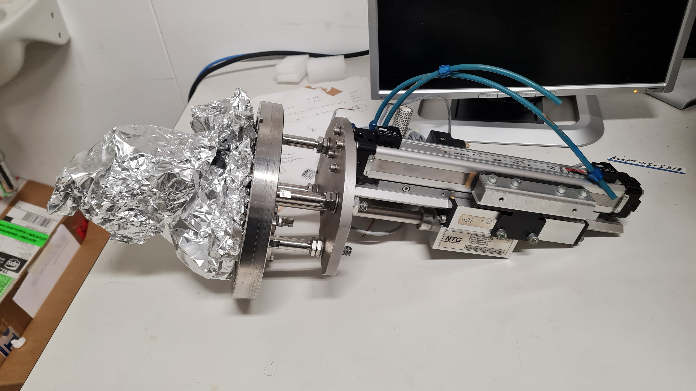
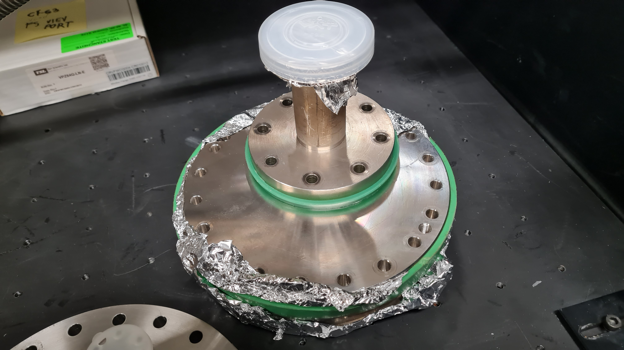
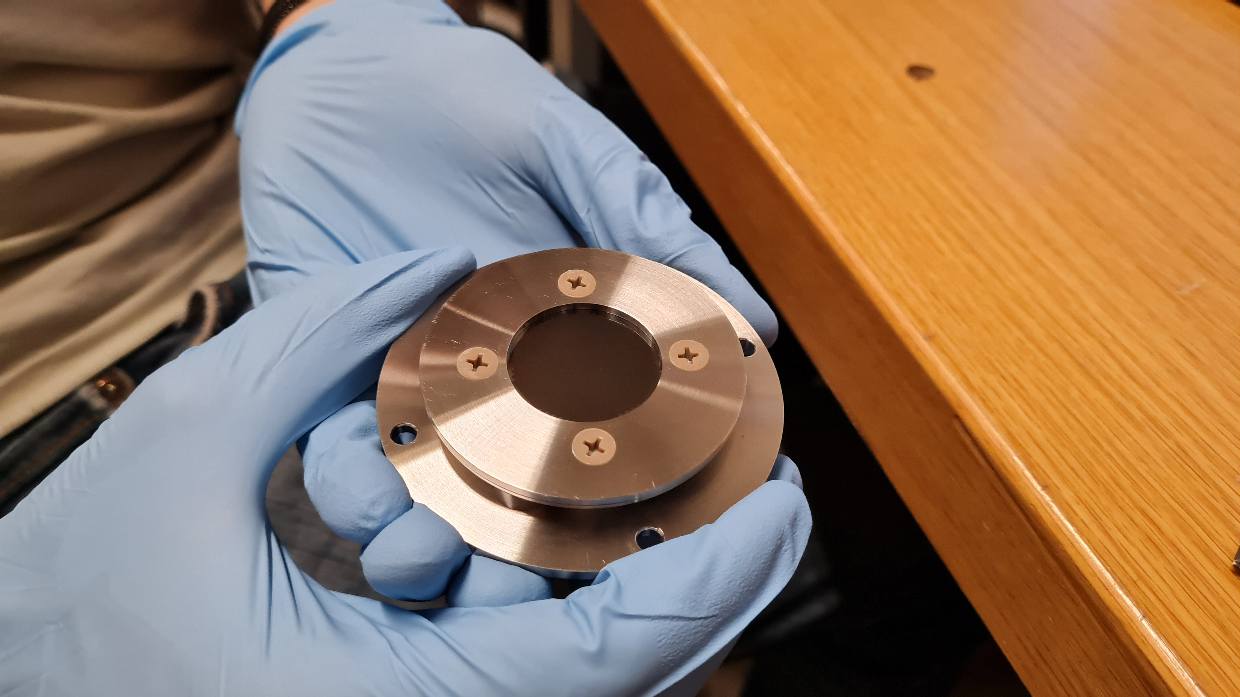
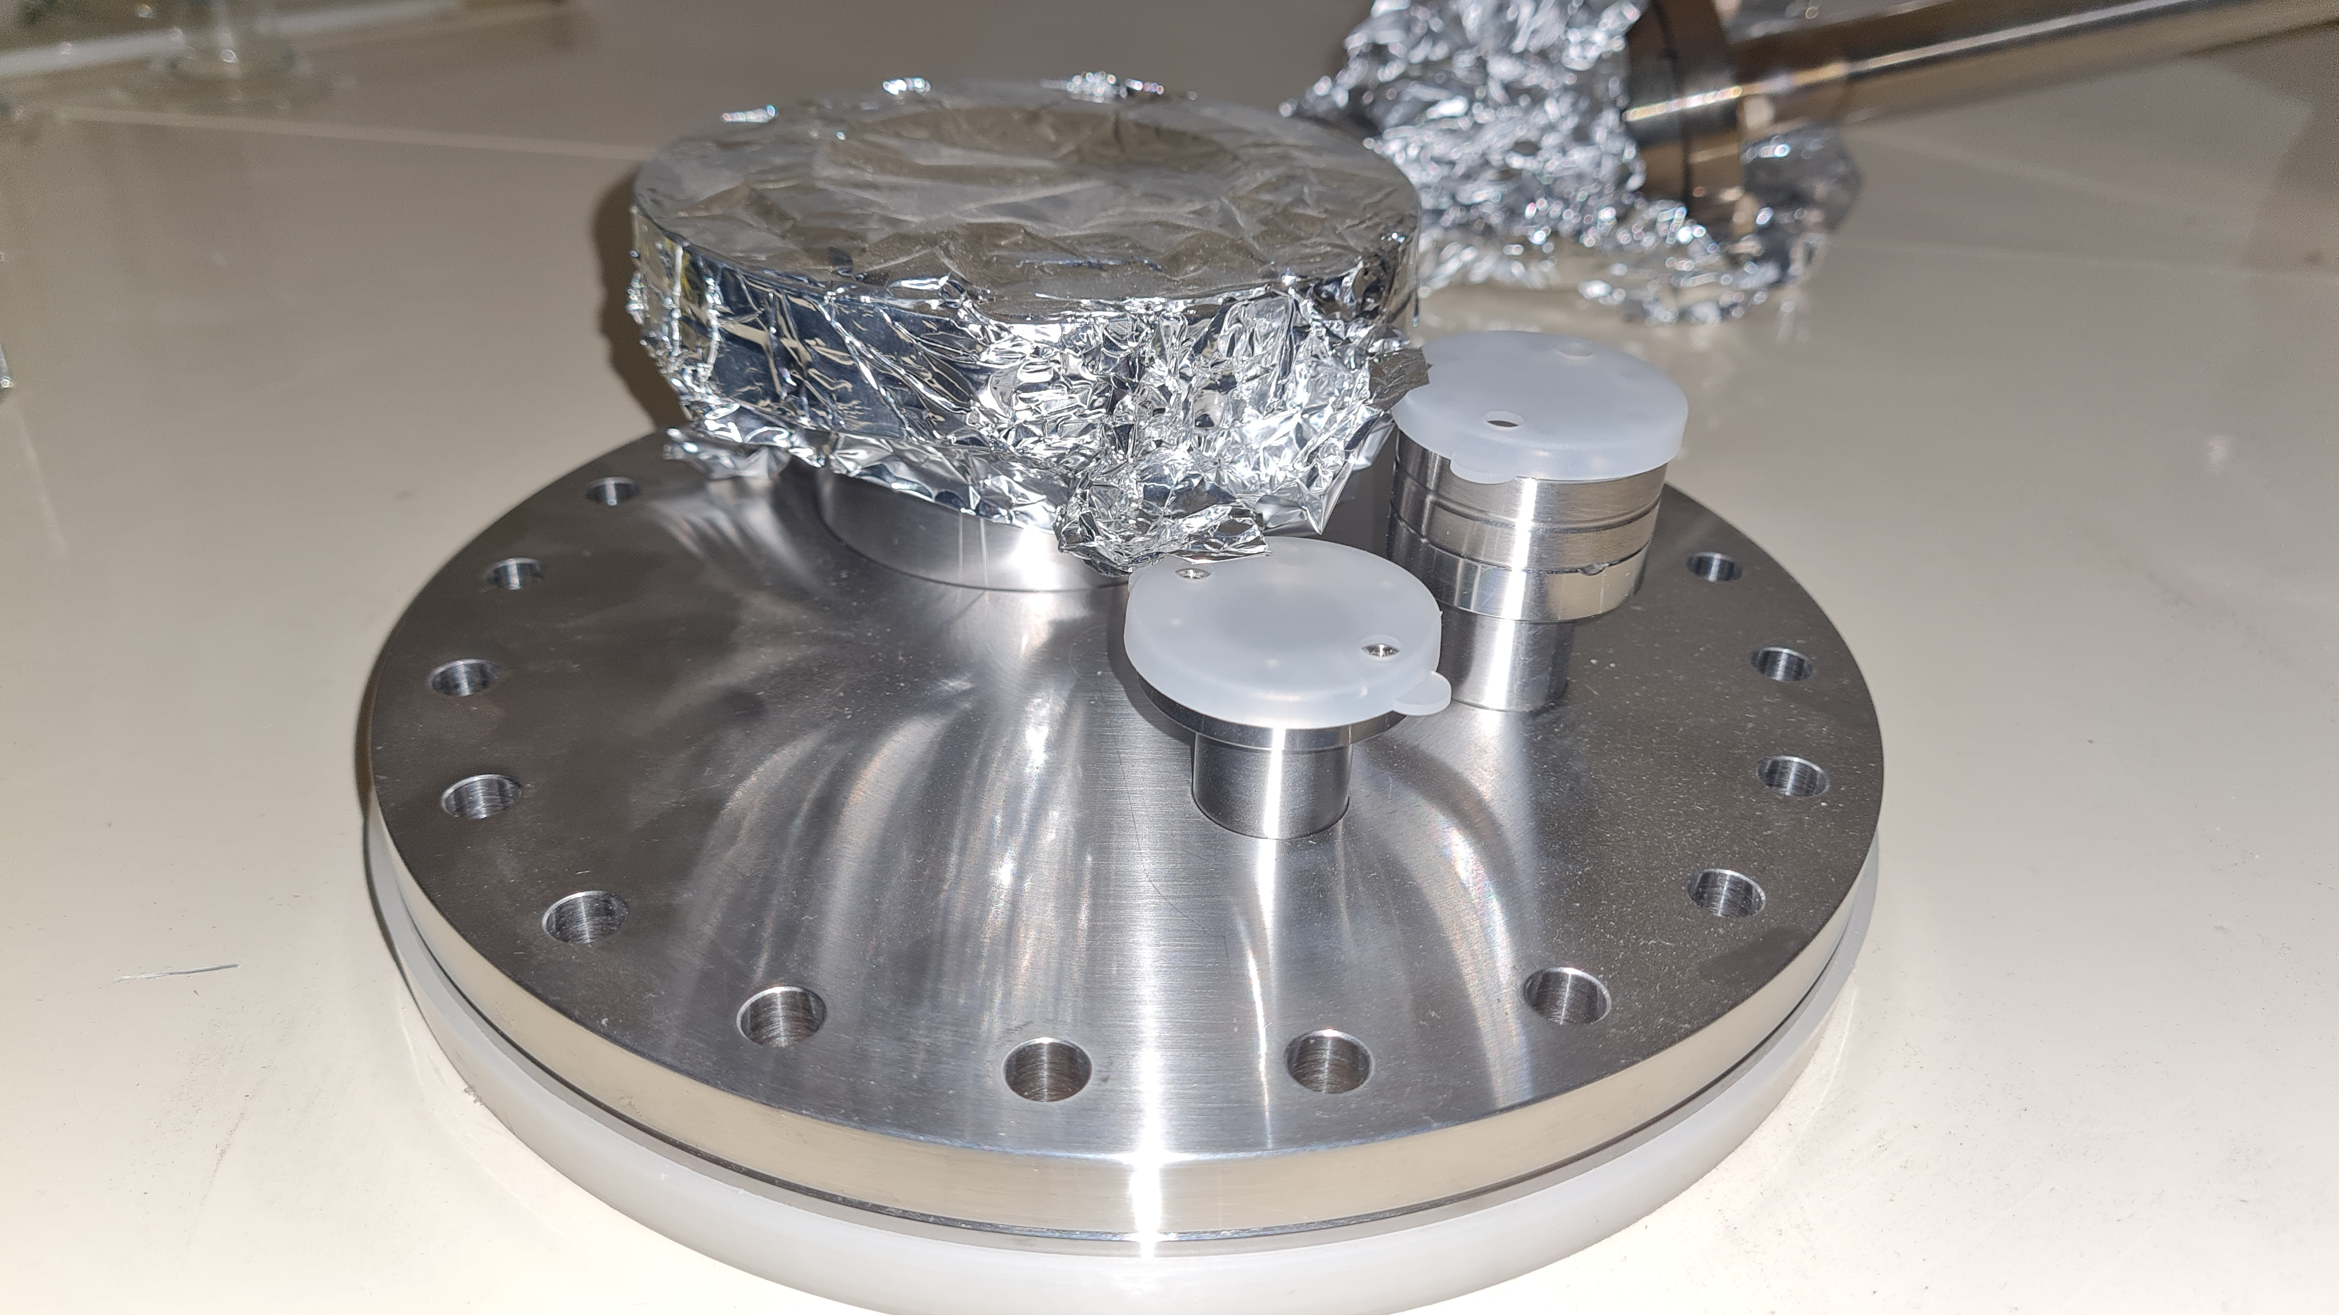
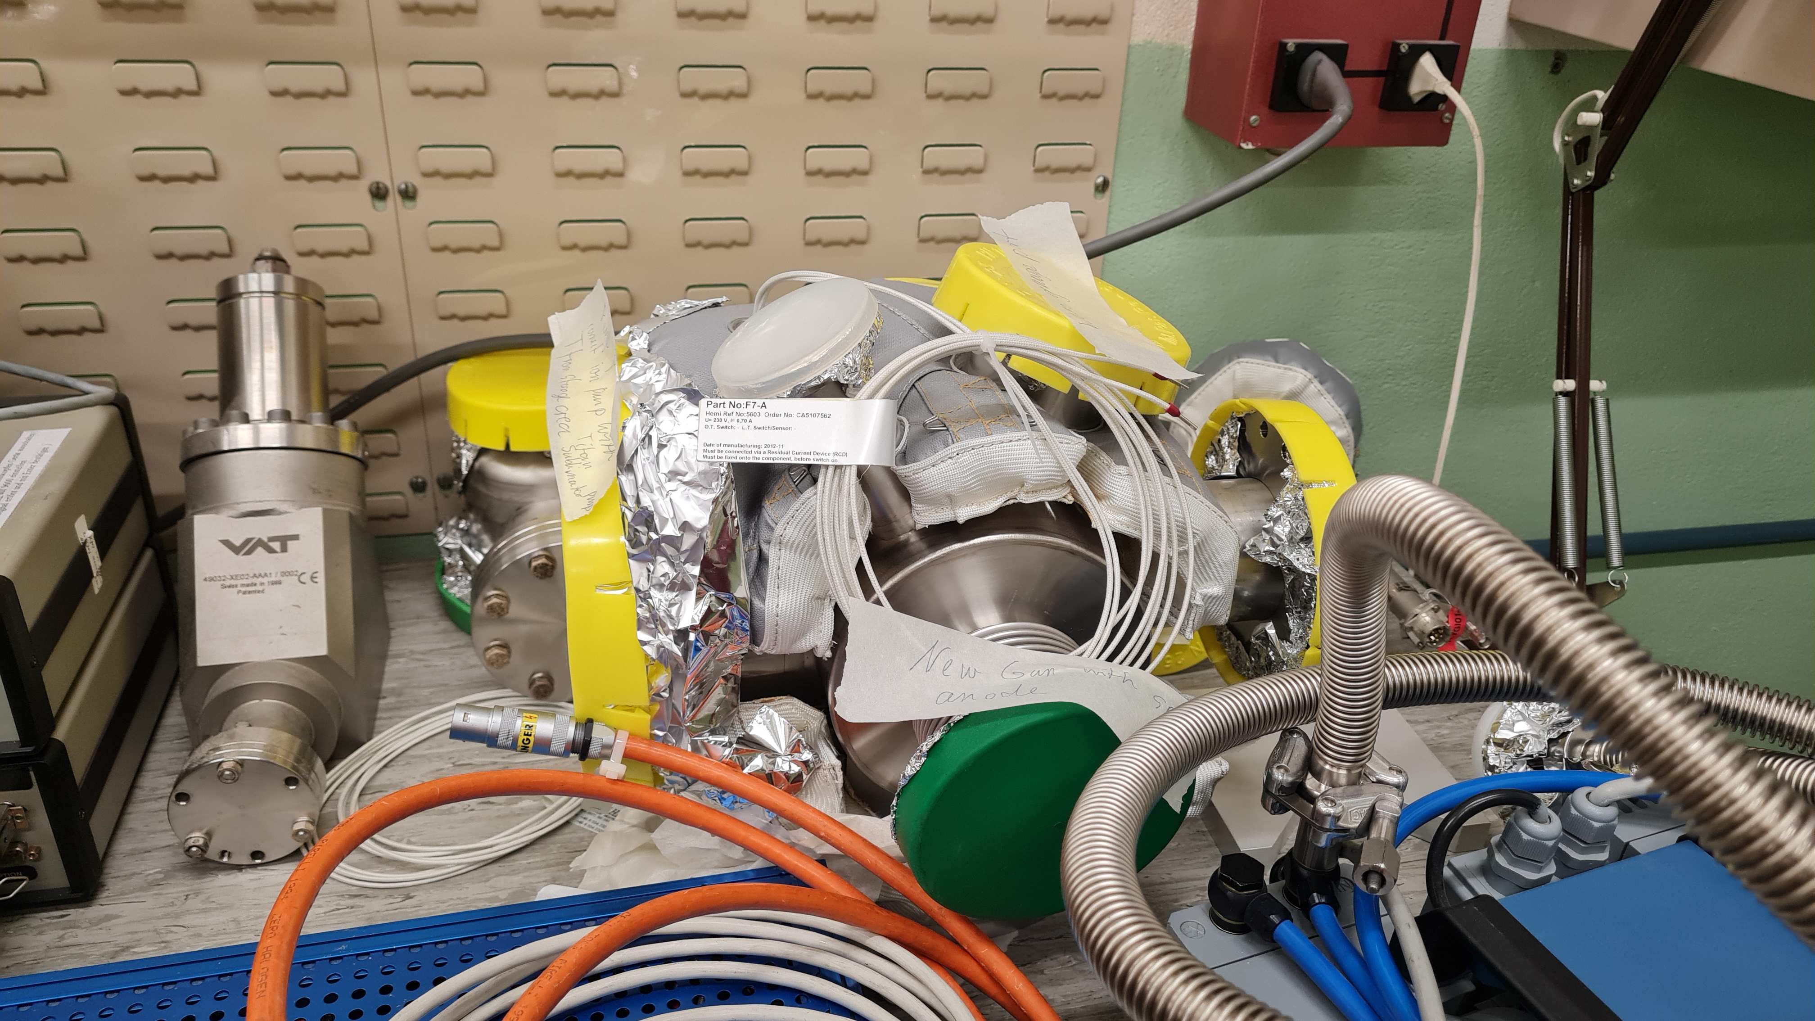
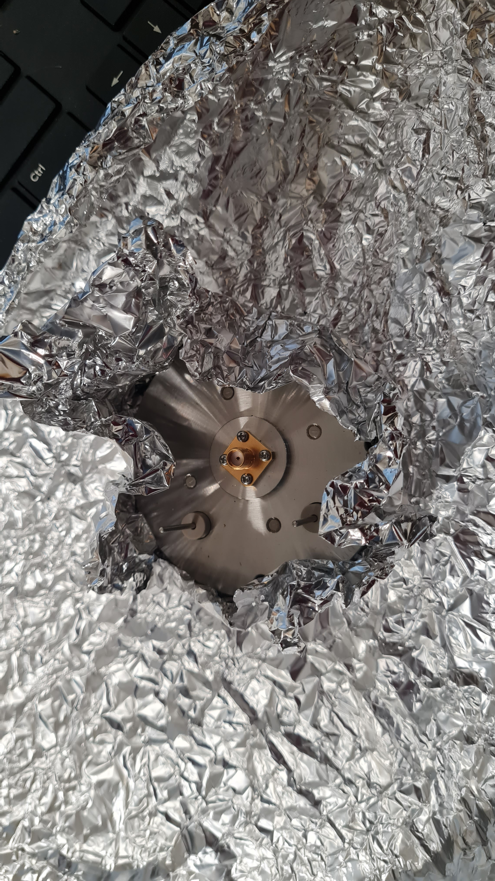
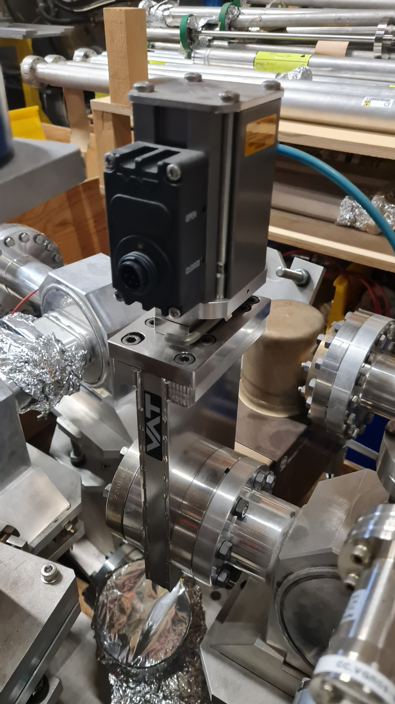
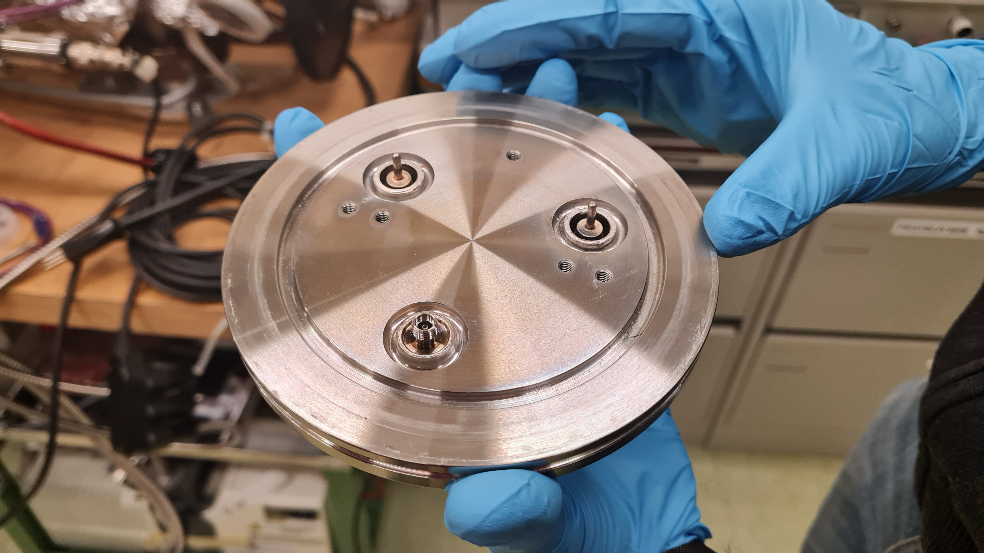
Equipment

Slide 19
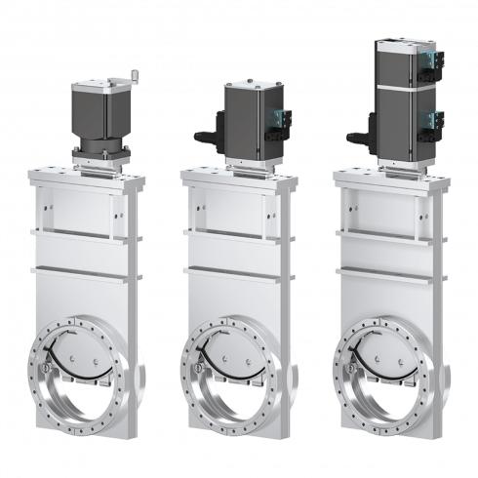
Vacuum considerations
Add gate valve
Gun + Solenoid
Interaction chamber + spectrometer
Detection chamber + Faraday cup
Want to reduce time needed to release the detection chamber from vacuum, in case of necessary adjustments. Also want to prevent contamination of cathode.
Implement a gate valve with interlock between the interaction chamber and the detection chamber.
Vacuum under 1e-9 mbar in the detection chamber.
Which vacuum expert for the detection chamber?
10.8 UHV Gate Valve CF100 (10840-CE24)

