Slide 1


Long-Range Near-Side Ridge Structure
in Small Systems:
Momentum Kick Model with Multiplicity Dependence
Hyeongwoo Noh
Prof. Jin-Hee Yoon*
Inha University, Department of Physics

Slide 2
List of Contents
Introduction
  Motivation & Goal
Theory
  Formalism of MKMwM
Result and Analysis
  Application to p-Pb collisions at 5.02 TeV
Summary

Slide 3

Introduction
Research topic
  $↳$ To describe long-range near-side ridge structures in small system.

Slide 4
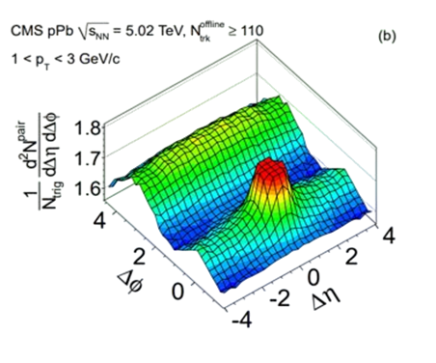
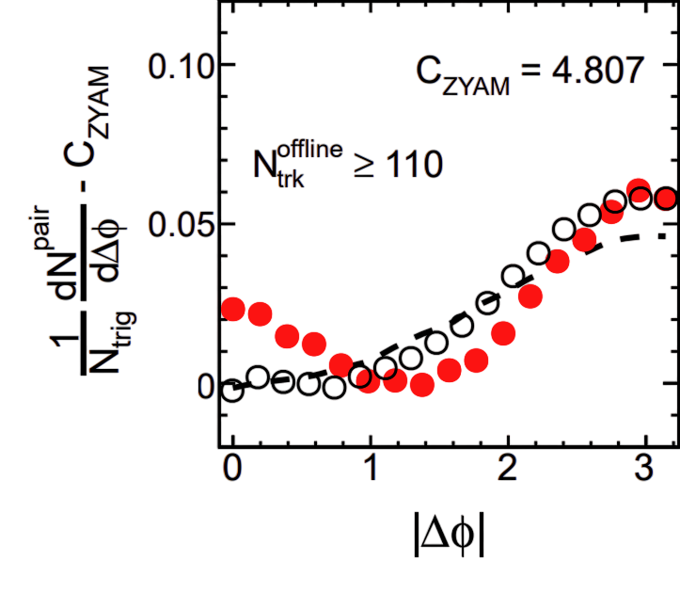

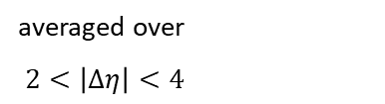
Introduction
Research topic
  $↳$ To describe long-range near-side ridge structures in small system.
  What is a long-range near-side structure?
    $↳$ An enhanced yield in region $2<\left|Δη\right|<4$ and $\left|Δφ\right|≈0$
averaged over
$2<\left|Δη\right|<4$
Fig. 1. Two-particle correlation function for p-Pb at 5.02 TeV

Slide 5
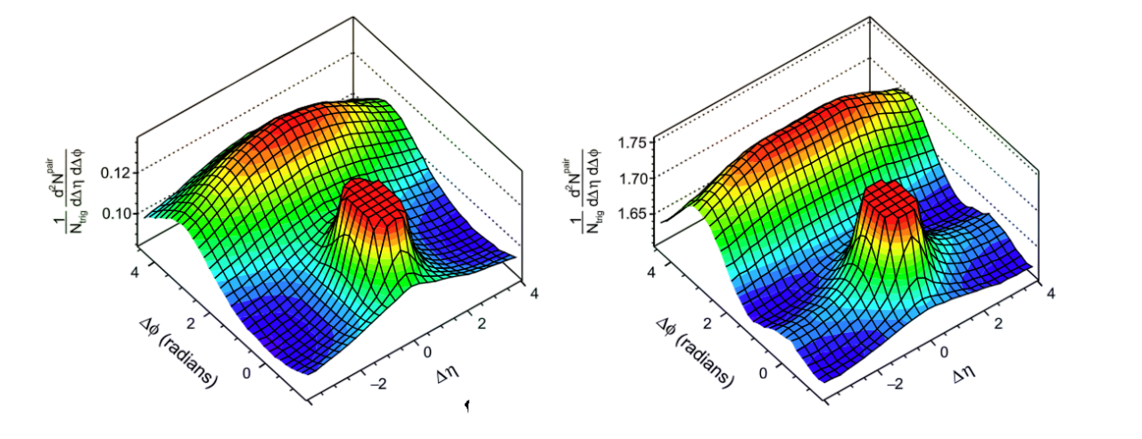
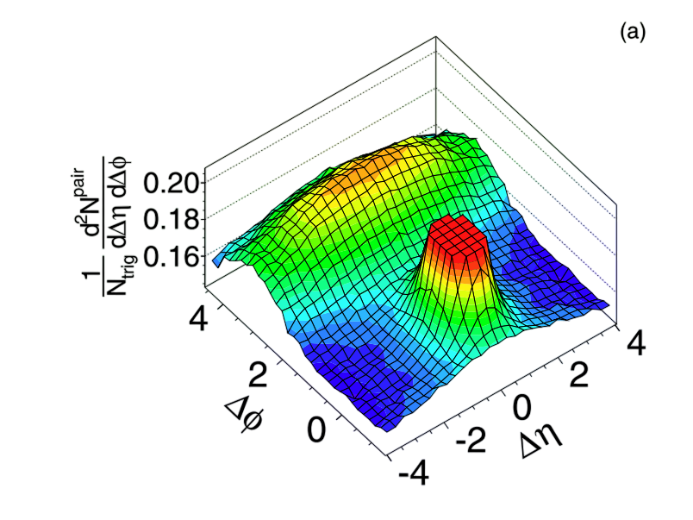
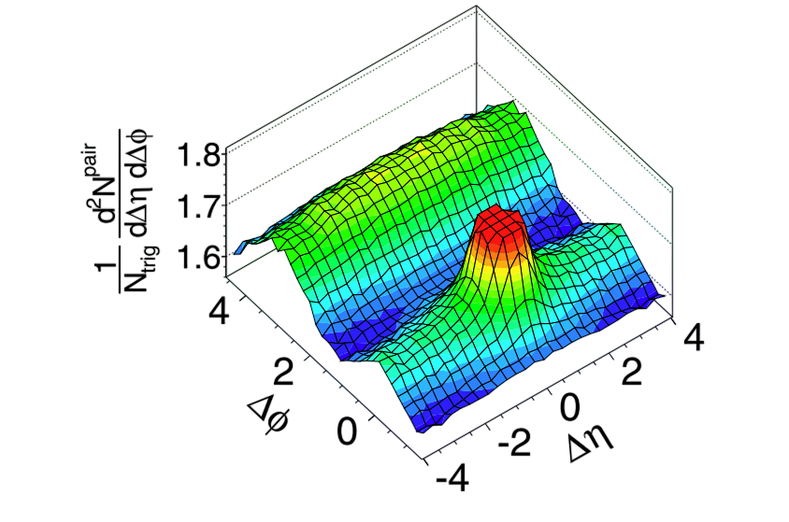
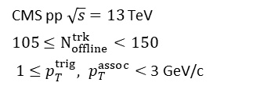
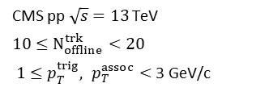
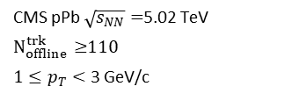
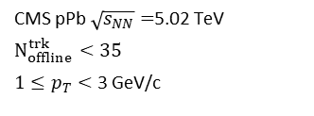
Introduction
  Observation : the ridge structure in high-multiplicity p-p and p-Pb.
Low multiplicity
High multiplicity
Low multiplicity
High multiplicity
CMS pp $\sqrt{s}=13$ TeV
$10≤N_{offline}^{trk}<20$
$1≤p_{T}^{trig}, p_{T}^{assoc}<$ 3 GeV/c
CMS pp $\sqrt{s}=13$ TeV
$105≤N_{offline}^{trk}<150$
$1≤p_{T}^{trig}, p_{T}^{assoc}<$ 3 GeV/c
CMS pPb $\sqrt{s_{NN}}=$5.02 TeV
$N_{offline}^{trk}<35$
$1≤p_{T}<$ 3 GeV/c
CMS pPb $\sqrt{s_{NN}}=$5.02 TeV
$N_{offline}^{trk}≥$110
$1≤p_{T}<$ 3 GeV/c
Fig. 2. Ridge structure in p-p at 13 TeV.
(Left) Low-multiplicity (Right) high-multiplicity
PLB 765 (2017) 193-220
Fig. 3. Ridge structure in p-Pb at 5.02 TeV.
(Left) Low-multiplicity (Right) high-multiplicity
PLB 718 (2013) 795-814

Slide 6
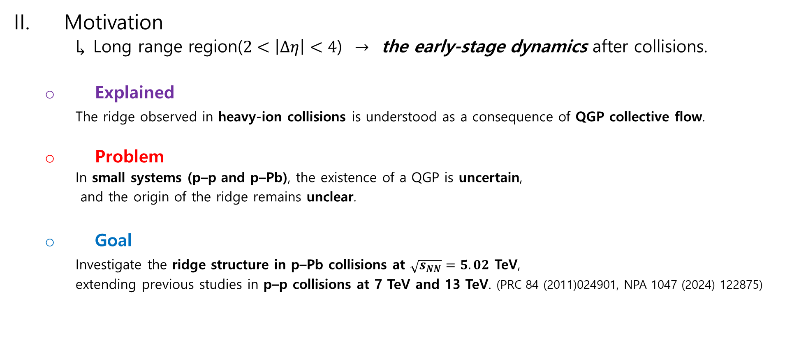
Introduction
Motivation
  $↳$ Long range region($2<\left|Δη\right|<4$) $→$ the early-stage dynamics after collisions.
  Explained
  The ridge observed in heavy-ion collisions is understood as a consequence of QGP collective flow.
  Problem
    In small systems (p–p and p–Pb), the existence of a QGP is uncertain,
    and the origin of the ridge remains unclear.
  Goal
    Investigate the ridge structure in p–Pb collisions at $\sqrt{s_{NN}}=5.02$ TeV,
    extending previous studies in p–p collisions at 7 TeV and 13 TeV. (PRC 84 (2011)024901, NPA 1047 (2024) 122875)
Notes:
This ridge structure implies the information on the initial state of medium.

Slide 7
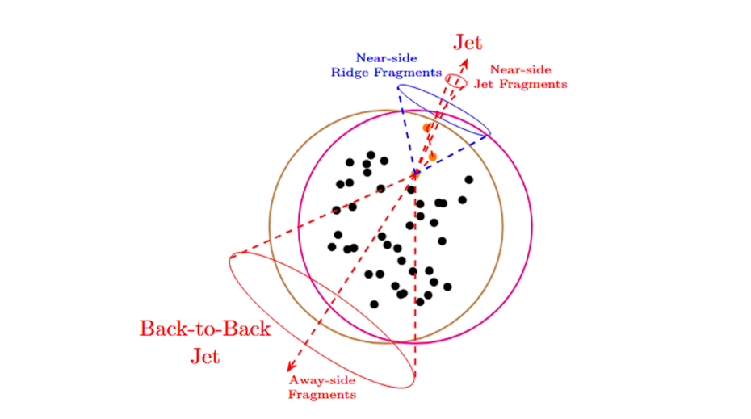

Theory
Momentum kick model with multiplicity dependence (MKMwM)
  $↳$ A jet kicks nearby medium partons that then spread over the long-range near-side
  ,forming the ridge structure.
Near-side ridge fragment
Fig. 4. Geometric representation of yield fragmentation in the MKM.

Slide 8

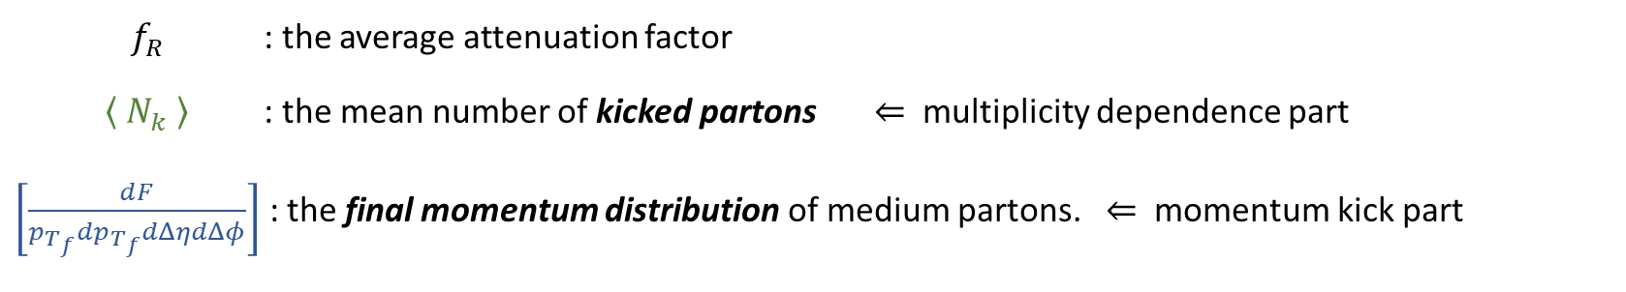
Theory
  Formalism
    Ridge yield
    $≔$ the ensemble average of the final momentum distribution of the kicked partons
    ${\left[\frac{1}{N_{trig}}\frac{dN_{ch}}{p_{T_{f}}dp_{T_{f}}dΔηdΔφ}\right]}_{ridge}= \left\langle \frac{2}{3}⋅\sum_{n}^{N}{f_{R_{n}}⋅ \left[\frac{dF_{n}}{p_{T_{f}}dp_{T_{f}}dΔηdΔφ}\right]} \right\rangle$
    $≃\frac{2}{3}f_{R}⋅\left\langle N_{k} \right\rangle ⋅ \left[\frac{dF}{p_{T_{f}}dp_{T_{f}}dΔηdΔφ}\right]$
$f_{R}$ : the average attenuation factor
$\left\langle N_{k} \right\rangle$ : the mean number of kicked partons $⇐$ multiplicity dependence part
$\left[\frac{dF}{p_{T_{f}}dp_{T_{f}}dΔηdΔφ}\right]$ : the final momentum distribution of medium partons. $⇐$ momentum kick part
Notes:
the factor 2/3 accounts for charged-particle fraction

Slide 9
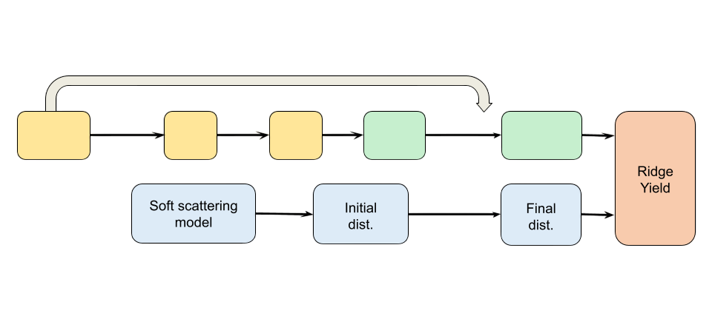



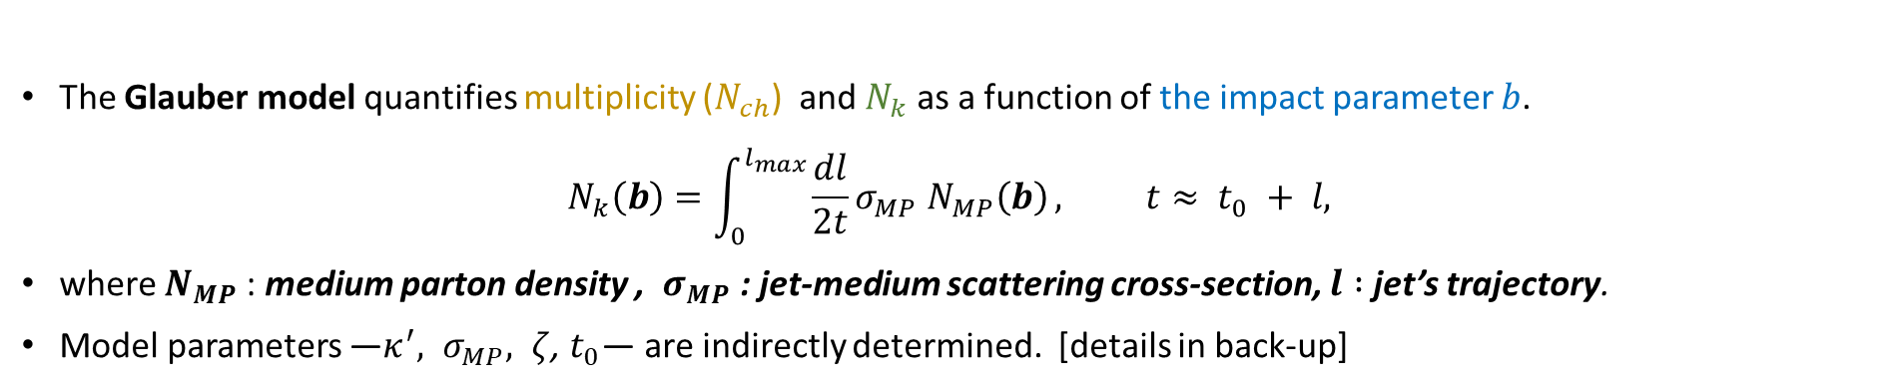









Theory
Multiplicity dependence part $\left\langle N_{k}\right\rangle$
The Glauber model quantifies multiplicity ($N_{ch}$) and $N_{k}$ as a function of the impact parameter $b$.
$$N_{k}\left(b\right)=\int_{0}^{l_{max}}{\frac{dl}{2t}σ_{MP} N_{MP}\left(b\right)}, t≈ t_{0} + l,$$
where $N_{MP}$: medium parton density , $σ_{MP}$ : jet-medium scattering cross-section, $l :$jet’s trajectory.
Model parameters —$κ^{′}, σ_{MP}, ζ$, $t_{0}$— are indirectly determined. [details in back-up]
Multiplicity dependence
Glauber
Model
$$σ_{MP}$$
$e^{−ζN_{k}}$, $P_{jet}$
$$T_{p}, T_{Pb}$$
$$N_{Part}$$
$$×κ′$$
$$N_{MP}$$
$$N_{k}$$
$$\left\langle N_{k}\right\rangle$$
Thickness
$$f_{R}$$
$$T$$
$$\vec{q}=\vec{p_{f}} −\vec{p_{i}}$$
Fig. 5. Flow diagram of ridge yield in MKMwM
Notes:
Parameters are indirectly chosen by external experiment data. the collision geometry -> dependence on the multiplicity.

Slide 10
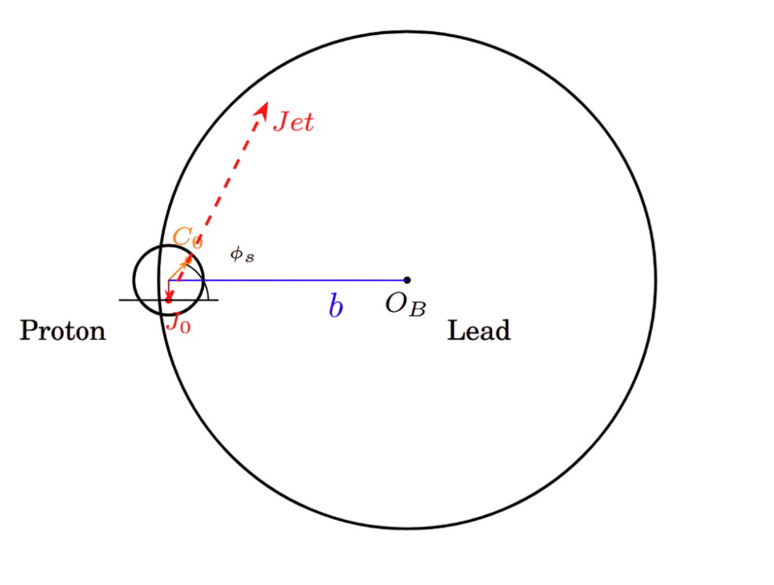
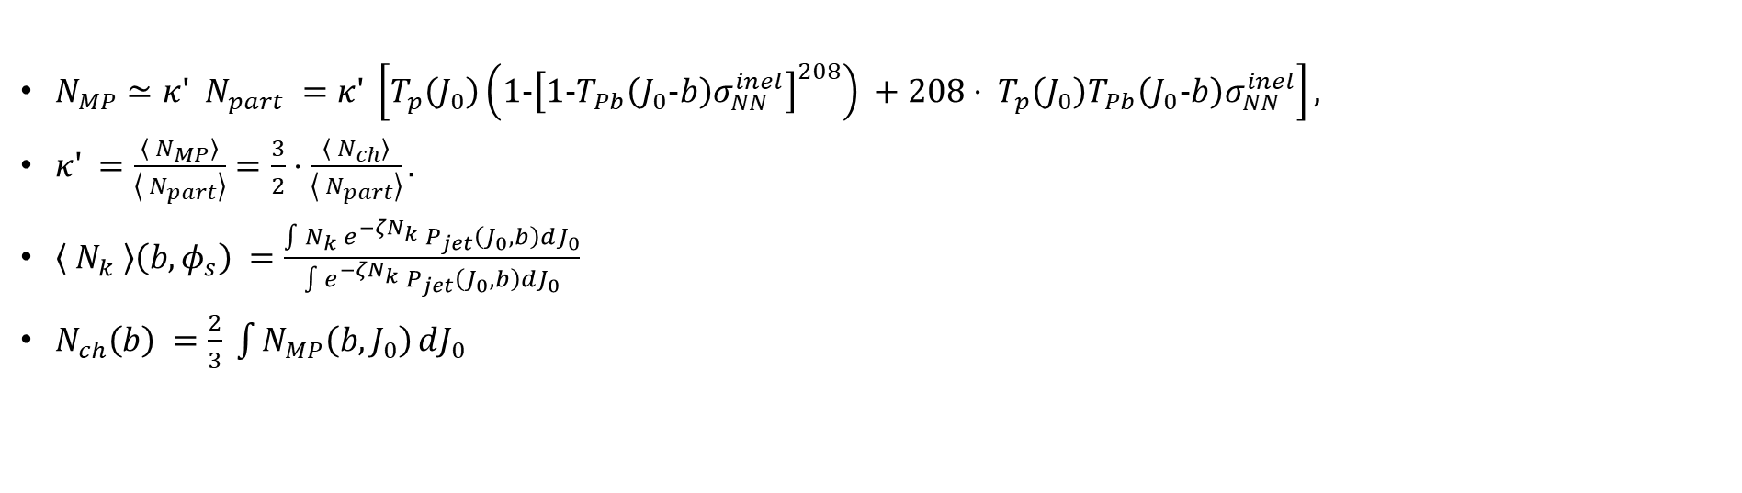






Theory
Multiplicity dependence part $\left\langle N_{k}\right\rangle$
$N_{MP}≃κ′ N_{part} =κ′ \left[T_{p}\left(J_{0}\right)\left(1−{\left[1−T_{Pb}\left(J_{0}−b\right)σ_{NN}^{inel}\right]}^{208}\right) +208⋅ T_{p}\left(J_{0}\right)T_{Pb}\left(J_{0}−b\right)σ_{NN}^{inel}\right],$
$κ′ =\frac{\left\langle N_{MP}\right\rangle }{\left\langle N_{part}\right\rangle }=\frac{3}{2}⋅\frac{\left\langle N_{ch}\right\rangle }{\left\langle N_{part}\right\rangle }.$
$\left\langle N_{k} \right\rangle \left(b,φ_{s}\right) =\frac{\int{N_{k} e^{−ζN_{k}} P_{jet}\left(J_{0},b\right)}dJ_{0}}{\int{e^{−ζN_{k}} P_{jet}\left(J_{0},b\right)}dJ_{0}}$
$N_{ch}\left(b\right) =\frac{2}{3} \int{N_{MP}\left(b,J_{0}\right)}dJ_{0}$
Multiplicity dependence
Glauber
Model
$$σ_{MP}$$
$e^{−ζN_{k}}$, $P_{jet}$
$$T_{p}, T_{Pb}$$
$$N_{Part}$$
$$×κ′$$
$$N_{MP}$$
$$N_{k}$$
$$\left\langle N_{k}\right\rangle$$
Thickness
Fig. 5. Flow diagram of ridge yield in MKMwM
Fig. 6. Collision geometry of p-Pb collisions.
Notes:
Parameters are indirectly chosen by external experiment data. the collision geometry -> dependence on the multiplicity.

Slide 11



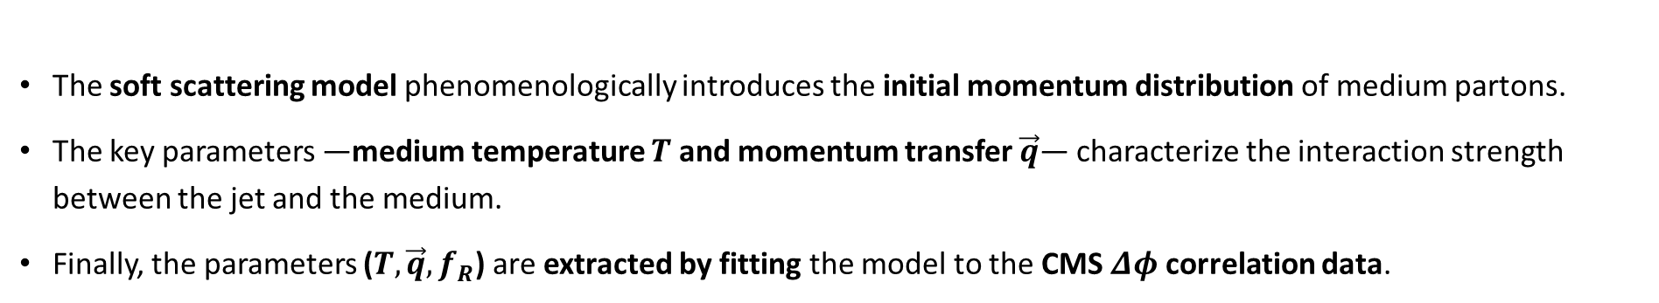




Theory
Momentum kick part
The soft scattering model phenomenologically introduces the initial momentum distribution of medium partons.
The key parameters —medium temperature $T$ and momentum transfer $\vec{q}$— characterize the interaction strength between the jet and the medium.
Finally, the parameters ($T, \vec{q}, f_{R}$) are extracted by fitting the model to the CMS $Δφ$ correlation data.
Glauber
Model
$$σ_{MP}$$
$e^{−ζN_{k}}$, $P_{jet}$
$$T_{p}, T_{Pb}$$
$$N_{Part}$$
$$×κ′$$
$$N_{MP}$$
$$N_{k}$$
$$\left\langle N_{k}\right\rangle$$
Thickness
$$f_{R}$$
$$T$$
$$\vec{q}=\vec{p_{f}} −\vec{p_{i}}$$
Momentum kick
Fig. 5. Flow diagram of ridge yield in MKMwM
Notes:
Parameters are indirectly chosen by external experiment data.

Slide 12
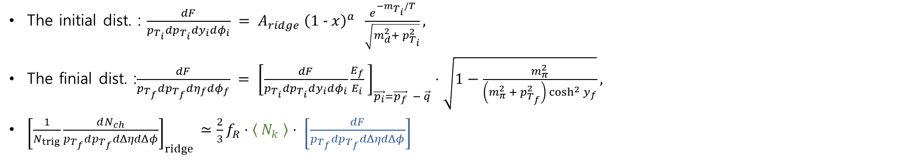
Theory
Momentum kick part
The initial dist. : $\frac{dF}{p_{T_{i}}dp_{T_{i}}dy_{i}dφ_{i}} = A_{ridge} {\left(1 − x\right)}^{a} \frac{e^{−m_{T_{i}}/T}}{\sqrt{m_{d}^{2}+ p_{T_{i}}^{2}}},$
The finial dist. :$\frac{dF}{p_{T_{f}}dp_{T_{f}}dη_{f}dφ_{f}} = {\left[\frac{dF}{p_{T_{i}}dp_{T_{i}}dy_{i}dφ_{i}}\frac{E_{f}}{E_{i}} \right]}_{\vec{p_{i}}=\vec{p_{f}} − \vec{q}}⋅\sqrt{1−\frac{m_{π}^{2}}{\left(m_{π}^{2} + p_{T_{f}}^{2}\right)\cosh^{2}{y_{f}}}},$
${\left[\frac{1}{N_{trig}}\frac{dN_{ch}}{p_{T_{f}}dp_{T_{f}}dΔηdΔφ}\right]}_{ridge}$ $≃\frac{2}{3}f_{R}⋅\left\langle N_{k} \right\rangle ⋅ \left[\frac{dF}{p_{T_{f}}dp_{T_{f}}dΔηdΔφ}\right]$
Glauber
Model
$$σ_{MP}$$
$e^{−ζN_{k}}$, $P_{jet}$
$$T_{p}, T_{Pb}$$
$$N_{Part}$$
$$×κ′$$
$$N_{MP}$$
$$N_{k}$$
$$\left\langle N_{k}\right\rangle$$
Thickness
$$f_{R}$$
$$T$$
$$\vec{q}=\vec{p_{f}} −\vec{p_{i}}$$
Momentum kick
Fig. 5. Flow diagram of ridge yield in MKMwM
Notes:
Parameters are indirectly chosen by external experiment data.

Slide 13
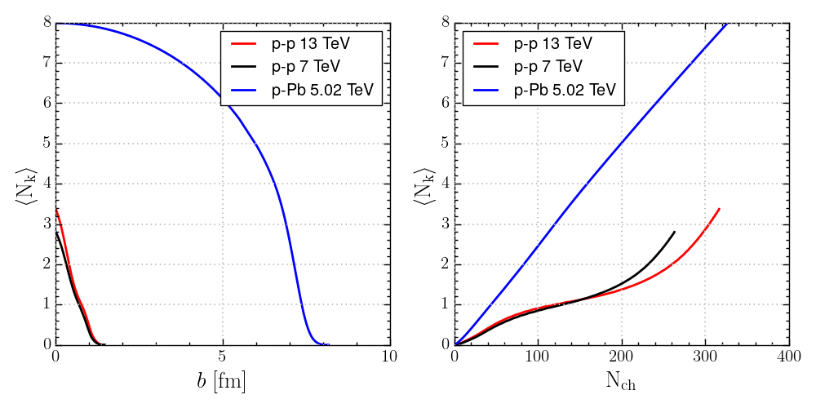
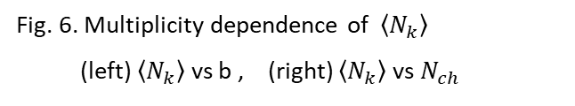


Result and Analysis
Multiplicity dependence of $\left\langle N_{k}\right\rangle$
  In p-Pb collisions,
    At $b≈7$fm, $\left\langle N_{k}\right\rangle ≈3$.
    $\left\langle N_{k}\right\rangle ≥3$ for $N_{ch}≥100$ .
  In p-p collisions,
    $\left\langle N_{k}\right\rangle =1∼3$ for $N_{ch}≥100$
  Different collision geometry
  $⇒$ Different kick effect
  $⇒$stronger ridge formation in p–Pb than in p–p.
Fig. 6. Multiplicity dependence of $\left\langle N_{k}\right\rangle$
(left) $\left\langle N_{k}\right\rangle$ vs b , (right) $\left\langle N_{k}\right\rangle$ vs $N_{ch}$
$b≈7$ fm

Slide 14
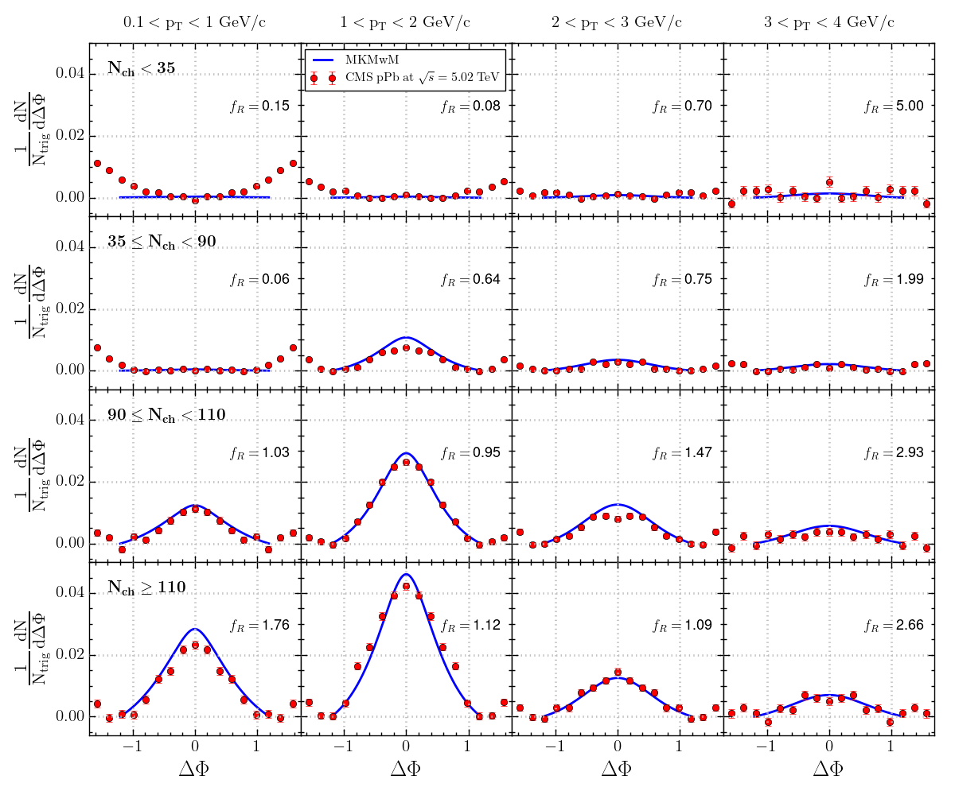

Result and Analysis
CMS $Δφ$ distribution ($90≤N_{ch}<110$, $N_{ch}≥$110 )
  Column : same $p_{T}$ bin.
  Row : same $N_{ch}$ interval.
  The best-fit parameters are
  $q=1.0$ GeV/c, $T=0.74$ GeV
  In $1<p_{T}<2$ GeV/c ,
  the ridge structure becomes
  prominent on the near side.
  For $N_{ch}≥$110,
  the ridge structure is noticeable.
Fig. 8. Comparison of the MKMwM calculations (blue solid lines) with CMS p–Pb data (red circles)
at 5.02 TeV. The associated yield per trigger is shown as a function of ∆ϕ for different $p_{T}$ and $N_{ch}$.
Notes:
Each column correspondsto a different transverse-momentum range (0.1 < pT < 1 GeV/c, 1 < pT <2 GeV/c, 2 < pT < 3 GeV/c, and 3 < pT < 4 GeV/c), while each row representsa multiplicity interval (Nch < 35, 35 ≤ Nch < 90, 90 ≤ Nch < 110, , and

Slide 15
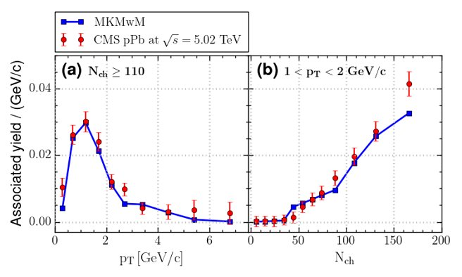
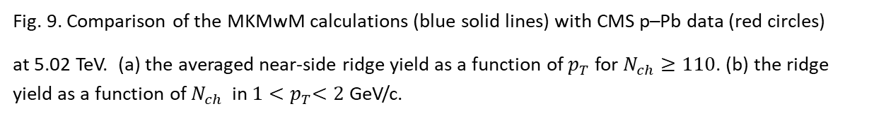

Result and Analysis
CMS $p_{T} \& N_{ch}$ distribution.
  Averaged over $\left|Δφ\right|≤1.2$ for
  high multiplicity, (b) intermediate- $p_{T}$
  The associated yield peaks
  around $1<p_{T}<2$ GeV/c.
  The associated yield increases
  approximately linearly with $N_{ch}$.
Fig. 9. Comparison of the MKMwM calculations (blue solid lines) with CMS p–Pb data (red circles)
at 5.02 TeV. (a) the averaged near-side ridge yield as a function of $p_{T}$ for $N_{ch}≥110$. (b) the ridge yield as a function of $N_{ch}$ in $1{<p}_{T}<2$GeV/c.
Notes:
Each column correspondsto a different transverse-momentum range (0.1 < pT < 1 GeV/c, 1 < pT <2 GeV/c, 2 < pT < 3 GeV/c, and 3 < pT < 4 GeV/c), while each row representsa multiplicity interval (Nch < 35, 35 ≤ Nch < 90, 90 ≤ Nch < 110, , and

Slide 16
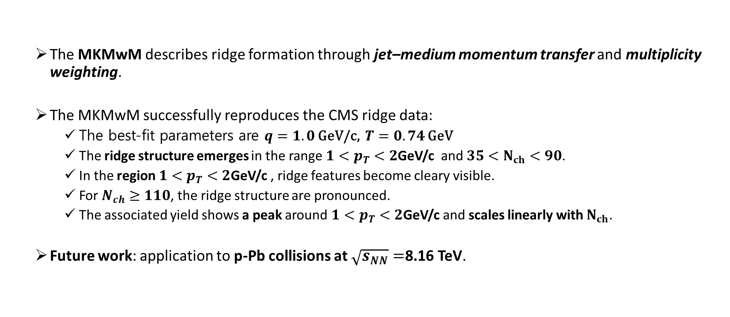
Summary
  The MKMwM describes ridge formation through jet–medium momentum transfer and multiplicity weighting.
  The MKMwM successfully reproduces the CMS ridge data:
    The best-fit parameters are $q=1.0$ GeV/c, $T=0.74$ GeV
    The ridge structure emerges in the range ${1<p}_{T}<2$GeV/c and $35<N_{ch}<90$.
    In the region ${1<p}_{T}<2$GeV/c , ridge features become cleary visible.
    For $N_{ch}≥110$, the ridge structure are pronounced.
    The associated yield shows a peak around ${1<p}_{T}<2$GeV/c and scales linearly with $N_{ch}$.
  Future work: application to p-Pb collisions at $\sqrt{s_{NN}}=$8.16 TeV.
Notes:
This ridge structure implies the information on the initial state of medium.

Slide 17


Thank you!

Slide 18
Back-up

Slide 19

Theory
Momentum kick model with multiplicity dependence (MKMwM)
  $↳$ A jet kicks nearby medium partons
Near-side jet fragment
Near-side ridge fragment
Away-side fragment
Fig. 4. Geometric representation of yield fragmentation in the MKM.

Slide 20
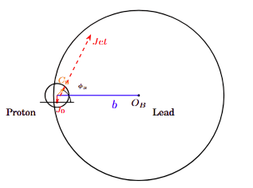

Theory
Multiplicity dependence part $\left\langle N_{k}\right\rangle$
A jet is produced at a point $J_{0}$ in the overlapping.
Medium partons are created after $t_{0}$.
The jet travels through $l$w.r.t $φ_{s}$in the reaction plane .
The jet collides with nearby partons.
The medium parton density ($N_{MP}$) traverses the jet-medium cross section ($σ_{MP}$).
$$N_{k}\left(b\right)=\int_{0}^{l_{max}}{\frac{dl}{2t}σ_{MP} N_{MP}\left(b\right)}, t≈ t_{0} + l.$$
Fig. Schematic representation of proton and lead
on the transverse plane in high energy collisions.

Slide 21
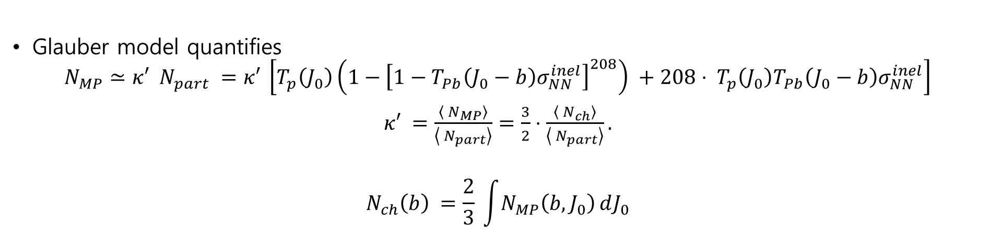
Theory
Multiplicity dependence part $\left\langle N_{k}\right\rangle$
Glauber model quantifies
$$N_{MP}≃κ′ N_{part} =κ′ \left[T_{p}\left(J_{0}\right)\left(1−{\left[1−T_{Pb}\left(J_{0}−b\right)σ_{NN}^{inel}\right]}^{208}\right) +208⋅ T_{p}\left(J_{0}\right)T_{Pb}\left(J_{0}−b\right)σ_{NN}^{inel}\right]$$
$κ′ =\frac{\left\langle N_{MP}\right\rangle }{\left\langle N_{part}\right\rangle }=\frac{3}{2}⋅\frac{\left\langle N_{ch}\right\rangle }{\left\langle N_{part}\right\rangle }.$
$$N_{ch}\left(b\right) =\frac{2}{3} \int{N_{MP}\left(b,J_{0}\right)}dJ_{0}$$
Multiplicity dependence
Glauber
Model
$$σ_{MP}$$
$e^{−ζN_{k}}$, $P_{jet}$
$$T_{p}, T_{Pb}$$
$$N_{Part}$$
$$×κ′$$
$$N_{MP}$$
$$N_{k}$$
$$\left\langle N_{k}\right\rangle$$
Thickness
Fig. 5. Flow diagram of ridge yield in MKMwM
Notes:
Parameters are indirectly chosen by external experiment data. the collision geometry -> dependence on the multiplicity.

Slide 22
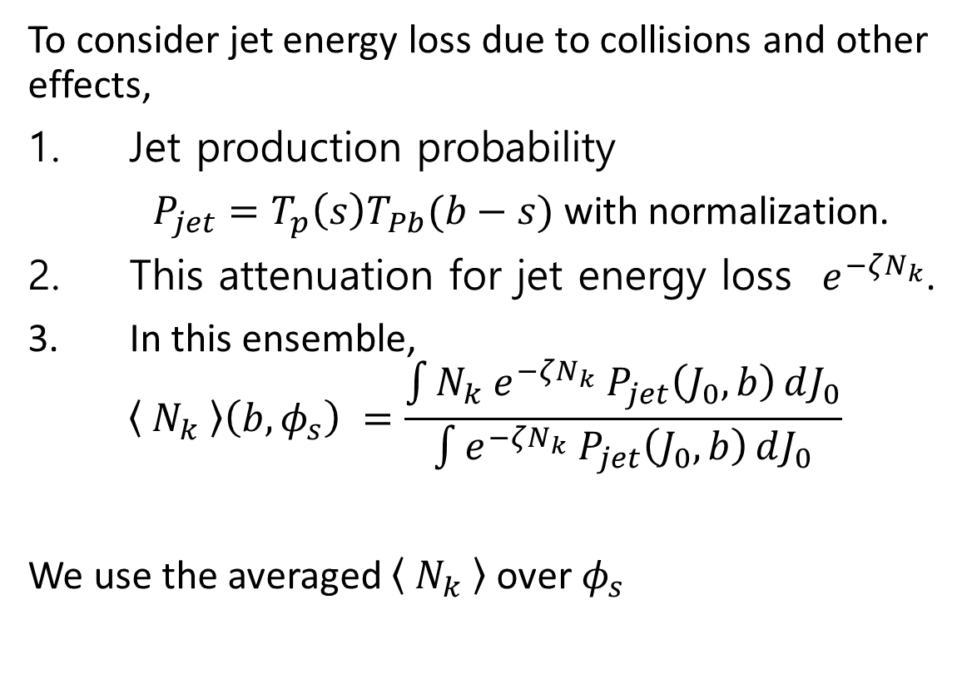
Theory
To consider jet energy loss due to collisions and other effects,
Jet production probability
$P_{jet}=T_{p}\left(s\right)T_{Pb}(b−s)$ with normalization.
This attenuation for jet energy loss $e^{−ζN_{k}}$.
In this ensemble,
$$\left\langle N_{k} \right\rangle \left(b,φ_{s}\right) =\frac{\int{N_{k} e^{−ζN_{k}} P_{jet}\left(J_{0},b\right)}dJ_{0}}{\int{e^{−ζN_{k}} P_{jet}\left(J_{0},b\right)}dJ_{0}}$$
We use the averaged $\left\langle N_{k} \right\rangle$ over $φ_{s}$
Fig. Schematic representation of proton and lead on the transverse plane in high energy collisions.

Slide 23
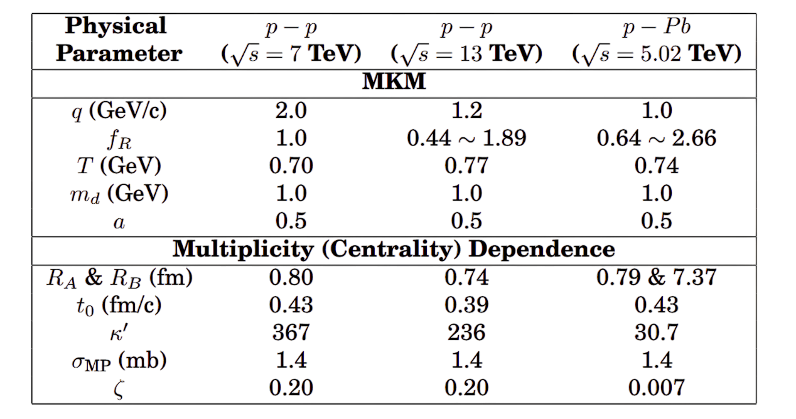
Result
  Parameter fitting result
Notes:
Parameters are indirectly chosen by external experiment data.

Slide 24

Result and analysis
Multiplicity dependence parameters
The radius of the proton and lead is determined the inelastic cross section measured as $σ_{in}=2.09$ b at LHC.
$R_{p}+R_{Pb}=\sqrt{\frac{σ_{in}}{π}}=8.16$ fm.
$R_{p}=0.79$ fm is adopted from CMS result due to a comparable energy scale.
$t_{0}$ is not a directly measurable quantity, but is related to $p_{T}$ via the uncertainty relation:
$t_{0}≃0.43$ fm/c
$κ^{′}=\frac{3}{2}⋅\frac{\left\langle N_{ch}\right\rangle }{\left\langle N_{part}\right\rangle }=\frac{3}{2}⋅\frac{161}{7.87}=30.7$
Notes:
Parameters are indirectly chosen by external experiment data.

Slide 25
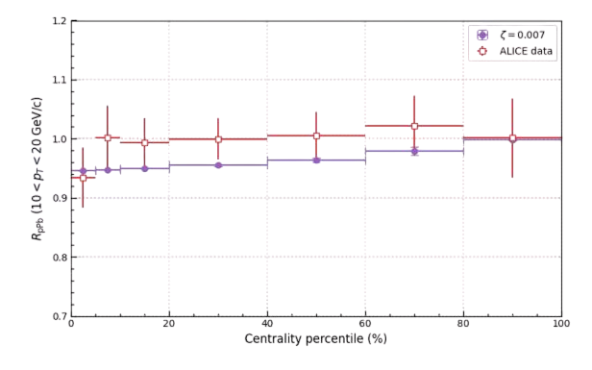

Result and analysis
Multiplicity dependence parameters
$σ_{MP}$ & $ζ$ are determined by fitting jet quenching measure $Y_{pPb}=\frac{N_{trig}}{N_{bin}}=∫ds e^{−ζN_{k}}P_{jet}$ to $R_{pPb}$.
$σ_{MP}=1.4$ mb is fixed, which is estimated in the previous study .
$ζ=0.007$.
Notes:
Parameters are indirectly chosen by external experiment data.

Slide 26

Result and Analysis
CMS $Δφ$ distribution ($N_{ch}<35$, $35≤N_{ch}<$90 )
  Column : same $p_{T}$ bin.
  Row : same $N_{ch}$ interval.
  The best-fit parameters are
  $q=1.0$ GeV/c, $T=0.74$ GeV
  In ($1<p_{T}<2$ GeV/c , $35≤N_{ch}<$90),
  ridge structure begins to emerge
  on the near side.
  The difference around $\left|Δφ\right|≈1.5$
  originates from the away side ridge
  contribution.
Fig. 7. Comparison of the MKMwM calculations (blue solid lines) with CMS p–Pb data (red circles)
at 5.02 TeV. The associated yield per trigger is shown as a function of ∆ϕ for different $p_{T}$ and $N_{ch}$.
Notes:
Each column correspondsto a different transverse-momentum range (0.1 < pT < 1 GeV/c, 1 < pT <2 GeV/c, 2 < pT < 3 GeV/c, and 3 < pT < 4 GeV/c), while each row representsa multiplicity interval (Nch < 35, 35 ≤ Nch < 90, 90 ≤ Nch < 110, , and

Slide 27
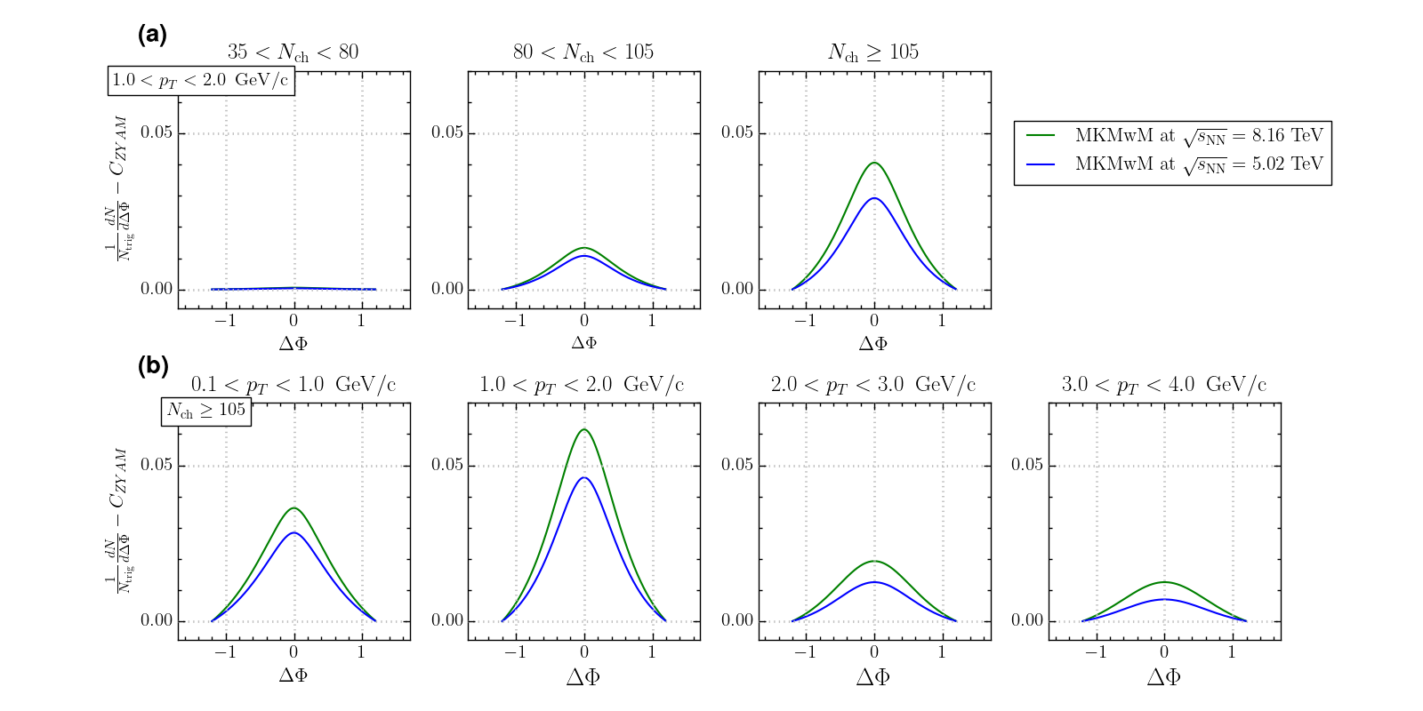
Status
MKMwM prediction to pPb collisions at 8.16 TeV
0.84 GeV | 1.0 GeV

