Slide 1

The EMFFs of the hyperon in the
time like region
Jiali Shi（石家丽）
with Lingyun Dai（戴凌云）
Hunan University
Baryons 2025 - International Conference on the
Structure of Baryons
International Convention Center Jeju
224, Jungmungwangwang-ro, Seogwipo-si, Jeju-do, Republic of Korea

Slide 2
Outline
Background
Theoretical framework
Fit results
Summary

Slide 3
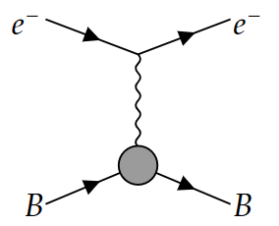
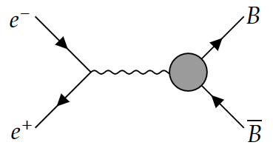
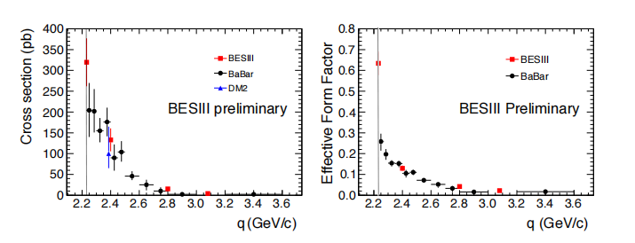

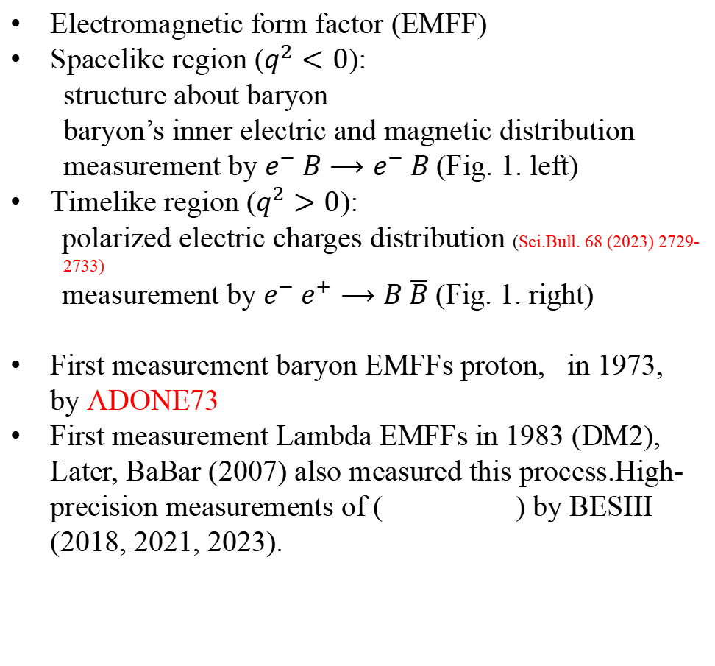
Background
Electromagnetic form factor (EMFF)
Spacelike region ($q^{2}<0$):
structure about baryon
baryon’s inner electric and magnetic distribution
measurement by $e^{−} B⟶e^{−} B$ (Fig. 1. left)
Timelike region ($q^{2}>0$):
polarized electric charges distribution (Sci.Bull. 68 (2023) 2729-
2733)
measurement by $e^{−} e^{+}⟶B \overline{B}$ (Fig. 1. right)
First measurement baryon EMFFs proton, in 1973, by ADONE73
First measurement Lambda EMFFs in 1983 (DM2), Later, BaBar (2007) also measured this process.High-precision measurements of ( ) by BESIII (2018, 2021, 2023).
Fig. 1.
Fig. 2.

Slide 4
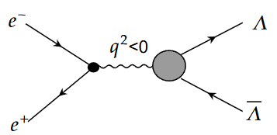
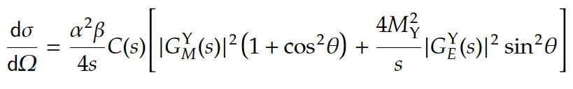
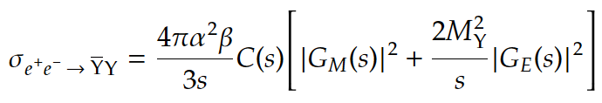
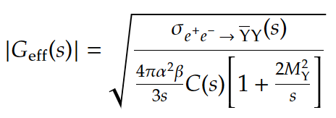
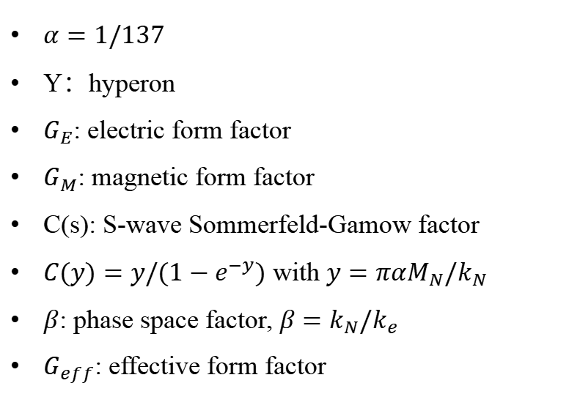
Theoretical framework
Theoretical study in Lambda’s EMFFs by
the cross section and differential cross section can be parameterized by electric form factor($G_{E}$) and magnetic form factor($G_{M}$). (eq. (1))
$α=1/137$
Y：hyperon
$G_{E}$: electric form factor
$G_{M}$: magnetic form factor
C(s): S-wave Sommerfeld-Gamow factor
$C(y)=y/(1−e^{−y})$ with $y=παM_{N}/k_{N}$
$β$: phase space factor, $β=k_{N}/k_{e}$
$G_{eff}$: effective form factor
Fig. 3.
(1)

Slide 5
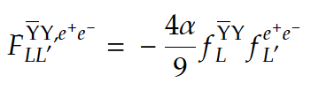
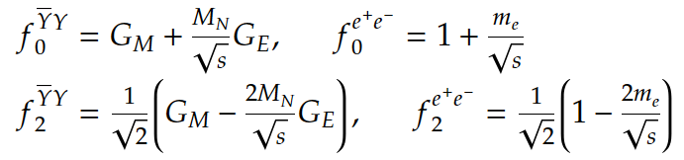
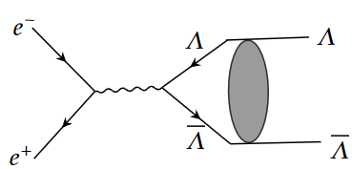
Theoretical framework
eq. (2): Factorization of the partial wave amplitude
eq. (3): Relation between cross section and partial wave amplitude
(2)
with
(3)
The energy region under study is near the threshold
Final state interaction(FSI) should be considered!
complete feynman diagram is Fig. 4.
Total angular momentum is conservation, we consider [3S1-3D1] coupled partial wave in final lambda system
Fig. 4.

Slide 6
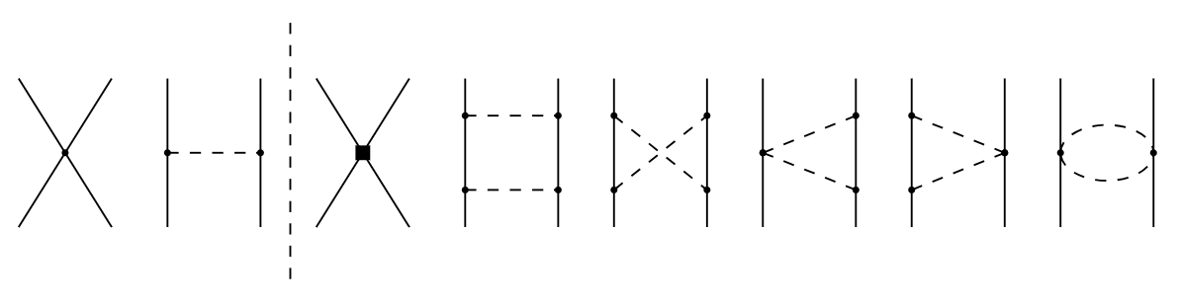
Theoretical framework
Lagrangian and potential about FSI is derived from chiral effective field theory (𝜒𝐸𝐹𝑇) up to next-to-leading order (NLO). we think the potential consists of three part (eq. (4))
(4)
Relevant feynman diagrams Fig.5
The contact term and annihilation part parameterized as follow. C is low-energy constants (LECs)
Fig. 5.
(5)
(6)

Slide 7


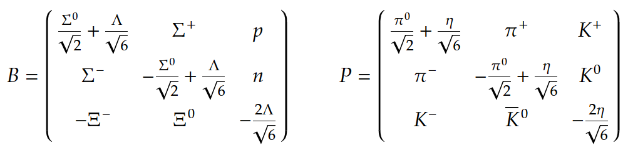


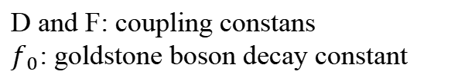
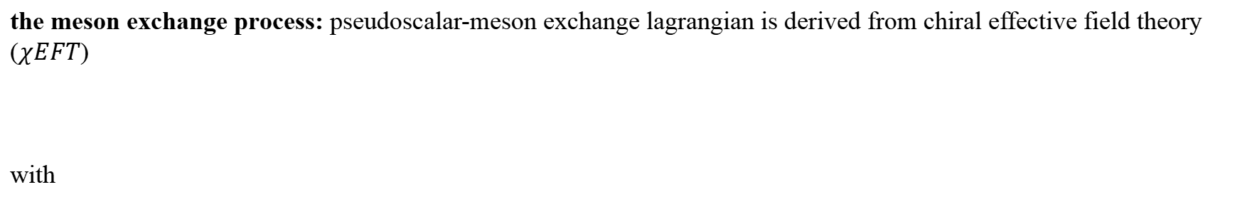
Theoretical framework
the meson exchange process: pseudoscalar-meson exchange lagrangian is derived from chiral effective field theory ($χEFT$)
with
(7)
D and F: coupling constans
$f_{0}$: goldstone boson decay constant
Calculated the amplitude in old-fashioned time-ordered perturbation theory,we have
For example: Considering one meson exchange processes.
Amplitude:
(8)
Propagator:
(9)

Slide 8
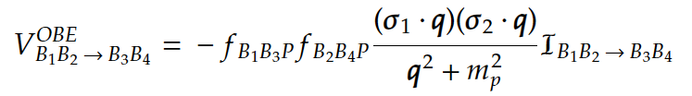
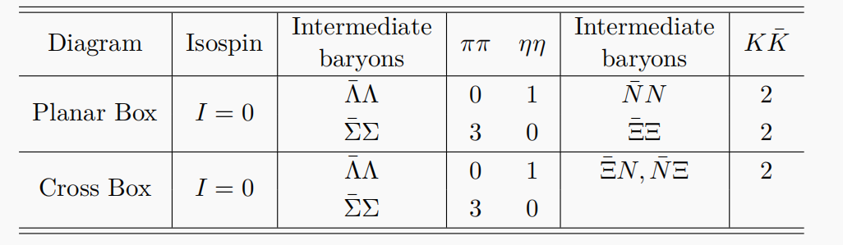
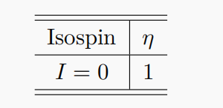
Theoretical framework
(9)
Derive potential from amplitude:
Defined the standard one meson exchange potential as
called the isospin factor
Other standard meson exchange
process potential refer JHEP 08 (2024) 208
(10)
Table 1:
isospin factor table

Slide 9
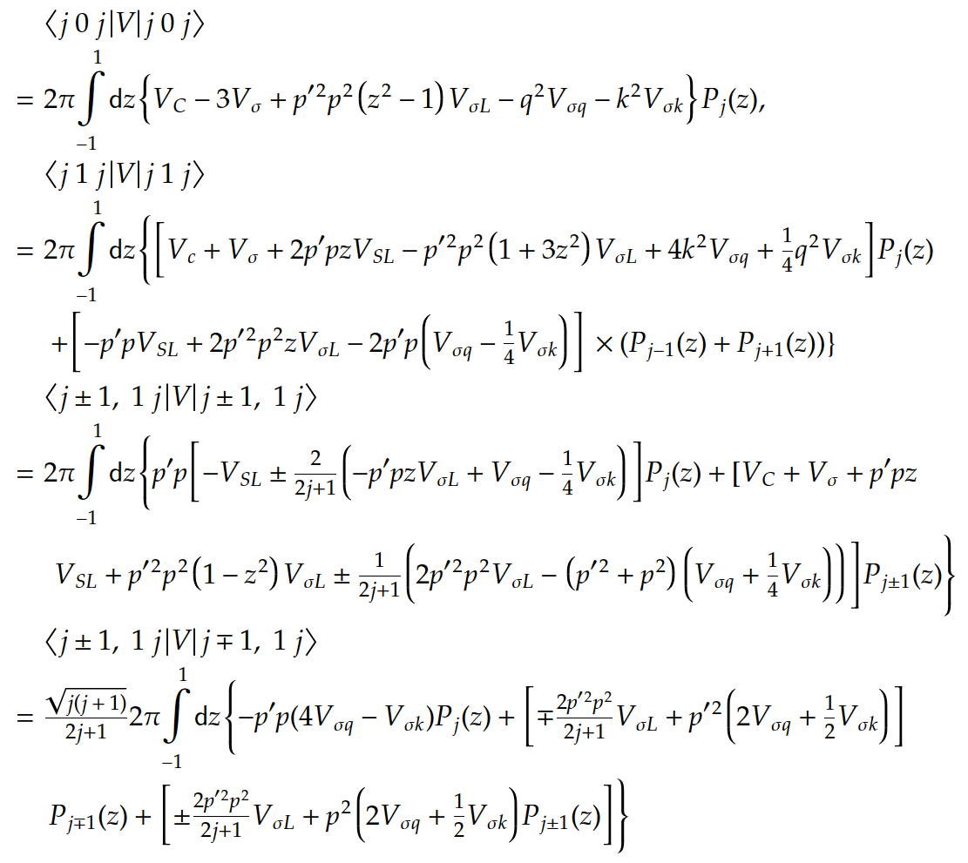
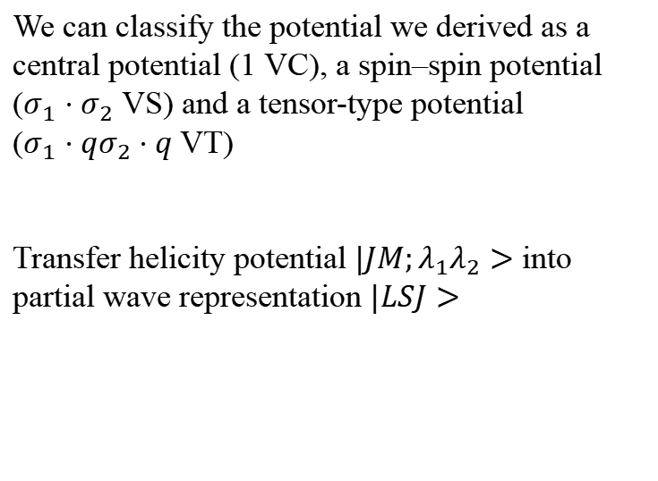
Theoretical framework
We can classify the potential we derived as a
central potential (1 VC), a spin–spin potential
($σ_{1}⋅σ_{2}$ VS) and a tensor-type potential
($σ_{1}⋅qσ_{2}⋅q$ VT)
Transfer helicity potential $|JM;λ_{1}λ_{2}>$ into partial wave representation $|LSJ>$
(11)

Slide 10

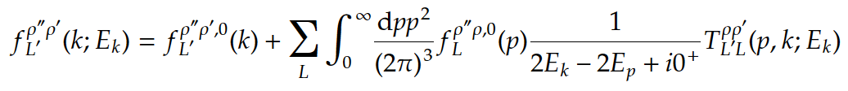
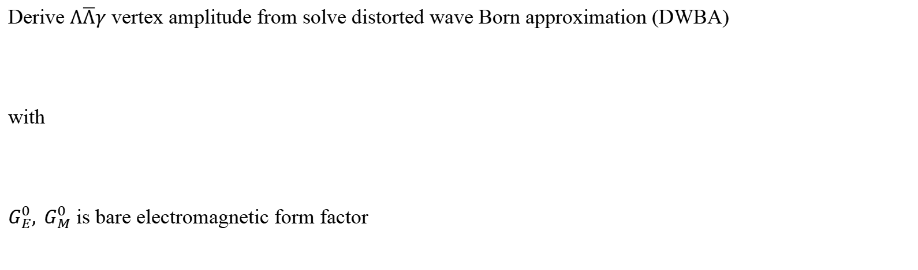
Theoretical framework
Derive FSI T amplitude by solving Lippmann-Schwinger (LS) equation.
Potential needs to cut off by a regular function before it putted into LS equation
(12)
(13)
Derive $Λ\overline{Λ}γ$ vertex amplitude from solve distorted wave Born approximation (DWBA)
with
$G_{E}^{0}, G_{M}^{0}$ is bare electromagnetic form factor
(14)
(15)

Slide 11
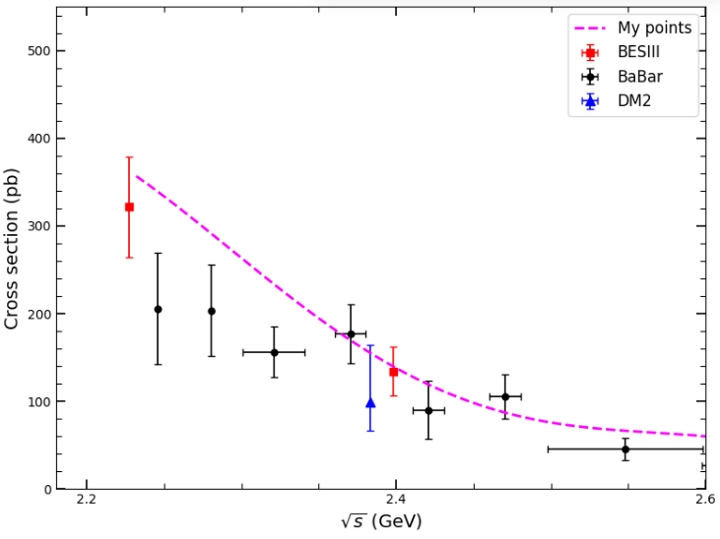
Fit results
Results about LECs and bare electromagnetic form factor fit to cross section data from threshold to 2.6GeV.

Slide 12
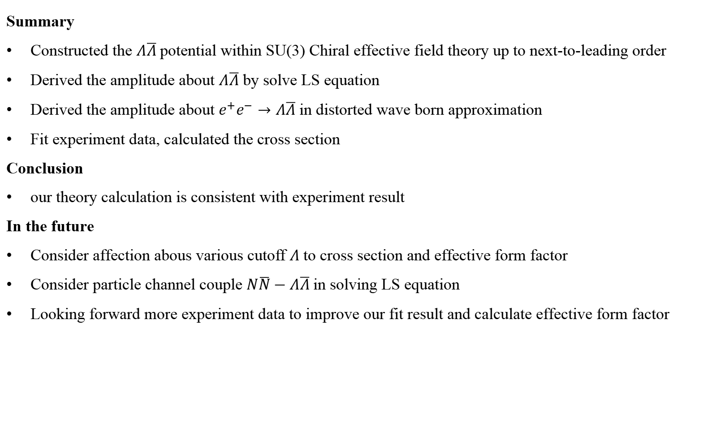
Summary
Summary
Constructed the $Λ\overline{Λ}$potential within SU(3) Chiral effective field theory up to next-to-leading order
Derived the amplitude about $Λ\overline{Λ}$ by solve LS equation
Derived the amplitude about $e^{+}e^{−}→Λ\overline{Λ}$in distorted wave born approximation
Fit experiment data, calculated the cross section
Conclusion
our theory calculation is consistent with experiment result
In the future
Consider affection abous various cutoff $Λ$ to cross section and effective form factor
Consider particle channel couple $N\overline{N}−Λ\overline{Λ}$in solving LS equation
Looking forward more experiment data to improve our fit result and calculate effective form factor

Slide 13
Thanks for your attention !

