Slide 1
Effective gluon operators for heavy-light systems in the instanton vacuum
Speaker: Nurmukhammad Rakhimov
Inha University
International Conference on the Structure of Baryons (Baryons 2025)
Now 10-14, 2025, ICC Jeju

Slide 2
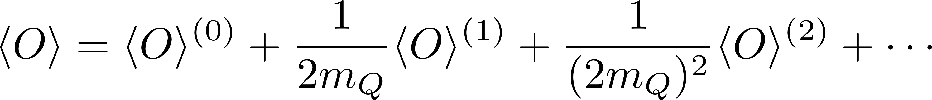
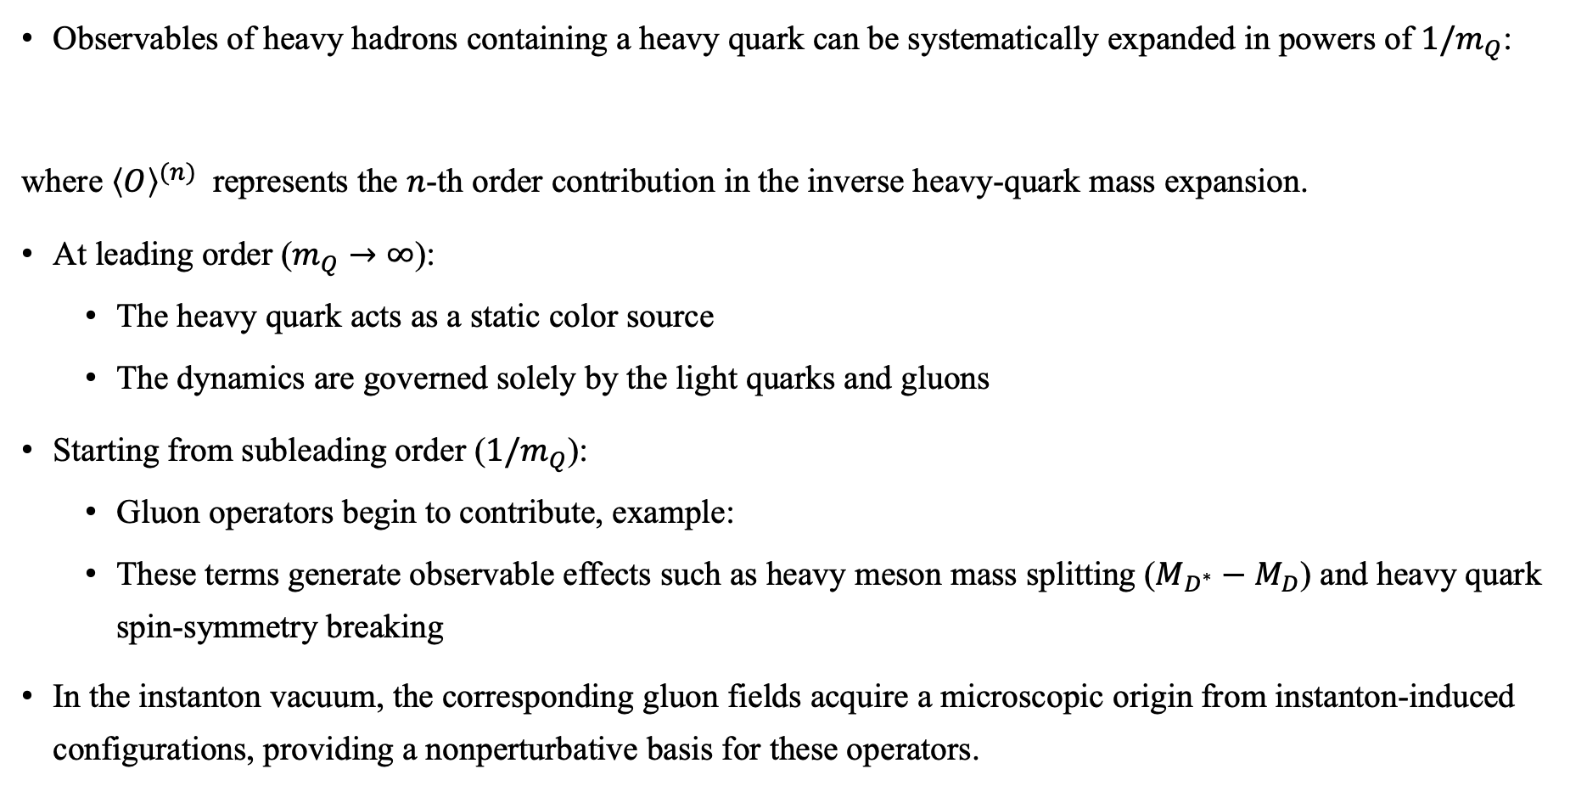
Motivation
Observables of heavy hadrons containing a heavy quark can be systematically expanded in powers of $1/m_{Q}$:
where ${\left\langle O\right\rangle }^{(n)}$ represents the $n$-th order contribution in the inverse heavy-quark mass expansion.
At leading order ($m_{Q}→∞$):
  The heavy quark acts as a static color source
  The dynamics are governed solely by the light quarks and gluons
Starting from subleading order ($1/m_{Q}$):
  Gluon operators begin to contribute, example:
  These terms generate observable effects such as heavy meson mass splitting ($M_{D^{∗}}−M_{D}$) and heavy quark spin-symmetry breaking
In the instanton vacuum, the corresponding gluon fields acquire a microscopic origin from instanton-induced configurations, providing a nonperturbative basis for these operators.

Slide 3
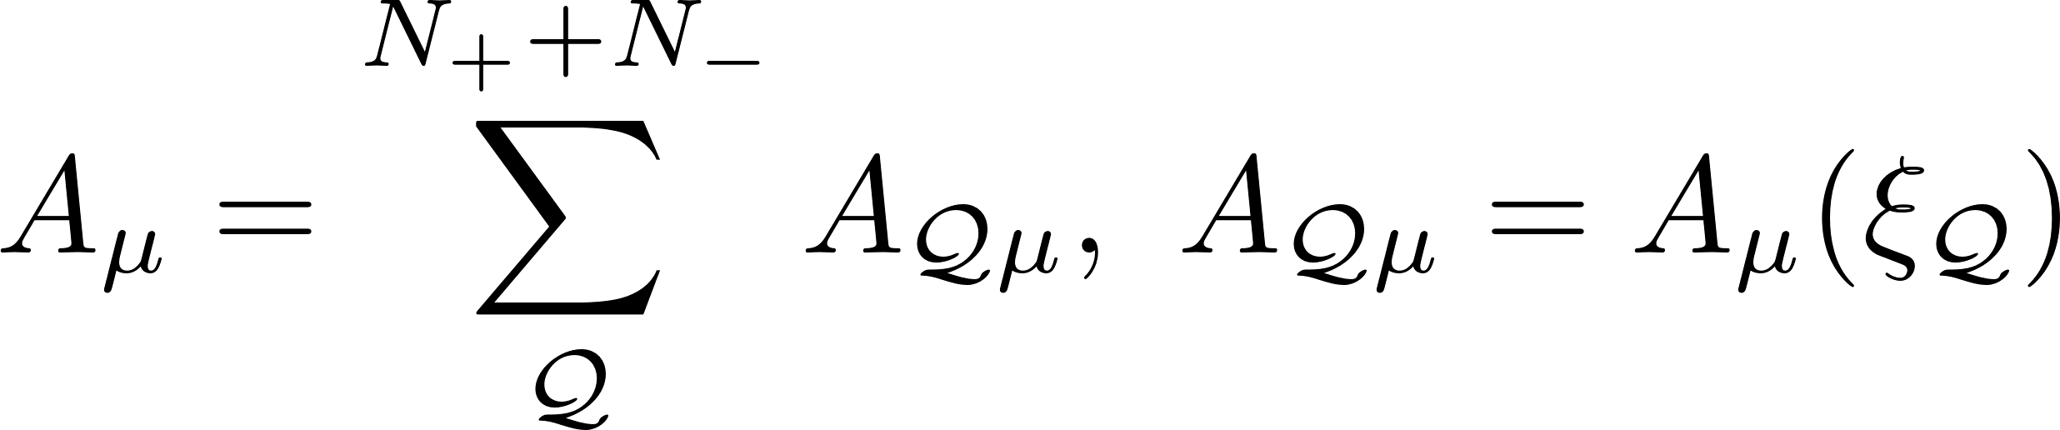
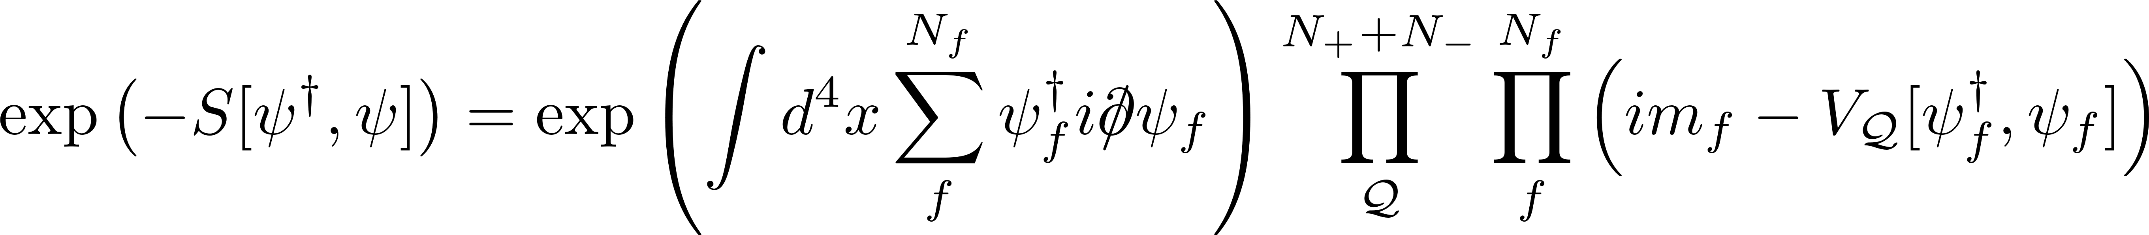
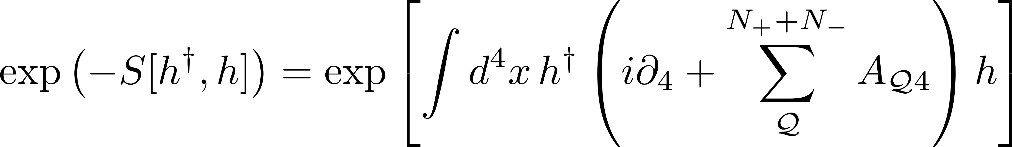
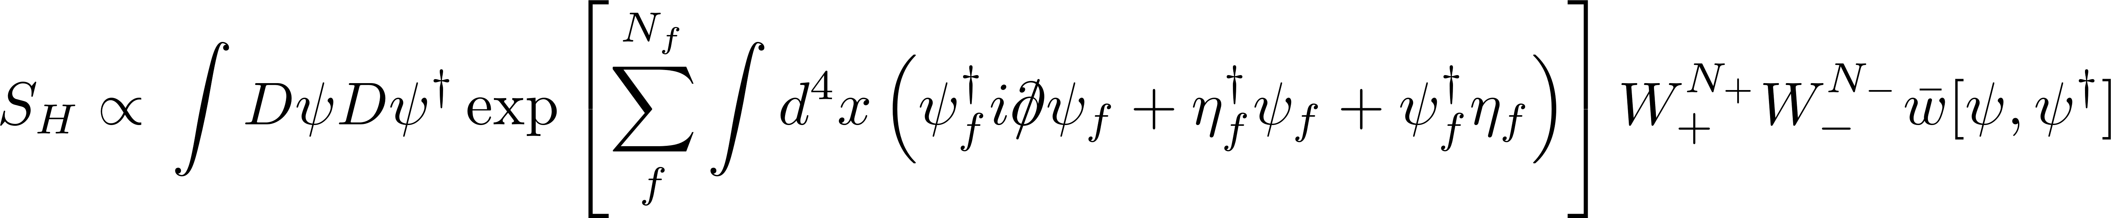
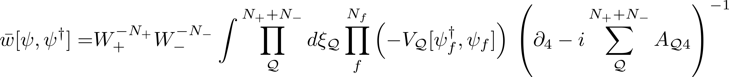
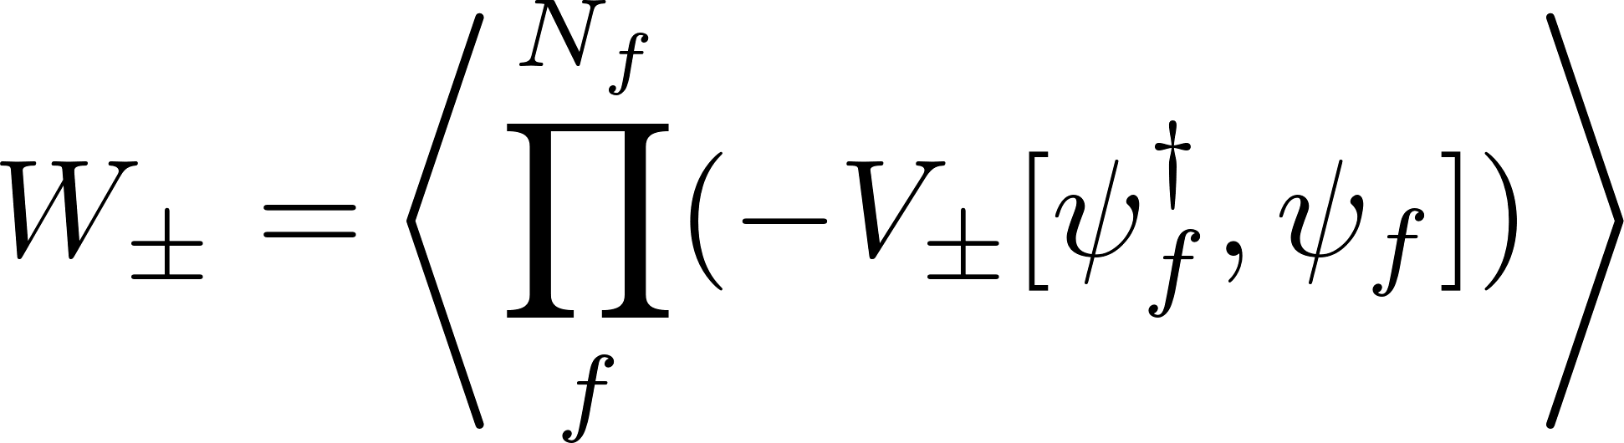
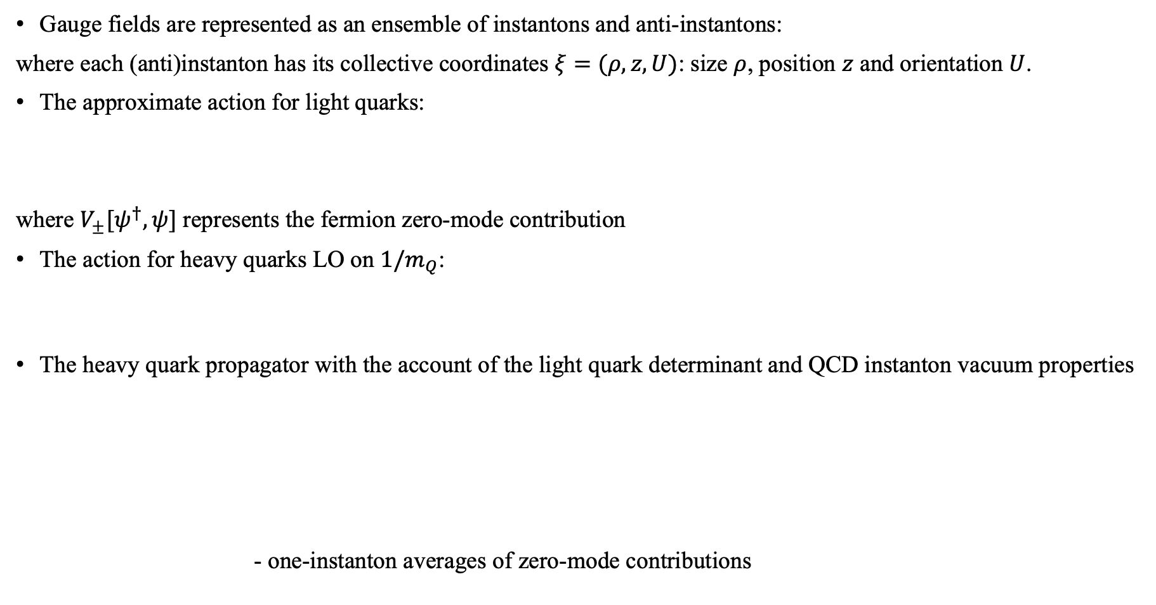
Theoretical framework
Gauge fields are represented as an ensemble of instantons and anti-instantons:
where each (anti)instanton has its collective coordinates $ξ=(ρ,z,U)$: size $ρ$, position $z$ and orientation $U$.
The approximate action for light quarks:
where $V_{±}[ψ^{†},ψ]$ represents the fermion zero-mode contribution
The action for heavy quarks LO on $1/m_{Q}$:
The heavy quark propagator with the account of the light quark determinant and QCD instanton vacuum properties
- one-instanton averages of zero-mode contributions

Slide 4
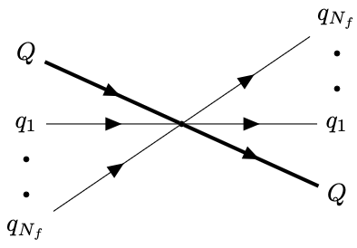

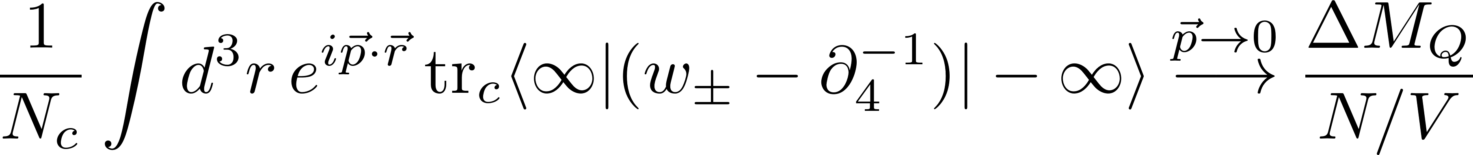


Effective heavy-light quark interaction
Averaging over the ensemble of $I$’s quand $\overline{I}$’s in low density instanton approximation we obtained effective $N_{f}$ light flavor quarks and a heavy quark interaction
Effective interaction at $N_{f}=1$
Effective interaction at $N_{f}>1$, LO on $1/N_{c}$

Slide 5
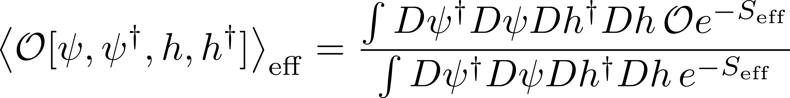



Application ($N_{f}$=1)
Averages of operators within effective theory in the $1/N_{c}$ limit
After bosonization, one obtains an effective action that includes heavy mesons
The weak decay constants: - renormalized axial-vector current
[K.Hong et al, Phys.Rev.D 110 (2024) 11, 114044]

Slide 6
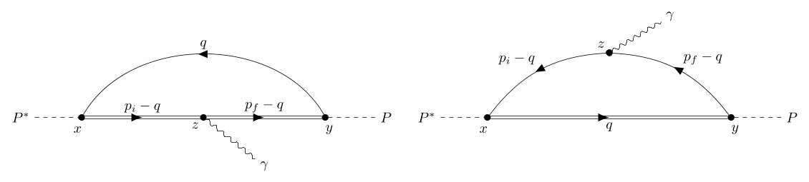
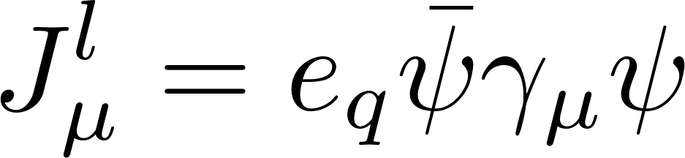
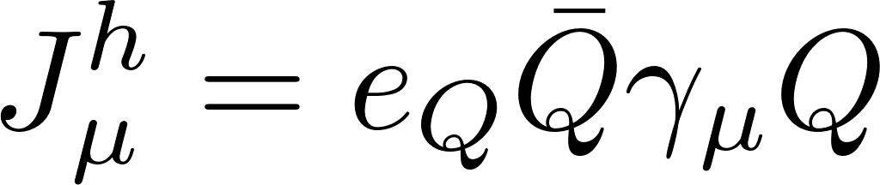

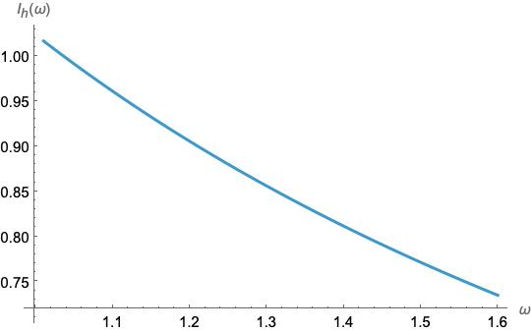
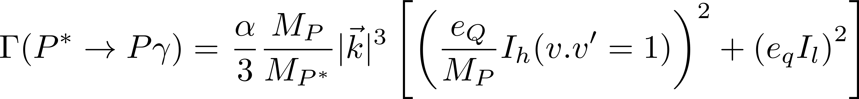
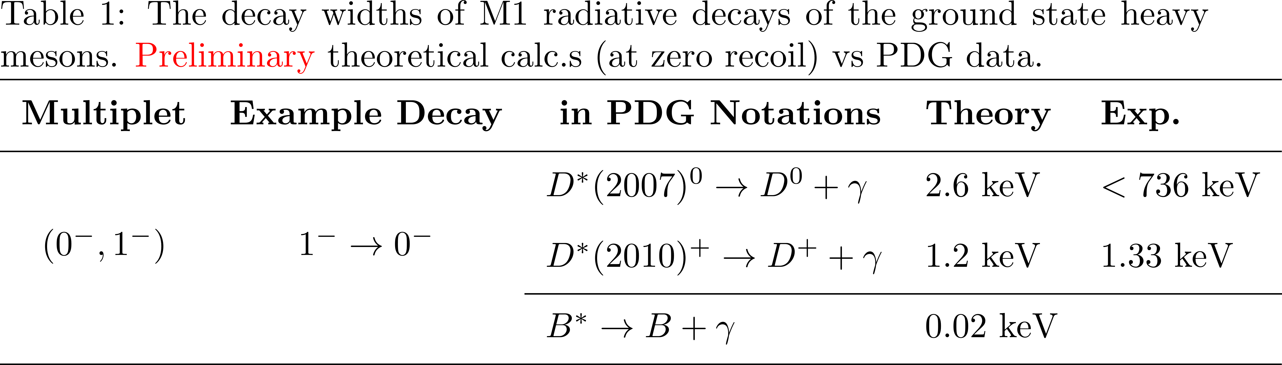

Application II: radiative transitions
Flavor conserving radiative transition:
Decay width at zero recoil , LO on $1/m_{Q}$
Isgur-Wise function

Slide 7
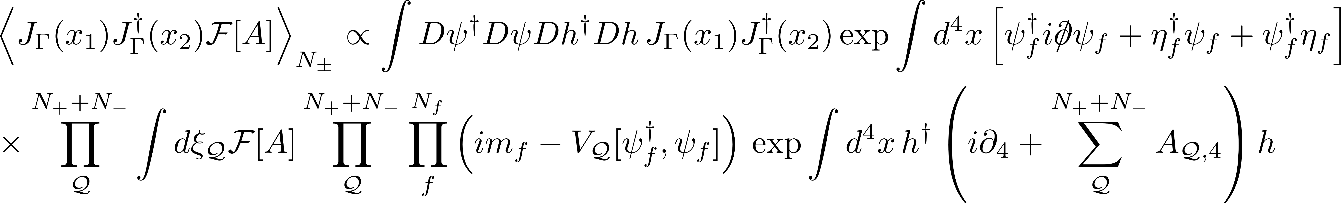
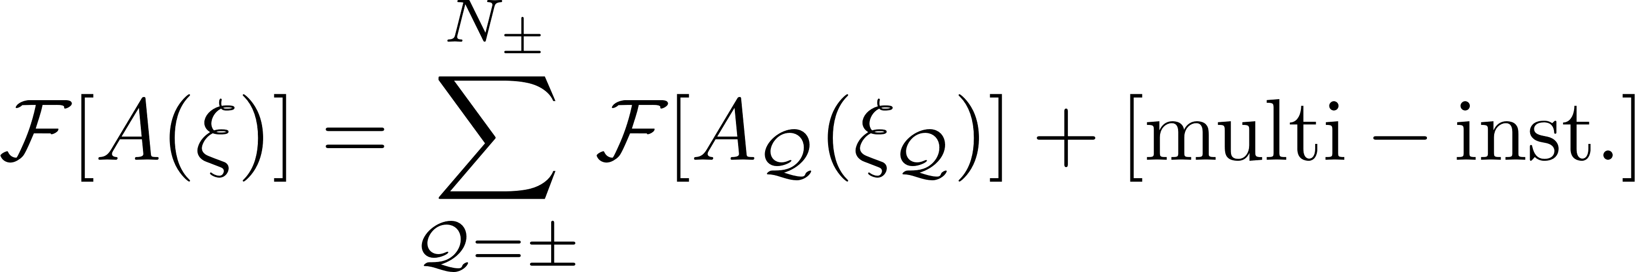
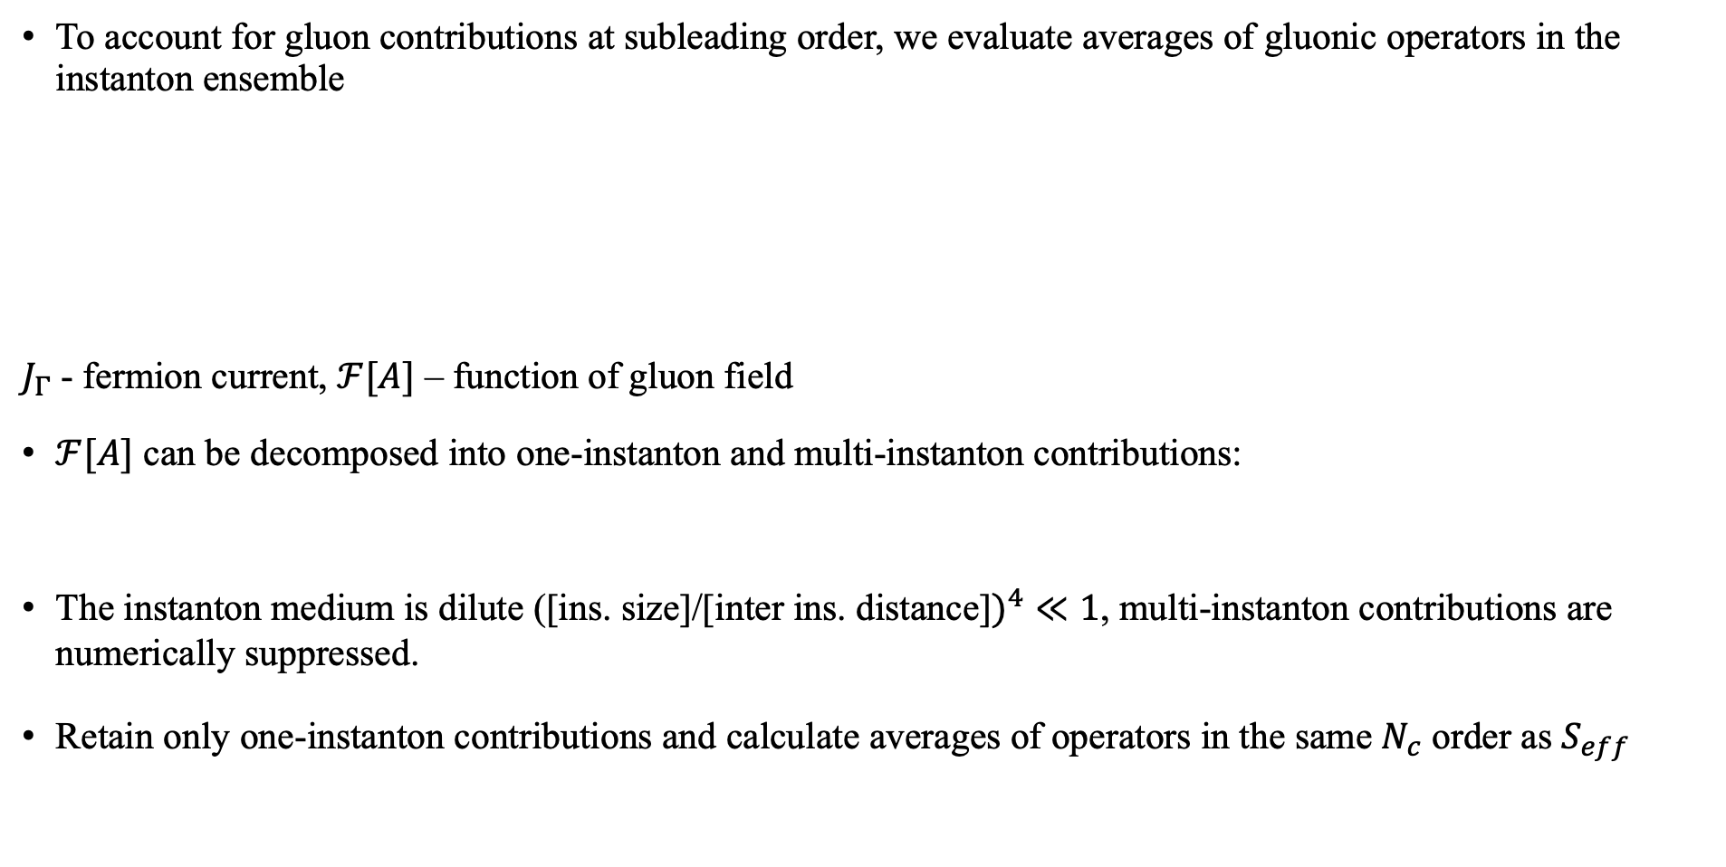
Averages of operators containing gluons
To account for gluon contributions at subleading order, we evaluate averages of gluonic operators in the instanton ensemble
$J_{Γ}$ - fermion current, $ℱ[A]$ – function of gluon field
$ℱ[A]$ can be decomposed into one-instanton and multi-instanton contributions:
The instanton medium is dilute ([ins. size]/[inter ins. distance]$)^{4}≪1$, multi-instanton contributions are numerically suppressed.
Retain only one-instanton contributions and calculate averages of operators in the same $N_{c}$ order as $S_{eff }$

Slide 8
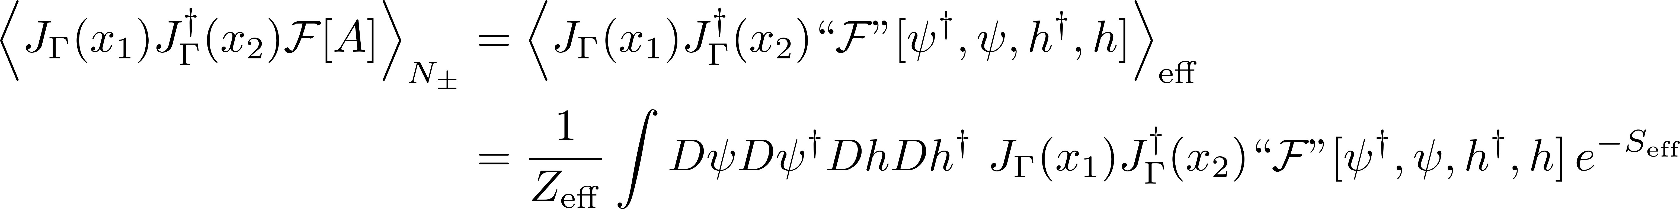
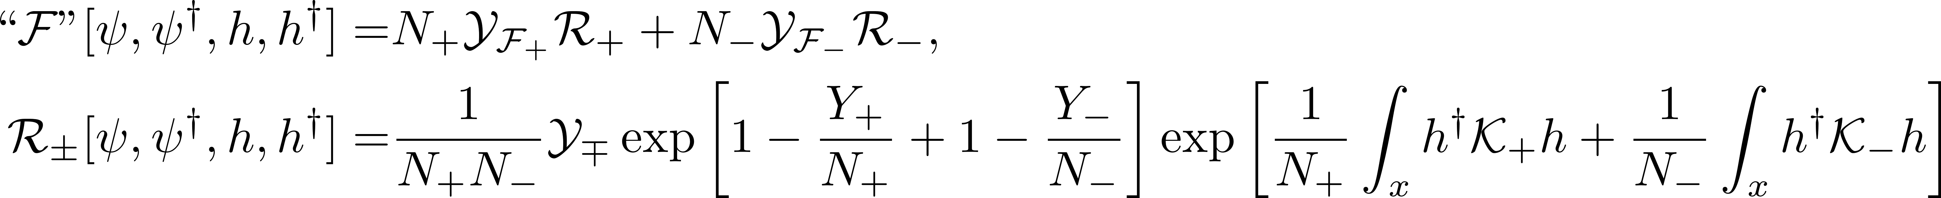
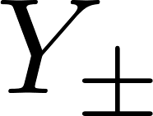
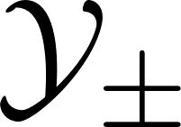
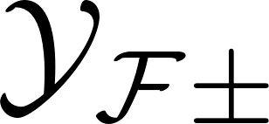
Effective operators for gluons
Represent the instanton ensemble averaged operator within the effective fermion theory
Effective operator:
  - light quarks interaction vertex (t’Hooft vertex)
  - light quarks and a heavy quark interaction vertex
  - light quarks , a heavy quark and instanton interaction vertex

Slide 9
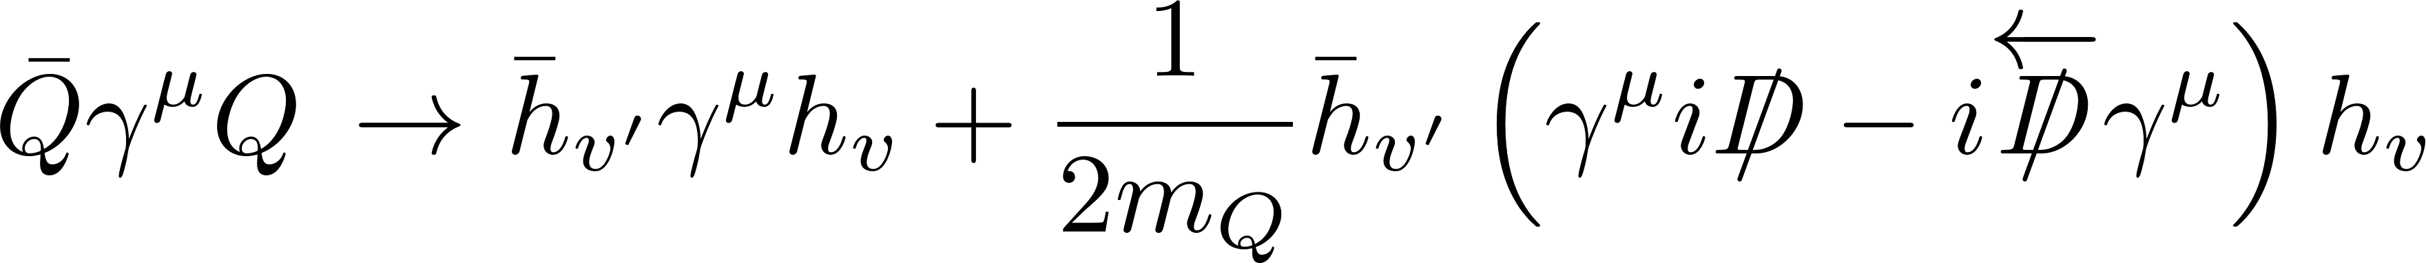
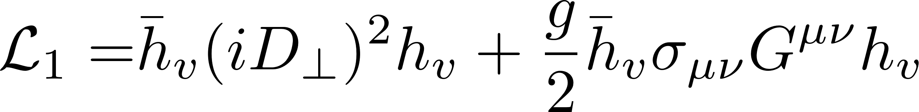
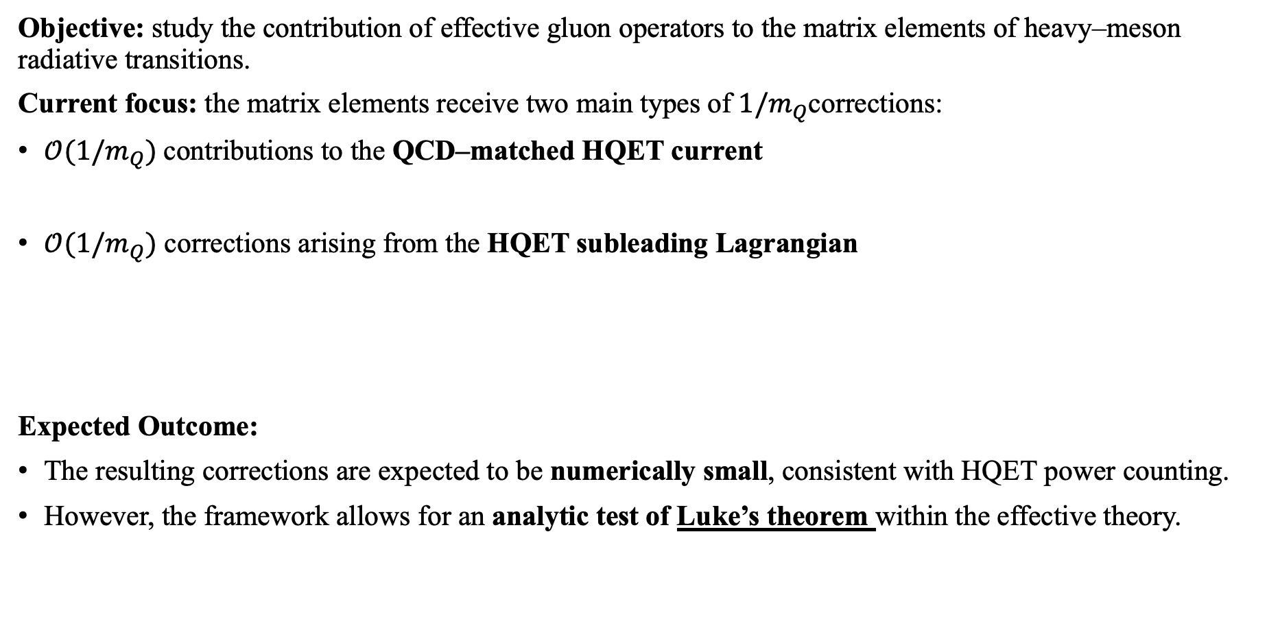
Current status and ongoing work
Objective: study the contribution of effective gluon operators to the matrix elements of heavy–meson radiative transitions.
Current focus: the matrix elements receive two main types of $1/m_{Q}$corrections:
$𝒪(1/m_{Q}​)$contributions to the QCD–matched HQET current
$𝒪(1/m_{Q}​)$ corrections arising from the HQET subleading Lagrangian
Expected Outcome:
The resulting corrections are expected to be numerically small, consistent with HQET power counting.
However, the framework allows for an analytic test of Luke’s theorem within the effective theory.
At zero recoil $v.v^{′}=1$, the $1/m_{Q}$corrections to hadronic matrix elements vanish

Slide 10
Discussion and Future Remarks
Derived the effective heavy–light quark interaction within the QCD instanton vacuum framework
Evaluated the weak decay constants and flavor-conserving radiative decays at zero recoil at leading order in 1/mQ​; the results show good agreement with PDG averages
Established a framework for constructing effective gluon operators in the QCD instanton vacuum for heavy–light quark system
Demonstrated that instanton-induced configurations provide a microscopic, nonperturbative origin for gluonic corrections to heavy–hadron observables
Extend calculations to higher-order corrections in 1/𝑚𝑄
Explore further applications to heavy baryons and semileptonic transitions
Provide a systematic comparison with other nonperturbative approaches such as lattice QCD and QCD sum rules.
Thank you for your attention!

