Slide 1
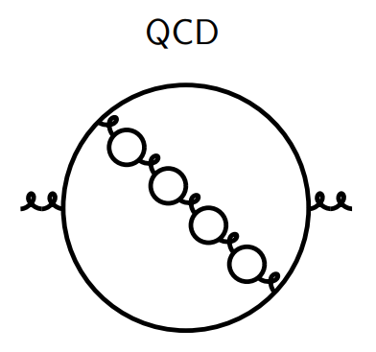
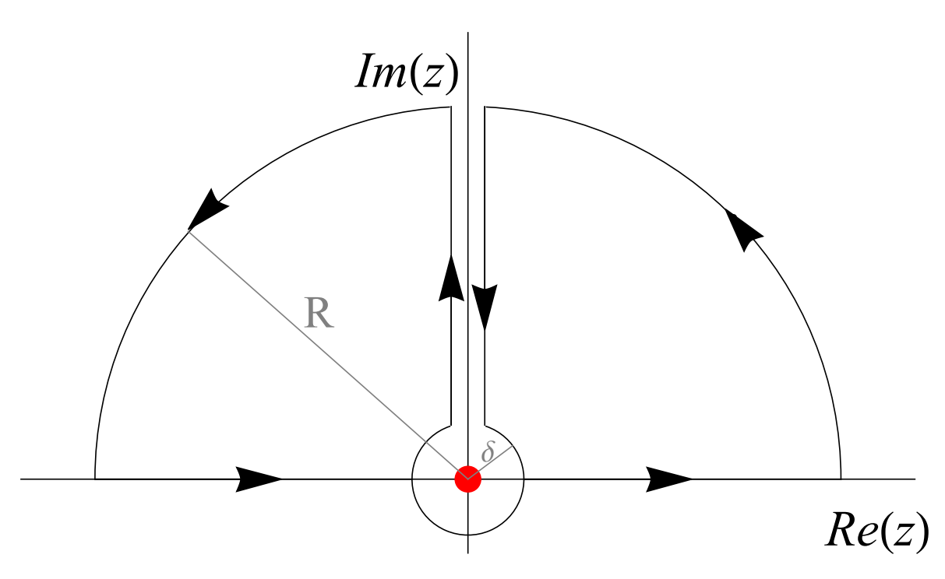
RENORMALON-BasED Resummation OF THE BJORKEN SUM RULE IN HoloMORphic QCD
Camilo Castro Arriaza
(Nagoya University)
Nov. 13, 2025
Baryons 2025, JEjU

Slide 2
Based on
This presentation is based on:
Ayala, C., Castro-Arriaza, C., & Cvetič, G. (2023). Evaluation of Bjorken Polarised Sum Rule with a Renormalon-motivated Approach. Physics Letters B, 848, 138386. https://doi.org/10.1016/j.physletb.2023.138386
Ayala, C., Castro-Arriaza, C., & Cvetič, G. (2024). Renormalon-based Resummation of Bjorken Polarised Sum Rule in Holomorphic QCD. Nuclear Physics B, 1007, 116668. https://doi.org/10.1016/j.nuclphysb.2024.116668

Slide 3
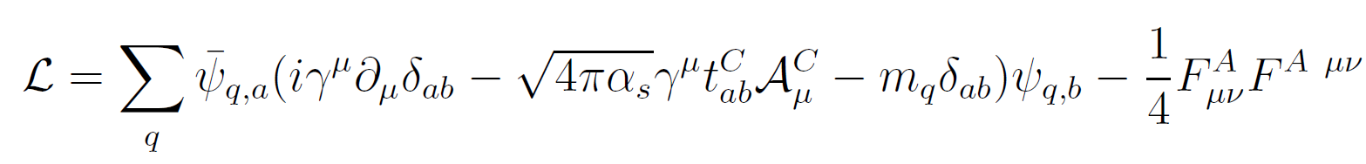
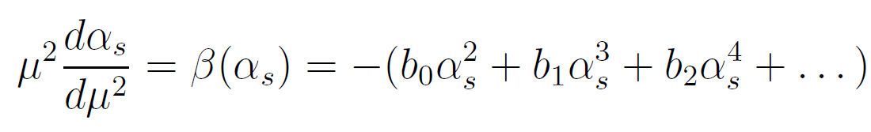
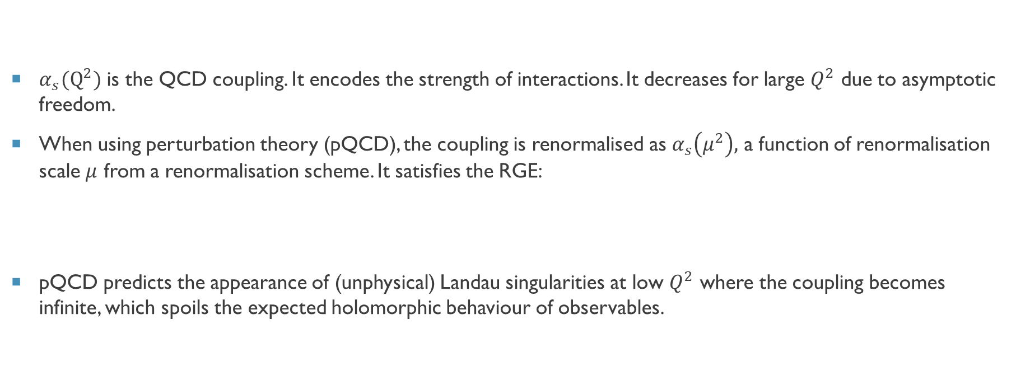
QCD COUPLING AND PQCD
$α_{s}(Q^{2})$ is the QCD coupling. It encodes the strength of interactions. It decreases for large $Q^{2}$ due to asymptotic freedom.
When using perturbation theory (pQCD), the coupling is renormalised as $α_{s}\left(μ^{2}\right),$ a function of renormalisation scale $μ$ from a renormalisation scheme. It satisfies the RGE:
pQCD predicts the appearance of (unphysical) Landau singularities at low $Q^{2}$ where the coupling becomes infinite, which spoils the expected holomorphic behaviour of observables.

Slide 4
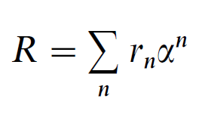
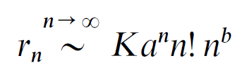
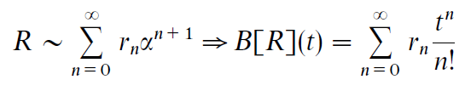
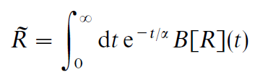
Divergent Series
In QFTs, observables can be expressed as series expansion in terms of the coupling such as:
These series are usually divergent independently of the coupling itself:
As we do not know R non-perturbatively, we can use this expansion as a good approximation for the perturbative regime, but simply adding more terms does not give better predictions past a certain point and thus it is required to introduce summations of the series, such as the Borel Transform.
Notes:
In this way the Borel sum provides more information that the simply truncated series, as the Borel transform works as a generating function of the coefficients and thus any divergencies therein are conceivably included for all orders.
When going to high orders in perturbative expansions, the divergence grows like n!, where n is the order of expansion, and this is due, essentially, to the multiplicity of diagrams that contribute to Green functions at such expansion order.

Slide 5
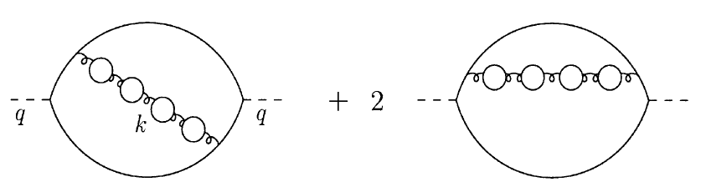
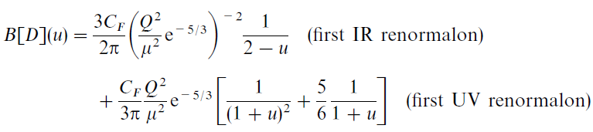
RENORMALONS
The Borel integral may not always be well defined, and can have singularities in its correspondent (complex) plane, which reflect and encode the inherent divergence of the original series.
These singularities in the Borel plane that can be found in observables are called renormalons. Originally, they were found in contributions to correlators (for the Adler function in the case of this example) in diagrams such as:
Renormalons do not always give contributions of this kind, but these are illustrative.
It’s the knowledge of the location of the renormalons for different observables what motivates their use in phenomenological methods such as the Sum Rule approach to obtain more information that what can be had from simple use of the truncated series.
M. Beneke, 1999.
Notes:
Contrary to what had been thought in the past, renormalons are unrelated to the Landau singularities that arise in the pQCD coupling at low Q^2, because renormalons can be found independent of the coupling used (such as in many effective models, and so on).

Slide 6
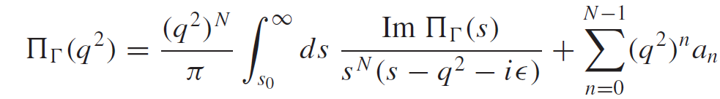

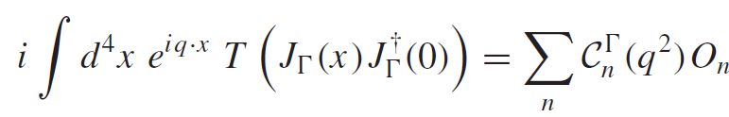
Sum rules and why they are used
Sum rules can be useful in bridging the low-energy regime to the usual perturbative regime of high energies by combining phenomenological and theoretical motivations.
Their existence is very general, but they require careful use of approximations to remain physically well grounded.
There are many, and are constructed from dispersion relations for the correlators of currents, based on singularity structure, such as:
Here we can introduce a phenomenological angle by expressing the invariant function as something like (just as an example):
But a representation for this can also be constructed theoretically from an operator-product expansion:

Slide 7
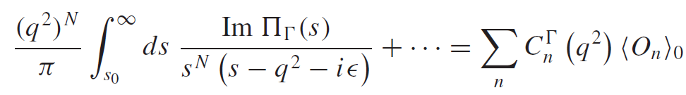
Sum rules and why they are used II
From all this, using certain assumptions when constructing these expressions, both approaches can be equated to obtain something solvable:
This is not analysed directly but its Borel transform can be (to satisfy the assumptions made). The OPE must be taken up to the order we may need, where higher dimension terms will be suppressed. This is useful as we can then think of it’s first term as purely perturbative and each subsequent term as representing solely higher dimension (non-perturbative) contributions.
This is where the renormalon-based approach comes in, being a specific method for the evaluation of QCD observables, as through the knowledge of the renormalon structure for a given observable we have information enough to use in the l.h.s., and through the OPE we have for the r.h.s.

Slide 8
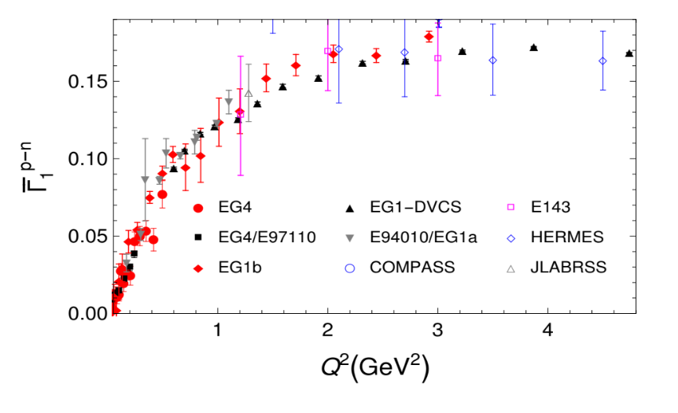
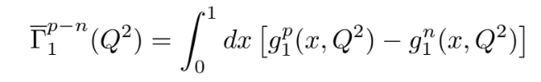
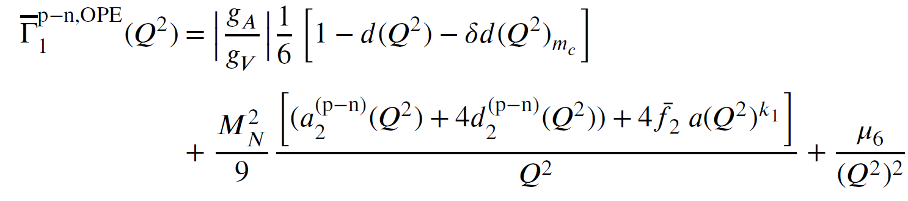
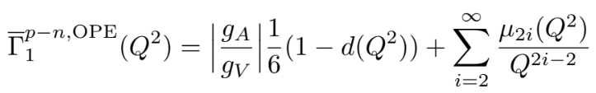
Bjorken sum rule (BSR)
It is the difference between the polarised structure functions g of the proton and neutron integrated over the Bjorken scaling variable x. Of particular interest is the inelastic part:
It has a known theoretical expression in OPE which is:
It has been measured by many experiments from JLab, CERN, DESY and SLAC.
C. Ayala, C.C.A. & G. Cvetič (2023)

Slide 9
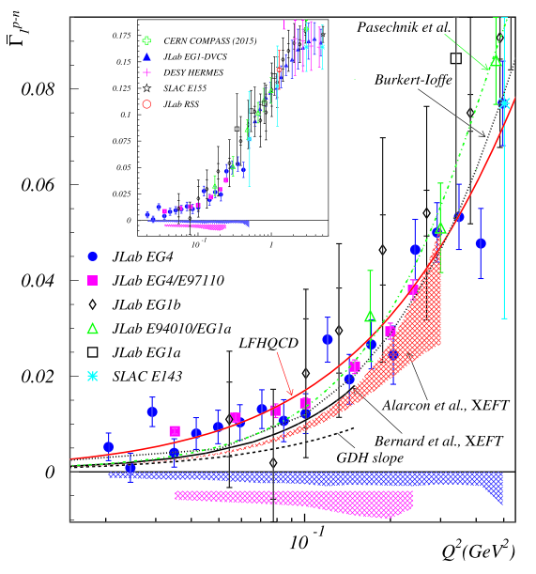


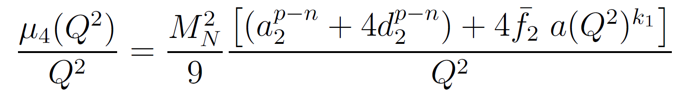
Bjorken sum rule (BSR) II
Data are available down to very low Q^2 values.
The canonical perturbative part of the OPE (first term) is known:
The coefficients in this quantity are known exactly up to d_3, but there are very good estimates for d_4 which we used.
For the D=2 term in the OPE we know its structure:
A. Deur et al., Phys. Lett. B 825 136878 (2022)

Slide 10
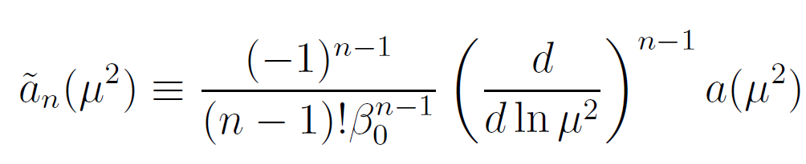


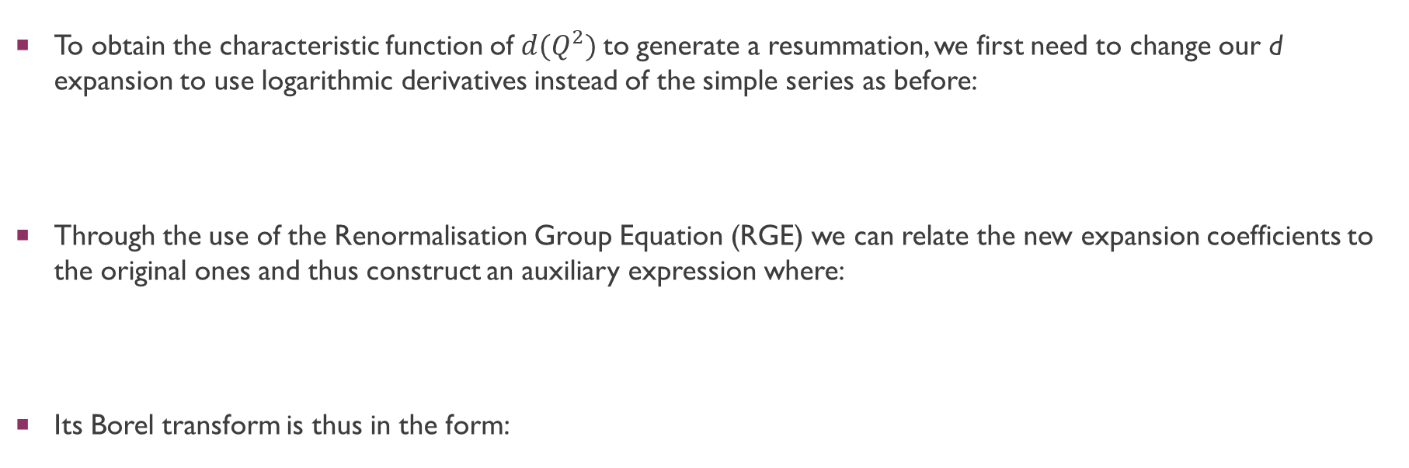
The Cvetic Method: Reconstructing quantities
To obtain the characteristic function of $d(Q^{2})$to generate a resummation, we first need to change our d expansion to use logarithmic derivatives instead of the simple series as before:
Through the use of the Renormalisation Group Equation (RGE) we can relate the new expansion coefficients to the original ones and thus construct an auxiliary expression where:
Its Borel transform is thus in the form:

Slide 11
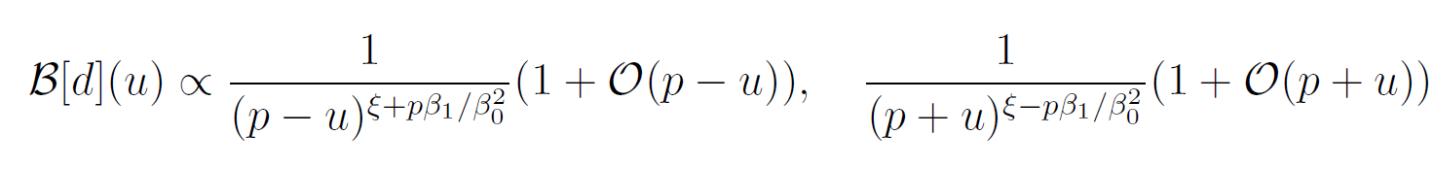
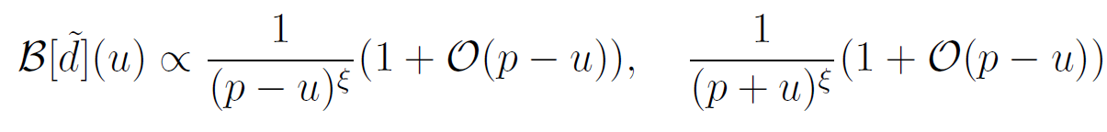

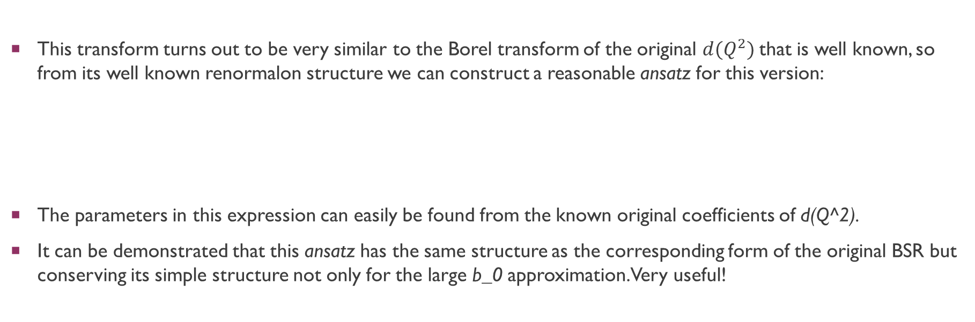
BSR CASE: Renormalon STRUCture
This transform turns out to be very similar to the Borel transform of the original $d(Q^{2})$that is well known, so from its well known renormalon structure we can construct a reasonable ansatz for this version:
The parameters in this expression can easily be found from the known original coefficients of d(Q^2).
It can be demonstrated that this ansatz has the same structure as the corresponding form of the original BSR but conserving its simple structure not only for the large b_0 approximation. Very useful!

Slide 12
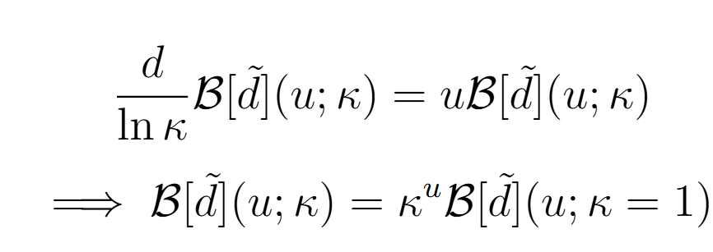
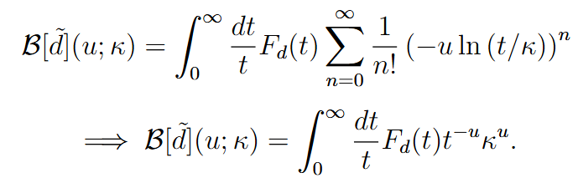
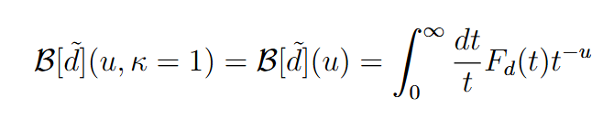

Note: Borel transform $κ$-dependence
Here, a very important show of the consistency of the method is that the k-dependence (which reflects renormalisation scale dependence) can be disregarded, as it should be for physical quantities:

Slide 13
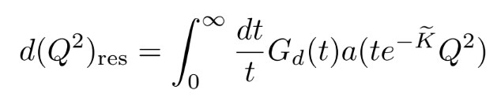
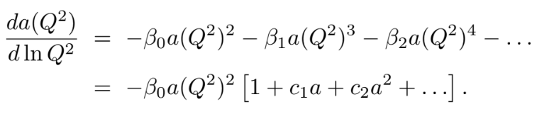
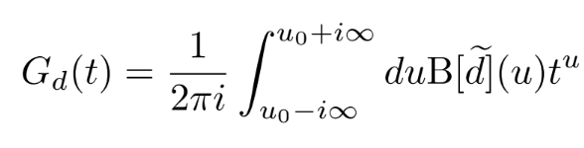
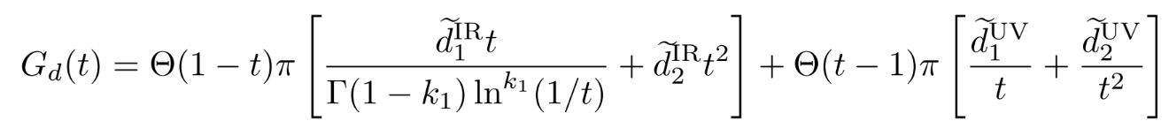
Renormalon Structure Consequences
The beta coefficients from before are those arising from the RGE:
It turns out that it is the structure of our special ansatz what permits a simple resummation since its inverse Mellin transform coincidentally turns out to be exactly the characteristic function we need:
Notes:
Resulta que la forma del ansatz es lo que permite la resumación a realizar ya que su transformada inversa de Mellin es justo la función característica que buscamos:

Slide 14
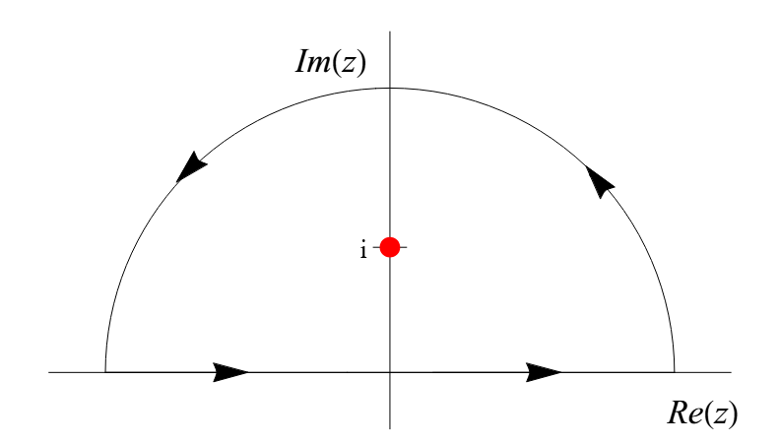
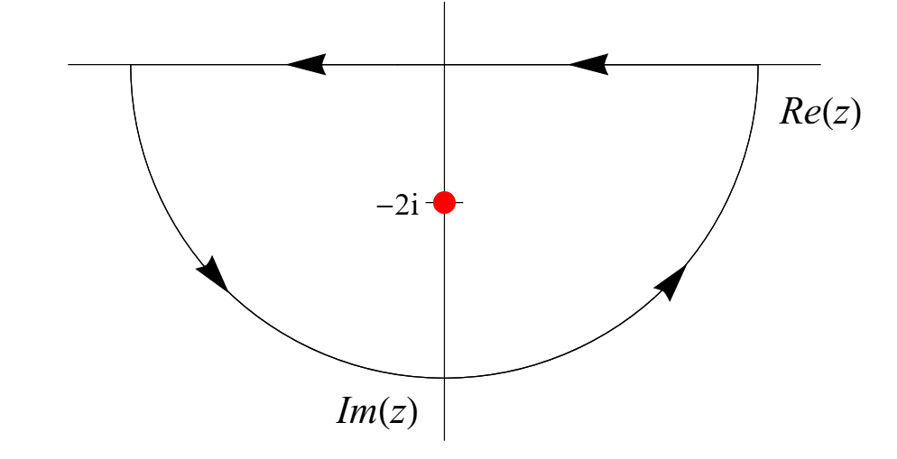
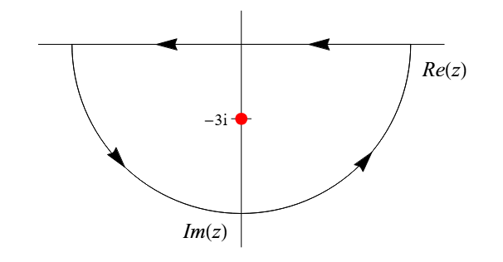
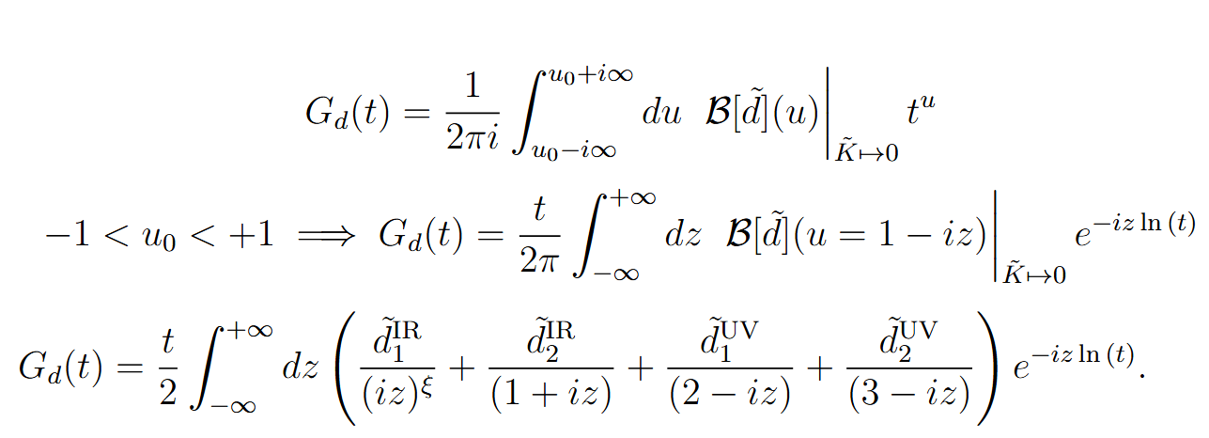
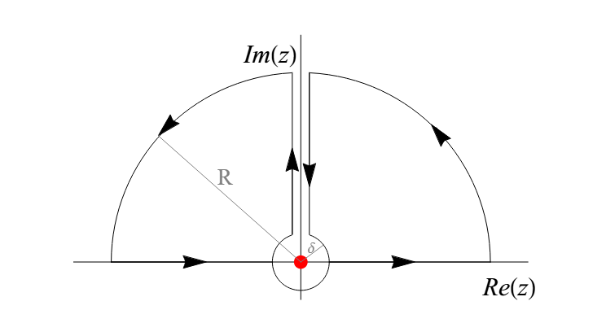
Comments on the computation of the characteristic function integralS
Requires some “clever” integration of each renormalon term in the ansatz:

Slide 15
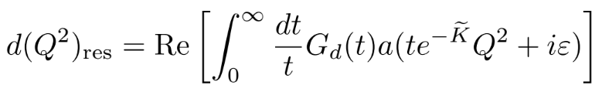
Finally, Resummation
With the found expression for G_d we can proceed to the resummation in the form of:
Consistence here can be tested by re-expanding in terms of the coupling around ln(Q^2).
BUT!: The pQCD coupling has Landau singularities at low Q^2, so this integral for the whole range has ambiguities we need to go around of:
This is completely skipped if, for instance, we use a different coupling constructed not to have such singularities but to conserve the pQCD behaviour at high Q^2.

Slide 16
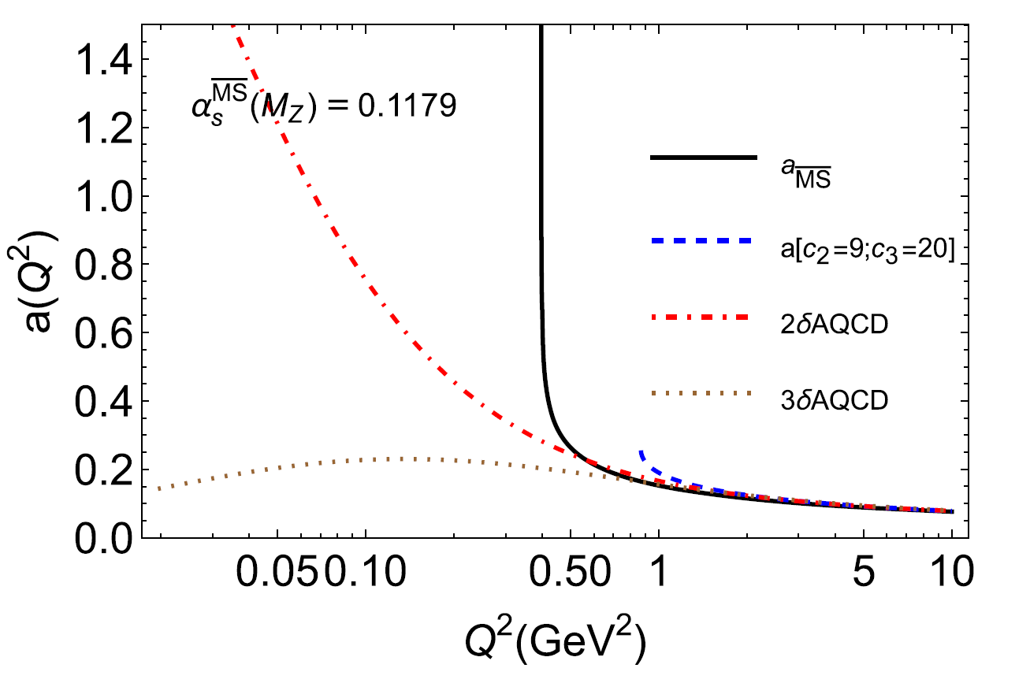
HOLOMORPHIC QCD Variants (AQCD)
C. Ayala, C.C.A. & G. Cvetič (2024)

Slide 17
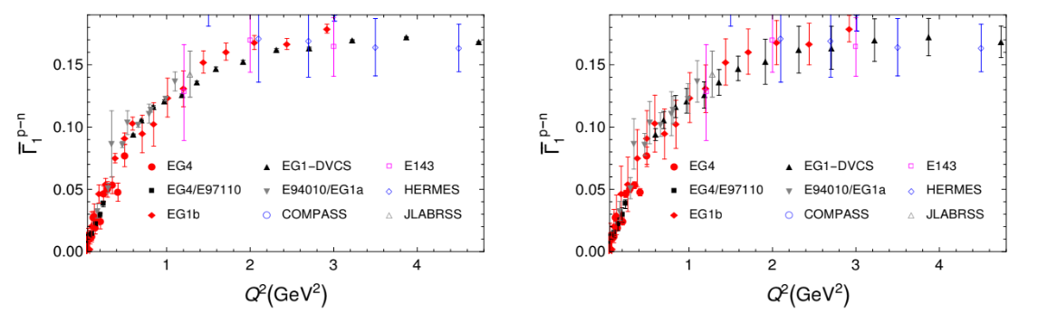
Application: Scheme Variation and Fitting to data
Having our renormalon-based resummmation of the BSR, we can tune it to qualitative expectations by varying the renormalisation scheme (RS) to be used, as there is still RS dependence.
With a chosen RS that reproduces the expected behaviour, we can fix the parameters and fit the next BSR term(s) to experimental data while using our resummed d(Q^2), thus complementing the perturbative part.
C. Ayala, C.C.A. & G. Cvetič (2023)

Slide 18
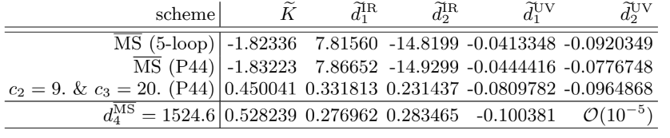
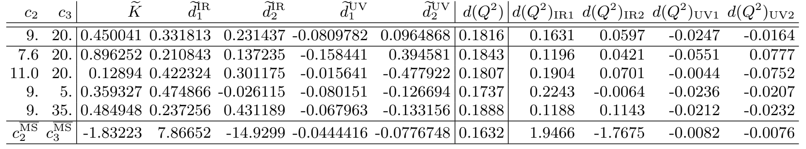


SCHEME VARIATION
The five ansatz coefficients change depending on the Renormalisation Scheme (RS) prescription used:
Given the expected behaviour of the BSR regarding renormalon contribution hierarchy, it can be seen that MS-bar is not suitable. Hence, it is necessary to look for a RS that returns the desired hierarchy. By varying the scheme parameters c_2 and c_3, we find a Padé form (“P44-type”) for the beta function:
Doing so for our expected hierarchy thus means our preferred RS parameters are in the range:

Slide 19
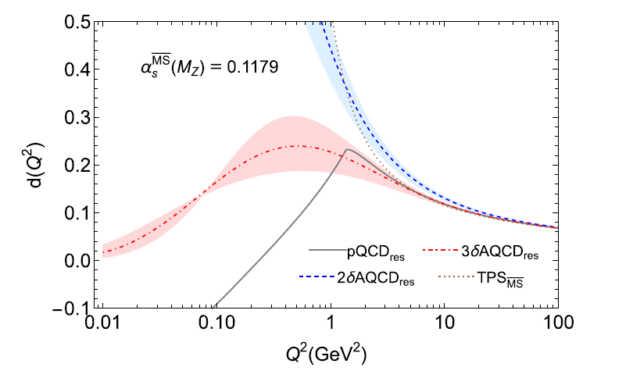

RESULTS FOR THE RESUMMED TERM
With this scheme and comparing different couplings used for the resummed term:
For pQCD the method clearly stops working at Q^2 < 1.44 GeV^2 due to Landau singularities in $a{\left(Q^{2}\right)}_{pQCD}$, although it still outperforms using Truncated Series (TPS).
C. Ayala, C.C.A. & G. Cvetič (2024)

Slide 20
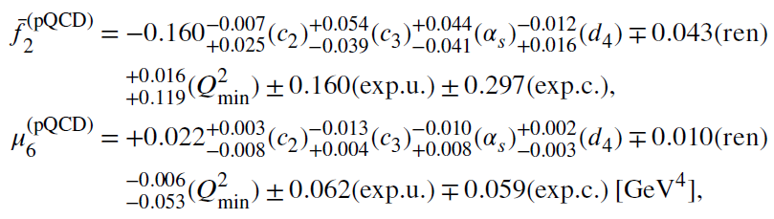
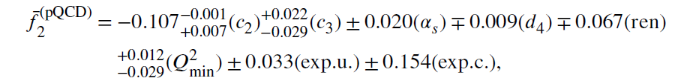
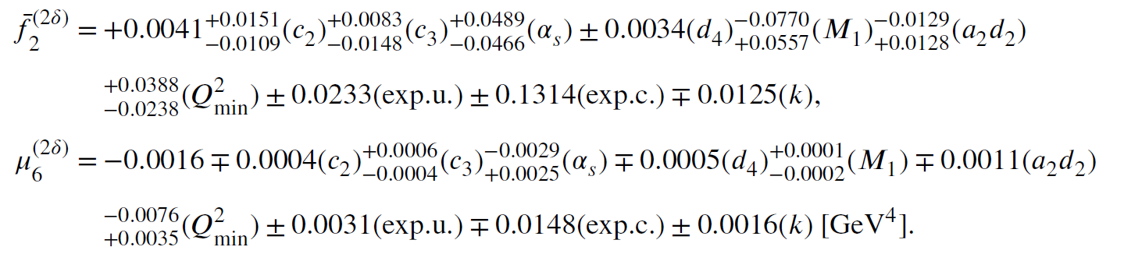
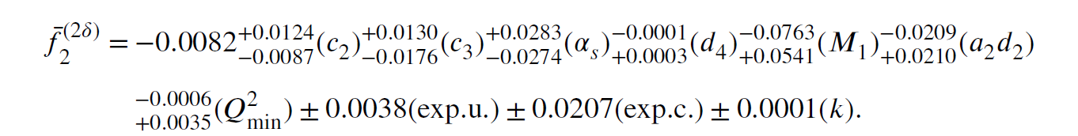
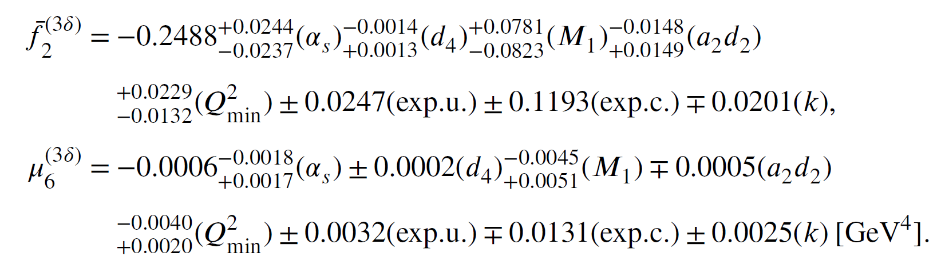
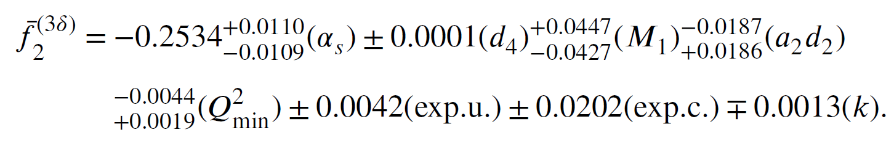
RESULTS FOR THE FULL OBSERVABLE
For adjusting the higher twist terms of the OPE we can either choose to truncate at D=2 or D=4, which gives:
In all cases the theoretical uncertainties are lower than those from experiment.

Slide 21

RESULTS FOR THE FULL OBSERVABLE
C. Ayala, C.C.A. & G. Cvetič (2024)

Slide 22
Summary of results and Outlook
As can be seen, the method generates a consistent resummation using the known renormalon structure of the BSR, which eliminates the problems of integrating directly in the Borel plane, or those of using a truncated perturbative expansion series.
The nonperturbative information that is conceivably introduced by using the renormalon resummation of the sum rule is shown to improve the evaluation potential of these kind calculations down to lower Q^2 values below the usual pQCD regime, and an even better improvement is reached when using analytic versions of the QCD coupling (AQCD) which eliminate Landau singularities.
It is interesting to apply this method to more observables, especially any of phenomenological interest for low-energy physics, as the combination of the Sum Rules approach and renormalon-resummation could be powerful for probing this region.

Slide 23

RECENT UPDATE!!!
(https://arxiv.org/abs/2509.09042)
Now it has been generalised to also apply to timelike quantities and noninteger powers of the canonical term, so more observables can be probed. Also, six theorems are proven which more robustly show the validity of the approach.

Slide 24


Possibly useful equations
Renormalon ambiguity of the first IR renormalon (as an example):
Borel Transform k-dependency:
Actual OPE used for charm quark corrections and explicit Higher Twist terms:

Slide 25


More useful things (RESULTS IN AQCD)

