Slide 1
Update on Task 3.2
Concept of a HTS solenoid
Michal Duda on behalf of HTS solenoid team
9/11/2023

Slide 2
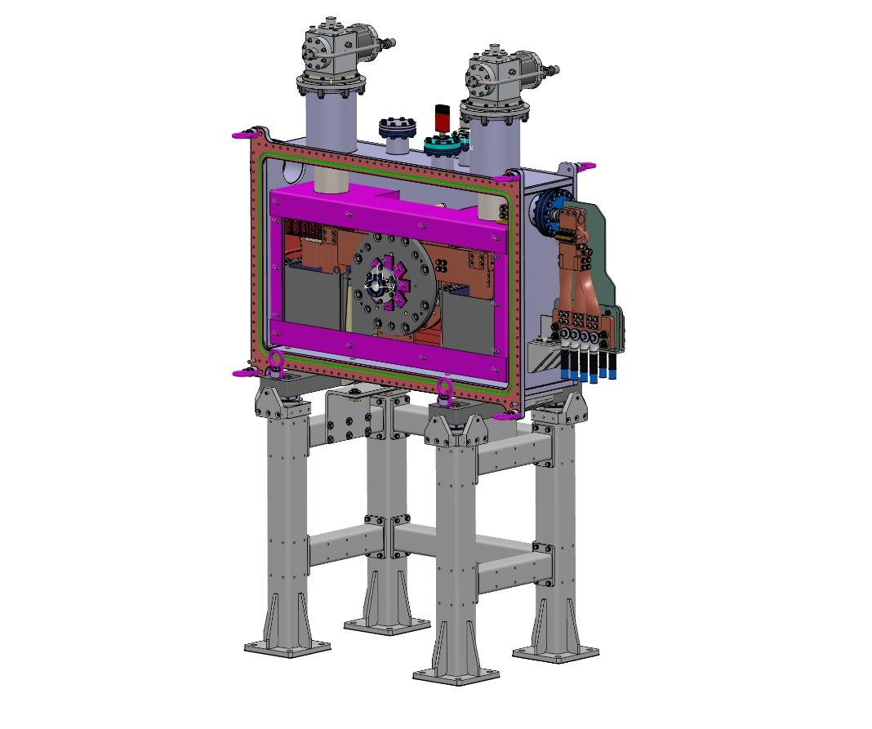
HTS solenoid for P³ experiment
Components status
power supply – delivery next month
cryocoolers - delivered
HTS tape - delivered
cryostat – main components - delivered
cryostat support – delivered
Experimental setup
HTS solenoid assembly
Warm wide bore through tube
Vacuum chamber
Thermal shielding
Cryo coolers
Electrical and thermal Leads
Thermal lead buffers
Support structure
Ground support frame
Backbone frame for vacuum chamber

Slide 3
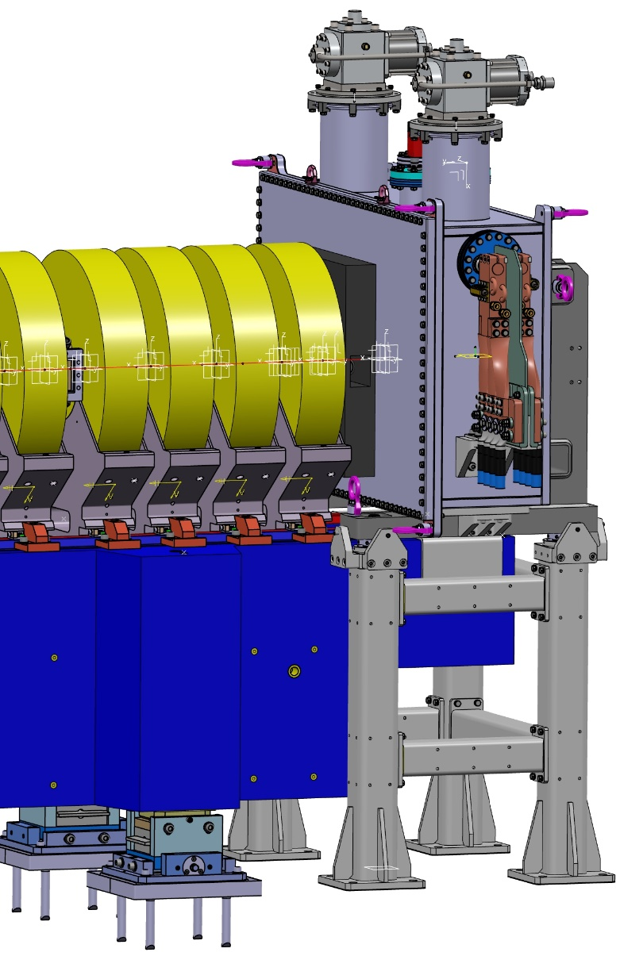
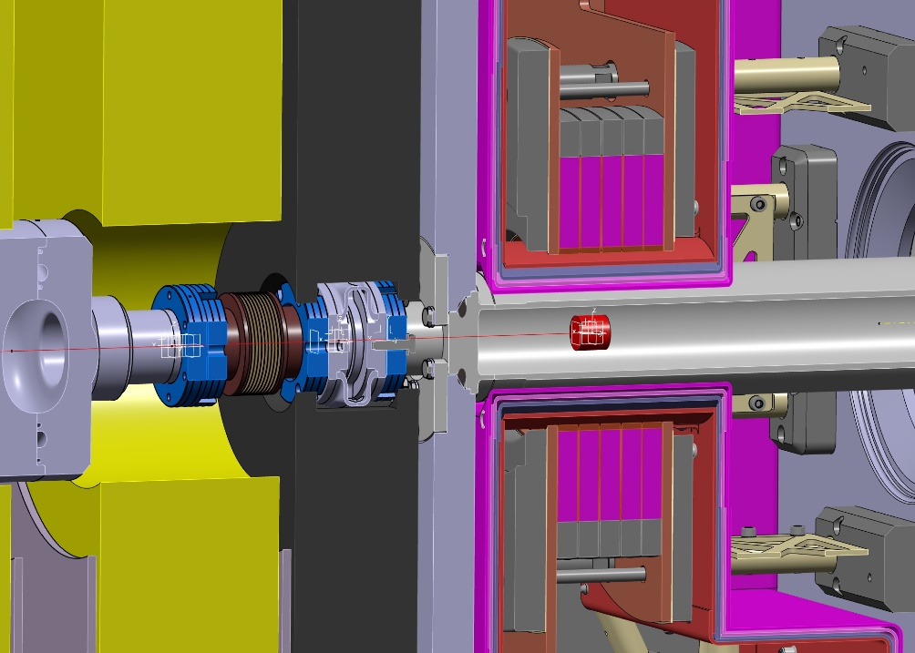
Specification Requirements
Needs of fine adjustment
of vacuum chamber
DN40CF gate valve
Lead shield
DN40CF bellow
Shielding
Chamber
144 mm
Courtesy of Thomas Uli Michlmayr

Slide 4
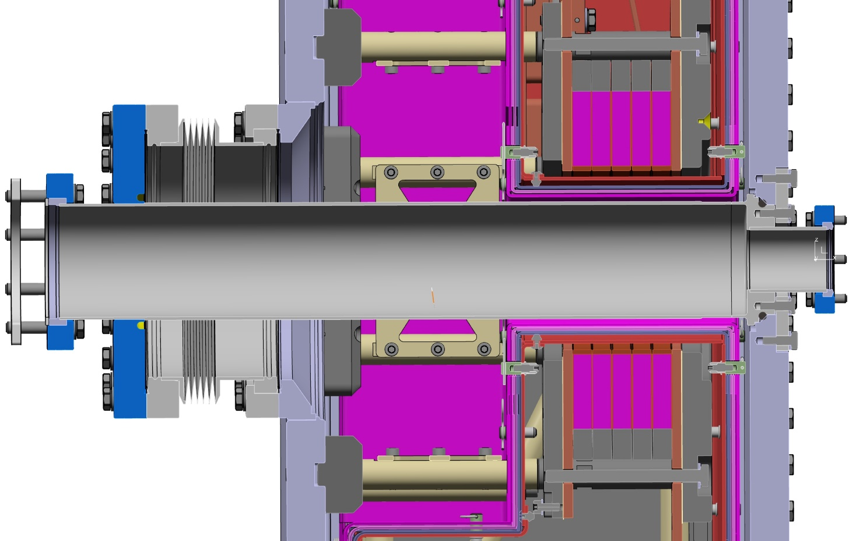
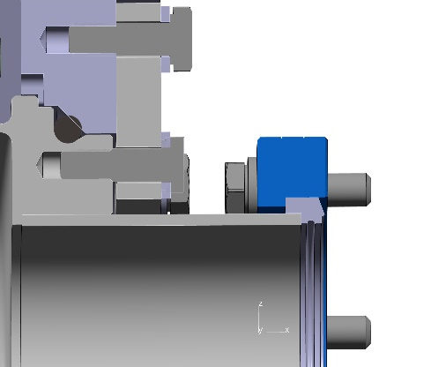
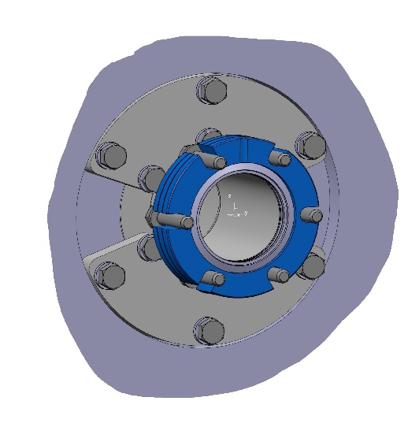
Solenoid Access Bore
DN160CF
Bellow
one side
rotatable
DN40CF-R
wide bore
downstream
flange
O-ring sealed
retention
groove
DN63CF-R
wide bore
upstream
flange
W target insertion
upstream side
Courtesy of Thomas Uli Michlmayr

Slide 5
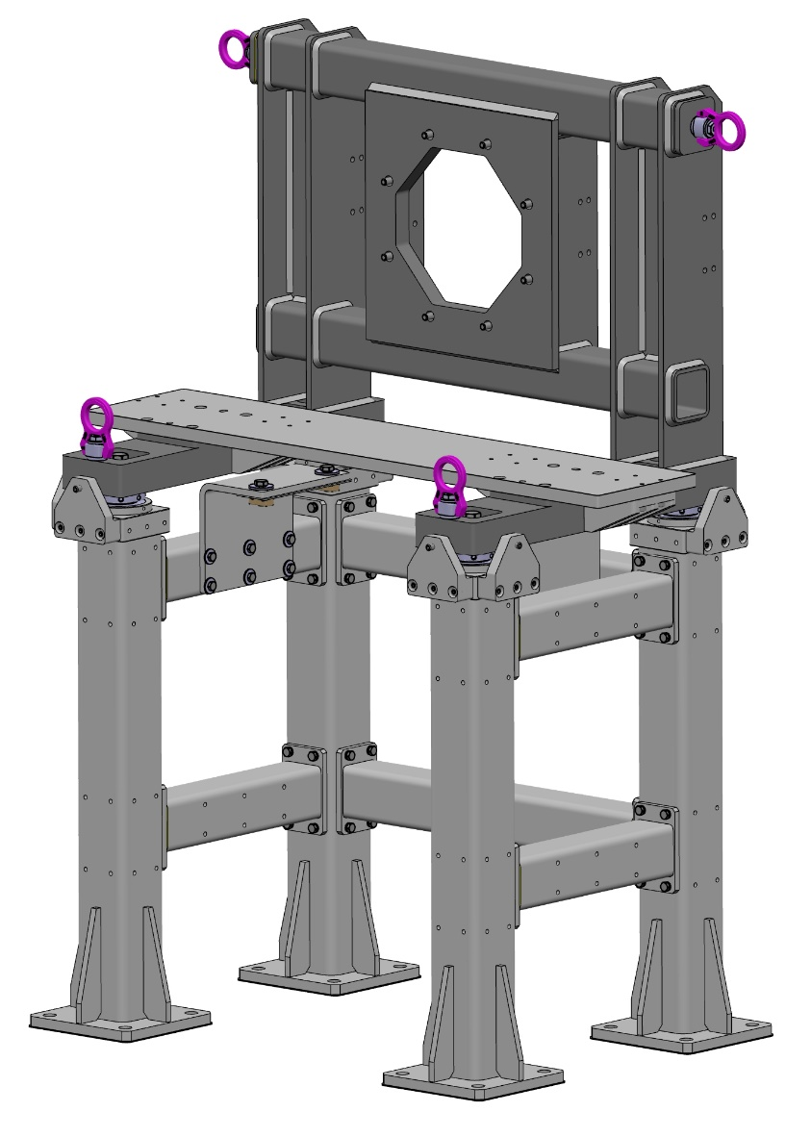
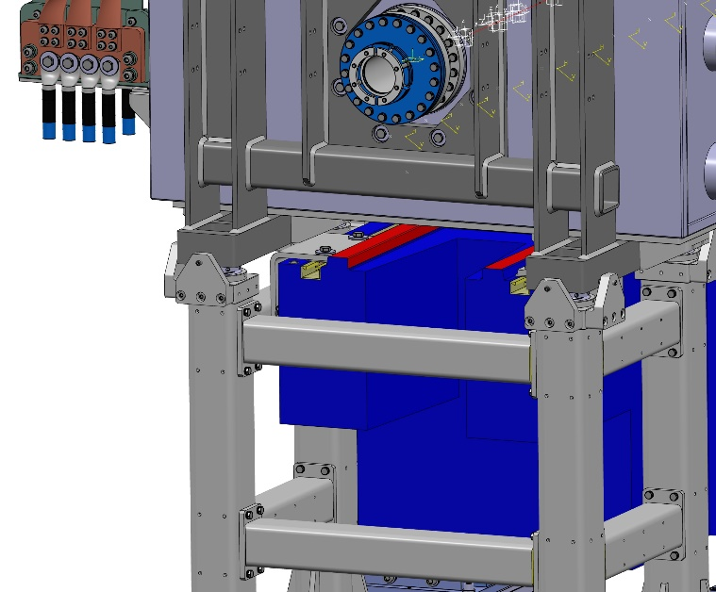
Support Structures
Crane
hooks
Weight of chamber assembly ~ 1 Ton
Force between NC and SC solenoids 30 kN
Welded frames from ▢80 / D6 and
▢100 / D8 stainless steel tubes
Solenoid support directly in contact
with backbone plate
Earthquake and deviation analysis
Sub mm adjustment
Vertical /
horizontal
Tilt
Remachined
support plates
for precise
repositioning
1200 mm
Girder
brackets
(D10)
Courtesy of Thomas Uli Michlmayr

Slide 6
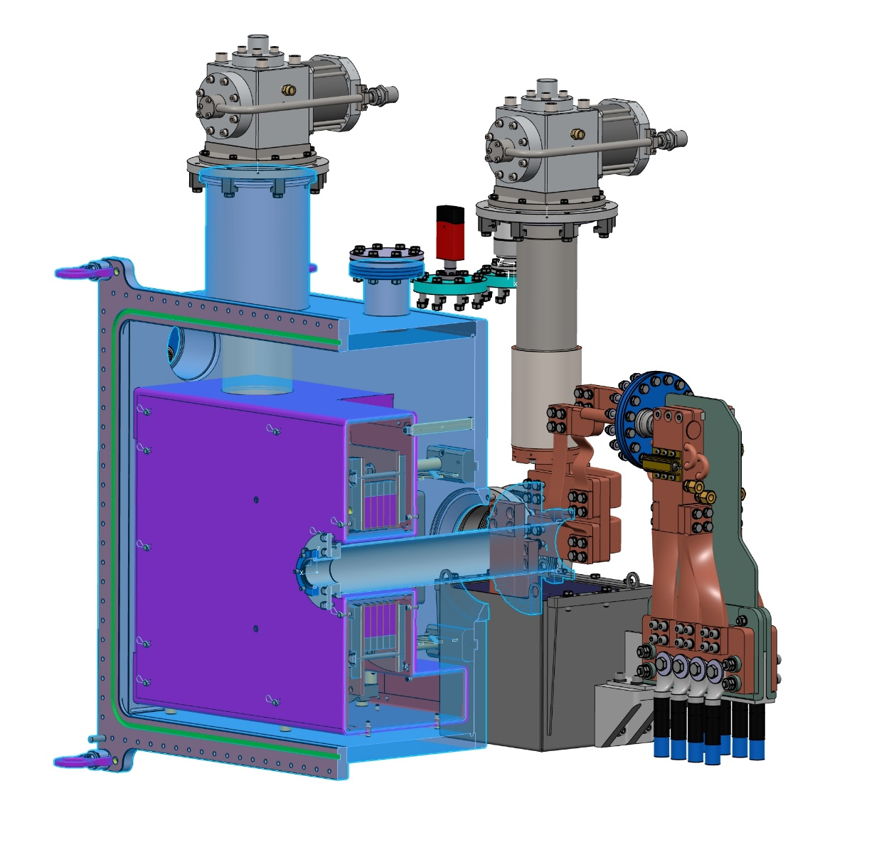
P3 Main Assembly
Cryo cooler 2
Coil assembly
Right buffer
Cryo cooler 1
Leads
Thermal shield
Thermal shielding
case EN AW-1050
and 3 x 10 layer MLI
7 G10 support
pillars
Supports only
Al shield D2
and MLI (7kg)
Air side cabling
and leads
Water cooler
with 50W heater
A = 3 * 300mm²
J = 1.3A/mm²
@ I = 1.17kA
G10 separator
Remachined
vacuum chamber
Warm wide bore 72
through pipe
Thermal lead buffers
Courtesy of Thomas Uli Michlmayr

Slide 7
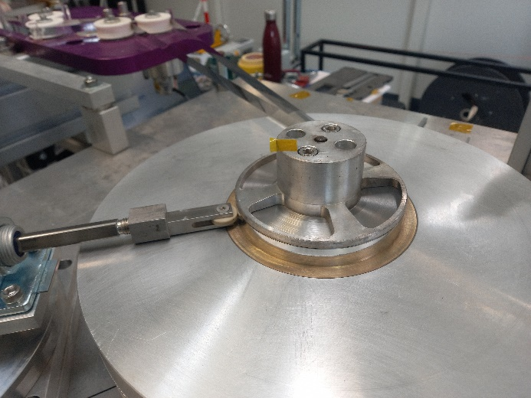
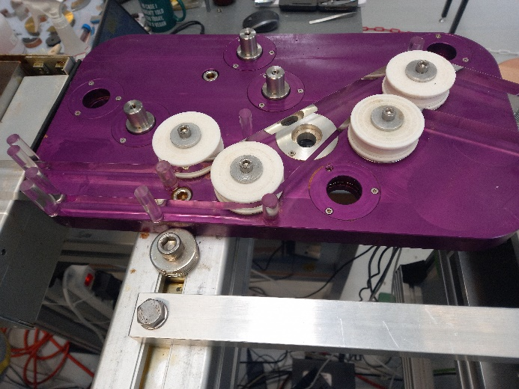
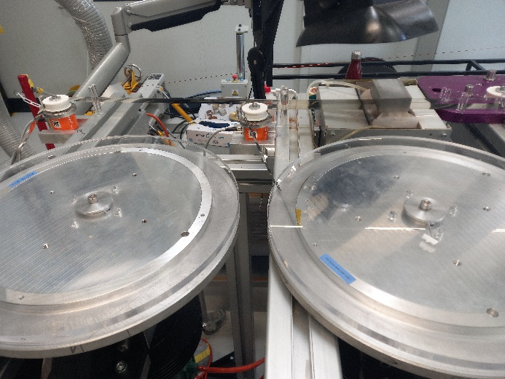
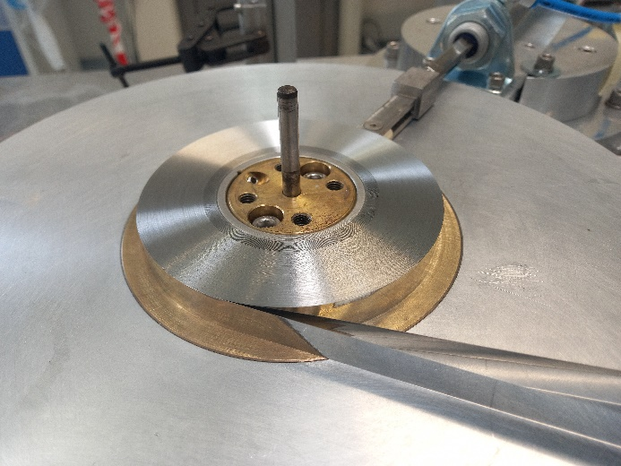
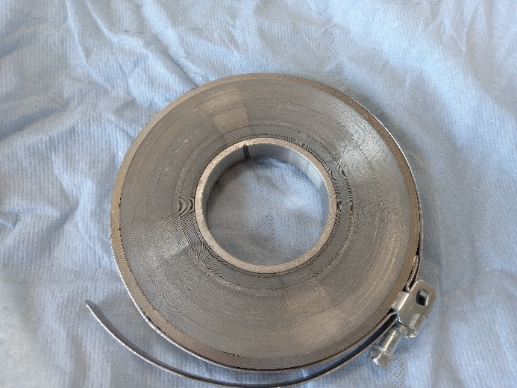
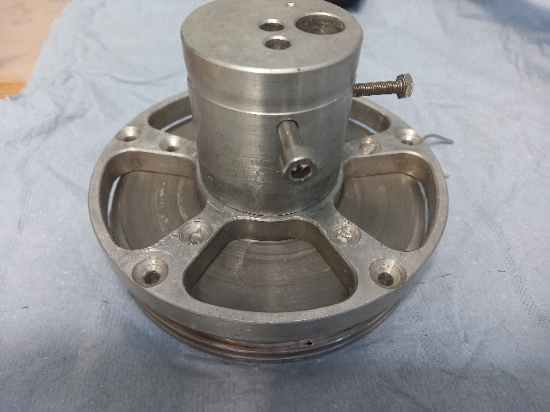
Coil winding
Courtesy of Henrique Garcia

Slide 8
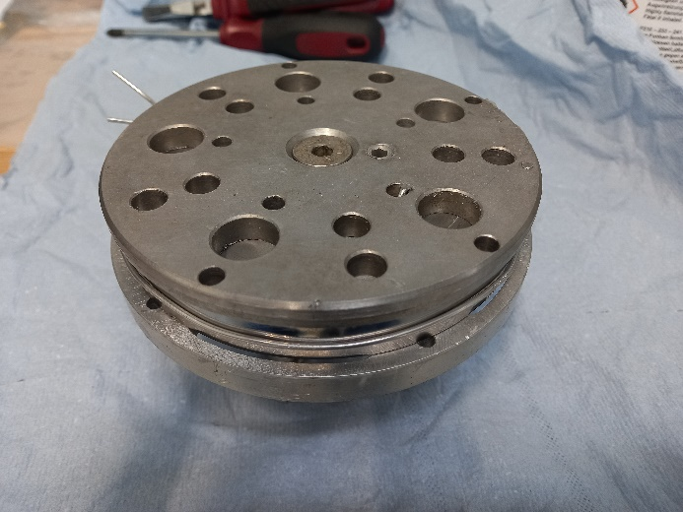
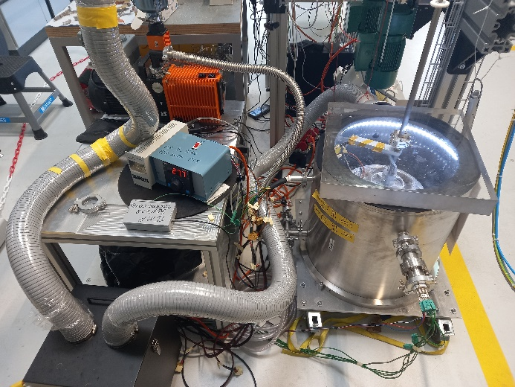
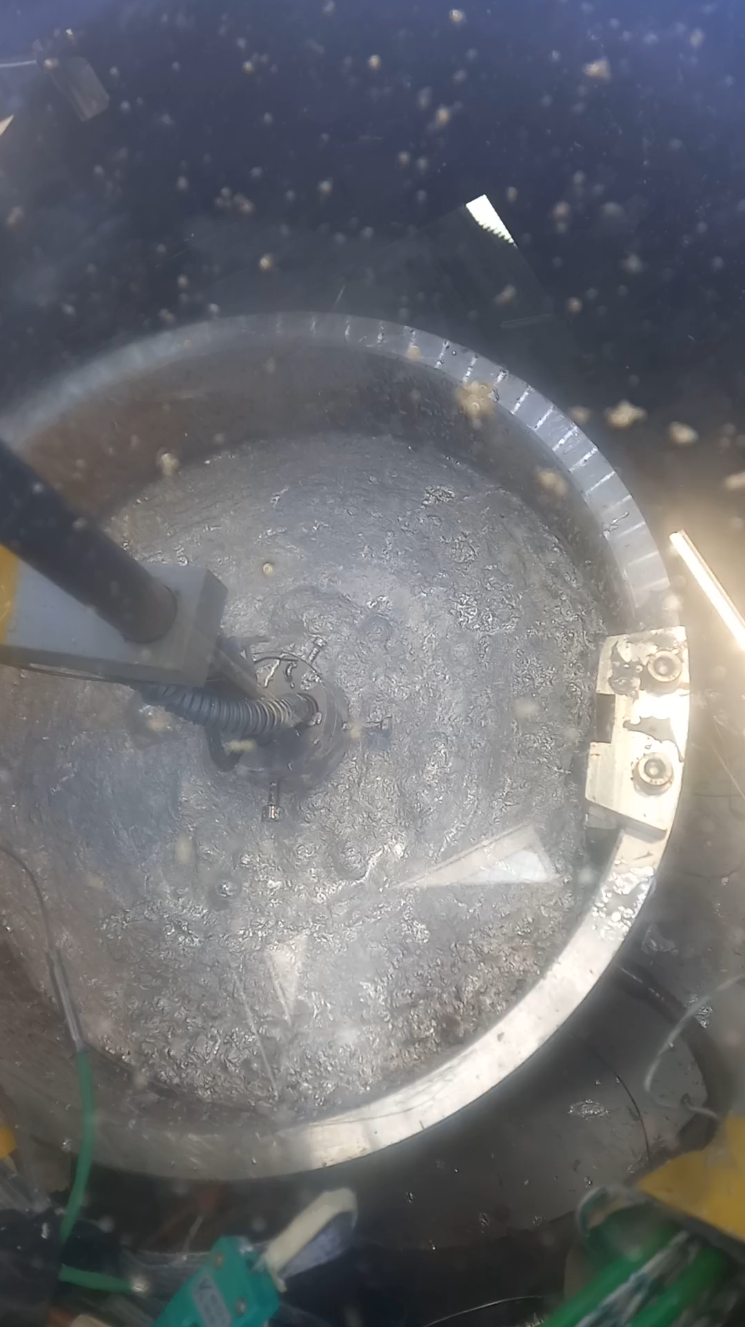
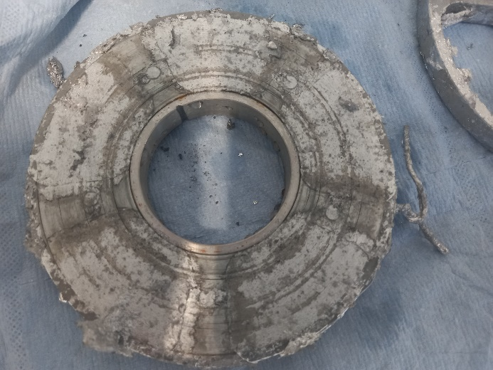
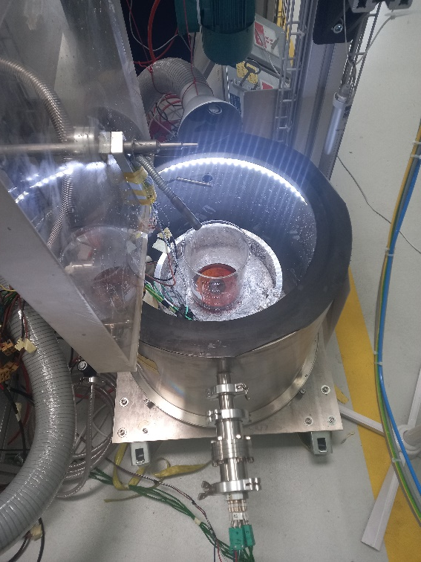
Coil soldering
Courtesy of Henrique Garcia

Slide 9
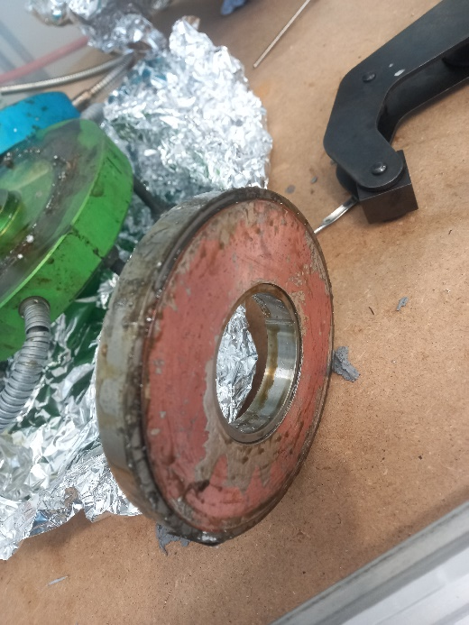
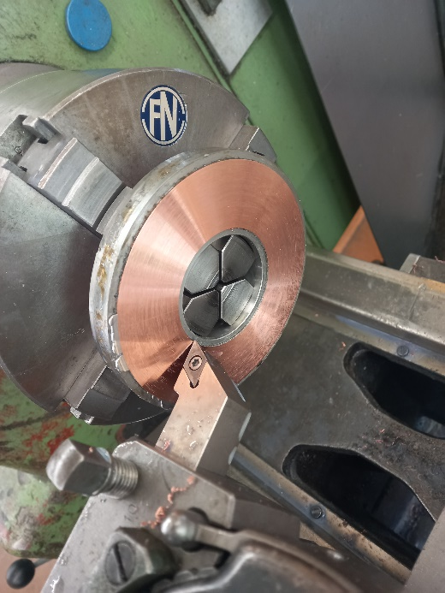
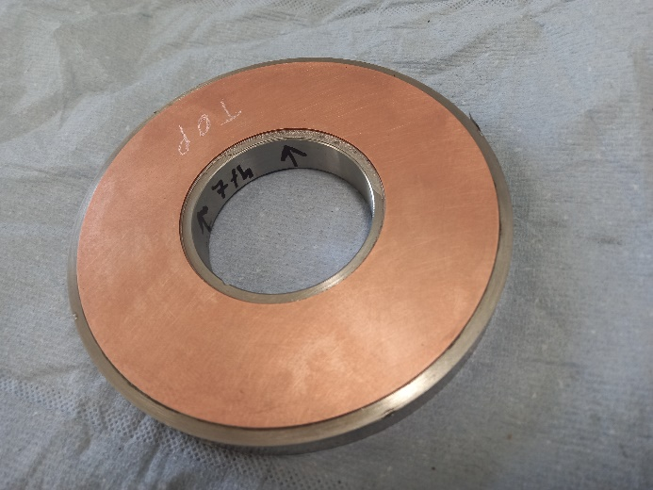
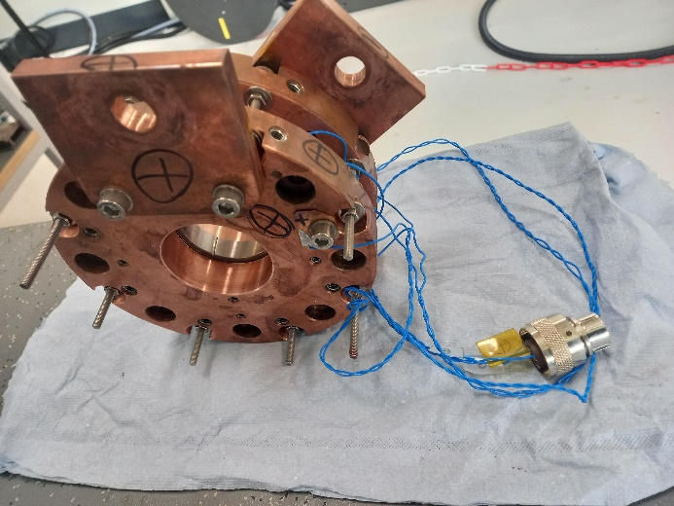
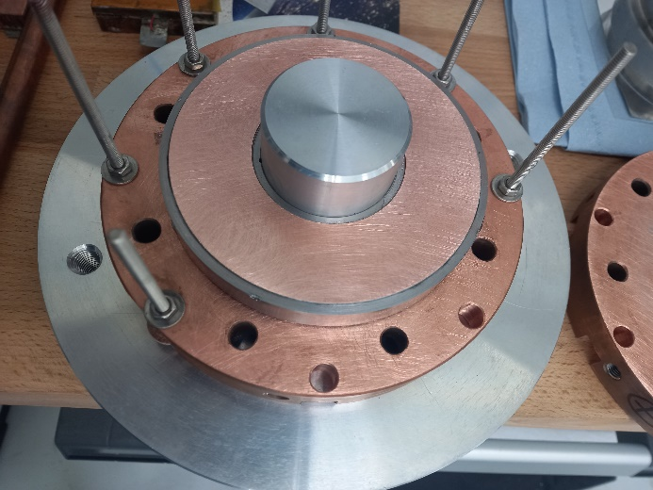
Coil soldering
Ready for testing!
Courtesy of Henrique Garcia

Slide 10
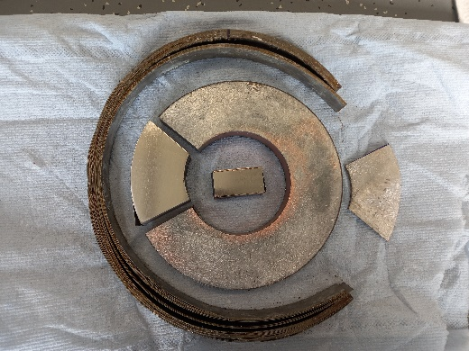
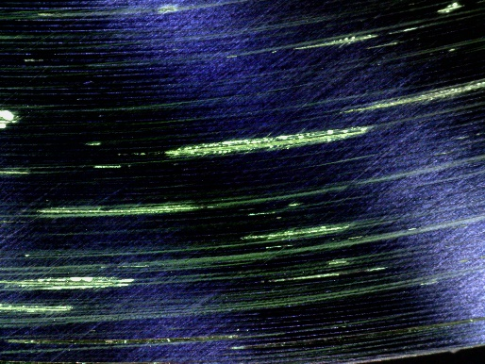
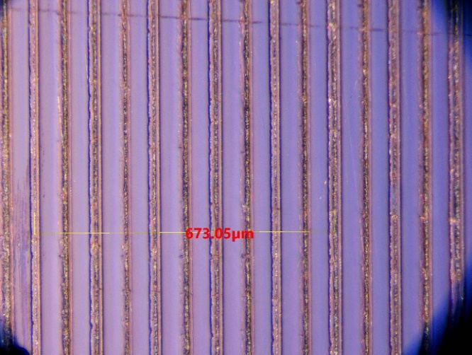
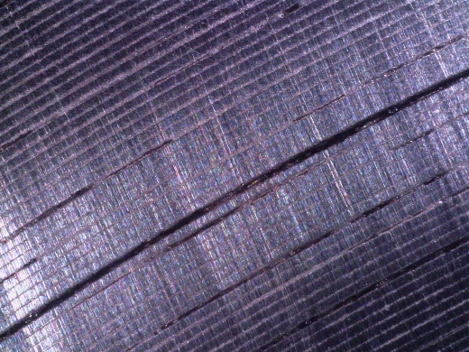
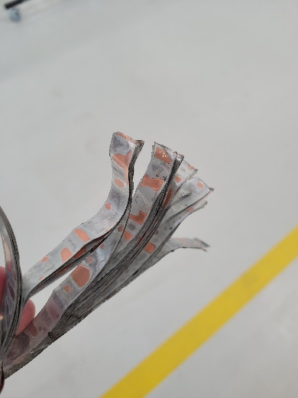
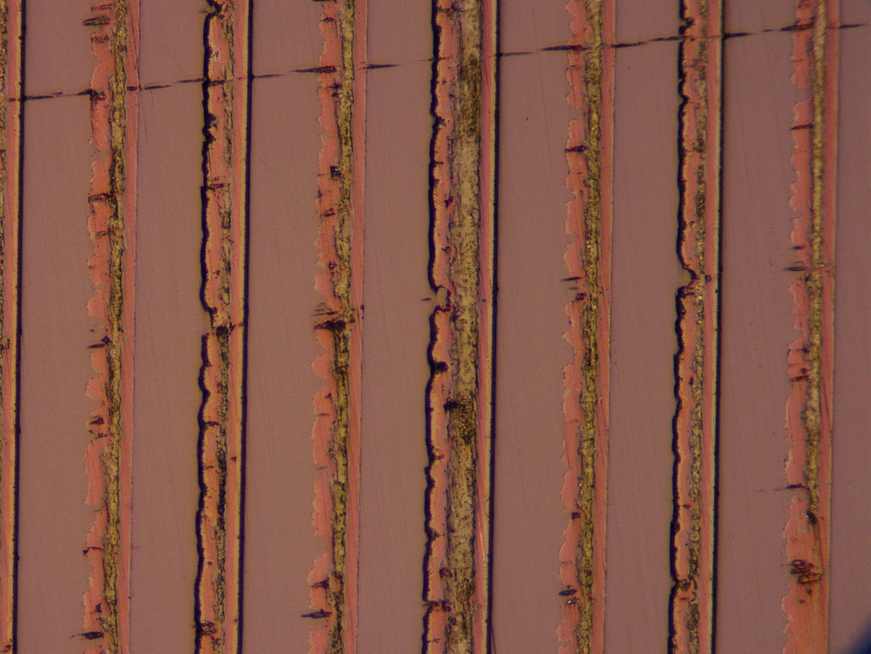
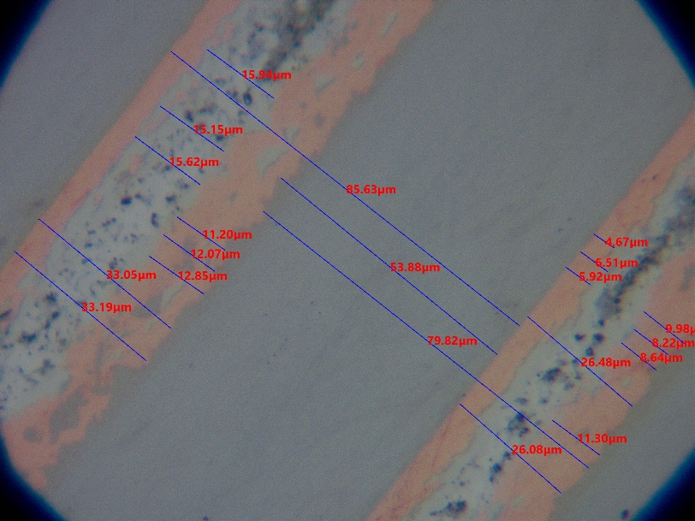
Coil verification
Courtesy of Henrique Garcia

