Slide 1
DAMSA, A Novel Dark Matter Discovery Experiment @ PIP-II
CERN Detector Seminar
November 10, 2023
Jaehoon Yu
University of Texas at Arlington
Outline
Introduction
What does DUNE got to do with dark matter?
What is DAMSA and are its requirements?
What is in Fermilab PIP-II Era?
DAMSA experiment specifics and sensitivity reach
The strategy, the team and the timeline
Conclusions

Slide 2
How do we design a HEP experiment?
Decide on physics goals to accomplish
Determine the capabilities and parameters for an experiment to meet the goals, taking into account the background mitigation
Decide on the beam and the best detector technology to meet the parameters
Perform R&D for the beam and the detector
Design and build prototype detectors to test the performance
Finalize the design and build the full-scale experiment

Slide 3
Neutrino fundamentals – 1
Postulated in 1930s to explain the nuclear β-decay and detected experimentally in 1956 (1995 Nobel)
Fundamental particles of matter in the current Standard Model of Particle Physics
  Make up a quarter of the whole particle table in TSM as massless particles
  Have three flavors – electron (ν_{e} – 2002 Nobel), muon (ν_{μ} – 1988 Nobel) , and tau (ν_{τ})
  Charge neutral and only interact via the weak force ➔ do not interact often in matter
    Need high intensity neutrino beams to obtain large number of interactions!!

Slide 4
Neutrino fundamentals – 2
Large numbers of low E neutrinos (ν_{e}) produced in the Sun (2002 Nobel) and in reactors
  ➔ 65x10⁹ ν_{e} /s/cm² (FFT: how many passes throughout your body/sec?)
Neutrino flavor oscillation was discovered & confirmed throughout late 1990 and early 2000 (2015 Nobel)
  Happens because flavor and mass eigenstates differ (oscillation probability dependent on L/E_{ν})
  Neutrinos have mass! ➔ SM in BIG trouble!

Slide 5
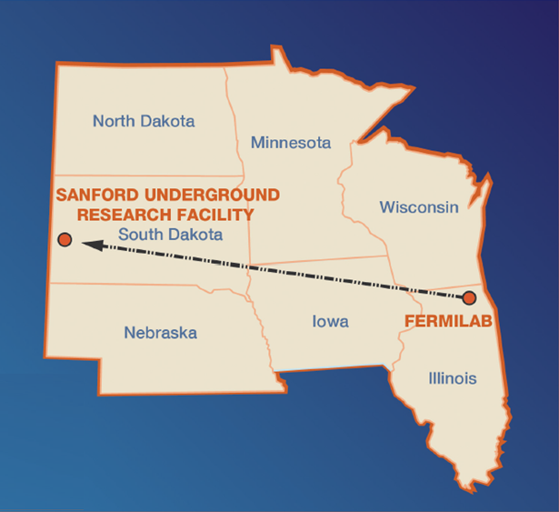
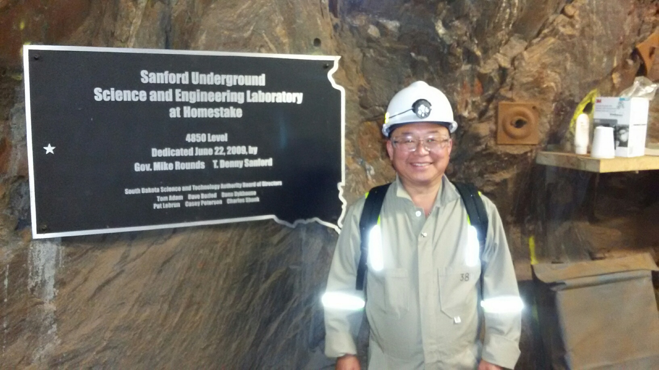
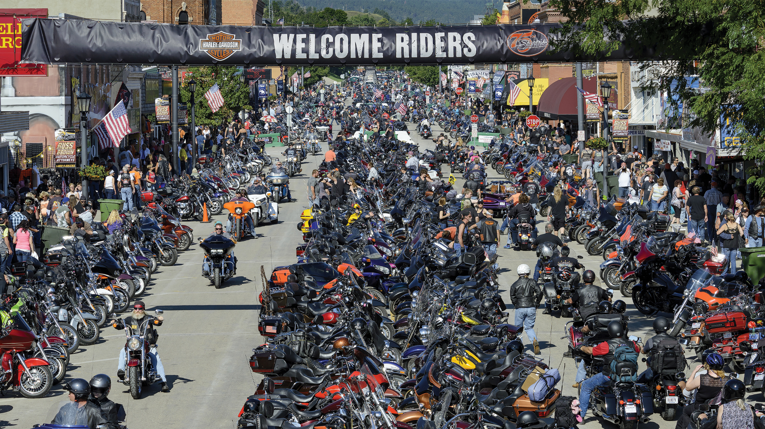
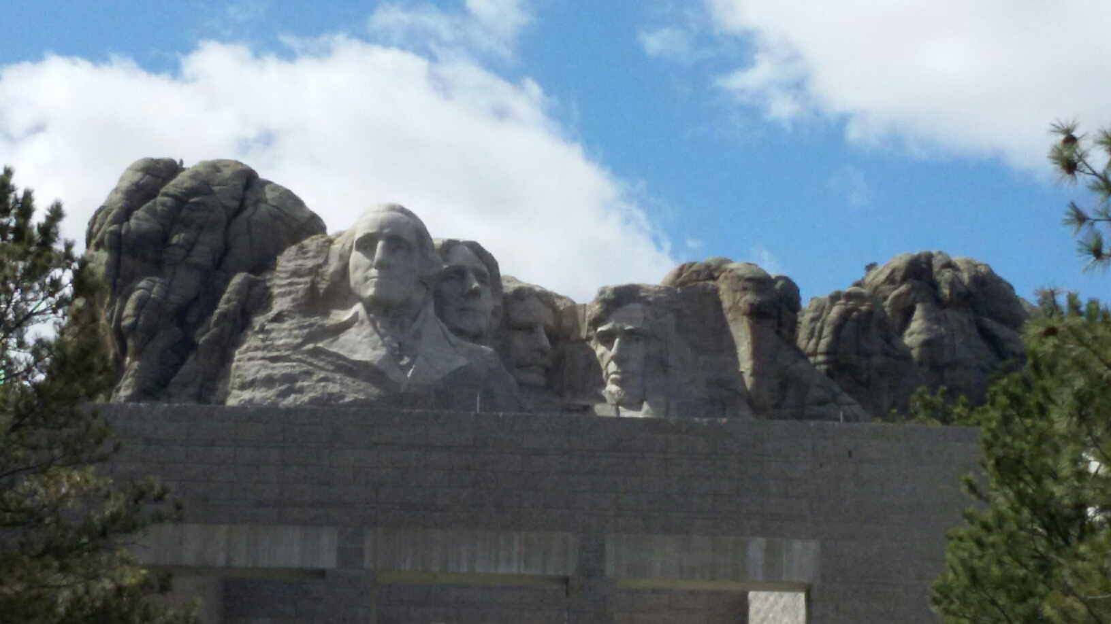
The Next Big Thing - DUNE Experiment
Stands for Deep Under Ground Neutrino Experiment
US flagship long baseline (1300km) ν experiment
  1500m underground in an old South Dakota gold mine
Yes, you are right, again!
That Sturgis is right next door!
Yes, you are right! Mount Rushmore!!
2002 Nobel Winning solar ν detection by Ray Davis
Many DM experiments
New DUNE area being excavated (>85%)

Slide 6

The Next Big Thing - DUNE Experiment
Stands for Deep Underground Neutrino Experiment
The US flagship long baseline (1300km) ν experiment
  1500m underground in an old South Dakota gold mine
Needs a very high intensity proton beams (1.2MW → 2.4MW!)
  Result in a large number of ν for property measurements
  Opportunity for dark matter search and other BSM physics
  FFT: How many 120GeV p/sec correspond to these powers?
Large mass (~70kt! total) LArTPC Far Detector at SURF
Powerful near detector complex to control systematics
Was born in March 2015!
  Combination of LBNE (US) and LBNO (EU)
>1500 collaborators from 209 institutes in 36 countries + CERN

Slide 7
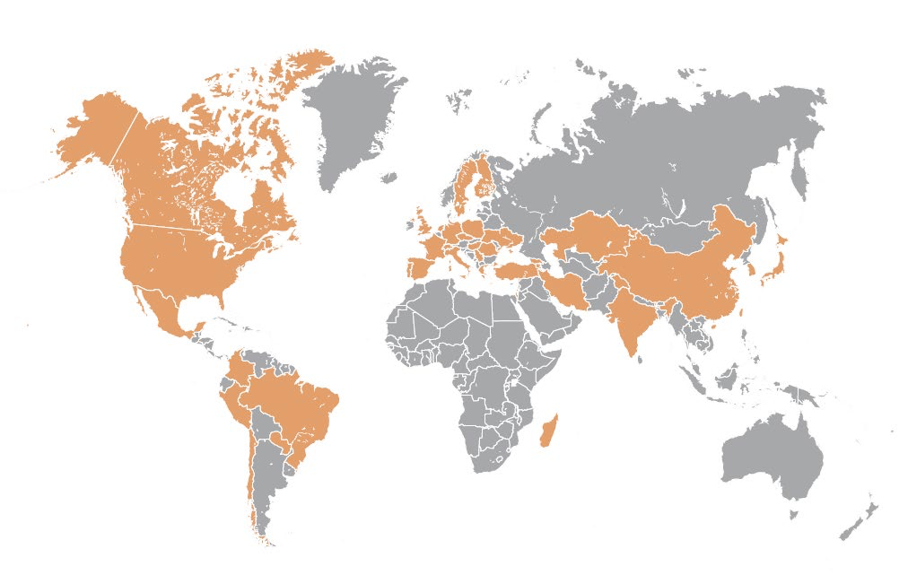
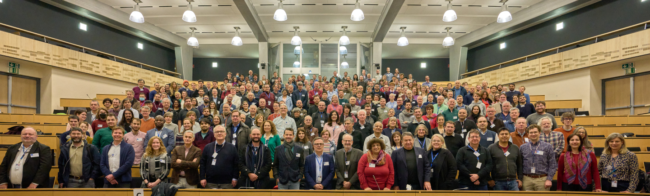
The Map of the DUNE Experiment
>1500 collaborators
209 institutions
36 countries + CERN
https://www.dunescience.org/about-the-collaboration/
CM@CERN, CH/Jan. 2023

Slide 8
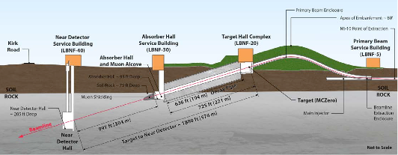
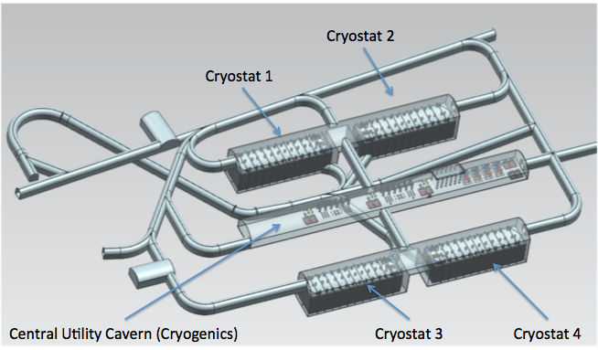
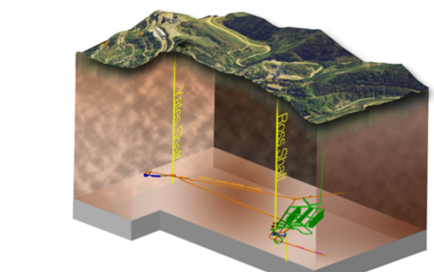
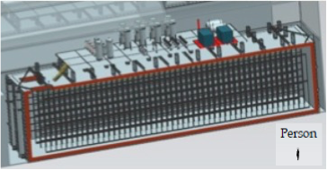
Anatomy of DUNE
LBNF ν Beam
Broadband ν from 60 – 120GeV p
P_{Beam} :1.2MW →2.4MW
Tgt
1300km (800 miles)
570m
ND
4 caverns for
M_{t}~ 70kt LAr
(>85% complete)
M_{A}~ 17kt LAr
LBNF Far Detector Site, SURF
1500m underground
18m
18m
66m

Slide 9
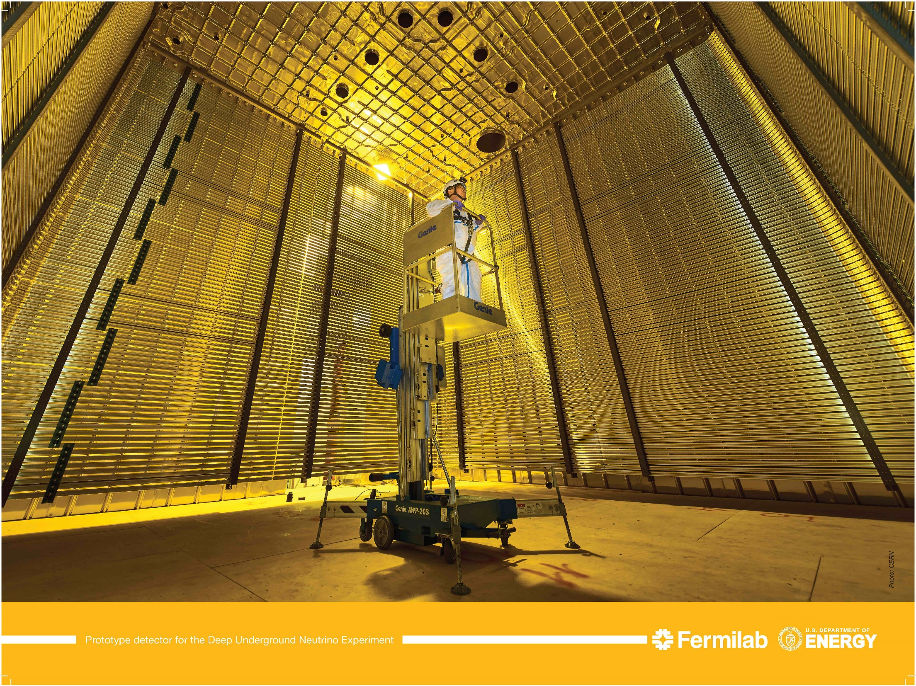
ProDUNE DP Field Cage @ CERN NP, cerca 2018
6m
6m
6m
V_{FD} =30*V_{PD}

Slide 10
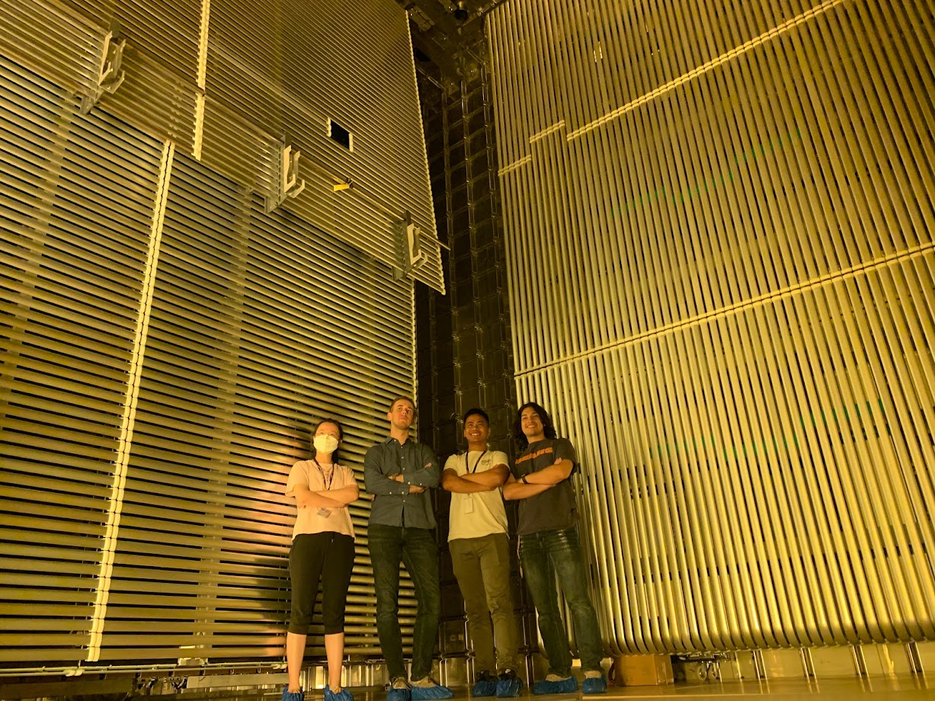
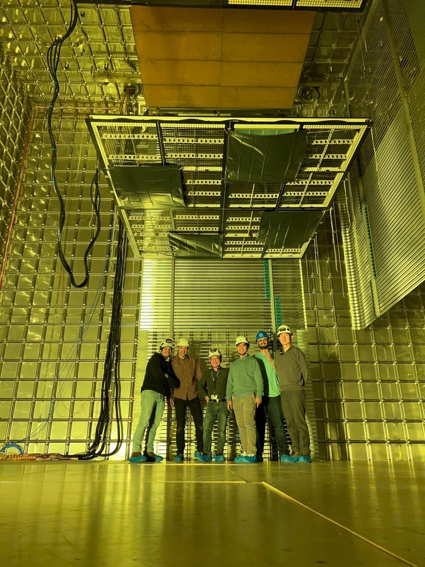
ProtoDUNE VD@NP, cerca 2023
ProtoDUNE HD@NP, cerca 2022

Slide 11
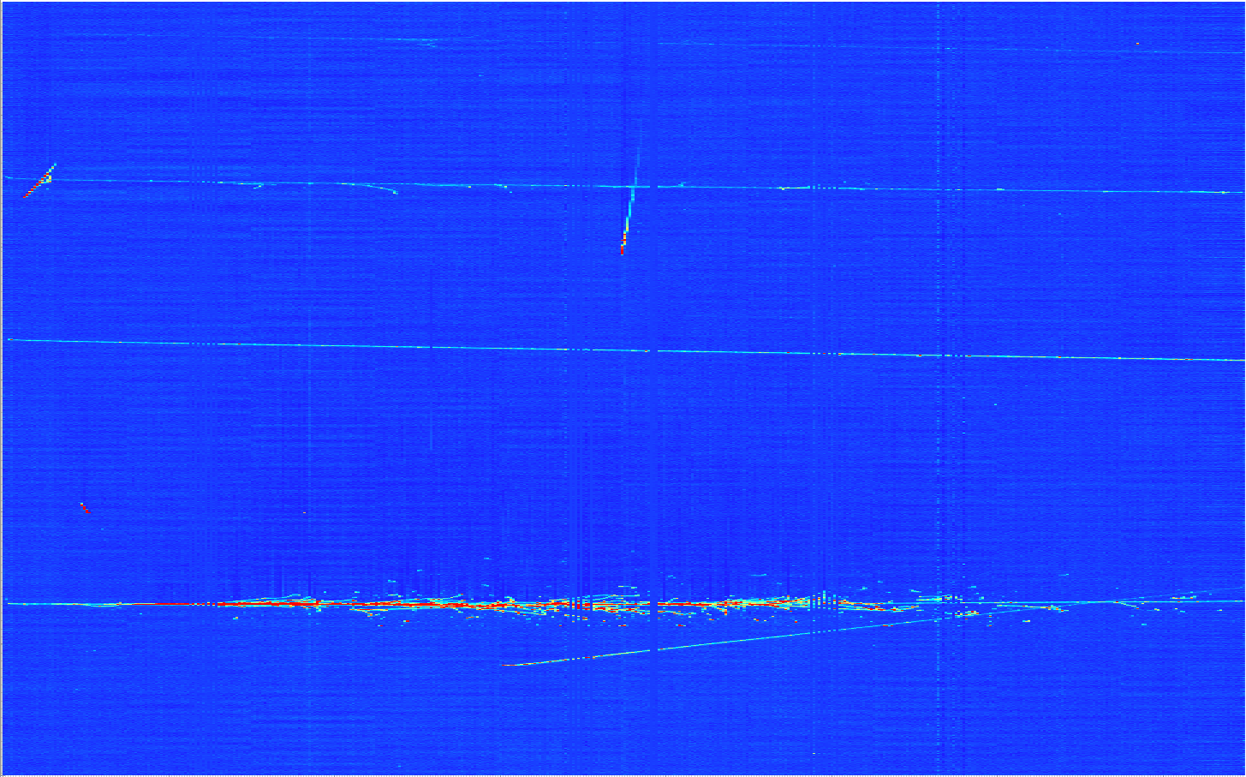
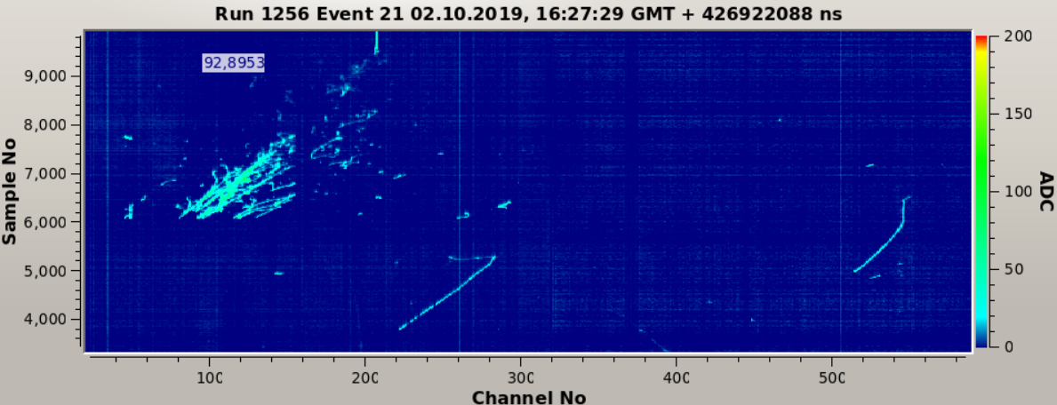
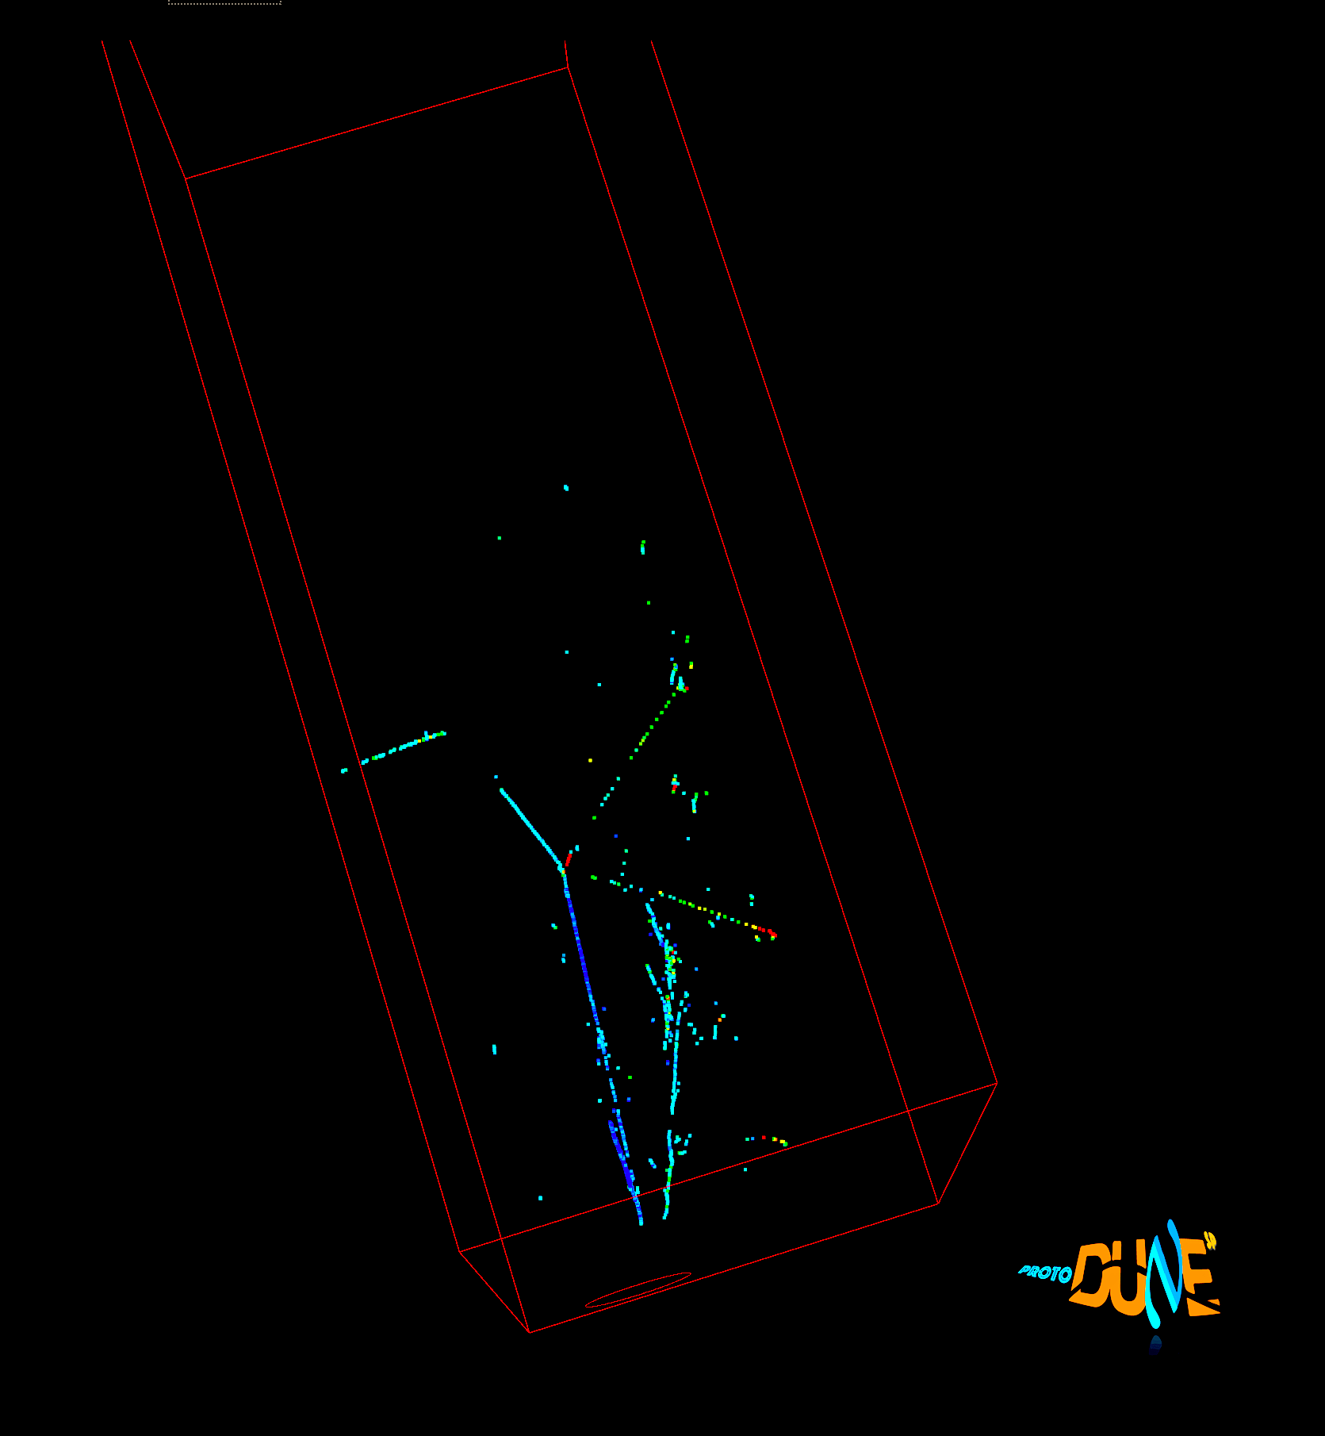
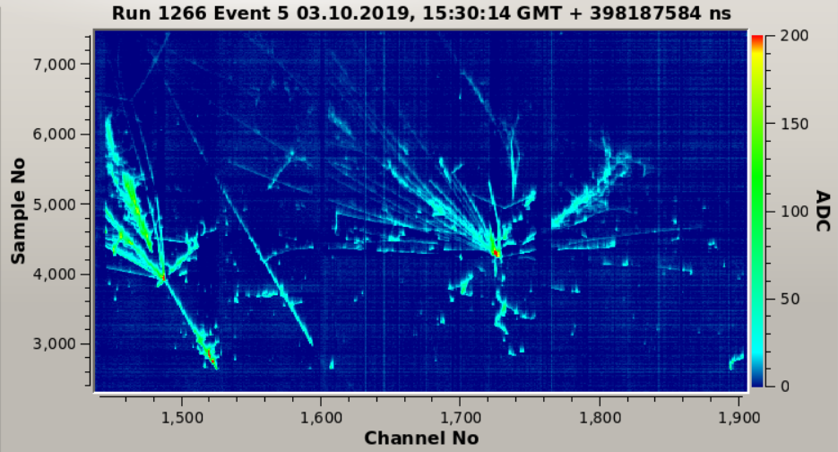
Images in DUNE LAr-TPC Prototypes
Throughgoing μ
Electromagnetic shower + two muon decays
E_{LEM} = 31 kV/cm
µ decay
EM shower
P = 1010 mbar
Multiple hadronic interactions in a shower
Run 4696, Ev 103:
2 EM showers and a pion interaction
E_{LEM} = 32 kV/cm
P = 1010 mbar

Slide 12
BSM Topics @ DUNE
DUNE’s facility enables DUNE a BSM physics machine
  Recall the Signal to Bck. ratio grows by the sqrt of the beam power
  Near Detector Searches ➔ Take advantage of high beam power
    Axion-like Particles (ALP)
    Low mass Dark Matter (LDM)
    Heavy Neutral Leptons (HNL)
    Dark Photon
    Neutrino Trident
    Milli-charge Particles (mCP)
    And many many more..
  Far Detector Searches ➔ Takes advantage of large mass LArTPC
    Sterile neutrino searches
    Non-standard Interactions, Non-Unitarity, CPT violation
    Large Extra Dimensions (LED)
    Inelastic Boosted Dark Matter (iBDM)
    And many many more…
Strong collaborations of theorists and experimentalists generate many new ideas
Some of these topics are covered in DUNE’s EPJ C.81, 322 (2021)

Slide 13
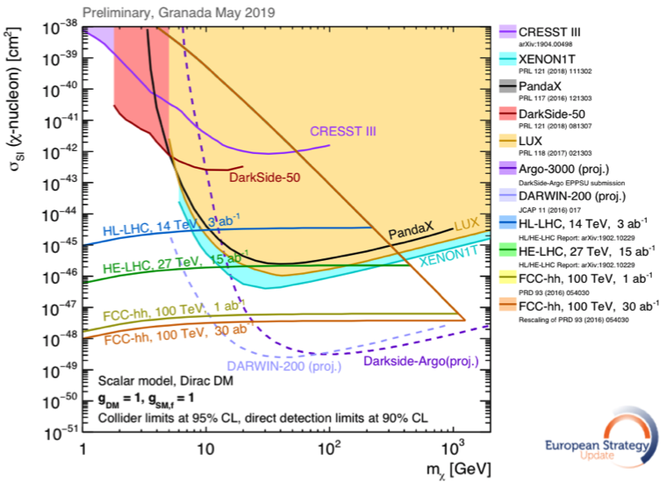
Physics Motivation For DSP
SM describes the visible ~5% of the matter in the universe ➔ becoming more solidly established, while the neutrinos sector requires modifications
Dark matter (Dark Sector Particle, DSP) makes up about 25% of the universe ➔must be explored better
Direct searches have limitations in kinematic reach, leaving low mass range un-explored
Strategy:
  Search for rare particles in unexplored kinematic regime
  Make and discover DSPs in accelerators
  Establish human infra on DM production
Focus
here
No DM

Slide 14
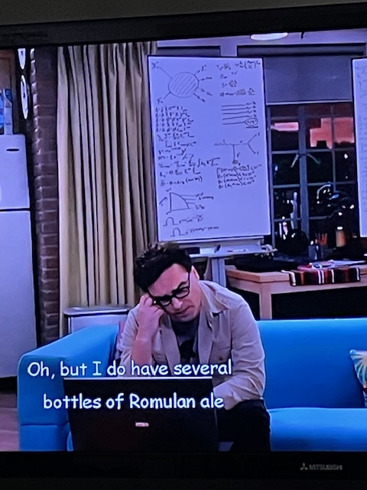
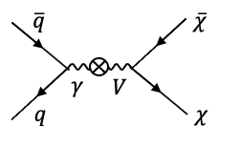
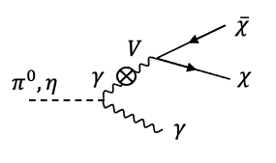
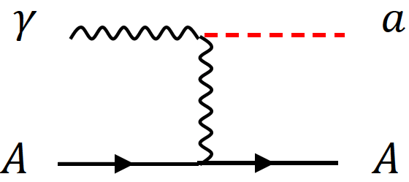
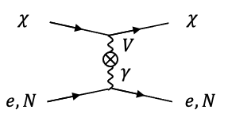
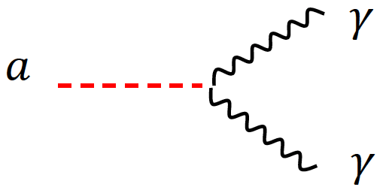
DSP’s? How are they made & seen?
New particles that do not experience known forces
DSPs can weakly couple to visible sector via mediator
Photons from brem, DY and neutral mesons decays ➔ new U(1) gauge coupling to SM γ possible
Detection through an electron scattering, N(n) recoil or 1, 2 γ final states

Slide 15
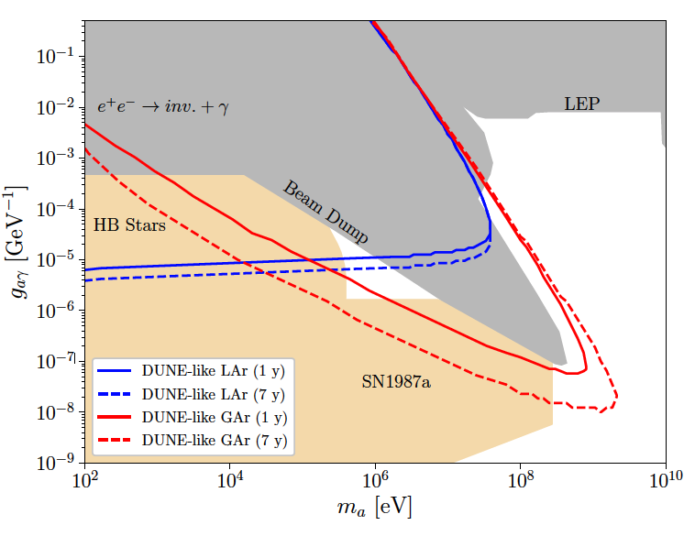
ALP Searches @ DUNE ND
Axion-like particles (ALP) produced in Primakoff process in the ν target
Detection through a scattering with e/N + γ or decays to two γ
DUNE ND Phase II enables complete closure of the Cosmic Triangle!!
Production in ν target
Detection
Phase I - NDLAr
Phase II - extension w/ NDGAr
Cosmic Triangle
Brdar, Yu et al., PRL126, 201801 (2021)

Slide 16
Opportunities on ALP Searches
What is the most interesting feature of the DUNE sensitivity reach?
Focus here
This edge constrained by the distance from the source to the detector

Slide 17
What is DAMSA?
A dark sector particle search and discovery experiment at low E, high intensity proton beam facility
Stands for Dump produced Aboriginal Matter Search at an Accelerator (DAMSA)
  담사 (潭思) = 깊은생각 – Deep thoughts, Rumination
    Jang, Yu et al., PRD 107, L031901 (2023)
Aims to discover DSP’s in the low mass regime at an accelerator ➔ ideally E_{beam} below the pion threshold
  Originally developed for 600MeV proton beams at a nuclear rare isotope facility to be built in SK
The 800MeV PIP-II LINAC beams fit the bill
  The goal is to build the experiment in time for PIP-II LINAC

Slide 18
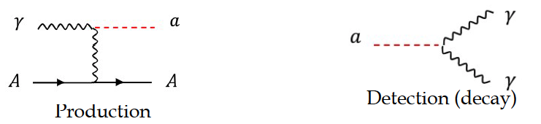
DAMSA Physics Strategy
Focus on Axion-like particles (ALP) search through their two- photon final state via the Primakoff process as the use case but 2e or 2μ final states also work
Produce as many photons as possible in the dump
Capture as many ALPs as possible in as wide a mass range as possible in its 2γ final state
  Minimize the distance from the source to the detector
  Utilize a vacuum chamber to further extend effective detector coverage
Minimize/mitigate the backgrounds from neutral particles
  Neutron spallation
  ν QE, RES, and NC interactions

Slide 19

DAMSA Exp. Concept
Inject and absorb as many low-E protons and produce as large number of γ in the dump as possible
Allow higher mass ALP’s to decay in the vacuum w/ as small number of neutrons escaping the dump as possible
Place the detector as close to the dump as possible on axis to expand the mass reach to higher mass region
Vacuum Decay Volume
L=1m, R=1.1m
Detector
R=1.1m
Proton
W Dump
L=1m
R=0.5m
Absorber
Effective Detection Range
(~1m from the source)
J. Bian, et. al

Slide 20
Accelerator Complex in the PIP-II Era
PIP-II LINAC is the essential first element for DUNE
PIP-II (Proton Improvement Plan – II) provides
  New SRF LINAC for injection into Booster at 800MeV
    Total proton current of 2mA which translates up to ~4x10²³ PoT/yr
  Booster cycle rates upgraded to 20Hz from current 15Hz
  Increased proton beam intensity at 8GeV for 1.2MW beam power from main injector
PIP-II era begins in 2029, DUNE 2031
  Mu2e (8GeV)
  Fixed target, test beams (120 GeV)
  0.8 GeV beam available for other exp, eg. with PAR and may be other options for beam dump
TeV Field
B. Flauger

Slide 21





The three key elements
The bad
The ugly
The good
The beam
The dump
The detector

Slide 22
DAMSA Requirements – The Beam
PIP-II LINAC’s 800MeV beam energy enables access to the tangible ALP mass range
  With much reduced neutrino backgrounds
PIP-II LINAC CW beam characteristics (total proton current: 2mA)
  Bunch length: 1ns
  N_{p}/bunch : 8x10⁷ p/bunch (~4x10²³ p/yr)
  Bunch spacing: 6.2ns
Can chop the bunches to mimic pulsed beam structure & raster the beam for dump thermal considerations
  Studies show that the intended physics reach can be accomplished even w/ 10% of the LINAC proton intensity

Slide 23
DAMSA Requirements – The Dump
What material on what depth would be most optimal?
  Produce most photons per unit length
  Produce least number of neutrons out the dump
  Absorb most particles per unit length
  Maintain short distance (~1m) to the detector
GEANT4 based study shows 1m diameter, 1m long cylindrical shape tungsten dump (~10 nuclear interaction lengths) produces most photons and absorb ~99.995% 600MeV protons
  Neutrons produce additional photons in the dump, providing additional source for ALP
  Charged pions get observed in the dump

Slide 24
DAMSA Requirements – The Detector 1
What detector capabilities are needed to
  Capture as many ALP’s as possible in as wide a mass range as possible
    Higher mass, high coupling ALP’s have shorter lifetime ➔ Need to be able to capture two photons from the ALP decays upstream of the detector
    Lower mass, low coupling ALP’s live longer ➔ Allow them to decay and interact in the detector and capture decay products upstream of the detector as much as possible
  Reject accidental backgrounds from neutron spallation
    Minimize the materials upstream of the detector for neutron interactions
Place a large decay volume in vacuum to fill the gap between the dump and the detector ➔ Extends effective detector range
  Allows higher mass ALPs to decay ➔ giving clear vertices where the two final state photons originate from
  Neutron interactions confined to the decay chamber walls

Slide 25
DAMSA Requirements – The Detector 2
What are other possible ways to further reduce the background from neutron spallation? ➔ Aim to reduce by order >=10¹⁰
  Leverage the speed of the neutrons ➔ Neutrons are 10 – 1000 times heavier than the ALPs, thus for the given momentum, the arrival time of the neutron induced photon accidentals would be slower than that of the ALP’s
  Arrival time difference between the two photons
  Leverage the distance of closest approach of the two photon traces
  Require the traceback of the overlapping two photon momentum sum point the dump

Slide 26
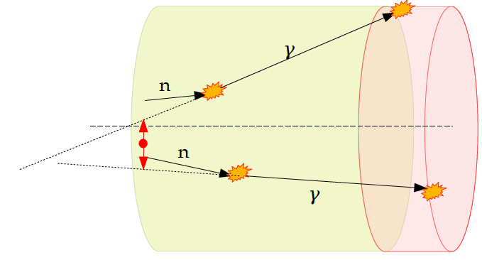
DAMSA Detector – The γ pair traceback
Require two photon track trace back position be inside the dump perimeter
2x10⁻² of γ pairs remain
Before cut
in unit of m
After cut
in unit of cm
100 cm

Slide 27
DAMSA Requirements – The Detector 2
What are other possible ways to further reduce the background from neutron spallation? ➔ Aim to reduce by order >=10¹⁰
  Leverage the speed of the neutrons ➔ Neutrons are 10 – 1000 times heavier than the ALPs, thus for the given momentum, the arrival time of the neutron induced photon accidentals would be slower than that of the ALP’s and randomer
  Arrival time difference between the two photons
  Leverage the distance of closest approach of the two photon traces
  Require the traceback of the overlapping two photon momentum sum point the dump
  Invariant mass of the two photon momenta be within the interested mass range
Large number of photons from neutrons at low kinetic energy ➔ Require the photon energy to be greater than 15 MeV (we can drive all the way up to 100MeV!!)

Slide 28
DAMSA Detector Study E_{γ} Cut
Geometry implemented in GEANT4
10⁸ 600MeV protons injected to dump
260k neutrons enter the decay chamber
  2.6x10⁻³ n/p
1.6x10⁶ γ produced from n
3.2x10³ γ with E>5MeV ➔ ~1k enter the detector fiducial volume
5.1x10⁵ γ−pair combination possible
All photons
E_{γ}>5MeV

Slide 29
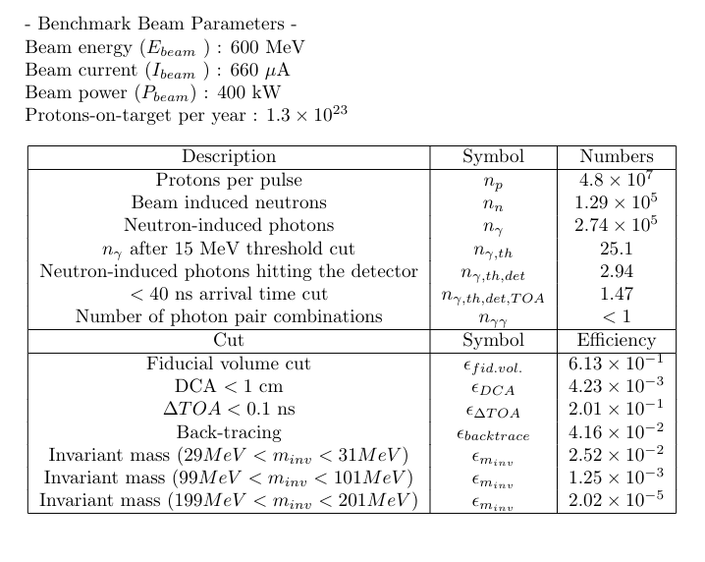
Neutron Background Reduction Summary
neutron-induced photons are reduced by (1 / 2.74e-5) = 3.6e-6
Overall rejection factors
1.92e-7
9.51e-9
1.54e-10
1.46

Slide 30
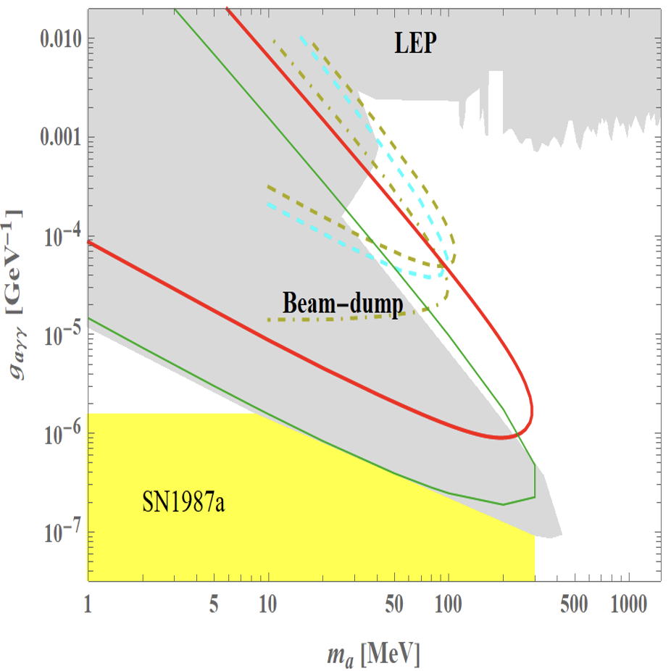
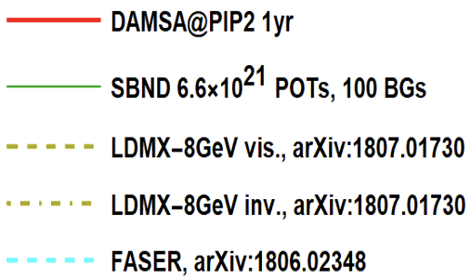
DAMSA Sensitivity – Running Experiments
Year 2031
Short lived! ➔ Capture decay products b4 det.
DAMSA Strength
Long lived! ➔ Capture decays in the detector

Slide 31
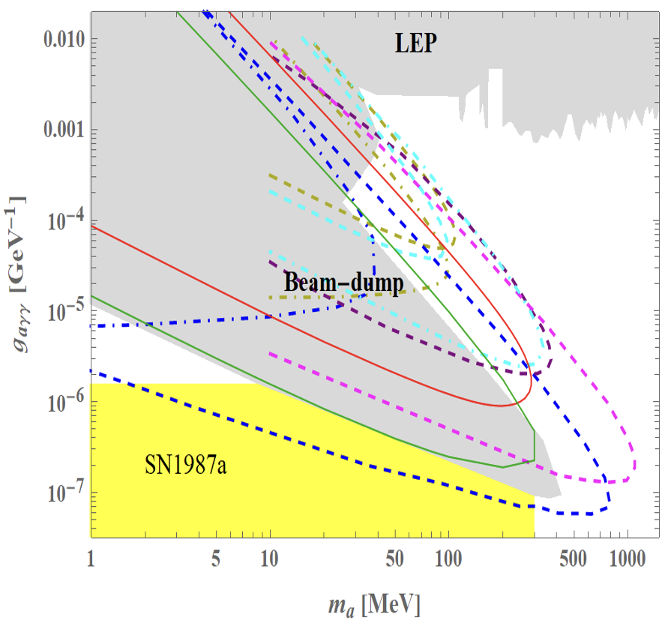
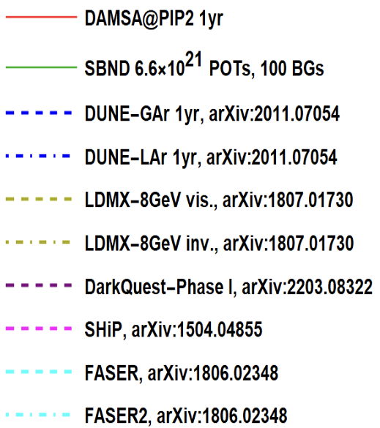
DAMSA Sensitivity – All Experiments

Slide 32
Physics Driven DAMSA Detector
Based on the physics studies using GEANT4 and neutron background mitigation ➔ The detector must have
  Fine granularity for a superb shower position and angular resolutions for two photon vertex pointing & DCA precision better than 1cm in the vacuum decay volume
  Fast timing capability at sub-ns level (100ps or better) for two photon arrival time differences
  Capability of measuring up to 500 MeV photons with as fine a mass resolution as accomplishable

Slide 33
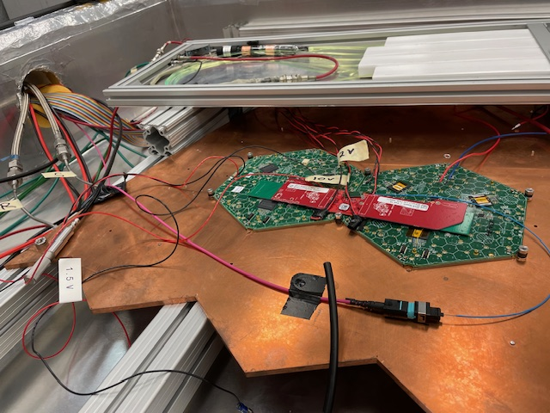
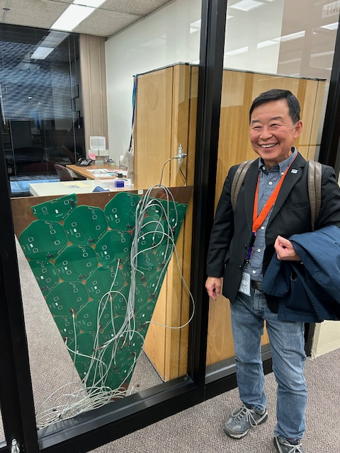
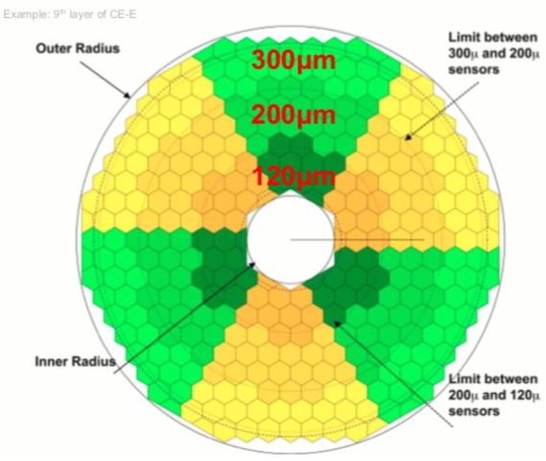
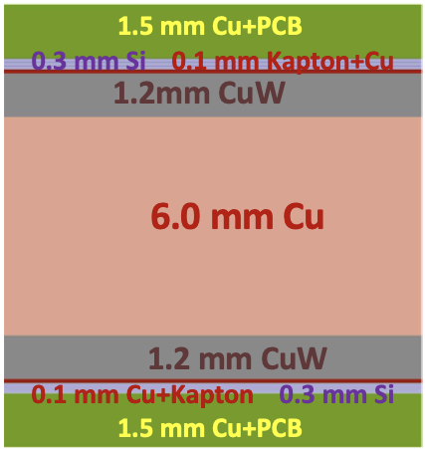
Potential DAMSA Baseline Detector
CMS Style W-Si calorimeter
  Detector development is complete
    Detailed supporting studies completed as well
  Component construction to be completed in the next two years for CMS
DAMSA EM calorimeter constructed out of 30 layers of 2.2mx2.2m dimension ➔ Geometry and sampling ratio optimization studies in progress
All infrastructure already constructed and being used for CMS ➔ to be fully refined in 2026 – 2027 time scale
Nov. 10, 2023
DAMSA @ PIP-II Jaehoon Yu
33

Slide 34
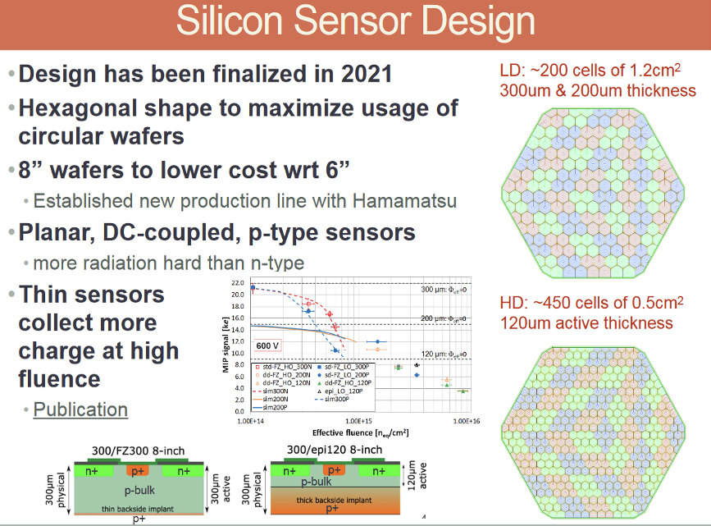
Zoltan Giesce

Slide 35
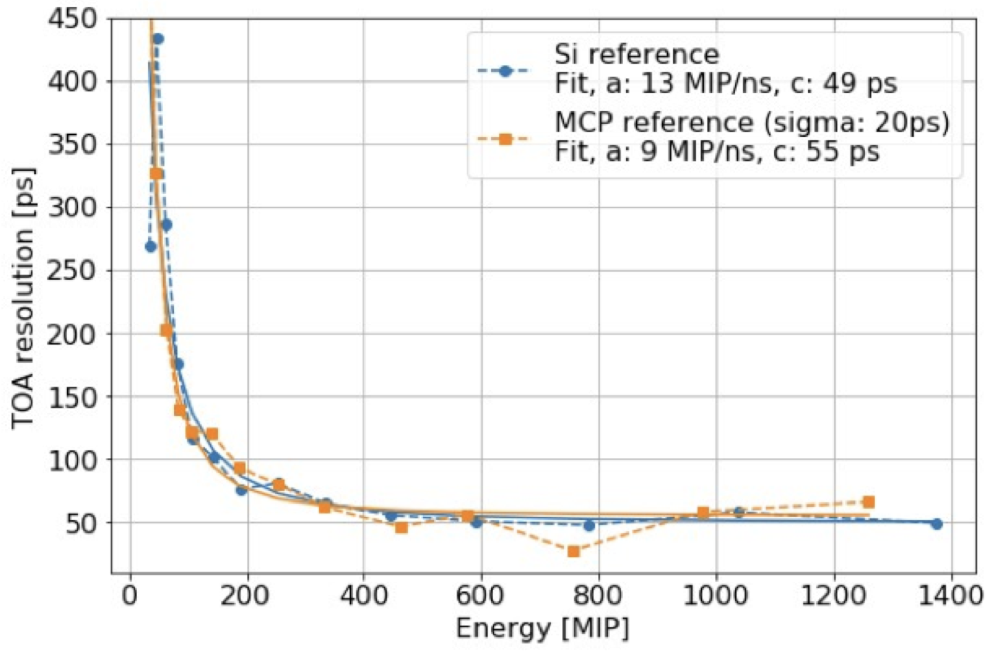
HGCAL Performances
Timing resolution : 30ps @ P_{T}>5GeV
JINST 15 C07003 (2020)

Slide 36
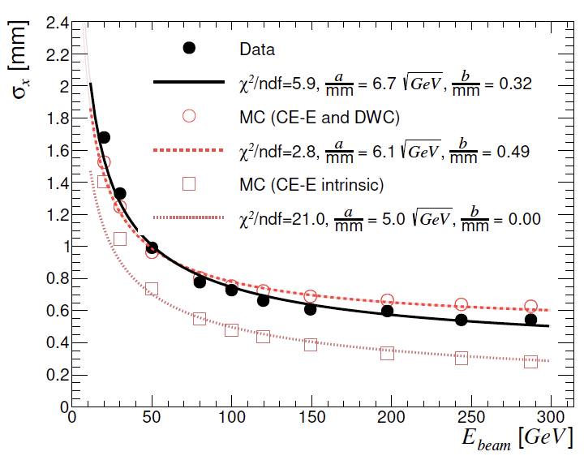
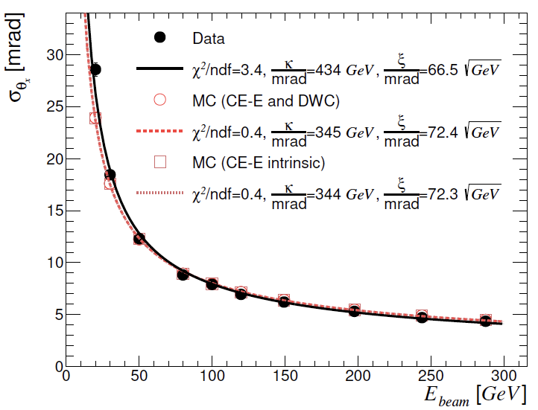
Shower axis position & angular resolution
3.3mm @ E_{e}=5GeV & 117mrad @ E_{e}=5GeV
JINST 17 P05022 (2022)

Slide 37
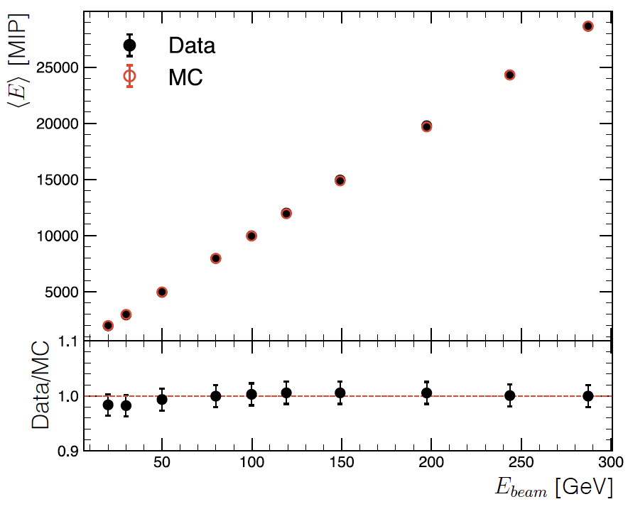
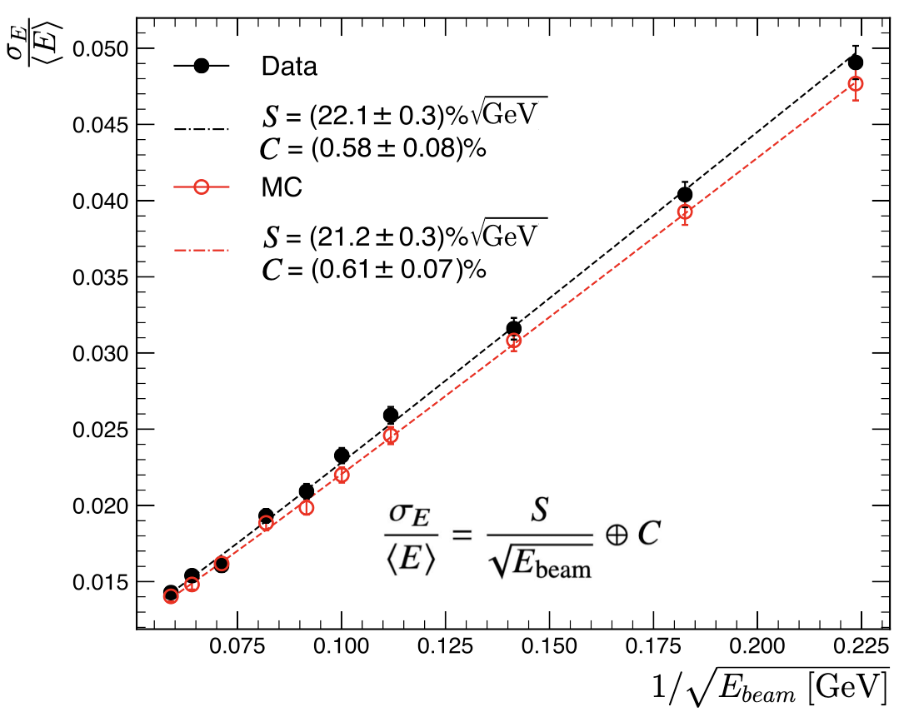
HGCAL Performances – E measurements
Energy resolution: 50%@E_{e}=5GeV
JINST 17 P05022 (2022)

Slide 38
Ongoing Studies
Detector geometry optimization
Dump design optimization to meet the safety requirements, while keeping the distance from the source to the detector @ 1m and high Z
Understanding neutron background impacts
  Optimal beam timing structure thru the chopping feature and the impact of it to the neutron flux
  Neutrons from the surrounding shielding materials, such as concrete walls
Other physics topics to be probed with DAMSA
  Promising results on dark photon to e⁺e⁻ final states

Slide 39
DAMSA Experiment Timeline
Overarching strategic goal: Get the detector ready to take data in time for PIP-II LINAC completion in 2029
Mid Dec. 2023 : Prepare & submit an LOI to Fermilab PAC
  Both the beam dump facility and the day 1 detector, DAMSA
Jan. 2024: Present the LOI to Fermilab PAC
2024 – 2025/2026: detector design, prototyping, experiment establishment and securing funds
2025/2026 – 2028: experiment construction
  Essential for Fermilab beam dump facility to be completed
    White paper on PIP-II BD opportunity to be released soon
2029: Complete the detector construction and start commissioning for data taking

Slide 40
DAMSA Activities Timeline
Project establish, Det. Design & prototyping
Experiment Construction
PAC LOI, CDR & TDR
Tech. Publications
Sim, analysis, recon. software development,
Tech. publications
Commissioning & Data taking
Seed funds for design studies
Data analysis & Tech & Phys. publications
Exp. construction funds
Exp. Ops. Funds
Yr 0 2024
Yr 1 2025
Yr 2 2026
Yr 3 2027
Yr 4 2028
Yr 5 2029
Yr 6 2030
Yr 7 2031

Slide 41
Fermilab Experimental Facility
Proposed Name: F2D2
  Fermilab Facility for Dark matter Discovery
Requirements
  Basic assumption : >=4 experiments operate simultaneously (2 on-axis and 2 off-axis)
  Sufficient footprint per experiment
  Sufficient height of the hall w/ a large capacity crane coverage
  Sufficient overburden (>=40.m.w.e.)

Slide 42
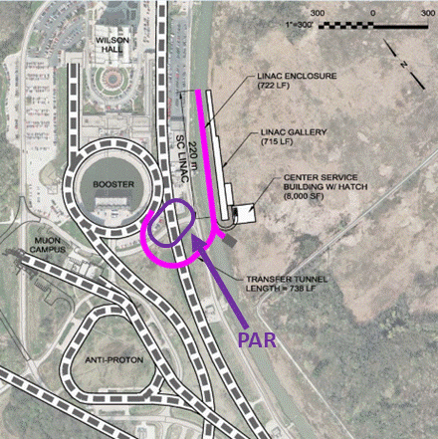
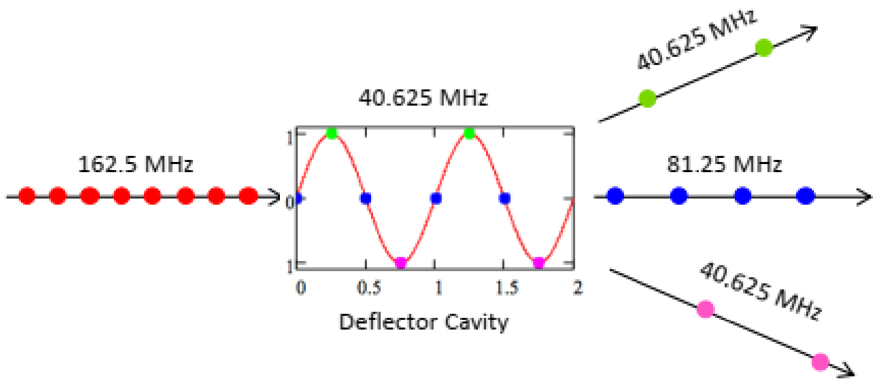
PIP-II Siting Enables Further Expansion
Magnetic switching elements and RF splitters can divide beam.
Real estate in TeV field allows for a variety of rings and lines, shapes and sizes.
TeV Field
Mu2e-II
Linac Extension
LINAC Extension @2GeV
J. Eldred

Slide 43
DAMSA Collaboration Building
DAMSA has been introduced to the community throughout the past 2.5 years, more intensely in 2023
  Concept included in a few Snowmass2021 white papers
  Physics case study published on PRD (Jan. 2023)
  Multiple presentations made at conferences, workshops and seminars in the U.S., SK and CERN LLP conf. in 2023
    Presented at a couple of P5 townhall meetings
  Introduced to Fermilab leadership April, May, Aug & Sept. 23
Lead Investigators: J. Yu (UTA) & J. Estrada (FNAL)
Institutions expressed interests thus far:
    US (8): UTA, FNAL, OU, TAMU, UCR, UCI, CSU and SDSMT
    SK (8): SNU, UoS, KNU-CHEP, Korea U., KyungHee U., Korea U. – Chochiwon campus, CNU, CBU
    Strongly encourage European colleagues to join in

Slide 44
Conclusions
DAMSA is a DSP search and discovery experiment that aims to be ready for beam on day 1 of FNAL PIP-II era
DAMSA has been making serious progress to meet the goal of being ready for PIP-II LINAC beam in 2029
DAMSA collaboration building ongoing
Detailed GEANT studies have been performed for detector requirements ➔ Optimization in progress
DAMSA presents an excellent opportunity for the community to turn Fermilab’s new accelerator facility to a DSP search and discovery facility

Slide 45
Parting Questions
Is the CMS style HGCAL detector sufficient to meet the physics goals? Are there others?
  Impact of the beam radiations to the detectors?
  Various performance requirements for low E γ?
What other physic topics can we do with the DAMSA experiment configuration?
  Is there a SM measurement DAMSA can contribute?
What modifications to the DAMSA experimental configuration could dramatically expand the physics reach? – B field? μ-detector?

Slide 46
Interested in joining DAMSA?
Contact
Jae Yu (jaehoonyu@uta.edu)
or
Juan Estrada (estrada@fnal.gov)

Slide 47
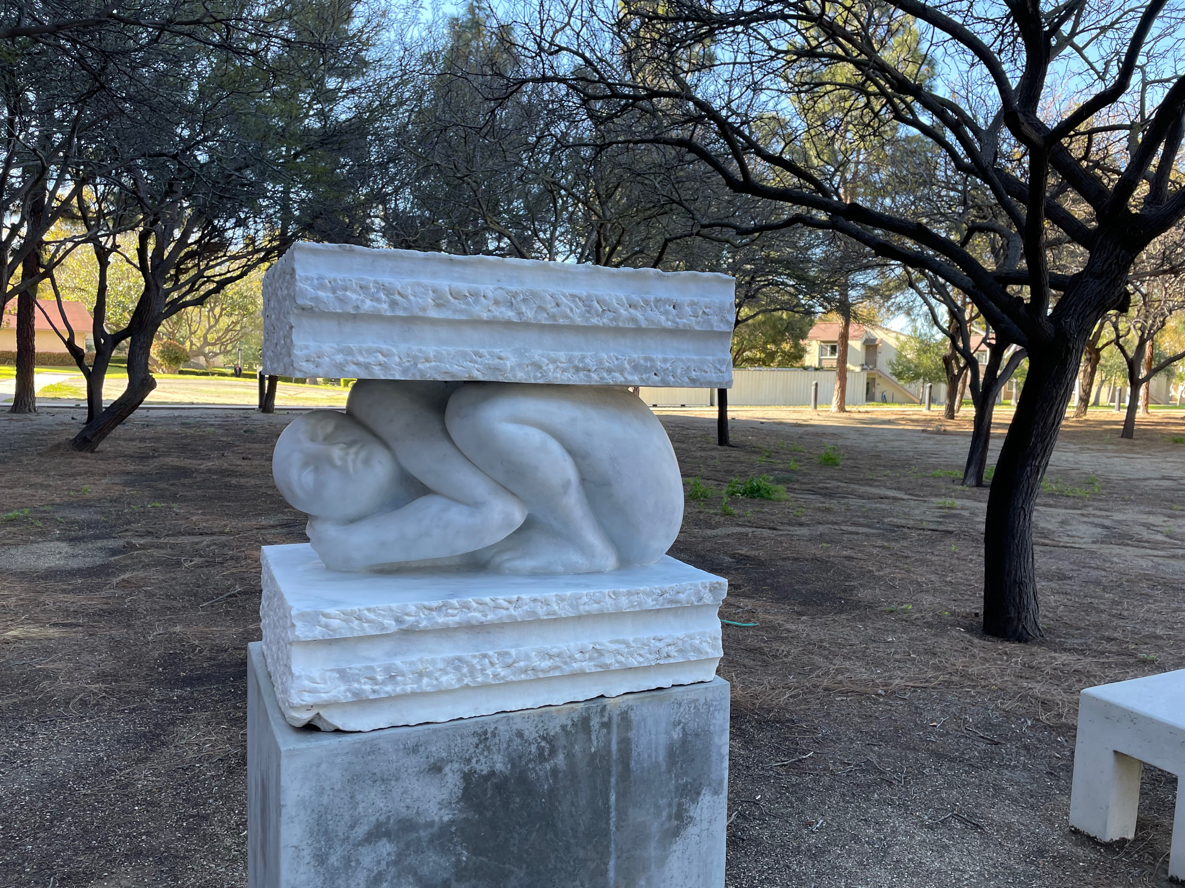
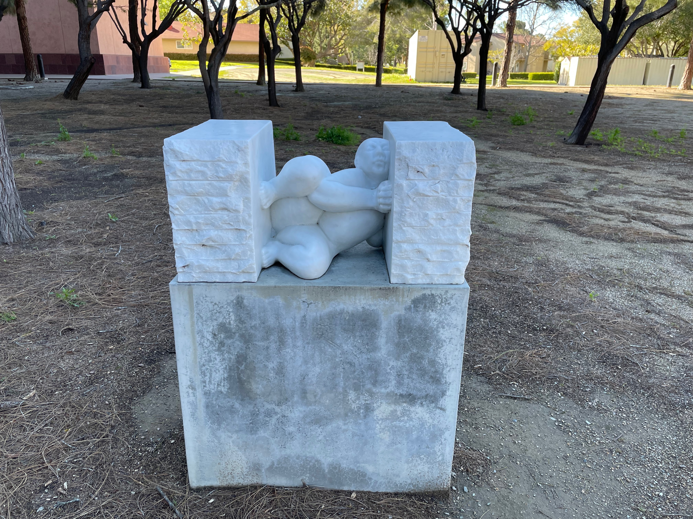
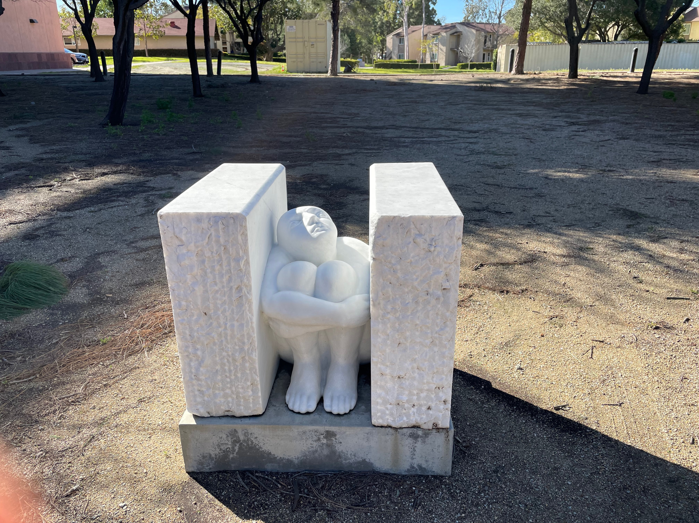
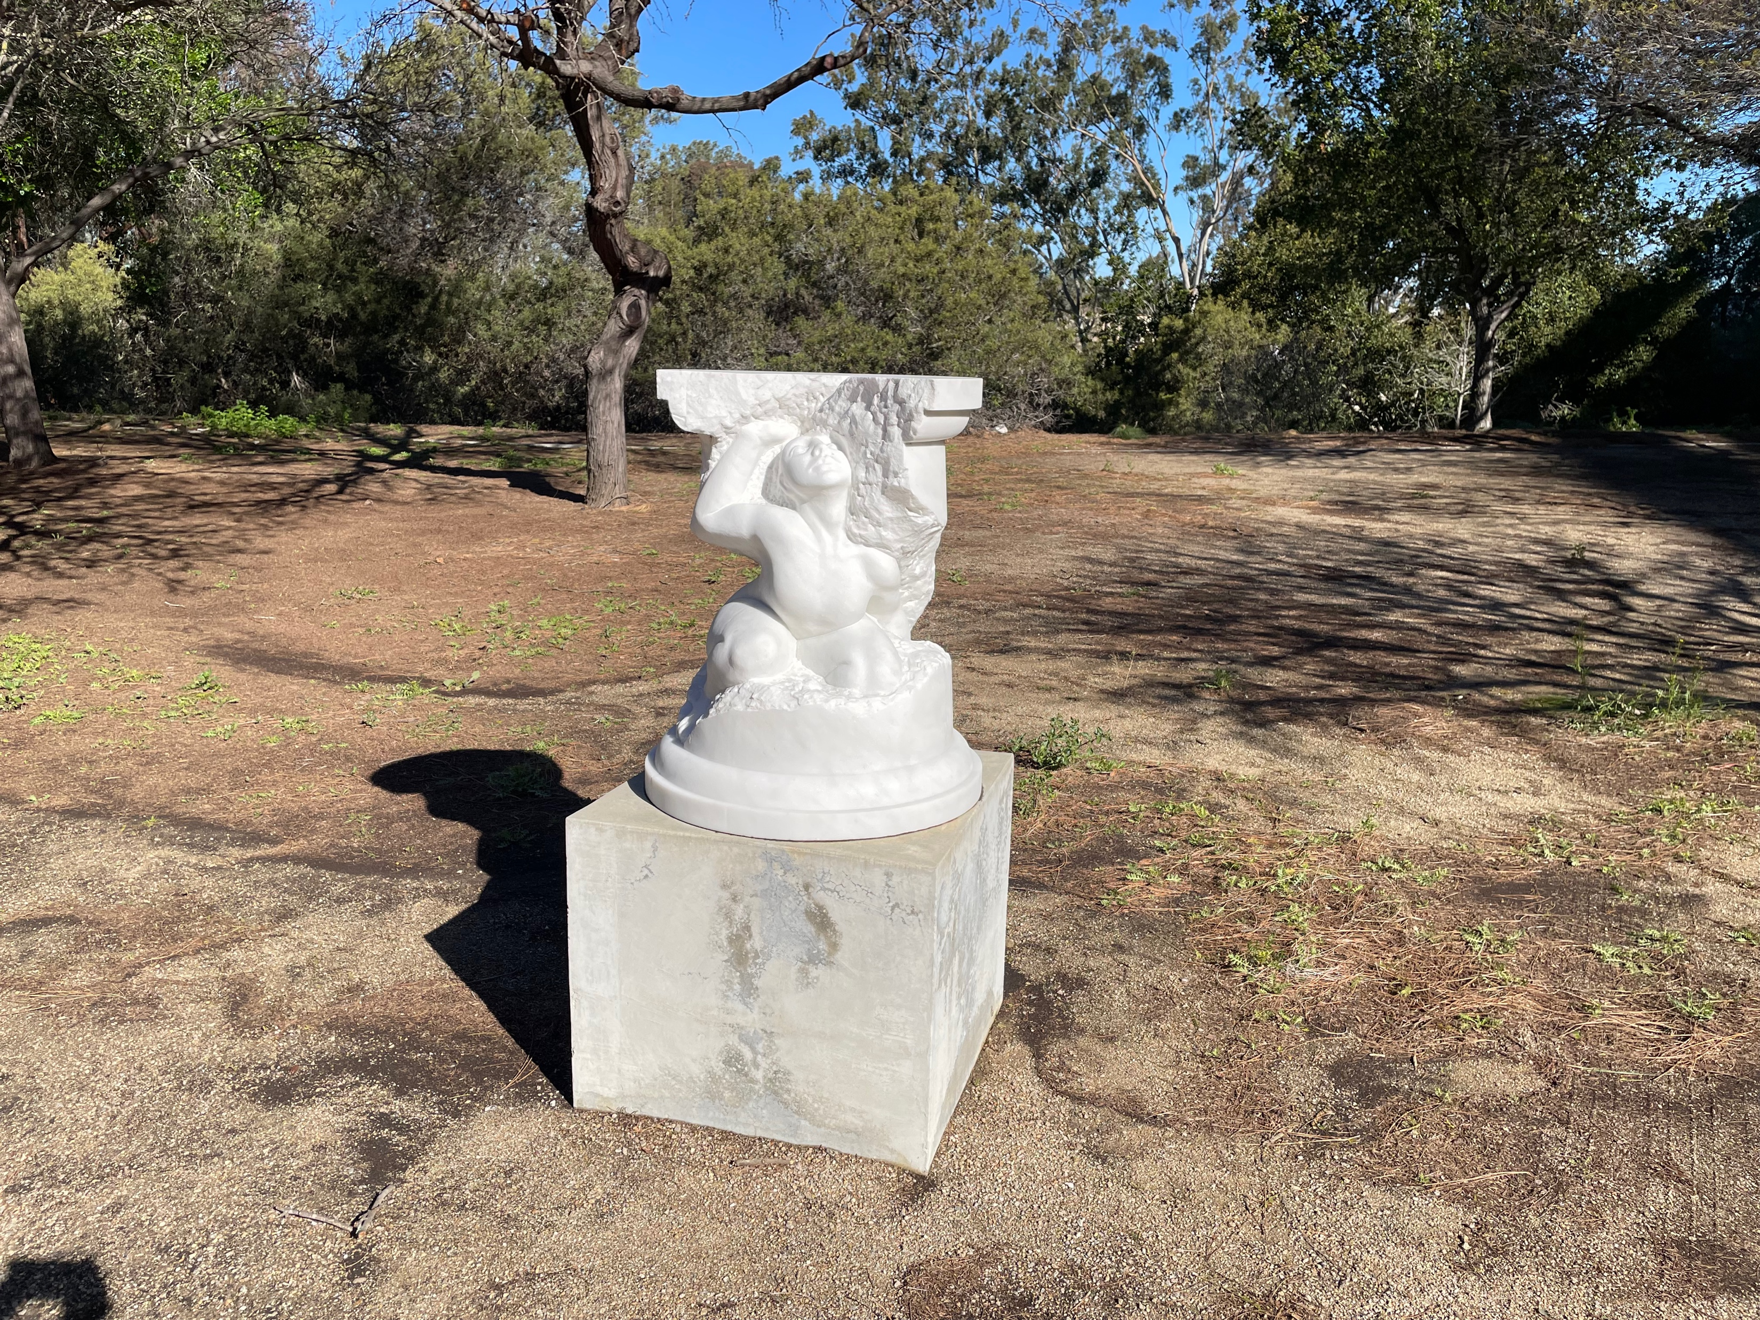


Slide 48
Take Home Messages
Time for the community to look for
dark matter in the beams
Accelerator facilities must leverage
their capabilities fullest
We must search wide, aim high,
and delve deep!!

Slide 49
Back Up

Slide 50
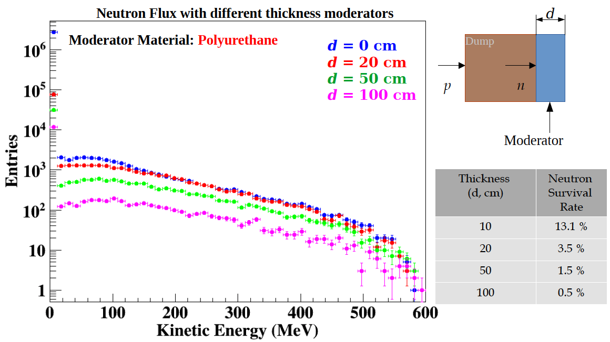
DAMSA Requirements – The absorber
Must reduce the number of n out the dump
What material at what depth optimal for neutron absorption?
GEANT4 based study shows the polyeuthrane provide most cost-effective solution for neutron moderation

Slide 51
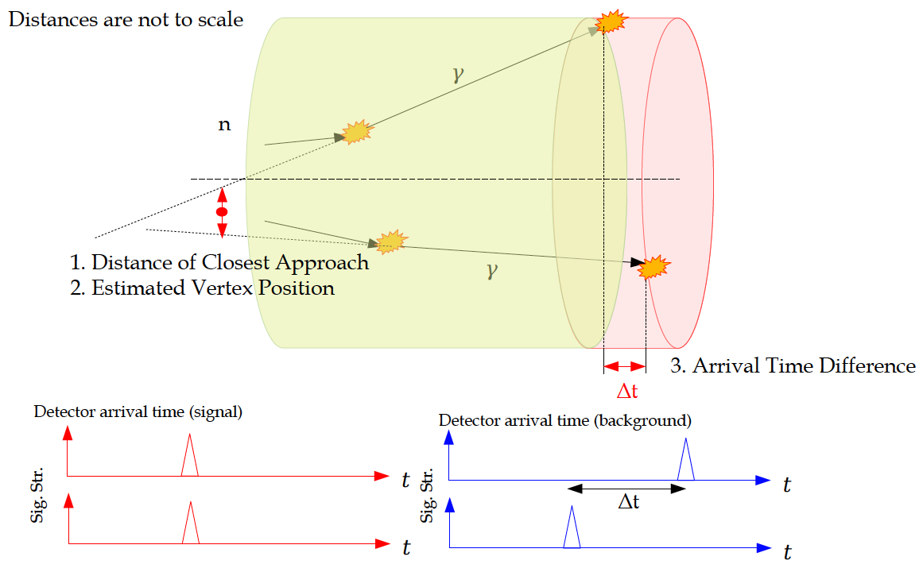
DAMSA Requirements – The Detector 2

Slide 52

DAMSA Detector – The γ Arrival Time
Δt_{γγ}<0.1ns ➔ ~10⁻² remain

Slide 53

DAMSA Detector – DCA
Distance of closest approach (DCA) computed the distance at the closest approaching point of the traces of all photon combinations
Optimal
DCA<1cm ➔ 2.9x10⁻² remain

Slide 54
DAMSA Detector – Invariant Mass
Optimize the selection based on the interested mass range
Could obtain an additional reduction factor of 10⁻³ depending on mass range
ΔM_{inv} = 1MeV/c²
ΔM_{Inv} (MeV/c²)

