Slide 1
AFT - Update of Fault Recording Guidelines
Definition of Fault Duration
Lukas Felsberger
Many thanks to inputs from Anti Asko, Michi Hostettler, David Nisbet, Jan Uythoven

Slide 2
Motivation
As part of automatic fault recording guidelines, the question of a clear definition of failure durations came up
Fault Recording Guidelines should provide reference - https://edms.cern.ch/document/2720138/1
„Fault Duration: indicate the start and end times of the fault e.g. from the moment of a beam dump/stop due to a fault to the end of the expert intervention of the involved system “
In principle clear as long as there is an expert involved in the intervention. What if not?
→ Need for a clearer definition!

Slide 3
How actually handled in previous years?
Proton injectors:
  Faults are often ‚fixed‘ without expert intervention
  Recovery time of beam is short
  → faults mainly recorded from loss of beam until recovery of beam
LHC
  Beam dumps following losses (e.g. UFO) are instantaneous (1 sec) but the recovery is governed by the machine turnaround time
  → used to be recorded as 1 sec faults but got increasingly registered from beam loss until injection probe beam is back

Slide 4
How should it be recorded?
One of the added values of AFT is that it allows to determine the operational impact of a fault.
„Fault when accelerator in state X – fault impact until machine back in state X“
Hence, we should differentate whether there was beam at the time of the fault:
Faults with beam are registered from the beam dump until (injection probe) beam or until the next fault without beam starts
  End of equipment intervention can be manually registered by the ‘System Expert Ended’ state for information. Still the downtime will be counted until beam is back
  → Unusually long recovery after expert intervention → log separate fault
Faults without beam are registered from when they block operations until they stop blocking operations
→ Fault recording guidelines will be updated accordingly!

Slide 5
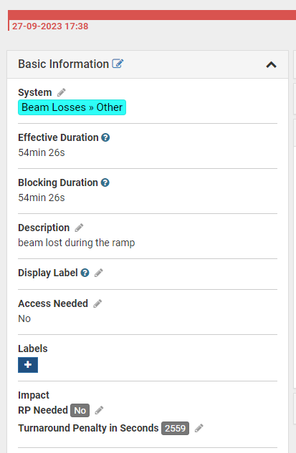
LHC case
Faults with beam counted until INJ PROBE beam back
It takes a significant time to go back to e.g. stable beams from INJ PROBE
Additional delay counted by turnaround penalty
Calculation defined for each phase of LHC cycle
  Table at the end of presentation
Additional reporting metric

Slide 6
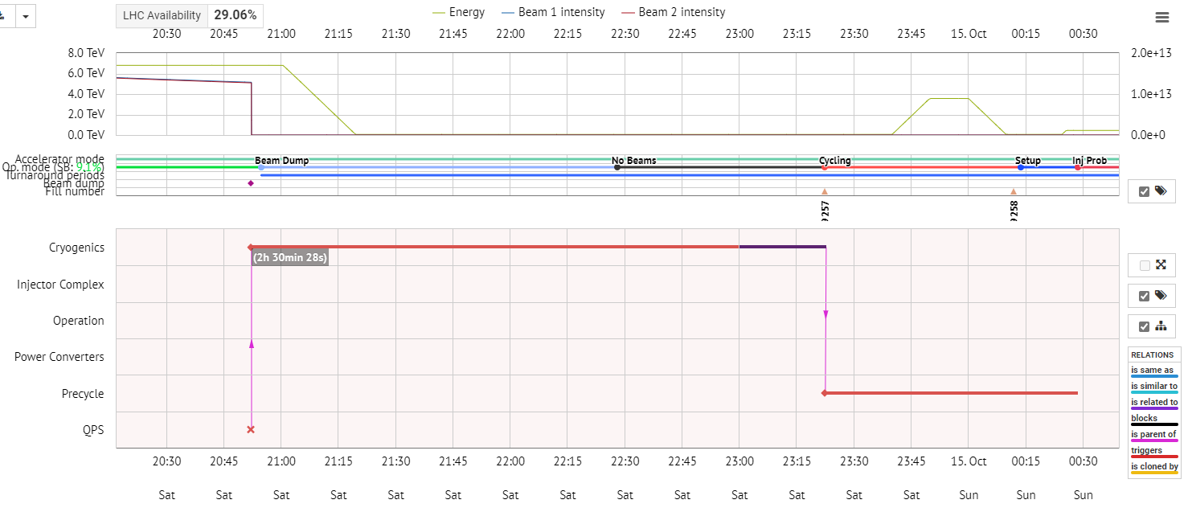
How does it look in practice?

Slide 7
Summary & Outlook
Fault recording guidelines will be updated for clearer definition of fault duration
Other clarifications of fault recording guidelines under discussion (e.g. how to capture recovery of multiple systems) and will be prepared during YETS
Updated version will be communicated in RAWG and ready ahead of 2024 run

Slide 8
LHC Turnaround Penalty Definition
Beam mode(s) | Rule to be applied | Comment
SETUP, ABORT, INJECTION PROBE BEAM, INJECTION SETUP BEAM | No penalty
INJECTION PHYSICS BEAM | Min(25 minutes, Time in mode)
PREPARE RAMP | 25 minutes | Time from INJ PROBE to RAMP
RAMP | 25 minutes + Min(25 minutes, Time in mode) | Time from INJ PROBE to RAMP + time in RAMP
FLAT TOP, SQUEEZE, ADJUST | 50 minutes | Time to ramp + time to go back from inj probe to ramp
STABLE BEAMS, UNSTABLE BEAMS, BEAM DUMP WARNING | Max[0, T_ta*(T_sb,opt- T_sb)/T_sb,opt – T_di] | Penalty calculated based on linear interpolation between actual and optimal fill length. Fault at the beginning of stable beams gets 1h15min penalty, whereas fault at or after 12 h of stable beams gets 0 h penalty. Faults between get linearly interpolated values. No negative penalty for faults after 12 h (to account that they normally would not happen) because beam stays in machine longer for a reason (typically injector problem, which should be logged separately so that it removes penalty from system dumping beam) Examples: 36 hrs stable beams with three fills without faults would take 42 hours and gets 0 hours penalty 36 hrs stable beams with six fills, all cut short by 1 hr faults after 6 hrs in stable beams, take 54 hrs and get 6 hrs penalty (equals the 6+6 hrs time loss in comparison to being able to do it in three fills)
RAMP DOWN | No penalty
NO_BEAM, INJECT AND DUMP, CIRCULAE AND DUMP | No penalty

Slide 9
LHC Turnaround Penalty Definition
T_ta: Reference time for beam dump in stable beams back to stable beams (turnaround) (~2 h)
T_di: Reference time between beam dump and start of injection probe beam if no faults delay recovery (e.g. after programmed dump) (~0.75 h)
T_sb, opt: Optimal fill length/time spent in stable beams before it gets more economical to dump the beam and re-fill the machine (~12 h)
T_sb: Time spent in stable beams at dump
T_r: Reference time for RAMP (~ 25 mins)

