Slide 1
Proposal of a new configuration for PB
M. Giovannozzi

Slide 2

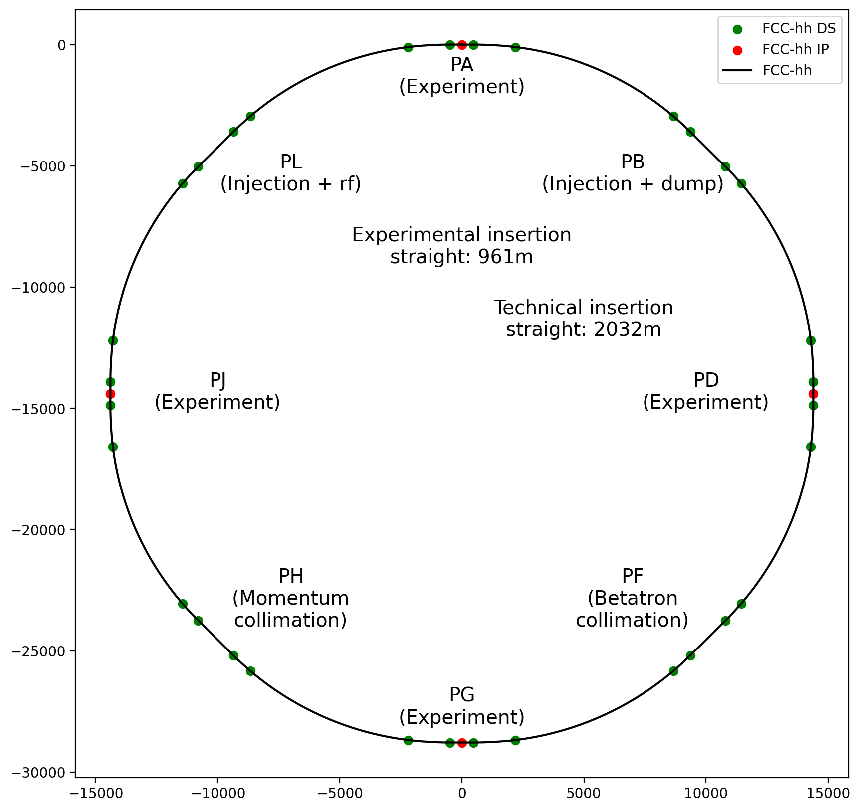
Current layout of the FCC-hh ring
IPA, IPD, IPG, IPJ: experimental insertions
Two collimation insertions
  IPF: betatron cleaning
  IPH: momentum cleaning
IPB: extraction (both beams) + injection (clockwise, external aperture)
IPL: RF (both beams) + injection (counter-clockwise, external aperture)
Last part of transfer lines in the ring tunnel
Compatible with LHC or a superconducting SPS as injector
Circumference: 90.66 km

Slide 3
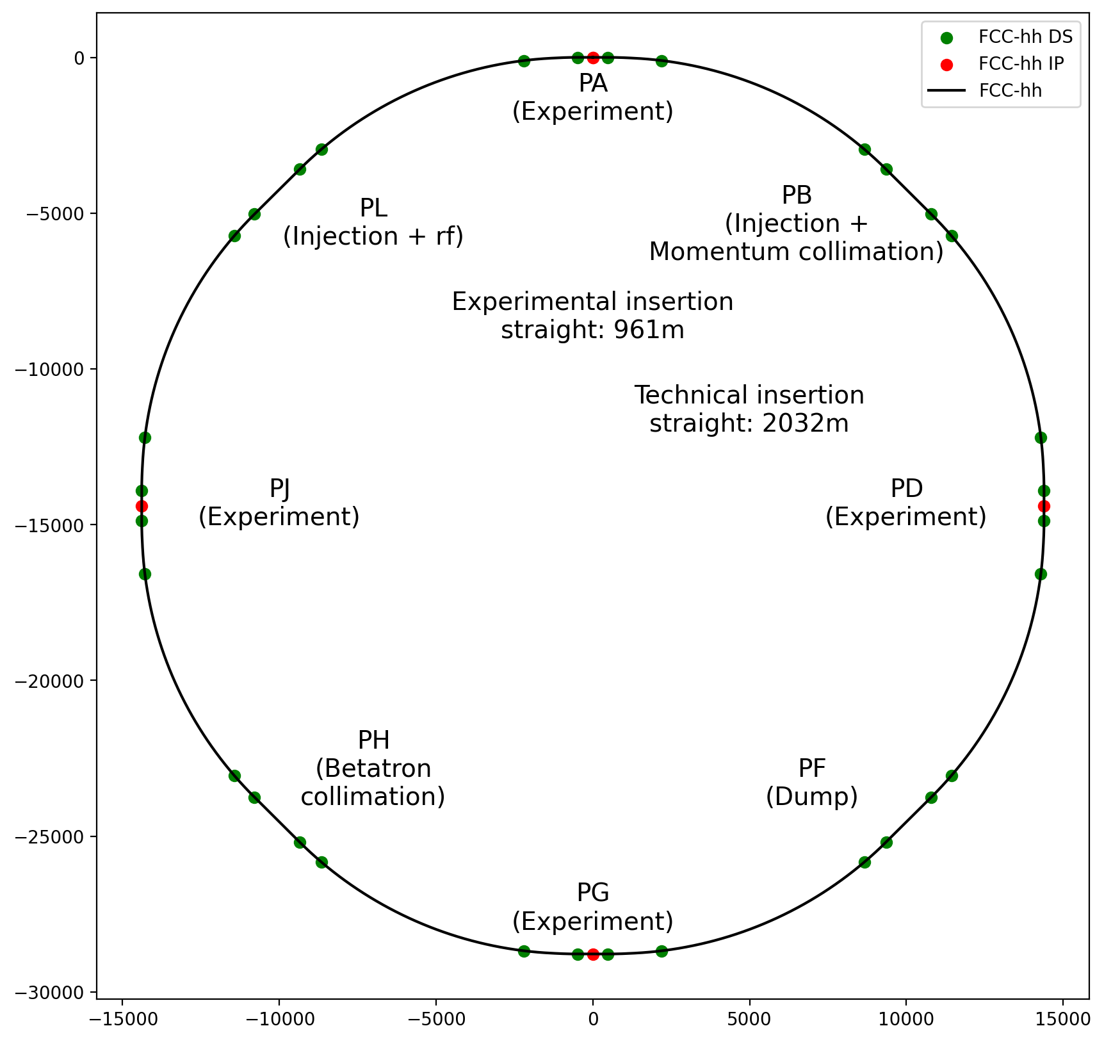
Alternatives to solve machine protection challenges
A different arrangement of insertions would solve the machine protection challenges
Two collimation insertions
  IPH: betatron cleaning
  IPB: momentum cleaning combined with injection
  (clockwise, external aperture)
IPF: extraction (both beams)
IPL: RF (both beams) + injection (counter-clockwise, external aperture)
In principle, one could also consider merging betatron and momentum collimation, but this
seems really challenging in terms of optics design.

Slide 4
Layout of the FCC-hh ring as of CDR
The CDR layout
Two high-luminosity experiments (A & G)
Two other experiments combined with injection (L & B)
Two collimation insertions
  betatron cleaning (J)
  momentum cleaning (F)
Extraction insertion (D)
Clean insertion with RF (H)
Compatible with LHC or a superconducting SPS as injector
The momentum cleaning insertion was located in a short straight section, 1.4 km long.
Circumference: 97.75 km

Slide 5

Possible layout of PB
Moving along the clockwise beam:
  Injection section (inspired by PL, but optimised in length)
  Transition region
  Momentum collimation section
Functions of the transition region
  Create optical conditions for the downstream momentum collimation
  Create a separation between the two sections to shield the kickers
Goals of this meeting
  Agree on the principle of this new layout.
  Discuss on provide guidance to design the transition region for the shielding aspects.

Slide 6
Thank you for your attention!

