Slide 1
Depolarizer Considerations
Ivan Koop and Alexei Otboev
BINP, 630090 Novosibirsk
EPOL meeting by Zoom
16.11.2023

Slide 2
Outline
Three different tasks for a depolarizer:
a) RDP of pilot polarized bunches
b) Fast spin rotation for Free Spin Precession frequency measurement
c) Continuous colliding bunches depolarization
(to keep the longitudinal component of the polarization below P_long < 10⁻⁵ )
Local bump spin rotator comprised of two identical transverse AC-field kickers
Harmonic strength evaluations at Z and at W beam energies
Discussion of results

Slide 3
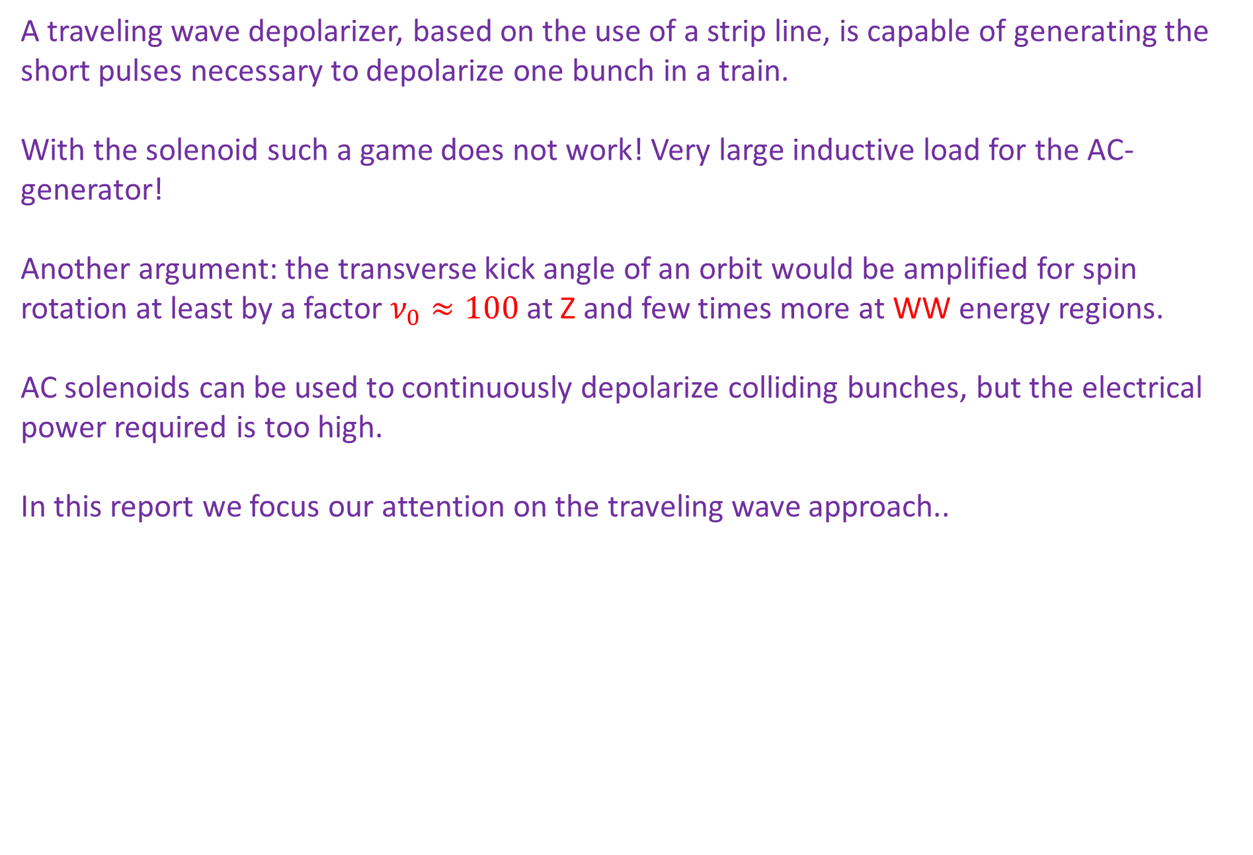
Why traveling wave depolarizer, but not AC-solenoid?
A traveling wave depolarizer, based on the use of a strip line, is capable of generating the short pulses necessary to depolarize one bunch in a train.
With the solenoid such a game does not work! Very large inductive load for the AC-generator!
Another argument: the transverse kick angle of an orbit would be amplified for spin rotation at least by a factor $ν_{0}≈100$ at Z and few times more at WW energy regions.
AC solenoids can be used to continuously depolarize colliding bunches, but the electrical power required is too high.
In this report we focus our attention on the traveling wave approach..

Slide 4
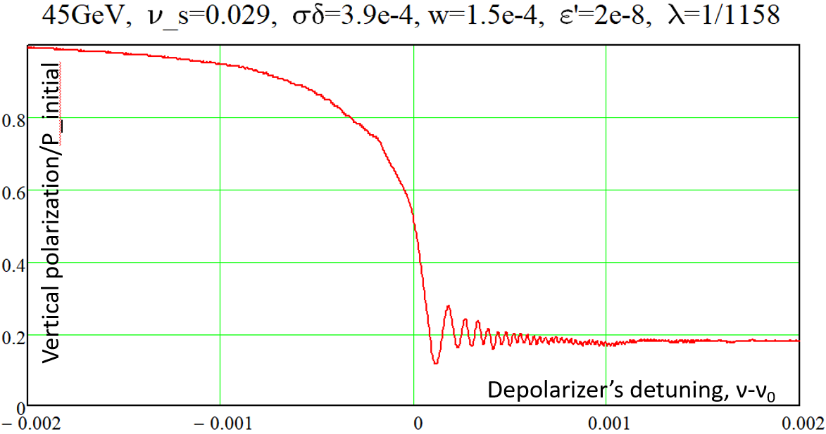
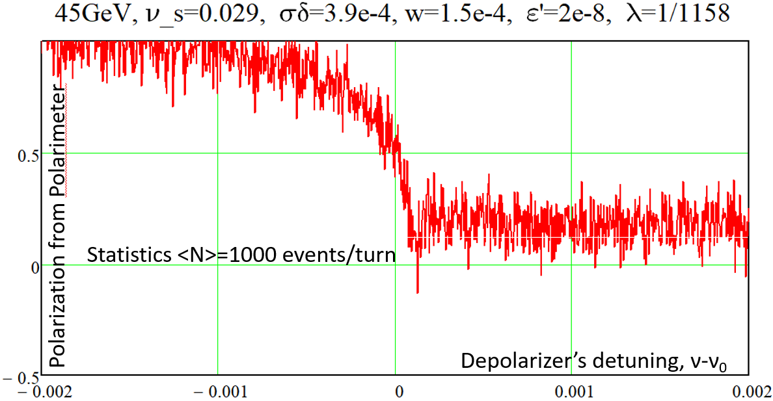
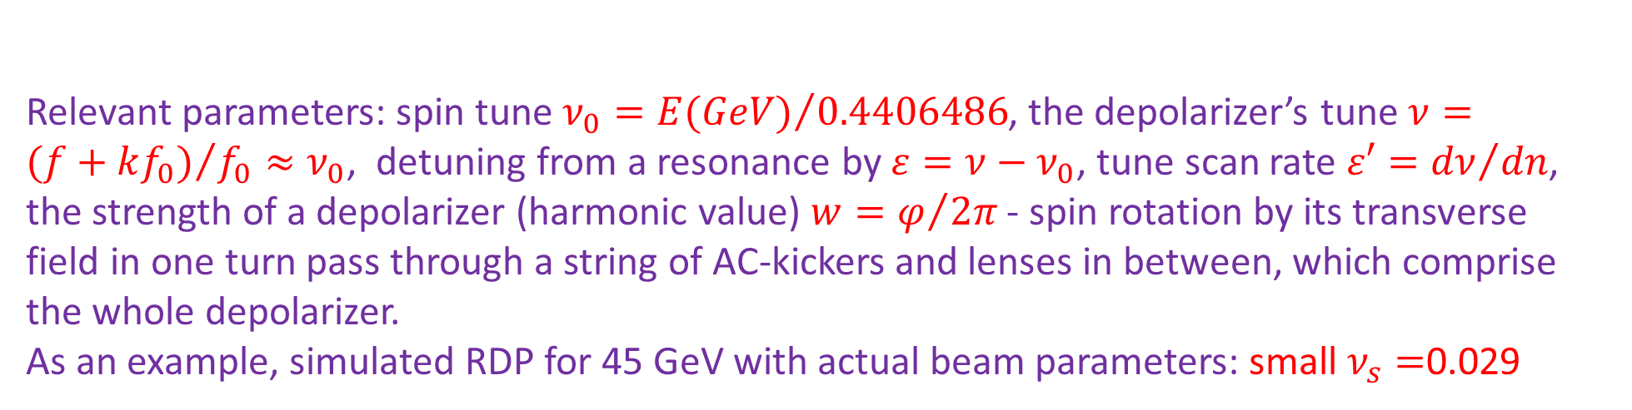
Baseline scenario for RDP: slow frequency scan.
Relevant parameters: spin tune $ν_{0}={E(GeV)}/{0.4406486}$, the depolarizer’s tune $ν={(f+kf_{0})}/{f_{0}≈ν_{0}}$, detuning from a resonance by $ε=ν−ν_{0}$, tune scan rate $ε′={dν}/{dn}$, the strength of a depolarizer (harmonic value) $w=φ/{2π}$ - spin rotation by its transverse field in one turn pass through a string of AC-kickers and lenses in between, which comprise the whole depolarizer.
As an example, simulated RDP for 45 GeV with actual beam parameters: small $ν_{s}=$0.029
The right plot shows how the statistical noise, which comes from the limited polarimeter’s counting rate, smears the depolarization jump.

Slide 5
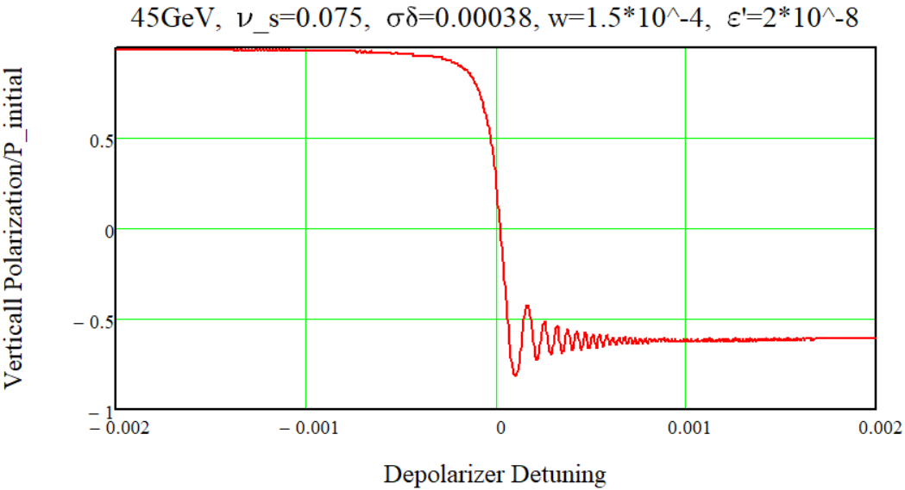
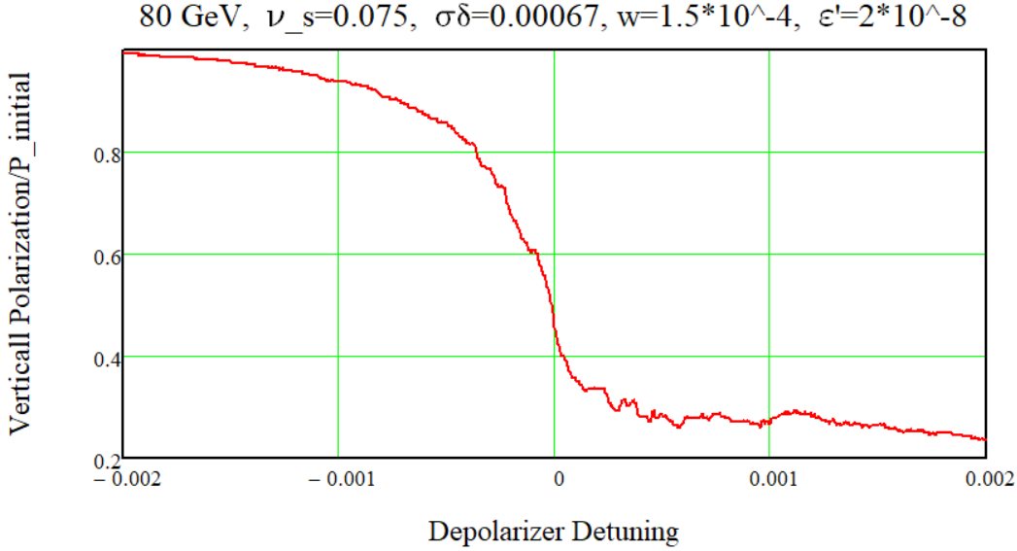
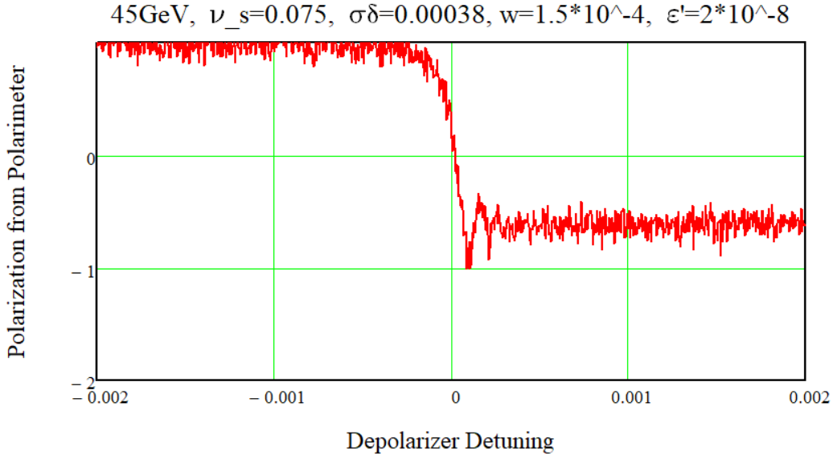
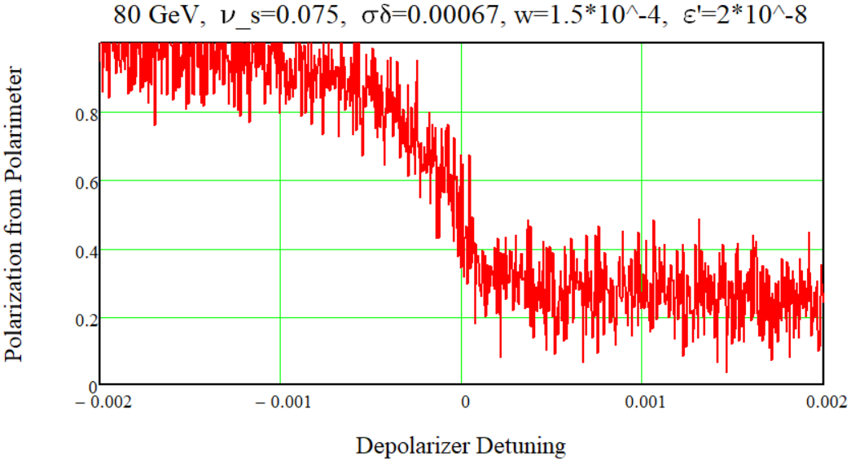
RDP frequency sweeps with the increased ν_s=0.075
60 s
Average ICS-polarimeter rate 1000 events/turn

Slide 6
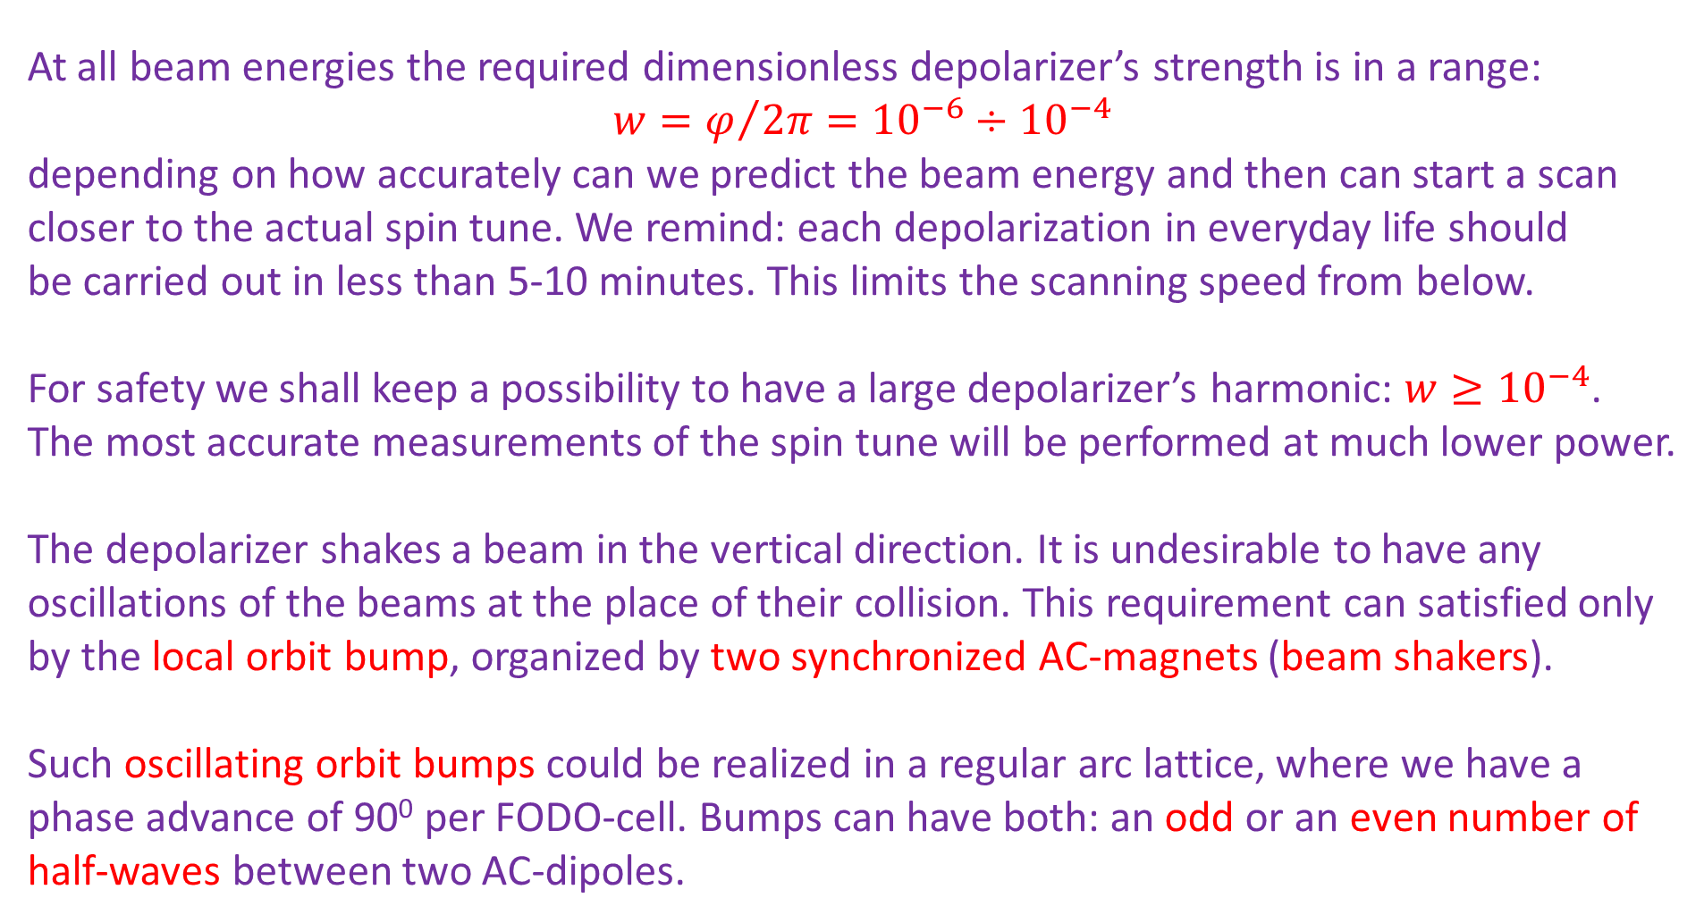
Regular RDP procedure: the required depolarizer’s strength
At all beam energies the required dimensionless depolarizer’s strength is in a range:
$w=φ/{2π={10}^{−6}÷{10}^{−4}}$
depending on how accurately can we predict the beam energy and then can start a scan closer to the actual spin tune. We remind: each depolarization in everyday life should
be carried out in less than 5-10 minutes. This limits the scanning speed from below.
For safety we shall keep a possibility to have a large depolarizer’s harmonic: $w≥{10}^{−4}$.
The most accurate measurements of the spin tune will be performed at much lower power.
The depolarizer shakes a beam in the vertical direction. It is undesirable to have any oscillations of the beams at the place of their collision. This requirement can satisfied only by the local orbit bump, organized by two synchronized AC-magnets (beam shakers).
Such oscillating orbit bumps could be realized in a regular arc lattice, where we have a phase advance of 90⁰ per FODO-cell. Bumps can have both: an odd or an even number of half-waves between two AC-dipoles.

Slide 7
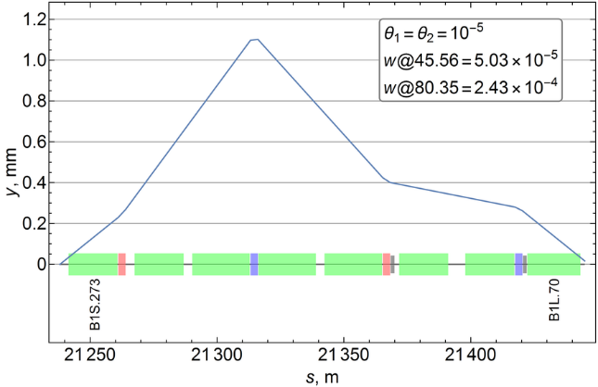
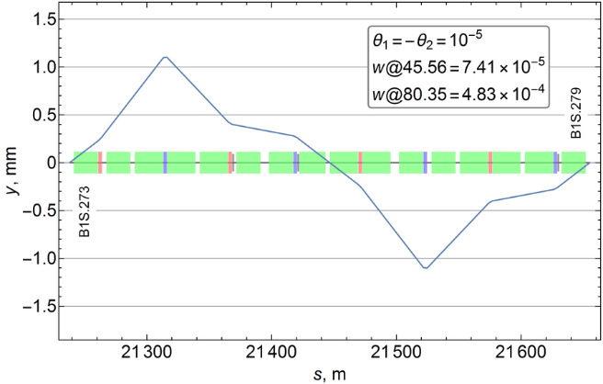
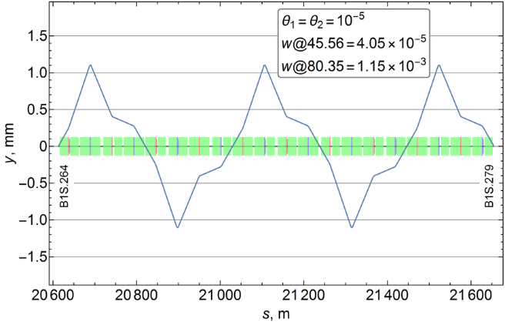
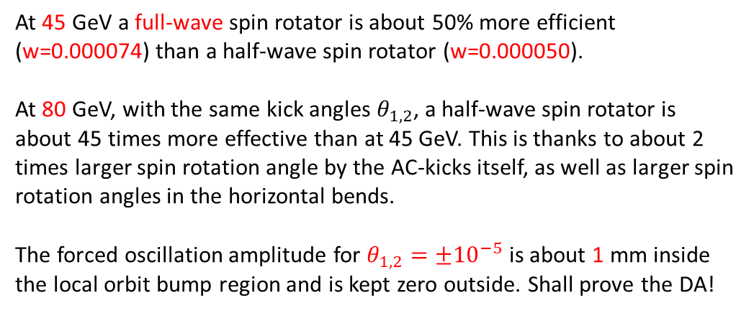
Local vertical orbit bumps (spin rotators) in FCC-ee arc
At 45 GeV a full-wave spin rotator is about 50% more efficient (w=0.000074) than a half-wave spin rotator (w=0.000050).
At 80 GeV, with the same kick angles $θ_{1,2}$, a half-wave spin rotator is about 45 times more effective than at 45 GeV. This is thanks to about 2 times larger spin rotation angle by the AC-kicks itself, as well as larger spin rotation angles in the horizontal bends.
The forced oscillation amplitude for $θ_{1,2}=±{10}^{−5}$ is about 1 mm inside the local orbit bump region and is kept zero outside. Shall prove the DA!

Slide 8
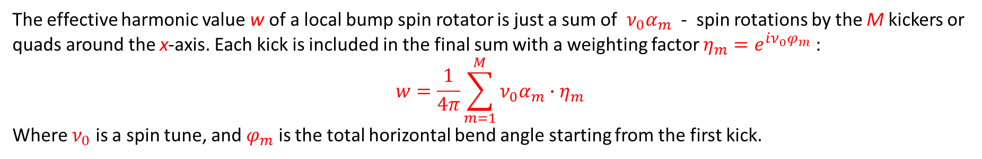
Algorithm to calculate w for the local vertical orbit bumps
The effective harmonic value w of a local bump spin rotator is just a sum of ${ν_{0}α}_{m}$ - spin rotations by the M kickers or quads around the x-axis. Each kick is included in the final sum with a weighting factor $η_{m}=e^{iν_{0}φ_{m}}$ :
$$w=\frac{1}{4π}\sum_{m=1}^{M}{{{ν_{0}α}_{m}∙η}_{m}}$$
Where $ν_{0}$ is a spin tune, and $φ_{m}$ is the total horizontal bend angle starting from the first kick.

Slide 9
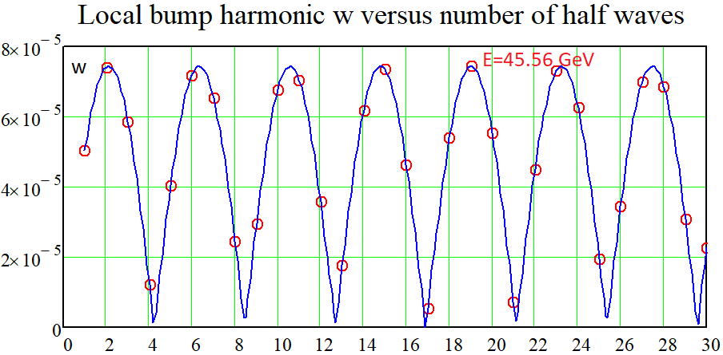
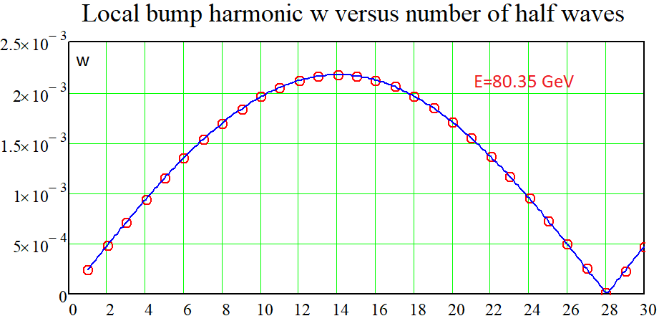
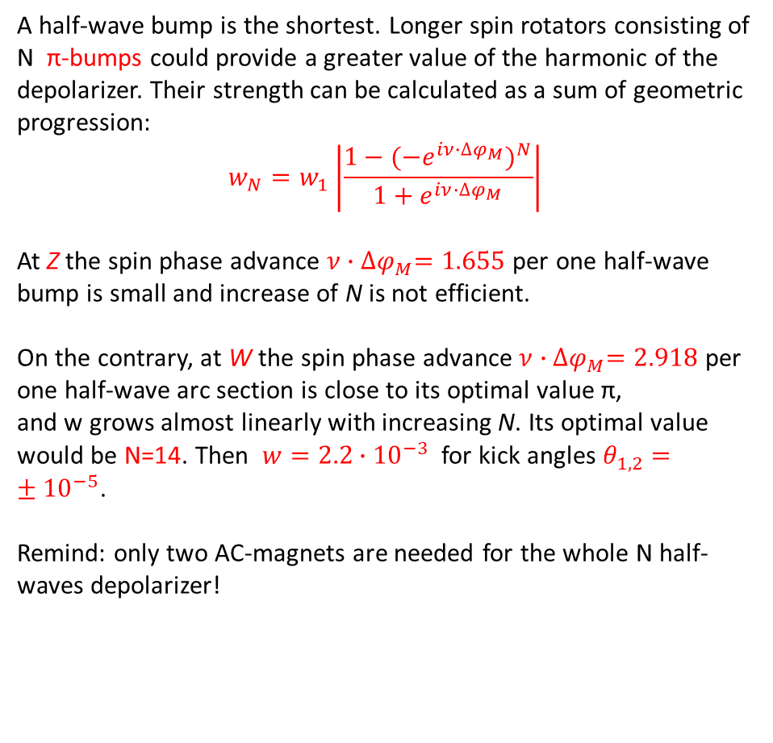
Harmonic value at Z and at W versus the number of half waves
A half-wave bump is the shortest. Longer spin rotators consisting of N π-bumps could provide a greater value of the harmonic of the depolarizer. Their strength can be calculated as a sum of geometric progression:
$$w_{N}=w_{1}\left|\frac{1−{(−e^{iν∙∆φ_{M}})}^{N}}{1+e^{iν∙∆φ_{M}}}\right|$$
At Z the spin phase advance $ν{∙∆φ}_{M}=1.655$ per one half-wave bump is small and increase of N is not efficient.
On the contrary, at W the spin phase advance $ν{∙∆φ}_{M}=2.918$ per one half-wave arc section is close to its optimal value π,
and w grows almost linearly with increasing N. Its optimal value would be N=14. Then $w=2.2∙{10}^{−3}$ for kick angles $θ_{1,2}=±{10}^{−5}$.
Remind: only two AC-magnets are needed for the whole N half-waves depolarizer!

Slide 10

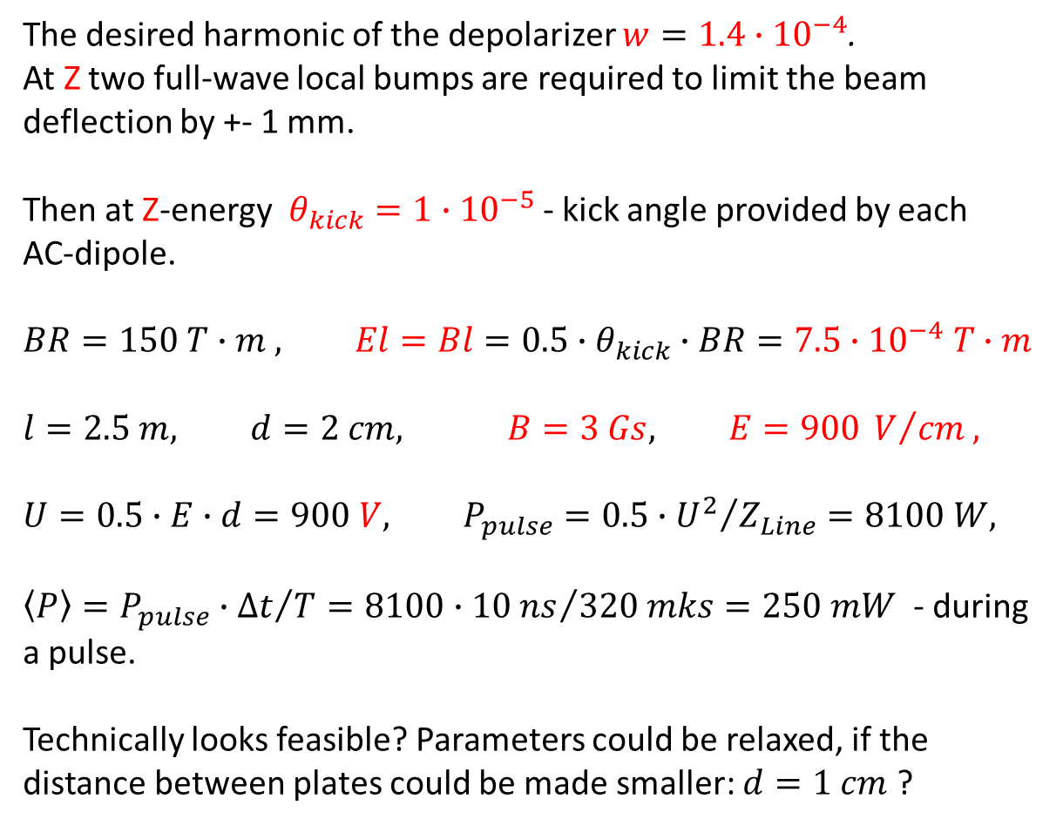

Depolarizer parameters for RDP of a single bunch
The desired harmonic of the depolarizer $w=1.4∙{10}^{−4}$.
At Z two full-wave local bumps are required to limit the beam deflection by +- 1 mm.
Then at Z-energy $θ_{kick}=1∙{10}^{−5}$ - kick angle provided by each
AC-dipole.
$$BR=150 T∙m , El=Bl=0.5∙θ_{kick}∙BR=7.5∙{10}^{−4} T∙m$$
$$l=2.5 m, d=2 cm, B=3 Gs, E=900 V/{cm},$$
$$U=0.5∙E∙d=900 V, P_{pulse}=0.5∙{U^{2}}/{Z_{Line}}=8100 W,$$
$\left\langle P\right\rangle =P_{pulse}∙{∆t}/T=8100∙{10 ns}/{320 mks}=250 mW$ - during a pulse.
Technically looks feasible? Parameters could be relaxed, if the distance between plates could be made smaller: $d=1 cm$ ?
Strip Line sketch:
$$\vec{E}$$
d
$$\vec{B}$$

Slide 11
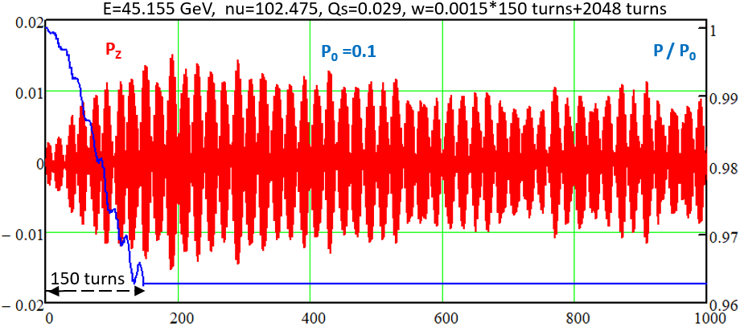
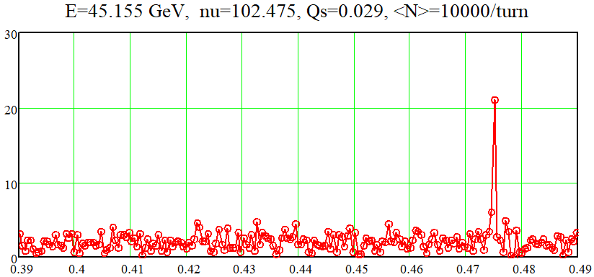
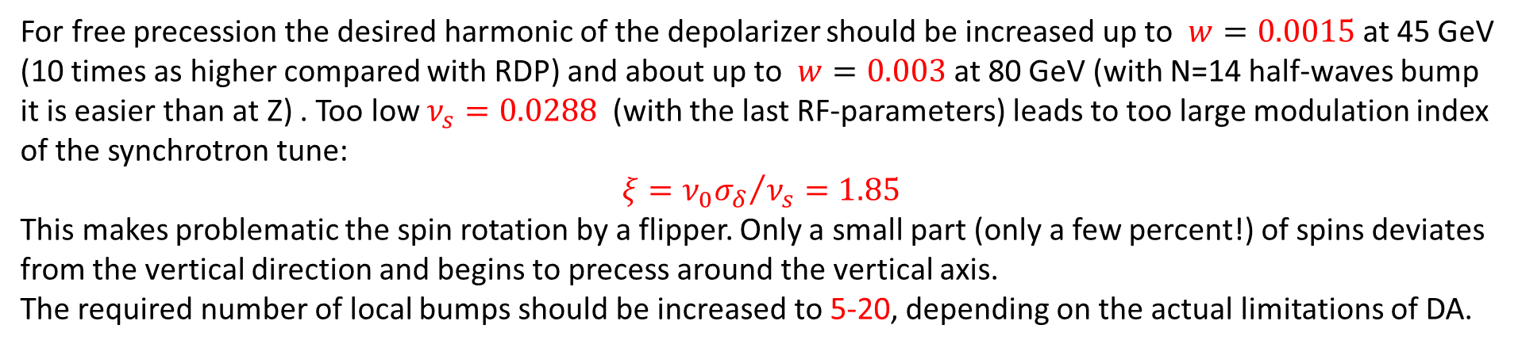
Depolarizer parameters for free precession mode at Z
For free precession the desired harmonic of the depolarizer should be increased up to $w=0.0015$ at 45 GeV (10 times as higher compared with RDP) and about up to $w=0.003$ at 80 GeV (with N=14 half-waves bump it is easier than at Z) . Too low $ν_{s}=0.0288$ (with the last RF-parameters) leads to too large modulation index of the synchrotron tune:
$$ξ={ν_{0}σ_{δ}}/{ν_{s}}=1.85$$
This makes problematic the spin rotation by a flipper. Only a small part (only a few percent!) of spins deviates from the vertical direction and begins to precess around the vertical axis.
The required number of local bumps should be increased to 5-20, depending on the actual limitations of DA.

Slide 12
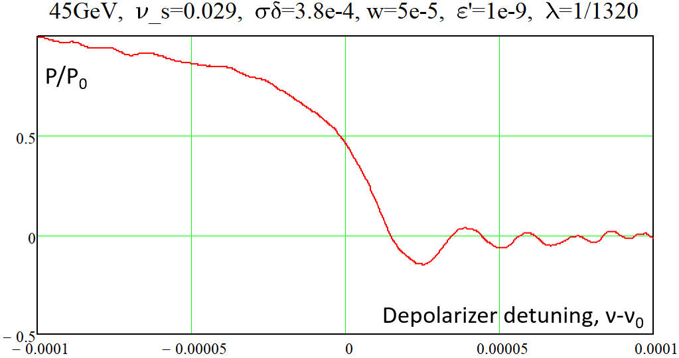
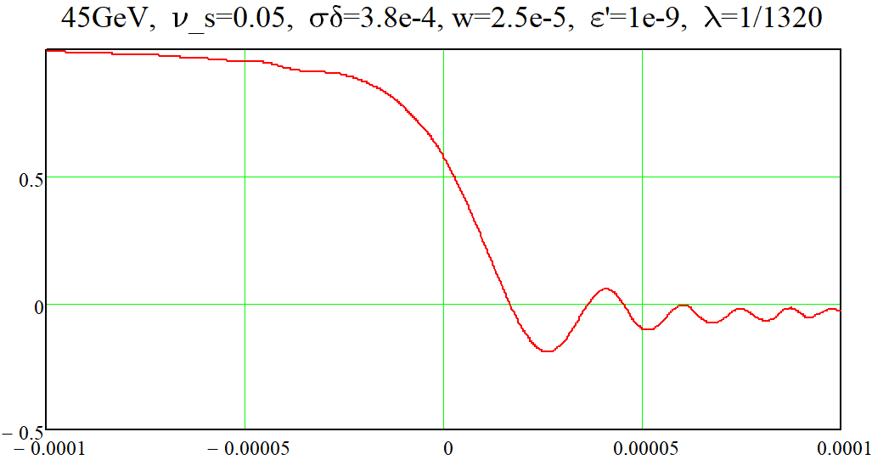
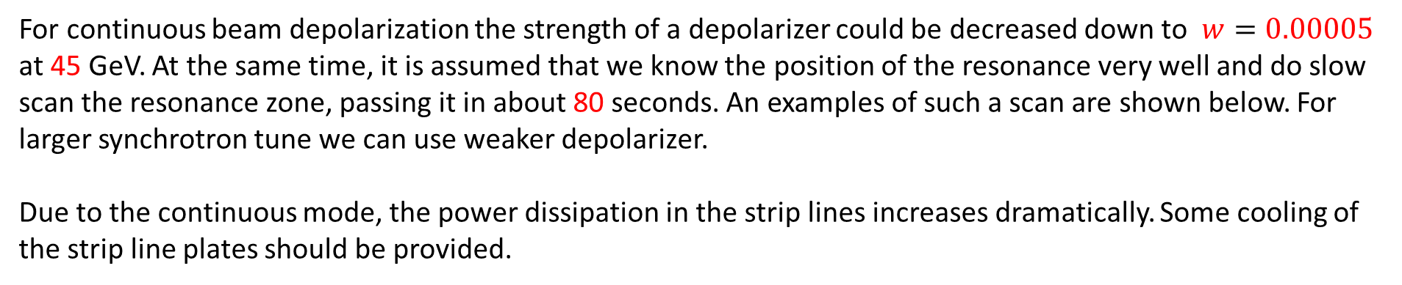
Parameters for continuous depolarization of the colliding bunches
For continuous beam depolarization the strength of a depolarizer could be decreased down to $w=0.00005$ at 45 GeV. At the same time, it is assumed that we know the position of the resonance very well and do slow scan the resonance zone, passing it in about 80 seconds. An examples of such a scan are shown below. For larger synchrotron tune we can use weaker depolarizer.
Due to the continuous mode, the power dissipation in the strip lines increases dramatically. Some cooling of the strip line plates should be provided.

Slide 13
Discussion of results
The concept of a local bump depolarizer looks feasible.
For beam energy of 45 GeV, the optimal length of such a device is the full-wave part of the arc section.
The depolarizer itself consists of two AC-magnets (strip lines) 2.5 meters long. The gap between the plates is about 1-2 cm.
The generator of the depolarizer should produce a sequence of short pulses of variable amplitude, lasting about 20 ns, spaced by one revolution period or by the time distance between the bunches. For continuous operation, the generator signal could be just a sine wave.
The electrical circuit of the depolarizer must be developed. Commercial broadband amplifiers show the required parameters to be chosen as the final devices.
An advantage of Free Spin Precession method – the orbit is completely undisturbed during the precession frequency measurement procedure.

