Slide 1
FCC-ee polarimeters: some studies
Aurélien MARTENS (IJCLab Orsay)
With many insights and lenghty discussions with Nickolai Muchnoi
With a bit of help of Santiago Martinez Saenz (UNAL Bogota)

Slide 2
Introduction
QED systematics studies now published in JINST
  https://doi.org/10.1088/1748-0221/18/10/P10001
Today’s menu:
  Small improvements on beam energy measurement
  Magnetic field tolerance
  Tentative study of pixel size
Prospects

Slide 3
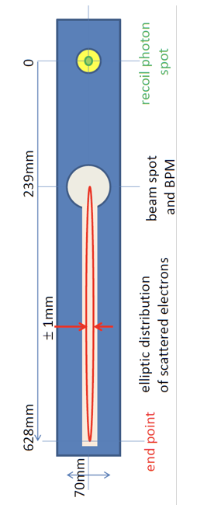



Compton polarimeter layout
x
Laser ($ω_{0}$)
X₀
Scattered photons
$$∝\frac{B}{E_{0}}$$
X₁
Electron beam
Blondel et al., arXiv:1909.12245; Muchnoi, JINST 17 P10014 (2022)
Dipole (filed B)
$$∝Bω_{0}$$
Lowest energy scattered electrons
Interaction region
X₂
about 100m
New concept (N. Yu Muchnoi) to measure all polarization parameters → 3D polarimeter

Slide 4
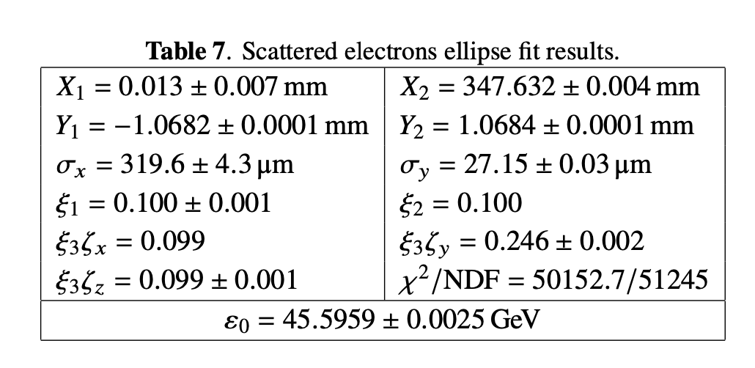
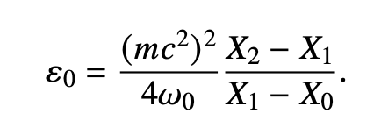
Refinement on energy measurement
Example taken from reference paper
Obtained from
N.Yu. Muchnoi 2022 JINST 17 P10014
Photon spot position
It assumes that the ellipse edge (high energy electrons) is at the nominal beam position
→ Not strictly speaking true¹
The correction is known. If we note $A=\frac{X_{2}−X_{1}}{X_{1}−X_{0}}$, the correction to $ε_{0}=\frac{{\left(mc^{2}\right)}^{2}}{4ω_{0}}A(1−\frac{A+2}{4{{(γθ}_{0})}^{2}})$
Where $θ$₀ is the nominal bending angle. This correction typically amounts to 1MeV.
This correction is of the order of the uncertainty here (10⁷ events generated)
¹ This was pointed out by Nickolai in previous email exchanges

Slide 5
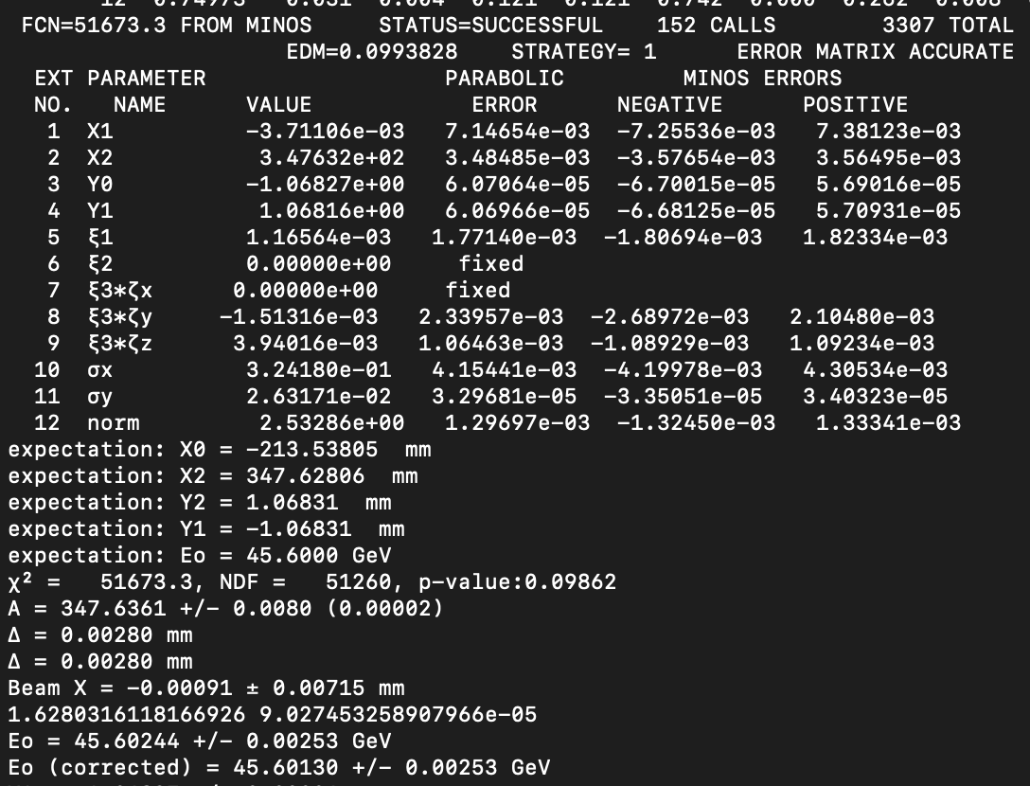
Modification of chi2 definition
So far Nickolai was using Pearson’s chi2 → replace it with more ‘conventional’ one where the chi2 is normalized with observed statistical uncertainty (rather than the expected one).
It improves the observed fit bias on ellipse position¹
N.Yu. Muchnoi 2022 JINST 17 P10014
¹ We strictly speaking have not demonstrated that there is a bias due to a lack of a statistical study.

Slide 6
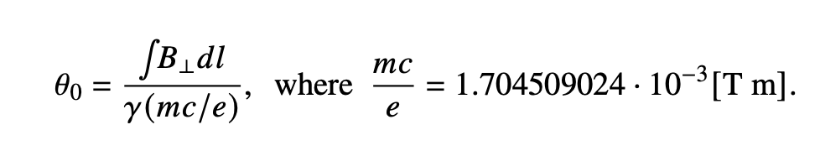
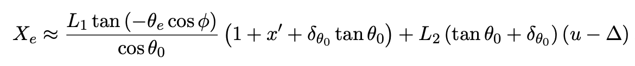
Magnetic field tolerances
Bending angle:
Disclaimer: many possible physical source for un-ideal bending angle (genuine inhomogeneities of B-field, short-/long-term fluctuations of currents, temperatures, alignments)
Try a generic approach, considering it is a nuisance term that either biases or smear the electron distribution in the pixel detector.
fluctuating bending angle can be compared to effect of horizontal divergence and energy spread

Slide 7
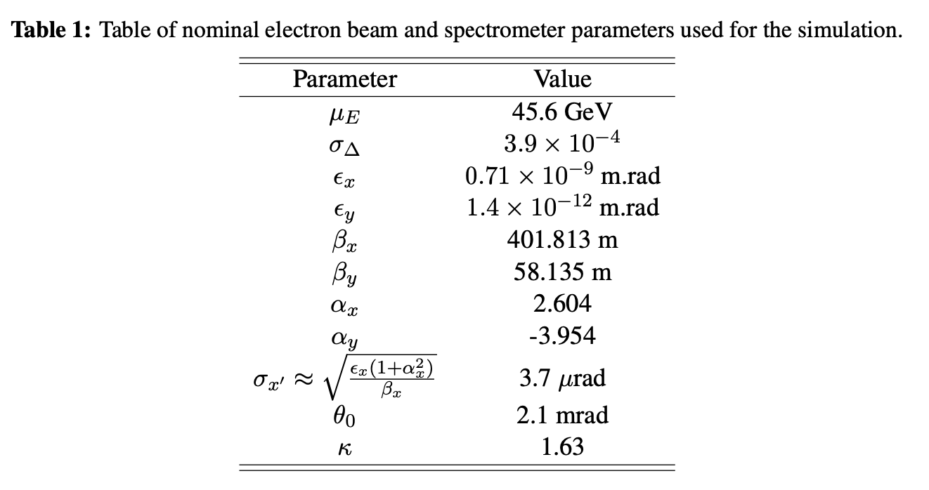
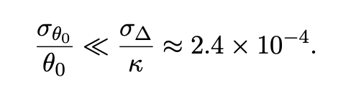
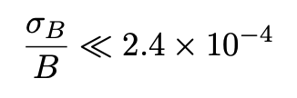
Magnetic field tolerances (2)
Numerically most stringent constraint:
Dispersive effect of the dipole field also induces a change of the path length for various energies, it relatively scales as $θ_{0}^{2}$→negligible effect
Holds on longitudinally integrated B-field
Constraint on the useful aperture a~5cm (horizontal direction)
Vertical aperture much smaller (beam dynamics, dispersions)
Does not provide a constraint on the longitudinal direction (averaged in the calculation)

Slide 8
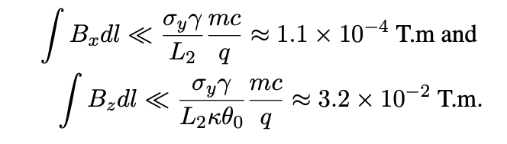
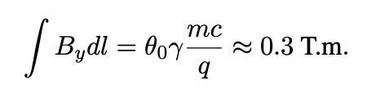
Fringe fields
Also an opportunity to look at fringe fields
Again generic approach is followed: look at magnitude of $p_{i}B_{j}$terms in Lorentz force
Remember that there is a large beam spread in the horizontal direction ~300µm
This spread must not be transfered to the vertical direction or it would prevent extraction of vertical beam polarization (typical ellipse vertical dimension is ~+-1mm)
Most stringent contraint on fringe fields
Nominal vertical field for reference:

Slide 9

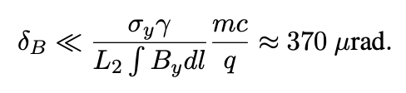
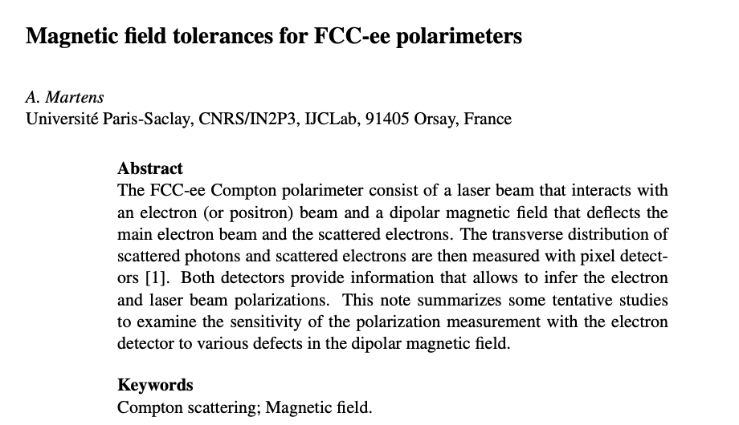

Angular alignment of dipole
Besides fringe fields, angular misalignement of dipole (wrt to nominal beam trajectory) can provide a similar exchange of x-y axes
$$\vec{B}$$
This study is summarized in a note

Slide 10
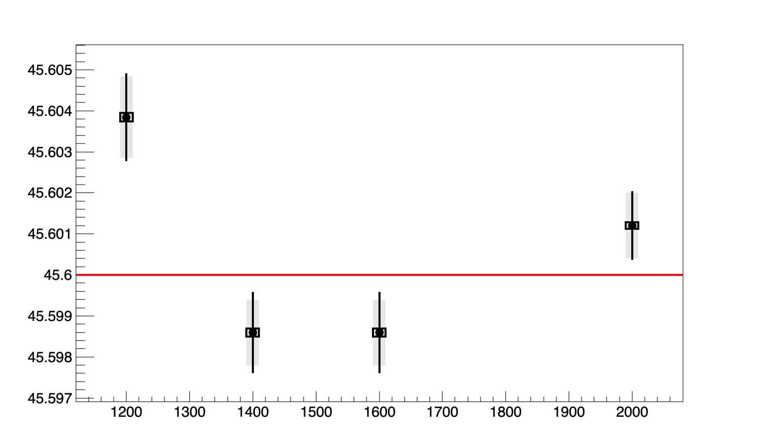
Preliminary study of pixel size
A toy MonteCarlo procedure is applied (100 experiments, 10⁸ events each)
Fit results for few different pixel sizes
Dot: average of fit central values
Grey band: average of single fit uncertainties
Black line: std of fit central values
Black box: stat uncertainty on average of fit central values
Extracted beam energy [GeV]
Npixel in horizontal direction, electron detector
The fit ellipse gets larger & the beam spread gets smaller → likely inconsistency between model and data (some approx. made for the fit)
Biased extrapolation of the ‘beam’ position

Slide 11
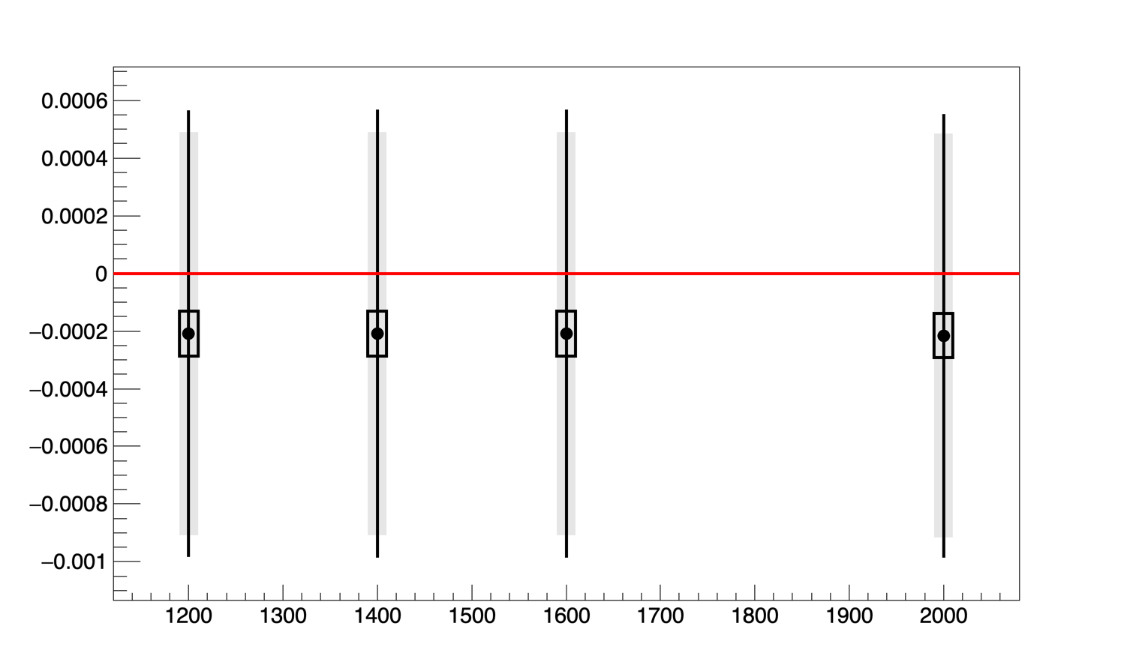
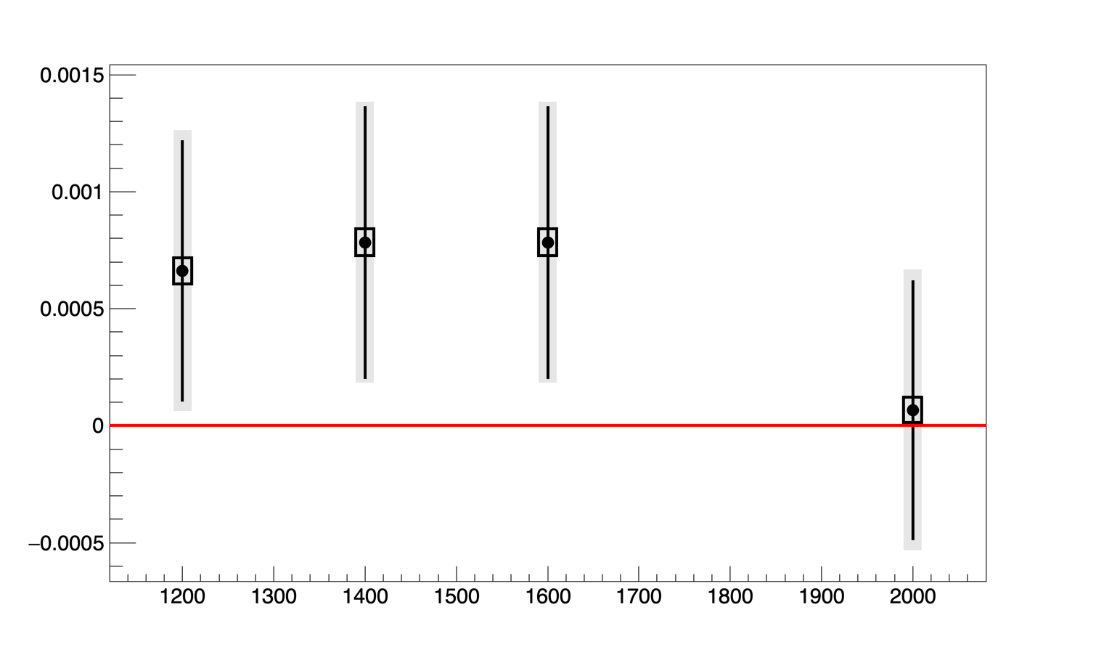
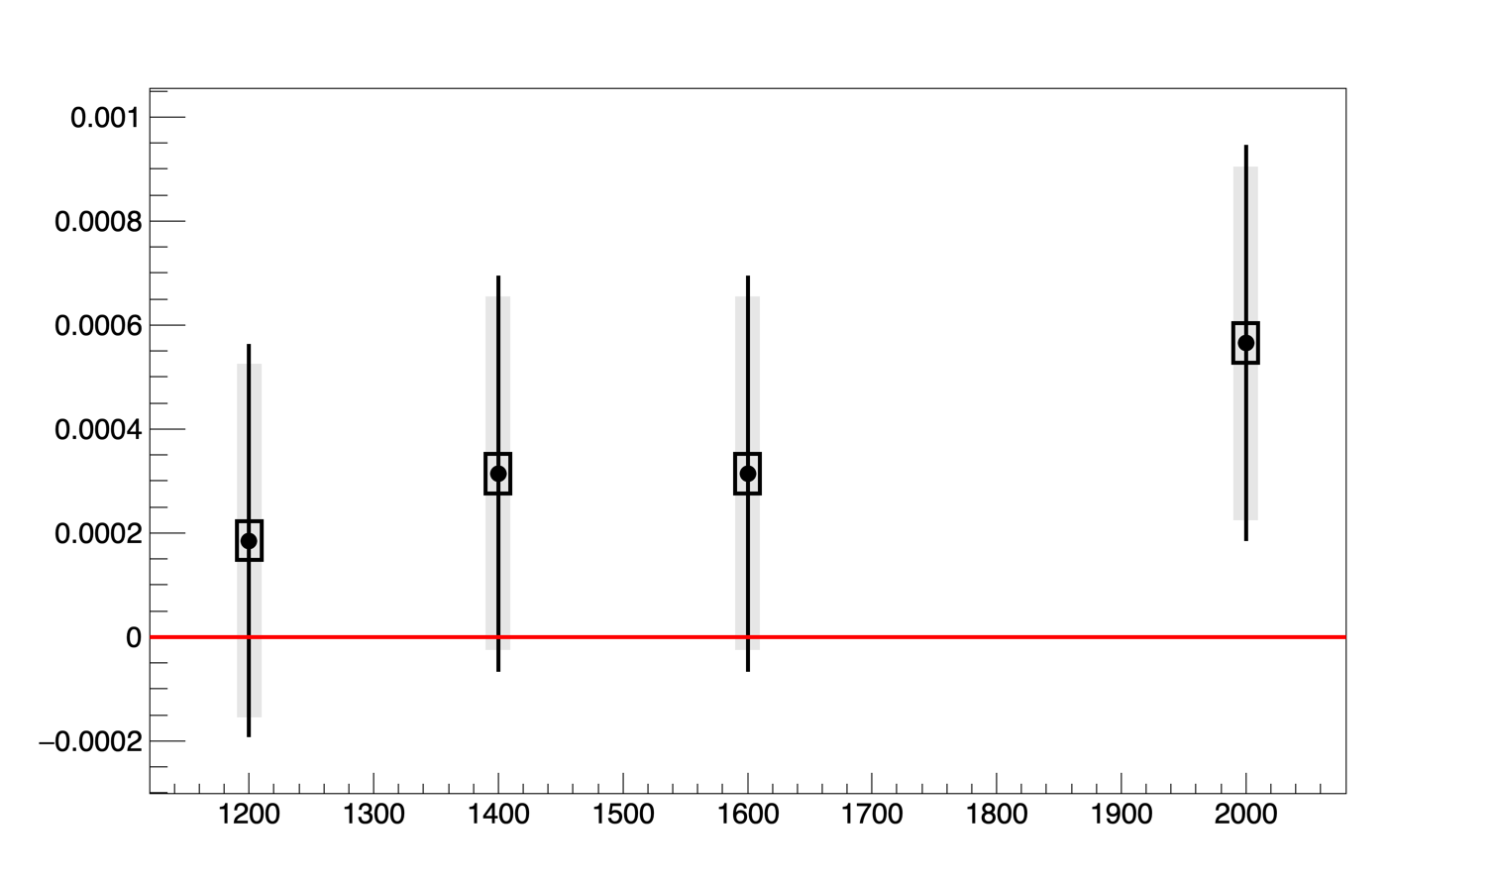
Preliminary study of pixel size (2)
Electron detector
Vert. Polar electrons
Laser Stokes parameter S1
Long. Polar electrons
Npixel in horizontal direction, electron detector
Bias (~5-6 10⁻⁴) increases with Npix.

Slide 12
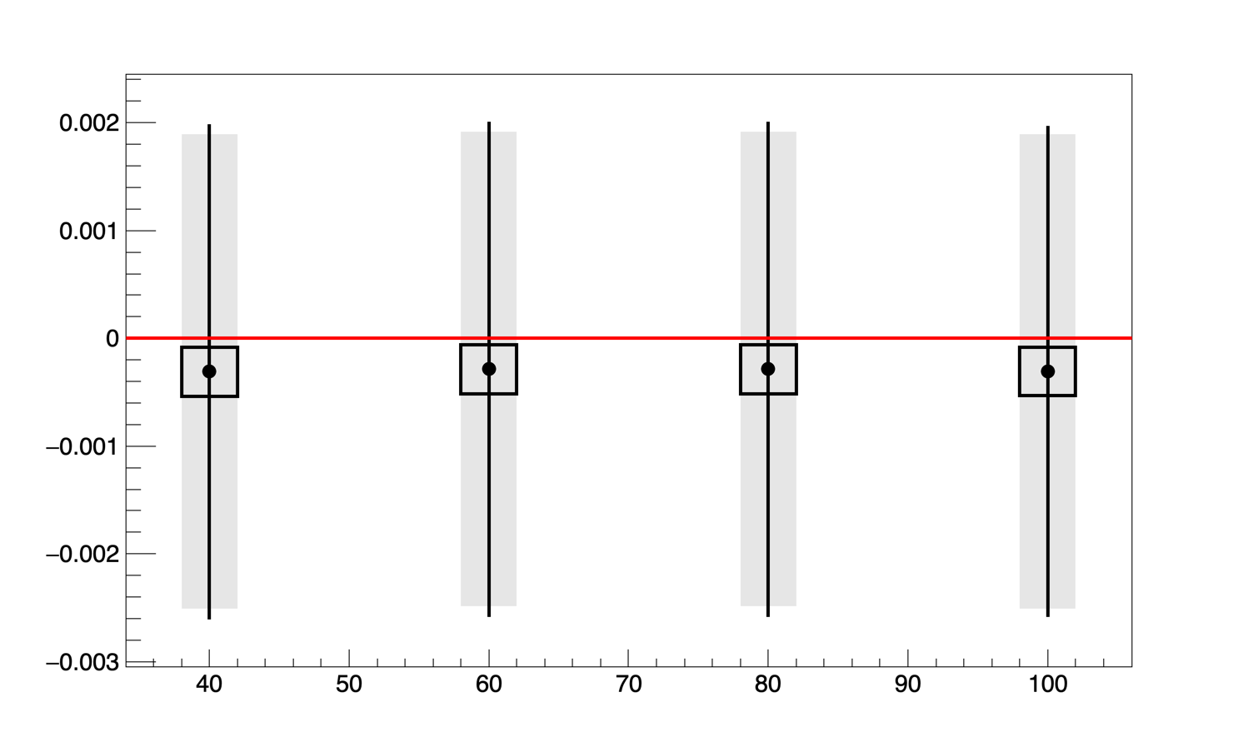
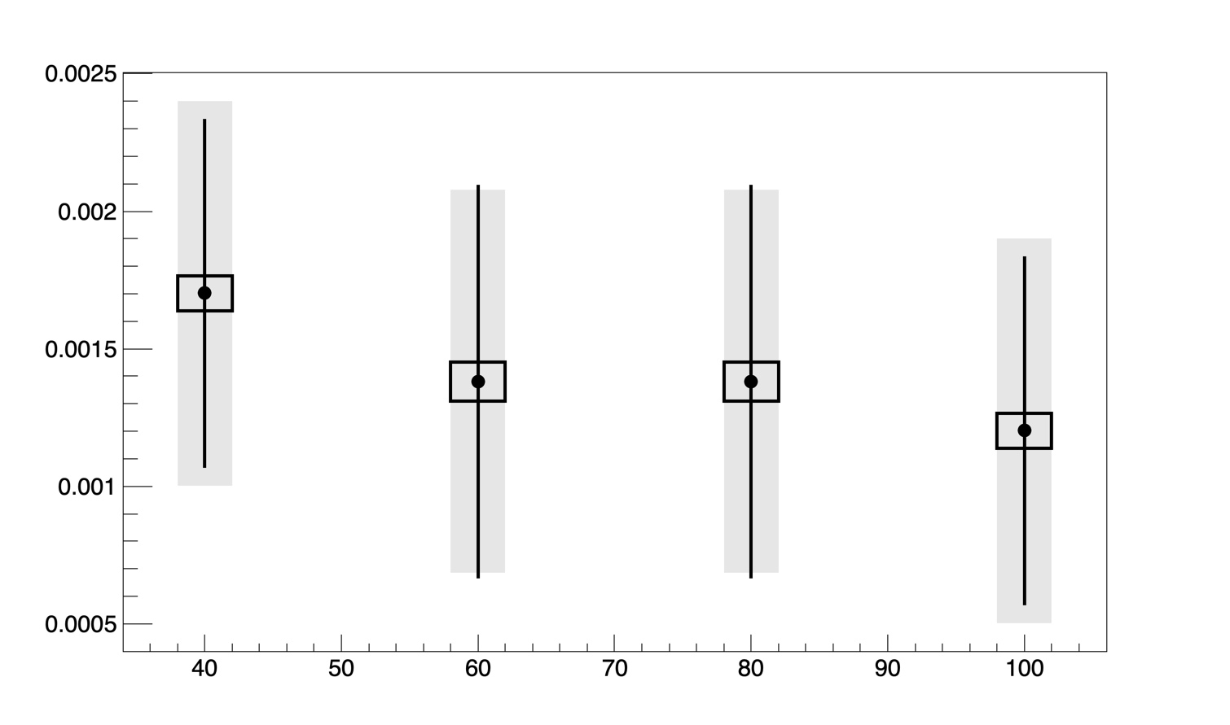
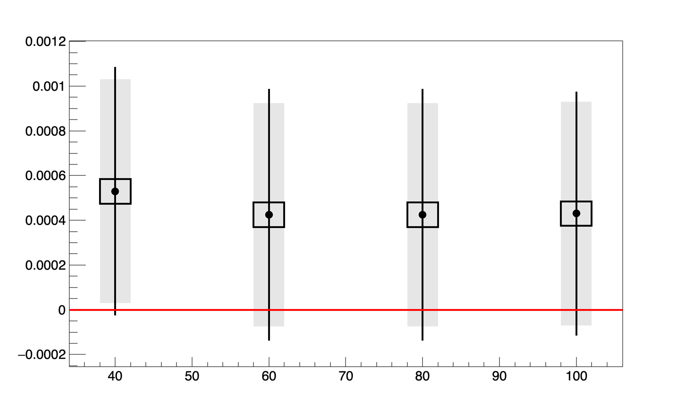
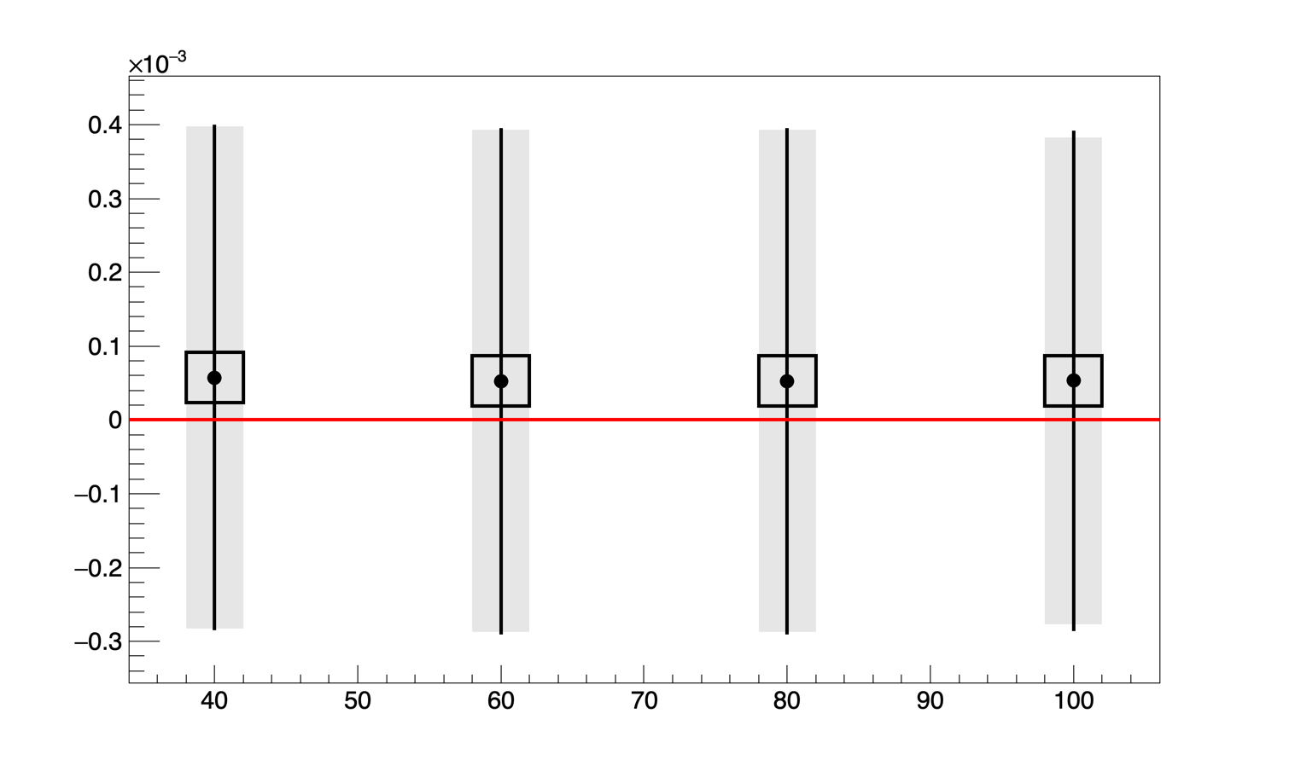
Preliminary study of pixel size (3)
Photon detector
Vert. Polar electrons
(similar for Horiz.)
Laser Stokes parameter S1
Large bias
→ Difficult extraction due to horizontal beam size
Npixel in horizontal direction, photon detector
Npixel in horizontal direction, photon detector
Long. Polar electrons
Laser Stokes parameter S2 (45°)
More stable results.
Bias ~5 10⁻⁴
Npixel in horizontal direction, photon detector

Slide 13
Conclusion/prospects
Few small improvements on the energy extraction since Nickolai’s paper
First inputs on field tolerancing
  Feedback from magnetic group is welcome
    Are proposed tolerances acceptable ?
  longer term task (not a priority):
    detailed simulation of realistic field map
    statistical study to validate performance
    Implement necessary refinements of fit procedure (if any)
Starting to look at minimum required pixelization
  Toy MC study tools implemented, time consuming…
  Some intriguing results pointing towards needs of refinements in the fit procedure → more thinking needed
Next steps:
  Studies on necessary laser polarization accuracy + discussion on sensitive optical elements (ongoing)
  Advances on detector design are needed
  Extraction of parameters from asymmetries (technical work)

