Slide 1
Welcome!
Martijn Mulders (CERN)
Chair of the International Organizing Committee
Phat Srimanobhas (Chulalongkorn University, Thailand)
Co-chair of the Local Organizing Committee

Slide 2
Organizers
(those present at the School this morning)
For the International Organizing Committee:
  Martijn Mulders - CERN, Chair of IOC
  Markus Elsing - CERN, IOC
  Kate Ross - CERN, Physics Schools Administrator
For the Local Organizers
  Phat Srimanobhas - Chulalongkorn University, Co-chair of LOC
  Chinorat Kobdaj, Narumon Suwonjandee, Pawin Ittisamai, Vichayanun Wachirapusitan, - Chulalongkorn University, LOC
  Team of students from Thailand

Slide 3
Asia-Europe-Pacific Schools of HEP
Series of schools for advanced students in High-Energy Physics, since 2012
  in Japan, India, China, Vietnam, Korea ... and now in Thailand
Mission:
  Latest developments in High-Energy Physics (theory, phenomenology, data analysis, instrumentation) taught by world class scientists
  Aim to foster cultural exchange and networking between participants from different countries and regions
We hope you can use this opportunity to learn as much as possible in these two weeks and to meet new people

Slide 4
The School Programme
Lectures, lectures, lectures...!
Discussion sessions
Poster session
A student project
Excursions
  1st Saturday afternoon
  next Tuesday all day (--> Bangkok)
  2nd Saturday optional excursion (or free afternoon)

Slide 5
Programme for today
(see indico web pages for the full programme)
09h00 Welcome
09h10 Field Theory & Standard Model, Anna Kulesza
10h40 Coffee break
11h00 Neutrino Physics, Stephane Lavignac
12h30 Lunch
+ Free time
15h30 Instrumentation, Maxim Titov
17h00 Coffee break
17h30 Discussion sessions – until 19h00
19h00 Welcome drink (only tonight) and Dinner

Slide 6
Lectures
Lectures last 1h15, plus time for questions
  Please don’t be shy to ask questions, even if they seem basic to you!
    During the lectures and also at the end
  Handouts available before each lecture with printout of the presentation, or download them on your tablet before the lecture
    Make notes on your handouts or your tablet device
    Take them to the discussion sessions
    Let us know if you don’t want or want a printed copy

Slide 7
Discussion Groups
Six discussion groups A, B, C, D, E, F
  Each student is assigned to a group
    Lists will be posted during the day
    Discussion Leader stays with the same group for the full two weeks
  Lecturers are invited to visit the groups
    Help answer detailed questions on their courses
  Discussion sessions should be driven by questions from the students
    Please make note of points that you did not understand in the lectures or other questions that you might have
    Make use of the lecture handouts in preparing your questions

Slide 8
Discussion Leaders
Discussion Groups
  Group A: Kento Asai
  Group B: Jamil Aslam
  Group C: Tomasz Dutka
  Group D: Shrihari Gopalakrishna
  Group E: Pooja Mukherjee
  Group F: Ryotaro Watanabe
Markus and I would like to meet the discussion leaders after lunch today to explain a few points
  Meet here in the auditorium at 14h00

Slide 9
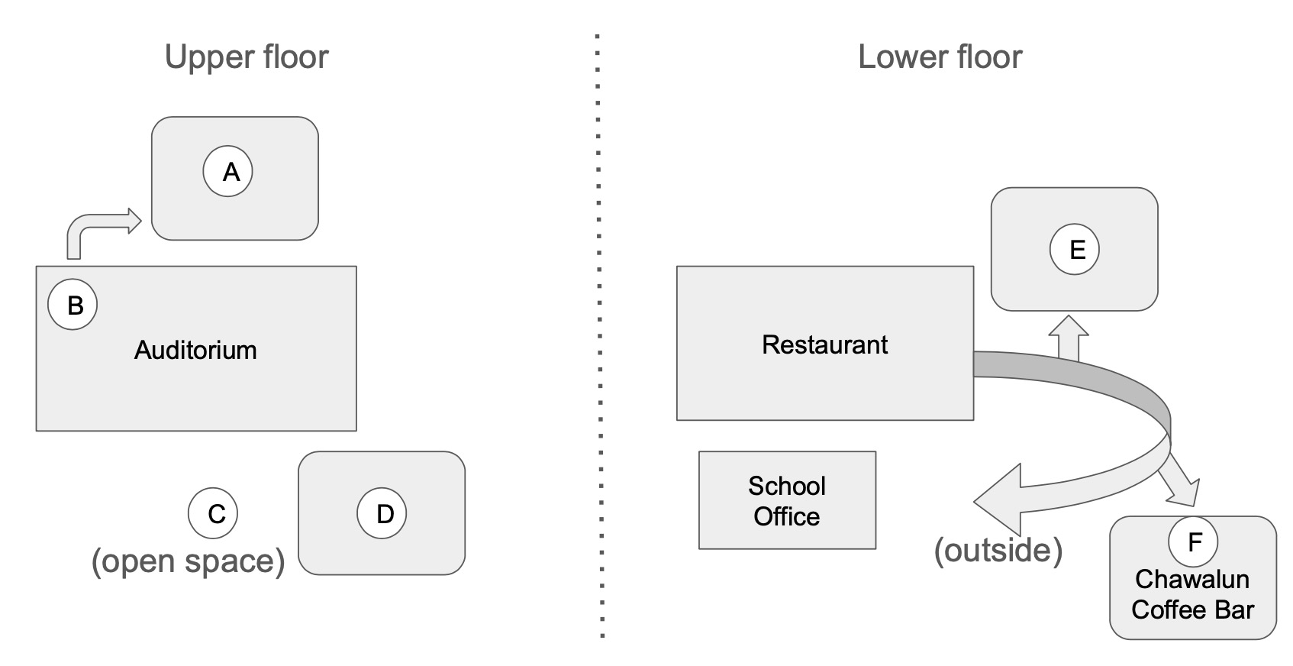
Locations of the Discussion Rooms

Slide 10
Please !
Lectures and discussion sessions
  Attendance is compulsory
  Arrive on time
  Don’t use your devices for non-school work
  Keep your focus on the lectures

Slide 11
Meals and drinks
All meals are served in buffet style:
  Breakfast 7:00-9:00 ; Lunch 12:30-13:30 ; Dinner 19:00-20:00
  Special dietary requirements: food at the buffet will have labels indicating type of meat / vegan
Drinks included with lunch and dinner
  Water is included (and Coffee / tea at breakfast)
  Other drinks are not for free ; bar in restaurant open until 22:00
Bar next to big swimming pool is open
  during lunch break (13:00-15:00) and after dinner (until 23:00)
  Pay with cash or credit card / phone

Slide 12
Free time activities
There are 2 swimming pools, open from 8:00 to 22:00
DO NOT SWIM in the lake!
You can use the boats (ask at / around the swimming pool)
Please be considerate about noise!
  We are happy for you to have fun evenings, but please do so well away from the sleeping areas

Slide 13
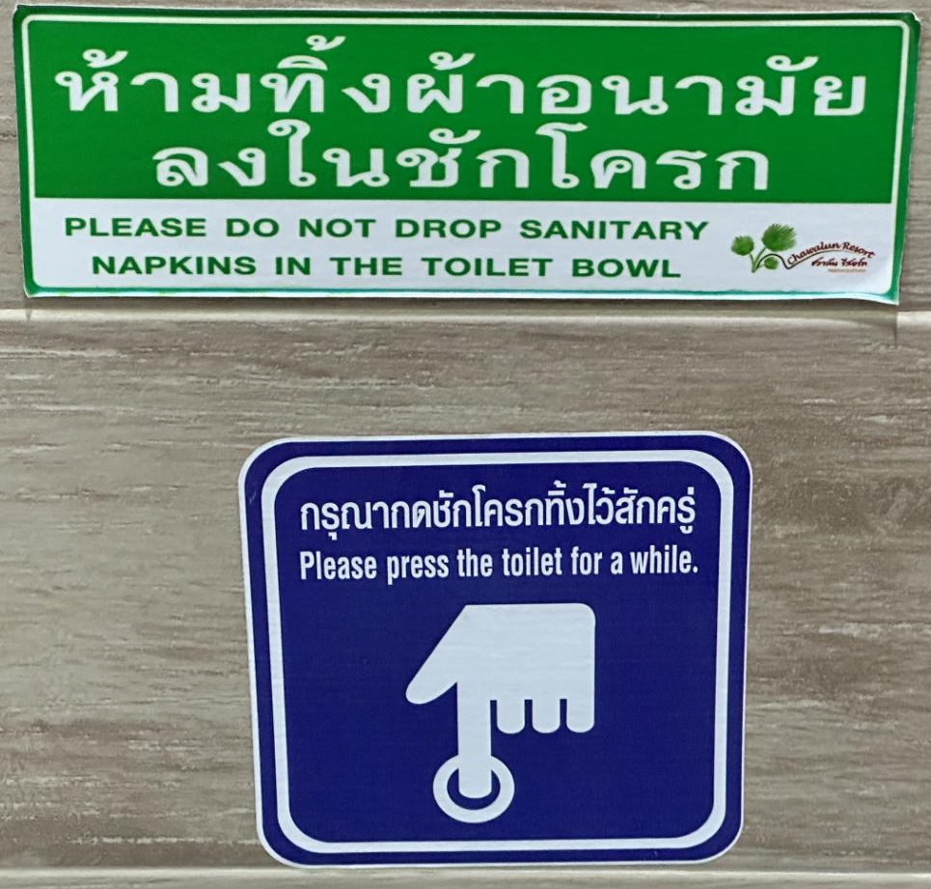
Other practical matters:
Drinking water
  The tap water is NOT SAFE to drink !!
  One bottle of water per person in each bedroom per day
  Refill at water fountain in reception area of the hotel
Do NOT throw toilet paper in your toilet bowl
  use the bin next to it instead
There will be a laundry service on 3 days:
  pick-up (return) 14 (17), 17 (21), 21 (24) June
  price list will be in your room

Slide 14
Office and announcements
School’s Office
  Kate Ross will be pleased to help in case of questions, problems or requests
  Our office is located downstairs, across from the Chawalun coffee bar
  There is a sign and the school poster is on the door of the office
Announcements
  From time to time we will make announcements at the end of the lectures

Slide 15

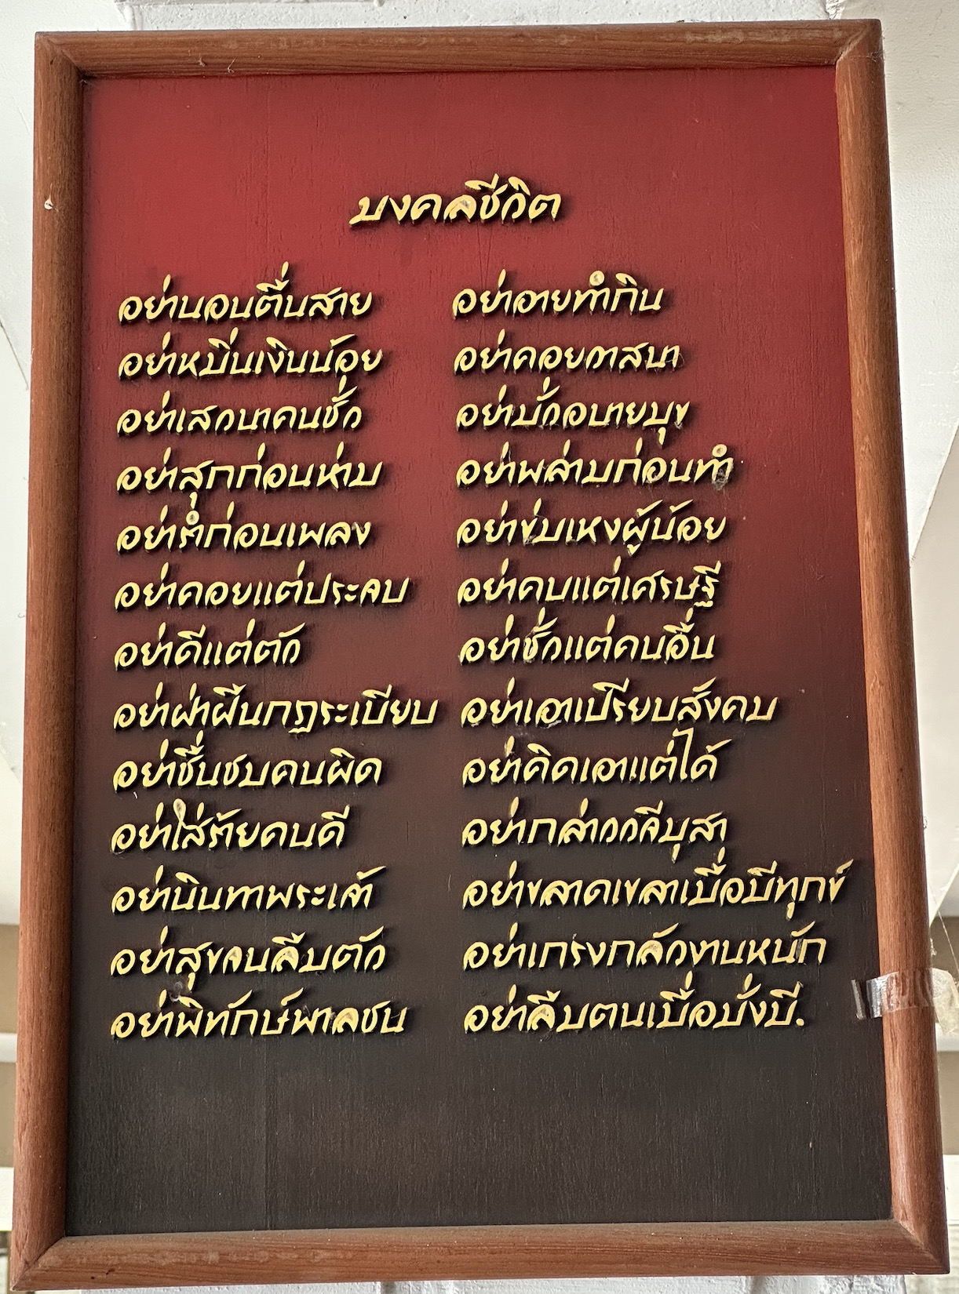
Be Nice
Thai Poem (restaurant)
Be welcoming and respectful to each other and to other guests in the hotel !
(e.g. CERN code of conduct)
We hope there won’t be any issues but in case you witness or experience inappropriate behaviour or harassment:
  Kate is available as point of contact

Slide 16
Enjoy the School!

