Slide 1
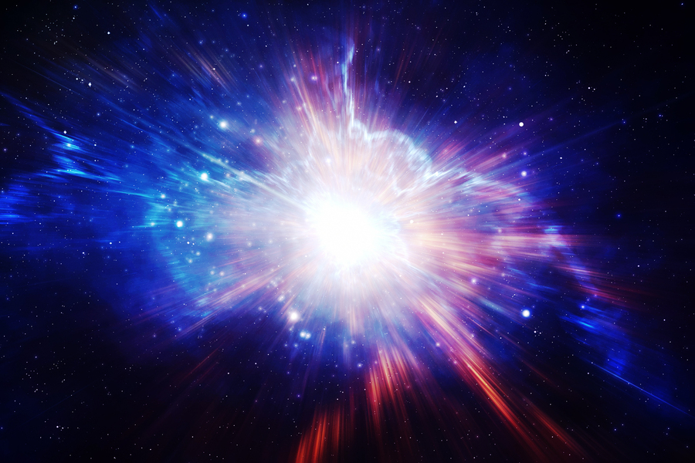
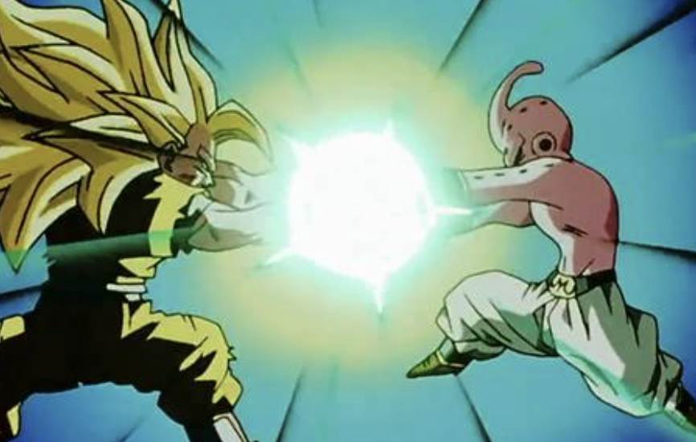
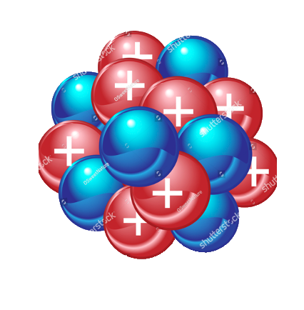

Measurement of higher-order harmonic azimuthal anisotropy in PbPb collisions
at $\sqrt{s_{NN}}=$ 2.76 TeV
Notes:
Before I start, I want to thank the organizers for this school. My group’s topic is the measurement of higher-rder harmonic azimuthal anisotropy in lead lead collision at 2.76 TeV at CMS.

Slide 2
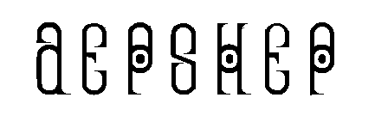
Content
Introduction
CMS Detector
Event and Track Reconstruction
Glauber Model Eccentricity
Methods
Results
Summary
Notes:
Here is the table of content, starting with the introduction, will briefly describe important part of CMS detector. Next, event and track reconstruction. After that, describing this Glauber Model Eccentricity. Then describe the three methods

Slide 3
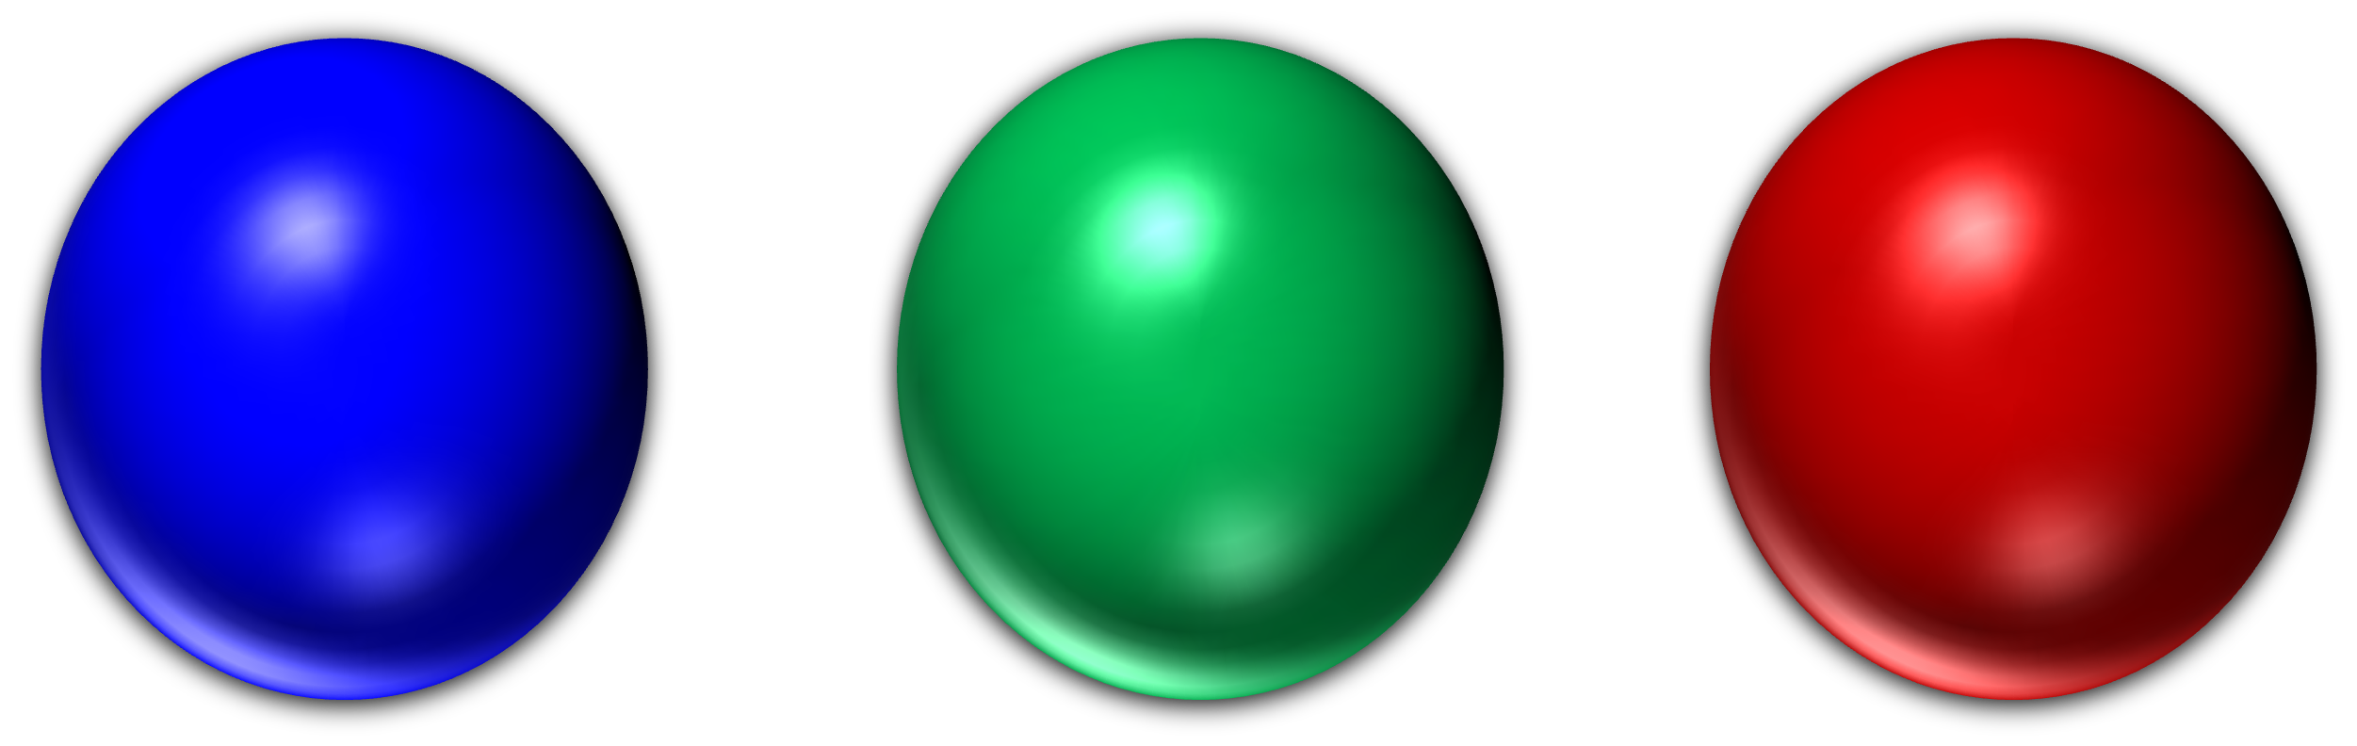
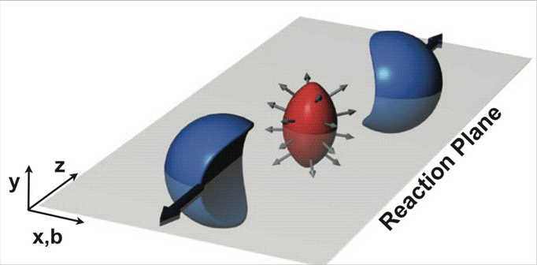
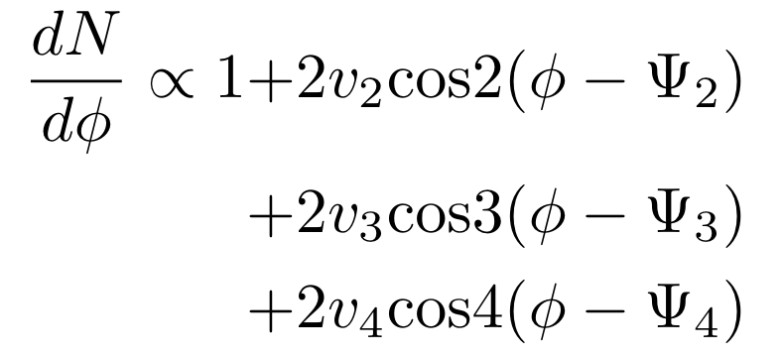
Introduction
Anisotropic momentum distribution
Quark Gluon Plasma (QGP) in local thermal equilibrium
Anisotropy of event should carry the characteristics and the initial condition of QGP
This then should reveal hydrodynamics and model of QGP.
https://phys.org/news/2018-10-early-universe-fluid-quark-gluon-plasma.html
Notes:
The multiplicity of particles can be expanded in terms of anisotropic momentum distribution. Due to elliptical shape of QGP, the elliptical flow of the expansion is dominated by geometry of QGP, however, higher order terms are not so sensitive to the geometry. One of the assumption that we make is that QGP has local thermal equilibriums in order to apply hydrodynamics to QGP. The higher order anisotropy flow, then could carry the fluctuations, initial state, characteristics of QGP. Ultimately revealing the hydrodynamics and model to descrive QGP/

Slide 4
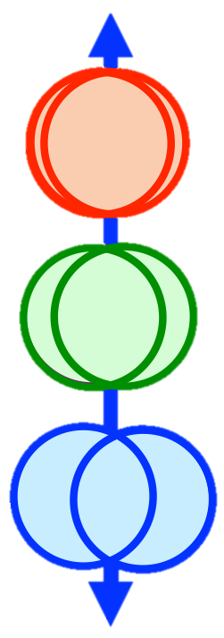
Introduction
0% Centrality
CMS Pb-Pb collision data
Three methods to measure the different order anisotropic
flow with respect to centrality, momentum and eccentricity.
  Event-plane
  Cumulant
  Lee-Yang Zero
100% Centrality
Notes:
In this paper, they used CMS lead lead collision data and measured the anisotropy flow in three different ways, … and plotted in terms of centrality, momentum, and eccentricity. Where as seen in this slide, less centrality means more overlapping collision.

Slide 5
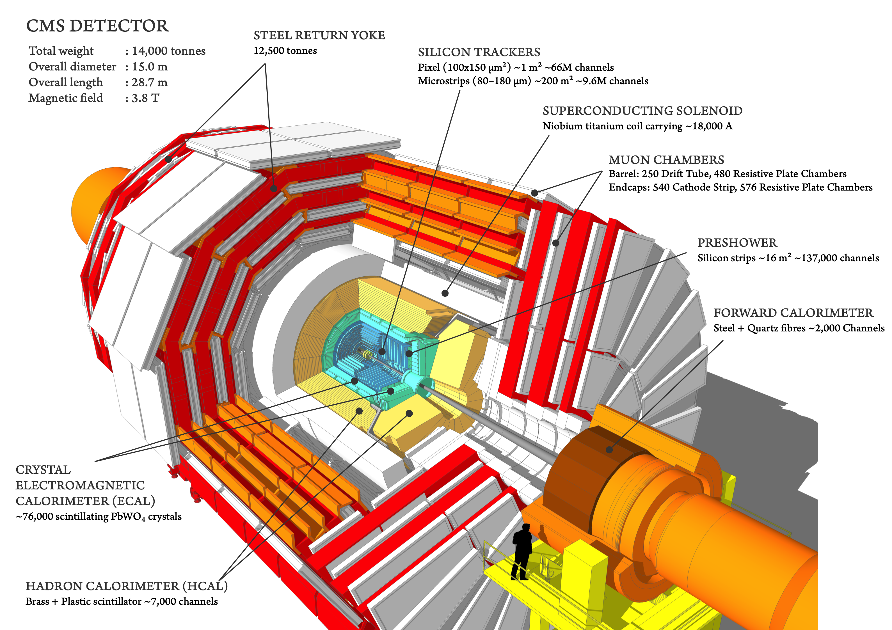
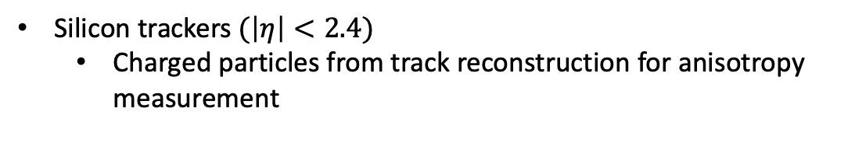
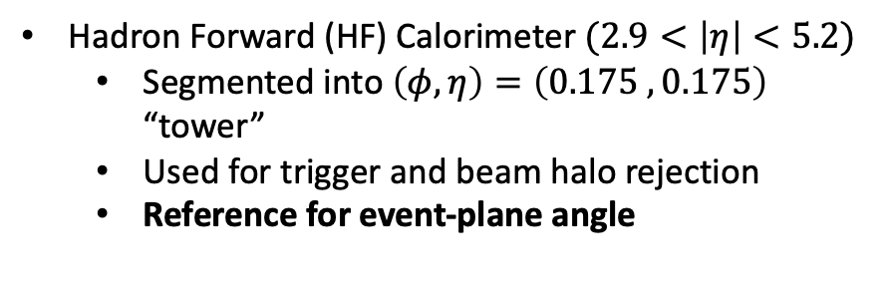
CMS Detector
Silicon trackers $(\left|η\right|<2.4)$
  Charged particles from track reconstruction for anisotropy measurement
Hadron Forward (HF) Calorimeter $(2.9<\left|η\right|<5.2)$
  Segmented into $\left(φ,η\right)=\left(0.175 ,0.175\right)$ “tower”
  Used for trigger and beam halo rejection
  Reference for event-plane angle
https://cms-opendata-workshop.github.io/workshop2023-lesson-cms-detector/aio/index.html
Notes:
Here I will describe the key part of CMS detector for this study, since details of trackers and calorimeters are covered in instrumental lectures/ First the silicon trackers tracks the charged particles which are used to directly measure the anisotropy. Forward hadron calorimeter, which is referred as HF Calorimeter, that serves two main purposes, setting the reference angle for event-plane method and trigereing

Slide 6
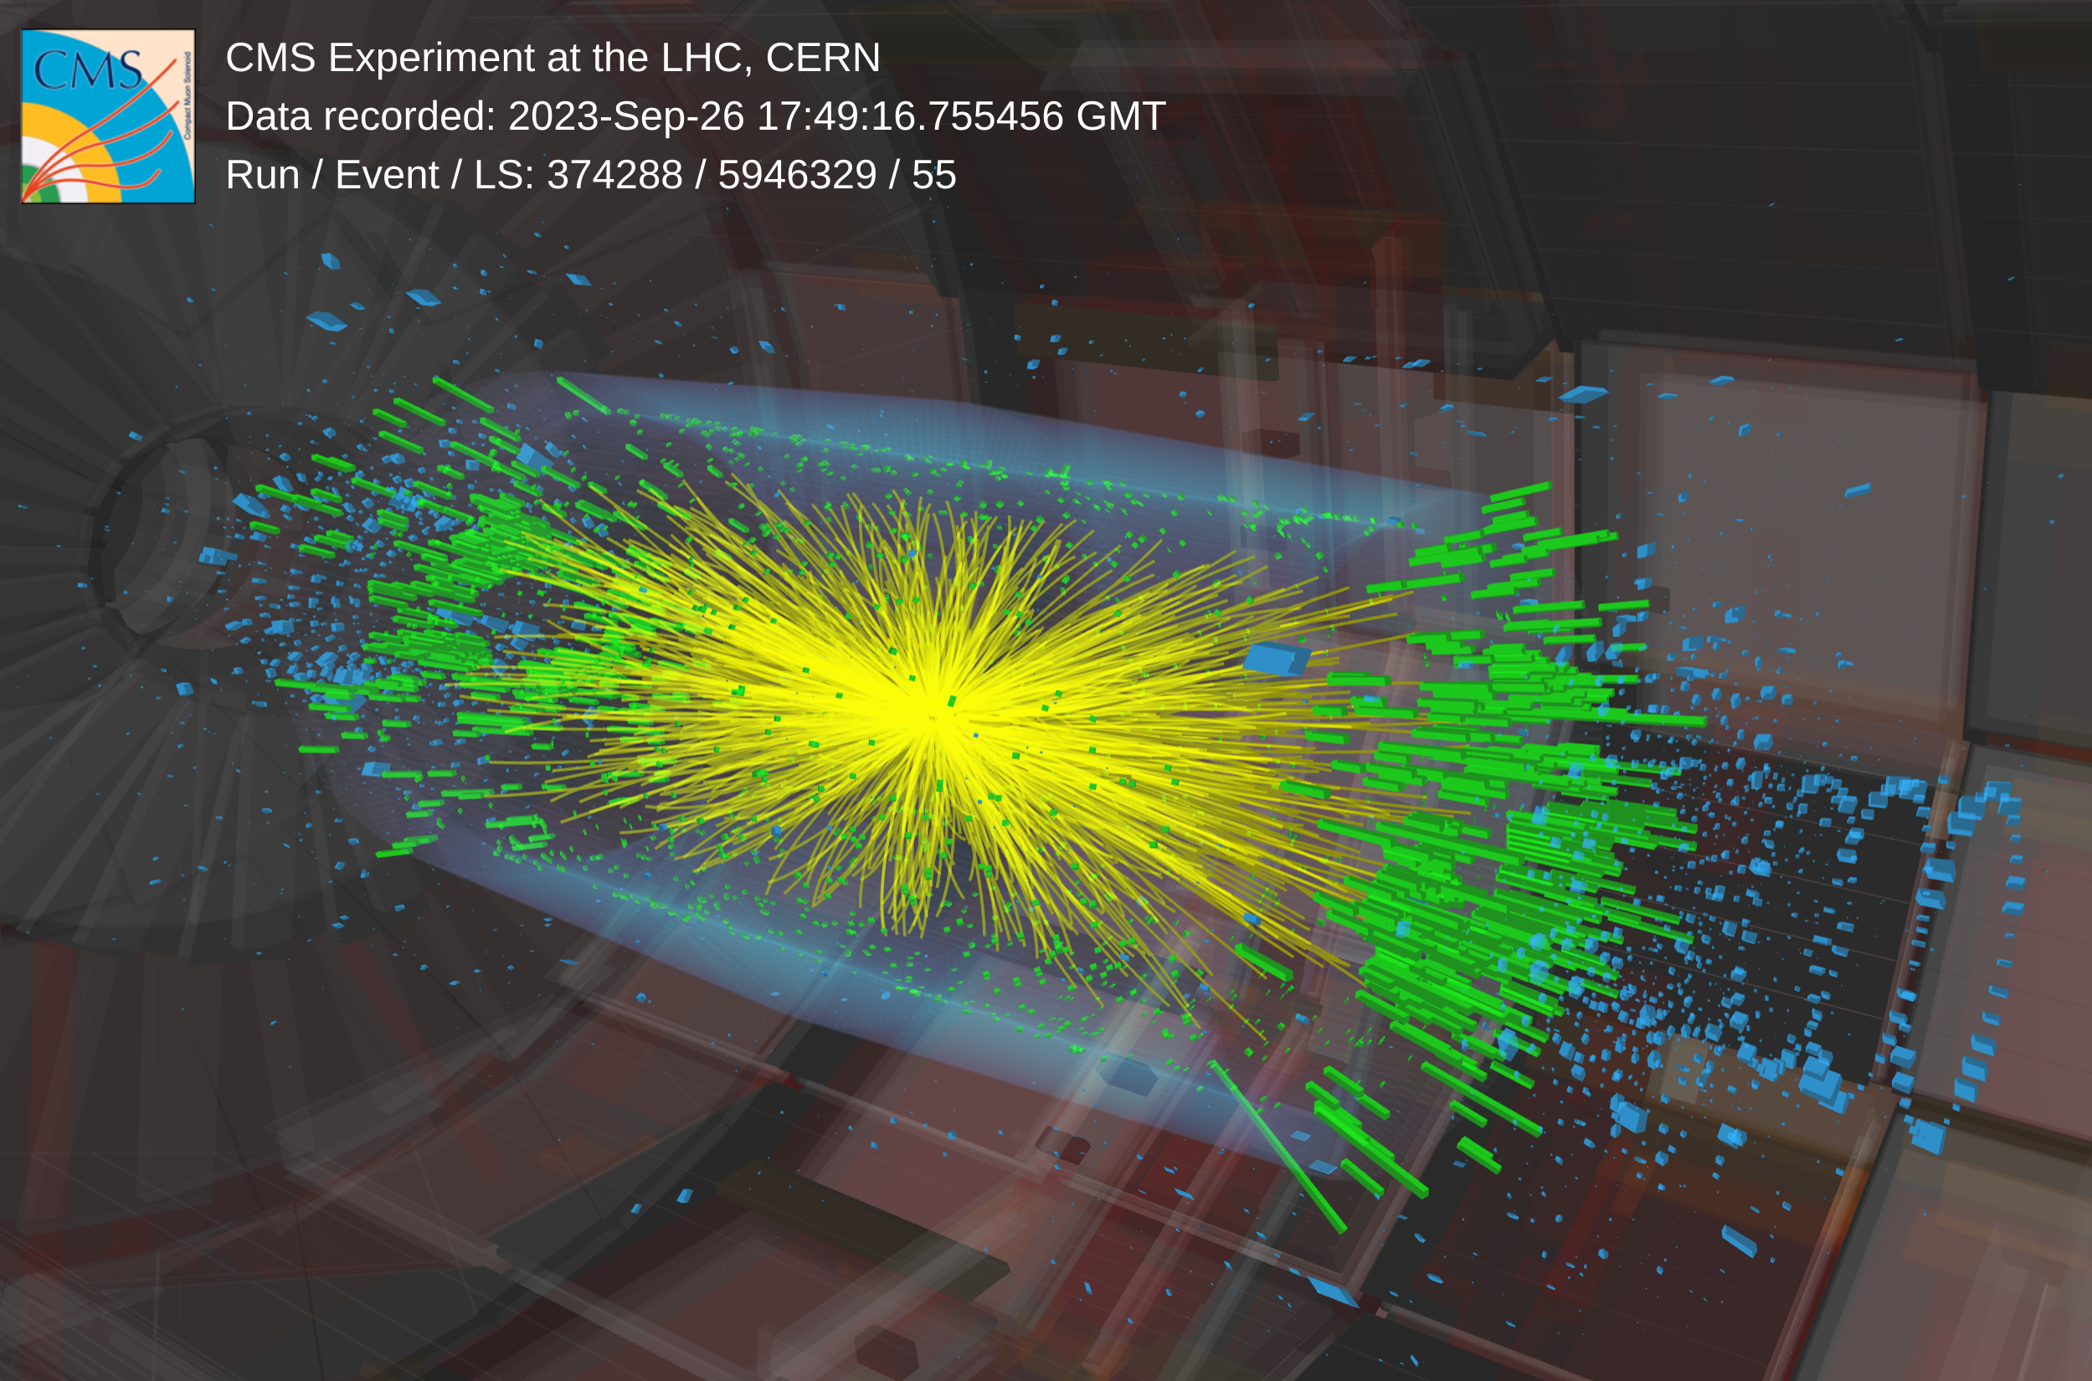
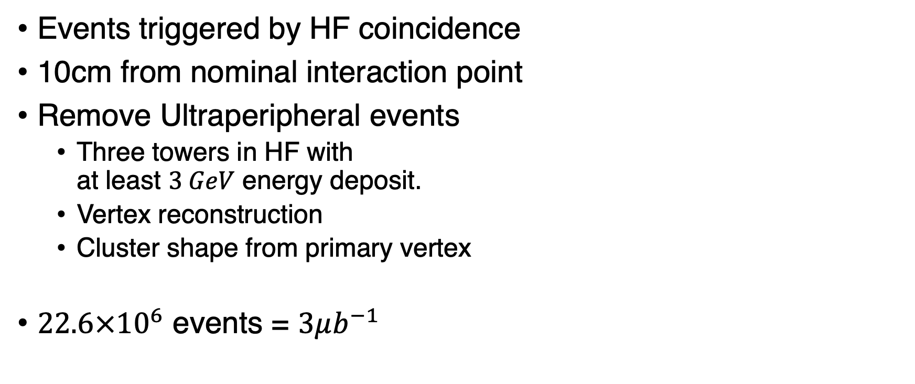
Event and Track Reconstruction
Events triggered by HF coincidence
10cm from nominal interaction point
Remove Ultraperipheral events
  Three towers in HF with
  at least $3 GeV$ energy deposit.
  Vertex reconstruction
  Cluster shape from primary vertex
$22.6×{10}^{6}$ events = $3μb^{−1}$
https://cds.cern.ch/record/2872371

Slide 7
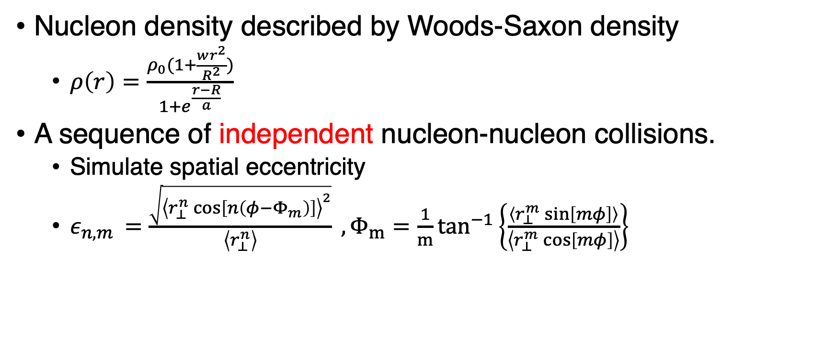
Glauber Model Eccentricity
Nucleon density described by Woods-Saxon density
  $ρ\left(r\right)=\frac{ρ_{0}(1+\frac{wr^{2}}{R^{2}})}{1+e^{\frac{r−R}{a}}}$
A sequence of independent nucleon-nucleon collisions.
  Simulate spatial eccentricity
  $ε_{n,m }=\frac{\sqrt{{\left\langle r_{⊥}^{n}\cos\left[n\left(φ−Φ_{m}\right)\right]\right\rangle }^{2}}}{\left\langle r_{⊥}^{n}\right\rangle } , Φ_{m}=\frac{1}{m}\tan^{−1}\left\{\frac{\left\langle r_{⊥}^{m}\sin\left[mφ\right]\right\rangle }{\left\langle r_{⊥}^{m}\cos\left[mφ\right]\right\rangle }\right\}$

Slide 8
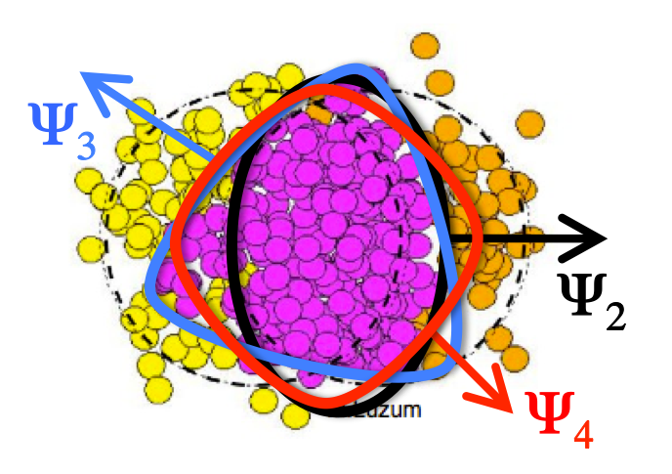
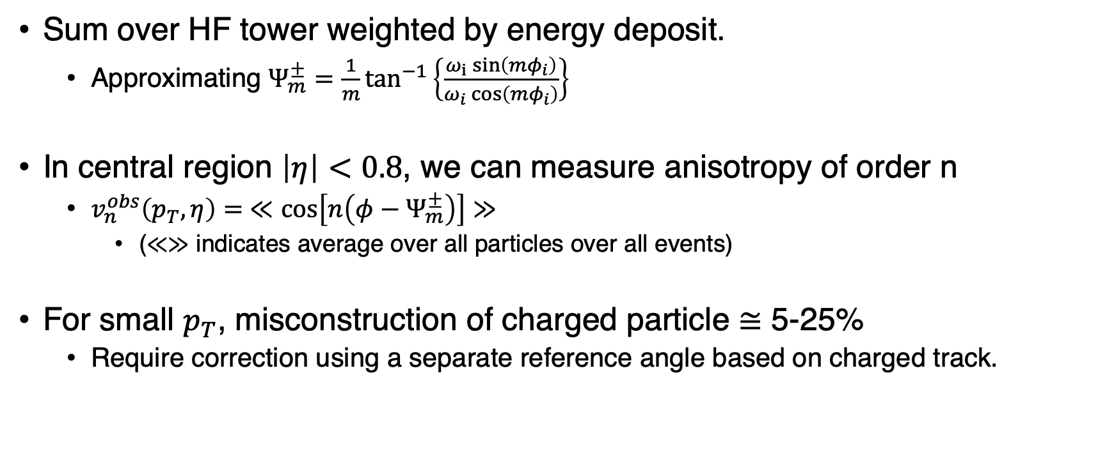
Methods (Event-Plane)
Sum over HF tower weighted by energy deposit.
  Approximating $Ψ_{m}^{±}=\frac{1}{m}\tan^{−1}\left\{\frac{ω_{i}\sin\left(mφ_{i}\right)}{ω_{i}\cos\left(mφ_{i}\right)}\right\}$
In central region $\left|η\right|<0.8$, we can measure anisotropy of order n
  $v_{n}^{obs}\left(p_{T}, η\right)= ≪\cos\left[n\left(φ−Ψ_{m}^{±}\right)\right]≫$
    ($≪≫$ indicates average over all particles over all events)
For small $p_{T}$, misconstruction of charged particle $≅$ 5-25%
  Require correction using a separate reference angle based on charged track.

Slide 9
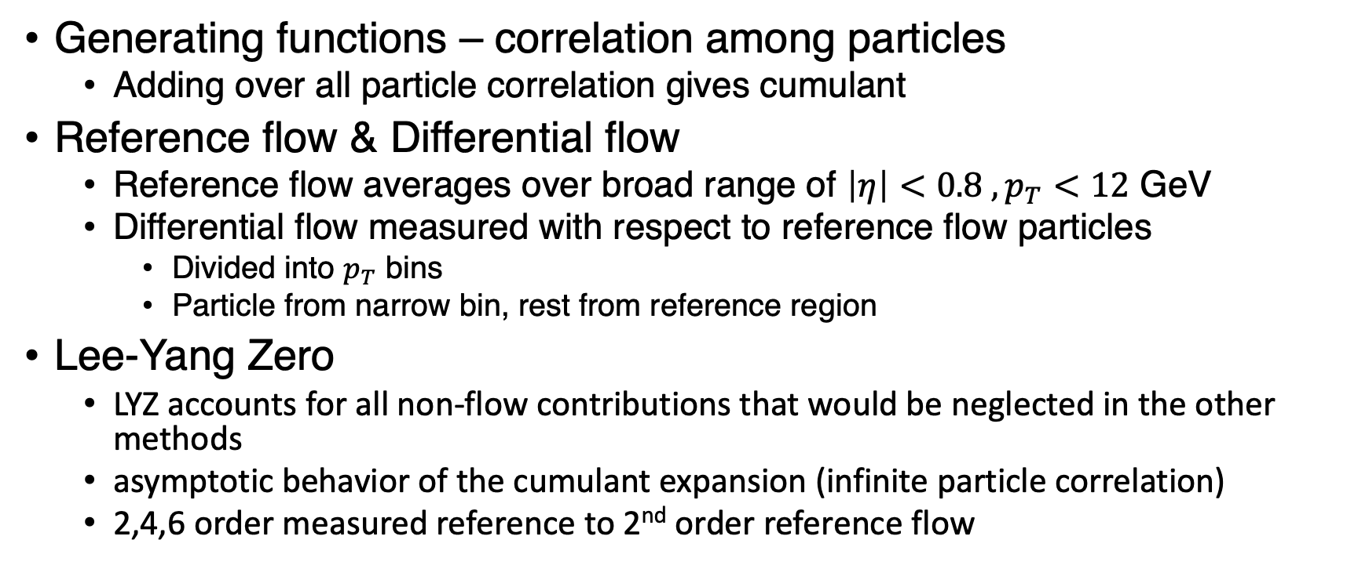
Methods (Cumulant & Lee-Yang Zero)
Generating functions – correlation among particles
  Adding over all particle correlation gives cumulant
Reference flow & Differential flow
  Reference flow averages over broad range of $\left|η\right|<0.8 , p_{T}<12$ GeV
  Differential flow measured with respect to reference flow particles
    Divided into $p_{T}$ bins
    Particle from narrow bin, rest from reference region
Lee-Yang Zero
  LYZ accounts for all non-flow contributions that would be neglected in the other methods
  asymptotic behavior of the cumulant expansion (infinite particle correlation)
  2,4,6 order measured reference to 2nd order reference flow

Slide 10
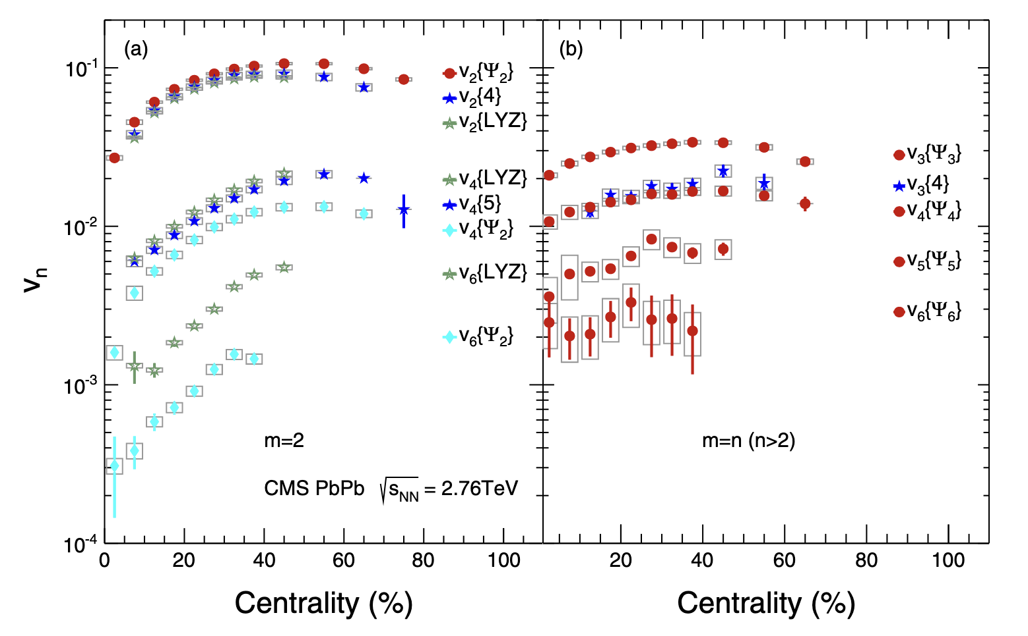
Results
(Left) Second order anisotropy
highly depends on the
centrality
(Right) Higher order terms
no effected by geometry
of QGP, rather shows
flat distribution

Slide 11
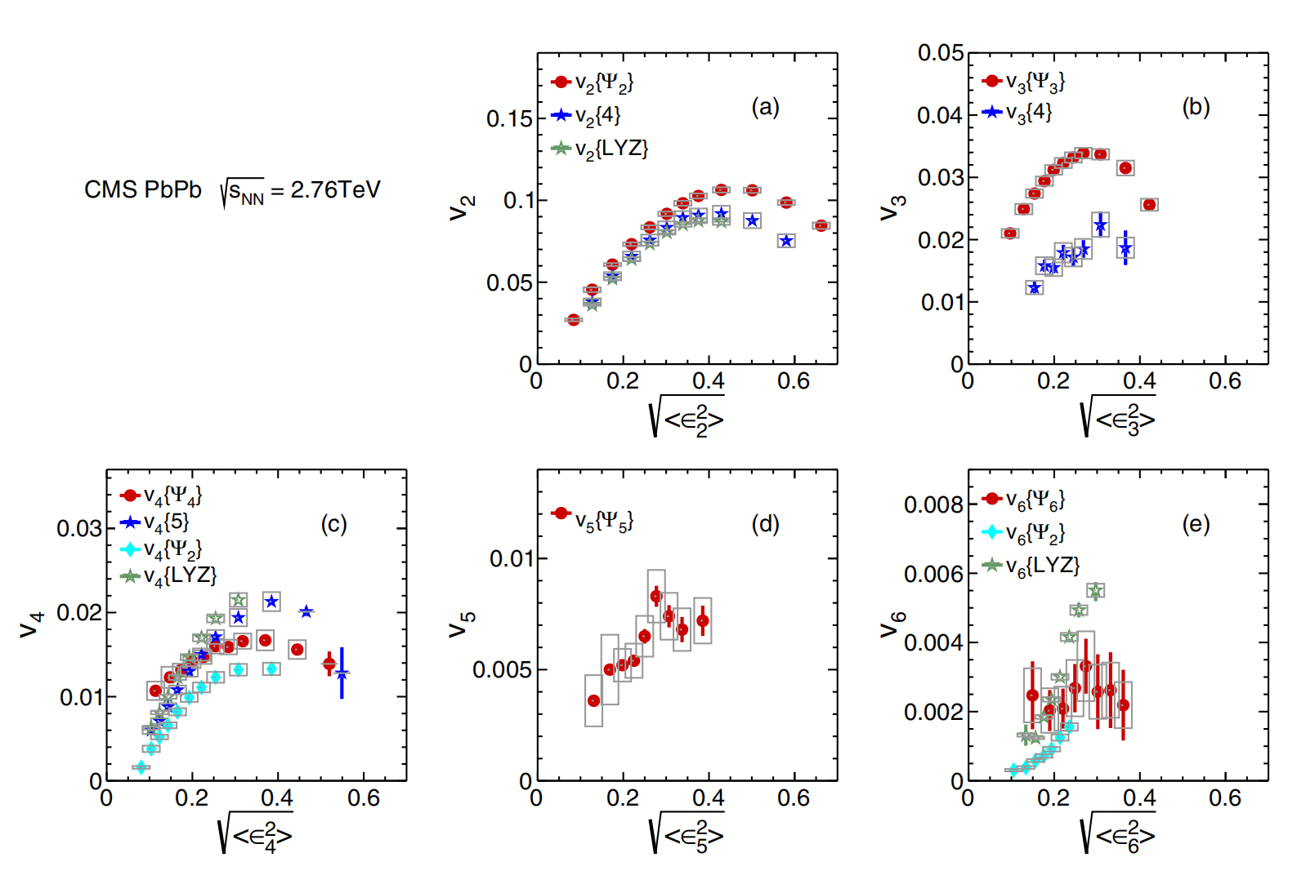

Results
Eccentricity vs anisotropy
Linear response at low $ε$
Large $ε$ → smaller QGP
  Not enough time for particle
  to interact with QGP

Slide 12
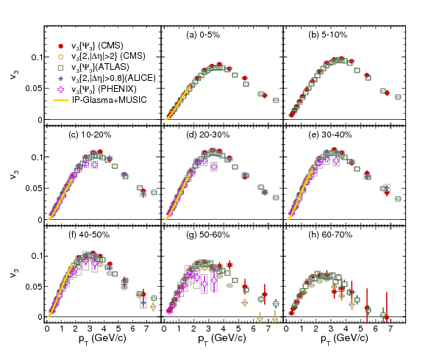
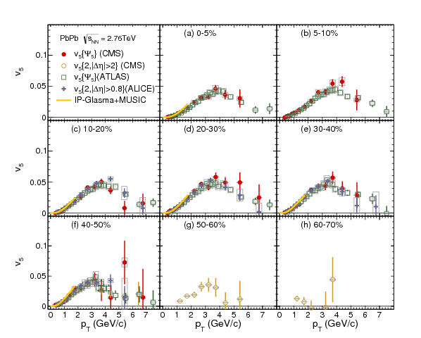


Results
$$v_{3 } \text{vs} p_{T}$$
$$v_{5 } \text{vs} p_{T}$$
CMS, ATLAS, ALICE, PHENIX and IP-Glasma + MUSIC model

Slide 13
Summary
High order anisotropy should carry QGP information
  Initial condition, viscosity, speed of sound, fluctuation
Using three different method, the higher order anisotropies were measured
Furthermore, results of second order measurement compared among different methods and experiments
Many model assumptions of QGP seems to agree with the data.

Slide 14
Back up

Slide 15
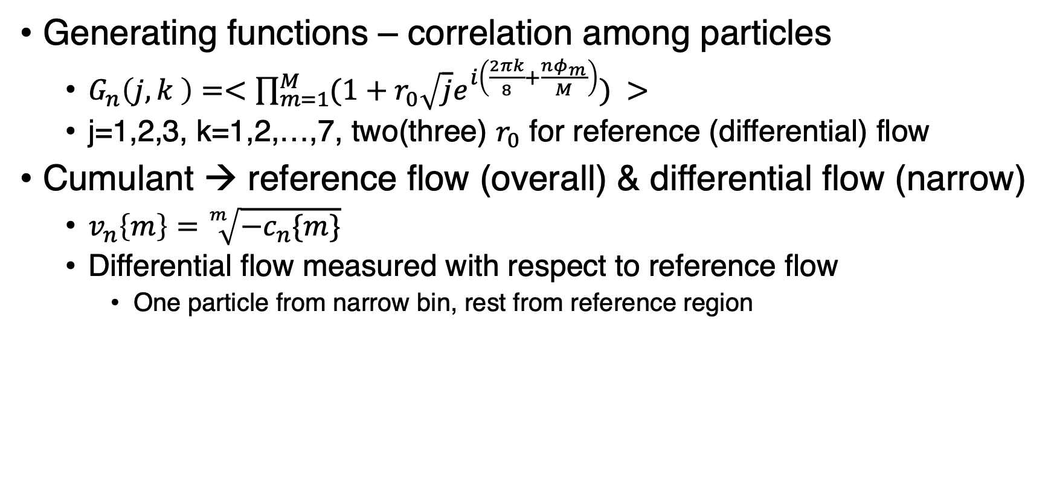
Methods (Cumulant & Lee-Yang Zero)
Generating functions – correlation among particles
  $G_{n}\left(j,k \right)=<{\prod_{m=1}^{M}{(1+r_{0}\sqrt{j}e^{i\left(\frac{2πk}{8}+\frac{nφ_{m}}{M}\right)})}}^{ }>$
  j=1,2,3, k=1,2,…,7, two(three) $r_{0}$ for reference (differential) flow
Cumulant → reference flow (overall) & differential flow (narrow)
  $v_{n}\left\{m\right\}=\sqrt[m]{{−c}_{n}\{m\}}$
  Differential flow measured with respect to reference flow
    One particle from narrow bin, rest from reference region

Slide 16
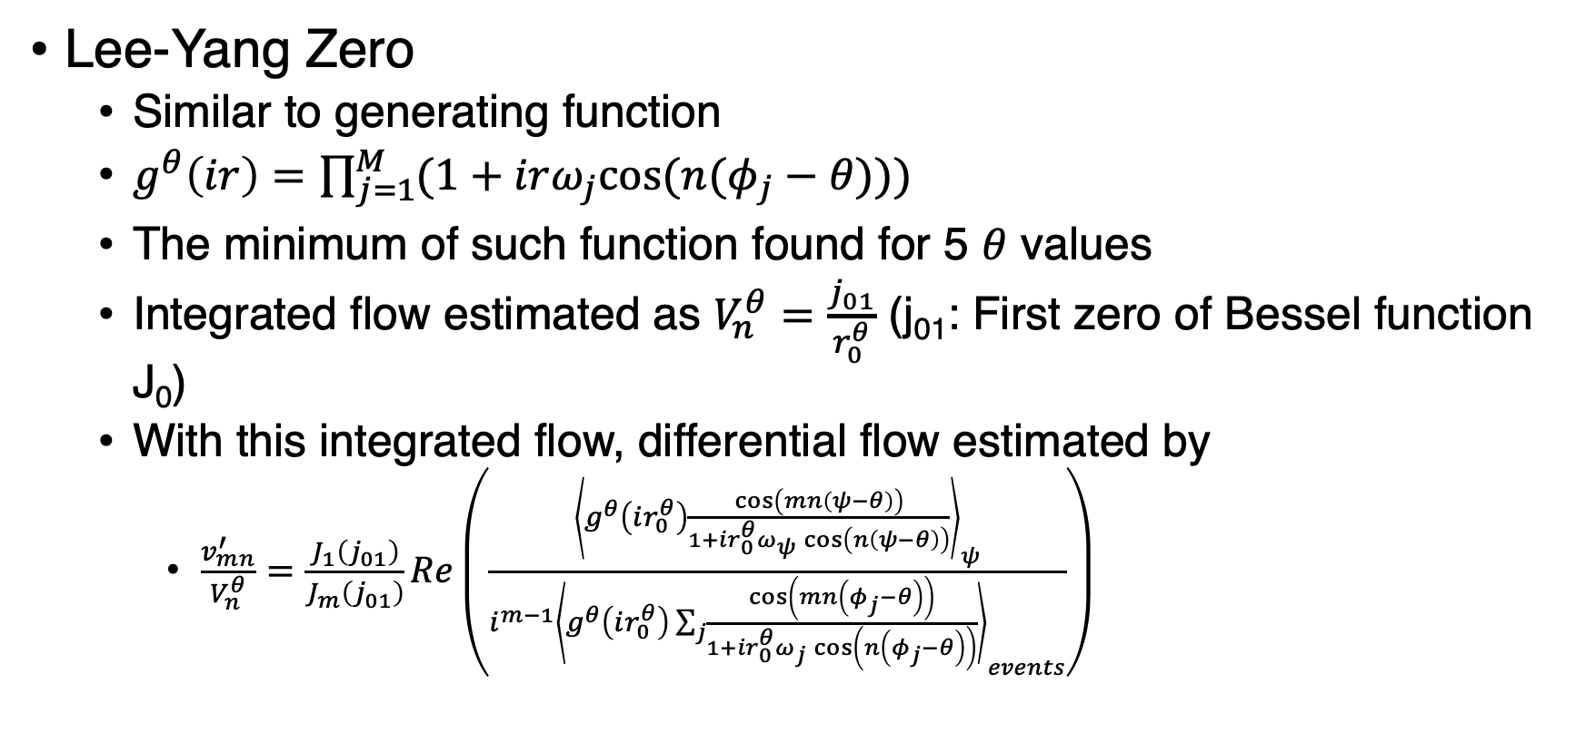
Methods (Lee-Yang Zero)
Lee-Yang Zero
  Similar to generating function
  $g^{θ}\left(ir\right)={\prod_{j=1}^{M}{(1+irω_{j}cos⁡(n(φ_{j}−θ)))}}_{ }$
  The minimum of such function found for 5 $θ$ values
  Integrated flow estimated as $V_{n}^{θ}=\frac{j_{01}}{r_{0}^{θ}}$ (j₀₁: First zero of Bessel function J₀)
  With this integrated flow, differential flow estimated by
    $\frac{v_{mn}^{′}}{V_{n}^{θ}}=\frac{J_{1}\left(j_{01}\right)}{J_{m}\left(j_{01}\right)}Re\left(\frac{{\left\langle g^{θ}\left(ir_{0}^{θ}\right)\frac{\cos\left(mn\left(ψ−θ\right)\right)}{1+ir_{0}^{θ}ω_{ψ}\cos\left(n\left(ψ−θ\right)\right)}\right\rangle }_{ψ}}{i^{m−1}{\left\langle g^{θ}\left(ir_{0}^{θ}\right)\sum_{j}{\frac{\cos\left(mn\left(φ_{j}−θ\right)\right)}{1+ir_{0}^{θ}ω_{j}\cos\left(n\left(φ_{j}−θ\right)\right)}}\right\rangle }_{events}}\right)$

Slide 17
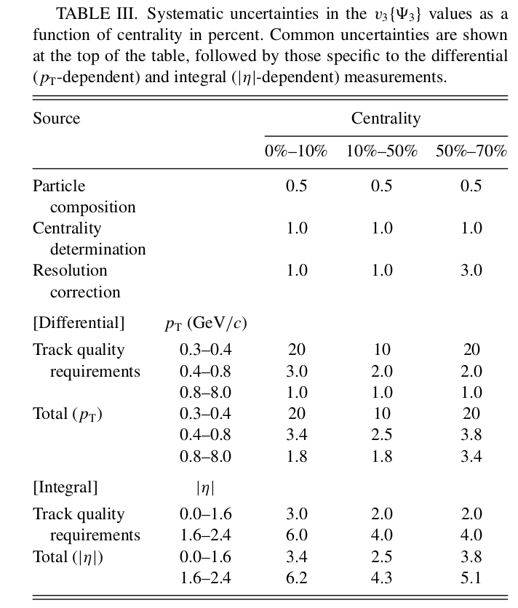
Event-Based Systematics
Different hadrons can have different v_{n} values and tracking efficiency affecting the unidentified, charged-particle results.
v_{n} sensitivity to centrality calibration by trigger efficiency scale ±3%.
HF+ and HF− resolution difference correction. (Significant in high order)
Various track quality requirements (pointing back to vertex, goodness-of-fit…).

Slide 18
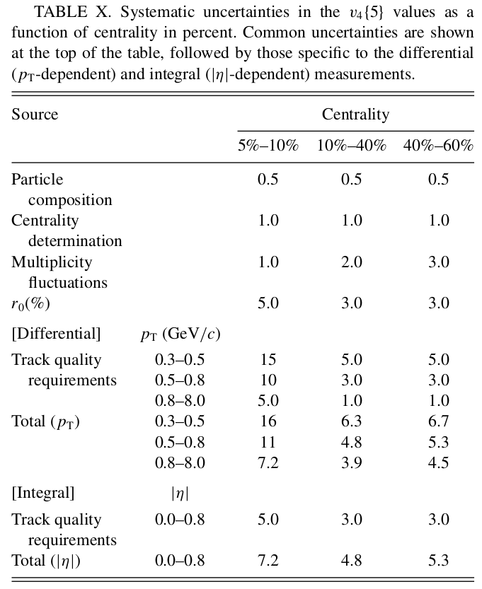
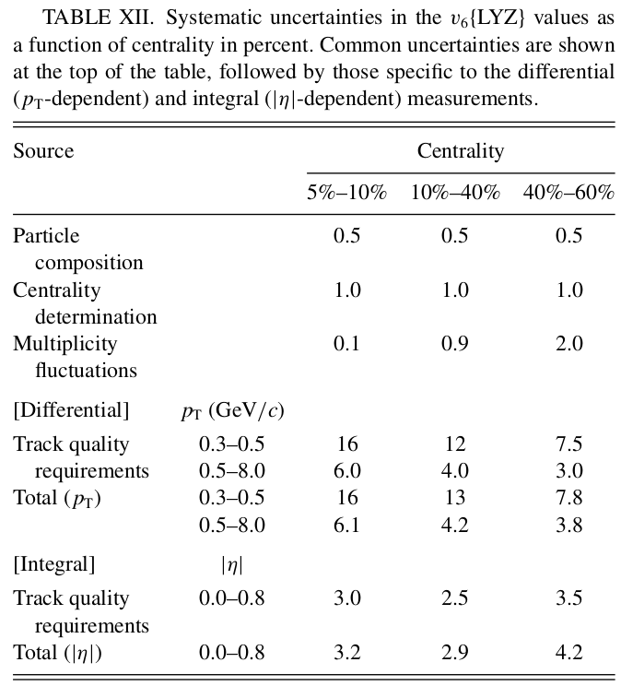
Cumulant and LYZ Systematics
Different $r_{0}$ parameter
results with and without the selection of 80% of the mean multiplicity.

Slide 19
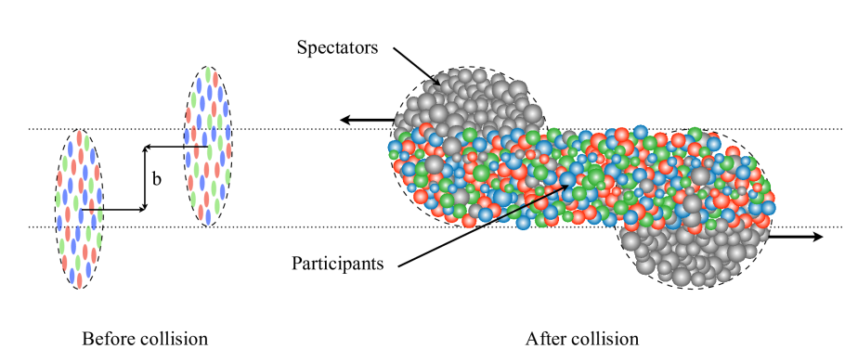

Heavy Ion Model
Glauber model
  Collision model
Color Glass Condensate (CGC) model
  Nucleus model before collision
High energy
Color Glass Condensate (CGC)
Dense gluonic states in hadrons which universally appear in the high-energy limit of scattering
  When the density of gluons becomes high,
  they start to interact with each other → CGC
Fluctuations of a fast moving parton become real particles in reactions
the nucleus-nucleus interaction in terms of elementary nucleon-nucleon interaction
It assumes
  The nuclei follow a straight-line trajectory
  The nucleons as a point-like object
The anisotropy also depends on the initial conditions,
whether the Glauber-like picture prevails or if gluon-saturated effects, as found in the CGC model

Slide 20
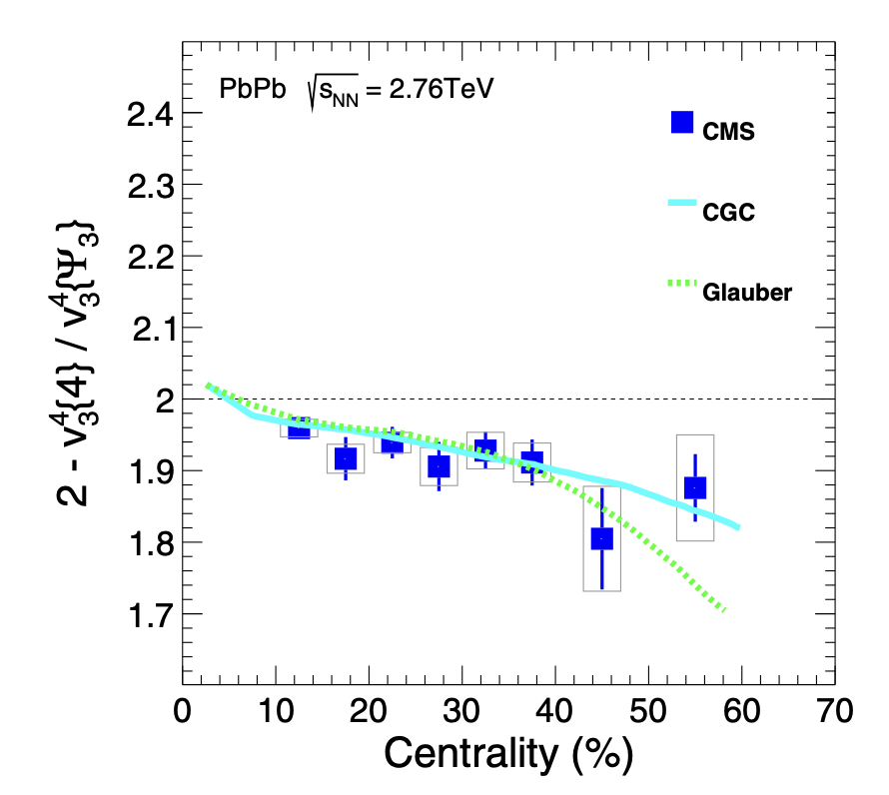
Heavy Ion Model
With this experiment, it cannot be
determined which nuclear model
describes the collision better.

Slide 21
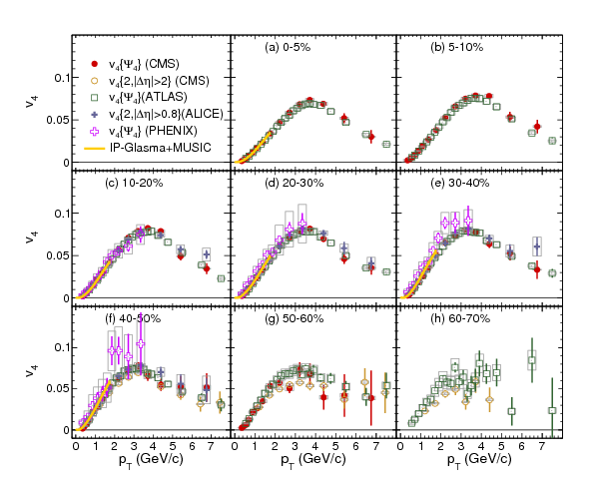
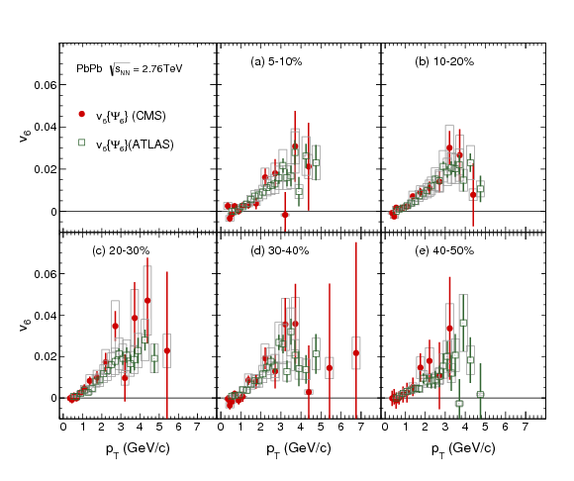
Additional back up
Comparison of the v₄ (left, fig 10) and v₆ (right, fig 12) results of CMS, ATLAS, ALICE, PHENIX and IP-Glasma + MUSIC model

