Slide 1
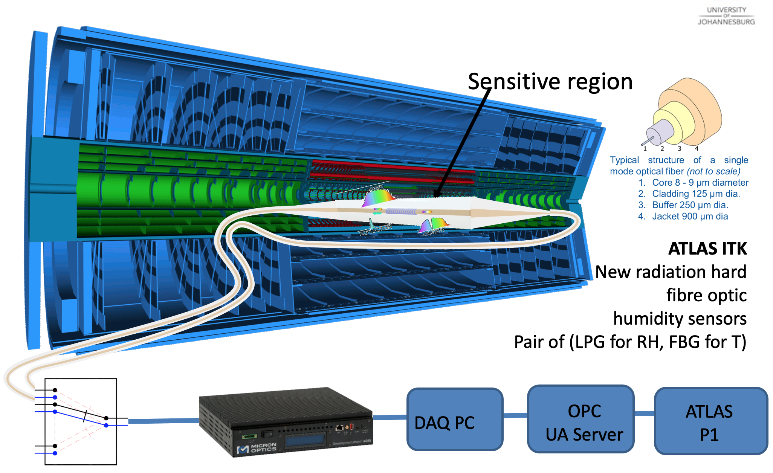
Fibre Optic Sensors in ATLAS … Keep ATLAS Dry !

Slide 2
Humidity in the ITk: Keep ATLAS ITk dry
Novel Fibre Optic Sensor (FOS) system
FOS technology
Rad Hard
Long Term Stability
Sufficiently precise
Need Companion conventional sensor for calibration, then they die
R&D, Procurement, Manufacture, QA, Ongoing development during Run 3
Take charge of feed throughs, cabling
Dashboard at PP1 via OPC Server
R&D
Develop FOS technology further
Bare fibre type selections
Grating writing technology
Functional Coating Technology
Environment Chamber for tests, calibrations
Algorithms for readout, compensation, calibration
Modelling
Continuum Fluid Dynamics (CFD) 3D simulation of fluid flow, thermals, leaks
Operational conditions
Dry-out, normal, fault, bake-out
Future
Manufacture, QA and provide throughout ATLAS ITk : 54 Sensors
More R&D to improve Design, Manufacture, Readout, Performance in long term

Slide 3
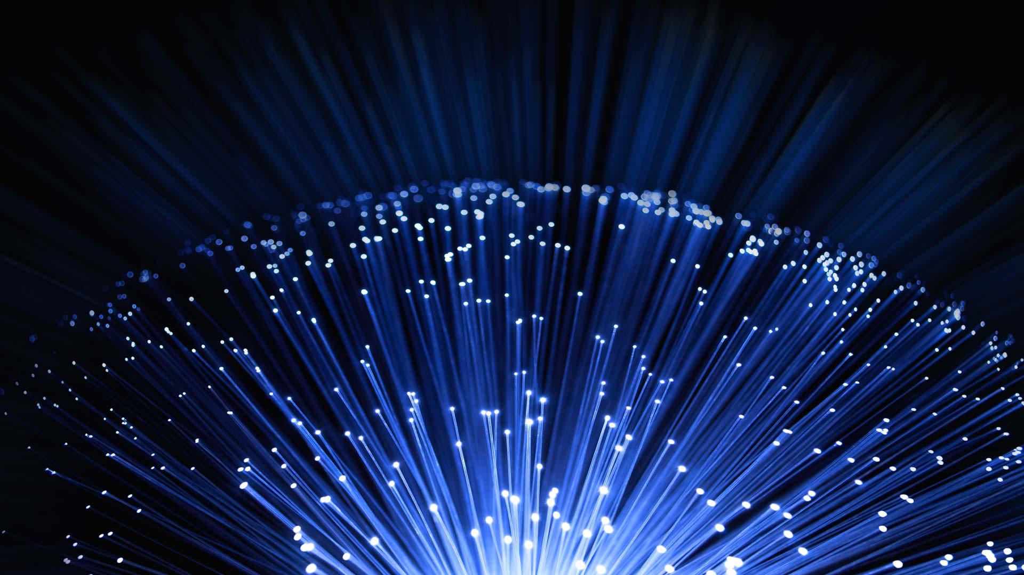
Fibre Optic Sensors : FOS ……. a growth area
ISI Web of Science : fibre + optic + sensor

Slide 4


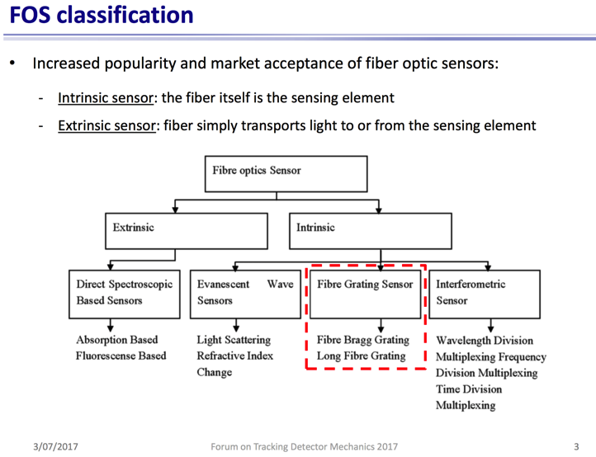
Fibre Optic Sensors : FOS ……. many types
(from G Berruti, Forum on Tracking Detector Mechanics 2017 3 -5- July, CPPM Marseille)
Option :
Functional Coating
to target sensitivity to specific measurement parameter.

Slide 5
Fibre Optic Sensors : FOS ……. advantages
Extreme environments
  Dust, moisture, vacuum, temperature (hot / cold), vibration, EM interference, radiation, aggressive chemicals
Many Sensing Modes
  Strain, temperature, humidity, vibration (including 3-D displacements), many specific bio-molecules, radiation dose
Highly Customisable
Sensitivity (enhanced sensitivity to a single environmental parameter and also relative sensitivity between different environmental parameters)
Dynamic range
Multiplexing factor
Interrogator (Expensive / cheaper)
Type of functional coating (what is sensed)
Parameters of the grating (FBG / LPG / no grating)
Type and treatment of fibre (modes, physics mechanism)
Smart
Light, near microscopic in size, can be embedded, can be mass-produced, durable, stable, wavelength and time encoded (not reliant on absolute intensity), optical readout, (very) remote interrogator, 4IR, IoT, ……

Slide 6
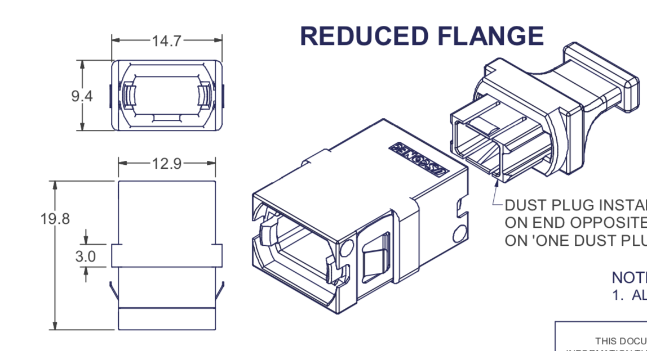
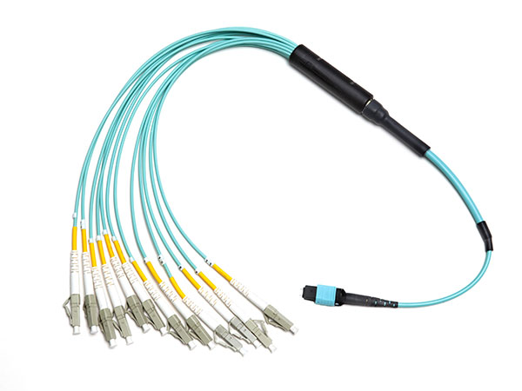
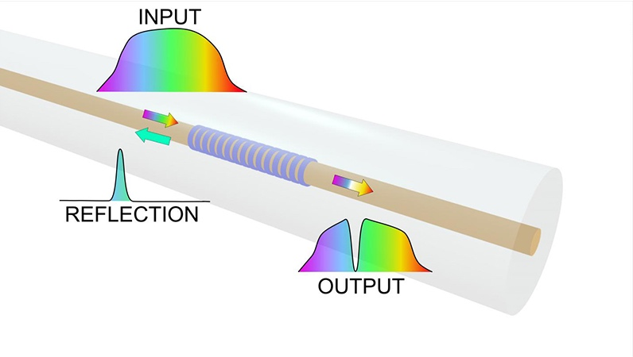
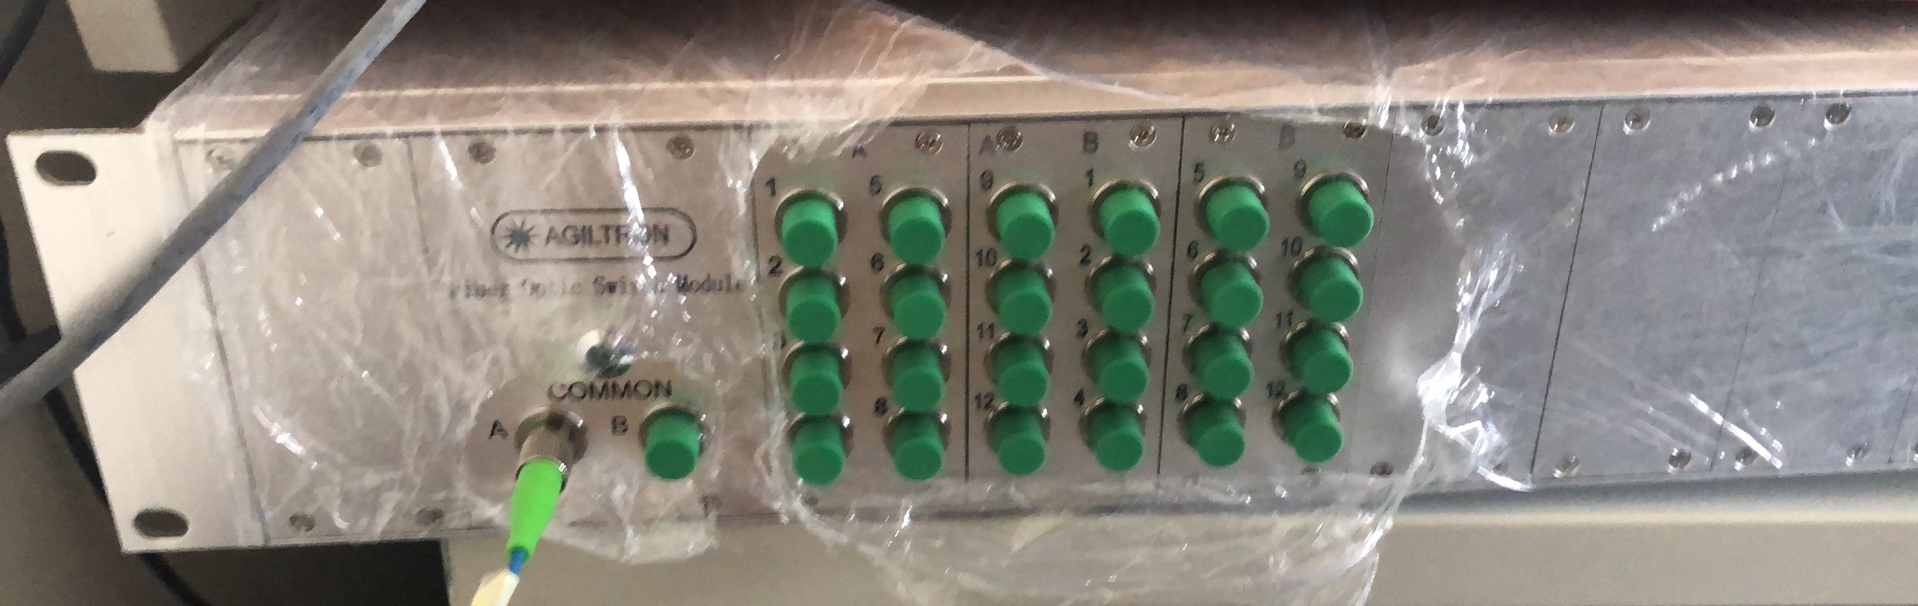

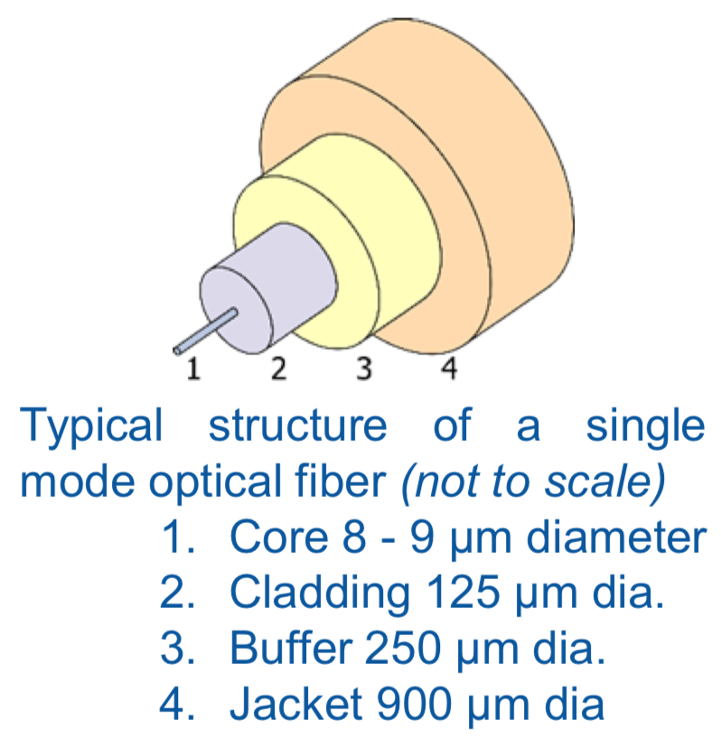
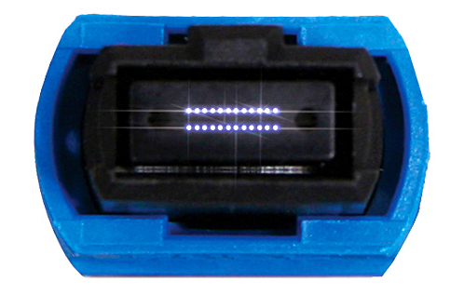
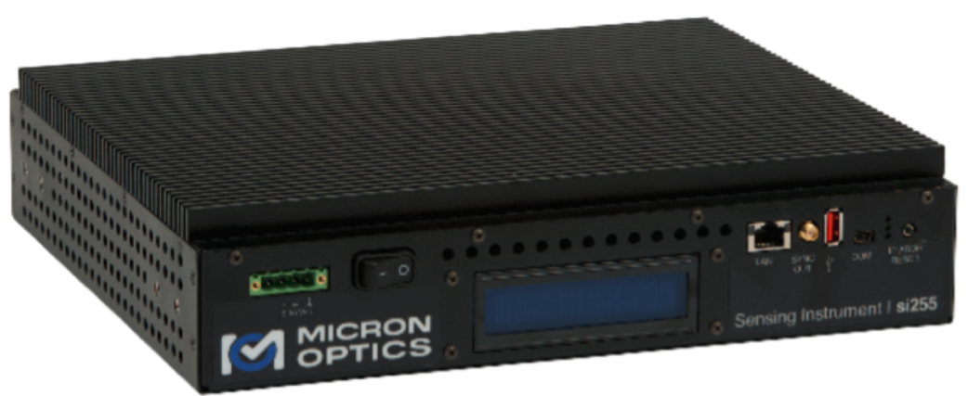
Fibre Optic Sensors
MPT 12 fibre feedthrough
Switch
Credit: Maria Konstantaki, Foundation of Research and Technology - Hellas)

Slide 7
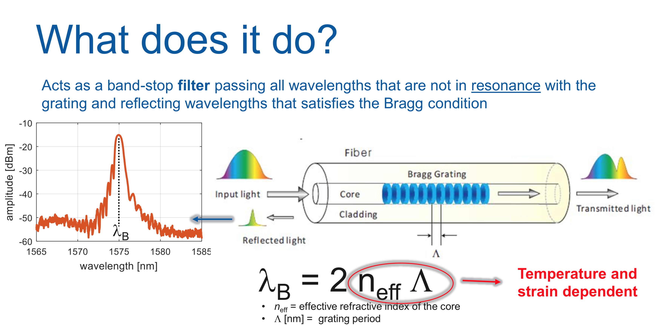
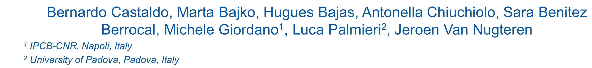
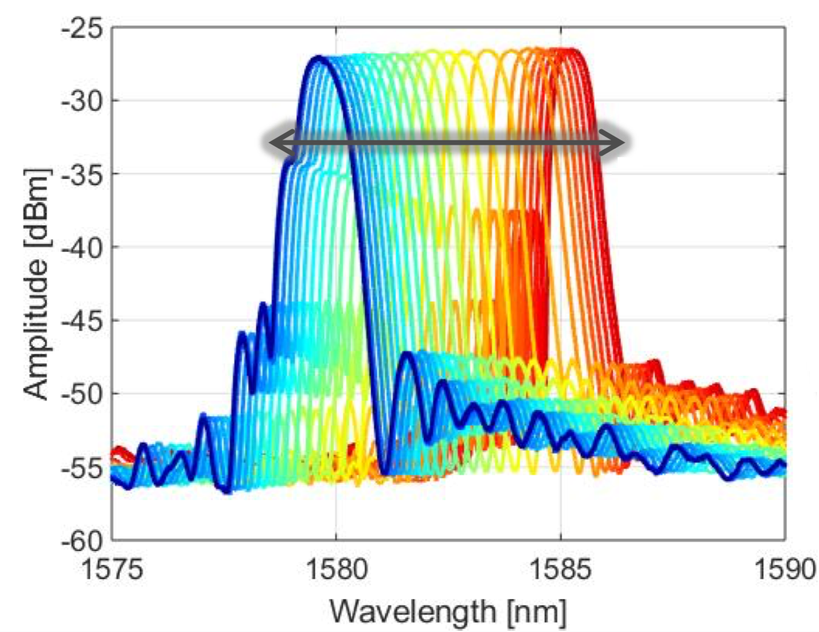
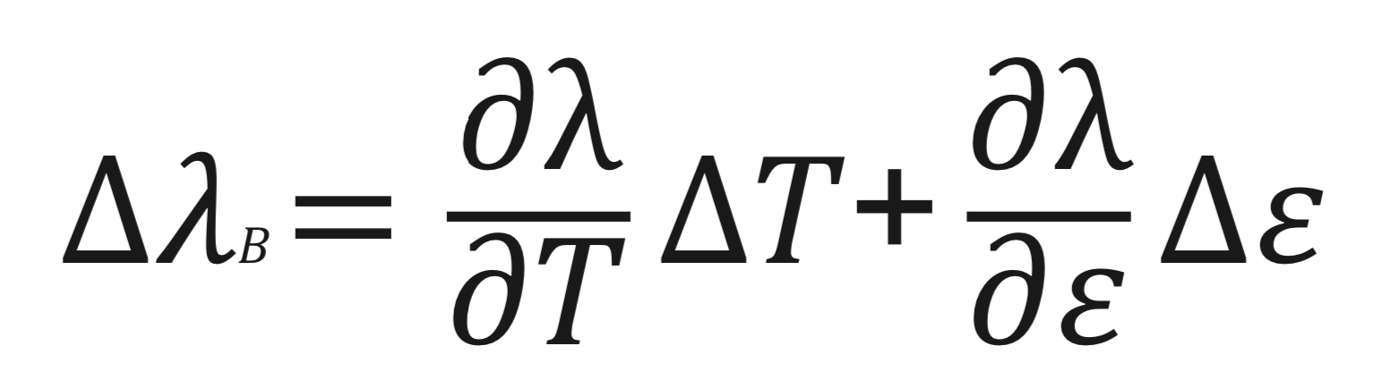
Fibre Optic Sensors : Fibre Bragg Grating (FBG)
From https://indico.cern.ch/event/837593/

Slide 8
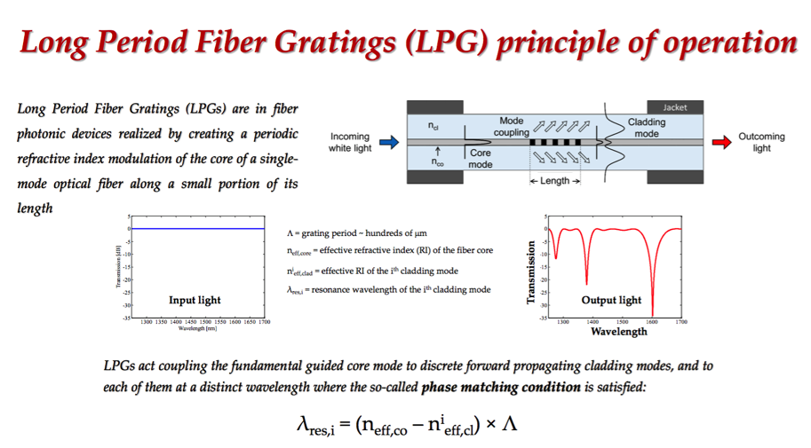
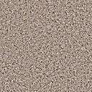
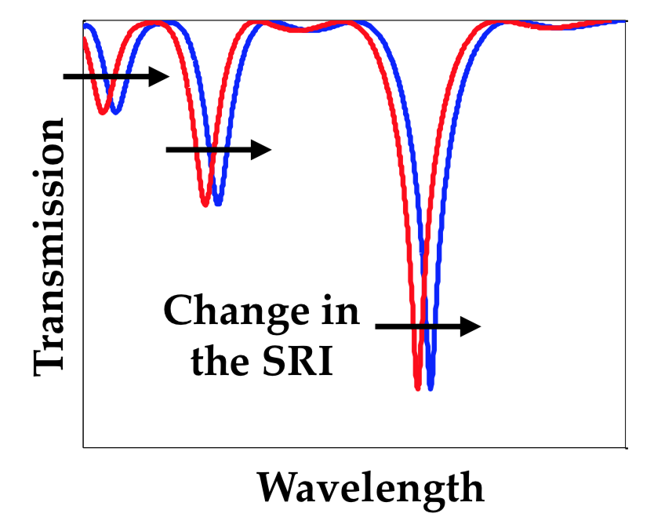
Fibre Optic Sensors : Long Period Grating (LPG)
environment
functional coating
TiO₂
from G. Berruti and A. Cusano
functional coating : nano-crystalline layer of TiO₂ - absorbs H₂O reversibly
Leads to both change in Λ and also n^{i}_{eff,cl}
TiO₂

Slide 9
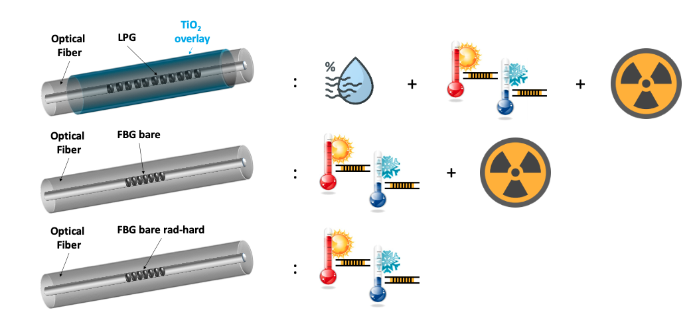
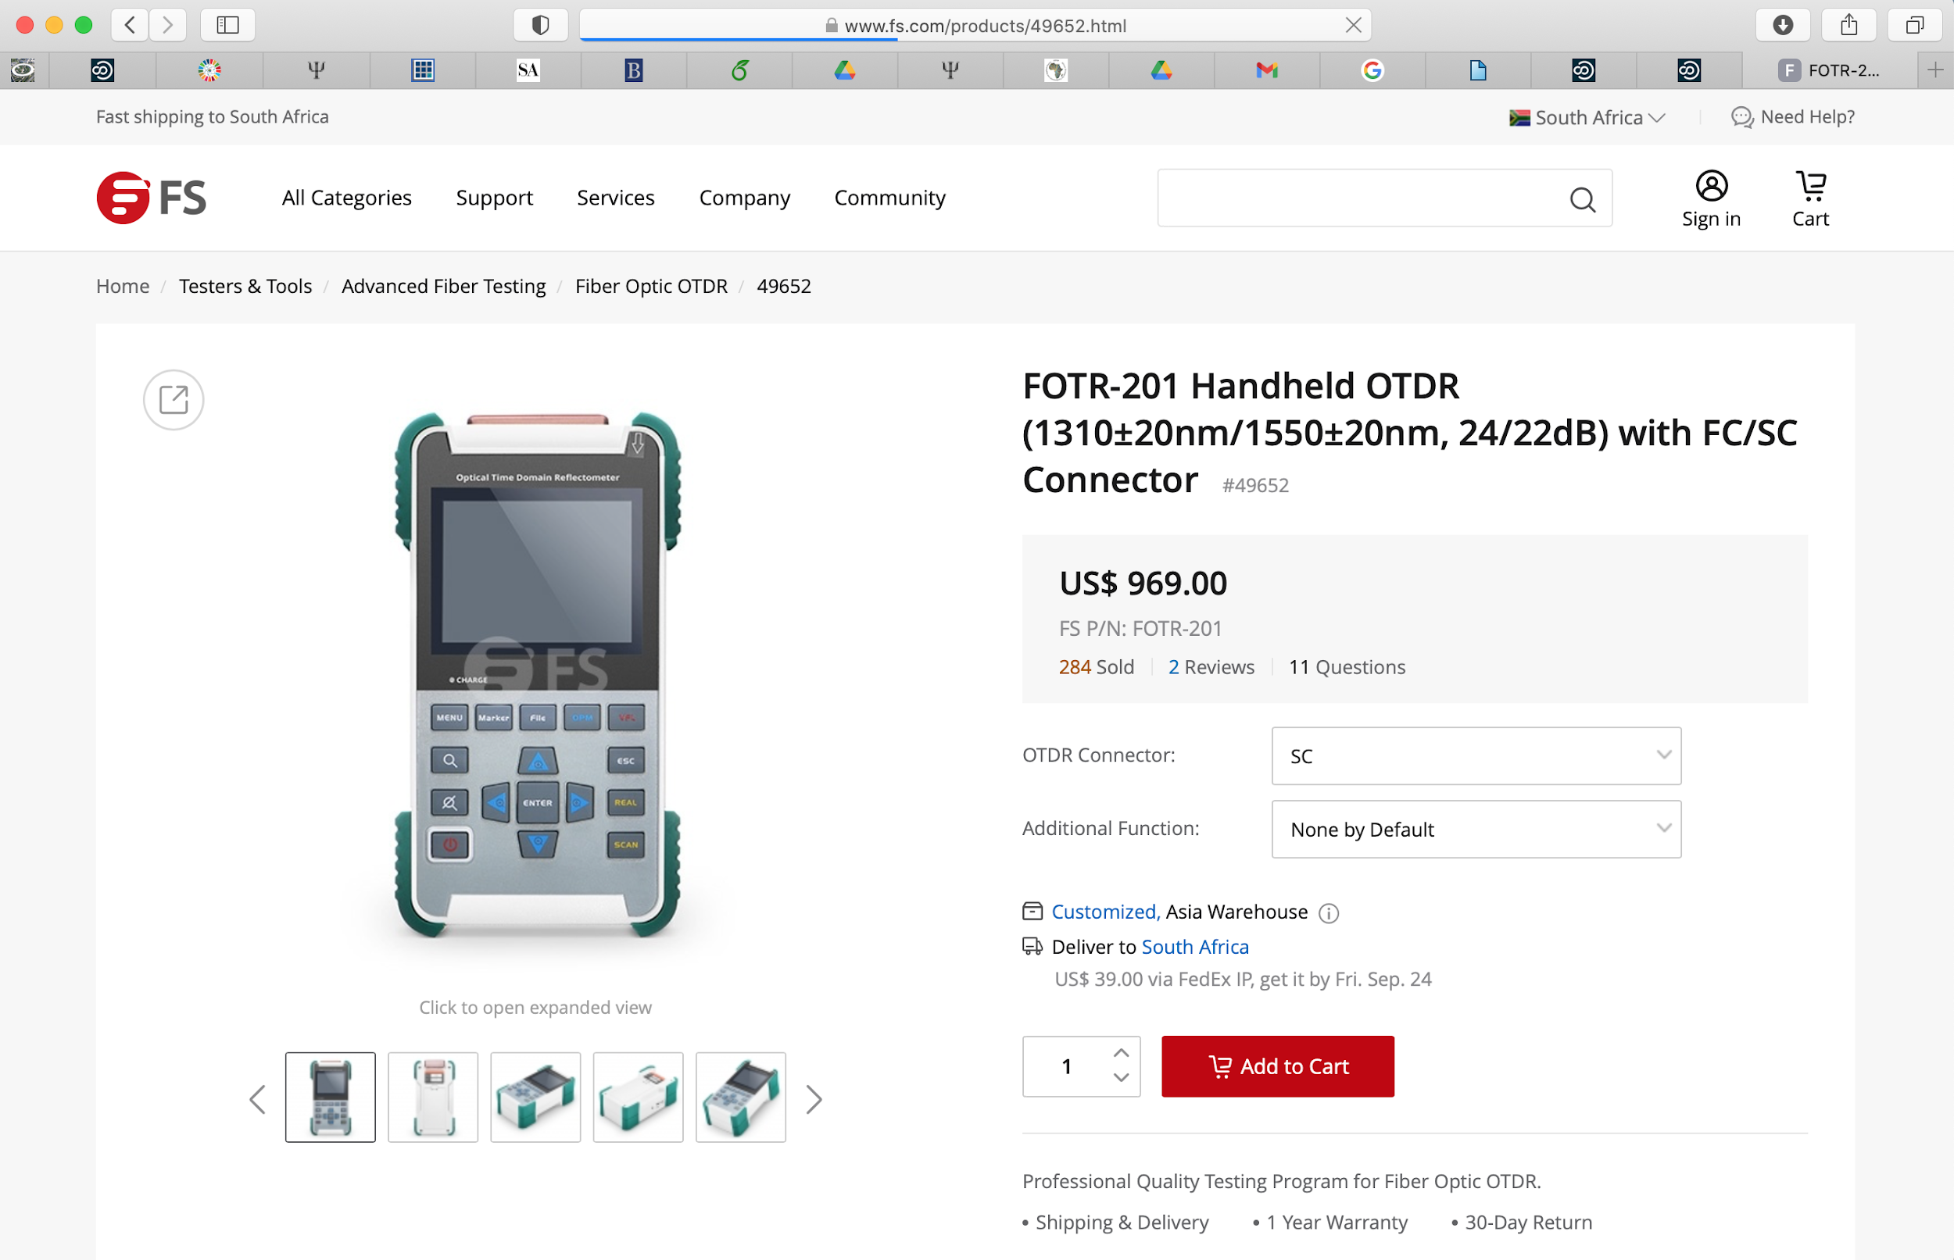
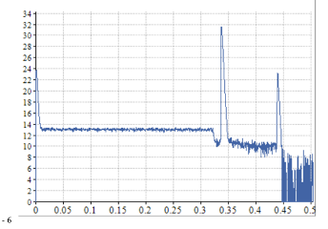
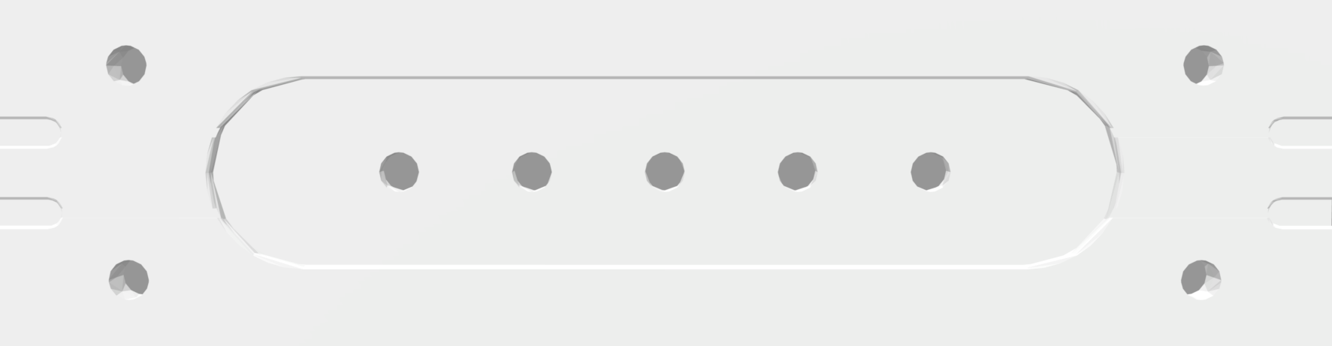


FOS Package and Sacrificial Sensors - overview
RH measurement
by T and Dose compensation
QA during integration by OTDR
FOS Package (54)
Free end as flylead (6m)
Will later splice to flylead from PP1
Length 30cm
LPG (H)
FBG (D)
FBG (T)
>15mm
5 wire Sacrificial Sensors (58)
HIH4000
Pt10k
Mount very close to FOS package holes

Slide 10
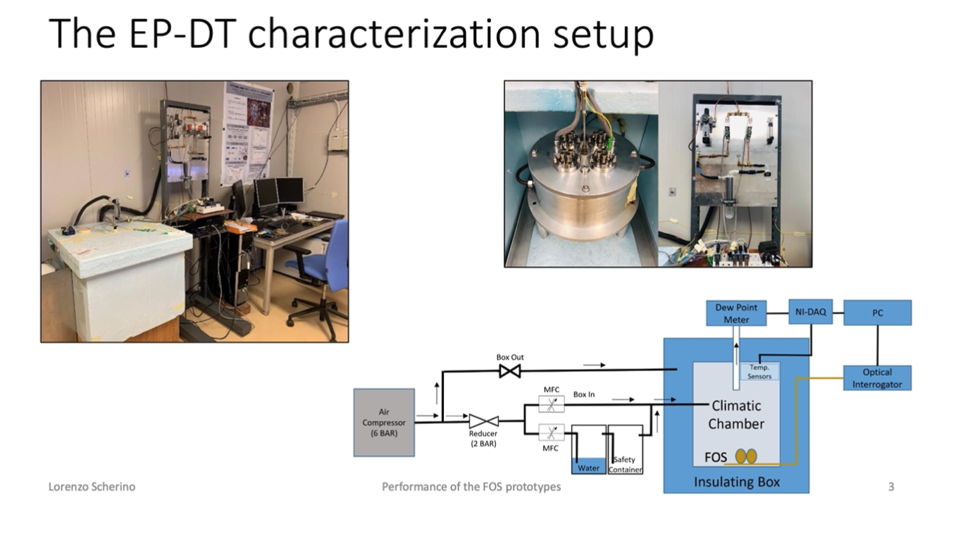
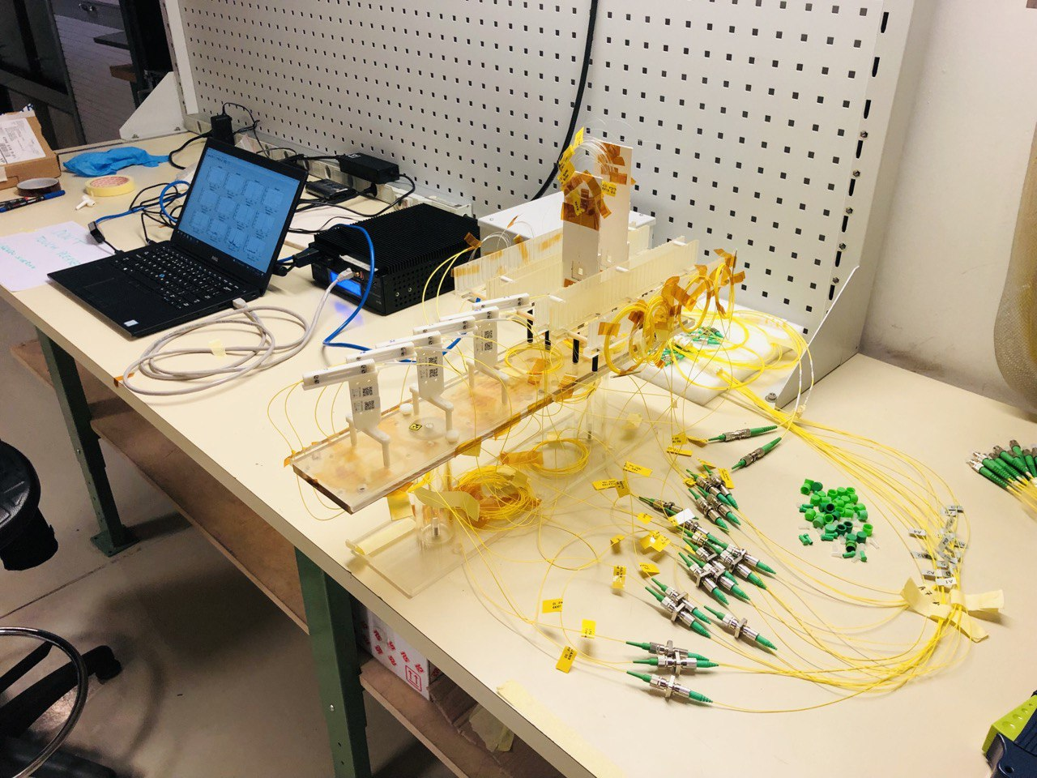
R&D and Manufacture at CERN

Slide 11
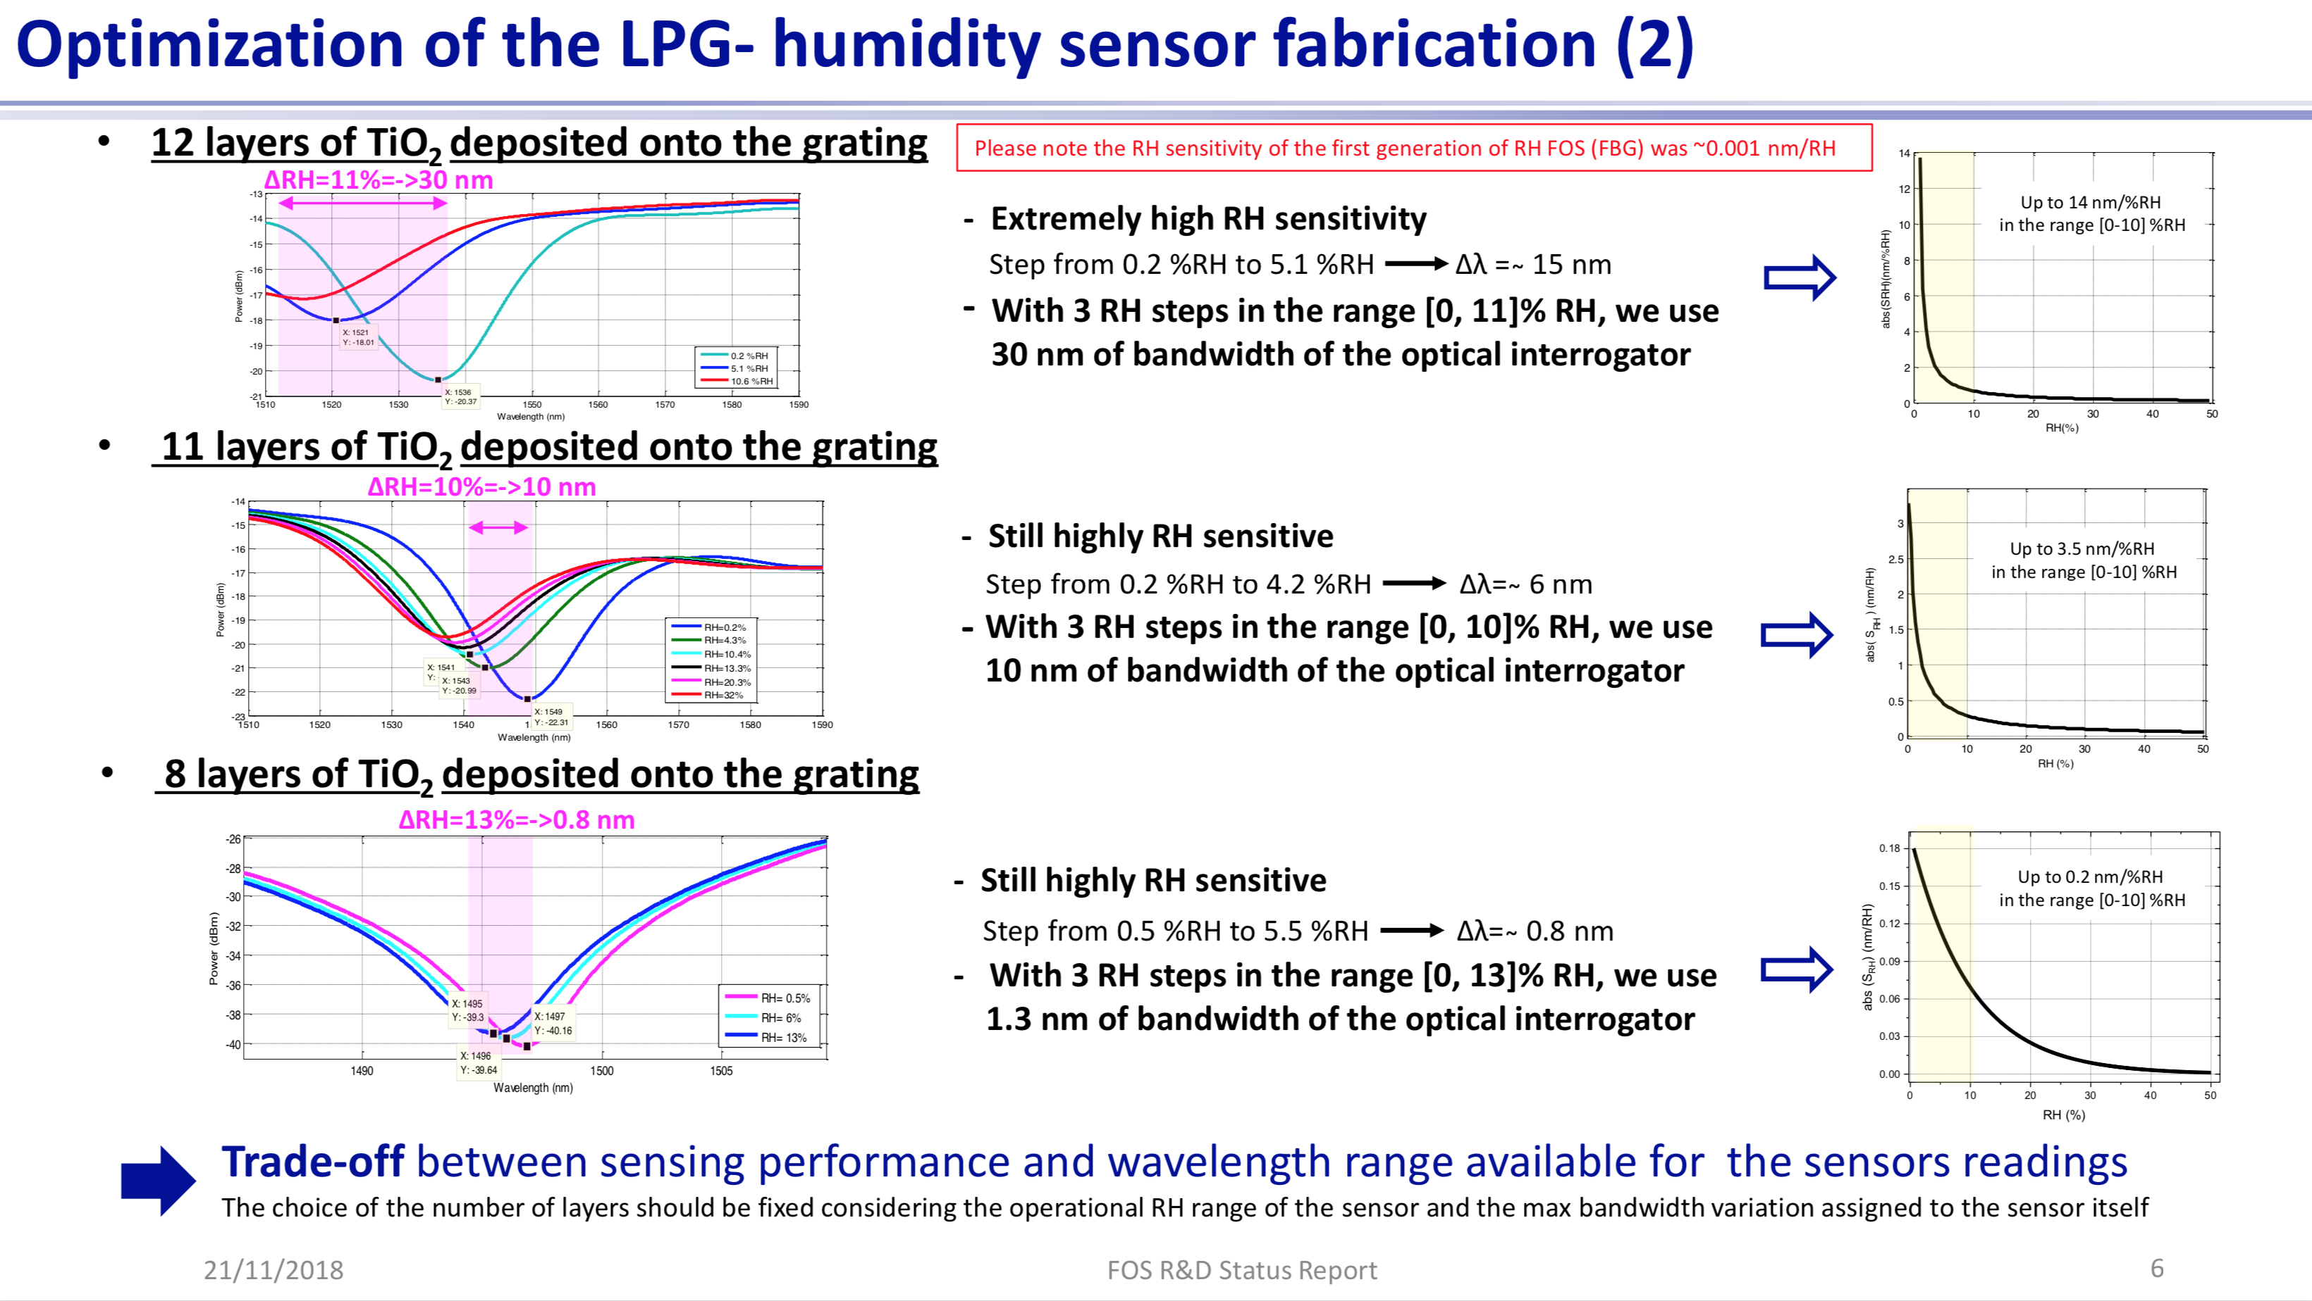
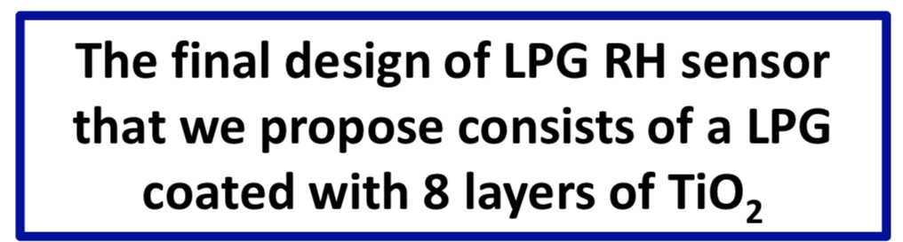

Fibre Optic Sensors : Long Period Grating (LPG) design
Gaia Maria Berruti (EP-DT-FS)

Slide 12
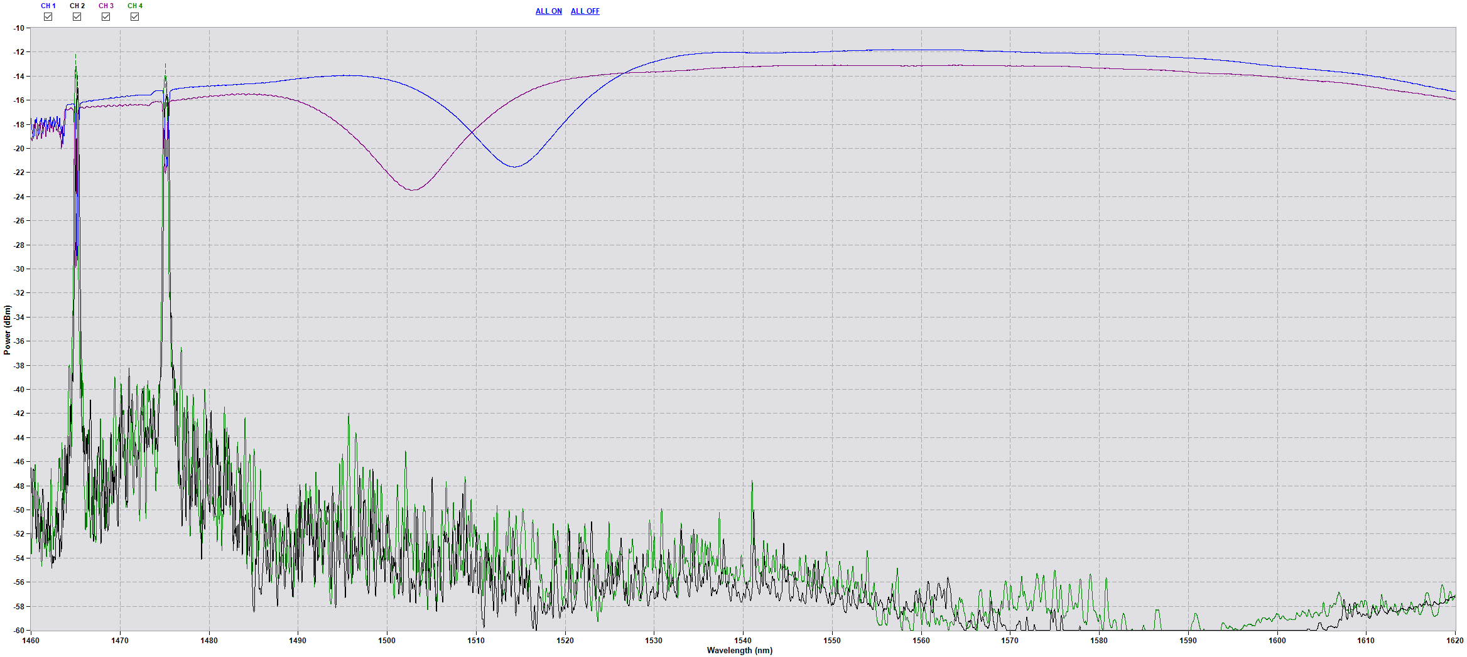
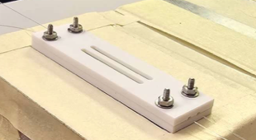
Fibre Optic Sensors : Raw Data
LPG (H)
FBG (T)
LPG (H)
FBG (D)
FBG (T)
FBG (D)

Slide 13
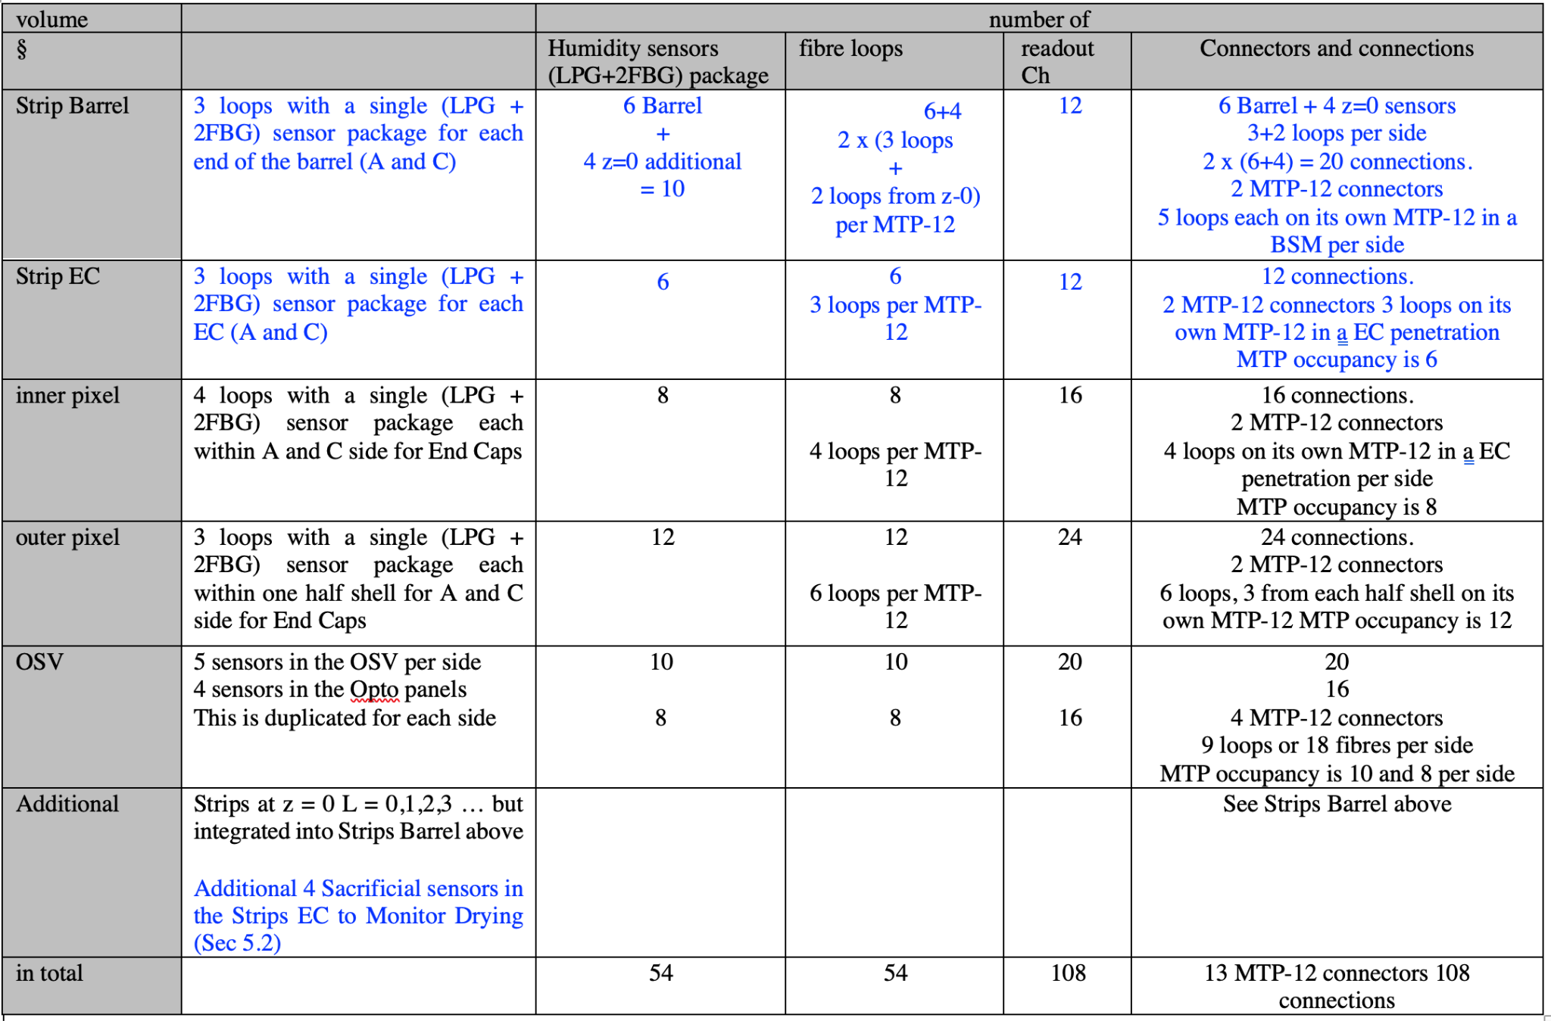
Fibre Optic Sensors : Placements
Recap – Original Number of Sensors … see below …
now 4 Additional FOS + partner Sacrificial + 4 Additional Sacrificial

Slide 14
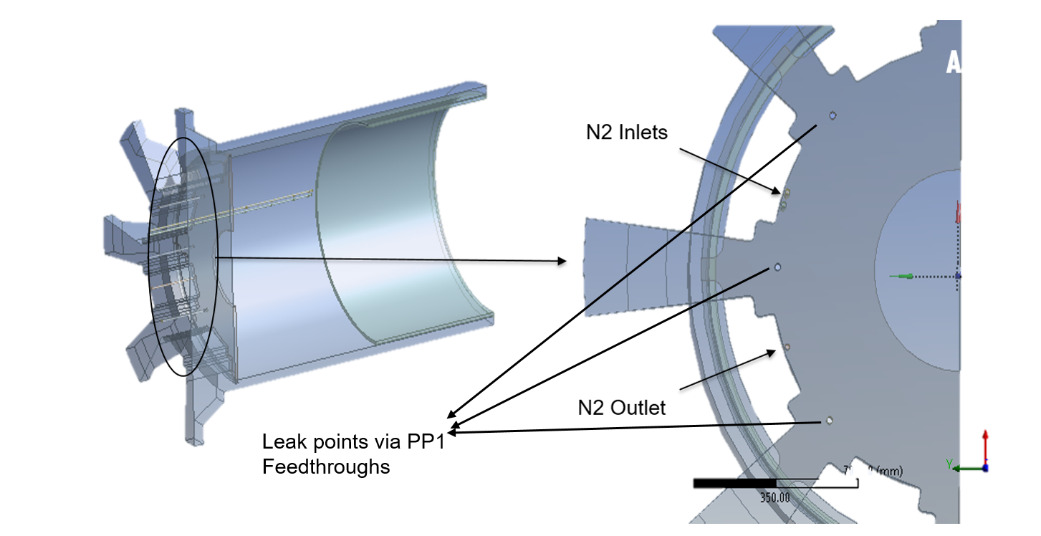
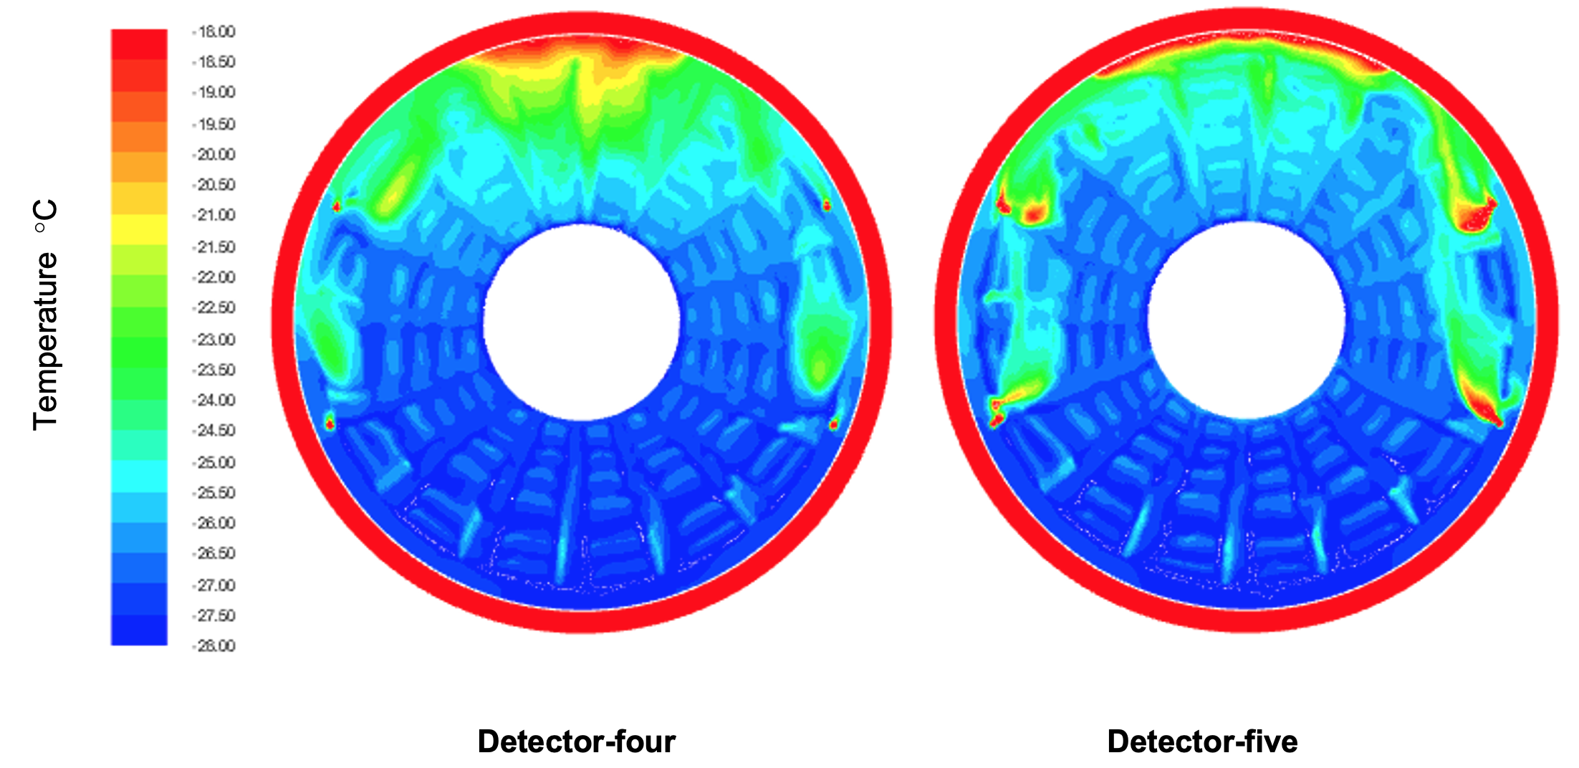
ITk Humidity : CFD : Strips
Showing buoyancy driven internal flow
Flush gas is warm and rises
Fluid temperature visualized on a disk
5 mm away from petals

Slide 15
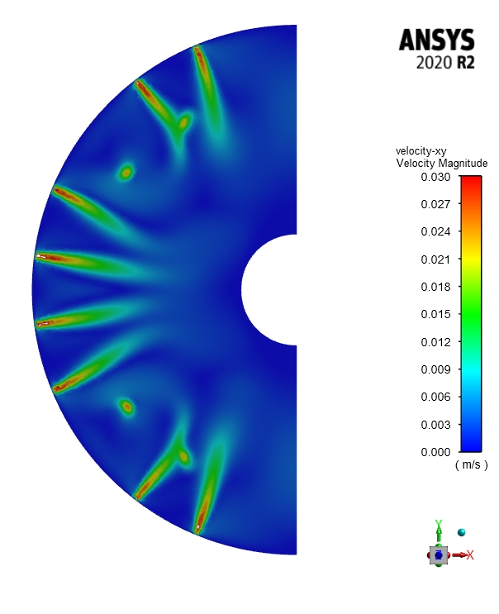
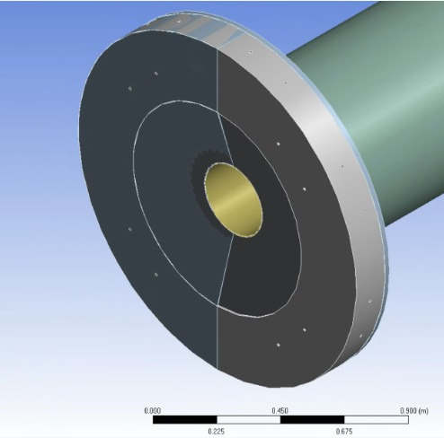
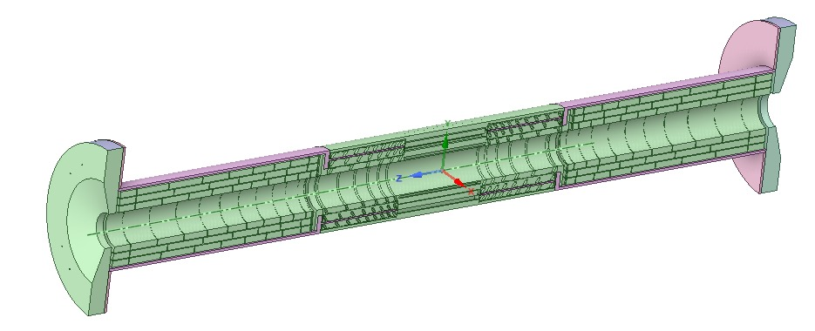
ITk Humidity : CFD : Outer Pixels
Similar plot for outer pixels
Inlet flows shown

Slide 16
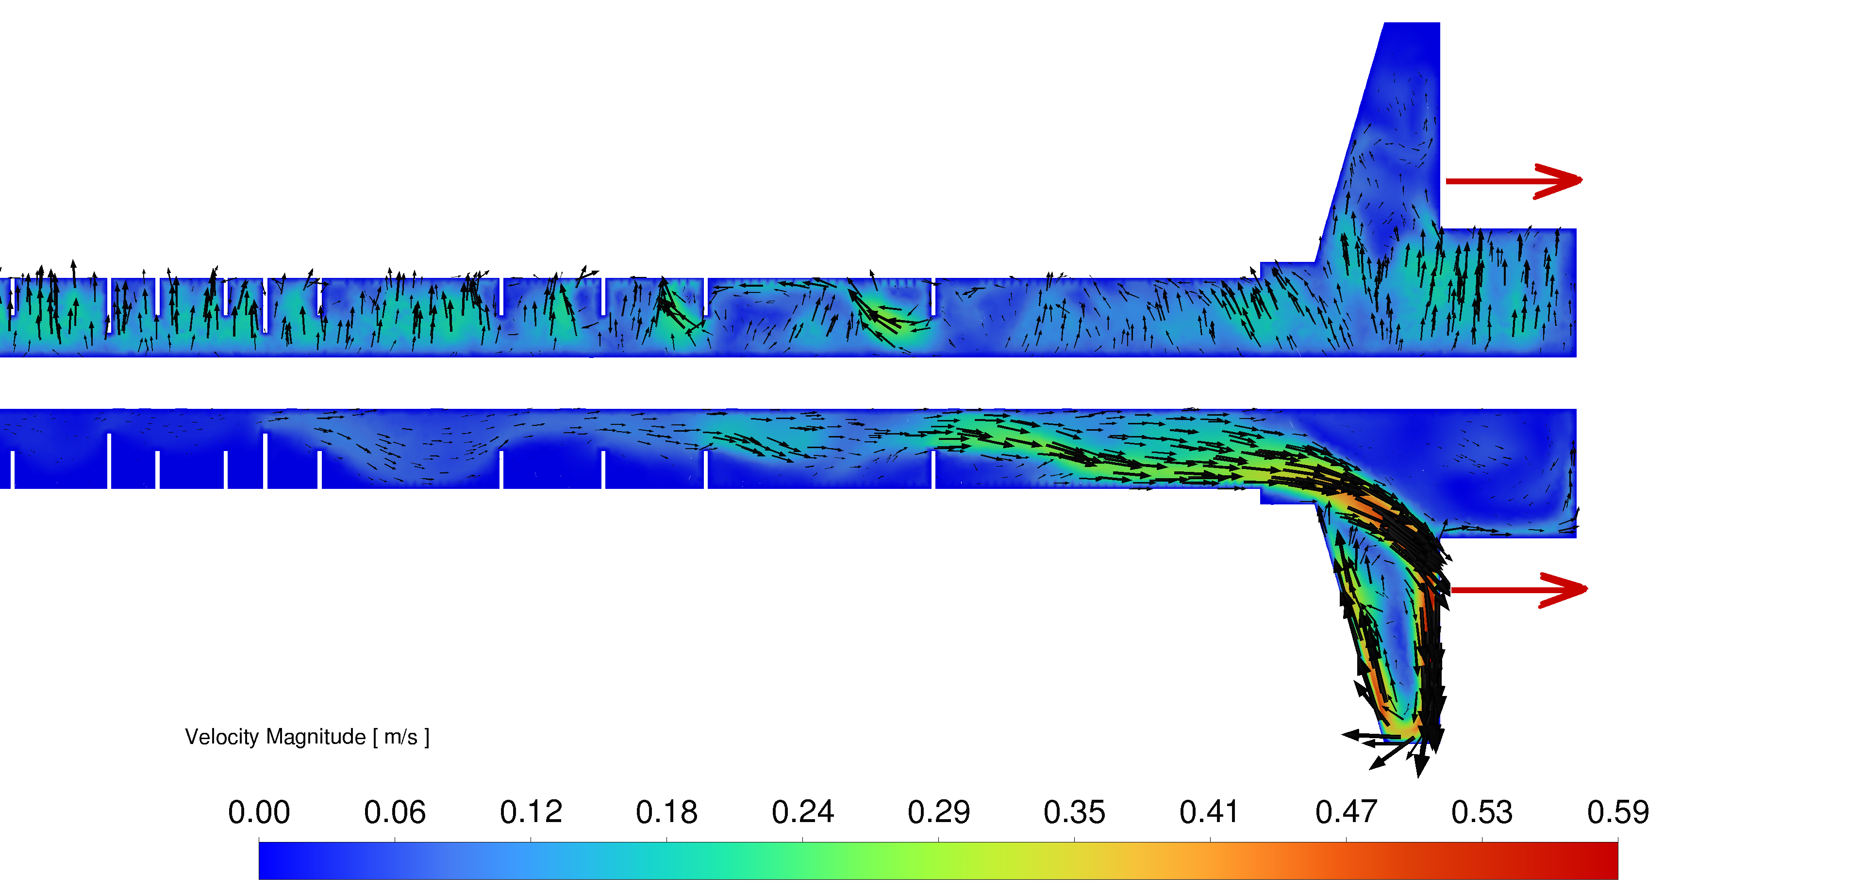
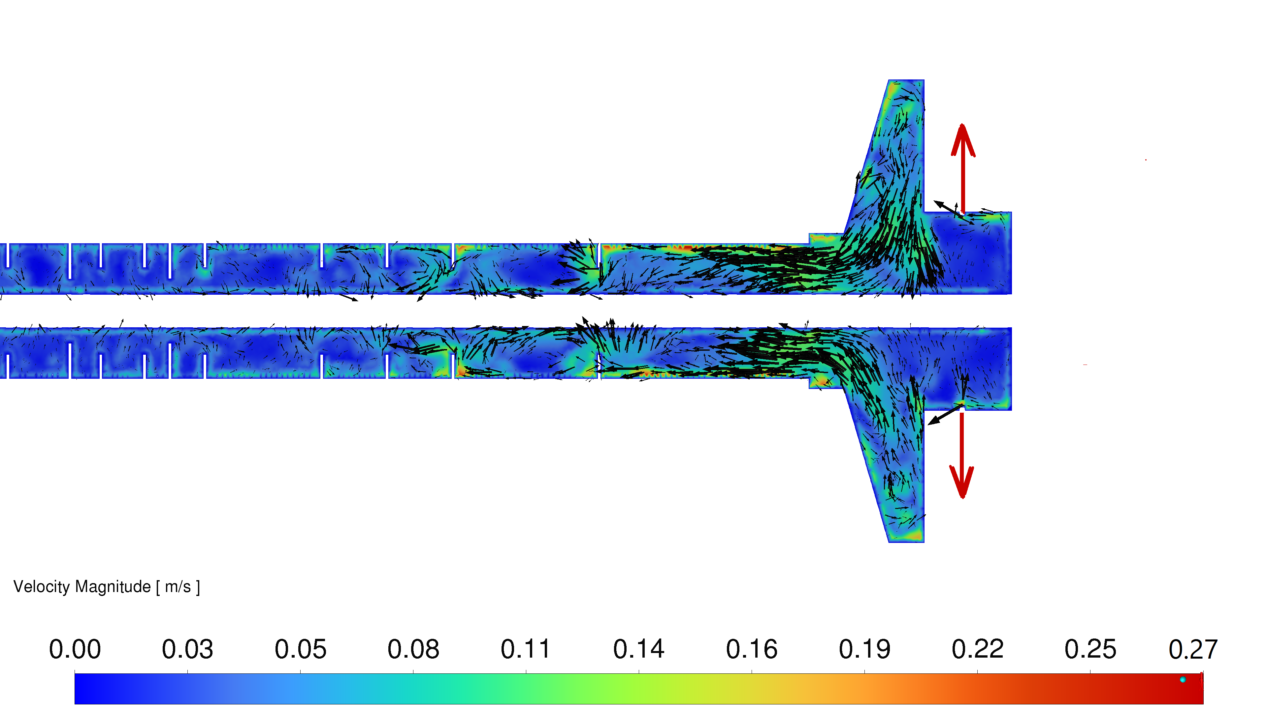
ITk Humidity : CFD : Inner Pixels
Similar flow pattern in inner pixels
Vertical plane
Horizontal plane

Slide 17
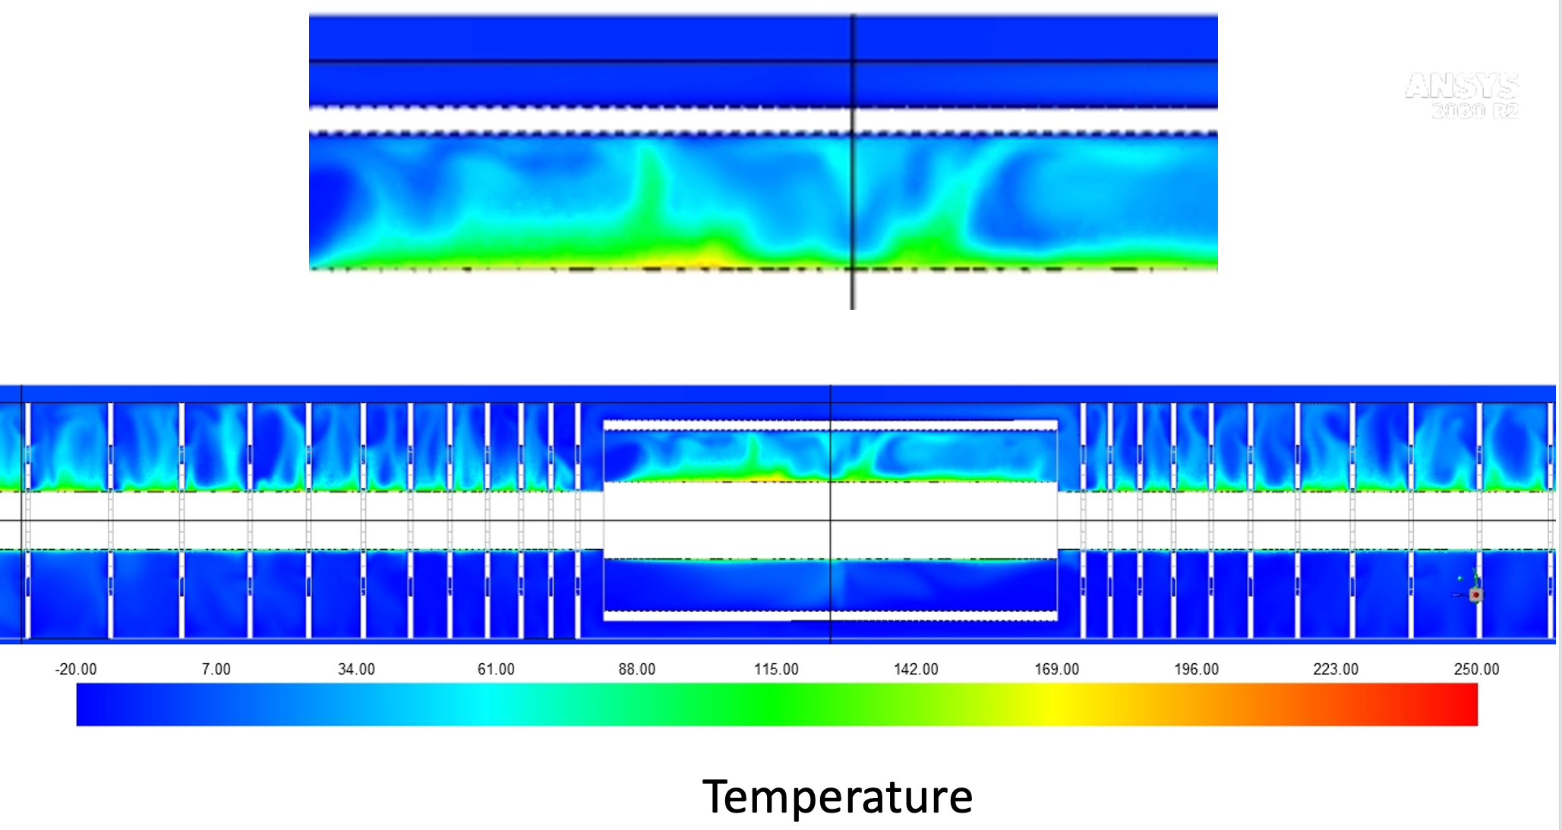
Continuum Fluid Dynamics → CFD : model the fluid system
Simulate fluid flow, drying out, vapour leaks, thermal conditions, sensor placement, performance
Example from ITk Inner Pixels volume …… In this example … bake-out conditions.

Slide 18
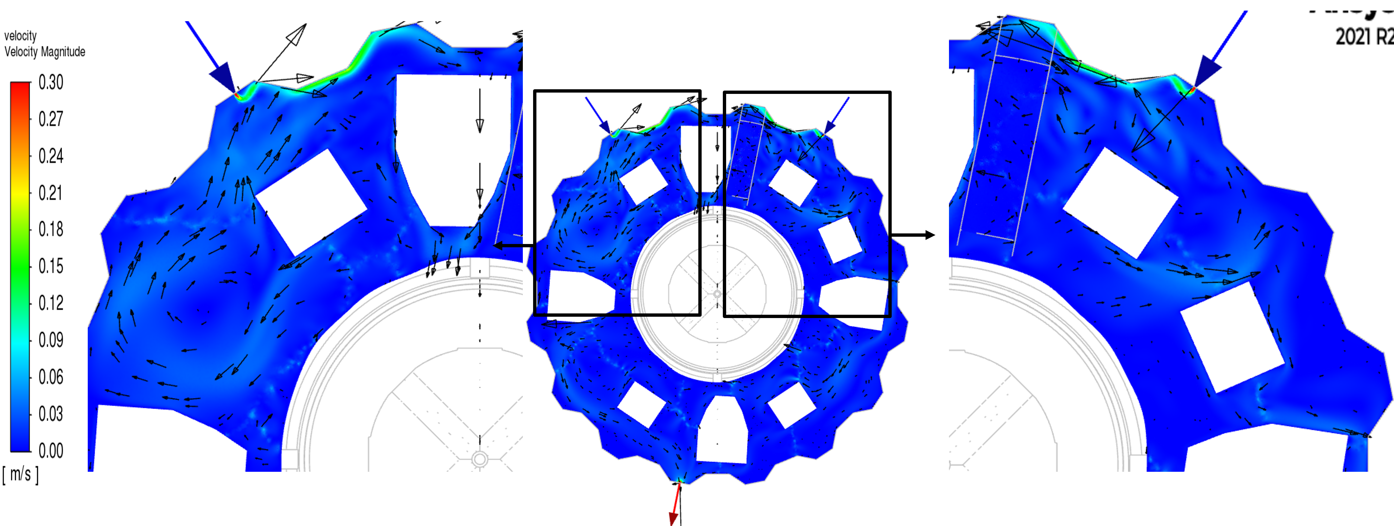
ITk Humidity : CFD : OSV
Flushing ports in OSV still need optimization in order to get circulation throughout.

Slide 19
ITk Humidity : CFD : OSV
More R&D to improve Design, Manufacture, Readout, Performance in long term
R&D
Transition the LPG Fibre to a Rad Hard Fibre
  Currently no site of technology that can write in a grating for LPG in a Rad Hard Fibre
    It needs to be tensioned and also azimuthally rotated during write.
    Requires Femto-second laser, stepper rotation and translation motors
  Produce Functional Coating – nano-TiO2 layer – hygroscopic, reversible, in own lab
Develop further the various compensations
  Requires further radiation resting,
  Calibration work in the Environment Chamber
Maintain Integrity and Monitoring of Humidity in ATLAS
  Longer term committmemnt
Spin out the technology
  To SA
  Nuclear Industry
    First of a Kind, in-core, real-time, on-line, monitoring in Nuclear Power Reactors
    Temperature, strain, water level, TID Dose, NIEL Dose
  Space
  Other

