Slide 1

PLC Based Controls Systems workshop summary
Jeronimo ORTOLA on behalf of Bard SCHOFIELD and Enrique BLANCO

Slide 2
Goals
4th edition of the PLC workshop
Create collaborative atmosphere
Promote exchange of expertise, methods, tools, solutions, lessons learned…
Seek for collaboration opportunities

Slide 3




Scope
Control systems specification: Formalisation
Engineering: standardisation, automated code generation, versioning
Testing and verification: methods, automated testing, virtual commissioning
Maintenance: Obsolescence, upgrades, asset management

Slide 4
Organisation
Two sessions:
9 general presentations from the institutions: UMCG-PARTREC, STFC - ISIS Neutron and Muon Source, SLAC, ELBE (Helmholtz-Zentrum Dresden-Rossendorf), EBG MedAustron GmbH, CEA Paris-Saclay, NFN-LNL, SOLEIL.
5 talks on specific topics:
  Virtual Commissioning for Advanced Controllers
  Optimizing control: Engineering lifecycle
  XFEL. PLC framework
  Database driven control system specification
  Full Stack PLC to EPICS Integration at ESS

Slide 5
Participation
55 participants: 19 institutes, 7 companies, 12 countries
- Australian Nuclear Science And Technology Organization
- CEA Paris-Saclay. France
- CERN. Switzerland
- ELETTRA Synchrotron Trieste. Italy
- European Spallation Source. Sweden
- European XFEL (X-Ray Free-Electron Laser Facility). Germany
- Helmholtz. Germany
- INFN-LNL. Laboratori Nazionali di Legnaro. Italy
- Institute of High Energy Physics, CAS. China
- Institute of Modern Physics, Chinese Academy of Sciences. China
- King Faisal Specialist Hospital And Research Centre. Saudi Arabia
- Lawrence Livermore National Laboratory. United States
- LNLS. Laboratório Nacional de Luz Síncrotron. Brazil
- Oak Ridge National Laboratory. United States
- NRF-iThemba LABS. South Africa
- SLAC National Accelerator Laboratory. United States
- UKRI. UK Research and Innovation. UK
- PARTREC. Particle Therapy Research Center. Netherlands
- SARAO. South African Radio Astronomy Observatory
1st | Barcelona 2017 | 45
2nd | New York 2019 | 34
3rd | Shanghái 2021 | 57
4th | Cape Town 2023 | 55
- AWE
- Beckhoff
- Medaustrron
- FMBFeinwerk Und Messtechnik
- PROCON
- Observatory Sciences Ltd.
- Nusano

Slide 6
Highlights. General presentations
INFN-Legnaro
  Many different PLC brands
  Users of UNICOS
SLAC
  Most of their control system migrated to Beckhoff
  Well stablished internal standards (UNICOS-like)
  Variety of control system domains (Vacuum, Stepping motors, Diagnostics, CRYO, Water distribution, CV, buildings, Optics, Machine protection, Sample and optical laser delivery).
  TwinCat unit testing FW
SOLEIL
  OPC UA integration in TANGO. Performance not yet evaluated
  Developing automated code generation strategies
PARTREC
  A few PLC base control systems (26 ABB PLCs)
  Considering migrating to SIEMENS PCS7
ISIS (UKRI)
  Omron, Siemens, Pilz, Allen-Bradley
  Interested in standardisations and Model Predictive Control
ELBE (Helmholtz-Dresden)
  ELBE facility to be replaced soon
  Introducing: Asset management, Codesys, automated code generation (interest on UNICOS)
MED AUSTROM
  Moving away from WinCC OA due to cost
  Challenges: Regression tests, FAT, Requirements and documentation
SACLAY
  Automatic code generation tools for Siemens PLCs and EPICS
  Integrating OPC UA

Slide 7
Dedicated talks
CERN (BE-ICS): Virtual commissioning for advanced controllers
  Model predictive control for Air Handling units
PROCON: Optimising Control: Engineering lifecycle
  A view from industry about engineering control systems engineering (Requirements, design, Implementation, testing,…)
CERN (EN-CV): Database driven specification
  CORE. A tool to create control system specification from a DB
XFEL: PLC framework
  Based on Beckhoff. Visual studio
  Architectural design, abstraction layers
  Test driven development
  ESS: PLC to EPICS integration
  Siemens S7-1500, Beckhoff for motion applications
  PLCFactory, a python tool for automated code generation and comm interface between PLC and EPICS
  Future: Integrate CCDB in the engineering workflow

Slide 8
Outcome
High quality presentations
Great participation and discussions
Follow-up sessions to be organised on:
  Asset management
  Modern software development (Test driven development, CI, Automated code generation)
  Versioning
  Use of AI techniques in PLCs (ML, Model predictive control,…)
Interest from many participants in a PLC experts and users' online community

Slide 9
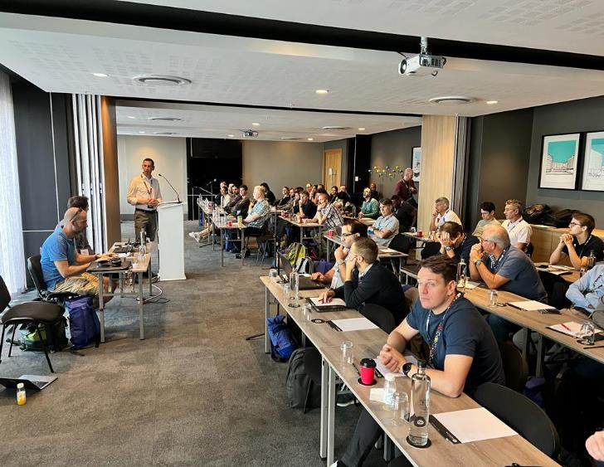
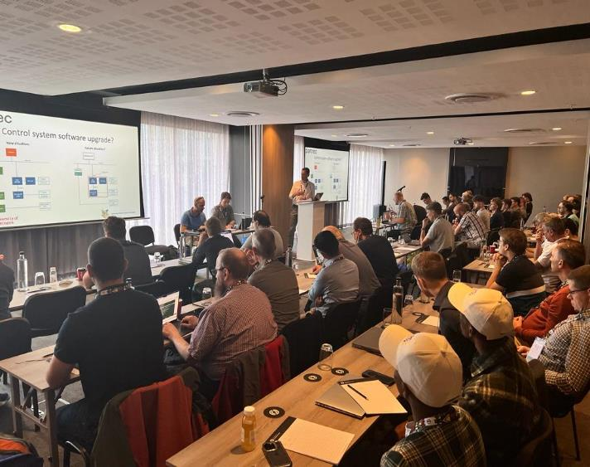

Slide 10
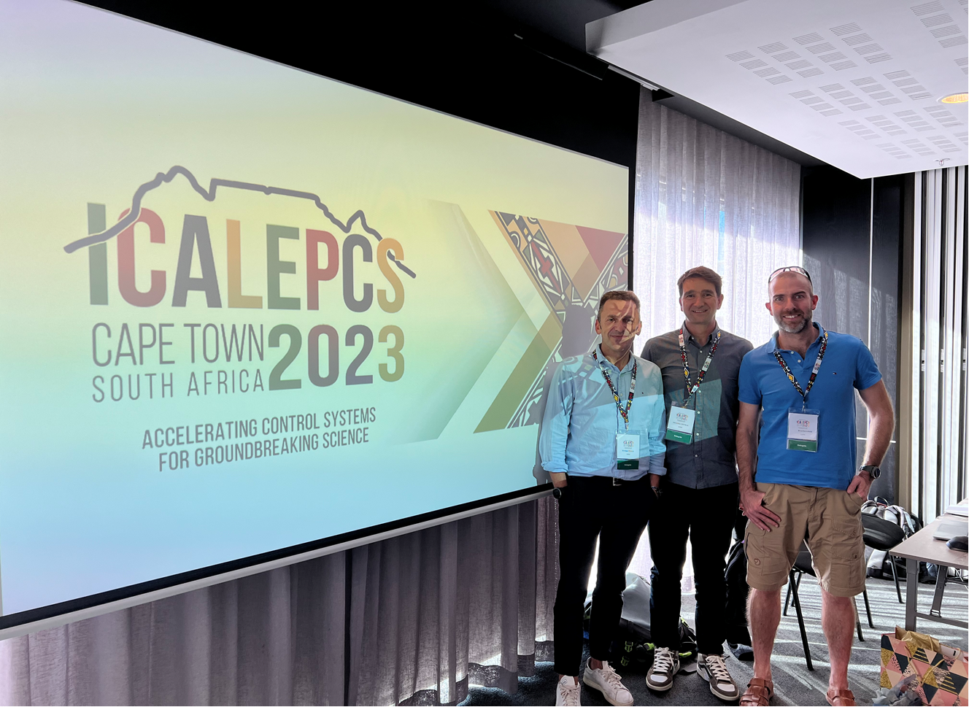
Program and presentations available at
https://indico.cern.ch/event/1250169/timetable/#20231007.detailed

