Slide 1
ICALEPCS Feedback
Brad Schofield
16/11/2023

Slide 2
Topics of interest
Continuous Integration/Continuous Deployment for PLCs
Applications of advanced control (specifically Model Predictive Control) in several different fields
System models/digital twins in focus, often as a means of training machine learning algorithms

Slide 3
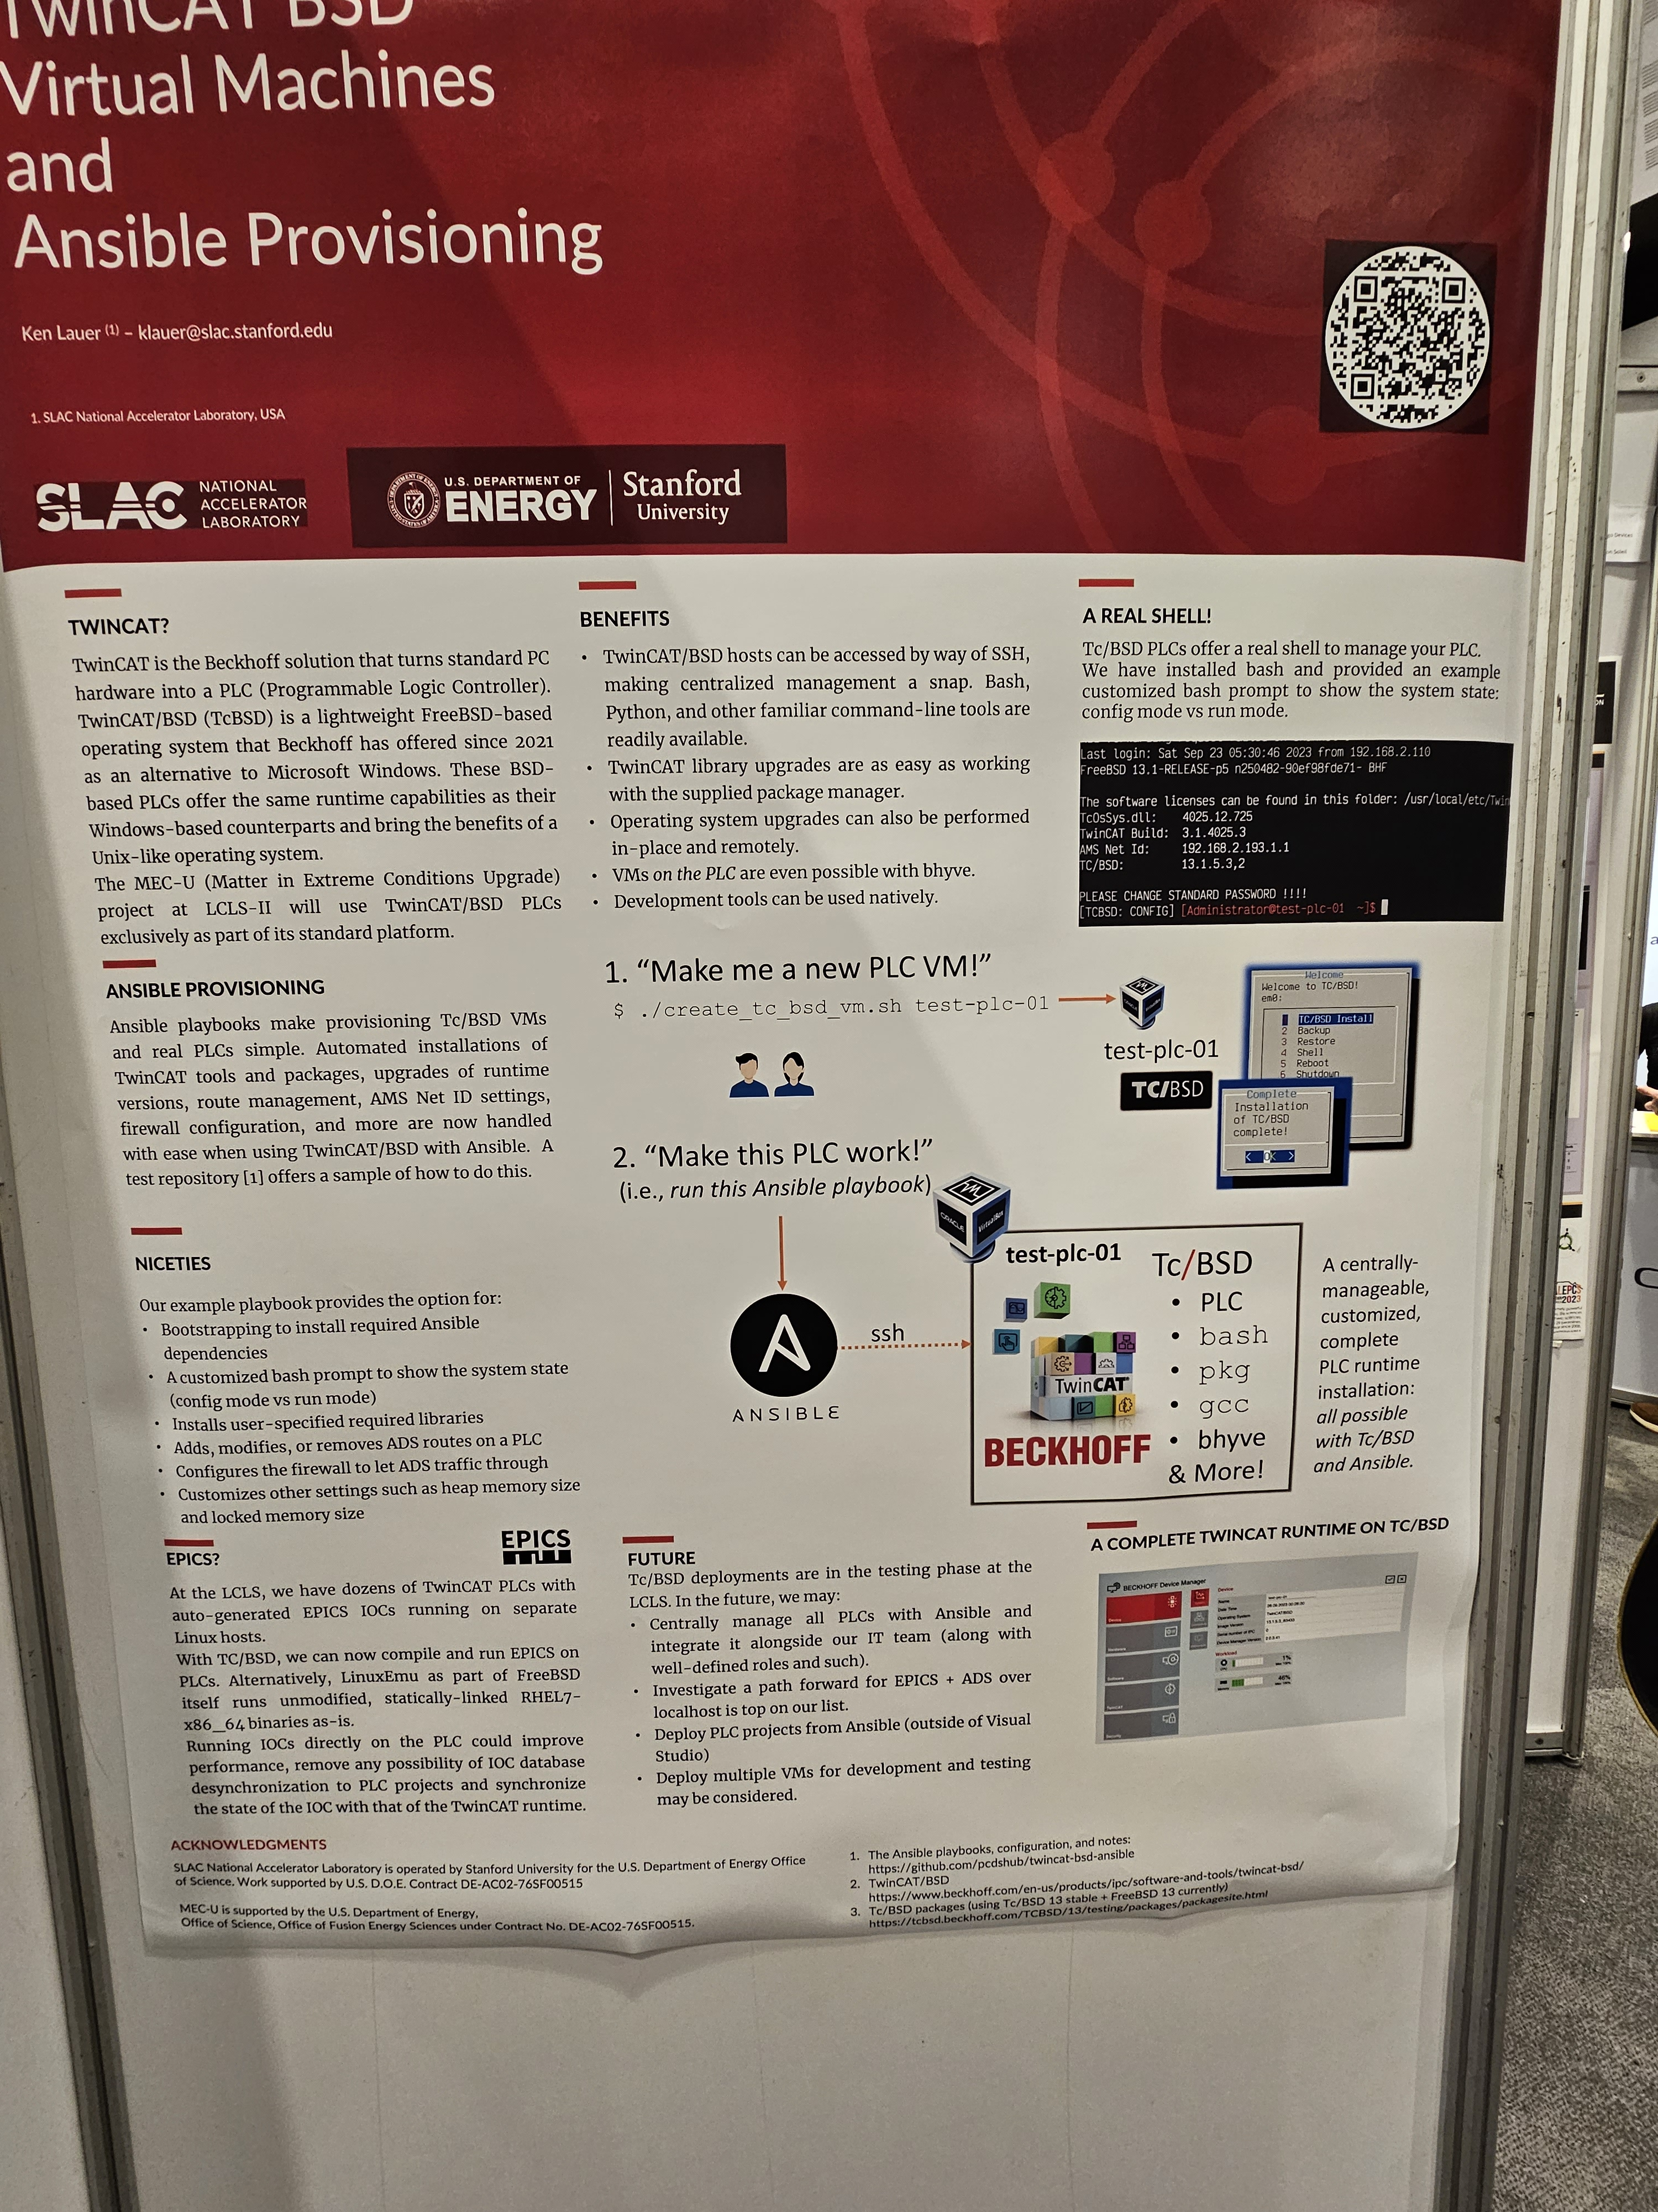
Continuous Integration/Continuous Deployment for PLCs
Clearly a growing theme at the conference
Driving force seems to be shrinking development teams in charge of growing numbers of PLCs
Increasing focus on centralized management of PLCs. For example, an interesting poster from SLAC about management of TwinCAT BSD PLCs using Ansible:

Slide 4
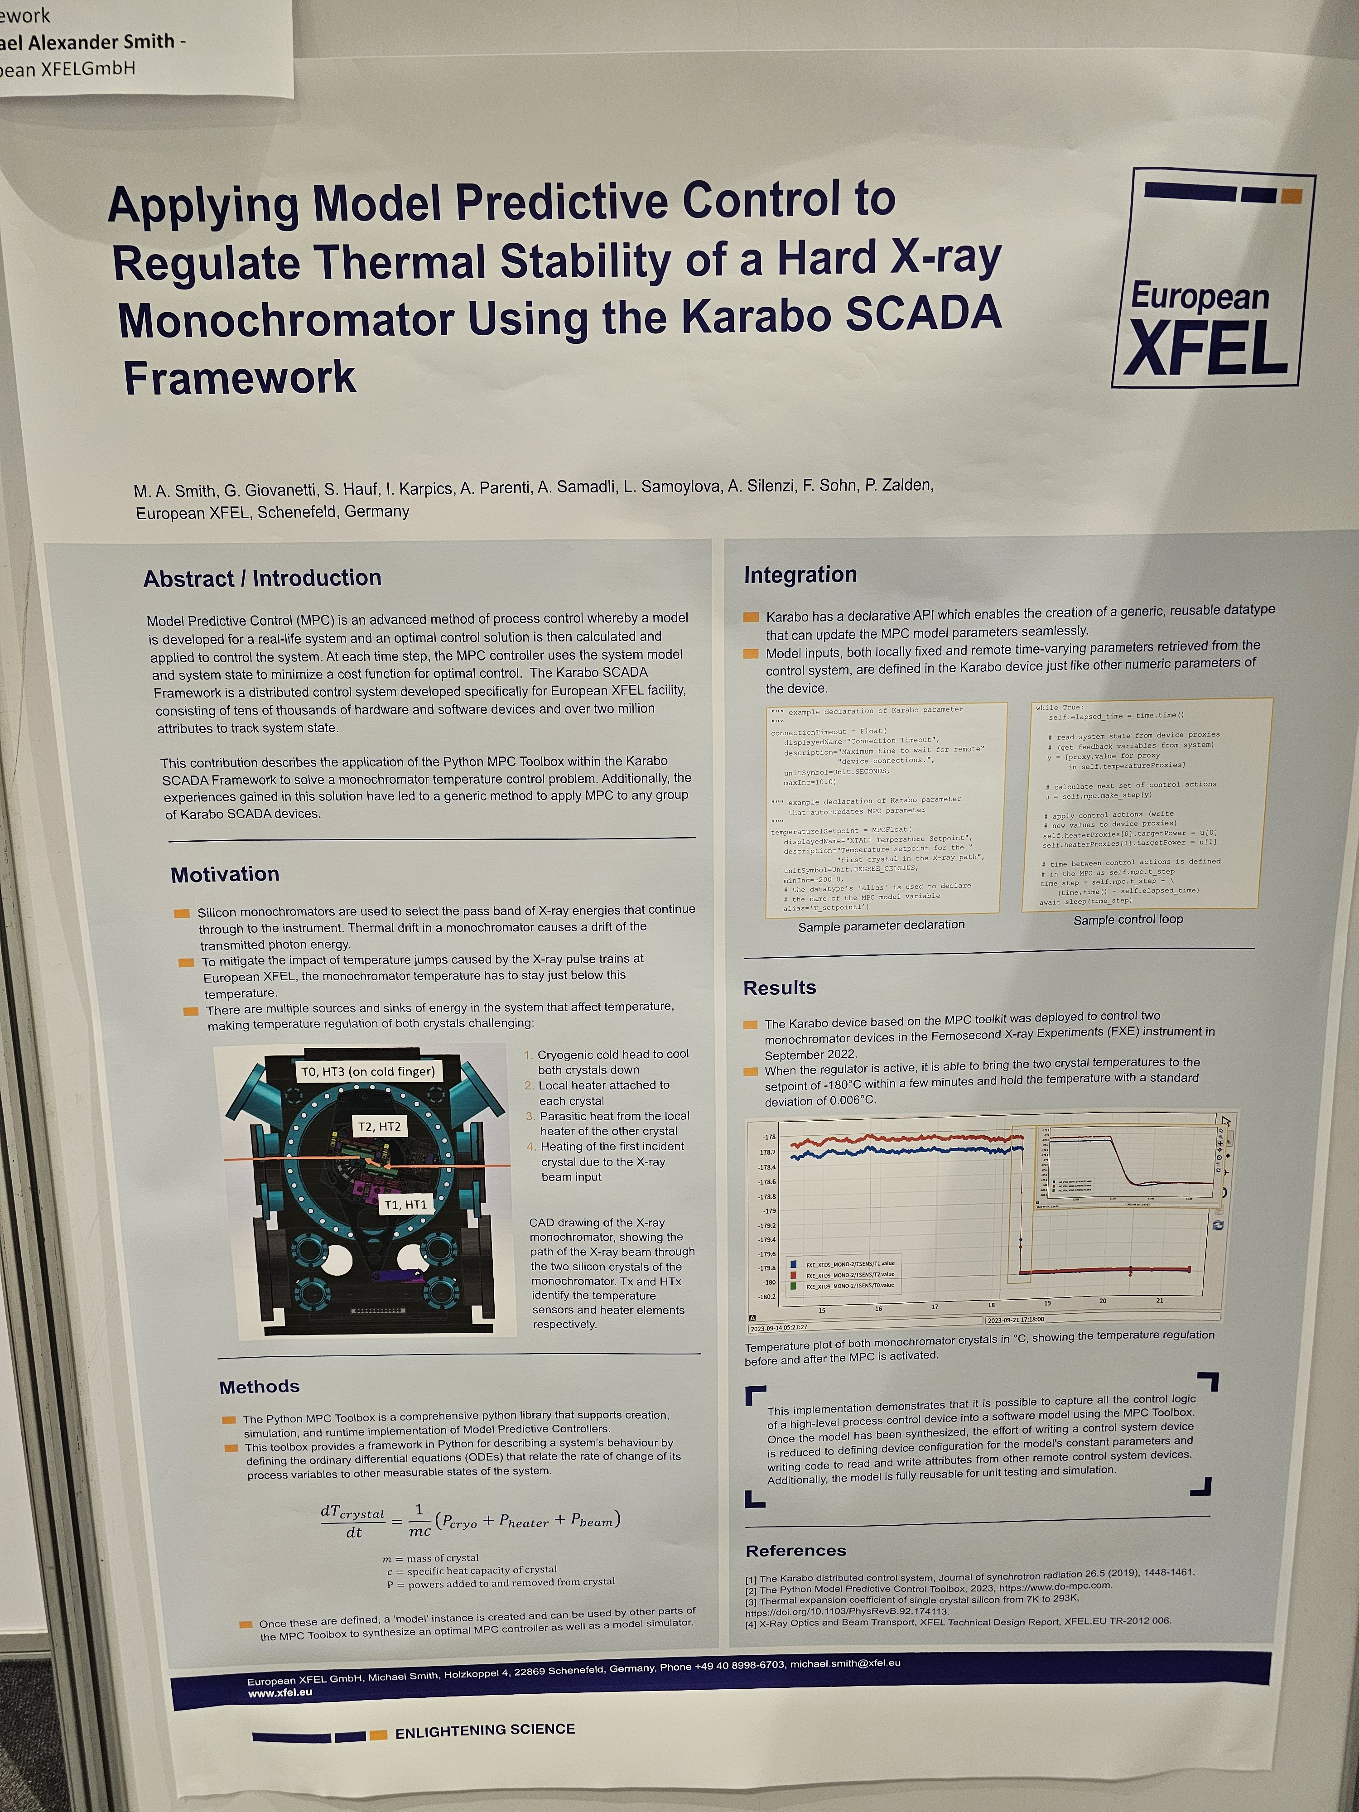
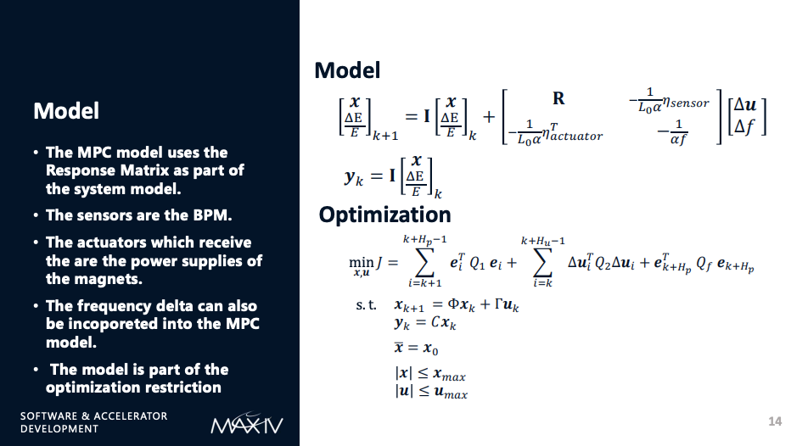
Applications of advanced control (Model Predictive Control)
MPC appearing in several application domains:
  Slow orbit feedback control (MAX IV)
  Thermal control in X-ray Monochromator (European XFEL)
  RF cavity active resonance control
  (not to mention our own: energy optimal control for cooling systems)

Slide 5
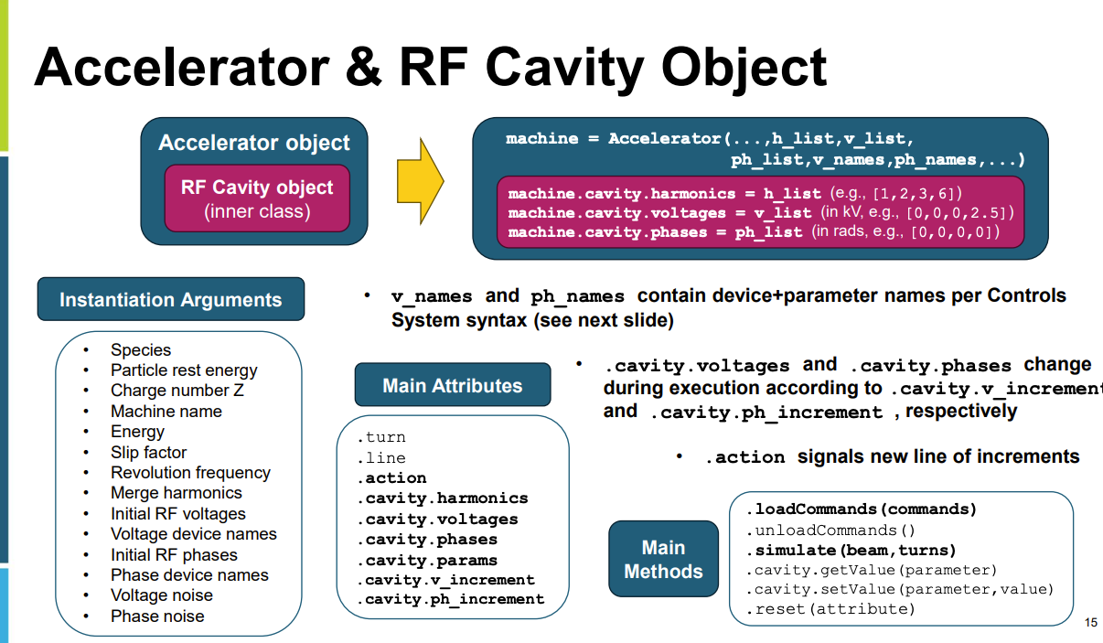
System models/digital twins
Quite a few different applications with various levels of model complexity
  From fairly simple Python models for accelerators to advanced laser modeling (NIF)
Numerous different intended uses:
  as basis for training machine learing algorithms
  for improvement of controls/performance
  for operator training
A common message was that the time invested in developing the models was seen as well-invested
Python simulator for RHIC (Brookhaven)

