Slide 1
ICALEPCS’23
Key Takeaways (personal view)
Diogo Monteiro (EN-CV-CL)
CTTB Industrial Controls Forum - #11 | ICALEPCS’23
16-11-2023

Slide 2

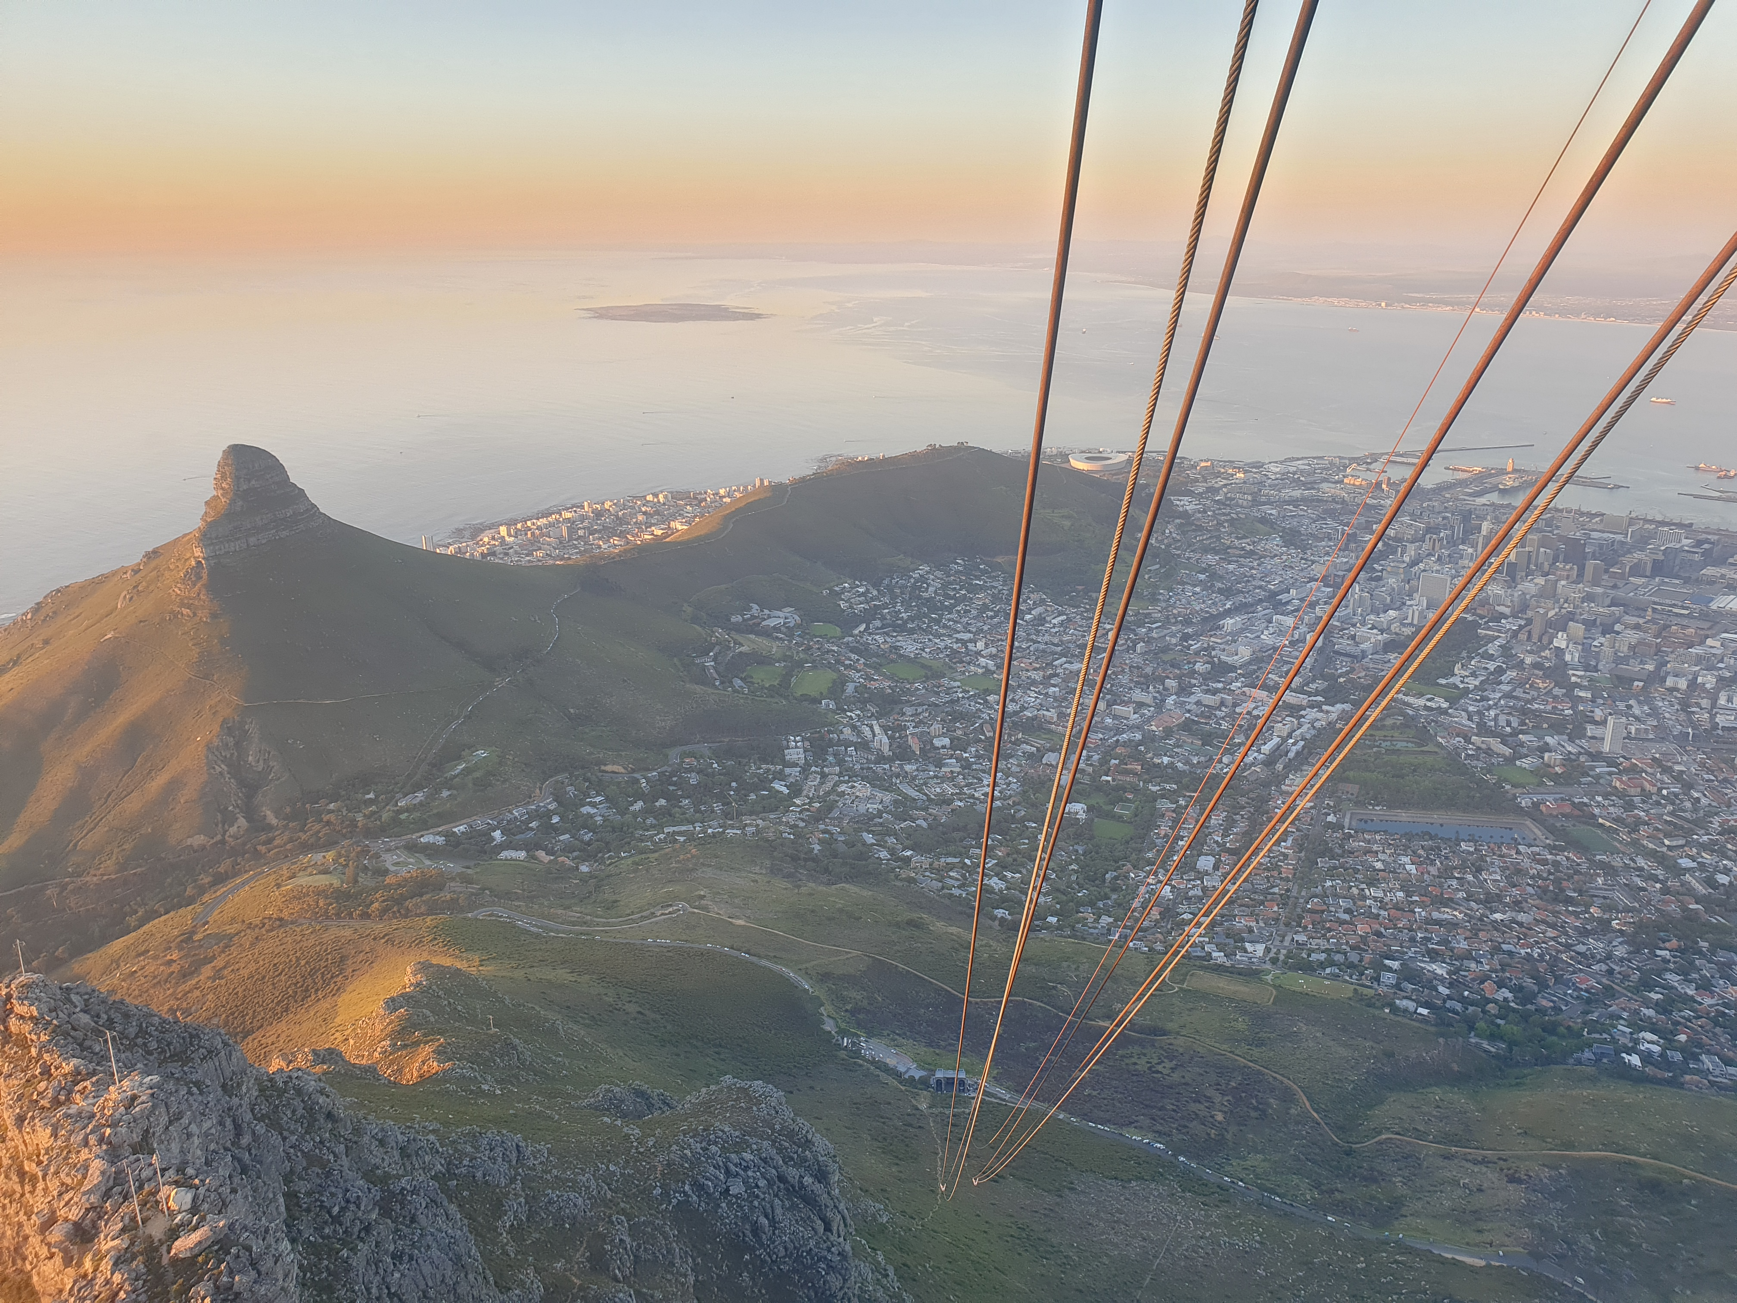
ICALEPCS’23
Robben Island
Programme overview
Week-end: Workshops
  PLC based control systems
  Efficiency through automation
Week: Talks & poster sessions
Technical visit to iThemba Labs (accelerator research center)
Cape Town
ICALEPCS from Table Mountain

Slide 3
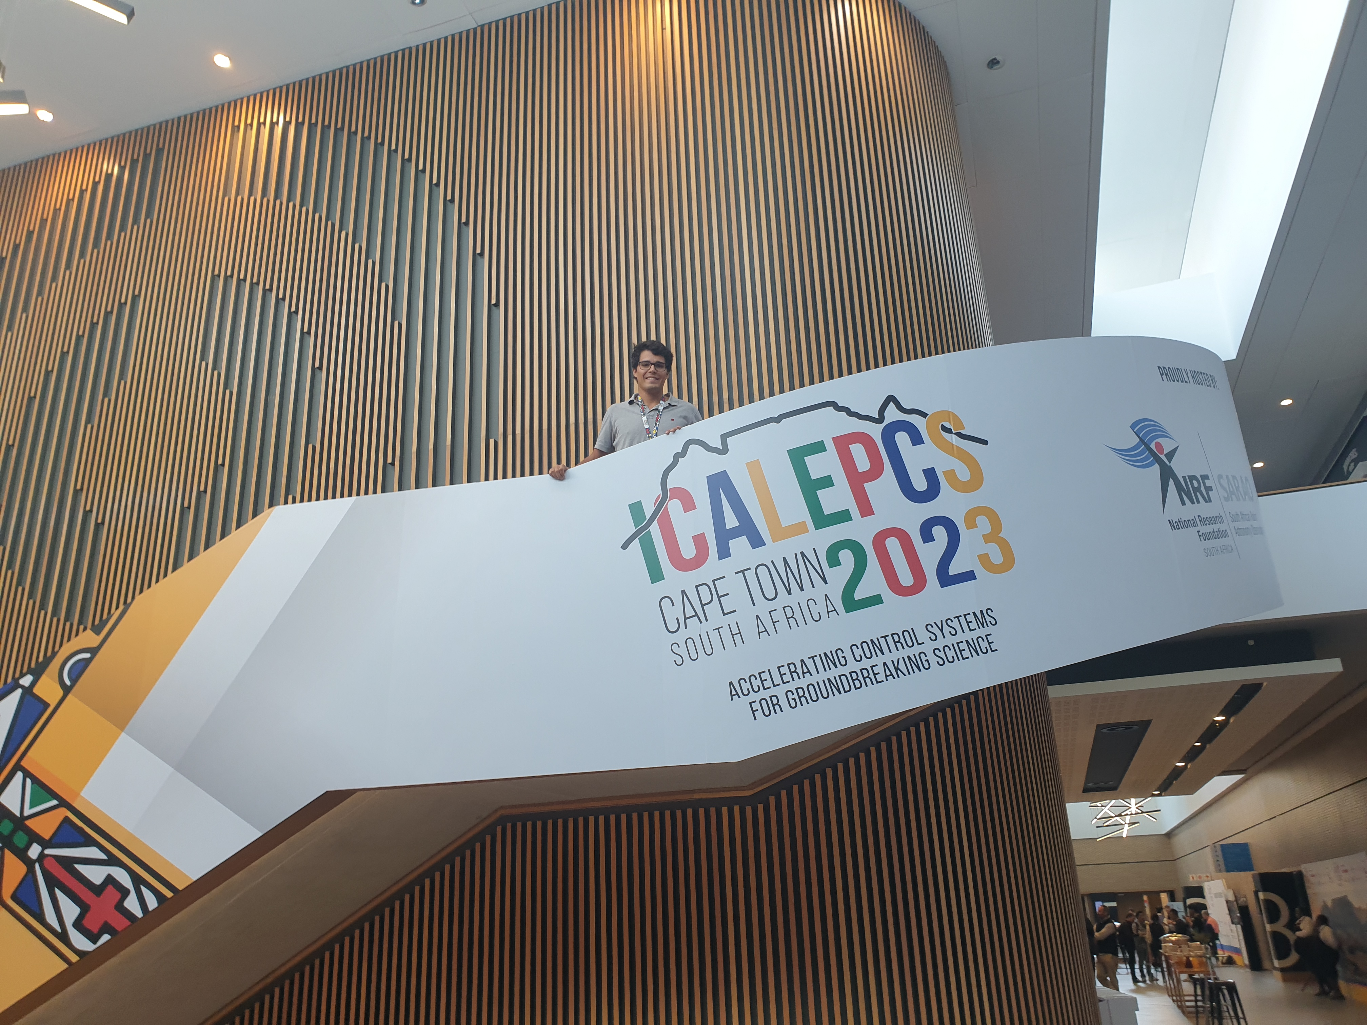
ICALEPCS’23
Perspective from a first-timer:
Loaded agenda
Extremely broad coverage of topics
  Industrial controls
  Controls frameworks
  Controls software
  Low level hardware (FPGA)
  Accelerators’ instrumentation
  Management
  … and more
Worldwide Institutes & professionals
Excellent organization

Slide 4
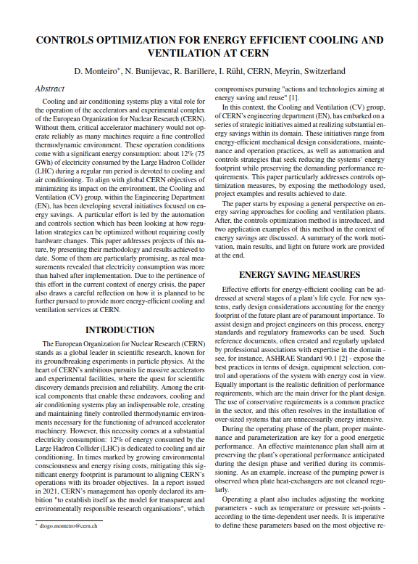
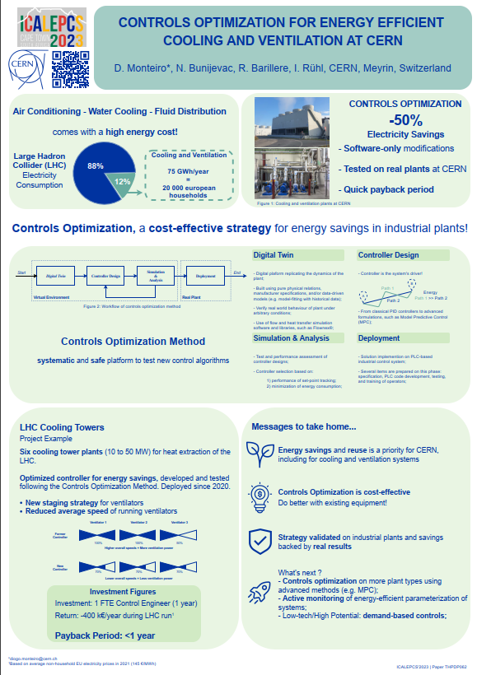
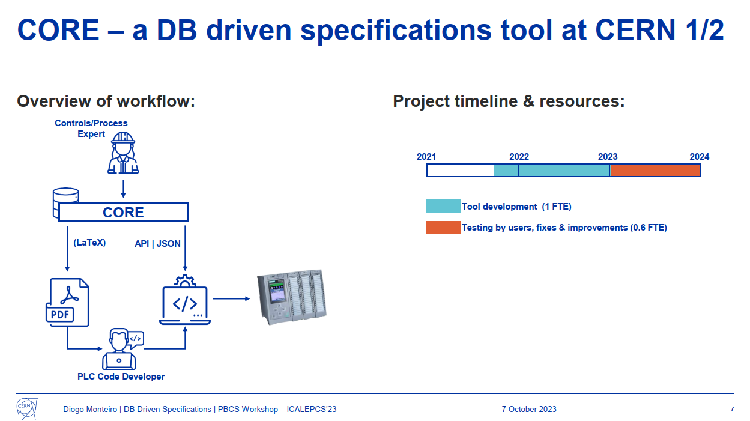

ICALEPCS’23
Contributions by EN-CV
More details during ICALEPCS Flash Seminar at CERN
7TH December 2023
https://indico.cern.ch/event/1343307
Paper + Poster
Presentation at PLC Workshop

Slide 5
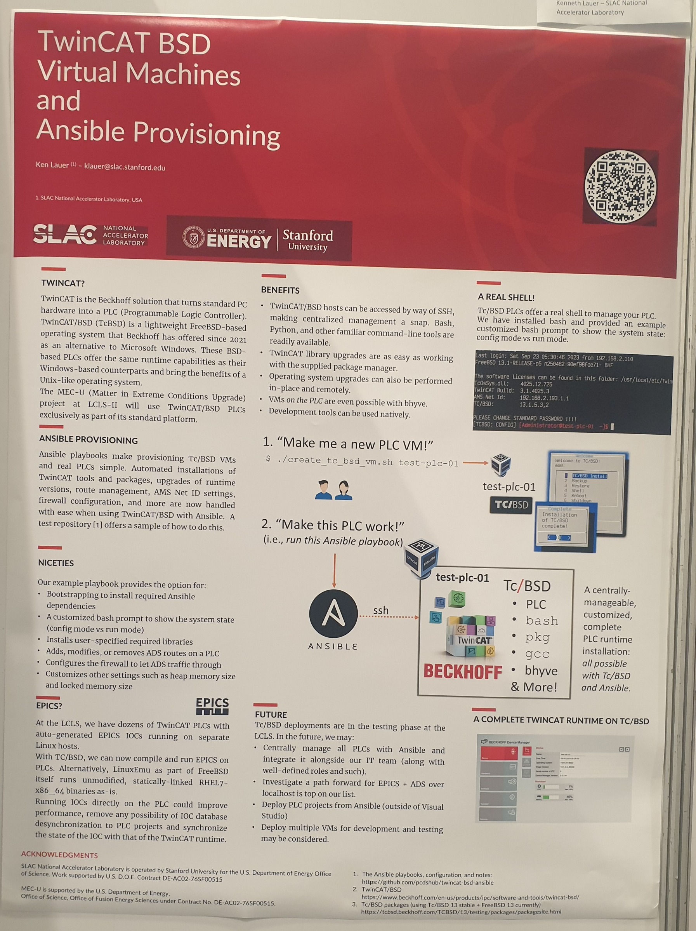
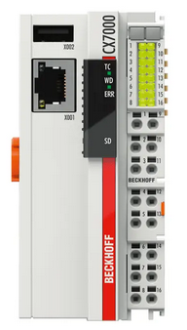
ICALEPCS’23
Key takeaways:
PLC
  Hype around Beckhoff automation
    PC becomes a PLC w/ TwinCAT solution
    Some arguments:
      User-friendly IDE in Visual Studio
      Linux server like management
      Better integration for code development & versioning
      Unit testing
      Heavy presence in HEP world
  Others mentioned:
Siemens ; Omron ; Schneider ; Honeywell ;

Slide 6
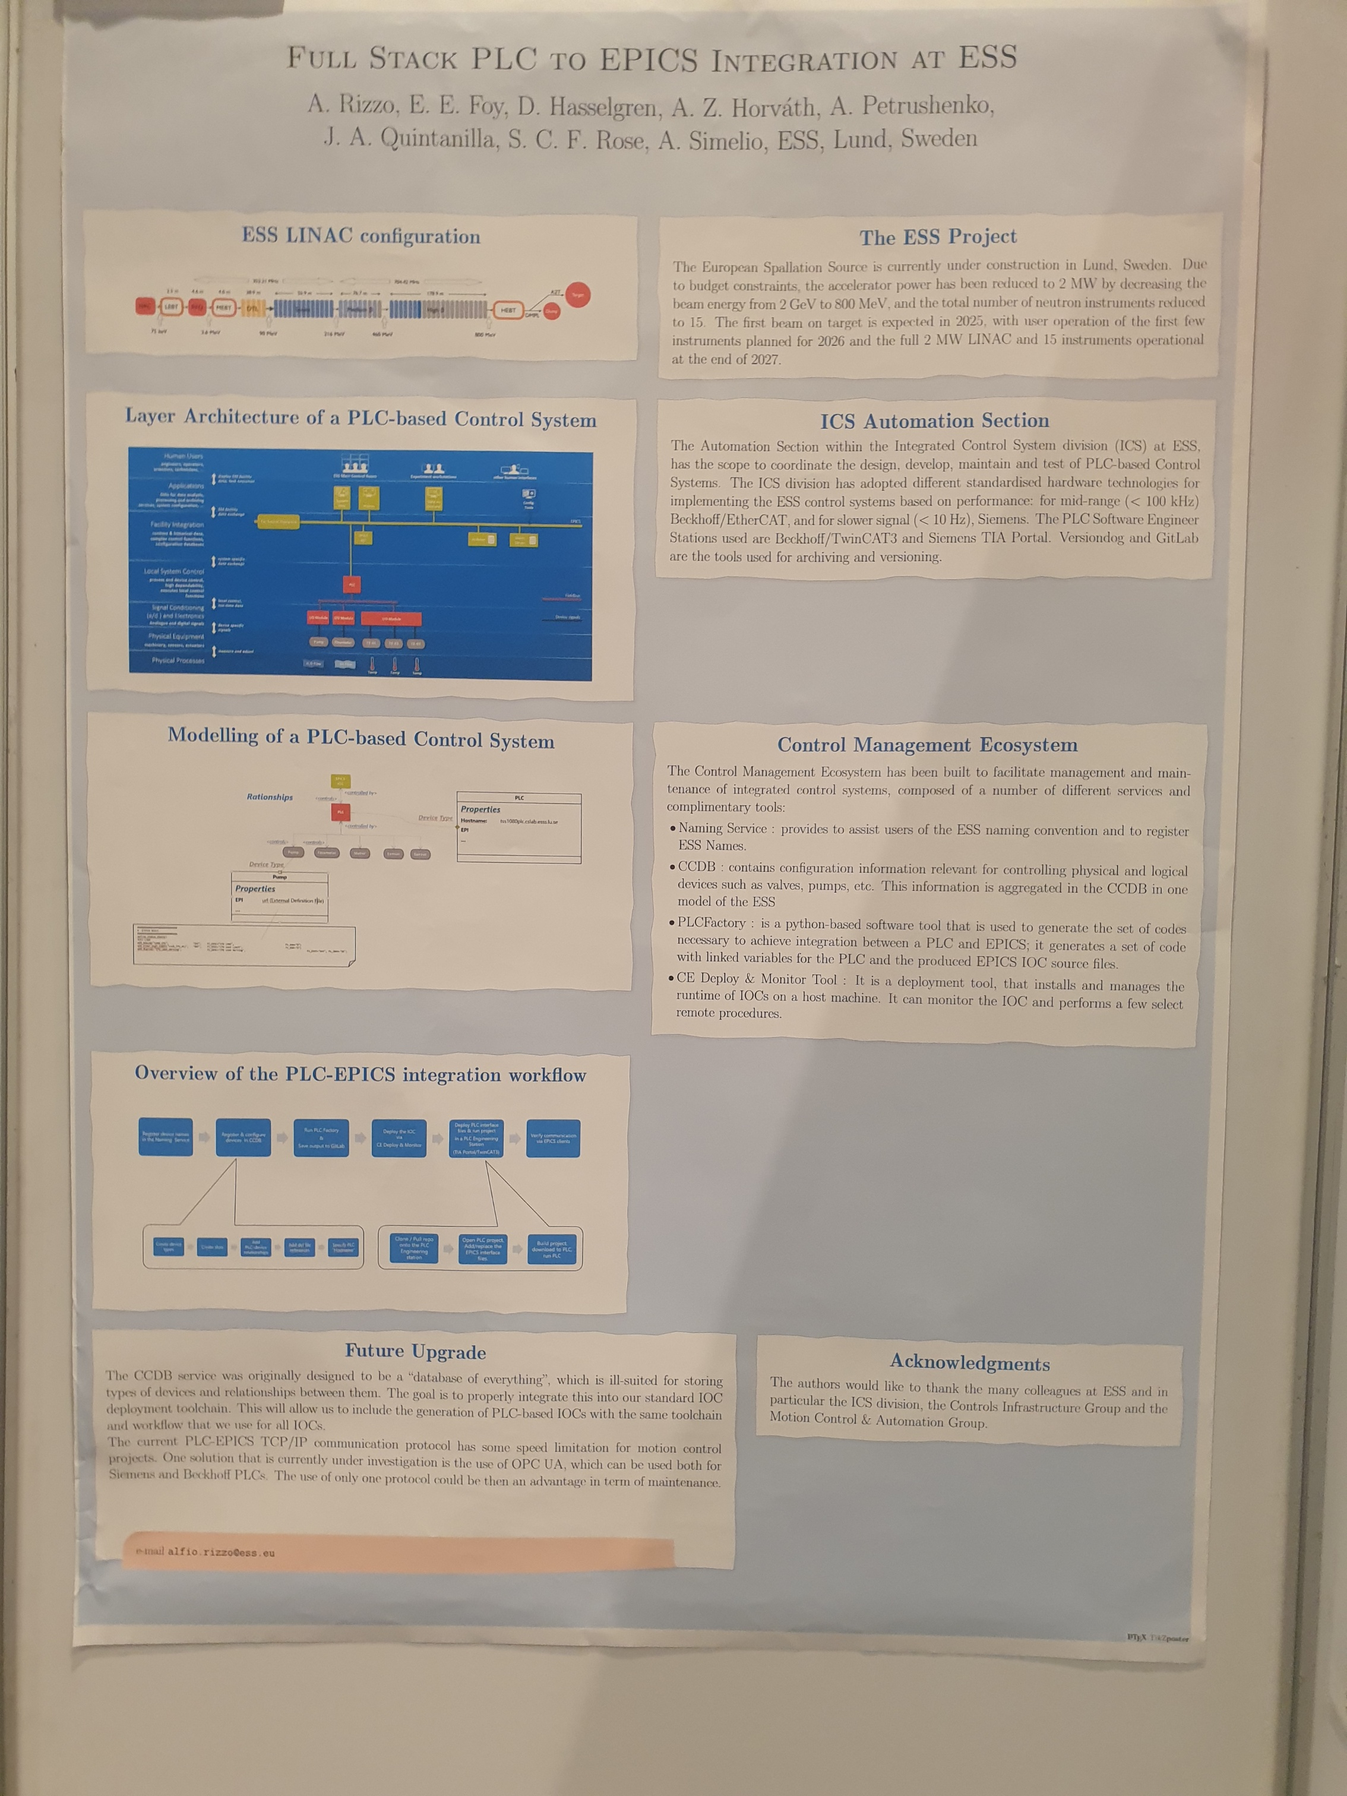
ICALEPCS’23
Key takeaways:
SCADA
  Mostly EPICS or TANGO
    Open-source frameworks for accelerator and industrial controls
  WinCC
  Atvise

Slide 7
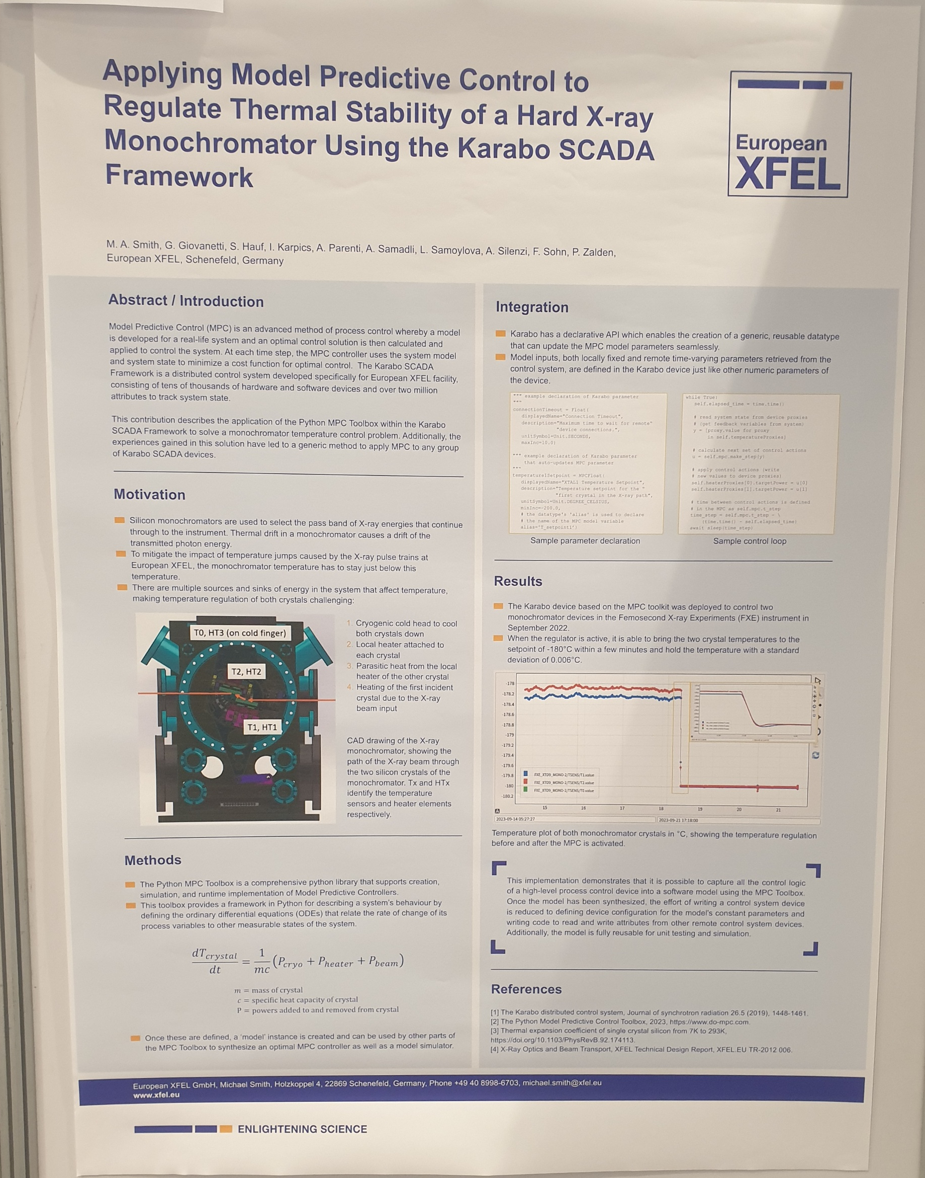
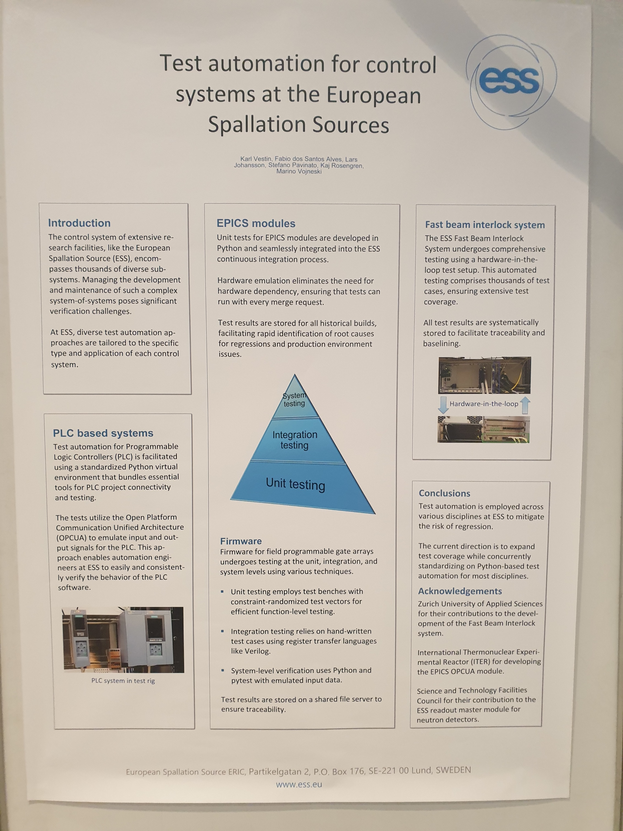
ICALEPCS’23
Key takeaways:
Unit Testing / Test Driven Development
Automatic Code Generation
  Many looking at it, few doing it
Enhanced testing environments
  Model-based simulation; virtual commissioning;
Advanced Controls for optimization
  Model-Predictive Control / Reinforcement Learning / Other
Infrastructure (IT+PLC) Monitoring
  Zabbix mentioned a few times
Control System Specification
  Little mention, only by CERN and CEA Paris-Scalay
Redundant PLC w/ S7-1500

