Slide 1


CMS Experimental Results on Dark Showers
Long Wang (UMD)
on behalf of the CMS experiment
May 17, 2024
@Roadmap of Dark Matter models for Run3

Slide 2

Outline
Introduction
Semi-visible Jets (SVJ)
Emerging Jets (EJ)
Soft unclustered energy patterns (SUEP)
Summary

Slide 3
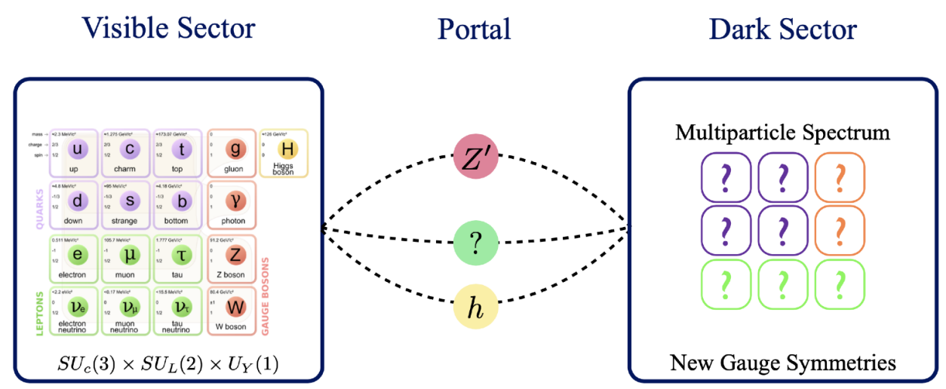
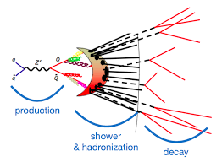
Dark QCD/Dark Shower
Motivations:
  So far, WIMP DM searches have excluded large phase spaces at the LHC;
  Dark QCD models can easily explain the coincidence between energy density of DM and baryons;
If producible at the colliders, mediator particles connects Dark Sector and SM;
  bifundamental scalar mediator X, vector mediator Z’, ect.
Dark quarks undergo showering under SU(N_{D}) , where the stable dark hadrons contribute to DM candidates, unstable ones can decay back into SM, leaving exotic signatures on detector.

Slide 4
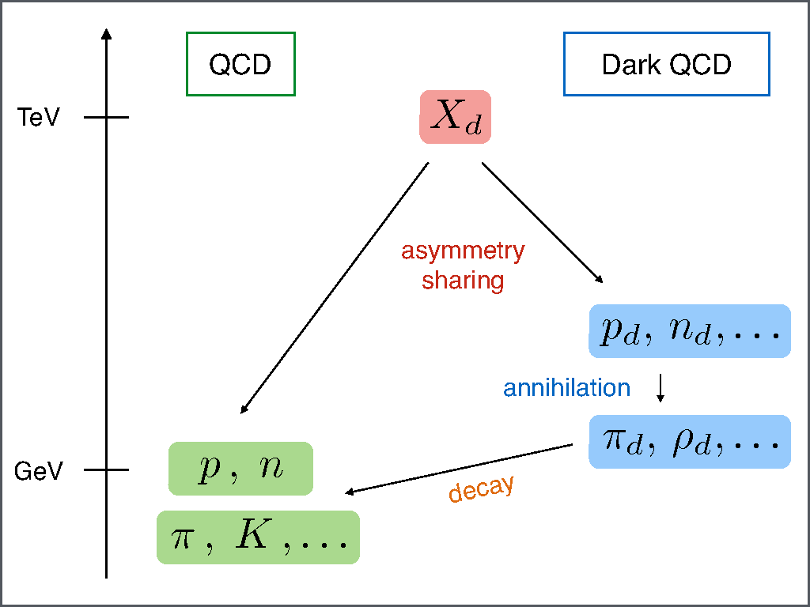
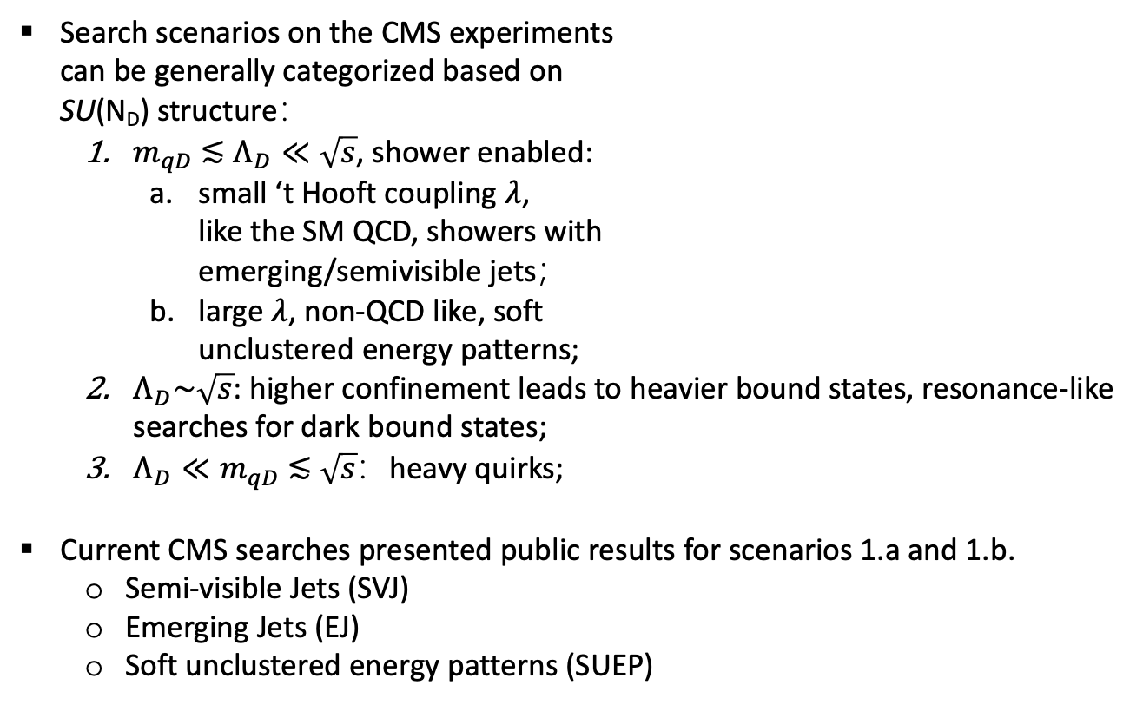
Dark QCD/Dark Shower
Search scenarios on the CMS experiments
can be generally categorized based on
SU(N_{D}) structure：
  $m_{qD} \text{≲} Λ_{D}≪\sqrt{s}$, shower enabled:
    small ‘t Hooft coupling $λ$,
    like the SM QCD, showers with
    emerging/semivisible jets；
    large $λ$, non-QCD like, soft
    unclustered energy patterns;
  $Λ_{D}\sim \sqrt{s}$: higher confinement leads to heavier bound states, resonance-like searches for dark bound states;
  $Λ_{D}≪m_{qD} \text{≲} \sqrt{s}$：heavy quirks;
Current CMS searches presented public results for scenarios 1.a and 1.b.
  Semi-visible Jets (SVJ)
  Emerging Jets (EJ)
  Soft unclustered energy patterns (SUEP)

Slide 5
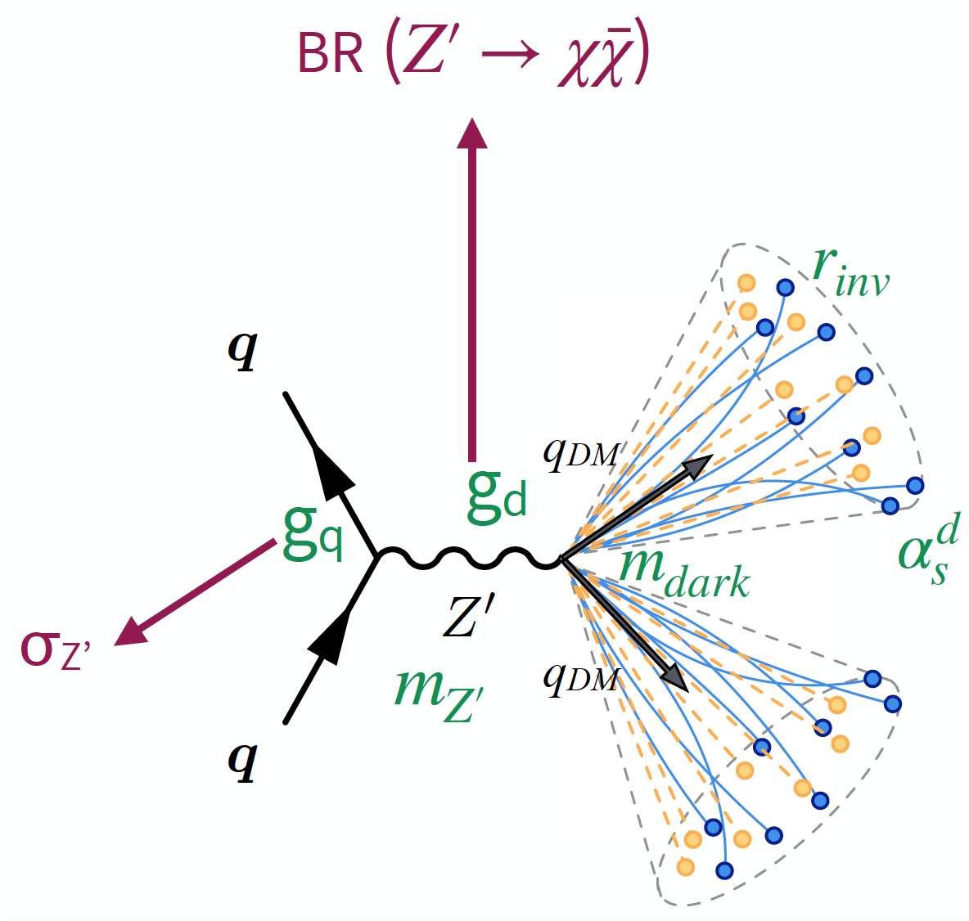
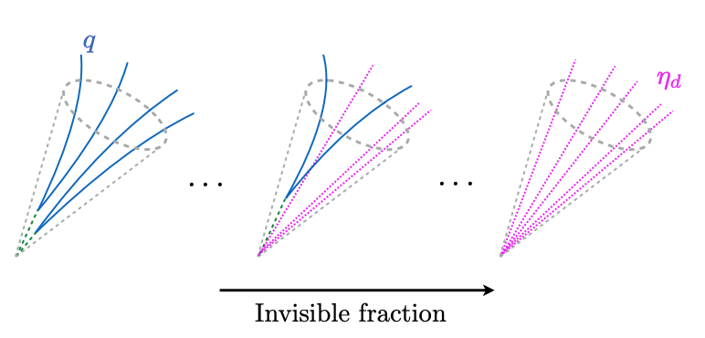
SVJ-search models
JHEP 06 (2022) 156
s-channel dark quark pair produced via leptophobic vector Z’ mediator from broken U(1) symmetry;
SU(N_{D}) with N_{f}^{dark} = 2, N_{D} = 2;
Dark quarks shower and hadronize, unstable dark hadrons decay back to SM promptly, stable ones characterized by invisible fraction r_{inv};
Model parameters have:
  m_{Z’} : mediator mass;
  m_{dark}: dark hadron mass;
  r_{inv}: stable hadrons fraction;
  𝛼_{dark}: running coupling of dark QCD.

Slide 6
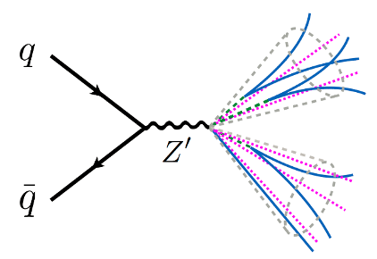
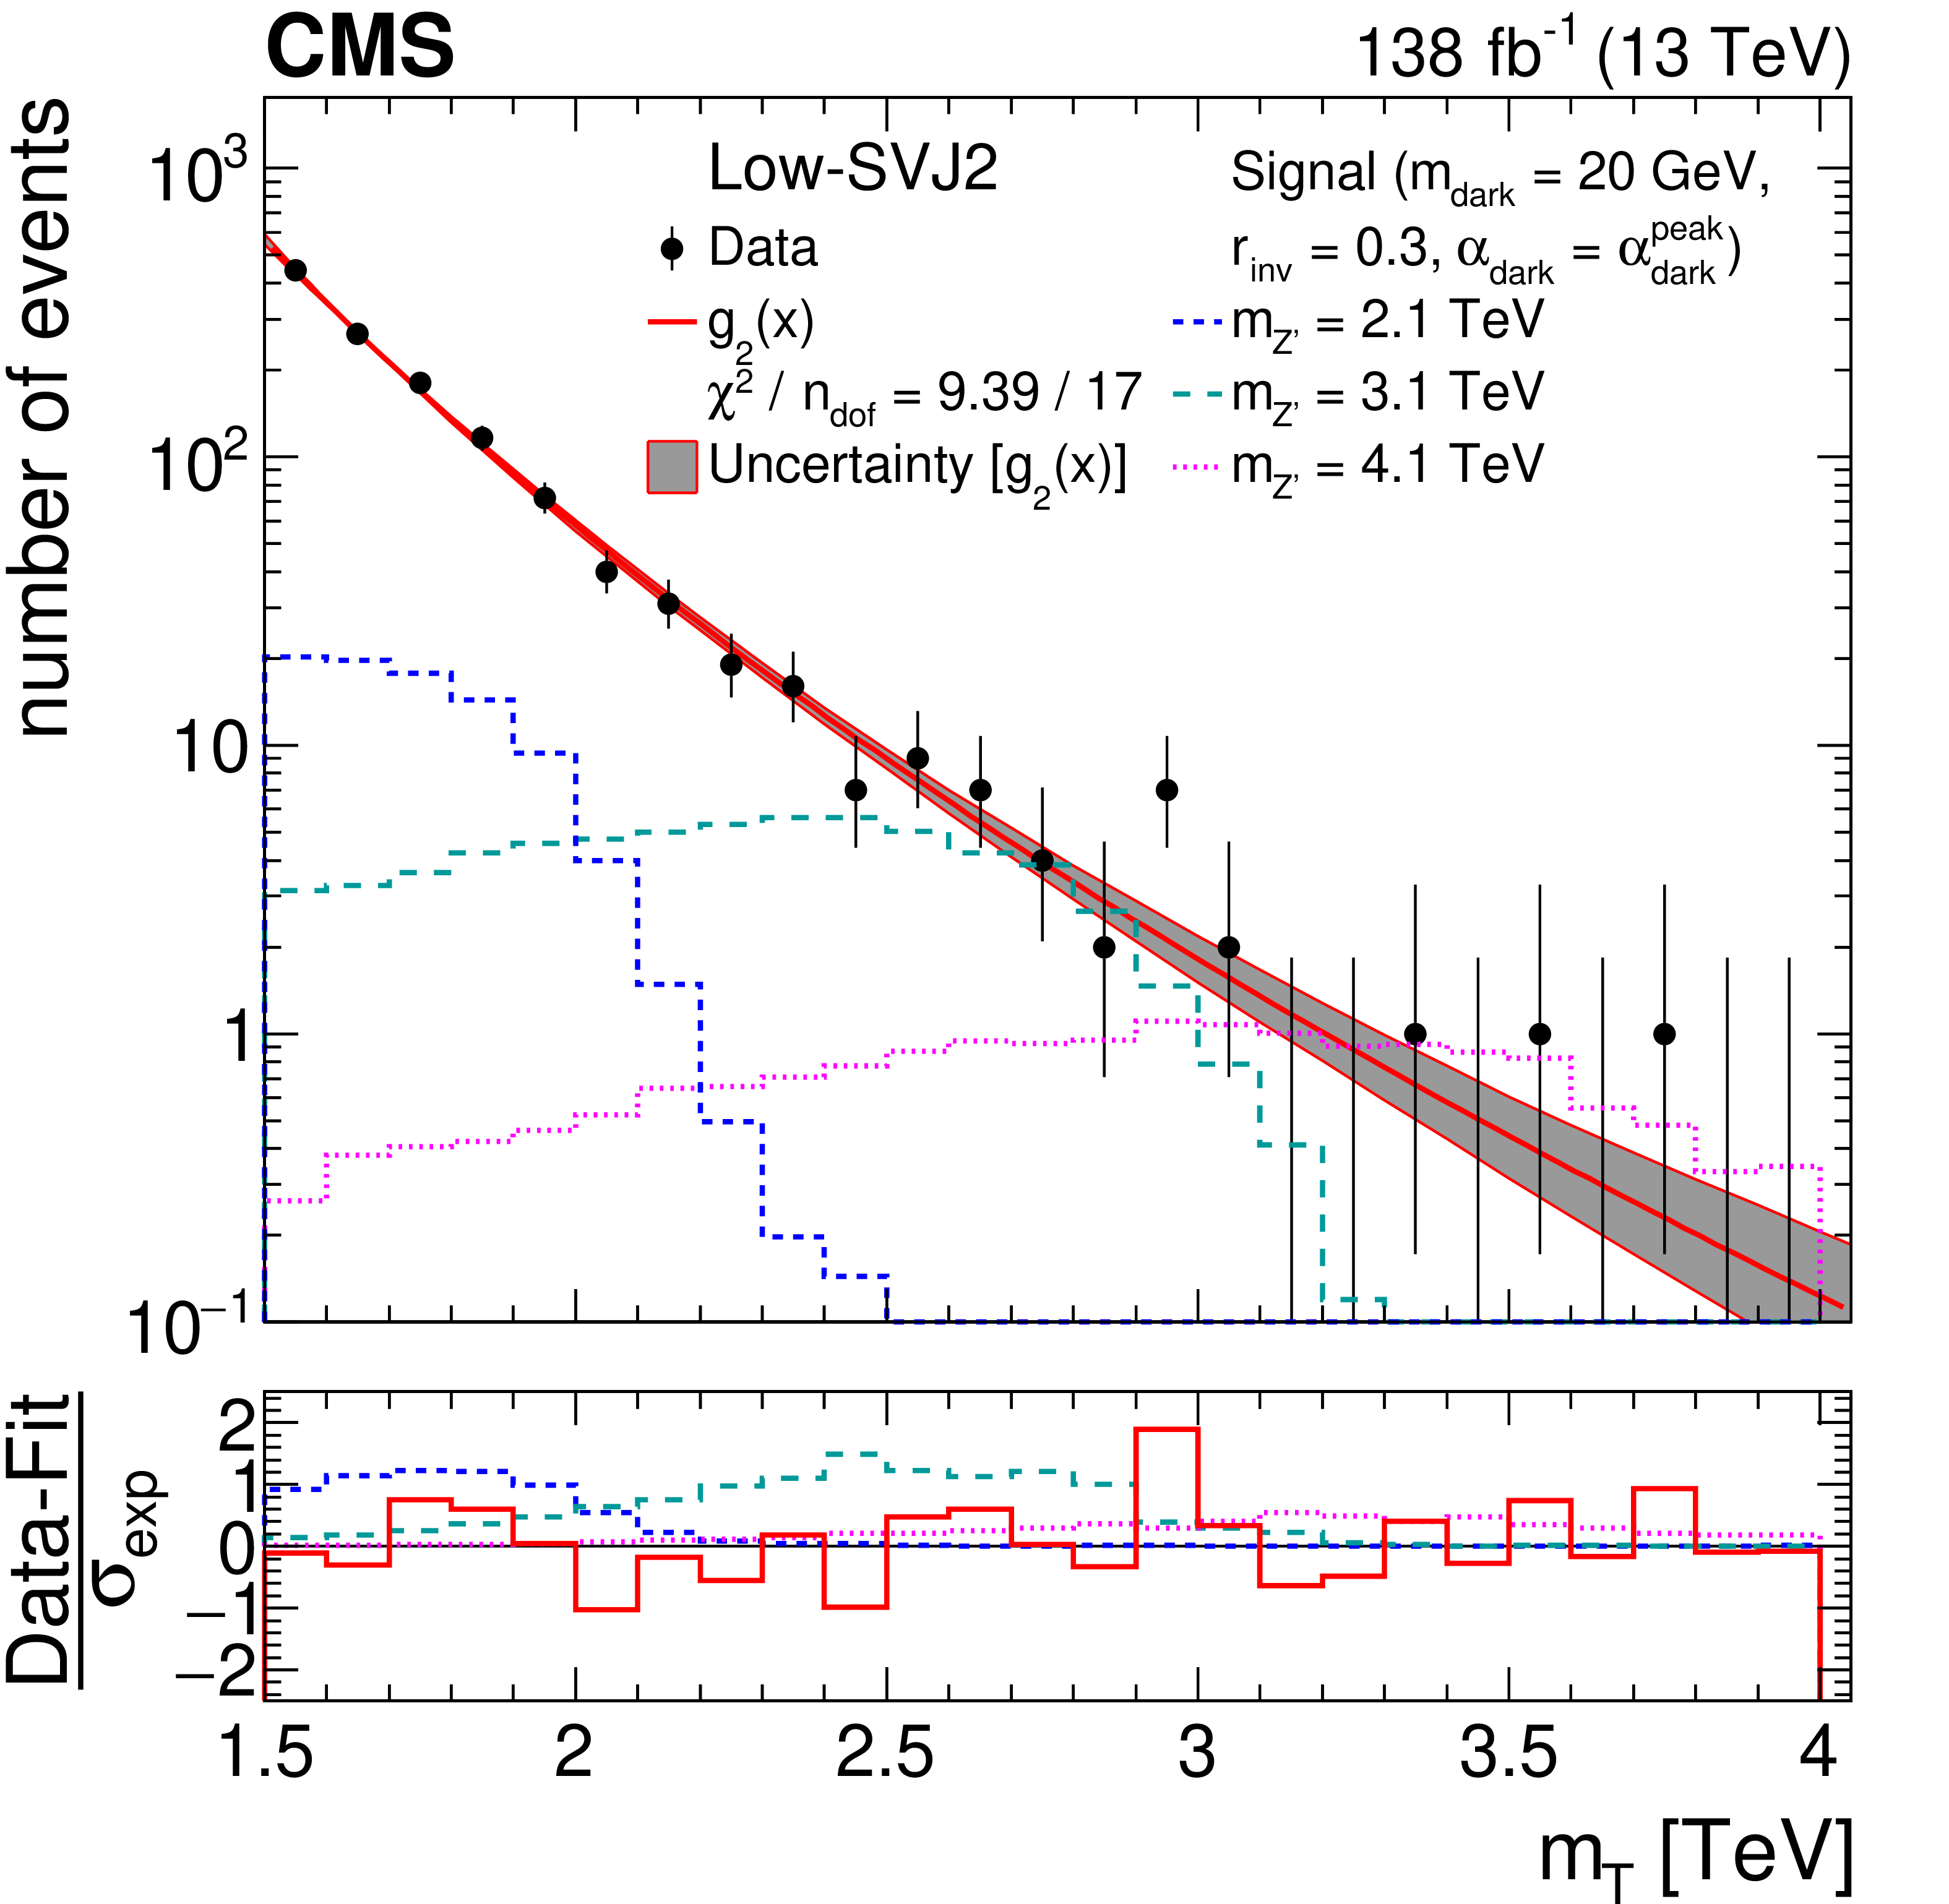
SVJ-search methodology
Signal signatures on detector:
  Two high-p_{T} and wide jets that contain mix of visible
  and invisible particles;
  MET aligned with jets due to invisible contents in jets;
Bump hunt of Z’ resonant in m_{T}(JJ, MET);
Background estimated with analytic fit to observed m_{T} distribution from data;
Dual strategy:
Inclusive search:
  Use only event-level kinematic variables;
  Provides reinterpretability for other models with similar signature;
BDT-based search:
  Employ machine learning for optimized SVJ tagger;
  maximizes sensitivity for the chosen signal models;

Slide 7
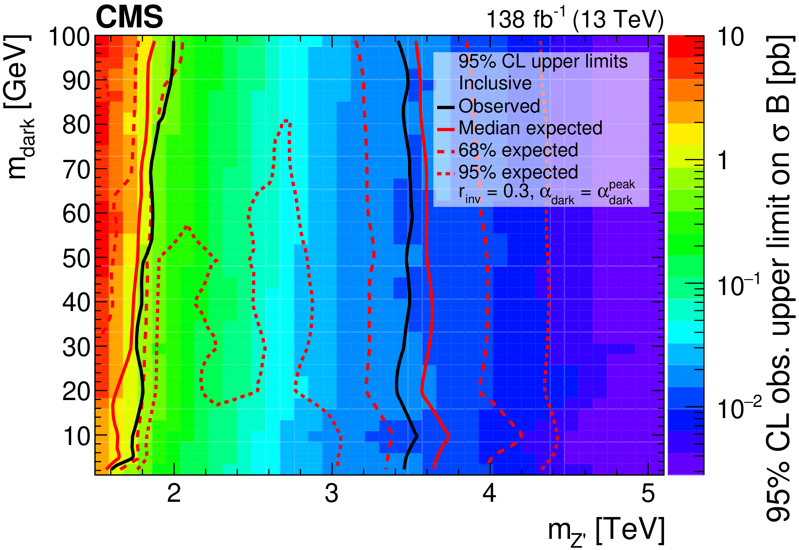
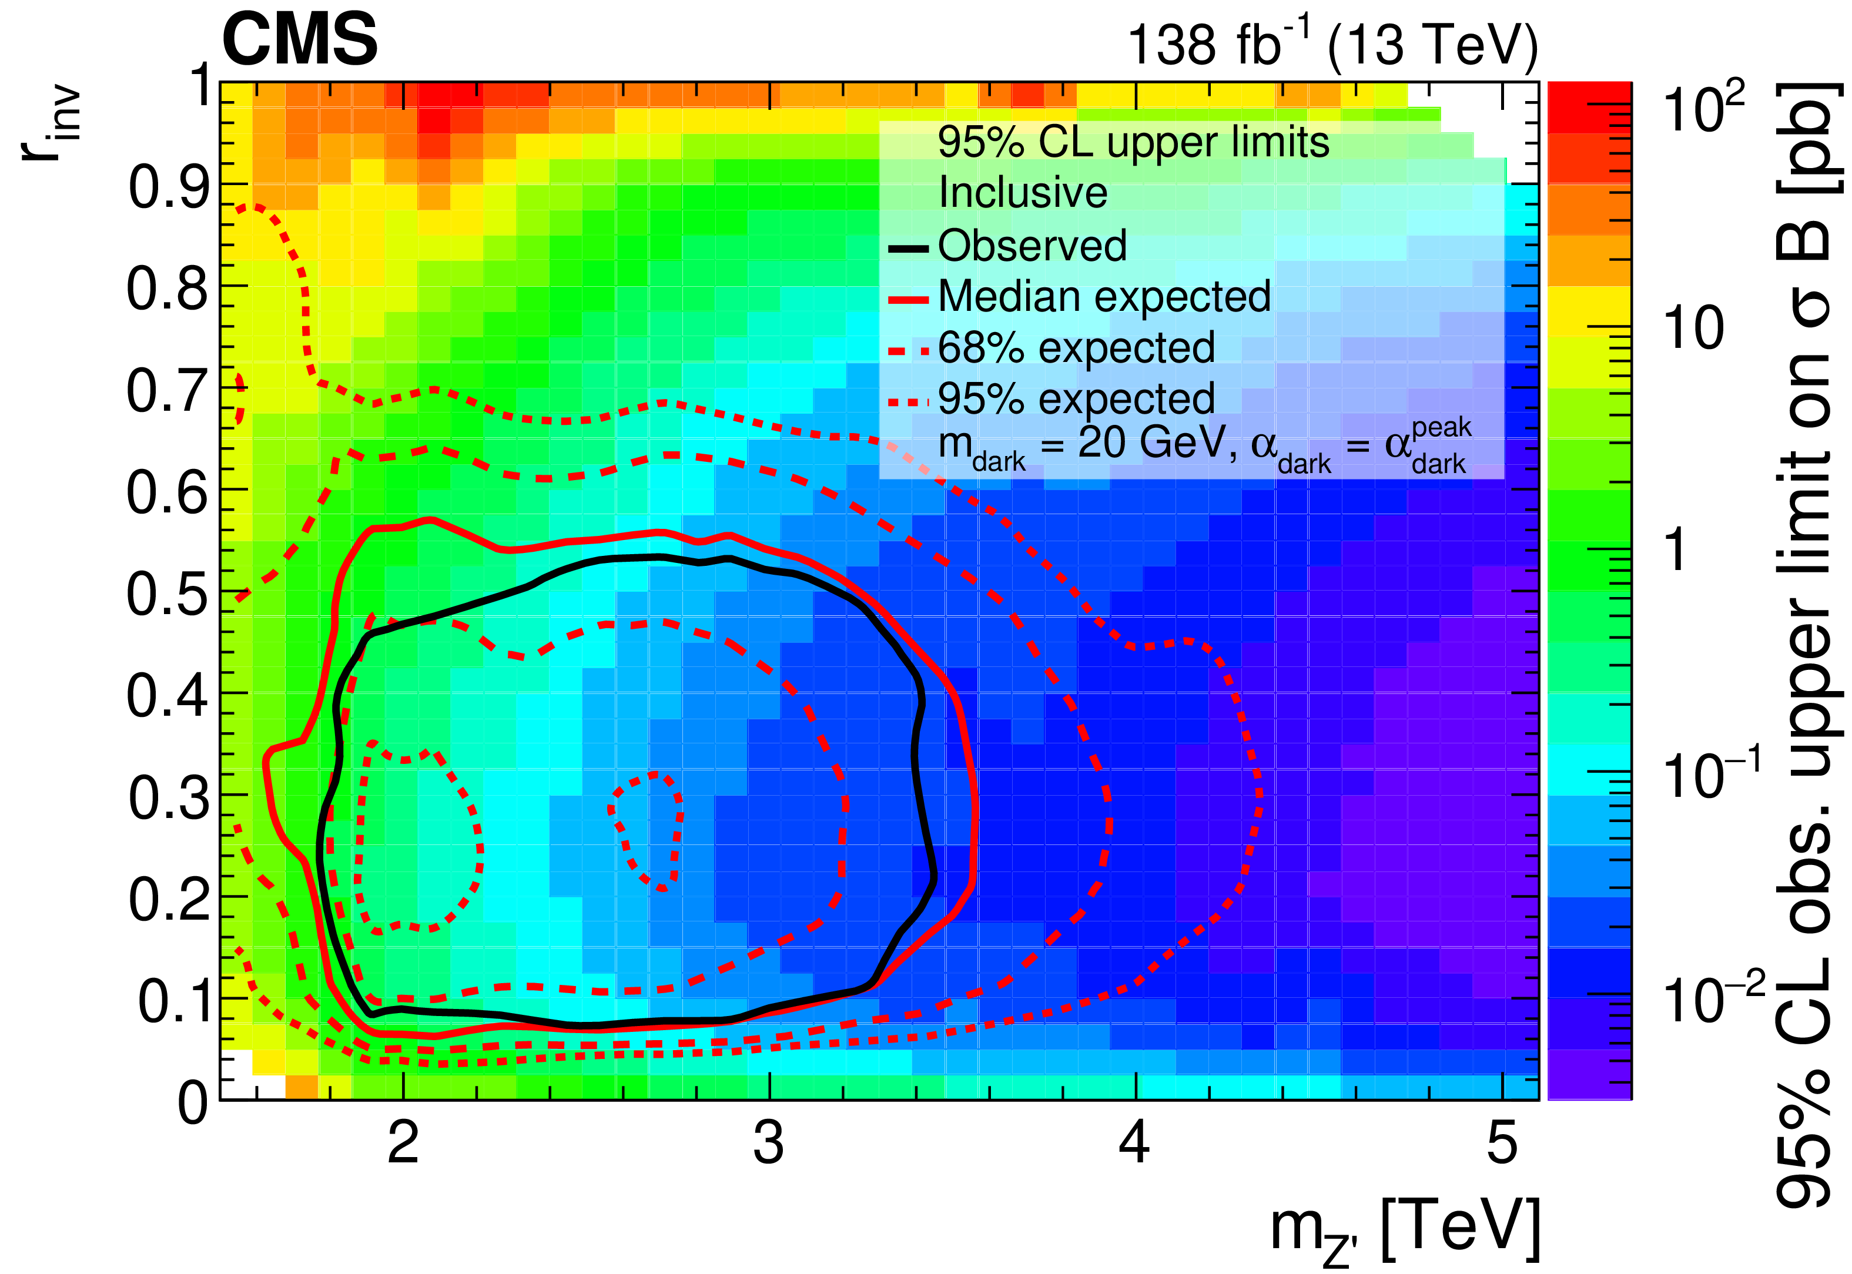
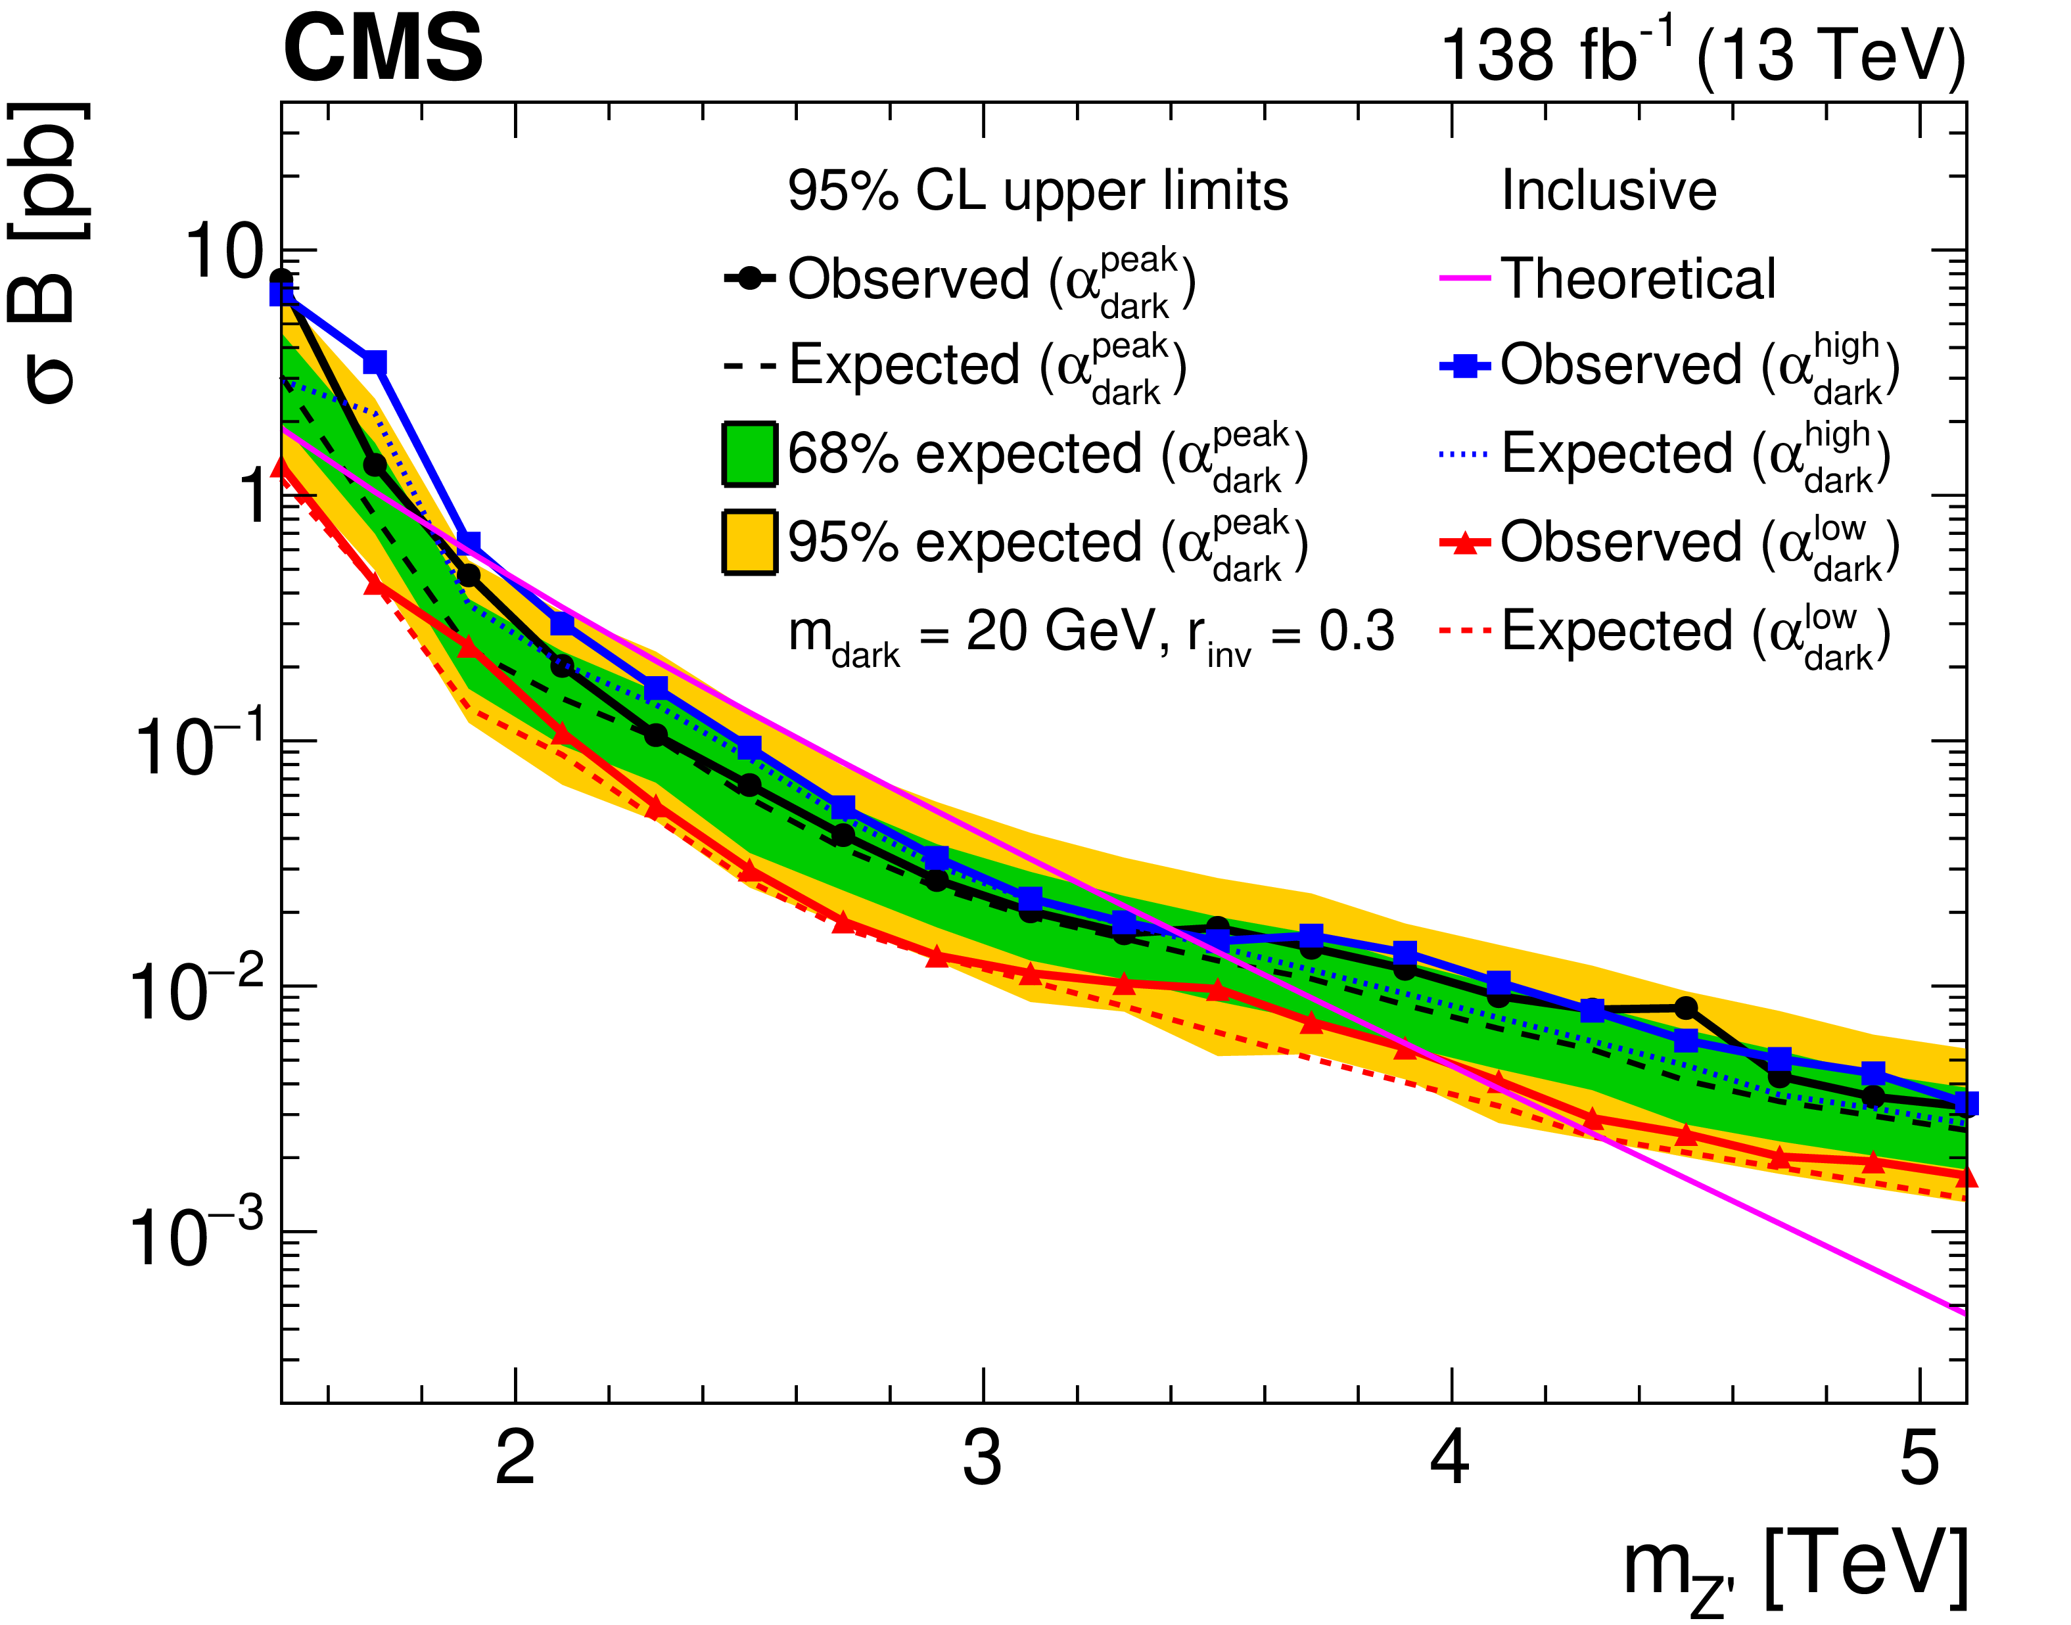
SVJ-search results, inclusive
Observed (expected) exclusions:
1.5 < m_{Z’} < 4.0 TeV (1.5 < m_{Z’} < 4.3 TeV)
Depending on mZ’:
  0.07 < r_{inv} < 0.53 (0.06 < r_{inv} < 0.57)
Lower bound on m_{Z’} due to search using two resolved jets, boosted SVJ search probing lower m_{Z’} close to publication.

Slide 8
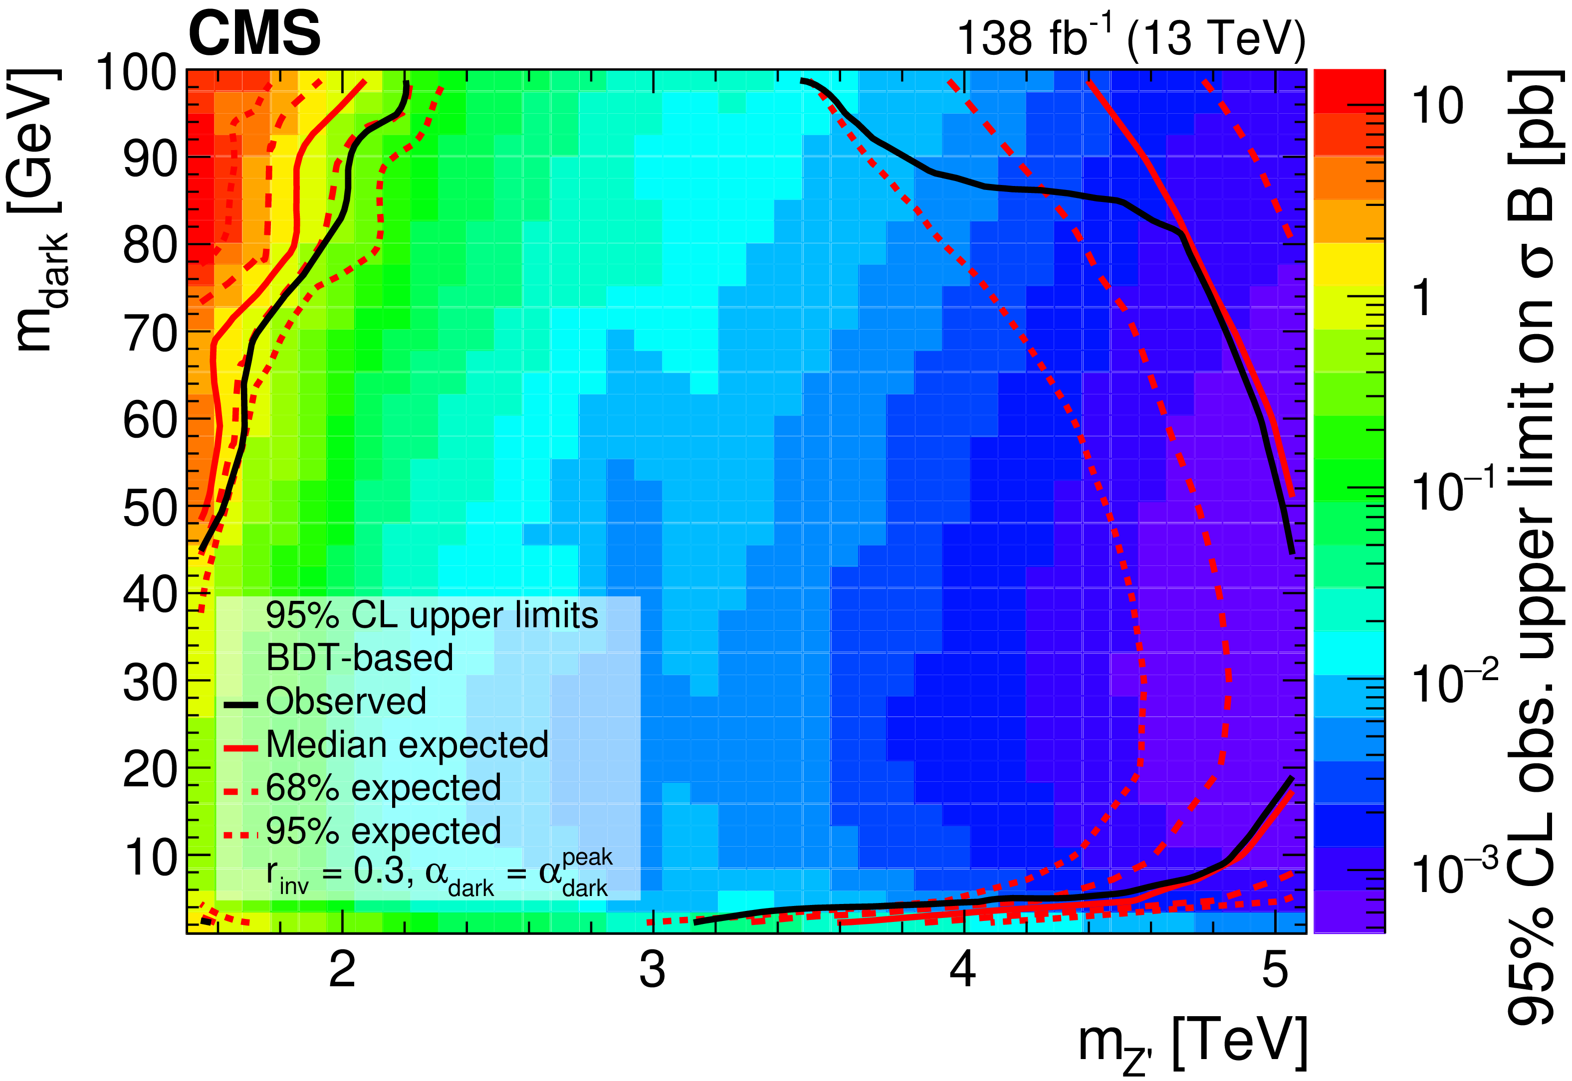
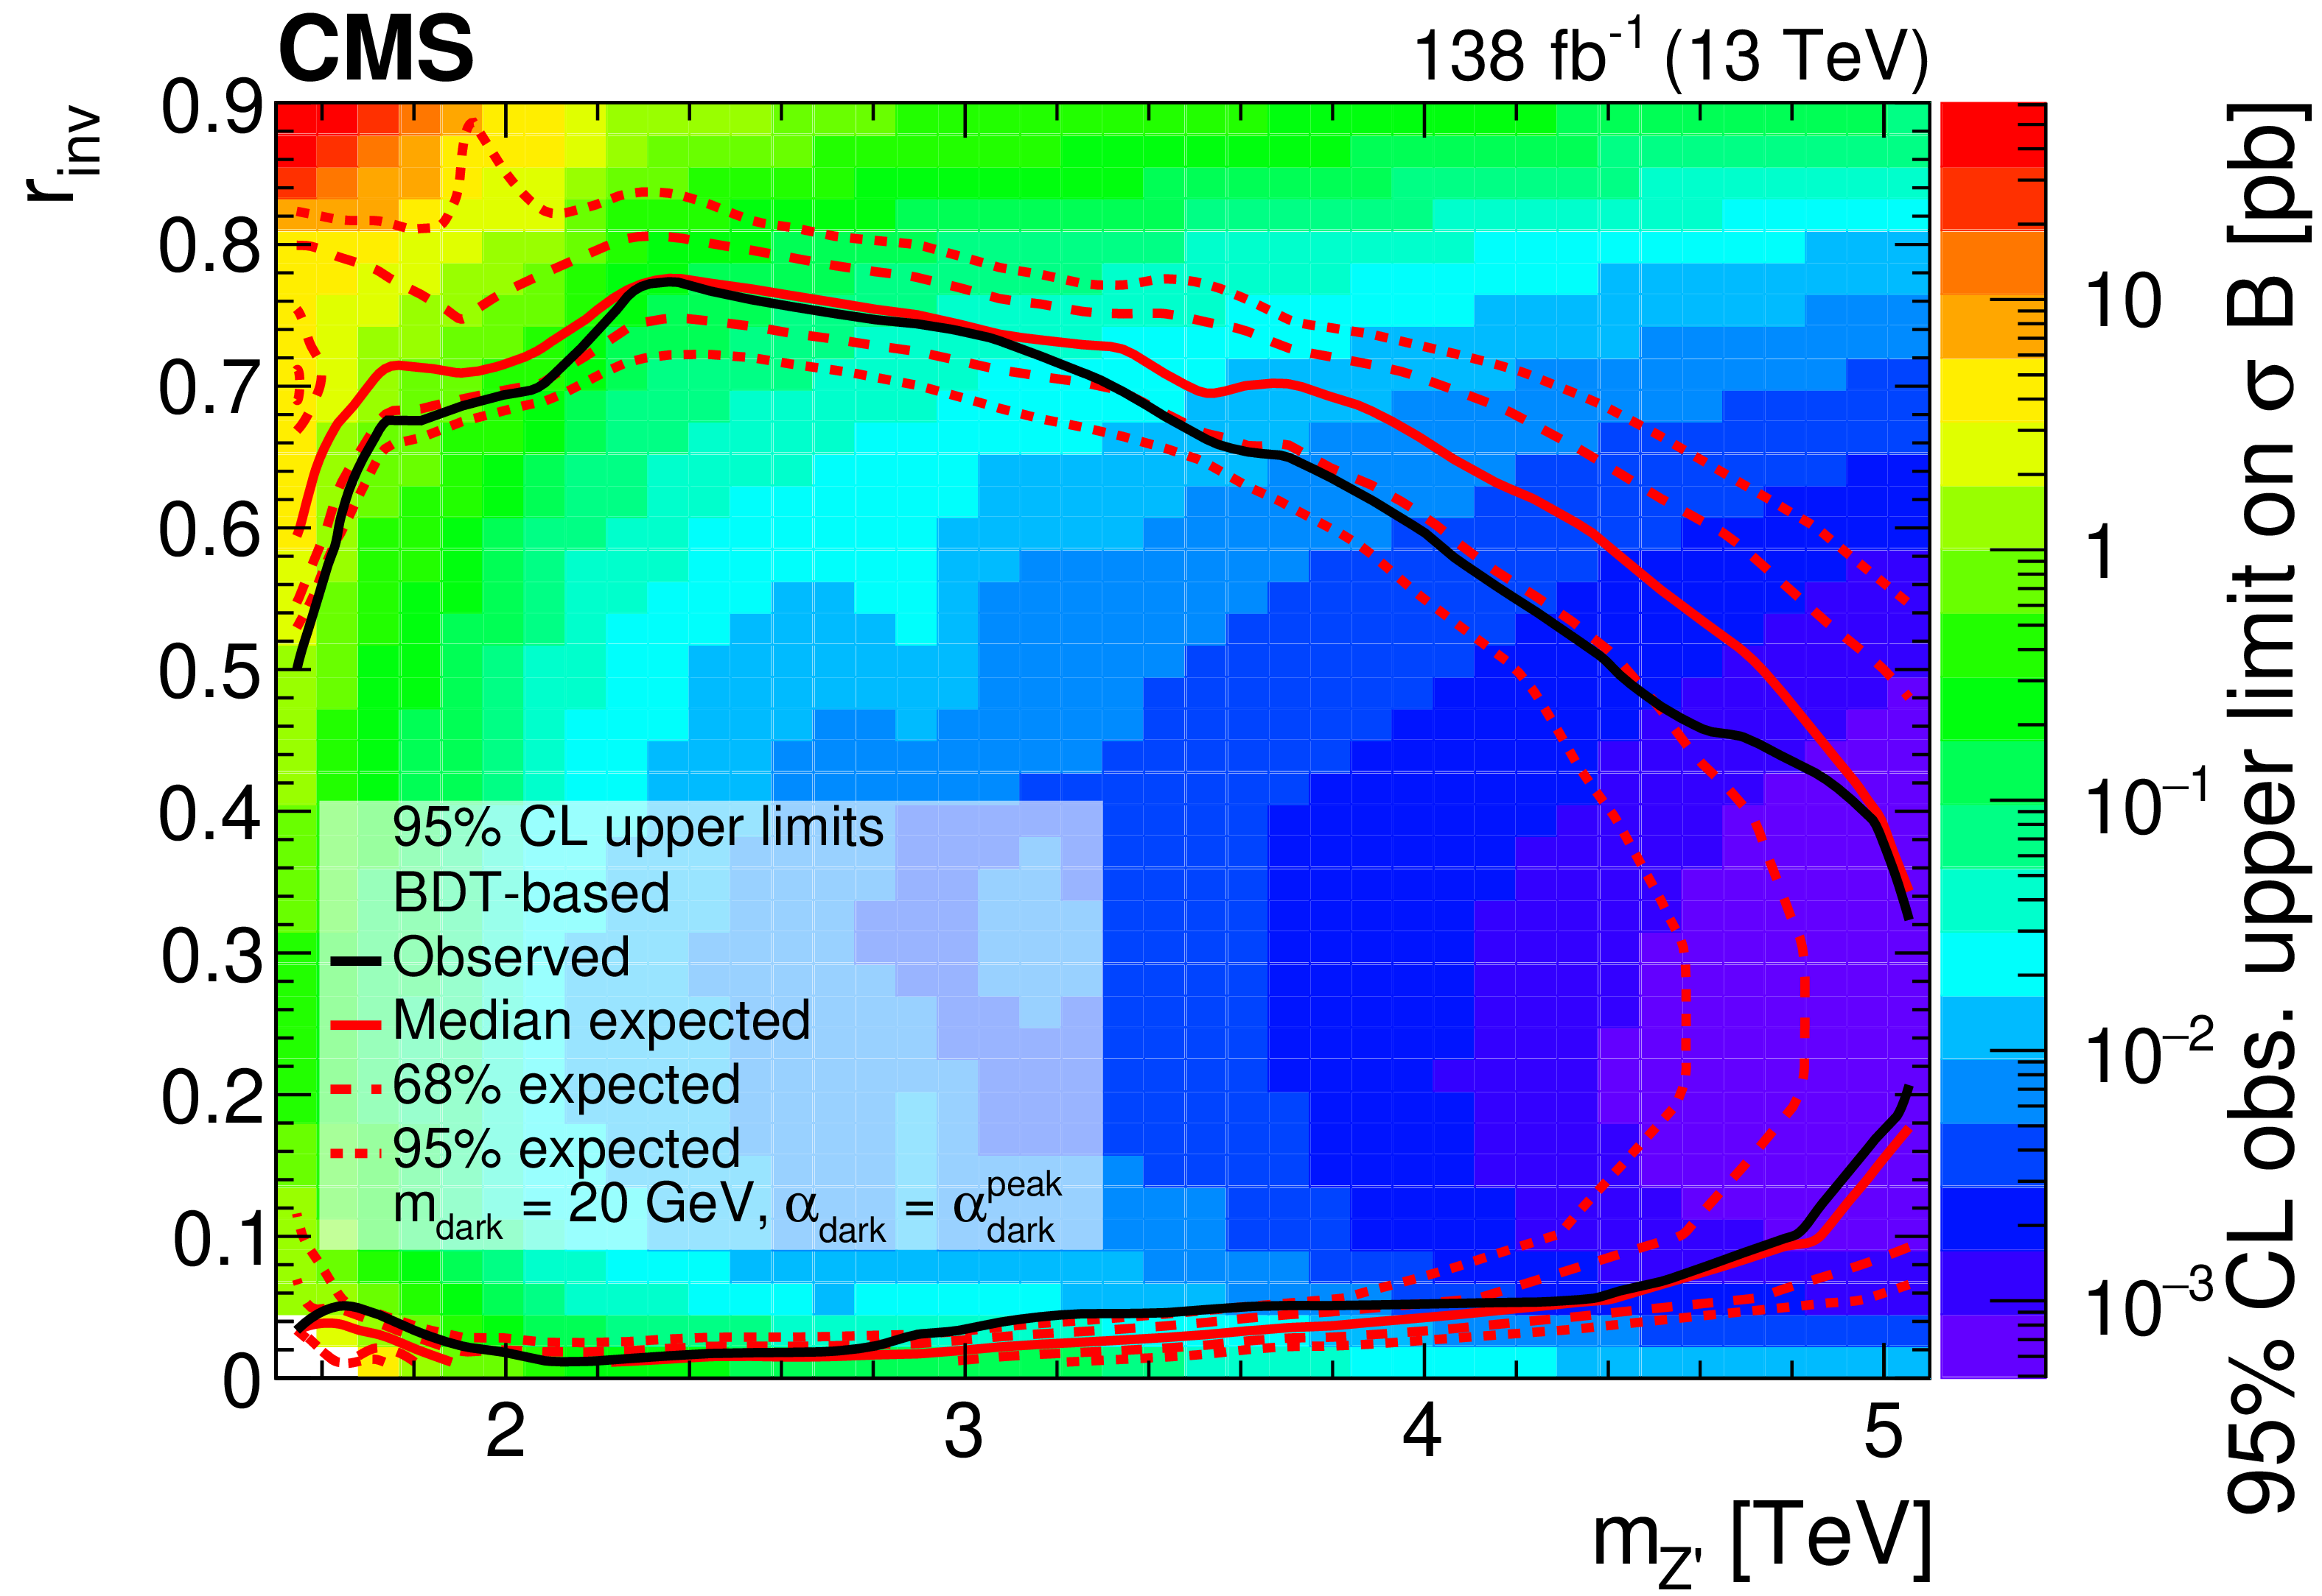
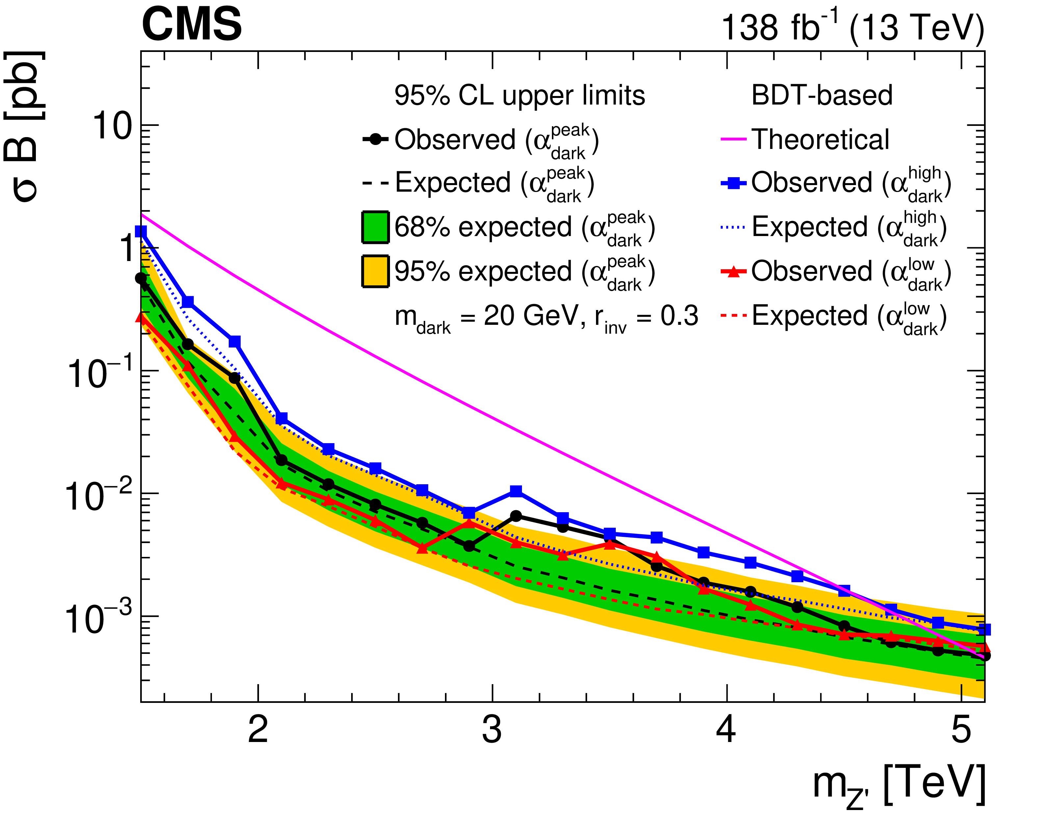
SVJ-search results, BDT-based
Observed (expected) exclusions:
1.5 < m_{Z’} < 5.01 TeV (1.5 < m_{Z’} < 5.1 TeV)
Depending on mZ’:
  0.01 < r_{inv} < 0.77 (0.01 < r_{inv} < 0.78)
Wider exclusion comparing to inclusive approach.

Slide 9
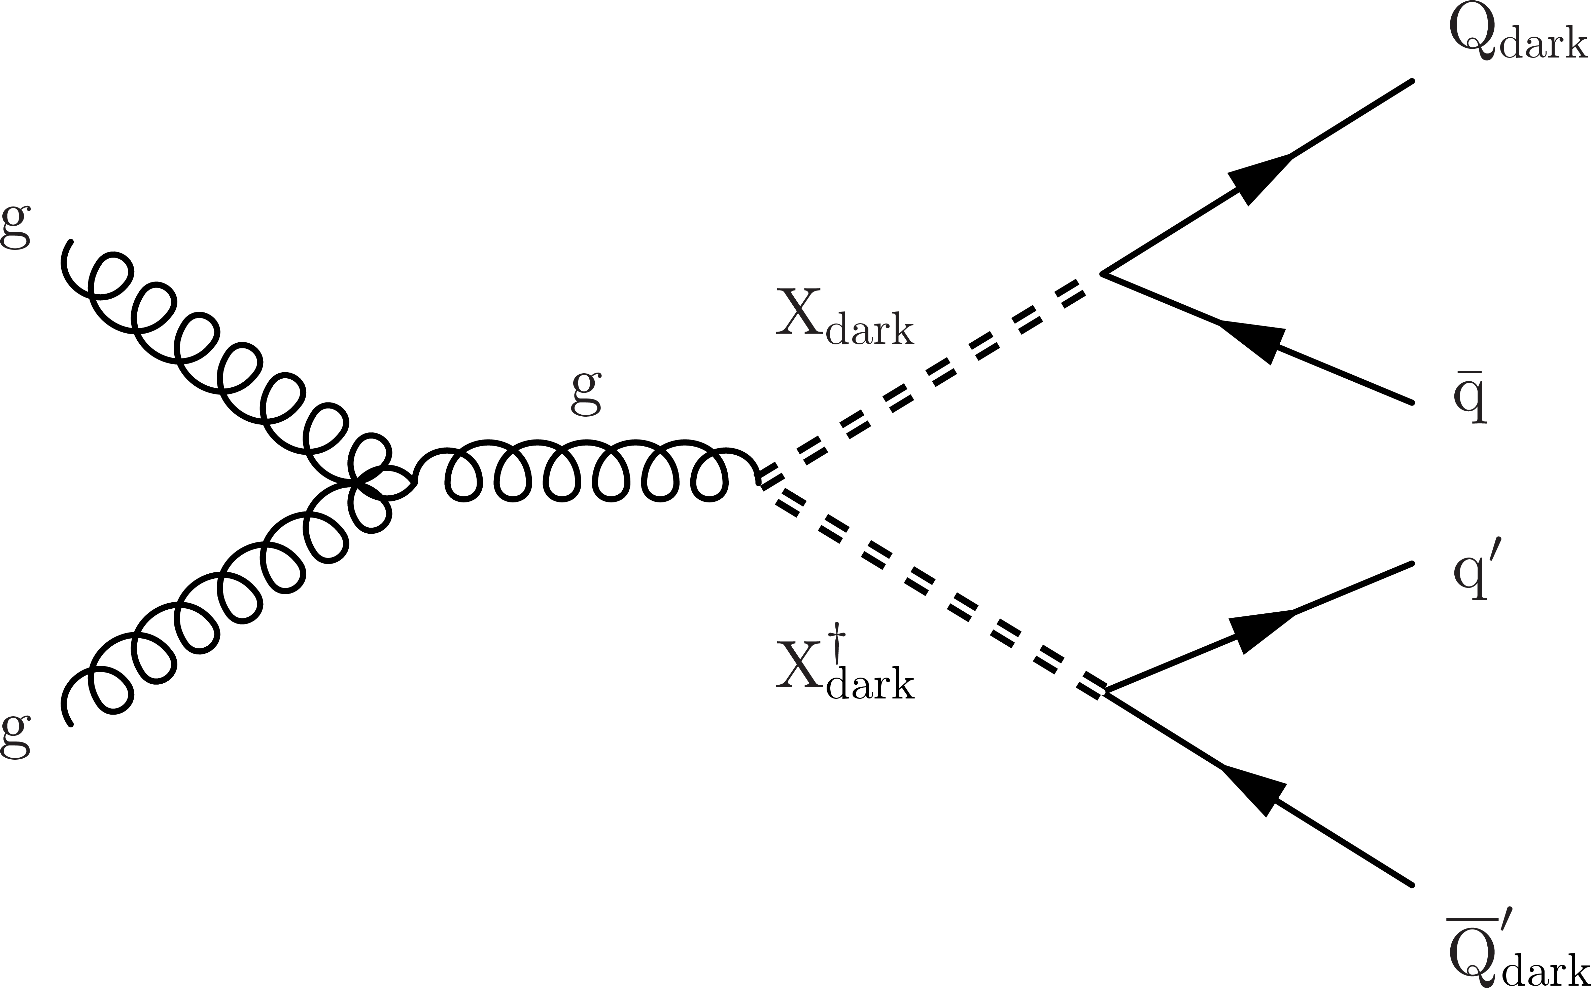
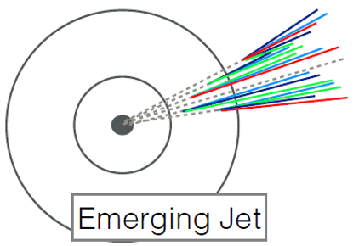
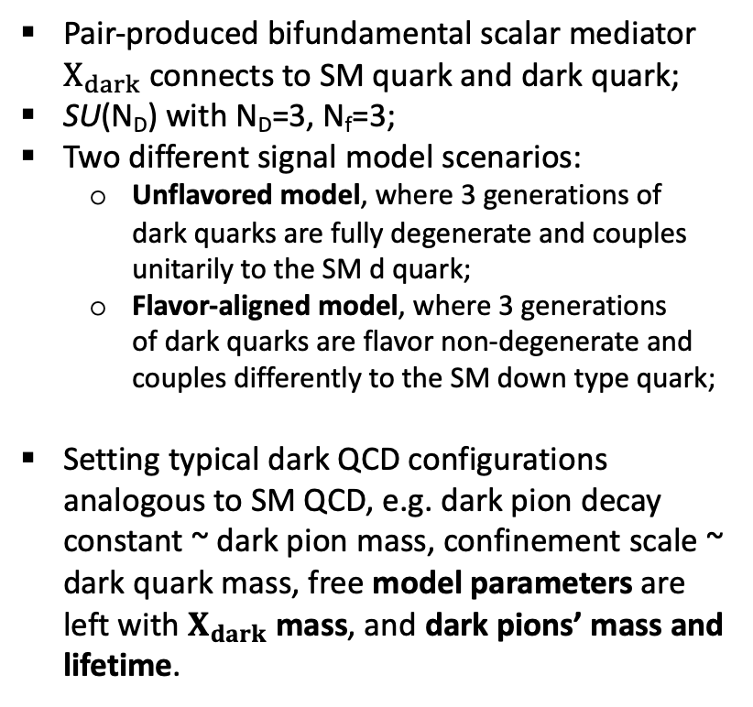
EJ-search models
JHEP 02 (2019) 179
arXiv:2403.01556 submitted to JHEP
Pair-produced bifundamental scalar mediator
$X_{dark}$ connects to SM quark and dark quark;
SU(N_{D}) with N_{D}=3, N_{f}=3;
Two different signal model scenarios:
  Unflavored model, where 3 generations of
  dark quarks are fully degenerate and couples
  unitarily to the SM d quark;
  Flavor-aligned model, where 3 generations
  of dark quarks are flavor non-degenerate and
  couples differently to the SM down type quark;
Setting typical dark QCD configurations analogous to SM QCD, e.g. dark pion decay constant ~ dark pion mass, confinement scale ~ dark quark mass, free model parameters are left with $X_{dark}$ mass, and dark pions’ mass and lifetime.
Notes:
next in line is the emerging jet, where the model consists of …

Slide 10
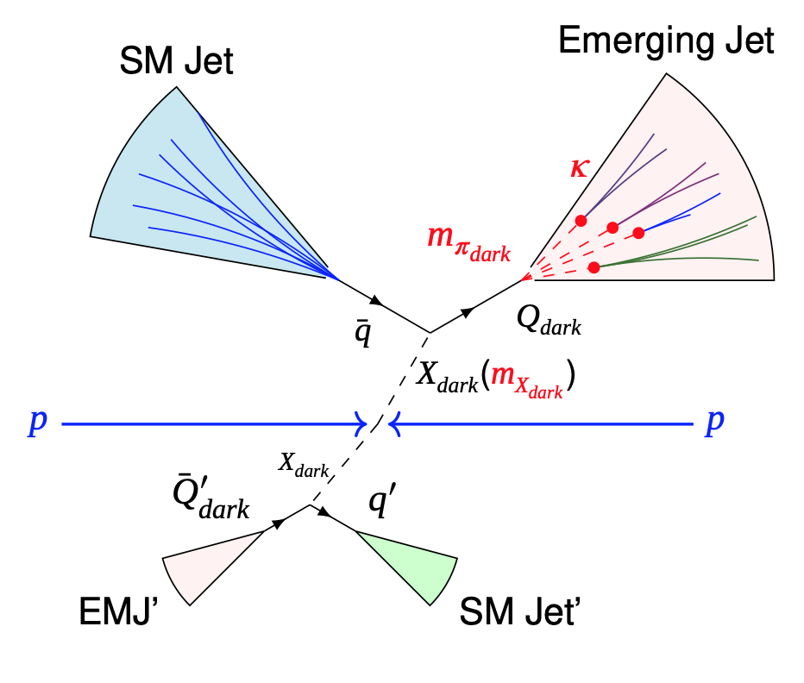
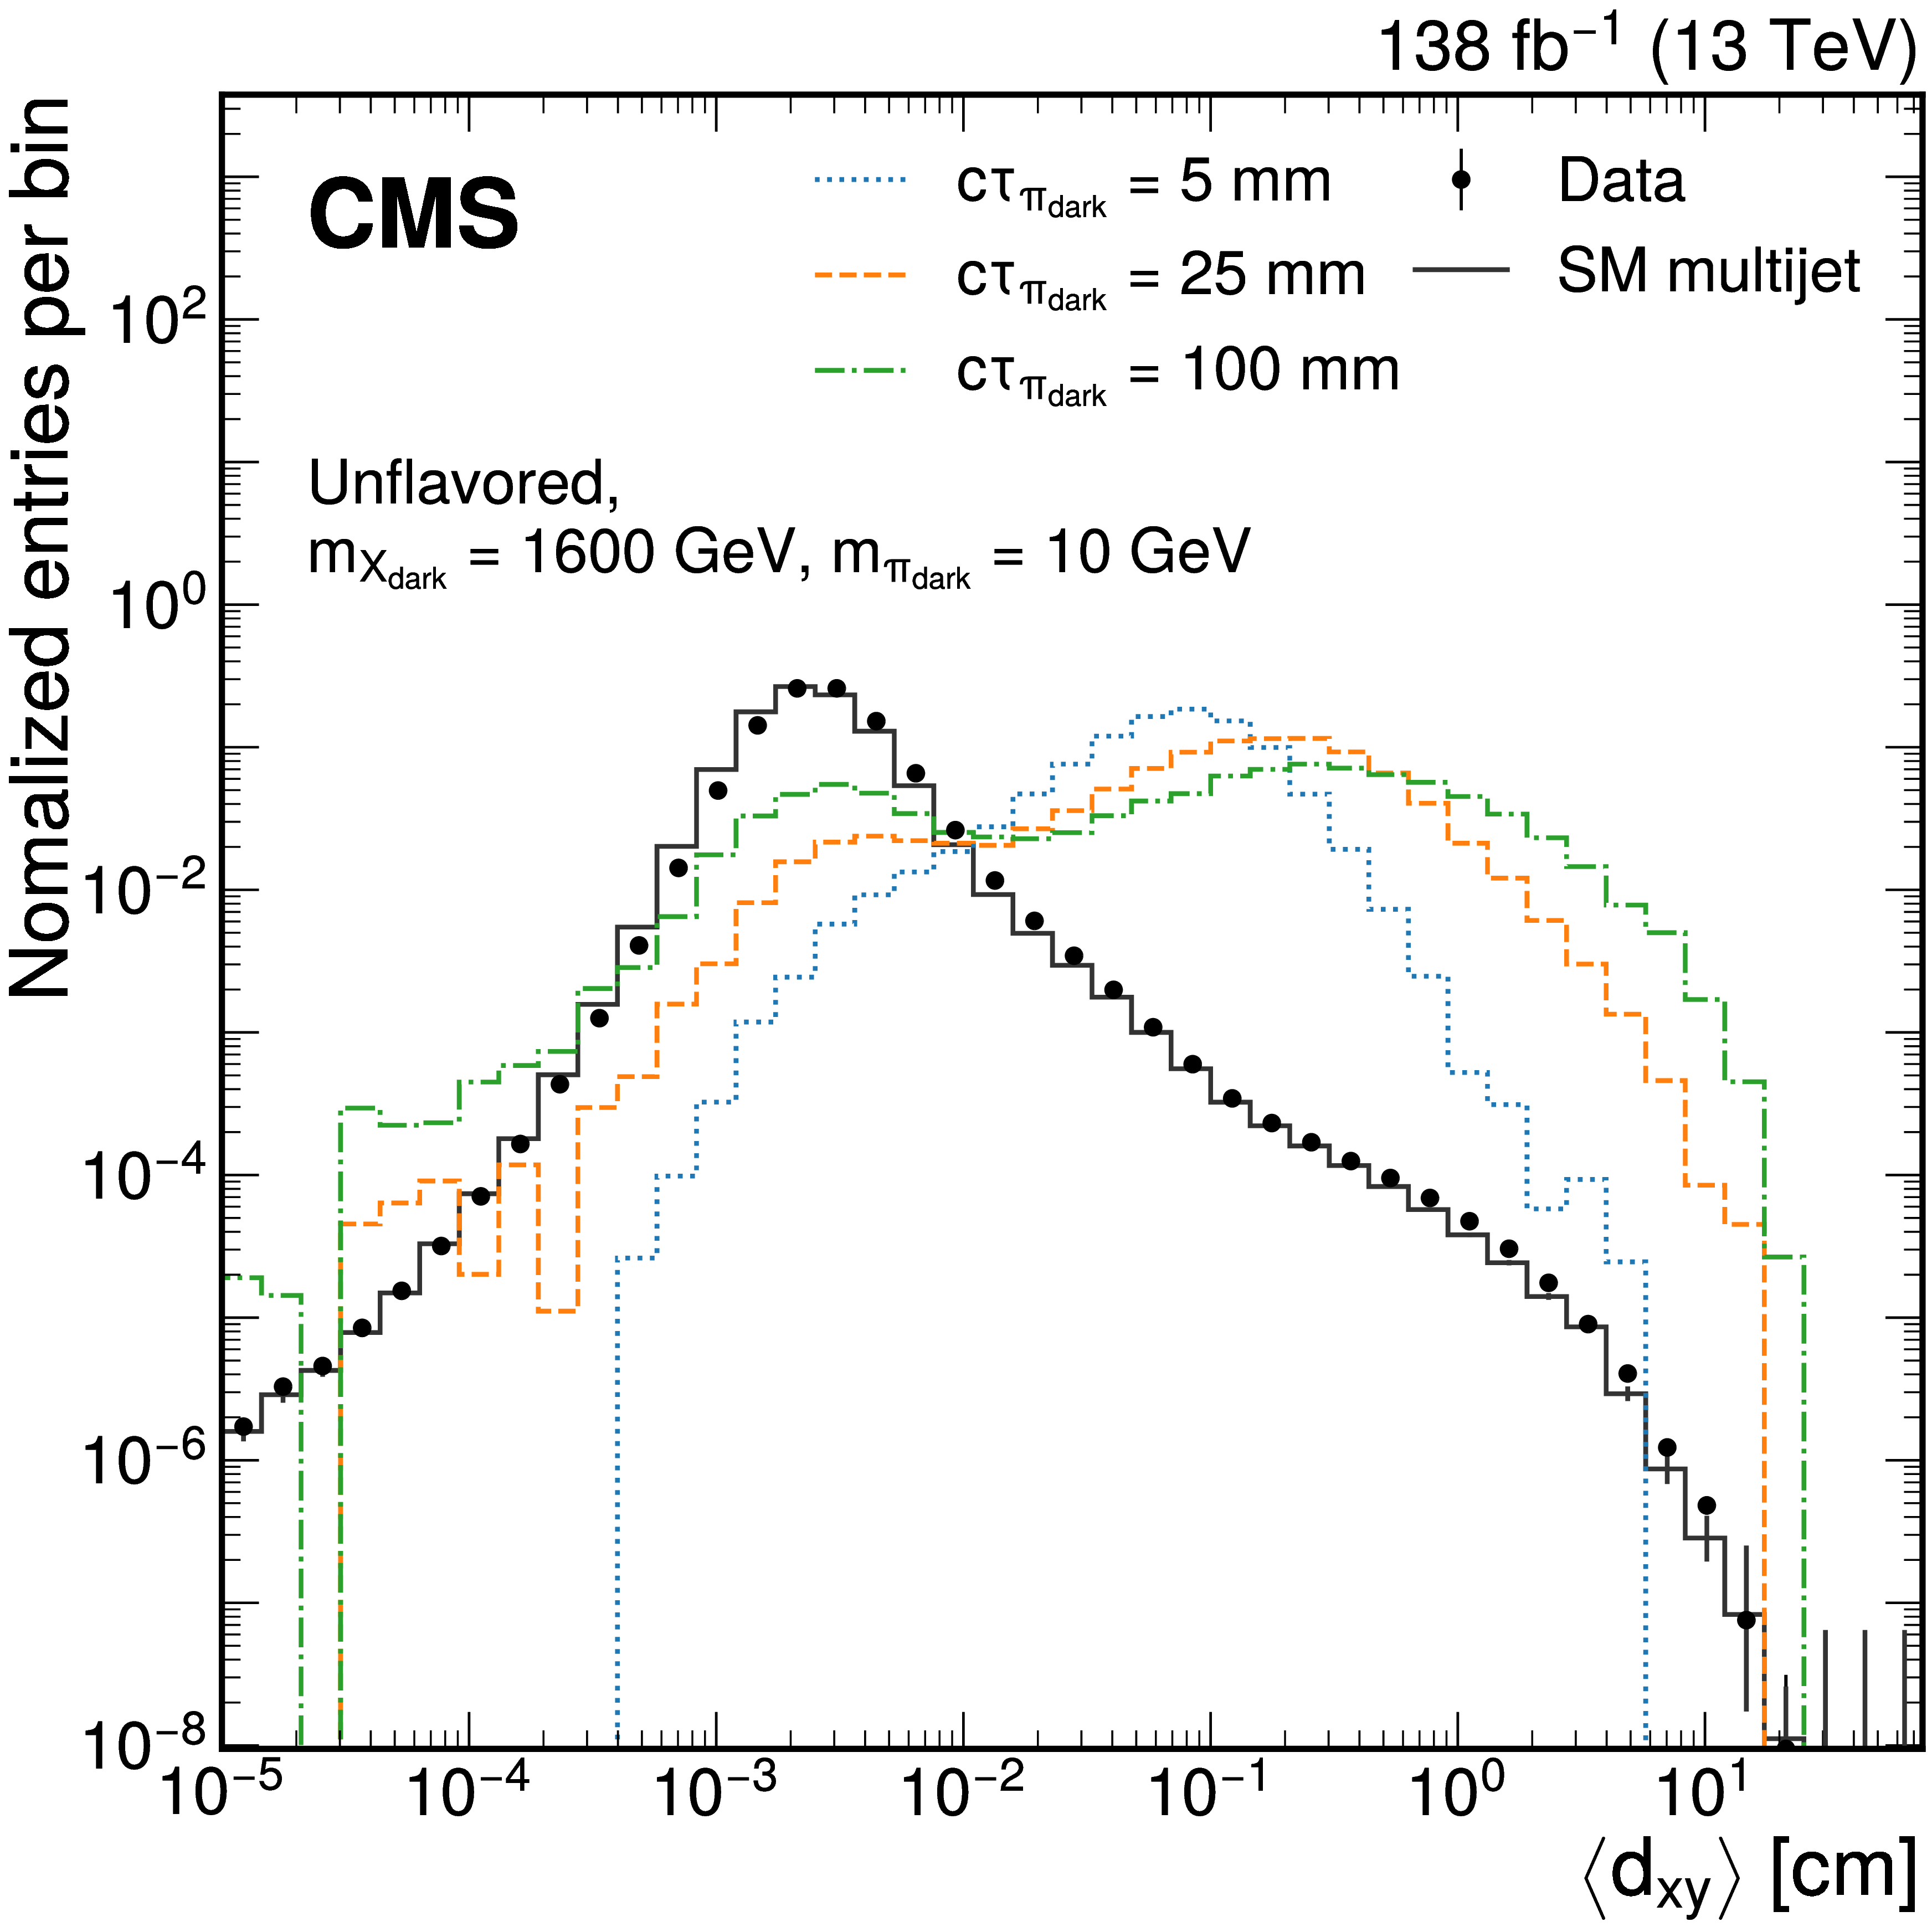
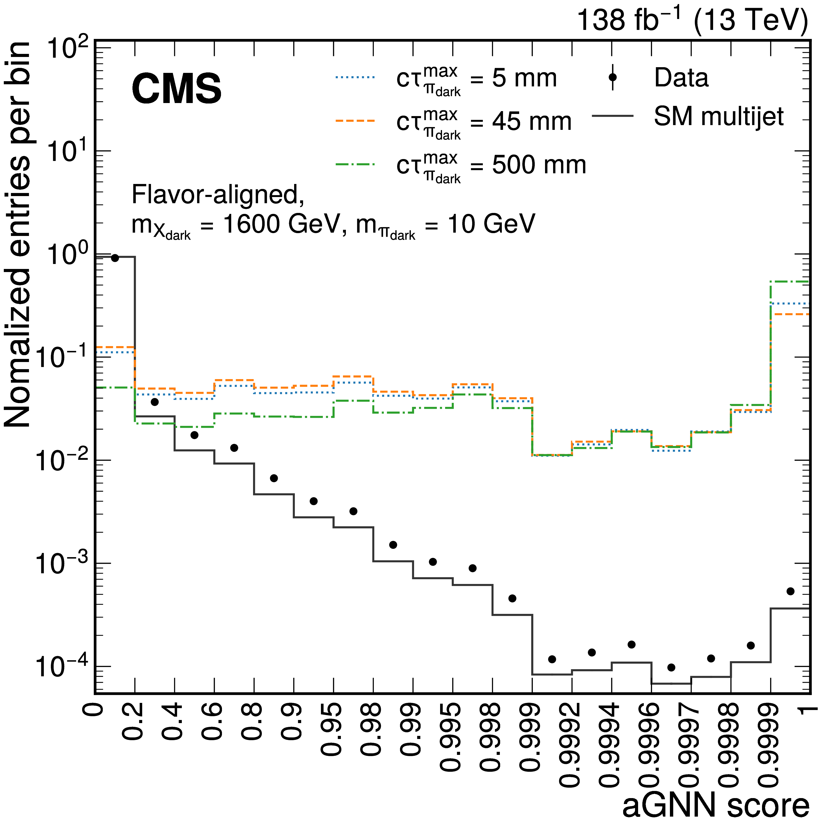
EJ-search methodology
Signal signatures on detector:
  Semi-long-lived dark mesons decay back to
  SM particles, forming SM showers emerging
  from vertices finite distances away from
  collision points;
  Tree level two SM jets + 2 emerging jets;
Cut & Count analysis
Background estimated using control samples in data based on jet misidentification probabilities.
Two approaches:
Model-agnostic approach for reinterpretability;
ML-based approach to maximize sensitivity for the chosen models under search.

Slide 11
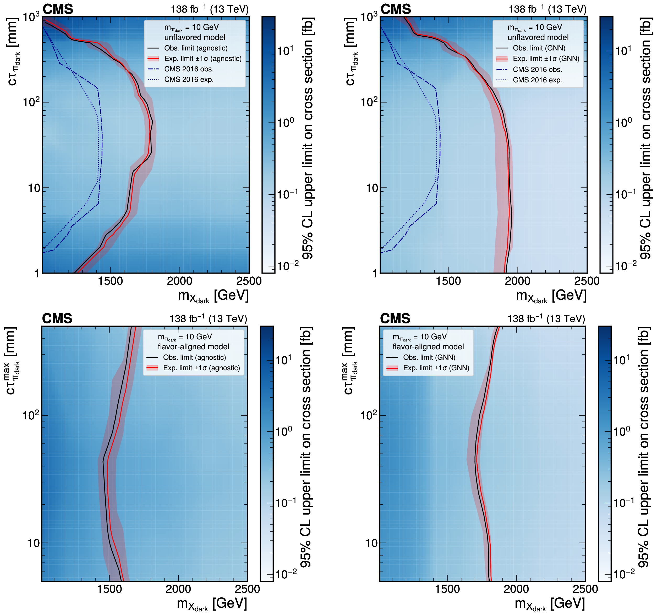
EJ-search results for m_{πD}=10 GeV
Top: unflavored;
Bottom: flavor-aligned;
Left: model-agnostic;
Right: ML-based;
Left side of the contours are excluded by the search;
Large improvement in the unflavored search comparing to previous publication;
Better sensitivity in low dark pion lifetime regions with ML-based search;
Search also provides tabulated observed event yields in the paper.

Slide 12
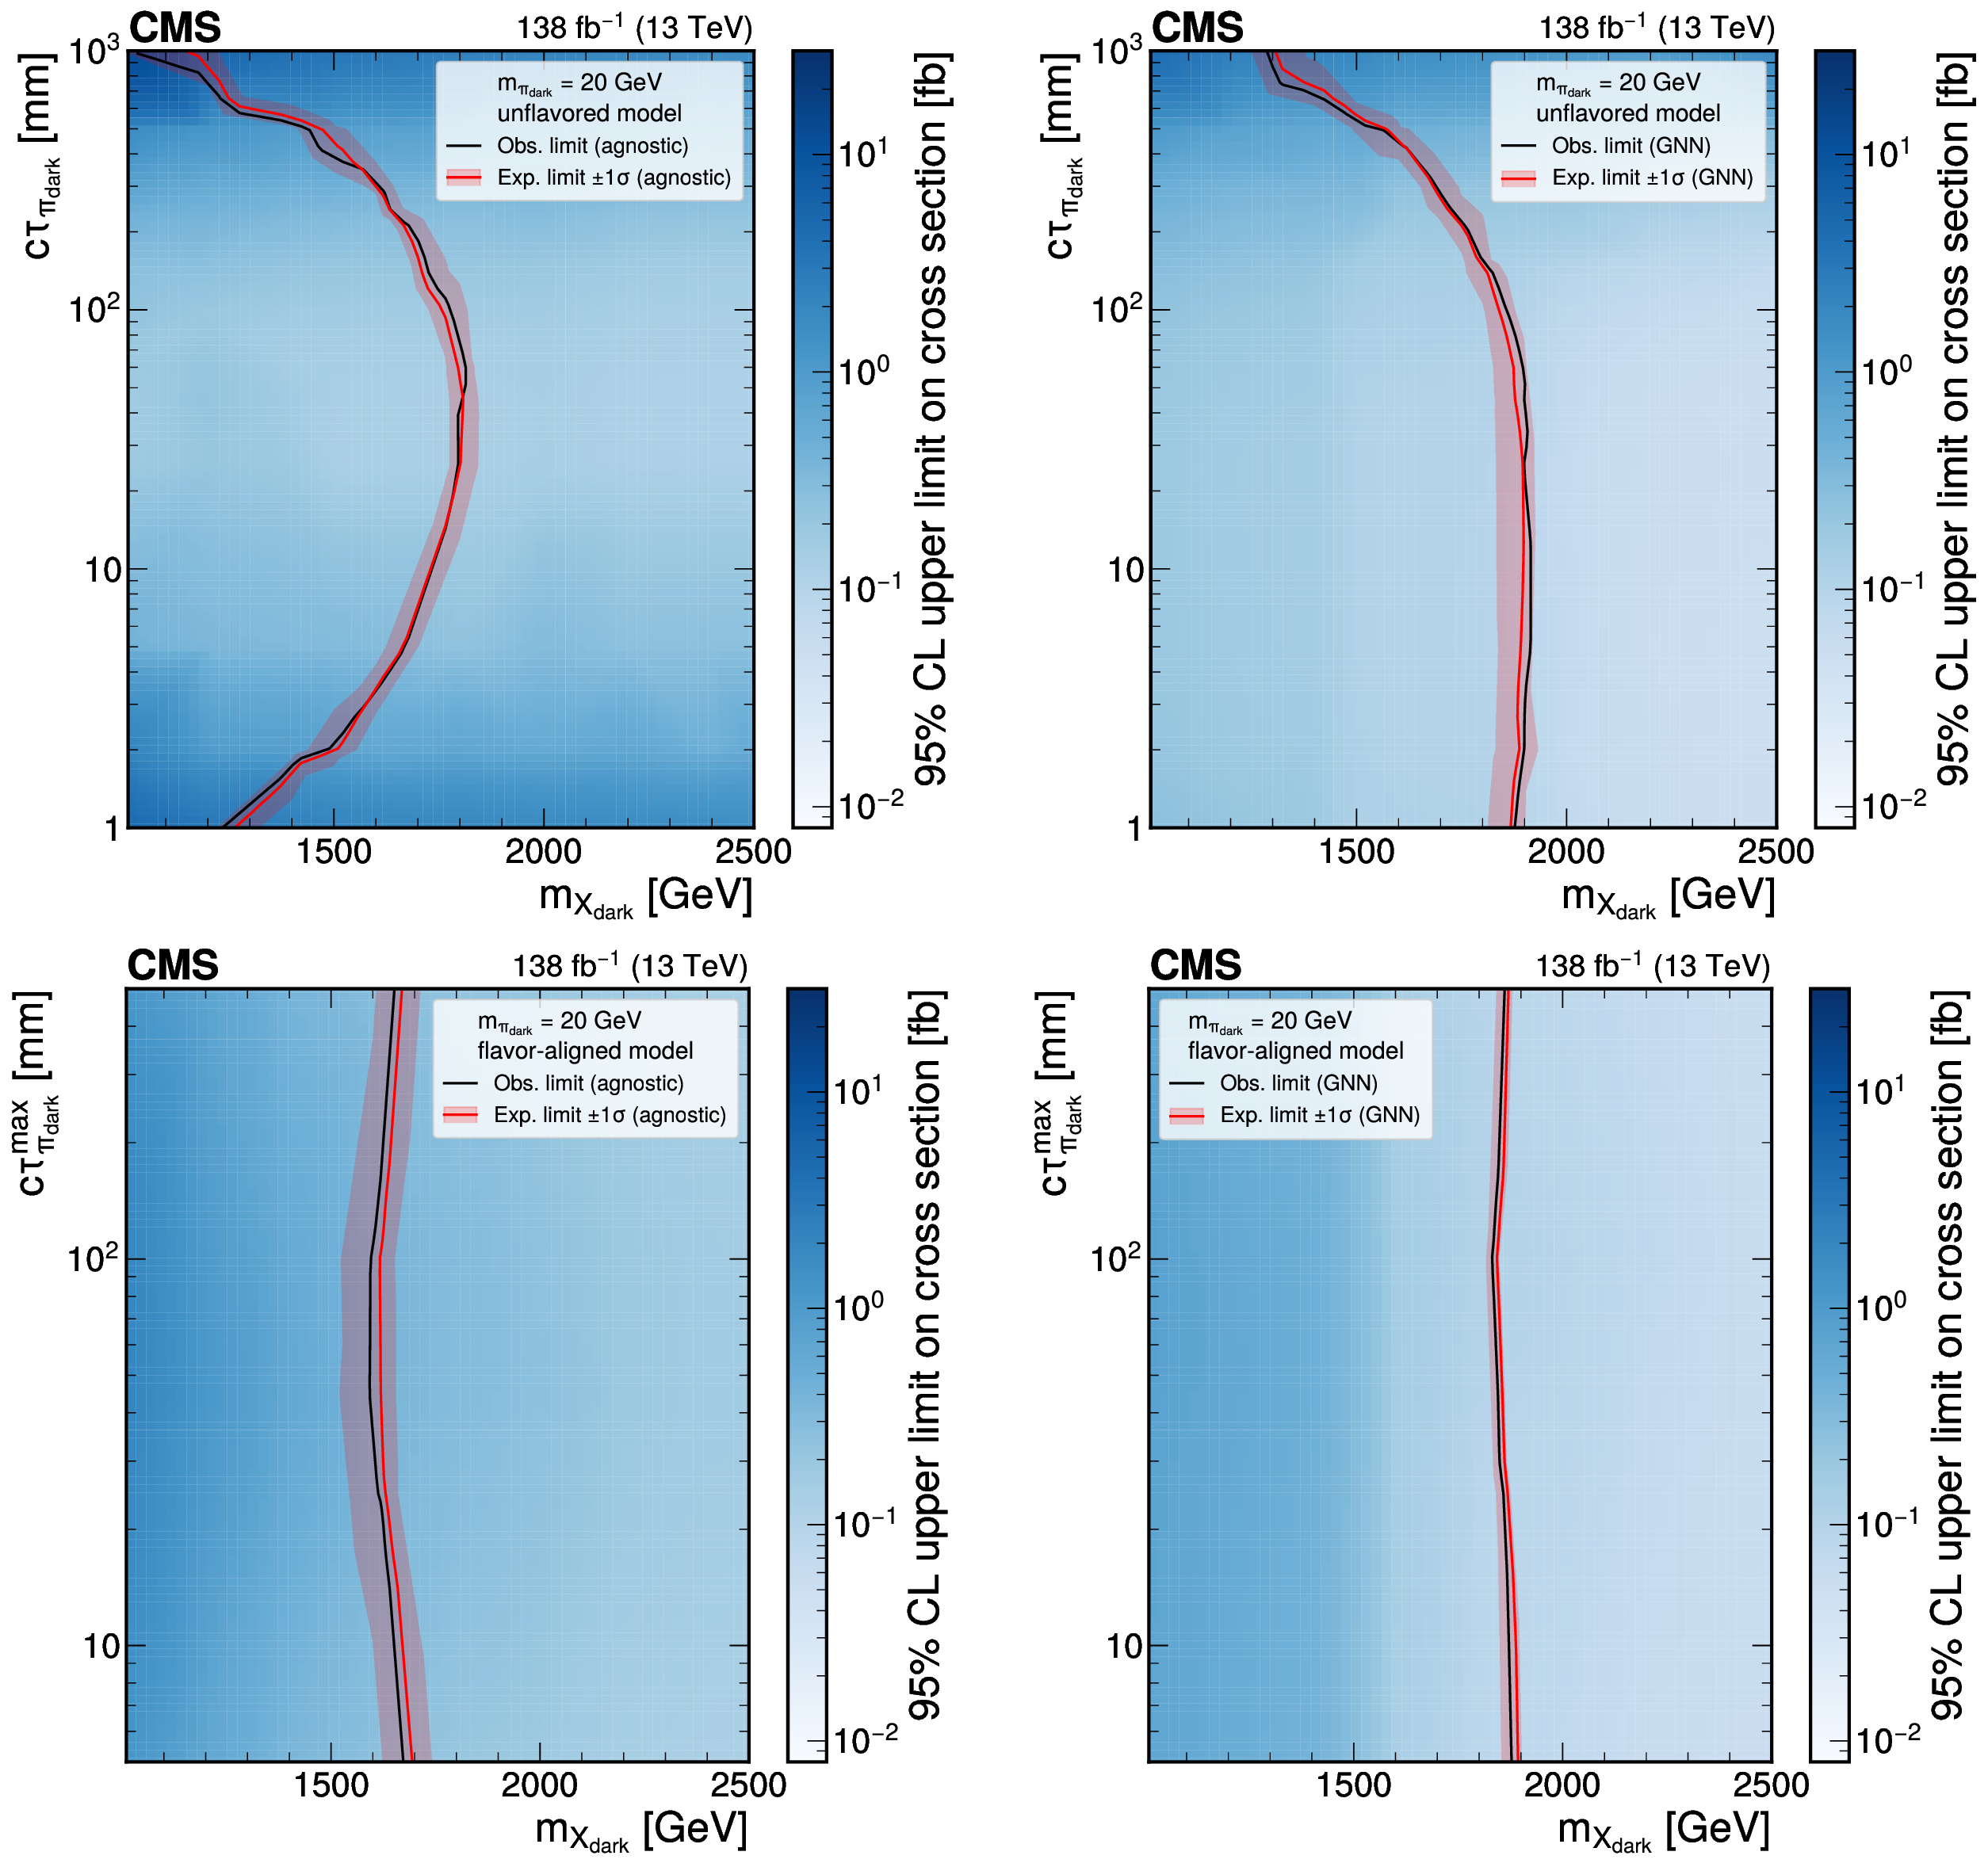
EJ-search results for m_{πD}=20 GeV
Top: unflavored;
Bottom: flavor-aligned;
Left: model-agnostic;
Right: ML-based;
Left side of the contours are excluded by the search;
Large improvement in the unflavored search comparing to previous publication;
Better sensitivity in low dark pion lifetime regions with ML-based search;
Search also provides tabulated observed event yields in the paper.

Slide 13
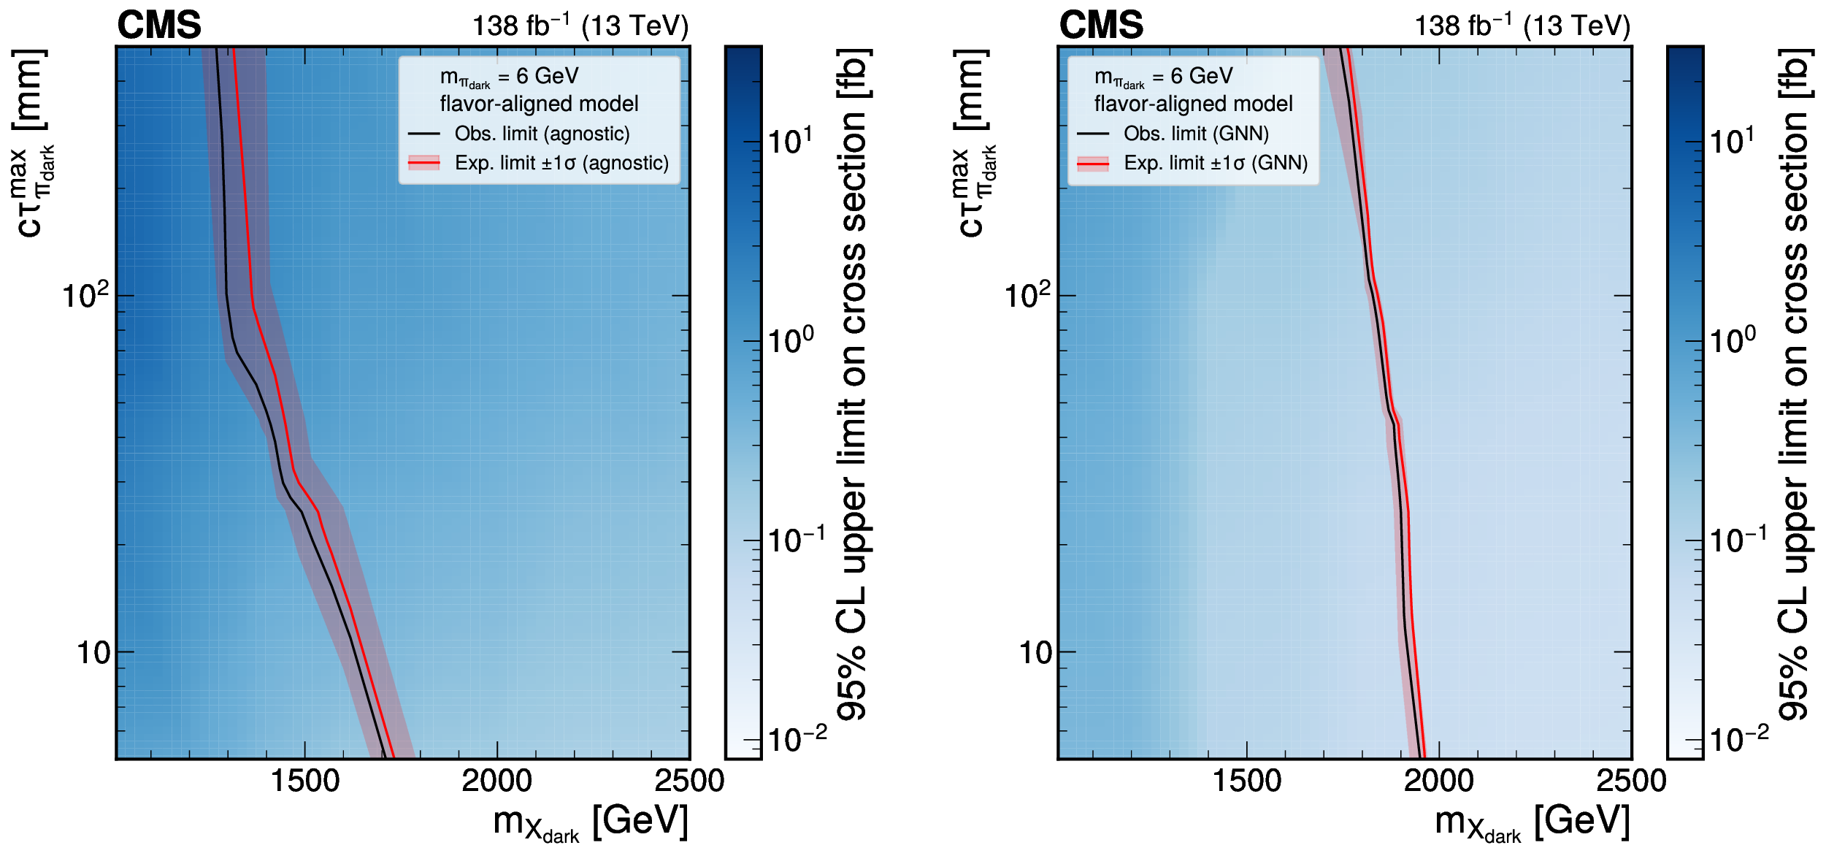
EJ-search results for m_{πD}=6 GeV
Left: model-agnostic search; Right: ML-based search;
Only relevant for flavor-aligned model scenario as the decay of dark pions starts to behave differently due to kinematics accessibility;
Wider exclusion in ML-based approach comparing to model-agnostic approach.

Slide 14
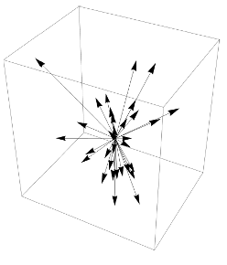
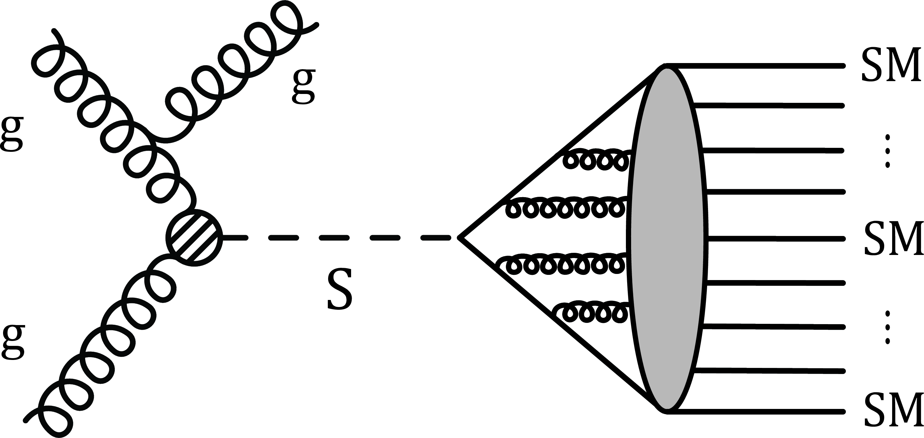
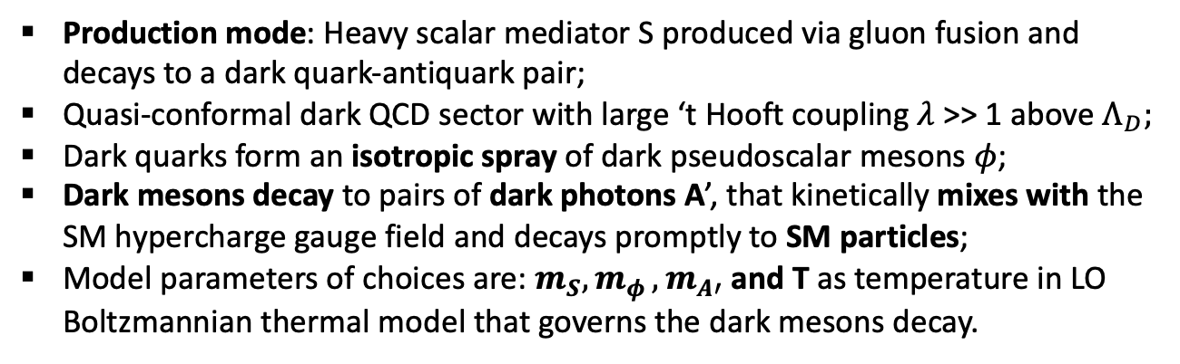
SUEP-search models
arXiv:2403.05311 submitted to PRL
Production mode: Heavy scalar mediator S produced via gluon fusion and decays to a dark quark-antiquark pair;
Quasi-conformal dark QCD sector with large ‘t Hooft coupling $λ$ >> 1 above $Λ_{D};$
Dark quarks form an isotropic spray of dark pseudoscalar mesons $φ$;
Dark mesons decay to pairs of dark photons A’, that kinetically mixes with the SM hypercharge gauge field and decays promptly to SM particles;
Model parameters of choices are: $m_{S}{, m}_{φ}{, m}_{A′}$ and T as temperature in LO Boltzmannian thermal model that governs the dark mesons decay.
Notes:
The latest public result on dark shower from CMS is the SUEPs. The model production model… Due to the large ‘t Hooft coupling,

Slide 15
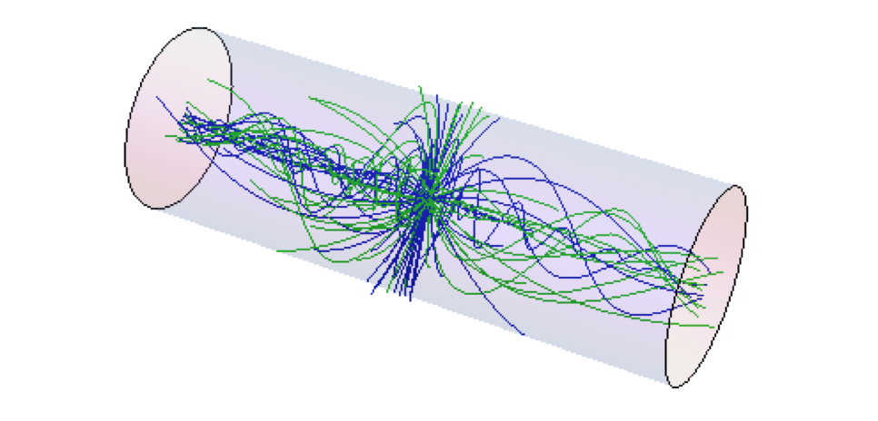
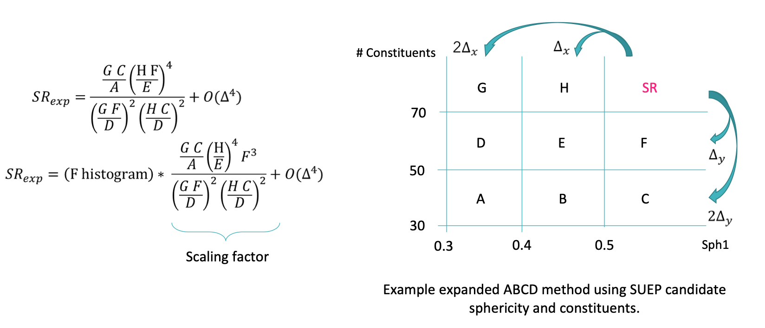
SUEP-search methodology
Signal signatures on detector:
  Large multiplicities of isotropic,
  low p_{T} tracks final state;
  Spherically-symmetric event shape;
Cut & Count with track multiplicity and event sphericity;
Background estimated using control samples in data, based on an extended ABCD method;

Slide 16
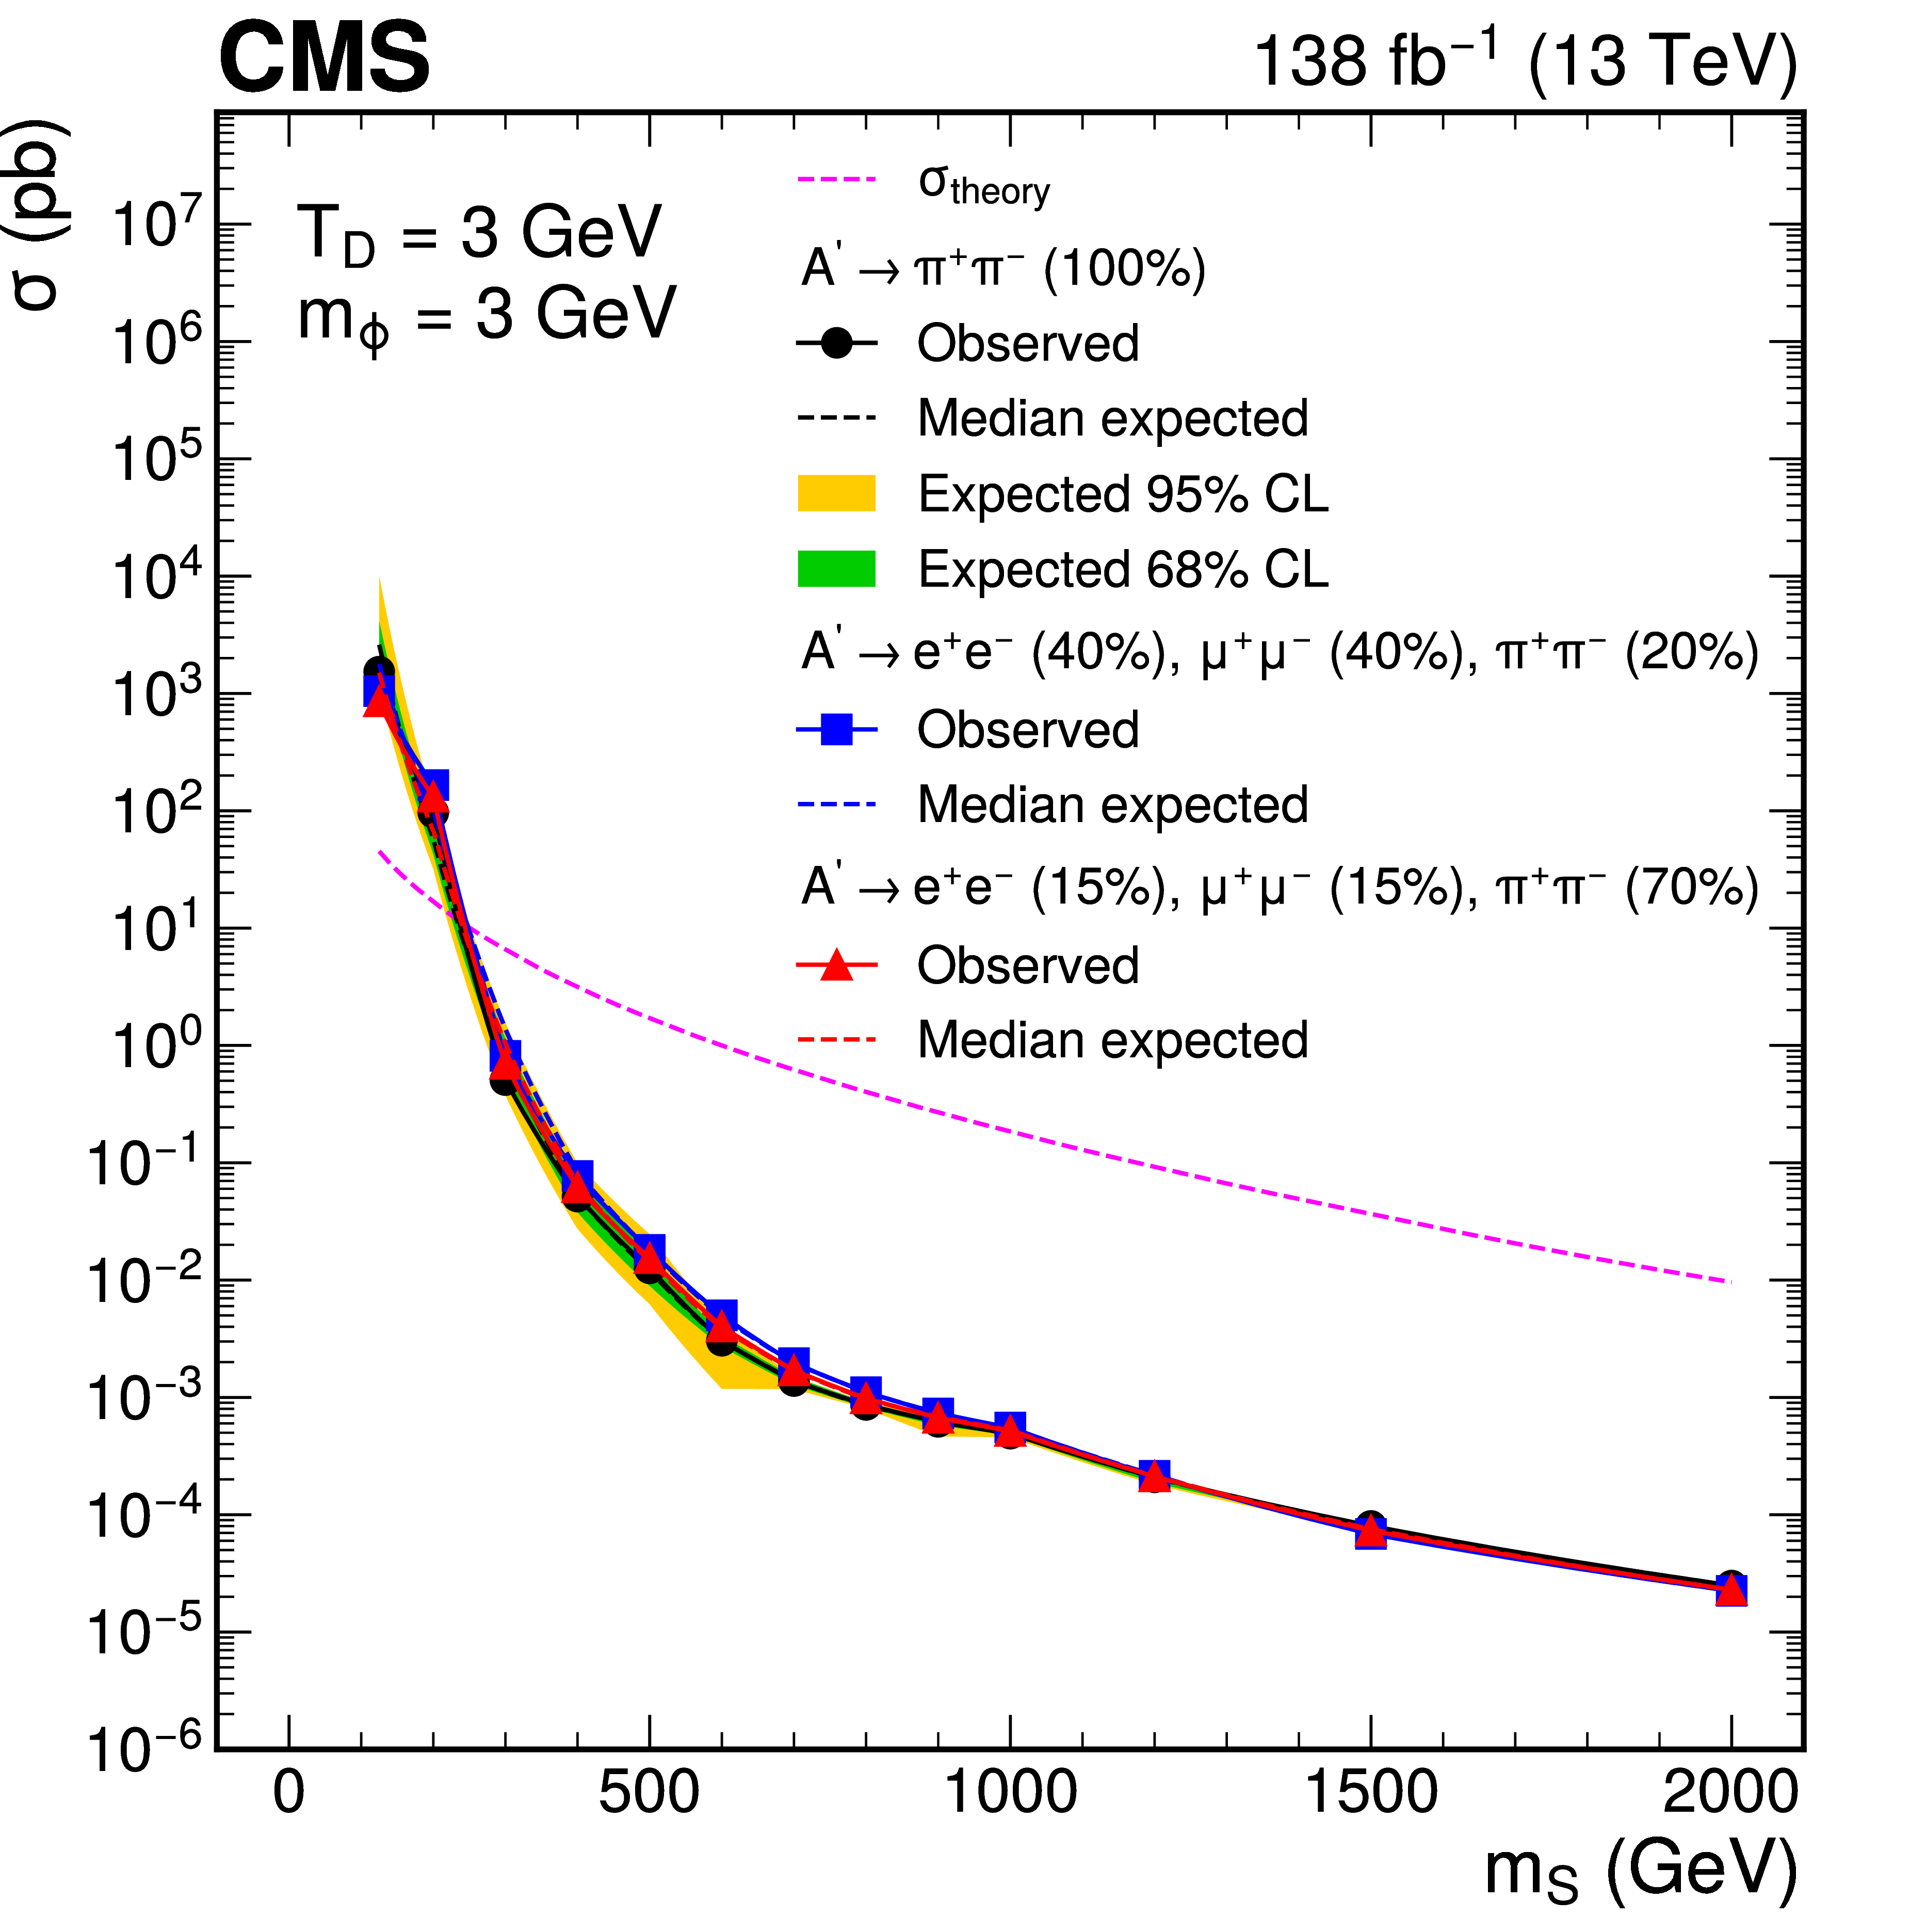
SUEP-search results
No significant excess of events over the SM prediction;
1-D upper limits on production cross section from toy frequentist approach；
Best sensitivity for low-medium T, 𝑚_{𝜙}, and medium-high m_{S}, as all increase the number of constituents, and push the signal in the last bins of SR;
Similar sensitivity to different A’ decay modes as shown in the colored observed lines.

Slide 17
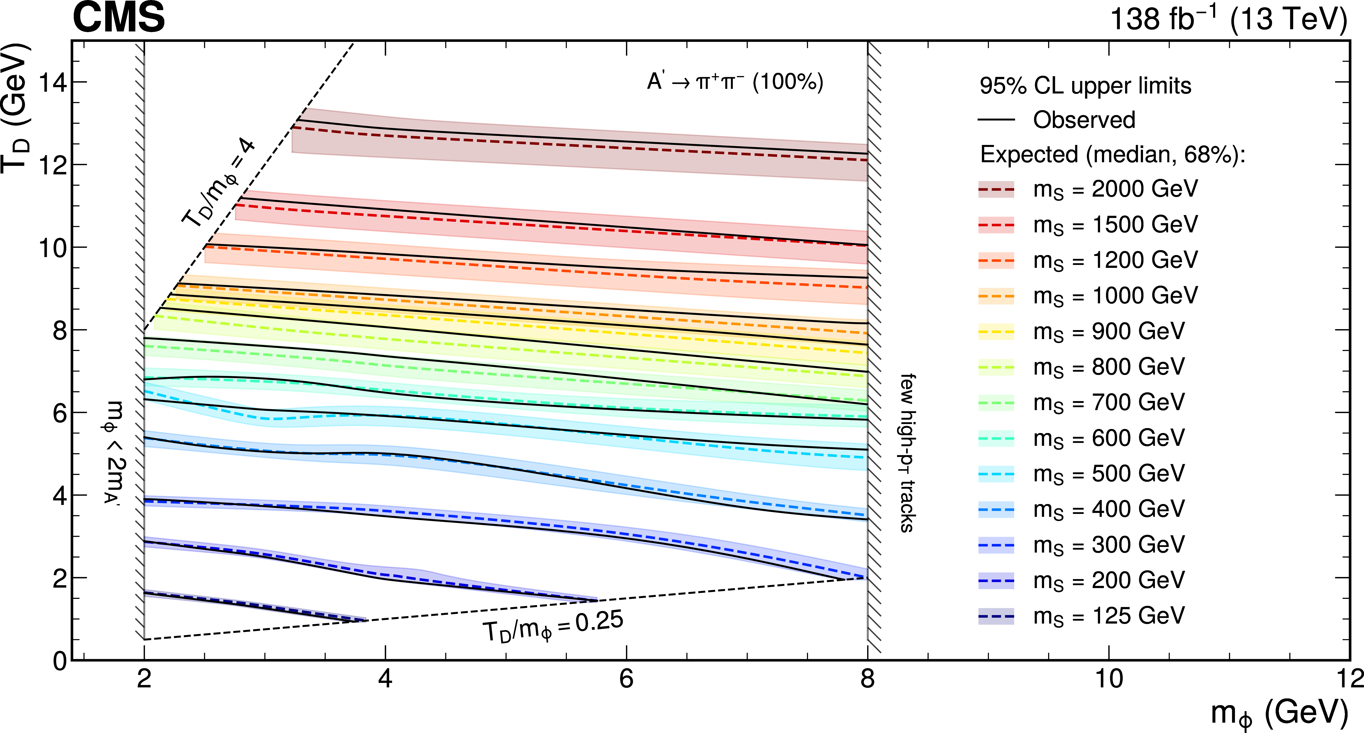
SUEP-search results
Exclusion limits for various scalar masses in the plane of 𝑚_{𝜙} vs T for A’->π⁺π⁻ with B=100%, regions below the observed limits are excluded;
Available for SUEP-like cases with m_{S}/T ∼ m_{S}/m_{𝜙} ∼ 100 where the final state has sufficient track multiplicity to populate the last bins of the SR.

Slide 18
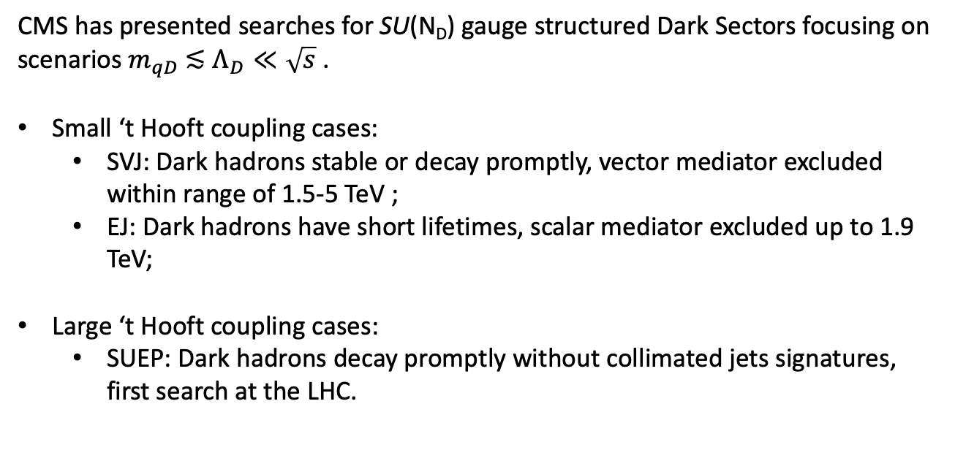
Summary
CMS has presented searches for SU(N_{D}) gauge structured Dark Sectors focusing on scenarios $m_{qD} \text{≲} Λ_{D}≪\sqrt{s}$.
Small ‘t Hooft coupling cases:
  SVJ: Dark hadrons stable or decay promptly, vector mediator excluded within range of 1.5-5 TeV ;
  EJ: Dark hadrons have short lifetimes, scalar mediator excluded up to 1.9 TeV;
Large ‘t Hooft coupling cases:
  SUEP: Dark hadrons decay promptly without collimated jets signatures, first search at the LHC.

Slide 19
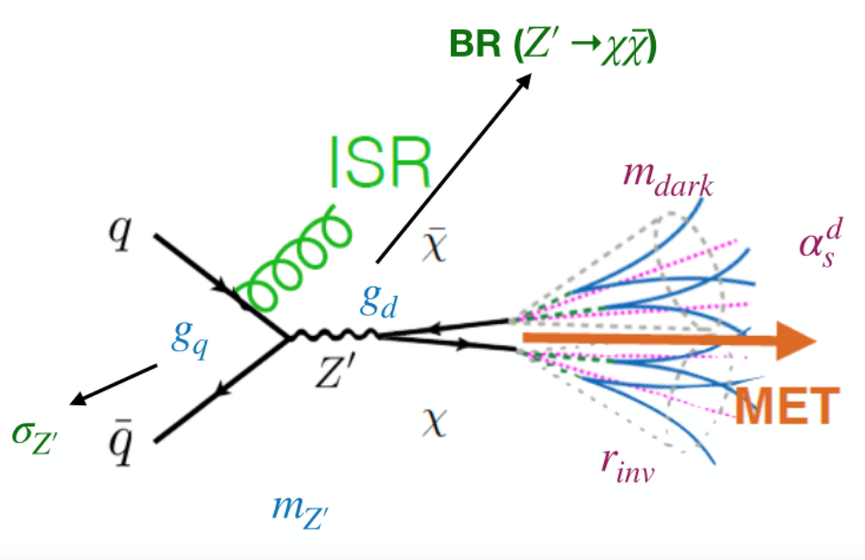
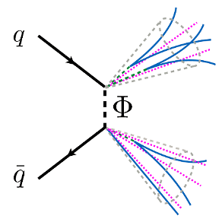
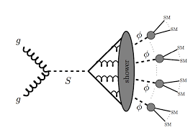
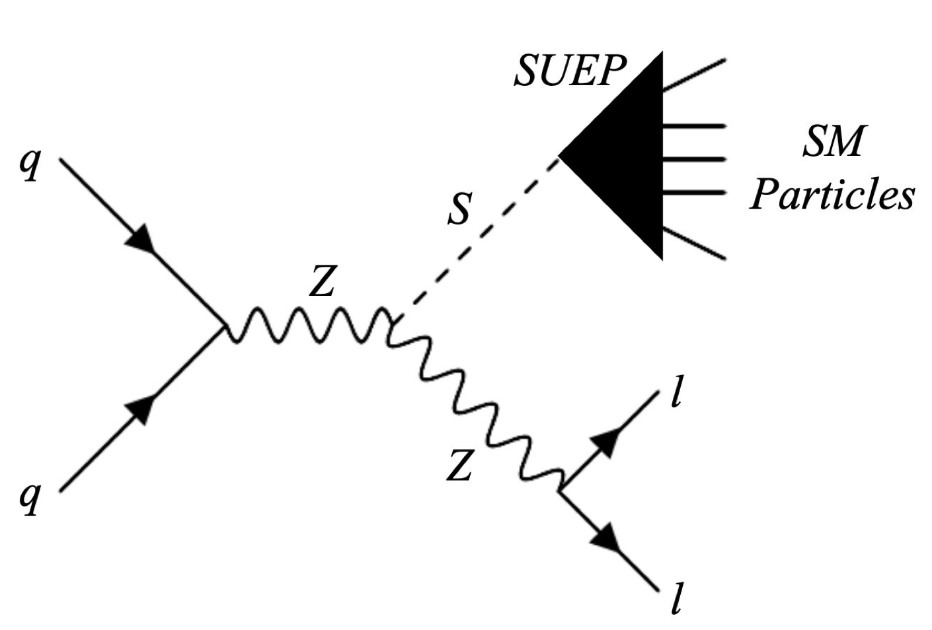
Backups - Undergoing DS searches
Boosted SVJ; t-channel SVJ; SVJ with leptons.
SUEP with scouting data
Associated SUEP production

Slide 20
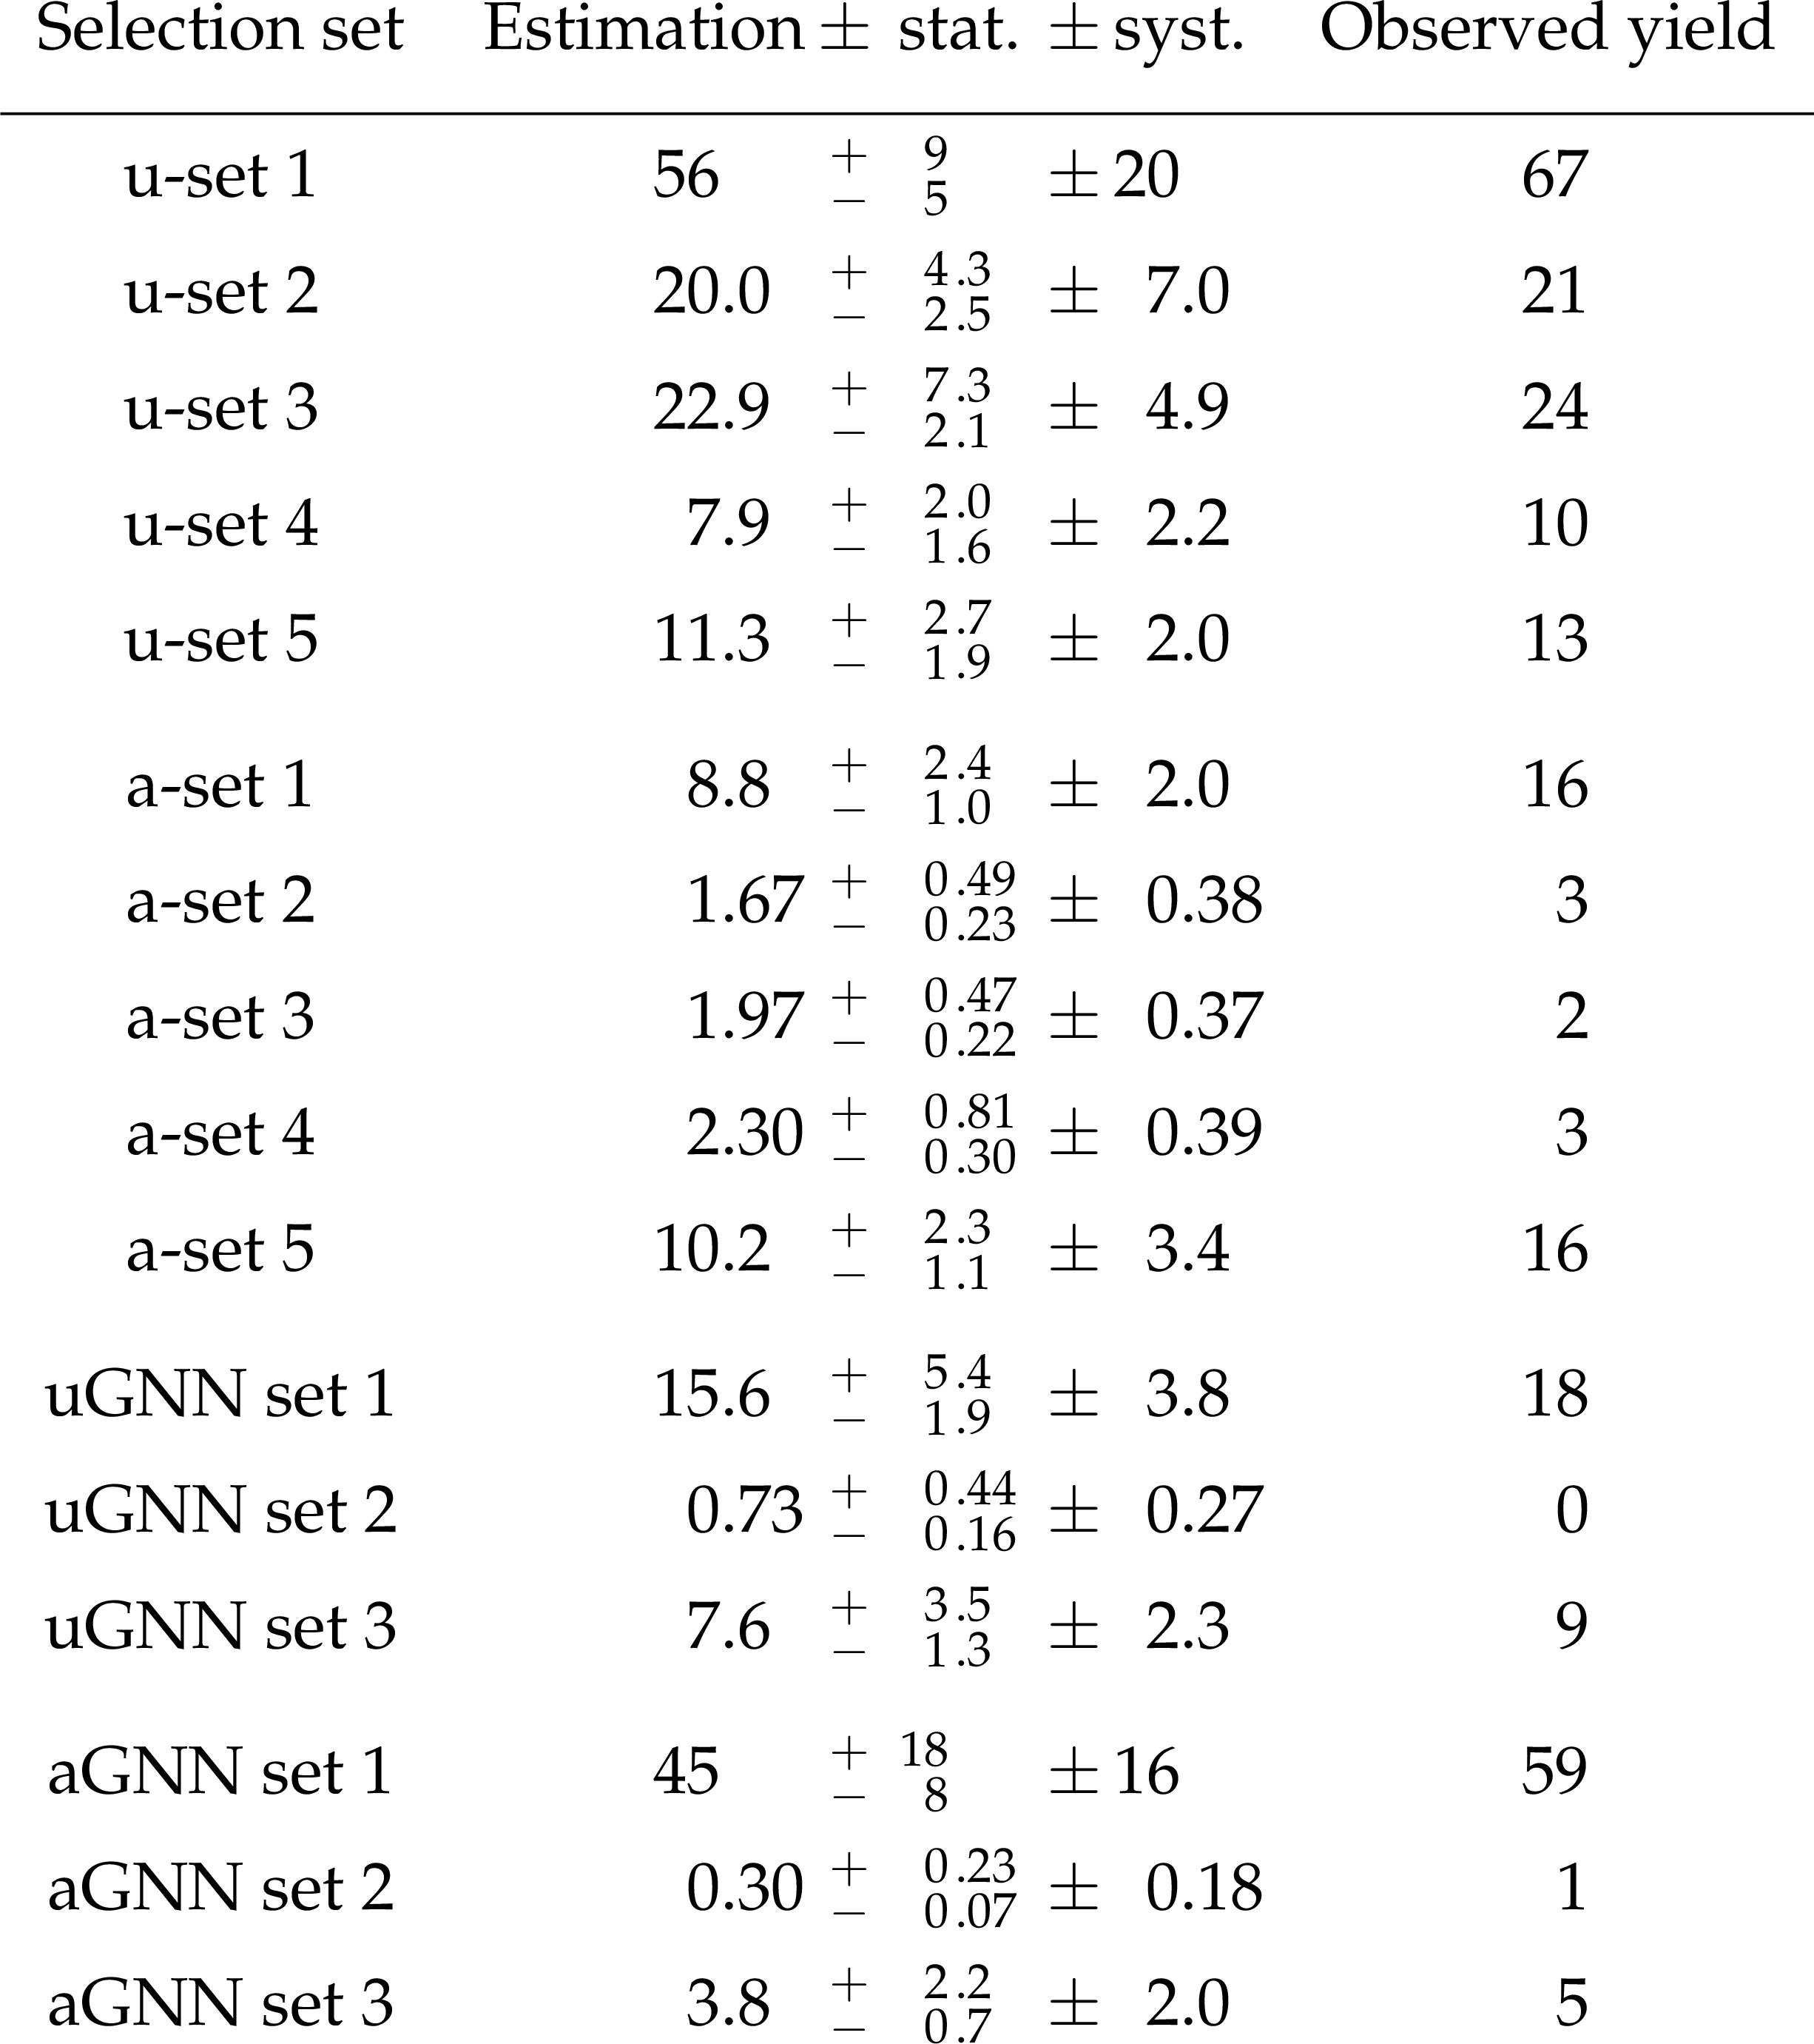
Backups - EJ tabulated result

