Slide 1


Accelerating Science and Innovation
Introduction
Science
A Forward Look
R.-D. Heuer, CERN CERN Summer Student Program, July 6, 2010
Notes:
1

Slide 2
Accelerating Science and Innovation
Introduction
CERN
Notes:
2

Slide 3
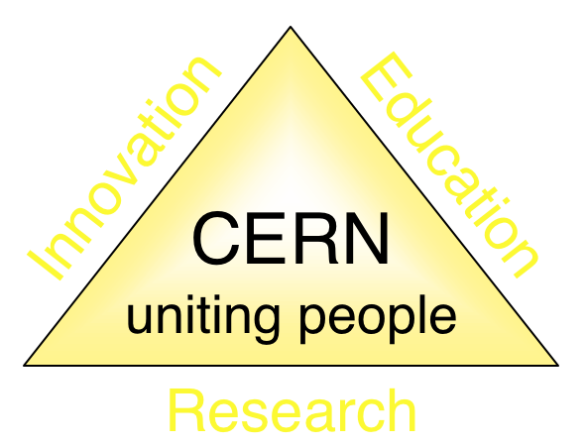
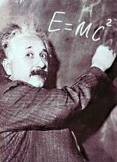



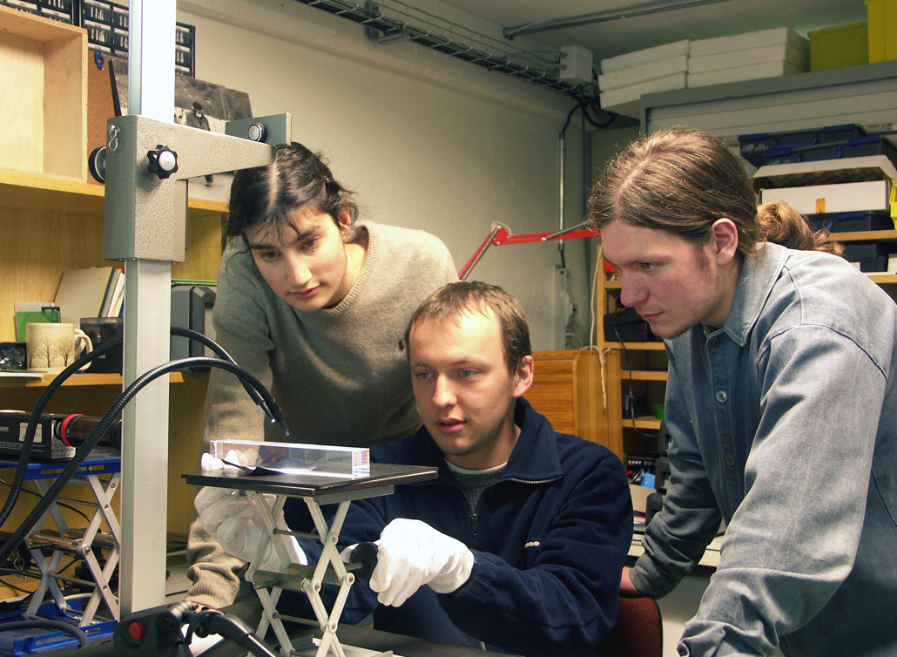
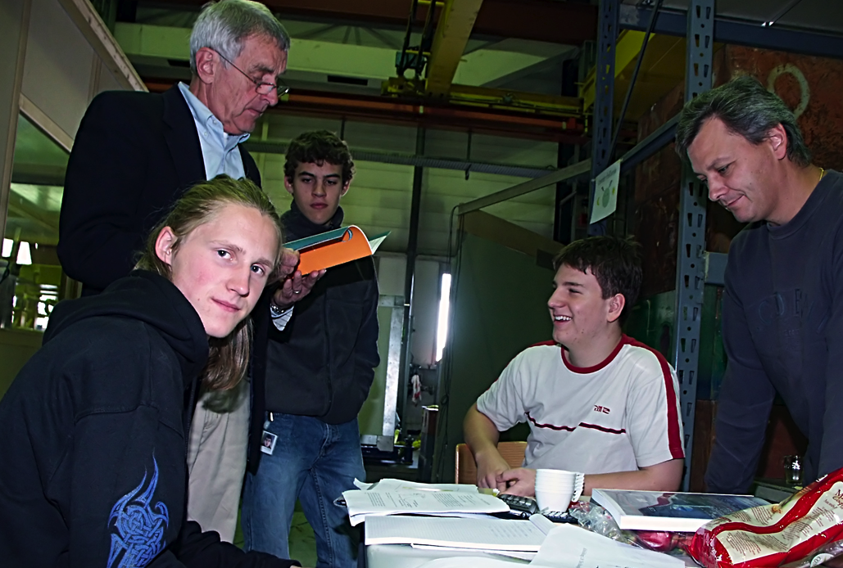
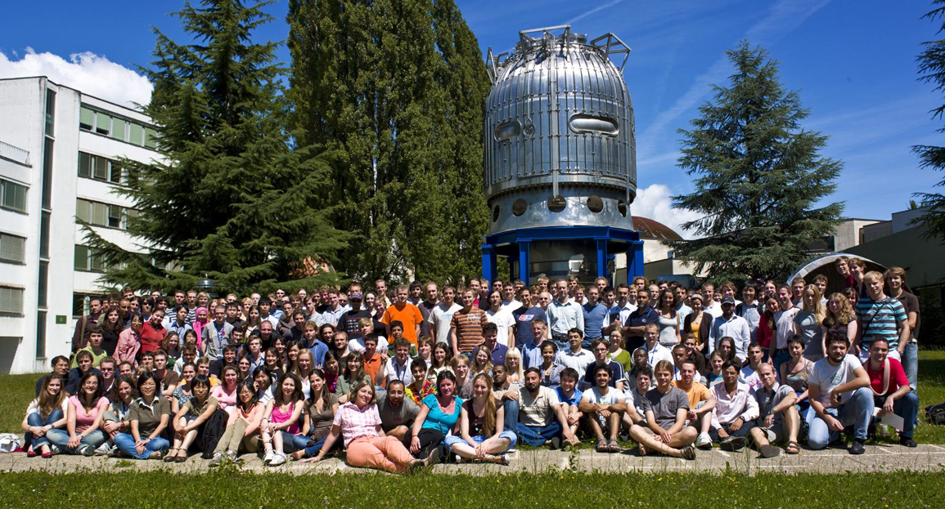
The Mission of CERN
Push back the frontiers of knowledge
E.g. the secrets of the Big Bang …what was the matter like within the first moments of the Universe’s existence?
Develop new technologies for accelerators and detectors
Information technology - the Web and the GRID
Medicine - diagnosis and therapy
Train scientists and engineers of tomorrow
Unite people from different countries and cultures
Notes:
3

Slide 4

CERN was founded 1954: 12 European States
“Science for Peace”
Today: 20 Member States
~ 2300 staff
~ 790 other paid personnel
> 10000 users
Budget (2011) ~1000 MCHF
Countries applying for membership:
Cyprus, Israel, Serbia, Slovenia, Turkey
20 Member States: Austria, Belgium, Bulgaria,
the Czech Republic, Denmark, Finland, France, Germany, Greece, Hungary, Italy, Netherlands, Norway, Poland, Portugal, Slovakia, Spain, Sweden, Switzerland and
the United Kingdom
1 Candidate for Accession: Romania
8 Observers to Council: India, Israel, Japan,
the Russian Federation, the United States of America, Turkey, the European Commission and UNESCO
4
Notes:
4

Slide 5

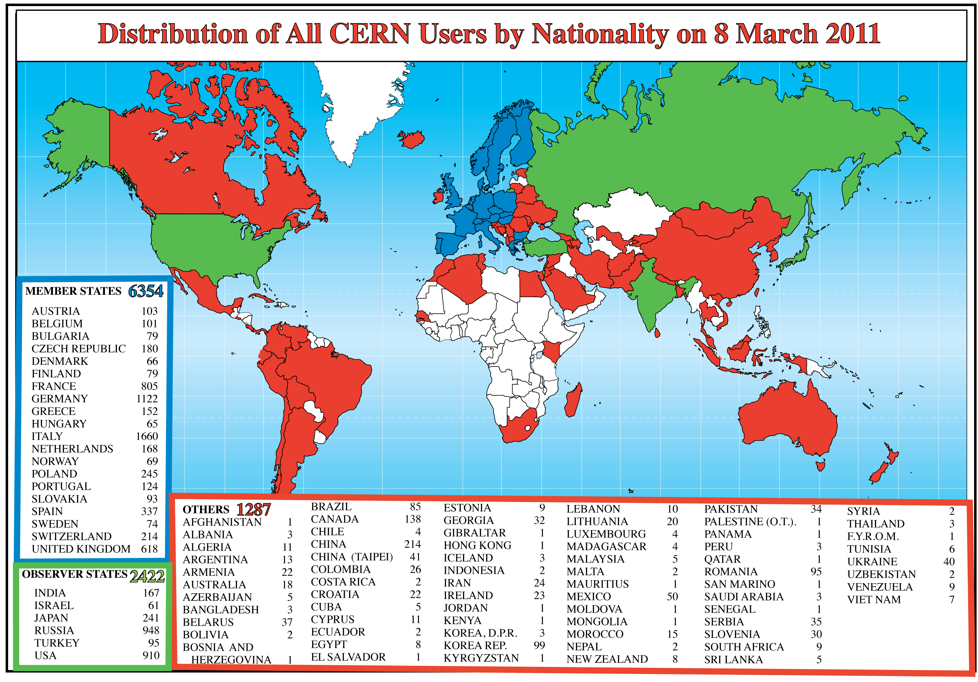
Science is getting more and more global
Diplomacy through Science
Operating very high profile Research Infrastructures is a very effective way to avoid brain drain − and promote brain gain
Notes:
5
5

Slide 6
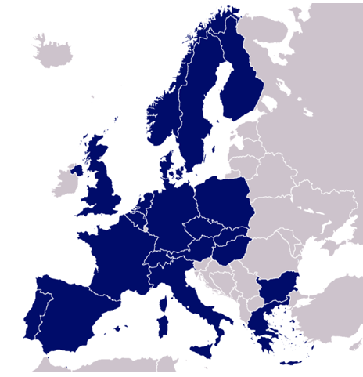
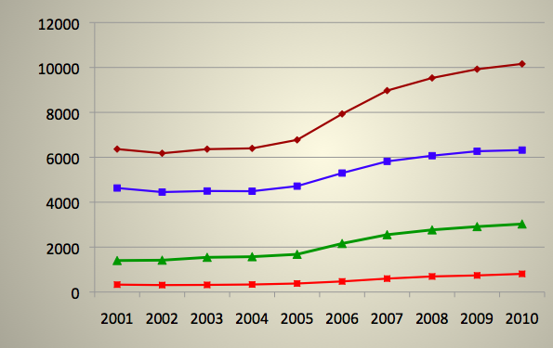
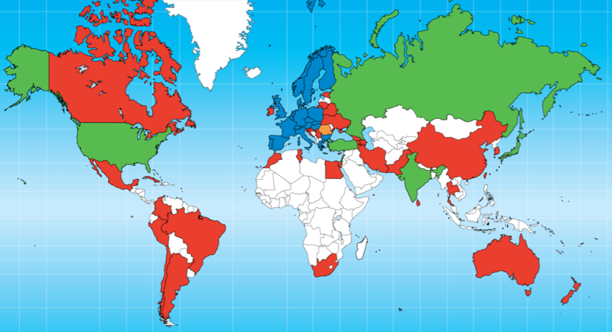
Impact of LHC on Evolution of CERN Users
Evolution of the number of CERN users by geographical location of the home institute: 2001-2010
% increase since 2001
20 MS
60%
all
Member States
40%
User
Observer States
120%
6 Observer States:
India, Israel, Japan,
Russia, Turkey, USA
Other Non-MS
145%
year
42 NMS

Slide 7

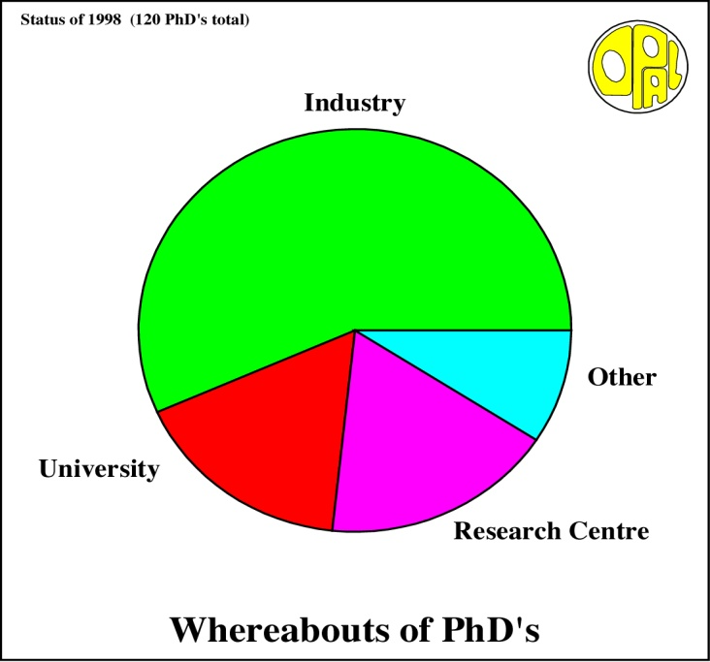
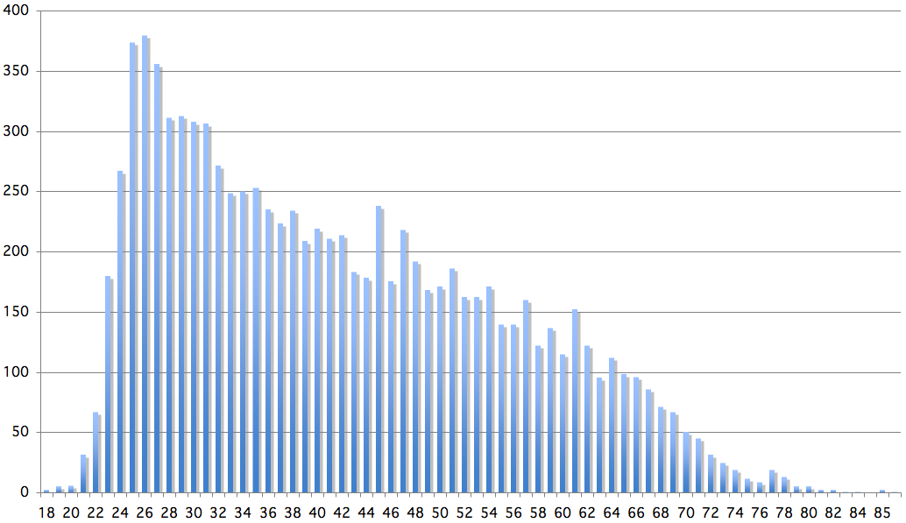
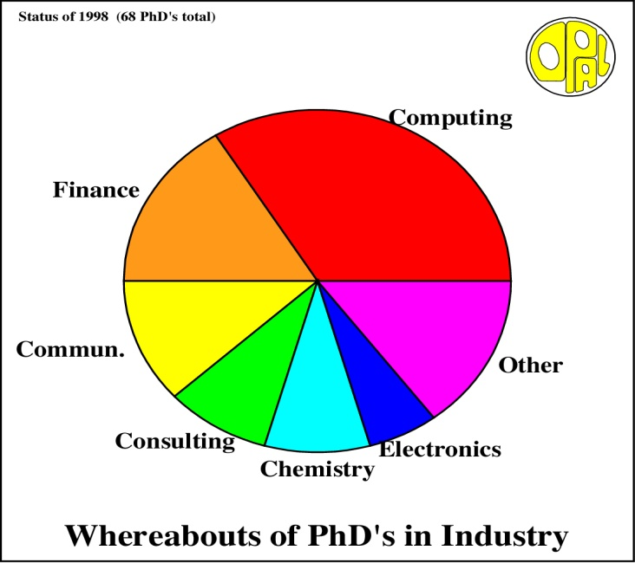
Age Distribution of Scientists
- and where they go afterwards
Survey in March 2009
2500 PhD students
in LHC experiments
They do not all stay: where do they go?

Slide 8


CERN: Particle Physics and Innovation
Interfacing between fundamental science and key technological developments
CERN Technologies and Innovation
Accelerating particle beams
Detecting particles
Large-scale computing (Grid)
Notes:
8

Slide 9
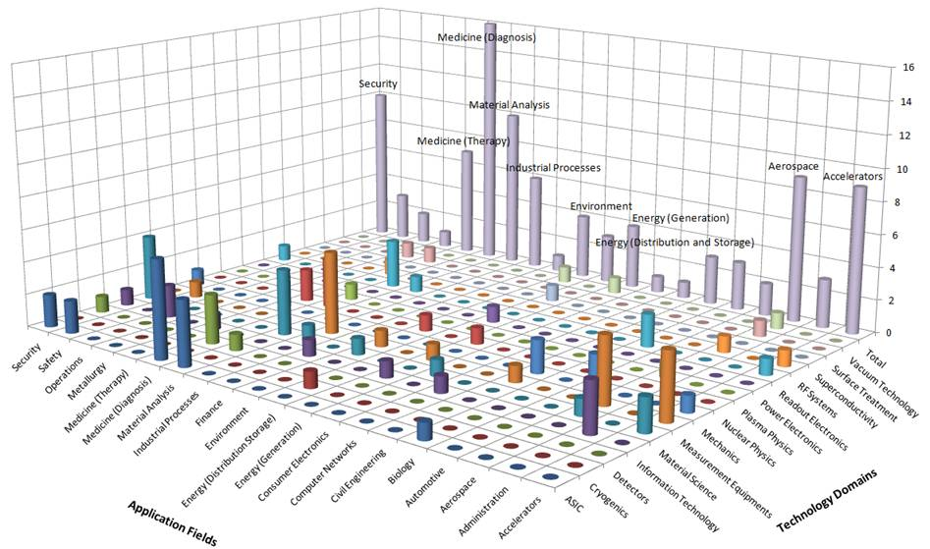
CERN Technologies and Innovation
Cutting edge Research Infrastructures play a key role in a knowledge driven society
Science for Society
Knowledge is − and will be more and more − the most precious resource for a sustainable development
Notes:
9

Slide 10
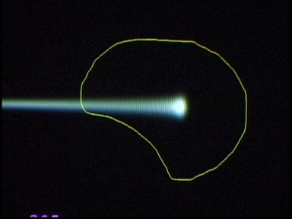
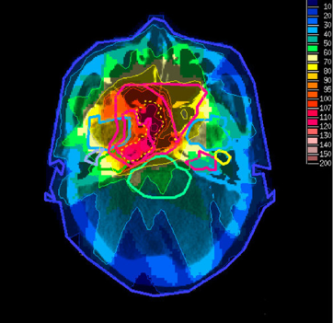
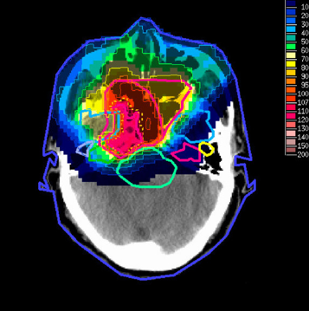
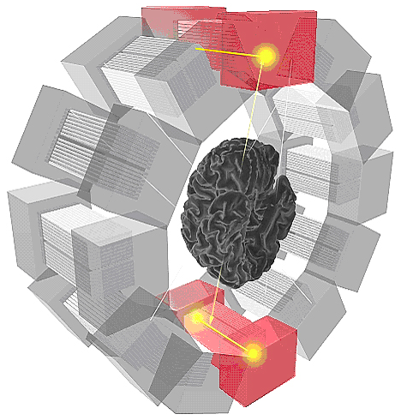
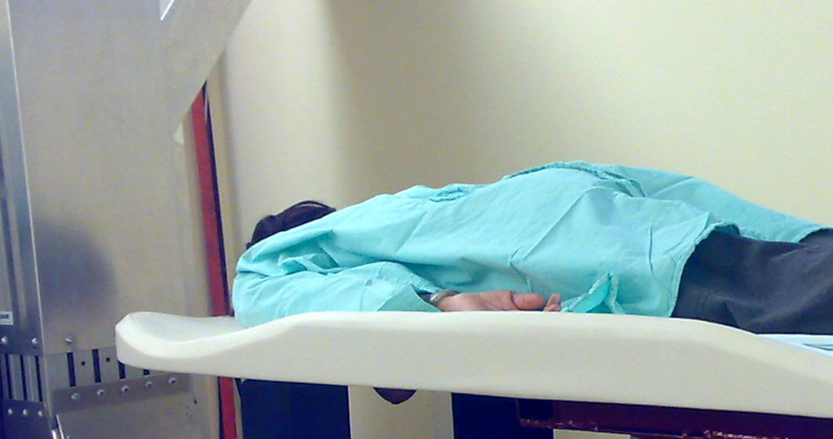
CERN Technologies and Innovation
Example: Medical applications
Combining Physics, ICT, Biology and Medicine to fight cancer
Hadron Therapy
Tumour Target
Leadership in Ion Beam Therapy now in Europe and Japan
Protons
light ions
Accelerating particle beams
~30’000 accelerators worldwide
~17’000 used for medicine
X-ray
protons
>70’000 patients treated worldwide (30 facilities)
>21’000 patients treated in Europe (9 facilities)
Imaging
PET Scanner
Clinical trial in Portugal for new breast imaging system (ClearPEM)
Detecting particles
Notes:
10

Slide 11
Accelerating Science and Innovation
Science
Particle Physics at CERN: Experiments and Theory
Notes:
11

Slide 12
Les Machines du CERN
Main emphasis: High energy frontier, i.e. LHC and beyond
But:
rich program of accelerator based particle physics

Slide 13

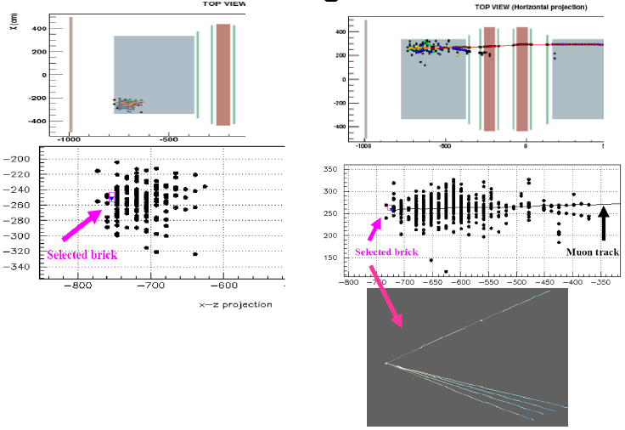
Fixed Target Physics
Antiproton Physics
Neutrino Physics
Cold antiprotons
(“manufacturing anti-matter”)
1. PS p → pp 10⁻⁶/collision
2. AD deceleration + cooling
stochastic + electron
3. Extraction @ ~ 0.1c
4. Produce thousands of anti-H
CERN NEUTRINOS TO GRAN SASSO
Anti-H annihilations detected
ATHENA (→ ALPHA)
anti-H (pe⁺) + matter → π⁺π⁻ + γγ
732 Km
ν_{μ}
732 Km
ν_{τ}
OPERA
Charge Current
Neutral Current

Slide 14
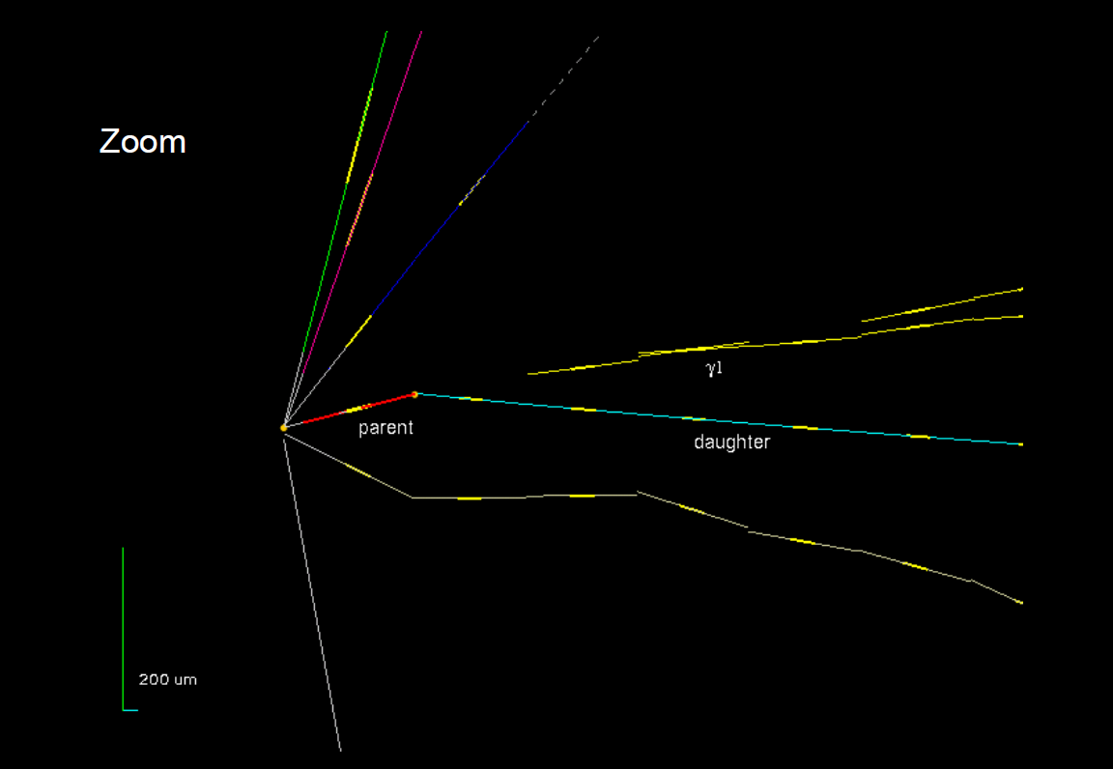
CNGS - OPERA
First υ_{τ} Candidate
expect new results (candidates?) soon

Slide 15
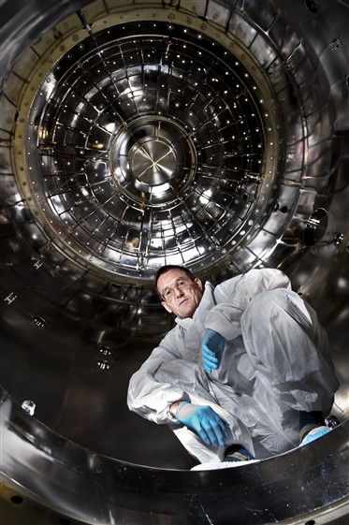
The CLOUD Experiment
Experiment using cloud chamber to study possible link between cosmic- rays and cloud formation.
  Studies suggest that cosmic- rays may have an influence on the amount of cloud cover through the formation of new aerosols (tiny particles suspended in the air that seed cloud droplets).
Understanding the underlying microphysics in controlled laboratory conditions is a key to unraveling the connection between cosmic-rays, clouds and climate.
First time high-energy physics accelerator used to study atmospheric and climate science.
Notes:
15

Slide 16
Accelerating Science and Innovation
LHC
Notes:
16

Slide 17

“Discovery” of Standard Model
Past few decades
through synergy of
hadron - hadron colliders (e.g. Tevatron)
lepton - hadron colliders (HERA)
lepton - lepton colliders (e.g. LEP)

Slide 18
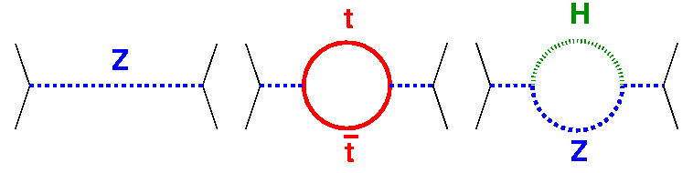
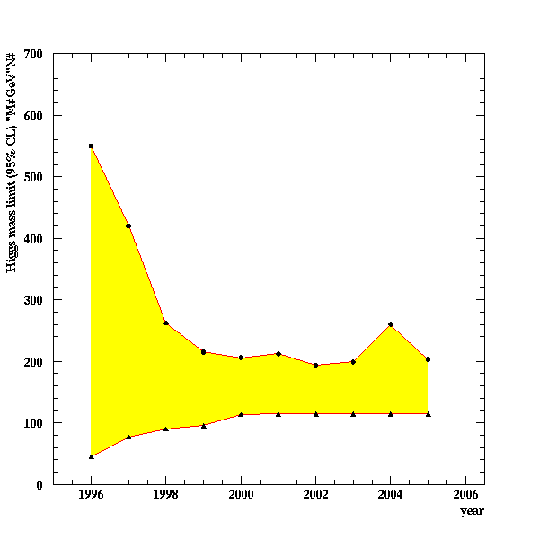
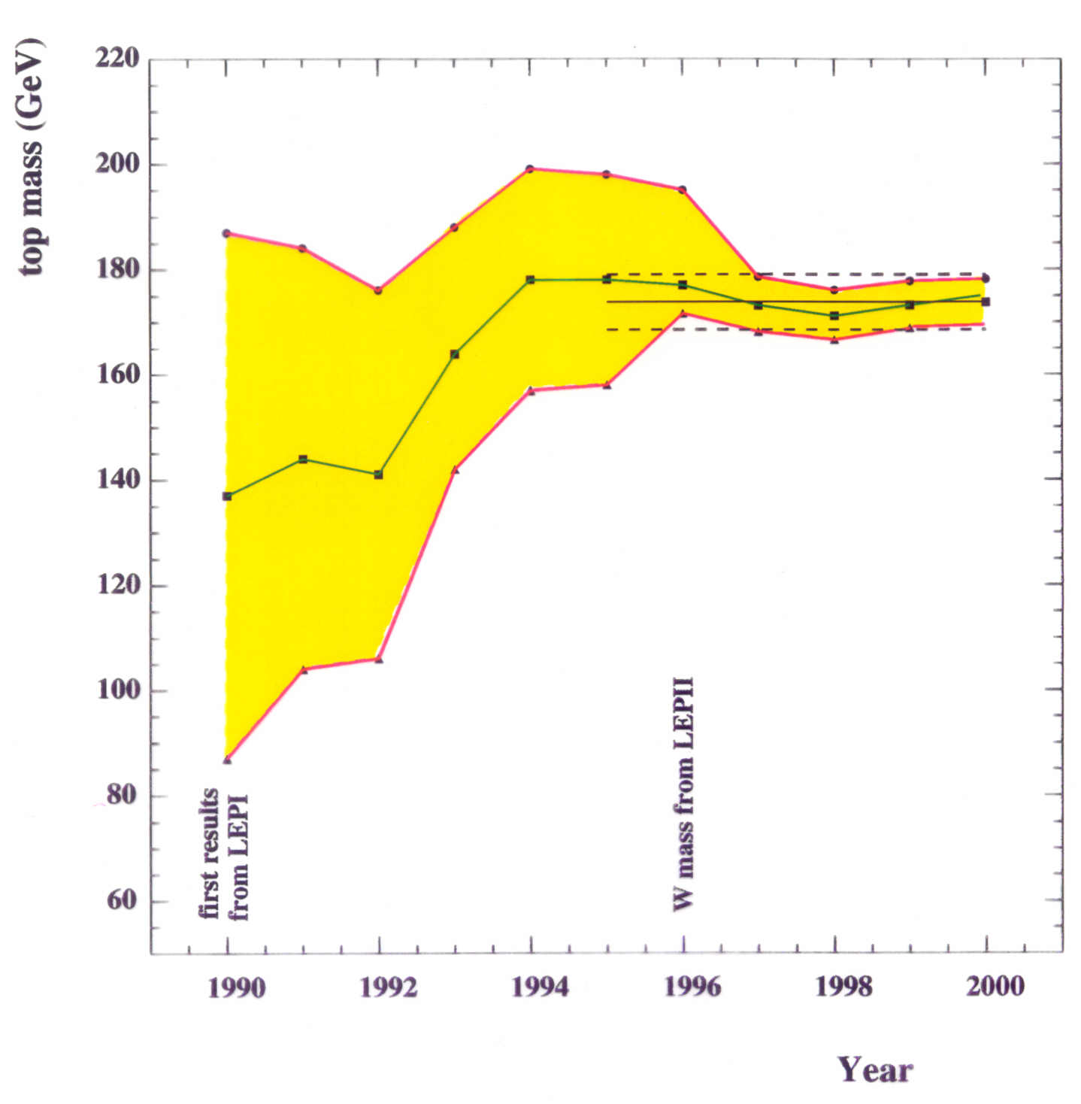
Test of the SM at the Level of Quantum Fluctuations
prediction of the range
for theHiggs mass
indirect determination of the top mass
LEP
possible due to • precision measurements • known higher order electroweak corrections

Slide 19
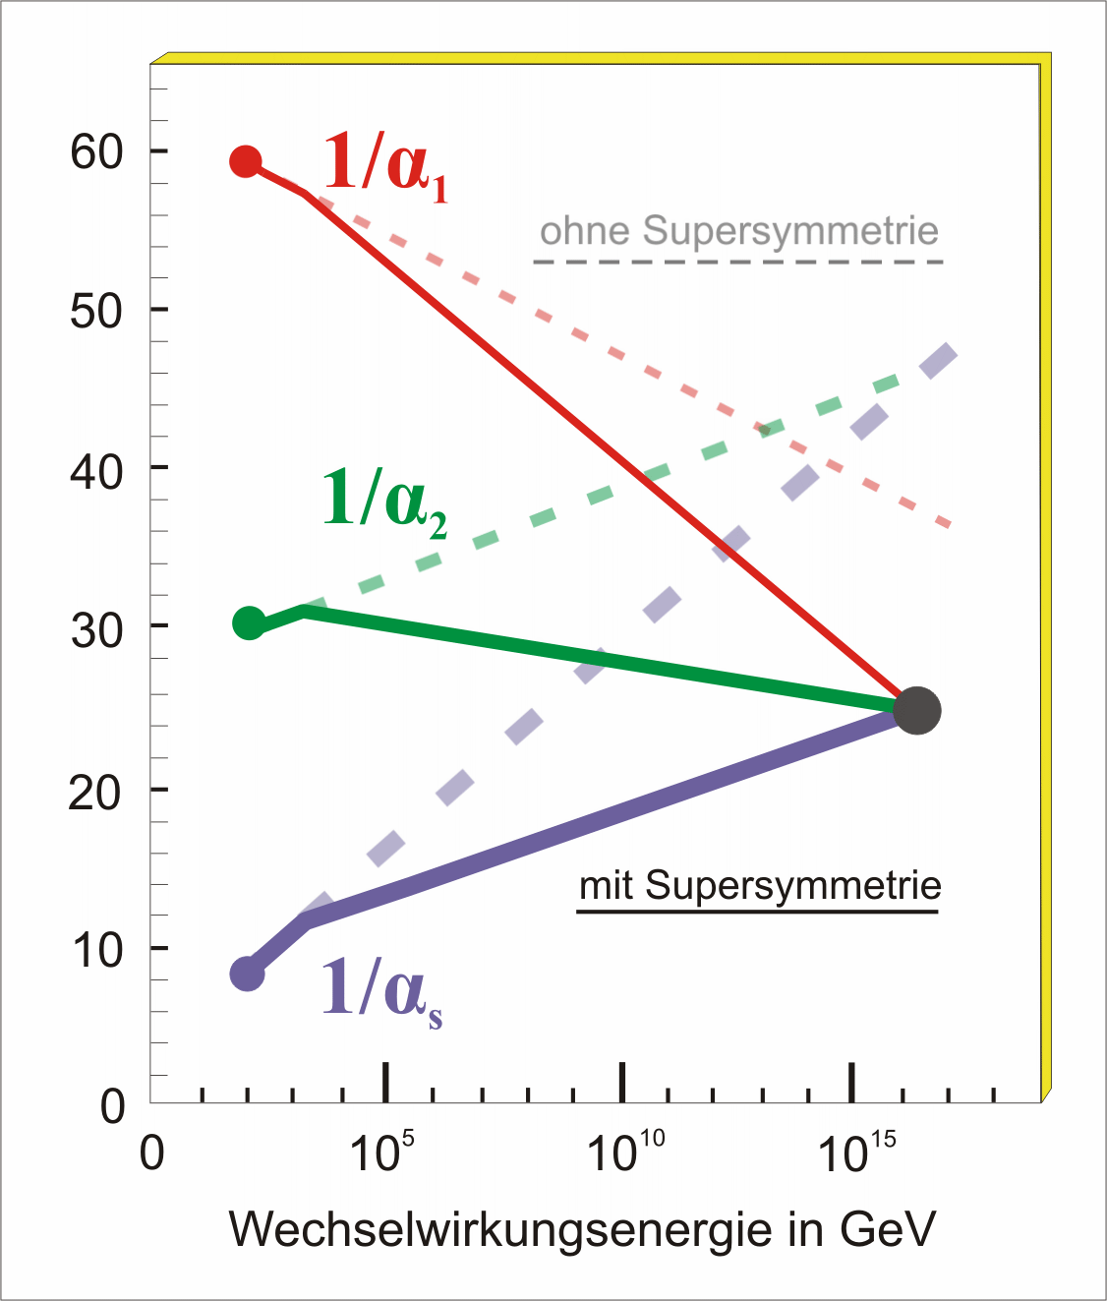
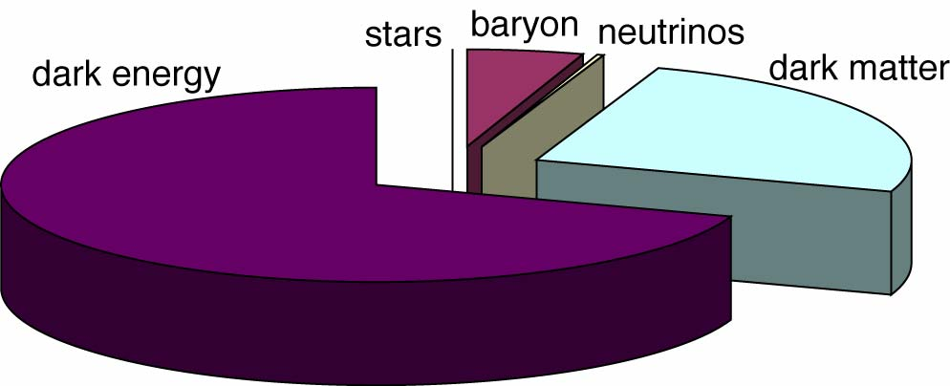
Key Questions of Particle Physics
origin of mass/matter or origin of electroweak symmetry breaking
unification of forces
fundamental symmetry of forces and matter
where is antimatter
unification of quantum physics and general relativity
number of space/time dimensions
what is dark matter
what is dark energy

Slide 20



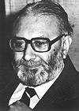
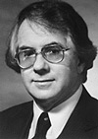




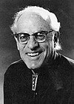
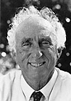
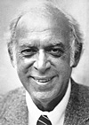
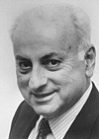
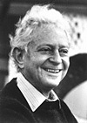
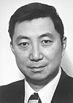
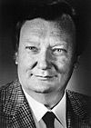
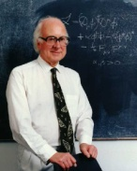
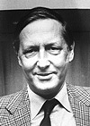
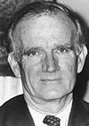
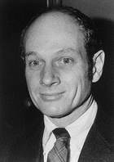
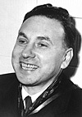

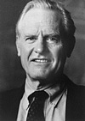

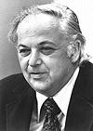
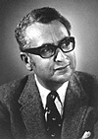
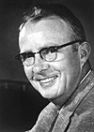
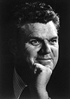
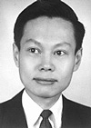
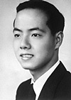
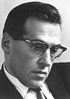
Solutions?
Technicolor
New (strong) interactions produce EWSB
Extensions of the SM gauge group :
Little Higgs / GUTs / …
Standard Model
Wilczek
Gross
Salam
Glashow
Weinberg
Politzer
Veltman
‘t Hooft
Reines
For all proposed solutions:
new particles should appear
at TeV scale or below
→ territory of the LHC
Friedman
Perl
Rubbia
Higgs
van der
Meer
Schwartz
Lederman
Ting
Fitch
Cronin
Hofstadter
Steinberger
Schwinger
Kendall
Selected NP
since 1957
Except P. Higgs
Feynman
Richter
Gell-Mann
Alvarez
Taylor
Yang
Lee
successful for ever ??
Supersymmetry
New particles at ≈ TeV scale, light Higgs
Unification of forces
Higgs mass stabilized
No new interactions
Extra Dimensions
New dimensions introduced
m_{Gravity} ≈ m_{elw}  Hierarchy problem
solved
New particles at ≈ TeV scale

Slide 21

Enter a New Era in Fundamental Science
Start-up of the Large Hadron Collider (LHC), one of the largest and truly global scientific projects ever, is the most exciting turning point in particle physics.
Exploration of a new energy frontier
Proton-proton and Heavy Ion collisions
at E_{CM} up to 14 TeV
Notes:
21

Slide 22
Proton-Proton Collisions at the LHC
2808 + 2808 proton bunches
separated by 7.5 m
→ collisions every 25 ns
= 40 MHz crossing rate
10¹¹ protons per bunch
at 10^{34/}cm²/s
≈ 35 pp interactions per crossing
pile-up
→ ≈ 10⁹ pp interactions per second !!!
in each collision
≈ 1600 charged particles produced
enormous challenge for the detectors
and for data collection/storage/analysis

Slide 23
Experimental Challenge
High Interaction Rate: N=Lσ = 10³⁴ x 100 x 10⁻²⁷
pp interaction rate 10⁹ interactions/s
data for only ~100 out of the 40 million crossings can be recorded per sec (100 – 150 MB/sec)
need fast, pipelined, intelligent electronics and sophisticated
data-acquisition
High Energy and Large Particle Multiplicity
~ <20> superposed events in each crossing
~ 1000 tracks stream into the detector every 25 ns
need highly granular detectors with good time resolution for low occupancy
large detectors, a large number of channels
High Radiation Levels
radiation hard (tolerant) detectors and electronics

Slide 24
Physics Requirements
Follow from requirements to observe Higgs boson whether it is heavy or light,
to observe Supersymmetry if it is there (missing energy), to find other new
physics if it is there; all this in the presence of a huge background of
standard processes (QCD)
Very good muon identification and momentum measurement
trigger efficiently and measure charge of a few TeV muons
High energy resolution electromagnetic calorimetry
~ 0.5% @ E_{T}~50 GeV
Powerful inner tracking systems
factor 10 better momentum resolution than at LEP
Hermetic calorimetry
good missing E_{T} resolution
(Affordable detector)

Slide 25
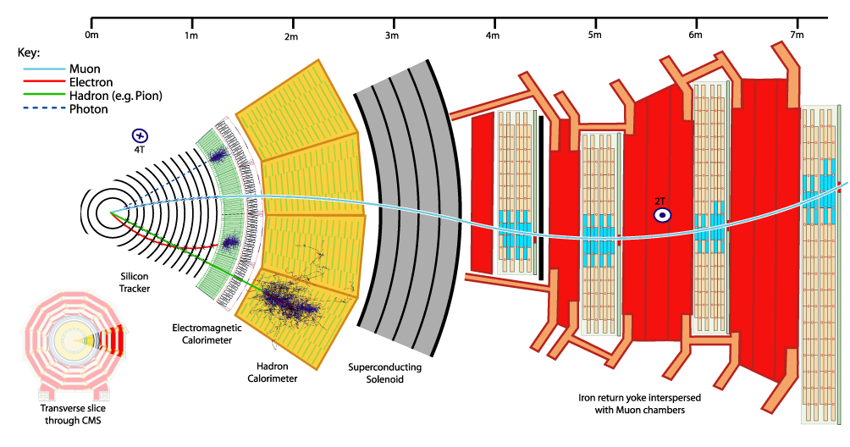
‘Generic’ experimental set-up
Deflection ~ BL²/p → need high B ( s.c.) and large magnets; need high resolution position measurements (10 -100μ)
at large p; also energy and position measurement through total absorption (photon, electron, hadron)

Slide 26

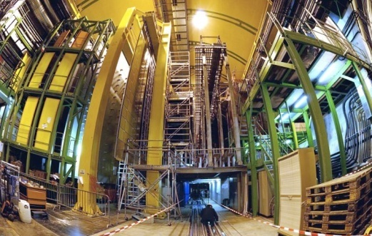


Enter a New Era in Fundamental Science
Start-up of the Large Hadron Collider (LHC), one of the largest and truly global scientific projects ever, is the most exciting turning point in particle physics.
CMS
LHCb
Exploration of a new energy frontier
Proton-proton and Heavy Ion collisions
at E_{CM} up to 14 TeV
ALICE
LHC ring:
27 km circumference
TOTEM
LHCf
MOEDAL
ATLAS
Notes:
26

Slide 27





LHC Experiments → complementary
LHCb
Specialised detector to study b-quarks → CPV
CMS
General purpose detectors
ATLAS
ALICE
Specialised detector to study heavy ion collisions

Slide 28



LHC Experiments → complementary
LHCb
Overlap in physics reach
Key feature: reconstruct secondary vertex
LHCb
CMS
ATLAS
ATLAS
ALICE

Slide 29



LHC Experiments → complementary
LHCb
Overlap in physics reach
Key feature: reconstruct
> 20’000 charged tracks in one event
CMS
CMS
ATLAS
ALICE
ALICE
Overlap in physics reach

Slide 30





LHCb
CMS
ATLAS
Versatility of LHC & complementarities of experiments make the whole of LHC a more powerful instrument than the sum of its parts
ALICE
Notes:
30

Slide 31


Basic processes at LHC
q
Jet
q’
Jet

Slide 32


Basic processes at LHC
g
W/Z
g
W/Z

Slide 33

Cross sections at the LHC
“Well known” processes. Don’t need to keep all of them …
New Physics!!
We want to keep!!

Slide 34

Stored Energy in the LHC
34

Slide 35
Overall LHC efficiency in 2010
65%
availability!
~50/pb
delivered
Great achievement for the first year of operation!
W. Venturini

Slide 36




Grid Computing and CERN
285 sites in 48 countries
~250k CPU cores
~100 PB disk
Large number of users
1M jobs/day
Astronomy & Astrophysics
Civil Protection
Computational Chemistry
Comp. Fluid Dynamics
Computer Science/Tools
Condensed Matter Physics
Earth Sciences
Finance
Fusion
High Energy Physics (WLCG)
Humanities
Life Sciences
Material Sciences
Social Sciences
EGEE-III INFSO-RI-222667

Slide 37



W and Z production at 7 TeV
q
l⁺
Z
−
q
l⁻
Z → e⁺e⁻

Slide 38






W and Z production at 7 TeV
Z
W

Slide 39

Lepton charge asymmetry in inclusive W
We are able to produce precision EWK measurements good enough to constrain significantly the PDF global fits.
April 2011)

Slide 40

Summary of main electroweak and top cross-section measurements
Measuring cross-sections down to ~ 10 pb
Uncertainties dominated by systematics in all cases except Zγ, WW, WZ
Good agreement with SM expectations (within present uncertainties)
Experimental precision starts to challenge theory for W, Z, top-pairs

Slide 41

Excellent performances 2010
Excellent start-up in 2011:
already some 1.3/fb (!) delivered
Experiments demonstrated readiness in the exploitation of the 7 TeV p-p and
2.76 TeV Pb-Pb data;
analyses proceeded very rapidly;
Experiments have about completed their journey through the Standard Model … and have started to take us into uncharted territories …

Slide 42



Higgs-Boson at 7 TeV
g
W/Z
Not enough data yet
→ Interesting in 2011 and 2012!
H
g
W/Z
m_{4μ}=201 GeV
CMS

Slide 43


Search for the Higgs-Boson at the LHC
Production rate
of the Higgs-Bosons
depends on its mass
as well as its decay possibilities
(“Signature (or picture)”
as seen in the detector)

Slide 44

CMS & ATLAS Projections Compared
120

Slide 45
Summary of Prospects
SM Higgs Search Prospects (Mass in GeV)
ATLAS + CMS ≈ 2 x CMS | 95% CL exclusion | 3 σ sensitivity | 5 σ sensitivity
1 fb⁻¹ | 120 - 530 | 135 - 475 | 152 - 175
2 fb⁻¹ | 114 - 585 | 120 - 545 | 140 - 200
5 fb⁻¹ | 114 - 600 | 114 - 600 | 128 - 482
10 fb⁻¹ | 114 - 600 | 114 - 600 | 117 - 535
cccccccccc
Sergio Cittolin
Higgs Boson, if it exists between masses of (114 - 600 GeV) will either be discovered or ruled out in ≈ next two years
→ Decided to run in 2011 and 2012

Slide 46

The 2011 and 2012 run …
Search for physics beyond SM
Discovering new particles
Making precise measurements of
properties of known particles/forces:
e.g. LHCb: B_{s} → μ⁺μ⁻
→ will enter new territory !

Slide 47

New Rough Draft 10 year plan
Shutdown will
extend far into
2014
update of European HEP Roadmap
Shutdown
2017 or 2018
Plan to continue
until around 2030

Slide 48
beyond LHC ?
Notes:
48

Slide 49
Road beyond Standard Model
Next decades
through synergy of
hadron - hadron colliders (LHC, HL/HE-LHC?)
lepton - hadron colliders (LHeC ??)
lepton - lepton colliders (LC (ILC or CLIC) ?)

Slide 50
Linear e⁺e⁻Colliders
The machine which will complement and extend the LHC best, and is closest to be realized, is a Linear e⁺e⁻ Collider with a collision energy of at least 500 GeV.
PROJECTS:
⇒ TeV Colliders (CMS energy up to 1 TeV) → Technology ~ready
ILC with superconducting cavities
⇒ Multi-TeV Collider (CMS energies in multi-TeV range) → R&D
CLIC → Two Beam Acceleration

Slide 51


The International Linear Collider
Energy 250 Gev x 250 GeV
# of RF Units 560
# of Cryomodules 1680
# of 9-cell Cavities 14560
  Accelerating Gradient 31.5 MeV/m
  Peak luminosity 2 10³⁴ cm⁻²s⁻¹
  Rep. Rate 5 Hz
  IP σ_{x} 350 – 620 nm; σ_{y} 3.5 – 9.0 nm
  Total Power ~230 MW
  2 Detectors Push-pull

Slide 52


Cavity Gradient Milestone Achieved
TDR
Goal
2010
Milestone

Slide 53

CLIC Overall Lay-out

Slide 54






Gradient at CLIC 4*10⁻⁷ BDR and 180 ns pulse length
Today:
CTF3 running with accelerating structures
reaching design value (100 MV/m).
T18 and TD18 built and tested at SLAC and KEK
real prototypes with improved design are T24 and TD24
measurements in plot on the right for TD18 at KEK

Slide 55
Road beyond Standard Model
Next decades
through synergy of
hadron - hadron colliders (LHC, HL/HE-LHC?)
lepton - hadron colliders (LHeC ??)
lepton - lepton colliders (LC (ILC or CLIC) ?)
LHC results will guide the way at the energy frontier

Slide 56
Results from LHC will guide the way
Expect
period for decision enabling on next steps earliest 2012
(at least) concerning energy frontier
(similar situation concerning neutrino sector Θ₁₃)
We are NOW in a new exciting era of accelerator
planning-design-construction-running
and need
intensified efforts on R&D and technical design work
to enable these decisions
global collaboration and stability on long time scales
(don‘t forget: first workshop on LHC was 1984)
→ more coordination and more collaboration required

Slide 57
Opening the door…
Membership for Non-European countries
New Associate Membership defined
Romania in accession to membership
Negotiations started with Cyprus, Israel, Serbia, Slovenia, and Turkey concerning membership
Several countries expressed interest in associate membership
New Relations with International Organizations in Geneva
Improved Relations with the regions and communes surrounding CERN

Slide 58
We need to define the most appropriate organizational form
for global projects NOW and need to be open and inventive
(scientists, funding agencies, politicians. . .)
Mandatory to have accelerator laboratories in all regions
as partners in accelerator development / construction /
    commissiong / exploitation
Planning and execution of HEP projects today need
global partnership for global, regional and national projects
in other words: for the whole program
Use the exciting times ahead to establish such a partnership

Slide 59
Particle Physics can and should play its role as
spearhead in innovations as in the past
now and in future

